Slide 1
Disclosures
With respect to the following presentation, there has been no relevant (direct or indirect) financial relationship between the faculty listed above or other activity planners (or spouse/partner) and any for-profit company in the past 12 months which would be considered a conflict of interest.
The views expressed in this presentation are those of the faculty and may not reflect official policy of Community Health Center, Inc. and its Weitzman Institute.
We are obligated to disclose any products which are off-label, unlabeled, experimental, and/or under investigation (not FDA approved) and any limitations on the information that are presented, such as data that are preliminary or that represent ongoing research, interim analyses, and/or unsupported opinion.

Slide 2
Introduction to Child/Adolescent Rotation☺
Name/location/“child” experience
Purpose/info about child rotation
Structure of workshops
Part 1
CHILD 101
How to conduct a child psychiatric evaluation
Part 2
Diagnostics
Intro to treatment
Part 3
Psychopharm (deep dive) and review of other interventions
Levels of care
Roles/Consultations

Slide 3
Ice Breaker
*What do you think is the best thing/decision you’ve done/made in your life?
and
*What do you think is the biggest mistake you’ve made in your life?

Slide 4
Phenomenology for Childhood
Marnie Flynn
Emily Farb

Slide 5
What do we know about kids?

Slide 6
WHAT DO WE KNOW ABOUT KIDS/QUALITIES
SMALLER
NONVERBAL DOMINATES-RIGHT BRAIN!
EVEN ADOLESCENTS ARE NOT LIVING IN THE VERBAL WORLD FULLY
LESS EXPERIENCED/FEWER TEMPLATES
RAPID AND UNEVEN DEVELOPMENT-INDIVIDUAL VARIATION
WHAT IS REAL-MIXED TILL AGE 4
LESS TIME ON EARTH
SAFETY AND SECURITY PRIMARY
ATTACHMENT
WIRED OR CONNECTION/RELATIONSHIPS
TEMPERAMENT/GOODNESS OF FIT (WITH CAREGIVER AND/OR CULTURE; FAMILY AND SCHOOL)
CONTINUUM FROM UNINTERESTED TO SLOW TO WARM TO BALANCED TO EXTROVERTED TO INTRUSIVE
POOR REGULATION OF COGNITION, EMOTIONS AND BEHAVIOR
VISCERAL RESPONDERS-CODE INTO BODY THRU SENSES

Slide 7
WHAT DO WE KNOW ABOUT KIDS/QUALITIES
ATTEND TO DIFFERENT THINGS-MORE SENSORY BASED
MORE IMPULSIVE
MORE REACTIVE
GENERALLY MORE ACTIVE (VARIES)
CONCRETE TILL 14YO-ISH
TIME IS ORGANIZED AND PERCEIVED/REMEMBERED DIFFERENTLY
*DEPENDENT (NON-VOLUNTARY)
LARGER RESPONSES
CAUSATION IS NOT ESTABLISHED-GENERALLY THRU TIME AND NOT WITH INTENT
OVERGENERALIZE
EASILY THREATENED
INFLUENCED BY IMMEDIATE FAMILY, THEN EXTENDED FAMILY, SCHOOL AND COMMUNITY
NEED SIMPLE SEQUENCES AND MORE CUEING
EAGER TO PLEASE AND IDEALIZE PARENTS
CURIOUS
PLAYFUL

Slide 8
WHAT DO WE KNOW ABOUT KIDS/QUALITIES
FASTER INFULENCE OF PHYSIOLOGICAL CUES (HANGRY)
SHORTER ATTENTION
DELAY OF GRATIFICATION-MIXED
LIVE IN PHYSICAL BODY MORE
GULLIBLE/SUSCEPTIBLE TO ADULT INTERPRETATIONS
LACK OF KNOWLEDGE
INSIGHT LIMITED
JUDGMENT MIXED BUT EVOLVES WITH MORAL DEVELOPMENT
ALL ADULTS WERE KIDS ONCE!

Slide 9
USING PHENOMENOLOGICAL DATA TO PRODUCE SOUND EVALUATIONS
GOAL OF TREATMENT FOR MH ISSUES IN CHILDREN IS TO REMOVE BARRIERS TO THE NORMAL FLOW OF DEVELOPMENT AND RETURN THEM TO THEIR NORMATIVE TRENDLINE
WINDOWS OF VULNERABILITY WILL SHAPE PATTERNS OF BEHAVIOR AND SYMPTOMS AND GIVE CLUES TO EVENTS, TIME AND PORTRAIT
UNDERSTANDING THAT WHAT IS ‘NORMAL’ BY WESTERN, WHITE STANDARDS IS NOT A UNIVERSAL NORM, MAY BE IN CONFLICT WITH THE VALUES AND CULTURE OF THE FAMILY
THIS AFFECTS WHAT WE CONSIDER OBJECTIVE DATA LIKE SCALES AND INSTRUMENTS
Notes:
Goal- return child to

Slide 10
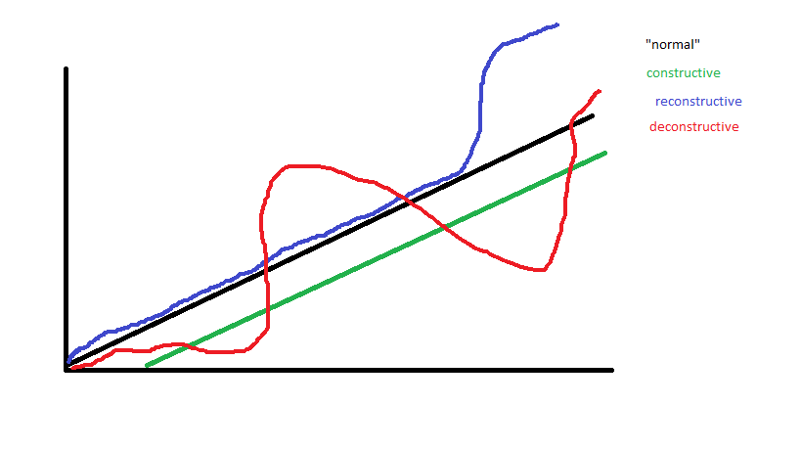
Notes:
THIS PROCESS IS EITHER:
CONSTRUCTIVE- usually neurobiological, needs a new map
RECONSTRUCTIVE- had a strong foundation, needs to get redirected back on track, has structures to build upon
DECONSTRUCTIVE AND RECONSTRUCTIVE/CONSTRUCTIVE- development aborted/no foundation, need for establishment of a new baseline

Slide 11
KIDS VS ADULTS
Developmental perspective- return to developmental trajectory
Different task of engagement due to non-voluntary status
Systems perspective- parent, child, school, community, PCP etc.
DSM 5- poor fit, less central role
Reliability / validity of reports; information variance
Non-verbal – primary up until adolescence
Presenting problems- for whom?
Hidden agendas, cultural factors, misconceptions

Slide 12
REMOTE VS IN PERSON
Some considerations for remote:
Privacy, mostly lack thereof
Distractions/noise
Meeting times challenges with caregivers on different schedules
Sibling involvement
Motor movements/activity level
MSE assessment limitations
Missing school/apt availability, resistance to do so w/video apt
Vital signs
Access to care
Seeing home environment (goes both ways)
In person
Mask
Safety
Family comfort
Childcare and space

Slide 13
Cultural Factors
Goodness of fit
Values lead to practices
How divergent is the presentation from the family’s identified culture
Assessment tools are biased
Religion
Immigration status
Interpretation of scales

Slide 14
Notes about our Population
THE NORMS ARE DIFFERENT AND DIVERGE FROM MAINSTREAM
THESE KIDS CANNOT BE OUTSIDE IN THE SAME WAY-TOO HIGH RISK: MORE TV, INSIDE ACTIVITIES LIKE PHONE USE AND VIDEO GAMES
MUCH LESS EXPOSURE TO EXPERIENCES IN THE BROADER WORLD
GENERALLY, RESPECT IS TOTALLY MORE IMPORTANT TO ALL-THEY LAUGH AT MAINSTREAM PARENTS LETTING KIDS DICTATE TO THE PARENTS, SHOW DISRESPECT TO ELDERS AND OFFER OPINIONS AS EQUALS!
EATING AND SLEEPING GOALS MAY ALSO BE DIFFERENT-AS IS WEIGHT MANAGEMENT!
NEVER DICTATE FROM OUR EDUCATED/CULTURAL PERSPECTIVE

Slide 15
Notes about our Population
PARENTS NEED TO FEEL SEEN, HEARD AND INCLUDED IN THE PROCESS
DISCIPLINE SHOULD FOCUS ON STRATEGIES FOR REPARATION AND NOT JUST CONSEQUENCES
BE ALERT TO RACISM, MARGINALIZATION, CONCERNS, PARENTAL EXPERIENCE
REMAIN NON-JUDGMENTAL AT ALL COSTS-SEEK UNDERSTANDING
REMEMBER TO GET THE PARENTS ‘FROM THE OUTSIDE’INFO AND ‘FROM THE INSIDE’ INFO FROM THE KIDS
CAREFUL WHO YOU ADDRESS FIRST, ASK PARENT WHO THEY WANT THE CHILD TO ADDRESS YOU
EVEN DATA LIKE EYE CONTACT CAN VARY DUE TO CULTURAL NORMS FOR THEM
****REMEMBER TO CHECK ON THE CONGRUENCE AND DO-ABILITY OF ANY PLAN FOR THE CHILD’S CARE!!!!!
WE MEDICATE THE FAMILY, NOT JUST THE CHILD

Slide 16
Break 5 min

