Slide 1

STRATEGIC
FOCUSED
Quality Improvement Seminar
Alyson Faires, Natalie Ewashkow, Mark Splaine
October 13, 2022
RELEVANT
INTERACTIVE
TEAM WORK
INFORMATIVE
FUN
SKILL BUILDING
Nurse Practitioner & Post Doctoral
Training Programs
Notes:
Mark

Slide 2




Welcome!
Notes:
Mark

Slide 3
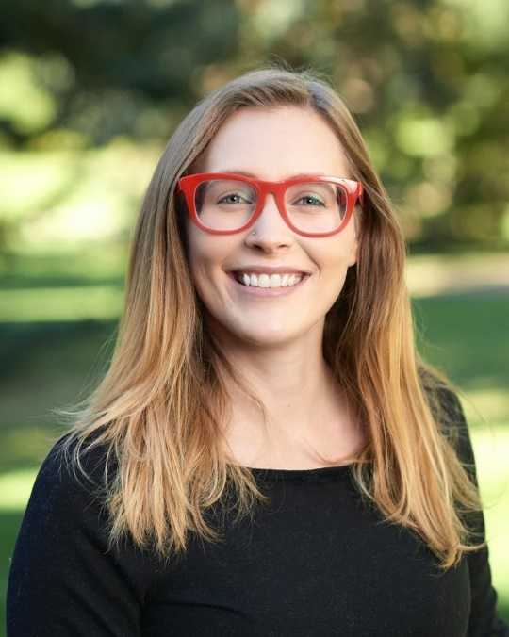
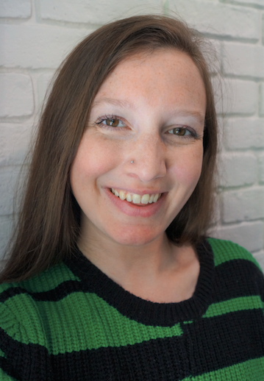
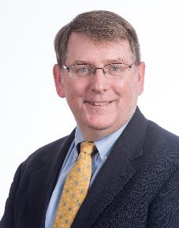
Your Support Team
Alyson Faires, PsyD
Behavioral Health
Clinician, CHC, Inc.
Natalie Ewashkow, MS
Education Specialist,
Weitzman Institute
Mark Splaine, MD, MS
Quality Improvement
Education Consultant
Notes:
Mark / Natalie

Slide 4
Additional Faculty
Chelsea McIntosh, PsyD
  Postdoctoral Training Director
Nicole Seagriff, DNP
  Clinical Program Director, Primary Care NP Residency Program
4
Notes:
Natalie / Chelsea

Slide 5
Session Goals
Learn a bit more about each other
Develop a shared understanding of the seminar series
Discuss a framework for improving care
5
Notes:
Natalie

Slide 6
Goals for the Seminars
Provide you with an opportunity to develop the knowledge and skills to improve care
Learn about multiple tools/methods and ways to use them
Create opportunities for you to try these out as a resident (and consider how you might use them in your work after residency)
Understand the concept and importance of high performing teams
Enhance our experience working in an interprofessional environment
Notes:
Natalie

Slide 7
Agenda
Welcome and Introductions (15 minutes)
Accessing seminar information (5 minutes)
What is QI? (10 minutes)
Overview of projects (10 minutes)
Theory burst on QI framework (20 minutes)
Summary and take-home points (10 minutes)
Preview of next session (5 minutes)
7
Notes:
Natalie

Slide 8
Curriculum Plan
  An overview of Quality Improvement (10/13/22)
  Care Observations & Stakeholder Considerations (10/27/22)
  Organizing your Improvement Project (11/10/22)
  Global Aim and Fishbone Diagram (12/8/22)
  Process Mapping (Flowcharts) (12/22/22)
  Measurement to Inform Change (1/12/23 & 1/26/23)
  An Approach to Testing a Change (2/9/23)
  Communication about your Improvement Effort (2/23/23)
  Stakeholder Analysis & Conflict Management (3/9/23)
  Managing Up and Gaining Leadership Buy-In (3/23/23)
  Negotiation (4/13/23)
  Negotiation and More About Cycles of Change (4/27/23)
  Sustaining your Improvement Effort (5/11/23)
  Resident Presentations (5/25/23, 6/8/23, 6/22/23)
Notes:
Natalie

Slide 9
Roles
Moderator
  Mark
Facilitator & Timekeeper
  Natalie
Technical genius
  Meaghan
Take-home thoughts report-out
  Chelsea
9
Notes:
Natalie

Slide 10
Education Credits & Attendance
Each seminar has continuing education credits associated with it
You can earn these credits by:
  Attending the seminar
  Completing the evaluation after the seminar
The seminar team takes attendance
  Make sure your name is visible on Zoom
  If you are attending as a group, use the Zoom chat function to list your group members and site
10
Notes:
Natalie

Slide 11
Introductions
Summary of responses from Survey Monkey
  Where are you located?
  What did you do before starting the residency?
  What is one strength or characteristic that you are bringing to the program/seminars?
  What has been your exposure to quality improvement?
11
Notes:
Natalie

Slide 12
Info from Surveys (n=16)
People from several states (CA, CT, IN, MA)
Previous work
  Nursing
  Graduate programs
  Community health
  Clinical research
More strengths than we can list
QI experience (25% said ‘yes’)
Thanks for sharing!
12
Notes:
Natalie

Slide 13
Poll
Check any of the following that you have done in the past.
  Changed something you do in your clinical work.
  Worked with others or a team to change something in the clinical environment.
  Reviewed data about a group of clients/patients.
  Participated on a committee that discussed operations, safety, quality, client/patient experience.
  Searched for/read about how others (people or organizations) are able to achieve better results in the care they provide
  Discussed the results of the care you provide with a colleague.
  Provided feedback to a colleague regarding something you noticed in the clinical environment.
  Helped a learner understand how care works and described why things are done the way they are done.
  Reviewed and/or implemented an evidence-based practice in
  your work.
13
Notes:
Natalie / Mark

Slide 14

Reminders About the Series
  Learning is meant to be active and experiential
  Seminars include assignment discussions, theory bursts, and interactive exercises
  Projects are team-based and the topic is chosen by your team of residents (more next slide)
  Resources are available to provide ideas for your project work and to enhance your
  knowledge/skills
Notes:
Mark

Slide 15

Project Teams
  Project teams are selected by you
    Can be site-based (everyone from one site works on the same topic)
    Can be topic-based (residents from different sites work on a common topic of interest together)
  Team size ideally should be 2-6 people
  Timeline
    Teams should be created by 11/1/22
    Topics should be finalized by 11/10/22
Notes:
Mark

Slide 16

Holyoke Health Center: Intimate Partner Violence
Nicole Phalen, Elna Rose Preston, & Faith Woodside
2022
Notes:
Mark

Slide 17
Diabetes Education
Monica Gomez and Jeremy Michaelis
HealthLinc
Valparaiso, IN
June 23, 2022
Notes:
Mark

Slide 18

Experiences from a Quality Improvement Effort
By: Alanna Sade- Milberg, Courtney Clark, Philip Imholte, Elizabeth Williams and Alyson Faires
Nurse Practitioner & Post-Doctoral
Training Programs
Notes:
Mark

Slide 19
Identifying Provider Burnout:
A Quality Improvement Project
Adam Rosen, PsyD, Anna-Lee Stafford, PhD, Mary Elizabeth Pioli, PhD, Kerri Merritt, APRN
Community Health Center, Inc. Quality Improvement Seminar
May 26, 2022
Notes:
Mark

Slide 20
AVS Quality Improvement
OpenDoor Community Health Center
NP Residents: Stephanie Randall and Han Ding
Notes:
Mark

Slide 21
Models for Improving Care
“All models are wrong, some are useful.”
- George Box
21
Notes:
Mark

Slide 22



A way to think about the care we provide…
Person w/ Diabetes
Measured Improvement
In Health
Evidence Based
Practice
+
Particular
Patient
22
Notes:
Mark

Slide 23
Linking Evidence to Improvement
Clinic w/ Diabetics
Measured Performance
Improvement
Generalizable Scientific Evidence
+
Particular
Context
Batalden PB, Davidoff F. Qual Saf Health Care. 2007; 16:2-3.
Notes:
Mark

Slide 24
Connecting Curriculum to Framework
Clinical Didactic
Seminars
Organizing a
Project
Understanding
Care Delivery
Testing a
Change
Measurement
Methods
Measured Performance
Improvement
Generalizable Scientific Evidence
+
Particular
Context
Communication
Plan
Care Team
Dynamics
Quality of
Care Results
Stakeholder
Analysis
Measurement Design
Notes:
Mark

Slide 25
Model for Improvement
What are we trying to accomplish? (Aim)
How will we know that a change is an improvement? (Measures)
What change can we make that will result in improvement? (Change)
Three questions...
…coupled with
an approach for
testing change.
Act
Plan
Study
Do
Langley GJ, et. al. The Improvement Guide (2nd Edition), 2009.
Notes:
Mark

Slide 26
Stages of Improvement
Notes:
Mark

Slide 27
More about Each Ramp Step
1. TEAM AND ROLES DEFINED
Coach Assigned, Identify Core and Extended Team Members, Define Roles, Schedule Team Meetings, Communication Plan
TOOLS/SKILLS/PROCESS:
Effective Meeting Tools
Forming/Storming/Norming/
Performing
2. ASSESSMENT AND BASELINE DATA
What is our current state? Describe population of interest, Identify data sources, Drill down to specific areas of focus. Related to other projects?
TOOLS/SKILLS/PROCESS:
Tick & Tally & other data collection
Process Mapping
Role Assessment
Team Practice Assessment
3. GLOBAL AIM
What is our overall goal for advancing TBC Model? Theme, Name process, location, Start/End of Process, Benefits/Imperatives
TOOLS/SKILLS/PROCESS:
Build Consensus
Fishbone Diagram (cause & effect diagram)
4. PROBLEM STATEMENT/THEME
Problem Statement, Importance, Goals/ Objectives, Deliverables, KPIs
TOOLS/SKILLS/PROCESS:
QI Charters as agenda items
Brainstorming/ Brain writing
Multi-Voting
Impact/ Effort Grid
Fishbone Diagram
Five Whys
Process Map
Build consensus
5. SPECIFIC AIMs and MEASURES
What do we want to accomplish in days and weeks ? What will change, by how much & when , How will we know that we accomplished it?
TOOLS/SKILLS/PROCESS:
Specific Aim Tool
Build Consensus
Fishbone Diagram (cause & effect)
Tick & Tally & other data collection
6. SOLUTION STORMING for CHANGE IDEA
What could we try?
Realistic ideas, Manager|Leader involvement.
TOOLS/SKILLS/PROCESS:
Idea Tree
Parking Lot
Force Field Analysis
Impact Effort
Multi-Voting
7. PDSA
Aim, test, who, when, where.
PLAN Tasks: How will we do it? What, Who, When, Where. Predictions, Measures
DO: Lets try it out. Results
STUDY: How is it working out? ACT: Lets try it again with modifications?
TOOLS/SKILLS/PROCESS:
PDSA Template
Keep test SMALL
Only one PDSA at a time
Measures
8. SDSA
Standardize the test that was successful. Will it work the same in every day routine? Document.
TOOLS/SKILLS/PROCESS:
Involve all team members
Communication Plan
Playbook – Influence Spread
9. SPREAD, MEASURE & MONITOR
Implement spread strategy and track how it is working.
TOOLS/SKILLS/PROCESS:
  Communication Skills
  Spread Strategy
  Big Picture View
  Connecting the dots
  QI Process
8
9
7
5
6
4
2
3
1
On-Going Data Collection & Review
Notes:
Mark

Slide 28
About the Ramp
Adapted from Clinical Microsystems and IHI
A systematic organized approach to improvement that relies on data
Not truly a linear process: often need to step back to get more data or clarify aims before moving forward again
Number 1 mistake: Skipping steps 1-5!!
  Everybody has a good idea for how to fix something before understanding why it is happening in the first place.
Notes:
Mark

Slide 29
What haven’t we figured out yet?
Questions or issues that remain unclear?
29
Notes:
Mark

Slide 30
Take-home Thoughts
Chelsea – share 1 or 2 ideas you will take away from our discussion
30

Slide 31
Summary
We are using frameworks to guide our thinking about how to organize improvement work
  There are many frameworks/approaches available
  Each framework can be applied to patient care, improvement efforts, and even education
Our seminars together are designed to be interactive
  Your preparation and participation is essential for promoting our shared learning
Getting to know a bit more about each other as well as our sites will help us in our learning
31
Notes:
Mark

Slide 32
Remember to…
Complete the feedback survey for Session I
Review list of project topic ideas (see separate document)
Begin talking with colleagues about who you may wish to work with on your project
32
Notes:
www.clinicalmicrosystem.org
32
Mark

Slide 33
Assignment for Session II
Please do two things:
  Find at least one improvement priority for your organization
  Notice at least one thing at your site that interests you about the way care is provided; is there anything you wonder about in terms of improving care related to what you noticed?
You may work with resident colleagues to generate a composite Notice/Wonder list, or do this individually
Check with leaders/providers/team members at your site to find out about an organization improvement priority
Contact Mark, Alyson, and Natalie if you have questions or need assistance
Send your Notice/Wonder list to Mark, Alyson, and Natalie by Tuesday (10/25/22) at 6pm EDT
Our next session will be on Thursday, 10/27/22
33
Notes:
www.clinicalmicrosystem.org
33
Mark

Slide 34
References
Batalden PB, Davidoff F. Quality Safety in Health Care. 2007; 16:2-3.
Langley GJ, Moen R, Nolan KM, Nolan, TW, Norman CL, and Provost LP. The Improvement Guide: A Practical Approach to Enhancing Organizational Performance (2nd Edition). San Francisco, CA: Jossey-Bass, 2009.
34
Notes:
www.clinicalmicrosystem.org
34

