Slide 1
STRATEGIC
FOCUSED
Quality Improvement Seminar
Alyson Faires, Natalie Ewashkow, Mark Splaine
October 27, 2022
RELEVANT
INTERACTIVE
TEAM WORK
INFORMATIVE
FUN
SKILL BUILDING
Nurse Practitioner & Post Doctoral
Training Programs
Notes:
ALYSON

Slide 2
Session Goals
Hear about and discuss many of the things you are noticing and wondering about
Review the evidence for the team-based care approach in primary care
Share some examples of team-based care in your setting
2
Notes:
ALYSON

Slide 3
Roles
Theory burst presenter
Mark
Facilitator
Alyson
Timekeeper
Natalie
Technical genius
Monique
Take-home thoughts report-out
Chelsea
3
Notes:
ALYSON

Slide 4
Agenda
Welcome and announcements (10 mins)
Theory burst on team-based care (10 mins)
Examples of team-based care (15 mins)
Brief break (5 mins)
Assignment small group discussion (30 mins)
Summary and take-home points (5 mins)
Preview of next session (10 mins)
4
Notes:
ALYSON

Slide 5
Curriculum Plan
An overview of Quality Improvement (10/13/22)
Care Observations & Stakeholder Considerations (10/27/22)
Organizing your Improvement Project (11/10/22)
Global Aim and Fishbone Diagram (12/8/22)
Process Mapping (Flowcharts) (12/22/22)
Measurement to Inform Change (1/12/23 & 1/26/23)
An Approach to Testing a Change (2/9/23)
Communication about your Improvement Effort (2/23/23)
Stakeholder Analysis & Conflict Management (3/9/23)
Managing Up and Gaining Leadership Buy-In (3/23/23)
Negotiation (4/13/23)
Negotiation and More About Cycles of Change (4/27/23)
Sustaining your Improvement Effort (5/11/23)
Resident Presentations (5/25/23, 6/8/23, 6/22/23)
Notes:
ALYSON

Slide 6
Office Hours
Alyson and Natalie hold office hours for all residents on the 1st and 3rd Thursday of each month from 1-1:30pm ET
Mark is available to meet with any resident or team from HealthLinc, Holyoke, Open Door, or CHC, Inc. if they need an alternative time – just email to set up a time
6
Notes:
NATALIE

Slide 7
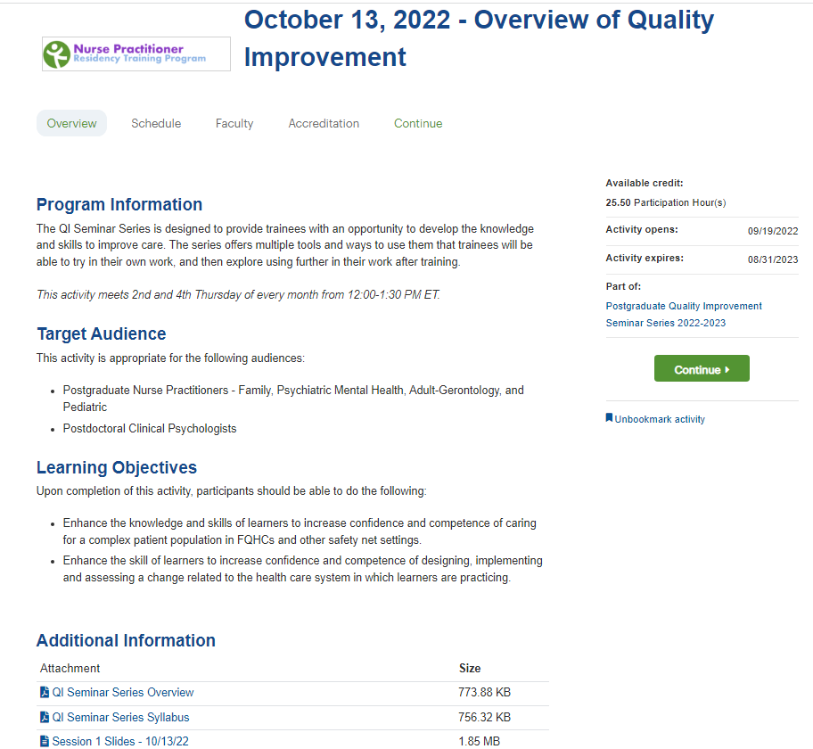
Weitzman Education Platform
7
Notes:
NATALIE

Slide 8
High Performing, Patient-Centered, Team-Based Primary Care
What does the evidence tell us?
Notes:
MARK

Slide 9
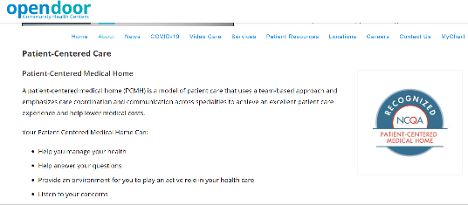
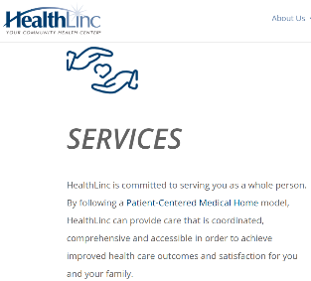
Patient-Centered Medical Home
9
Notes:
MARK

Slide 10
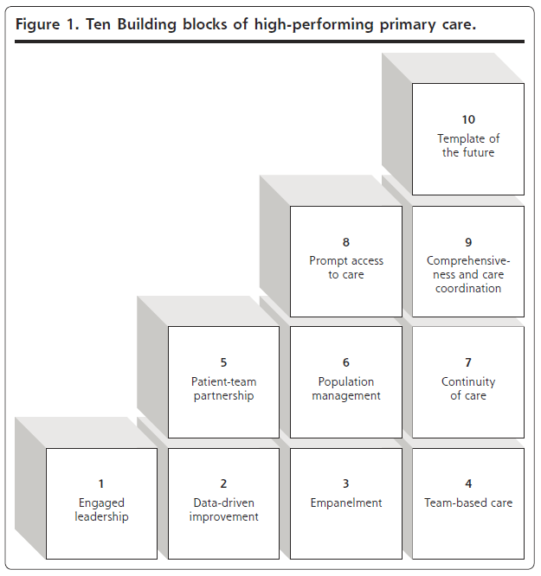
High Performing Primary Care
Foundational or first-tier blocks (1-4)
First-tier blocks support achievement of upper blocks (5-10)
Bodenheimer T, et. al. Ann Fam Med 2014;166-171. doi:10.1370/afm.1616
Notes:
MARK

Slide 11
National Cooperative Agreement (NCA) Webinars
https://vimeo.com/635689772/3b16008074
11
Notes:
MARK

Slide 12
12
Notes:
MARK

Slide 13
13
Notes:
MARK

Slide 14
14
Notes:
MARK

Slide 15
15
Notes:
MARK

Slide 16
16
Notes:
MARK

Slide 17
17
Notes:
MARK

Slide 18
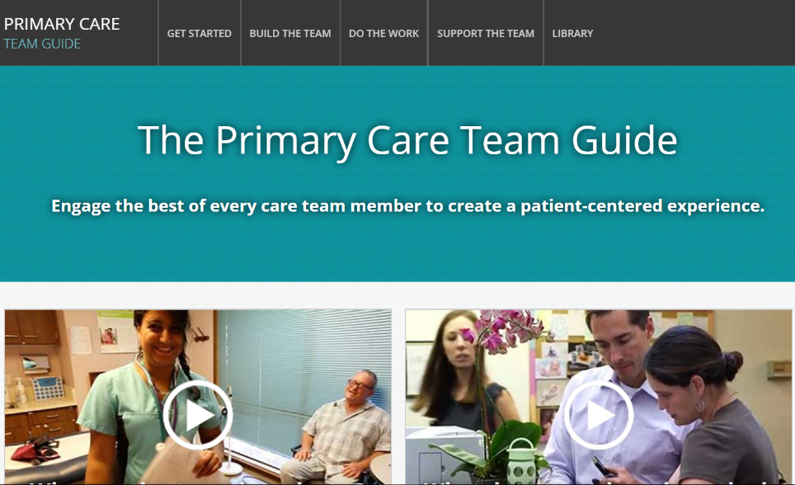
https://improvingprimarycare.org
18
Notes:
MARK

Slide 19
Poll Questions
At which organization are you located?
Who do you work with directly when you provide care?
Which health professional disciplines are available at your site?
Thanks for sharing your information!
Notes:
NATALIE

Slide 20
Examples from Sites
We will ask for volunteers to share an example of team-based care you have seen at your site
Holyoke HC
CHC Danbury/Waterbury
Open Door
HealthLinc
CHC New Britain
We will hear from as many sites as time allows
20
Notes:
NATALIE

Slide 21
Break!
Take five minutes to recharge and refresh.
21
Notes:
MARK

Slide 22
Session II Assignment
Now we will focus on your assignment for today’s session
We will divide into three breakout rooms
Alyson, Natalie, and Mark will facilitate the discussion in each room
We will do two rounds of sharing in each group
Round 1: a quality improvement priority for your organization
Round 2: an example of something you noticed and are wondering about in their clinic setting
Each group will ask for a volunteer to report on highlights of the discussion
After the small group discussion, we will return to the large group to hear each reporter’s summary ideas
22
Notes:
www.clinicalmicrosystem.org
22
ALYSON

Slide 23
Small Group Discussion
We will break into three groups (A, B & C):
Group A (Alyson facilitate)
CHC Danbury, New London, Waterbury
HealthLinc
Group B (Natalie facilitate)
CHC Hartford, Meriden, New Britain
Open Door
Group C (Mark facilitate)
CHC Hartford, Middletown, Stamford/Norwalk
Holyoke HC
Notes:
ALYSON

Slide 24
Highlights from Small Groups
Reporter’s summary from each group -- share 1 or 2 highlights from the discussion (2-3 mins)
Group A (Alyson’s group)
Group B (Natalie’s group)
Group C (Mark’s group)
Notes:
ALYSON

Slide 25
What haven’t we figured out yet?
Questions or issues that remain unclear?
25
Notes:
ALYSON

Slide 26
Take-home Thoughts
Chelsea – share 1 or 2 ideas you will take away from our discussion
26
Notes:
MARK

Slide 27
Summary
You have learned about frameworks to guide your thinking about how to organize improvement work
You have identified some of your organization’s priorities for improvement
You have begun to investigate processes in the clinical environment that you think can be improved with quality improvement interventions
Consider using one of these processes for your team’s QI project
We have discussed the person-centered, team-based approach to primary care and emphasized the great opportunity at health centers to provide integrated care
27
Notes:
MARK

Slide 28
Assignment for Session III
Send a list of who you will be working with and what you will focus on for your QI project to Mark, Alyson and Natalie by 11/9/22
Work with your project team to make a draft of the project charter
Send your draft project charter to us by Wednesday, 11/9/22 at 6pm EST
28
Notes:
www.clinicalmicrosystem.org
28
MARK

Slide 29
Notes:
MARK

Slide 30
A PROJECT CHARTER adds structure as you plan
What are we trying to accomplish? & Why?
Will we know if the change made an impact?
A tool for training and/or communication
Baseline data
Goals
Measures
Stakeholders
Barriers
Expectations
Ideas
30
Notes:
MARK

Slide 31
Date charter revised
Problem Statement
Create this statement with team
Team Members
Central Question/ Why work on this now?
Include coach, sponsor and each member (core and extended)
Measures
What is the impact anticipated OR what are the current losses
Scope
Goal Statement
Measurement from PI Goals
Milestones/ Dates
Goals from PI Goals spreadsheet – baseline and follow up.
Date team first meeting and date project charter created
Document first & last process steps.
Deliverables and when they are due
If implementation goal –evidence that it is implemented?
List areas of exclusion for this project
Create this statement with team
Date each PDSA launched, completed.
Project Charter Template
Notes:
MARK

Slide 32
Session III Highlights
We will hear reports from several groups about their draft project charter for their project idea
We will introduce and briefly discuss the templates for creating:
A global aim statement
A fishbone diagram
32
Notes:
www.clinicalmicrosystem.org
32
MARK

Slide 33
References
The Primary Care Team Guide (https://improvingprimarycare.org)
Bodenheimer T, Ghorob A, Willard-Grace R, Grumbach K. Ann Fam Med 2014;166-171. doi:10.1370/afm.1616
NCA Implementing Team-Based Care Webinar (https://vimeo.com/635689772/3b16008074)
Batalden PB, Davidoff F. Qual Saf Health Care. 2007; 16:2-3
33
Notes:
www.clinicalmicrosystem.org
33
MARK

