Slide 1
Transference and Countertransference: Understanding the Concepts and Implementing Them Effectively
Kate Patterson, PsyD
Clinical Director, Child Guidance Clinic
On Site Behavioral Health Director
Middletown

Slide 2
Disclosure
With respect to the following presentation, there has been no relevant (direct or indirect) financial relationship between the party listed above (or spouse/partner) and any for-profit company in the past 12 months which would be considered a conflict of interest.
The views expressed in this presentation are those of the presenter and may not reflect official policy of Community Health Center, Inc. and its Weitzman Institute.
I am obligated to disclose any products which are off-label, unlabeled, experimental, and/or under investigation (not FDA approved) and any limitations on the information hat I present, such as data that are preliminary or that represent ongoing research, interim analyses, and/or unsupported opinion.

Slide 3
Objectives
Understand and define transference and countertransference from a psychoanalytic perspective.
Learn how to identify transference and countertransference in session and effectively use the transference with patients as a place of intervention and case formulation.
Learn how to discuss transference and countertransference in supervision while understanding the parallel process of interactions as they unfold in both supervision and session.

Slide 4
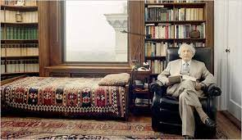
Openings
“Psychiatrist: We are here to understand your unconscious.
Patient: My unconscious is none of my business.”—Jackie Mason
“I have seen no better defense than that that of being a therapist.” –Anna Freud

Slide 5
Inquiries
What is it to learn?
What is it to know?
What is it to be seen?
How do you integrate these questions and answers into your therapeutic work?

Slide 6
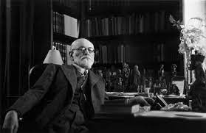
History of Transference and Countertransference
Transference and countertransference originate from psychoanalysis. Freud originally saw these concepts as deterrents, however, went on to see them as considerable tools within the therapeutic relationship.
“Analyst’s blind spots which presented an obstacle to the analysis” –Freud
Freud went on to note that the mind was an “instrument” that was being impeding the analysis by countertransference. Moreover, the countertransference was seen as the equivalent of resistance in the patient (Sandler, 1976).
Summers and Barber (2010) describe transference and countertransference as an “essential feature” of therapy.

Slide 7
Definitions of Transference
The patient’s feeling towards the therapist (Summers & Barber, 2010).
Repressed experiences in childhood that emerge later in life into various relationships. Guntrip (1971) writes, “This phenomenon of ‘transference’—so prolific a cause of disruption in friendships, marriages, and adult partnerships of all kinds—inevitably erupts, unrecognized by the person in the treatment situation” (p. 9).

Slide 8
Analytic Thoughts on Transference
“Furthermore, the patient proceeds to react to these non-existent characteristics in the analyst with appropriate counter attitudes of love, adoration, competitiveness and hostility. It is as if a drama were being enacted with the analyst, and presently this drama seems to become more important to the patient than talking about his troubles.” (Thompson, 2014, p. 1).

Slide 9
Definitions of Countertransference
How the therapist feels about the client (Summers & Barber, 2010).
“Analyst’s blind spots which presented an obstacle to the analysis” (Freud, 1910, as cited in Gait & Halewood, 2019).
The therapists response to the client in a both an unconscious and conscious form (Gait & Halewood, 2019).

Slide 10
Analytic Thoughts on Countertransference
How the therapist feels about the client (Summers & Barber, 2010).
“Countertransference is any and all of the feelings that the therapist has put towards his patient. This might include his own analyzed transference to the patient of a displacement on to the patient from the outside, but it would also include feelings put into him by the patient” (Alvarez, 1983, p.11).
“The analytic situation induces the development of derivatives of the repressed, and at the same time a resistance is operative against it. The derivatives may make their appearance as highly concrete emotional needs directed toward the person who happens to be present. Resistance distorts the true connections. The patient misunderstands the present in terms of the past; and then instead of remembering the past, he strives, without recognizing the nature of his action, to relive the past and to live it more satisfactorily than he did in childhood. He ‘transfers’ past attitudes to the present” (Fenichel, 1945, p.29 as cited in Searles, 1978-1979, p. 193).

Slide 11
Holding our countertransference
All of the internal work that the analyst does with his countertransference—inhibiting retaliatory impulses, holding the patient’s evacuated mental contents in consciousness long enough to submit them to processes of reverie which cleanse them of their toxicity—is akin to the internal work that the good-enough mother does in both surviving and maintaining her connection to her baby during those episodes in which she “becomes the target for excited experience backed by crude instinct tension.” (Epstein, 1999).

Slide 12
Contributing Ideas
Projective identification (Klein): Client splits off and “projects disavowed affect into the therapist” (p. 257, Gait & Halewood, 2019).
“A group of fantasies and accompanying object relations having to do with the ridding of the self of unwanted aspects of the self, the epositing of those unwanted ‘parts’ into another person, and, finally, with the ‘recovery’ of a modified version of what was extruded.” (p. 208, James, 1984).
Containment, or holding the projective identification
Therefore, for containment to occur the therapist needed to be able to tolerate the ‘emotional storm’ long enough for it to be thought about and given meaning (Bion, 1962, as cited in Gait & Halewood, 2019)
Reverie (Bion/Ogden)
Client projects part of their mind into the therapist, who then ‘metabolizes’ it before it is put back to the client in a way that can be managed
An unconscious simpatico between patient and therapist
Notes:
Bion (1962) suggested that the provision of ‘containment’ allows the client to
reintroject the experience which facilitates growth and development. In contrast, if
the therapist becomes influenced by the projected feelings and lacks the capacity
to tolerate them long enough to modify and detoxify them, they may then reject
them (Bion, 1962).

Slide 13
Positive and Negative Countertransference
Originally, positive countertransference was seen as facilitative, or fostering growth. However, positive countertransference can be viewed as the therapist hindering the relationship under a positive valence; for example, seeming supportive but perhaps becoming overly involved, or dependent.
Negative countertransference can be viewed as “punitive, avoidant, or aggressive” (p. 1230, Miller Friedman & Gelso, 2000).
Common examples of negative countertransference include:
Rejecting the client in session
Distancing
Apathy
Being critical
Providing too much structure
Time spent complaining during session

Slide 14
Utilizing Transference in Treatment
How do we take irrational, “untrue,” and unconscious thoughts towards us, and use it?
Beliefs about who we are as people—what assumptions do our patients (and supervisors) make about us? (Clinical example: TW)
Transference from paranoid and psychotic patients—how can we challenge irrational thoughts while keeping our clients safe.
Kumin (1985, as cited in Messler-Davies, 1994) notes that “a growing awareness of erotic transference or countertransference can include feelings of such intense dysphoria, frustration, shame, humiliation, and disgust that it might best be termed ‘erotic horror.’ Moreover, the author notes that it is the desire of the analyst to suppress the development and elaboration of the transference.
Clinical example: PK

Slide 15
Transference Based Interventions
Process comments and the utilization of the “here and now”
(Re)Enactments
The goal reenactments is to recreate a space within the countertransference where the patient’s previous experiences of “anxiety, sadness, envy, rage and erotic hyperarousal” can be held (p. 157, Messler Davies, 1994)
Guided reflections
Rupture and repair

Slide 16
Utilizing Countertransference as Intervention
Commons feelings to have towards patients?
How do we deal with the “difficult” patient and how do we use that countertransference to create insight and influence change?
“To help the general psychiatrist the psycho-analyst must not only study for him the primitive stages of the emotional development of the ill individual, but also must study the nature of the emotional burden which the psychiatrist bears in doing his work. What we as analysts call the counter-transference needs to be understood by the psychiatrist too. However much he loves his patients he cannot avoid hating them, and fearing them, and the better he knows this the less will hate and fear be the motive determining what he does to his patients.” (Winnicott, 1949).

Slide 17
Common Examples for Eliciting Countertransference
Medication seeking
Ambivalent suicidality
Highly anxious
Antisocial
Inept parenting
Cluster B personality disorders
Hostile
Flooding
Racism/systemic injustice

Slide 18
Impacts of Countertransference in Supervision
Not all training programs integrate ideas of transference and countertransference. In Gait & Halewood’s (2019) study examining countertransference and supervision, they identified numerous themes of being unprepared, overwhelmed, and at times, ashamed about their countertransference.
Supervisees may be hesitant to engage in sharing, and moreover, some supervisors may not have experience with supervisees sharing countertransferential responses.

Slide 19
Utilizing Transference and Countertransference in Supervision
Understanding parallel process in supervision
Questions to ask supervisees or what to bring up in supervision:
How are you feeling about this patient?
What makes you feel more empathetic towards them?
What makes you more frustrated about certain patients?
Differences between countertransference, burnout, and vicarious trauma?

Slide 20
Parallel Process
Parallel process can be defined as “The therapists unconscious transfer of some unresolved patient conflict (e.g. issues with authority, interpersonal distrust) from the treatment experience into supervision” (Ekstein & Wallerstein, 1958; Searles, 1955 as cited in Watkins, 2017, p.506).”
How can supervision sessions mimic what’s happening in therapy sessions?

Slide 21
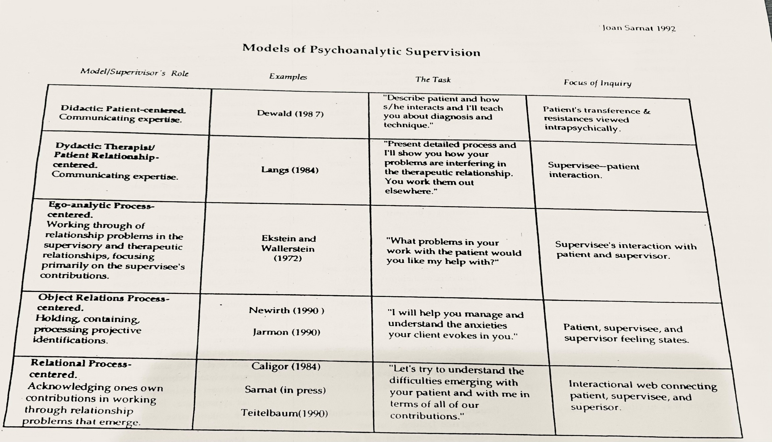

Slide 22
Clinical Cases
Child Case (AY)
Adult Cases (CT, MJ)

Slide 23
Group Discussion
Cases to share?
Thoughts on how to utilize these concepts?
Is this really necessary?

Slide 24
References
Alvarez, A. (2004). Problems in the use of the countertransference: Getting it across (1983). In P. S. Barrows (Ed.), Key papers from the Journal of Child Psychotherapy. (pp. 63–81). New York, NY: Brunner-Routledge. Retrieved from https://search.ebscohost.com/login.aspx?direct=true&db=psyh&AN=2004-14258-004&site=ehost-live&scope=site
Devlin, M. J., Cutler, J. L., & Harper, O. L. (2012). Taking it personally: Exploring medical students’ emotional responses and professional roles during the psychiatry clerkship. Academic Psychiatry, 36(3), 243–245. https://doi.org/10.1176/appi.ap.11060109
Epstein, L. (1999) The Analyst's “Bad-Analyst Feelings.” Contemporary Psychoanalysis, (35)2, 311-325, DOI: 10.1080/00107530.1999.10747036
Frederickson, J. (2015). Countertransference in supervision. Psychiatry: Interpersonal and Biological Processes, 78(3), 217–224. https://doi.org/10.1080/00332747.2015.1069641
Friedman, S. M., & Gelso, C. J. (2000). The development of the Inventory of Countertransference Behavior. Journal of Clinical Psychology, 56(9), 1221–1235. https://doi.org/10.1002/1097-4679(200009)56:9<1221::AID-JCLP8>3.0.CO;2-W
Guntrip, H. (1971). Psychoanalytic theory, therapy, and the self: A basic guide to the human personality in Freud, Erikson, Klein, Sullivan, Fairbairn, Hartmann, Jacobson, & Winnicott. Basic Books.
James, D. C. (1984). Bion’s “Containing” and Winnicott’s “Holding” in the context of the group matrix. International Journal of Group Psychotherapy 34(2), 201-213.
Messler Davies, J. (1994). Love in the afternoon. A relational reconsideration of desire and dread in the countertransference. Psychoanalytic Dialogues, 4(2), 153-170.
Ogden, T. H. (1997). Reverie and interpretation. Northvale, NJ. Jason Aronson, Inc.
Sandler, J. (1976). Countertransference and role-responsiveness. Int. Rev. Psycho-Anal, (3)43, 43-47.
Searles, H. F. (2017). Concerning transference and countertransference. Psychoanalytic Dialogues, 27(2), 192–210. https://doi.org/10.1080/10481885.2017.1285167
Summers, R. F. & Barber, J. P. (2010). Psychodynamic therapy: A Guide to Evidence-Based Practice. New York, NY. The Guilford Press.
Thompson, C. (2014). Transference as a therapeutic instrument. Psychiatry: Interpersonal and Biological Processes, 77(1), 1–7. https://doi.org/10.1521/psyc.2014.77.1.1
Watkins, C. E., Jr. (2017). Reconsidering parallel process in psychotherapy supervision: On parsimony, rival hypotheses, and alternate explanations. Psychoanalytic Psychology, 34(4), 506–515. https://doi.org/10.1037/pap0000127
Winnicott, D. W. (1949). Hate in the countertransference. International Journal of Psychoanalysis (30), 69-74.

