Slide 1

Heart Failure
Mary Blankson, DNP, APRN, FNP-C
Community Health Center, Inc.

Slide 2
Objectives
Review definition and pathophysiology of heart failure.
Gain a general understanding of heart failure treatment guidelines.
Understand the PCP’s role in heart failure care optimization.
Understand the PCP’s role in self-management of heart failure.

Slide 3
Outline
Definition
Pathophysiology
Stages and Treatment
Transitions
Care Coordination
Medication Management
Self Management Goals

Slide 4
Outline
Definition
Pathophysiology
Stages and Treatment
Transitions
Care Coordination
Medication Management
Self Management Goals

Slide 5
Stages, Phenotypes and Treatment of HF

Slide 6
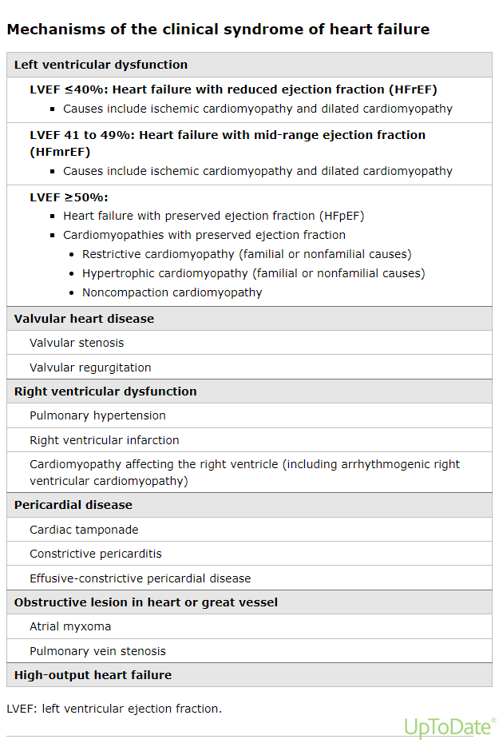

Slide 7
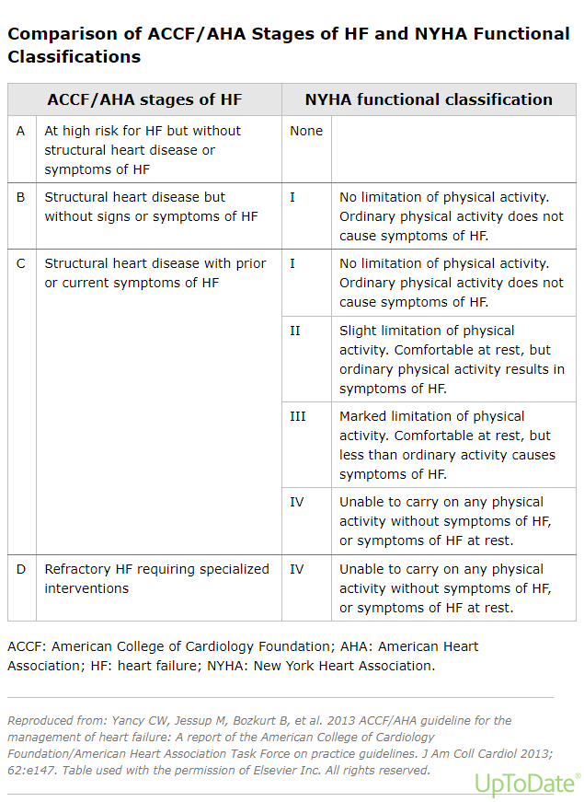

Slide 8
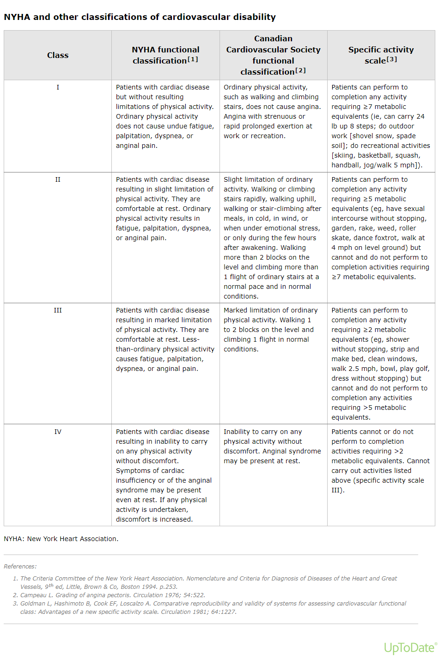

Slide 9
Outline
Definition
Pathophysiology
Stages and Treatment
Transitions
Care Coordination
Medication Management
Self Management Goals

Slide 10
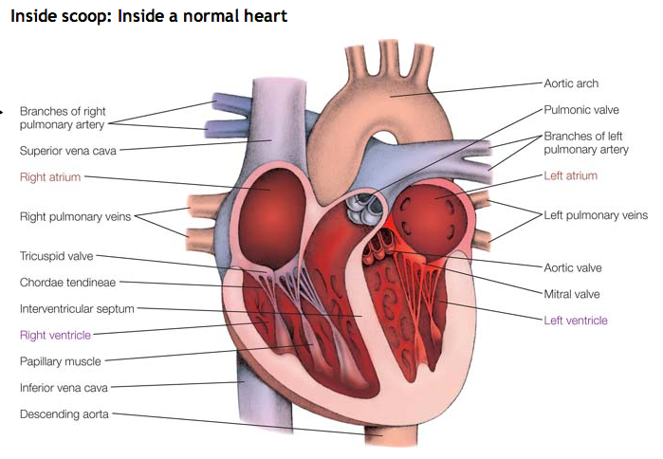
Cardiac Physiology

Slide 11
Types of Heart Failure
Left-sided heart failure | Right-sided heart failure | Congestive heart failure
Oxygen rich blood moves from left atrium (LA) -> left ventricle (LV) -> to body. | “Used” blood moves from right atrium (RA) -> right ventricle (RV) -> lungs for re-oxygenation | Blood flow to heart slows -> blood returning to heart “backs up” -> congestion in body’s tissues
Systolic Failure = LV loses ability to contract normally (poor pump) * Reduced ejection fraction (EF) | Results from left-sided failure; when LV fails -> increased fluid pressure transferred back to the lungs -> backs up to body’s veins (poor pump) | Swelling in legs/ankles -> peripheral edema Lungs -> pulmonary edema
Diastolic failure/dysfunction = LV loses ability to relax normally; doesn’t fill with sufficient blood during relaxation *preserved EF | Key symptoms: Swelling in legs and ankles | Interferes with kidneys ability to dispose of sodium and water -> worsens edema
Notes:
Left-sided heart failure
The heart's pumping action moves oxygen-rich blood as it travels from the lungs to the left atrium, then on to the left ventricle, which pumps it to the rest of the body. The left ventricle supplies most of the heart's pumping power, so it's larger than the other chambers and essential for normal function. In left-sided or left ventricular (LV) heart failure, the left side of the heart must work harder to pump the same amount of blood.
There are two types of left-sided heart failure. Drug treatments are different for the two types.
Heart failure with reduced ejection fraction (HFrEF), also called systolic failure: The left ventricle loses its ability to contract normally. The heart can't pump with enough force to push enough blood into circulation.
Heart failure with preserved ejection fraction (HFpEF), also called diastolic failure (or diastolic dysfunction): The left ventricle loses its ability to relax normally (because the muscle has become stiff). The heart can't properly fill with blood during the resting period between each beat.
Right-sided heart failure
The heart's pumping action moves "used" blood that returns to the heart through the veins through the right atrium into the right ventricle. The right ventricle then pumps the blood back out of the heart into the lungs to be replenished with oxygen.
Right-sided or right ventricular (RV) heart failure usually occurs as a result of left-sided failure. When the left ventricle fails, increased fluid pressure is, in effect, transferred back through the lungs, ultimately damaging the heart's right side. When the right side loses pumping power, blood backs up in the body's veins. This usually causes swelling or congestion in the legs, ankles and swelling within the abdomen such as the GI tract and liver (causing ascites).
Congestive heart failure
Congestive heart failure (CHF) is a type of heart failure which requires seeking timely medical attention, although sometimes the two terms are used interchangeably.
As blood flow out of the heart slows, blood returning to the heart through the veins backs up, causing congestion in the body's tissues. Often swelling (edema) results. Most often there's swelling in the legs and ankles, but it can happen in other parts of the body, too.
Sometimes fluid collects in the lungs and interferes with breathing, causing shortness of breath, especially when a person is lying down. This is called pulmonary edema and if left untreated can cause respiratory distress.
Heart failure also affects the kidneys' ability to dispose of sodium and water. This retained water also increases swelling in the body's tissues (edema).

Slide 12
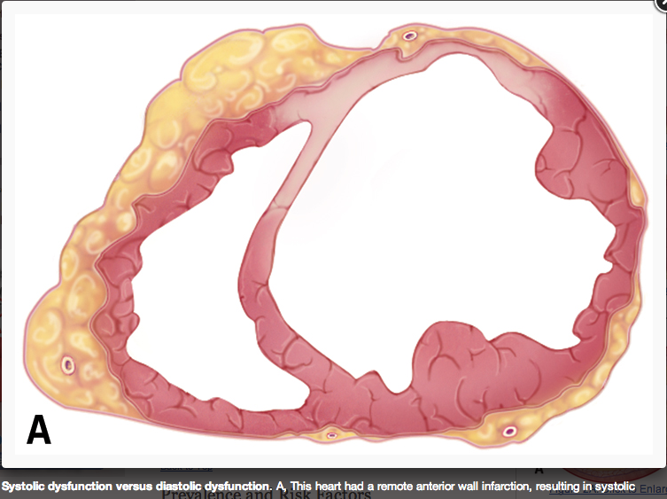

Slide 13
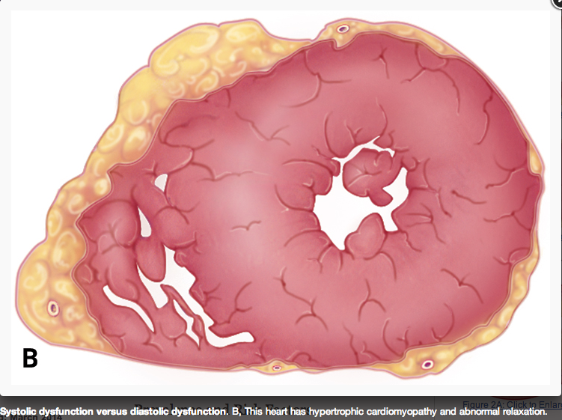

Slide 14
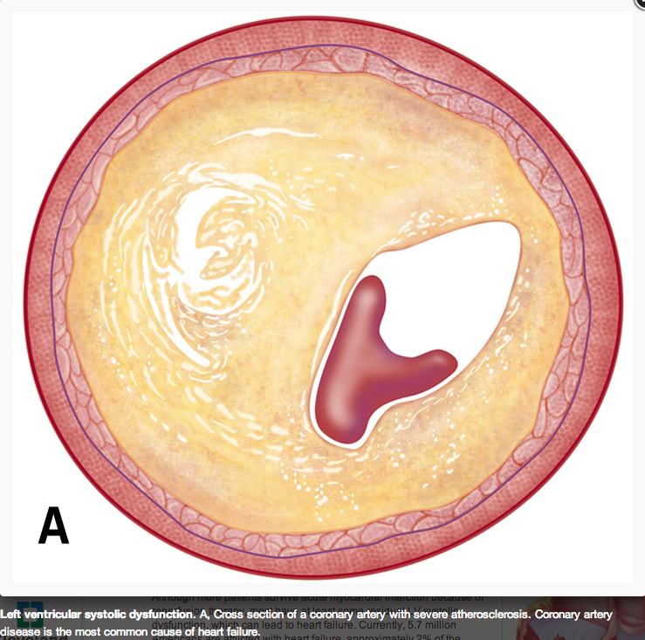

Slide 15
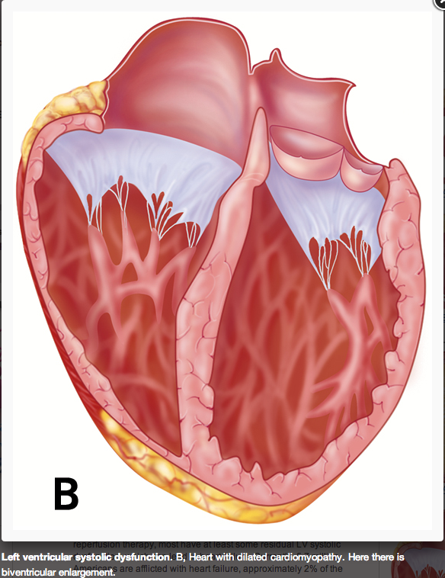

Slide 16
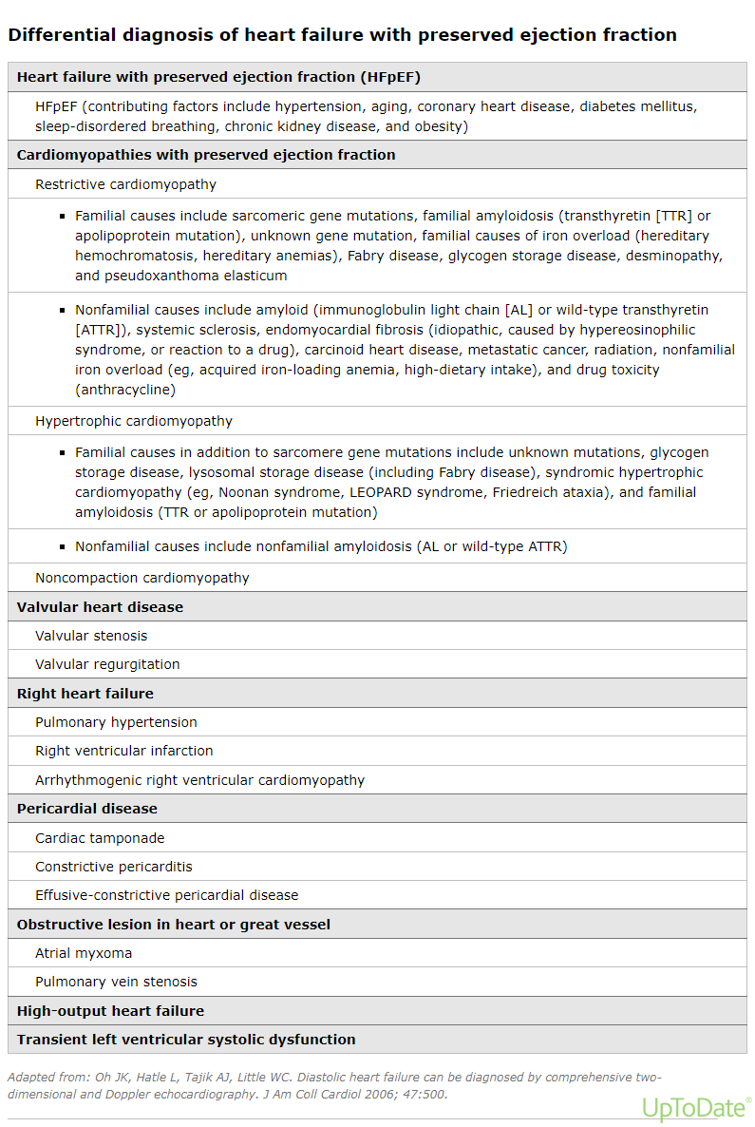

Slide 17
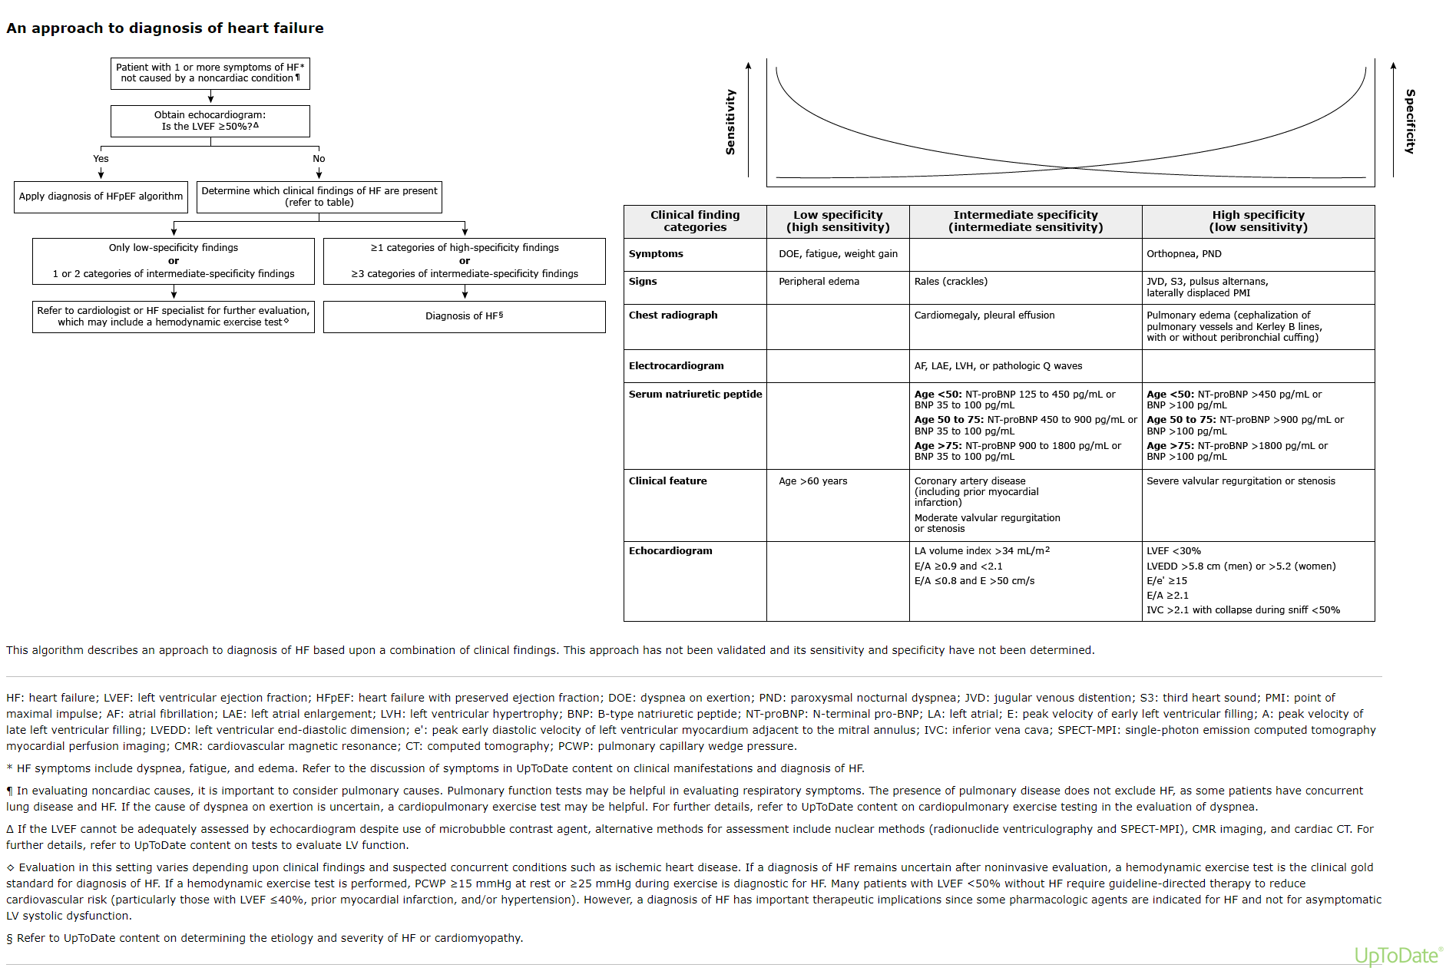

Slide 18
Outline
Definition
Pathophysiology
Stages and Treatment
Transitions
Care Coordination
Medication Management
Self Management Goals

Slide 19
Treatment
Stage A

Slide 20
Stage A
I
IIa
IIb
III
Hypertension and lipid disorders should be controlled in accordance with contemporary guidelines to lower the risk of HF.
Other conditions that may lead to or contribute to HF, such as obesity, diabetes mellitus, tobacco use, and known cardiotoxic agents, should be controlled or avoided.
A
I
IIa
IIb
III

Slide 21
Treatment
Stage B

Slide 22
Recommendations for Treatment of Stage B HF
Recommendations | COR | LOE
In patients with a history of MI and reduced EF, ACE inhibitors or ARBs should be used to prevent HF | I | A
In patients with MI and reduced EF, evidence-based beta blockers should be used to prevent HF | I | B
In patients with MI, statins should be used to prevent HF | I | A
Blood pressure should be controlled to prevent symptomatic HF | I | A
ACE inhibitors should be used in all patients with a reduced EF to prevent HF | I | A
Beta blockers should be used in all patients with a reduced EF to prevent HF | I | C
An ICD is reasonable in patients with asymptomatic ischemic cardiomyopathy who are at least 40 d post-MI, have an LVEF ≤30%, and on GDMT | IIa | B
Nondihydropyridine calcium channel blockers may be harmful in patients with low LVEF | III: Harm | C

Slide 23
Treatment
Stage C

Slide 24
Treatment
Nonpharmacological Interventions

Slide 25
Stage C: Nonpharmacological Interventions
I
IIa
IIb
III
Patients with HF should receive specific education to facilitate HF self-care.
Exercise training (or regular physical activity) is recommended as safe and effective for patients with HF who are able to participate to improve functional status.
Sodium restriction is reasonable for patients with symptomatic HF to reduce congestive symptoms.
B
I
IIa
IIb
III
A
I
IIa
IIb
III

Slide 26
Stage C: Nonpharmacological Interventions (cont.)
I
IIa
IIb
III
Continuous positive airway pressure (CPAP) can be beneficial to increase LVEF and improve functional status in patients with HF and sleep apnea.
Cardiac rehabilitation can be useful in clinically stable patients with HF to improve functional capacity, exercise duration, HRQOL, and mortality.
B
I
IIa
IIb
III
B

Slide 27
Treatment
Pharmacological Treatment for Stage C HFrEF

Slide 28
Pharmacologic Treatment for Stage C HFrEF
Notes:
LOE=Level of Evidence

Slide 29
Drugs Commonly Used for HFrEF
(Stage C HF)
Drug | Initial Daily Dose(s) | Maximum Doses(s) | Mean Doses Achieved in Clinical Trials
ACE Inhibitors
Captopril | 6.25 mg 3 times | 50 mg 3 times | 122.7 mg/d (421)
Enalapril | 2.5 mg twice | 10 to 20 mg twice | 16.6 mg/d (412)
Fosinopril | 5 to 10 mg once | 40 mg once | ---------
Lisinopril | 2.5 to 5 mg once | 20 to 40 mg once | 32.5 to 35.0 mg/d (444)
Perindopril | 2 mg once | 8 to 16 mg once | ---------
Quinapril | 5 mg twice | 20 mg twice | ---------
Ramipril | 1.25 to 2.5 mg once | 10 mg once | ---------
Trandolapril | 1 mg once | 4 mg once | ---------
ARBs
Candesartan | 4 to 8 mg once | 32 mg once | 24 mg/d (419)
Losartan | 25 to 50 mg once | 50 to 150 mg once | 129 mg/d (420)
Valsartan | 20 to 40 mg twice | 160 mg twice | 254 mg/d (109)
Aldosterone Antagonists
Spironolactone | 12.5 to 25 mg once | 25 mg once or twice | 26 mg/d (424)
Eplerenone | 25 mg once | 50 mg once | 42.6 mg/d (445)

Slide 30
Drugs Commonly Used for HFrEF (Stage C HF) (cont.)
Drug | Initial Daily Dose(s) | Maximum Doses(s) | Mean Doses Achieved in Clinical Trials
Beta Blockers
Bisoprolol | 1.25 mg once | 10 mg once | 8.6 mg/d (118)
Carvedilol | 3.125 mg twice | 50 mg twice | 37 mg/d (446)
Carvedilol CR | 10 mg once | 80 mg once | ---------
Metoprolol succinate extended release (metoprolol CR/XL) | 12.5 to 25 mg once | 200 mg once | 159 mg/d (447)
Hydralazine & Isosorbide Dinitrate
Fixed dose combination (423) | 37.5 mg hydralazine/ 20 mg isosorbide dinitrate 3 times daily | 75 mg hydralazine/ 40 mg isosorbide dinitrate 3 times daily | ~175 mg hydralazine/90 mg isosorbide dinitrate daily
Hydralazine and isosorbide dinitrate (448) | Hydralazine: 25 to 50 mg, 3 or 4 times daily and isorsorbide dinitrate: 20 to 30 mg 3 or 4 times daily | Hydralazine: 300 mg daily in divided doses and isosorbide dinitrate 120 mg daily in divided doses | ---------

Slide 31
Pharmacological Therapy for Management of Stage C HFrEF
Recommendations | COR | LOE
Diuretics
Diuretics are recommended in patients with HFrEF with fluid retention | I | C
ACE Inhibitors
ACE inhibitors are recommended for all patients with HFrEF | I | A
ARBs
ARBs are recommended in patients with HFrEF who are ACE inhibitor intolerant | I | A
ARBs are reasonable as alternatives to ACE inhibitor as first line therapy in HFrEF | IIa | A
The addition of an ARB may be considered in persistently symptomatic patients with HFrEF on GDMT | IIb | A
Routine combined use of an ACE inhibitor, ARB, and aldosterone antagonist is potentially harmful | III: Harm | C
Notes:
Class of Recommendation
Level of Evidence

Slide 32
Pharmacological Therapy for Management of Stage C HFrEF (cont.)
Recommendations | COR | LOE
Beta Blockers
Use of 1 of the 3 beta blockers proven to reduce mortality is recommended for all stable patients | I | A
Aldosterone Antagonists
Aldosterone receptor antagonists are recommended in patients with NYHA class II-IV HF who have LVEF ≤35% | I | A
Aldosterone receptor antagonists are recommended in patients following an acute MI who have LVEF ≤40% with symptoms of HF or DM | I | B
Inappropriate use of aldosterone receptor antagonists may be harmful | III: Harm | B
Hydralazine and Isosorbide Dinitrate
The combination of hydralazine and isosorbide dinitrate is recommended for African-Americans, with NYHA class III–IV HFrEF on GDMT | I | A
A combination of hydralazine and isosorbide dinitrate can be useful in patients with HFrEF who cannot be given ACE inhibitors or ARBs | IIa | B
Notes:
Class of Recommendation
Level of Evidence
Guideline-directed medical therapy

Slide 33
Pharmacologic Therapy for Management of Stage C HFrEF (cont.)
Recommendations | COR | LOE
Digoxin
Digoxin can be beneficial in patients with HFrEF | IIa | B
Anticoagulation
Patients with chronic HF with permanent/persistent/paroxysmal AF and an additional risk factor for cardioembolic stroke should receive chronic anticoagulant therapy* | I | A
The selection of an anticoagulant agent should be individualized | I | C
Chronic anticoagulation is reasonable for patients with chronic HF who have permanent/persistent/paroxysmal AF but without an additional risk factor for cardioembolic stroke* | IIa | B
Anticoagulation is not recommended in patients with chronic HFrEF without AF, prior thromboembolic event, or a cardioembolic source | III: No Benefit | B
Statins
Statins are not beneficial as adjunctive therapy when prescribed solely for HF | III: No Benefit | A
Omega-3 Fatty Acids
Omega-3 PUFA supplementation is reasonable to use as adjunctive therapy in HFrEF or HFpEF patients | IIa | B
Notes:
Class of Recommendation
Level of Evidence

Slide 34
Pharmacological Therapy for Management of Stage C HFrEF (cont.)
Recommendations | COR | LOE
Other Drugs
Nutritional supplements as treatment for HF are not recommended in HFrEF | III: No Benefit | B
Hormonal therapies other than to replete deficiencies are not recommended in HFrEF | III: No Benefit | C
Drugs known to adversely affect the clinical status of patients with HFrEF are potentially harmful and should be avoided or withdrawn | III: Harm | B
Long-term use of an infusion of a positive inotropic drug is not recommended and may be harmful except as palliation | III: Harm | C
Calcium Channel Blockers
Calcium channel blocking drugs are not recommended as routine in HFrEF | III: No Benefit | A
Notes:
Class of Recommendation
Level of Evidence

Slide 35
Medical Therapy for Stage C HFrEF: Magnitude of Benefit Demonstrated in RCTs
GDMT | RR Reduction in Mortality | NNT for Mortality Reduction (Standardized to 36 mo) | RR Reduction in HF Hospitalizations
ACE inhibitor or ARB | 17% | 26 | 31%
Beta blocker | 34% | 9 | 41%
Aldosterone antagonist | 30% | 6 | 35%
Hydralazine/nitrate | 43% | 7 | 33%
Notes:
Guideline-directed medical therapy

Slide 36
Treatment
Treatment for Stage C HFpEF

Slide 37
Treatment of HFpEF
Recommendations | COR | LOE
Systolic and diastolic blood pressure should be controlled according to published clinical practice guidelines | I | B
Diuretics should be used for relief of symptoms due to volume overload | I | C
Coronary revascularization for patients with CAD in whom angina or demonstrable myocardial ischemia is present despite GDMT | IIa | C
Management of AF according to published clinical practice guidelines for HFpEF to improve symptomatic HF | IIa | C
Use of beta-blocking agents, ACE inhibitors, and ARBs for hypertension in HFpEF | IIa | C
ARBs might be considered to decrease hospitalizations in HFpEF | IIb | B
Nutritional supplementation is not recommended in HFpEF | III: No Benefit | C
Notes:
Class of Recommendation
Level of Evidence
Guideline-directed medical therapy

Slide 38
Treatment
Stage D

Slide 39
Clinical Events and Findings Useful for Identifying Patients With Advanced HF
Repeated (≥2) hospitalizations or ED visits for HF in the past year
Progressive deterioration in renal function (e.g., rise in BUN and creatinine)
Weight loss without other cause (e.g., cardiac cachexia)
Intolerance to ACE inhibitors due to hypotension and/or worsening renal function
Intolerance to beta blockers due to worsening HF or hypotension
Frequent systolic blood pressure <90 mm Hg
Persistent dyspnea with dressing or bathing requiring rest
Inability to walk 1 block on the level ground due to dyspnea or fatigue
Recent need to escalate diuretics to maintain volume status, often reaching daily furosemide equivalent dose >160 mg/d and/or use of supplemental metolazone therapy
Progressive decline in serum sodium, usually to <133 mEq/L
Frequent ICD shocks
Adapted from Russell et al. Congest Heart Fail. 2008;14:316-21.

Slide 40
Outline
Definition
Pathophysiology
Stages and Treatment
Transitions
Care Coordination
Medication Management
Self Management Goals

Slide 41
Therapies in the Hospitalized HF Patient
Recommendation | COR | LOE
HF patients hospitalized with fluid overload should be treated with intravenous diuretics | I | B
HF patients receiving loop diuretic therapy, should receive an initial parenteral dose greater than or equal to their chronic oral daily dose, then should be serially adjusted | I | B
HFrEF patients requiring HF hospitalization on GDMT should continue GDMT unless hemodynamic instability or contraindications | I | B
Initiation of beta-blocker therapy at a low dose is recommended after optimization of volume status and discontinuation of intravenous agents | I | B
Thrombosis/thromboembolism prophylaxis is recommended for patients hospitalized with HF | I | B
Serum electrolytes, urea nitrogen, and creatinine should be measured during the titration of HF medications, including diuretics | I | C
Notes:
Class of Recommendation
Level of Evidence
Guideline-directed medical therapy

Slide 42
Therapies in the Hospitalized HF Patient
Recommendation | COR | LOE
When diuresis is inadequate, it is reasonable to a) Give higher doses of intravenous loop diuretics; or b) add a second diuretic (e.g., thiazide) | IIa | B
 |  | B
Low-dose dopamine infusion may be considered with loop diuretics to improve diuresis | IIb | B
Ultrafiltration may be considered for patients with obvious volume overload | IIb | B
Ultrafiltration may be considered for patients with refractory congestion | IIb | C
Intravenous nitroglycerin, nitroprusside or nesiritide may be considered an adjuvant to diuretic therapy for stable patients with HF | IIb | B
In patients hospitalized with volume overload and severe hyponatremia, vasopressin antagonists may be considered | IIb | B

Slide 43
Hospital Discharge
Recommendation or Indication | COR | LOE
Performance improvement systems in the hospital and early postdischarge outpatient setting to identify HF for GDMT | I | B
Before hospital discharge, at the first postdischarge visit, and in subsequent follow-up visits, the following should be addressed: a) initiation of GDMT if not done or contraindicated; b) causes of HF, barriers to care, and limitations in support; c) assessment of volume status and blood pressure with adjustment of HF therapy; d) optimization of chronic oral HF therapy; e) renal function and electrolytes; f) management of comorbid conditions; g) HF education, self-care, emergency plans, and adherence; and h) palliative or hospice care. | I | B
Multidisciplinary HF disease-management programs for patients at high risk for hospital readmission are recommended | I | B
A follow-up visit within 7 to 14 days and/or a telephone follow-up within 3 days of hospital discharge is reasonable | IIa | B
Use of clinical risk-prediction tools and/or biomarkers to identify higher-risk patients is reasonable | IIa | B

Slide 44
Outline
Definition
Pathophysiology
Stages and Treatment
Transitions
Care Coordination
Medication Management
Self Management Goals

Slide 45
Coordinating Care for Patients With Chronic HF
I
IIa
IIb
III
Effective systems of care coordination with special attention to care transitions should be deployed for every patient with chronic HF that facilitate and ensure effective care that is designed to achieve GDMT and prevent hospitalization.
Every patient with HF should have a clear, detailed and evidence-based plan of care that ensures the achievement of GDMT goals, effective management of comorbid conditions, timely follow-up with the healthcare team, appropriate dietary and physical activities, and compliance with Secondary Prevention Guidelines for cardiovascular disease. This plan of care should be updated regularly and made readily available to all members of each patient’s healthcare team.
Palliative and supportive care is effective for patients with symptomatic advanced HF to improve quality of life.
B
I
IIa
IIb
III
I
IIa
IIb
III
B
Notes:
Guideline-directed medical therapy

Slide 46
Outpatient Transitions Care
Medication Reconciliation
  Medication discrepancies double the risk for readmission within 30 days
Communication
  Discharge Planner
  Patients & caregivers
  Pharmacists
  SVN
  PCP

Slide 47
Outline
Definition
Pathophysiology
Stages and Treatment
Transitions
Care Coordination
Medication Management
Self Management Goals

Slide 48
Medications
Is the patient taking duplicate medications?
Is the patient taking all evidence based medications?
Is the patient taking optimal doses?
Is the patient on any “do not use” medications?

Slide 49
Do Not Use
Generic | Name Brands
NSAIDs | Aleve, Motrin, Advil
TZDs | Actos
Dilitiazem | Cardizem, Cardizem CD/LA, Cartia XT, Dilacor XR, Dilt-CD, Diltia XT, Taztia XT, Tiazac
Verapamil | Calan, Calan SR, Covera-HS, Isoptin SR, Verelan, Verelan PM
Nifedipine | Adalat CC, Afeditab CR, Nifediac CC, Nifedical XL, Procardia, Procardia XL
Saxagliptin | Onglyza
Sotalol | Betapace, Sorine
Dronedarone | Multaq

Slide 50
Medication Adherence
Side effects
Understanding – Teach Back
Refills
SMG/MI
Reminders (Smartphone Apps)
Financial Barriers
Medication Lists

Slide 51
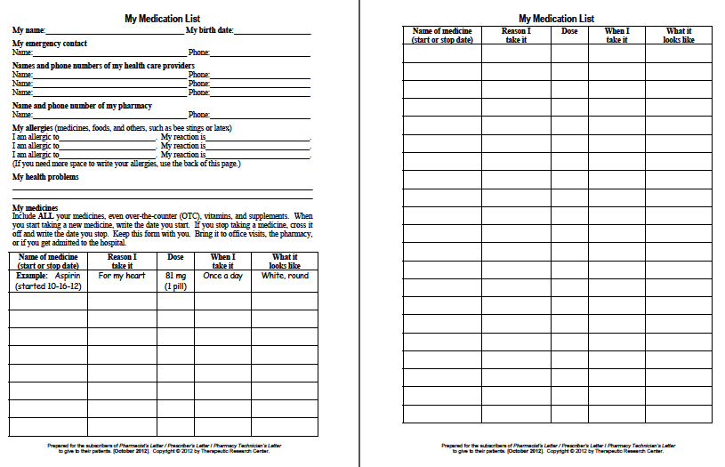

Slide 52
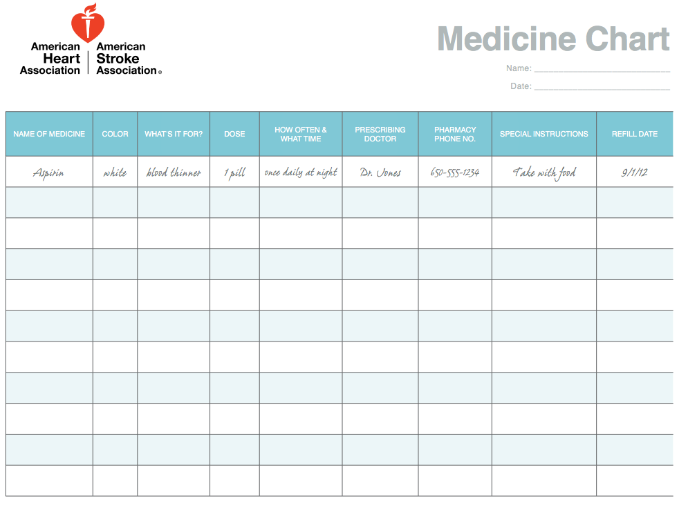

Slide 53
Outline
Definition
Pathophysiology
Stages and Treatment
Transitions
Care Coordination
Medication Management
Self Management Goals

Slide 54
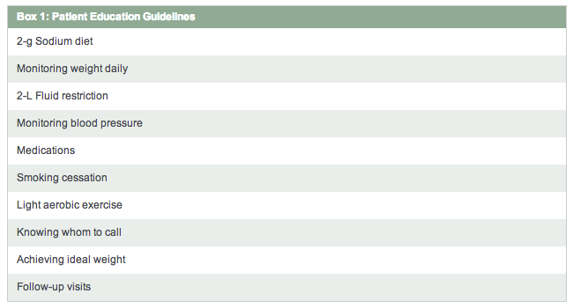
Lifestyle Modifications: CHF

Slide 55
Self Management
Home scale and BP monitor
Medication Adherence
Understanding Symptoms Baseline-Changes
  Edema/weights
  Shortness of breath (ADLS)
  # Pillows used to sleep (Trouble Sleeping)
  Dizziness
  Change in BP or Pulse
  Appetite Change

Slide 56
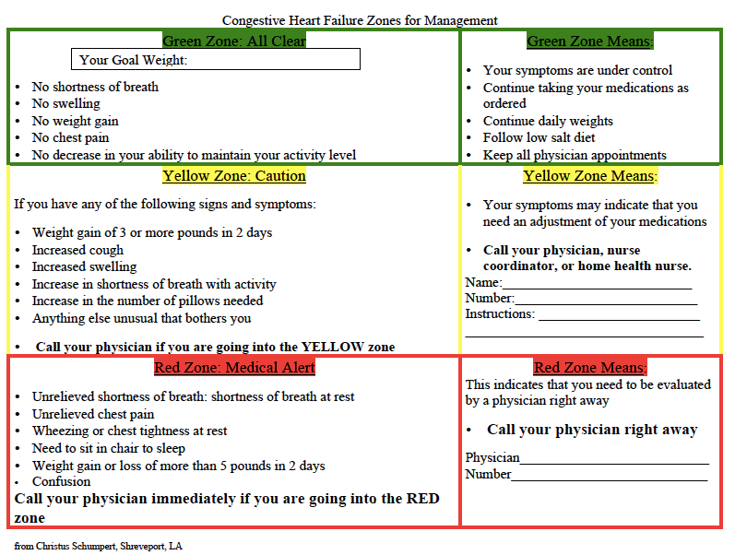
Heart Failure Zones For Management

Slide 57
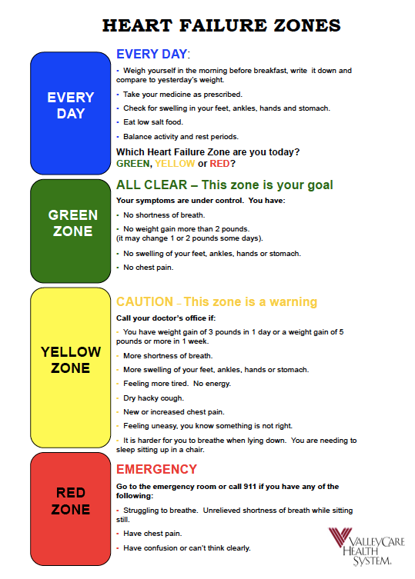

Slide 58
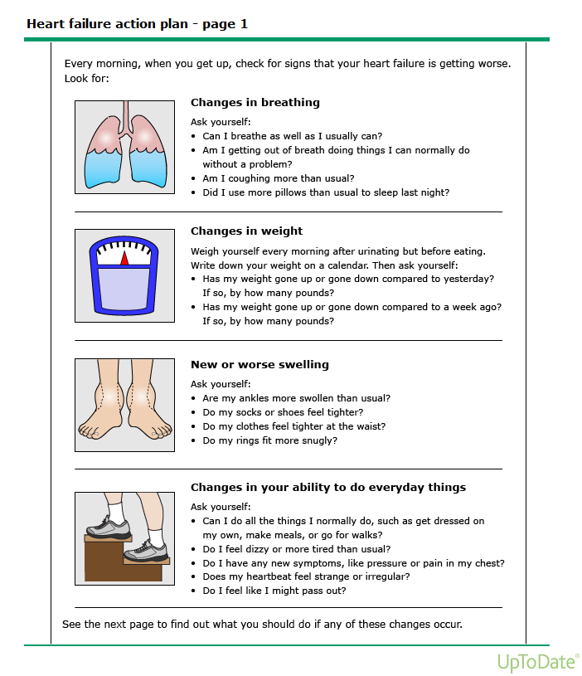

Slide 59
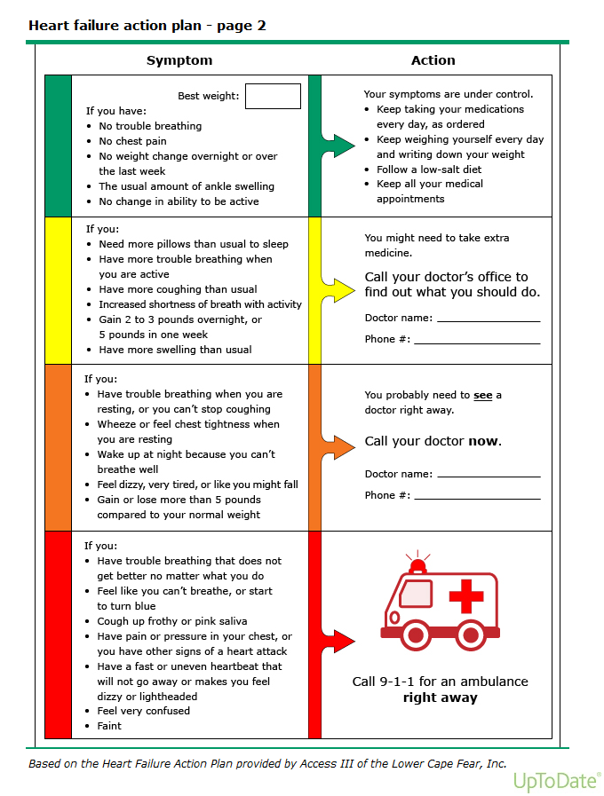

Slide 60
Resources
2013 ACCF/AHA Guideline for the Management of Heart Failure. E-Published on June 5, 2013, available at: [http://content.onlinejacc.org/article.aspx?doi=10.1016/j.jacc.2013.05.019 and http://circ.ahajournals.org/lookup/doi/10.1161/CIR.0b013e31829e8776]
2017 Updates to the 2013 ACCF/AHA Guidelines:
http://www.onlinejacc.org/content/70/6/776?_ga=2.162934719.2024483074.1573136234-469999210.1573136234
http://prescribersletter.therapeuticresearch.com/pl/ArticleDD.aspx?nidchk=1&rn=4&cs=&s=PRL&pt=2&fpt=31&dd=291120&pb=PRL&searchid=45597726&segment=6288
http://prescribersletter.therapeuticresearch.com/pl/ArticleDD.aspx?rn=4&cs=&s=PRL&pt=2&fpt=31&dd=291120&pb=PRL&searchid=45597726&segment=6289
http://prescribersletter.therapeuticresearch.com/pl/ArticleDD.aspx?pt=2&segment=5785&dd=290704
http://www.clevelandclinicmeded.com/medicalpubs/diseasemanagement/cardiology/heart-failure/
Goldman, L & Schafer, A.I. (2012) Goldman’s Cecil Medicine, 24th Edition. Philadelphia: Elsevier.
Anatomy & Physiology Made Incredibly Visual. (2009). Philadelphia: Lippincott Williams & Wilkins.
http://www.heart.org/HEARTORG/Conditions/More/ToolsForYourHeartHealth/Keep-Track-of-Your-Heart-Health_UCM_318041_Article.jsp
http://www.acc.org/latest-in-cardiology/ten-points-to-remember/2017/04/27/15/50/2017-acc-aha-hfsa-focused-update-of-hf-guideline

