Slide 1
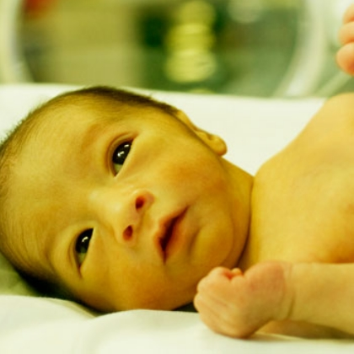
Bilirubin & Management of Jaundice in the Newborn
Megan Ratchford, MD

Slide 2
Disclosure
With respect to the following presentation, there has been no relevant (direct or indirect) financial relationship between the party listed above (or spouse/partner) and any for-profit company in the past 12 months which would be considered a conflict of interest.
The views expressed in this presentation are those of the presenter and may not reflect official policy of Community Health Center, Inc. and its Weitzman Institute.
I am obligated to disclose any products which are off-label, unlabeled, experimental, and/or under investigation (not FDA approved) and any limitations on the information that I present, such as data that are preliminary or that represent ongoing research, interim analyses, and/or unsupported opinion.

Slide 3
Learning Objectives:
1. Review and understand the pathophysiology of hyperbilirubinemia
2. Review the differential diagnosis of jaundice
3. Become familiar with bilirubin nomograms
4. Discuss the work up and management strategies for jaundice
5. Be able to explain to parents the etiology and treatment of jaundice in a newborn

Slide 4
Clinical Practice Guideline Revision: Management of Hyperbilirubinemia in the Newborn Infant 35 or More Weeks Gestation
AAP updated 2004 guidelines in 2022
After thorough review by experts of studies/outcomes thresholds for treatment have increased slightly
We will cover their “Key Action Statements” and the new phototherapy/exchange transfusion nomograms throughout the presentation
Full updated guidelines are available on-line

Slide 5
Clinical Practice Guideline Revision: Management of Hyperbilirubinemia in the Newborn Infant 35 or More Weeks Gestation
AAP recognizes that in US and other “high resource” countries, the recommended management & risk of kernicterus can differ significantly from countries w/ more limited resources
Evidence regarding monitoring &treatment of hyperbilirubinemia has expanded from 2004 guidelines
Raised phototherapy thresholds by a narrow range that committee of experts considered safe
Used new research findings to revise risk-assessment based on hour-specific bili concentration & the approach to rapidly address elevated bilirubin concentrations defined as “escalation of care”

Slide 6
AAP Guidelines for Preventing and Managing Hyperbilirubinemia (2004)
1. Promote and support successful breastfeeding
2. Establish nursery protocols for the jaundiced newborn and permit nurses to obtain TSB levels without physician’s order.
3. Measure TSB or TcB concentrations on infants jaundiced in first 24 hrs after birth.
4. Recognize that visual diagnosis of jaundice is unreliable.
5. Interpret all TSB levels according to infant’s age in hours, not days.

Slide 7
AAP Guidelines for Preventing and Managing Hyperbilirubinemia (cont.)
6. Do not treat a near term infant the same as a term infant.
7. Perform a pre-discharge systematic assessment on all infants for the risk of hyperbilirubinemia.
8. Provide parents with information about newborn jaundice.
9. Provide follow up based upon time of discharge and risk assessment
10. When necessary, treat with phototherapy or exchange transfusion.

Slide 8
Bilirubin: What Is It?
A yellow compound that occurs in the normal catabolic pathway that breaks down heme
Necessary process in the body's clearance of waste products that arise from the destruction of aged red blood cells
Newborn jaundice is a yellowing of a baby’s skin and eyes
Newborn jaundice is very common and can occur when babies have a high level of bilirubin
A newborn’s still-developing liver may not be mature enough to remove bilirubin
In most cases newborn jaundice goes away on its own as a baby’s liver develops and as the baby begins to feed, which helps bilirubin pass through the body (most cases resolve within 2 to 3 weeks)
The American Academy of Pediatrics (AAP) recommends that all newborn babies be examined for jaundice before discharge from the hospital and again when the baby is between 3 and 5 days old.

Slide 9
What Causes It?
Babies at highest risk for developing newborn jaundice are:
premature babies (babies born before 37 weeks’ gestation)
Not enough breast milk or formula (having a hard time feeding or because mother’s milk isn’t in yet)
Incompatible blood types
Incompatible blood types: baby can develop a buildup of Abs that can destroy their red blood cells and cause a sudden rise in bilirubin levels.
Other causes of newborn jaundice include:
bruising at birth or other internal bleeding
liver problems
an infection
an enzyme deficiency
an abnormality in baby’s red blood cells

Slide 10
Why Is It Bad?
Rare, but serious complications from high bilirubin levels include:
Cerebral palsy
Deafness
Kernicterus, which is brain damage from very high bilirubin levels

Slide 11
CASE REPORT
23yo G0P1 mother delivered a 36 week gestation male infant
No complications with pregnancy
infant initially w/ some difficulty latching on for breastfeeding. Improved before leaving hospital BUT his nursing quality was only considered “fair.”
At 25 hours of age he appeared slightly jaundiced w/ bilirubin concentration of 7.5mg/dL
D/cd at age 30 hours, with a follow-up visit scheduled for 1 week after discharge.
On DOL# 5, at about 4:30 pm, the mother called the clinician’s office b/c infant was not nursing well, was becoming increasingly sleepy and he had become more jaundiced over the past 2 days
Mother given appt to see clinician the following morning. Exam in office revealed a markedly jaundiced infant w/ high-pitched cry who intermittently arched his back. Total serum bilirubin (TSB) concentration was 36.5 mg/dL . Admitted to the hospital for immediate exchange transfusion . Neuro eval at age 18 months showed profound neuromotor delay, choreoathetoid movements, an upward gaze paresis, and a sensorineural hearing loss.

Slide 12
What happened and could it have been prevented?

Slide 13
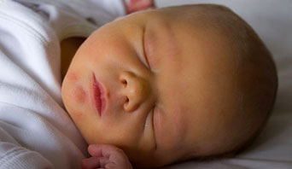
Jaundice in the Newborn
Majority are benign
Occasional infant with pathologic, exaggerated or atypical hyperbilirubinemia
Potential for toxic hyperbilirubinemia

Slide 14
Symptoms

Slide 15
Causes of Jaundice Things to consider:
TIMING: Early, Classical, Late
GESTATION: PRETERM vs FULL TERM
SET UP: ABO incompatibility, ROM
ETIOLOGY: Hemolytic, Conjugated, Enterohepatic, Infection, Other

Slide 16
Causes
Causes of Jaundice by Age of Onset
<24 hours of Age >3 Weeks of Age
-Rhesus Incompatibility Unconjugated: -Breast Milk
-ABO Incompatibility -Infection
-G6PD Deficiency - Hypothyroidism
-Hereditary Spherocytosis Conjugated: -Biliary Atresia
-Infection -Neonatal Hepatic
2 Days to 3 Weeks Syndrome
-Physiologic
-Breast Milk
-Infection
-Hemolysis
-Crigler-Naijar Syndrome

Slide 17
Jaundice in the Newborn
Physiological Jaundice:
Almost universal
>80% of newborns will have some degree of jaundice
Peak bilirubin level is 4 days
Bottle ~ 6
Breast ~ 15 – 18 mg/dL
Declines day 6 or 7

Slide 18
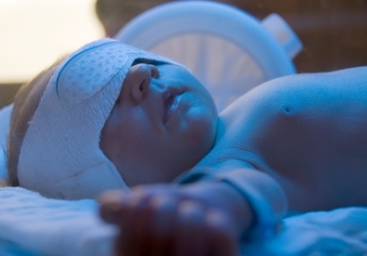
Mechanisms of Physiologic Jaundice
Increased bilirubin load on liver
Increased enterohepatic circulation
Shorter RBC lifespan
Decreased hepatic uptake
Decreased conjugation & elimination
(UDP) glucuronyl transferase activity

Slide 19
Pathophysiology

Slide 20
BILIRUBIN METABOLISM

Slide 21
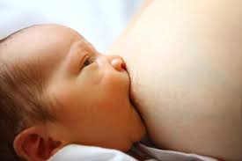
Breastfeeding and Jaundice
Significant association between breastfeeding and increased rates of physiologic jaundice in newborns
Breastfeeding jaundice: jaundice seen in first 3 to 5 days
Due to increase in enterohepatic circulation

Slide 22
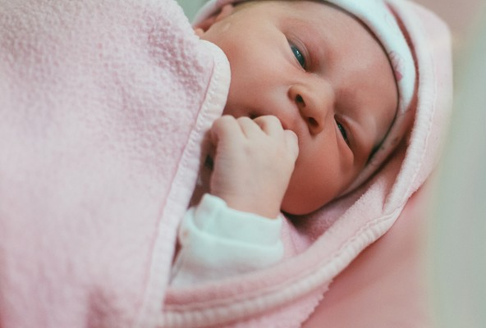
Breastfeeding and Jaundice
Up to 20-30% of breast fed infants may have mild persistent unconjugated hyperbili
Due to an enzymatic inhibition of bilirubin conjugation
If bili is high, may need to stop breastfeeding for 24 hours
Can last for months!

Slide 23
BREAST FEEDING JAUNDICE vs BREAST MILK JAUNDICE What’s the difference??

Slide 25
Bilirubin and Feeding (rev. guidelines)
Providing Feeding Support
Exclusive breastfeeding and hyperbilirubinemia are strongly associated
Breastfeeding jaundice now referred to as “suboptimal intake hyperbilirubinemia” typically peaks on days 3 to 5 and is frequently associated with excess weight loss
Almost always associated with inadequate milk intake rather than breastfeeding per se
Breastfeeding fewer than 8x per day assoc with higher TSB conc.
Low milk and low caloric intake contribute to decreased stool frequency and increased enterohepatic circulation of bilirubin

Slide 26
Feeding (cont. rev. guidelines)
Adequate feeding important; family centered breastfeeding support
Promote breastfeeding support within 1 hour of birth with frequent feeding on demand
Breastfed infants who are adequately hydrated should not routinely receive supplementation with formula
Breast Milk Jaundice= jaundice that persists with adequate milk intake
Can last up to 3 months
Not assoc with direct/conjugated hyperbili

Slide 27
PATHOLOGIC JAUNDICE

Slide 28
Pathologic Jaundice
Keep it simple….
1 – Increased bilirubin production
a. hemolysis (Rh, ABO, minor groups)
b. RBC enzyme deficiency (G6PD, pyruvate kinase)
c. structural defects (spherocytosis)
2 – Decreased bilirubin elimination (less common. genetics)
a. impaired conjugation
b. deficiency in hepatic uptake (ie Gilbert syndrome)
c. increased enterohepatic circulation

Slide 29
Other Pathologic Causes of Jaundice
Sepsis / DIC
hematomas, hemorrhage
Polycythemia
Macrosomia in IDM
Increased enterohepatic circulation: breast milk jaundice, pyloric stenosis, bowel obstruction or ileus
Decreased Clearance: Prematurity, Inborn errors of metabolism (Galactosemia, Tyrosinemia…) , and metabolic (hypothyroidism, hypopit)

Slide 30
Prematurity
Shortened RBC lifespan
(increased breakdown = more bili)
Infant of Diabetic Mother
-Polycythemia
- Ineffective erythropoesis

Slide 31
ABO hemolytic disease
Isoimmune hemolysis in newborn
Common early cause hyperbilirubinemia
Rare cause of readmission
Rh immunoglobulin has decreased incidence of Erythroblastosis fetalis
In about 15% of pregnancies, an infant who has blood type A or B is carried by a mother who is type O
1/3 will be Coombs positive
twice as likely to have hyperbilirubinemia

Slide 32
ABO Incompatability
A, B, AB, and O are the 4 major blood types
Types based on small substances (molecules) on the surface of the blood cells
When people who have one blood type receive blood from someone with a different blood type, it may cause their immune system to react. This is called ABO incompatibility.
ABO hemolytic disease of the newborn:
maternal IgG antibodies with specificity for the ABO blood group system pass through the placenta to the fetal circulation where they can cause hemolysis of fetal red blood cells
can lead to fetal anemia and HDN.
In Rh disease, about half of the cases of ABO HDN occur in a firstborn baby and ABO HDN does not become more severe after further pregnancies

Slide 33
The ABCs of ABO Incompatibility
The letters A, B, and O refer to the four blood types— A, B, AB, and O.
Blood type is determined based on proteins on the surface of red blood cells. These proteins are potential antigens—substances the immune system doesn't recognize.
For protection, the immune system will create antibodies to fight off the unfamiliar protein. These antibodies can cross the placenta, where they will break down the baby's red blood cells after she's born.
The reason a baby's blood type isn't always the same as his mother is that blood type is based on genes from each parent. So, for example, a mother who is type O and a father who is type A could have a child who is type A. The reason the baby wouldn't have type O blood, like his mom, is because the gene for O is recessive.

Slide 34
ABCs cont.
Not all non-matching combinations of blood types are problematic
ABO incompatibility can occur only if a woman with type O blood has a baby whose blood is type A, type B, or type AB.
If a baby is type O there won't be a problem with a negative immune response because type O blood cells don't have immune-response triggering antigens.
Not every baby with ABO incompatibility will develop jaundice

Slide 36
Prevention (rev. guidelines)
Prevention
Begins in pregnancy by preventing hyperbili associated with Isoimmune Hemolytic Disease
If MOC not screened for anti-erythrocyte antibodies during pregnancy, eval &tx should occur shortly after delivery
ACOG recommends pregnant women be tested to determine ABO and Rh(D) type and receive an antibody screen to determine need for Rh(D) immunoglobulin & to assess for potential isoimmune hemolytic disease of the newborn
IF maternal Ab screen is positive or unknown infant should have a direct antiglobulin test (DAT) & infant blood type should be determined ASAP using either cord or peripheral blood

Slide 38
Coombs Testing:What Is It and Why Does It Matter?
A Coombs test (also known as Coombs' test, antiglobulin test or AGT) is either of two clinical blood tests used in immunohematology and immunology.
The direct Coombs test is used to test for autoimmune hemolytic anemia; i.e., a condition of a low count of red blood cells (aka RBCs) caused by immune system lysis or breaking of RBC membranes causing RBC destruction.
A positive result means your blood has antibodies that fight against red blood cells.
Indirect Coombs test: A positive test result means that your blood is incompatible with the donor's blood and you can't receive blood from that person.

Slide 39
Direct vs Indirect Coombs

Slide 40
Coombs Testing Better Explained

Slide 41
Case – ABO Incompatability
8 day old male born at 37 2/7 weeks via repeat c-section to a G1P2 to1 mother. Birth weight 2.61kg. No complications with pregnancy or delivery
Infant is breastfeeding with some concern re: supply but improving
Jaudice develops a few days after birth
Serum bili 15.4 at 116 hours
Does this infant have any risk factors?
When do we need to think about starting phototherapy?

Slide 42
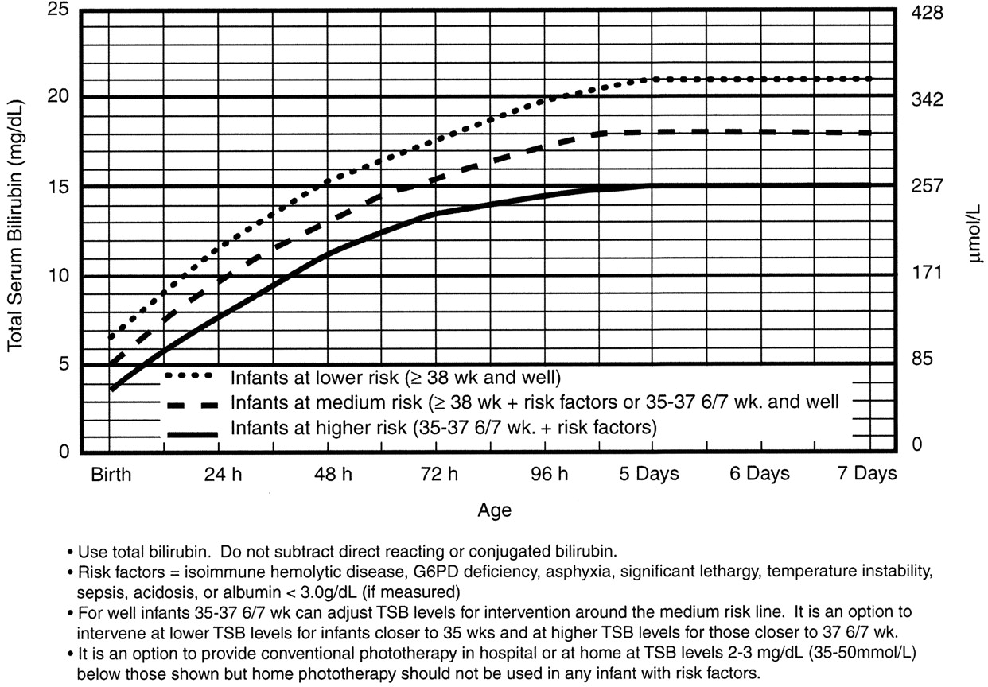
ABO case cont.

Slide 43
New Bilirubin Nomogram

Slide 44
ABO case (cont)
Light Up Level = 15 and patient has a total bili of 15.4
What do you do?
Additional labs show that mother is O+ and infant is A+ w/ a positive coombs test
Infant has a hematocrit of 47.7% with retic of 1.8
Went under phototherapy at 24 hours and bilirubin decreased to 11.7 at 139 hours with rebound (10 hours later) of 11.7 with stable hct and retic
Seen in office at 8 days old with normal exam and great weight gain
What do you need to consider at the newborn visit?
Do you repeat a bilirubin level?

Slide 45
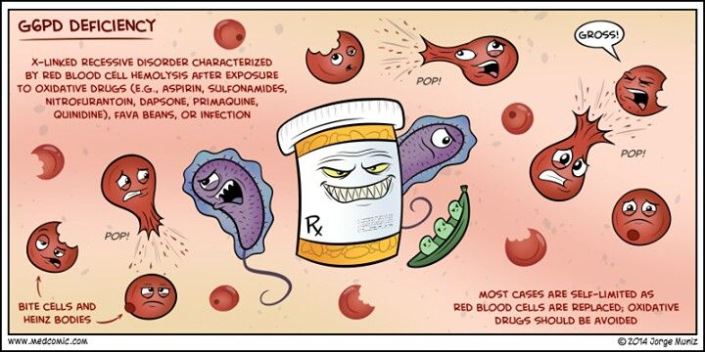
Glucose-6-phosphate Dehydrogenase (G-6PD)
Enzyme important for red blood cell metabolism
Affected Infants have impaired ability to conjugate bilirubin
Protects RBCs against oxidative damage

Slide 46
Glucose-6-phosphate Dehydrogenase (G-6PD) Deficiency
Clinically significant red cell enzyme defect
X-linked recessive enzymopathy that decreases protection against oxidative stress
Males usually more affected due to homozygosity (X linked)
Affects as many as 4,500,000 newborns worldwide each year
Recognized as 1 of most important of hazardous hyperbili leading to kernicterus in the US and globablly
Genetic ancestry from Mediterranean, Middle East, Arabian Peninsula, Southeast Asia, and Africa can help predict risk
Found in 11% to 13% of African-American newborns = 32,000 to 39,000

Slide 47
G6PD Deficiency Cont.
G6PD Deficiency Continued
Infants with risk factor require closer monitoring
G6PD deficiency:
Dx is a challenge: most affected infants will not have positive family hx
Clinical events that should raise suspicion:
more likely to get phototx before hospital discharge
greater risk readmission &re-treatment
severe hyperbili or atypical development like elevated TSB in formula fed infant or late-onset jaundice should raise possibility of G6PD

Slide 48
MORE on G6PD Deficiency
Infant with G6PD Def can develop a sudden and extreme increase is TSB that may be hard to anticipate or prevent
Measuring G6PD activity during or soon after a hemolytic event or exchange transfusion can lead to falsely normal result
If strongly suspected G6PD activity should be measured again 3 or more months later

Slide 49
Risk Factors for Developing Significant Hyperbilirubinemia
Lower gestation age (ie risk increases w/ each additional wk less than 40 wk)
Jaundice in first 24 hours after birth
Pre-discharge TcB or TSB close to phototherapy threshold
Hemolysis from any cause (based on rapid rate of increase in TsB/TcB of >0.3 mg/dL /hour in first 24 hours of life or >0.2 mg/dL/ hour thereafter
Phototherapy before discharge
Parent or sibling requiring phototherapy or exchange transfusion
Family hx or genetic ancestory suggestive of inherited RBC disorders including G6PD deficiency
Exclusive breastfeeding with suboptimal intake
Scalp hematoma or significant bruising
Down Syndrome
Macrosomic infant of diabetic mother (congenital hypothyroidism, transient myeloproliferative disorder)

Slide 50
Hyperbilirubinemia Neurotoxicity Risk Factors
Gestational Age <38 wk and this risk increases w/degree of prematurity
Albumin <3.0 g/dL
Isoimmune hemolytic disease (ie positive direct antiglobulin test), G6PDD or other hemolytic conditions
Sepsis
Significant clinical instability in previous 24 hours

Slide 51
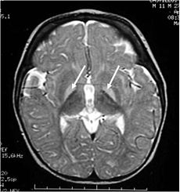
Protective factors
TSB in the low risk zone
Gestational age > 41 weeks
Exclusive bottle feeding
African American race
Discharge from the nursery after 72 hours

Slide 52
TIMING
AFTER 3RD DAY during FIRST WEEK:
Sepsis
UTI
Congenital infections
AFTER the FIRST WEEK
Breast-milk jaundice
Sepsis
Galactosemia
Hypothyroidism
CF
Spherocytosis
Some other weird hemolytic anemia
PERSISTENT :
Hepatitis
Bile or bile duct problem
TORCH
Galactosemia

Slide 53
Kernicterus (bilirubin encephalopathy)
Rare
Elevated serum bili = can be toxic to CNS
Known cause of CP
Preventable

Slide 54
Clinical features of Acute Bilirubin Encephalopathy
Initial Phase:
Lethargy, sleepiness
Slight hypotonic
Poor sucking, slightly high-pitched cry
Intermediate Phase:
Moderate stupor, irritable
Tone variable, usually increased; some have retrocollis-opisthotonos
Minimal feeding, high-pitched cry
Advanced Phase:
Deep stupor to coma
Hypertonia, retrocollis-opisthotonos
No feeding, shrill cry

Slide 55
Clinical Features of Chronic Post-Kernicteric Encephalopathy
Kernicterus = permanent disabling neurologic condition characterized by:
Choreoathetoid cerebral palsy
Gaze abnormalities (upward gaze paresis)
Sensorineural hearing loss or auditory neuropathy
Intellectual deficits, but minority are in the intellectually disabled range
Enamel dysplasia of deciduous teeth

Slide 56
What determines if the baby will have kernicterus?
1. Concentration of bili in the brain
2. Duration brain has been exposed
MRI will show deposition in basal ganglia
Long term effects vary
Boys tend to have worse long term outcomes

Slide 57
Who Should be Checked?
Jaundice on 1st day of life = ALWAYS pathologic
r/o infection
Most infants discharged from nursery before 48 hours, well before their bilirubin has peaked
AAP has guidelines for follow up of all infants discharged before 72 hours of age, requiring that they are seen within 2 days of discharge.
Follow up to prevent severe hyperbilirubinemia and kernicterus.
Over 38 weeks, no jaundice, formula fed, no risk factors → follow up 3-4 days

Slide 58
Bilirubin Concentration
Visual Estimation of TSB Concentrations
Correlations are generally highly statistically significant differences as great as 13 to 15 mg/dL btwn actual TSB and TcB and bilirubin values estimated by jaundice observed
All infants should be visually assessed for jaundice at least Q12 hours following delivery until discharge. TsB or TcB should be measured ASAP for infants noted to be jaundiced <24 hours after birth
Although jaundice before 24 hours may not have an identifiable cause, when a cause is identified it is most likely to be a hemolytic process

Slide 59
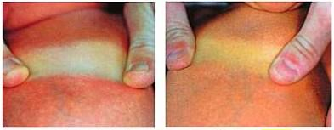
Visual Assessment of Jaundice
Traditional identification requires blanching the skin with digital pressure to reveal the underlying color of the skin and subcutaneous tissue
More difficult in particularly in darkly pigmented infants
Difference between a TSB value of 5 mg/dL and 8 mg/dL cannot be perceived by the eye, but this represents the difference between the 50th and the 95th percentiles at 24 hours
Potential errors associated w/visual diagnosis have led some experts to recommend that all newborns have a TSB or TcB measured prior to discharge

Slide 60
Treatment
Indentifying Need for Treatment
Use TSB as definitive test to guide phototherapy and escalation-of-care decisions including exchange transfusion
Based on gestational age, hour specific TSB and presence for risk factors for bilirubin neurotoxicity
Hyperbili Neurotoxicity Risk Factors
Gestational age < 38 wk – risk increases with degree of prematurity
Albumin <3.0
Isoimmune hemolytic disease, G6PD def, other hemolytic conditions
Sepsis
Significant Clinical Instabilityin the previous 24 hours

Slide 61
Transcutaneous Bili
Transcutaneous Bili Levels
TsB level can be estimated based on TcB
Measure yellowness of reflected light transmitted from the skin and use an algorithm to predict TsB level
Do not directly assess bili levels but they are valid and reliable when used as a screening test to determine who needs TsB
Good correlation- generally within 3mg/dL
Difference btwn may depend on skin melanin concentration and the instrument used (BiliChek instruments may underestimate TsB at higher levels in in infants with greater skin melanin; JM instruments may overestimate the TsB in infants with greater skin melanin)
Bili should be measured btwn 24-48 hours after birth or before discharge if that occurs earlier

Slide 62
Work up Transcutaneous Bilirubin (TcB) - noninvasive - quick - cost effective

Slide 63
TcBili vs TsBili
Several studies completed over past 5 years comparing accuracy of Tc (transcutaneous) bili levels compared to Ts (serum) bili levels
Results have shown that Tc bili levels are accurate and correlate well with Ts bili levels in infants born >35 weeks
Tc bili is more reliable when checked on sternum compared to forehead
Tc bili tends to overestimate serum level in light skinned infants and underestimate it is dark skinned infants

Slide 64
Bili Levels
TsB should be measured IF TcB exceeds or is within 3mg/dL of phototherapy treatment threshold or if the TcB is greater than or equal to 15mg/dL
If more than 1 measurement is available the rate of increase may be used to identify Infants at higher risk of subsequent hyperbili
Rapid rate of increase (≥0.3mg/dL per hour in 1st 24 hours or ≥0.2mg/dL per hour thereafter) suggest hemolysis
IF appropriate follow up cannot be arranged for an infant outpt discharge may be delayed

Slide 65
Work up
Total & Direct Bilirubin (heel stick vs venous) - hours of life - rate of rise
Total serum bilirubin = combination of bilirubin production, conjugation, and enterohepatic circulation

Slide 66
Heel Stick

Slide 67
What if the bilirubin is elevated?
INDIRECT/UNCONJUGATED
Look for reticulocytosis & peripheral smear with RBC destruction
HEMOLYSIS (ABO, Rh)
If no blood group incompatibility suspect something non-immunologic
→ shortened RBC lifespan (spherocytosis, polycythemia…)
DIRECT/CONJUGATED (bili > 2mg/dL)
Biliary atresia, cholestasis, hepatitis, inborn error, CF, infection

Slide 68
Laboratory Tests for the Jaundiced Infant
Finding | Obtain
Jaundice in first 24 hours | Total Serum Bilirubin
Jaundice that appears excessive for infant’s age | TSB, Blood Type, Coombs (DAT)
Infant receiving phototherapy or having TSB count above 75th percentile | Direct (conjugated) bilirubin, repeat bilirubin in 4 to 24 hours, on infant’s age and TSB level; consider G6PD deficiency in African-American infants
A TSB approaching exchange level or not responding to phototherapy | Retic, G6PD, albumin
An elevated direct bilirubin level | UA and culture, evaluate for sepsis
Jaundice present at or beyond age 3 weeks | Total and direct bilirubin, if direct is elevated, evaluate for cholestasis. Also check newborn to check for hypothyroidism and galactosemia. Evaluate for signs and symptoms of thyroidism.

Slide 69
CONJUGATED/DIRECT BILI
Evaluating direct-reacting or conjugated bili
Direct serum bili >1 mg/dL is abnormal
Cutoff of >=0.3 mg/dL has been used for conjugated bili
Prevalence of biliary atresia is low therefore infants who have a single elevation of the direct/conjugated bili do not have biliary atresia (if suspected need to repeat lab in a few days to a few weeks)
An increase (not single elevated level) suggest possibility of pathologic cholestasis that requires further eval
Also consider UTI, isoimmune hemolytic disease, sepsis and some inborn errors of metabolism
BF infants still jaundiced at 3-4 weeks, formula fed at 2 weeks should get a repeat total & direct/conjugated bili to eval for possible pathologic cholestasis
Check newborn screen (galactosemia, hypothyroidism and tyrosinemia can cause prolonged jaundice)

Slide 70
Bilirubin Nomogram
**important to consider the rate of rise**

Slide 71
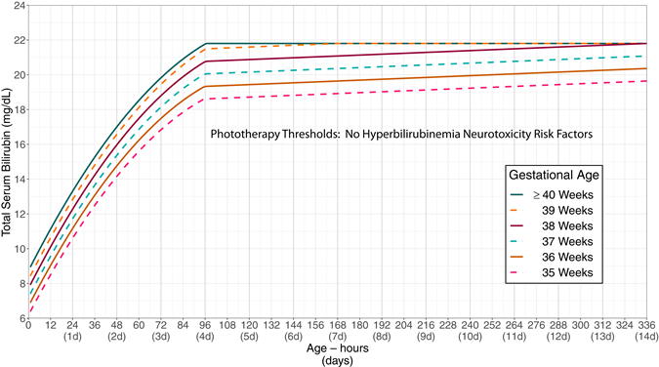
PthoPt

Slide 72
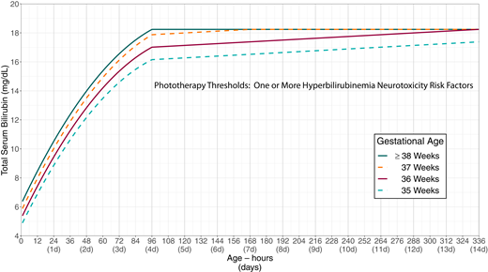

Slide 73
Exchange Transfusion

Slide 74
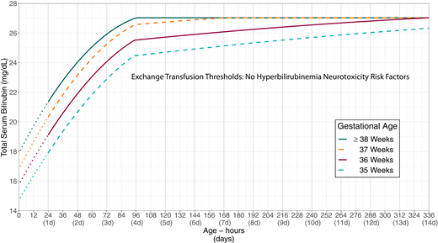

Slide 75
When to intervene?
USE YOUR NOMOGRAM!!
AAP 2004 recommendation for phototherapy:
25 – 48 hours: 15 mg/dL
49 – 72 hours: 18 mg/dL
72 hours: 20 mg/dL
Bilitool – not sure if this has been updated to new guidelines
Use your clinical judgement!

Slide 76
Urgent Intervention if:
Total Serum bilirubin > 25 – 30 mg/dL
Exchange transfusion if > 30 mg/dL or if signs of kernicterus are present

Slide 77
Let’s Practice
Baby Girl 4 days old in your office for her newborn visit
Born at 39 1/7 weeks with no complications
MOC is A+
Infant is formula fed
Birth Wt 7 lbs 8.1 oz
Wt in office today 7 lbs 10 oz
Newborn records show TcB 8.3 @43 hrs
No jaundice on exam. What was risk level for this pt in newborn nursery? What would LL be today?

Slide 78
Nomogram

Slide 79
New Nomogram

Slide 80
Practice #2
Baby Boy now 2 days old in your office for newborn visit
Born at 37 6/7 weeks; no complications
Pt is both breastfeeding and formula feeding
MOC is B+
Birth Wt 6 lbs 4.7 oz; Wt today 6 lbs 2 oz
Tc bili 6.9 @30 hours of life
No jaundice on exam
Does this infant have any risk factors?
What risk level was his bilirubin in newborn nursery?
What is his LL today?
When do you want to bring this patient back to check weight/jaundice?

Slide 81
Nomogram

Slide 82
New Nomogram

Slide 83
Practice #3
Baby Girl now 8 days old in your office for newborn visit
You have NO newborn records and MOC is a poor historian
MOC does not know the birth weight
All she can tell you is that infant was in local hospital and fine right after delivery but shortly afterwards oxygen levels dropped, pt intubated and transferred to children’s hospital NICU. MOC thinks patient may have had jaundice
Pt is well appearing with normal exam with exception of jaundice to abdomen
What do you do?

Slide 84
You Get a serum Bilirubin – level is 10.3

Slide 85
On New Nomogram

Slide 86
Finally the NICU Records Arrive
Infant was born at 37 4/7 weeks with APGARs of 8 and 9
A few hours after birth her O2 (both pre and post ductal) dropped dramatically. Infant was intubated and transferred to children’s hospital where pt was found to have a large PDA
Infant received phototherapy in NICU with last bili level of 10.8
MOC is O+, Patient O+ with negative direct coombs

Slide 87
Practice #4
Baby Girl now 2 days old in you office for newborn visit
Born at 38 5/7 weeks
No complications aside from MOC having gestational diabetes
MOC is A+
Tc bili in newborn nursery 7 @ 30 hours of life
Birth Wt 9 lbs 1.3 oz
Discharge Wt: 8 lbs 10 oz
Formula fed
No jaundice on exam
What was the risk level for infant in nursery? What is LL today?
Does this infant have any risk factors

Slide 88
Nomogram

Slide 89
Using the New Nomogram

Slide 90
Practice #5
Baby Girl now 2 days old in you office for newborn visit
Born at 39 2/7 weeks, no complications
Pt is formula fed
MOC is O+
Patient is O neg; direct coombs negative
Tc bili 4.4 @ 31 hours of life
Birth Wt 6 lbs 14 oz
Wt in office 6 lbs 11.5 oz
What was risk level in newborn nursery? What is LL today?

Slide 91
Nomogram

Slide 92
New Nomogram

Slide 93
Practice #6
Baby Boy now 3 days old being seen in you office for newborn visit
Born at 39 3/7 weeks, no complications
Pt is breastfed
MOC O+
Infant is O neg, direct coombs neg
Birth weight 6 lbs 7 oz
Wt in office today 6 lbs 6 oz
Tc Bili 8.3 @ 48 hours
Jaundice to chest on exam
What was risk level in nursery? What is LL today? Does this patient have risk factors?

Slide 94
Nomogram

Slide 95
New Nomogram

Slide 96
Case – Bright Yellow Infant at Newborn Visit
Seeing a newborn in your office for initial newborn visit and they are bright yellow. You review the newborn records and find the following:
Born at 39 3/7 weeks via SVD to a G3 P2to3 mother. Birth wt 3.39kg
Newborn Nursey noted jaundice starting around 24 hours of age
Checked a Tc bili (13) → serum bili 12.4
Mother is O+ (Ab screen negative)
Infant is B+, coombs negative
What is LL for this patient? Any risk factors? Is this ABO incompatability?

Slide 98
Case pres. Cont.
LL – 11.7
Started on bili blanket b/c patient looks good and is feeding well
After 8 hours under biliblanket total serum bili has increased to 14.5 at 34 hours (LL 13.3)
Admit to NICU and overhead phototherapy is started. Bili maxes out at 17.4 and by time of discharge has decreased to 14.9 (at 67 hours) with LL of 17.2
Hematcrit 51% and retic 10.4 ; G6PD pending at time of d/c
He was off lights x 24 hours prior to d/c home on a Friday evening. Sent home w/ diagnosis of ABO incompatibility as reason for jaundice
Went for repeat bili at hospital 2 days later (Sunday) and total serum bili is now 16.6 (no intervention initiated and pt follows up the next day)
He is bright yellow on exam but gaining weight and otherwise looks great. What do you do?

Slide 99
Case Presentation - conclusion
Decision is made to order a STAT bili and family gets blood drawn as advised around 11am
6 hours later no results from QUEST – after several calls/complaints re: not getting run STAT we get a result at 11pm (12 hours later) that Total serum bili is now 19.2 (direct 0.3)
Parents are called and told to get to CCMC ED immediately (over 12 hours from lab draw so cannot be direct admit)
Bili in ED is 20 (w/ direct of 0.4), biliblanket started immediately and admitted with heme/onc consult
At d/c bili decreased to 12.2 w/ direct of 0.5; G6PD elevated at 25 but could be inaccurate b/c of high retic – needs repeating at 6 months
NOT ABO incomp. (negative coombs)
F/u bili in office 10.8 (direct 0.2) and he is doing well

Slide 100
New Nomogram

Slide 101
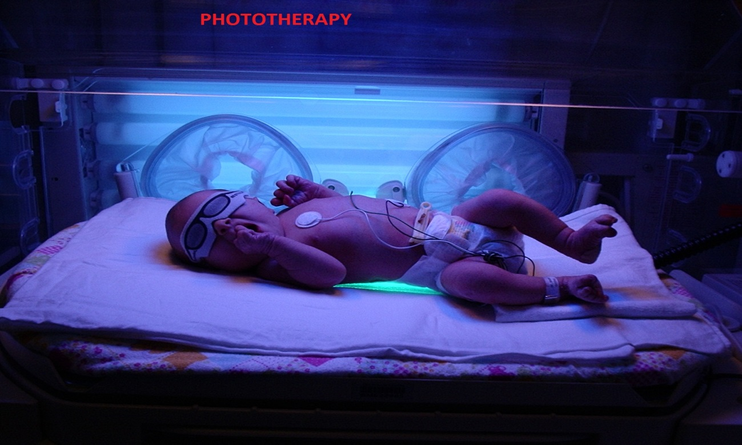
TREATMENT
PHOTOTHERAPY
Double/Triple
Lumirubin
Exposed skin
Insensible losses
Temp
Hydration
Can stop once bili has gone down by 4-5 mg/dL
Rebound hyperbilirubinemia rare
EXCHANGE TRANSFUSION
https://www.youtube.com/watch?v=r-g7UB-MJS0

Slide 102
Phototherapy
Decreases bilirubin concentrations through a variety of photochemical reactions that allow bili to be more easily excreted
Effectiveness dependent on intensity of phototherapy administered and surface area of the infant exposed
No standard method exists and substantial variation with equipment
General approach: provide intensive phototherapy to as much of infants surface area as possible
Primary goal: decrease likelihood of further increases in TSB that would lead to need for escalation of care

Slide 103
Natural Sunlight
Although direct exposure to sunlight has been shown to decrease TSB concentrations “the practical difficulties involved in safely exposing infants to the sun….while also avoiding sunburn, preclude use of sunlight as a reliable therapeutic tool and therefore is not recommended”

Slide 104
Home Phototherapy
For newborns who have already been discharged and then develop TSB above phototherapy threshold can consider home phototx (LED-based device)
Need to meet criteria:
Gestational Age ≥38 weeks
≥ 48 hours old
Clinically well with adequate feeding
No known hyperbili neurotoxicity risk factors
No previous phototherapy
TSB no more than 1 mg/dL above tx threshold
LED device available without delay
TSB can be measured daily

Slide 105
Water/Dextrose Water
Oral supplementation with water or dextrose water should NOT be provided to prevent hyperbilirubinemia or decrease bilirubin
No evidence of benefit and there are possible harms
Potential Harm
Interfering with breastfeeding
Hyponatremia (can lead to seizures)
Water intoxication

Slide 106
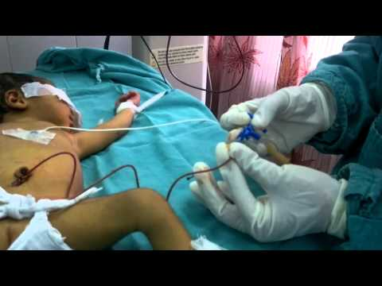
TREATMENT
Exchange Transfusion
Mechanical removal
Small amts blood removed &
replaced w similar amt blood/fluid
Done until twice blood volume
has been replaced
Good for ongoing hemolysis

Slide 107
Risks of Phototherapy
RETINAL DAMAGE
Eye covers used as standard prophylaxis.
Some evidence that phototherapy may lead to a small increase in the risk of subsequent childhood epilepsy
BRONZE BABY SYNDROME
Some infants with cholestatic jaundice when treated with phototherapy. With exposure to phototherapy lamps, these infants develop a dark, gray-brown discoloration of skin, urine, and serum. Exact etiology is not understood; effect thought to be the result of an accumulation of porphyrins and other metabolites.
PURPURA OR BULLAE
infants with cholestatic jaundice or congenital erythropoietic porphyria → infants who have this diagnosis or a positive family history for this disorder, have an absolute contraindication for phototherapy.

Slide 108
Risks of Exchange Transfusion
Thrombocytopenia
Portal Vein Thrombosis
NEC
Electrolyte problems
Graft vs host
Infections

Slide 109
How can we prevent hyperbilirubinemia?
Increase the number of oral feeds!!
Increases bili excretion
Reduced bili in enterohepatic circulation

Slide 110
CASE REPORT
A 23-yo G0P1 mother delivered a 36 wks’ gestation male infant
uncomplicated pregnancy
Infant initially had some difficulty latching on for breastfeeding, but subsequently appeared to nurse adequately (nursing quality was considered “fair.”)
At age 25 hours, he appeared slightly jaundiced and his bilirubin concentration was 7.5 mg/dL.
He was discharged at age 30 hours, with a follow-up visit scheduled for 1 week after discharge. On DOL#5, at about 4:30 pm, mother called the pediatrician’s office b/c infant was not nursing well and was becoming increasingly sleepy.
he had become more jaundiced over the previous 2 days. The mother was given an appointment to see the pediatrician the following morning.
Examination in the office: markedly jaundiced infant w/ a high-pitched cry who intermittently arched his back. TSB concentration was 36.5 mg/dL
Admitted,immediate exchange transfusion was performed. Neuro eval at age 18 months showed profound neuromotor delay, choreoathetoid movements, an upward gaze paresis, and a sensorineural hearing loss.

Slide 111
Two very important risk factors:
Gestational age less than 38 weeks
- 13x more likely to be readmitted for severe jaundice
Breastfeeding (esp w poor latch)
- majority cases of kernicterus
36 weekers …. “Near-term” infants
- treated like regular babies in the nursery
- much more likely to nurse ineffectively : fewer calories, greater wt loss
- immaturity of the liver
Any infant discharged at less than 72 hours of age should be seen within 2 days of discharge
*sooner if risk factors present (within 24 h of discharge)

Slide 112
Pop Quiz!

Slide 113
Jaundice is caused by: a. Excess of uric acid in the blood b. Excess of hemoglobin in the blood c. Excess of bilirubin in the blood d. Excess of potassium in the blood

Slide 114
Jaundice is caused by: a. Excess of uric acid in the blood b. Excess of hemoglobin in the blood c. Excess of bilirubin in the blood d. Excess of potassium in the blood

Slide 115
Bilirubin is a waste product released during the break down of: a. Mast cells b. Red blood cells c. White blood cells d. Platelets

Slide 116
Bilirubin is a waste product released during the break down of: a. Mast cells b. Red blood cells c. White blood cells d. Platelets

Slide 117
Jaundice is also known as: a. Icterus b. Hemophilia c. Anemia d. Hypercholesterolemia

Slide 118
Jaundice is also known as: a. Icterus b. Hemophilia c. Anemia d. Hypercholesterolemia

Slide 119
Hemolytic jaundice occurs due to: a. Liver diseases b. Rapid destruction of erythrocytes or red blood cells c. Intestinal diseases

Slide 120
Hemolytic jaundice occurs due to: a. Liver diseases b. Rapid destruction of erythrocytes or red blood cells c. Intestinal diseases

Slide 121
True/False: Obstruction of bile duct causes jaundice.

Slide 122
True/False: Obstruction of bile duct causes jaundice. TRUE

Slide 123
Jaundice caused due to obstruction of bile duct is also referred to as: a. Hemolytic jaundice b. Hepatocellular jaundice c. Cholestasis

Slide 124
Jaundice caused due to obstruction of bile duct is also referred to as: a. Hemolytic jaundice b. Hepatocellular jaundice c. Cholestasis

Slide 125
True/False: Full term babies have a lower risk of contracting jaundice than the premature babies.

Slide 126
True/False: Full term babies have a lower risk of contracting jaundice than the premature babies. TRUE

Slide 127
Which of the following factors leads to neonatal hyperbilirubinemia? a. Shortened neonatal red cell life span. b. Impaired excretion of unconjugated bilirubin. c. Limited conjugation of bilirubin in the liver. d. Increased enterohepatic circulation. e. All of the above.

Slide 128
Which of the following factors leads to neonatal hyperbilirubinemia? a. Shortened neonatal red cell life span. b. Impaired excretion of unconjugated bilirubin. c. Limited conjugation of bilirubin in the liver. d. Increased enterohepatic circulation. e. All of the above.

Slide 129
True/False: Hemoglobin degradation results in the formation of biliverdin and carbon monoxide.

Slide 130
True/False: Hemoglobin degradation results in the formation of biliverdin and carbon monoxide. TRUE

Slide 131
A total serum bilirubin >17 mg/dL in a term neonate is: a. physiologic b. pathologic

Slide 132
A total serum bilirubin >17 mg/dL in a term neonate is: a. physiologic b. pathologic

Slide 133
In G6PD deficiency, there is hyperbilirubinemia on the basis of: a. hemolysis b. decreased conjugation c. both d. neither

Slide 134
In G6PD deficiency, there is hyperbilirubinemia on the basis of: a. hemolysis b. decreased conjugation c. both d. neither

Slide 135
True/False: Systemic sulfonamide medications are avoided in the newborn because they displace bilirubin from albumin and increase free bilirubin.

Slide 136
True/False: Systemic sulfonamide medications are avoided in the newborn because they displace bilirubin from albumin and increase free bilirubin. TRUE

Slide 137
True/False: Breast milk jaundice is more common than breast feeding jaundice.

Slide 138
True/False: Breast milk jaundice is more common than breast feeding jaundice. FALSE

Slide 139
True/False: Supplementation of breast feeding with water or dextrose lowers the serum bilirubin.

Slide 140
True/False: Supplementation of breast feeding with water or dextrose lowers the serum bilirubin. FALSE

Slide 141
True/False: Discontinuation of phototherapy in a healthy, term neonate is usually associated with rebound hyperbilirubinemia.

Slide 142
True/False: Discontinuation of phototherapy in a healthy, term neonate is usually associated with rebound hyperbilirubinemia. FALSE

Slide 143
Which of the following factors should be strongly considered in determining whether an exchange transfusion is indicated in a term neonate with an indirect bilirubin of 21 mg/dL? a. Age of the neonate (time since birth). b. Whether the cause is hemolytic or non-hemolytic. c. The presence of other clinical factors such as intraventricular hemorrhage or meningitis. d. All of the above. e. None of the above

Slide 144
10. Which of the following factors should be strongly considered in determining whether an exchange transfusion is indicated in a term neonate with an indirect bilirubin of 21 mg/dL. a. Age of the neonate (time since birth). b. Whether the cause is hemolytic or non-hemolytic. c. The presence of other clinical factors such as intraventricular hemorrhage or meningitis. d. All of the above. e. None of the above

Slide 145
1.e, 2.True, 3.b, 4.c, 5.True, 6.True, 7.False, 8.False, 9.False, 10.d

Slide 146
CASE STUDY
Sarah was born at 36 weeks gestation to a 27-year-old woman with a blood type of O positive. At 24 hours of life, Sarah noted to be breastfeeding poorly and visibly jaundiced. A total serum bilirubin = 21 mg/dL with a conjugated bili level of 1.1 mg/dL. At that time, phototherapy was started in an attempt to reduce the serum bilirubin level. Blood test results showed an A positive blood type and a positive Coombs’ test. The reticulocyte count was elevated at 5%.
To ensure proper caloric intake and hydration, the infant received a formula supplement after each breastfeeding attempt. The mother was encouraged to breastfeed every two hours to facilitate hydration and adequate milk production. After 24 hours, the bilirubin level had decreased to 17 mg/dL, and the mother stated that her milk supply had increased and Sarah seemed to be nursing more efficiently. After three days of phototherapy, the bilirubin level dropped to 13 mg/dL and phototherapy was discontinued. After two days of observation and intermittent total serum bilirubin levels, Sarah was discharged home with her parents.

Slide 147
Sarah’s elevated reticulocyte count indicates which of the following?
A. Hemolytic process
B. Dehydration
C. Infection
D. Hyperbilirubinemia

Slide 148
Sarah’s elevated reticulocyte count indicates which of the following?
A. Hemolytic process
B. Dehydration
C. Infection
D. Hyperbilirubinemia

Slide 149
Sarah’s risk factors for neonatal hyperbilirubinemia include:
A. ABO incompatibility only
B. Inadequate breastfeeding only
C. Prematurity and inadequate breastfeeding
D. Prematurity, inadequate breastfeeding and ABO incompatibility

Slide 150
Sarah’s risk factors for neonatal hyperbilirubinemia include:
A. ABO incompatibility only
B. Inadequate breastfeeding only
C. Prematurity and inadequate breastfeeding
D. Prematurity, inadequate breastfeeding and ABO incompatibility

Slide 151
ABO Incompatibility Causes
A. Hemolysis due to maternal antigens attacking the infant’s RBCs
B. Hemolysis due to fetal antigens attacking the infant’s RBCs
C. Hemolysis due to ineffective erythropoesis
D. Hemolysis due to anemia

Slide 152
ABO Incompatibility Causes
A. Hemolysis due to maternal antigens attacking the infant’s RBCs
B. Hemolysis due to fetal antigens attacking the infant’s RBCs
C. Hemolysis due to ineffective erythropoesis
D. Hemolysis due to anemia

Slide 153
Inadequate breastfeeding increases the risk of hyperbilirubinemia by:
A. Causing an ileus
B. Decreasing excretion of bile through the intestines
C. Decreasing the enterohepatic circulation
D. Causing hemolysis

Slide 154
Inadequate breastfeeding increases the risk of hyperbilirubinemia by:
A. Causing an ileus
B. Decreasing excretion of bile through the intestines
C. Decreasing the enterohepatic circulation
D. Causing hemolysis

Slide 155
THANK YOU! Questions?
Contact Information:
Megan Ratchford, MD
CHC of New Britain
ratchfm@chc1.com

