Slide 1

STRATEGIC
FOCUSED
Quality Improvement Seminar
Alyson Faires, Natalie Ewashkow, Mark Splaine
December 8, 2022
RELEVANT
INTERACTIVE
TEAM WORK
INFORMATIVE
FUN
SKILL BUILDING
Nurse Practitioner & Post Doctoral
Training Programs
Notes:
ALYSON

Slide 2
Session Goals
Hear about and discuss your efforts to draft a global aim statement from your project idea
Draft a problem statement related to a global aim example
Brainstorm ideas to begin populating a fishbone diagram
2
Notes:
ALYSON

Slide 3
Roles
Theory burst presenter
  Mark
Interactive discussion leader
  Natalie/Alyson
Timekeeper & facilitator
  Natalie/Alyson
Technical genius
  Meaghan
Take-home thoughts report-out
  Chelsea
3
Notes:
ALYSON

Slide 4
Agenda
Welcome (10 minutes)
Theory burst (5 minutes)
  Global aim tips
Global aim examples (25 minutes)
Break
Theory burst (5 minutes)
  Fishbone diagrams
Fishbone small group work & discussion (30 minutes)
Summary and take-home points (5 mins)
Preview of next session (5 minutes)
4
Notes:
ALYSON

Slide 5
Curriculum Plan
  An overview of Quality Improvement (10/13/22)
  Care Observations & Stakeholder Considerations (10/27/22)
  Organizing your Improvement Project (11/10/22)
  Global Aim and Fishbone Diagram (12/8/22)
  Process Mapping (Flowcharts) (12/22/22)
  Measurement to Inform Change (1/12/23 & 1/26/23)
  An Approach to Testing a Change (2/9/23)
  Communication about your Improvement Effort (2/23/23)
  Stakeholder Analysis & Conflict Management (3/9/23)
  Managing Up and Gaining Leadership Buy-In (3/23/23)
  Negotiation (4/13/23)
  Negotiation and More About Cycles of Change (4/27/23)
  Sustaining your Improvement Effort (5/11/23)
  Resident Presentations (5/25/23, 6/8/23, 6/22/23)
Notes:
ALYSON

Slide 6
Global Aim Statements (Tips)
Some things to consider (from NICHQ):
  The concrete goals you want to achieve
  Who will benefit from this improvement? Whose interests are served?
  What will be done? Is it supported by evidence or experience?
  Where will the change occur?
  When will it start and stop?
  What are the boundaries of the processes? What is in, what is out?
6
Notes:
MARK

Slide 7
Global Aim Assignment
Decide on the topic for the project you would like to develop at your site (agree together as a group on this)
Session preparation:
  Review templates
  Watch the two videos on brainstorming
Work with your site colleagues to generate a draft of a global aim statement for your project topic
If you have time, draft a problem statement and begin filling in your fishbone diagram
7
Notes:
www.clinicalmicrosystem.org
7
MARK

Slide 8
Poll Question
Which of the following best describes your team’s experience in drafting your global aim statement? (select one)
Thanks for sharing your information!
Notes:
ALYSON

Slide 9

Reports on Assignment
  We will hear from four teams:
    CHC Middletown (Jill & Jennifer)
    HealthLinc (Sarah, Nicole, Tiara)
    And a couple more teams….
  Share your global aim draft as well as anything your group learned when considering project ideas
Notes:
ALYSON

Slide 10
Project Charter – CHC Middletown
Problem Statement
  Initial visits don’t require incoming patients to elicit any past medical history, medications they are taking, or any acute concerns to be addressed at the first encounter with the CHC provider
Team Members
  Jennifer Araujo APRN, Jill Fal APRN, and Middletown APRNs
Central Question/ Why work on this now?
  How can we ask patients to provide this information to make our first encounter more productive?
  We anticipate that this will help with provider efficiency and patient satisfaction
  We often find it difficult to start an encounter without any background history for the patient. Much of the first visit consists of building their medical profile. If we had this info before the visit, it would be more effective for both parties.
  Helps make first visit more focused and patient-specific
  Guides their medical history organization to be implemented in the chart
  This is typically mandatory at all other doctor’s offices, even dental visits. It is an area of improvement for CHC
Measures
  We would want to survey the providers at the Middletown office for what they would want to see their patients fill out before being seen in clinic for initial visit
  If we could come to a consensus about pertinent medical history questions providers want to know before the visit, we could potentially implement this on the online platform where patients in put their initial demographics. Then this could be seen in preparation for the first medical visit.
Goal Statement
  Goal is to standardize process for initial appointments
Milestones/ Dates
  11/10/2022: team first meeting and date project charter created
  TBD: Deliverables and when they are due
  TBD: Date each PDSA launched, completed.
Scope
  Understand current initial intake process and identify patients who need more urgent care or additional follow up
  Provide initial visit template for all new patients on the online portal when signing up for first visit
Notes:
ALYSON

Slide 11
Project Charter – Feedback
Faculty Questions/Comments:
  The topic is such a fundamental issue in most ambulatory practices that it makes us wonder if anyone has worked on this previously (or are there sites at CHC other than Middletown that do this)?
  There is a standard request for outside records. Is that process a potential place to link this process?
  If there is nothing at CHC upon which to build, then the idea of surveying providers to gather a collective sense about the content of this initial visit info makes good sense. This might be something to check with Nicole Seagriff on in terms of is this done elsewhere at CHC.
Notes:
ALYSON

Slide 12
Global Aim – CHC Middletown
The aim is to improve the quality and value of: new patient registration process
The process starts with: Surveying what components providers what to know about a patient and their past medical history before meeting patients for the first visit.
The process ends with: implementing this form online to be completed during patient registration.
By working on this we expect to:
  Have more effective, patient-centered initial appointments
  Create an organized medical history in place on the EHR before meeting the patient
  Spend the face to face time meeting with the patient to learn their acute concerns and have a focused visit
  Ensure provider preparedness
It is important to work on this now because:
  This is something CHC does not require of new patients
  It is frustrating to not know anything about the patient before meeting them
  The time spent meeting with them the first time is often disorganized and not as productive as we’d like it to be
Notes:
ALYSON

Slide 13
Project Charter – HealthLinc
Notes:
ALYSON

Slide 14
Project Charter – Feedback
Faculty Questions/Comments:
  You might want to consider narrowing this idea to something smaller. For example, possibly focusing on one social determinant – an example of this could be food insecurity with the project looking at how to help people with HTN understand healthy food options available in the community.
  Another issue to consider is who else you might want to gain insights from as a partner on this project? Roles that come to mind include health educators, community health workers, and social workers.
  Since this is a HealthLinc QI priority, is there an aspect the QI department would find helpful to have you as providers work on related to this topic?
Notes:
ALYSON

Slide 15

Global Aim HealthLinc
We aim to improve
In
The process begins with
HealthLinc Valparaiso
The process ends with
Working on this now we expect
Improvement of blood pressure control.
It is important to work on this now because
To determine which social determinants are affecting blood pressure management compliance
We realize that uncontrolled hypertension can lead to various complex comorbidities.
Determining which social determinants are most prevalent amongst the minority population.
Overall health outcomes and quality of life in minority hypertensive patients with underlying social determinants.

Slide 16
Global Aim – Other Examples?
Notes:
ALYSON

Slide 17



Break!
Take five minutes to recharge and refresh.
17
Notes:
MARK

Slide 18
Poll Question
Do you have any prior experience using a fishbone (cause-and-effect) diagram? (select one)
Thanks for sharing your information!
Notes:
MARK

Slide 19
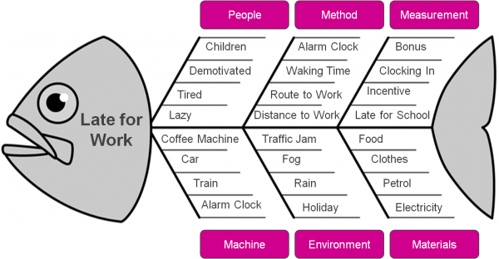
Fishbone Diagram or
Cause & Effect Diagram
A tool to help a team work together using a structured approach to brainstorming a list of causes of a problem
The head of the fish is the problem:
Late for work
The bones are causes grouped by category.
Notes:
MARK

Slide 20
Steps to Follow
Team must agree on the problem statement related to the global aim first
Decide on which general categories you will use. Typical ones include:
  Equipment/supplies
  Technology
  Staff
  Processes/procedure
  Environment
  Patients
Begin brainstorming contributing causes (within a category or as a whole)
Focus on current state!! No solutions yet!
Don’t worry about messiness
Notes:
MARK

Slide 21
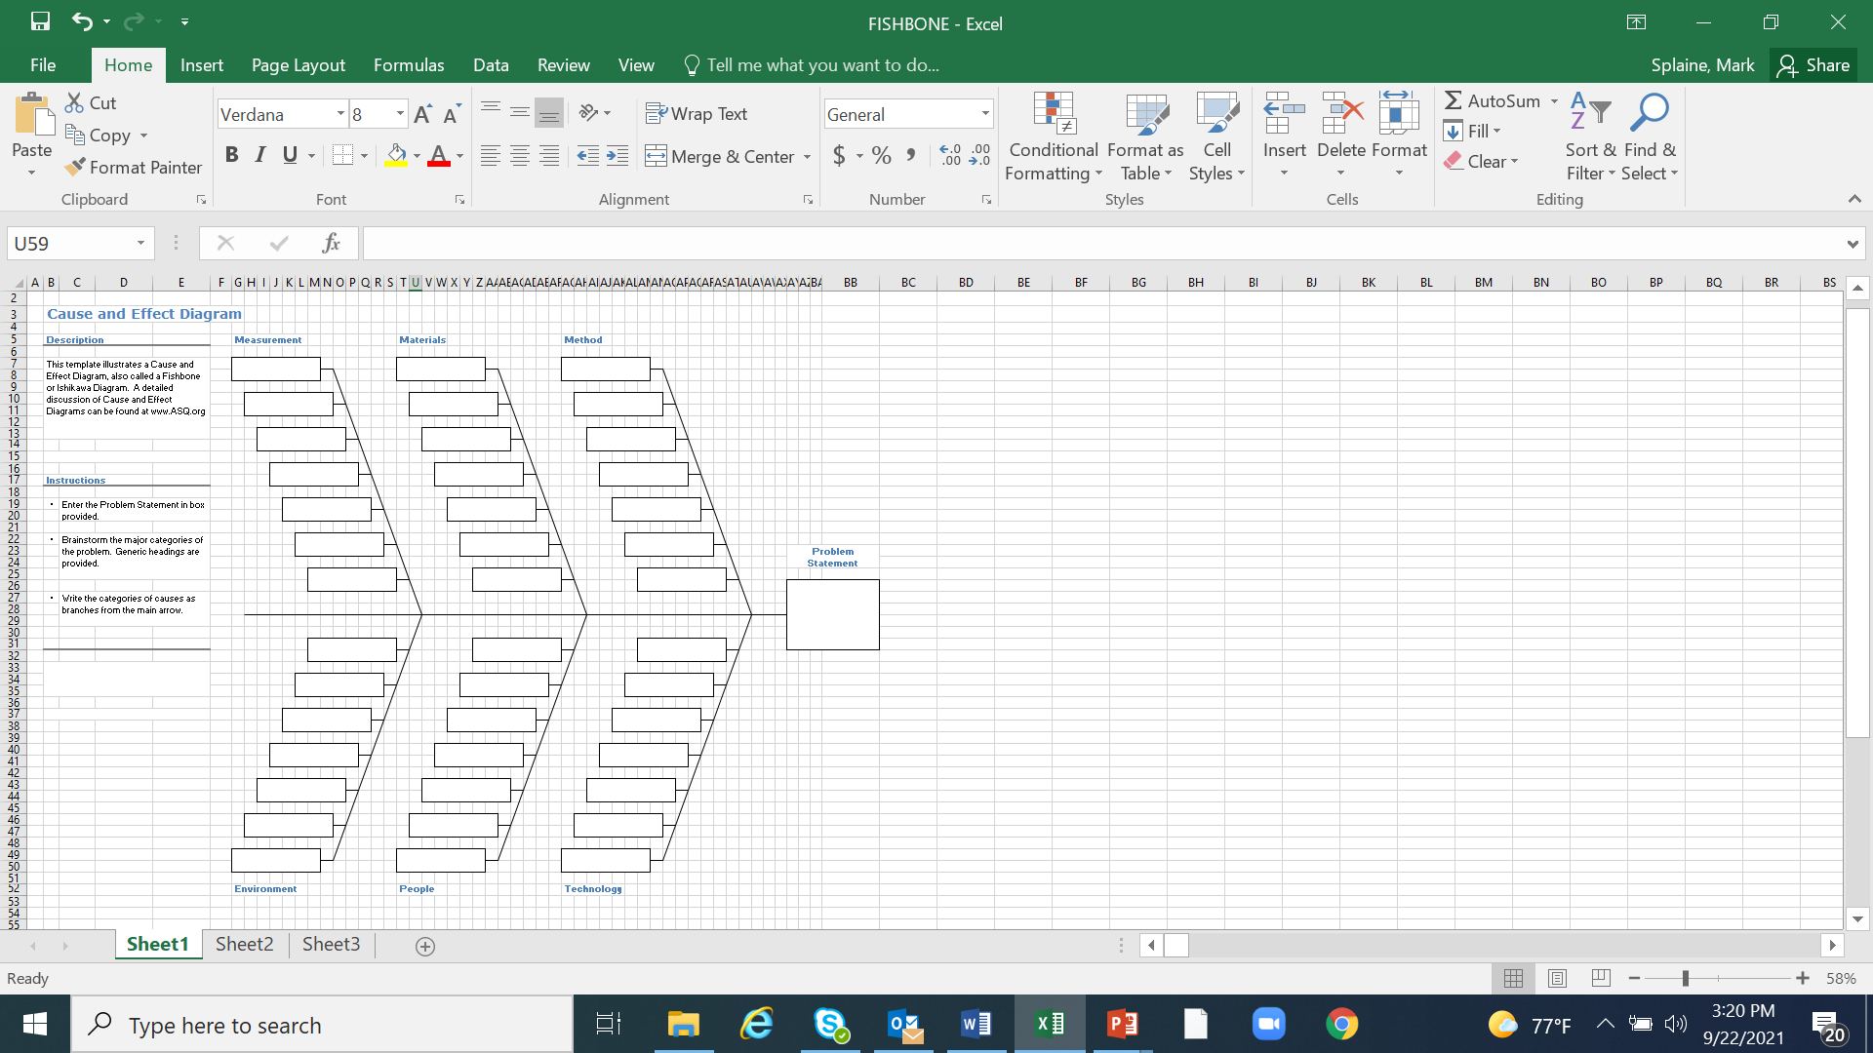
Template
Notes:
MARK

Slide 22
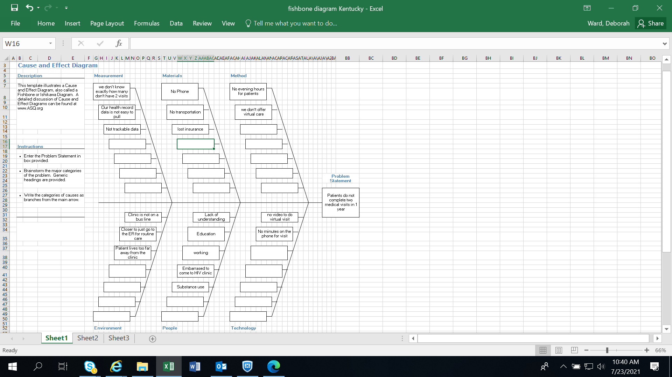
Completed Template
Notes:
MARK

Slide 23
Work on a Fishbone
We will break into project groups (15 minutes)
Select a problem statement from one of the teams in your group
Brainstorm contributing causes and place the ideas in the template
Nominate someone from your group to share how your work went with the large group
23
Notes:
NATALIE

Slide 24
Small Groups for Fishbone Discussion
We will break into project groups:
    CHC New Britain
    CHC New London
    CHC Hartford/Meriden
    HealthLinc
    CHC Postdocs
    Holyoke HC
    CHC Middletown
    CHC Danbury
    CHC Stamford
    Open Door
Notes:
NATALIE

Slide 25
Highlights from Project Groups
  Reporter’s summary from some groups -- share 1 or 2 highlights from the discussion
Notes:
NATALIE

Slide 26
What haven’t we figured out yet?
Questions or issues that remain unclear?
26
Notes:
NATALIE

Slide 27
Take-home Thoughts
Chelsea – share 1 or 2 ideas you will take away from our discussion
27
Notes:
NATALIE

Slide 28
Summary
You have learned about a framework to guide your thinking about how to organize improvement work
Also, we have reviewed some important tools for quality improvement work – global aim and fishbone diagram
Based on your submissions, it is clear you are already formulating some very good ideas for your projects.
Our next step will be to better understand the process related to your project topic.
28
Notes:
MARK

Slide 29
Session V Highlights
We will discuss tips and strategies for using flowcharts to enhance your understanding of an improvement effort
We will break into small groups to discuss draft examples of flowchart related to your projects
29
Notes:
www.clinicalmicrosystem.org
29
MARK

Slide 30
Assignment for Session V
Revise your global aim statement, if needed, based on today’s discussion or additional ideas you have about your project
Next, review your initial fishbone diagram draft, and brainstorm as a group about additional factors that contribute to your problem statement
Session preparation (background on flowcharting):
  Watch the two videos on flowcharting
  Read the document on flowcharting
Work with your site colleagues to generate a draft of the actual process for your project topic
If you have time, review your ideas about the process with others involved in the process for their feedback
Contact Alyson, Natalie, or Mark if you have questions or need assistance
Send a summary of your draft process by Tuesday (12/20/22)
Our next session will be on Thursday, 12/22/22
30
Notes:
www.clinicalmicrosystem.org
30
MARK

Slide 31
Resources to Review
The two video links provided below will give you a brief but helpful introduction to developing a process map (flowchart)
  https://www.youtube.com/watch?v=GoEP4dTAmAQ (simple overview, roughly 4 minutes)
  https://www.youtube.com/watch?v=JENOhSXzi2U (more detailed info, roughly 8 minutes)
We will send you an additional reading to provide more detailed insights about flowcharting
31
Notes:
www.clinicalmicrosystem.org
31
MARK

Slide 32
References
Science of Improvement: Setting Aims. Institute for Healthcare Improvement Website. (http://www.ihi.org/resources/Pages/HowtoImprove/ScienceofImprovementSettingAims.aspx)
Global Aim Statement Document. Society of Teachers of Family Medicine Resource Library Website. (https://resourcelibrary.stfm.org/HigherLogic/System/DownloadDocumentFile.ashx?DocumentFileKey=27fc6113-ab04-4100-966c-8d2349b4494c&forceDialog=1)
QI Tips: A Formula for Developing a Great Aim Statement. National Institute for Children’s Health Quality Website. (https://www.nichq.org/insight/qi-tips-formula-developing-great-aim-statement)
American Society for Quality Website. (https://asq.org/quality-resources/fishbone)
32
Notes:
www.clinicalmicrosystem.org
32

