Slide 1
Stress tests and ischemia suspicion: when, why, and how
Dan Wilensky MD
Chief Preceptor
2022-2023

Slide 2
Disclosure
With respect to the following presentation, there has been no relevant (direct or indirect) financial relationship between the party list above (or spouse/partner) and any for-profit company in the past 24 months which could be considered a conflict of interest.
The views expressed in this presentation are those of the presenter and do not reflect the official policy of CHC, Inc.
I am obligated to disclose any products which are off-label, unlabeled, experimental, and/or investigation (not FDA approved) and any limitations on the information that I present, such as data that are preliminary or that represent ongoing research, interim analyses, and/or unsupported opinion.

Slide 3
Goals for this session
Strengthen your thought process around potential for cardiac ischemia
Understand when, how, and why to order an ischemic evaluation
Develop a framework for choosing how aggressive and independent to be
The scope of this lecture will not include other explanations for chest pain
But remember that you have to think about more than ischemia (PE, pneumonia, shingles, musculoskeletal/myofascial, esophageal, pericardial, pleural, cancer, emotional)

Slide 4
INDICATIONS FOR STRESS TESTS
Diagnosis of Coronary Artery Disease
Prognosis In Patients with Known CAD
Decision Making in Management Strategies in Patients with Known CAD (Invasive vs. Noninvasive)
Chest Pain Centers in Emergency Departments
Preoperative Risk Assessment for Noncardiac Surgery

Slide 5
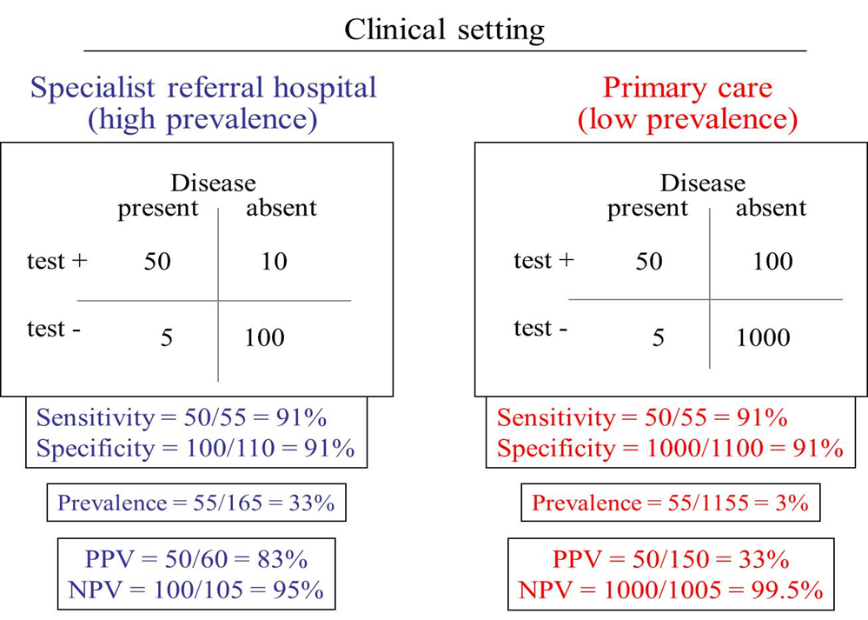
How Pretest Probability (prevalence in this example) makes the same test more or less useful

Slide 6
EXAMPLE 1
25 YEAR-OLD MAN WITH NO PMH BUT A VAGUE FH OF CAD PRESENTS WITH CHEST PAIN FOR 2 DAYS AFTER HIKING

Slide 7
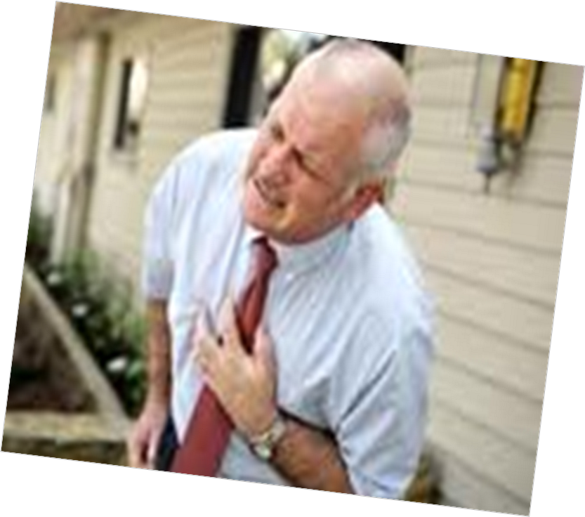
EXAMPLE 2
68 YEAR-OLD MAN WITH DM, HTN, SMOKING HISTORY, AND FH OF CAD PRESENTS WITH WORSENING CP AND DYSPNEA ON EXERTION, RELIEVED WITH REST AND NTG.

Slide 8
ORDERING A STRESS TEST
STRESS
Exercise
Treadmill (Bruce Protocol)
Bicycle
Pharmacologic
Adenosine
Persantine
Regadenoson (Lexiscan)
Dobutamine
TEST (cardiac assessment)
ECG
Echocardiogram
Nuclear Imaging
Thallium
Tc-99 Labelled agents
- Sestamibi (MIBI)
- Tetrofosmin

Slide 9
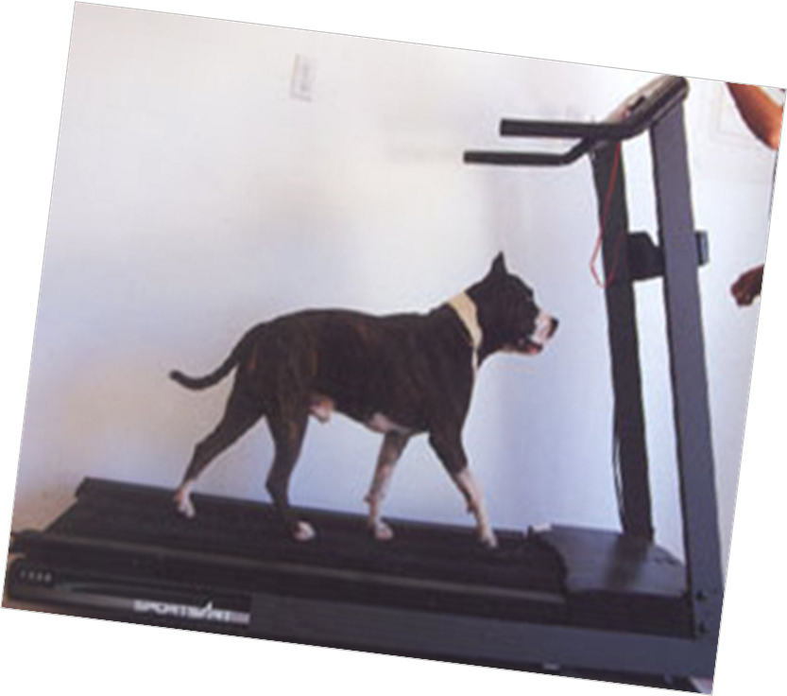
EXERCISE
-ALWAYS FIRST CHOICE FOR STRESS IN ANY PATIENT WHO CAN EXERCISE.
- NEED TO GET TO TARGET HEART RATE (THR): 0.85(220-AGE)

Slide 10
PATIENTS WHO SHOULD NOT HAVE EXERCISE AS STRESS (primary) MODALITY
Recent mi ( or positive troponin of ? etiology)
Severe aortic stenosis
Lower extremity amputees
Elderly deconditioned patients
Severe copd
Severe peripheral vascular disease
Severe arthritis/djd
Hip fractures/knee fractures/patient refusal/debilitated etc…
LBBB/ventricular-paced rhythm
-

Slide 11
ELECTROCARDIOGRAM (ECG)
Everyone will have EKG portion of test. An “EKG Stress Test” (“Standard stress test”, ETT or GXT) refers to a test when the patient only has this as the cardiac assessment portion. In this case, Exercise alone is used for the Stress portion of the test.
Far less sensitive/specific than the other imaging modalities (Echo/Nuclear)
Limited value if significant ST abnormalities or LBBB on baseline ECG.
Positive Test: ST-Depressions:
Downsloping
Horizontal
Upsloping

Slide 12
When to choose a standard stress test
Good for pre-ops and pre-participation
Lower sensitivity and specificity for women
When you’re confident that a patient can do a good job on the treadmill.
Need to get to target heart rate (thr): (220-age)x85%
When your suspicion for ischemia is on the low side (the sensitivity just isn’t good enough to give you a good enough negative predictive value if the pretest probability is high enough)
When the symptoms are predictably brought on by exertion and you can expect to capture them
Baseline EKG needs to be normal

Slide 13
BASELINE EKG

Slide 14
DURING PEAK EXERCISE WITH CHEST PAIN

Slide 15
ST DEPRESSIONS

Slide 16
STRESS ECHOCARDIOGRAM
Generally similar in accuracy to nuclear imaging, but very dependent on technical quality and reader experience.
Advantages: faster, cheaper, no radiation
Disadvantages: reader variability, often technically-limited, cannot use if baseline wall motion abnormality, cannot use with vasodilator (must use dobutamine or exercise)
My local hospital’s Cardiodiagnostics Dept asks me to change this order to a nuclear study any time I order it

Slide 17
NOT AN ECHO
If you need an ECHO for valve issues, possible CHF, Pulmonary HTN, etc.,
ORDER ONE
A stress ECHO doesn’t replace an ECHO

Slide 18
STRESS ECHOCARDIOGRAM

Slide 20
NUCLEAR STRESS TESTS
Patient is injected with radiotracer (Technetium/Thallium/Sestamibi/Tetrofosmin) agent at rest and radiotracer agent is taken up into the myocardium of tissue in direct proportion to myocardial blood flow.
Images are taken under SPECT Camera. These are “Rest Images.” Brighter areas represent sufficient uptake of the radiotracer agent.
Patient then undergoes stress (exercise/pharm) and injected at the moment of “peak stress”. Radiotracer is again taken up into myocardial tissue in proportion to blood flow at that very time.
Images are again taken in a similar fashion; these are “Stress Images.”
Rest Images and Stress Images are compared.

Slide 21
THE STRESS PORTION
It works by vasodilation
Counter-intuitive
The vasodilator only works when the endothelium is healthy and circumferential plaque prevents it.
The healthy arteries vasodilate creating a “steal syndrome” in the culprit artery/arteries.
In multi-vessel, severe disease, the stress may not cause this steal syndrome (false neg)

Slide 22
DOWNSIDES?
Exposure to nuclear radiation
Stress agents can trigger bronchospasm

Slide 23
Results
NORMAL STUDY: Normal perfusion is seen during both Stress and Rest Images.
REVERSIBLE DEFECT: There is a defect seen in Stress Images. This defect is significantly improved or resolves during Rest Images.
If present, how severe?
FIXED DEFECT: There is a defect seen in Stress Images. This defect is unchanged during Rest Images.
ARTIFACTUAL DEFECT: Breast Tissue/Diaphragmatic/Apical Thinning Artifact

Slide 24
NORMAL NUCLEAR STRESS TEST

Slide 25
REVERSIBLE DEFECT/ISCHEMIA

Slide 26
REVERSIBLE DEFECT/ISCHEMIA

Slide 27
FIXED DEFECT/INFARCT

Slide 28
What do I do?
Standard stress test: see slide #12, or:
I generally order the nuclear study with pharmacologic stress
I generally write “may augment with exercise”
Even a little bit of time on the treadmill can improve sensitivity.
I leave this to the discretion of the Cardiodiagnostics dept.
I don’t order either with only exercise being the form of stress
I don’t want to commit the radiation, cost, or the extensive time to a patient who might need a repeat because they don’t handle the treadmill well

Slide 29
ECHO VS NUCLEAR
.
From a recent Cardio eConsult
“if fine climbing 2 flights of stairs/walking 1 mile then treadmill echo (unless poor echo windows in which case treadmill MIBI)”
“ if inactive, chemical stress LEXISCAN or dobutamine stress echo
(DSE avoids radiation and false positives if large breast, elevated liver position, or unable to keep the left arm out of the views, but DSE can cause nausea, arrhythmia and it requires good echo windows)”

Slide 30
CARDIAC CATHETERIZATION

Slide 31
What about CCTA?
Coronary CT Angiogram
I’ve never ordered one and I think I wouldn’t be able to get it through a PA.
It is not a functional test like the stress test choices
A recent article suggests that one day it could be something we consider adding to this workup
I’m starting to see eCardiology consults recommend it first line for certain outpatient evaluations, but I haven’t appreciated a consistent approach.
2022 update: my local hospital doesn’t perform this, but I’m hearing from other CHC PCPs that they have been able to order them.

Slide 32
DOI: 10.1056/NEJMoa2200963

Slide 33
“Among patients referred for ICA because of stable chest pain and intermediate pretest probability of CAD, the risk of major adverse cardiovascular events was similar in the CT group and the ICA group.
The frequency of major procedure-related complications was lower with an initial CT strategy”
So, at the point where we now send to Cardiology to discuss Cath (ICA), maybe a courageous PCP might one day order a CCTA instead
Then we could reserve a CATH for revascularization
avoiding procedural risks and over-treatment
2022 update: The time is now. Find out if you have this available for you to order. Don’t find out with a cp patient

Slide 34
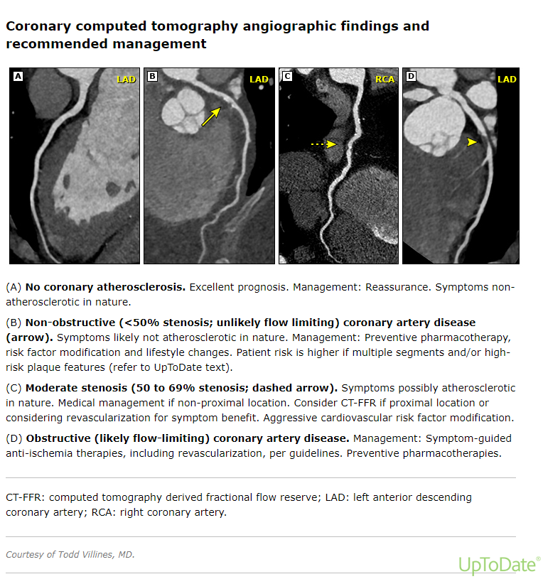

Slide 35
A case
Your patient is a 56 y.o. man who comes to you to find out if he has CAD after his younger brother just had a stent placed.
Med Hx: Overweight (BMI 28), HTN (well controlled on ARB)
LDL: 138 a few months ago with 10 year ASCVD: 6% (borderline risk)
Exam and EKG normal
Run/walk 5K twice weekly and lifts weights other days
What’s the answer to his question?/What test might you order?/Stress test?

Slide 36
Does he have CAD?
A negative stress test doesn’t rule out CAD in the slightest
It just rules out obstructive CAD
Coronary angiogram is the gold standard
But way too aggressive here
Coronary calcium score would be best test here
Any score greater than 0 is abnormal and would contribute to decision to start medium potency statin
For over 1,000, pretty good consensus that treating as active CAD is appropriate (ASA, high potency statin, Beta blockers, lower BP and LDL goals)
For 100-1,000 most Cardiologists would do the same
I have not been successful getting PAs for them, though
In non-FQHC primary care, many patients pay out of pocket

Slide 37
Now my suggestions on a framework for clinical decisions in the office setting
There’s such a spectrum of presentations that most of the time your patient won’t fall into any hard-and-fast rules
Underlying CV risk is very important for predicting which presentations will be from cardiac etiology
You will need to define and develop your own comfort level
Don’t forget the differential diagnosis

Slide 38
Other things to mention
Long-term diabetics and those who’ve had open heart surgery are much more likely to have painless ischemia
Women with ischemia are more likely to be falsely reassured and are more likely to present without classic symptoms
In my whole career, I’ve had only one patient come to my office with obvious, classic cardiac symptoms (“there’s an elephant sitting on my chest and my younger brother died of a heart attack last year and he was 100 pounds lighter than me”)
He had a negative angiogram!!!!
Dyspnea on exertion, jaw pain, arm pain, diaphoresis, nausea, “sense of impending doom”—don’t wait for chest pain

Slide 39
So how do we begin?

Slide 40
Does the patient have symptoms now?

Slide 41
Does the patient have the symptoms now?
Probably the most important question
If there is a chance that the symptom is ischemic in etiology, the presence of pain in the office (or on the phone) means ambulance/ED/rule out Acute Coronary Syndrome.

Slide 42
Is the pattern stable or unstable?

Slide 43
Stable Angina
Decreased blood/oxygen flow to area of the heart when there is increased oxygen demand
Etiology overwhelmingly from a stable atherosclerotic plaque in one or more coronary arteries, which has likely been there for months to years
Has been present for at least a month
Predictable
Not crescendo

Slide 44
Unstable Angina – New Angina
For less than a month
The natural history of new onset angina depends in part upon the degree of exertion required to induce chest pain. Patients with new onset angina occurring only after heavy physical exertion, such as shoveling snow or lifting a 50 pound weight, have a prognosis similar to patients with chronic stable angina. In comparison, new angina occurring after minimal exercise or at rest, particularly if prolonged, carries a worse prognosis in the absence of intervention.
UpToDate

Slide 45
Unstable Angina – Rest Angina
Rest angina, particularly if prolonged and/or associated with transient ST-segment changes >0.05 mV, identifies patients at increased risk
UpToDate

Slide 46
Unstable Angina – Crescendo Angina
Beginning sooner (e.g. at ¼ mile of walking when 2 weeks ago it was at ½ mile)
Longer duration
Increasing symptoms

Slide 47
Unstable angina – what’s happening?
An atheromatous plaque may have ruptured
Leading to activation of platelets and increasing artery stenosis
Often needs Cardiologist/Cardiothoracic surgeon to revascularize
Other condition may have led to increased cardiac demand even when plaque is stable
Increased elevation (decreased pO2)
Loss of blood (i.e. decreased O2 carrying capacity)
Infection
Arrhythmia
Hyperthyroidism
Treating the condition may return angina to stable

Slide 48
Is the pattern stable or unstable?
Even rather severe exertional cardiac ischemia is usually not terribly dangerous in the short term when the pattern is stable.
This is tricky (and messy)
When the etiology of an outpatient chest pain presentation is cardiac, it’s usually stable
When the etiology is musculoskeletal, esophageal, or emotional, it is much less likely to look stable.
Unstable chest pain from a cardiac source is very dangerous
How likely is it to be cardiac and if it’s cardiac, is it stable or unstable?
This is where the art of medicine lies

Slide 49
Just a reminder
When we are evaluating patients in the office, we don’t know for sure whether the symptoms are cardiac in etiology or not.
So this is a lot to balance
And stable vs unstable may wind up seeming more like a spectrum

Slide 50
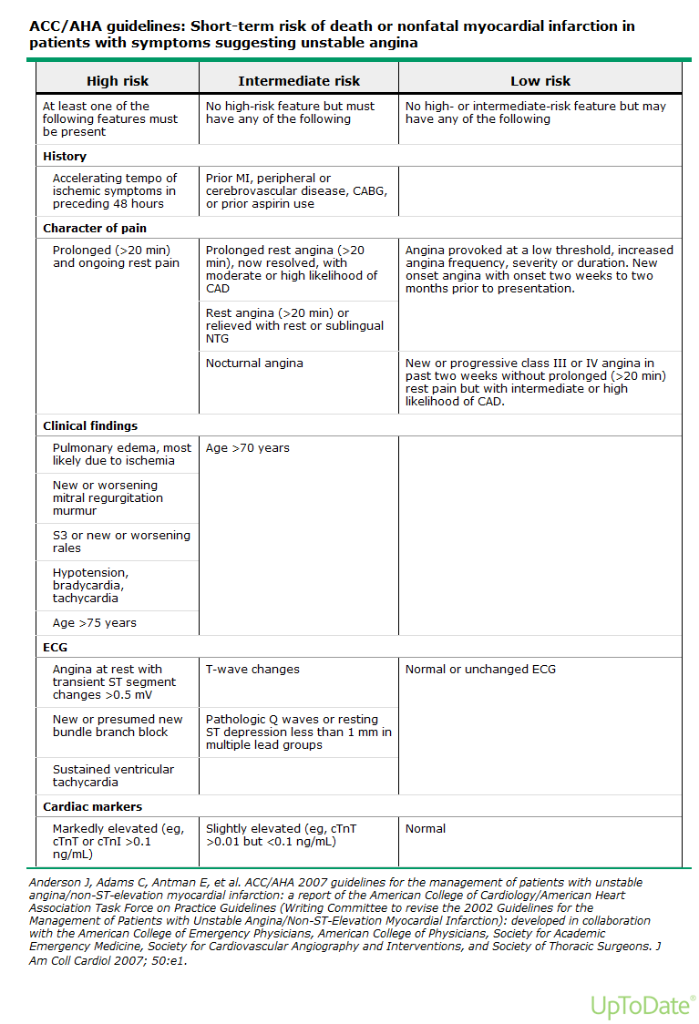

Slide 51
Let’s do this
What interventions do we have?
How do we choose which to use?
Ordered from most urgent to least
Start by giving an aspirin right away if CAD suspicion warrants
But remember to stop the Aspirin if CAD is later ruled out.
Check an EKG

Slide 52
Call an ambulance
You think that somebody has active coronary ischemia (an ACS – Acute Coronary Syndrome)
Have a low threshold –this is a potentially big miss
Chest hurts now (or the potential ischemia equivalent)
EKG shows ischemia
New exam findings (hypoxia, hypotension, new murmur, cyanosis, JVD/S3/edema, looks like s**t)
Unstable angina and no safe way to get to the ED without an ambulance
Other major medical problem which has caused an escalation in previously stable angina if no safe way to get to the ED.
The ambulance comes to my office so quickly, that I usually skip the EKG if it wouldn’t change my recommendation to call an ambulance

Slide 53
Private transport to E.D.
Substantial unstable angina but no pain now
CHF but not too bad
Safe and reliable transportation
Patient refusal of ambulance when it’s a soft call
You don’t want to fight them, but make sure you explain and document the reasons why you recommend the ambulance
But if the patient is crashing or has cognitive troubles, don’t accept this.

Slide 54
The safety discussion
“The reason I’m not sending you to the ER right now is that I think your heart is safe. But if something changes, if the pain you’re having comes back but is stronger or lasts longer, or if you have other concerning symptoms, you should be evaluated as an emergency to make sure you’re not having a heart attack. A third of people don’t survive their first heart attack, so don’t mess around”
“People can die while waiting for a stress test. And if your symptoms are bad enough, a stress test wouldn’t even be safe. And make sure you take the meds”
Say it, get teach-back, and chart the discussion
Maybe call them tomorrow to make sure they are OK

Slide 56
Urgent Cardiology consult within days
If they don’t need ED level of care (serial EKGs, cardiac enzymes, STAT labs, continuous monitoring, urgent medication)
Your gut instinct (something’s wrong but I don’t know what)
Intermediate to high probability crescendo angina w/o ischemia on EKG
Might want to call Cardio: present quickly and ask “would you prefer to see them in the office right away or consult in the ED now?”
Low to intermediate probability of cardiac etiology but symptoms (if cardiac) could be pretty alarming.
e.g. 30 minutes of rest pain at time of stress with CV risk factors

Slide 57
Timely Cardiology consult
When you choose not to order testing yourself
Uncertainty
Community standard
When your suspicion is so high that you know you would consult even if stress testing were to be negative.

Slide 58
Order stress testing
Yes you can do it
Read the results ASAP when in (and have your MA call for them if there’s a delay)
Make sure you get the entire result (2 departments/reports?)
Usually you will get a call if there is anything alarming
Generally if there is ischemia on the study, a Cardiologist should be consulted quickly or ED transport arranged
Is a Cath needed?
How much of the heart gets ischemic?
However, if you have the guts (or if you’ve got nobody to defer to), stable ischemia should be managed medically and we can do that without cardiology.

Slide 59
Cardiology eConsult
If available to you
When you’re not sure but you’ve decided it’s not an emergency
Maybe to help you choose a workup
But not all eConsultants are the same
Sometimes instead of helping you expand your scope of practice they tell you that you can’t

Slide 60
Reassure with no testing
If the ischemic likelihood is really low, a positive stress test would probably be a false positive.
If you have a good non-ischemic explanation for the pain/symptoms
Chest pain is common
Do they have back pain at a similar level/side?
If they’ve had thorough ischemic workups already for similar presentations
Especially if within the last couple of years.

Slide 61
If you aren’t sending to the ED, what should you do?
Aspirin – very low threshold
Don’t forget to tell them to stop it if/when CAD is no longer in question
CMP, CBC, Lipids, Chest X-ray, maybe a TSH
Consider a statin with lipids pending
Maybe even high intensity depending on risk factors and your estimation of CAD likelihood
Beta blocker?
Lowers MI/ischemia risk, but will make a stress test less likely to be diagnostic (prevent heart rate from rising)
Sublingual Nitroglycerin? (relieves symptoms but not shown to save lives)

Slide 62
Too many revascularizations are done in the U.S.
There’s great money in it
It’s hard to look at a tight artery and not want to open it.
We revascularize vessels that are not the culprit vessel
If it’s not unstable angina, an acute coronary syndrome, CHF, or serious left main disease there’s very little evidence to suggest that revascularization is better long term than aggressive risk factor management with lifestyle change, ASA, Beta Blockers, ACE inhibitors, and Statins
But, as PCPs (and APRNs), bucking our system is probably not what you want to be doing

Slide 63
The best medicine for reversing CAD is a whole-food, plant-based diet
https://nutritionfacts.org/video/flashback-friday-how-not-to-die-the-role-of-diet-in-preventing-arresting-reversing-our-top-15-killers/ --- Dr. Greger
This is the entire 80 minute presentation that convinced me to be vegan
For CAD reversal, start at 10:00 and listen for 6 minutes
Read “How Not to Die” by Dr. Michael Greger
Use the Daily Dozen App to learn to eat
Maybe read “How not to Diet” by Dr. Greger

Slide 64
Thanks! Questions and answers

