Slide 1
Myofascial Pain Disorder: An introduction to an unfortunately little taught concept of how the body works
Dan Wilensky MD
Chief Preceptor
2022-2023

Slide 2
Disclosure
With respect to the following presentation, there has been no relevant (direct or indirect) financial relationship between the party list above (or spouse/partner) and any for-profit company in the past 24 months which could be considered a conflict of interest.
The views expressed in this presentation are those of the presenter and do not reflect the official policy of CHC, Inc.
I am obligated to disclose any products which are off-label, unlabeled, experimental, and/or investigation (not FDA approved) and any limitations on the information that I present, such as data that are preliminary or that represent ongoing research, interim analyses, and/or unsupported opinion.

Slide 3
I am a beginner at this
I think it explains a lot of what we see, which conventional Allopathic Medicine often misdiagnoses or ignores
I attended Project ECHO – Pain for one year with UNM (they emphasize myofascial pain)
I have attended Project ECHO – Pain for many years with CHC/Arizona Pain Group (in which they don’t emphasize myofascial pain)

Slide 4
I have attended 2 workshops on Myofascial Pain Disorder
One of these, in New Mexico, was a weeklong program by the leading experts in the field
I have read both volumes of “Myofascial Pain and Dysfunction: The Trigger Point Manual” by Janet Travell and David Simons
I have lots of myofascial pain!

Slide 5
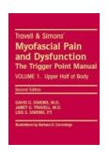
GENERAL
This is a general overview of myofascial pain syndrome (MPS)
Outline, tables and figures are from:
Boswell MV, Cole BE. Weiner’s Pain Management, 7th edition. NY: Informa, 2007.
Color illustrations from:
Travell, J.G.,& Simons, D.G., (1999). Myofascial Pain and Dysfunction: The Trigger Point Manual. (2nd ed.). Baltimore, MD: Williams & Wilkins.

Slide 6
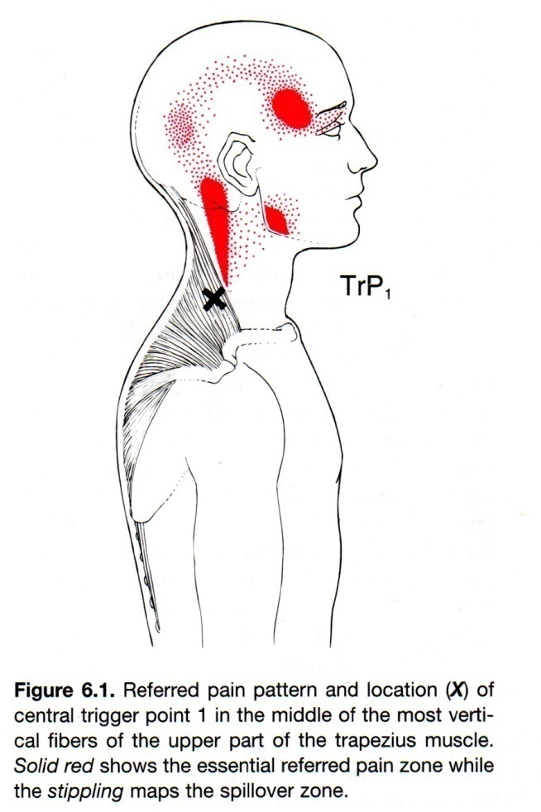
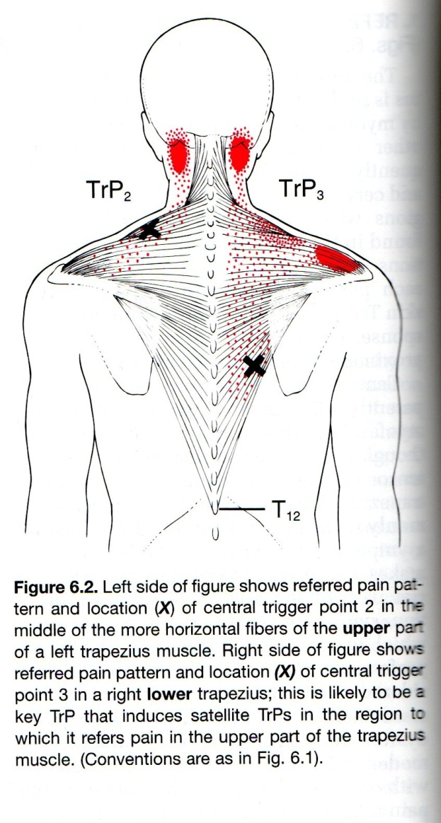
Upper Body Example: Trapezius

Slide 7
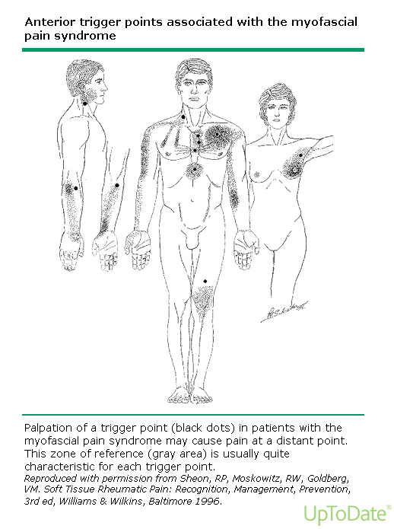

Slide 8
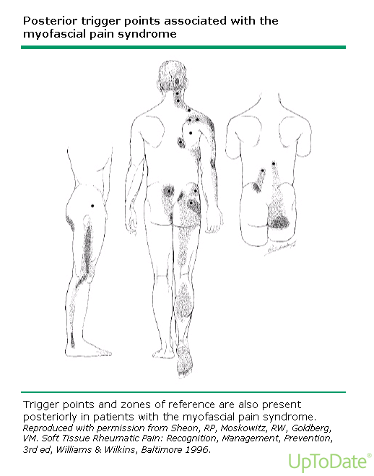

Slide 9
A helpful video to demonstrate what a Trigger Point (TrP) is
https://www.youtube.com/watch?v=QY9ePL690Dk

Slide 10
MYOFASCIAL PAIN SYNDROME
PREVALENCE (since 1980’s)
Primary care:
30% present with pain
30% of these pts. have MPS
Pain clinics:
50-85% of pts. present with MPS
REF: Travell

Slide 11
Let’s take a step back: What does myofascial refer to?
Myo (muscle)
Fascia (connective tissue)
Myofascial involves all of the muscles in the body, all of the connective tissue connecting this to bones, skin, organs
It also supports the nerves (sensory, motor, and autonomic) and the blood vessels.

Slide 12
Wait! This is huge!? Have I learned about this?
Mostly not.
In anatomy lab, we stripped away the fascia so we could see the anatomy
Many well taught conditions involve the myofascia (e.g. tennis elbow) but attention is not drawn to it.

Slide 13
So who does know this?
Physical therapists….some focus primarily on this
Physiatrists…to greater and lesser degrees
Orthopedists?.....myofascial pain is not treated surgically.
Chiropractors….it’s not part of their tradition, but many are becoming quite adept at it
“Body workers”
Trainers
Increasingly, everybody except us (anybody with a foam roller)
Neurologists/Rheumatologists?....maybe, maybe not

Slide 14
Precipitating and perpetuating Factors
Anatomic variations
Posture
Work-related stress
Degenerative conditions
Injuries, trauma
Medical conditions
Deficiencies of: iron, folic acid, vitamin B12, thyroid hormone, vitamin D
Presence of: gout, candidiasis, parasites, interstitial cystitis, IBS, ureteral stones, endometriosis, insomnia, OSA, depression, anxiety, other psychological stress

Slide 17
vs. Fibromyalgia
MPS often co-exists in those with FM
But, MPS is
Regional (usually several muscles)
Exhibits local twitch responses (during palpation and/or treatment)
Verifiable in research setting (electro-diagnostically; inter-rater reliability)
Those who don’t know about myofascial pain disorder will call most of it fibromyalgia. Many research studies don’t do a good job of distinguishing between the two.

Slide 18
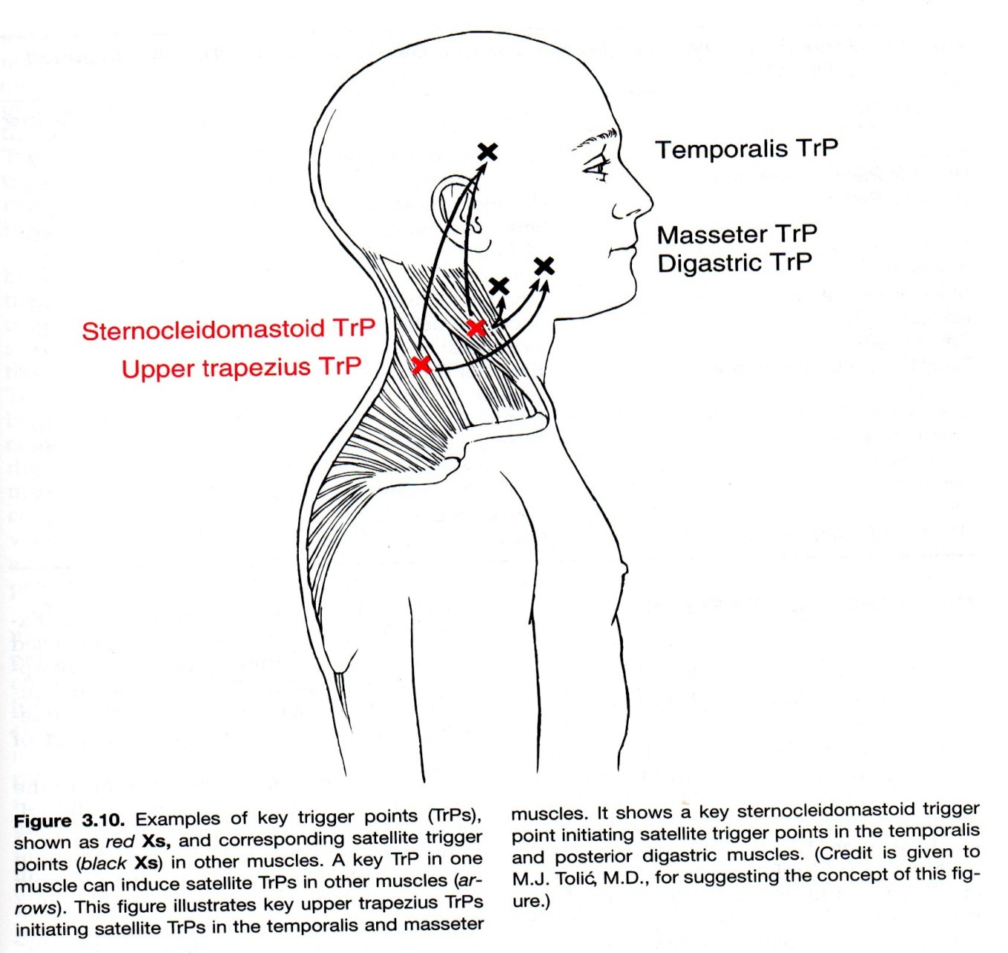
A main TrP may lead to other (satellite) TrPs to become active

Slide 19
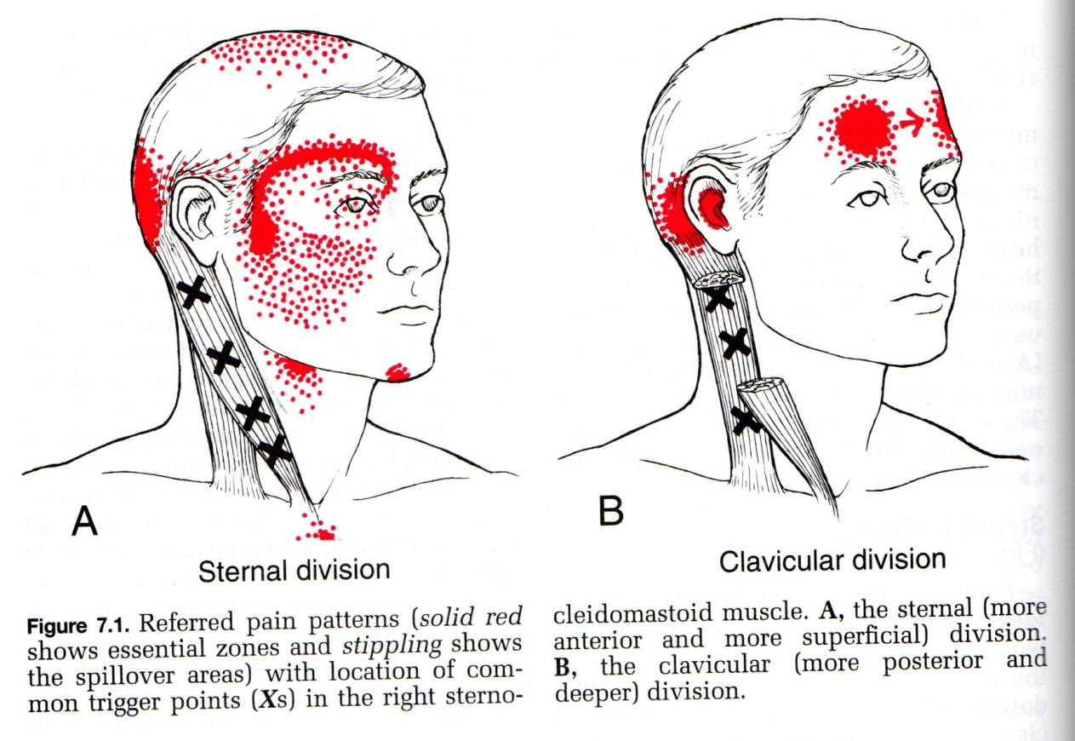
Notice the headache caused by trigger points in the neck (which may be unnoticed or not connected by the patient)

Slide 20
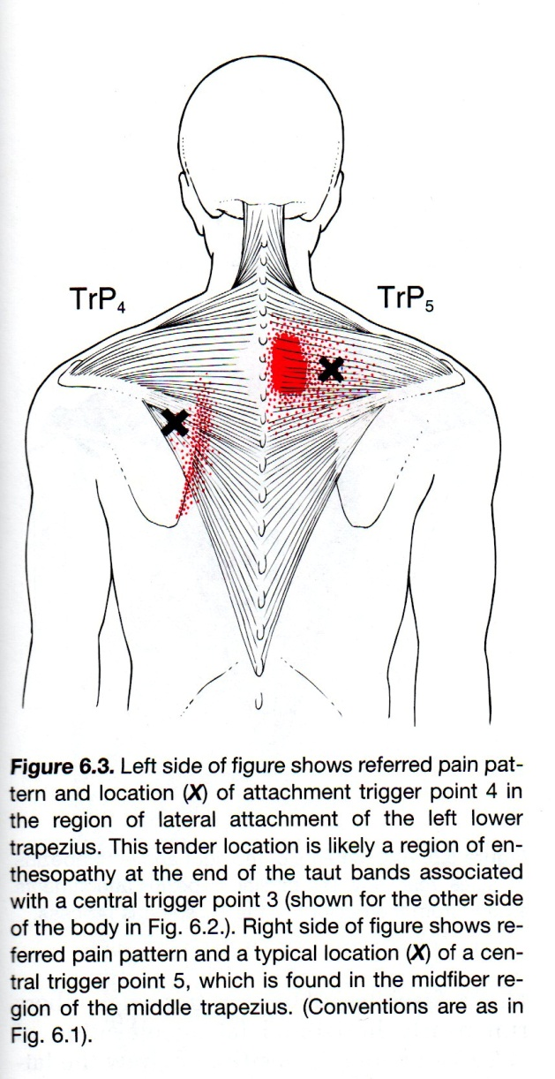
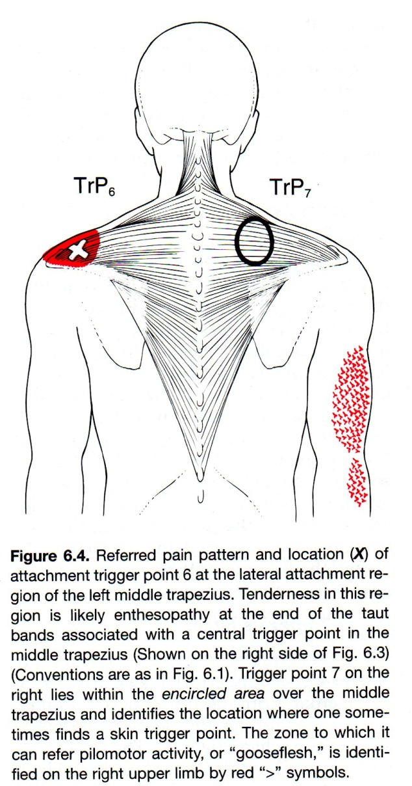
An interesting superficial trigger point (that I had once)

Slide 21
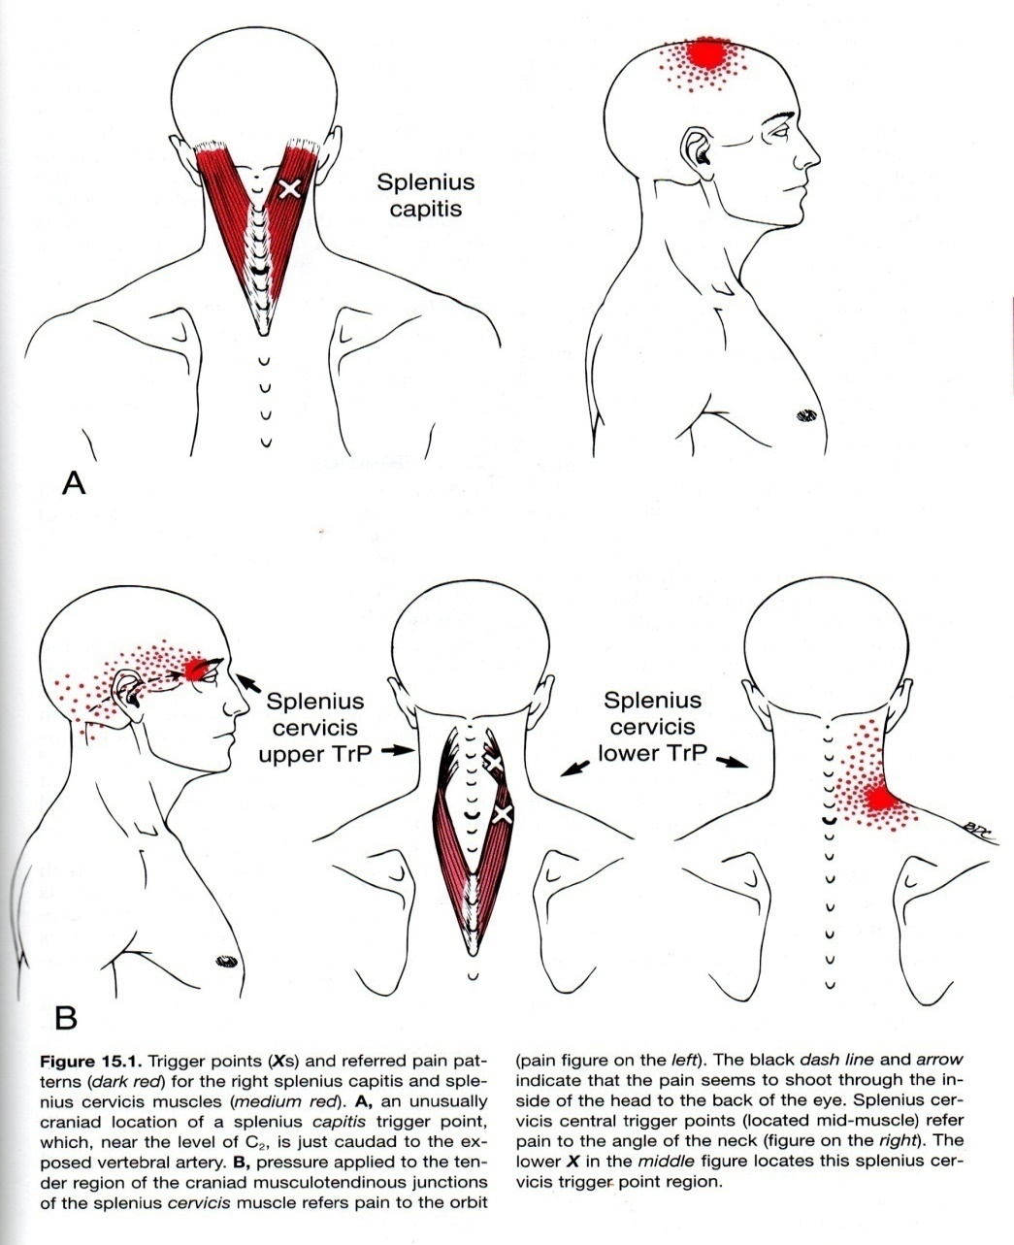
Now imagine this referral pattern superimposed on the SCM referral pattern noted on the previous page….”my whole head hurts.” And there are plenty of other muscles whose referral patterns overlap.

Slide 22
.
So you are now getting a glimpse of this important condition
We are not going to be able to diagnose much of this after this didactic
We are not going to be able to treat much of this after this didactic
But it is important that we recognize this exists and with it will come a different appreciation for how the body works.

Slide 23
Some key points of what we’ve learned so far
Myofascial structures are everywhere
They are a big source of pain and dysfunction
They are little recognized by conventional Allopathic Medicine
Referral patterns may overlap and activate other regional trigger points
They may mimic other conditions, such as arthritis, migraine, MI.
They may aggravate other conditions or be caused by other pain conditions
Psychosocial, nutritional, and biomechanical situations may provoke/perpetuate the TrP activity

Slide 24
When I suspect myofascial pain syndrome, here’s how I approach it.
First: I ask the patient to draw the symptoms on a blank body diagram.

Slide 25
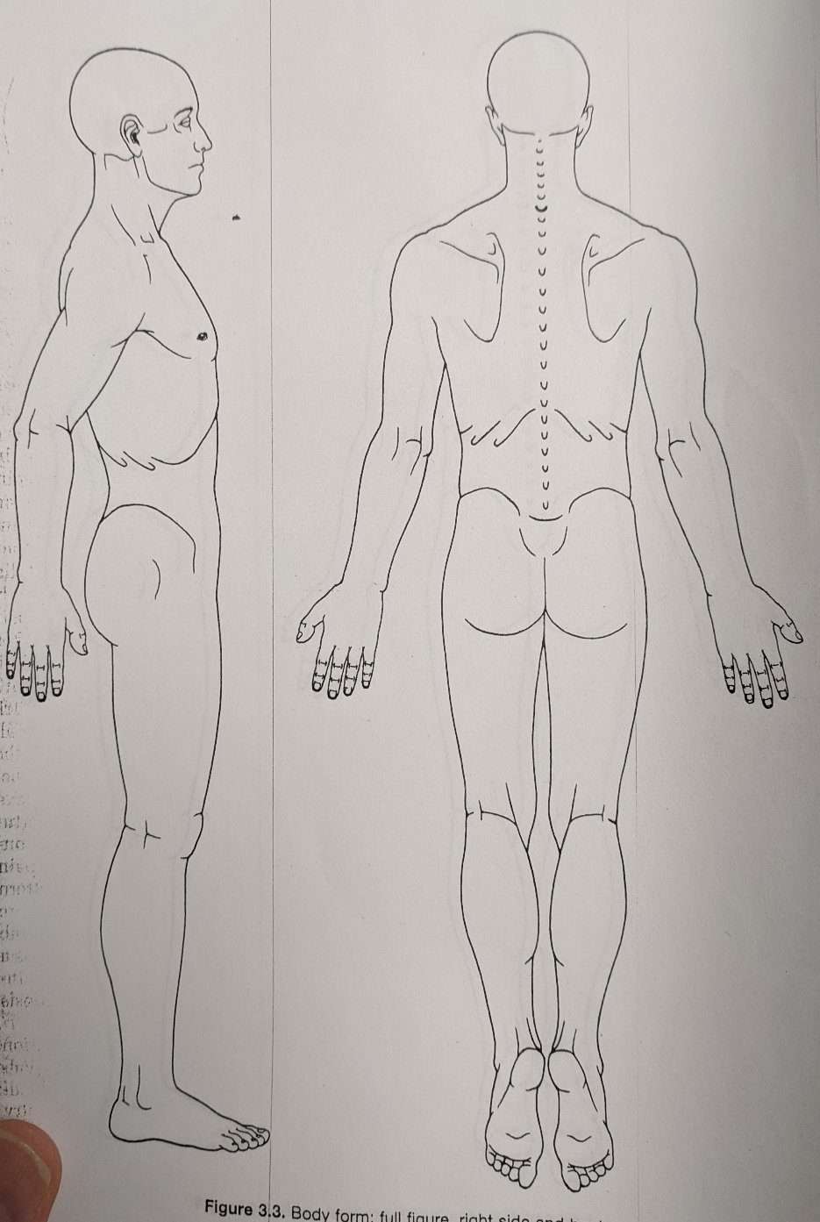
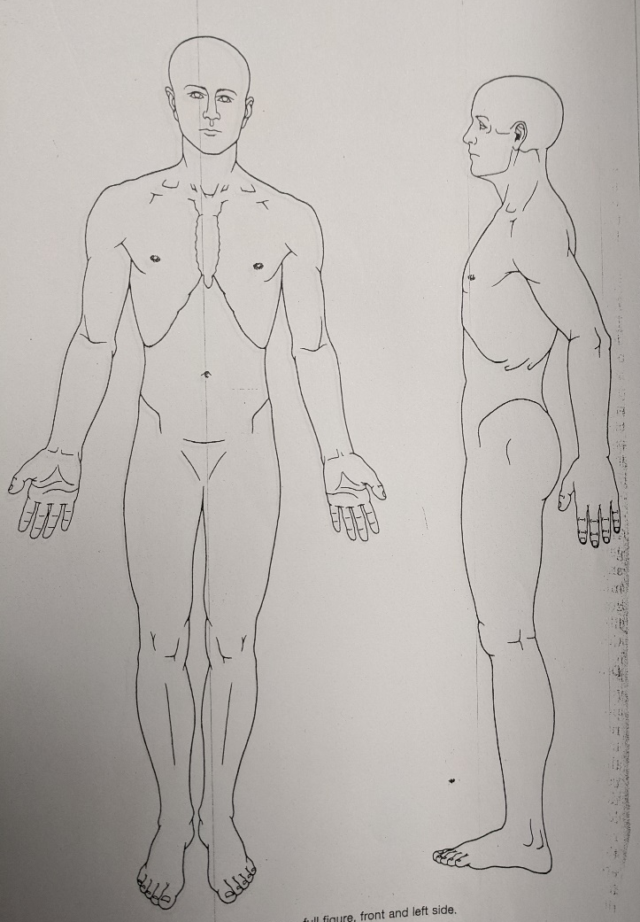

Slide 26
What I do when I suspect myofascial pain syndrome
Second: I review the muscles which cause pain in that region of the body, using the “Pain Guide” from the beginnings of Travell’s chapters

Slide 28
Third: I try to identify the dysfunction by weakness and decreased ROM of the muscle and demonstration that referral pattern by trigger point palpation reproduces the complaint.
Travell felt that it was unethical to activate any TrP that you didn’t then inactivate by treatment at the same visit. But that puts us in too much of a bind.

Slide 29
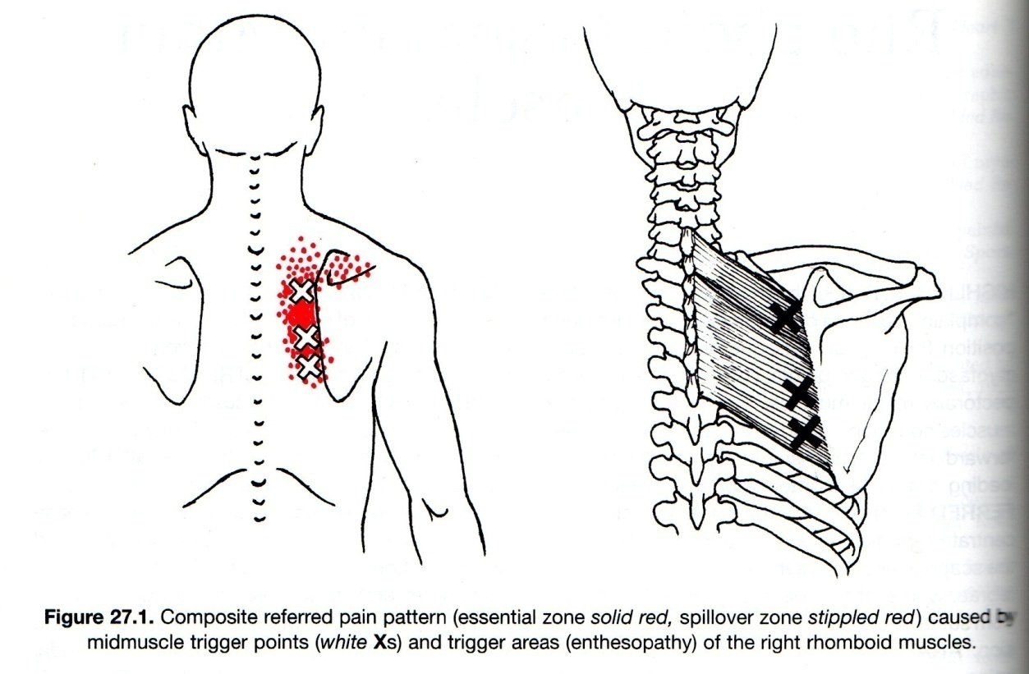
Just because the trigger points exacerbate pain does not mean that this is not referred pain from a cholecystitis. However, if you inactivate the pain with TrP injection or other, that would be quite suggestive. That is, be careful ruling out a dangerous medical condition just because there is also a myofascial explanation

Slide 30
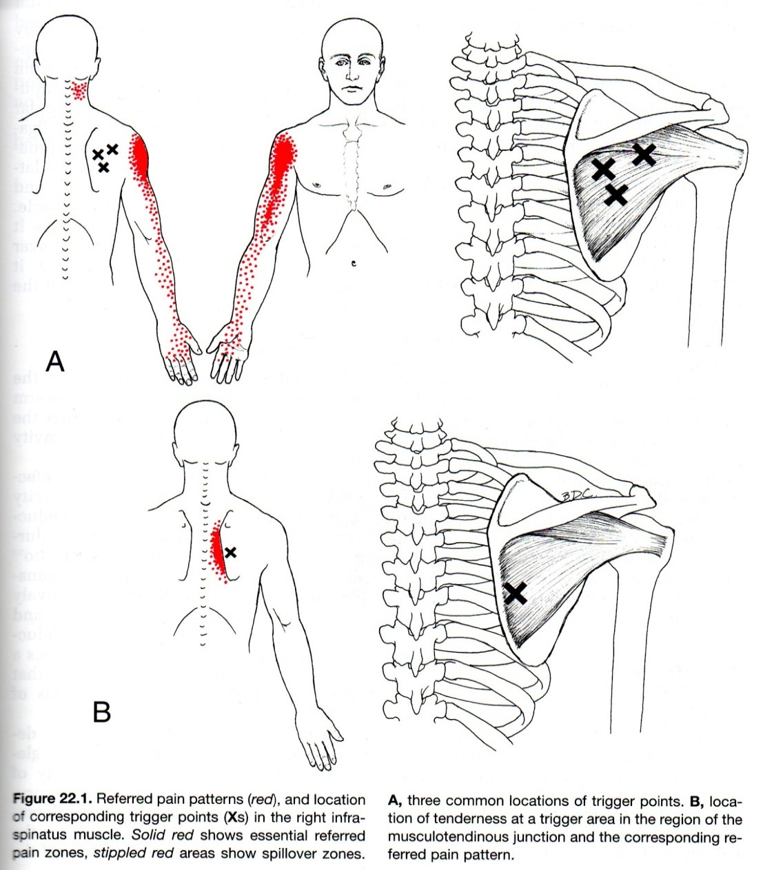
Wouldn’t most clinicians think that this was radicular? In this situation, if a C-Spine MRI were to show disc troubles, this might lead to a harmful surgery.

Slide 31
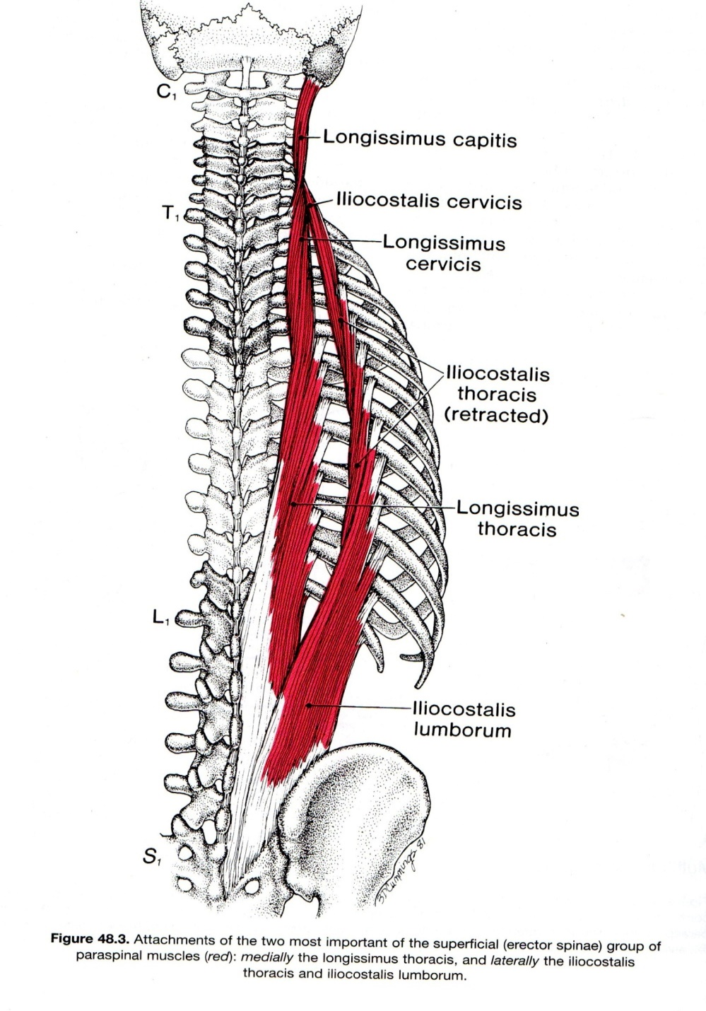

Slide 32
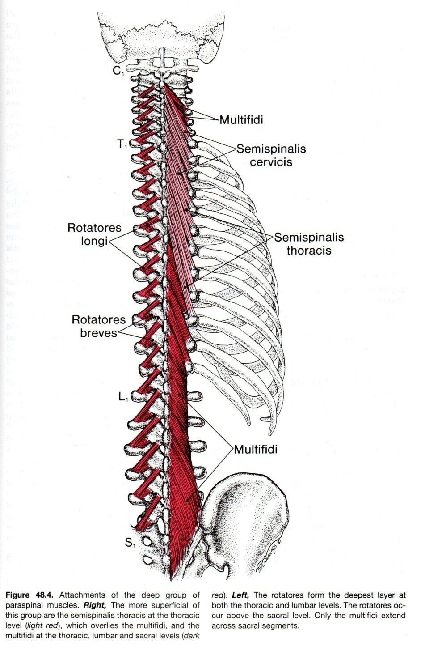

Slide 33
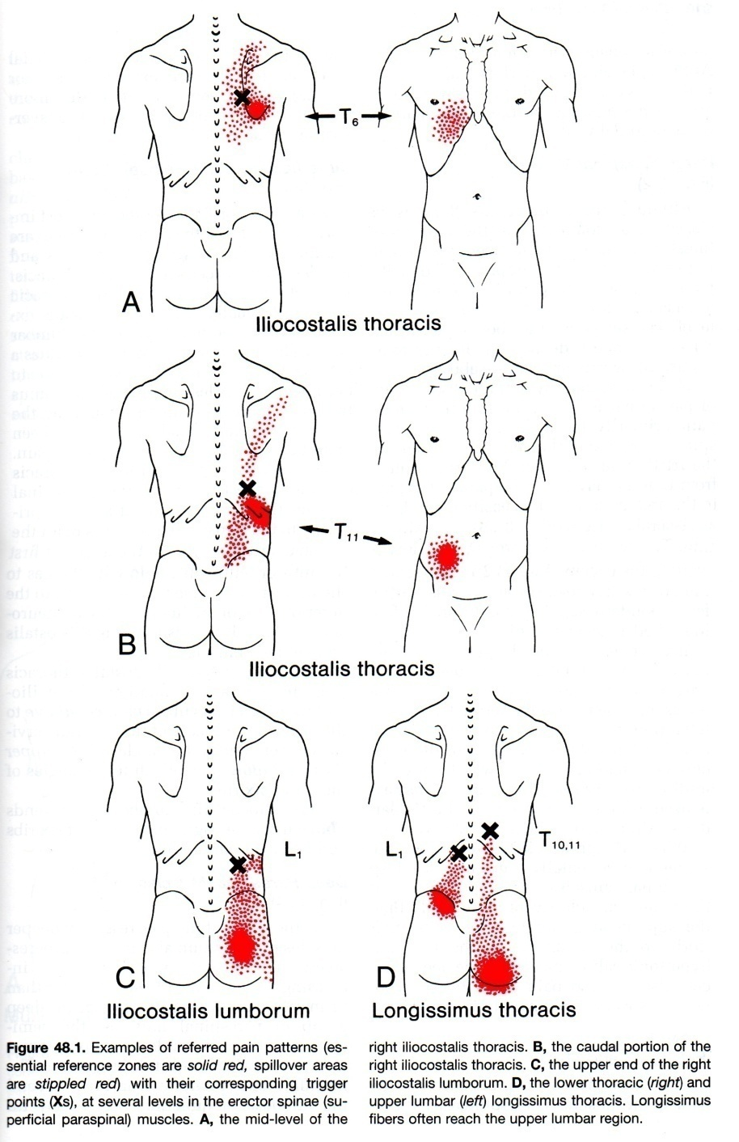

Slide 34
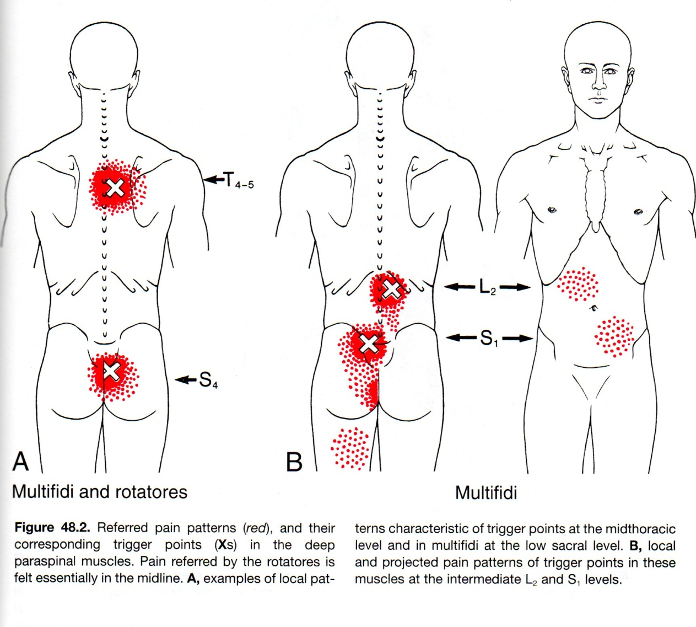
Note the TrPs in the back causing abdominal pain for some. This may be misdiagnosed as IBS, abdominal or pelvic pain of undetermined significance.

Slide 35
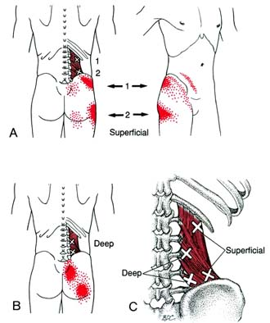
Quadratus Lumborum referred pain can be crippling. It can double somebody over and make it hurt to breathe. Very difficult to examine for this as the muscle is difficult to get to and there are usually other associated activated TrPs in more superficial muscles.

Slide 36
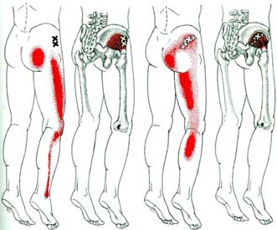
Gluteus Minimus: Doesn’t this make you think radicular?

Slide 37
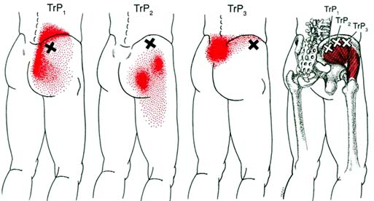
Gluteus Medius – “the lumbago muscle”

Slide 38
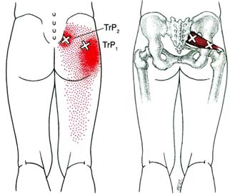
Piriformis: for some people, the sciatic nerve perforates this muscle leading to a greater risk of sciatica when this muscle activates

Slide 39
Treatment: Manual Therapies
Wide variety, including:
Spray and Stretch with Fluorimethane
Massage
Soft tissue mobilization techniques, including post-isometric relaxation (aka “muscle-energy technique”)
PT
OT
Main common mechanisms:
Disruption of trigger point
Physical elongation of muscle fibers
Avoidance of recurrence/precipitating factors

Slide 40
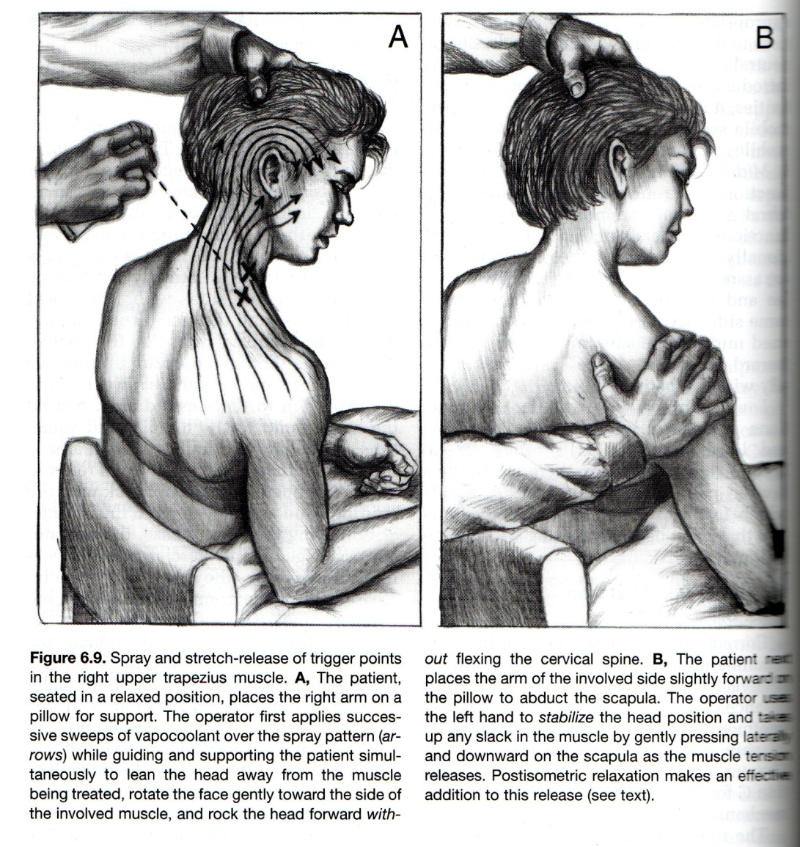
Treatment: Spray and Stretch
Note that in
spraying the
trapezius muscle, the cold spray includes the area of the referred symptoms

Slide 41
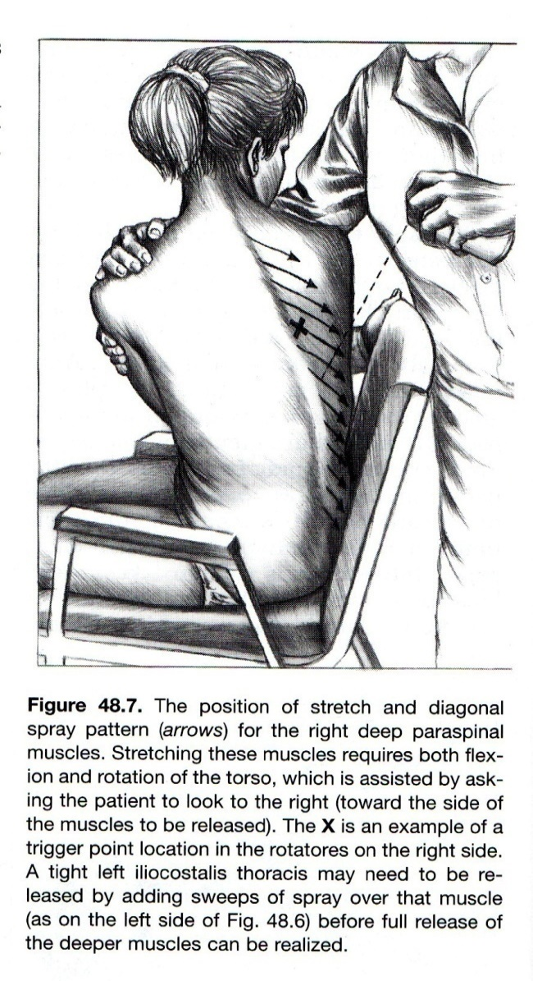
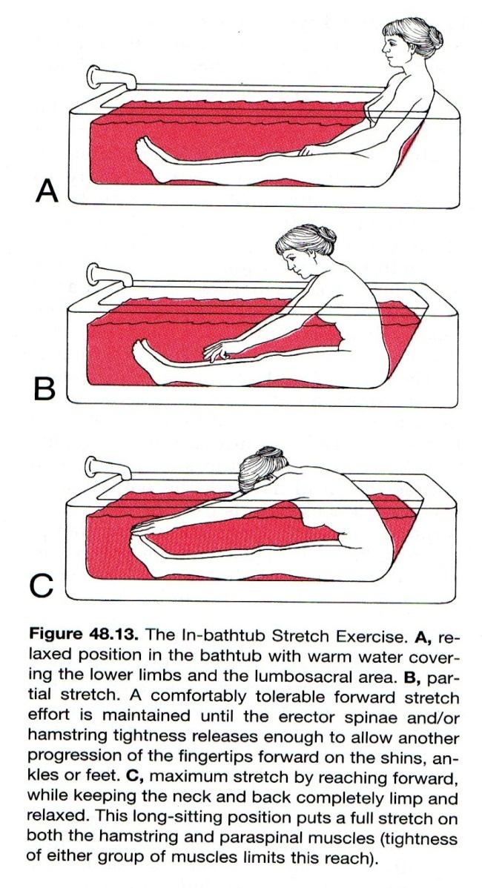

Slide 42
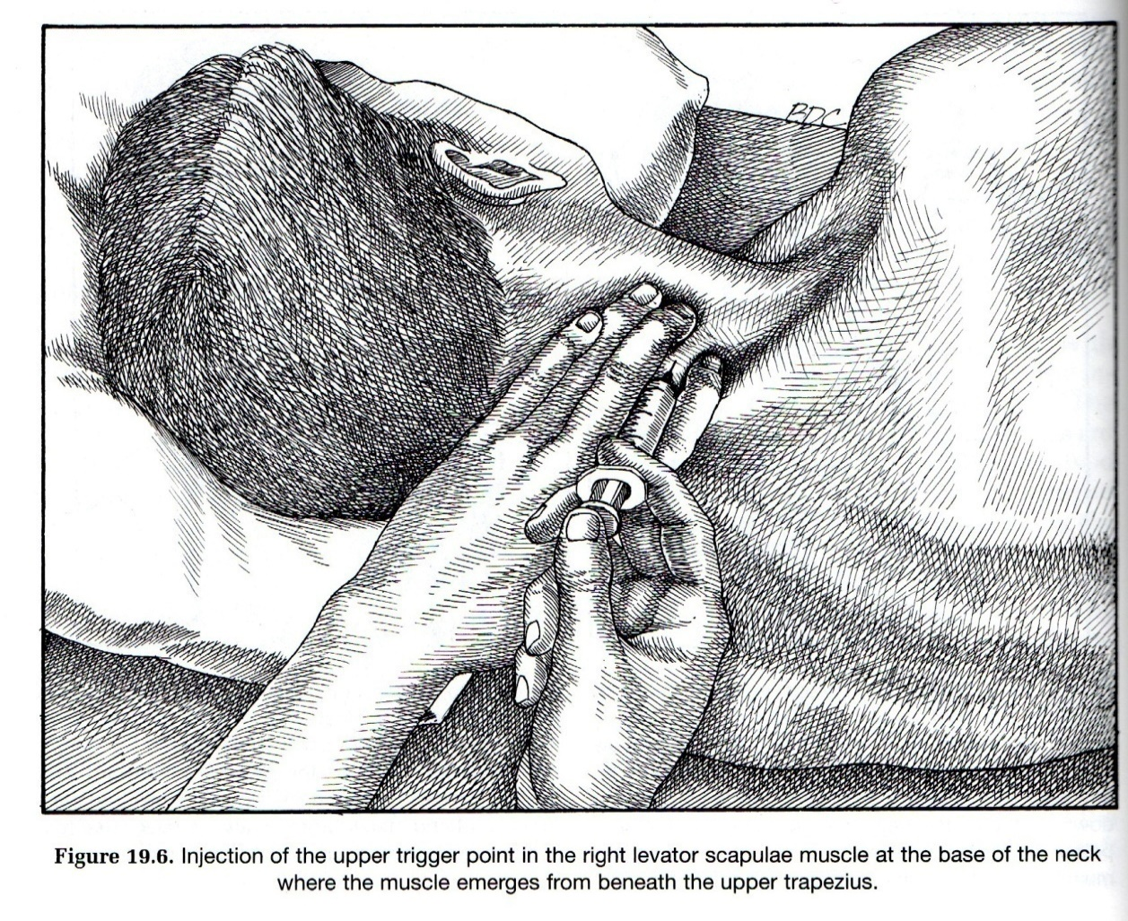
Treatment: Trigger Point Injection (TPI)

Slide 43
TPI
One way to do this:
1% lidocaine, without epinephrine
27 G needle, 1.25” long
3 cc syringe
Inject 0.25-0.50 cc per site
Inject 4-10 sites per session, in same region
First time: just a few

Slide 44
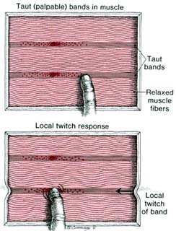
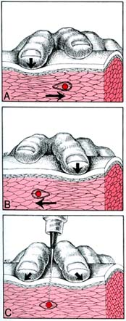

Slide 45
Effect of TPI
Muscular level: TPI often induces a local twitch response (contraction and release), which is what often leads to positive therapeutic outcome.
Mechanical disruption by the needle seems to be the level at which TPI works, since dry needling and anesthetic are both effective in deactivating trigger point (Travell and Simons, vol. 1, p. 152).
The LTR possibly interrupts the dysfunctional spinal and NMJ cycles, as well (Botox works at NMJ).

Slide 46
The Science
There is some.
Trigger points have a high inter-observer reliability (but only with the right observers)
Trigger points can be identified on finely tuned radiographic studies and on micropipelle acidity testing
ncbi.nlm.nih.gov/pmc/articles/PMC4508225/pdf/nihms-695755.pdf

Slide 47
TPI Data
Cummings TM, White AR. Needling therapies in the management of myofascial trigger point pain: a systematic review. Archives of Physical Medicine & Rehabilitation. 2001;82(7):986-992:
Better than placebo
Substance injected not important in therapeutic response, just post-injection soreness

Slide 48
Dry needling: a literature review with implications for clinical practice guidelines
http://www.ncbi.nlm.nih.gov/pmc/articles/PMC4117383/
Effect of acupuncture depth on muscle pain
http://www.biomedcentral.com/content/pdf/1749-8546-6-24.pdf
Superficial versus deep dry needling.
http://www.ncbi.nlm.nih.gov/pubmed/12216605

Slide 49
Uemoto L, Garcia MA, Gouvêa CV, Vilella OV, Alfaya TA. Laser therapy and needling in myofascial trigger point deactivation. J Oral Sci. 2013;55(2):175-81. PubMed PMID: 23748458.
Rocha CB, Sanchez TG. Efficacy of myofascial trigger point deactivation for tinnitus control. Braz J Otorhinolaryngol. 2012 Dec;78(6):21-6. PubMed PMID: 23306563.
Ozkan F, Cakır Özkan N, Erkorkmaz U. Trigger point injection therapy in the management of myofascial temporomandibular pain. Agri. 2011 Jul;23(3):119-25. doi: 10.5505/agri.2011.04796. PubMed PMID: 21935818.
Itoh K, Katsumi Y, Kitakoji H. Trigger point acupuncture treatment of chronic low back pain in elderly patients--a blinded RCT. Acupunct Med. 2004 Dec;22(4):170-7. PubMed PMID: 15628774.

Slide 50
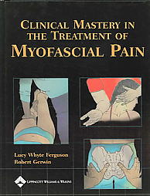
OTHER REFERENCES
Ferguson LW, Gerwin R. Clinical Mastery in the Treatment of Myofascial Pain. Lippincott Williams & Wilkins, 2004.
Alvarez DJ. Trigger Points: Diagnosis and Management. American Family Physician 2002;65(4):653-660.
Simons DG. Myofascial Pain Syndrome Due to Trigger Points. International Rehabilitation Medicine Association, Monograph Series #1, November 1987.
Myers H, Rakel D. Strain and counter-strain manipulation technique. From Rakel D, ed., Integrative Medicine. Philadelphia : Saunders, 2003.

Slide 51
Questions/Answers

