Slide 1
Lab Values in Primary Care Part 2: case-based
Dan Wilensky MD
Chief Preceptor
2022-2023

Slide 2
Disclosure
With respect to the following presentation, there has been no relevant (direct or indirect) financial relationship between the party list above (or spouse/partner) and any for-profit company in the past 24 months which could be considered a conflict of interest.
The views expressed in this presentation are those of the presenter and do not reflect the official policy of CHC, Inc.
I am obligated to disclose any products which are off-label, unlabeled, experimental, and/or investigation (not FDA approved) and any limitations on the information that I present, such as data that are preliminary or that represent ongoing research, interim analyses, and/or unsupported opinion.

Slide 3
Learning objectives
Learn to order and interpret lab values in the clinical context.
Review common lab abnormalities
Review the use of labs used when considering differential diagnoses that may be less common

Slide 4
The Rules of ordering and interpreting labs
There really aren’t any.
Labs mean little without clinical correlation.
Be mindful of what you order/ order tests for a reason.
The lower the pretest probability, the higher the chance that a positive test is a false positive or is unrelated.

Slide 6
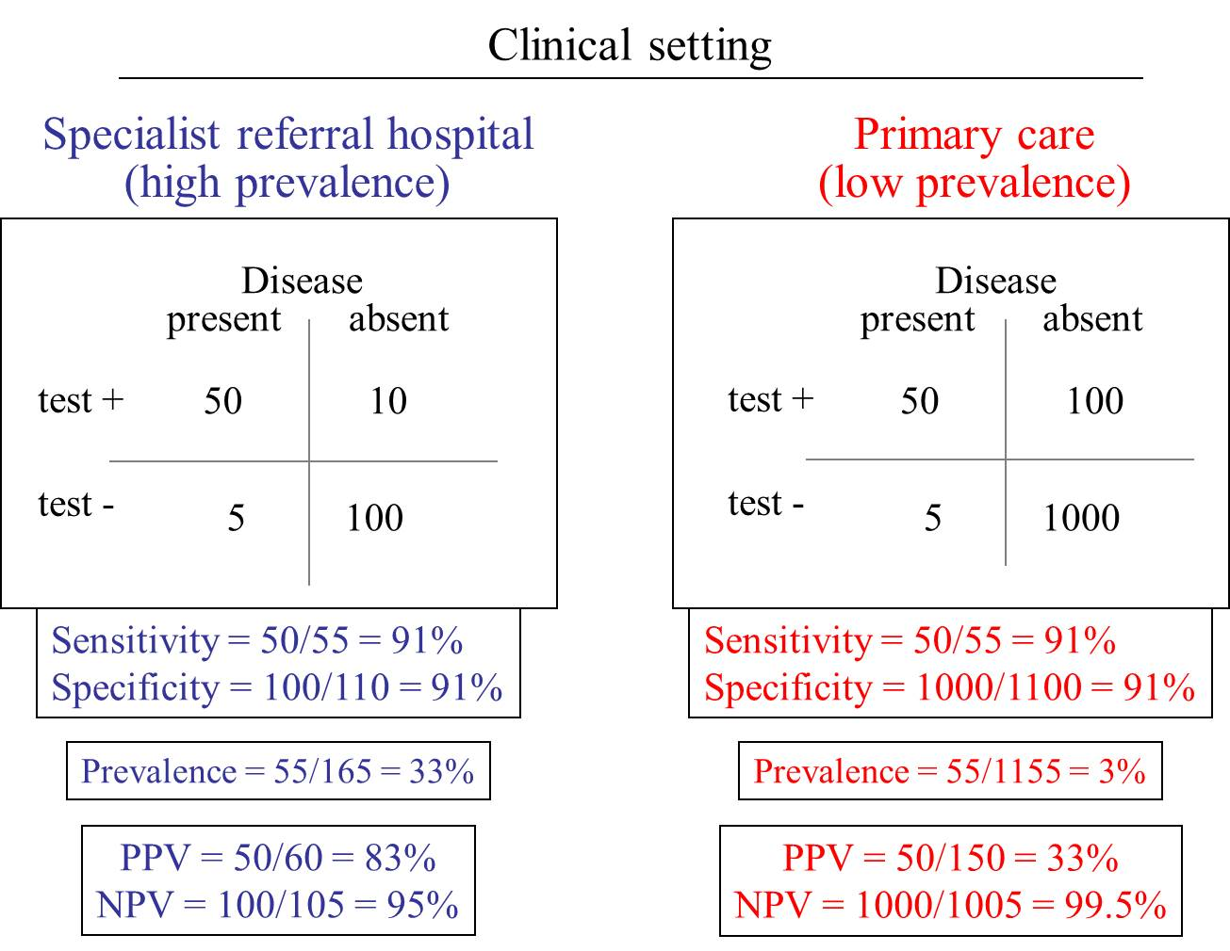
How Pretest Probability (prevalence in this example) makes the same test more or less useful

Slide 7
Wilensky disease
Wilensky disease is a horrible, fatal condition that effects 1 in 10 billion people worldwide
Wilensky Corporation has created an excellent test to screen for Wilensky disease, and plans to sell it for only $9.99 each.
The sensitivity and specificity are both excellent, 99%
What is the positive predictive value of a positive Wilensky test?
Answer: 0.00001% (i.e.99.99999% of positive results will be false positive). If we test 1 billion patients, we will find 10 million positives and find 0.1 case of Wilensky disease

Slide 8
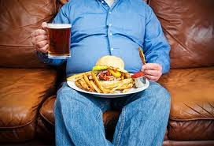
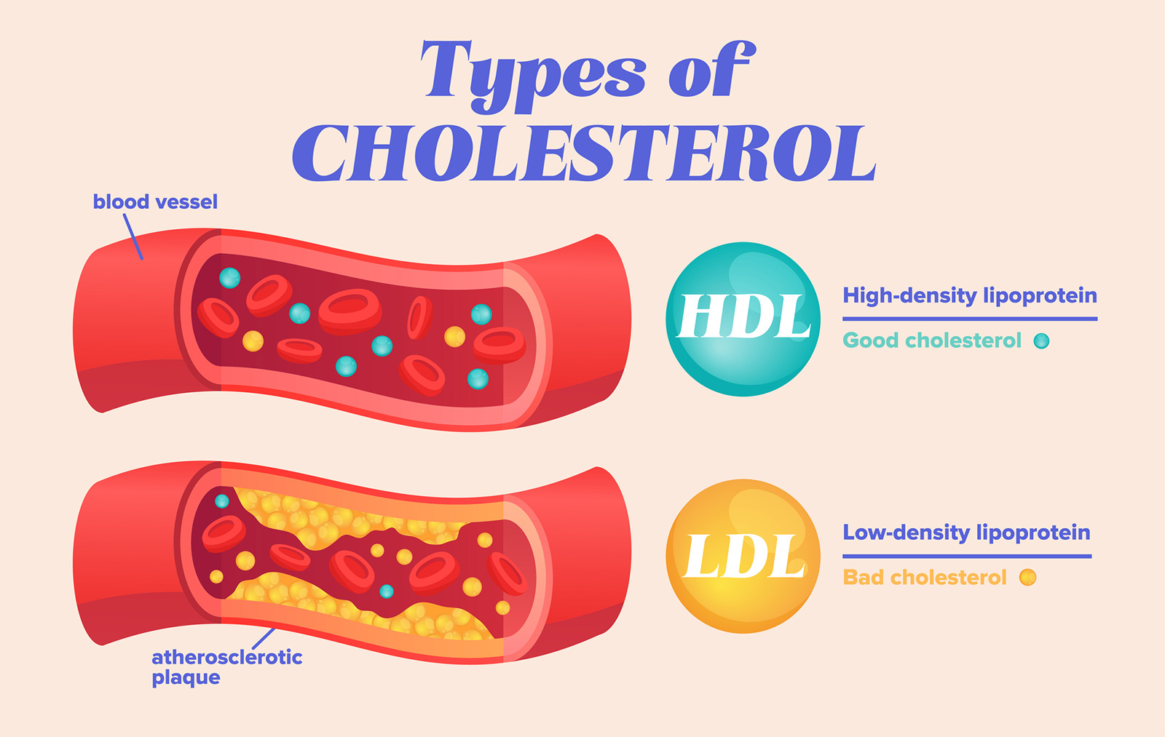
Lipid stuff

Slide 9
Lipid issues
A 63 year old male heavy smoker with diabetes (A1c: 9), poorly controlled HTN, possible CAD (had a modestly positive stress test for exertional chest pain and decision was made to manage medically without cath when he no-showed for cardiology visit and was feeling somewhat better)

Slide 10
Total Cholesterol: 169
TG: 480
HDL: 40
LDL: na
Current Lipid med: Tricor: 148mg
What do we think? What do we do?

Slide 11
Please choose your action
A: No action. Patient is at goal
B: Initiate statin, which should have been standard initial med, not fibrate
C: Refer
D: Add a cardio CRP

Slide 12
My pet peeve
Don’t order a direct LDL or a reflex direct LDL
It will incorrectly reassure you that all is well
It is expensive
The calculated LDL is what is used
This patient’s direct LDL is 59….are you happy now?
The non HDL Cholesterol is a much better reflection of CV risk and doesn’t cost anything
Welsh C et al Comparison of conventional lipoprotein tests and apoliproteins in the prediction of cardiovascular disease Circulation 2019 Jun 20
Boekholdt SM et al. Association of LDL cholesterol, hon-HDL-cholesterol and apolipoprotein B levels with risk of cardiovascular events among patients treated with statins; a meta-analysis JAMA 2012 Mar 29; 307:1302

Slide 13
Reminder of non HDL Cholesterol
Non-HDL-Cholesterol =Total Cholesterol – HDL [169 – 40 = 129]
The LDL equivalent is 30 points less: [99]
Calculated LDL = Tchol – HDL – [TG/5]
FYI: TG/5 is the estimation for VLDL
Therefore LDL = non-HDL-Chol –[TG/5]
Normal TG is <150
150/5 = 30
Therefore, by convention, the LDL equivalent of the n-HDL-C is 30 points lower

Slide 14
Uh oh….getting complicated
They are replacing the Friedewald LDL calculation
Good thing for computers
https://www.ncbi.nlm.nih.gov/pmc/articles/PMC7240357/

Slide 15
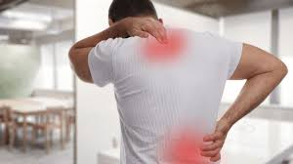
You correctly started a statin
This patient then calls your nurse in 2 weeks saying “that medication made me sick. I hurt all over and I can’t sleep. I’m going to stop it”

Slide 16
Please choose your action
A: Continue the medication. Benefit outweighs the risk
B: Decrease the statin by 50%
C: Check a CK and then hold the statin
D: See immediately. This is not related to the new medication

Slide 17
T.Chol: 102
TG: 370
HDL: 38
LDL:10
CK: 60
What do you do now? ---volunteers?

Slide 18
What medication would be best?
30 yo man in to f/u injuries from a fight. He hasn’t had medical care, so you order Lipids
T.Chol: 168, TGs: 600, HDL:63
A: Rosuvastatin 20 mg
B: Acamprosate 333 mg 2 tabs TID
C: Fenofibrate 145 mg
D: Lovaza 1 gram 4 caps daily
When the TGs are high, low HDL suggests metabolic syndrome, high suggests alcohol

Slide 19
Some assorted labs

Slide 20
Patient is a 22 year old female coming in for routine annual CPE. No concerns. Physical exam normal
Normal labs include: Comp metabolic panel, HIV, A1c, RPR, GC/Chlam, vitamin D, Lipids, and Urinalysis
CBC shows MCHC: 31.5 [nl 32-36]
TSH: 4.6 [nl: 0.4-4.5], reflex free T4: 1.1 [nl: 0.9-1.4]
Chronic Hepatitis Panel: HCV neg, HBV SAg neg, HBV SAb Positive, HAV total: neg

Slide 21
Please choose your action
A: Do nothing. Meh. Stop ordering so many tests
B: Order I-131 thyroid uptake and scan
C: Send for MCHC Transfusion, STAT
D: Refer

Slide 22
CBC (Complete Blood Count)

Slide 23
83 yo male pt. w/ DM, HTN, CKD 3b, hyperlipidemia who’s in for routine visit stating he’s fine and “every day above ground is a blessing”.
CBC done routinely for CKD
WBC: 7.4 [nl 3.8-10.8 Thousand/uL]
Hgb: 12.6 [nl 13.2-17.1 g/dL]
Hct: 37.3 [nl 38.5-50 %]
MCV: 87.9 [nl 80-100 fL]
RDW and PLT normal
Last H&H (15 months prior): 13.6/41.2
Your thoughts?/ Actions?
Pretty good. Recheck in 6-12 months

Slide 24
High WBC in sick child
11 y.o. girl with fevers for 2 days, dysuria, and needing to pee every few minutes.
In office, temp 102, mildly ill appearing, equivocal CVAT
Urine dip: 4+ LE, Pos Nitrites sg:1.015, Ketones: neg
You consider sending her to the ED, but she seems well compensated. What are you going to do?
CBC and Urine culture sent
Rocephin IM 50 mg/kg given in office and sent home with Bactrim po.

Slide 25
The next day
Urine: >100K Gram Neg Rods
WBC: 25,000 with 80% granulocytes, 20% Bands, 3% Metamyelocytes.
PLT: 600K
What do you think? What would you do?
Leukemoid reaction vs. Leukemia
Call her. How’s she doing?
“She went to school today and I haven’t heard anything”
Repeat CBC in a few weeks: Completely normal

Slide 26
Look for hints
New patient w/o records for acute visit. 37 y.o. female school teacher with Crohn’s disease on 6MP, her only med. She’s had a couple of weeks of swelling of the knuckles of her fingers and toes and now she’s feeling exhausted and drained. ROS is + for a rash she had a month ago
Vitals normal x HR: 105. Your exam confirms mild synovitis of fingers/toes and you note her to be pale. No splenomegaly. O/w seems fine
You obtain labs, which return the next morning

Slide 27
Achy, pale teacher on 6MP
Normal/Neg: RF, ANA, ESR, TSH, vit B12, Comp.
CBC:
Low H&H: 8/28, nl MCV, RDW
Low WBC: 2,500 [nl 4.5-11.5k]
All WBC forms down
PLT: Low: 85
What do you do?
A: Call her and send her to the ER
B: Call her and tell her to stop the 6-MP
C: Nothing. These are fine for somebody on this med
D: Call the lab right away to add on orders

Slide 28
Fax from lab in afternoon
Peripheral smear (manual diff)
confirms moderate pancytopenia.
No abnormal morphologies, blasts, etc.
Reticulocyte count
Zilch
You call her to find out how she’s doing and ask f/u ?
“I’m not sure if this is important, but I just found out about something at work. Lots of kids had really red faces and runny noses. They told my colleague who’s pregnant but they didn’t call me….Do you think all this could be……..?”
Not too late to add more labs…what do you want?

Slide 29
Fifth’s disease is weird in adults
Parvovirus B-19 serology
Negative IgG
Strongly positive IgM
Can appear like RA and even lead to chronicity
Can lead to severe anemia and pancytopenia
Most people with this problem have underlying hematological abnormality (e.g. Sickle Cell) or immune compromise (e.g. on 6-MP)
Only the kids get the “slapped cheek” rash, but all can get a lattice-like rash
1 week later: All cell lines rising and Reticulocyte count is 2x upper limit of normal

Slide 30
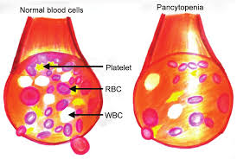
Pancytopenia causes
Bone Marrow infiltration/replacement
Malignant (e.g. leukemias)
Non-malignant
Bone marrow failure
Immune destruction/suppression
Nutritional
Marrow suppression
Ineffective hematopoiesis
Destruction/sequestration/redistribution
Consumption
Splenomegaly

Slide 31
Anemia
56 yo female pt. w/ DM, CAD, CHF w/ EF 35% presents feeling run down and some SOB for a month
Exam is OK except for pale sclera and pulse: 110
Labs come back late afternoon.
H&H: 6.5/22, RDW: 25, MCV: 69

Slide 32
Please choose your action
A: Arrange IV Iron at infusion center
B: Likely iron deficiency anemia. Send to ED for consideration of transfusion, work-up, probable admission
C: Likely anemia of chronic disease. Perform work-up for rheumatologic and neoplastic disease
D: Repeat CBC with reticulocyte count tomorrow to assure stability and good bone marrow response

Slide 33
Another case
22 y.o. female pt. for an Immigration physical.
Just came from a refugee camp where she had to carry water from a lake for 4 miles uphill every day
Has never seen a doctor. Has no complaints. Exam is normal except for pale sclera and a 3/6 SEM
H&H: 6/19, MCV:68, RDW:25
Diagnosis?/Actions? --volunteers
Probable iron deficiency anemia, compensated, without CV risk
Call to add iron stores and rx. p.o. iron
Follow closely and w/u for sources of blood loss (including parasitic)

Slide 34
More CBC discussion will be in the Hematology didactic, which I also give

Slide 35
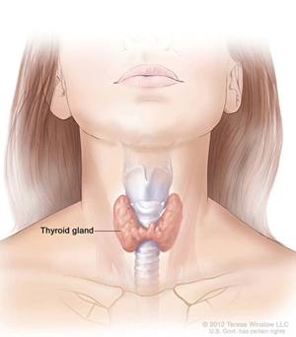
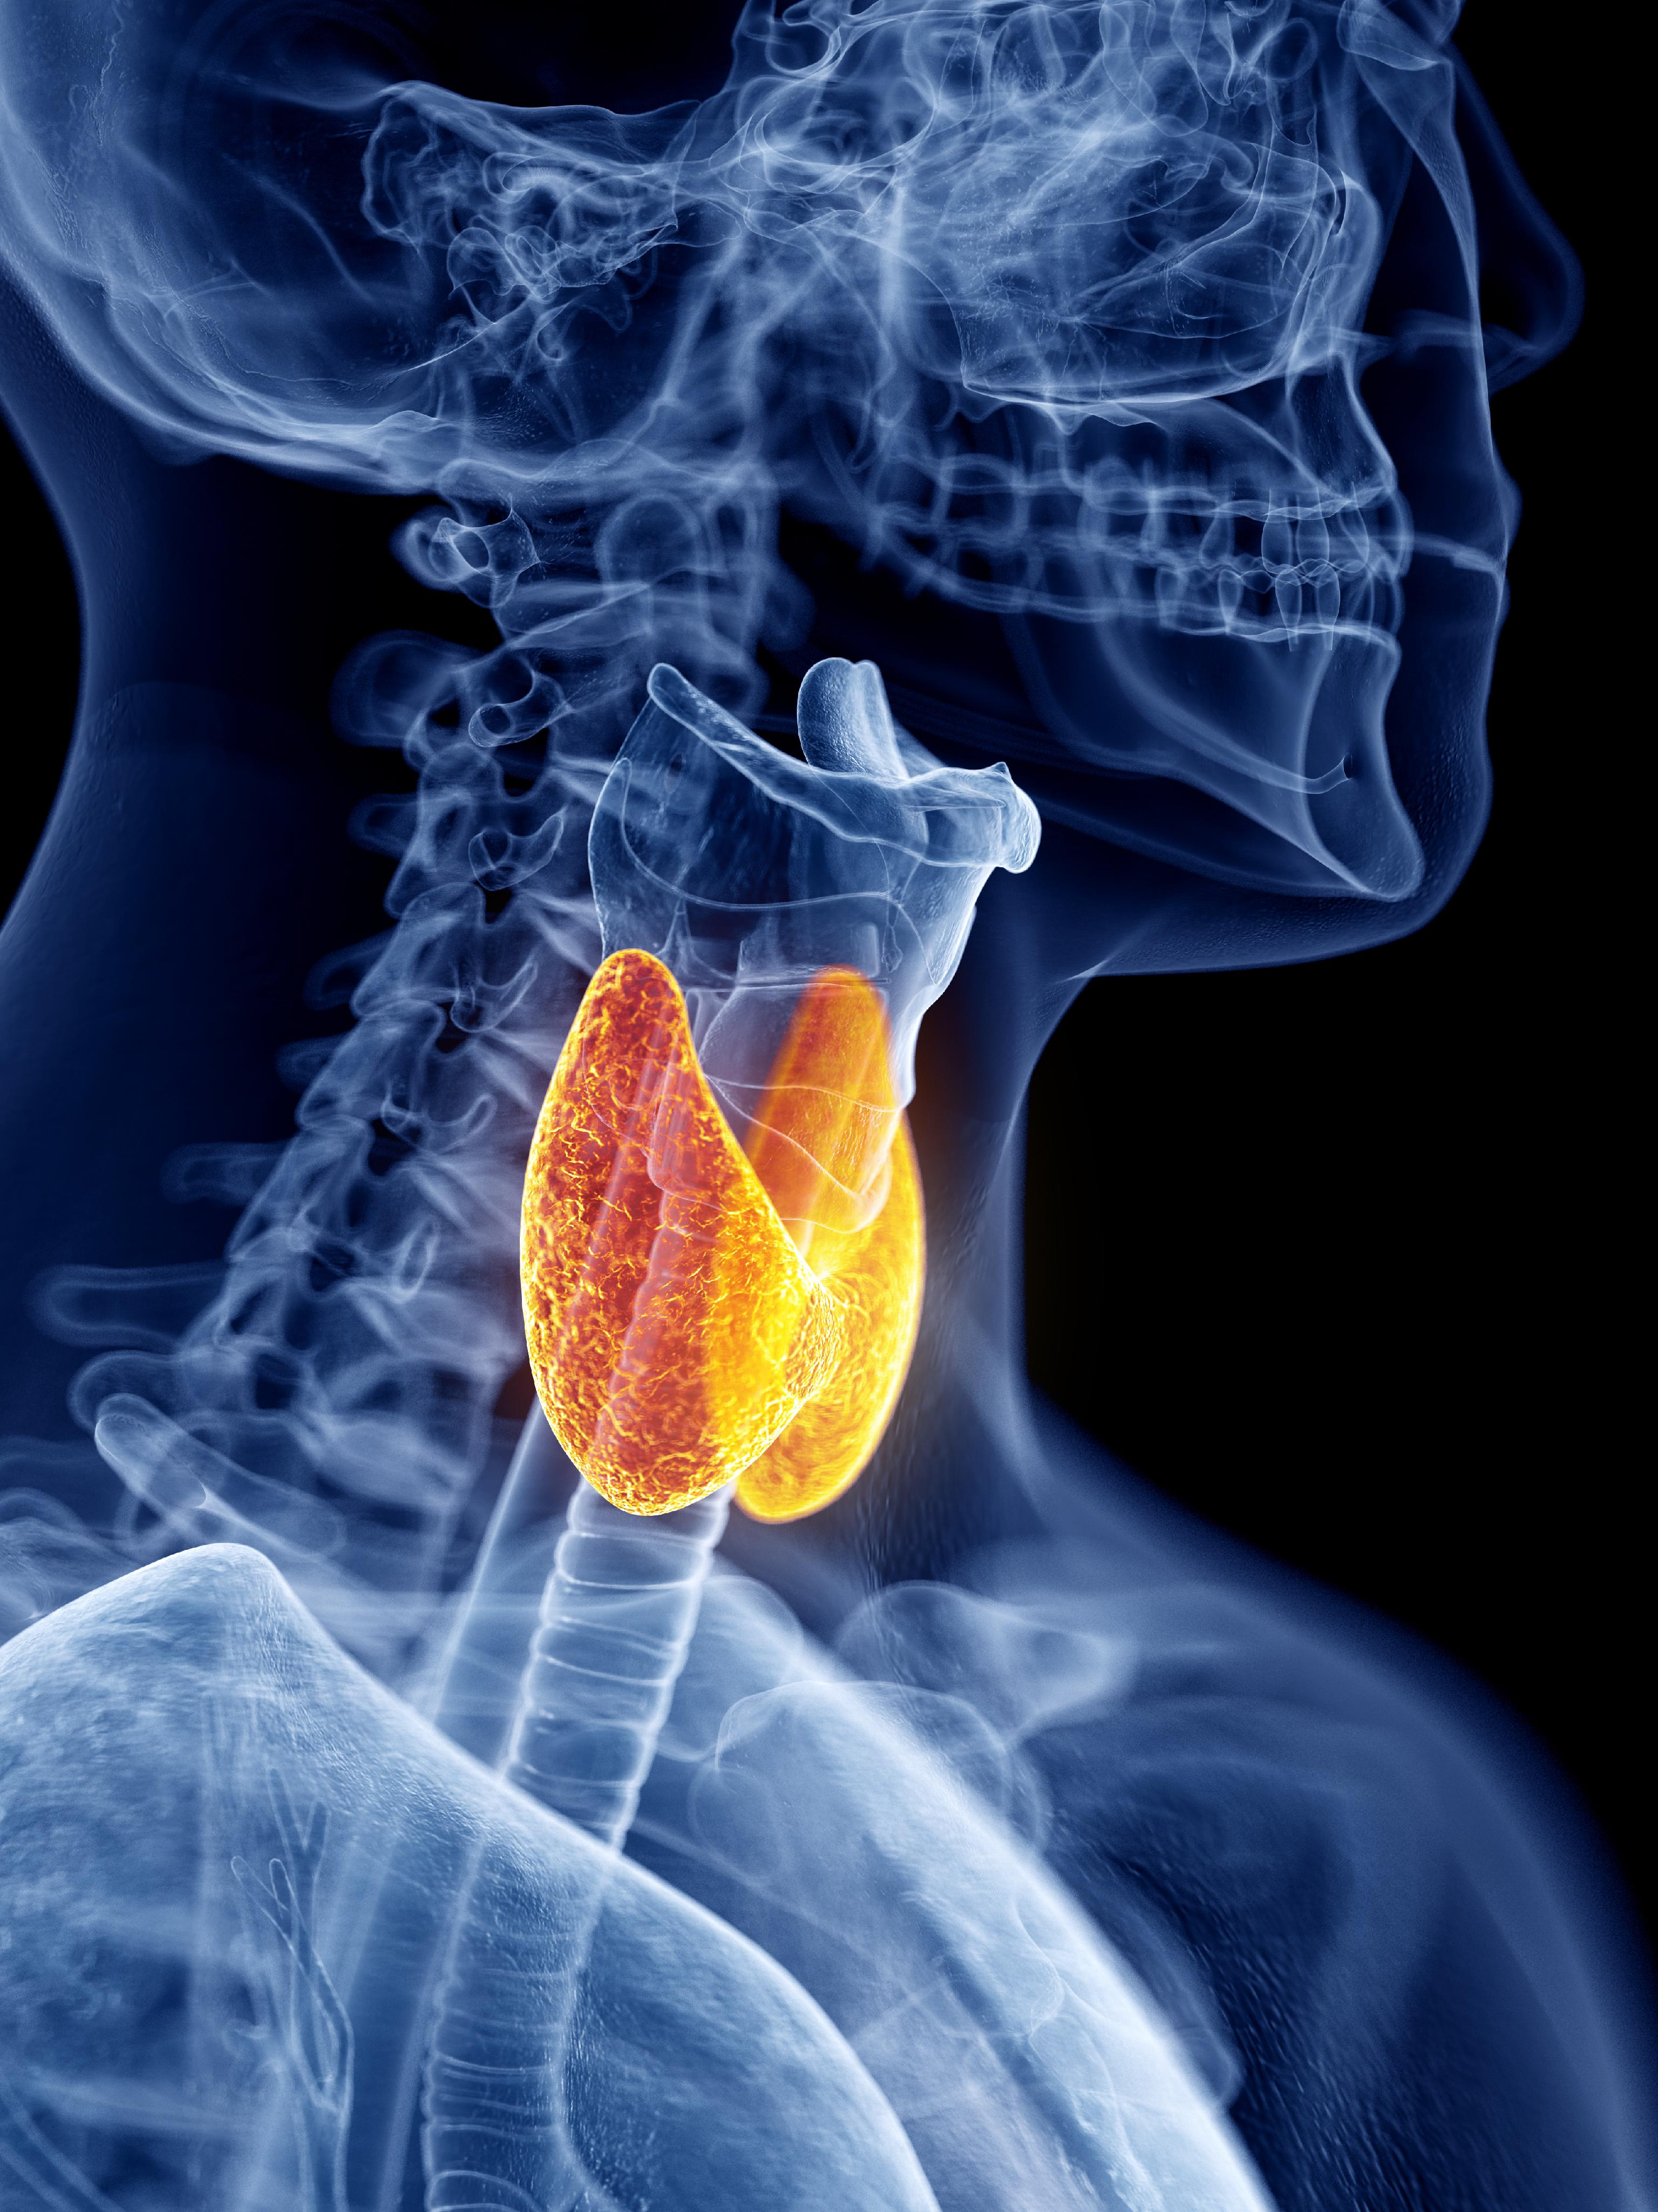
Thyroid Tests

Slide 36
22 year old female with 12 # weight gain over the last 4 months despite going to the gym and eating salads. LMP 3 months ago and before that it had been irregular. Skin has become dry and she’s been feeling colder than her friends.
TSH: 5.6, free T4: 1.1
HCG: neg
What do you think? Action? ---volunteer?

Slide 37
Mild (Subclinical) Hypothyroidism
When to begin replacement is controversial
Normal TSH is actually 0.5-2.9 (once patients with auto-antibodies are removed from the Bell curve)
“There’s a movement to start treatment in the high single digits”
Consider replace at TSH of 2.5 when treating female infertility
Source: Dr. Oberstein presentation ConferMED ECHO
We often start meds when TSH>=10 or + auto-antibodies
700+ pts >=65 yo w/ TSH: 4.6-20 ---- no clinical benefit from replacement
Scott DJ et al NEJM 2017 Apr 3

Slide 38
Random thyroid issues
Biotin intake can alter the TFTs substantially
Lots of people take substantial amounts of Biotin (hair/nails)
Hold it for at least 3 days prior to drawing.
Biotin also messes w/ PTH
Adherence issue solution
Levothyroxine has a 1 week half life
Fill a pill box every week
Take a pill every day
At the end of the week, take all left over pills together
Go up by nearly 15%? “Just take an extra pill every Sunday”.
Treating in pregnancy is beyond the scope of this didactic
Just know you’ve got to look it up
Substantial changes with each trimester

Slide 39
22 year old woman with morbid obesity that developed after her child was born 3 years ago. She’s been trying to conceive for over a year w/o success. She’s feeling sluggish and depressed She appreciates a fullness in her neck and she is constipated
TSH: 35, reflex T4: 0.5 [nl 0.9-1.4]
What do you think? Actions? ---volunteer?

Slide 40
She is now 39 and on 125 mcg/day with rock steady TSH for years. She has been getting depressed for 6 months and gaining lots of weight. 3 weeks ago, her husband told her he wants a divorce. She is distraught. She thinks the meds have stopped working
TSH: 1.5
Free T4: 2.5 [nl 0.9-1.4]
What do you think is happening? – volunteer?

Slide 41
What you can do in primary care: a patient of mine
1/2010: Pt. is a 9 year old brought in for lack of attention in class and a lump in his neck
Exam showed a smooth, symmetric goiter, about 4 times normal size without bruits. No tremor. DTRs fine
I ordered some labs
TSH: 0.01
Free T4: 5.2 [nl 0.9-1.4]
TSI (Thyroid Stimulating Immunoglobulin): 395 [nl<140%]

Slide 42
Graves Disease diagnosis made, I-131 uptake/scan deferred, Methimazole begun and Ophtho referral made.
TSH and T4 normalized. Mild Graves Ophthalmopathy per Ophtho (asymptomatic)
Now TRAB are often favored over TSI
Both are very specific for Graves’, but TRAB is more sensitive

Slide 44
Age 19
Years of getting lost to f/u, needing years of reminding to get labs, and consistent hyperthyroidism secondary to poor adherence
Treated with I-131 ablation
Never got his f/u labs after ablation
Multiple phone calls and letters.
Oh well.

Slide 45
56 y.o. woman w/ FH of thyroid dz whose sister recommended she get tested.
Gland minimally enlarged and somewhat firm. No nodules. Clinically euthyroid.
TSH: 0.28 [nl 0.45-4.5]
Free T4: 1.2 [0.9- 1.4]

Slide 46
Please choose diagnosis/action
A: Mild hyperthyroidism (the condition formerly know as subclinical hyperthyroidism)/follow review of systems and TFTs
B: Check a total T3 to rule out T3 toxicosis
C: No imaging, no treatment unless worsens
D: All of the above

Slide 47
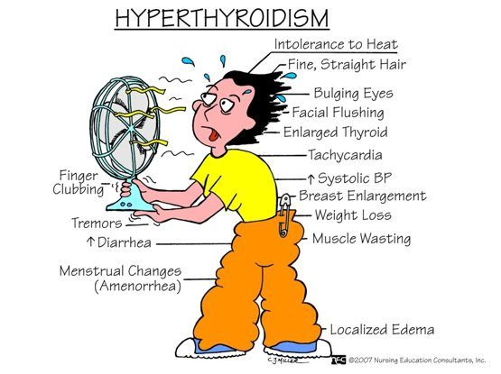
Follow up
7 years later, she comes in for palpitations and some loose stools.
A.Fib with V.Response of 85 noted.
TSH: 0.05
Free T4: 1.4 [nl 0.9-1.4]
Total T3: high normal.
Thoughts?/Actions? -- volunteer?

Slide 48
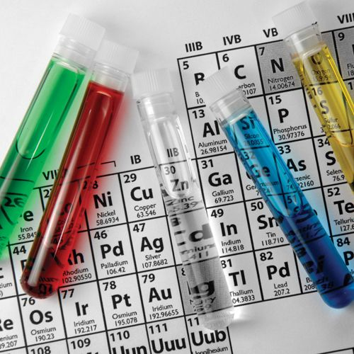
Chemistry Studies

Slide 49
Renal insufficiency
68 year old male with longstanding DM, HTN, obesity, microalbuminuria w/ GFR always over 60
Routine 3 month f/u, doing well. Trace edema
Meds: Lisinopril/HCTZ 20/25 mg, Metformin 1000 mg BID, Meloxicam prn.

Slide 50
Lab results come in 3 weeks later:
GFR:56 (you confirm using MDRD on your smartphone and get 55)
U. Microalbumin/creat: 400 (last one was 200)
A1c: 7.9
LDL<100, Comp o/w unremarkable.
What do you think? What do you do? –volunteer?

Slide 51
A more urgent case
52 yo female pt w/ HTN and hyperlipidemia (Only meds: Atorvastatin 80 mg and HCTZ) presents with 1 month of progressively increasing peripheral edema, weakness, dark urine, and back pain that is sometimes very severe. Also, some diffuse cramping
Vitals are OK x for a pulse of 95. equivocal CVAT. Seems tired and groans when standing up, but not really ill appearing
Urine dip: sg>1.030, 3+ blood
Further labs ordered

Slide 52
Creatinine: 3.2 (last one was normal)
BUN: 32
Urine micro: No RBCs, No WBCs, casts noted that are described as “redish gold”
Any other test we need?
What do you think is happening?
What do you think of the hematuria? ---volunteer?

Slide 53
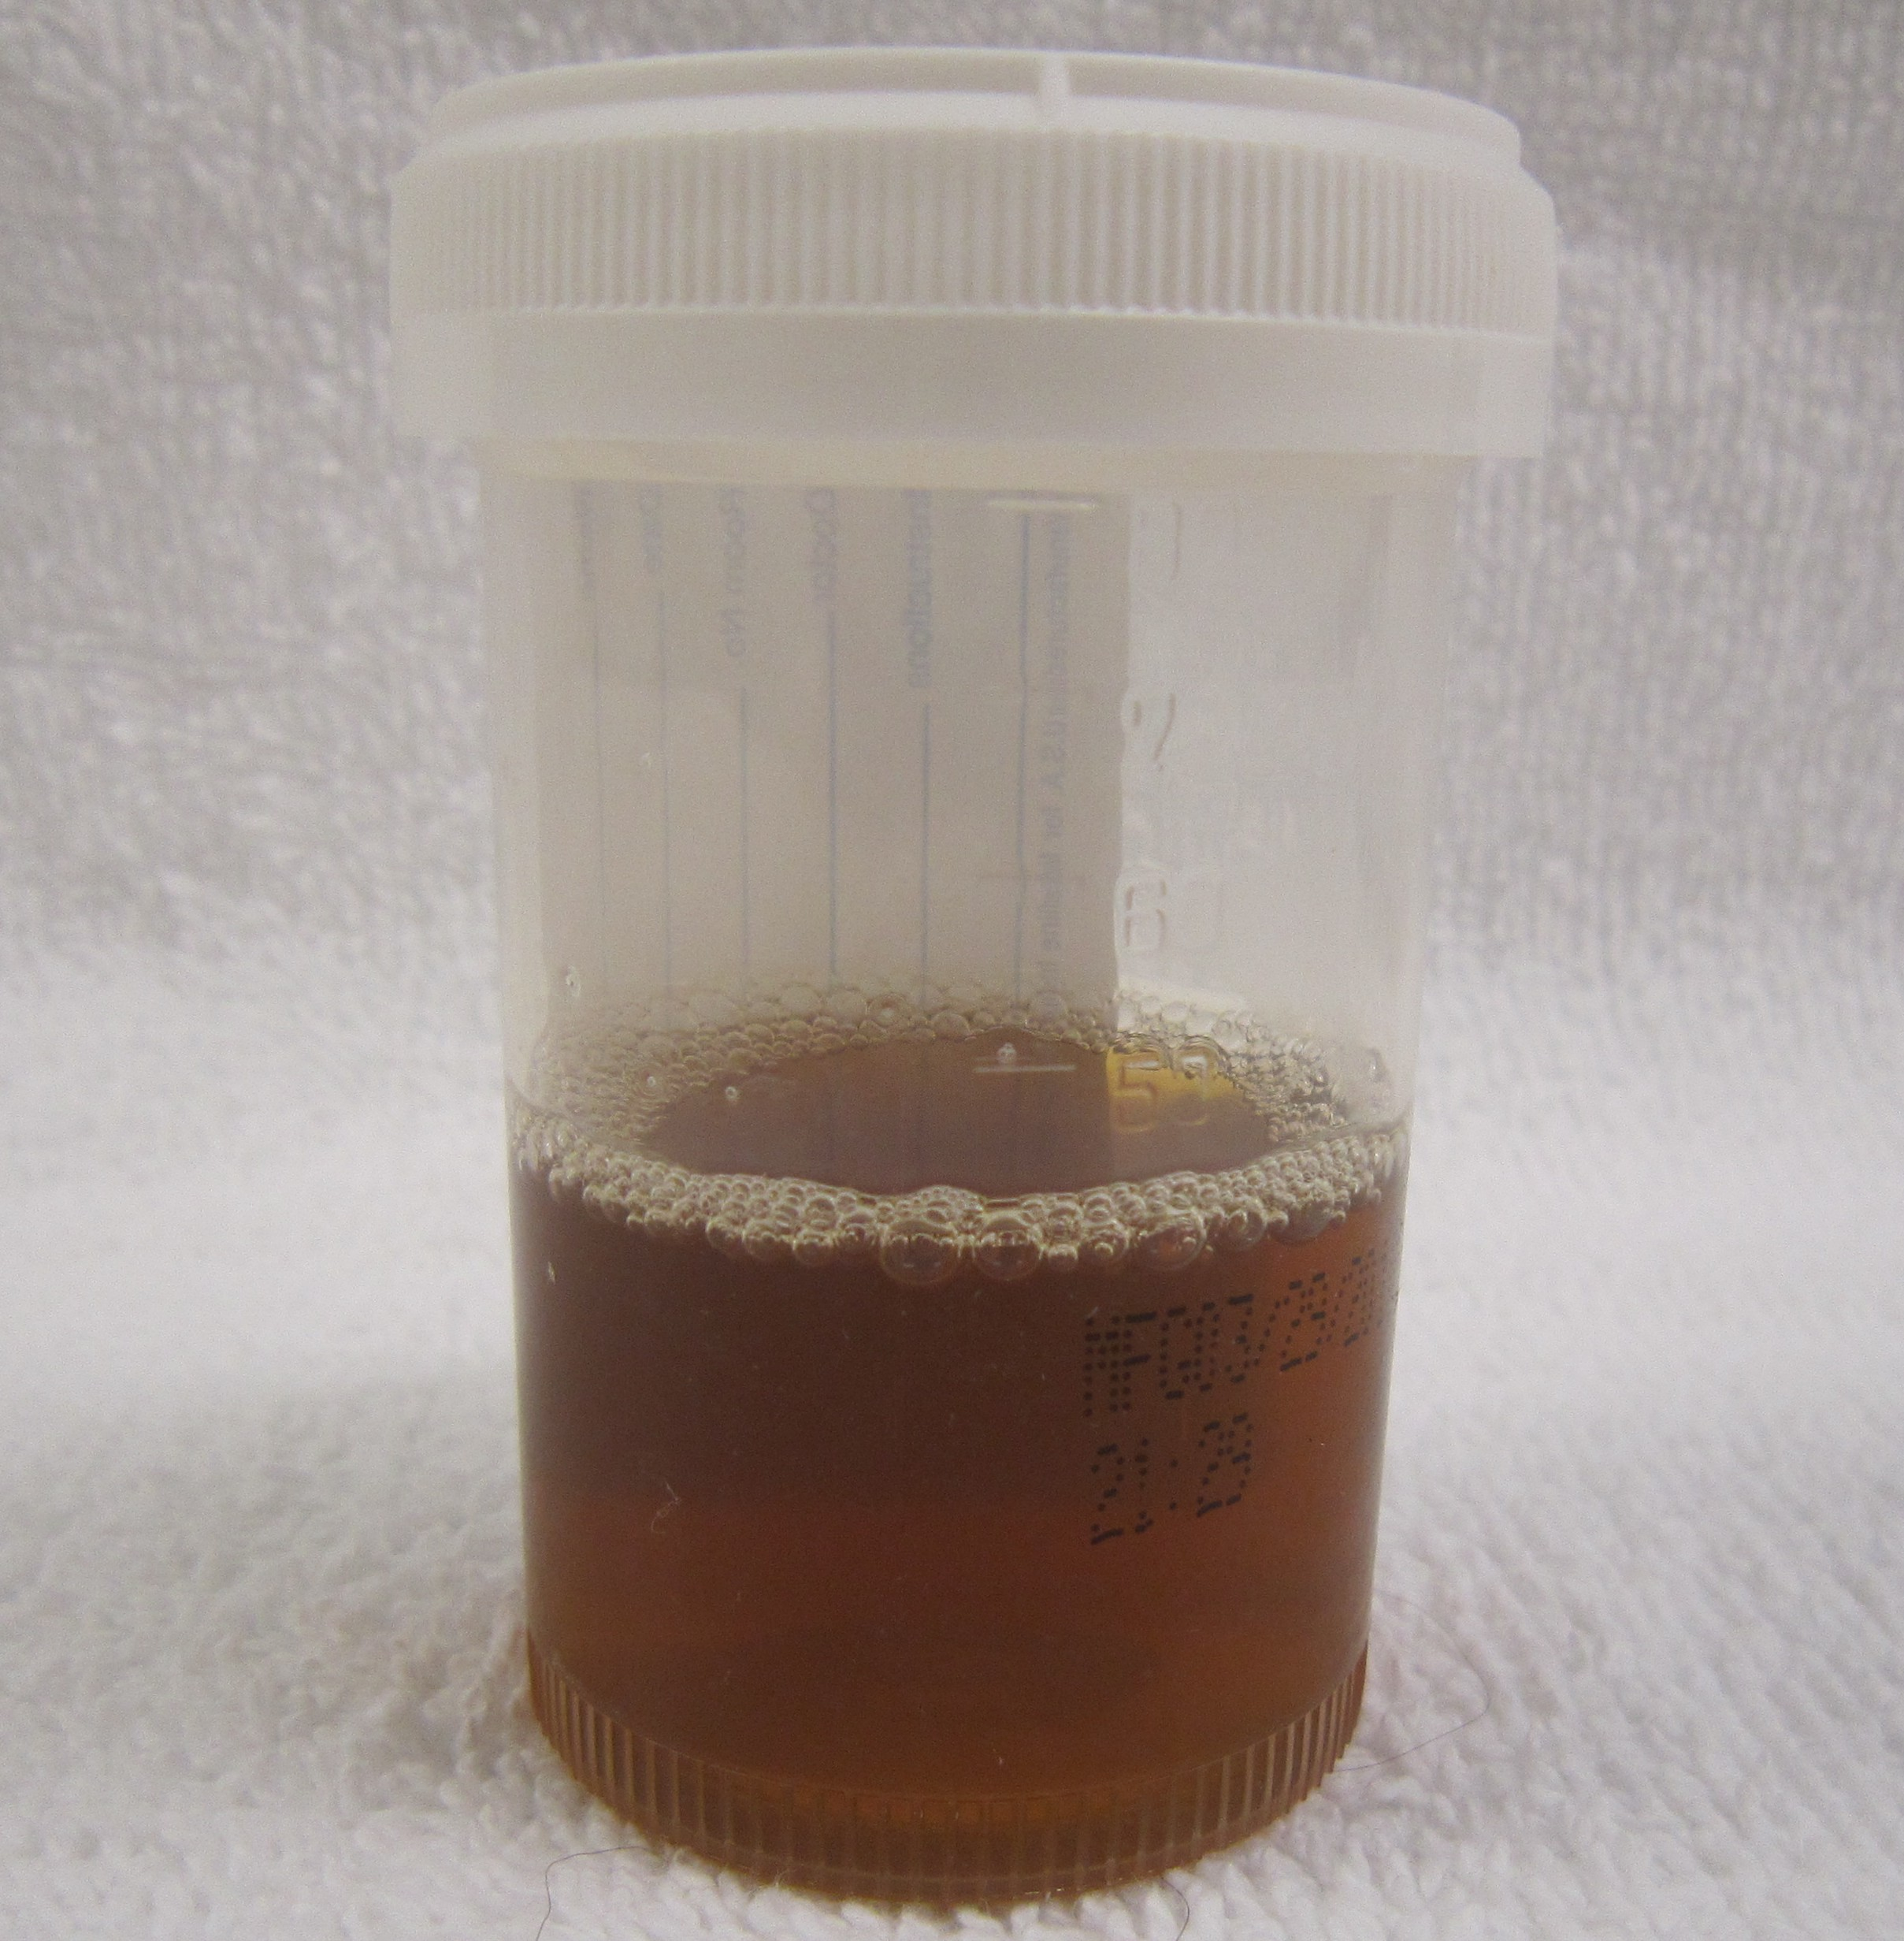
You order a CK level. It’s not back the next day and you have the MA call.
She is told, “for levels over 50,000, we have to send to an outside lab”
Diagnosis? Volunteer?/chat it out?
Statin induced rhabdomyolysis

Slide 54
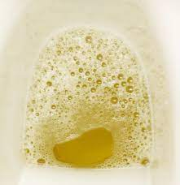
What does he have?
A 42 y.o. male w/o major medical problems presents with 3 weeks of progressive edema up his legs, foamy urine, now feeling his belly swollen. Tired.
Cholesterol: 672
Albumin 1.9
Urine dip: 4+ protein.
Spot protein/creatinine ratio: 6.2 gram/mg creat.

Slide 55
Please choose the diagnosis
A: pseudoproteinuria due to excessive licorice ingestion
B: Primary hypercholesterolemia with secondary complications
C: Nephrotic syndrome
D: Kwashiorkor

Slide 56
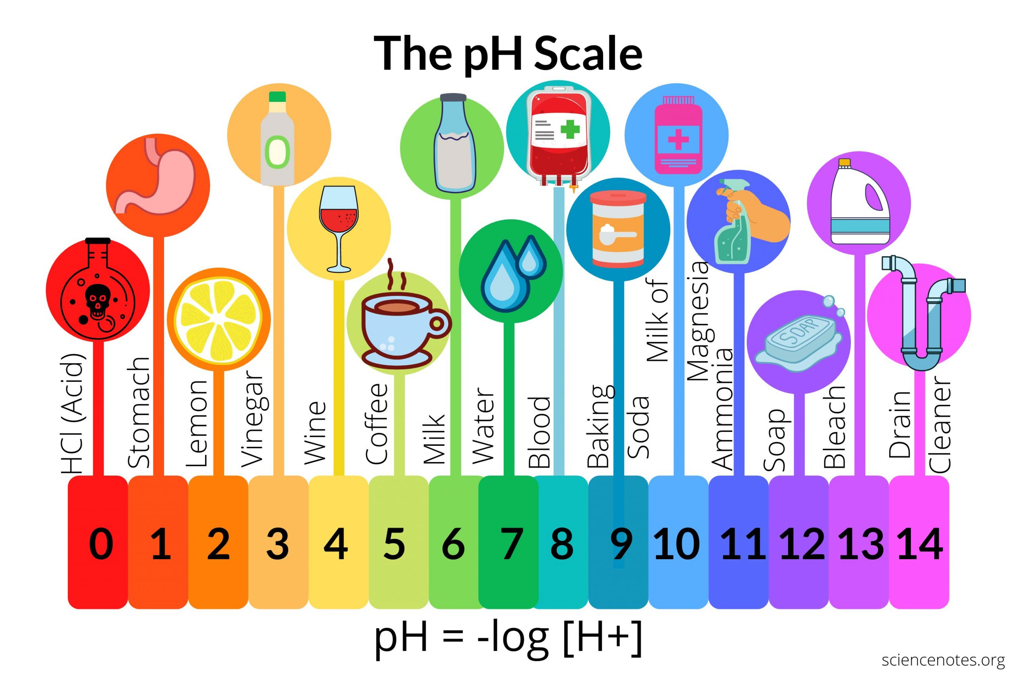
Bicarb, Acid-Base issues, Anion Gap

Slide 57
Bicarb [HCO3(-)]
72 year old man with ischemic CHF and Diabetes
Seemed pretty stable yesterday on an ACEi, Beta Blocker, ASA, Lasix, oral nitrates
You get labs results today
Sodium:139, Bicarb (“Carbon Dioxide”) 36 [nl:19-30 mmol/L], Chloride: 91 [nl:98-110]
Is the anion gap normal?
Ideas? Go back to the note…what are you looking for?

Slide 58
His AG is normal
Anion gap = Na - [ Bicarb + Chloride]
i.e. = Cation minus Anion
(K+ ignored here, but there’s a different normal if you use potassium in the calculation)
Normal = 12 mmol/dL +/-2
139-[89+36] = 12 mEq/L
OK, now why does he have this high bicarb?

Slide 59
“Contraction Alkalosis”:
Diuretic causes vascular contraction and excretion of chloride, so bicarb rises.
Had his weight trended down?
Skin turgor?
Urine output change?
BP on the low side?
Absence of edema?

Slide 60
Compensatory metabolic Alkalosis
*Primary issue is patient is retaining Carbon Dioxide secondary to chronic respiratory compromise.
*Carbon Dioxide is an acid=primary respiratory acidosis
*Chronically, the kidney correctly corrects by retaining bicarb (the biochemistry is more complicated and more than I can explain)
What was the respiratory rate?, the pulse ox? Is he a known “retainer”

Slide 61
Why is Acid Base stuff so confusing in the office?
First step is to know the pH.
That requires an ABG (Arterial Blood Gas) or VBG
We don’t have ready access to this in the office
ABG is painful and we generally wouldn’t use it anyway
Otherwise you don’t know if you have an acidosis or an alkalosis (or a compensated state)
Clinical scenario is still primary.
Bicarb level should usually be no surprise

Slide 62
Anion Gap
81 year old male diabetic with compensated CHF, CKD stage 3-4 (lowest GFR was 20…most recent was 48) presents having fallen 2 days ago with some minor injury. He says he feels fine but his daughter-in-law tells you that he isn’t himself, has been drinking and eating much less than normal, and takes 3 tries to get himself out of the chair. Sugar is 160. Dipstick without ketones. Exam shows mild dehydration, pulse 110. He declines to go to the ED, but agrees to bloodwork
Meds: Lisinopril, metoprolol, aspirin, metformin, amlodopine, sertraline, and prn hydrocodone

Slide 63
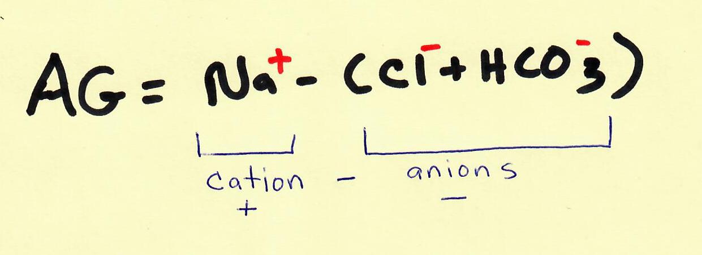
Sodium: 142
Chloride: 102
Bicarb: 12 [nl 19-30]
GFR:25
Is there an Anion Gap?
What do you think is happening?
Is there anything you want to do?
Metformin induced Lactic Acidosis.
Send him to E.D.

Slide 64
You will see this
60 year old male diabetic w/HTN, Hyperlipidemia, CKD 3a
Meds: Statin, ACEi, CCB, Metformin, SGLT2i
Vitals OK. No volume overload, seems to be stable clinically
A1c: 7.2, CBC nl, microalb/creatinine:65. LDL:90
CMP: k+:5.5 [nl 3.2-5.2 mmol/L], Na: 140, Cl:113 Bicarb:16 [23-30 mEq/L], Gluc: 175, eGFR: 61, o/w nl
Last potassium was 5.4
What’s the most likely condition causing this pattern?

Slide 65
HypoReninemic HypoAldosteronism
Also referred to as RTA 4 (Type 4 Renal Tubular Acidosis)
Diabetes, especially with renal involvement is the most common cause

Slide 66
11 yr old girl for routine WCC
Seen in ED 6 months ago for gross hematuria and a kidney stone was found. There was an insurance gap, so they never followed up with specialty care and it seems the stone passed.
When pt goes to give a urine, mom says “I don’t know what it is, but of my 4 kids, this is the one that worries me a little”
UA dipstick: no blood, pH: 7
Comp: bicarb:20 [nl 22-26], k+:3.3 [nl: 3.5-5.5], nl gap
o/w unremarkable.
What condition should we consider? (broadly)—volunteer?

Slide 67
Renal Tubular Acidosis
In children, renal tubular acidosis (RTA) is due to either an inherited or acquired defect that affects the kidney's ability to absorb filtered bicarbonate, or excrete ammonia or titratable acid. RTA is characterized by a normal anion gap (hyperchloremic) metabolic acidosis caused by the net retention of hydrogen or loss of bicarbonate. (resource: UpToDate)
Milder cases may go undiagnosed into adulthood.
It can be acquired as an adult

Slide 68
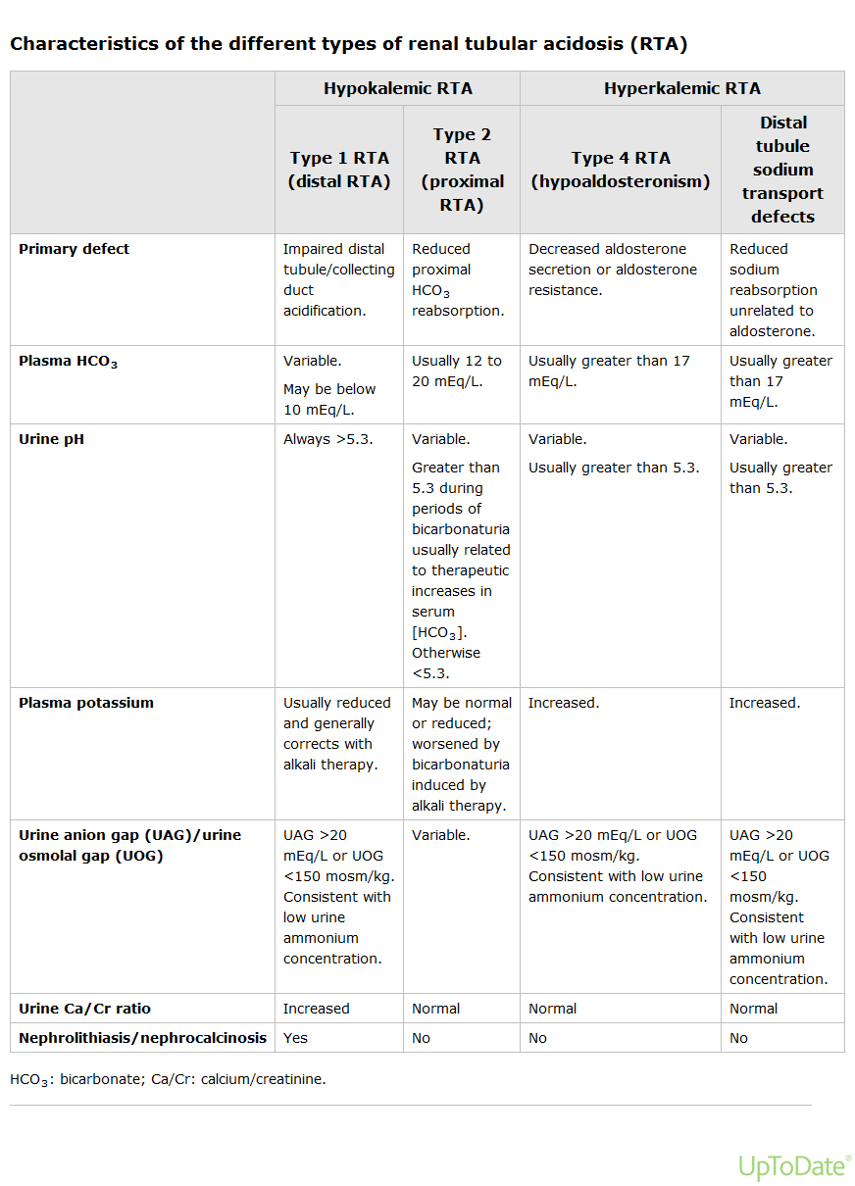
From UpToDate

Slide 69
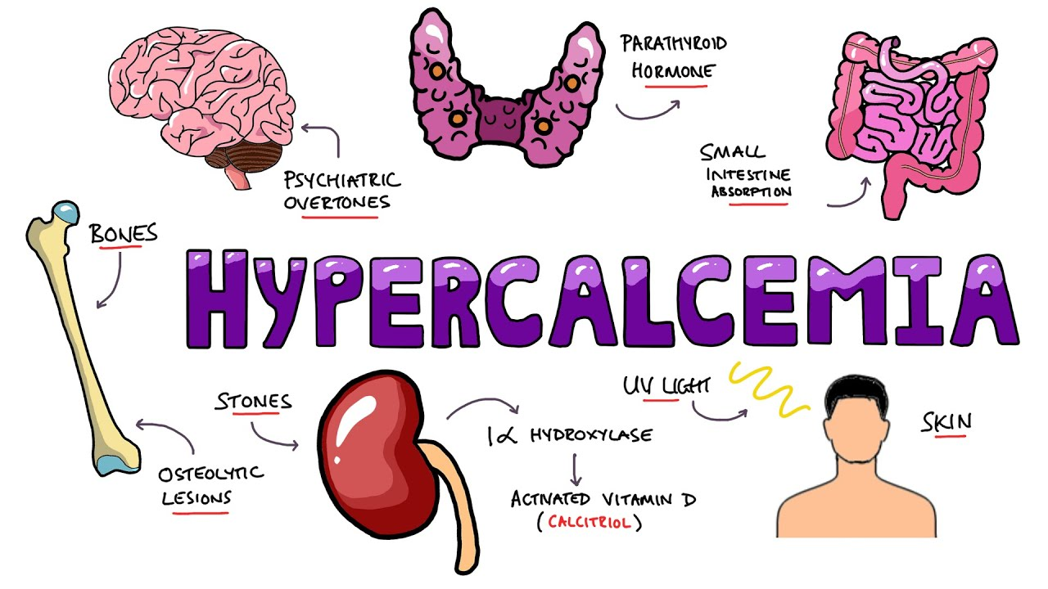
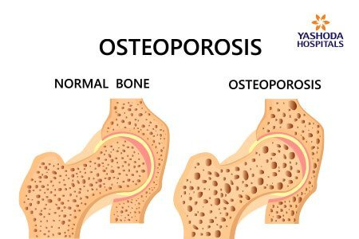
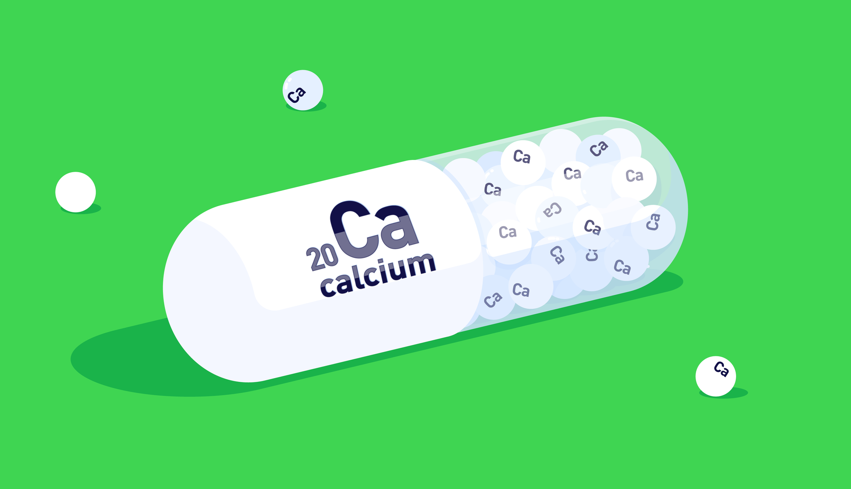
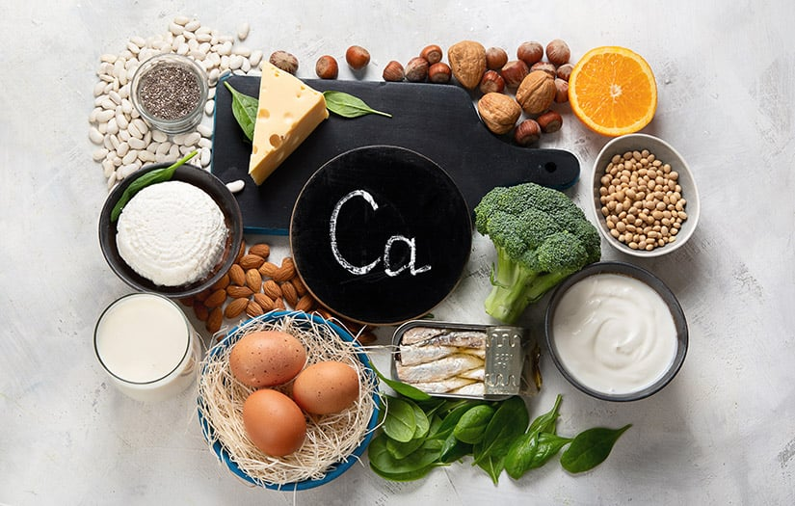
Calcium issues

Slide 70
What kind of calcium issue is this?
42 year old man with cirrhosis, active alcohol abuse and Hep C, presenting with weakness and vomiting
Comp: normal x for Calcium: 7.1 [nl 8.6-10.2], AST/ALT: 72/40, Bili: 2.2, Albumin: 2
What’s wrong with his calcium?

Slide 71
Answer: Pseudo-hypocalcemia
Corrected Calcium =
0.8 x (normal Albumin – Pt. Albumin) + Serum Calcium
His corrected calcium is 8.7 (normal)
He has many problems, but calcium is not one of them.

Slide 72
Hypercalcemia
My first week in CHC, taking over a large panel from a burned out doctor
Female pt. in her early 20’s who’s been experiencing longstanding pain everywhere, lightheadedness, and depression
Problem list says “Hypercalcemia of uncertain etiology”
Last Calcium was 10.9 from about a year before
Calcium: 11.6

Slide 73
If you have only one more test to order, what would it be?
A: BRCA testing
B: ionized calcium
C: Magnesium level
D: PTH (parathyroid hormone) level

Slide 74
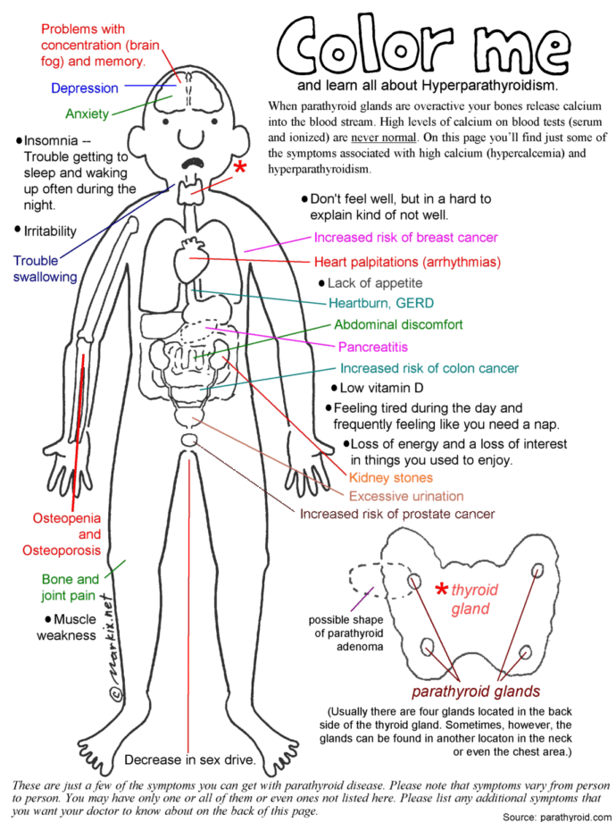
PTH (Parathyroid Hormone) Level: 180 [normal: 14-64 pg/mL]
Interpretation? – volunteer?
Dx: Primary Hyperparathyroidism

Slide 75
In about 1997, I got a BMP or a CMP on a young man. I can’t remember why but he didn’t have much medical going on and on no meds.
I had been getting annoyed because so many of our patients seemed to have high potassiums. I attributed this to my nurse drawing with a 25G butterfly.
Called the next day for a potassium of 7.6, “not hemolyzed”. Otherwise the chemistries were normal
I brought him back within 10 minutes for redraw and EKG.
EKG normal….no hyperkalemia findings.
Physical fine
Potassium: 7.1

Slide 76
I opened up a book and read about hyperkalemia and decided pseudohyperkalemia was still most likely in a well patient in the outpatient setting with a normal bicarb and creatinine
I drew him myself with an 18 gauge needle and no tourniquet
Potassium: 4.1
Here is a lab rule for you!!
If a lab result doesn’t make sense or surprises you, repeat it before you act on it
Within Reason

Slide 77
Another Hyperkalemia case but sneakier
60 yr old unfortunate African American man to initiate care.
Major trauma in his 30s, bilateral AKAs
Myasthenia gravis x 5 years with progressive muscular atrophy
Diabetes and HTN since his mid 50s.
Well controlled since he became vegan last year
Comp: k+:6.1, CO2:16 (low), nl anion gap. Mildly low corrected calcium. Creat: 1.1 – eGFR:83. UA: 2+ protein. CBC w/ moderate normocytic anemia.
What test might explain this? – (volunteer?/chat?)

Slide 78
Serum Cystatin C for eGFR
You order a serum Cystatin C test
Elevated with new eGFR calculation of 31.
Why such a discrepancy?
Calculation doesn’t include race
Missing legs: total body creatinine markedly diminished
Atrophic muscles: Same
Low activity level: muscles not releasing much creatinine
Vegan: Creatinine comes from the creatine in meat when cooked
JAMA Sept 6, 2022 Vol 328, Number 9, pp 883-. Serum Cystatin C for Estimation of GFR; Shilpak MD et.al,

Slide 79
4 AM Phone Call
The lab calls when you are on call
“John Doe has a blood sugar of 520. Everything else is fine. Do you want his phone number?”
You don’t want to get out of bed. What question do you ask?
Remember that the person on the line has no clinical information beyond an ICD10 code

Slide 80
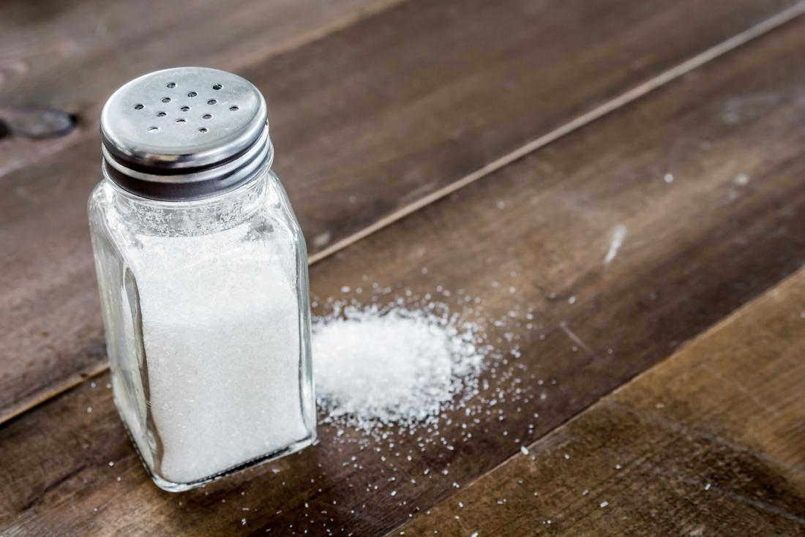
Sodium
“Sodium is normal. It’s 145”
Can you go back to sleep?
What if it’s low at 132?

Slide 81
Corrected Sodium for Hyperglycemia
We were all taught that for every 100 points over 100 the glucose goes, correct the sodium up 1.6 points
However (per MDCalc.com) “The classic correction factor of 1.6 mEq/L for every 100 mg/dl increase in serum glucose was challenged by a paper by Hillier et al in 1999, and sometimes a factor of 2.4 mEq/L is used.”
I use a factor of 2

Slide 82
75 y.o. male w/ HTN on HCTZ is doing well, and is euvolemic on exam. You get a routine Basic Metabolic Panel
Sodium: 133 [nl: 135-146 mmol/L]
Calcium 10.8 [nl 8.6-10.3]
What do you think is happening?
Hyponatremia secondary to thiazide
Hypercalcemia secondary to thiazide
This sometimes represents an “unmasking” of mild hyperparathyroidism.

Slide 83
45 y.o. male with bipolar d/o vs. schizophreniform d/o presents with a sprained ankle. He seems fine.
Meds: Trileptal, Lithium, Hydroxyzine, Xanax.
You order labs because of the Lithium
Sodium: 123, rest of CMP OK.

Slide 84
Na+ 123, what will you do?
A: Look up the tests for hyponatremia and order them (blood and urine? Osmolality?)
B: Refer
C: Rx Sodium Chloride 2 grams BID
D: Fluid restriction 1.5 liters/day

Slide 85
Hyponatremia
Results
Repeat sodium: 124
Urine osmolality: 700 [ nl 50-1200 mOsm/Kg]
Serum osmolality: 260 [nl 278-305 mOsm/Kg]
Urine Na+/creatinine ratio: 200 [nl 28-280 mmol/g creat]
What’s going on?
SIADH (Syndrome of Innappropiate Anti Diuretic Hormone) caused by Oxcarbazepine

Slide 86
Trileptal is DC’ed and Sodium comes back to normal
3 months later he seizes and is admitted with a sodium of 117. He is hallucinating.
This time urine sodium and osmolality is maximally dilute.
You place him on a 1 liter per 24 hour fluid restriction but you are called 45 minutes later.
He is screaming at the nurses because they say he can’t have more water. He drank his roommate’s water
1 hour later they catch him drinking from the toilet
What’s he got? -- volunteer?
Psychogenic Polydipsia

Slide 87
Alkaline Phosphatase

Slide 88
38 year old female with metabolic syndrome, PCOS, acanthosis nigricans, central obesity comes for knee pain and you get unrelated labs.
Alk. Phos: 139 [nl 33-130 U/L]
ALT: 45 [nl 6-29 U/L]
AST: 33 [nl 10-35 U/L]
What do you think? -- volunteer?

Slide 89
NAFLD/NASH, but what is on the differential of abnormal liver enzymes?
Viral Hepatitis: chronic hepatitis panel
AAH (autoimmune hepatitis): ANA, ESR, Antismooth muscle antibodies (ASMA), Anti-liver-kidney microsome-1 antibodies (anti-LKM-1)
Hemochromatosis: Ferritin (if high, might be an acute phase reactant, so only consider positive if Transferrin saturation is >=45%)
Alpha-1 Antitrypsin deficiency
Celiac Disease

Slide 90
more
Wilson’s disease: Ceruloplasmin (low if copper is high….serum or urine copper level if abnormal)
A high ceruloplasmin isn’t what you’re looking for
Thyroid disorders: TSH reflex FT4
Adrenal insufficiency: early AM serum cortisol and ACTH
I don’t usually do this one, unless there are clinical features
Alcohol: GGT, MCV, Alcohol metabolites in urine if pt claims not to drink.
Drug induced liver injury: Acetaminophen and a thousand others (Augmentin is the most commonly reported cause)

Slide 91
Same patient is now 41 years old. She had bariatric surgery, lost 50 pounds, does Crossfit.
Every few weeks for a year, she’s been getting severe abdominal pain about 15 minutes after eating that lasts about half an hour.
Last night, she got the same thing, but it is still bothering her, though not as badly.
RUQ mild-moderate tenderness w/ negative Murphy’s sign
Alk. Phos: 195
AST: 180
ALT: 180

Slide 92
What’s going on? Other tests? Actions?
A: Bone scan
B: ionized calcium and PTH
C: Ultrasound right away followed by a timely referral
D: CBC and ESR

Slide 93
Uncomplicated knee pain?
63 year old male who says he has arthritis in his knee and he took his brother’s Percocet and that really helped. He’d like an rx.
He has no effusion and good ROM. You refer him to PT.
He’s due for lipids and you decide to get a CMP with this drug abuse
Alk. Phos: 166
AST/ALT: 19/20 (normal), Bili: normal
Calcium normal
Interpretation?/ Actions?

Slide 94
High Alk. Phos: Liver vs. Bone
GGT: normal. (suggests not a hepatic source)
Alk. Phos. Isoenzymes: % from bone very high, liver low.
Vitamin D: 46 [nl >20-30] – to r/o osteomalacia
Interpretation?/ Actions? -- volunteer?
X-ray of Knee shows a normal knee but shows proximal tibia has a focal region of Trabecular coarsening described as “diagnostic of Paget’s Disease” by radiologist

Slide 95
What do you do?
19 year old woman from Puerto Rico presents because she cannot get pregnant. She has to pull chin and areola hairs out weekly. Her periods are irregular and infrequent. She has acne. BMI is 23
Prolactin, HCG, TSH normal
DHEAS, Testosterone are high normal
LH is greater than FSH

Slide 96
What do you do next? Choose the best option
A: Diagnose Polycystic ovarian syndrome
B: Genetic testing for polymorphisms
C: Send to dietician
D: 17 hydroxyprogesterone level to look for non-classical congenital adrenal hyperplasia

Slide 97
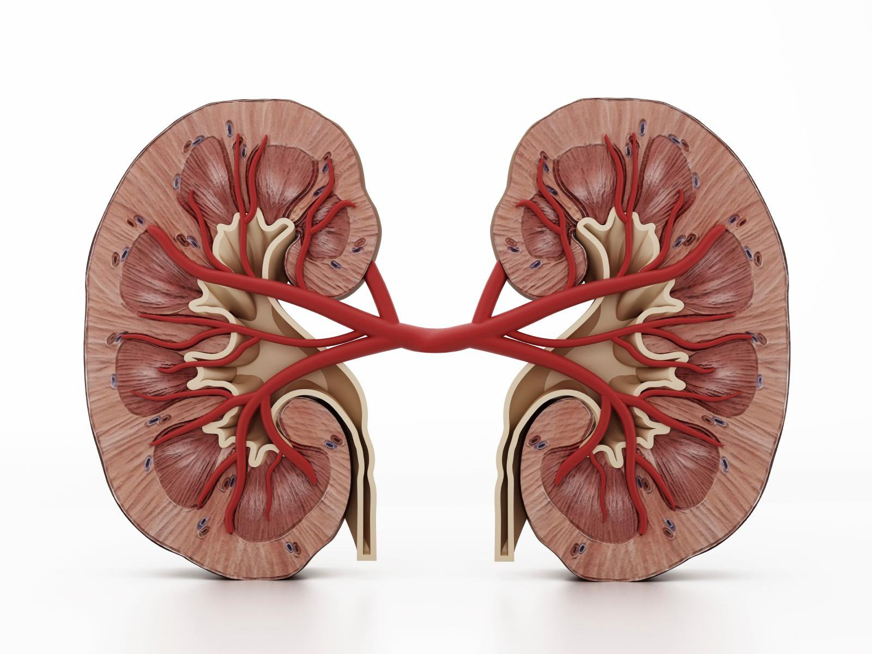
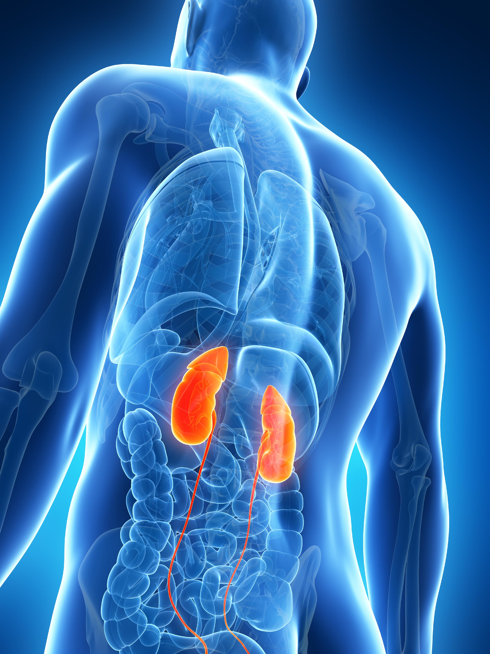
Renal

Slide 98
Microalbuminuria screening
58 y.o. diabetic man
Microalbumin,Rand Ur (w/creat) ordered
Result
Creatinine: 600 [nl: 20-320 mg/dL]
Microalbumin: 30 mg/dL
Microalbumin/Creatinine Ratio: 20 [nl <30 mcg/mg creat]
Interpretation? ---volunteer?

Slide 99
Another
64 y.o. diabetic woman
Creatinine: 12 [nl 20-320 mg/dL]
Microalbumin: < 0.2 [ref.range: “see note”]
Microalbumin/Creatinine Ratio: “NOTE”
[nl: <30 mcg/mg creatinine]
Interpretation? -- volunteer?

Slide 100
A Dementia workup
Your 79 year old male patient with DM, HTN, CAD s/p CABG is here w/ his wife who says he can’t remember anything anymore. Gradual onset over years. Can’t drive (gets lost). Can’t safely use the kitchen w/o supervision.
Meds: Metformin, Metoprolol, ASA, Lisinopril
Unremarkable labs: TFTs, Syphillis, CMP, Urinalysis
Vitamin B12: 270
CBC: H&H: 13/40, MCV 103

Slide 101
What do you think?
A: I may have found something important
B: I can probably reverse his dementia with B12 injections
C: He probably has Pernicious anemia
D: This guy needs to eat more meat
Answer A: The B12 might be important. It’s not likely the cause of his memory loss. Even if it is, treating generally prevents further functional loss, rather than cures it.
Nobody needs to eat more meat!

Slide 102
B12 deficiency causes high Methylmalonic acid and Homocysteine levels

Slide 103
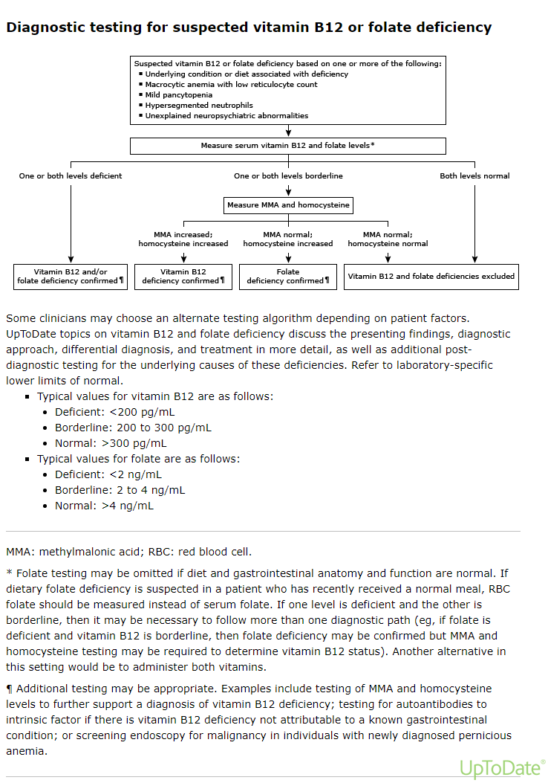

Slide 104
A quick phone call and the lab could run it
Methylmalonic acid and Homocysteine levels are normal
On further questioning (nurse, telephone call), he’s drinking 6-8 oz of gin 5-6 nights per week, explaining the high MCV
He’s not a vegan in the slightest
What other factor may explain the borderline B12?
Metformin

Slide 105
More concerning
A 74 y.o. woman is having some unsteadiness with walking and tremendous fatigue, GI discomfort, and moodiness.
Exam remarkable for pallor, tachycardia, and neuro exam showing normal sensation and reflexes but poor proprioception in great toe. You can’t find your tuning fork

Slide 106
Suspicion confirmed
Normal CMP, TSH, Syphillis cascade, HIV, HCV, CRP, Celiac studies, ANA
CBC: MCV: 115, H&H: 9/29. Hypersegmented neutrophils on smear
Vitamin B12: 95
High Methylmalonic Acid and Homocysteine

Slide 107
Does she have Pernicious Anemia?
Anti Intrinsic Factor (IF) Antibodies
High specificity: if high, PA diagnosis is made
Sensitivity: unfortunately only 70% of those w/ PA have this antibody
Parietal Cell antibodies
More sensitive for PA
Specificity: more common generally. Many patients with gastritis have positive Gastric Parietal cell Abs
Autoimmune chronic atrophic gastritis
So positive is suggestive, but not diagnostic

Slide 108
Yes, she has PA
Presence of both Parietal Cell and IF antibodies
So she needs lifelong injection therapy, right? Y or N
MYTH BUSTER
Even in Pernicious anemia, where intrinsic factor is totally gone, most people can maintain on high dose oral replacement.
RDA is 2.4 mcg of B12
Tabs/caps/sublingual sprays come in 500, 1,000, 2,500 mcg (and others)
“Oral Cobalamin for Pernicious Anemia: Medicine’s Best Kept Secret” F.Lederle JAMA January 2, 1991 – Vol 265 No 1; p 94-95

Slide 109
Further support
Wang H, Li L, Qin LL, et al. Oral vitamin B12 versus intramuscular vitamin B12 for vitamin B12 deficiency. Cochrane Database Syst Rev 2018; 3:CD004655.
Kuzminski AM, Del Giacco EJ, Allen RH, et al. Effective treatment of cobalamin deficiency with oral cobalamin. Blood 1998; 92:1191.
Bolaman Z, Kadikoylu G, Yukselen V, et al. Oral versus intramuscular cobalamin treatment in megaloblastic anemia: a single-center, prospective, randomized, open-label study. Clin Ther 2003; 25:3124.
Butler CC, Vidal-Alaball J, Cannings-John R, et al. Oral vitamin B12 versus intramuscular vitamin B12 for vitamin B12 deficiency: a systematic review of randomized controlled trials. Fam Pract 2006; 23:279.
Takhar A. Pernicious anaemia: switch to oral B12 supplementation to reduce risk of covid-19 transmission. BMJ 2020; 369:m2383.

Slide 110
Treatment
First patient: Recommend vitamin B12
“What dose?”
“Whatever’s cheap, even a B Complex would be fine”
If a person is vegan, just GOOGLE ‘Vegan B12’
All vegans should be on this supplement, unless they have found an alternative (e.g specific brands of nutritional yeast)
PA patient
No, I didn’t wait for her f/u labs to treat her with signs and a B12 of 95!
I choose to start with injectable B12 for repletion and then attempt a switch to high dose oral B12 for maintenance
Reticulocyte counts will be the first marker to improve and they should rise dramatically within 2 weeks.

Slide 111
Other B12 stuff
Gastric cancer risk in PA, refer to GI
Relative risk: 6.8
Vannella L, Lahner E, Osborn J, et al. Systematic review: gastric cancer incidence in pernicious anaemia. Aliment Pharmacol Ther 2013; 37:375.
B12 stays in the liver for 3 months to 5 years
So a B12 negative state may take years to become a clinical issue
And don’t think that if the B12 is fine 3 months after the last replacement that they no longer need it!
High B12
It’s not dangerous. If over 2,000 on replacement, don’t lower the replacement
There could be medical conditions that relate to a high B12 level in the absence of supplementation
UpToDate: “Elevated levels of vitamin B12 or folate ”

Slide 112
There’s no pleasing some people
From a ConferMED Neuro eConsult:
”The B12 level of 331 is very low from neuro perspective. I have several pts with B12 levels less than 500 with brain and spinal cord lesions and neuropathies as a result of deficiency. I aim pts B12 levels to be above 900. Rec SQ/IM and PO supplementation”
I’ve seen other Neurologists express the same idea, just not as aggressively
Reminder: UpToDate and the lab say over 300 is normal
Yet, B12 pills are cheap and safe
You decide

Slide 113
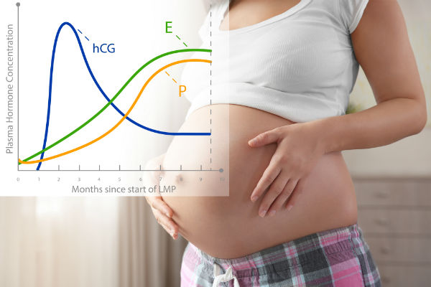
Quantitative Beta HCG (“Beta Quant”)

Slide 114
20 year old female w/ LMP 4 weeks ago gets a + home pregnancy test. Excited. The following night, she develops post coital vaginal bleeding.
In ED, pregnancy test is +, cervix is closed. Vag probe U/S shows nothing abnormal. No gestational sac noted. Bleeding has subsided.
Beta HCG: 400
Follows up with you the next morning, frightened.
What would you do? Volunteer?/chat?
Repeat Beta Quant should be done 48 – 72 hours after first.
Doubling by 48-72 hours must be noted to be reassuring that there is a viable intrauterine pregnancy

Slide 115
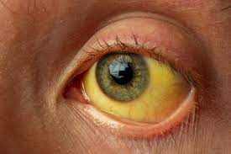
Viral Hepatitis issues

Slide 116
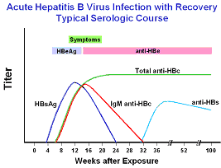

Slide 117
The dreaded isolated core
32 y.o. male, just out of rehab, without major medical issues. You get a chronic hep. panel (which I would not have ordered)
Hep C Ab: Neg
Hep B SAb Neg
Hep B SAg Neg
Hep B Core Ab (total) POSITIVE
Hep A Total Ab: Neg

Slide 118
Isolated Hep B Core differential
Acute Hep B 6 months ago and is in the narrow window between SAg clearance and Sab appearance
Chronic Hep B, but SAg too low to measure (exceedingly uncommon)
Can obtain a hep B DNA, but I only do this if there’s a clinical reason
SAb used to show immunity but declined gradually, so pt. really is immune (common)
Core Ab is a false +, Assay crossreacting with other Abs. (common for certain diseases, like RA, Hep C)

Slide 119
When do you order a chronic Liver Profile?
Workup of elevated LFTs
Maybe if somebody tells you “I had Hepatitis before”
Otherwise, test for what you want to know

Slide 120
Components of chronic hepatitis panel
Hep C Ab w/ reflex to RNA: do you want to know whether…….. the patient has Hep C?
Heb B S.Ab: …. whether the patient is immune to hep B or needs a hep B vaccine?
Hep B S.Ag: ….. the patient has chronic hep B?
Hep B Total Core Ab: ( I already talked about how useless this is)
Hep A Ab Total: ….. the patient needs a Hep A vaccine
Don’t test for immunity if there’s no reason to vaccinate. We don’t vaccinate all adults against A and B

Slide 121
Latest update: February 2022
The Advisory Committee on Immunization Practices (ACIP) recommends hepatitis B (HepB) vaccination among all adults aged 19–59 years and adults > 60 years with risk factors for hepatitis B or without identified risk factors but seeking protection.

Slide 122
Hepatitis B “carrier”
Mid 40’s male, active heroin abuser, transferred to me for Suboxone. DM w/ sugars in 500’s, Lipids w/ T.chol and TG>800 and diagnoses of Chronic hep C and Hep B Carrier on PL. Only Hep B test in chart is a + SAg
ALT:800
Hep C RNA: Neg
Hep B DNA: 10 million copies
Is he a carrier? What’s next? – volunteer?/chat?

Slide 123
follow up
Hep B EAg: Positive
Heb B EAb: Negative
Hep D Ab: Negative
Hep A total: Immune
Antiviral begun, virus dropped to undetectable, ALT came down to 50s

Slide 124
New Topic (no hints)

Slide 125
32 y.o. woman with BMI 32, o/w no medical history, asymptomatic and normal physical exam for CPE
A1c, TSH reflex T4, Comp., and Lipids done for weight
All normal except Globulin: 4.6 [nl 1.9-3.7], Albumin: 4
Thoughts? Actions? Volunteer?/chat?
Let’s say you ordered an SPEP
SPEP: PolyClonal Gammopathy
Thoughts?/ Actions? –Volunteer?/chat?

Slide 126
Acute Phase Reactants
The polyclonal gammopathy reflects a systemic inflammatory process.
ESR: 65
ANA: negative
HIV: Positive
HCV Ab w/ reflex: Positive, RNA: 10 million
She apologizes. She was told she had these diseases last year but she didn’t believe it. Remote injection drug use “when I was young and stupid.”

Slide 127
Acute Phase Reactants
Abnormal when inflammatory process exists (from effects of cytokines and rise of IL -6)
ESR (Erythrocyte Sedimentation Rate) rises when Fibrinogen rises.
CRP (C-Reactive Protein): it’s complicated
Neither are specific for inflammation and sometimes they are discordant
CRP rises more quickly than ESR and is more specific for inflammation

Slide 128
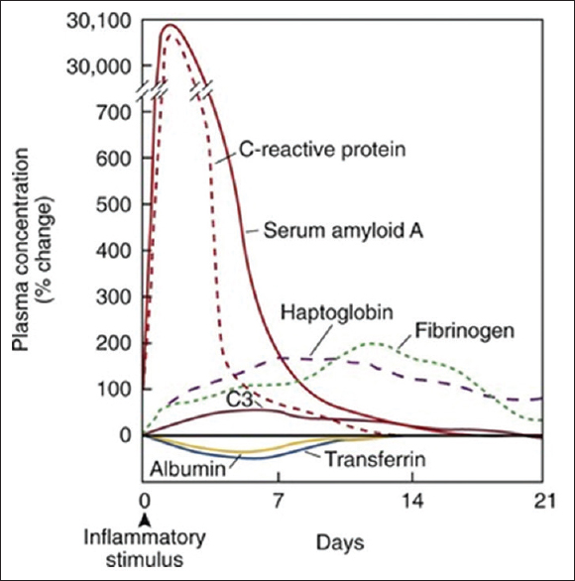
Other acute phase reactants
Ceruloplasmin
Fibrinogen
Complements
Haptoglobin
Alpha-1 antitrypsin
Ferritin
Platelets
TIBC (Transferrin) goes down with inflammation

Slide 129
Another new topic for you to guess

Slide 130
What do you think the main problem is here?
Patient presents after having a seizure late last night. Never had one before, but he doesn’t seem too worried and didn’t go to the ED. Normal exam.
MCV: 105 w/o anemia
PLTs: 86K
AST/ALT: 100/59
GGT elevated
You suspect EtOHism but pt assures you he hasn’t had a drink in months. Action? – volunteer?/chat?
Urine for alcohol metabolites: Positive in high levels

Slide 131
Rheumatology tests
I have a whole Rheum lecture to give you, so this will be just a smattering

Slide 132
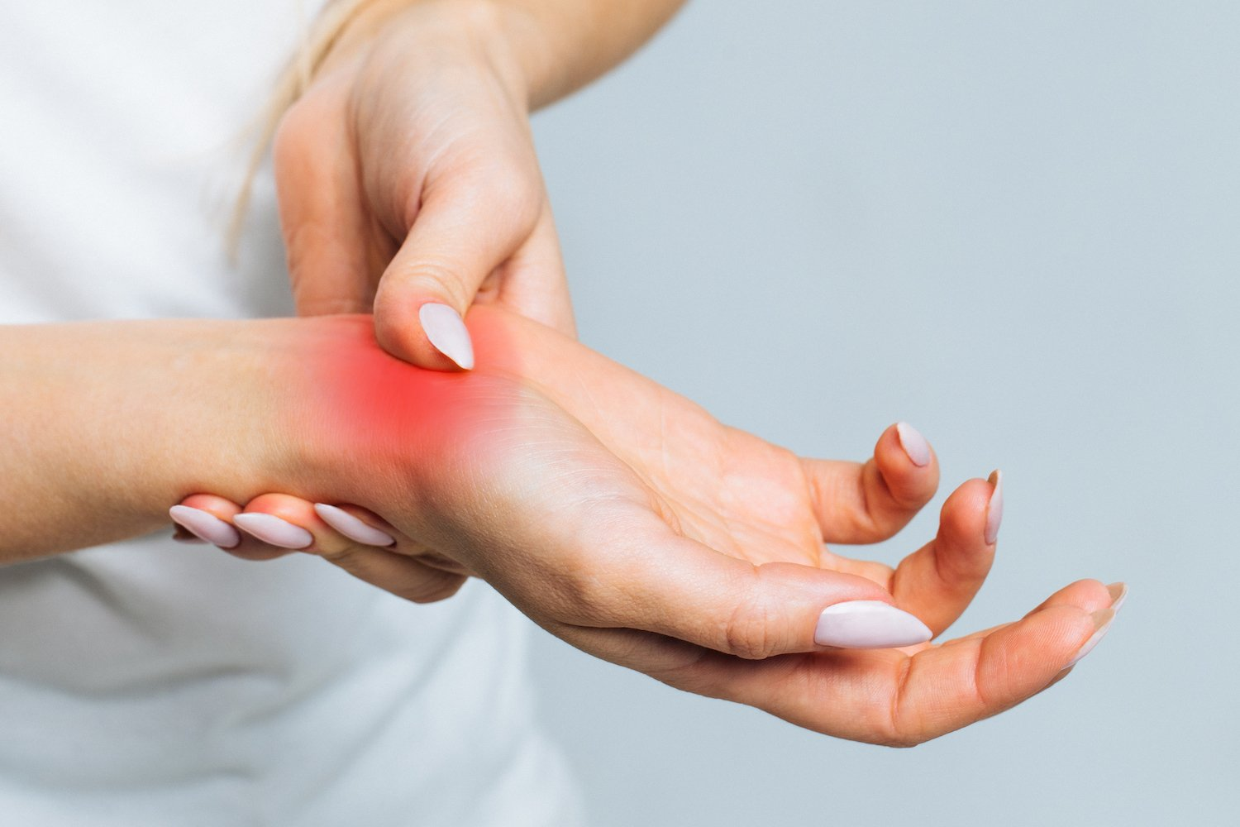
Rheumatoid factor
32 y.o. female w/o PMH presents with 6 months of pain in knuckles, wrists, and ankles. Takes 2 hours and a hot shower just to be able to open her hands.
RF (Rheumatoid Factor): 18 [nl <14 IU/mL]
Anti-CCP (Cyclic Citrullinated Peptide): 75
[Negative <20 units
Strong Positive: >59 units]
Dx: Rheumatoid Arthritis

Slide 133
62 y.o female w/ h/o migraines, bipolar, PTSD, IBS, fibromyalgia, c/o all of her joints hurting. Says she was told that she has Rheumatoid Arthritis. Never treated for it.
RF: 18 [nl <14 IU/mL]
Anti-CCP: 21 [Weak Positive: 20-39]
ESR and CRP normal
Diagnosis? – volunteer/chat?
Chronic Pain Syndrome with Significant Psychosocial Dysfuntion [G89.4]
Up to 5% of adult population will develop a positive RF with age

Slide 134
Lupus testing
44 yo male was in ICU 3 months ago after having his first seizure while driving.
His younger sister was just diagnosed with Lupus.
He tells her that his ankle is sore and all of his hair is falling out.
She is sure he has SLE also and makes him come to ask you.
What would you order?
ANA: negative
What will you tell him? volunteer-?/chat?
Ankle soreness: “you are still recovering from a major trauma”
Hair falling out: Telogen efuvium
“ANA is very sensitive for lupus…if it’s negative, it’s almost certain you don’t have it”

Slide 135
32 y.o. female with 3 months of multiple complaints
Fatigue
Red spots on skin
Muscle aches
Joint pains: “kind of all over…well, some days my knees bother me, some my wrists, some my elbows”
What labs will you order?
CMP: Creatinine: 1.5, Albumin/Globulin ratio low
CBC: H/H: 9.5/31 [nl 13-17/38-50], MCV:84 [nl 80-100]
ESR: 63
ANA: + 1:320, rim pattern
You see the patient back immediately and what tests might you order?

Slide 136
Lupus
Urinalysis: 20-30 RBCs/HPF, 20-30 WBCs/HPF, RBC casts present
Anti-ds DNA: Positive
Anti-Smith: Negative
Both Anti-Smith and double stranded DNA are very specific for SLE but not sensitive.

Slide 137
Lyme disease?
A 22 y.o. healthy woman works as a landscaper in Mystic, CT. She has a palm-sized, circular, non-bothersome rash on proximal calf for 3 days. There is no central clearing. Now she has a temp of 101. No other symptoms.
What should you do? Volunteer?/chat?
Treat with antibiotics for clinically diagnosed Lyme
no doxycycline unless she’s got a very low pregnancy risk
And remember the photosensitivity (landscaper)

Slide 138
Evidence-based Cancer screening recommendations. Why I don’t really trust the USPSTF

Slide 139
My patient was a 50 year old man in recovery from EtOH use d/o, chronic back pain and a h/o seizures. Routine labs included a normal screening PSA of 2.7.
Age 51: PSA 1.5
2011: USPSTF changes recommendations to D, meaning that prostate cancer screening was not recommended.
My response to that was to decrease how often I discussed PSAs with my patients, though I still tried to have the conversation. At physicals I still did, but my patients don’t usually come in for physicals.

Slide 140
10 years passed
Age 62: he comes in for his routine back pain visit and mentions a gradual weakening of urinary stream, post void dribbling, and frequent nocturia
DRE: he couldn’t relax and straightened his hips. Not able to feel prostate
Started on alpha-blocker
PSA: 68 --- called…to Urology
Prostate biopsy: 12 core samples all showing adenocarcinoma, Gleason 8
Staging bone and CT scan: intense acetabular and ilio-pubic uptake. f/u MRI strongly suggestive of metastatic dz.

Slide 141
One month later
Saw Oncology and started in with treatment (non-curative)
Then slipped off his tractor onto his hip
CT showed a fracture of the lytic lesion in the cortex of his acetabulum.
3 years later (now) – Age 66
He says he’s doing well
No further fractures
Oncology changing his treatment regimen
He’s cushingoid on steroids

Slide 142
New USPSTF guidelines (10/2018)
They recognize they got it wrong
Return to informed patient decision as to whether screening will be undertaken
For Age 55-70
Other ages still category D

Slide 143
Prostate Cancer: to screen or not to screen
Second most likely cancer of men
12% lifetime risk
2.4 % of U.S. men die from it
A PSA cutoff of 4.0 ng/mL had a sensitivity of 21 percent with specificity of 91 percent for detection of any prostate cancer; for detection of a high-grade cancer, sensitivity was 51 percent
So PSA is an imperfect screening test for a cancer that many more men die with than die from
From UpToDate

Slide 144
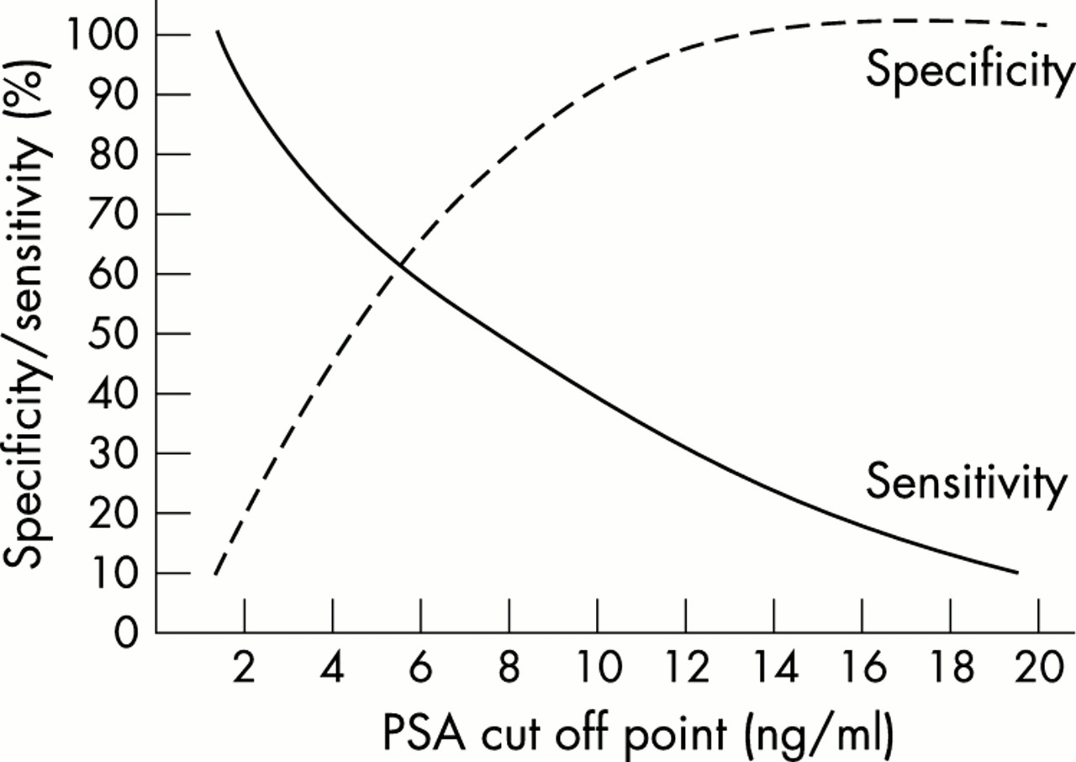
Do we even know how good/bad it is: different numbers
“The traditional cut off of 4 ng/ml that has been used to identify which men need further investigation has a sensitivity for detecting cancer of approximately 75% but a specificity of only 40%.”
Source: Post-Graduate Medical Journal: https://pmj.bmj.com/content/78/925/646

Slide 145
Normal rises with age

Slide 146
The downside of screening
A prostate biopsy is invasive, painful, frightening and comes with risks of infection, bleeding, and urinary obstruction
Antibiotic prophylaxis
Hemospermia for weeks afterward
Overdiagnosis of prostate cancer
Many cancers found would not ever go on to cause morbidity and mortality
Most U.S. studies don’t suggest that screening with a PSA leads to decrease in mortality
Complications of cancer treatment
Impotence
Incontinence
Radiation damage
Missed work
Anxiety-inducing
The standard threshold misses many or most cancer cases

Slide 147
The Upside of screening
Screening might reduce the likelihood of dying from prostate cancer
Men with prostate cancer live longer when treated
In the early 1990’s, the PSA became widely used, creating an enormous uncontrolled experiment.
No other countries did the same
This is probably why PSA studies in Europe tend to be positive while U.S. studies are generally negative
No major new cures have come out in all this time
So what happened?

Slide 148
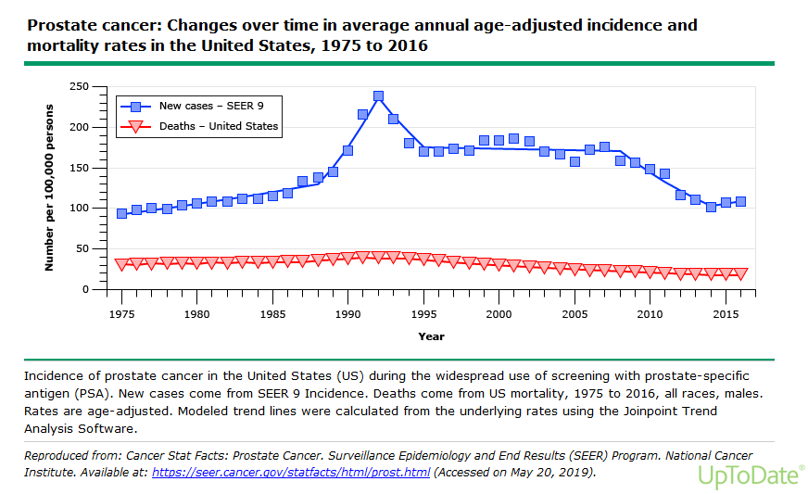
Death from Prostate cancer went down from 39 to 19 per 100,000 men, at a time when the average lifespan was increasing

Slide 149
Relatively

Slide 150
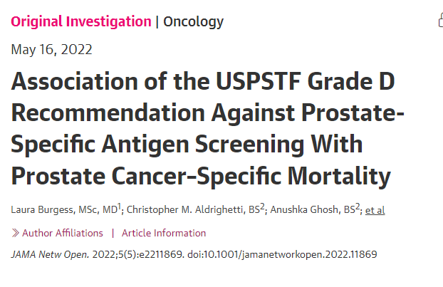
…
Bibub
Vyuv
https://jamanetwork.com/journals/jamanetworkopen/fullarticle/2792368

Slide 151
“Conclusions and Relevance This cross-sectional study using comprehensive PCSM (Prostate Cancer Specific Mortality) data through 2019 demonstrated decreasing PCSM rates that flattened or increased after the 2012 USPSTF Grade D recommendation, suggesting that decreased PSA screening may be a factor associated with this change. This change was seen across ages, races and ethnicities, urbanization categories, and US Census regions. The updated 2018 USPSTF guideline supporting shared decision-making may reverse these trends in the coming years.”

Slide 152
PSA screening: shared decision-making
A careful discussion and then the patient chooses.
We don’t say “you should” or “you shouldn’t”
Adjust the conversation for those at higher risk
African Americans and Carribean men of African ancestry
Family history of prostate cancer
Particularly a 1st degree relative who was diagnosed at <65 yoa
BRCA mutation
Resource for all PSA slides unless o/w specified: UpToDate

Slide 153
My latest approach
“OK, so we just talked this through for a long time and you decided to screen for prostate cancer.
Going forward, I’m going to check you every year until you are 70
If you ever decide you want to stop screening for prostate cancer or you just want to discuss it, let me know”
This way, I don’t withhold a PSA that is due because we haven’t had the talk recently.

Slide 154
But, wait!

Slide 155
Bingo!

Slide 157
So what will the American Task Force on Prevention Do After This Landmark Study?

Slide 158
What does an aggressive protocol look like?
Memorial Sloan Kettering Cancer Center Guidelines
Age: 45-49: Baseline PSA
>= 3 ng/mL : discuss biopsy
1-3: Repeat in 2-4 years
<1: Repeat again 51-55
Age: 50-59: Check PSA
>=3: discuss biopsy
1-3: Repeat 2-4 years
<1 ng/mL: Repeat at 60

Slide 159
Sloan Kettering (cont)
Age 60-70: Check PSA
>=3: discuss biopsy
1-3: Repeat 2-4 years
<1: no further screening recommended
Ages 71-75
Individual discussion w/ Provider
Base on past PSA levels and health of man
Men 76 y.o. and older
Prostate cancer screening not recommended.

Slide 160
Questions and Answers
If we run out of time, email me (and all of us) questions at wilensd@chc1.com

