Slide 1
STRATEGIC
FOCUSED
Quality Improvement Seminar
Alyson Faires, Natalie Ewashkow, Mark Splaine
February 23, 2023
RELEVANT
INTERACTIVE
TEAM WORK
INFORMATIVE
FUN
SKILL BUILDING
Nurse Practitioner & Post Doctoral
Training Programs
Notes:
ALYSON

Slide 2
Session Goals
Review strategies for planning a Plan-Do-Study-Act (PDSA) cycle
Share examples of PDSA approaches from your projects
Hear examples from leaders regarding work with stakeholders
Review tools for communication plans and stakeholder analysis
Practice developing a stakeholder analysis plan
2
Notes:
ALYSON

Slide 3
Agenda
PDSA case discussion (10 minutes)
Your PDSA examples (7 minutes)
Chelsea & Nicole stakeholder example (18 minutes)
Theory burst (10 minutes)
Stakeholder Analysis/Influencing Strategy/Communication Plan
Break (5 minutes)
Exercise (15 minutes)
Debrief discussion (15 minutes)
Summary and take-home points (10 mins)
3
Notes:
ALYSON

Slide 4
Roles
Guest presenters
Chelsea, Nicole
Theory burst presenter
Mark
Facilitator
Natalie
Technical genius
Meaghan
Timekeeper
Alyson
Take-home thoughts report-out
Alyson
4
Notes:
ALYSON

Slide 5
Curriculum Plan
An overview of Quality Improvement (10/13/22)
Care Observations & Stakeholder Considerations (10/27/22)
Organizing your Improvement Project (11/10/22)
Global Aim and Fishbone Diagram (12/8/22)
Process Mapping (Flowcharts) (12/22/22)
Measurement to Inform Change (1/12/23 & 1/26/23)
An Approach to Testing a Change (2/9/23)
Communication about your Improvement Effort (2/23/23)
Stakeholder Analysis & Conflict Management (3/9/23)
Managing Up and Gaining Leadership Buy-In (3/23/23)
Negotiation (4/13/23)
Negotiation and More About Cycles of Change (4/27/23)
Sustaining your Improvement Effort (5/11/23)
Resident Presentations (5/25/23, 6/8/23, 6/22/23)
Notes:
ALYSON

Slide 6
Notes:
MARK

Slide 7
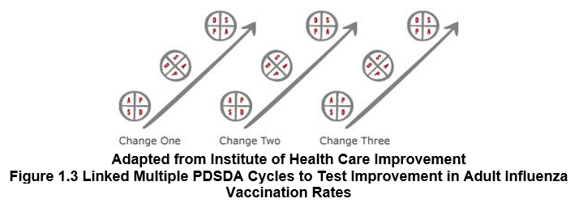
Change 1 – initial query of patients
Change 2 – develop scripting for MA’s
Change 3 – provider education about vaccine risks and benefits
Change 4 – educate staff
Notes:
MARK

Slide 8
PDSA Case Study
Any questions or issues about the case?
8
Notes:
MARK

Slide 9
Project Team Example
Notes:
NATALIE

Slide 10
Poll Question
Notes:
NATALIE

Slide 11
Stakeholder Examples: Chelsea McIntosh & Nicole Seagriff
Notes:
NATALIE

Slide 12
Change can be hard.
“The status quo feels comfortable and steady because much of the choice has been squeezed out. You have your routines, your ways of doing things.”
Chip Heath, Switch: How to Change Things When Change Is Hard
12
Notes:
MARK

Slide 13
Stakeholder Analysis
Stakeholder | Strongly against | Moderately against | Neutral | Moderately supportive | Strongly supportive
Providers |  |  |  | C | D
IT | C |  |  | D
HR |  |  | C D
Nursing
Reception
Other stakeholder
How to use this tool
Plot where individuals currently are with regard to change (C = current)
Plot where individuals need to be (D = desired) in order to successfully accomplish change. Identify gaps between current and desired with horizontal arrows.
Indicate which individuals may influence others by drawing arrows between them.
Action steps for closing gaps will be discussed in the “Influencing Strategy.”
Not all stakeholders need to be “strongly supportive” for successful change
Notes:
MARK
Understand where your stakeholders currently stand on their understanding and support of your project and test of change

Slide 14
Stakeholder Analysis Example
Stakeholder | Strongly against | Moderately against | Neutral | Moderately supportive | Strongly supportive
Providers |  | C |  | D
PSAs |  |  |  | C | D
Patients |  |  | C
Nursing |  |  |  | C | D
Medical Assistants |  |  | C |  | D
Finance |  |  |  | CD
IT |  |  |  | CD
Jane Smith |  |  | C
Dental |  | C |  |  | D
Behavioral Health |  | C |  |  | D
Senior Leadership |  |  |  | C | D
Trainers/HR |  |  | C
Current State = C
Desired State = D
Notes:
MARK
Example

Slide 15
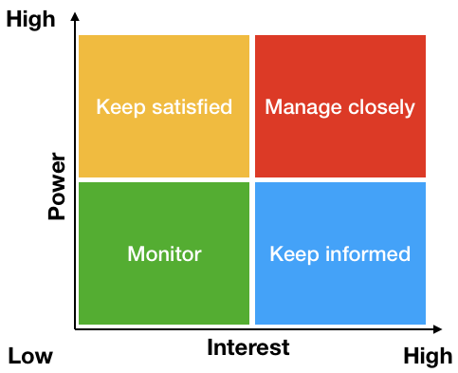
Prioritization Matrix
Notes:
MARK
Organize your stakeholders into categories to help you prioritize which stakeholders need more or less communications and how much information.

Slide 16
Communication Plan
Audience | Communication Objectives | Message(s) | Media & Methods | Timing & Frequency | Who/When Where
Media Method Examples to Consider:
Email.
Newsletter.
Teleconference.
Notice boards.
CEO briefing.
Posters.
Lunchtime meeting.
Intranet article.
Launch event.
Team meeting.
Notes:
MARK
Understand the best way to communicate with your stakeholders

Slide 17
Break!
Take five minutes to recharge and refresh.
17
Notes:
MARK

Slide 18
Small Group Discussion
We will use Zoom Breakout Rooms to allow you to gather as a project team
You will discuss the questions on the following slide related to a stakeholder for your project (also see the Word document template)
Answer as many of the questions as you are able
Have one member of your team record the answers
Be ready to share some of your discussion with the larger group
18
Notes:
www.clinicalmicrosystem.org
18
NATALIE

Slide 19
Familiar Stakeholder Considerations
10 Minute Breakout Rooms
What is their level of interest in the project and/or test?
What is their level of influence on the project and/or test?
How do they want to contribute and be involved in the project?
What are their expectations for this project or test of change?
What challenges do you predict might come up regarding this stakeholder?
19
Notes:
NATALIE

Slide 20
Debrief Discussion
Teams to share examples
Questions to address
Briefly review your planned change
Which stakeholder did you focus on?
What challenges or issues are you anticipating?
Are there additional stakeholders you think might be helpful to consider?
20
Notes:
NATALIE

Slide 21
What haven’t we figured out yet?
Questions or issues that remain unclear?
21
Notes:
ALYSON

Slide 22
Take-home Thoughts
Alyson – share 1 or 2 ideas you will take away from our discussion
Notes:
ALYSON

Slide 23
Summary
Many people approaching an improvement effort underappreciate the importance of the Plan step of the PDSA cycle.
The fishbone diagram can be a helpful tool for brainstorming ideas for possible changes to test. Once generated, you can prioritize the list of change ideas and begin testing those of highest priority.
Input from stakeholders is critical throughout any improvement effort. It is particularly informative when selecting an effort, developing an understanding of a process, and considering what change to test.
Because stakeholder input is important throughout an improvement effort, it is useful to have a strategy for communicating with stakeholders.
23
Notes:
ALYSON

Slide 24
Session X Assignment
Interview a stakeholder for your planned change with whom you have not had regular interaction regarding the change
Use the template we used today to guide your interview (see separate Word document)
Contact Natalie, Alyson, or Mark if you have questions
Be prepared to discuss your interview next session on 3/9/23
24
Notes:
www.clinicalmicrosystem.org
24
ALYSON

Slide 25
References
HRSA.org - Health Resources and Services Administration, agency of U.S. Department of Health and Human Services, Rockville, Maryland: Testing for Improvement
Warrick DD. Developing Organization Change Champions: A High Payoff Investment! OD Practitioner. 2009;41(1):14-19.
25
Notes:
www.clinicalmicrosystem.org
25

