Slide 1

STRATEGIC
FOCUSED
Quality Improvement Seminar
Alyson Faires, Natalie Ewashkow, Mark Splaine
February 9, 2023
RELEVANT
INTERACTIVE
TEAM WORK
INFORMATIVE
FUN
SKILL BUILDING
Nurse Practitioner & Post Doctoral
Training Programs
Notes:
NATALIE

Slide 2
Session Goals
Review & learn by sharing your examples
Introduce Plan-Do-Study-Act (PDSA) cycle as a change method
Review a case study in group discussion & plan out a test of change idea
Use a PDSA Worksheet as a tool to organize your test of change
2
Notes:
NATALIE

Slide 3
Agenda
Welcome (5 minutes)
Reminder about projects/presentation
(5 minutes)
Review of measure displays (20 minutes)
Theory burst (10 minutes)
Break (5 minutes)
Small group work
  Set-up (5 minutes)
  Planning a Test of Change small group (15 minutes)
Small group debrief (20 minutes)
Summary and take-home points (5 mins)
3
Notes:
NATALIE

Slide 4
Roles
Theory burst presenter
  Mark
Small Group Facilitators
  Natalie, Alyson, Mark
Technical genius
  Monique
Timekeeper
  Alyson
Take-home thoughts report-out
  Chelsea
4
Notes:
NATALIE

Slide 5
Curriculum Plan
  An overview of Quality Improvement (10/13/22)
  Care Observations & Stakeholder Considerations (10/27/22)
  Organizing your Improvement Project (11/10/22)
  Global Aim and Fishbone Diagram (12/8/22)
  Process Mapping (Flowcharts) (12/22/22)
  Measurement to Inform Change (1/12/23 & 1/26/23)
  An Approach to Testing a Change (2/9/23)
  Communication about your Improvement Effort (2/23/23)
  Stakeholder Analysis & Conflict Management (3/9/23)
  Managing Up and Gaining Leadership Buy-In (3/23/23)
  Negotiation (4/13/23)
  Negotiation and More About Cycles of Change (4/27/23)
  Sustaining your Improvement Effort (5/11/23)
  Resident Presentations (5/25/23, 6/8/23, 6/22/23)
Notes:
NATALIE

Slide 6
HealthLinc Example
Notes:
MARK

Slide 7
HealthLinc Example (Run Chart)
Notes:
MARK

Slide 8
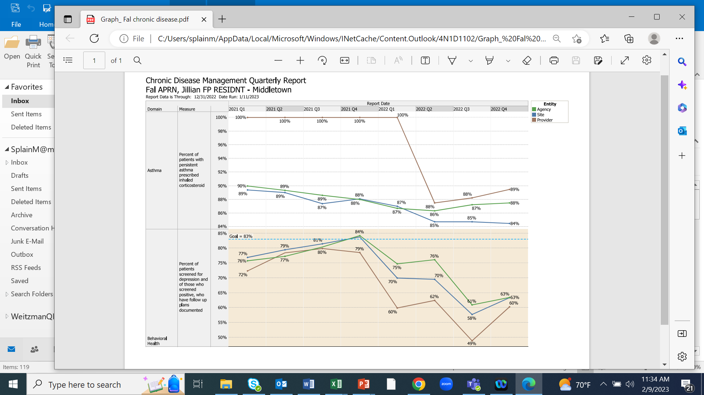
Middletown Example
Notes:
MARK

Slide 9
Middletown Example (Run Chart)
Notes:
MARK

Slide 10
Poll Questions
Notes:
MARK

Slide 11
PDSA Cycle as an Approach for Making Change
Testing allows an organization to try a change in a controlled situation, which minimizes risk and the potential for a system wide adverse event.
HRSA.gov/quality. Testing for Improvement,.
11
Notes:
MARK

Slide 12
Model for Improvement
What are we trying to accomplish? (Aim)
How will we know that a change is an improvement? (Measures)
What change can we make that will result in improvement? (Change)
Three questions...
…coupled with
an approach for
testing change.
Act
Plan
Study
Do
Langley GJ, et. al. The Improvement Guide (2nd Edition), 2009.
12
Notes:
MARK

Slide 13
A
P
Plan
Step 1: Getting started
Step 2: Assemble the team
Step 3: Examine current approach
Step 4: Identify potential solutions
Step 5: Develop an improvement theory
Act
Step 8: Standardize the improvement or develop a new theory
Step 9: Establish future plans
Study
Step 7: Use data to study the result
Do
Step 6: Test the theory for improvement
S
D
Notes:
MARK

Slide 14
PDSA
PLAN  DO  STUDY  ACT
Aim of the project:
What is the SMALL change you want to test?
PLAN
  Identify tasks to prepare for this test
  List the baseline data you have
  List your predictions and measures you will be looking at
DO
  What actually happened during the test
STUDY
  Describe the measured results and how they compared to the predictions
ACT
  Describe what modifications to the plan will be made for the next cycle from what you learned
Notes:
MARK

Slide 15
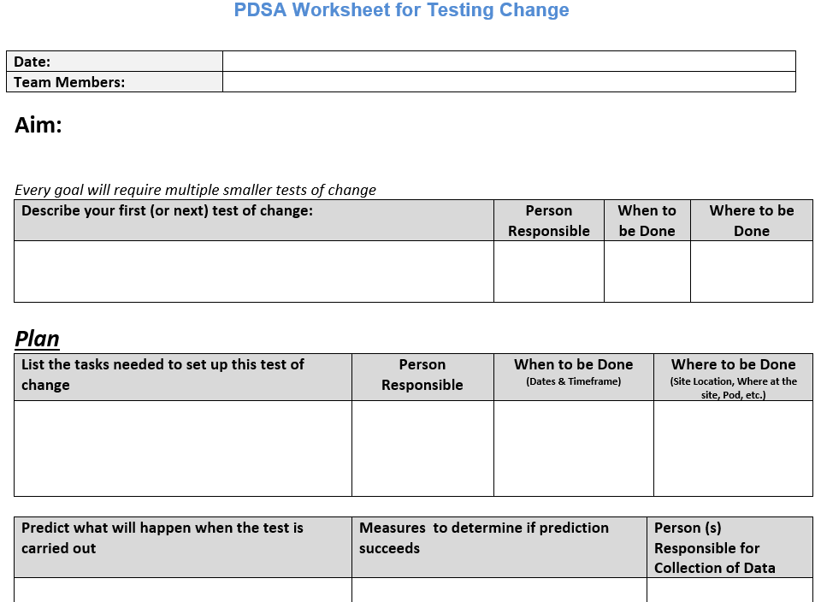
Notes:
MARK

Slide 16



Break!
Take five minutes to recharge and refresh.
16
Notes:
MARK

Slide 17
Small Group Exercise
(See separate Word document)
We will discuss developing a test of change related to the case presented in the accompanying document
You will each be assigned to a breakout room with Natalie, Alyson, or Mark as facilitator. Each group will work on developing the plan for their assigned change from the case for 15 minutes
Have one group member record the discussion using the tables in the case document
We will then hear from each group regarding their proposed plan to test their change idea
Notes:
ALYSON

Slide 18
Problem Background for Exercise
(See separate Word document)
Only 50% of people age 50-64 have received their flu shot at Redline Health Clinic
Initial thought was care team members forgot to inform patients about the importance of vaccination for influenza, but the care team assured this point was stressed with patients.
QI team investigated by randomly selecting 15 patients, aged 50 to 64, who were not vaccinated.
Found that 6 of 10 patients reached reported some type of fear or anxiety as a reason for not receiving their influenza immunization
Notes:
ALYSON

Slide 19
Changes for Groups
Alyson’s group (Postdocs & PMHNP – Stamford & Danbury)
  BH handout to be created by BH staff to address providing psychoeducation about fears and anxiety related to vaccines (it may be worth thinking about whether or not this should be given to all patients receiving vaccines or just those who identify as anxious, fearful, and/or hesitant/skeptical).
Natalie’s group (Holyoke, New Britain, Meriden/Hartford)
  A brief survey is sent to all patients who are eligible for a vaccine (this could be a collaborative effort between medical and BH) to gather information on what may prevent an individual from getting a vaccine at that specific visit or from an individual being compliant with vaccines in the future. This may target the specific question of “what prevents vaccine compliance,” as it may be more than just fear (e.g., cultural considerations, inaccurate information, etc.).
Mark’s group (HealthLinc, Open Door, Middletown, Stamford, New London)
  A medical assistant trained as a community health worker and able to do vaccinations does outreach to patients who have screened positive on the Social Drivers of Health questionnaire (PRAPARE) administered by the health center. The medical assistant will offer the vaccination during a home visit.
Notes:
ALYSON

Slide 20
Small Group Debrief
Notes:
ALYSON

Slide 21
What haven’t we figured out yet?
Questions or issues that remain unclear?
21
Notes:
ALYSON

Slide 22
Take-home Thoughts
Chelsea – share 1 or 2 ideas you will take away from our discussion
Notes:
ALYSON

Slide 23
Summary
The Model for Improvement offers a specific approach to testing a change – the PDSA cycle.
The PDSA cycle is modeled on the scientific method that one would use to do an experiment in a lab or design a research study.
PDSA is one of several approaches to testing and implementing change (others include lean, six sigma, theory of constraints).
Many people approaching an improvement effort underappreciate the importance of the Plan step of the PDSA cycle.
23
Notes:
MARK

Slide 24
Session IX Assignment
Read the HRSA case study (see Word document)
Complete the Plan section of the PDSA worksheet for your project
  Include list of metrics that you recommend be measured
Contact Alyson, Natalie, or Mark if you have questions or need assistance
Send your completed PDSA to Alyson, Natalie, and Mark by 6pm EST on 2/22/23 before our next session on 2/23/23
24
Notes:
www.clinicalmicrosystem.org
24
MARK

Slide 25
References
Donald Berwick, MD, MPP, President and CEO, IHI, www.ihi.org
The Improvement Guide: A Practical Approach to Enhancing Organizational Performance (2nd Edition), Langley GL, Nolan KM, Nolan TW, Norman CL, Provost LP, San Francisco, California, USA: Jossey-Bass Publishers; 2009
Health Resources and Services Administration, agency of U.S. Department of Health and Human Services, Rockville, Maryland: Testing for Improvement Part 2
25
Notes:
www.clinicalmicrosystem.org
25

Slide 26
FYI: PDSA Examples from Previous Resident Teams

Slide 27
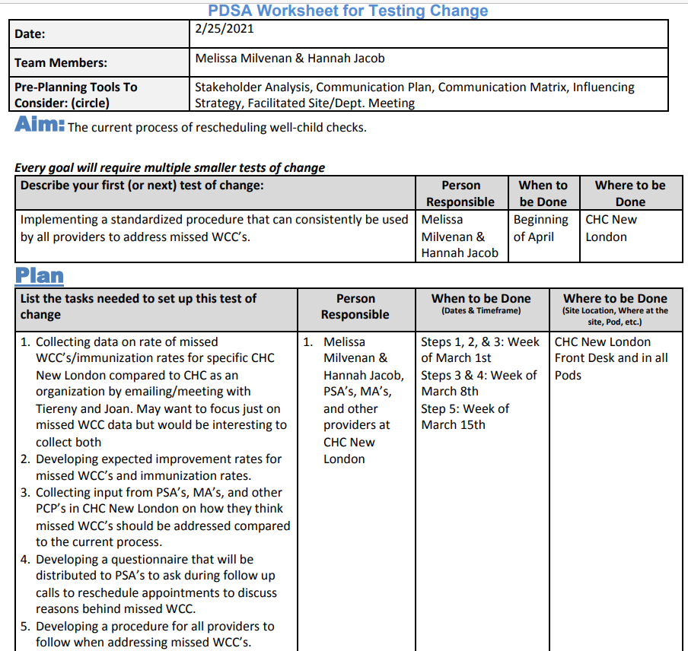
CHC
New
London

Slide 28
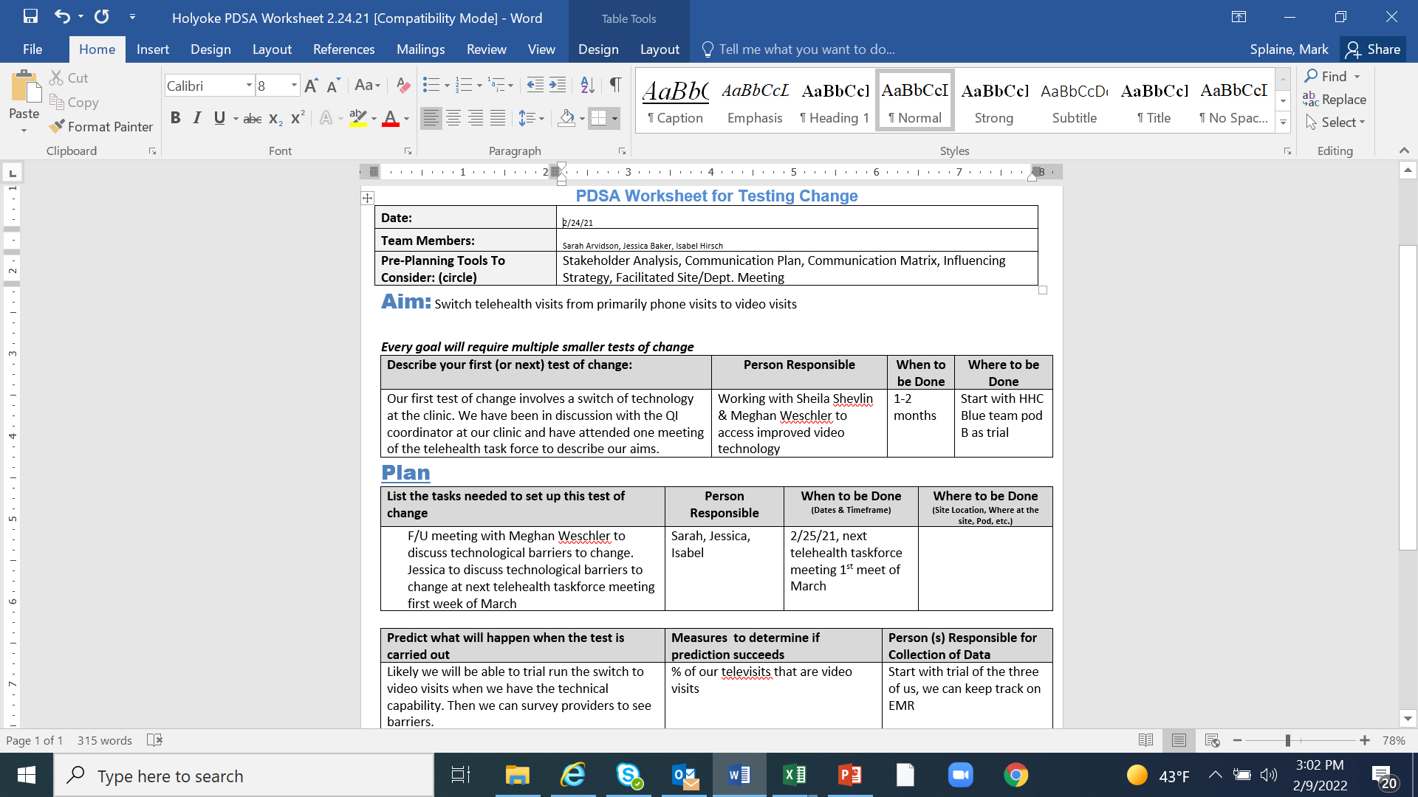
Holyoke
CHC

Slide 29
PDSA Cycle (CHC Meriden)
Plan
List the tasks needed to set up this test of change | Person Responsible | When to be Done | Where to be Done
New visit cards printed and ready to give to patients We need initial patients to test our intervention on | Sarah Sarah & Yalitza | March March | Minuteman Press In Clinic
Predict what will happen when the test is carried out | Measures to determine if prediction succeeds
There will be an increase in the amount of patients that have their blood work drawn within one week of ordered date. Which will lead to quicker diagnosis and treatment of acute and chronic conditions without a delay in care. | Measures: The amount of patients having their blood work drawn within one week of them being ordered.
Do: More patients were having their blood work done more quickly than we thought. Patients really liked the map.
Study: More patients were having their blood work done more quickly than we thought.
Act: For the next cycle: A larger sample number would have to studied. It might be useful to ask the patients what made them get their blood work at that certain time (a post survey). Cards should be printed in color.
Changes made based on these feedback: None yet

Slide 30
PDSA Cycle (Open Door)
Plan:
Improve current RN triage system
Will improve RN and provider satisfaction
Will increase productivity.
Collect Qualitative data
Do:
RN SOAP note documentation improved.
Difficulty finding provider
In pod RN gaining the most.
Act:
Initiate pre-meeting with RNs
Identify point of contact.
Encourage RNs to seek help with all visits.
Study:
RN satisfaction improved.
Provider satisfaction improved
Time management concerns

