Slide 1
Treating Trauma in Adults
Chelsea McIntosh, PsyD
February 2nd, 2023

Slide 2
Continuing Education Credits
In support of improving patient care, Community Health Center, Inc./Weitzman Institute is jointly accredited by the American Psychological Association (APA), Association of Social Work Boards (ASWB), Accreditation Council for Continuing Medical Education (ACCME), the Accreditation Council for Pharmacy Education (ACPE), and the American Nurses Credentialing Center (ANCC), to provide continuing education for the healthcare team.
This session is intended for behavioral health clinicians and nurse practitioner residents as part of a behavioral health didactic series.
Completing a post-session survey is required to claim your CME/CE credits and certificate. A comprehensive certificate will be available after the conclusion of the series.

Slide 3
Disclosure
With respect to the following presentation, there has been no relevant (direct or indirect) financial relationship between the party listed above (or spouse/partner) and any for-profit company in the past 12 months which would be considered a conflict of interest.
The views expressed in this presentation are those of the presenter and may not reflect official policy of Community Health Center, Inc. and its Weitzman Institute.
I am obligated to disclose any products which are off-label, unlabeled, experimental, and/or under investigation (not FDA approved) and any limitations on the information that I present, such as data that are preliminary or that represent ongoing research, interim analyses, and/or unsupported opinion.

Slide 4
Objectives
Discuss how to assess for trauma in adults
Identify ways of distinguishing a trauma presentation from other presenting concerns
Review considerations to creating a trauma-informed environment in your treatment setting
Review general principles of treating trauma in adults

Slide 5
Caveat
Reviewing basic principles and interventions of treating trauma in adults
  Many modalities to treat trauma
    EMDR, Somatic, Art, Yoga, Performance, Movement
    Good overview of all modalities found in:
      Van Der Kolk, B.(2014). The Body Keeps the Score: Brain, Mind, and Body in the Healing of Trauma. Viking.

Slide 6
Recognizing Trauma in Our Clients
Trauma is widespread
  80 percent of adults in primary care report experiencing one traumatic event (Raja et. al, 2021)
Every patient has a story
  Trauma is at the root of many of the presenting symptoms we see
    If we are not addressing the root, we may be insufficiently treating the problem

Slide 7
Recognizing Trauma in Our Clients
Distinguishing trauma exposure from PTSD
  Just because someone may not meet criteria for PTSD, does not mean that their exposure to traumatic events is not impacting their symptoms or their way of viewing the world
  Clients define if an event is traumatic to them
    Understanding that definition, also understanding when trauma may be normalized

Slide 8
Recognizing Trauma in Our Clients
Awareness that some groups are likely to have higher rates of exposure to traumatic events
  Women
    Trauma is more likely to occur earlier and last longer, and is more likely to be perpetuated by loved ones (Najavits, 2002)
  Impact of trauma via non-dominant identities: sociopolitical trauma
    Considering impact of intersectionality (being in more than one non-dominant group increases risk of exposure to trauma(Classen & Clark, 2017)

Slide 9
A Note on Collective Trauma (Hirschberger, 2018)
  Traumatic events that affect widespread groups
    COVID-19 pandemic, climate change, war
  Impacts overall sense of meaning
    Shared societal meaning
  Impact of media exposure (Holman et al., 2019)
  Correlation of perceived authenticity with recovery from collective trauma (Maffly-Kipp et al., 2020)

Slide 10
Recognizing Trauma in Our Clients (Van Der Kolk, 2014; Barnett et. al., 2020; Ellis, 2020)
  Developmental trauma (ACEs/Chronic PTSD) can result in presenting:
    Multiple medical concerns, chronic pain
      Impact on health related behaviors
      Correlation with inflammatory processes (Sin et al., 2015)
      Impact of overactive stress management system impacting immune system and other body systems (Lisak, 2014)
    Multiple trauma exposures
      Exposure increases risk of re-traumatization

Slide 11
Recognizing Trauma in Our Clients (Van Der Kolk, 2014; Barnett et. al., 2020; Ellis, 2020)
    Reduced sense of safety
    Emotion regulation/interpersonal concerns
    Difficulty with treatment compliance
  Increased ACES in marginalized groups, exposure to reduced SDOH quality
    Intervention priority addressing SDOH
    Externalization of trauma to sociopolitical structure

Slide 12
Approaching the Criteria
A: Exposure to a traumatic event (as defined by DSM 5)
  What is the event (or events?) Definition of trauma and limits of this criteria (Panisch et al., 2022)
  Events seen as normative that can be traumatic (eg: living in a high crime area)
  Shame/hesitancy to respond to the word “trauma/traumatic”
    What is some language you could use to assess this criteria not using trauma?
  Need to assess for presence of more than one event (Adams and Allwood, 2020)
    Cumulative effect of multiple/repeated events
  Consider events that result in other criteria’s symptoms
  Traumatic exposure ongoing? Assess for safety

Slide 13
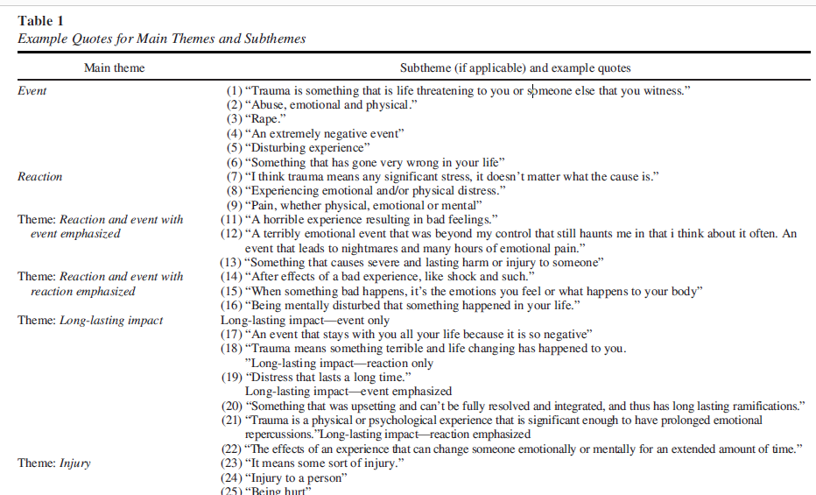
Approaching the Criteria (Panisch et al., 2022)

Slide 14
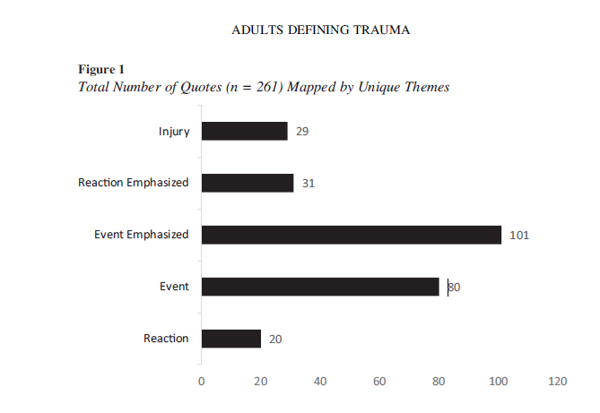
Approaching the Criteria (Panisch et al., 2022)

Slide 15
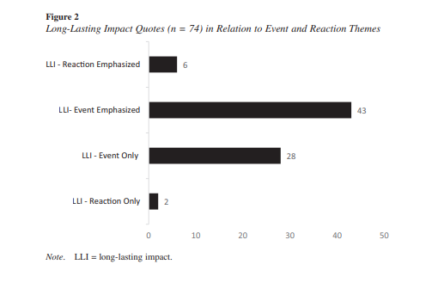
Approaching the Criteria (Panisch et al., 2022)

Slide 16
Approaching the Criteria
B: Intrusive symptoms (flashbacks, nightmares), dissociation, reactions to certain cues
  Identify precipitating cues, themes
C: Avoidance behaviors (places, people, songs, smells, foods, etc.)
  Psychoeducation about why these associations are created
D: Negative effects on cognitions and mood
  Discuss beliefs about self, others, world as a result of these event(s)
E: Arousal
  Insomnia
  Consider B-E symptoms endorsed that there may be an etiology based in trauma exposure even if A is not met

Slide 17
Differential/Comorbid Factors
Consider etiology of trauma as a rule out for all diagnoses
Common comorbid disorders:
  Mood disorders
  Substance use disorders
  Personality disorders

Slide 18
Trauma Informed Care (Classen & Clark, 2017; Robey et al., 2021)
Trauma informed:
  Realize prevalence, recognize symptoms, respond, resist retraumatization
  Associated with improved healthcare outcomes
Avoid re-traumatizing individuals/promote sense of safety
  Waiting in waiting room, waiting in room once roomed
Sense of control over care
    Control about when, how and with whom information is shared, right from the intake
    Collaboration/choice throughout treatment
      Goals
  Transparency: Providing explanations
    Preface anything that you are going to do
    Open communication

Slide 19
Trauma Informed Care (Classen & Clark, 2017)
Structural: consideration of consistent room you use, quiet space
Maintaining reliability, predictability
Setting clear boundaries/expectations
Engage in grounding from the beginning: be aware of nonverbal cues
Focus on relationship building
  Strength based approach
  Normalize symptoms, provide psychoeducation
How are you creating a trauma responsive environment currently?
Examples: Levenson et. al, 2023

Slide 20
Psychoeducation of Trauma (Van der Kolk, 2014)
Physiological response (fight/flight/freeze)
Role of normalizing symptoms in the context of their experiences
  Body’s way of responding to events
How traumatic memories are stored and retrieved based on physiological response
    Stored nonverbally, contributing to flashbacks and cues in association with physiological responses promoting connection to trauma
    Stored in fragments contributing to confusion and fear when flashbacks/nightmares occur
    Role of verbalization in “re-storing” memory
Protective behaviors maintaining the symptoms
  Avoidance, hyper-reactivity

Slide 21
Treatment
Need to establish actual safety before working on sense of safety
Top down vs bottom up approach:
  Top down: looks at cognitions
  Bottom up: focuses on regulation, often a starting point with trauma
    Coping with physiological response
    Grounding vs coping skills, role of mindfulness in managing symptoms
    Goal is not to accept what happened but rather to gain mastery over internal sensations and emotions

Slide 22
Treatment
  Construct anxiety hierarchy of avoidant cues and participate in exposure
  If substance use (and other maladaptive coping): identify what the substance/coping served for the client: match the purpose to an appropriate coping skill
  Past treatment as compared present focused treatment: patients do not need to tell their trauma story in order to recover

Slide 23
Grounding Examples (Najavits, 2002)
Mental Grounding
  Describe your environment in detail using all your senses.
  Describe objects, sounds, textures, colors, smells, shapes, numbers, and temperature
  Play a "categories" game with yourself
  Do an age progression. If you have regressed to a younger age (e.g., 8 years old), you can slowly work your way back up (e.g., "I'm now 9"; 'Tm now 10"; "I'm now 11 "_.) until you are back to your current age
  Describe an everyday activity in great detail
  Use an image to address your emotional state
  Glide along on skates away from your pain; change the TV channel to get to a better show; think of a wall as a buffer between you and your pain
  Say a safety statement. "My name is __; I am safe right now. I am in the present, not the past. I am located in ___; the date is : ______
  Read something, saying each word to yourself. Or read each letter backwards so that you focus on the letters and not on the meaning of words
  Use humor. Think of something funny to jolt yourself out of your mood.
  Count 1 to 10 or say the alphabet, very slowly
  Repeat a favorite saying to yourself over and over

Slide 24
Grounding Examples (Najavits, 2002)
Physical Grounding
  Run cool or warm water over your hands
  Grab tightly onto your chair as hard as you can
  Touch various objects around you
    Notice textures, colors, materials, weight, temperature
    Compare objects you touch: Is one colder? Lighter?
  Dig your heels into the floor-- literally "grounding" them
  Notice the tension centered in your heels as you do this
  Remind yourself that you are connected to the ground
  Carry a grounding object in your pocket
  Jump up and down
  Notice your body
    Wiggling your toes in your socks
    The feel of your back against the chair
  Stretch. Extend your fingers, arms or legs as far as you can; roll your head around
  Walk slowly, noticing each footstep, saying "left,” “right" with each step
  Eat something, describing the flavors in detail to yourself
  Focus on your breathing, noticing each inhale and exhale. Repeat a pleasant word to yourself on each inhale (for example, a favorite color or a soothing word such as "safe," or "easy").

Slide 25
Grounding Examples (Najavits, 2002)
Soothing Grounding
  Say kind statements, as if you were talking to a small child
    Ex: "You are a good person going through a hard time. You'll get through this.”
  Think of favorites. Think of your favorite color, animal, season, food, time of day, TV show
  Picture people you care about
  Remember the words to an inspiring song, quotation, or poem that makes you feel better
  Remember a safe/soothing place (real or imagined)
    Focus on everything about that place: the sounds, colors, shapes, objects, textures
  Say a coping statement
    "1 can handle this", "This feeling will pass.“
  Plan out a safe treat for yourself, such as a piece of candy, a nice dinner, or a warm bath
  Think of things you are Iookinq forward to in the next week

Slide 26
For Grounding/Coping Skills
Role of practice
  Using when distressed and not distressed
  Practicing multiple times
Finding preferred skills
Matching skills to symptoms
Having a “tool box” of multiple skills

Slide 27
Processing Trauma Narrative
Full control over trauma narrative, when, where, how, with whom it is processed (no control over trauma)
Identify themes related to self/world as a result of that/those experience(s). Work to challenge/reconstruct those beliefs
  “How has this event changed what you think about yourself?” and, “How has this event changed how you think about others?” (Cahill & Foa, 2007)
Sit with emotions that arise when processing the narrative and utilize coping/grounding strategies
What makes symptoms better? Worse? (positive and negative coping strategies)

Slide 28
Processing Trauma Narrative: Cognitive Appraisals (McIlveen et. al, 2022)
Alienation appraisals (disconnection from self and others) associated most strongly with PTSD symptoms
  Examples: “There is a huge void inside me” and “My friends don’t understand my reactions”,
  Association with withdrawal from others, endorsing loneliness
  Prioritization of building a strong therapeutic alliance

Slide 29
Seeking Safety Cognitive Restructuring Examples (Najavits, 2002)
  I'm Crazy
  You believe that you shouldn't feel the way you do
  Cognitive restructuring: Honor Your Feelings. You are not crazy. Your feelings make sense in light of what you have been through. You can get over them by talking about them and learning to cope.
  Time Warp
  It feels like a negative feeling will go on forever
  Cognitive restructuring: Observe Real Time. Take a clock and time how long it really lasts. Negative feelings will usually subside after a while; often they will go away sooner if you distract with activities.
  The Past is the Present
  Because you were a victim in the past, you are a victim in the present
  Cognitive Restructuring: Notice Your Power. Stay in the present: I am an adult (no longer a child); I have choices (I am not trapped); I am getting help (I am not alone)
I am My Trauma
  Your trauma is your identity; it is more important than anything else
  Cognitive restructuring: Create a Broad Identity. You are more than what you have suffered. Think of your different roles in life, your varied interests, your goals and hopes.

Slide 30
Consideration of Posttraumatic Growth (Gleeson et al., 2022)
  Associated with greater appreciation of life, improved interpersonal relationships, greater personal strength, recognition of new possibilities, and spiritual or religious growth
  Positive appraisals of traumatic event (eg being able to cope with event successfully) associated with posttraumatic growth
  Potential need to create space for ruminative process related to disrupted schemas associated with event (processing emotional impact of control, safety, identity) prior to transition into PTG process

Slide 31
Consideration of Posttraumatic Growth (Gleeson et al., 2022; Raja et al., 2021)
  Reduced PTG with interpersonal related events and multiple/prolonged events
  Consideration of Trauma Appraisal Questionnaire to determine focus of cognitive restructuring
    betrayal, self-blame, fear, alienation, anger, and shame
    Betrayal and shame associated with PTG significantly
  Resilience associated with single events, having a support system, healthy coping strategies

Slide 32
References
Adams, S. & Allwood, M. (2020). Profiles of home violence and posttraumatic stress symptoms among young adults: Distinguishing between trauma and adversity using latent class analysis. Psychological Trauma: Theory, Research, Practice and Policy, 13, 284-92.
Barnett, M. L., Kia-Keating, M., Ruth, A., & Garcia, M. (2020). Promoting equity and resilience: Wellness navigators’ role in addressing adverse childhood experiences. Clinical Practice in Pediatric Psychology, 8(2), 176– 188. https://doi.org/10.1037/cpp0000320
Breslau, N. & Kessler, R. (2001). The stressor criterion in DSM-IV posttraumatic stress disorder: an empirical investigation. Biological Psychiatry, 50, 699-704.
Cahill, S. & Foa., E. (2007). Psychological Theories of PTSD. Handbook of PTSD: Science and Practice. New York: Guilford Press
Cusack, K., Frueh, C., Brady, K. (2004). Trauma screening in a community health center. Psychiatric Services, 55, 157-62.

Slide 33
References
Ellis, A. E. (2020). Providing trauma-informed affirmative care: Introduction to special issue on evidence-based relationship variables in working with affectional and gender minorities.Practice Innovations, 5(3), 179–188. https://doi.org/10.1037/pri0000133
Gleeson, A., Curran, D., Simms, J., Dyer, K., Fletcher, S., & Hanna, D. (2022). The role of trauma, psychological therapy, and trauma appraisals in predicting posttraumatic growth. Psychological Trauma: Theory, Research, Practice, and Policy, 14, 998-1006. http://dx.doi.org/10.1037/trm0000393
Hirschberger, G. (2019). Collective trauma and the social construction of meaning. Frontiers of Psychology, https://doi.org/10.3389/fpsyg.2018.01441
Holman, A., Garfin, D., Lubens, P., & Silver, R. (2019). Media Exposure to Collective Trauma, Mental Health and Trauma, Does it Matter What you See? Clinical Psychological Science, 8, 111-24.
Lisak, D. (2014). Trauma and neurodevelopment. Paper presented at the Arizona Psychological Association Annual Convention, Tucson, AZ.

Slide 34
References
Levenson, J. S., Craig, S. L., & Austin, A. (2023). Trauma-informed and affirmative mental health practices with LGBTQ+ clients. Psychological Services, 20, 134– 144. https://doi.org/10.1037/ser0000540
Maffley-Kipp, J., Flanagan, P., Kim, J., Schlegel, R., Vess, M. & Hicks, J. (2020). The role of perceived authenticity in psychological recovery from collective trauma. Journal of Social and Clinical Psychology, 39, https://doi.org/10.1521/jscp.2020.39.5.419
McIlveen, R., Mitchell, R., Curran, D., Dyer, K., Corry, M., DePrince, A., Dorahy, M., & Hanna, D. (2022). Exploring the relationship between alienation appraisals, trauma, posttraumatic stress, and depression. Psychological Trauma: Theory, Research, Practice, and Policy, 14(6), 998– 1006. https://doi.org/10.1037/tra0000523
Najavits, L. (2002) Seeking Safety: A Treatment Manual for PTSD and Substance Abuse. Guilford Press, NewYork.
Panisch, L. S., Sperlich, M. I., & Fava, N. M. (2022). How Adults From the General Population DefineTrauma: Highlighting a Need for a Broader and More Inclusive Understanding. Traumatology. Advance online publication. https://dx.doi.org/10.1037/trm0000422

Slide 35
References
Raja, S., Rabinowitz, E. P., & Gray, M. J. (2021). Universal screening and trauma informed care: Current concerns and future directions. Families, Systems, & Health, 39(3), 526– 534. https://doi.org/10.1037/fsh0000585
Robey, N., Margolies, S., Sutherland, L., Rupp, C., Black, C., Hill, T., & Baker, C. N. (2021). Understanding staff- and system-level contextual factors relevant to trauma-informed care implementation. Psychological Trauma: Theory, Research, Practice, and Policy, 13(2), 249– 257. https://doi.org/10.1037/tra0000948
Sin, N., Graham-Engeland, J., Gng, A. & Almeida, D.M. (2015). Affective reactivity to daily stressors is associated with elevated inflammation. Health Psychology, 34, 1154-1165.
Tolin, D. F., & Foa, E. B. (2006). Sex differences in trauma and posttraumatic stress disorder: A quantitative review of 25 years of research. Psychological Bulletin, 132, 959-992. doi: 10.1037/0033-2909.132.6.95
Van Der Kolk, B.(2014). The Body Keeps the Score: Brain, Mind, and Body in the Healing of Trauma. Viking.
APA Handbook of Trauma Psychology: Vol. 2. Trauma Practice, 2017. http://dx.doi.org/10.1037/0000020-025

