Slide 1
The Crimson Tide
Meghan Constantino , CNM
Notes:
Talk slower- plenty of time.
996471 acct
Teens?

Slide 2
Continuing Education Credits
In support of improving patient care, Community Health Center, Inc./Weitzman Institute is jointly accredited by the Accreditation Council for Continuing Medical Education (ACCME), the Accreditation Council for Pharmacy Education (ACPE), and the American Nurses Credentialing Center (ANCC), to provide continuing education for the healthcare team.
This series is intended for post-graduate residents engaging in a year-long Residency program.
Please complete the survey on New Innovations to satisfy your continuing education credit.
A comprehensive certificate will be sent out after the end of the series, June, 2022.

Slide 3
Disclosures
With respect to the following presentation, there has been no relevant (direct or indirect) financial relationship between the faculty listed above or other activity planners (or spouse/partner) and any for-profit company in the past 12 months which would be considered a conflict of interest.
The views expressed in this presentation are those of the faculty and may not reflect official policy of Community Health Center, Inc. and its Weitzman Institute.
We are obligated to disclose any products which are off-label, unlabeled, experimental, and/or under investigation (not FDA approved) and any limitations on the information that are presented, such as data that are preliminary or that represent ongoing research, interim analyses, and/or unsupported opinion.

Slide 4
Learning Objectives
By the end of this didactic, the NP Resident will be able to:
Identify terms related to abnormal uterine bleeding
Identify the differential diagnoses and work up associated with different types of AUB
Identify potential treatment options for various types of AUB
Apply the knowledge gained to real life case studies

Slide 5
Terminology
Amenorrhea
Oligomenorrhea
Polymenorrhea
Menorrhagia
Metrorrhagia
Abnormal/Dysfunctional Uterine Bleeding
Postmenopausal Bleeding
Postcoital Bleeding
Intermenstrual bleeding
Ovulatory bleeding

Slide 6
“No Bleeders”

Slide 7
Amenorrhea/oligomenorrhea
Differentials:
pregnancy
PCOS
Menopause/perimenopause
Thyroid
Prolactin
Adolescence
Iatrogenic
Other: exercise, stress, underweight, overweight
Zebras: mullerian defect

Slide 8
Pregnancy

Slide 9
Pregnancy
Presentation: brown, spotting, red flow, clots- in setting of +HCG
Up to 30% of women have bleeding in first trimester
Approximately ½ will miscarry
Tests:
HCG (urine or serum)
Ultrasound when appropriate
Differentials:
viable pregnancy
ectopic
miscarriage

Slide 10
HCG quantatitive
Best used up to 6 weeks EGA
after 6 weeks US is better tool
If EGA is >6 weeks, but nothing seen on US, HCG can be helpful
expect to double q48 hours (up to ~6000)
If doubling (or more)- suggestive of viable pregnancy
If decreasing- suggestive of SAB
If variable~ suggestive of ectopic vs SAB
1500= earliest might see gestational sac in uterus (to document IUP and r/o ectopic)

Slide 11
Pregnancy
Common Scenarios where serum HCG quantitative will be helpful:
Pt presents with:
history of irregular cycles. doesn’t know when LMP is, but it has been several months.
Positive home pregnancy test but now with bleeding
Recent prolonged spotting
Plan:
urine HCG today.
If positive, check serum HCG quant today and again in 2 days (also blood type/Rh)
if doubling and no more spotting, no further labs needed
if not doubling, continue to check every 2 days until diagnosis is made

Slide 12
PCOS

Slide 13
PCOS
Presentation: missed periods, possibly followed by prolonged bleeding
Need 2/3 following criteria to make diagnosis:
Oligomenorrhea
2 years post menarche
>45 days between cycles
Hyperandrogenism- symptoms or biochemical
Polycystic appearing ovaries on US (>= 12 follicles 2-9mm)
50-70% women with PCOS have PCO
75% anovulatory woman (any cause) can have PCO
8-25% normal women can have PCO
*Exclude other endocrine etiologies*
1
2
3

Slide 14
PCOS
Detailed menstrual history:
Menarche, cycle length, how long periods have been irregular
Symptomatology:
Hirsute
Acne
BMI

Slide 15
PCOS
Testing
Labs:
Oligomenorrhea: TSH, PRL, FSH, LH, HCG
Ovary/adrenal function: total testosterone, SHBG, DHEAS, 17 OHP
Metabolic: lipids, fasting glucose and insulin, A1c, 2hr GTT (etc)
Ultrasound
Do after withdrawal bleed / period
FSH > 30 Primary Ovarian Insufficiency or “early menopause”
LH:FSH >2-3 c/w PCOS
DHEAS >700→ adrenal pathology
17 hydroxyprogesterone- rare, one time ever, atypical CAH when elevated

Slide 16
Testosterone
Helpful to get with SHBG
Sponges up free testosterone (women have more than men)
Increases with pregnancy, COCPs
Decreases with DM, obesity and elevated testosterone
 | Normal SHBG | Low SHBG
Normal total testosterone | Normal | Elevated testosterone
Elevated total testosterone | elevated testosterone | VERY elevated testosterone

Slide 17
PCOS treatment
Goal:
Manage hirsutism
Regulate cycles
Prevent endometrial hyperplasia
Help fertility
Decrease metabolic risk

Slide 18
PCOS treatment
Hirsutism
Temporary/permanent hair removal
shave, wax, electrolysis, laser
Vaniqa/Eflornithin
2x/day
6-8 weeks to see effect
$30/mo
Stops working when stop medication

Slide 19
PCOS treatment
Hirsutism
COCPs *first line*
Estrogen 20-30mcg
progesterone:
Yes: norgestimate, desogestrel*, norethindrone, drospirinone *
*best for acne
No: levonorgestrol or norgestrel
good choices: Yaz, Yasmin, gianvi, desogen, apri
If COCPs contraindicated- consider spiranoloactone 50-100mg BID *must use another form of contraception. Can feminize a fetus.
COCPs x 6 months and local treatment. If unsatisfied, can add spiranolactone

Slide 20
PCOS treatment
Regulate cycles
COCPs, patch, ring, cyclical progesterone
Prevent endometrial hyperplasia
COCPs, patch, ring, depo, nexplanon, hormonal IUD
Cyclic progesterone:
Provera challenge: Provera 10mg x 10day- expect menses within 10days of stopping
If fails, trial one month COCPs for withdrawal bleed- consider endocrine referral
Provera 10mg 1st 10 days of every month

Slide 21
PCOS treatment
Promote fertility
Clomid
Decrease metabolic risk
metformin

Slide 22
PCOS treatment
*****WEIGHT LOSS!!!******
Even 5-10% weight loss, ovulation can resume

Slide 23
PCOS
Common Scenarios:
Pt presents with:
Gets menses q 2-3 months since menarche
But now currently bleeding daily for 1 month
Trying to get pregnant without success
Plan:
Order blood work:
Minimum: Hcg, PRL, TSH, FSH, testosterone
Consider US
Provera challenge- follow up 1 month
Weight counseling, if indicated

Slide 24
“Bleeders”

Slide 25
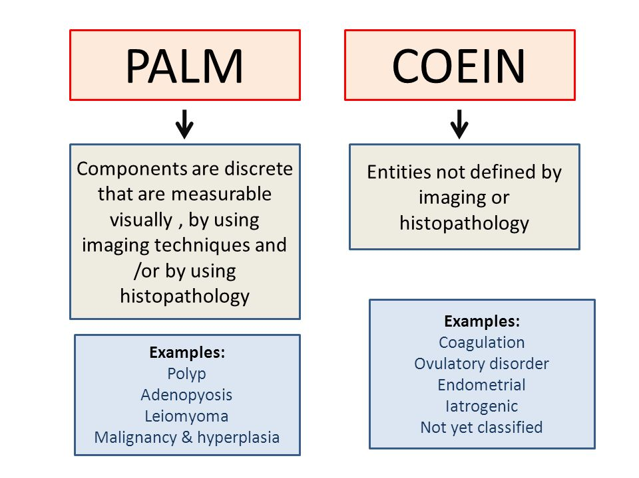
PALM- COEIN

Slide 26
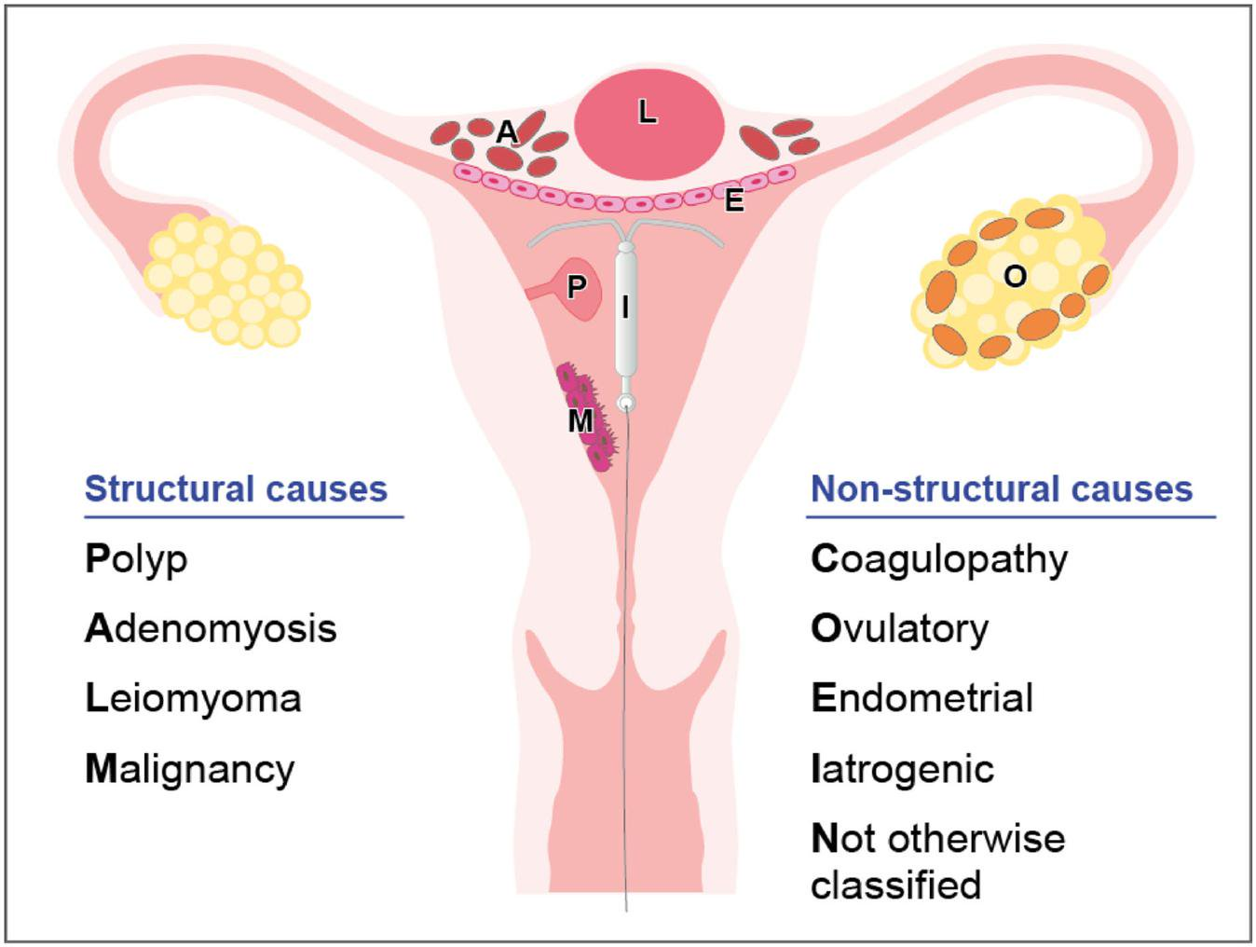
PALM- COEIN

Slide 27
Polyp
hyperplastic overgrowths of endometrial glands and stroma
usually benign (95%)
Malignancy more common in postmenopausal and symptomatic women
Presentation: heavier periods, longer periods, intermenstrual bleeding, PMP bleeding, Can be asymptomatic
Diagnosed by: ultrasound, sonohysterogram, hysteroscopy
Treatment: polypectomy, D&C, can respond to hormones
If asymptomatic, remove if: >1.5cm in diameters, multiple polyps, prolapsed through cervix, infertility
Small percentage resolve on its own

Slide 28
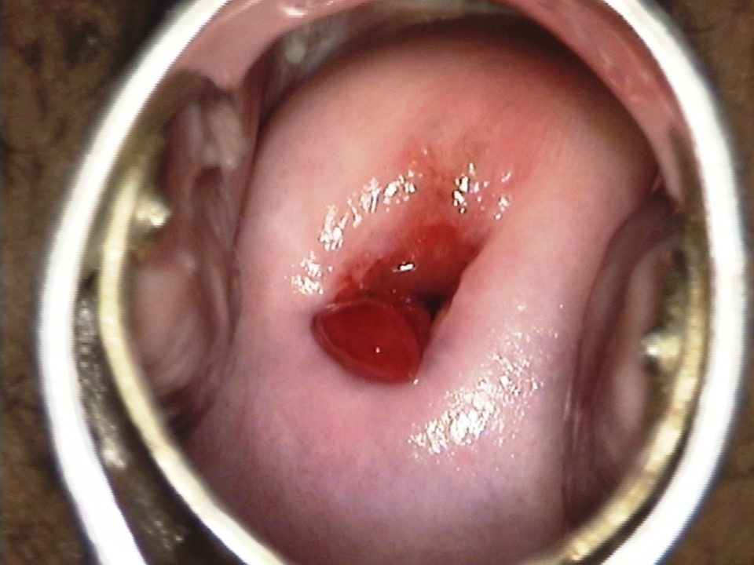
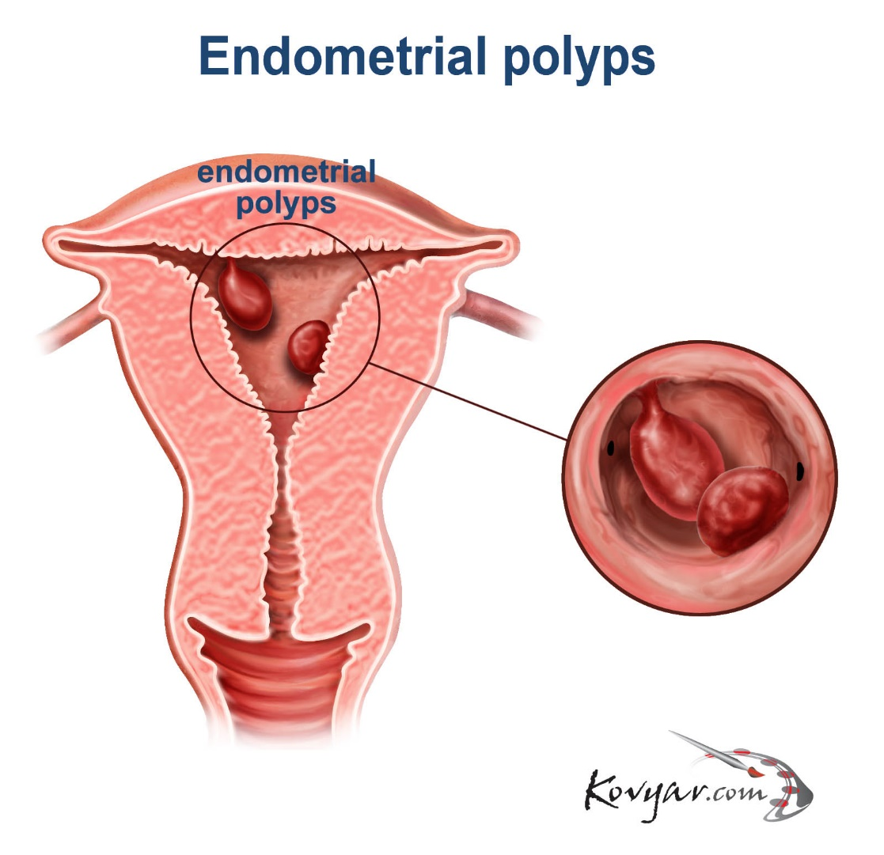
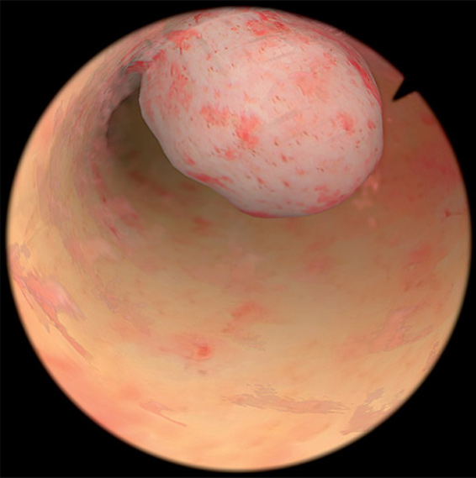

Slide 29
Adenomyosis
endometrial tissue in myometrium vs hyperplasia of myometrium.
increased endometrial surface of the enlarged uterus
Presentation: heavy painful periods, Can be asymptomatic
Diagnosed by: ultrasound, MRI, hysterectomy
Treatment: hysterectomy, uterine artery embolization, can respond to hormones

Slide 31
Leiomyoma/ Fibroids
benign fibromuscular tumors of the myometrium
Submucosal most likely to contribute to AUB
Presentation: heavy painful periods, Can be asymptomatic
Diagnosed by: ultrasound
Treatment: hysterectomy, myomectomy, uterine artery embolization, endometrial ablation, can respond to hormones

Slide 32
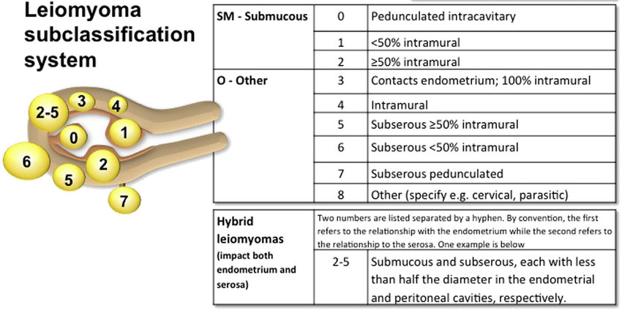
Leiomyoma

Slide 33
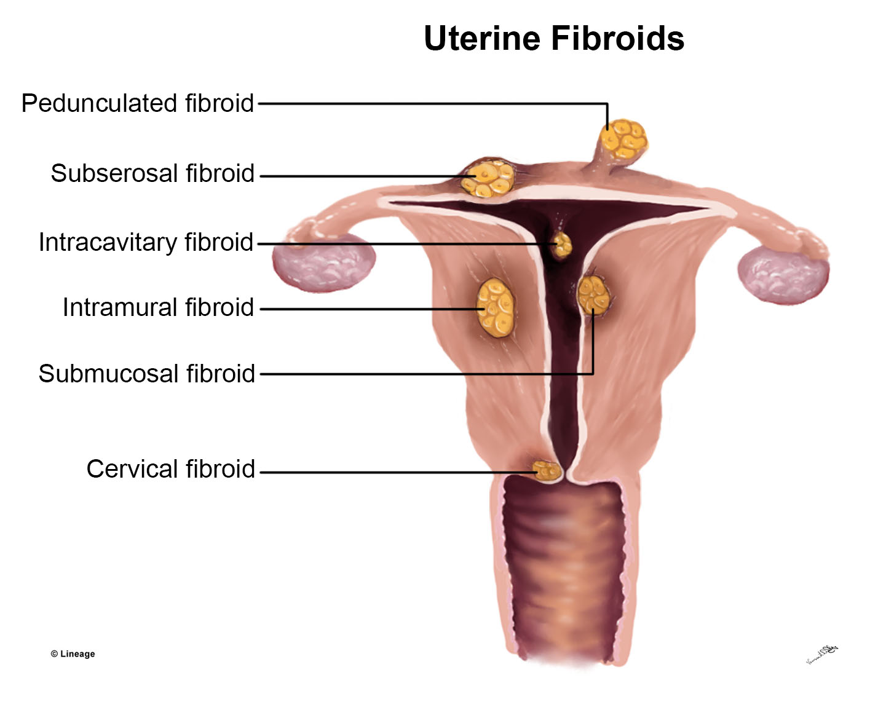
Leiomyoma

Slide 34
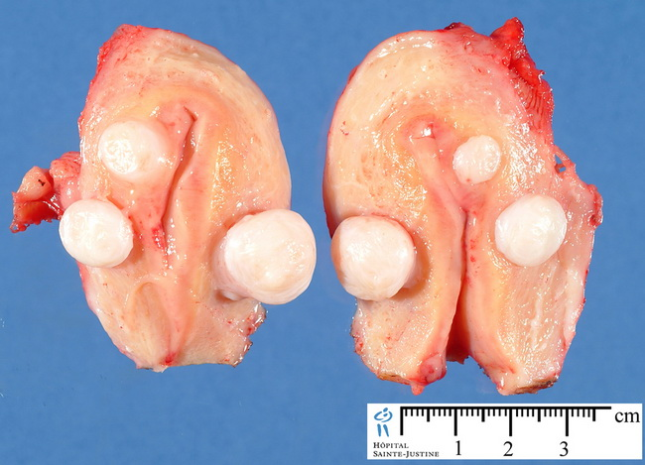
Leiomyoma

Slide 35
Malignancy and Hyperplasia
Malignancy= endometrial (or cervical!)
Subcategories:
Hyperplasia without atypia
Atypical hyperplasia/Endometrial intraepithilieal neoplasia
Presentation: menorrhagia, polymenorrhea, postmenopausal bleeding
Signs: PMP ultrasound endometrial lining >4mm (with symptoms) >11mm (without symptoms)
Diagnosis: pap smear/biopsy, endometrial biopsy or D&C
Ultrasound: heterogenous versus homogenous endometrial lining

Slide 36
Malignancy and Hyperplasia
Age >35

Slide 37
COEIN
Coagulopathy- VWBD
Ovulatory dysfunction- PCOS, PRL, Thyroid, mental stress, obesity, anorexia, weight loss, extreme exercise
Endometrial- disorder of endometrium (inflammation, infection, abnormal vasculature)
Ie Post coital
Iatrogenic- coper IUD, hormonal birth control, anticoagulants
Not yet classified

Slide 38
Management Menorrhagia/Polymenorrhea
NSAIDS- ibuprofen, naproxen
Mirena/ Liletta
Depo- Provera150mg
can receive up to 1 month early for bleeding
COCPs/ring/patch
Continuously cycling
Taper
2 pills daily for 3-5 days
3 pills x 2 days, 2 pills x 2 days, 1 pill daily

Slide 39
Management Menorrhagia/Polymenorrhea
Provera:
10 mg daily for 10 days or beyond
can take 2 or 3 pills prn
Agestin, norenthindrone 5mg
Lysteda (tranexamic acid 650mg- 2 tab TID x 5 days).
Surgery
D&C
Uterine artery embolization
Myomectomy
Endometrial Ablation
hysterectomy

Slide 40
Management Post Coital
Treat cause (based on results)
If no identifiable infection, treat for general cervicitis
Doxycycline 100mg BID x 10d
Check pap
Consider colpo if persists despite treatment

Slide 41
Recap
Oligo/amenorrhea
Work up:
TSH, PRL, HCG, FSH, PCOS labs
Treatment:
Weight loss, Provera challenge, Protect the endometrium! hormones
Menorrhagia
Workup:
pap, sureswab, bloodwork: TSH/CBC , Ultrasound, sampling: EMB or D&C
Treatment:
Slow the bleed! hormones

Slide 42
Recap
Postmenopausal bleeding
Work up:
pap, sureswab, bloodwork: TSH/CBC , Ultrasound, sampling: EMB or D&C
Treatment:
Benign: Expectant management, monthly provera,
Hyperplasia: referral GYN/ GYN ONC
Pregnancy bleeding
Work up:
Serial HCG quants, ultrasound
Treatment:
Expectant management, referral to OB

Slide 43
Recap
Postcoital Bleeding
Work up:
Cultures for infection, pap, colpo
Treatment:
Treat infection
Frequent bleeding
Work up:
TSH, VWBD panel, ultrasound *see also menorrhagia*
Treatment:
Regulate bleeding or quiet endometrium

Slide 44
Recap
Medication protocols:
NSAIDs
Ibuprofen 600mg q 6hours
Naproxen 500mg BID
Provera
TO START BLEEDING: Challenge= used to induce withdrawal bleed
10mg x 10 days- anticipate bleeding in the 10 days after stopping medication
TO STOP BLEEDING: 10 mg x 10 days (or longer! Can double up if needed)

Slide 45
Recap
Medication Protocols:
Norethindrone
Minipill: 0.35mg
Aygestin 5mg
COCPs
As directed
Continuously cycling
Taper: 2 pills daily for 5 days vs 3-2-1 approach
Patch/ring
As directed
Continuously cycling
FYI ring is equally effective eif left in place for 4 weeks

Slide 46
Recap
Medication Protocols:
Depo
As directed
If pt starts bleeding
Can give up to a month early
Can add additional progesterone vs COCPs
Mirena/Liletta
Nexplanon
20-25% have little to no bleeding
Tranexamic acid
2 pills TID x 5 days when bleeding starts or is heavy

Slide 47
Case Studies

Slide 48
“AEG”

Slide 49
AEG
29 yo hispanic G2P2002 c/o bleeding x 2 weeks. LMP prior to this one was 2 months ago. Also c/o pelvic pain
Pertinent medical hx: none
Menstrual hx:
Menarche: ?
Menses q2-3 months x 1 week for the past 5 years. No hirsutism, no acne, BMI 27
Exam: brown discharge/blood noted in vaginal vault, mild adnexal tenderness bilateral, mild fundal tenderness

Slide 50
AEG
What’s your plan? (work up? Treatment?)
Labs: PRL, TSH, HCG, testosterone with SHBG, FSH, LH, estradiol, 17 hydroxyprogesterone, DHEAS, pap, sureswab, urine culture
Imaging: declined US for pelvic pain
Offered naproxen 500mg BID x 7-14 days. f/u 2 weeks

Slide 51
AEG
2 weeks later:
Bleeding stopped
Labs all normal
Plan: Pt chose to expectantly manage with bleeding diary

Slide 52
“ES”

Slide 53
ES
18yo white G0 presents with no bleeding x 4 years
Pertinent medical hx: none
Menstrual hx: menarche age 14, x2 days no bleeding since
+sexually active, using condoms
BMI 34, no acne, no hirsutism (admits to plucking hair on chin)

Slide 54
ES
What’s your work up? What’s your plan?
Labs: PRL, TSH, HCG, testosterone with SHBG, FSH, LH, estradiol, 17 hydroxyprogesterone, DHEAS, androstenedione, A1c, fasting glucose and insulin
Provera challenge: 10mg x 10 days,
f/u 1 month

Slide 55
ES
1 month later:
+withdrawal bleeding
Labs:
elevated free and total testosterone
LH 16.6/FSH 3.8 (ratio >3)
elevated fasting insulin (normal A1c, normal fasting glucose).
Plan:
goals? Contraception, endometrial protection, decrease metabolic risks
start gianvi,
refer to PCP for weight management/ impaired fasting insulin

Slide 56
“VMG”

Slide 57
VMG
29yo Hispanic G0 presents wanting pregnancy. Trying to conceive x 4 years
Pertinent medical hx: prolactinoma in past- used meds
Menstrual hx: menarche age 11, menses q1-2 months x 7days

Slide 58
VMG
Whats your work up? Whats your plan?
Labs: prl, TSH, HCG, FSH, LH, PRL,testosterone with SHBG, DHEAS, 17 hydroxyprogesterone, estradiol, androstenedione, A1c, AMH, day 21 progesterone
Imaging: US for fertility purposes

Slide 59
VMG
Results:
AMH: 5.86
FSH/LH: 6.0/5.9
D21 progesterone: <0.1
Imaging: US “small peripherally oriented follicles are noted in outer ovaries. This appearance may be seen with PCOS but is not diagnostic”

Slide 60
VMG
Assessment:
PCOS
Annovulatory
Plan:
Provera prn
Clomid

Slide 61
“AA”

Slide 62
AA
Cc: Pt here today for vaginal bleeding x 7d after years of no bleeding (one other episode of vaginal bleeding 2 years ago)
56yo G4P3013
MHx: hyperlipidemia, hypothyroid, GERD, tobacco use, h/o cocaine use, type 2 DM (hx diabetic ulcer LLE), sleep apnea, morbid obesity (last documented BMI 64), HTN arthritis
GYNHx: menarche age 10, no menses since last child was born (pt age 37), no hx abn paps, last pap 11/2015 WNL neg HPV

Slide 63
AA
What stands out?
56yo G4P3013
MHx: hyperlipidemia, hypothyroid, GERD, tobacco use, h/o cocaine use, type 2 DM (hx diabetic ulcer LLE), sleep apnea, morbid obesity (last documented BMI 64) HTN , arthritis
GYNHx: menarche age 10, no menses since last child was born (pt age 37), no hx abn paps, last pap 11/2015 WNL neg HPV

Slide 64
AA
Today:
HPI:
no periods x 19 years. 2 years ago had episode of bleeding x 4d. At that time: Pap WNL, neg HPV. Was sent for pelvic ultrasound but never went. bleeding got better.
Now presents for another episode of light bleeding with some small clots x 7 days.
Reports family has a history of early menopause. She also states has several family members who had similar symptoms- post menopausal bleeding- and then needed hysterectomies

Slide 65
AA
Chart review from 2 years ago:
Pt reported bleeding after 18yr of amenorrhea. Reported normal bx in 2012.
Assessment: PMP bleeding
Plan:
pap (WNL, neg HPV)
sureswab (neg)
TVUS (pt did not go)

Slide 66
AA
In summary: stopped bleeding at age 37, then had 2 episodes of bleeding in her early fifties. Has not completed a full work up. Has multiple risk factors for endometrial malignancy.
What is your assessment?
PMP bleeding vs AUB
What are you going to do today?
Exam including pap, order US, order FSH , plan for EMB
Pt declined exam because she “did not prepare”

Slide 67
AA
Results
LABS: FSH 16.6, LH 13.3
ULTRASOUND: endometrial stripe 8mm
What do these results tell you?
FSH is NOT in menopausal range. She has AUB
For premenopause endometrial stripe is normal, for postmenopause endometrial stripe is ABNORMAL for a woman with bleeding

Slide 68
AA
Pt did not come in for follow up for 5 months

Slide 69
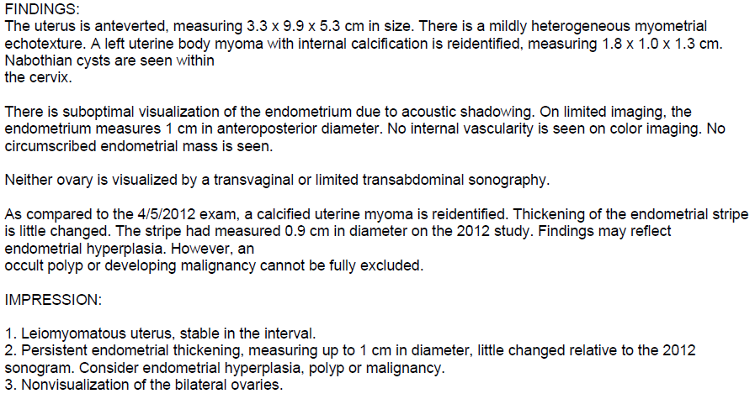
AA
US:

Slide 70
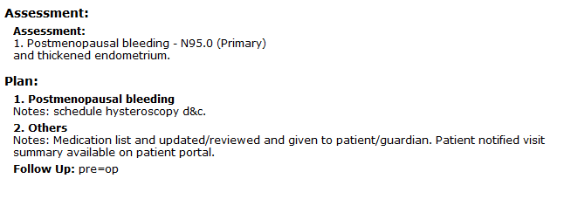
AA
2 months later:

Slide 71
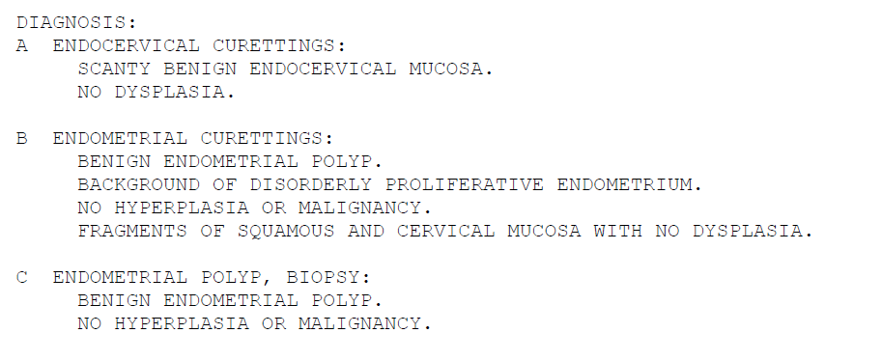
AA
2 months later: Hysteroscopic D&C
c
c
c
c
c

Slide 72
AA
Options for treatment/followup:
Expectant management
Provera 10mg x 10 days monthly until withdrawal bleeding stops
How long is uterine pathology “good for”?
1 year

Slide 73
“JB”

Slide 74
Case Study JB
10/2018 PCP visit
54-year-old female with a past medical history of hypertension, Hashimoto's, genital herpes who presents with a complaint of abnormal uterine bleeding. -Menses q 3 weeks- recently lasting 2+ weeks. Soaking pad q hour at heaviest. -Does "vaginal weight lifting." -Normal Pap with negative HPV 4 years ago. -Positive chlamydia 5/26/18, negative 7/13/18. Denies risky sexual behavior since.

Slide 75
Case Study JB
What is your work up and plan?

Slide 76
Case Study JB
Assessment: AUB
Plan: (PCP consulted with CNM)
check FSH
Suspect related to perimenopausal bleeding
recommend US and EMB
Pt declines US. Has no insurance
Discussed use of NSAIDs to help with bleeding and cramping while in Ireland.

Slide 77
Case Study JB
TE to pt after consult with CNM regarding plan. Pt upset at suggesting EMB to r/o malignancy, stating "why would you put that in someone's mind! that's completely untrue I'm not going to get cancer"

Slide 78
Case Study JB
11/2018 (1 month interim)
FSH 28.3
EMB:

Slide 79
Case Study JB
What’s you’re plan?
Pt expectantly managed

Slide 80
Case Study JB
1/4/2019 (3 month interim)
presents with a complaint of nonstop bleeding for past 20 days. Slows down some days but typically heavy, changing a pad every hour. Tired of it, feeling weak. Tried oral iron in the past but it made her stomach hurt so now tries to eat iron rich foods. Hemoglobin today 14.3.
Had same many years ago and took OCPs for. Previously controlled for years, then started over a year ago, off and on.

Slide 81
Case Study JB
Exam: benign (pelvic exam not performed)
Plan?
Provera 10mg daily (advised could take 2 pills daily if needed)

Slide 82
Case Study JB
1/8/19 (4 day interim)
Taking provera 1-2 pills daily. Bleeding less but still heavy
Plan: continue provera, agree to trial mirena

Slide 83
Case Study JB
1/22/19

Slide 84
Case Study JB
What are her options?

Slide 85
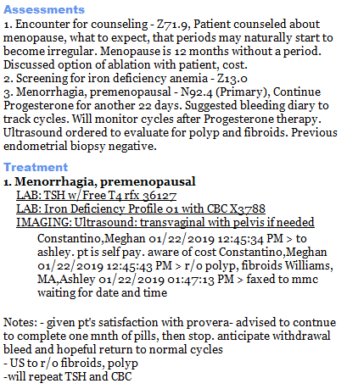
Case Study JB

Slide 86
“EW”

Slide 87
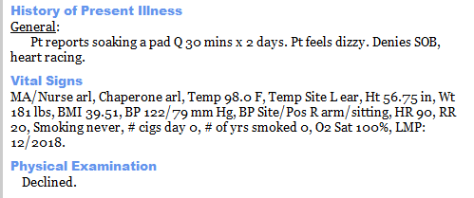
Case Study EW
12/12/18
36 yo G1P1 with minimal medical hx (sister with breast ca age 27) presents for problem visit. No pap on file

Slide 88
Case Study EW
What are your differentials?
What are you going to do?

Slide 89
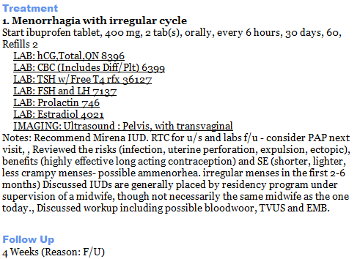
Case Study EW

Slide 90
Case Study EW
Hgb 8.2/hct 27.7

Slide 91
Case Study EW
12/17/18 (5 day interim) pt called and was reporting significant symptoms of anemia. Bleeding had slowed. Sent to ED where H/H was 5.7/20.0. Transfused x 2units
12/19/18 pt reports stating bleeding again
What’s your plan?

Slide 92
Case Study EW
Plan:
provera 10mg daily x 10d
Stat US
Mirena insertion ASAP

Slide 93
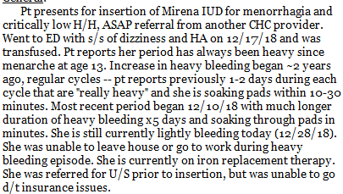
Case Study EW

Slide 94
Case Study EW
Plan?
Pt counseled and accepts EMB and Mirena placement today

Slide 95
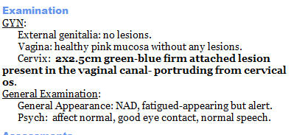
Case Study EW

Slide 96
Case Study EW
1. mass removed and sent to pathology
2. EMB performed
3. Mirena IUD placed successfully

Slide 97
Case Study EW

Slide 98
“AVR”

Slide 99
AVR
39 yo Hispanic female without insurance
Pertinent Med hx: anemia with hx blood transfusion, migraine w/o aura
OB hx: G3P3003 svd x 3
GYN hx:
Menarche age 12
Menses: hx irregular menses prior to pregnancies but regulated after last pregnancy. Heavy in the past few years
Pap smear: this year normal, neg HPV. No history of abnormals

Slide 100
AVR
10/23/18
Reports menses q month x 7-9 days. The first three days are heavy, reporting gushes “like I’m peeing” and golfball sized clots. +cramps but doesn’t like to take meds
Hgb 9.1 and iron studies consistent with iron deficiency anemia
Normal TSH

Slide 101
AVR
What is your work up and plan?
Ultrasound!
EMB!
TSH/CBC (already done)
Mirena!

Slide 102
AVR
Pt declined US due to cost (no insurance)
11/13/18 EMB done (benign) and Mirena IUD inserted
1/2/19 IUD follow up visit- light bleeding for 2 weeks then stopped. Strings not visible on exam
1/14/19 TVUS showed IUD in situ, 2 left ovarian simple cysts 4.9cm and 2.9 cm
3/25/19 TVUS normal- IUD in situ and cysts decreased in size
5/14/19 TSH WNL

Slide 103
AVR
6/18/19 (8 month interim)
First few months s/p mirena minimal bleeding then in past 3 months had monthly menses x 6 d but heavy flow.
Hgb 8.3
Rx provera 10 mg prn heavy bleeding
7/9/19 (1 month interim)
Visit for acute pelvic pain. Exam concerning for appendicitis- refused ED. also noted bleeding daily x 1 month despite provera. Bleeding is lighter but present

Slide 104
AVR
10/17/19 (3 month interim)
Did not follow up as scheduled- did not continue provera
Bleeding 3weeks/month- flow varies. Saw PCP week before and restarted provera but when stopped, heavy bleeding returned.
Hgb 7.6

Slide 105
AVR
What is your plan?
Started on norethindrone 5mg daily with close follow up

Slide 106
AVR
11/14/19 (1 month interim)
bleeding daily. Changing pad q3-4 hours . No clots. c/o dizziness, fatigue, SOB.
Hgb 7.5

Slide 107
AVR
What is your plan?
COCP taper
Junel Fe 1.5/30- three pills x 2 days, two pills x 2 days, one pill daily, SKIP placebos.
Close f/u
Consider depo/IUD removal

Slide 108
AVR
11/23/19 TE (1 week interim):
Pt in neuro ICU with stroke, Thrombectomy. lethargic cannot get full history. reviewed with MD- pt's gyn hx (G3P3 svd x 3, bleeding hx, pelvic US, meds for bleeding- including recent start of estrogen to control bleeding after failing mirena, provera, aygestin). answered questions to help coordinate care.

Slide 109
AVR
2021-2022 update:
Pt with Mirena replaced 2020 due to malposition (in cervical canal).
11/2021. Had episode of prolonged bleeding .US again showed IUD in lower uterine segment/cervical canal (as well as fibroids). Declines using other medications.
12/2021 IUD replaced. EMB performed-benign.
1/2022 f/u US showed IUD in situ

Slide 110
“VMG”

Slide 111
VMG- remember her???
***This case takes place during COVID 19 pandemic***
TE: 31 yo Hispanic woman calls reported 3 weeks of spotting
Medical hx: prolactinoma, PCOS diagnosed by oligomenorrhea and PCO on US (1 year ago)
OBGYN hx:
G0P0
Pap 1 year ago normal, neg HPV
TTC x several years
Menarche age 11
Menses q1-7 months
LMP 2 months prior. States she has taken 2 negative HPT (the most recent one 2 weeks ago). Of note, pt had been taking fertility medications- though not in the past 2 months- was awaiting next period to restart

Slide 112
VMG
What is your plan?
Serum HCG
Telehealth visit after results

Slide 113
VMG
Telehealth visit:
pt being followed for infertility/annovulation. had spontaneous pregnancy! (LMP 5/4/2020) called 7/2 and reported spotting for 3 weeks. 7/2/2020 HCG 514 7/4/2020 went to ED- HCG 473. US- no IUP. blood type O+ had darker spotting which eventually turned to red bleeding and passing something. Has photo- will send in

Slide 114
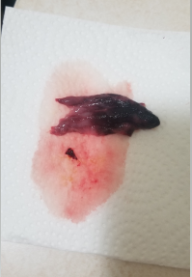
VMG
Photo:

Slide 115
VMG
Assessment?
Likely SAB
Plan?
Follow HCGs to negative. Will order one now. If trending downward can check q1-2 weeks until negative

Slide 116
VMG
HCG result: 486
HCG hx: 514 -->473 --> 486
Plan?
Check q 48 hours
Next HCG: 681
HCG hx: 514 -->473 --> 486--> 681
Plan:
STAT US to r/o ectopic

Slide 117
VMG
STAT US report: no IUP, anechoic area adjacent to ovary
Plan?
To ED for methotrexate
Need HCGs on d1, d4 and d7
Expect at least a 15% drop between d4 → d7, then follow HCG weekly until negative
Pt’s HCGs dropped appropriately, were followed until negative and then had a spontaneous period.

Slide 118
“LM”

Slide 119
LM
36 yo presents to review US-ordered for pelvic pain and irregular and heavy bleeding
Medical hx: hemorrhoids, asthma, foot pain
OB hx: G6P3033 c/s x 3, sab x 3
GYN hx: menarche age 11, menses q month, recent inter menstrual bleeding, s/p BTL, hx ovarian cysts, pap 1.5 yr ago normal neg HPV, no hx abnormals

Slide 120
LM
HPI:
-menses q month but has intermenstrual bleeding 2 weeks after period x 2 days with associated cramps -menses x 6-7 days, heavy (needs to change overnight pad q1 hour) some golfball sized clots, +cramps tylenol helps but wears off -US 9/5/19 shows multiple small fibroids (largest 1.5cm) and possible endometrial polyp vs calcification).

Slide 121
LM
Assessment?
Menorrhagia
Plan?
CBC and TSH ordered
Already on COCPs x 2 weeks- advised continuation
Offered EMB vs Hyst D&C (recommend Hyst D&C)- surgical consult with MD made

Slide 122
LM
Pathology:
Plan:
Reviewed with MD, pt desires definitive treatment with hysterectomy

Slide 123
LM
Pathology:

Slide 124
“FAM”

Slide 125
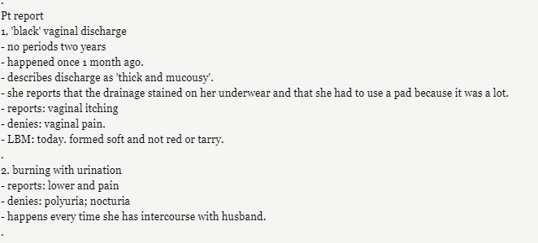
FAM
49yo hispanic woman with a hx of menorrhagia, high cholesterol, obesity, pre-DM, chronic pain syndrome and migraines
Meds: vit D, imitrex, atorvostatin, gabepentin
Visit date: 12/13/21

Slide 126
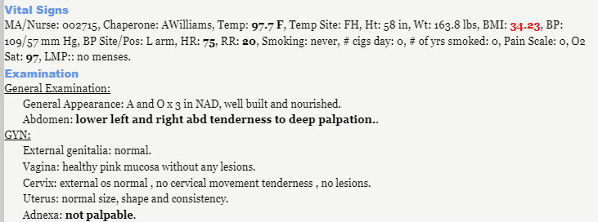
FAM

Slide 127
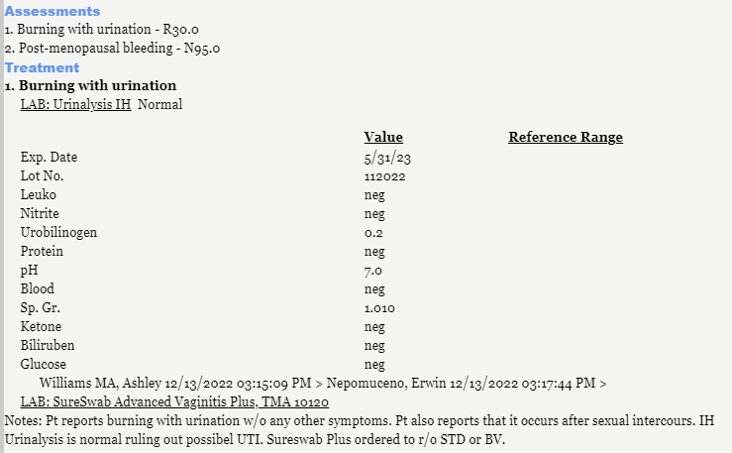
FAM

Slide 128
FAM

Slide 129
FAM

Slide 130
FAM

Slide 131
FAM
What’s your plan?
EMB vs D & C
(appointment pending)

Slide 132
“YM”

Slide 133
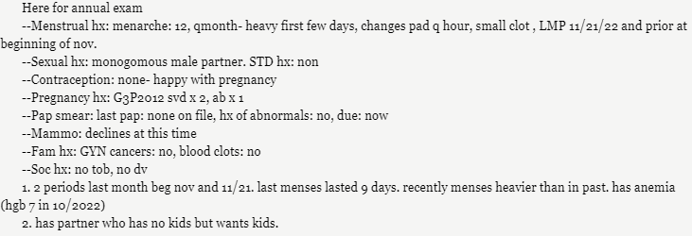
YM
44yo Hispanic G3P2012 with medical hx: asthma, hypothyroid, fibromyalgia
Meds: levothyroxine, albuterol, gabapentin, ferrous sulfate, colace

Slide 134
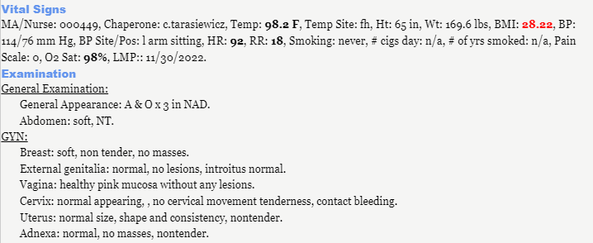
YM

Slide 135
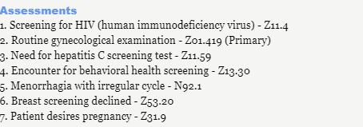
YM

Slide 136
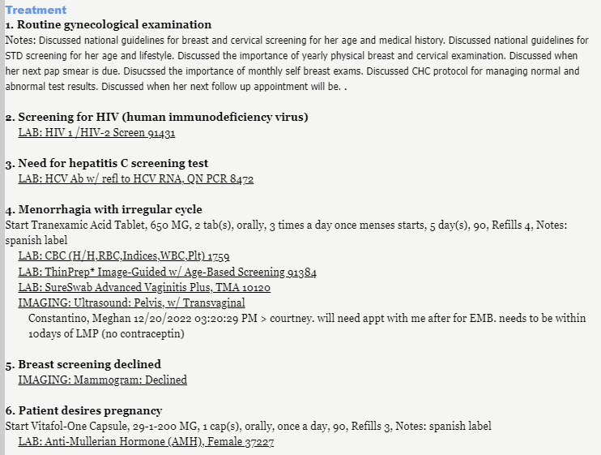

Slide 137
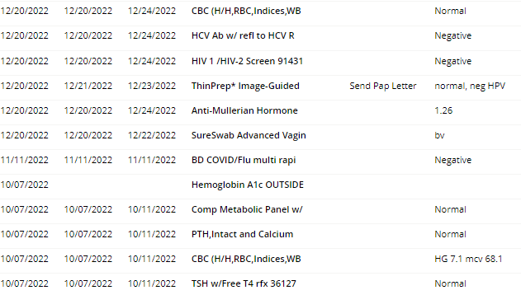
YM

Slide 138
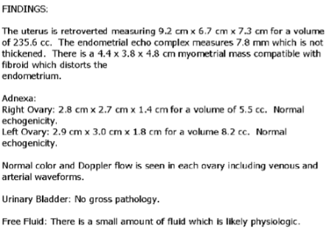
YM

Slide 139
YM
Diagnosis:
Fibroid
Plan:
Does she still need EMB?
Yes!

Slide 140
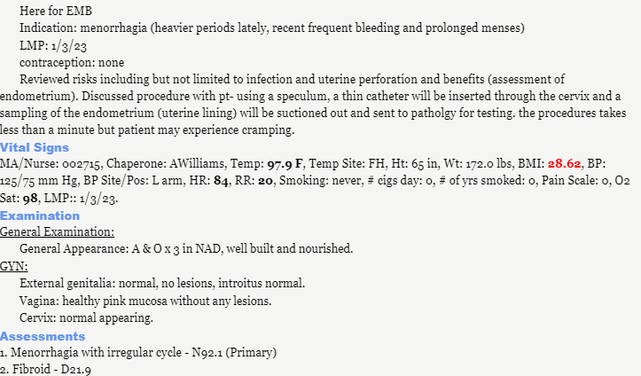
YM

Slide 141
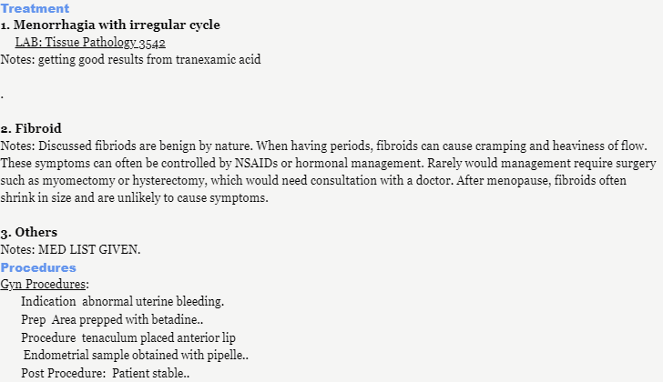
YM

Slide 142
YM
EMB result:
PLAN:
Doxycycline 100mg BID x 10-14 days

