Slide 1
HIV Primer (and then some) for the Non-HIV Provider
March 23, 2023
Marwan Haddad MD, MPH, AAHIVS
Center for Key Populations
Community Health Center, Inc.
Middletown, CT

Slide 2
Disclosure
With respect to the following presentation, there has been no relevant (direct or indirect) financial relationship between the party list above (or spouse/partner) and any for-profit company in the past 24 months which could be considered a conflict of interest.
The views expressed in this presentation are those of the presenter and do not reflect the official policy of CHC, Inc.
I am obligated to disclose any products which are off-label, unlabeled, experimental, and/or investigation (not FDA approved) and any limitations on the information that I present, such as data that are preliminary or that represent ongoing research, interim analyses, and/or unsupported opinion.

Slide 3
Outline
Epidemiology
HIV Screening
PrEP/Treatment as Prevention
Preventive Care and Monitoring
HIV Treatment and Anti-Retroviral (ARV) Complications
Common Opportunistic Infections (OIs) (time permitting)
Case Study

Slide 5
Epidemiology of HIV
About 1.2 million people with HIV are living in the U.S. in 2019.
1 in 8 (about 13 %) unaware of their infection.
In 2020, 30,635 new infections occurred.

Slide 6
HIV Incidence

Slide 7
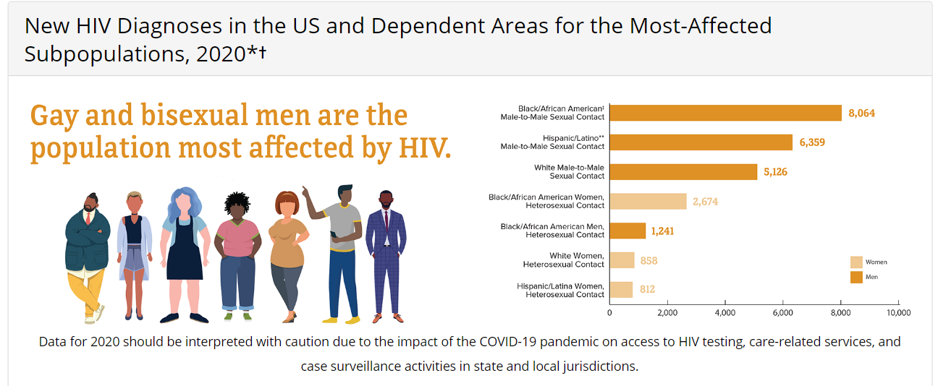

Slide 8
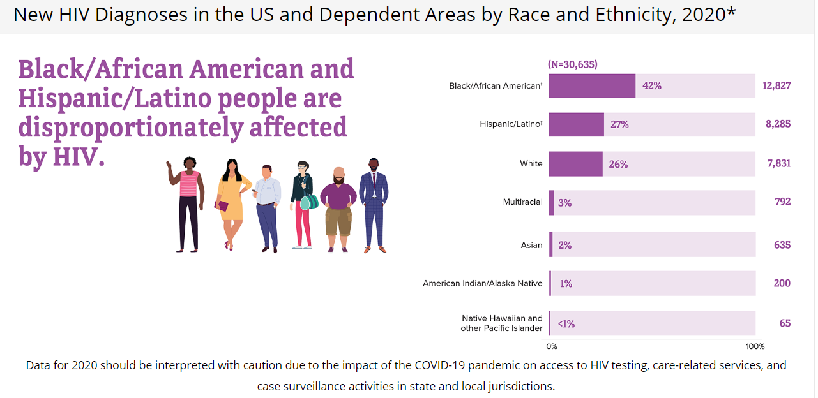

Slide 9
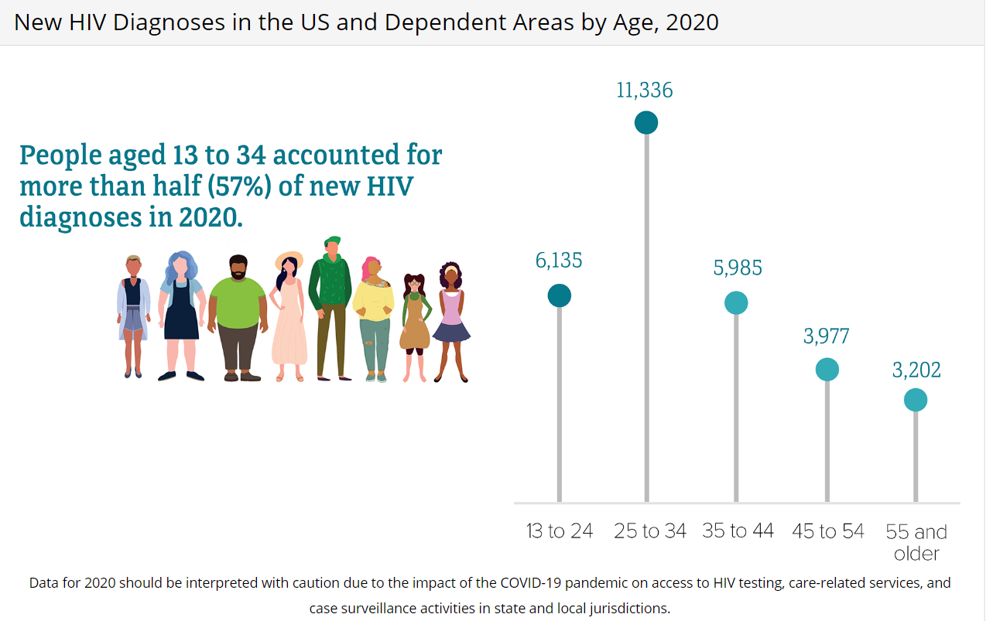

Slide 10
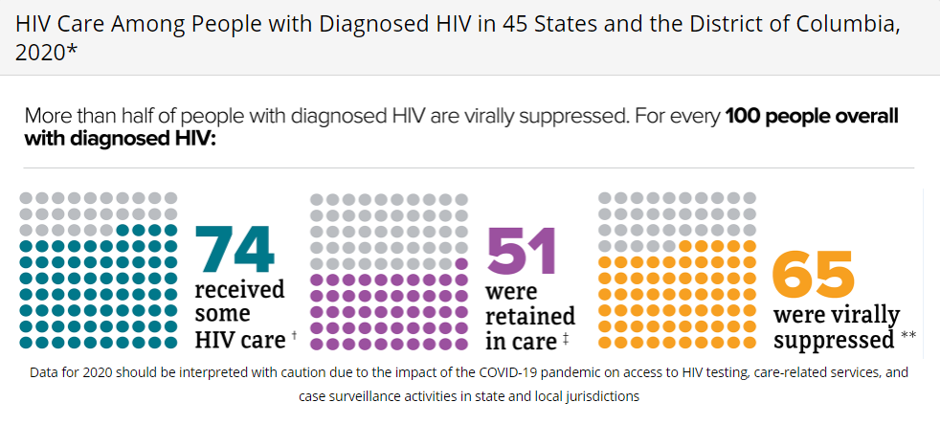

Slide 11
HIV Prevention Strategies
Risk reduction counseling
Barrier methods, partners, syringe services
HIV testing
STI testing and treatment
PEP (post-exposure prophylaxis)
PrEP (pre-exposure prophylaxis)
Treatment as Prevention
U=U (Undetectable = Untransmittable)

Slide 12
Risk Reduction Counseling
Substance Use
Clean needles/works; syringe exchange programs
Medication for substance use disorders (e.g. methadone, buprenorphine)
PrEP
PEP
Sexual Transmission
Barrier methods (condom use)
PrEP
PEP
Treatment as Prevention

Slide 13
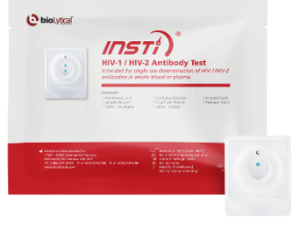
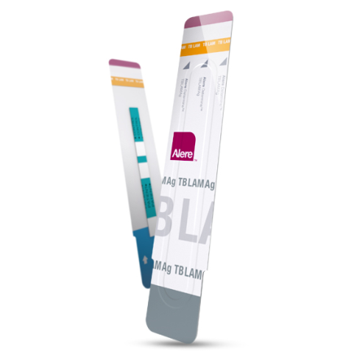
HIV Tests
Routine HIV Test
4th generation Ab/Ag testing
Blood test (results in 1-2 weeks)
Sensitivity >99.7%, Specificity 100%
Rapid Tests
INSTI HIV1/2 Ab IgM/IgG (3rd generation)
Blood test (results in 1 minute)
Sensitivity >99.8%, specificity >99.5%
Picks up infection by 3 weeks
Alere Determine HIV1/2 Ab/Ag(4th generation)
Blood test (results in 15 minutes)
Sensitivity 100%, specificity 99.8%
Picks up infections earlier (by 1-2 weeks).
Positive results require confirmation

Slide 14
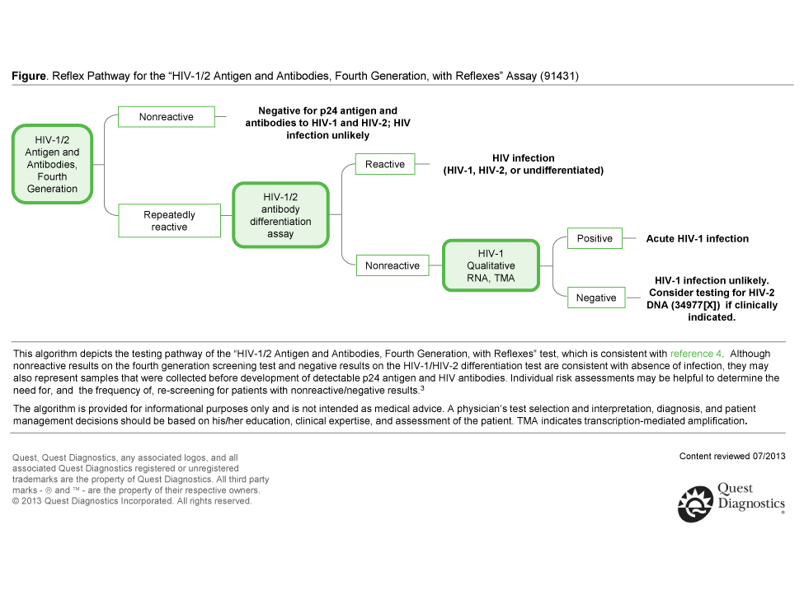
HIV 4th Generation Testing

Slide 15
HIV Testing
CDC and USPSTF recommend routine HIV testing for 13 (15)-64 year olds.
Recommendation for those at higher risk testing at least once a year.
Routine, opt-out, voluntary testing
Part of consent to routine medical care
Opportunity to ask questions
Option to decline
Separate written/oral consent not required
Prevention counseling not required in conjunction with testing.
Status Neutral Approach
People with HIV who are aware of status can get HIV treatment
Promote individual health
Prevent transmission
People who don’t have HIV but are at-risk can make decisions about their health, including PrEP.

Slide 16
Who Should We Be Testing?
All patients 13-64 years of age, at least once
USPSTF recommends starting at age 15
Any patient suspected of acute HIV infection
Pregnant women
TB patients
Patients seeking STD treatment and attending STD clinics
HBV/HCV patients
Patients starting new sexual relationship
Occupationally exposed individuals
Patients with risk-taking behavior, at least annually
Injection drug users (IDUs) and their sex partners
Persons who exchange sex for money or drugs
Sex partners of HIV-infected persons
MSM or heterosexual persons who themselves or their partners have had more than one sexual partner since their last HIV test
CDC MMWR Sept 26, 2006

Slide 17
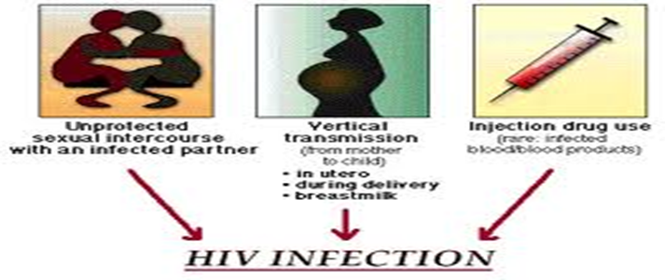
HIV Transmission
Infectious Bodily Fluid:
Blood
Semen
Vaginal Secretions
Breast milk
Comes into contact with:
mucous membranes
damaged tissue
Is injected/ingested into the body
Typically through:
Vaginal, anal, or oral sex
Contaminated needles
IV drug use
(Mother to child)
(Breastfeeding)

Slide 18
Bodily Fluids and HIV Risk
Infectious* | Potentially Infectious | Not Infectious!
Blood | Cerebrospinal fluid | Feces
Tissue | Synovial fluid | Nasal secretions
Semen | Pleural fluid | Saliva
Vaginal Secretions | Peritoneal fluid | Sputum
Breast Milk | Pericardial fluid | Sweat
 | Amniotic fluid | Tears
 |  | Urine
 |  | Vomitus
* Increased risk with visible blood on device; needle directly from vein/artery; hollow-bore needle; deep injury; source patient with terminal illness; high viral load.
! Unless visibly bloody

Slide 19
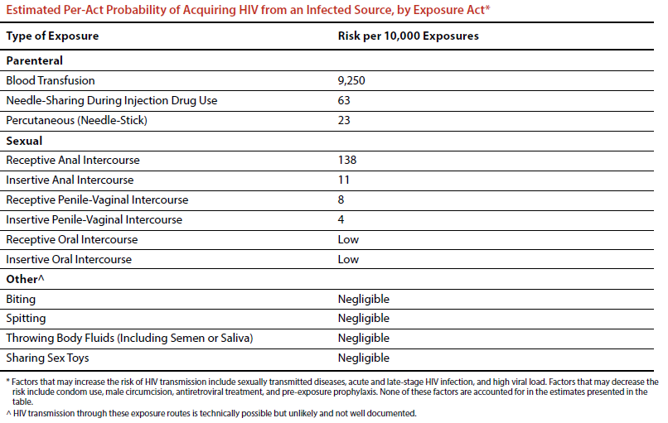
Mucous Membrane (occupational):
9 per 10,000 Exposures

Slide 20
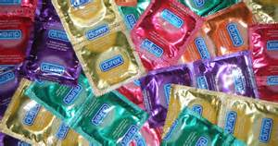
Condom Use Protection Against HIV
Consistent condom use with usual rates of breakage and slippage protects about 80% (with range: 35 to 94%)
Estimates mainly based on heterosexual couples.
Very few studies in MSM or with anal sex.
Holmes KK, Levine R, Weaver M. Effectiveness of condoms in preventing sexually transmitted infections. Bull World Health Organ. 2004 Jun;82(6):454-61. PMID: 15356939; PMCID: PMC2622864.

Slide 21
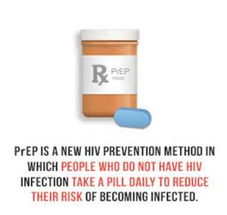
Pre-Exposure Prophylaxis (PrEP)
An individual without HIV takes antiretroviral medication(s) before potential HIV exposure.

Slide 22
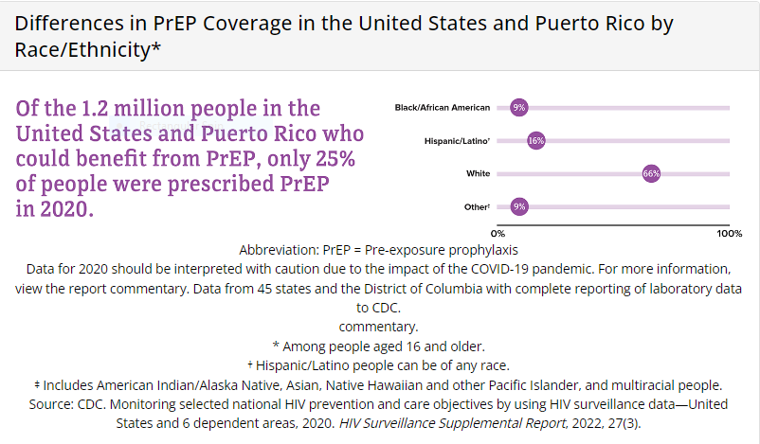
PrEP in the United States, 2020
Approximately 1.2 million persons in the United States are likely to benefit from PrEP^{[1]}
1 in 4 sexually active MSM: 814,000^{[2]}
1 in 5 PWIDs: 73,000^{[2]}
1 in 200 heterosexual adults: 258,000^{[2]}
Though Blacks and Hispanics account for 69% of new HIV infections, their use of PrEP is relatively low.
22
Volume 27 Number 3 | HIV Surveillance | Reports | Resource Library | HIV/AIDS | CDC
22
1. Harris. MMWR Morb Mortal Wkly Rep. 2019;68:1117. 2. Smith. Ann Epidemiol. 2018;28:.e9. 3. Sullivan. J Int AIDS Society. 2020;23:e25461.
Notes:
Marwan
Update dates?

Slide 23
PrEP with TDF/FTC Works!
Study | Efficacy Overall, % | Blood Samples With TFV Detected, % | Efficacy By Blood Detection of TFV, %
iPrEx^{[1]} | 44 | 51 | 92
iPrEx OLE^{[2]} | 49 | 71 | NR
Partners PrEP^{[3]} | 67 (TDF) 75 (TDF/FTC) | 81 | 86 (TDF) 90 (TDF/FTC)
TDF2^{[4]} | 62 | 80 | 85
Thai IDU^{[5]} | 49 | 67 | 74
Fem-PrEP^{[6]} | No efficacy | < 30 | NR
VOICE^{[7]} | No efficacy | < 30 | NR
FTC, emtricitabine; NR, not reported; PrEP, pre-exposure prophylaxis; TDF, tenofovir disoproxil fumarate; TFV, tenofovir.
1. Grant RM, et al. N Engl J Med. 2010;363:2587-2599. 2. Grant RM, et al. Lancet Infect Dis. 2014; 14:820-829. 3. Baeten JM, et al. N Engl J Med. 2012;367:399-410. 4. Thigpen MC, et al. N Engl J Med. 2012;367:423-434. 5. Choopanya K, et al. Lancet. 2013;381:2083-2090. 6. Van Damme L, et al. N Engl J Med. 2012;367:411-422. 7. Marrazzo J, et al. CROI 2013. Abstract 26LB.
Notes:
FTC, emtricitabine; NR, not reported; PrEP, pre-exposure prophylaxis; TDF, tenofovir disoproxil fumarate; TFV, tenofovir.
Oral PrEP works, but adherence is critical. For IPrEx, when you analyze efficacy with the detection of tenofovir in the person’s blood, it showed that if you took tenofovir as instructed, the efficacy of PrEP was 92%.

Slide 24
Oral PrEP Reduces Incidence of HIV in MSM, Even With Incomplete Adherence
iPreX OLE: open-label extension of iPrEX trial of daily TDF/FTC oral PrEP in MSM and transgender women (N = 1603)
100% adherence was not required to attain full benefit from PrEP
Benefit of 4-6 tablets/wk similar to 7 tablets/wk
2-3 tablets/wk also associated with significant risk reduction
Higher levels of sexual risk taking at baseline were associated with greater adherence to PrEP
HIV Incidence and Drug Concentrations
5
< 2 Tablets/Wk
2-3 Tablets/Wk
4-6 Tablets/Wk
7 Tablets/Wk
4
3
Off PrEP
HIV Incidence per 100 Person-Yrs
2
1
On PrEP
0
LLOQ
350
500
700
1000
1250
1500
0
TFV-DP in fmol/punch
Follow-up Risk Reduction 95% Cl
26% 44% -31 to 77%
12% 84% 21 to 99%
21% 100%
12% 100%
86 to 100% (combined)
1. Grant R, et al. IAC 2014. Abstract TUAC0105LB. 2. Grant R, et al. Lancet Infect Dis. 2014;14:820-829.

Slide 25
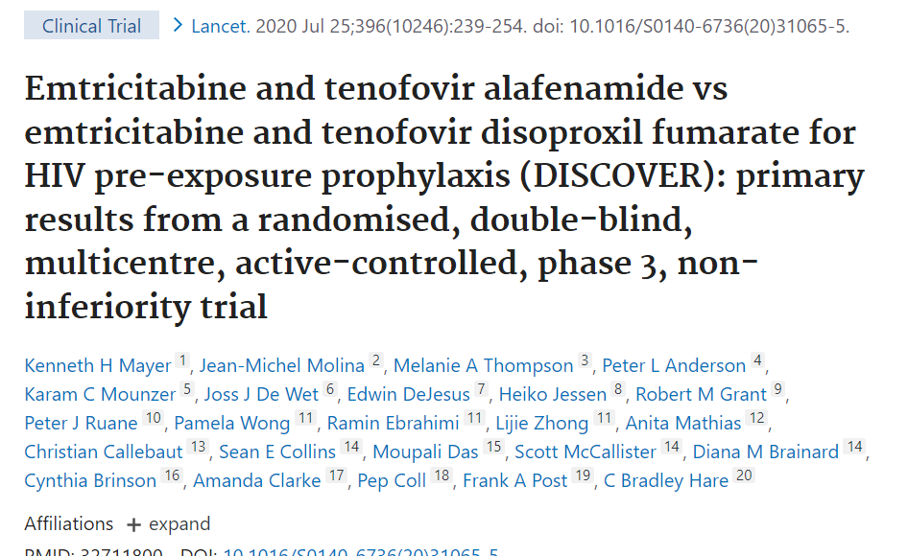
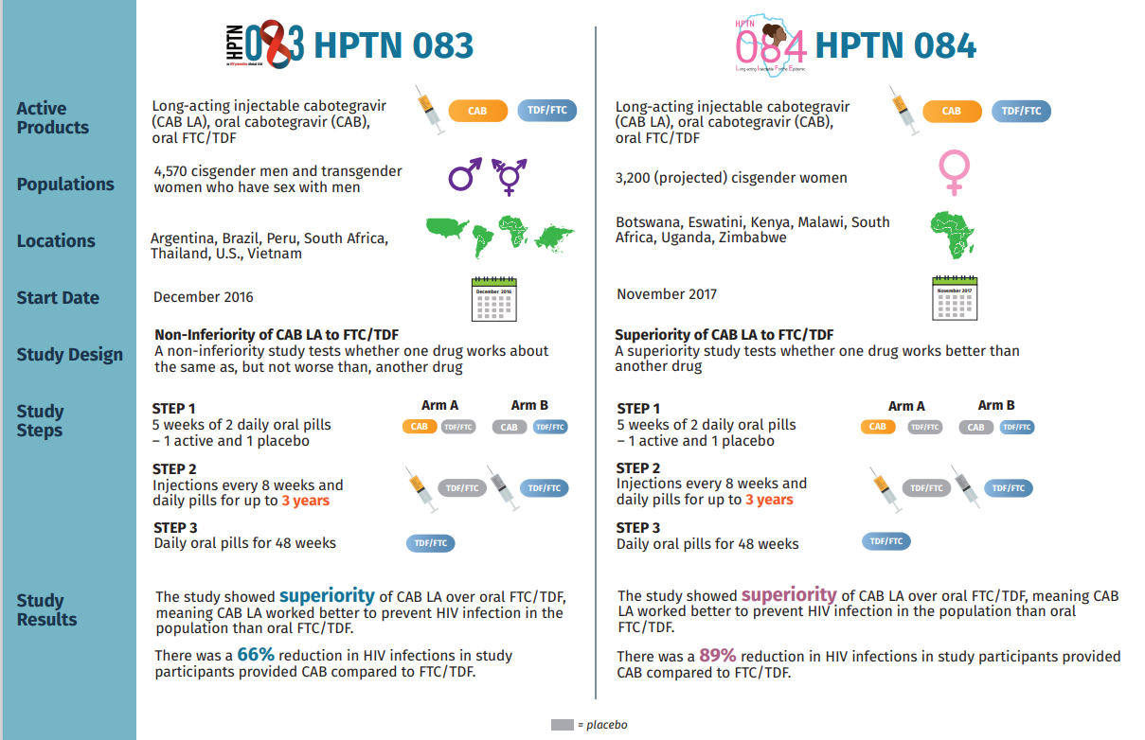
PrEP with TAF/FTC
Works!
PrEP with Cabotegravir Works!

Slide 26
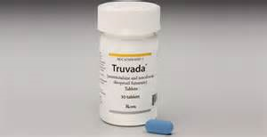
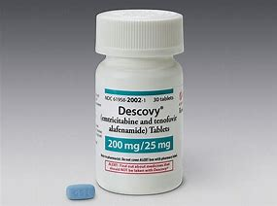
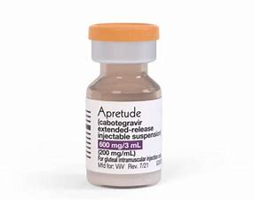
PrEP Prescribing Choices
TDF/FTC (Truvada, generic) for men who have sex with men (MSM), transgender women, heterosexually active men and women, and people who inject drugs who meet PrEP prescribing criteria.
Dosed as a single pill once daily
ONLY for MSM and transgender women, can be dosed on demand (2-1-1)
TAF/FTC (Descovy) for MSM and transgender women at sexual risk.
Dosed as a single pill once daily
Injectable cabotegravir (Apretude) for adults/adolescents 35 kg + at sexual risk.
Monthly injection for 2 months then every other month.
26

Slide 27
2-1-1 PrEP On-Demand with TDF/FTC
Studied only with TDF/FTC and only with men who have sex with men
ANRS IPERGAY study (France, Canada): demonstrated 86% risk reduction
ANRS PREVENIR study (Paris): equivalent HIV protection between daily PrEP and on-demand PrEP
AMPrEP study (Amsterdam): equivalent HIV protection between daily PrEP and on-demand PrEP
Taking PrEP before and after sex, instead of daily
2 pills at least 2-24 hours before sex
1 pill 24 hours after first dose
1 pill 48 hours after first dose
If sexually activity continues, take 1 pill every 24 hrs until 48 hrs after last sex
Best avoid in people with chronic active HBV
Can trigger hepatitis flares with being on and off TDF/FTC

Slide 28
What is Treatment As Prevention?
https://www.cdc.gov/hiv/risk/art/index.html

Slide 29
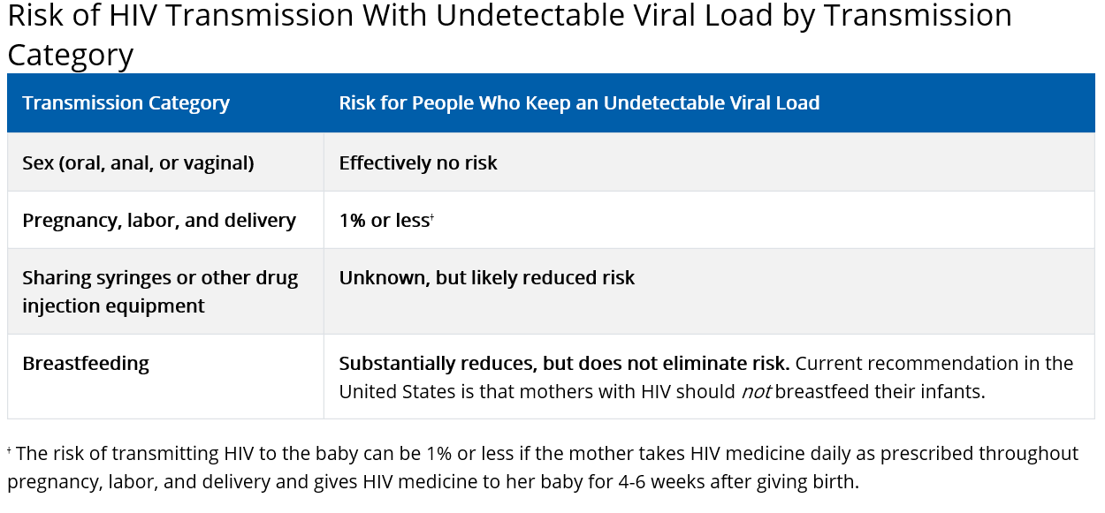
Risk by Transmission Category

Slide 30
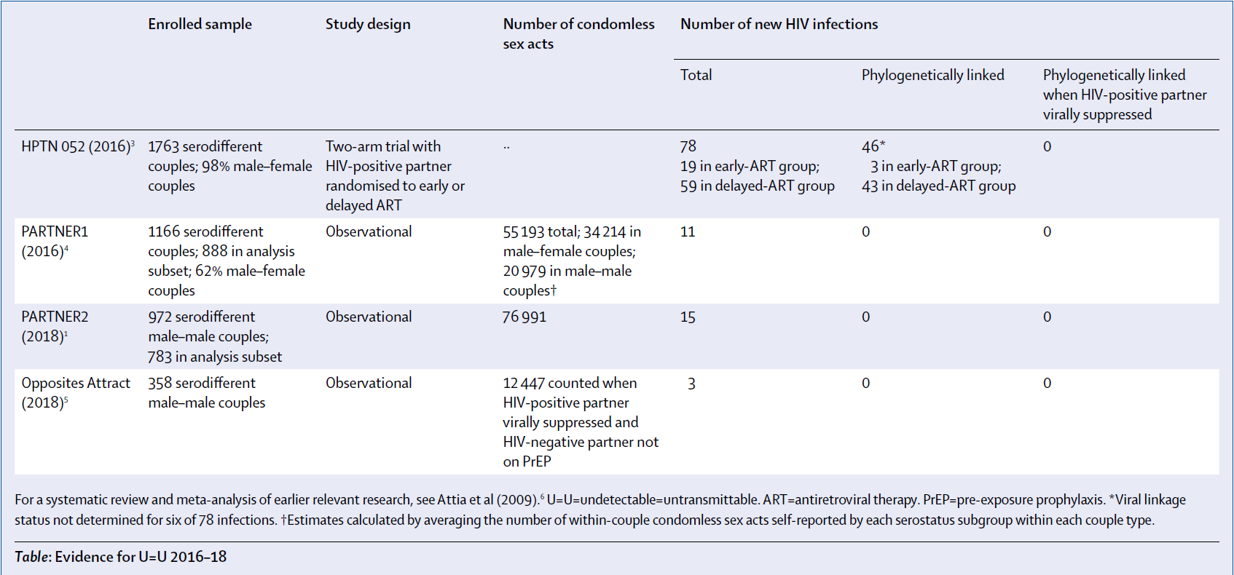
Scientific Evidence

Slide 31
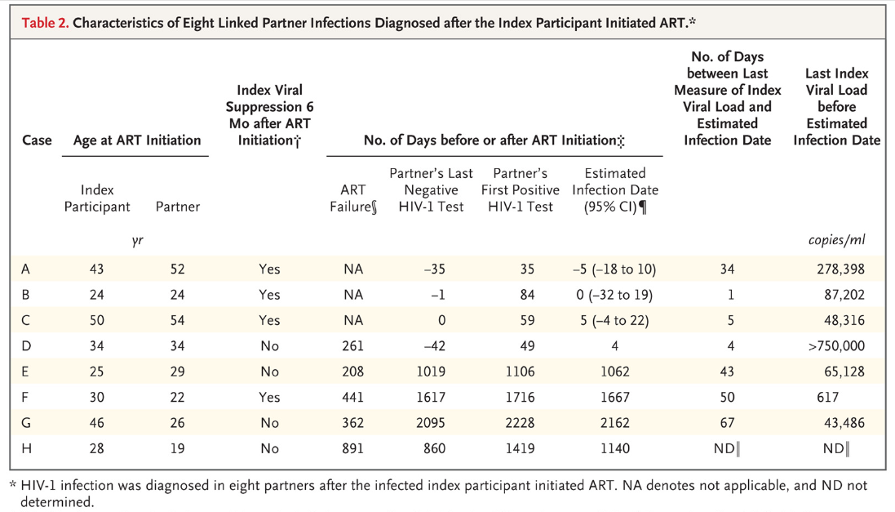
HPTN 052: Last known VLs prior to HIV diagnosis in the 8 linked transmissions after ARV start

Slide 32
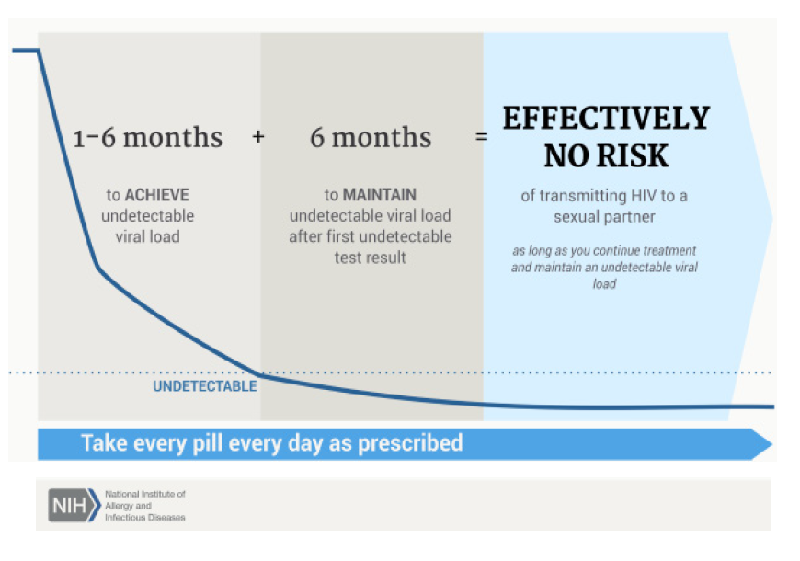
When does TasP become effective?

Slide 33
Prevention Access Campaign: 2016

Slide 34
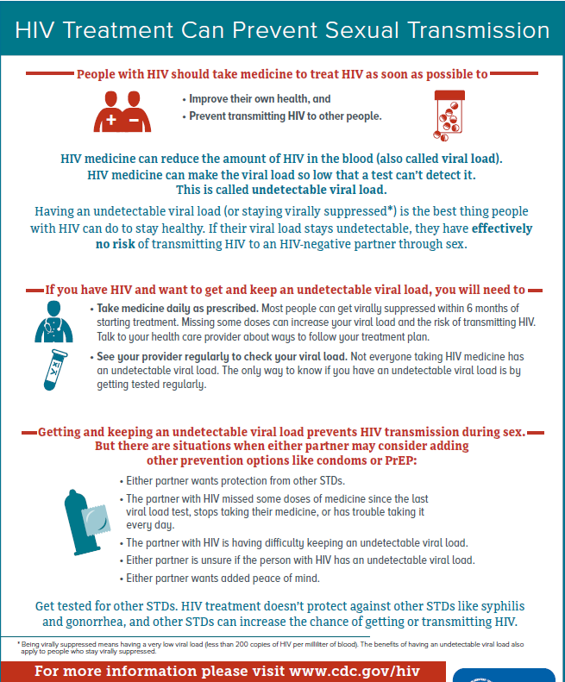

Slide 36
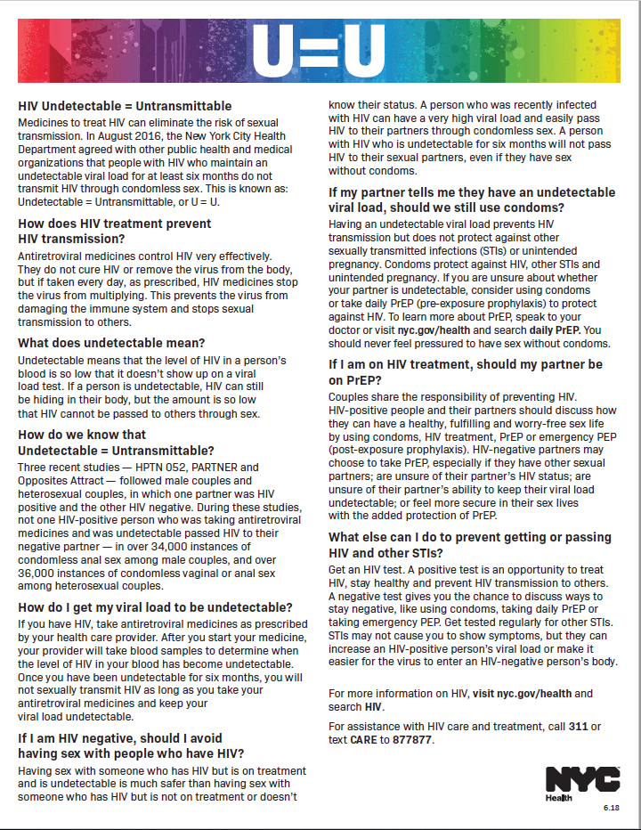
STI and Condom Use
U=U prevents HIV transmission but does not protect against STIs or unintended pregnancy.
Condoms protect against HIV, other STIs, and pregnancy.
All options should be considered when thinking about HIV and STI prevention and pregnancy– condoms, HIV treatment, PrEP, PEP, and birth control.

Slide 37
HIV Preventive Care & Monitoring

Slide 38
Lab Tests | Initial | Monitoring
CD4 cell count | Baseline | Q 3-6 m If VL<200 x 2yrs and CD4 >300, annually CD4 >500, optional
HIV Viral Load | Baseline | Q 1 m until VL suppressed, then Q 3-6 m
HIV Resistance Testing | Baseline | At ARV start; VL failure
CBC | Baseline | Q 3-6 m
CMP incl. glucose, renal, hepatic function | Baseline | Q 3-6 m
Lipids | Baseline | Annually (if on ARVs)
HAV/HBV/HCV | Baseline | Repeat based on risk
Syphilis | Baseline | Annually; more frequently if at risk
GC/Chlamydia/ Trichomonas | Baseline; at all sites of exposure | Annually; more frequently if at risk
TB (PPD/IGRA) | Baseline | Annually if at risk
Pregnancy Test | Baseline | As needed
Baseline HIV Labs and Ongoing Monitoring

Slide 39
HIV Resistance Testing
HIV RNA testing
RT (NRTI and NNRTI) and PR (PIs)
Integrase Inhibitor
Baseline
Order RT and PR
Upon ARV failure if exposed to integrase inhibitors
Order RT, PR, and Integrase
RT= reverse transcriptase; NRTI= nucleoside reverse transcriptase inhibitor; NNRTI= non-nucleoside reverse transcriptase inhibitor; PR- protease; PI= protease inhibitor

Slide 40
HLA-B5701 Testing
Order if considering using abacavir or abacavir-containing medication.
Predicts abacavir hypersensitivity reaction.
If positive, DO NOT use abacavir.
If negative, can proceed with abacavir use.

Slide 41
Tropism Testing
Tests HIV-1 co-receptor usage.
Use if considering using CCR5 co-receptor antagonist (maraviroc).
Use if ARV failure containing CCR5 co-receptor antagonist (maraviroc).
Reported as:
R5 (CCR5)
X4 (CXCR4)
Dual/Mixed

Slide 42
Other Viral Testing
Measles, Mumps, Rubella
Test for immunity in those born in 1957 and after.
Varicella
Test for immunity in those without a history of chicken pox or shingles.

Slide 43
Routine Screening
Mental Health Screening
Smoking Cessation
Substance Use/Alcohol Use Screening
Cancer Screenings based on general recommendations
Breast (Mammogram)
Colon (FOBT/Colonoscopy)
Lung (Low dose CT scan)
Prostate
Oral Health
Bone Density (baseline in post-menopausal women and men ≥50)
Nutrition
Retinal Screening (esp. if CD4 <50)

Slide 44
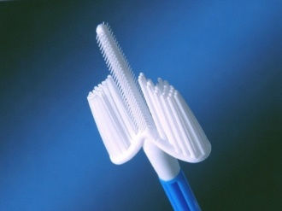
Cervical Cancer Screening
Begin within one year of onset of sexual activity or at age 21+ and continue through lifetime.
Women with HIV < 30 years of age
Cytology only
Annual for 3 years
Some experts recommend first year to do q 6 months.
If negative, every 3 years
Women with HIV 30 years of age or older
Cytology + HPV
Every 3 years if negative
Some experts recommend first year to do q 6 months.
Referral for colposcopy:
ASCUS with +high risk HPV, or higher
Same guidelines as women without HIV
www.asccp.org

Slide 45
Why is Cervical Cancer Screening Important For Women with HIV?
Cervical HPV more prevalent in women with HIV
Prevalence in women with HIV: 64%^{1,2}
Prevalence in high risk women without HIV: 28-30%^{1,2}
Greater persistence and diversity of HPV types found in women with HIV
Increased incidence, recurrence of CIN 2,3³
HIV considered risk factor for cervical cancer⁴
Jamieson DJ et al. Am J Obstet Gynecol 2002;186(1); 2. Palefsky JM et al. J Natl Cancer Inst 1999;91(3); 3. Moscicki et al. JID 2004;190; 4. Pinto & Crum. Clin Obstet Gyn 2000;43(2)

Slide 46
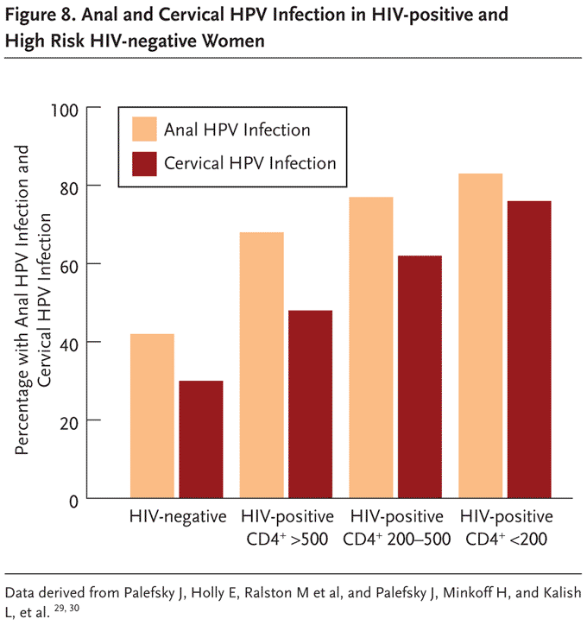
HPV and HIV
20-40% of women with HIV have abnormal pap results¹
Lower CD4 counts (<200 cells/uL) at highest risk²
1. Danso et al. Int J STD AIDS 2006;17. 2. Massad et al. JAIDS 1999;21.

Slide 47
Anal Cancer Screening
Anal Pap Smears
Men who have sex with men (MSM) and women with HIV have higher risk for anal intraepithelial neoplasia (AIN) and anal cancer than general population
No decreased risk with anti-retroviral (ARV) medication use
No national recommendations for screening
Some recommend annual DRE
Some recommend Anal Pap smears and if abnormal, high resolution anoscopy (HRA) with biopsy of suspected lesions
Recent ANCHOR study demonstrated treatment of HSIL significantly reduced progression to anal cancer.

Slide 48
Anal Pap Smear Recommendations (perhaps)
Persons with history of receptive anal sex
Persons with abnormal cervical Pap tests
Persons with anogenital warts

Slide 49
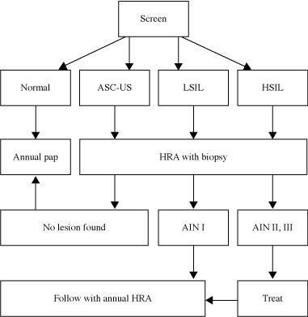

Slide 50
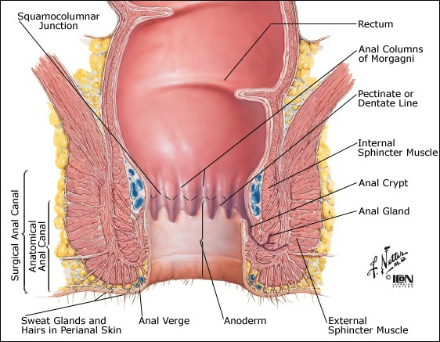
Technique: insert moistened dacron swab or cytobrush 2cm past anal verge; move in and out while rotating and applying light pressure to walls, immerse in liquid pap solution, label as ANAL pap smear!

Slide 51
Vaccinations
Tdap
Pneumovax
Pneumo 23 (2 shots at least 5 years apart; one more shot after age 65)
*Pneumo 13 (1 shot 8 weeks before or 1 year after Pneumo-23)
Influenza shot annually
Hepatitis A and B series
HPV as per HIV-negative
Meningococcal vaccine
MCV4 two doses at least 2 months apart and then every 5 years
COVID-19 vaccine
Primary series + Booster
If CD4<200 or not on ARVs, primary series includes 3rd shot + booster.
*New recommendations using PCV-20 or PCV-15 are available. Follow guidance for general population.

Slide 52
Opportunistic Infection (OI) Prophylaxis
OI | CD4 Level | Preferred Regimen | Alternative
Pneumocystis Pneumonia (PCP) | <200 | Bactrim DS daily/TIW | -Dapsone +/- pyrimethamine + leucovorin -Atovaquone
Toxoplasmosis | <100 | Bactrim DS daily/TIW | -Dapsone +/- pyrimethamine + leucovorin -Atovaquone +/- pyrimethamine + leucovorin
Mycobacterium Avium Complex (MAC) | <50 and not on ARV or not virologically suppressed | Azithromycin once a week | Clarithromycin
Latent TB Infection | Any | Rifapentine/INH weekly x 12 weeks (with B6) or INH/Rifampin daily x 12 weeks (with B6) | -INH/B6 x 6-9 months -Rifampin x 4 months -Rifapentine/INH daily for 4 weeks (with B6)

Slide 53
HIV Treatment

Slide 54
Clinical Course of HIV
Main part of immune system is white blood cells (WBCs).
WBCs include neutrophils, lymphocytes, eosinophils, and basophils.
Under lymphocytes, there are CD3, CD4, and CD8 cells.
HIV attacks CD4 cells only.
With progression of disease, absolute CD4 and CD4/CD8 ratio (%) decrease.
HIV RNA load
Clinically
latent
period
CD4
lymphocytes
6–24
weeks
0.5–15
years
2–3
years
Clinical symptoms
Retroviral Syndrome
Clinical symptoms
Opportunistic Illnesses

Slide 55
CD4 and HIV RNA (Viral Load) Relationship

Slide 56
Department of Health And Human Services (DHHS) Guidelines: Anti-Retroviral (ARV) Initiation
Recommended for ALL individuals with HIV to reduce risk of disease progression and AIDS- and non-AIDS-related complications regardless of CD4 count.
Recommended for individuals with HIV to prevent transmission of HIV.

Slide 57
ARV Regimen
In general, ARV regimens involve at least 3 drugs from 2 classes of HIV medication
2 NRTIs (backbone) + Integrase or NNRTI or PI
Requires high adherence rates
Take ALL the regimen or none (easier with single tablet regimens)
Resistance can develop with non-adherence
Some classes/drugs more forgiving than others
Low genetic barrier to resistance
3TC/FTC, many NNRTIs, raltegravir, elvitegravir
High genetic barrier to resistance
NRTIs (other than 3TC/FTC), PIs, dolutegravir, bictegravir, doravarine (NNRTI)
NRTI= nucleoside reverse transcriptase inhibitor; NNRTI= non-nucleoside reverse transcriptase inhibitor; PI= protease inhibitor

Slide 58
Missing Doses Leads To Resistance

Slide 59
Antiretroviral (ARV) Medications
Where Do The Drugs Work?
Entry/Fusion/Attachment
Fusion inhibitors
Entry inhibitors
Attachment and Post Attachment inhibitors
Reverse Transcription
NRTIs
NNRTIs
Integration
Integrase inhibitors
Assembly
Protease Inhibitors
Maturation
Maturation Inhibitors

Slide 60
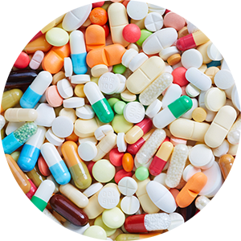
ARV Classes
NRTI
FTC/emtricitabine/Emtriva
3TC/lamivudine/Epivir
Tenofovir disoproxil fumarate/TDF/Viread
Tenofovir alafenamide/TAF
Abacavir/ABC/Ziagen
AZT/zidovudine/Retrovir
ddI/didanosine/Videx
d4T/stavudine/Zerit
PI
Darunavir/DRV/Prezista (w/ food)
Atazanavir/ATV/Reyataz (w/ food)
Lopinavir/LPV/Kaletra (co-formulated with ritonavir)
Ritonavir/RTV/Norvir (booster)
Fosamprenavir/Lexiva
Tipranavir/Aptivus
Indinavir/Crixivan
Nelfinavir/Viracept
Saquinavir/Invirase
NNRTI
Efavirenz/EFV/Sustiva (w/o food)
Nevirapine/Viramune
Rilpivirine/RPV/Edurant (w/ large meal)
Etravirine/Intelence (after meals)
Doravirine/DOR/Pifeltro
Integrase Inhibitor
Raltegravir/RAL/Isentress
Elvitegravir/EVG/Vitekta (w/ food)
Dolutegravir/DTG/Tivicay
Bictegravir/BIC
NRTI: Nucleos(t)ide Reverse Transcriptase Inhibitor
NNRTI: Non-nucleoside Reverse Transcriptase Inhibitor
PI: Protease inhibitor

Slide 61
ARV Classes
CCR5 Receptor Antagonist
Maraviroc/Selzentry
Attachment Inhibitor
Fostemsavir/Rukobia
Fusion Inhibitor
Enfuvirtide/Fuzeon (injection)
Post-Attachment Inhibitor
Ibalizumab-uiyk/Trogarzo (infusion)
Capsid Inhibitor
Lenacapavir
(subcutaneous injection)

Slide 62
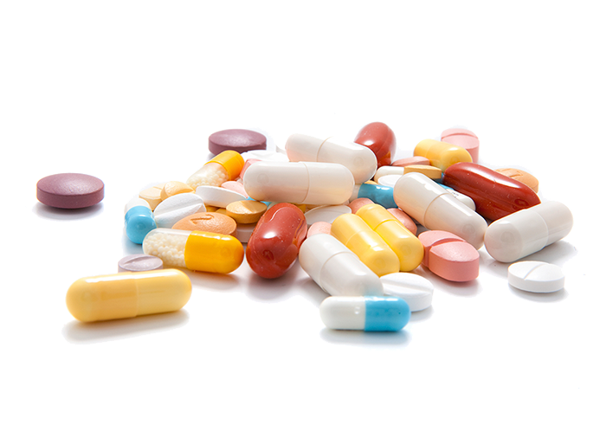
Using Pharmacokinetics To Our Advantage…
Ritonavir: inhibitor of CYP3A4
Cobicistat: inhibitor of CYP3A4, P-glycoprotein
Inhibit metabolism of PIs
Inhibits metabolism of Integrases (cobicistat only)
Used to “boost” PIs/Integrases
Co-formulation is possible

Slide 63
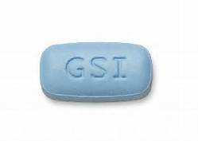
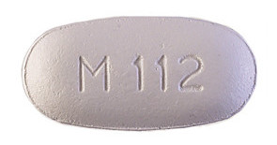
Co-formulated ARVs
Truvada: TDF + FTC (2 NRTIs) 1 tab daily
Descovy: TAF + FTC (2 NRTIs) 1 tab daily
Cimduo: TDF + 3TC (2 NRTIs) 1 tab daily
Epzicom: ABC + 3TC (2 NRTIs) 1 tab daily
Combivir: AZT + 3TC (2 NRTIs) 1 tab BID
Trizivir: AZT + 3TC + ABC (3 NRTIs) 1 tab BID

Slide 64
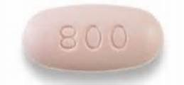
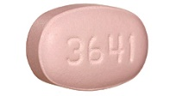
Co-formulated ARVs
Prezcobix: DRV + cobicistat (boosted PI) 1 tab daily (w/ food)
Evotaz: ATV + cobicistat (boosted PI) 1 tab daily (w/ food)
Kaletra: LPV + RTV (boosted PI) 2 tabs BID

Slide 65
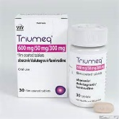
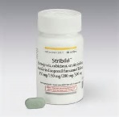
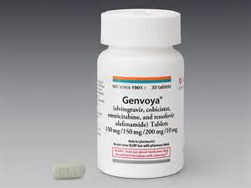
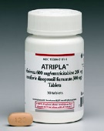
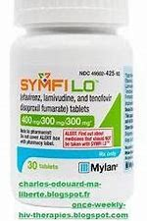
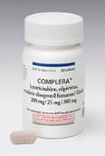
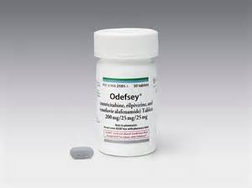
Co-formulated Single Tablet ARV Regimens
Triumeq: ABC/3TC/DTG 1 tab daily
Stribild: TDF/FTC/EVG/cobicistat 1 tab daily (w/ food)
Genvoya: TAF/FTC/EVG/cobicistat 1 tab daily (w/ food)
Atripla: TDF/FTC/EFV 1 tab daily (w/o food)
Symfi/Symfi Lo: TDF/3TC/EFV 1 tab daily (w/o food)
Complera: TDF/FTC/RPV 1 tab daily (w/ large meal (350-500 cal))
Odefsey: TAF/FTC/RPV 1 tab daily (w/ large meal (350-500 cal))

Slide 66
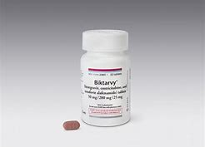
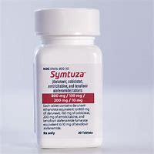
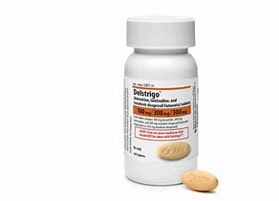
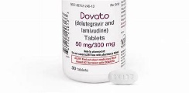
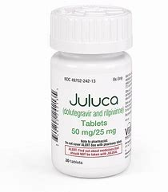
Co-formulated Single Tablet ARV Regimens
Biktarvy: TAF/FTC/BIC one tablet once a day
Symtuza: TAF/FTC/DRV/cobicistat one tablet once a day with food
Delstrigo: TDF/3TC/DOR one tablet once a day
Dovato: DTG/3TC one tablet once a day
Juluca: DTG/RPV one tablet once a day with a large meal

Slide 67
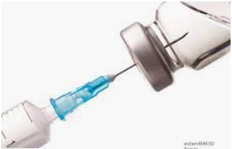
Injectable ARV Regimen
Cabotegravir + Rilpivirine
Can use oral lead-in for 28 days
Should be virally suppressed prior to use
Injections every 30-60 days
Monthly:
Initial: 600mg-900mg IM on last day of oral lead-in.
Continuation: 400 mg-600mg given up to 7 days before or after scheduled monthly injection
Every-2 month
Initial: 600mg-900 mg IM on last day of oral lead in then repeated in 1 month (up to 7 days before or after due date)
Continuation: 600 mg-900 mg IM every 2 months given up to 7 days before or after due date.

Slide 68
Bottom Line: Most Commonly Used HIV Regimens
TDF or TAF or Abacavir +
3TC or FTC +
Dolutegravir or Bictegravir or boosted Darunavir
Medication to be familiar with:
Cabotegravir, Rilpivirine, Doravirine may become more used.

Slide 69
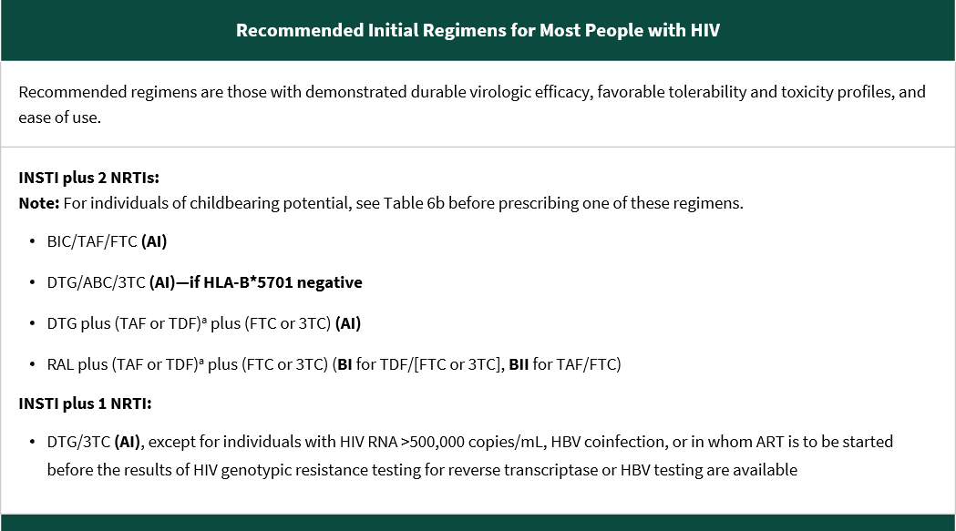
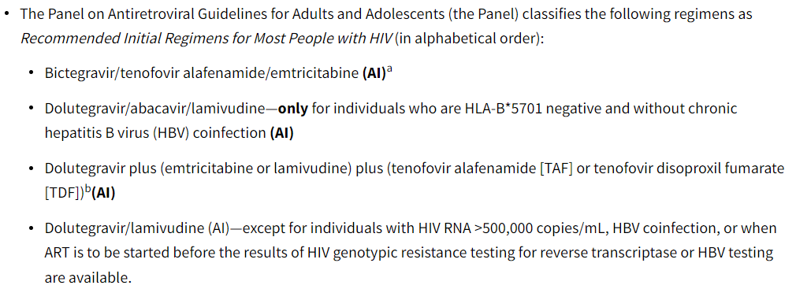
DHHS Guidelines
Biktarvy
Triumeq
Tivicay + Truvada or Descovy
Dovato

Slide 70
Practical Issues to Consider
Patient readiness
Patient Preferences
Number/size of pills
Dosing frequency
Meal requirements
Adherence
Stigma
Pill fatigue/trauma
Mental health
Low health literacy
Insurance coverage
Baseline CD4, HIV RNA levels, Resistance patterns
Co-morbidities (HBV/HCV/OIs/Kidney/Heart/Bone disease)
Pregnancy and pregnancy potential
Drug interactions
Potential side effects…

Slide 71
ARV Side Effects
GI side effects (nausea, vomiting, diarrhea, heartburn) (NRTIs, PIs)
Rash (PIs, NNRTIs)
ABC hypersensitivity reaction (HLAB5701)
Renal toxicity (TDF, HIV)
Bone toxicity (TDF)
Cardiac toxicity (ABC, PIs, HIV)
Hyperbilirubinemia (ATV)
CNS effects (EFV, RPV, Integrases)
Hepatotoxicity (NRTI/NNRTI/PI)
Peripheral neuropathy (d4T, ddI, HIV)
Weight gain (TAF, Integrases)

Slide 72
ARV Side Effects
GI side effects (especially with PIs)
Nausea – prochlorperazine, ondansetron
Diarrhea – loperamide, diphenoxylate/atropine
Heartburn – PPIs, H-2 blockers (careful with atazanavir + rilpivirine)
Peripheral Neuropathy (d4T, ddI, HIV)
Tricyclic Antidepressants (TCAs)
Gabapentin and other anticonvulsants
Opioids

Slide 73
Renal complications: HIVAN
HIV-associated nephropathy
Most common cause of biopsy proven ESRD in HIV+
Presentation: nephrotic range proteinuria, renal failure
Histology: focal segmental glomerulosclerosis
Risk factors: AA race, high HIV RNA, low CD4, HCV coinfection
Diagnosis = exclusion, biopsy
Treatment = HAART, ACE-I, steroids?
Screening: baseline UA, routine creat/GFR

Slide 74
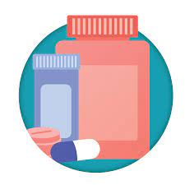
Renal Dose Adjustments
Most NRTIs require renal dosing
Exception: abacavir, TAF
Co-formulations need to be split
PIs/NNRTIs/Integrase – no adjustments needed
CCR5-receptor antagonist – adjustment at lowest creatinine clearance (<30 ml/min)

Slide 75
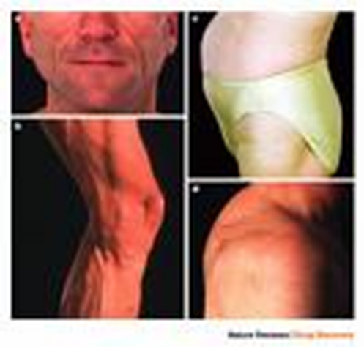
Lipodystrophy Syndrome
Seen with older regimens (esp with NRTIs/PIs)
Lipoatrophy
Lipohypertrophy
Insulin Resistance
Dyslipidemia

Slide 76
Lipodystrophy Syndrome
Lipoatrophy
Switch off implicated ARVs
Fillers (e.g. Restylene),Anabolic steroids, Human Growth Hormone
Lipohypertrophy
Switch off implicated ARVs
Liposuction ?
Exercise ?
Thiazolidinedione (TZDs), particularly pioglitazone?
Insulin Resistance
Metformin, TZDs
Hyperlipidemia
Statins, Fibrates, Niacin, Fish oil

Slide 77
Other ARV Complications
CVD Risk (abacavir, PIs)
Increase risk of MIs
HIV-associated cardiomyopathy
Switch off ARVs if possible
Smoking cessation
Lipid, BP, DM control
Bone Loss (TDF)
Osteopenia/osteoporosis
Bone Density Scans
Bisphosphonates
Calcium/Vit D

Slide 78
Drug Interactions
Look it up every time!!
PIs and NNRTIs have higher drug interactions including
Statins (pravastatin, atorvastatin, rosuvastatin can be used– start low dose)
Benzodiazepines
Methadone
Fluticasone (Advair, Flonase, Flovent)– avoid with ritonavir
St. John’s wort
Proton pump inhibitors (ATV and RPV)
Other acid suppressants (ATV, RPV)

Slide 79
Drug Interactions
Triumeq, Dovato, Tivicay (DTG)
Administer 2 hours before or 6 hours after cation-containing antacids or laxatives, sucralfate, oral supplements containing iron or calcium, or buffered medications.
Alternatively, Triumeq/Dovato/DTG and supplements containing calcium or iron can be taken together with food.

Slide 81
https://hivdb.stanford.edu/hivdb/by-mutations/

Slide 82
Common Opportunistic Infections

Slide 83
CD4 Count and Risk of Opportunistic Infections
NHL (well-differentiated)
VZV
Histoplasmosis
350
MTB
Bacterial pneumonia
CD4 Count
KS
Thrush
Candida Esophagitis
NHL (poorly -differentiated)
Toxoplasmosis
200
PCP
Cryptococcosis
Cryptosporidium
50
MAC
CMV
PML
Years

Slide 84
Mucocutaneous Candidiasis
ORAL THRUSH
Painless, creamy, white, plaque-like lesions of buccal or oropharyngeal mucosa or tongue surface.
Can be easily scraped off with tongue depressor.
Less commonly can have erythematous patches without white plaques
Treatment:
Oral fluconazole
Clotrimazole troches or nystatin suspension

Slide 85
Oral Hairy Leucoplakia

Slide 86
Mucocutaneous Candidiasis
Candida vulvovaginitis:
Mild to mod, sporadic episodes, similar to HIV- ; if low CD4, may be more severe and frequent.
Treatment: Oral fluconazole or topical azoles
Esophageal candidiasis:
Retrosternal burning pain or discomfort and odynophagia; endoscopic diagnosis.
Treatment: Fluconazole or itraconazole

Slide 87
Aphthous Ulcers
Treatment:
Topical
Mild to moderate ulcers
Corticosteroids, e..g. Kenalog in Orabase
Topical Lidocaine
Elixirs (Magic Mouthwash)
Oral steroids
Severe ulcers
Thalidomide
Severe ulcers

Slide 88
Bacterial Pneumonia
Incidence higher than HIV negative population
Increased incidence of bacteremia, especially with S. Pneumoniae.
Higher rates of resistant S. Pneumoniae.
Symptoms and Signs similar to non-HIV population
CXR, blood cultures (if not well enough to be treated as outpatient)
Treatment:
Oral beta-lactam (high dose amoxicillin or amoxicillin-clavulanate) plus oral macrolide (azithromycin or clarithromycin).
Oral respiratory fluoroquinolone (e.g. levaquin) can be used with macrolide if penicillin allergic.

Slide 89
PCP (Pneumocystis jirovecii)
Risks: CD4<200; CD4%<14, oral thrush, recurrent bacterial pneumonia, high viral load, weight loss
Symptoms and Signs
Subacute onset of progressive dyspnea
Fever
Non-productive cough
Chest discomfort that worsens within days to weeks.
May be normal exam at rest.
With exertion, tachypnea, tachycardia, and diffuse dry rales.
Oxygen desaturation with exercise occurs.
Oral thrush may be present.
Elevated LDH >500 common but non-specific.
CXR: diffuse bilateral symmetrical interstitial infiltrates in butterfly pattern or normal. Pneumothorax can be associated.
About 13-18% have another concurrent pulmonary disease

Slide 90
PCP (Pneumocystis jirovecii)
Treatment:
TMP-SMX +/- corticosteroids within 72 hours if moderate-severe hypoxemia
Prophylaxis if CD4<200 or history of oral thrush
Bactrim DS daily or TIW or SS daily
Dapsone +/-pyrimethamine/leucovorin
Atovaquone

Slide 91
Toxoplasma gondii Encephalitis
Occurs as reactivation of latent tissue cysts of the protozoa
Clinical disease rare with CD4 >200; highest risk with CD4 <50
Eating undercooked meat containing the cysts or ingesting the oocytes shed in cat feces and sporulated in the environment

Slide 92
Toxoplasma gondii Encephalitis
Symptoms and Signs:
Focal encephalitis with headache, confusion, or motor weakness
Fever
Focal neurological abnormalities
Progresses to seizures, stupor, and coma.
CT or MRI– multiple contrast-enhancing lesions often with edema
Diagnosis:
Toxo IgG positive,
Lesion on CT/MRI,
Detection of organism on biopsy

Slide 93
Toxoplasma gondii Encephalitis
Treatment
Pyrimethamine plus sulfadiazine plus leucovorin
At least 6 weeks
Corticosteroids for treatment of mass effect
Prophylaxis
CD4<100 and Toxo IgG positive
TMP-SMX DS daily or TIW
Dapsone-pyrimethamine plus leucovorin
Atovaquone +/- pyrimethamine plus leucovorin

Slide 94
Mycobacterium Avium Complex (MAC)
Typically is disseminated multi-organ infection occurring when CD4 <50
Viral load >100,000, previous colonization with MAC, previous OIs increase susceptibility
Symptoms and Signs:
Fever, night sweats, weight loss, fatigue, diarrhea, and abdominal pain.
Anemia, elevated liver alk phos, hepatomegaly, splenomegaly, lymphadenopathy.
Early symptoms may be minimal and precede detectable mycobacteremia for several weeks.

Slide 95
Mycobacterium Avium Complex (MAC)
Treatment
Clarithromycin and Ethambutol +/- Rifabutin +/- fourth drug
After 12 months, asymptomatic, CD4>100 for at least 6 months, can stop treatment
Prophylaxis
CD4<50 and not on ARV or on ARV but not virologically suppressed
Azithromycin weekly
Clarithromycin
Discontinue when CD4 >100 for 3 months or more

Slide 96
Cytomegalovirus (CMV)
Occurs typically when CD4<50
Symptoms and Signs: Retinitis most common manifestation. Usually unilateral disease but can spread to other eye without treatment. Floaters, scotomata, peripheral visual defects. Can cause blindness. Can progress within 2-3 weeks. Other manifestations involve colitis, esophagitis, pneumonitis, neurologic disease

Slide 97
Cytomegalovirus (CMV)
Treatment
Valganciclovir, IV ganciclovir, IV foscarnet, IV cidofovir, intraocular implants
Maintenance treatment can be stopped if CD4>100 for greater than 3-6 months on ARV
Prophylaxis
Testing visual acuity regularly
Fundoscopic examinations by ophthalmologist if CD4<50

Slide 98
Cytomegalovirus (CMV) Retinitis

Slide 99
Cryptococcosis
Majority of cases observed when CD4 <50
Symptoms and Signs
Usually as subacute meningitis or meningoencephalitis with fever, malaise, and headache
Neck stiffness and photophobia in 1/4 to 1/3 patients
Lethargy, altered mentation, personality changes, memory loss in small groups of patients
Cryptococcal antigen almost always positive
CSF analysis

Slide 100
Cryptococcosis
Treatment
Amphotercin B plus flucytosine
Fluconazole plus flucytosine (alternative but inferior)
If opening pressure high, daily LPs recommended
After 2 weeks and negative CSF culture, can switch to fluconazole for 8 weeks
Prophylaxis
After 10 weeks of treatment, maintain on fluconazole 200 mg daily
Can stop when CD4>200 for 6 months or more

Slide 101
Molluscum Contagiosum

Slide 102
Human Papilloma Virus

Slide 103
Seborrheic Dermatitis

Slide 104
Kaposi’s Sarcoma

Slide 105
Case Study
MS, 54 year old African American
Diagnosed 2000
Has been out of care until now
Complains of rash
History?
Physical?

Slide 106
Case Study
History
Risk factors (MSM, Heterosexual, IDU)
Past/current
Diagnosis date
OIs (major, minor), previous CD4/VL, CD4 nadir
Co-morbidities
Previous treatments/hospitalizations/surgeries
Medications/Allergies
Symptoms
Physical
Mental health

Slide 107
Case Study
History
Mental Health and Substance use
Mental health disorders
Drugs
Alcohol
Sexual Orientation/Gender Identity
Sexual Risk Assessment
Social (housing, employment, insurance, relationships)
Partner Notification
Vaccine history

Slide 108
Case Study
Physical
General
HEENT
Lungs/Heart
Skin
Abdomen
Targeted exam based on complaints
PHQ2/9
SBIRT

Slide 109
Case Study
Musician, on the road,
Identifies as cis-gender heterosexual
No IDU but alcohol/cocaine; quit 1 year ago
Working as a driver
Living at home with mother
No relationship at the moment; mainly has sex with women but has had male partners in past
Last encounter with female 3 months ago, oral and vaginal, condoms used with vaginal
Last encounter with male about 10 months ago, oral sex given/received

Slide 110
Case Study
Last in care 7 years ago when diagnosed with HIV
Never took HIV medications– prescribed but never took them
Not remember CD4 or VL levels– done once he thinks
No major OIs, he thinks he may have had thrush
Had shingles 8 years ago
Told in past has high blood pressure, has not checked
Hospitalized 5 years ago for pneumonia
Not taking any medications; no allergies
Smokes tobacco 1 pack a day

Slide 111
Case Study
The reason he came in: the severe rash on his body, went to ER and they told him he had to follow with PCP; itchy++; so bad, he almost got in accident at work because of his scratching
Weight loss of about 5 pounds in last month; poor appetite, not sleeping well; anxious
Some night sweats; no fever

Slide 112
Case Study
Physical
Unable to sit for prolonged period
Weight: 190 pounds (BMI 26)
BP 150/94, P 100, T=99, RR=16
Large extensive dark plaques on arms, torso, legs, none on face
Mild thrush on palate, asymptomatic
Rest of exam normal

Slide 113
Case Study
What would you do next?
Would you prescribe anything?
Would you order any labs?

Slide 114
Case Study
Prescribed
Bactrim DS one pill once a day
Triamcinolone cream
Vistaril for itch

Slide 115
Case Study
Labs?
HIV test
HIV VL/CD4 count
HIV genotype
CBC/CMP
Lipids
RPR
GC/Chlamydia urethral
GC pharyngeal
Quantiferon
Hepatitis A/B/C
Toxoplasmosis (?)
HLAB5701 (?)
CCR5 tropism (?)
Anal Pap (?)

Slide 116
Case Study
CD4 <20
HIV RNA 120,000
HIV genotype– pansensitive
Hg 11
Platelet 100
Lipids normal
HAV total positive
HBV cAb positive/sAb and sAg negative
HCV negative

Slide 117
Case Study
RPR/Chlamydia/GC negative
Quantiferon negative
HLAB5701 negative
Toxoplasmosis positive
At next visit, BP 154/96
What would you do next?
Would you treat BP?
Would you prescribe ARVs? If so, which ones?

Slide 118
Case Study
Order HBV DNA
Vaccinate with flu shot
Wait until CD4 higher for other vaccines
Biktarvy one pill once a day
Lisinopril 10 mg one pill once a day

Slide 119
Case Study
When do you want to see him again?
When would you repeat labs?
Which labs repeated?

Slide 120
Case Study
Back in 2 weeks
Repeat CBC/CMP
No side effects
Feeling better
Itch better
BP 140/90
PHQ9– 15
HBV DNA negative
What do you do next?

Slide 121
Case Study
Warm hand off
Start Lexapro 10 mg
Bring back in 2 weeks
What would you do at next visit?

Slide 122
Case Study
PHQ-9 – 9; seeing therapist
Rash better
CBC/CMP/HIV RNA/CD4
When do you bring him back in?

Slide 123
Case Study
Monthly labs until VL <20
Meets your team; contact numbers
Connect him with Case Managers (RW Part A/B)
Increase Lexapro 20 mg
2 months later: CD4 120, VL 150, Hg and platelets normal
Presents with SOB on exertion, easily fatigued
Night sweats continue

Slide 124
Case Study
What is in your differential?
What would you do next?

Slide 125
Case Study
Bacterial Pneumonia
PCP
Immune reconstitution syndrome**
Rule out MI/cardiac cause (cardiomyopathy)

Slide 126
Case Study
Sent to ER
Diagnosed with PCP
Started on Bactrim
Did well

Slide 127
Case Study
6 months later
HIV VL <20
CD4 200
BP 130/86
Vaccinations given
Would you stop his Bactrim prophylaxis?
If not, when would you?
How many would vaccinate for Hep B? Full series? Regular dose?

Slide 128
Case Study
He is stable; comes to see you every 4 months.
Encourage continued BH therapy and support.
Working
Moved out and living by himself
Starting to date this woman
You counsel him on HIV disclosure
Prevention strategies (e.g. PrEP, Treatment as Prevention, PEP)
Offer for his GF to come in to an appt for further discussion
They opt to not use condoms

Slide 129
Summary
Test, Test, Test, Test
Preventive measures
Vaccines, TB/Hep/STD screening, Pap, Routine screenings
OI prophylaxis
Risk reduction counseling
ARV treatment and adherence
Side effects
Drug interactions
Monitor for OIs at various CD4 levels
Mental health screening and support

Slide 130
QUESTIONS

