Slide 1
HEPATITIS B INFECTION: A PRIMER FOR NP RESIDENTS
Jeannie McIntosh, APRN, FNP-C, AAHIVS
CHC Center for Key Populations
NP Residency Didactic, March 2023

Slide 2
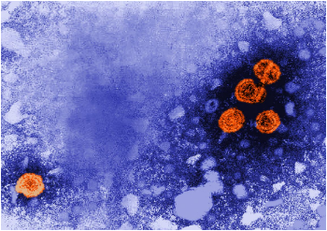
TOPICS COVERED:
Epidemiology
Screening and Prevention
Interpreting HBV Labs
Phases of HBV Infection
Diagnosis and Initial Evaluation of Chronic HBV Infection
Hepatocellular Carcinoma Screening
Basics of HBV Management

Slide 3
EPIDEMIOLOGY
Most common form of viral hepatitis in the world
- Nearly 250 million people in world are estimated to be chronic carriers
- Overall prevalence estimated at 3.6%
- Accounts for nearly 800,000 deaths annually
United States:
- Est. 850,000 – 2.2 million people with chronic HBV
- Dramatic decrease in incidence since advent of vaccine in 1980s
- Small uptick in cases over the past decade
- 2/3 people with HBV infection thought to be unaware
Mode of transmission:
- Vertical transmission most common in high prevalence areas
- Horizontal transmission in early childhood most common in intermediate
prevalence areas
- Horizontal transmission in adulthood (sex, IVDU) most common in low
prevalence areas

Slide 4
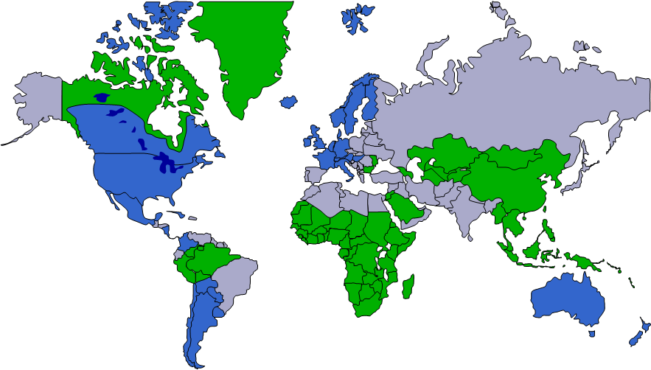
PREVALENCE MAP
2008 CDC guidelines recommended screening for HBV in:
- Persons born in countries with ≥ 2% HBsAg prevalence
- US-born persons not vaccinated whose parents born in regions ≥ 8% HBsAg prevalence

Slide 5
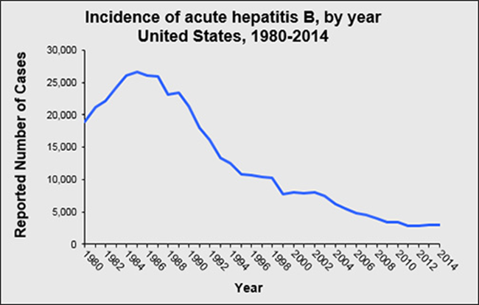
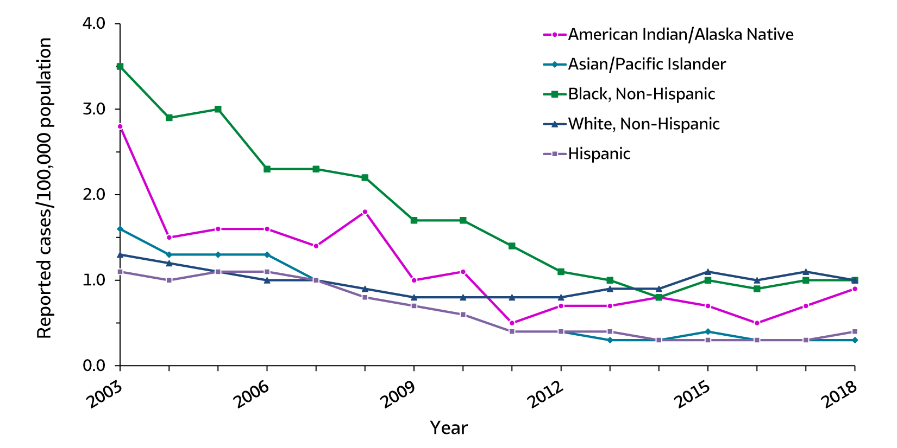
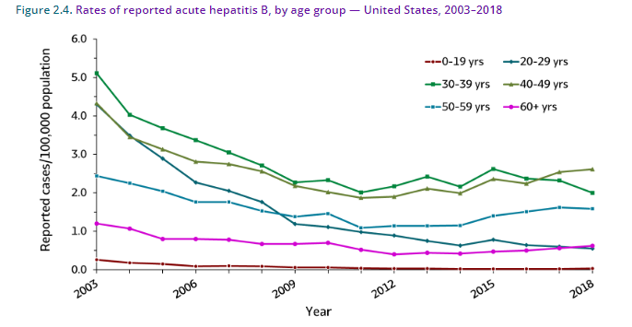
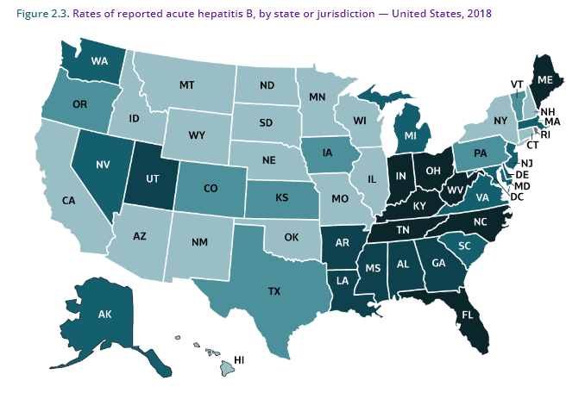
HEPATITIS B IN THE US
Incidence by race / ethnicity
All graphics from CDC

Slide 6
HBV SCREENING
Older guidelines recommended screening based on specific risk factors
2023 CDC guidelines:
- Triple panel test (SAg + SAb + CAb) unless noted
- Universal screening in adults 18 and older
- Repeat screening with SAg only during first trimester of each pregnancy (if prior documented triple test in adulthood)
- Anyone who requests HBV testing
- Infants born to antigen positive people (SAg + CAb)
- Periodic risk-based testing if the following risk factors are
present:

Slide 7
PEOPLE AT INCREASED HBV RISK
History of STIs or multiple sex partners
Current or past HCV infection
Current or past incarceration
People born in regions with ≥ 2% prevalence
US-born people not vaccinated as infants whose parents were born in countries with prevalence ≥ 8%
People who use IV drugs
People with HIV
Men who have sex with men
Household contacts of people with HBV
IVDU or sexual partners of people with HBV
ESRD on dialysis
Elevated AST/ALT

Slide 8
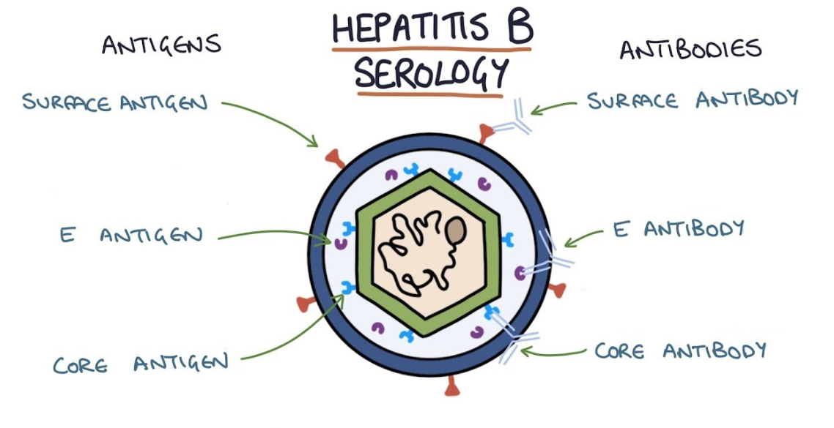
HBV SCREENING LABS
Surface Antigen (HBsAg) = active infection
Core Antibody (HBcAb) = evidence of exposure to virus, past or present
Surface Antibody (HBsAb) = immune response
* Order QUANTITATIVE TITER (immunity if titer > 10 mIU/mL)

Slide 9
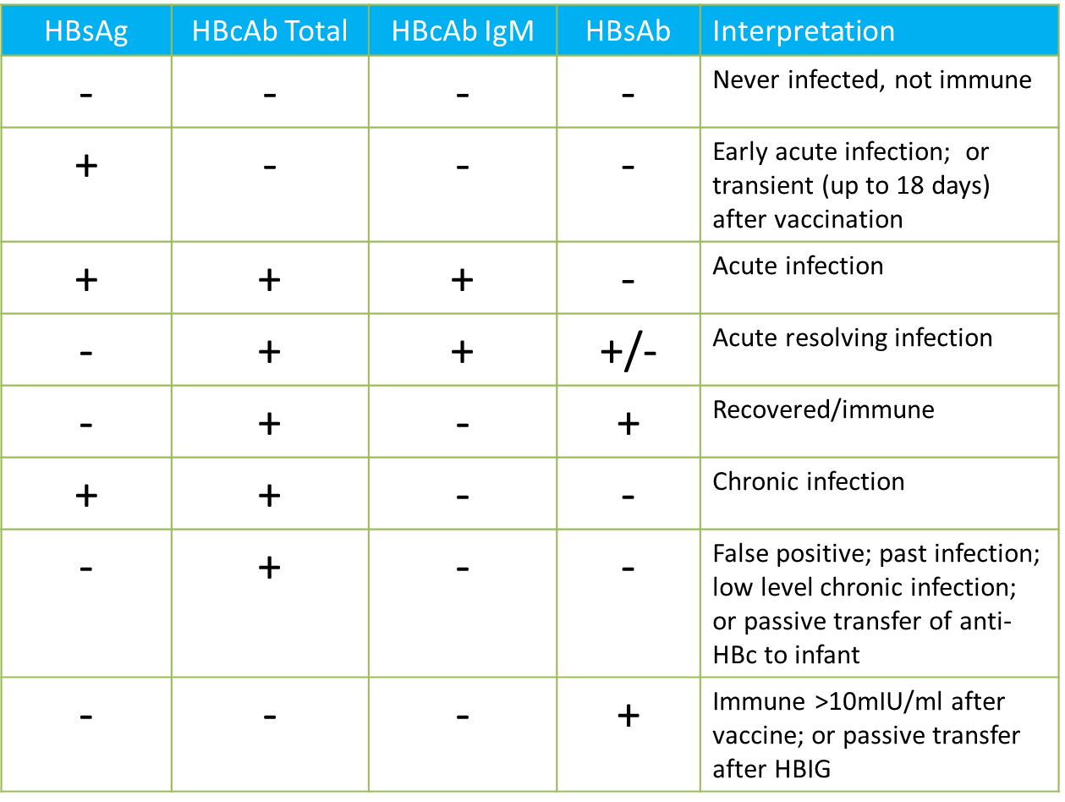

Slide 10
PREVENTION OF HBV TRANSMISSION
Vaccinate close contacts (household members, sex partners, those who share needles, etc.)
If close contacts are non-immune:
- Use barrier protection for sexual intercourse
- Don’t share toothbrushes/razors
- Cover open cuts and scratches
- Clean blood spills with detergent or bleach
Can participate in all activities including contact sports
Can share food, utensils, or kiss others
Should not be excluded from daycare or school participation and should not be isolated from other children

Slide 11
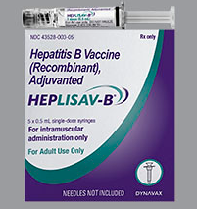
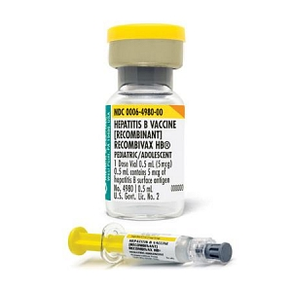
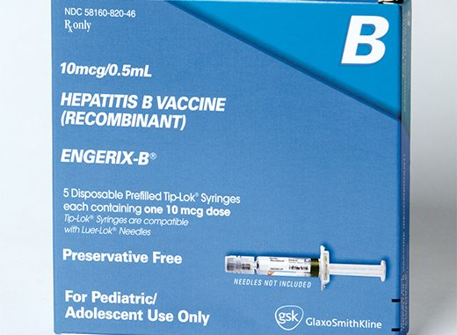
HBV VACCINATION
All infants, beginning at birth
All children <19 not vaccinated previously
Adults: see next slide
Standard 3-dose vaccine: 0, 1-2 months, and 6-18 months
Heplisav: for patients ≥ 18 y/o, 2 shots dosed one month apart

Slide 12
INDICATIONS FOR VACCINATION IN ADULTS
Older guidelines recommended vaccination in adults based on risk only
2022 CDC ACIP Updated Guidelines
- All adults 19-59 should be vaccinated if HBV series not previously
completed in childhood
- Adults ≥ 60 years old with known risk factors
- Adults ≥ 60 years old without risk factors can also choose to
receive vaccine
- In settings with high rates of HBV infection can consider opting
out of pre-vaccination HBSAb testing documents HBV immunity **

Slide 13
RATIONALE FOR THE CHANGE
Progress in recent years on further reducing HBV incidence has stalled
Risk behavior and exposure info often missing (37% of cases in 2019 per CDC)
Rate of new infections increasing among adults 40-59 y/o (CDC, 2019)
Large racial / ethnic disparities, with non-Hispanic Black Americans being at highest risk
Chronic liver disease and other comorbidities (ex. T2DM) can decrease HBV immune response
MMWR, April 2022

Slide 14
HBV IMMUNITY STATUS TESTING
Should be performed 4-8 weeks after final vaccine dose (results less valid outside that window)
Indications:
- Healthcare workers
- Infants with perinatal HBV exposure (test at 9 to 15 months)
- People with HIV
- People on dialysis
Some HBV vaccine experts consider HBSAb indicative of immunity only if HBCAb++ (i.e. if HBSAb titer ≥, core antibody negative and complete vaccine series not documented then still vaccinate!)

Slide 15
INITIAL HBsAg+ WORK-UP
LABS:
HAV, HCV and HDV Ab
HBV DNA (viral load)
CMP (ALT)
CBC
Liver fibrosis panel
HIV Ab/Ag screening
HB E Antigen
HB E Antibody
(Additional STI screenings if transmission thought to be sexual)
**The italicized labs are especially critical in guiding hep B management decisions
HISTORY:
Metabolic risk factors
ETOH and tobacco use
Family hx HCC
Transmission risk factors
Immunization history
PHYSICAL:
Signs of cirrhosis or acute liver inflammation

Slide 16
CHRONIC HBV INFECTION
HBV infection that persists beyond 6 months
6-10% of acute HBV infections progress to chronic infection
Risk for both cirrhosis and hepatocellular carcinoma
There are different phases in immune response to virus:
- Immune-tolerant
- Immune-active (HBeAg+ or HBeAg neg)
- Inactive
- Resolved infection

Slide 17
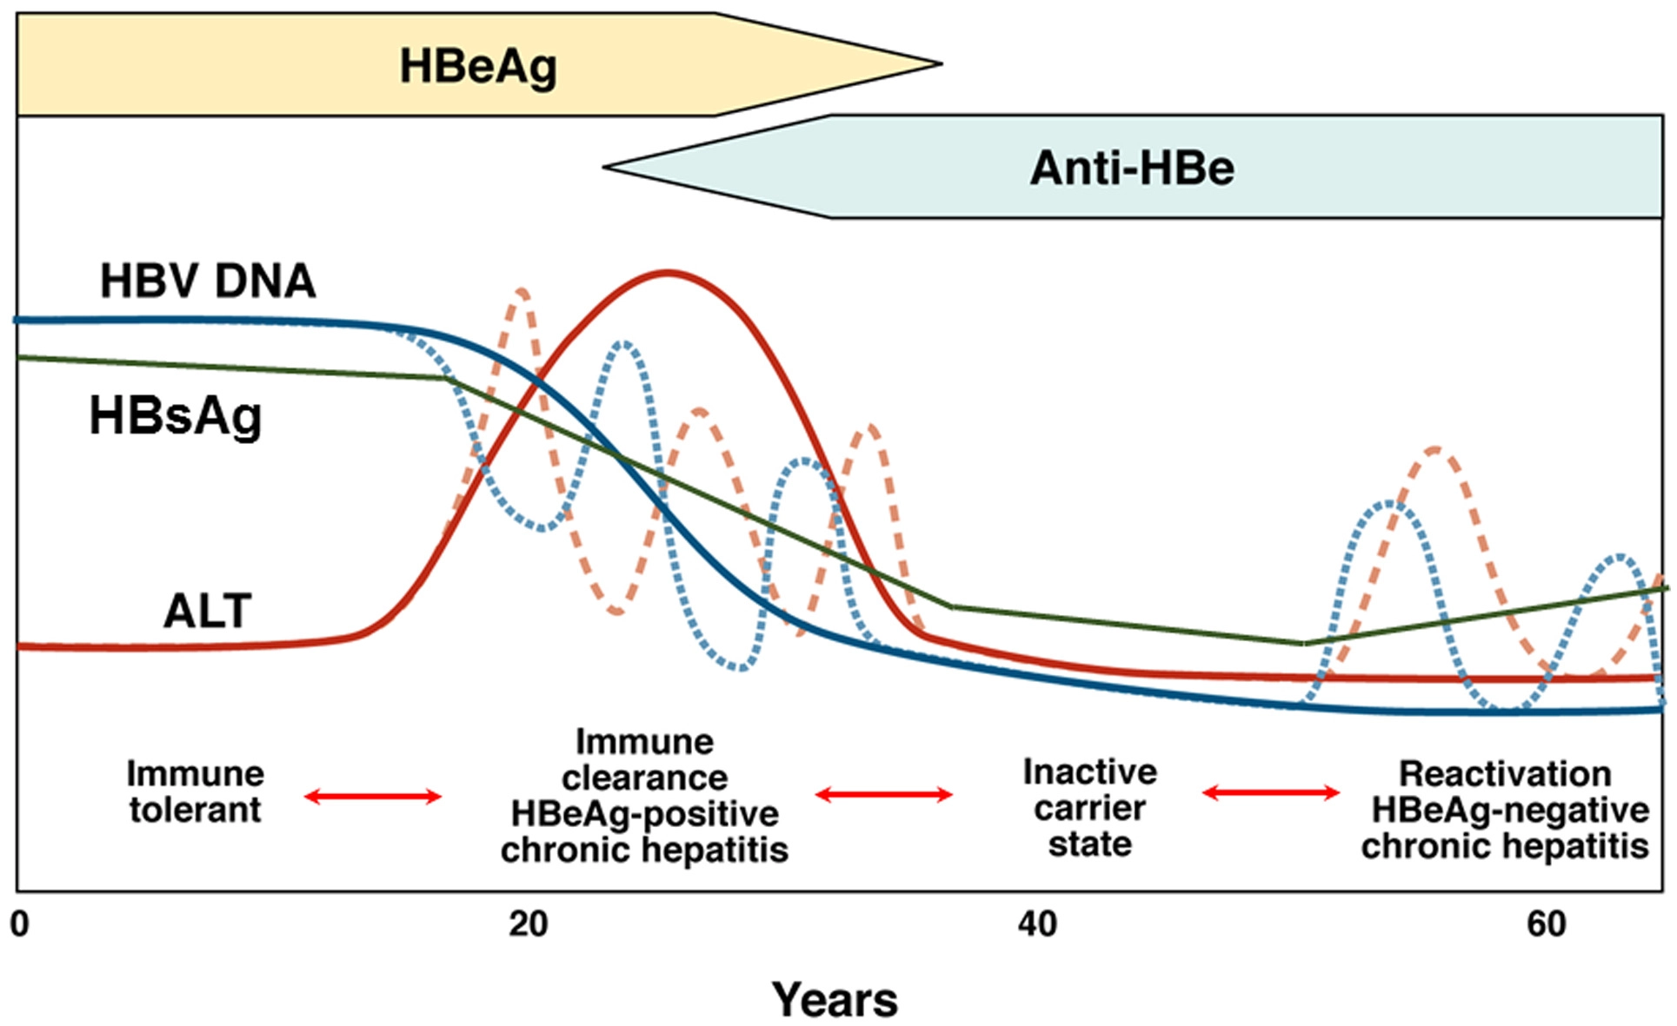

Slide 18
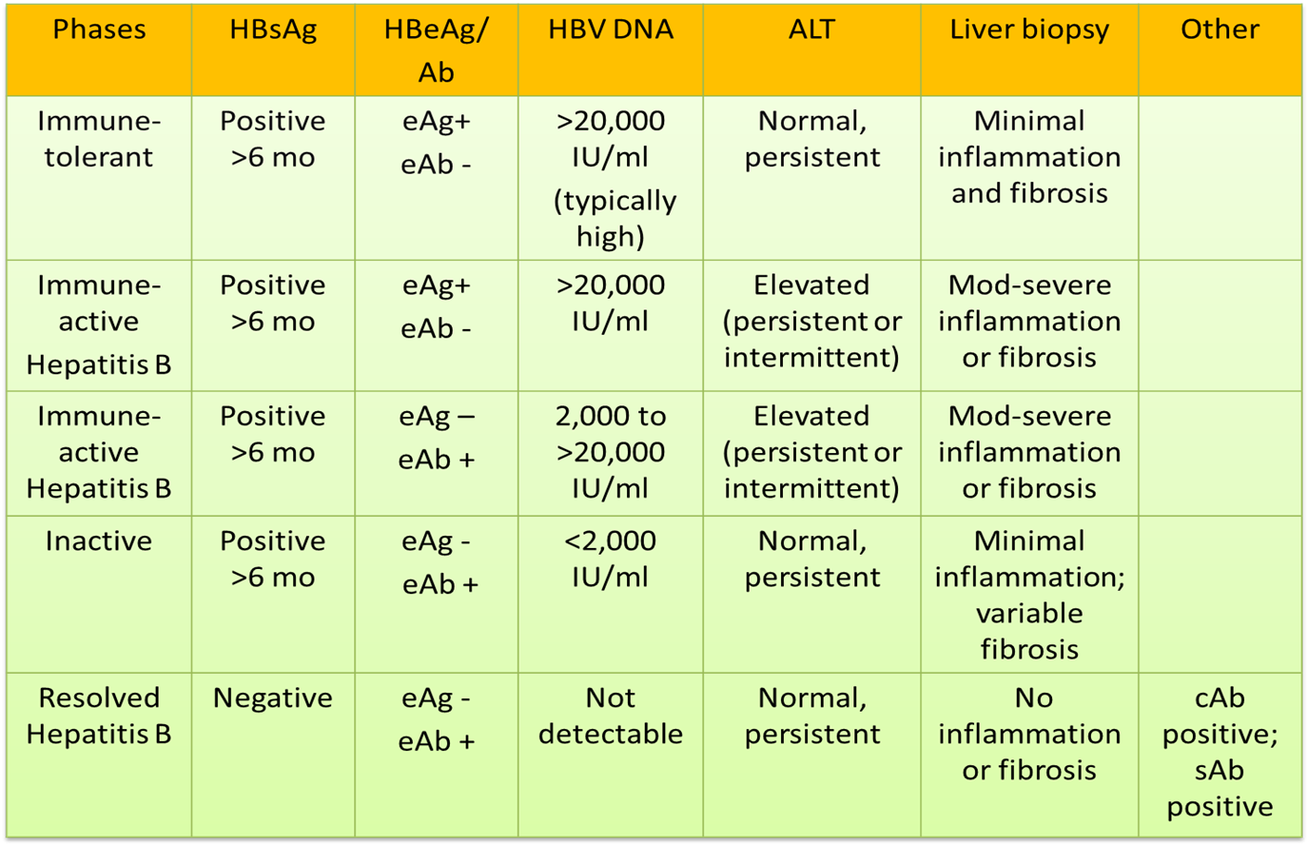
HBeAg+ infection
HBeAg+ disease
HBeAg-
disease
HBeAg-
infection

Slide 19
RISK FACTORS FOR HBV DISEASE PROGRESSION
CIRRHOSIS
High HBV DNA (>2000)
Elevated ALT
Heavy alcohol consumption
HCV/HDV/HIV
Immune compromise
Metabolic syndrome
Male
Older age (>40 y/o)
HBV genotype C
Prolonged time to HBeAg seroconversion
HCC
All of the previous risk factors as well as:
- Cirrhosis
- Carcinogens (e.g. aflatoxin)
- Smoking
- Family history
- Born in Sub-Saharan Africa

Slide 20
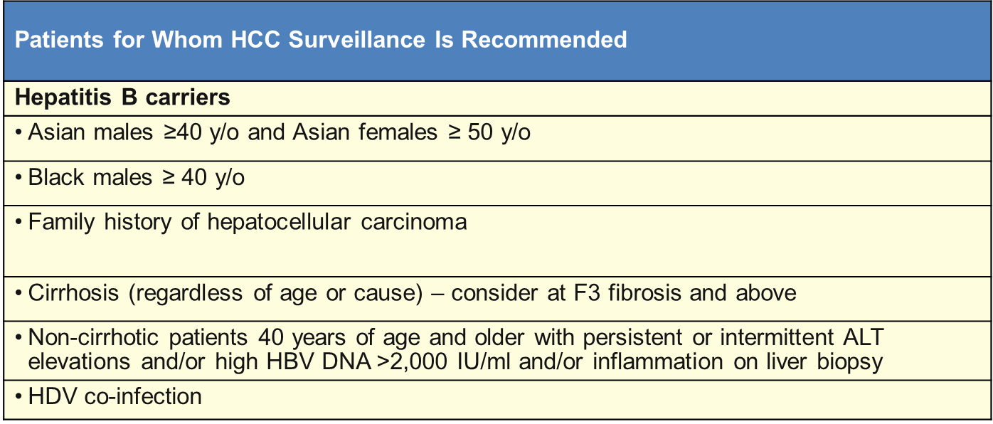
HEPATOCELLULAR CARCINOMA (HCC) SCREENING
HBV is oncogenic in two ways:
- Via DNA integration and viral replication process in host
hepatocyte
- Via chronic liver inflammation
Screening:
- Liver U/S
- + / - Alpha-fetoprotein (AFP) – not very sensitive or specific
- Q 6-12 months

Slide 22
MONITORING OF UNTREATED HBV PATIENTS
Often medication is not indicated for chronic HBV infection and instead labs are monitored regularly over time
ALT and HBV viral load are trended Q 3, 6 or 12 months depending duration of infection and how stable the labs are
ALT upper limit of normal (ULN) is 35 for males and 25 for females (AASLD)
The HBV viral load threshold for treatment is different for HBeAg++ vs. HBeAg negative infection
Essential resources:

Slide 24
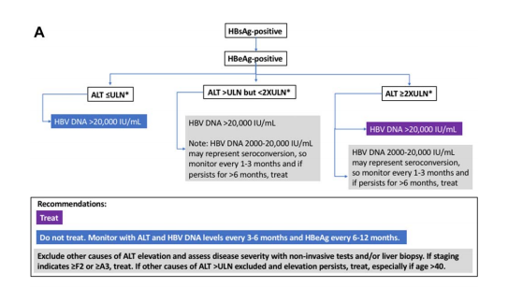

Slide 26
CRITERIA FOR TREATMENT (AASLD)
Treat IMMUNE-ACTIVE infection:
- ALT ≥ 2 x ULN AND
- Elevated HBV viral load
> 20,000 if HBeAg++
$≥$ 2,000 if HBeAg neg
Treat if cirrhosis present (may consider at F2-3)
Treat during pregnancy if HBV VL > 200,000

Slide 27
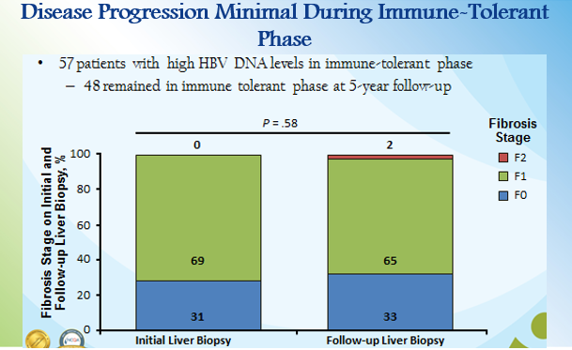

Slide 30
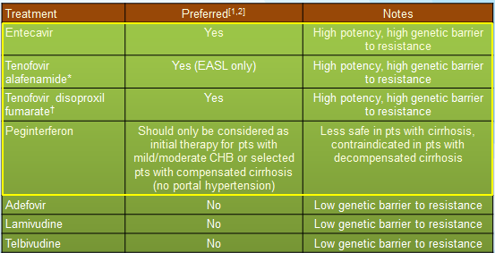
Guidelines: What to Start as Initial HBV Therapy
***Update: 2018 AASLD guidelines do include TAF*** †Pts receiving TDF: monitor renal function, consider monitoring BMD in pts at risk.^{[1]}
ETV, TDF, TAF have very favorable safety profiles^{[2}
1. Terrault NA, et al. Hepatology. 2016;63:261-283. 2. EASL. J Hepatol. 2017;67:370-398.

Slide 31
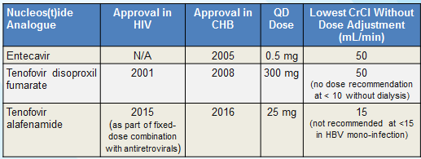
Recommended Nucleos(t)ide Analogues for HBV
Entecavir [package insert]. 2017. Tenofovir disoproxil fumarate [package insert]. 2017. Tenofovir alafenamide [package insert]. 2017.

Slide 32
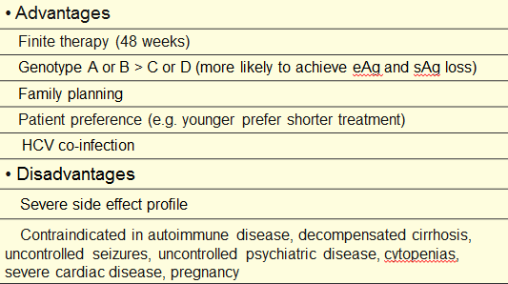
Factors to Consider With Interferon as Initial Therapy

Slide 33
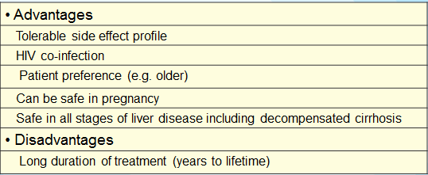
Factors to Consider With Nucleos(t)ides as Initial Therapy

Slide 34
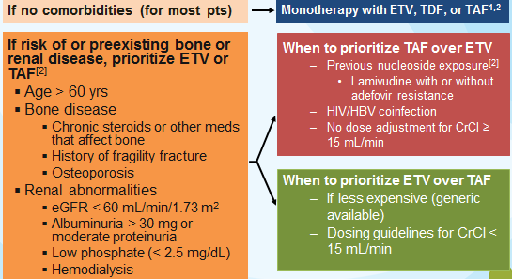
Choosing Among Nucleos(t)ide Analogues

Slide 35
Monitoring while on Treatment
Interferon
Monthly
Blood counts and liver panel
Every 3 months
TSH and HBV DNA
Every 6 months
If HBeAg+, eAg/eAb
Every 3 months for the first 6 months post treatment
Blood counts, liver panel, TSH, HBV DNA, and if eAg+ originally, eAg/eAb

Slide 36
Monitoring while on Treatment
NAs
Every 3 months
Liver panel
Creatinine (if on adefovir or tenofovir)
Every 3-6 months
HBV DNA
Every 6 months
If HBeAg+, eAg/eAb
Every 6-12 months
HBsAg (if eAg negative with HBV DNA persistently undetectable)

Slide 37
Duration of Treatment
Interferon
eAg positive (4-12 months)
eAg negative (12 months)
NAs
eAg positive (no cirrhosis with anti-HBe seroconversion)
Treat until at least 12 months with normal ALT and undetectable HBV DNA and then stop.
If stop, monitor for viremia, ALT increase, seroreversion of eAg, and decompensation q 3 mos.
OR continue until HBsAg loss
If cirrhosis, continue treatment indefinitely.
eAg negative
Continue indefinitely

Slide 38
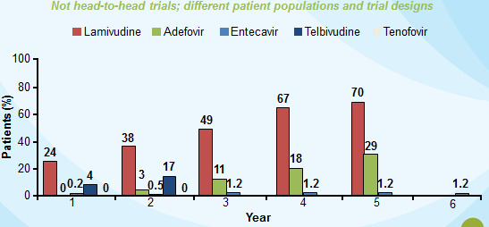
Cumulative Rates of Resistance With Oral Agents in Nucleos(t)ide-naive Patients
EASL clinical practice guidelines. J Hepatol. 2009;50:227-242. Tenney DJ, et al. EASL; 2009; Copenhagen, Denmark. Abstract 20.

Slide 39
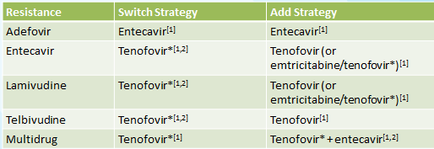
Chronic HBV Infection: Management of Pts With NA Resistance
*Includes either TDF or TAF in EASL guidelines; AASLD guidelines not yet updated since approval of TAF.

Slide 45
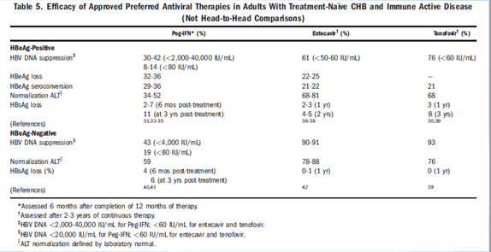

Slide 46
Summary of HBV Treatment
Tenofovir, entecavir, and peginterferon are preferred first-line drugs
First decision is between NAs vs peginterferon
3rd generation NAs have high efficacy, very low rates of resistance, and excellent safety record
Peginterferon offers finite therapy, some evidence of off-treatment benefits
HBeAg seroconversion
Increases over time with NAs
Approximately same after 3 yrs continuous treatment with NAs vs 1 yr of peginterferon
HBsAg loss
Infrequent and increases slowly (< 10% at 3-4 yrs)
Rare with NAs in HBeAg-negative chronic Hep B
After 3-4 yrs follow-up, somewhat higher with peginterferon than NAs

Slide 47
Higher risk of HCC among untreated immuno-tolerant patients compared to matched treated cohorts
Potential benefits in treating all patients with HBV DNA > 2000:
- circumventing the transition to active disease
- reducing transcriptionally active integrations
- inducing a slow decline in the cccDNA pool and hepatic clone size
Newer investigational therapies, alone or in combination with DAAs, may be more effective in bringing about functional cure
- Entry inhibitors
- RNA interference agents
- HBSAg assembly agents
- Capsid (core) assembly modulators
- Immunomodulators

Slide 48
Summary
HBV screening, prevention, and vaccination can and must be done in primary care.
HBV treatment can also be done in primary care or in conjunction with GI.
Evaluate and/or refer all those with chronic HBV for monitoring and potential treatment.
Correlation between HBV DNA and cirrhosis and HCC well known.
Cirrhosis is by far the largest risk factor for HCC.
Antiviral therapy currently does not eradicate HBV, BUT
Treatment when indicated can alter natural history of HBV and can slow or even reverse disease progression, especially if
Risk of liver-related morbidity and mortality is high and
There is a strong likelihood of maintaining viral suppression with treatment.

Slide 49
THANK YOU!
Jeannie McIntosh, APRN
CHC Center for Key Populations
mcintosj@chc1.com
Questions?

