Slide 1
MEDICATIONS FOR OPIOID USE DISORDER (MOUD)
Jeannie McIntosh, APRN, FNP-C, AAHIVS
CHC Center for Key Populations
NP Residency Didactic, March 2023

Slide 2
TOPICS COVERED
Origins and Epidemiology of Opioid Epidemic
Pathophysiology of Addiction
Types of MOUD
- Naltrexone
- Methadone
- Buprenorphine***
Prescribing Buprenorphine in a Community Health Primary Care Setting: CHC’s Program

Slide 3
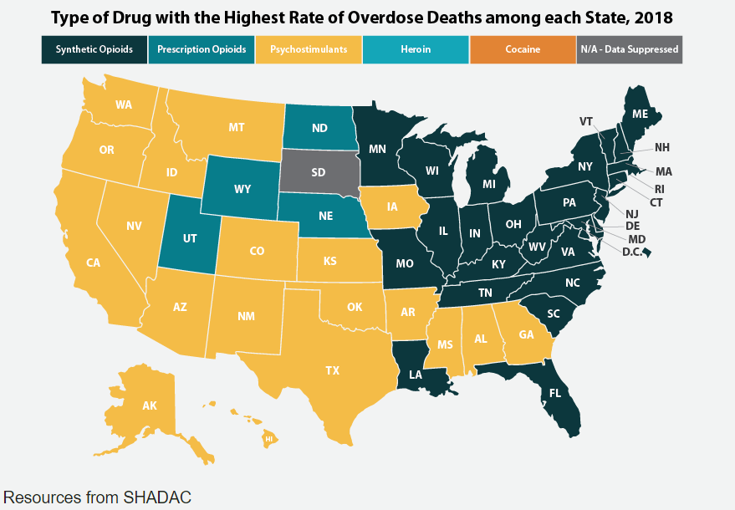
OPIOID USE DISORDER IN THE US
2018

Slide 4
EPIDEMIOLOGY
Nearly 841,000 people have died since 1999 from a drug overdose (CDC).
Over 70% of drug overdose deaths in 2019 involved an opioid and nearly 73% of those deaths involved synthetic opioids like fentanyl.
30% increase in overdose deaths in US from 03/2020 to 03/2021.
Cocaine-related OD deaths are also increasing.
Increased prevalence of OUD in metropolitan areas and among African Americans over past five years.

Slide 5
ORIGINS OF THE EPIDEMIC: HOW DID WE GET HERE?
1. Rise in opioid prescription for treatment of chronic pain

Slide 6
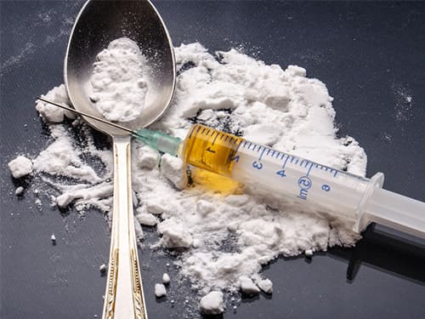
2. Rise in heroin use
- Lower cost
- Increasingly restricted access to rx oral narcotics
WHO pain mgmt. guidelines (2011)
Increase in state PDMP systems
3. Rise in synthetic opioid (ex. Fentanyl) use
- Cheap
- Potent

Slide 8
OPIOID USE DISORDER (DSM-V)
Tolerance
Need for increased amounts to achieve desired effect, or
Diminished effect with continued use of same amount
Withdrawal
The characteristic opioid withdrawal syndrome, or
The same or closely related substances are taken to relieve or avoid withdrawal symptoms
Opioids taken in larger amounts/longer period than intended
Inability to/persistent desire to cut down or control opioid use
Great deal of time spent in activities necessary to obtain, use or recover from opioids
Craving/strong desire to use opioids

Slide 9
Recurrent use results in failure to fulfill obligations at work, school, or home
Social, occupational and recreational activities given up or reduced because of opioid use
Recurrent opioid use in situations in which it is physically hazardous
Continued use despite knowledge of having persistent/recurrent physical/psychological problem that is likely caused/exacerbated by opioids
*** 2 or more within a 12 month period
*** Severity: Mild= 2-3; Moderate= 4-5; Severe= 6 or more

Slide 10
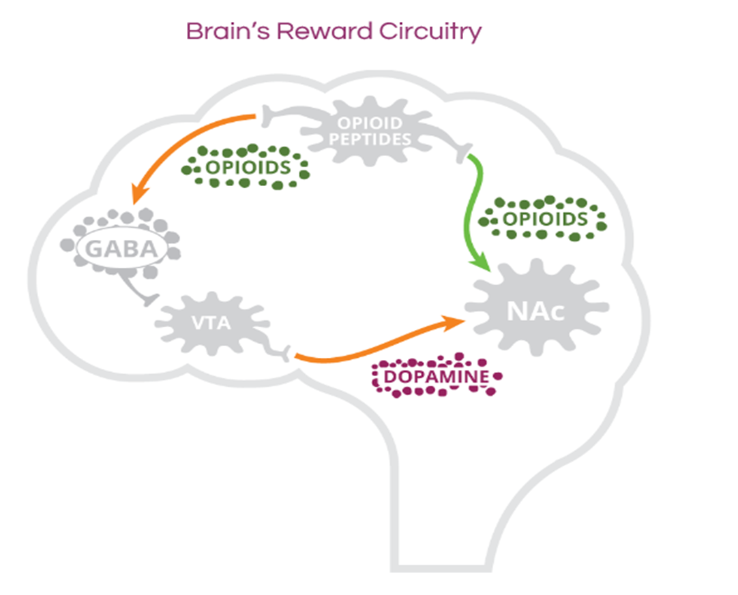
PATHOPHYSIOLOGY OF OPIOID DEPENDENCE
• Reward pathway:
- VTA + nucleus accumbens (with projections into prefrontal cortex)
- A dopaminergic system modulated by mu receptors
- Stimulated by opioids to much higher degree than other rewarding behaviors (ex. sex, food)
• Tolerance: needing increased dose over time to produce effect
• Physical dependence: s/s withdrawal with reduction or cessation of exposure
• Euphoria becomes less over time while physical dependence (withdrawal symptoms) worsen; patient begins to
need opioid to feel normal

Slide 11
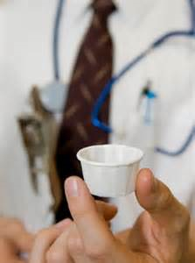
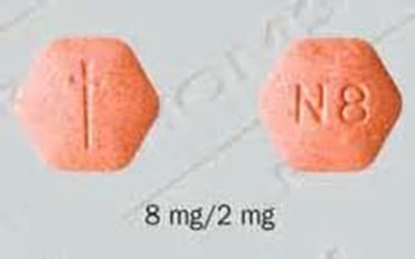
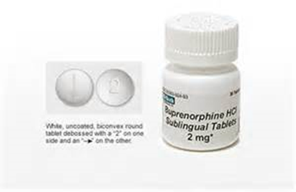
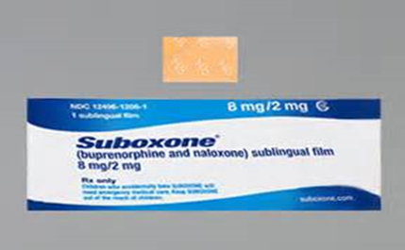
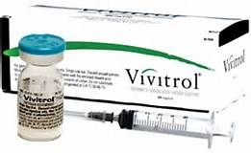
MEDICATION FOR OPIOID USE DISORDER (MOUD)
Best evidence-based treatment for opioid use disorder
Biological rationale
Prevents withdrawal
Relieves craving for opioids
Blocks or attenuates euphoric effect of exogenous opioids
3 types with different activity at mu receptor:
- NALTREXONE – full antagonist
- METHADONE – full agonist
- BUPRENORPHINE– partial agonist

Slide 12
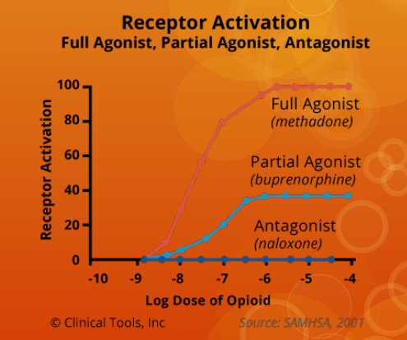
California Bridge Program, 2018

Slide 13
Comparison of Short-Acting Heroin vs. Long-Acting Methadone Treatment
OD
“High”
Functional State
“Normal”
M
M
M
“Sick”
AM
PM
AM
PM
AM

Slide 14
NALTREXONE
Full opioid antagonist
Must be off opioids 7-10 (?14) days prior to initiation
- Heroin, PO narcotics – off 5-7 days
- Buprenorphine– off 9 days
- Methadone– off 12-15 days, if not longer (? Fentanyl too)
Consider in-office NALOXONE CHALLENGE to ensure opiates are out of system prior to first dose
If any doubt start with PO naltrexone
Dosing:
- ORAL:
* 25 mg on first day, then 50 mg after that
* Alternate: 50 mg on week days + 100 mg weekend dose (for Sat/Sun)
150 mg every 3 days
- IM: 380 mg every 4 weeks
Caution in cirrhosis
Injection: administered in office; very viscous; needs to be deep IM; risk of abscess, tissue necrosis with improper administration
Disadvantages: OD risk due to loss of tolerance; frequent loss of patients to follow-up at start of treatment
Advantages: monthly IM injection affords a lot of independence; some patients do not want to be on agonist therapy

Slide 15
METHADONE
Full opioid agonist
Very long half-life
Positive outcomes:
- Reduction in death rates, IVDU relapse, crime days, HIV
seroconversion
- Improved employment rates, health, & social function
Safe in pregnancy
Can be used for medical maintenance, medically supervised withdrawal, and detoxification
Can only be prescribed in a SAMHSA-certified Opioid Treatment Program (OTP)
- Patients start with daily med pick-ups and graduate to increased “take-home
bottles” – typically up to a month supply
- Average dosing in US: 60-120 mg
Advantages: some patients with severe OUD and / or concomitant chronic pain find it is more effective
Disadvantages: requires more frequent follow-up (less independence), higher OD risk, increased sedation, some patients do not like that they “feel high” on it

Slide 16
BUPRENORPHINE
Partial opioid agonist at the mu receptor. Has a high affinity and low dissociation rate from receptor.
Lower risk of OD due to “ceiling effect.”
Typically co-administered with naloxone as an abuse deterrent.
Must be prescribed by an x-waivered clinician if used for OUD
Buprenorphine monotherapy is safe in pregnancy
Formulations:
- Sublingual buprenorphine-naloxone – film or tablet [Suboxone, Zubsolv,
generic]
- Sublingual buprenorphine – tablet [Subutex]
- Subcutaneous buprenorphine-naloxone injection [Sublocade] – monthly
Daily sublingual dosing: ** Zubsolv is dosed differently
- Typically 8-24 mg daily bup dose – may be as low as 2 mg and as high as
32 mg (esp. if comorbid chronic pain)
- Almost all mu receptors saturated at 16 mg dose

Slide 17
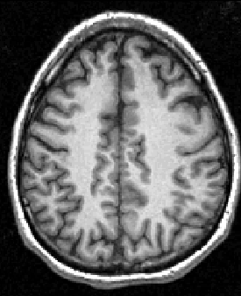
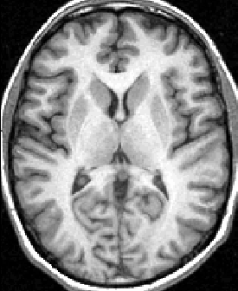
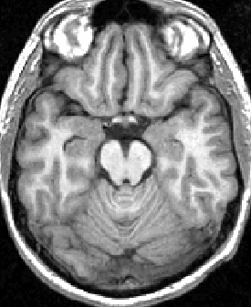
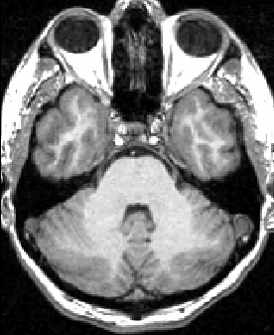
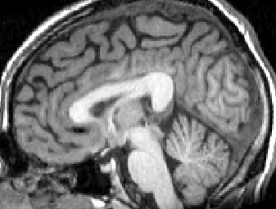
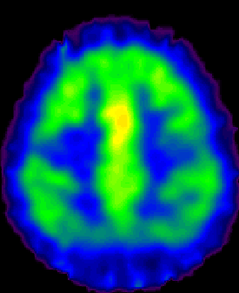
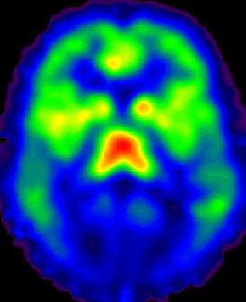
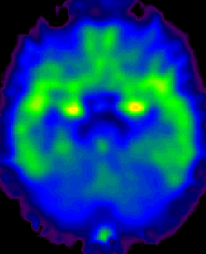
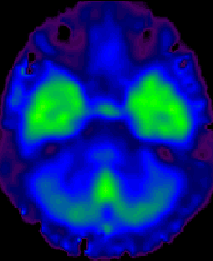
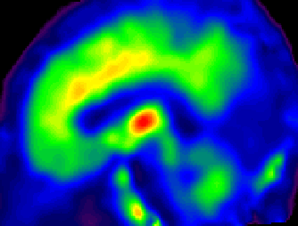
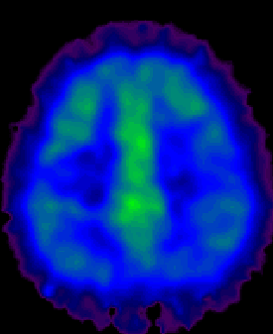
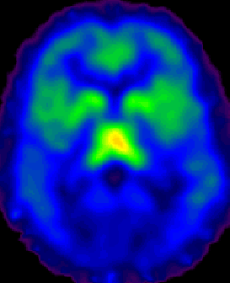
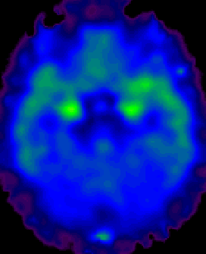
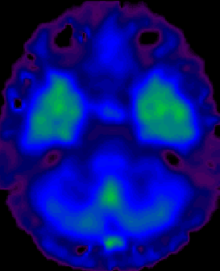
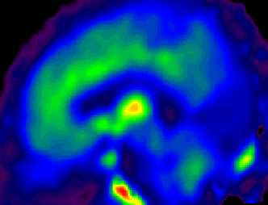
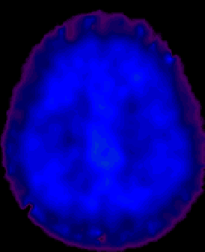
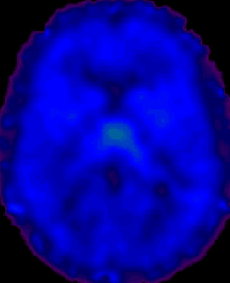
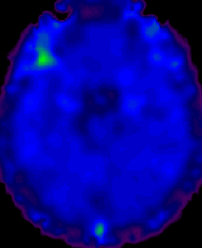
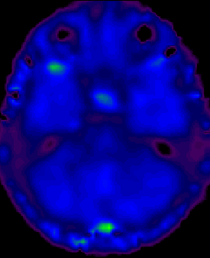
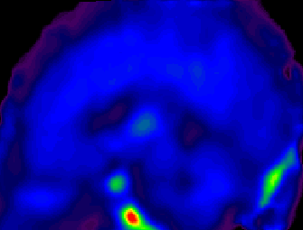
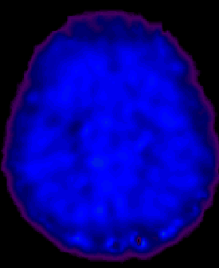
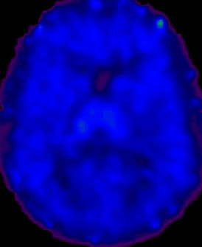
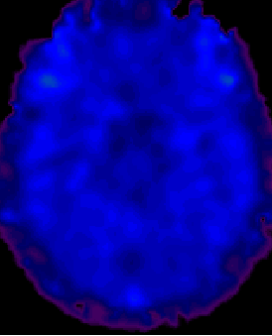
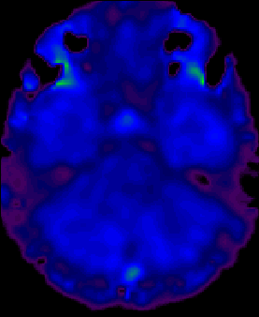
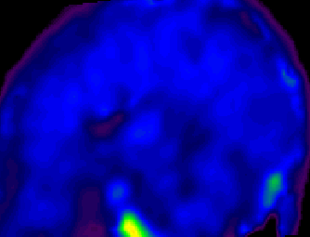
Effects of Buprenorphine Dose on µ-Opioid Receptor Availability in a Representative Subject
MRI
Bup 00 mg
Binding
Potential
(Bmax/Kd)
Bup 02 mg
4 -
Bup 16 mg
0 -
Bup 32 mg
Slide Courtesy of Laura McNicholas, MD, PhD

Slide 18
INTAKE VISIT
HISTORY:
Opioid use history
Last opioid use
Cravings
Withdrawal symptoms
Prior treatment history
Other substance use
Mental health comorbidities
Medical comorbidities (HIV, HCV, endocarditis, etc.)
PDMP
Any toxicology screenings on file
Housing
Employment
Social supports
Goals, reasons for seeking care
H/o transactional sex ?

Slide 19
PHYSICAL EXAM
LABS
Toxicology
(urine and / or saliva)
HIV and HCV screening
Auscultate heart and lungs
Examine skin for injection site abscesses, cellulitis
Psych assessment
Grading withdrawal signs and symptoms
**PRESCRIBE NALOXONE**

Slide 20
CLINICAL OPIATE WITHDRAWAL SCORE (COWS)
Resting pulse
Sweating
Restlessness
Pupil size
Bone or joint aches
Runny nose or tearing
GI upset
Tremor
Yawning
Anxiety or irritability
Gooseflesh skin
Mild: 5-12
Moderate: 13-24
Moderately severe: 25-36
Severe: > 36

Slide 21
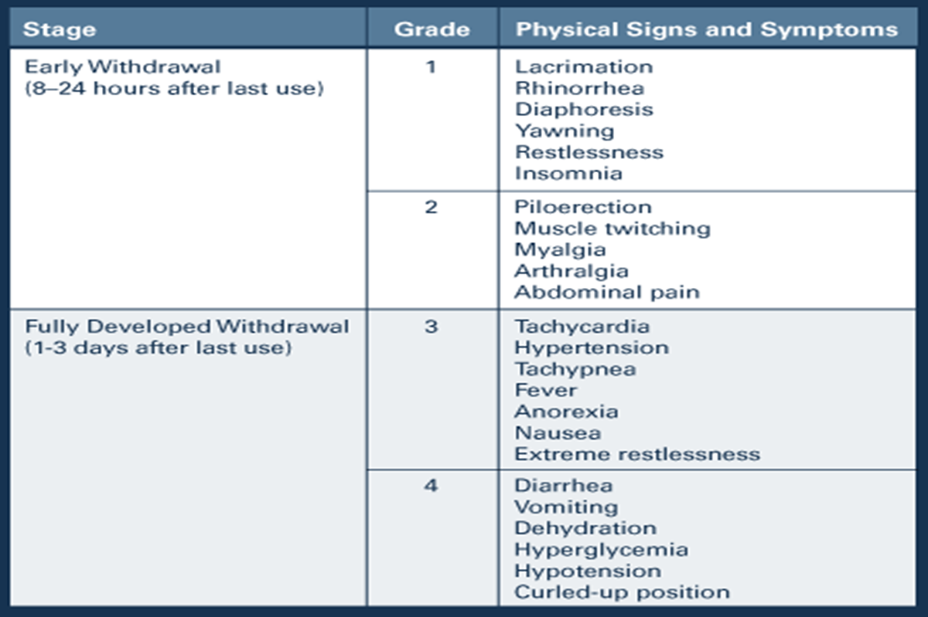

Slide 22
Buprenorphine Eligibility Considerations
Is (are) there
Is the patient
A diagnosis of Opioid Use Disorder?
Signs of intoxication or withdrawal?
An interest in BMT?
An understanding of risks and benefits of BMT?
An ability to adhere to treatment plan?
An ability to follow safety procedures?
An agreement for treatment after review of options?
Needed resources available?
Prior adverse reaction to buprenorphine?
Drug interactions with buprenorphine?
Medical problems that are contraindications to BMT?
Psychiatrically stable?
Pregnant?
Dependent or abusing alcohol?
Dependent or abusing benzos or other sedative-hypnotics?
At risk for continued use or relapse? Using other drugs? Has history of previous treatment?
In a stable/supportive recovery environment?
At an appropriate level of motivation/stage of change?

Slide 23
INDUCTION
Home induction vs. in-office induction
Wait at least 24 hours since last opioid use (72 hours if methadone) AND
moderate withdrawal symptoms
Day 1:
- Take 2-4 mg, then wait an hour
- If still in withdrawal then take another 4 mg
- Max dose 8 mg on first day
Days 2-7:
- Increase by 4 mg per day as needed
- Max dose 16 mg per day
- Nurse or provider can call to check in mid-week

Slide 24
MANAGEMENT OF WITHDRAWAL SYMPTOMS
ANXIETY
Hydroxyzine
Gabapentin
Clonidine
Quetiapine
NAUSEA
Ondansetron
Metoclopramide
DIARRHEA
Loperamide
PAIN
NSAIDs
Lidoderm patch
? Low dose baclofen

Slide 25
MAINTENANCE
Buprenorphine dose titrated until control of opiate cravings + withdrawal sx achieved
As OUD becomes stabilized and opioid use diminishes can consider decreased frequency of follow-up sessions over time
Patient drives length of therapy - may choose to stay on BMT for decades or choose to gradually titrate off once OUD in sustained remission

Slide 26
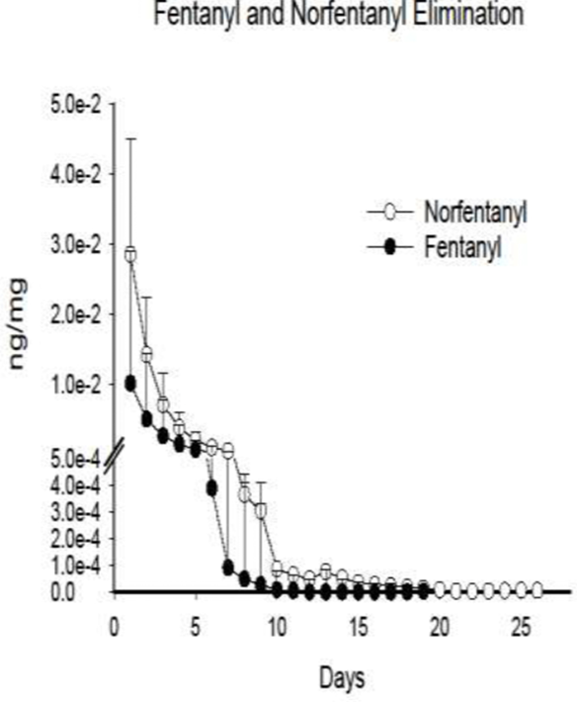
Revisiting Standard Method
Precipitated Withdrawal r/t Buprenorphine Induction
Risk for severe withdrawal increase when taking Buprenorphine w/in 24-48 hours after Fentanyl use
24 hours: 22%
48 hours: about 8-10%
Fentanyl
Bup
Mu Receptor
Mu Receptor
Mu Receptor
Mu Receptor
Varshneya NB, Thakrar AP, Hobelmann JG, Dunn KE, Huhn AS. Evidence of Buprenorphine-precipitated Withdrawal in Persons Who Use Fentanyl. J Addict Med. 2021 Nov 23

Slide 27
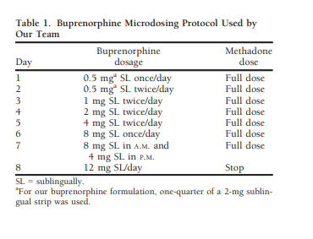
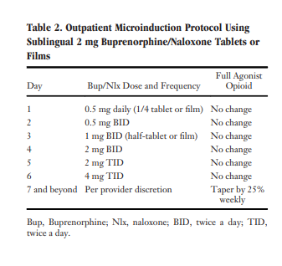
Micro-Dosing and Low-Dosing
Overarching Goal: Transition from full opioid agonist to buprenorphine without requiring patients to undergo period of opioid abstinence without symptoms of withdrawl
Principles
Step 1: Overlapping of concurrent full agonist use
Step 2: Bridge incremental small doses of bup, gradual changes in the mu-receptor activation
Step 3: Cross-titration with full agonist discontinued and bup at normal dose
Advantages:
Decreased risk of precipitated withdrawal
Reddit study: many users used micro-dosing at home to assist with prevention
Autonomy
Disadvantages:
Very small dosing – manipulation of medication based on micro vs. low dosing
Suboxone vs. Belbuca
Insurance difficulties
Limited data – arguably new concept
 | Initial Dosing | Day 1 Total
Micro Dosing | 0.02-0.25mg | 0.25-0.48mg
Low Dosing | 0.5mg-1mg | 0.5mg-2mg
Transitioning Hospitalized Patients with Opioid Use Disorder from Methadone to Buprenorphine without a Period of Opioid Abstinence Using a
Microdosing Protocol Dale Terasaki*1 Christopher Smith,2 and Susan L. Calcaterra2 1 Addition Medicine Fellowship, University of Colorado Hospital, CeDAR, Aurora, Colorado; 2 Department of Medicine, Hospital Medicine, University of Colorado Hospital, Aurora, Colorado
Buprenorphine Microdose Induction for the Management of Prescription Opioid Dependence Jonathan L. Robbins, MD, MS, Honora Englander, MD, and Jessica Gregg, MD, PhD (2/2021)

Slide 28
Macro-Dosing
Overarching goal: Increasing presence of partial agonist to not only satisfy receptor, but also provide agonism of the receptor without precipitating withdrawal
Advantages:
Fast induction
Greater receptor saturation
>90% allows for cumulative effect w/out precipitated withdrawal
No continuation of full-agonist
Keeps fentanyl from re-binding
Disadvantages:
Limited data
Mainly clinical trials
Risks unclear w/ pregnancy, concomitant substance use disorder
Risk for possible withdrawal
Quick Literature Review
Ang-Lee et al. Singel Dose of 24 mg of Buprenorphine of Heroine Detoxification An Open-label Study of Five Inpatients
Five participants with heroine use disorder given single 24mg dose of Buprenorphine
One episode of precipitated withdrawal, resolved in 4 hours
Single high dose buprenorphine can be used safety for inpatient detox
Withdrawal Symptoms Happen … Treat Them
Nausea/Vomiting:
Ondansetron 4mg q 6 hr prn
Diarrhea
Loperimide 4mg
Agitation/Irritation/Restlessness
Clonidine 0.1-0.3mg q6-8 hours
Gabapentin 300mg TID
Tizanidine (off-lable)
Musculoskeletal Pain
Acetaminophen 650mg q 4 hr prn
Tizanidine
Insomnia
Hydroxyzine 25mg po nightly
Trazadone 100mg nightly
Non-Pharmacologic
 | Initial Dose | Day 1 Total
Macro Dosing | 8-20mg | 16mg-32mg

Slide 29
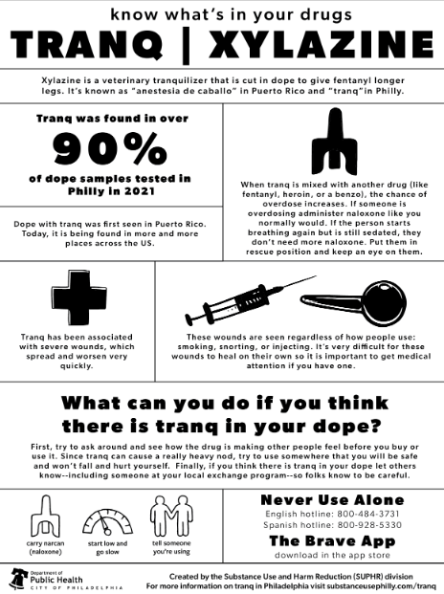

Slide 30
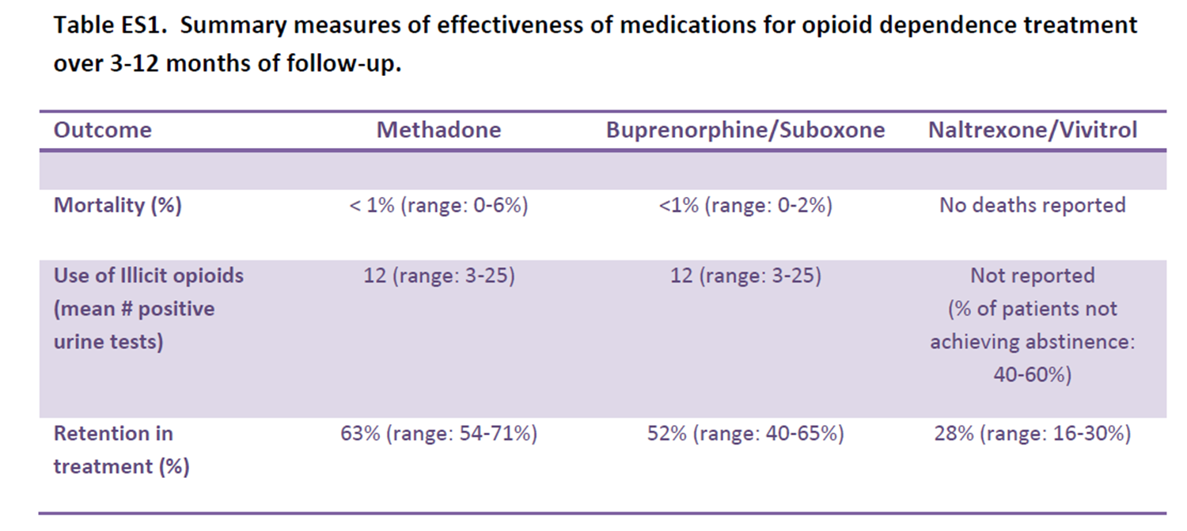

Slide 31
BEHAVIORAL HEALTH ENGAGMENT
Can help patient identify and explore root causes for opioid use, develop alternate coping mechanisms, and navigate stressors that trigger cravings
Individualized based on patient needs and BH assessment
Involves interdisciplinary care coordination and a team based approach
CLINIC-BASED BH CARE:
- Group counseling
- Individual therapy
- Psychotropic mgmt. with psych prescriber
HIGHER LEVEL OF CARE (HLOC):
- Intensive outpatient program (IOP)
- Residential treatment program
Some patients also choose to engage in PEER SUPPORT, such as NA

Slide 32
INTERPRETING TOXICOLOGY SCREENINGS

Slide 33
Norbuprenorphine is the active metabolite of buprenorphine
Detectable in urine longer than in saliva
There are no absolute values that are “right” or “wrong” - instead need to look at an individual’s toxicology over time for accurate interpretation
However, BUP levels significantly higher than NORBUP levels may raise suspicion

Slide 34
We typically use urine GC/MS test as lab send-out
Rapid urine immunoassay allows for quick result and is cheap but less accurate
Consider saliva if patient cannot urinate (ex. on dialysis, prostate issue) or if concern of tampering with urine sample
Urine bup/norbup levels:
- Norbuprenorphine is the active metabolite – if very low levels may be not taking
med or swallowing before letting it fully dissolve
- No absolute number for an “appropriate” level so look for trend in patient’s
toxicology screenings over time
- Norbup typically > 100-200, norbup : bup ratio > 0.02
(ex. if bup > 2000, norbup 40 I would have concern for possible tampering)
- If any doubt can bring patient in for observed med administration with serial
toxicology screenings
Heroin may show up as morphine or 6-acetyl-morphine
“Fentanyl tail” phenomenon

Slide 35
Potential Inaccurate Results
False Positive
“False” Negative
Amphetamine
Pseudoephedrine, ephedrine, phenylephrine
Other commonly used meds e.g. atenolol, propranolol, levodopa, carbidopa
Methamphetamine
d- (prescribed/abused meds) vs
l- isomers (OTC meds)
Opioids
Poppy seeds, e.g. bagel, pastries
PCP
OTC cold meds, e.g. DM
Cannabinoid/marijuana
Hemp containing products, dronabinol (Marinol)
Amphetamines
MDMA, crystal meth, methylphenidate (Ritalin) NOT included
Opioids
Meperidine (Demerol), oxycodone, fentanyl, buprenorphine NOT included
Benzodiazepines
Clonazepam NOT included
Other commonly abused drugs
GHB, LSD, ketamine, designer amphetamines, synthetic cannabinoids NOT included

Slide 36
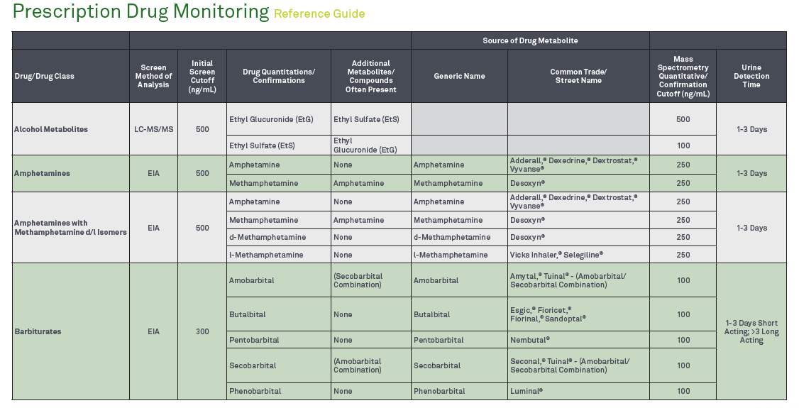

Slide 37
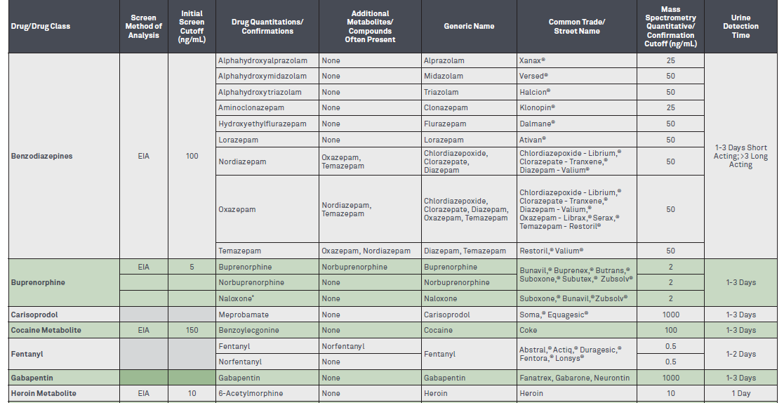

Slide 38
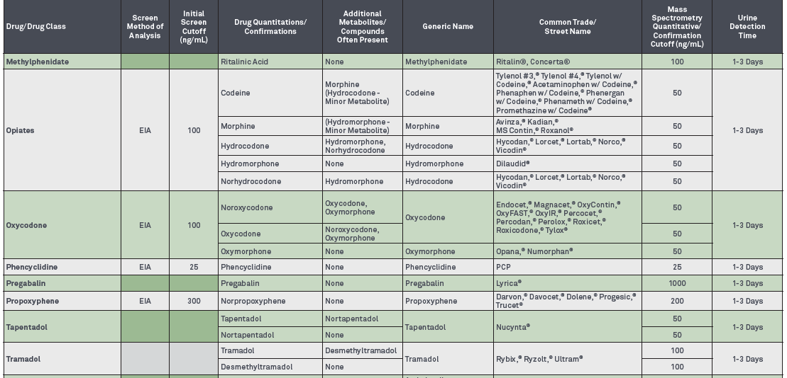

Slide 39
Concerns with Polysubstance Use
Benzo/Alcohol Use
Patients need to be warned about the dangers of benzo/alcohol use, which include fatalities, while taking buprenorphine.
Prescribed stable benzo use may be approved at the discretion of the prescriber.
Weigh risks of continuing buprenorphine with risks of discontinuing treatment and potential for complications including overdose and death.
Cocaine Use
Buprenorphine is treatment for opioid dependency, not cocaine.
Additional behavioral health support may be needed
Some pharmacotherapy may be tried, though no medication has yet been approved by FDA for cocaine dependency.

Slide 40
PRESCRIBING BUPRENORPHINE IN A COMMUNITY HEALTH PRIMARY CARE SETTING: CHC’S PROGRAM

Slide 41
Maintenance
MD/RN
BH and Medical assessments and treatment
Every 2-4 weeks
Home
Initial Visit
Weekly visits
(Revised)
Treatment Plan
Relapse
In Office
Eligibility, Hx, Px, Labs, Tox screen, Agreements
Stabilization
BH Counseling
Weekly visits
Induction
Internal or external
Reengage-ment
Death
Overdose
Program Failure/ Out of Care
Partial Abstinence
Complete Abstinence
Buprenorphine Program Workflow

Slide 42
LINKAGE TO CARE
Self-referral
External referrals – hospital, detox program, prison
Internal referrals – from other providers in clinic
**All go to a central TEACH-BMT electronic bin and are then routed by coordinators to a prescriber at the desired clinic location

Slide 43
MOUD CARE TEAM
Recovery care coordinator
MAT prescriber
BH clinician(s)
Nurse(s)
MA(s)
**Monthly case review meeting

Slide 44
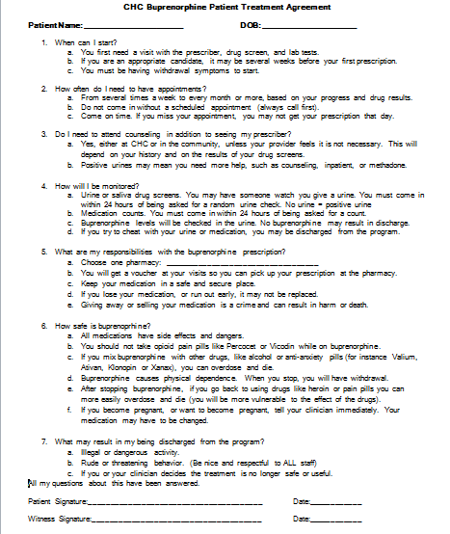
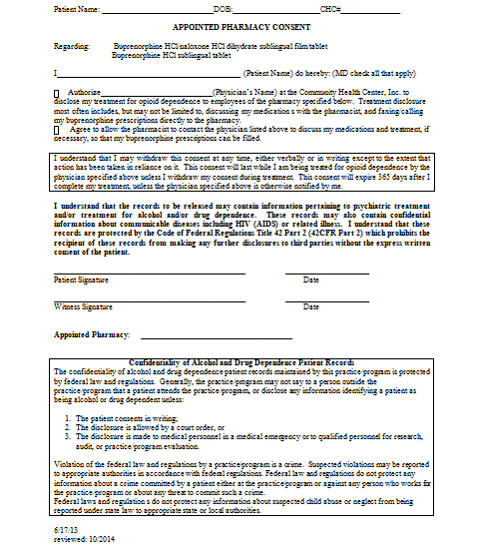
Buprenorphine Treatment and Pharmacy Agreement

Slide 45
FOLLOW-UP VISITS
Vary in frequency based on patient need and stage of recovery
Typically weekly nurse visits and counseling + follow-up with prescriber Q 2-4 weeks
Patients may eventually progress to monthly nurse visit + prescriber visit Q 3 mos.

Slide 46
Buprenorphine Nursing Visit
Review how they have been since last visit; any triggers; how behaved in response to triggers, to stresses.
Opportunity for motivational interviewing, self-management goal setting, brief intervention
Review any illicit drug or alcohol use.
Review support system/network.
Review buprenorphine side effects; effectiveness, adherence, taking as directed, cravings curbed, withdrawal symptoms.
Review toxicology screens including buprenorphine levels.
Review treatment plan
Are they in group? Attending? ROI? May need to call to verify.
Are they seeing BH? Attending? ROI? May need to call to verify.
Do they have updated and signed Bup/Pharmacy Agreement?
Using voucher? Do they have refills?
Call in refill and pull prescription into Rx tab and fill appropriately and/or
Send TE to prescriber
Do they have an appointment with the prescriber?

Slide 47
WHAT TO DO IF A PATIENT IS STRUGGLING
Motivational interviewing!
Titrate up on dose
If UDS inconsistent – add random saliva screenings, observed med administration
More frequent BH and medical follow-up
Referral to psych prescriber to ensure mental health comorbidities are adequately managed
Regular check-ins with recovery care coordinator
Referral to HLOC: IOP
Detox → residential program
Consider switching to a different form of MAT, such as methadone

Slide 48
DIFFERENT STYLES OF PROGRAMS
Separate MOUD visits vs. Integrated primary care + MOUD visits
Standardized protocols vs. Individualized to patient goals and needs
Abstinence model vs. Harm reduction model

Slide 49
CHANGES DUE TO COVID PANDEMIC
Opioid overdoses on the rise
More limited availability in detox, residential program and IOPs
CHC BH sessions all telehealth, mostly individual
Some providers are decreasing frequency of toxicology screenings and increasing refill duration to minimize risk of covid exposure
Voucher system not as widely implemented
MAT intake visit may occur with provider joining remotely and nurse on-site

Slide 50
PRINCIPLES OF HARM REDUCTION
PRAGMATISM - substance use will not be eliminated in society, so maybe limiting the use should be the goal.
HUMANISTIC VALUES - respect individual’s rights and dignity by accepting their decision to use.
FOCUS ON HARMS - minimize the negative consequences that come with drug use.
BALANCE OF COSTS vs. BENEFITS (to individual and society) - identify the consequences of drug use and the costs and benefits for preventing the consequences
HIERARCHY OF GOALS - address the most immediate goals of patients, and keep engaged in care

Slide 51
RECOVERY
Typically not a linear process
Important to take stock of positive changes along the way:
- “Graduating” to 14 or 28 day refills
- 6 or 12 month anniversary of sobriety
- Helping reunite or keep a family together
- Symptoms stabilize to the point where
patient can maintain a job or go back to school

Slide 52
FINAL THOUGHTS…
Substance use disorder treatment is a part of primary care
MOUD works best when it is team-based – use the clinical support services available to you!
Providing MOUD in a community health setting is crucial to help extend access to this life-saving service

Slide 53
THANK YOU!
Jeannie McIntosh, APRN
CHC Center for Key Populations
mcintosj@chc1.com

