Slide 1
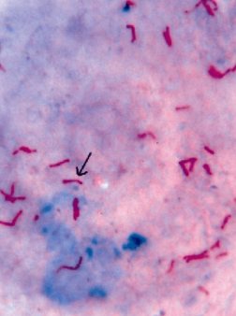
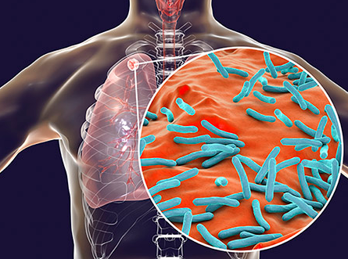
TUBERCULOSIS: A PRIMER FOR NP RESIDENTS
Jeannie McIntosh, APRN, FNP-C, AAHIVS
CHC Center for Key Populations
NP Residency Didactic, March 2023

Slide 2
Disclosures
With respect to the following presentation, there has been no relevant (direct or indirect) financial relationship between the faculty listed above or other activity planners (or spouse/partner) and any for-profit company in the past 12 months which would be considered a conflict of interest.
The views expressed in this presentation are those of the faculty and may not reflect official policy of Community Health Center, Inc. and its Weitzman Institute.
We are obligated to disclose any products which are off-label, unlabeled, experimental, and/or under investigation (not FDA approved) and any limitations on the information that are presented, such as data that are preliminary or that represent ongoing research, interim analyses, and/or unsupported opinion.

Slide 3
Continuing Education Credits
In support of improving patient care, Community Health Center, Inc./Weitzman Institute is jointly accredited by the Accreditation Council for Continuing Medical Education (ACCME), the Accreditation Council for Pharmacy Education (ACPE), and the American Nurses Credentialing Center (ANCC), to provide continuing education for the healthcare team.
This series is intended for post-graduate residents engaging in a year-long Residency program.
Please complete the survey on New Innovations to satisfy your continuing education credit.
A comprehensive certificate will be sent out after the end of the series, June, 2022.

Slide 4
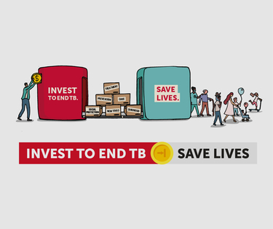
MARCH 24TH IS WORLD TB DAY!
STOP TB PARTNERSHIP (UNOPS)
www.stoptb.org

Slide 5
TOPICS COVERED:
Global Epidemiology
TB in the US
Natural History
Signs and Symptoms
Screening and Diagnosis
MDR-TB
HIV-TB Coinfection
LTBI treatment
Pediatric Considerations
Care Coordination: DPH

Slide 6
GLOBAL EPIDEMIOLOGY
23% of the world’s population estimated to be infected with TB (incl. latent + active)
Leading cause of infectious disease death worldwide prior to Covid-19 pandemic
An estimated 1.5 million people died from TB in 2020
- Compared to 3 million people from Covid-19 and 700,000 from HIV/AIDS
- Largest number since 2012 (had been steadily declining over past decade prior to that)
- Increase attributed to decline in screening and interruptions in access to care due to Covid-19
- India, Indonesia and Philippines thought to be most affected by pandemic changes
- 2022 WHO update: further increases in rates of active TB, DR-TB and TB deaths in 2021
8 countries (India, Indonesia, China, Philippines, Pakistan, Nigeria, Bangladesh and South Africa) account for about two-thirds of all TB infections in the world
Notes:
World Health Organization (WHO) Tuberculosis Fact Sheet. https://www.who.int/news-room/fact-sheets/detail/tuberculosis. 10 Oct 2021.

Slide 7
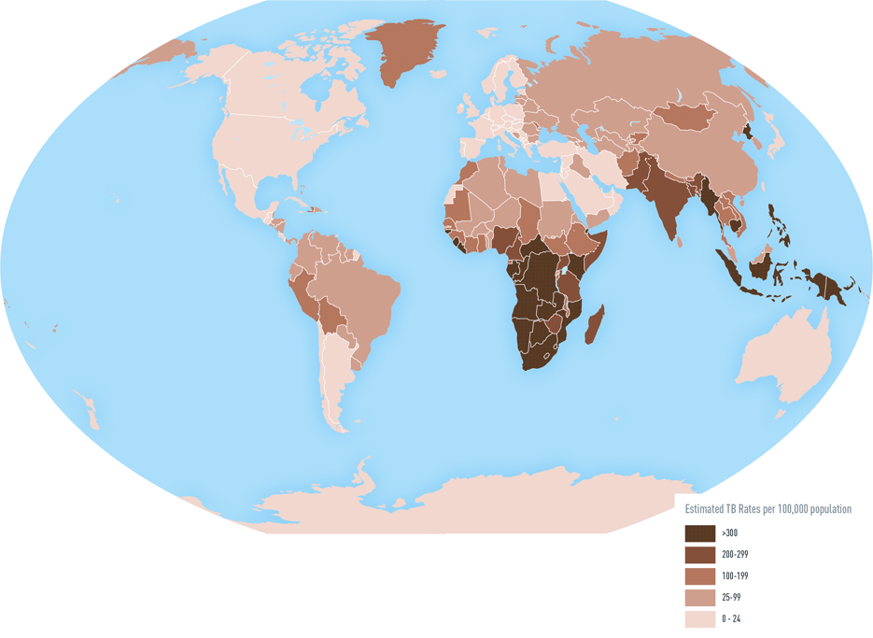
TB Incidence per 100,000
WHO Global TB Report
2017
Notes:
https://www.who.int/tb/publications/global_report/gtbr2017_main_text.pdf

Slide 8
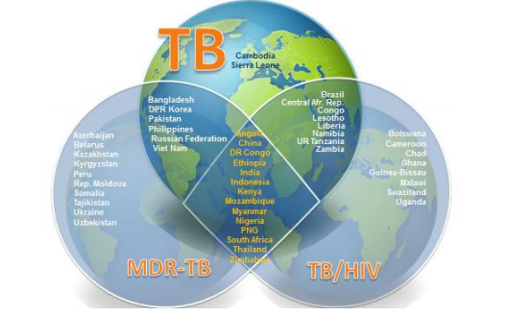
WHO now defines High Burden Country (HBC) in three different ways:
1. 30 countries with largest burden in general – 20 with the most absolute cases + 10 with highest rates
2. Countries with highest rates of TB-HIV coinfection
3. Countries with highest rates of MDR TB
ANGOLA BANGLADESH
BRAZIL CAMBODIA
CHINA CONGO
CF DPR KOREA
DRC ETHIOPIA
INDIA INDONESIA
KENYA LESOTHO
LIBERIA MOZAMBIQUE
MYANMAR NAMIBIA
NIGERIA PAKISTAN
PNG PHILIPPINES
RUSSIA SIERRE LEONE
SOUTH AFRICA THAILAND
TANZANIA VIETNAM
ZAMBIA ZIMBABWE
Notes:
Use of high burden country lists for TB by WHO in the post-2015 era: Summary. WHO. https://www.who.int/tb/publications/global_report/high_tb_burdencountrylists2016-2020summary.pdf?ua=1

Slide 9
TB IN THE US
Substantial decline in incidence over past three decades
2.2 cases per 100,000 in 2020 – historic low, 19% decrease from previous year, likely due to Covid-19 (CDC)
71% of cases occur in foreign-born individuals emigrating from medium and high burden countries; 11.5 cases per 100,000 in this population subset
Most common countries of origin: Mexico, Philippines, Vietnam, India, China, DR, Haiti
In 2019 4.9% of people with TB in US estimated to have HIV coinfection
States with highest number of new cases per 100,000 (2020) – Alaska (7.9), Hawaii (6.5), California (4.3), New York (3.1), Texas (3)
Notes:
Trends in Tuberculosis – 2020. Centers for Disease Control and Prevention (CDC). 12 Oct 2021. https://www.cdc.gov/tb/publications/factsheets/statistics/tbtrends.htm#:~:text=During%202020%2C%20the%20United%20States,Statistics)%3A%201953%E2%80%932020).

Slide 10
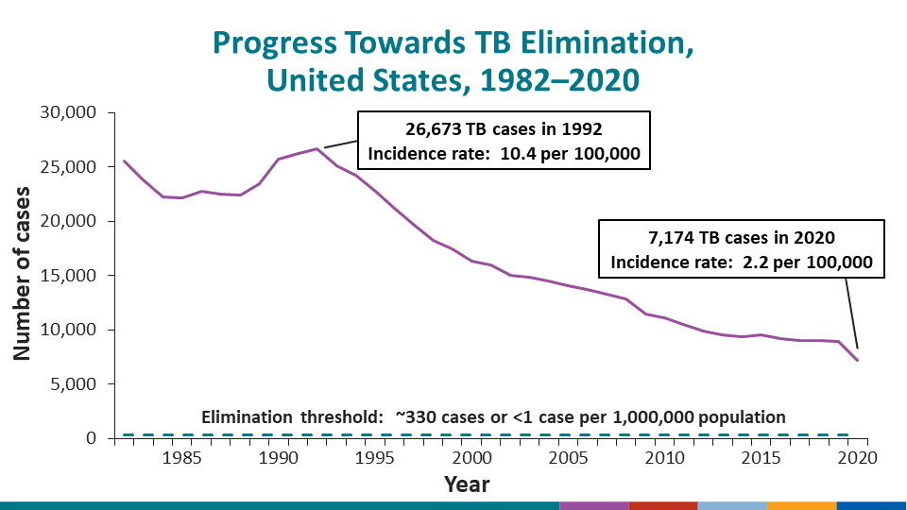
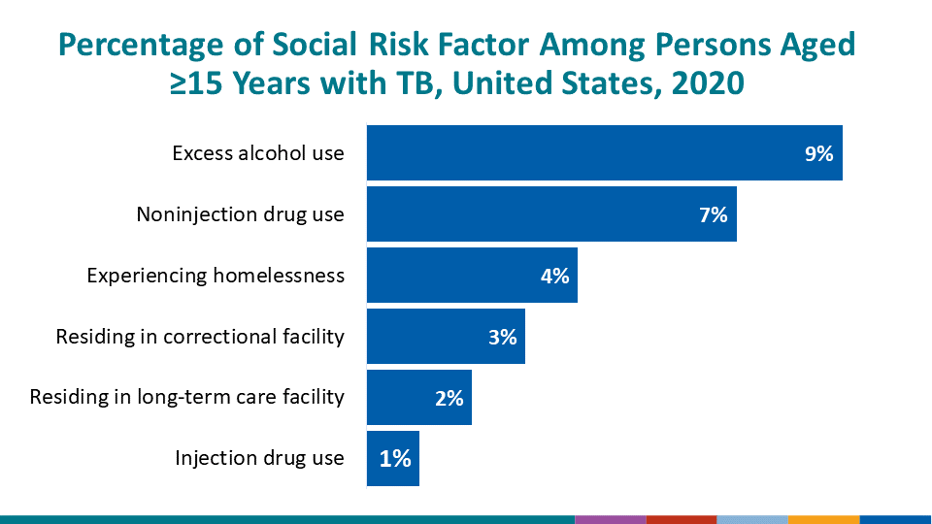
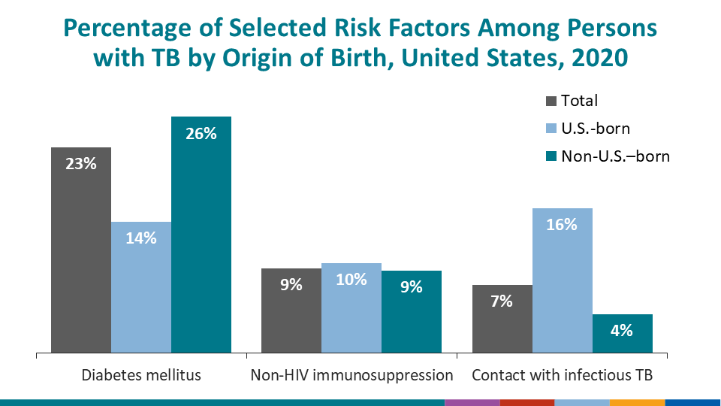
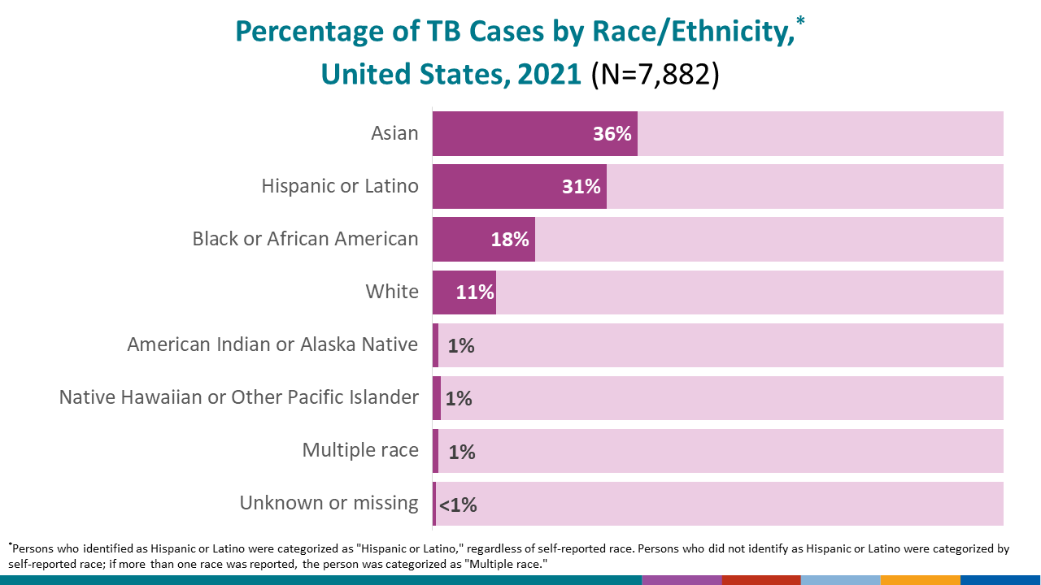
Notes:
Trends in Tuberculosis – 2020. Centers for Disease Control and Prevention (CDC). 12 Oct 2021. https://www.cdc.gov/tb/publications/factsheets/statistics/tbtrends.htm#:~:text=During%202020%2C%20the%20United%20States,Statistics)%3A%201953%E2%80%932020).

Slide 11
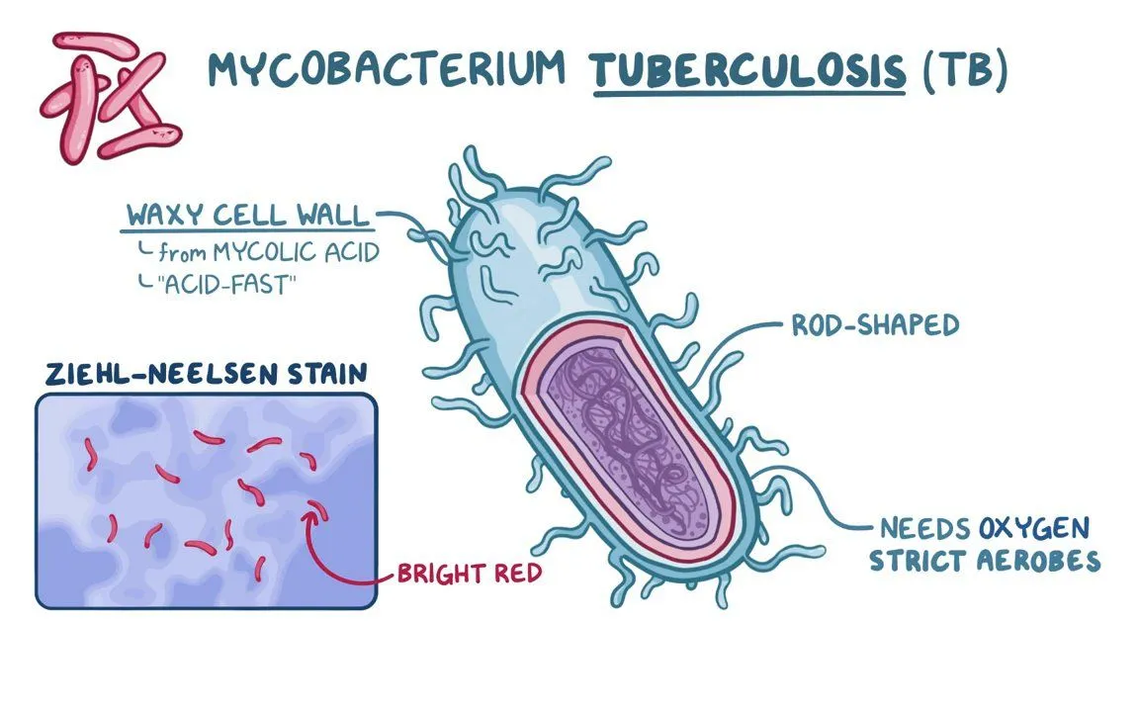
TB INFECTION BASICS
MYCOBACTERIUM TUBERCULOSIS
- Facultative aerobic bacillus
- Can persist intracellularly for prolonged periods
- Very slow growing
- Waxy coat stains red with acid fast testing
- M. africanum and M. bovis also (less commonly) cause TB disease
TRANSMISSION
- Airborne, via inhalation of droplet nuclei
- Aerosolized particles can remain in air for up to 6 hours
- Usually associated with prolonged exposure (ex. close household contact) but there are documented
cases of infection after more brief exposure, esp. in high risk settings (shelters, prisons, hospitals)
Notes:
Image from: https://www.osmosis.org/learn/Mycobacterium_tuberculosis_(Tuberculosis)

Slide 12
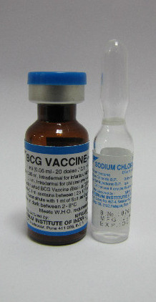
PREVENTION
SCREENING: individuals at risk → then treating LTBI or monitoring (symptom screen, serial CXR)
MITIGATING HEALTHCARE-ASSOCIATED TRANSMISSION:
- Negative pressure rooms
- N95 masks
- Tuberculocidal disinfectants
BACILLUS CALMETTE-GUERIN (BCG) VACCINE:
- Live attenuated vaccine derived from M. bovis
- Compulsory in many countries with higher TB burden (≥ 40 / 100,000)
- Administered to children under 5 y/o (usually 0-6 months)
- More effective in preventing miliary TB and TB meningitis than pulmonary TB
ADDRESSING SOCIAL DETERMINANTS OF HEALTH (SDOH) that put some individuals and communities at higher risk [ex. safer housing, occupational and prison environments]

Slide 14
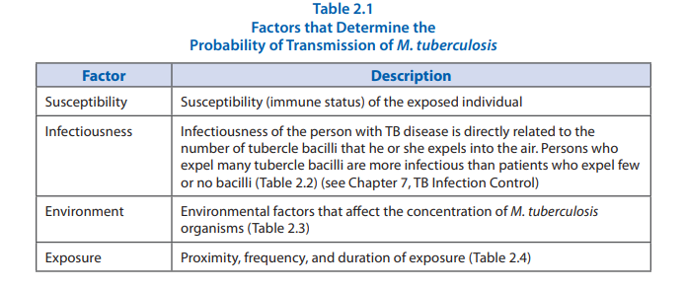
NATURAL HISTORY OF PULMONARY TB
Inhaled bacteria evade alveolar macrophage activity then disseminate in blood and lymph tissue
2. Adaptive immune mechanisms are activated within 2-13 weeks of infection
- T cells and macrophages form granulomas around the bacteria to contain their spread.
- These primary complexes can heal over time, leaving a small cavitary lesion.
Notes:
Transmission and Pathogenesis of Tuberculosis. Core Curriculum on TB (6th Ed). 2013. https://www.cdc.gov/tb/education/corecurr/pdf/chapter2.pdf

Slide 15
THREE PATHWAYS FROM HERE:
1) PRIMARY TB DISEASE (5%):
- Direct progression to active TB within first 2 years of infection
- Slightly under 50% of active TB cases
2) LATENT TB INFECTION (95%):
- Period of clinical latency maintained by active immune system
- The majority of patients infected with TB remain in this phase for life
- 5-10% lifetime risk of progression to…
3) SECONDARY (REACTIVATION) TB DISEASE FOLLOWING LTBI:
- May occur after an immunosuppressing event, development of comorbid conditions, or for unknown reasons
- The granulomas necrotize, resulting in cavitary lung disease (caseum, central collection of necrotized macrophages
in granuloma, harbors the bacteria)
- Extensive inflammation can result in apoptosis of responsive T cells

Slide 16
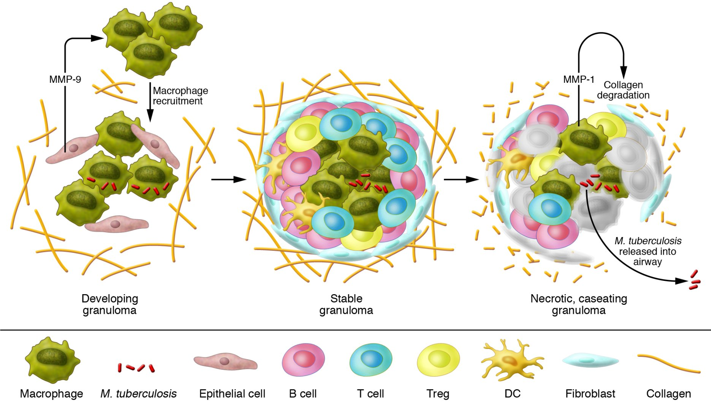
Notes:
https://www.jci.org/articles/view/57423/figure/1

Slide 17
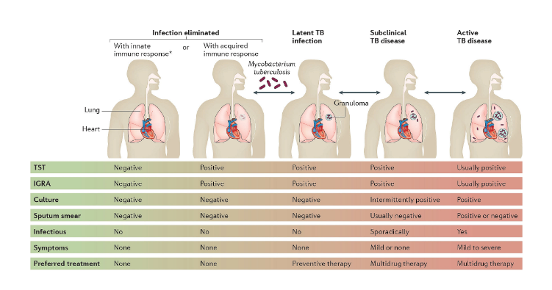
Notes:
Pai, M. The Spectrum of Tuberculosis and Why It Matters. 4 Aug 2017. Nature. https://microbiologycommunity.nature.com/posts/19192-the-spectrum-of-tuberculosis-and-why-it-matters.

Slide 18
EXTRAPULMONARY TB
Approx. 20% of TBD cases in HIV-negative individuals; more common in PLWHA
Areas endemic for TB: often concurrent with pulmonary TB, associated with primary disease, seen in children
Low prevalence areas: often isolated (no pulmonary disease); elderly; seen in reactivation disease
MILIARY TB: hematogenous dissemination of TB throughout body; liver, adrenal and CNS involvement are common; 25-30% fatality in adults even with antibiotic therapy
TB MENINGITIS: when tuberculomas (granuloma conglomerate) develop in brain or spinal cord; more common in children in endemic areas
Locations: pleura, lymph nodes, pericardium, peritoneum / GI tract, kidneys, vertebrae, uterus

Slide 19
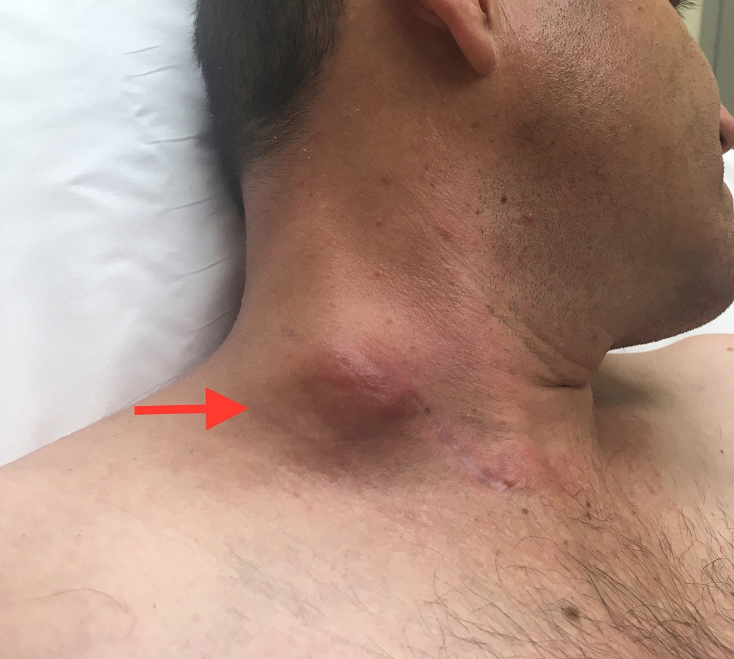
Scrofula
MTB cervical lymphadenitis

Slide 20
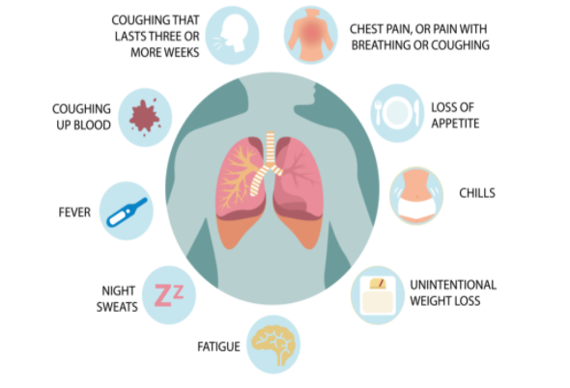
SIGNS AND SYMPTOMS OF ACTIVE TB
ON EXAM:
Cachexia
Post-tussive apical rales
Erythema nodosum
Often no abnormal findings**
FLORIDA DPH

Slide 21
SCREENING
PEOPLE AT HIGH RISK OF TB EXPOSURE
PEOPLE AT HIGH RISK OF DEVELOPING ACTIVE TB IF EXPOSED
CDC SCREENING RECOMMENDATIONS:
People who have spent time with someone who has TB disease
People from a country where TB disease is common – case burden > 20 / 100,000 per IDSA guidelines; CDC guidelines specifically mention Mexico, the Philippines, Vietnam, India, China, Haiti, and Guatemala for screening in US
People who live or work in high-risk settings (for example: correctional facilities, long-term care facilities or nursing homes, and homeless shelters)
Health-care workers who care for patients at increased risk for TB disease
Infants, children and adolescents exposed to adults who are at increased risk for latent tuberculosis infection or TB disease

Slide 22
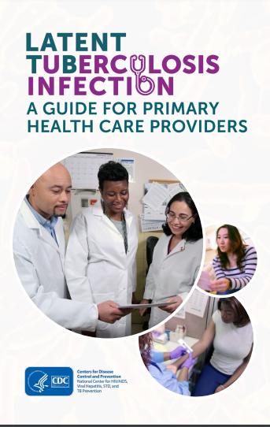
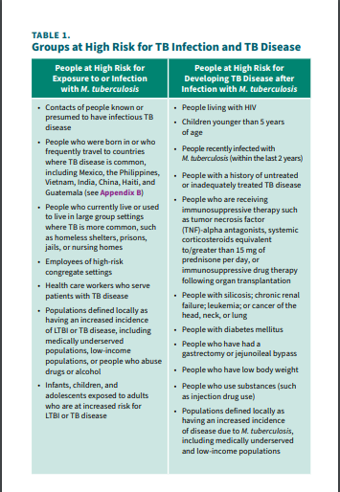

Slide 23
TUBERCULIN SKIN TEST (TST):
0.1 PPD containing 5 tuberculin units is injected intradermally on volar surface of forearm using 27 gg TB syringe, then transverse width measured 48-72 hours after injection
77% sensitive, 97% specific
Advantages: no blood draw required; preferred test for children < 2 y/o
Disadvantages: requires a second visit; can get a false positive if prior BCG vaccination; can get a false negative if immunocompromised; reaction can wane if LTBI many years after exposure
INTERFERON GAMMA RELEASE ASSAYS (IGRAs):
Ex. Quantiferon and T-SPOT
Check for T-cell-mediated interferon gamma release in response to specific MTB antigens
60-90% sensitivity, > 95% specificity
Advantages: multiple visits not required; better accuracy if prior BCG vaccination; probably slightly more accurate in the setting of HIV
Disadvantages: more expensive; requires blood draw; less data on use < 2 y/o
SECONDARY SCREENING (after treatment):
PRIOR LATENT TB → CXR
PRIOR ACTIVE TB → symptom screening

Slide 24
Notes:
https://www.grepmed.com/images/2645/interpretation-tuberculosis-thresholds-induration-tuberculin

Slide 25
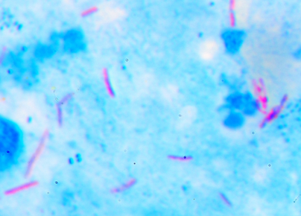
DIAGNOSIS
CXR
Positive x-ray alone not diagnostic of active TB!
Focal infiltrate, esp. in upper lobe(s) though can be lower as well; may be unilateral or bilateral
Other features (dependent upon disease stage): cavitations, fibrosis, hilar and mediastinal LAD, volume loss, calcified nodular lesions from healed tubercles
ACID-FAST BACILLI (AFB) TEST
Sample early morning deep cough x 3 consecutive days
Sputum smear + culture
Still the mainstay for dx
Can take 10-60 days to get result!
OTHER METHODS
NAAT: result within 48 hours, $$$
Pleural fluid testing

Slide 26
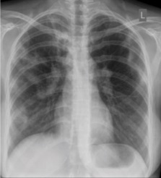
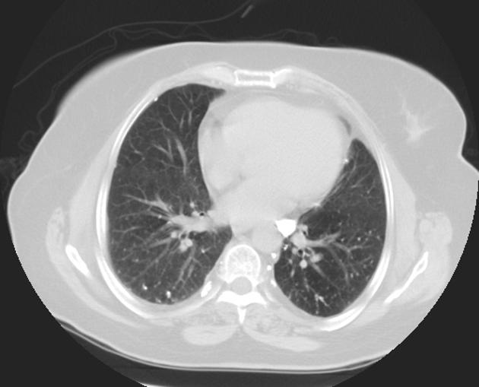
patchy opacification on the upper right and mid-zone lung with fibrotic shadows, as well as bilateral hilar lymphadenopathy
Calcified mediastinal and abdominal lymph nodes. Calcified pulmonary and splenic granulomas.
Notes:
Basem Abbas Al Ubaidi - (2018). "The Radiological Diagnosis of Pulmonary Tuberculosis (TB) in Primary Care". Journal of Family Medicine and Disease Prevention
https://radiopaedia.org/cases/calcified-tuberculous-granulomas?lang=us

Slide 27
HIV-TB COINFECTION
Individuals with HIV-TB coinfection are 18 x more likely to develop active TB.
Accounts for more than 30% of AIDS-related deaths worldwide.
Extra-pulmonary TB more common than in general population.
10% annual risk of progressing to active TB if HIV-positive.
LTBI treatment – major drug interactions between rifamycins and multiple ART classes
TBD treatment – start PRIOR to initiating antiretroviral therapy if not already on ART
- Start ART within 2 weeks if CD4 < 50
- Start ART within 8 weeks if CD4 > 50
- Why??? To prevent TB-associated IRIS
Notes:
TB/HIV. USAID. April 2021. https://www.usaid.gov/global-health/health-areas/tuberculosis/tbhiv

Slide 28
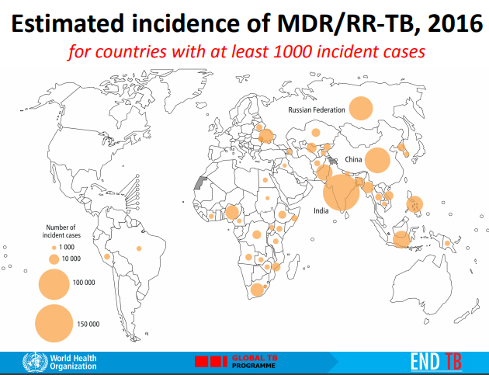
MULTIDRUG-RESISTANT TB
MDR-TB: TB that is resistant to at least INH and rifampin, the two most potent TB drugs
Extensively Drug Resistant TB (XDR-TB): also resistant to fluoroquinolones and at least 1 of 3 third line injectable drugs
Drug resistant strains have emerged due to inadequate
treatment regimens or incomplete treatments.
Addressing TB on a global level can help prevent
the spread of MDR-TB.

Slide 29
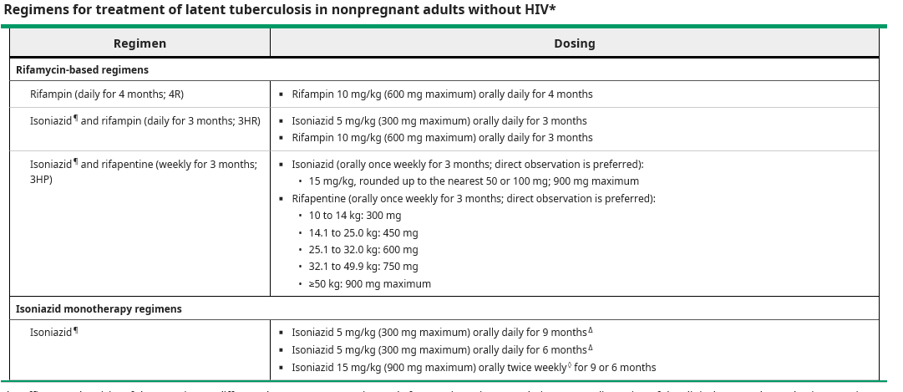
LTBI TREATMENT

Slide 30
MONITORING
See patient at least monthly during treatment to assess adherence and side effects (can be a nurse visit)
Concerning side effects – hepatitis, peripheral neuropathy (INH), rash or thrombocytopenia (rifamycins)
Weekly RN visit if 12-week DOT treatment
Monitor for signs and symptoms of hepatotoxicity – d/c INH or rifamycin if symptomatic and ALT > 3 x ULN or if asymptomatic and ALT > 5 x ULN
Labs
- Isoniazid: baseline and periodic CMP
- Rifampin: baseline CMP + CBC; repeat every 2-4 weeks if liver or kidney disease
- Rifapentine: baseline AST/ALT and monitor every 2-4 weeks if preexisting liver disease
PYRIDOXINE (B6) SUPPLEMENTATION WITH INH USE
INH can cause peripheral neuropathy secondary to B6 deficiency but this is uncommon at standard doses
Diabetes, malnutrition and ETOH use increase risk
CDC recommends supplementation with 10-50 mg pyridoxine QD if an individual develops neuropathy during treatment or is at increased risk for neuropathy

Slide 31
INH MONOTHERAPY
Previously the gold standard LTBI treatment. CDC guidelines now favor rifamycin-based treatments due to favorable treatment completion rates and lower incidence of hepatotoxicity.
May be the preferred regimen if significant drug-drug interactions with rifamycins.
60-90% effective in preventing active TB but in reality efficacy likely lower due to adherence issues.
Limited data on comparative efficacy of 6 vs. 9 months of INH therapy but there appears to NOT be a statistically significant advantage to 9 month treatment.
Alternate dosing option is twice weekly DOT x 6-9 months.
Up to 2% risk of peripheral neuropathy due to interference with pyridoxine metabolism.
Notes:
Horsburgh, C.R. “Treatment of latent tuberculosis infection in HIV-uninfected non-pregnant adults.” UpToDate. April 2021.

Slide 32
INH + RIFAPENTINE (3HP)
RPT is a rifamycin derivative with a long half-life and greater in vitro potency against M. tuberculosis than RIF
Shown to be non-inferior to INH x 9 mos in a 2011 RCT including 2011 patients w/o HIV at high risk of TB progression.
Hypersensitivity or flu-like symptoms (eg, light headedness, dizziness, headache, nausea or vomiting, syncope, rash, or angioedema) have been observed in about 3.5% of people while taking 3HP but less than 0.3% of these reactions have been serious and none have resulted in death.
May consider self-administered therapy for patients who can reliably take meds on a schedule and notify provider promptly if side effects occur (per small 2018 study).
Notes:
Three months of rifapentine and isoniazid for latent tuberculosis infection. AU Sterling TR, Villarino ME, Borisov AS, Shang N, Gordin F, Bliven-Sizemore E, Hackman J, Hamilton CD, Menzies D, Kerrigan A, Weis SE, Weiner M, Wing D, Conde MB, Bozeman L, Horsburgh CR Jr, Chaisson RE, TB Trials Consortium PREVENT TB Study Team SO N Engl J Med. 2011 Dec;365(23):2155-66.
Update of Recommendations for Use of Once-Weekly Isoniazid-Rifapentine Regimen to Treat Latent Mycobacterium tuberculosis Infection. AU Borisov AS, Bamrah Morris S, Njie GJ, Winston CA, Burton D, Goldberg S, Yelk Woodruff R, Allen L, LoBue P, Vernon A SO MMWR Morb Mortal Wkly Rep. 2018;67(25):723. Epub 2018 Jun 29.

Slide 33
RIFAMPIN MONOTHERAPY (4R)
Similar efficacy to INH x 9 months.
Well tolerated.
High completion rates.
Lower rate of hepatotoxicity.
Main issue is with drug-drug interactions – potent inducer of drugs undergoing metabolism via cytochrome P450 enzyme system.

Slide 34
INH + RIFAMPIN (3HR)
Short treatment course and low pill burden.
Ideal for a patient who needs short treatment course but cannot come in for weekly DOT.
Limited efficacy studies available but a meta-analysis of small studies in this population suggests that it is equally efficacious and not more toxic than INH for nine months.
Notes:
Short-course therapy with rifampin plus isoniazid, compared with standard therapy with isoniazid, for latent tuberculosis infection: a meta-analysis. Ena J, Valls V SO Clin Infect Dis. 2005;40(5):670. Epub 2005 Feb 1.

Slide 35
PEDIATRIC CONSIDERATIONS
Children under 5 years old are at the highest risk of progression to active TB and more severe manifestations such as miliary TB or TB meningitis.
Congenital TB is uncommon but may be seen in the setting of maternal TB endometritis or disseminated TB.
Breastfeeding should not be discouraged in parents being treated with first-line antibiotics (CDC, 2020)
Screening (AAP, 12/2021):
- $≥$ 2 y/o – IGRA preferred
- < 2 y/o – TST preferred due to risk of indeterminate or invalid results with IGRA
* However, IGRA is an acceptable alternative and preferred in children who received BCG vax
* Both tests are unreliable in infants less than 3 months old
- Can consider ordering both TST and IGRA to maximize sensitivity if high suspicion for TB
Notes:
Adams, L. and Starke, J. Tuberculosis Disease in Children.” UpToDate. Updated June 2022.
“TB and Pregnancy Fact Sheet.” CDC. September 2012.
Nolt, D. and Starke, J. “Tuberculosis Infection in Children and Adolescents: Testing and Treatment (AAP Clinical Report)”. Pediatrics (2021) 148 (6): e2021054663.

Slide 36
TREATMENT OF LTBI IN CHILDREN
WINDOW PROPHYLAXIS (after case contact with active TB):
- Start LTBI treatment (after ruling out active infection) regardless of IGRA/PPD screening result in children
under 5 years old and children with immunosuppressive conditions
- Repeat screening 8-10 weeks after exposure. If negative can consider stopping the treatment.
LTBI TX REGIMENS:
- All of the regimens used in adults are used in children as well
- Daily INH x 6-9 months: who recommends 6 months in high incidence settings; there are alternate DOT
dosing regimens BIW-TIW if adherence is a concern; infants who are exclusively BF need pyridoxine; can
crush tab
- Weekly DOT with INH/RPT x 12 weeks: only for children $≥$ 2 y/o
- Daily RIF x 4 months: some studies show better adherence than 6H or 9H; can open capsules
- INH/RIF daily x 3 months: alternate regimen per WHO; useful in settings where RPT not available
Notes:
Adams, L. and Starke, J. “Latent Tuberculosis Infection in Children.” UpToDate. Updated March 2022.

Slide 37
CARE COORDINATION: DPH
Reportable disease
DPH local resources variable according to county size, TB burden, etc.
- Some have designated TB clinics staffed with ID provider,
radiology, phlebotomy, etc.
- Others utilize public health nurse – DOT, rural outreach for testing
and med dispensing, etc.
- May supply meds, cover CXR and lab costs, etc.
- May rely on local primary care and ID providers outside of DPH

Slide 38
RESOURCES
LTBI: A Guide for Primary Health Care Providers. CDC. 2020. https://www.cdc.gov/tb/publications/ltbi/pdf/LTBIbooklet508.pdf
Core Curriculum on TB (6th Ed). CDC. 2013. https://www.cdc.gov/tb/education/corecurr/pdf/chapter2.pdf
Clinical Practice Guidelines: Diagnosis of Tuberculosis in Adults and Children. American Thoracic Society / IDSA / CDC.
2017. https://www.thoracic.org/statements/resources/tb-opi/diagnosis-of-tuberculosis-in-adults-and-children.PDF.
World Health Organization (WHO) Health Topics: Tuberculosis. WHO. https://www.who.int/health-topics/tuberculosis#tab=tab_1
Tuberculosis (TB). CDC. https://www.cdc.gov/tb/default.htm

Slide 39
THANK YOU!
Jeannie McIntosh, APRN
CHC Center for Key Populations
mcintosj@chc1.com
Questions?

