Slide 1
Bits ‘n Pieces
Pelvic Pain, Menopause & Pregnancy
Meghan Constantino, CNM
Notes:
Add case study: account 383002

Slide 2
Continuing Education Credits
In support of improving patient care, Community Health Center, Inc./Weitzman Institute is jointly accredited by the Accreditation Council for Continuing Medical Education (ACCME), the Accreditation Council for Pharmacy Education (ACPE), and the American Nurses Credentialing Center (ANCC), to provide continuing education for the healthcare team.
This series is intended for post-graduate residents engaging in a year-long Residency program.
Please complete the survey on New Innovations to satisfy your continuing education credit.
A comprehensive certificate will be sent out after the end of the series, June, 2022.

Slide 3
Disclosure
With respect to the following presentation, there has been no relevant (direct or indirect) financial relationship between the faculty listed above or other activity planners (or spouse/partner) and any for-profit company in the past 12 months which would be considered a conflict of interest.
The views expressed in this presentation are those of the faculty and may not reflect official policy of Community Health Center, Inc. and its Weitzman Institute.
We are obligated to disclose any products which are off-label, unlabeled, experimental, and/or under investigation (not FDA approved) and any limitations on the information that are presented, such as data that are preliminary or that represent ongoing research, interim analyses, and/or unsupported opinion.

Slide 4
Learning Objectives
By the end of this didactic, the NP Resident will be able to:
Identify differential diagnoses, work up and management for pelvic pain
Understand the definition and diagnosis of menopause
Identify common complaints in menopause and become familiar with treatment options
Understand prenatal care in general- terminology, milestones
Identify ways to handle common first trimester complaints
Understand medical diagnoses in pregnancy that require co management

Slide 5
Pelvic Pain

Slide 6
Differentials
Ovarian- cyst, torsion
Fibroids
Endometriosis
Adenomyosis
Infection- endometritis, PID
Dysmenorrhea
Pregnancy- ectopic, SAB, normal
Adhesions
Pelvic congestion
Malignancy
GI
Appendix
Diverticulitis
constipation
Renal
UTI
kidney stone
Musculoskelatal
Trauma
injury

Slide 7
Ovarian

Slide 8
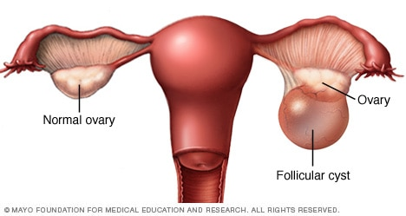
Ovarian Cysts
cyst
s/s: unilateral or bilateral pain, may be sharp or achy, may be constant or intermittent. May be worse with activity or sex, Usually responds to NSAIDs, may last days/weeks.
At time of rupture may have acute onset, intense pain
Exam:
Adnexal enlargement
Adnexal tenderness

Slide 10
Ovarian Cysts
Tests: Ultrasound
Simple: Anechoic, fluid filled cyst cavity, thin walls
Size:
Premenopausal
Up to 3-5cm can be physiologic
5-7 cm should have yearly US (at minimum)
>7cm consider MRI
Postmenopausal
> 3cm should have yearly US (at minimum)
Complex: septations (irregular, thickened), solid, +color/doppler flow

Slide 11
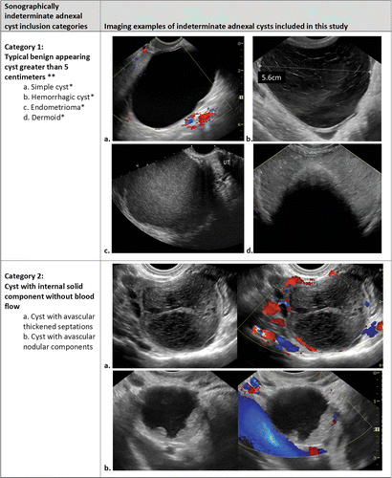
Ovarian Cysts

Slide 12
Ovarian Cysts

Slide 13
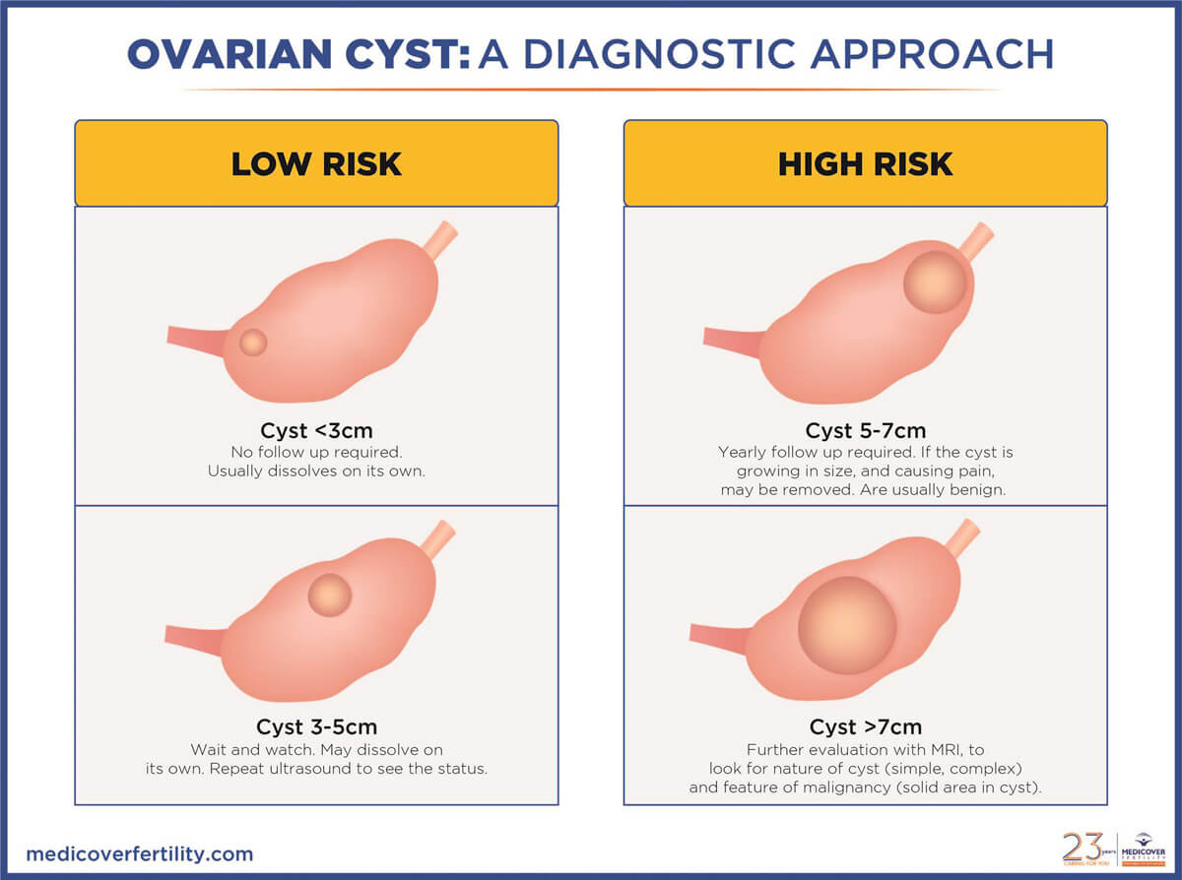

Slide 14
Ovarian Cysts
Management:
Most are benign
f/u US 6-8 weeks to ensure resolution (or decrease in size)
NSAIDs
Suppress ovulation
Surgery

Slide 15
Ovarian Torsion
Torsion
ovary twists around the ligaments that hold it in place. This twisting can cut off blood flow to the ovary and fallopian tube
Risk factors: mass (presence, size, benign vs malignant), age, pregnancy, hx torsion, ovulation induction,
s/s:
pelvic pain: Severe, sudden onset, sharp, dull, stabbing, colicky, or crampy, and may radiate to the flank, back, or groin
Nausea, vomiting
Less common: Fever, bleeding
Notes:
More common with benign than malignant masses
Most common 20s-30s (can occure in premenarchal girls, rare in postmenopausal women)

Slide 16
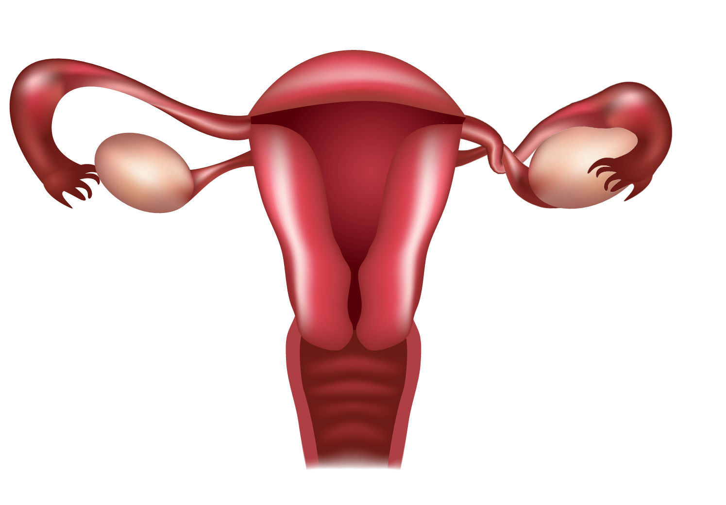
Ovarian Torsion
Torsion
Exam: tenderness (focal or diffuse), enlargement/mass
Tests: ultrasound, HCG, CBC
Management: surgical- to ED

Slide 17
Endometriosis

Slide 18
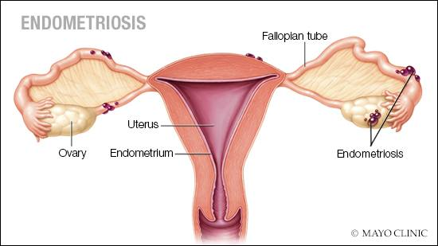
Endometriosis
Growth of endometrial tissue outside of uterus
Peak presentation 25-35yo

Slide 19
Endometriosis
Symptoms:
dysmenorrhea, dyspareunia, ovarian mass, infertility
Less common: bowel and bladder dysfunction, abnormal uterine bleeding, low back pain, or chronic fatigue
Can present with GI, urinary, chest symptoms based on site

Slide 20
Endometriosis
Top three Symptoms:
Pain since menarche
Pain with sex
Pain that starts before bleeding

Slide 21
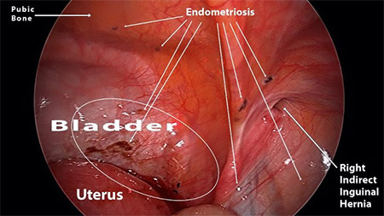
Endometriosis

Slide 22
Endometriosis
Exam:
tenderness on vaginal examination
nodules in the posterior fornix
adnexal masses
immobility or lateral placement of the cervix or uterus
May be normal
Tests:
No labs
US or MRI: ovarian cysts (endometriomas), nodules of the rectovaginal septum, and bladder nodules

Slide 23
Endometriosis
Diagnosis:
diagnostic delay of 7 to 12 YEARS
Surgery: the gold standard
Nonsurgical:
ultrasonographic finding of ovarian endometrioma
visual inspection of the posterior vaginal fornix and biopsy of rectovaginal lesions
cystoscopic evaluation and biopsy of detrusor lesions
physical examination findings of rectovaginal endometriosis that are confirmed with imaging
Presumptive : based on pt symptoms, exam and ruling out other causes

Slide 24
Endometriosis
Indications for surgery:
unexplained pelvic pain unresponsive to medical therapy
severe debilitating symptoms
treatment of anatomical abnormalities (ie cysts, bladder lesions)

Slide 25
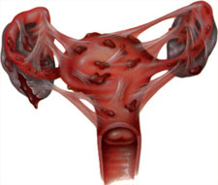
Endometriosis
Staging
Stage I: (minimal) isolated implants and no significant adhesions.
Stage II: (Mild) superficial, scattered implants that are less than 5 cm in aggregate. No significant adhesions
Stage III: (Moderate) multiple implants, both superficial and deeply invasive. Possible peritubal and periovarian adhesions
Stage IV: (Severe) multiple superficial and deep implants, large ovarian endometriomas. Filmy and dense adhesion.

Slide 26
Endometriosis
Treatment
Mild to moderate symptoms:
NSAIDS + continuous cycling COCPS (or POPs if estrogen contraindicated)
Reevaluate 3-4 months. If no better trial alternative regimen
Continuous treatment until pt desires pregnancy or menopause
If desires pregnancy- NSAIDs alone

Slide 27
Endometriosis
Severe/debilitating symptoms
If medical therapy fails after 3-4 consider surgery vs GnRH with add back therapy
GnRH: leuprolide (lupron) – add progestin to avoid hypoestrogen effects
Aromatase inhibitors- off label use for refractory/severe cases
Surgical resection
conservative (treatment of endometriosis lesions by ablation or resection)
definitive (hysterectomy, with or without oophorectomy, in addition to resection of endometriosis)
radical (removal of all visible implants at time of surgery).

Slide 28
Endometriosis
Needs more research:
Possible benefit from auricular acupuncture
Dietary- possible line with eating more meats, less green veggies

Slide 29
Adenomyosis

Slide 30
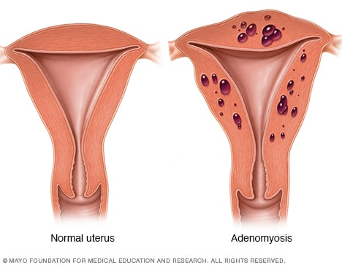
Adenomyosis
endometrial glands and stroma are present within the myometrium
Symptoms:
Heavy menstrual bleeding
Dysmenorrhea
chronic pelvic pain
Notes:
Heavy menstrual bleeding is possibly related to the increased endometrial surface of the enlarged uterus, while pain may be due to bleeding and swelling of endometrial islands confined by myometrium

Slide 31
Adenomyosis
Exam:
mobile, diffusely enlarged “globular”, soft “boggy” uterus (<12 weeks size)
Tests:
US ( radiologist skilled in adenomyosis)
MRI (if needed to determine management such as to differentiate from fibroids)
Diagnosis: definitively with hysterectomy
Management: hysterectomy, hormones, uterine artery embolization

Slide 32
Infection

Slide 33
Infection
PID
85% caused by STD or BV
Risks: multiple sex partner, younger than 25, partner with STD, hx prior PID or STD, instrumentation of cervix,
Protective: pregnancy after 12 weeks (mucous plug), barrier methods

Slide 34
Infection
Symptoms:
Lower abdominal pain
bilateral
Acute (<2 weeks)
worsens during coitus or with jarring
Pain shortly after menses is particularly suggestive
1/3 have Abnormal uterine bleeding (post-coital bleeding, inter-menstrual bleeding, menorrhagia)

Slide 35
Infections
Exam:
abdominal tenderness on palpation, greatest in the lower quadrants,
Acute cervical motion, uterine, and adnexal tenderness on bimanual pelvic examination
Prurulent vaginal discharge
significant lateralization of adnexal tenderness is uncommon in PID
Tests:
Cultures for vaginal/cervical infection (GC/CT/BV)
cbc, ESR, CRP (most women don’t exhibit- poor sensitivity and specificity)

Slide 36
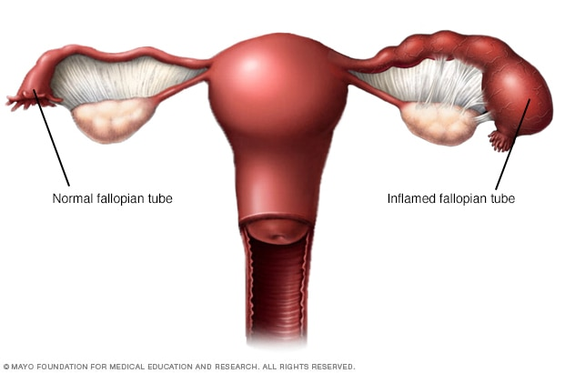
Infection
Presumptive Diagnostic criteria:
Sexually active woman with pelvic or lower abd pain
+CMT or fundal tenderness or adnexal tenderness

Slide 37
Infection
More diagnostic criteria
oral temperature >101°F (>38.3°C)
abnormal cervical mucopurulent discharge or cervical friability
presence of abundant numbers of WBC on microscopy
elevated ESR
elevated CRP
+GC/CT culture

Slide 38
Infection
Most diagnostic criteria
endometrial biopsy showing endometritis
US or MRI shows thickened, fluid-filled tubes with or without free pelvic fluid or tubo-ovarian complex, or Doppler studies suggesting pelvic infection
laparoscopic findings consistent with PID.

Slide 39
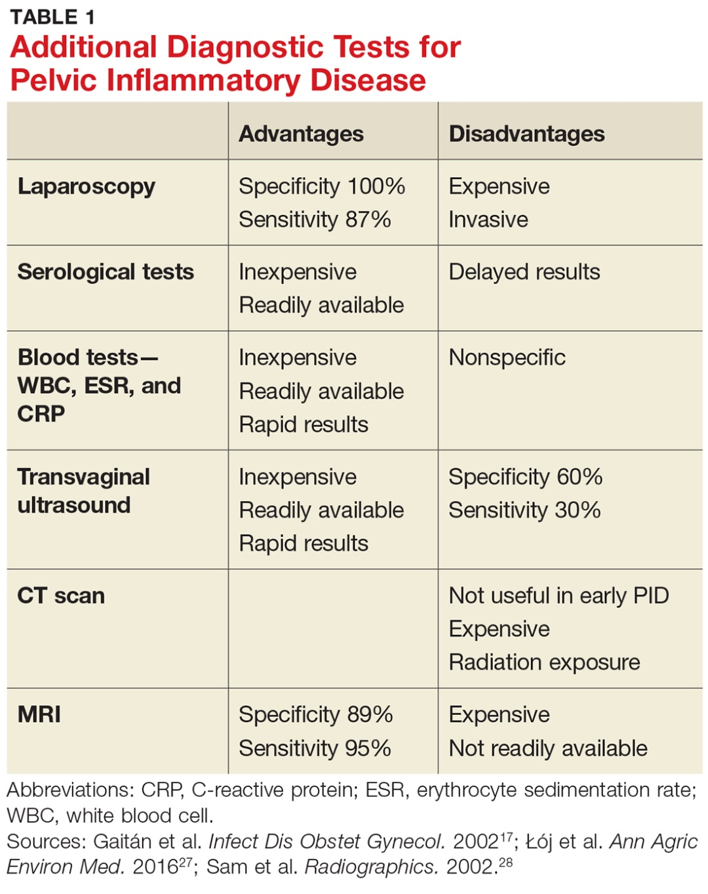
Infection

Slide 40
Infection
Treatment- per CDC
Ceftriaxone 500 mg IM in a single dose PLUS
Doxycycline 100 mg orally twice a day for 14 days WITH* or WITHOUT
Metronidazole 500 mg orally twice a day for 14 days
Expect response in 72 hours- if not- re-eval for other causes or admit for IV therapy

Slide 41
Other
Dysmenorrhea
Heat, exercise, hormones
Pregnancy
SAB, ectopic, IUP
Adhesions
Surgery ( cause, diagnosis and treatment)
Pelvic congestion
Venous pathology
malignancy
Notes:
Dysmenorrhea- poss low fat vegetarian diet, increased dairy, vit E, fisho oil, bit B1, vit D, ginger
Congestion- dull ache or heaviness that increases premenstrually; with prolonged standing, postural changes, walking, or activities that increase intraabdominal pressure; and after intercourse (postcoital ache). It is usually unilateral, but can be bilateral or shift from one side to the other. The patient may also complain of sharp exacerbations of pain, dysmenorrhea, deep dyspareunia, and urinary urgency. Gluteal, vulvar, and/or thigh varices may also be present

Slide 42
Pelvic Pain
Chronic | Endometriosis, adenomyosis, dysmenorrhea, fibroids
Acute | PID, cysts, torsion, ectopic pregnancy
Unilateral | Cyst, torsion, ectopic pregnancy
Bilateral | Endometriosis, adenomyosis, PID, dysmenorreha
Worse with menses | Endometriosis, adenomyosis, dysmenorrhea, fibroids
Pain in between menses | Endometriosis, adenomyosis, PID, cyst
No menses | Pregnancy
Abnormal bleeding | Endometriosis, PID, adenomyosis, pregnancy

Slide 43
Case Study
JA

Slide 44
JA
17 yo presents with mother c/o prolonged heavy bleeding – daily for 3 months with accompanied pelvic pain and nausea/vomiting daily. Soaks tampon in 1.5 hours. Pain is sharp shooting bilaterally in pelvis. Feels 4x/day, lasting 5 mins, PS 10/10 “brings me to my knees”. Was seen in ED 2x in one week- had normal pelvic US there
Menarche age 14- had prolonged menses. Used depo and COCPs which essentially controlled bleeding but pt d/c’d secondary to weight gain
30 missed school days in first half of academic year.

Slide 45
JA
Exam:
VS: Temp 98.5 F, Temp Site ORAL, Ht 59.25 in, Wt 148.4 lbs, BMI 29.72, BMI Percentile 95.12, BP 109/73 mm Hg,
General Appearance: A & O x 3 in NAD, well built and nourished. External genitalia: normal, no lesions, introitus normal. Vagina: healthy pink mucosa without any lesions, no blood noted in vault. Cervix: normal appearing, , no cervical movement tenderness. Uterus: normal size, shape and consistency, nontender. Adnexa: normal, no masses, bilateral tenderness.

Slide 46
JA
Labs: TSH, FSH, PRL, Hgb A1c, VWB panel, 17 OHP= normal, elevated testosterone
TVUS: in ED was normal

Slide 47
JA
What is your assessment?
Endometriosis
Adenomyosis
PID
Fibroids
Ovarian cysts
Ovarian torsion
Pregnancy
Other (non GYN)
Poll # 1

Slide 48
JA
Assessment:
pelvic pain- possible endometriosis
Plan:
start continuous COCPs (gianvi)
naproxen
see PCP to continue GI work up

Slide 49
JA
2 weeks later MOC calls stating pt still with significant pain, no relief, requesting consult with MD for surgery
Pt saw GI, had endoscopy which showed severe GERD
Pt had diagnostic laparoscopy that showed no evidence of endometriosis, did show significantly dilated sigmoid colon- plans colonoscopy

Slide 50
Case Study
MS

Slide 51
MS
37yo G5P5 with hx c/s x 1, VBAC x 4 and hx BTL presents for annual. Notes menses q month with increase flow and clots. +dysmenorrhea. Hx of anemia
Exam:
“abd benign”
Plan:
US and f/u mirena

Slide 52
MS
4 months later
US:
1. slightly heterogeoneous uterine endometrium
2. right ovary 1.8cm hypoechoic cystic structure with no internal vascularity and is non specific

Slide 53
MS
EXAM
ABDOMEN: Tenderness: none. Masses: none. Guarding: absent. GENITOURINARY - FEMALE: Vulva: normal, no lesions. Vagina: no lesions. Cervix or cuff: no lesion, no cervical motion tenderness. Uterus: normal size, shape and contour. Adnexae: no mass, non tender, ovaries not enlarged. Pap smear: taken.

Slide 54
MS
What is your Assessment?
Endometriosis
Adenomyosis
PID
Fibroids
Ovarian cysts
Ovarian torsion
Pregnancy
Other (non GYN)
Poll # 2

Slide 55
MS
What’s your plan?
Mirena placed 4 days later, US ordered to f/u on cyst

Slide 56
MS
1 week later:
HPI: -Patient went to ED diagnosed with labial cyst that was drained by needle aspiration. Started on bactrim -the next day: pelvic pain, that increases with cough. Constant cramps, "they never go away" No fevers. No chills. She reports no sexual intercourse for the last two months. Denies dysuria, and urinary frequency. Vaginal discharge described as yellow/red, nonodorous. She denies internal/external vaginal itching. Denies diarrhea/constipation.

Slide 57
MS
Exam:
GENITOURINARY - FEMALE: Vulva: Firm palpable, tender mass to right upper vulva, some dried blood present on external skin. Vagina: No lesions, moist, IUD present 3 CM IUD strings visualized on speculum exam. No odor, +streaks of bright red blood. Cervix or cuff: No lesion, clear discharge with streaks of bright red blood, tender with motion. Uterus: tender with movement. Adnexae: Unable to palpate bilateral adnexae, tender to palpation bilaterally.

Slide 58
MS
What is you assessment?
Endometriosis
Adenomyosis
PID
Fibroids
Ovarian cysts
Ovarian torsion
Pregnancy
Other (non GYN)
Poll # 3

Slide 59
MS
What is your plan?
-treated for PID

Slide 60
MS
3 days later
Went to ED with severe pain radiating down leg and itching all over
Diagnosed with allergic reaction
Given vicodin for pain(helped a little)
US:
1. non specific heterogeneous uterus
2. Normal ovaries
3. IUD in situ (tip at level of lower uterine segment)

Slide 61
MS
Plan
IUD removed
Pt eventually underwent robotic hysterectomy

Slide 62
Case Study
VE

Slide 63
VE
20 yo sexually active G0 presents for ED f/u visit.
PMH: neuroblastoma age 1, depression, anorexia, ADHD, PMDD
Meds: miralax, docusate, proair, levsin, minastrin24, trazadone, lamictal, minipress, abilify, naproxen

Slide 64
VE
PAIN: Had been exercising and noted bad pelvic pain bilaterally. was somewhat better overnight but happened again the next day- but so bad it hurt while walking and made pt cry while in the store, so went to ED -ED for pelvic pain- TVUS left 4cm ovarian cyst/dominant follicle -was started on naproxen. pain got better one week later. currently almost no pain. BLEEDING: was on loloestrin for 9 months and had developed frequent bleeding (x10-14days midpack). Switched to minastrin24 on to try to help with bleeding profile. since started new pill 1 month ago and bled daily until 1 week ago (on last row of pills)- flow varied with some days clotty. had an episode of heavier bleeding around the time pain resolved.

Slide 65
VE
Plan?
f/u US 6-8 weeks
Nsaids prn pain

Slide 66
VE
2 months later
f/u US shows cyst increased from 4cm to 4.9cm
Plan?
Opted for consult with MD because still in pain
Chose surgical removal
Outcome
s/p scope with right ov cystectomy and bx of culdesac lesion -- lesion result endometriosis

Slide 67
VE
2 months later:
Here to follow up on COCPs. has mood disorder and history of suicidal ideation on different pills. Has had successful mood management on loloestrin in past but with significant BTB. Trial of minastrin 24 helped somewhat with BTB, but mood issues returned. Of note, pt also with hx ovarian cysts (requiring ovarian cystectomy 9/2019) and endometriosis (found and fulgurated during surgery). Takes naproxen prn for bleeding and pain with some success

Slide 68
VE
Pt has been on minastrin24 x 5 month-
MOOD: noticed bad mood swings and depression on and off for weeks at a time
BLEEDING: originally had bleeding daily for two months, then stopped and had monthly period until recently when started bleeding mid-pack lasting > 2 weeks. flow varied.
Plan?
pt wishes to return to loloestrin. “I'd rather deal with the bleeding"

Slide 69
VE
2 months later (now)
on loloestrin.
BLEEDING: on 3rd week of pack got menses and continued into 4th week then stopped. on the next pack got menses 2nd week and was heavy and very crampy. bled through pants despite pad and tampon.
PAIN: Has also pain with sex- mostly with deep thrusting but can be on entrance. Feels dry at times. Has had some episodes of random pelvic pain.

Slide 70
VE
Plan?
Check pap, sureswab and TVUS
Pt asking about hormonal IUD
Thoughts???

Slide 71
Case Study
KTE

Slide 72
KTE
33 yo female
Med hx: depression/anxiety, obesity, mild alcohol abuse
Surg hx: none
GYN hx: menarche age 12, G3P3003 svd x 3, last pap 3 yrs ago WNL, reports hx CIN 1, no hx STDs

Slide 73
KTE
3/10/22 PCP visit

Slide 74
KTE

Slide 75
KTE

Slide 76
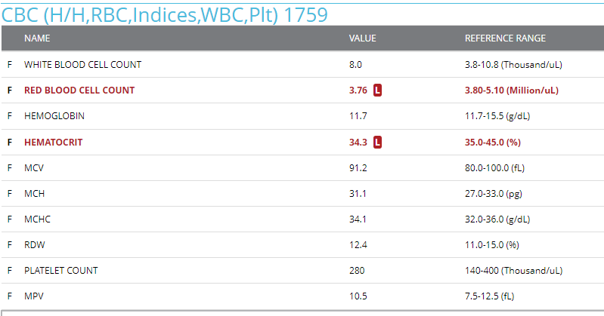
KTE

Slide 77
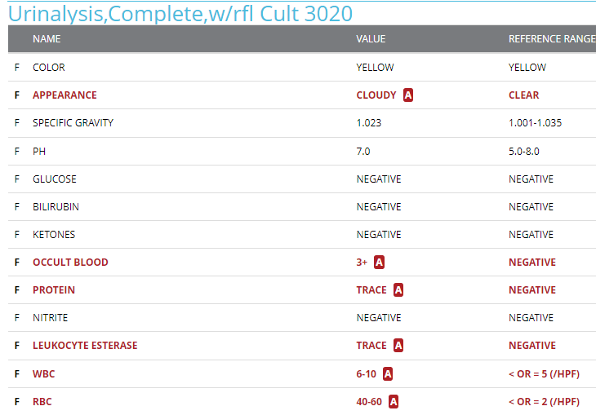
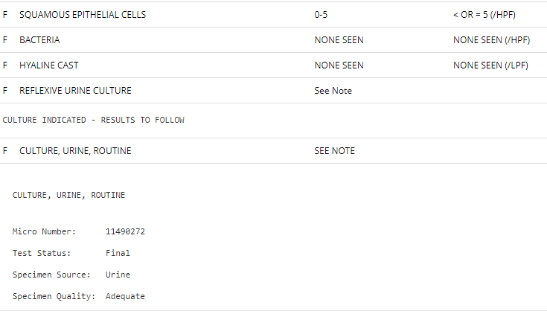
KTE
NO GROWTH

Slide 78
KTE

Slide 79
KTE
3/14/22 PCP Phone visit

Slide 80
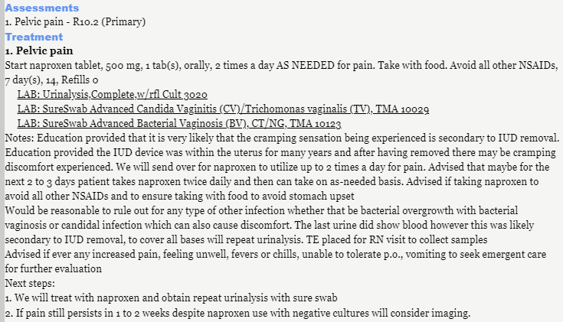
KTE

Slide 81
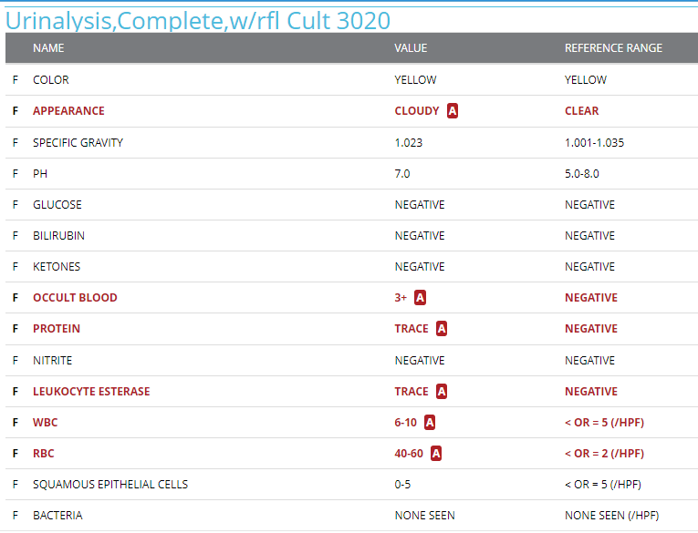
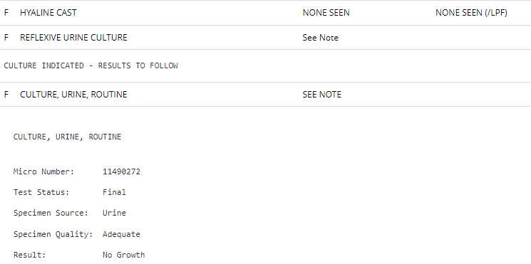
KTE

Slide 82
KTE

Slide 83
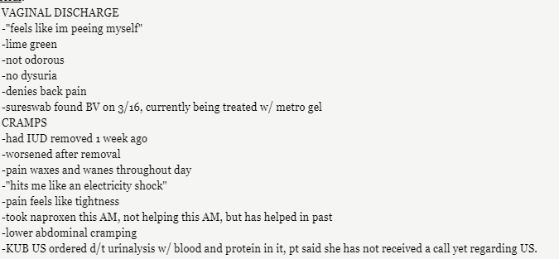
KTE
3/18/22 PCP visit

Slide 84
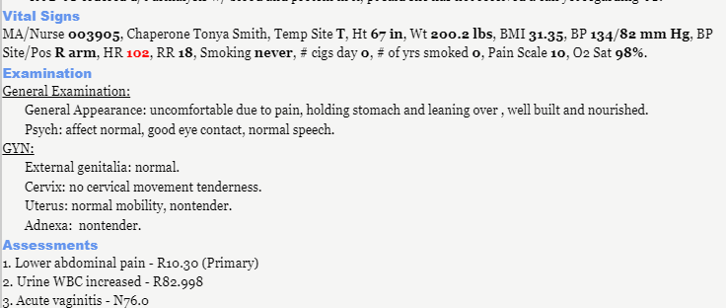
KTE

Slide 85
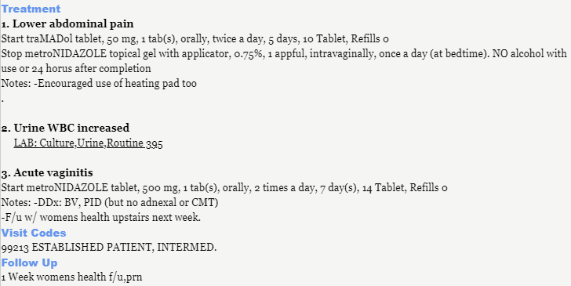
KTE

Slide 86
KTE
3/21/22 GYN visit

Slide 87
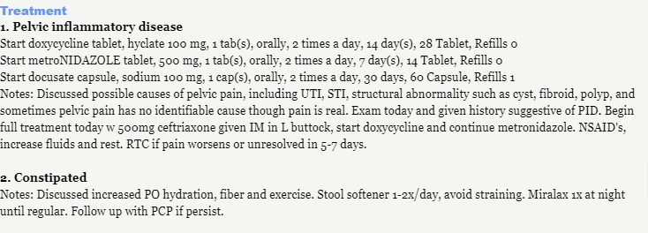
KTE
Assessment?
1. PID
2. constipation
Plan?

Slide 88
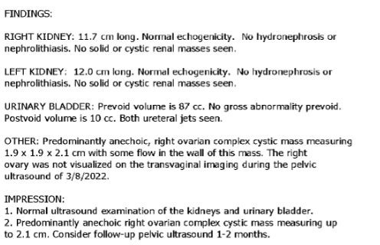
KTE
3/26/22 KUB US

Slide 89
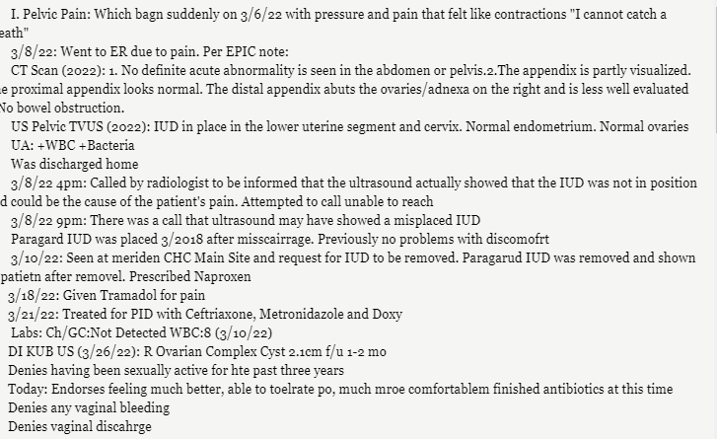
KTE
3/31/22 PCP Phone visit

Slide 90
KTE
5/6/22 PCP Phone visit

Slide 91
KTE
Referred to GYN for follow up
US ordered

Slide 92
Menopause

Slide 93
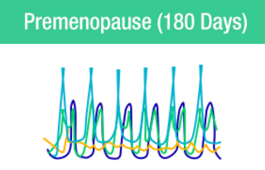
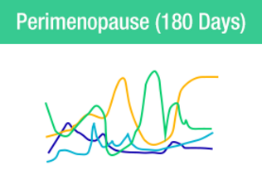
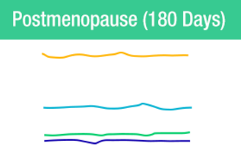
Menopause
Average age: 51-52 (range 40-58)
Perimenopause
Average age: 47
Duration 4-8 years
Effected by smoking, genetics
Diagnosis:
No menses >12 mo
Surgical oopherectomy
Elevated serum FSH (>25)

Slide 94
Menopause
How do you diagnosed when pt is s/p hysterectomy or endometrial ablation?
When symptomatic can check FSH
If >25 can initiate HRT if needed
If < 25 consider other etiologies

Slide 95
Peri-Menopause
Bleeding:
Oligomenorrhea
> 45yo presumptive diagnosis of perimenopause
<45yo investigate other causes
Prolonged heavy menses
Usually an effect of annovular cycles
Consider EMB
Can control with COCPs, cyclical provera, Mirena, depo

Slide 96
Peri-Menopause
Treatment
COCPS if not contraindicated
If no longer withdrawal bleed, stop pills, check FSH after 2-4 weeks
Consider stopping age 50
possibility of pregnancy
Age 45 to 49 yo 2-3%
Age 50yo <1 %

Slide 97
Spontaneous Primary Ovarian Insufficiency
Aka Premature ovarian failure/ premature menopause
Misnomers: because can intermittently produce estrogen and ovulate, menstruation
5-10% conceive and have normal pregnancy
Incidence: approximately 1 in 250 by age 35 years and 1 in 100 by age 40 years
Presentation: irregular menses, infertility, menopausal symptoms
Tests: FSH
Treatment: Estrogen/progestin therapy (like menopause) vs COCPs

Slide 98
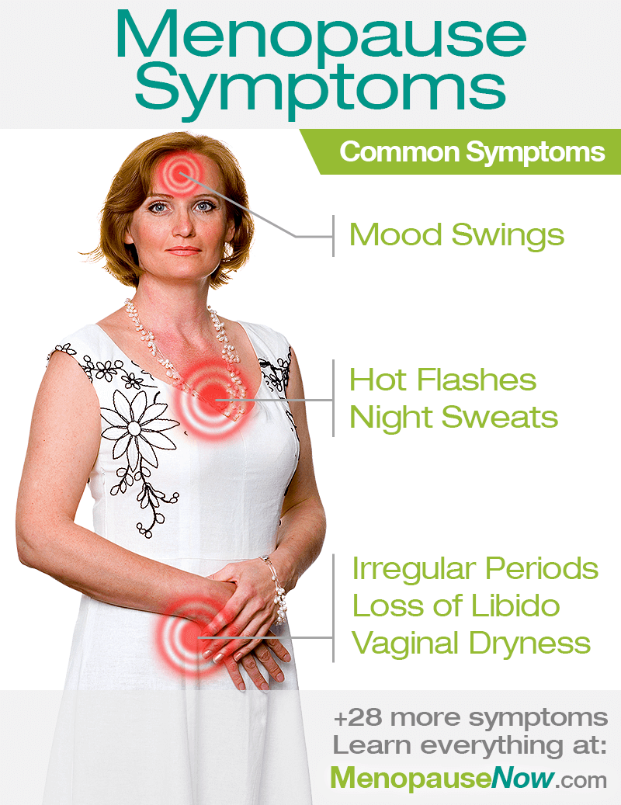
Menopause
Symptoms
Hot flashes
Sleep disturbances
Vaginal dryness, painful sex
Depression
Weight gain
Cognition/memory

Slide 99
Hot flashes
Lifestyle modifications:
lowering room temperature, using fans, dressing in layers of clothing that can be easily shed, and avoiding triggers (such as spicy foods and stressful situations),
Promising: CBT/mindfulness, vitamin E, neurokinin 3 receptor antagonist, stellate ganglion block
Inconsistent: black cohosh, phytoestrogens, exercise, paced respiration, weight loss, hypnosis
Ineffective: acupuncture, EPO, flaxseed

Slide 100
WHI
Women’s Health Initiative
Longitudinal study of 27,000+ women looking at estrogen therapy (ET) and estrogen and progestin therapy (EPT) effect on disease prevention
Stopped 3yrs early when results showed increased risks

Slide 101
WHI
Disease | ET | EPT
CVD |  | Increased 80%/18%
Breast ca |  | Increased 24%
VTE | Increased 33% | Increased 33%
Hip fracture | Decreased 33% | Decreased 33%
Colorectal ca |  | Decreased
Overall illness and death |  | Increased 12%
Dementia | Increased | Increased
Gall bladder dx | Increased | Increased
Urinary incontinence | Increased | Increased
DM | Decreased | Decreased
Hot flashes | Decreased | Decreased

Slide 102
Hot Flashes
HRT
Candidates:
Within 10 years of menopause OR
Younger than 60
Contraindications: hx breast ca, CVD, VTE/stroke, active liver disease (elevated TGs, active gallbladder disease), thrombophilia
h/o migraines with aura- transdermal form preferred

Slide 103
Hot flashes
Online calculate for 10 year CVD risk based on age, sex, race, lipids, BP, DM, smoking

Slide 104
Hot flashes- HRT
Route:
systemic
Oral (ie FemHRT)
Transdermal: patch (ie combipatch), topical gels (ie Divigel), sprays (ie evamist)
vaginal rings (ie E-string)
Local:
intravaginal creams (ie estrace, premarin) and tablets (ie vagifem)

Slide 105
Hot Flashes-HRT
side effects of HRT
breast soreness
With progestin: mood symptoms and bloating
Vaginal bleeding- esp in early months

Slide 106
Hot Flashes- HRT
Added progestin
Any woman with a uterus – prevents endometrial hyperplasia (which can occur in as little as 6 mo with unopposed estrogen)
Timing
Cyclic:
micronized progesterone (prometrium) 200 mg/day x 12 days/mo
Perimenopausal, newly menopausal
More erratic bleeding, mood swings, bloating
Continuous:
micronized progesterone (prometrium) 100 mg/day
2-3 years post menopause
Increased risk breast ca?
Off label: Mirena/liletta (if cannot tolerate oral) or bazedoxifene (increased risk VTE)

Slide 107
Hot Flashes- HRT
Dose
Start lower dose and titrate up (re-eval monthly)
Oopherectomy- often require higher doses initially
Duration
Less than 5 years
Not beyond age 60
*hot flashes duration= 7.4 years
Consider non hormonal
Consider extended therapy
Individualized, risk vs benefit
40% age 60 to 65 years persistent hot flashes that can impair sleep and quality of life

Slide 108
Hot Flashes- HRT
Stopping HRT
40-50% stop within 1 year
65-75% stop within 2 years
Stopping abruptly:
increase immediate return of hot flashes, better after 3 months
Gradual taper (6 months)
Increased hot flashes at 6 months
Same symptoms at 9-12 months as abrupt

Slide 109
Hot Flashes
Non hormonal treatment
SSRIs/SNRIs
Paroxetine (7.5mg Brisdelle)
Citolapram 20mg
Venlafaxine/desvenlafaxine 37.5mg SR → increase to 75mg SR after 1 week
Escitalopram
Not effective: sertraline, fluoxetine

Slide 110
Hot Flashes
Non hormonal
Gabepentin 900mg/day
300mg TID
100-900mg qhs (titrate)
Clonidine patch 0.1-0.3mg/day
Other
Depo provera 500mg IM
Norethindrone 10mg/day

Slide 111
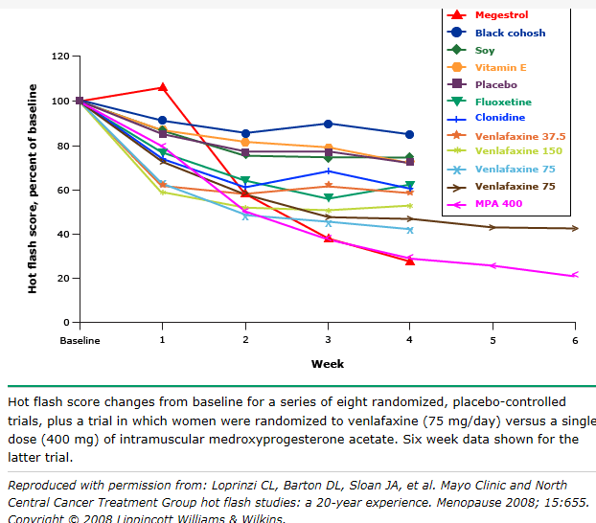
Hot Flashes

Slide 112
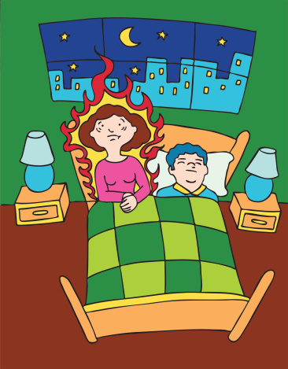
Sleep Disturbances
Sleep disturbances
May be due to hot flashes/ night sweats
May be due to anxiety/depression
Treat the possible underlying cause
Vasomotor symptoms
Mental health
Sleep disorder

Slide 113
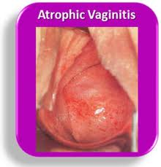
Vaginal Atrophy
Vaginal atrophy
Thinning and less elastic vaginal walls, vulva
Symptoms: Dryness, itching, dyspareunia, less natural lubrication with arousal

Slide 114
Vaginal Atrophy
Treatment
Lubrication
Topical estrogen
Estrace, premarin, vagifem
Loading dose followed by maintenance dose
Estrace 1gm per vagina nightly for 2 weeks, then 2x/week

Slide 115
Menopause-other
Depression
Estrogen may help
SSRIs most helpful
Weight gain
Cognitive changes

Slide 116
Case study
MM

Slide 117
MM
54 yo presents for annual exam
~~Menstrual hx: menarche: 15, post menopausal x10 years --Sexual hx: not in past 4 years --Contraception: Menopausal, s/p BTL --Pregnancy hx: G3P3, c/s x3 --Pap smear: this year Negative ThinPrep/Negative HPV, abnormal result in 1995 cleared spontaneously, no other abnormals --Mammo: recent BIRADS1 --Fam hx: GYN cancers: 2 grandmothers uterine CA, maternal and paternal aunts breast CA (dx'd ages 34, 24) - pt denies genetic testing in the past, blood clots: maternal grandfather had DVT

Slide 118
MM
Previously on PO Estrace for vaginal dryness, but it gave her HAs, so she d/c'd. She has never tried any other method. she is not sexually active.
Chart review shows:
Told PCP was on vagifem but causing her vaginal pimples
PCP switched her to estrace vaginal cream which caused her an increase in hot flashes
PCP switched her to oral estradiol 1mg which she eventually stopped due to worsening HA

Slide 119
MM
Exam
External genitalia: no lesions, dry, some erythema present around the introitus. Vagina: healthy pink dry mucosa without any lesions. Cervix: normal appearing, no CMT, small amount of white discharge present in vaginal canal. Uterus: normal size, shape and consistency, nontender. Adnexa: normal, no masses, nontender.

Slide 120
MM
What is your plan?

Slide 121
Case study
MPR

Slide 122
MPR
58 yo Here for annual exam --Menstrual hx: menarche: 13, hysterectomy --Sexual hx: not sexually active x 1 year --Contraception: hysterectomy --Pregnancy hx: G2P2002 c/s x 2 --Pap smear: none on file, no hx abnormals, no longer indicated due to TAH --Mammo: per pt- had one within past year- normal --Fam hx: GYN cancers: no, blood clots: no --Soc hx: no working, no tob, has hx DV (emotional) with prior partner- no longer in her life

Slide 123
MPR
1. taking estradiol 1mg for 3years- helps with hot flashes. works well when taking, cant sleep when doesn’t take. wondering if she should be on this medication but also hesitant to stop 2. very elevated BP today. repeat slightly better. no chest pain, no SOB, no headache.

Slide 124
MPR
Temp 97.6 F, Temp Site oral, Ht 60.5 in, Wt 145.6 lbs, BMI 27.96, BP 185/104 mm Hg, BP Site/Pos r forearm, HR 79, RR 20, Smoking never, # cigs day 0, # of yrs smoked 0, Pain Scale 0, O2 Sat 100, LMP: no menses, Repeat BP 170/97.
Breast: soft, non tender, no masses. External genitalia: normal, no lesions, introitus normal. Vagina: healthy pink mucosa without any lesions. Cervix: surgically absent. Uterus: surgically absent. Adnexa: non palpable (? ovary left side).

Slide 125
MPR
What is your plan?
Continue estrogen 1mg daily
Wean off estrogen
Stop estrogen now
Change to new medication

Slide 126
MPR
Plan:
HOT FLASHES
Start estradiol tablet, 0.5 mg, 1 tab(s), orally, once a day for 3 days then every other day for 30 days, 45, Refills 0 Start Paroxetine Hydrochloride tablet, 10 mg, 1 tab(s), orally, once a day, 90, Refills 0 advised in the setting of possibly poorly controlled HTN and been on for 3 years, consider tapering and discontinuing. will trial SSRI to see if gets symptom relief.

Slide 127
MPR
ELEVATED BP
known HTN- pt states she taking her meds as prescribed. chart review (though limited because pt is relatively new to this clinic) shows better control in general. Pt does admit to be nervous for GYN exam. PCP unavailable at time of visit, so consulted with on site medical director. Advised since other BPS better controlled pt can take BP at S&S can call CHC if elevated for follow up.

Slide 128
MPR
3 months later, appt to f/u meds:
Pt reports she stopped Estradiol completely as she was concerned it was "blocking her arteries."
Pt reports very tired, taking Paxil in the morning. Having occasional hot flashes, pt reports estrogen alone works better.
BP 115/71 mm

Slide 129
MPR
Plan?
Take paxil at night
Restart trial of 0.5mg estradiol

Slide 130
Case study
RV
Notes:
Raquel viele

Slide 131
RV
47yo G7P4034 presents for annual exam c/o hot flashes. (black cohosh seems to be helping), difficulty sleeping, difficulty concentrating
Med Hx: insomnia, ADD, depression, migraines no aura, asthma, former smoker,
Meds: asthma valtrex, zonisamide, zolpidem, strattera singulair, imitrex
Menses: q2-3 months for the past few years “was tested by Yale and told was perimenopausal”

Slide 132
RV
Plan?
Started on low dose COCPs (loestrin 1/20)

Slide 133
RV
4 months later
Took loestrin 1/20 x 3 months. had menses first month but not the the subsequent months. While on COCPs headaches seemed worse (not all were migraines, but bad HA esp before and after menses/placebos), moody/emotional but hot flashes were better. ran out 1 month ago and hot flashes are back. difficulty sleeping. currently on psych meds, so SSRIs not a good option takes ambien for sleep but still awakes with hot flashes

Slide 134
RV
Plan?
Started on gabepentin. start at 100mg QHS, can increase q3days to max dose of 900mg qHS.

Slide 135
RV
9months later
HOT FLASHES: terrible, not sleeping. night sweats. gabepentin was helping but was having crying jags. stopped in May and mood got better but hot flashes got worse, so restarted- now taking 2pills nightly for a few weeks.
Plan?
Norethindrone Acetate tablet, 5 mg, 2 tab(s), orally, once a day, 180, Refills 1

Slide 136
RV
1.5 years later (annual exam/now)
HOT FLASHES: at some point (unknown) stopped norethindrone. seen at PP and tried femring but was awful. bad yeast infections. tried for a month. restarted gabepentin (300-400mg)- which helps but not enough and if misses dose has emotional lability. also notes vaginal dryness. interested in medication- patch form would be great. No menses for > 1 year has hx migraines- no aura. had some bad headaches on low dose COCPs so stopped them in perimenopausal phase.

Slide 137
RV
Plan?
Start Combipatch film, extended release, 0.05 mg-0.14 mg/24 hours, 1 PATCH, applied topically, 2 times a week, 30, Refills 0

Slide 138
Pregnancy for the Primary Care Provider

Slide 139
Preconception
Preconception
Folic acid/PNV
Assess medication safety
Assess medical risk factors
Toxic exposures
Etoh, drugs, tobacco
Listeria
Mercury
Anticipatory guidance
May take up to 1 year for a healthy young woman with regular cycles to get pregnant

Slide 140
Fertility
Detailed history (prior preg, FOB’s prior preg), in depth menstrual history
PCOS work up:
androstenedione, 17 hydroxyprogestone, DHEAS, testosterone, LH, FSH, PRL, TSH with reflex, fasting insulin and fasting glucose, A1c
Ideal TSH when TTC is <3.0
Day 3 labs: FSH and estradiol, can add Anti Mullerian Hormone
Will tell you “egg quality” or “egg reserve”

Slide 141
Estradiol: want below 80. If elevated, might mean that a normal FSH is falsely suppressed and there is really an issue

Slide 142
Fertility

Slide 143
Fertility
Diet/lifestyle
Take a prenatal vitamin every day
Take omega-3 fatty acids- either as a separate pill or see if your prenatal vitamin has DHA (this is omega 3 fatty acids)
Eat one serving of full fat dairy a day (ie whole milk, whole milk yogurt, whole milk cheese)
Moderate exercise for 30-60 minutes on most days
Maintain a healthy weight
Avoid smoking and drugs. Limit alcohol to no more than 4 drinks per week while trying to conceive (and none if you become pregnant)
Use fertility lubricants like PreSeed

Slide 144
Fertility
Track Ovulation
Use a free app/calendar. Most ovulation occurs day 10-14
Cervical Mucous Monitoring
After period: discharge may be: dry, cloudy, muscousy, yellow or white
During ovulation: clear, stretchy discharge- looks like egg-whites. Will stretch between your fingers. Lasts one day
After ovulation: discharge may be: dry, cloudy, muscousy, yellow or white

Slide 145
Fertility
.
Ovulation Predictor Kits
Recommend: Clear Blue Digital Ovulation Test
Start testing on day 10, using a first morning urine until you get a positive (smiley face). Have sex that night, the next night and the following night

Slide 146
Case study
SC
Notes:
Samia chowdhury

Slide 147
SC
34 yo G1P1001 presents for annual. Notes menses q1-3 months. Is not contracepting, would like to be pregnant. Current child is 7yo and hasn’t contracepted nor conceived since.
Med hx: overweight (BMI 30), prediabetes (a1c 5.7 1 year ago)
Plan?
Order PCOS labs, TSH, PRL, Fertility labs

Slide 148
SC
NORMAL LABS:
Testosterone
Androstenedione
17 hydroxyprogesterone
Prolactin
thyroid

Slide 149
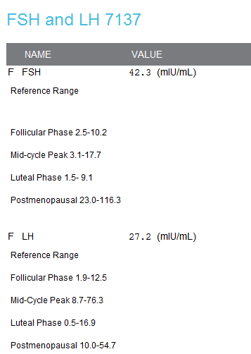
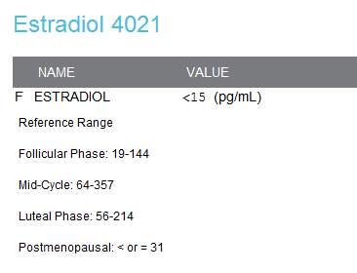
SC
NEED INTEPRETATION

Slide 150
SC
ABNORMAL LABS:

Slide 151
SC
ASSESSMENT?
PCOS (eEndocrinology consulted), POI
infertile
PLAN?
Refer to REI if pregnancy desired

Slide 152
Pregnancy for the Primary Care Provider

Slide 153
Pregnancy
Weeks | Milestones
before 10 | Prenatal labs, discuss genetic testing, flu vaccine, dating assessment, physical exam, assessment of risk factors
10-13.5 | First Trimester Screen, cell free fetal DNA
15-20 | Quad Screen or AFP, early GTT for those at risk
19+ | Anatomy US (level 1 or 2)
24+ | Fasting Glucose and labs
28-38 | TDAP
36-37 | GBS
40-42 | NST
PP | PHQ2, birth control counseling

Slide 154
Pregnancy
Labs:
PN1= blood type, rh, antibody screen, CBC, HIV, syphilis, Hep B, Rubella status, urine. Additional labs= cystic fibrosis, hgb Electrophoresis, A1c, hep C, Tb screening
Pap, GC/CT
Genetics= FTS, cell free DNA, QS/AFP, CVS, amnio
Diabetes screening= 1hr GTT, 3hr GTT
3rd trimester= CBC, repeat syphilis, HIV, GTT
GBS, repeat GC/CT

Slide 155
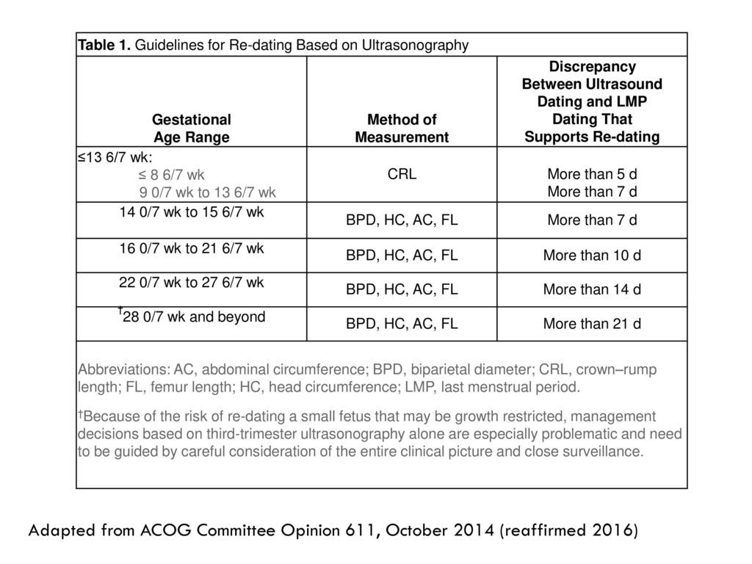
Pregnancy
Ultrasound uses
Dating
When to change EDD
Genetic screening
Anatomy
Growth
Position
Amniotic fluid
Fetal well being (BPP)
Placenta

Slide 156
Pregnancy
Week | Appointment Schedule
0-28 weeks | every 4 weeks
28-35 weeks | every 2 weeks
36+ | every 1 week
40+ | NST 1-2 x/week

Slide 157
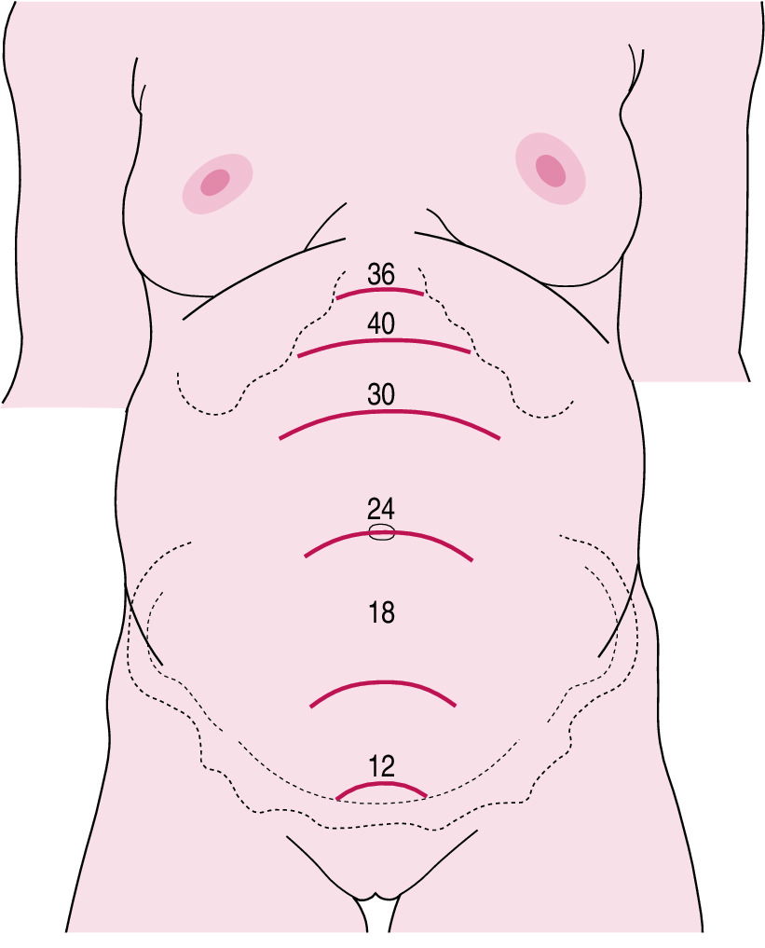
Pregnancy

Slide 158
First trimester complaints
Bleeding
Causes: infection, miscarriage, ectopic, friable cervix, recent intercourse
up to 30% of woman have bleeding in first trimester and over half have viable pregnancies
nothing that can be done to prevent a miscarriage nor hasten a miscarriage in early pregnancy
pelvic rest until one week after bleeding has stopped to avoid additional bleeding
bloodwork(serial HCGs, blood type and Rh) and US timing
ectopic and miscarriage precautions

Slide 159
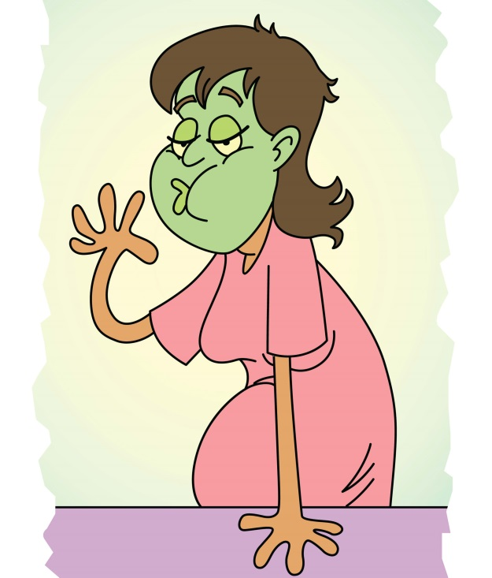
First trimester complaints
Nausea/ Vomiting
resolution usually at 10-12 weeks
lifestyle changes
OTC meds
RX
Diclegis
Zofran
Other antiemtics: phenergan, reglan, compazine
if unable to tolerate any PO for >24hrs, will need evaluation

Slide 160
Co Management
Thyroid
Monitor TSH every trimester (as frequent as q4-6 weeks)
Keep TSH <3
Dose requirements may increase by as much as 50 percent during pregnancy
URIs, UTIs, infections
Treat with appropriate antibiotics when indicated.
Single drug therapy, lowest effective dose
Penicillins, Cephalosporins, Erythromycin, Clindamycin (after 1st tri), augmentin
Avoid: tetracycline, streptomycin, kanomycin,

Slide 161
Co Management
Vaginal infections
treat per CDC
Use azithromycin as alternative to doxycycline in pregnancy
GC/CT TOC 4 weeks later, repeat at 36 weeks
Depression meds
Do not stop abruptly
Pregnancy not indication to stop most meds

Slide 162
Co Management
BP meds
-transition to labetalol or nifedipine
DM
Eye exam
EKG
Liver function
Kidney function
24 hour urine
Transition to insulin, some PO meds- done by endocrinology

Slide 163
Case study
FF
Notes:
Samia chowdhury

Slide 164
FF
28yo G3P0020 (SA B x 2 at 8 and 12 weeks) presents to f/u from ED
Yesterday she noticed blood in toilet paper, this episode happened twice in one day. Went to the emergency room where she was evaluated. Denies current bleeding, does not report pain. Reports feeling stressed and frightened given her hx of past miscarriages
PMHx of uncontrolled diabetes (A1c 11.3). Not taking Januvia. Was unsure if it was going to hurt the baby. Does not monitor BG.
Reports vaginal itching and some clear white discharge. Reports hx of frequent yeast infections. She was given a gel for pruritus in the emergency room. She has been using it at night since last night with mild improvement. .

Slide 165
FF
Visit Date: 12/20/2018
+urine HCG 12/6/18
LMP: 10/23/18
EGA: 6w5d by LMP; 6w0d by US
EDD: 7/30/19 by LMP; 8/5/19 by US.
12/9/18 ED visit for bleeding -Pelvic US: viable IUP at 5+6 FHR 105bpm -HCG 2884 -per hospital records: blood type RH pos/ rhogam not indicated

Slide 166
FF
Plan?
Sureswab taken (thin white discharge noted)
Serum HCG 48 hrs after last one
OB Intake ASAP

Slide 167
FF
f/u HCG : 6400 (had been 2884 48hrs prior)
Baseline labs:
LFTs normal
RFTs normal
833 mg PRO
EKG= sinus tachycardia
Retinopathy= to be scheduled
Bedside US “viable IUP 7-8 wks size; pt had spotting last night __ rh pos; will have f/u in 2 wks”
1 weeks later had spotting: STAT US: viable IUP at 8+3
1 week later: bedside u/s “reveals only one large empty appearing gestational sac”. STAT US: demise.

Slide 168
FF
6 months later, pt presents to with + pregnancy test
Had bleeding on and off throughout first trimester. started on vaginal prometrium at 15 weeks. US continued to show viable pregnancy
A1c=10.1
24hr urine= 1200mg pro
Referred to Endocrinology
Insulin regimen= levimir 30units in am and pm, metformin 100mg BID BS= states fastings 130s, 2hr PP 130s
A1c= 9.4 in early 3rd tri
Started on baby ASA
Followed byM FM- normal USs
Connected with community health worker

Slide 169
FF
Pt presented to local hospital at 31 weeks with PPROM and PEC. Had emergent c/s. Baby in NICU doing well for GA. Mother in ICU for cardiomyopathy (septic vs cardiogenic shock). Possible MRSA pneumonia. - ECHMO was considered, but pt improved. Pt discharged home after 2 weeks . Nexplanon inserted prior to discharge. Pending f/u appt this week. (attempt to reach pt by phone for f/u in interim unsuccessful)

