Slide 1
attention, concentration, impulsivity and mood
Anastasia Okoniewski, MSN, APRN, DNP
Community Health Center, Inc

Slide 2
Disclosures
With respect to the following presentation, there has been no relevant (direct or indirect) financial relationship between the faculty listed above or other activity planners (or spouse/partner) and any for-profit company in the past 12 months which would be considered a conflict of interest.
The views expressed in this presentation are those of the faculty and may not reflect official policy of Community Health Center, Inc. and its Weitzman Institute.
We are obligated to disclose any products which are off-label, unlabeled, experimental, and/or under investigation (not FDA approved) and any limitations on the information that are presented, such as data that are preliminary or that represent ongoing research, interim analyses, and/or unsupported opinion.

Slide 3
Learning Objectives
By the end of this didactic, the NP Resident will be able to:
1. Review ADHD symptoms and presentation in children, adolescents and adults
2. Review current medication interventions for ADHD across the lifespan
3. Discuss common comorbid diagnoses with ADHD
4. Discuss case examples
5. HAVE FUN! this is ADHD we’re talking about today!

Slide 4
Common Questions about ADHD
Is ADHD over- or underdiagnosed?
Do patients grow out of ADHD?
Does a patient not going to school or working need medication for ADHD?
What about the abuse potential for using stimulants?
Why do so many of my patients with ADHD have substance abuse issues?
What about marijuana?

Slide 5
ADHD: defined
Age inappropriate levels of inattention, hyperactivity and/or impulsivity interfering with normal development or functioning
Seriously effects productivity, life expectancy and quality of life throughout the lifespan
Hypothesized that childhood ADHD itself seems to be a risk factor for the later development of depression, and can be reduced by treatment.

Slide 6
ADHD: Statistics
Worldwide prevalence: between 5-10% for children; 2.5-5% for adults
Heritability is 60-80%-the highest of all psychiatric diagnoses
Ratio of male and female diagnosis
4:1 IN CHILDREN and 6:1 IN ADULTS
Boys most likely to be present with externalizing behaviors, hyperactivity
Girls more likely to be mis/under-diagnosed due to presenting with inattention and distractibility
https://youtu.be/dmeE3qTJRUw

Slide 7
ADHD
At least 15% continue to meet full diagnostic criteria at age 25
50% meet criteria in “in partial remission” with sub threshold symptoms that still cause significant impairment
Changes in presentation are likely related to the shift from traditional externalizing symptoms (hyperactivity)in childhood.
Adolescents present with more inattention and internalizing symptoms
Emotional lability becomes a dominate clinical feature in adulthood, with I/H persisting

Slide 8
ADHD:
Inattention, Impulsivity, Hyperactivity
Symptoms must have been present prior to the age of 12
Core symptoms: internal restlessness, unfocused mental activity, difficulty with focusing on conversations
Self regulation: problems controlling impulses, switching attention, regulating emotional responses, initiating tasks and problem solving
Additional problems: sleep problems, poor self esteem, comorbid conditions
15-50% children who have had a serious concussion or TBI develop secondary ADHD, which is clinically indistinguishable from idiopathic ADHD

Slide 9
ADHD: a disorder of over and under
OVER
Persistent need for over-stimulation
Over-focus on activities of enjoyment (video games)
Hypersensitive perception of justice
UNDER:
Neurologically likely related to under-sensitivity of receptors in prefrontal cortex- executive functioning and impulse control and cerebellum- balance- ACCIDENTS! INJURIES! SLEEP!
Avoidance or difficulty completing tasks that are challenging (homework, chores, bills)
Notes:
Over:
Persistent need: making noise, moving, tapping,. Will have radio tv on always. Focuses better with music on.
Over focuses on activities of enjoyment
Justice: concrete or rigid thinking are common in ADHD, children have difficulty, thinking “things are not fair” and are easily frustrated with changes in routine, ie. Substitute teachers
Under:
Prefrontal cortex is responsible for executive functioning
What are exec fx??
Organization
Time management
Prioritizing
Multitasking
Completing tasks in a logical or prescribed order

Slide 10
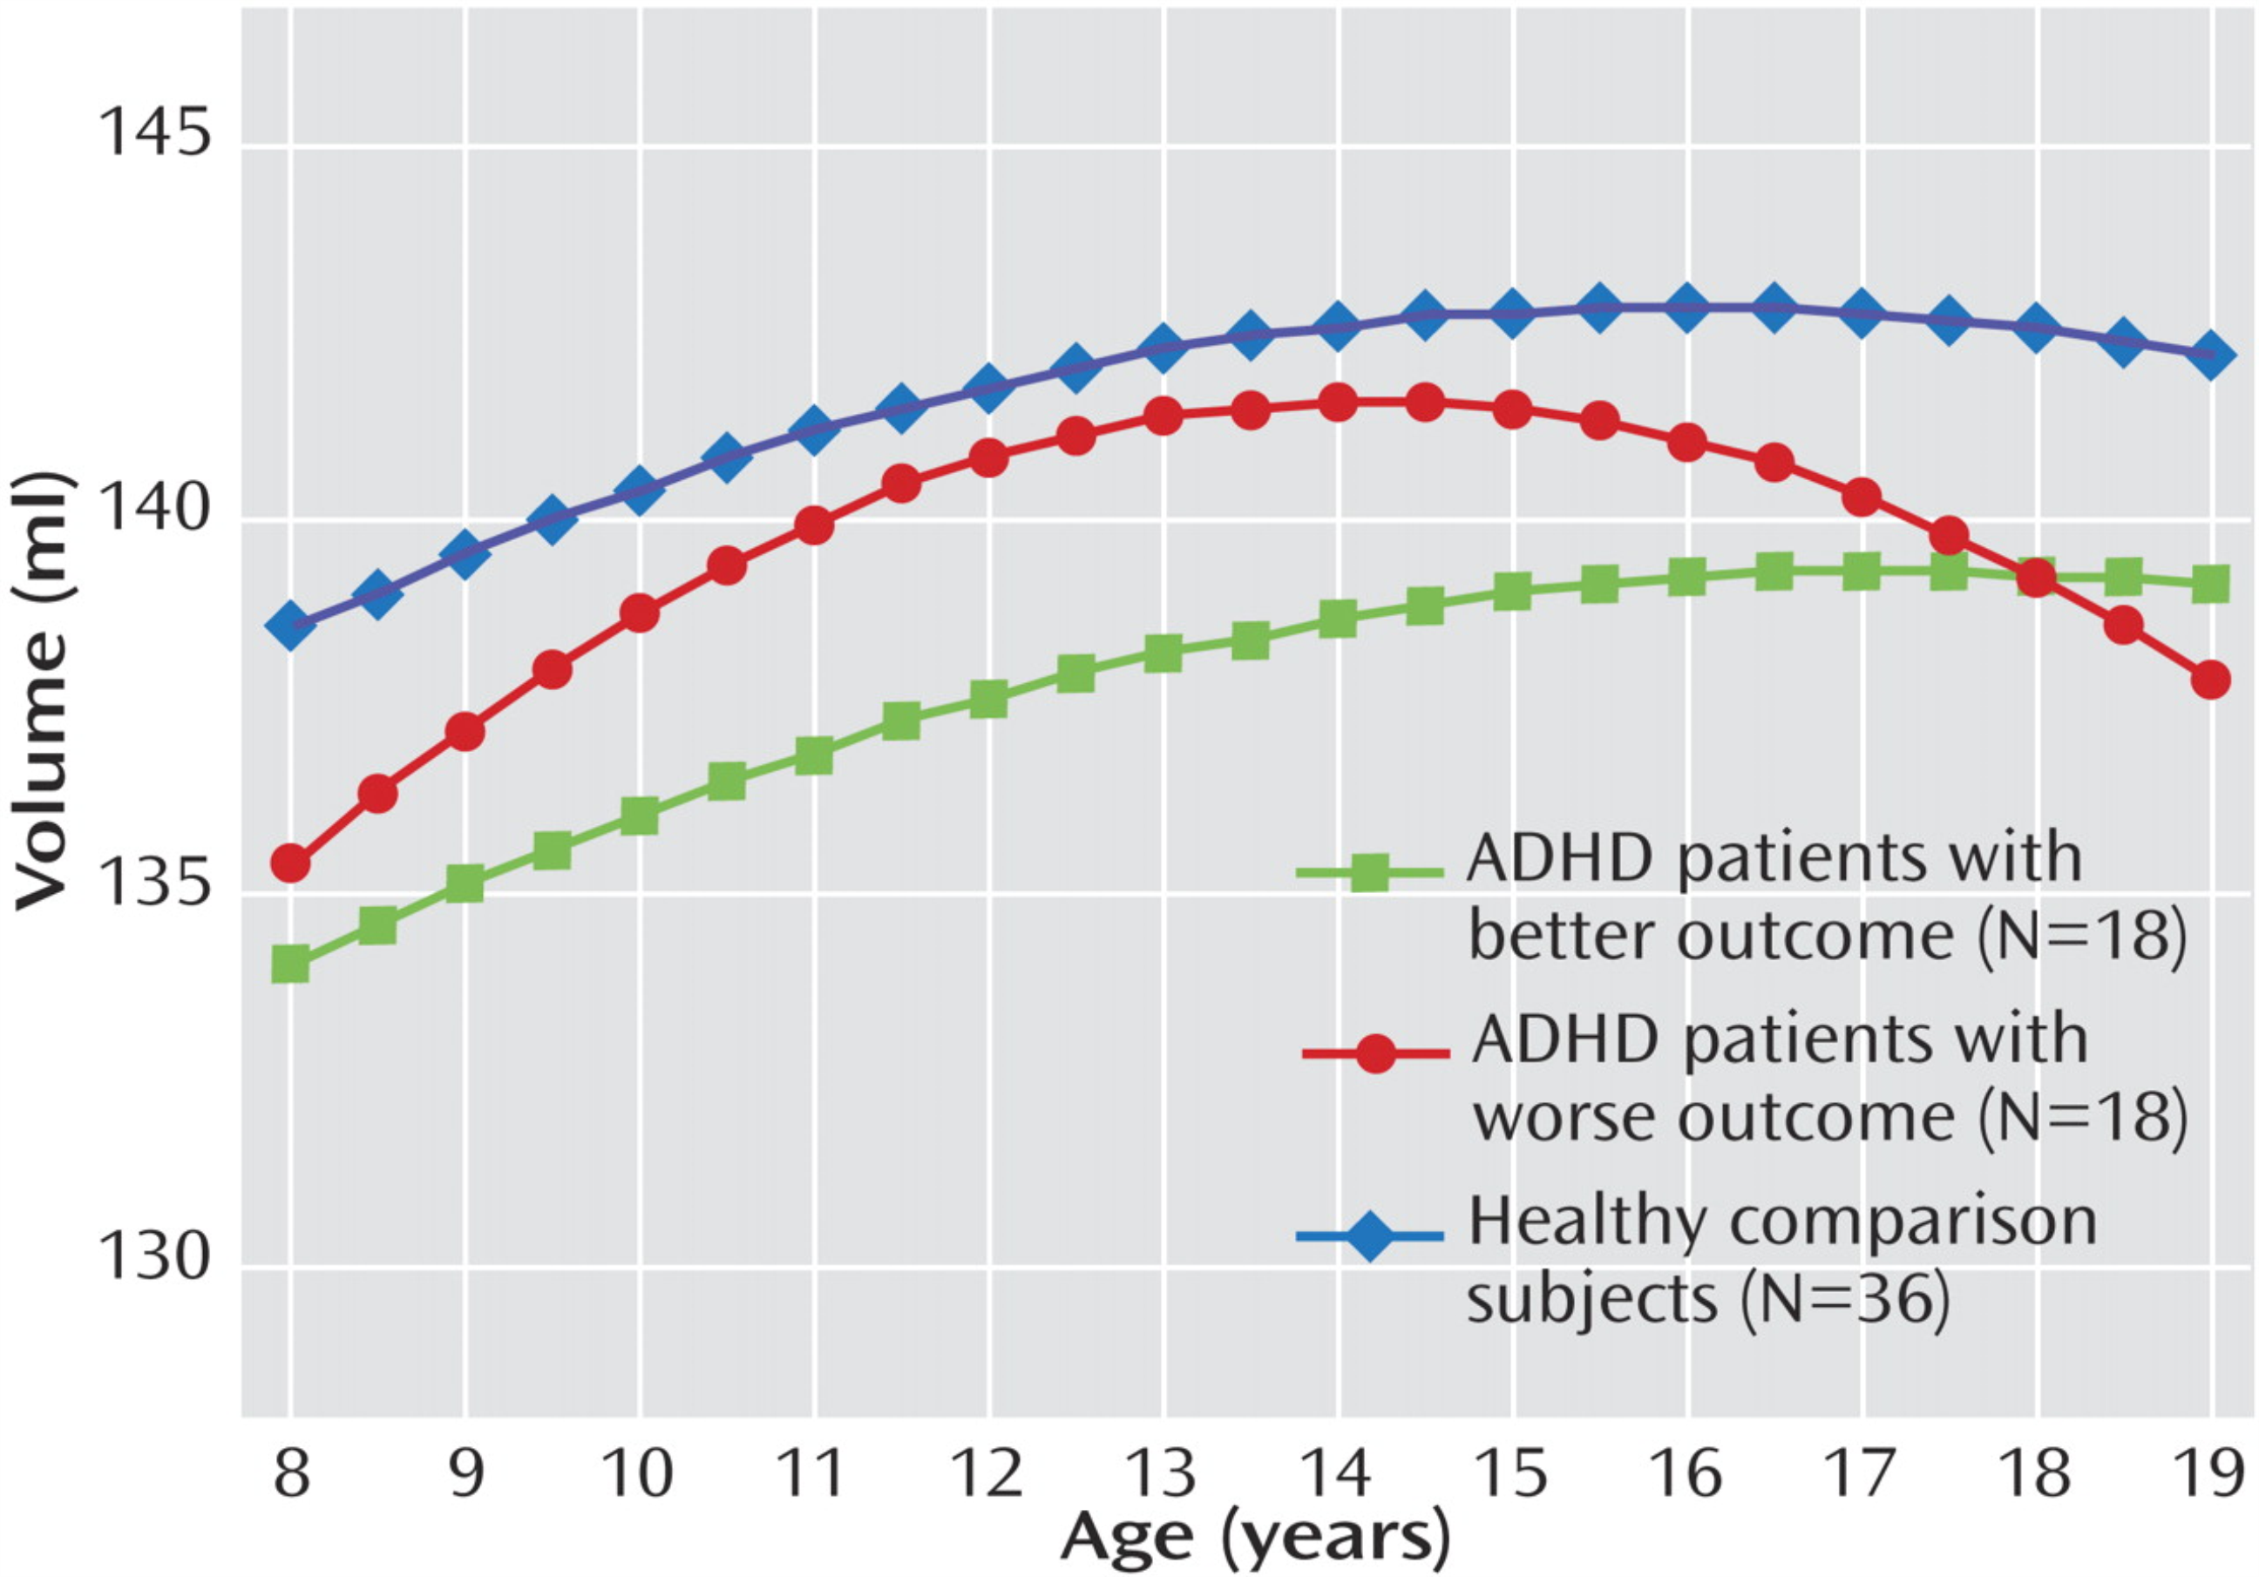
From: Cerebellar Development and Clinical Outcome in Attention Deficit Hyperactivity Disorder
Am J Psychiatry. 2007;164(4):647-655. doi:10.1176/appi.ajp.164.4.647
Date of download:
10/29/2013
Copyright © American Psychiatric Association. All rights reserved.

Slide 11
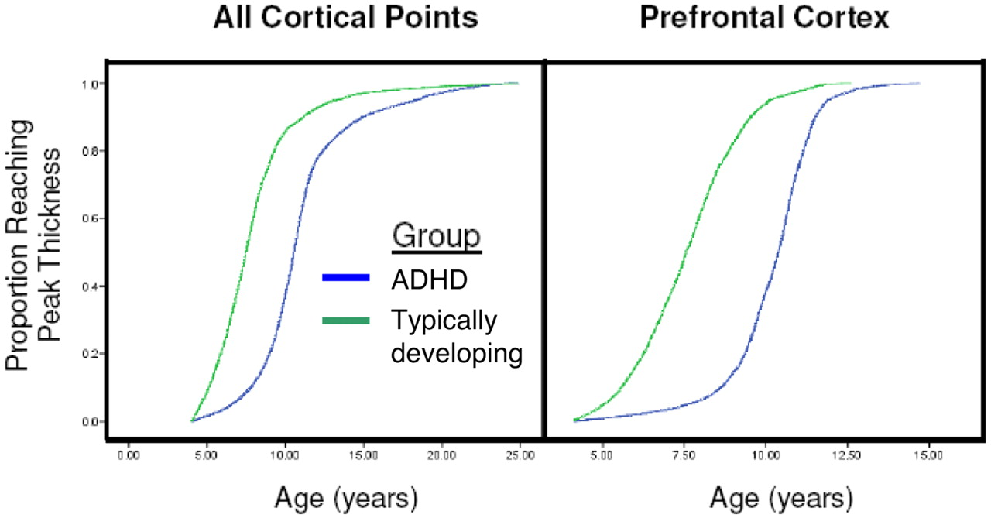
Kaplan–Meier curves illustrating the proportion of cortical points that had attained peak thickness at each age for all cerebral cortical points (Left) and the prefrontal cortex (Right).
Shaw P et al. PNAS 2007;104:19649-19654
©2007 by National Academy of Sciences
Notes:
Kaplan–Meier curves illustrating the proportion of cortical points that had attained peak thickness at each age for all cerebral cortical points (Left) and the prefrontal cortex (Right). The median age by which 50% of cortical points had attained their peak differed significantly between the groups (all P < 1.0 × 10−20)‏

Slide 12
ADHD and the DSM V
Why this change is NOT useful:
Changing the age at diagnosis to 12 adds MANY complicating environmental variables/leading to a muddier picture of ADHD and possible profiles.
There was no research to support this change and argues against neurodevelopmental etiologies
THERE IS CLEAR EVIDENCE OF THE SEPARATION OF ATTENTIVE ONLY AND COMBINED TYPE AS VERY DISTINCT DISORDERS
RUSSELL BARKELEY-CONCENTRATION DEFICIT DISORDER
SLOW COGNITIVE TEMPO
DISTINCT LIFE TRAJECTORIES/QUALITY OF LIFE OUTCOMES

Slide 13
ADHD Neurobiology
Over/under or tuning in/tuning out
Neuropsychological deficits are in tasks of inhibitory control, attention and timing.
Limbic system, associated with emotional regulation and reward drive develops before the prefrontal cortex- responsible for exec fx, judgment, planning, organization and inhibition
Developmental asymmetry may account for the inability of the frontal lobe to influence emotion, impulsivity and reward drive
Arnsten & Rubia, 2012

Slide 14
Attention Deficit Hyperactivity Disorder
Biologic factors
Genetics
Frontal lobe and cerebellar functioning
Comorbidities:
Anxiety
Depression
Mood Disorder
Learning Disorders
Autism
Untreated ADHD may lead to comorbid diagnoses later in life
Notes:
Genetics is a principal cause of ADHD with 76% concordance over multiple genes, for a child of a parent with ADHD the risk of developing ADHD may be as high as 54%
Nongenetic factors: maternal smoking or alcohol use during pregnancy, TBI perinatal stress and low birth weight.
Learning disorders: dyslexia most common. Also responsive to medication.
Imagine a life of loosing, forgetting, being told that you’re smart enough, and still not being able to get work done, stay organized and on task. Relationship failure, job failure, impacts self perception, self esteem

Slide 15
ADHD Developmental Trends by Age
INATTENTION
IMPULS
HYPER
IVITY
ACTIV
ITY
COMORBIDITY
RECOGNIZED
Childhood Adolescence Adulthood
Wasserstein. JCLP 2005. Mick et al. Psychiatr Clin N Am 2004.
Copyright © 2006 Neuroscience Education Institute. All rights reserved.
Notes:
The trends of ADHD symptoms by age are shown here.
In general, hyperactive and impulsive symptoms may lessen as an individual ages, possibly beginning in adolescence. However, inattentive symptoms seem to persist through adulthood.
Adults are also more likely to have comorbid disorders be recognized than children.
This may be because the comorbidities develop later, but could also be because of changes in symptom expression, ability of patients to express themselves, and other factors.

Slide 16
Persistence of ADHD Into Adulthood
NA
NA
Syndromatic: Loss of full diagnostic status Symptomatic: Loss of partial diagnostic status
Mick et al. Psychiatr Clin N Am 2004.
Copyright © 2006 Neuroscience Education Institute. All rights reserved.
Notes:
Although some have argued that ADHD rates diminish with age, others believe that the symptoms of ADHD simply change with development.
Specifically, symptoms such as hyperactivity are thought to diminish, while symptoms of inattention persist.
This may mean, depending on the diagnostic criteria and/or scales used, that patients would no longer meet syndromatic criteria, as shown in this study (dark blue bars). However, subsyndromal symptoms may still persist and require treatment and/or monitoring (light blue bars).

Slide 17
ADHD: assessment in children
Goal of assessment is to know what it is like to be in class and at the dinner table with your patient.
Longer time on initial evaluation + More psychoeducation during appointment = Longer length of stay in treatment
Differential diagnoses: ODD, IED, learning disorders, anxiety, depression, ASD, DMDD

Slide 18
ADHD assessment in children
Home
Organization (bedroom, backpack, homework)
Eating habits
Sleep (onset, quality, length)
School
Concentration, distractibility, restlessness
Time management
Social/Emotional
Peer/parent/teacher relationships
Temperament, coping skills
Activity Level/Interests
Accidents/injuries
Physical activity and exercise is very important!

Slide 19
ADHD: in Elementary school
https://youtu.be/-IO6zqIm88s
externalizing sx predominant
distractibility, hyperactivity, impulsivity
talking out in class, tantrums with homework
unable to wait in line, easily agitated in unstructured environments (lunch room, music class, recess)
arguments with teachers and peers
grumpy when routine changes
sleep delay common
negative self talk begins

Slide 20
ADHD in Middle School
internalizing begins to emerge
will not raise hand in class if they know the answer
will not order for self when at a restaurant
has trouble making friends
will not ask for help from teachers or peers
negative self talk increases

Slide 21
ADHD in High School
Fun mix of internalizing and externalizing symptoms
will not raise hand/ask questions (shame/ self consciousness)
substance use experimentation increasing
often masks by associating with peers that act how they see themselves
impulsivity with spending, DRIVING, fashion/style

Slide 22
Instruments and Scales
Connors - ADHD
SNAP IV - ADHD and mood
ADULT:
ASRS-ADULT ADHD SELF-REPORT SCALE
WUS-WENDER UTAH RATING SCALE
Limitations:
*Not appropriate for diagnostic use
*Not Selective for specific profiles
*Subjective and not normed for OTHER cultures
*Not always useful as a score, more useful with individual items and profiles

Slide 23
ADHD
Comorbidities and Differentials
(under the sea)

Slide 24
ADHD + Autism, Tics
20-50% of children with ADH also meet criteria for ASD
social deficits, peer relationship issues, empathy problems in both dx
Tic disorders in 10-20% of children with ADHD
severity often peaks 8-12 years old, decline in adolescence.

Slide 25
ADHD + Learning disorders
25-40% children with ADHD have major reading and writing difficulties, common co-occuring language, math disorders
Higher IQ and lower externalizing sx differentiated adult onset from lifelong ADHD
Higher intelligence and lack of comorbidity may allow disorder to go undetected in childhood
Cognitive reserve, resilience factors, lower symptomatology in childhood important factors in understanding ADHD through the lifespan
Stim increase cognitive processing, working memory, ability to manipulate information and planning (pref-c def)

Slide 26
ADHD + PITA (rule breakers)
25-80% children with ADHD will meet criteria for ODD/CD
ODD and CD predict more severe clinical sx, more severe functional impairments, higher persistence into adulthood, higher rates of substance abuse and comorbid depression
Symptom presentation does respond to medication

Slide 27
ADHD + Depression and Anxiety
20-40% of adults with Anxiety will have comorbid ADHD dx
Anxiety- worry/phobia ADHD- tension/restlessness
Inability to function d/t social and cognitive limitations
5-20% comorbid Major Depression
Poorly understood developmental trajectory leading to anxiety and depression

Slide 28
ADHD + irritability, lability
Sudden strong shifts that are inappropriate for age/dev
Strong emotional reactions, both positive and negative, brief (minutes to hours) not defined or cyclical (days or weeks)
Emotional lability independently contributes to high rates of incarceration, poor academic achievement, more driving accidents, and problematic social/marital relationships
Over-reactivity and lability more common in adult ADHD

Slide 29
ADHD + DMDD / Bipolar
Uncontrolled emotional and mood changes common in both children and adults with ADHD
In ADHD, emotional dysregulation occurs in the absence of comorbid disorders, is an independent predictor of impairment and responds to both stimulant and Atmx
20% comorbid bipolar disorder
Developmental trajectory unclear, even when irritability and anger are prominent symptoms
DMDD added to ease overdiagnosis of bipolar disorder in youth

Slide 30
ADHD + Substance Use
Earlier onset of tobacco, alcohol and illegal substance use
9-40% reverence of drug abuse or dependency in adulthood
Meta-analysis of ADHD cohort studies demonstrated ADHD significantly increases risk for nicotine use in middle school, risk for alcohol use in young adulthood, and elevated risk for cannabis use and psychoactive substance use as young adults
Development of a SUD in adulthood was found to be predicted by age fo treatment initiation in childhood (later/ higher risk)

Slide 31
ADHD:
Across the Lifespan
(worst enemy)

Slide 32
ADHD assessment in ADULTS
May initially present after their child is diagnosed
May present after an accident or legal issue
May present after a loss of a job or relationship
RETROSPECTIVE MEMORY is not perfect-get COLLATERAL if POSSIBLE
NEED DATA ABOUT:
School/academic achievement-behavioral problems
Legal difficulties/Substance Abuse/Arrests
Social difficulties/RELATIONSHIPS/Divorces/DV
Emotional Patterns-Anger/Aggression/Frustration Tolerance
Job losses/accidents
DAILY Functioning-time management, etc.

Slide 33
ADHD Updated
RDoC-NIMH efforts-DIMENSIONAL CONSTRUCTS
CLASSIFICATION OF DISORDERS USING
GWAS
CNVs: CHROMOSOMES 16, 15, 22
EXPLORING PLEIOTROPISM-BIPOLAR, ASD, SCHIZOPHRENIA-ONE GENETIC ANOMALY/MULTIPLE PRESENTATIONS
LONGITUNIDNAL RESEARCH
**WORLDWIDE RESEARCH-EUROPE IS FAR AHEAD

Slide 34
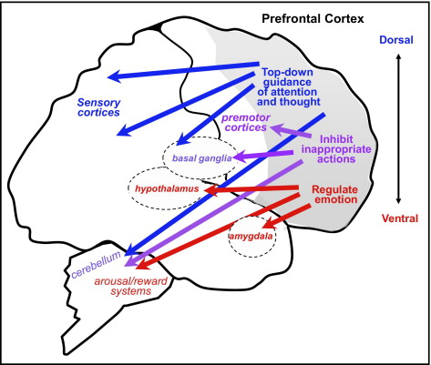
Notes:
The prefrontal cortex (PFC) regulates attention, behavior, and emotion through extensive network connections with other brain regions. Note: Dorsal regions (blue) subserve higher cognitive functions and regulate “top–down” attention through extensive projections to posterior cortical regions. In contrast, ventromedial PFC (vmPFC) regulates emotion through extensive projections to subcortical areas such as the amygdala, nucleus accumbens, and brainstem. In humans, the right inferior frontal cortex (IFC) is specialized for the inhibition of inappropropiate motor responses through projections to the basal ganglia. The PFC also has extensive connections with the cerebellar cortex via the pontine nuclei, which parallel projections through the basal ganglia. Thus, the PFC is positioned to orchestrate all aspects of behavior.
The DPFC is especially dependent on the levels of the catecholamines dopamine (DA) and norepinephrine (NE), exhibiting an “inverted U” dose-response to both modulators. Depletion of catecholamines from this region of PFC is as devastating as removing the cortex itself. Similarly, blockade of D1 or alpha-2 receptors in PFC impairs PFC function. NE stimulation of post-synaptic, alpha-2A adrenoceptors on PFC pyramidal cell spines is critical for strengthening appropriate PFC network connections (increasing “signals”), whereas DA D1 stimula tion on a separate set of spines is important for shunting inappropriate network connections (decreasing “noise”). The optimal level of D1 receptor stimulation varies according to task demands, e.g., moderate levels of D1 receptor stimulation are helpful for focused memory and attention, but can be harmful to attentional set-shifting or insight solutions when widespread network inputs may be needed. Thus, medications such as stimulants that increase DA actions may be helpful for some cognitive tasks (e.g., mathematics homework) but interfere with others (e.g., music composition). All PFC functions are impaired by very high levels of DA and NE release—as occurs during stress—through D1 and alpha-1 receptor stimulation, respectively. Under these conditions, all PFC networks disconnect and cell firing is suppressed.
There have been fewer studies of catecholamine actions in other regions of PFC. Emerging data indicate that NE has beneficial effects on ventrolateral and OFC function as well; e.g., stimulation of alpha-2A receptors with guanfacine improves the performance of motor and emotional regulation tasks that depend on these PFC regions. Atomoxetine, a selective noradrenaline transporter inhibitor, has been shown to enhance the activity and inhibitory functions of the right IFC in healthy adults.¹⁴ DA appears to have a complex influence on OFC function; these data are still emerging. A detailed discussion is provided by Robbins and Arnsten.¹¹

Slide 35
ADHD RELATED DISORDERS
COMORBIDITES
Disorders associated with ADHD: Anxiety, Tourettes, OCD
Lots of co-morbidities though: LDs, MOOD, OCD ODD, DEPRESSION,*SUBSTANCE ABUSE
Multiple genes implicated-subtypes*****
Not clear what are mediating, shared underlying biogenetics or causative factors

Slide 36
ADHD
Untreated ADHD may lead to comorbid diagnoses later in life
PALS (pittsburg ADHD longitudinal study) (sibley, et al 2012) found that period of increased risk for new psychopathology was most limited to adolescence
Did not indicate that ADHD subjects were not worse off than controls
Elevated dysfunction in adulthood reflected persistence of malfunction that had its onset in adolescence.

Slide 37
ADHD in Adulthood
https://youtu.be/Am-XbS0y0hE:
Inattention and Avoidance
task avoidance, mimics anxiety
not opening mail, paying bills, ADL’s, usually disorganized home
poor credit
chronically late
avoids social gatherings (poor auditory processing/discrimination)
forgetful
highly remorseful

Slide 38
ADHD Core Symptoms in ADULTS
Hyperactivity and Impulsivity
A subjective sense of restlessness-needs a job moving around and
Manual/physically engaging jobs over desk job
Low level of repetition (often first responders, athletes, sales, real estate)
Frequent speeding tickets, car accidents
Poor spending habits
New “interests” hobbies frequently

Slide 39
ADHD Core Symptoms in ADULTS
Executive Functioning no longer considered core
Temperament-the Hunter, not the Gatherer
Reward system-Dopamine driven
Alerting system-Norepinephrine driven
Functional changes due to technology-at least exacerbates

Slide 40
ADULT ADHD Issues
RISKS FOR Adults with ADHD
DIVORCES/Unstable relationships
POOR PARENTING/difficult parent-child communication
LOW PAY/LOWER SES
LESS EDUCATION-more drop outs
MORE JOBS LOST/CHANGES
DOMESTIC VIOLENCE
SUBSTANCE ABUSE
LEGAL ISSUES
EARLIER MORTALITY-HEALTH/CAR ACCIDENTS

Slide 41
ADHD Symptom Manifestation by Age
CHILDHOOD | ADOLESCENCE | ADULTHOOD
Hyperactivity | Easily distracted, inattentive | Inattentiveness
Low frustration tolerance | Easily bored | Poor organization of time/money
Aggression | Impatient | Missing deadlines or appointments
Easily distracted | Emotionally immature compared to peers | Poor bill tracking
Difficulty developing routines | Shifts activities | Restlessness
Impulsiveness | Poor driving | Emotional reactivity
Wasserstein. JCLP 2005. Wilens et al. Ann Rev Psychiatry 1999. Millstein et al. J Atten Disord 1997.
Copyright © 2006 Neuroscience Education Institute. All rights reserved.
Notes:
Some specific symptoms of ADHD by age are shown here.
in general, younger patients are more likely to display hyperactive and impulsive symptoms than adults.
In childhood, symptoms of ADHD may manifest as low frustration tolerance and aggression.
Children with ADHD may be easily distracted and have difficulty developing routines such as regular homework time or bedtime rituals.
In adolescence, symptoms may remain the same but manifest differently, or symptoms may begin to change at this stage with hyperactivity lessening. Symptoms may be exhibited in adolescence by poor driving (distraction), and it may become apparent that these patients are emotionally immature compared to their peers.
In adulthood, inattentive symptoms generally predominate, and may manifest as missed appointments or deadlines, poor organization of time and money, and poor bill tracking.

Slide 42
ADHD according to the patient
“worry-tasking”
your patient leaving to buy groceries:
“dont forget to lock the door, dont forget to grab your keys, do you have your phone? did you feed the dog? did you call your doctor back? you forgot milk last time you left. did you lock your notes? you got a snarky email last time you forgot. DONT FORGET! you are smarter than this. if you dont lock your notes your going to get fired. I know I am good at my job, why do I feel like such an imposter? My teachers always told me I was smart but acted stupid.”
BANG! they just backed into a parked car.

Slide 43
ADHD according to the patient
“worry-tasking”
your patient, appropriately medicated:
“I know I will make the right decision. I will remember everything I need to do today and get it done.”
OH LOOK A CAR! (accident avoided)
Quieting the anxiety of forgetfulness is key to helping your patients be mindful, present and successful.

Slide 44
ADHD Treatment
Continuity of treatment across the lifespan key factor in positive outcomes
Many patients lost to follow up at transitional age from adolescence to adulthood
According to NCS, only 10.9% of adults with ADHD in the US were obtaining treatment, though 40% sought out treatment within the last year (THIS IS NUTS TO ME)
Chart review found 1.2% young adults (20-44) received treatment for ADHD, 18% of the treatment rate for children with ADHD (should be 30-50% adjusted)

Slide 45
ADHD: Interventions
ADHD clip 2 (http://youtu.be/Ka59V4TFefM)
Cognitive behavioral techniques
Clear limits with clear consequences
Predictable environment with decreased stimuli
Establish eye contact before giving directions; ask to repeat what was heard
Encourage child to do homework in a quiet place
Encourage one assignment at a time
Notes:
ADHD treatment includes using Cognitive behavioral techniques and medications
CBT’s include clear consequences and expectations
Predictable environment, quiet with limited distractions
Encourage child to do homework in a quiet place
Encourage one assignment at a time
The primary pharmacologic interventions for ADHD are Stimulant medications that fall in to two categories: methyphenidate products and mixed-amphetamine products
Non-stimulant medications can also be used, including alpha agonists and anti-depressants with norepinepherine.
Any intervention other than stimulant medication has been repeatedly found in the literature to be not effective first line

Slide 46
ADHD medications
Mimic or enhance catecholamine transmission in PFC
NE make signal strength stronger
Dopamine opens transmission channels
MPH and Atom: blocks reuptake of DA and NE
Amph: Displaces and disrupts reuptake of DA and NE
AA: acts as a post-synaptic GLU receptor agonist (closes doors) making signal strength stronger and more efficient
Notes:
D and NE modulate glutamate

Slide 47
ADHD Medication
Screen for contraindicating medical conditions (cardiac, hyperthyroidism, glaucoma, COVID-19)
Screen for substance abuse (tox screens)
Co-morbid conditions (SA, Mood DO, Anxiety) that have serious acuity-TREAT FIRST

Slide 48
ADHD medications
Non-Stimulant medications:
Alpha-agonists: Tenex/Intuniv, Clondine/Kapvay
Wellbutrin
Strattera
Stimulant medications:
Methylphenidate: Ritalin, Ritalin LA, Concerta, Focalin, Quivilant
Mixed Amphetamines: Adderall, Adderall XR, Vyvanse
Understand functional and social demands, tailor medication to address patient needs
Notes:
ADHD handout

Slide 49
ADHD Treatment: Medications
NICE (2018) guidelines recommend pharmacotherapy as first line treatment for adult ADHD
Effect size for medication response across lifespan likely due to dosing regimens applied in clinical trials
Doses around 1mg/kg for MPH corroatled with better efficacy for Adult ADHD, but rarely achieved in studies.
Higher doses related to best efficacy
30% patients do not respond to currently available treatments

Slide 50
MEDICATIONS: STIMULANTS
ALL FAIRLY EQUAL IN EFFECTIVENESS (depending on dx or subclinical comorbidities)
USUALLY START W/LONGER ACTING FORMS
MAY DIFFER IN RESPONSE/SES
CHOOSE BY DESIRED TIMING/CONTEXT
START WITH ANY, IF PARTIAL RESPONSE KEEP MOVING DOSE UP TO FULL IMPROVEMENT
IF NO RESPONSE, BUT NO SIGNIFICANT SES, TRY A DIFFERENT STIMULANT
****WORKS FOR ADULTS BEST TOO!!!!!!!

Slide 51
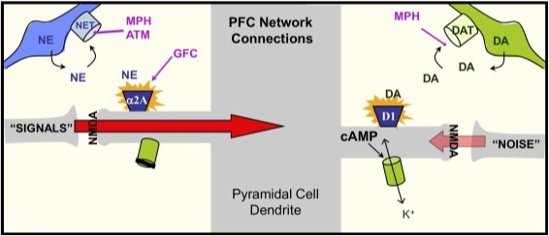
Prefrontal medication MOA
Arnsten, A. F. T., & Rubia, K. (2012). Neurobiological circuts regulating attention, cognitive control, motivation and emotion: Disruptions in neurodevelopmental psychiatric disorders. Journal of the American Academy of Child & Adolescent Psychiatry, 51(4), 356-367.
Notes:
FIGURE 3. Working model of catecholamine actions on prefrontal cortex (PFC) circuits at the molecular level. Note: The top–down regulatory abilities of the PFC depend on networks of pyramidal cells that excite each other through N-methyl-d-aspartate (NMDA) glutamate synaptic connections on dendritic spines, schematically shown in this figure. The catecholamines norepinephrine (NE) and dopamine (DA) have powerful and dynamic influences on the functional strength of network synapses. By increasing or decreasing cyclic adenosine monophosphate (cAMP) signaling, they alter the open state of ion channels on the spine and determine whether a network input is able to get through to reach the cell body. NE engagement of α_{2A} receptors on spines inhibits cAMP production, closes nearby potassium channels, and increases the strength of network connections. Conversely, moderate levels of DA engaging D₁ receptors on a different set of spines can gate out inappropriate network inputs via increased production of cAMP. However, high levels of cAMP production during stress disconnect all network inputs and shut off cell firing. These stress effects may arise from excessive DA D₁, and possibly NE β₁, receptor stimulation. Attention-deficit/hyperactivity disorder (ADHD) medications likely have some of their therapeutic effects by enhancing catecholamine actions in PFC. Stimulant medications such as methylphenidate (MPH) and the nonstimulant medication, atomoxetine (ATM) all block the NE transporter (NET); stimulants also block the DA transporter (DAT). Animal studies show that these agents can improve PFC function by indirectly increasing NE and DA stimulation of the α_{2A} and D₁ receptors, respectively. However, excessive doses of these medications impair PFC function. In contrast, the α_{2A} agonist guanfacine (GFC) appears to have therapeutic effects by mimicking NE at postsynaptic α_{2A} receptors on spines, thereby strengthening PFC network connections.

Slide 52
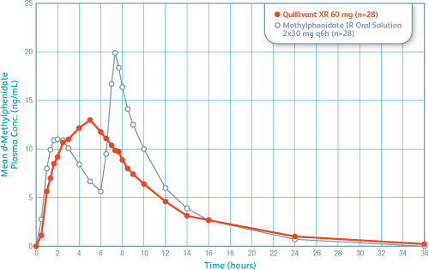
Know your pharmacokinetics!

Slide 53
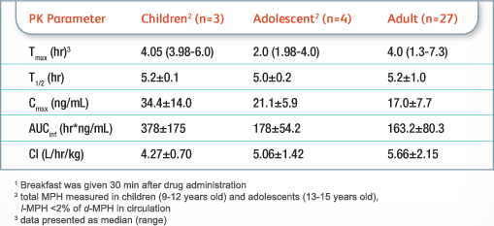
Know your pharmacokinetics!

Slide 54
ADHD MEDICATIONS: NON-STIMULANT MEDS for ADHD
A) Alpha - 2 Agonists /NE AGONISTS 1) Clonidine (Catapres*) 2) Guanfacine (Tenex*)
CAN USE W/STIMULANTS, GOOD W/TRAUMA
B) Atomoxetine (Strattera)-NE REUPTAKE INHIBITOR
DOSED BY WEIGHT, GOOD W/CO-MORBID ANXIETY/SUBSTANCE ABUSE
CAN USE W/STIMULANT
C) OTHER MEDICATIONS Bupropion (Wellbutrin*)-300-450XL Venlafaxine (Effexor*
Provigil/Nuvigil TCAs

Slide 55
ADHD medication: a graph
Strategies for coverage

Slide 56
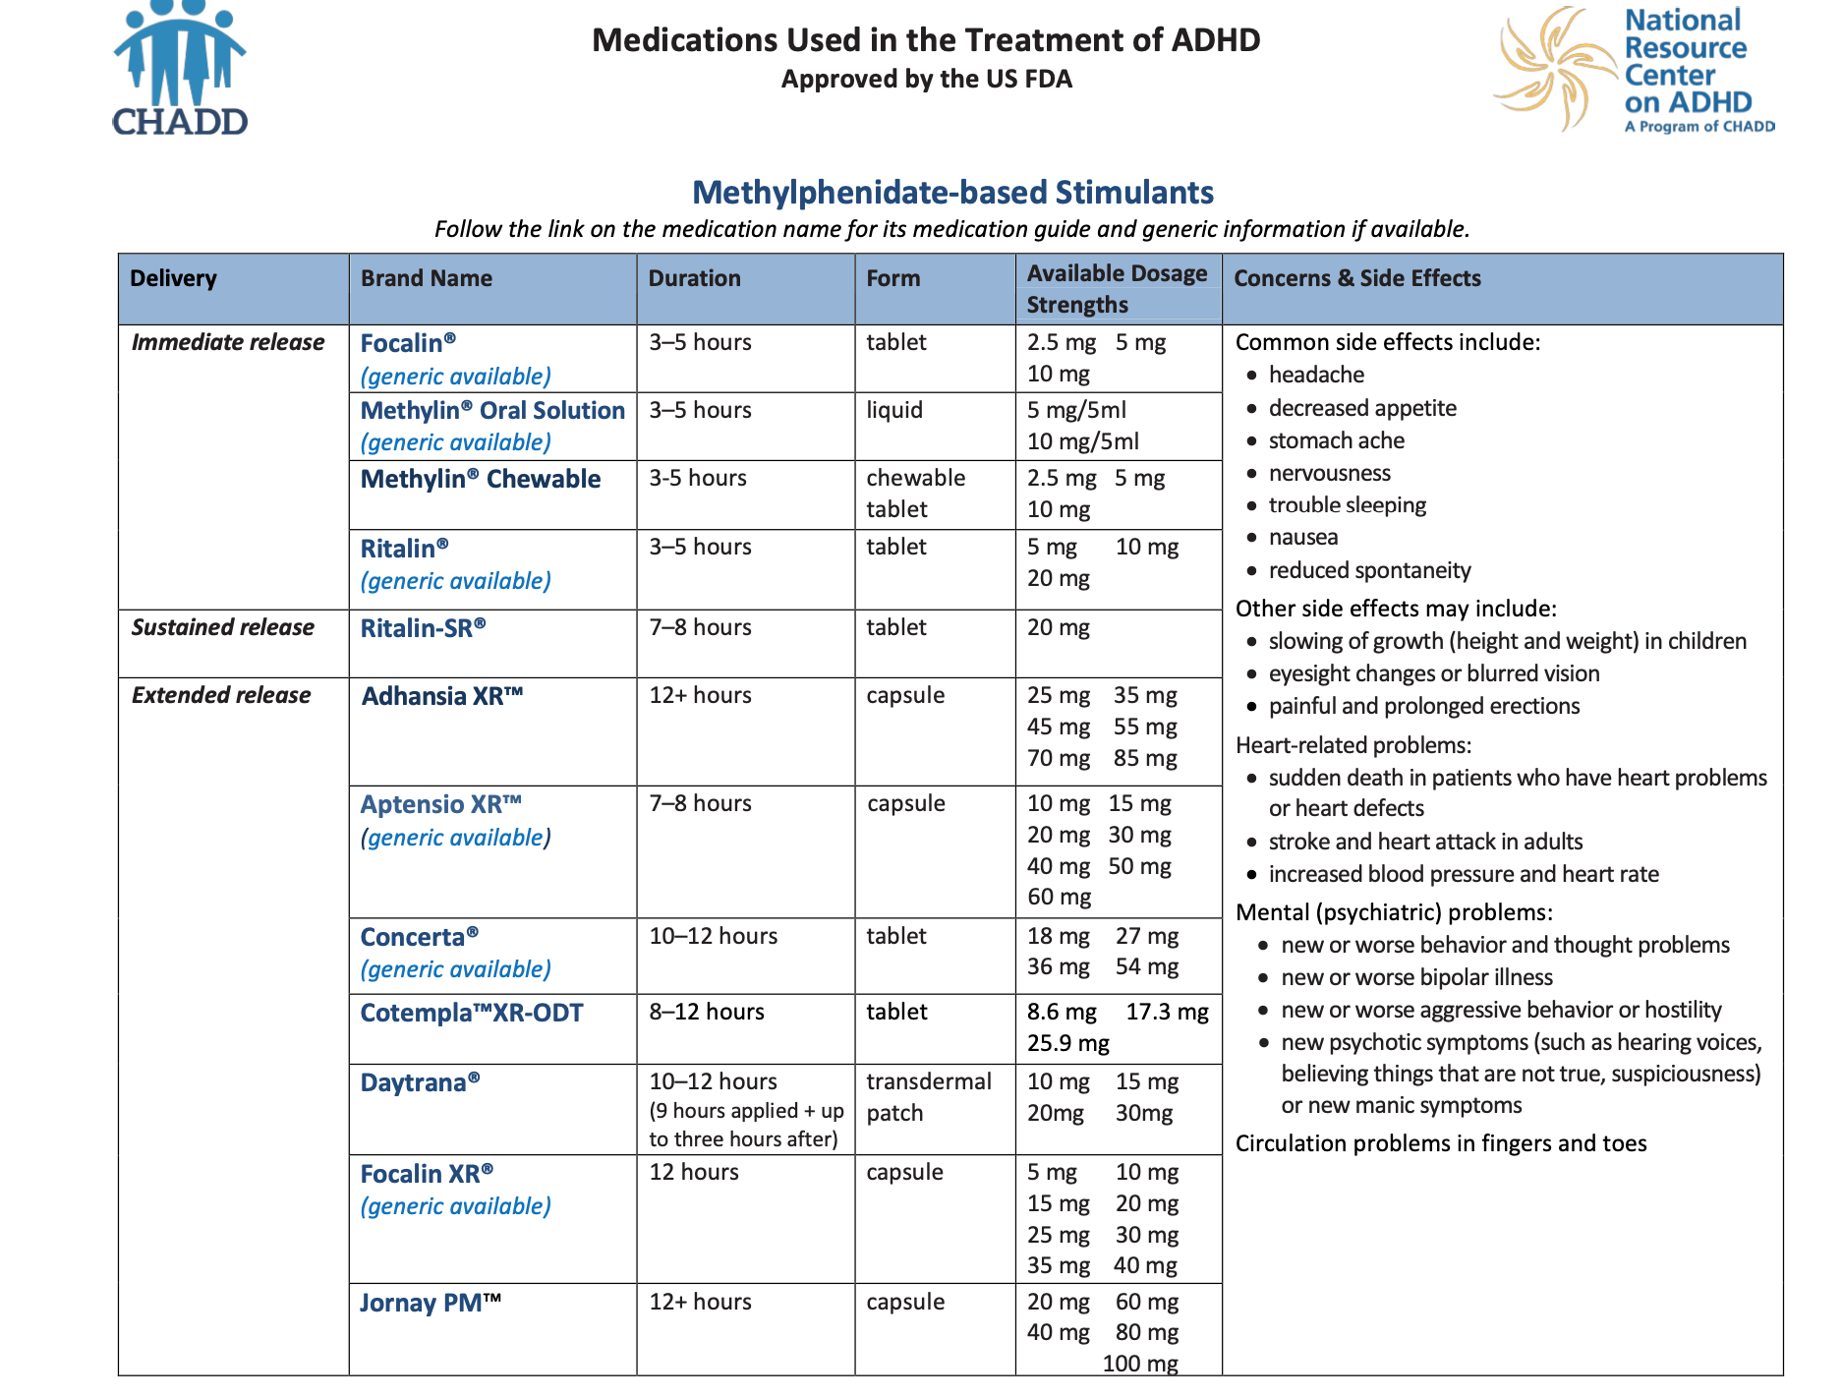
Type to enter a caption.

Slide 57
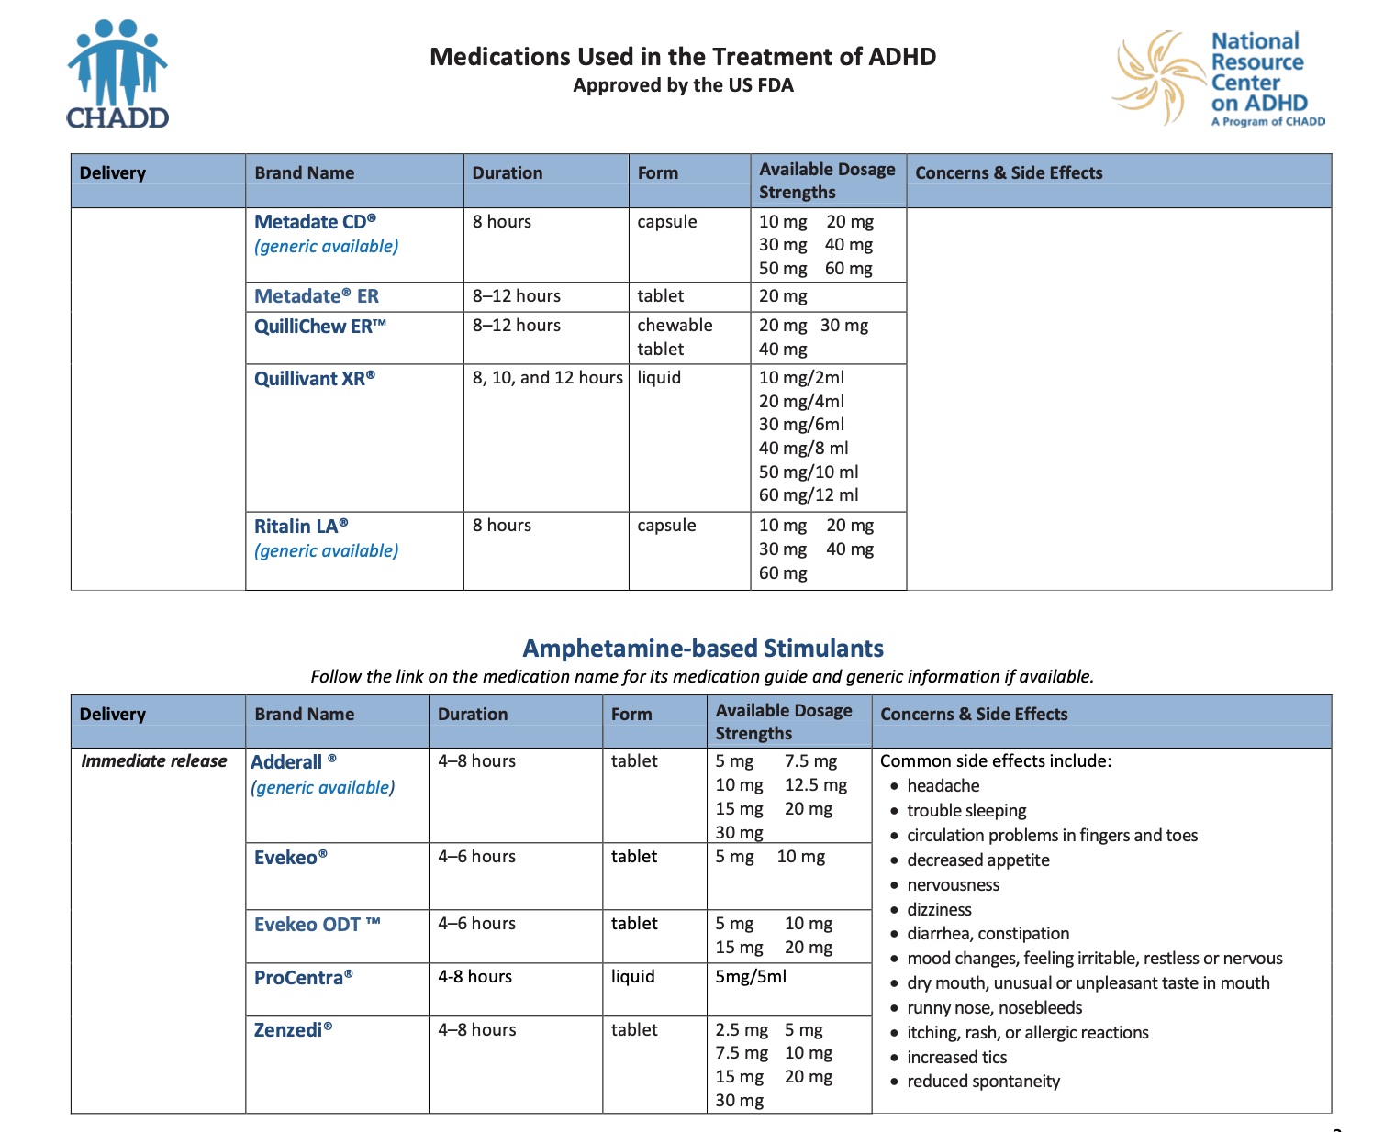
Type to enter a caption.

Slide 58
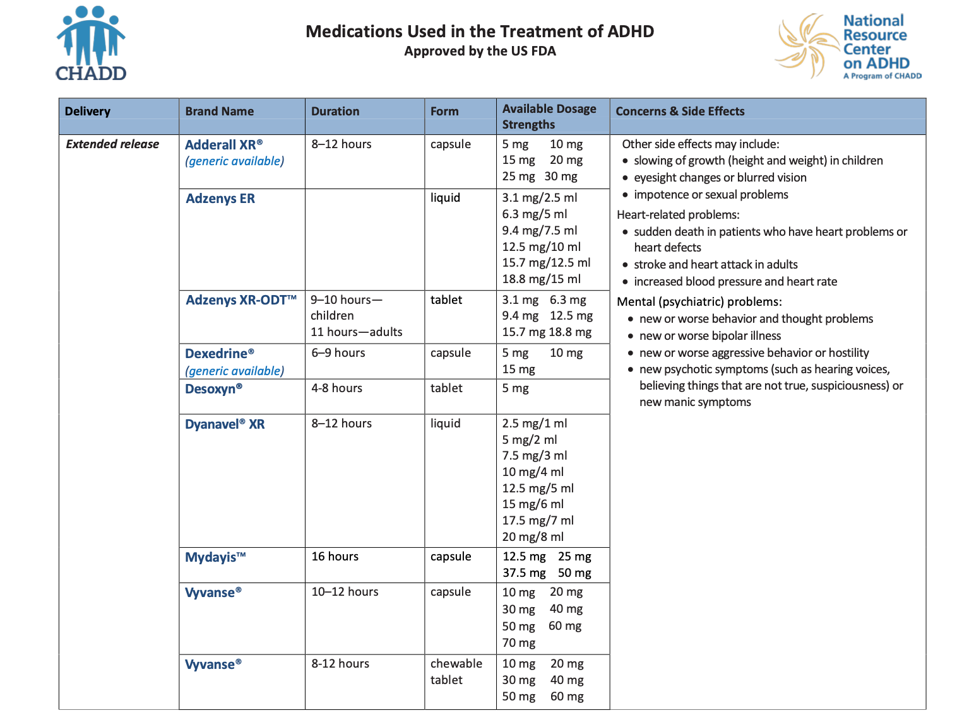
Type to enter a caption.

Slide 59
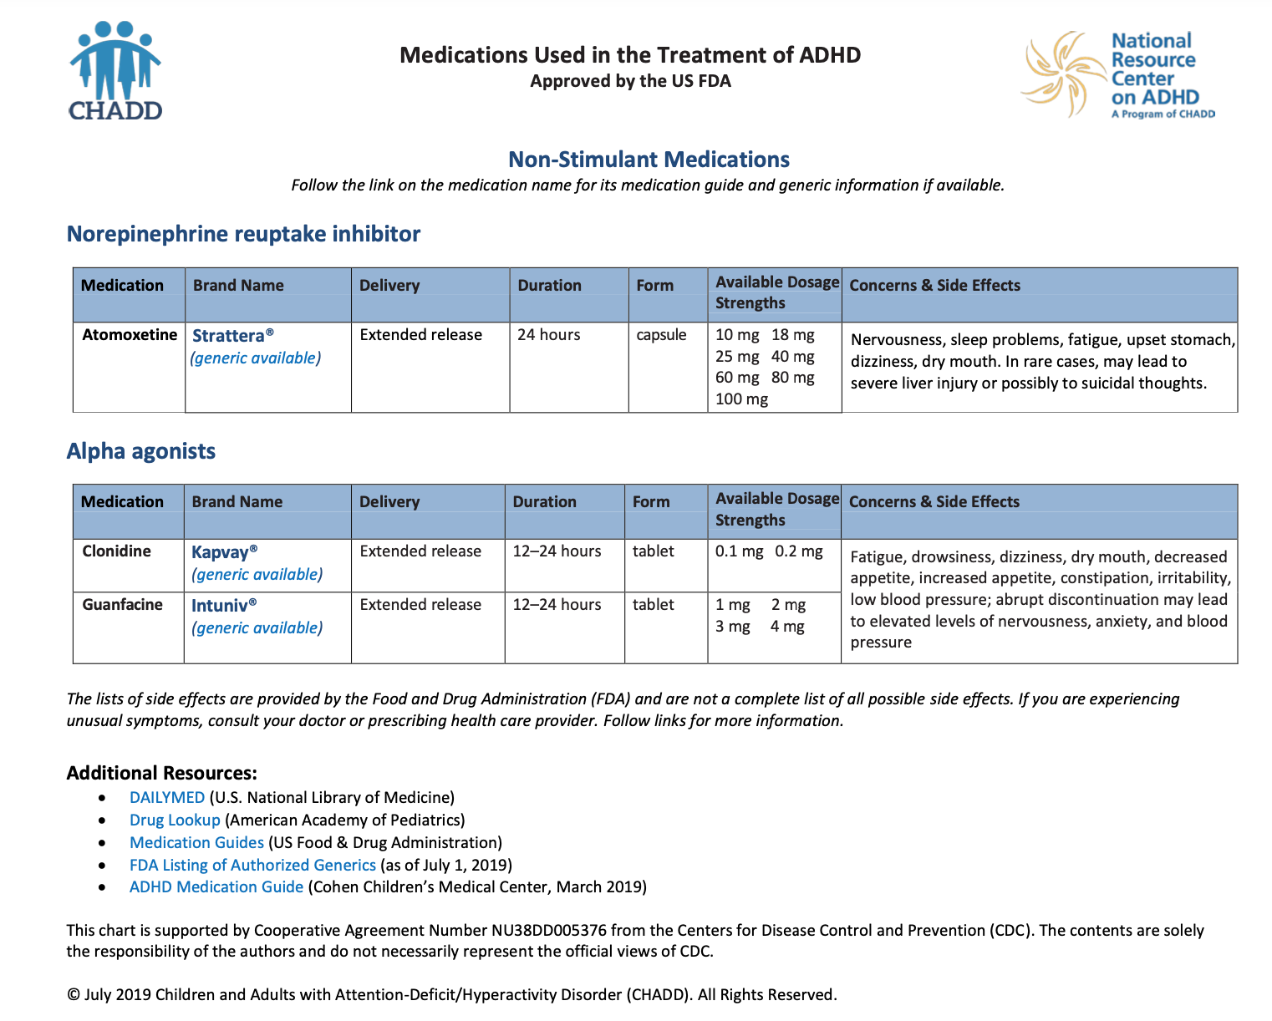
Type to enter a caption.

Slide 60
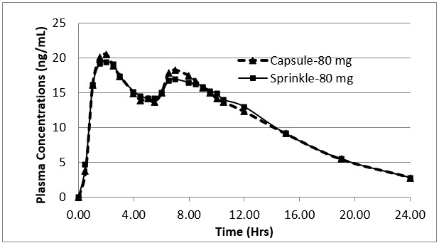
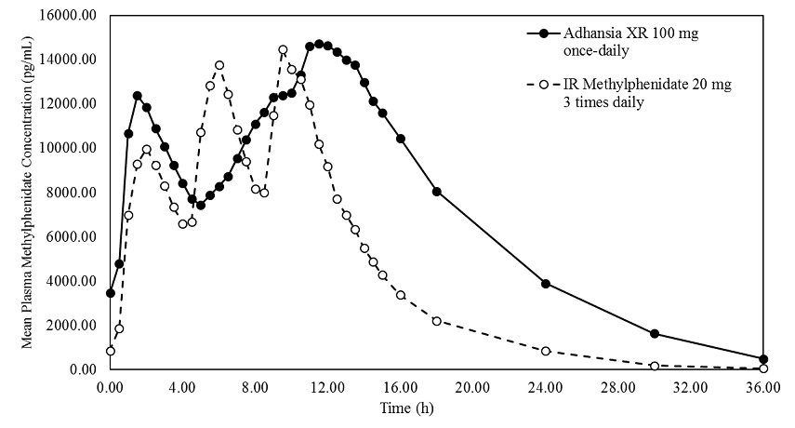
Adhansia XR
(Methylphenidate HCl)
Aptensio XR
(Methylphenidate HCl)
25mg- 85mg capsule
20/80 release
+/- 16 hr coverage
10-60mg capsules
40/60 release
+/- 12hr coverage

Slide 61
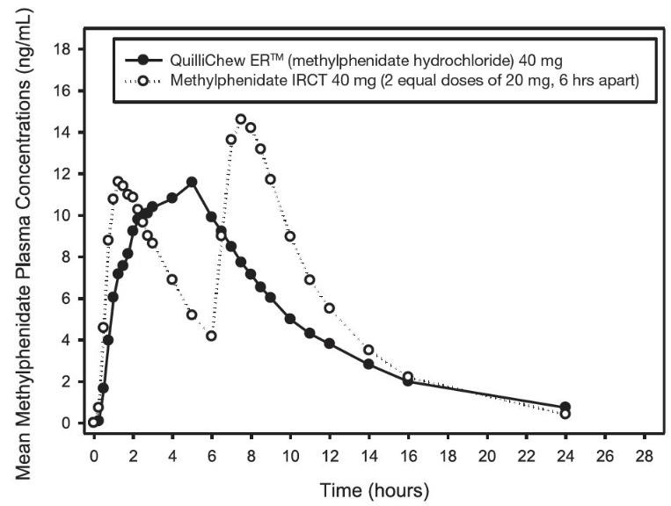
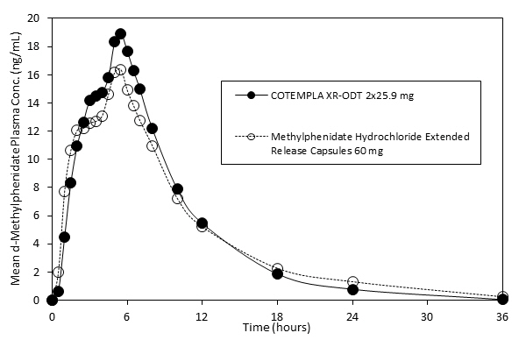
Cotempla XR ODT
(Methylphenidate)
Quilichew ER
(Methylphenidate Hcl)
8.6mg, 17.3mg, 25.9mg (dissolvable)
25/75 release
8-12hr coverage
20mg, 30mg, 40mg (chewable)
30/70 release
8-12 hr coverage

Slide 62
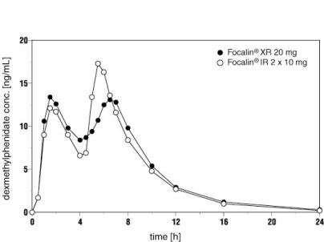
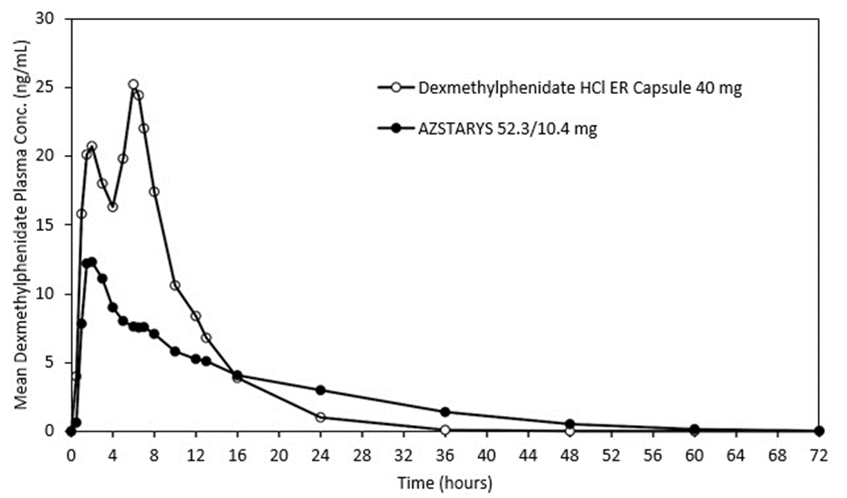
Focalin XR
(dexmethylphenidate HCL)
Azstarys
(serdexmethlyphenidate +dexmph)
5mg-40mg (capsule)
50/50 release
+/- 12hr coverage
26.1/5.2mg, 39.2/7.8mg, 52.3/10.4mg capsule
30% immediate release dex+ 70% prodrug serdex
10 + hr coverage

Slide 63
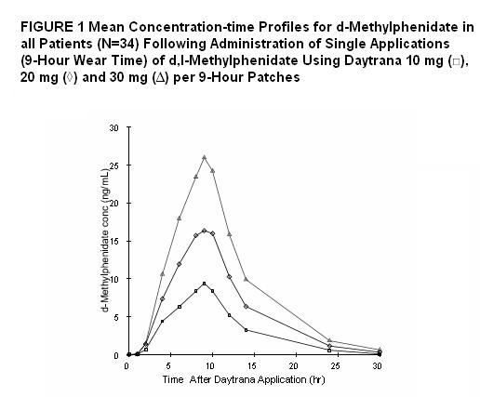
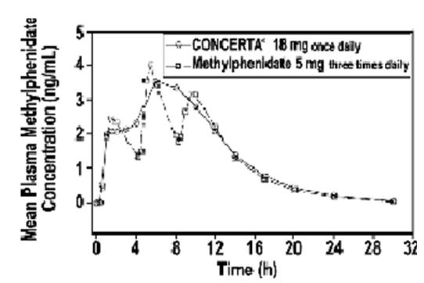
Concerta
(Methylphenidate Hcl)
Daytrana
(Methylphenidate)
18-54mg (tablet)
osmotically active trilayer core surrounded by a semipermeable membrane with an immediate-release drug overcoat
10 hr coverage?
10mg, 15mg, 20mg, 30mg (transdermal patch)
10-16hr coverage (4 hours from when you remove)

Slide 64
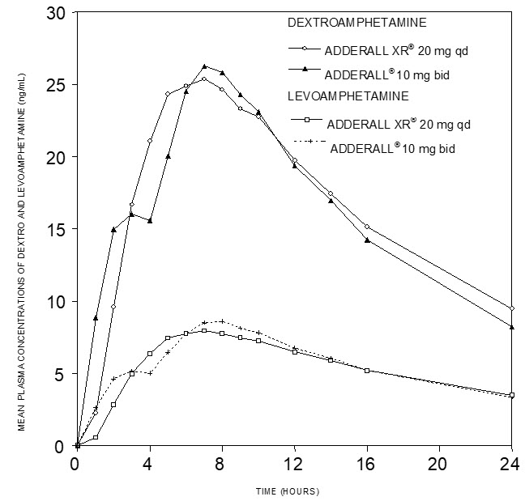
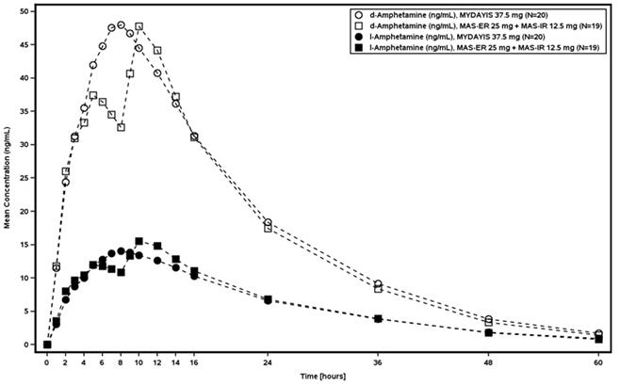
Adderall XR
(mixed amphetamine and d-amph)
Mydayis
(mixed amph and d-amph)
5-30mg (Capsules)
50/50 release
d-amphetamine and l-amphetamine salts in the ratio of 3:1.
+/- 8 hours
12.5mg, 25mg, 37.5mg, 50mg (capsule)
d-amphetamine and l-amphetamine salts in ratio of 3:1.
three types of beads, an immediate release and two delayed release beads, releasing at pH 5.5 and pH 7.0
+/- 16 hours

Slide 65
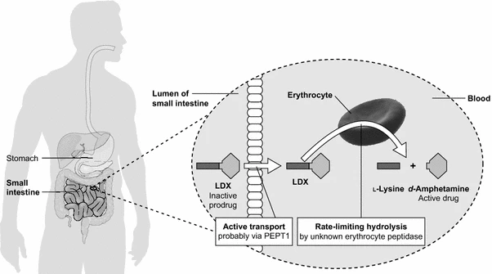
Adzenys XR
(amphetamine only)
Vyvanse
(lisdexafeamine)
5-30mg OTD or 3.1-18.8mg liquid
50/50 release
+/- 9-12 hr coverage
10mg-70mg capsules and chewable tablets
Lisdexamfetamine is converted to dextroamphetamine and l-lysine primarily in blood due to the hydrolytic activity of red blood cells after oral administration
Systemic delivery of d-amphetamine by hydrolysis of LDX in the blood. LDX lisdexamfetamine dimesylate, PEPT1 peptide transporter 1

Slide 66
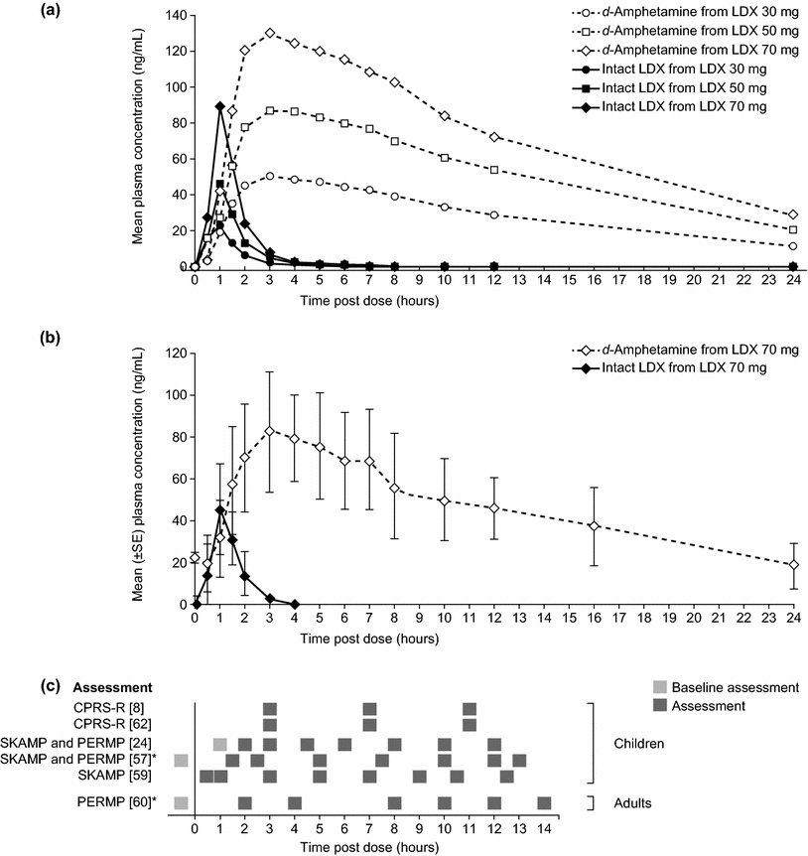
Vyvanse (lisdexafetamine)
Difference in plasma concentration between intact LDX and d-amph
?patients only “feeling” the intact LDX and not benefiting from d-amph alone?
https://doi.org/10.1007/s40261-015-0354-y
https://dailymed.nlm.nih.gov/

Slide 67
Long Term Treatment
ADHD is a chronic condition for which there is no cure; many deficits will remain
Emphasize strengths
Provide hope
Empower the patient

Slide 68
ADHD Treatment for Adults
Full life-assessment: work, relationships, substance use, legal issues, general functioning, self-concept, style of communication, values, goals, early life, beliefs
Medication: stimulants, alpha agonists, strattera, wellbutrin, effexor-what works/what fits/what needs are for coverage
Most stimulants diverted for functional purposes, not getting high*******
CBT
IFP
Marital/couples counseling
Parenting skills

Slide 69
ADHD Treatment for Adults
PREGNANCY: little data to suggest harm to fetus. Only studies on stimulants come from cocaine and methamphetamine abuse, so normal use has not been found to be problematic at this time. HOWEVER-a risk/benefit analysis should be done and the dosing of the medication should be at the lowest possible level, at the time of necessity.
SUBSTANCE ABUSE: using formulations that are less abusable: long-acting, unable to snort. VYVANSE or CONCERTA for stimulants. Strattera or Wellbutrin may have additional benefits.

Slide 70
ADHD medications- Side Effects
Appetite suppression
Anxiety
Depression
Bruxism
Growth delay
picking/dermatilliomania
Notes:
new data from MTA 12 year follow up noting persistent height average of 1 inch shorter

Slide 71
ADHD: Medication strategies
Start MPH or AMPH depending on subthreshold/diagnostic comorbidities, lifestyle demands
Assess for LOA, SE
Modify dose, augment based on remaining symptoms
Impulsivity and irritability remain but focused? Guanfacine
Focused but anxious? SSRI
Sleep delay but dosing meds appropriately? Clonidine
High dose AMPH/MPH but sx remain? Guanfacine or Wellbutrin (in adults)

Slide 72
hey wait, what about marijuana?
Genetic studies have found a correlation between cannabinoid receptor gene and ADHD
ADHD pathology associated with dopaminergic symptoms
CB1 receptors interact with dopaminergic symptoms and target to reduce impulsivity and distractibility
Exocannabinoids (from outside) delta9-THC demonstrated to induce dopamine release in prefrontal cortex and ventral striatum (key structural locations of ADHD)

Slide 73
hey wait, what about marijuana?
European studies have found that controlled use of Becodran (delta9-THC) was helpful in alleviated symptoms of poor frustration tolerance, anger outbursts, boredom and concentration problems in adults with ADHD
Delta9-THC + CBD has demonstrated effectiveness for sleep
nomedical use of THC shown to keep adults with ADHD away fro more harmful subsrtances, like cocaine
Observational studies show cannabis is often a substitute for alcohol illicit drugs and commonly diverted prescription drugs.

Slide 74
SO, marijuana is cool for my patients?
not exactly.
more research is needed.
but this may explain WHY many patients with ADHD use THC and the effects it has on calming internal agitation

Slide 75
ADHD medication
Prescribing SAFETY and SAFELY
Research consistently demonstrates highest risk for medication abuse, misuse or diversion among white, male college aged young adults
Does diversion happen? Of course. Are we the stimulant police. NO.
see patients monthly, no less than every 3 months.
30 day refills for new patients,
Check PMP at every refill, controlled substance contracts, UTOX if concerned (be aware of shame)

Slide 76
Disruptive Mood Dysregulation Disorder
New to DSM-V
Created to capture pts with ADHD + mood dysregulation frequently diagnosed as pediatric bipolar disorder
Validated following research showing pts diagnosed with PBPD with mania had similar rate of sx improvement on stimulants compared to pts dx with ADHD

Slide 77
DMDD diagnostic critera
Severe and recurrent temper outbursts
Inconsistent with developmental level
Mood between outbursts is persistently irritable
3x per week, persistent for 12 months with no periods lasting more than 3 months without sx

Slide 78
DMDD: a changing diagnosis?
56% of pts on inpatient unit met criteria for mania at parent report
Of those, 46% met criteria for DMDD by parent report
But only 17% met full criteria when observed on unit.
Margulies, D. M., Weintraub, S., Basile, J., Grover, P. J. and Carlson, G. A. (2012), Will disruptive mood dysregulation disorder reduce false diagnosis of bipolar disorder in children?. Bipolar Disorders, 14: 488–496. doi: 10.1111/j.1399-5618.2012.01029.x

Slide 79
ADHD Adult Cases
CASE 1: 32yo/H/M-father of 2. Cannot keep job >6mths. Gets bored easily. Never had close friendships. Cannot finish projects/school/training. Irritable. Gets annoyed when challenged. Feels guilty he is not helping his family and has low self-esteem.
CASE 2: 32yo/W/F-mother of 3. Chronic underachiever. Grew up in home with ETOH/DV. ‘Bad temper’. No patience. Early life: ‘free spirit’, happy, always on the ‘go’. Very embarrassed about making bad choices-especially around males she has in relationships.

Slide 80
ADHD Adult Cases
CASE 3: 54yo/W/M-teacher and Coach. Fired from job for inappropriate verbal abuse to student in game (had job for 12 years). Very outspoken/hard-charging. Workaholic. ‘My way or the highway’. Ranter and Raver. Wife is constant peace-maker at home. Poor time management.
CASE 4: 61yo/Eastern-European/F-no children. Has PhD. Describes self as stubborn, bossy, impulsive, unpopular and ‘difficult’. She has chronic DFA, with trouble waking and getting going in the AM-so often late. Able to compensate for attentional drift, but not socially or in daily life skills. Often forgets to pay bills. Brilliant academically.

Slide 81
Continuing Education Credits
In support of improving patient care, Community Health Center, Inc./Weitzman Institute is jointly accredited by the Accreditation Council for Continuing Medical Education (ACCME), the Accreditation Council for Pharmacy Education (ACPE), and the American Nurses Credentialing Center (ANCC), to provide continuing education for the healthcare team.
This series is intended for post-graduate residents engaging in a year-long Residency program.
Please complete the survey on New Innovations to satisfy your continuing education credit.
A comprehensive certificate will be sent out after the end of the series, June, 2023.

Slide 82
References & Resources
CHADD
ADDitude
https://howtoadhd.com
Faraone, S.V. et al. (2015). Attention-deficit/hyperactivity disorder. Nat. Rev. Dis. Primers doi: 10.1038/nrdp.2015.20
Franke, B., Michelini, G., Asherson, P., Banaschewski, T., Bilbow, A., Buitelaar, J. K., Cormand, B., Faraone, S. V., Ginsberg, Y., Haavik, J., Kuntsi, J., Larsson, H., Lesch, K.-P., Ramos-Quiroga, J. A., Réthelyi, J. M., Ribases, M., & Reif, A. (2018). Live fast, die young? A review on the developmental trajectories of ADHD across the lifespan. European Neuropsychopharmacology, 28(10), 1059–1088. https://doi.org/10.1016/j.euroneuro.2018.08.001
Hupli, A. M. M. (2018). Medical Cannabis for Adult Attention Deficit Hyperactivity Disorder: Sociological Patient Case Report of Cannabinoid Therapeutics in Finland. Medical Cannabis and Cannabinoids, 1(2), 112–118. https://doi.org/10.1159/000495307
Posner, J., Kass, E., & Hulvershorn, L. (2014). Using Stimulants to Treat ADHD-Related Emotional Lability. Current Psychiatry Reports, 16(10), 478. https://doi.org/10.1007/s11920-014-0478-4
okoniea@chc1.com
Please reach out!

