Slide 1
Addressing the Opioid Crisis
The Challenging Behaviors of Substance Use Disorders
Addiction 101—Session 3: Challenging Behaviors of SUD | 3/21/19
Notes:
PF

Slide 2
Learning Objectives
Understand the why behind many common behaviors in substance use disorders
Be able to frame these behaviors in the context of the disease model of addiction
Identify strategies for managing challenging behaviors in a healthcare setting
Addiction 101—Session 3: Challenging Behaviors of SUD | 3/21/19
Notes:
PF

Slide 3
Cross disciplinary training challenges
Why this topic?
Addiction 101—Session 3: Challenging Behaviors of SUD | 3/21/19
Notes:
DB

Slide 4
Inadequate Training
For behavioral health providers:
While 54% of clinicians report routinely treating SUDs only 34% ever took a course on it in graduate training
Even 58% of students believe their training is lacking
For medical providers:
Only 1,200 of the estimated 1 million physicians nation wide have a certificate in addiction medicine.
Only 52 practices nationwide offer fellowships in addiction medicine
Only one medical school nationwide offers education on addiction in all four years of schooling
For nurses:
Some basic motivational interviewing skills are taught but nothing extensive and nothing specific to SUDs
For administrative staff:
Frontline staff frequently interact with patients with substance use disorders but have no training at all if not provided by their company
Addiction 101—Session 3: Challenging Behaviors of SUD | 3/21/19
Notes:
DB- BH and Admin
MB- Medical and nursing

Slide 5
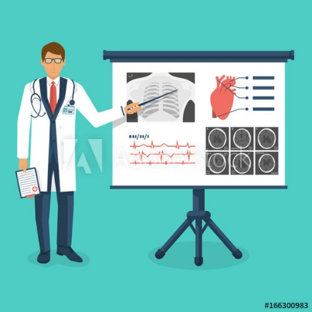
A Public Education on Addiction
In an absence of training and education, where do we learn about anything?
Media?
Personal experience?
Workforce experience?
Trusted friends and family?
What problematic lessons might we have learned?
Addiction 101—Session 3: Challenging Behaviors of SUD | 3/21/19
Notes:
DB to start conversation

Slide 6
A Self Preserving Disease Process
“Why Do Addicts ______?”
Addiction 101—Session 3: Challenging Behaviors of SUD | 3/21/19
Notes:
DB

Slide 7
A Self Preserving Disease Process
“Why Do Addicts ______?”
“Why Did This Patient______?”
Addiction 101—Session 3: Challenging Behaviors of SUD | 3/21/19
Notes:
DB

Slide 8
Reviewing the Disease Model
Addiction is like a disease in multiple different and important ways
It is a chronic relapsing condition that can be treated with medication similar to diabetes
What other chronic illnesses have dishonesty as a feature of treatment?
What other chronic illnesses have dishonesty as a feature in spite of obvious evidence against the patient’s statements?
What purpose does dishonesty serve in diabetes, hypertension, or obesity?
Addiction 101—Session 3: Challenging Behaviors of SUD | 3/21/19
Notes:
DB
What other chronic illnesses have dishonesty as a feature in spite of obvious evidence against the patient’s statements?- ask as a chat question

Slide 9
Shame
Many of the behaviors of addiction lead a person to feel ashamed
Protecting the individual from shame is another significant reason for some negative behaviors
Additional negative behaviors create additional shame
Addiction 101—Session 3: Challenging Behaviors of SUD | 3/21/19
Notes:
DB
The shame spiral

Slide 10
Dealing with Deception in Addiction
Lying
Addiction 101—Session 3: Challenging Behaviors of SUD | 3/21/19
Notes:
DB

Slide 11
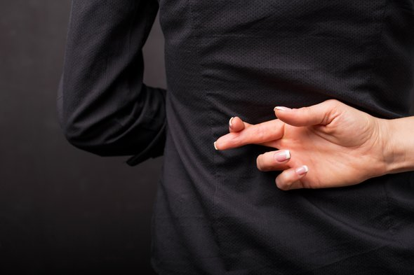
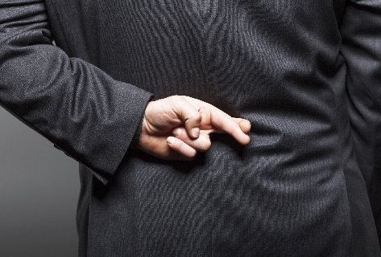
Lies
Everyone lies.
It is easy to get caught up in “Did I get fooled?” rather than the addiction itself.
Fighting about lies is a trap, but how do you respond to something you can verify is a lie?
Addiction 101—Session 3: Challenging Behaviors of SUD | 3/21/19
Notes:
DB
Everyone lies. Not just people with substance use disorders.
“In order to fool me, they first have to fool themselves.”

Slide 12
Toxicology
People lie, metabolites don’t.
Toxicology screens show us three different things:
The presence or absence of a specific metabolite
Metabolism
Time
Interpreting a toxicology report is part science and part art form
Make friends with your laboratory
Addiction 101—Session 3: Challenging Behaviors of SUD | 3/21/19
Notes:
The best tool we have in dealing with lies is toxicology.

Slide 13
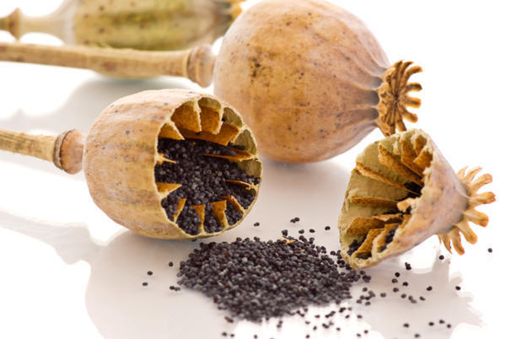
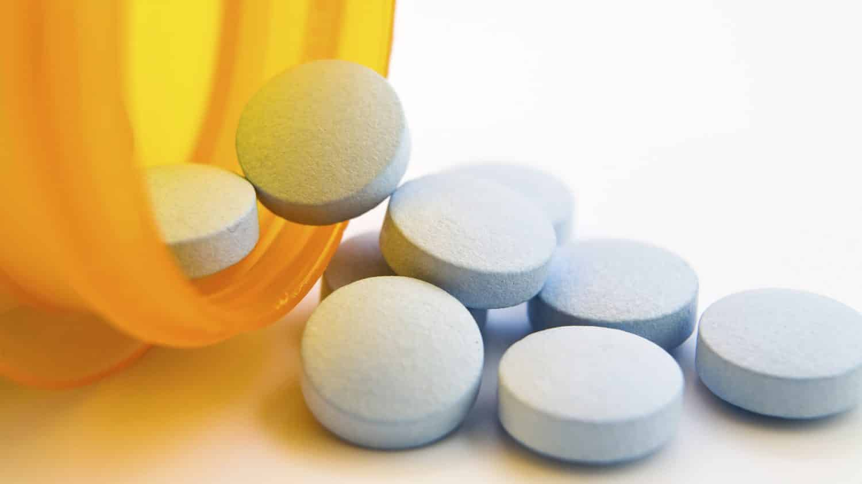
Opiates and Metabolites
Synthetic opioids, heroin, and poppy seeds all break down into numerous different metabolites.
You may also see the presence of the drug itself which has not yet fully metabolized.
Key metabolites are:
6-acetylemorphine
Morphine
Codeine
Norfentanyl
Norhydrocodone
Norhydromorphone
Noroxymorphone
Addiction 101—Session 3: Challenging Behaviors of SUD | 3/21/19
Notes:
DB
Don’t spend too much time, but emphasize short half life of 6-acetyl and what heroin typically looks like.

Slide 14
Case Study
27 year-old woman
Enrolled in a Medication Assisted Treatment
Referred to treatment by Department of Children and Families
Previous drug use
Multiple drug screens that contained high levels of codeine and morphine
Insisted that she was on a special “poppy seed diet.”
Addiction 101—Session 3: Challenging Behaviors of SUD | 3/21/19
Notes:
DB
bullet

Slide 15
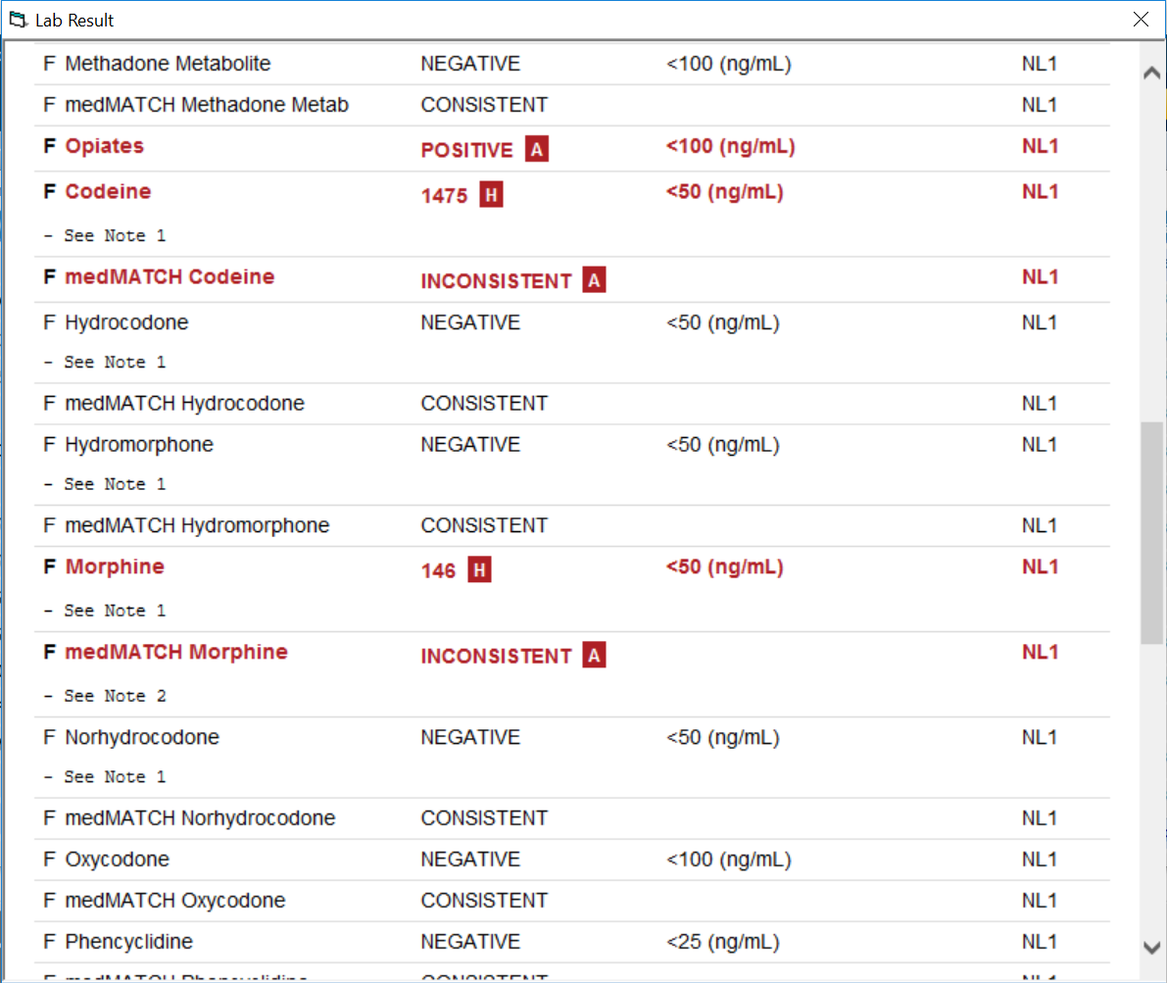
Toxicology Report
Notes:
DB
The case of the poppy seed diet.

Slide 16
How Outrage Changes a Patient’s Experience
Emotional Extremes
Addiction 101—Session 3: Challenging Behaviors of SUD | 3/21/19
Notes:
DB

Slide 17
Anger
“The low road to self-empowerment.”
Anger is a secondary emotion to fear, hurt, or embarrassment.
When someone gets angry how do you react?
Addiction 101—Session 3: Challenging Behaviors of SUD | 3/21/19
Notes:
DB
Add image

Slide 18
Case Study
49 year old man, nursing visit
Engaged in the MAT program for several years
Multiple relapses and periods of use
Most recent drug screen positive for cocaine
Denied that he had used cocaine and began yelling about the tests being wrong.
The nurse tried to discuss his drug screening but he continued to yell and stormed out.
Addiction 101—Session 3: Challenging Behaviors of SUD | 3/21/19
Notes:
DB

Slide 19
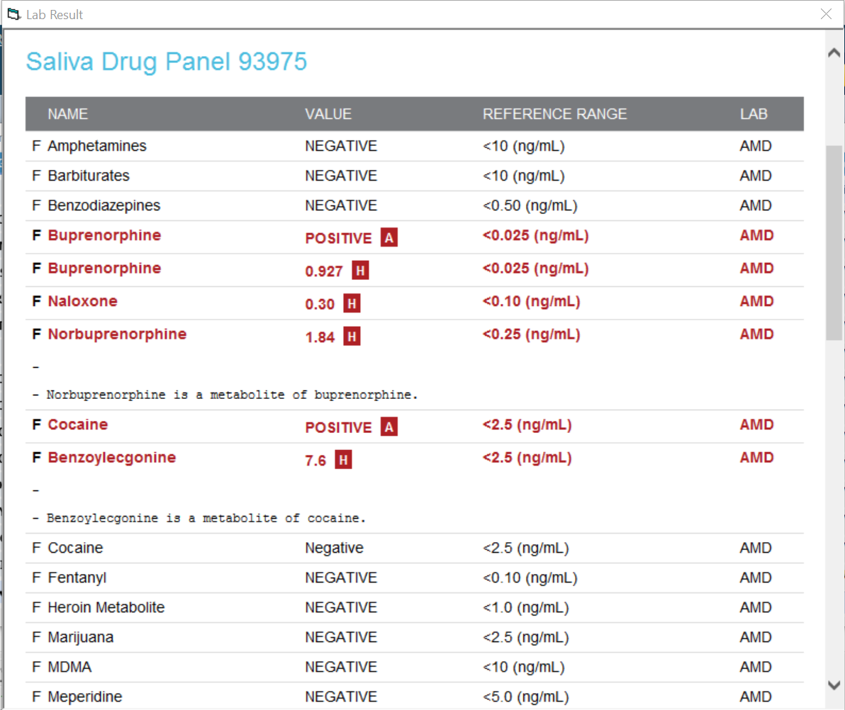
Toxicology Report
Notes:
Mention TBC

Slide 20
How Not to Get Divided
Splitting
Addiction 101—Session 3: Challenging Behaviors of SUD | 3/21/19
Notes:
DB

Slide 21
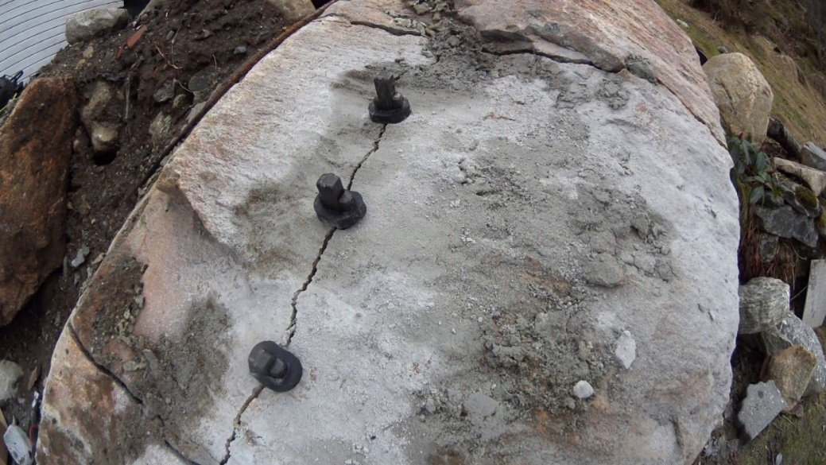
What is Splitting?
How well do you and your teams communicate?
How well do you communicate across disciplines?
If you have an integrated EHR, do you always check the documentation of other providers before seeing a patient?
Addiction 101—Session 3: Challenging Behaviors of SUD | 3/21/19
Notes:
DB (picture of splitting granite)
POLL
If you have an integrated EHR, do you always check the documentation of other providers before seeing a patient?

Slide 22
Case Study
24 year old man, Enrolled in MAT program.
Referred to behavioral health group, started on buprenorphine by his PCP.
Struggled with continuing to use opioids, not using his buprenorphine as prescribed.
BH provider recommended a higher level of care and patient stated he would do so.
Several weeks went by with patient stating that he was making efforts to get into a higher level of care to his BH provider and nurse, attending group less and less often, all while telling his prescriber that he was continuing to attend group regularly.
Addiction 101—Session 3: Challenging Behaviors of SUD | 3/21/19

Slide 23
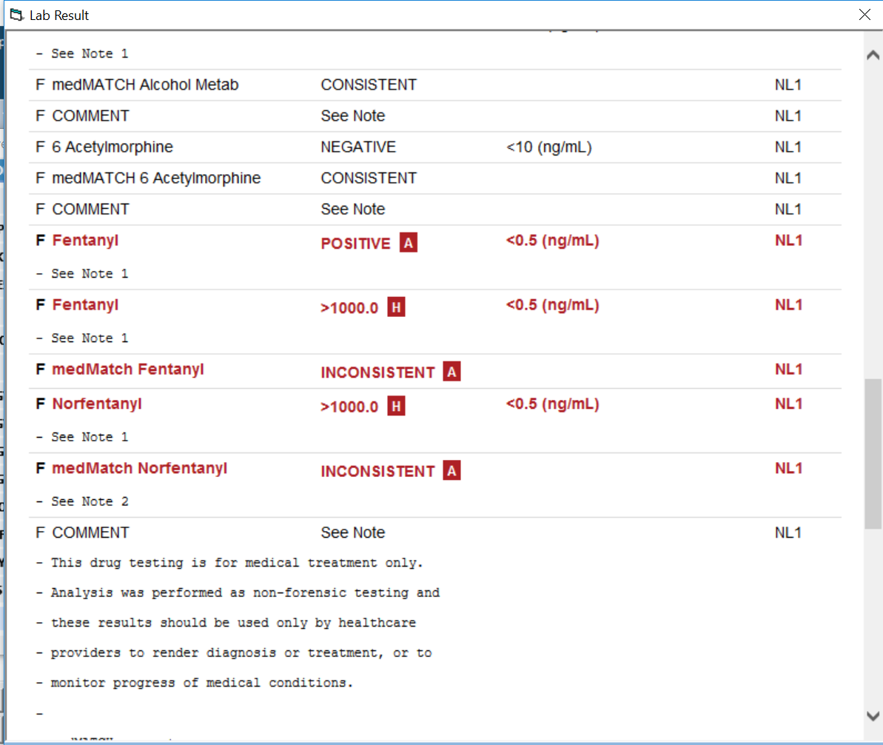
Toxicology Report

Slide 24
Case Study
A patient is seeing his provider for the first time after asking for MAT through the program’s care coordinators. When patient meets with the provider he discusses his use and his desire to get and stay abstinent from opioids. The provider informs him that we will do a UDS and consult as a team and then tries to set up a follow up appointment for the patient. The patient becomes panicked and insists that he was promised he would be able to start on MAT today by the care coordinator.
Addiction 101—Session 3: Challenging Behaviors of SUD | 3/21/19

Slide 25
Professional Boundaries
Addiction 101—Session 3: Challenging Behaviors of SUD | 3/21/19
Notes:
DB

Slide 26
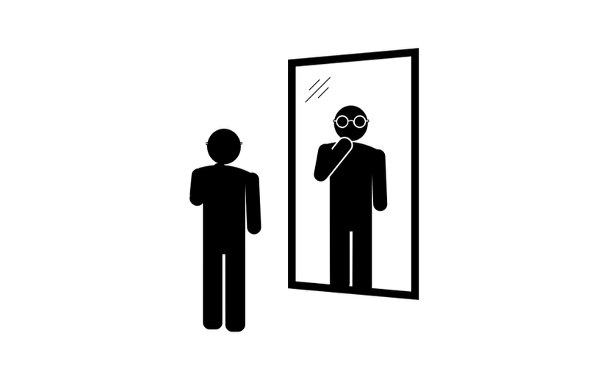
Personal Insight
How do we know when we’re being our best selves?
How about when we’re not?
Do we know when we need to ask for help?
Boundaries are important in all contexts, but addiction may press our buttons easier and more quickly
Addiction 101—Session 3: Challenging Behaviors of SUD | 3/21/19
Notes:
DB

Slide 27
Sustainability
Feedback as a part of your work culture
Address issues quickly and on an on-going basis
Debriefs and hotwashes
Addiction 101—Session 3: Challenging Behaviors of SUD | 3/21/19

Slide 28
Criteria for Discharge
Sometimes these behaviors end up warranting discharge from care.
What warrants discharge from MAT and warrants discharge from a practice?
How do we make sure we’re making this choice based on the patients behavior and not our feelings about it?
Addiction 101—Session 3: Challenging Behaviors of SUD | 3/21/19

Slide 29
QUESTIONS?
Addiction 101—Session 3: Challenging Behaviors of SUD | 3/21/19

