Slide 1

Rheumatology:
A focus on outpatient primary care evaluation and management of commonly encountered issues
Dan Wilensky MD
Chief Preceptor
2021-2022

Slide 2
Continuing Education Credits
In support of improving patient care, Community Health Center, Inc./Weitzman Institute is jointly accredited by the Accreditation Council for Continuing Medical Education (ACCME), the Accreditation Council for Pharmacy Education (ACPE), and the American Nurses Credentialing Center (ANCC), to provide continuing education for the healthcare team.
This series is intended for Nurse Practitioner Residents.
Please complete the survey – linked in the chat, and emailed to all attendees – to request your continuing education credit.
A comprehensive certificate will be sent out after the end of the series, June 2022.

Slide 3
Learning Objectives –
By the end of this didactic, the NP resident will be able to:
Improve our understanding of when to consider Rheumatologic conditions
Recognize that initial workup and treatment often falls to primary care, especially in FQHCs
Learn to order (and interpret) tests wisely so we don’t go down too many rabbit holes.

Slide 4
What we’ll review today
Approach to joint pain
Seronegative Spondyloarthropathies
Rheumatoid Arthritis (RA)
Sjogren’s Syndrome (SS)
Polymyalgia Rheumatica (PMR)
Rheum Review of Systems
Henoch-Schonlein Purpura (HSP)
Scleroderma
Lab issues (ANA, etc.)
Lupus (SLE)
Psoriatic Arthritis (PsA)
Giant Cell Arteritis(GCA/TA)
Gout
Juvenile Rheumatoid Arthritis (JRA/JIA)

Slide 5
Rheumatology is too big for one didactic unless we leave out a bunch of things
Hepatic issues
  Autoimmune hepatitis (AIH)
  Primary biliary cholangitis/cirrhosis (PBC)
Vasculitides (ANCA stuff)
Fibromyalgia
Pain management issues
Osteoarthritis
Uncommon/Rare diagnoses
**Essentially, we’re going to leave out anything that’s not a profoundly inflammatory condition that you are likely to see in your careers
**Pediatric Rheumatology will be shortchanged
--Less common
--I’m not really comfortable teaching it

Slide 6
Disclosure
With respect to the following presentation, there has been no relevant (direct or indirect) financial relationship between the party list above (or spouse/partner) and any for-profit company in the past 24 months which could be considered a conflict of interest.
The views expressed in this presentation are those of the presenter and do not reflect the official policy of CHC, Inc.
I am obligated to disclose any products which are off-label, unlabeled, experimental, and/or investigation (not FDA approved) and any limitations on the information that I present, such as data that are preliminary or that represent ongoing research, interim analyses, and/or unsupported opinion.

Slide 7
Joint Pain
This is the approach as presented in ConferMED ECHO-Rheumatology series

Slide 8
Abbreviations in these slides
PsA: Psoriatic Arthritis
AS: Ankylosing Spondylitis.
CPPD: Pseudogout (calcium pyrophosphate crystal deposition)
OA: Osteoarthritis (also DJD – degenerative joint disease)
SpA: Spondyloarthropathy
SLE: Lupus (Systemic Lupus Erythematosus)
IBD: Inflammatory Bowel Disease

Slide 9

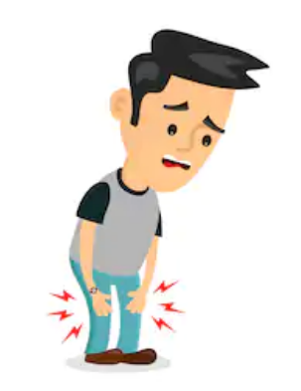
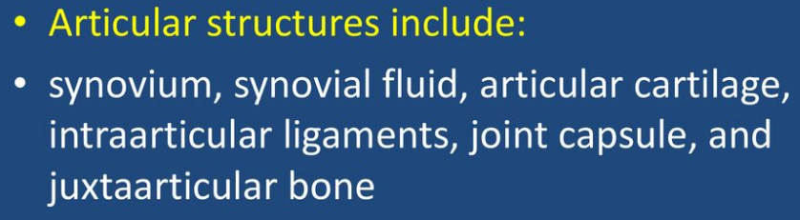
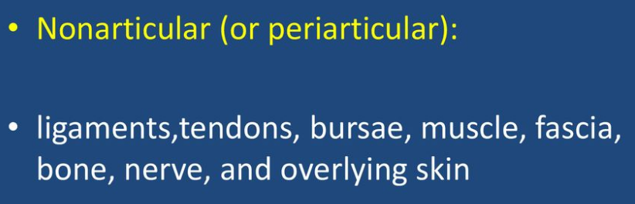
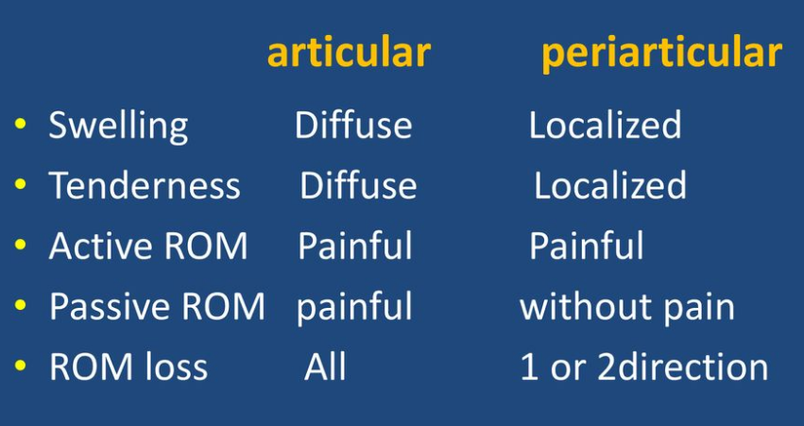
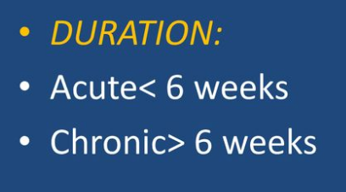
Is it an emergency??
My joint hurts!
Initial rheumatic H&P
Is it articular?
Is it acute or chronic?

Slide 10

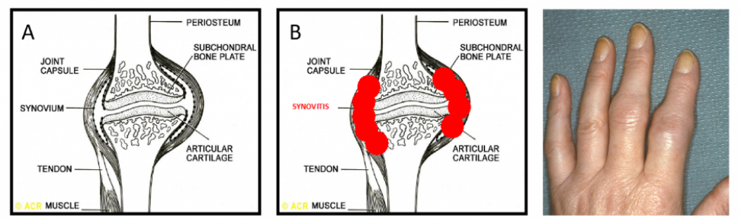
Is it an emergency??
My joint hurts!
Initial rheumatic H&P
Is it articular?
Is it acute or chronic?
Is synovitis present?
What is synovitis? inflammation of the synovial membrane

Slide 11
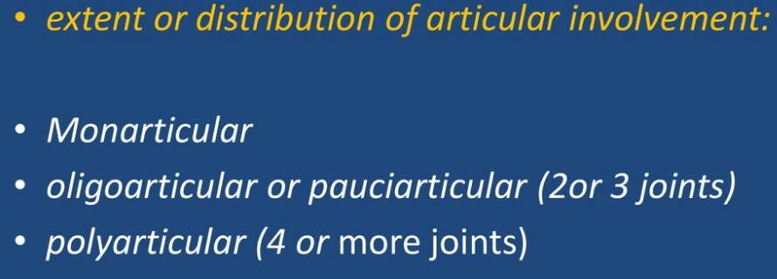
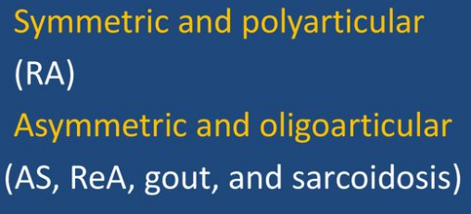
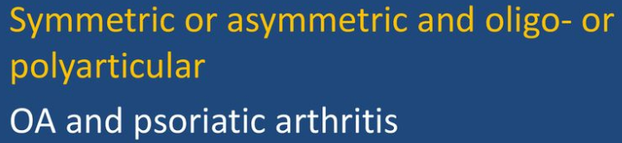
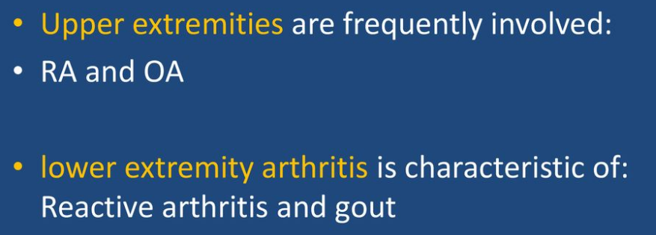
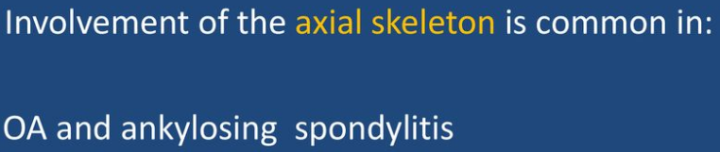
Is it an emergency??
Initial rheumatic H&P
Is it articular?
Is it acute or chronic?
Is synovitis present, stiffness?
Distribution pattern,
mono or polyarticular,
Upper lower extremities, which joints
Symmetric asymmetric
Axial skeleton involvement
My joint hurts!
Specific joints:
OA: Knee, Hip, PIPs, DIPs, rigidity < 30 mins
Wrists: RA, CPPD
Gout: podagra, any other joint
RA: MCPs, PIPs, AA joint, any other

Slide 12
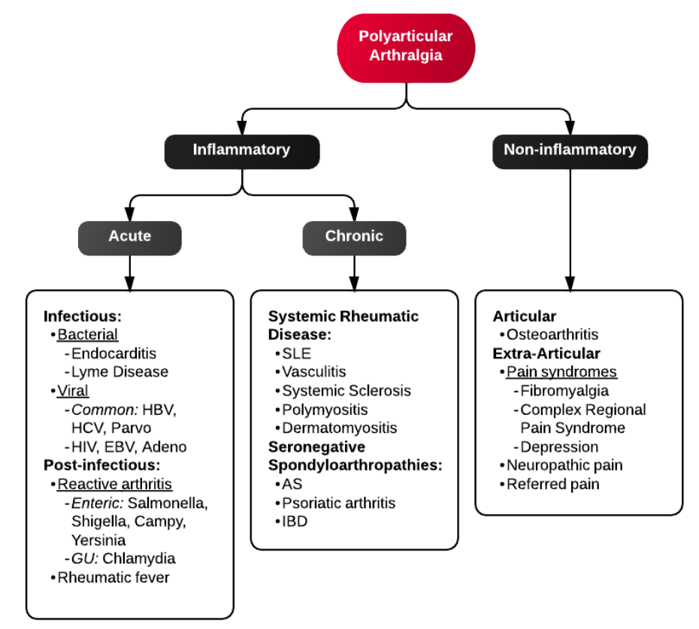
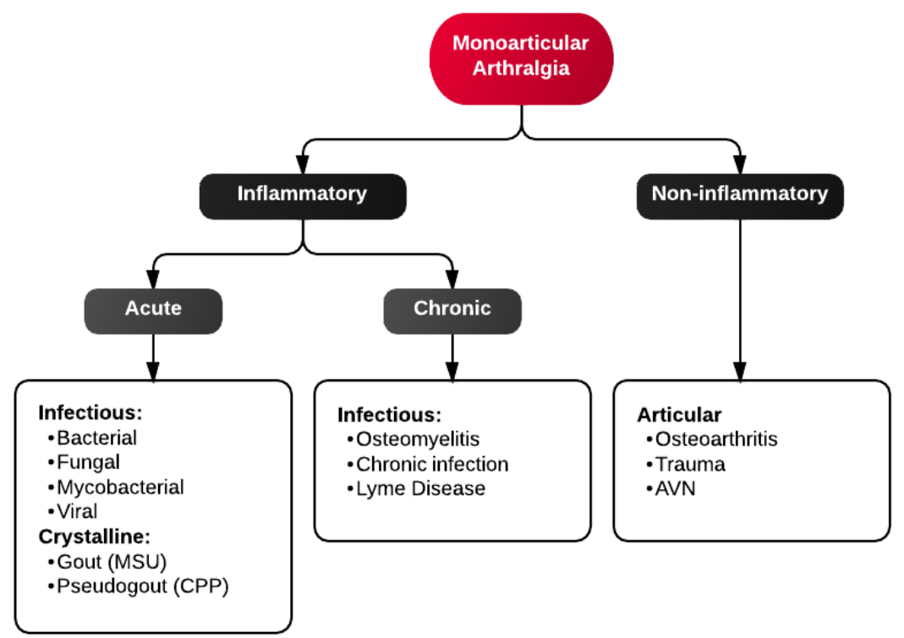
Mono- and poly-articular arthralgia causes

Slide 13
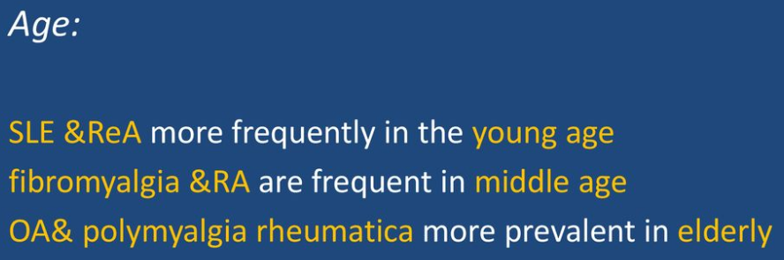
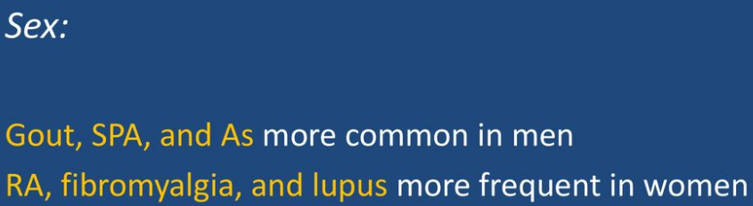
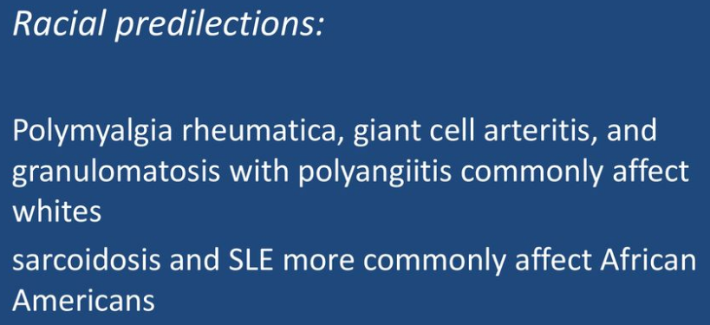
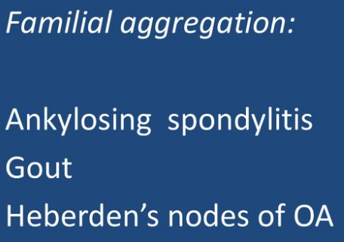
Initial rheumatic H&P
Is it articular?
Is it acute or chronic?
Is synovitis present, stiffness?
Distribution pattern,
mono or polyarticular,
Upper lower extremities
Symmetric asymmetric
Axial skeleton involvement
Epidemiology: Age, race, sex, familial agg.
Timing pattern: intermittent, migratory, additive
Is it an emergency??
My joint hurts!
Evolution:
Intermittent: crystal arthritis
Migratory: RA, gonococcal, or viral arthritis
Additive: RA, PsA

Slide 14
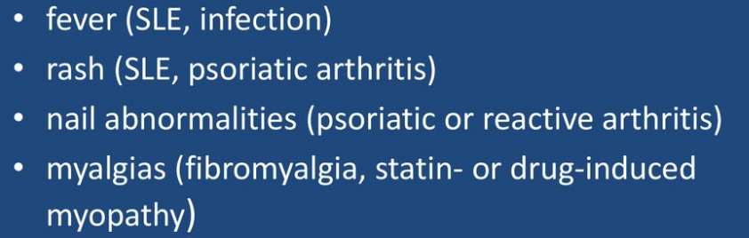

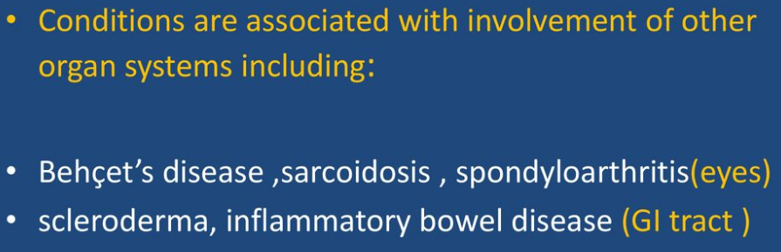
Is it an emergency??
Initial rheumatic H&P
Is it articular?
Is it acute or chronic?
Is synovitis present, stiffness?
Distribution pattern,
mono or polyarticular,
Upper lower extremities
Symmetric asymmetric
Axial skeleton involvement
Epidemiology: Age, race, sex, familial agg.
Overtime: intermittent, migratory, additive
Systemic manifestations?
Taking meds than induce joint pain?
Neurologic/vasc findings ?
My joint hurts!
, Anastrazole
Neuro/vasc findings:
paresthesias, reduced sensation, muscle weakness, diminished pulses

Slide 15
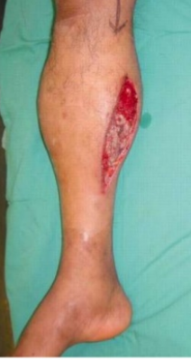
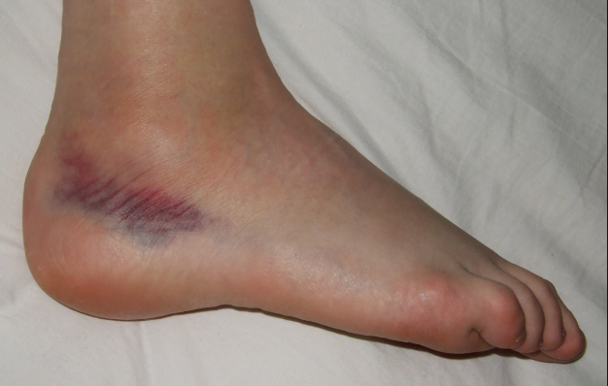
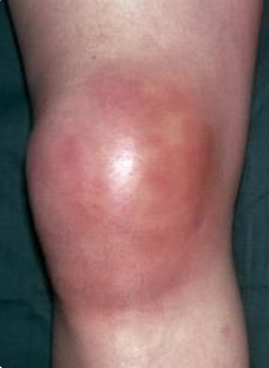
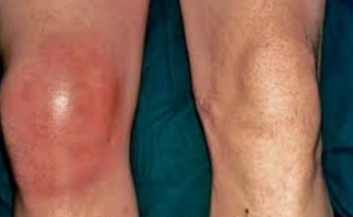
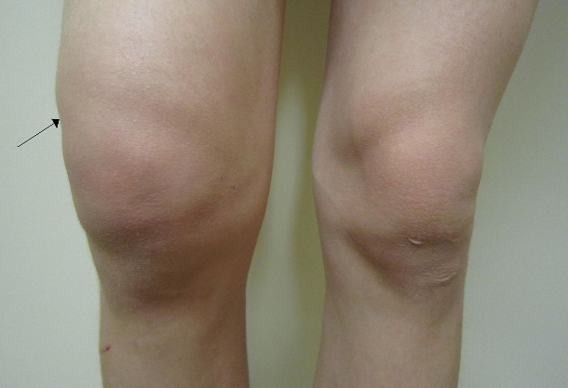
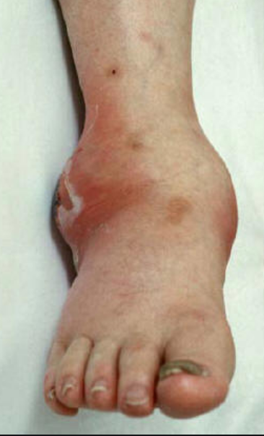
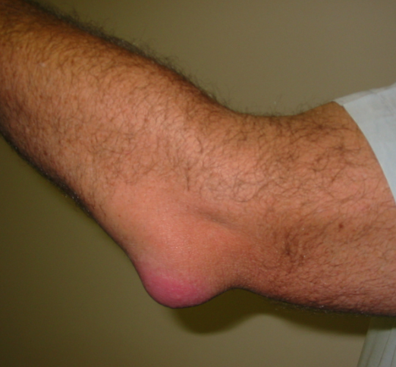
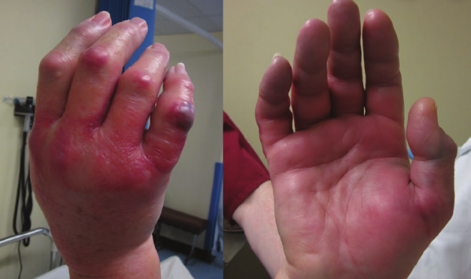
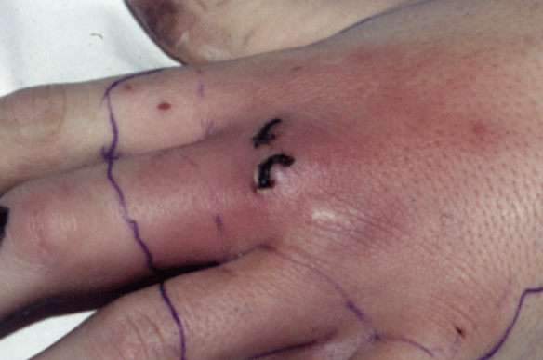
Gout
Septic arthritis
Sprain
Compartment S.
Septic arthritis
Septic arthritis
Trauma with deformity: ortho
It looks like joint but is not :
*)compartment syndrome
*)Acute joint weakness, vague pain, numbness, burning pain, paresthesia might be an acute myelopathy, radiculopathy, or neuropathy
RA
Compartment S.
Septic arthritis
Bursitis

Slide 16
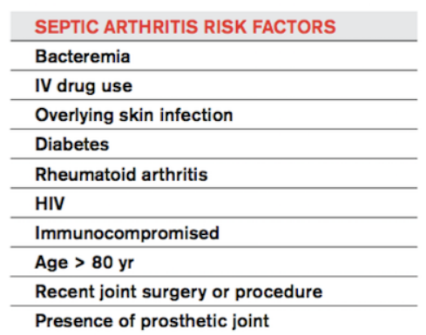
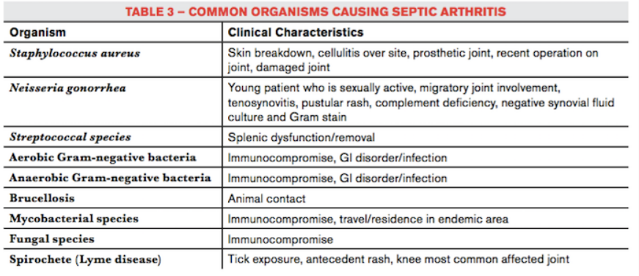

Septic arthritis
Helpful tips
Acute presentation,
Mono-articular
20 % of cases polyarticular, more in immunocompromised patients
Knee (50% cases)> hip > shoulder > elbow
Drug users: sacroiliac or sternoclavicular joints
Oral temperature more than 101.3°F (38.5°C),
Pseudoparalysis: refusal to bear weight on the affected leg,
Labs: ESR> 40 mm /hr, WBC in blood > 12,000 per mm3, CRP> 20 mg/l.
Other constitutional symptoms: weight loss, malaise Ill appearance,
tachycardia, fussiness/irritability, decreased appetite
Tap, drain joint, sent for culture, WBC, gram stain, crystals, then start ABX (vanco until culture and gram stain back, then adjust), ortho
If you do not have the resources to tap, then stat referral to the ED
Notes:
Synovitis, physical exam, describe it, pi
picture
What to do as PMD

Slide 17
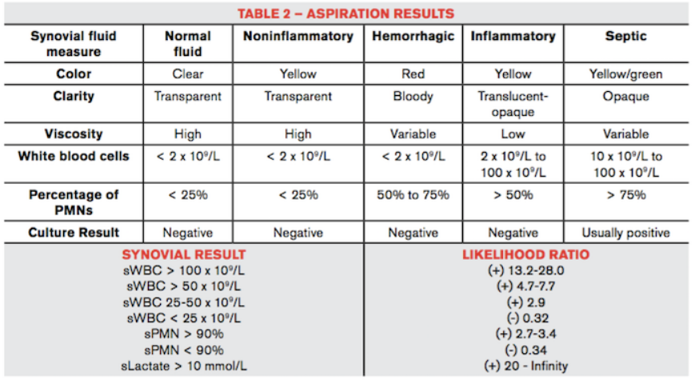
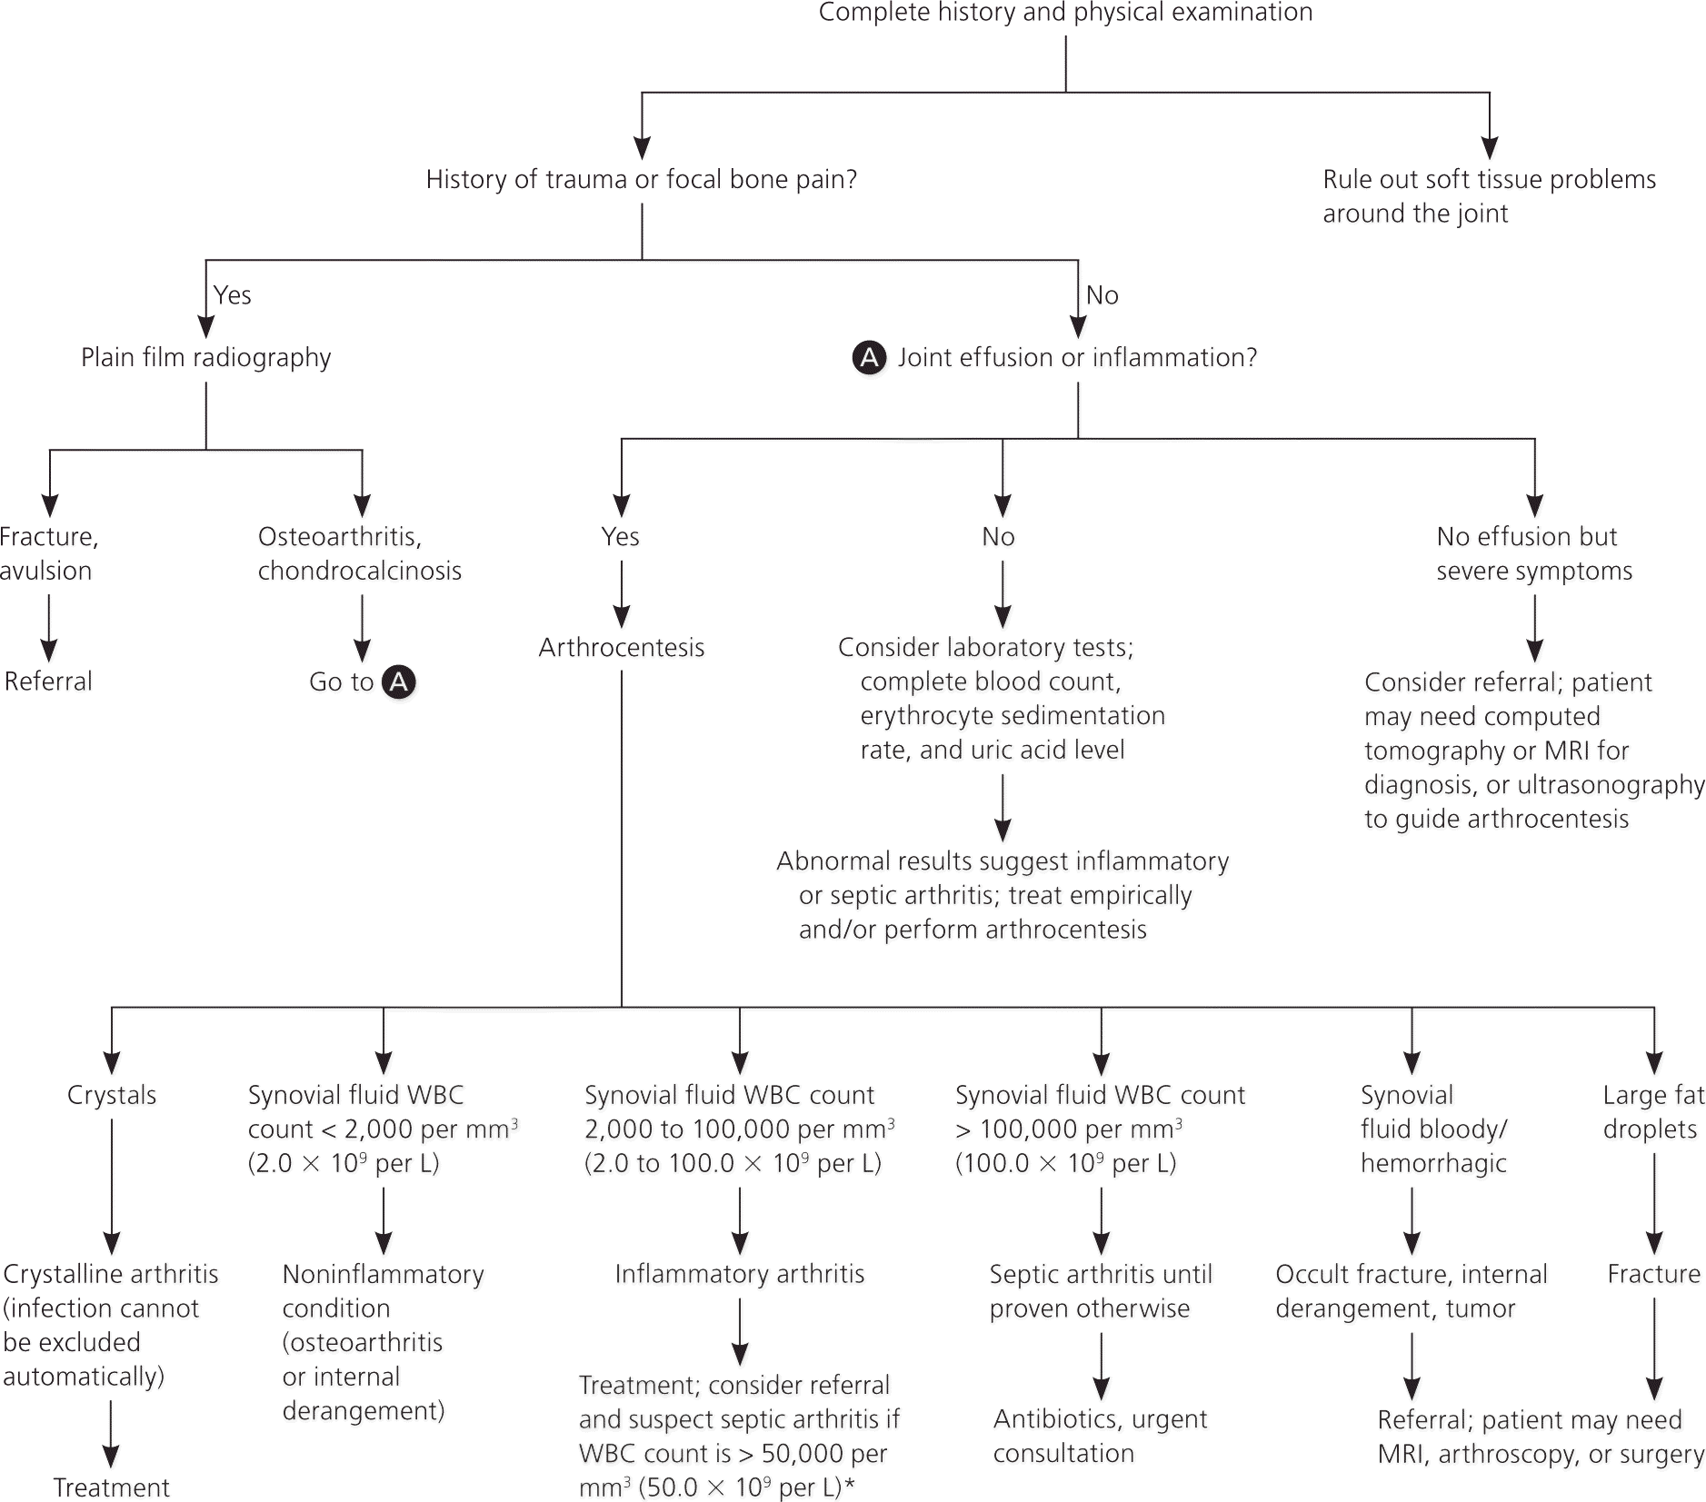
Arthrocentesis

Slide 18
Initial rheumatic H&P
Is it articular?
Is it acute or chronic?
Is synovitis present, stiffness?
Distribution pattern,
mono or polyarticular,
Upper lower extremities
Symmetric asymmetric
Axial skeleton involvement
Epidemiology: Age, race, sex, familial agg.
Overtime: intermittent, migratory, additive
Systemic manifestations?
Taking meds than induce joint pain?
Neurologic/vasc findings ?
My joints hurt!

Slide 19
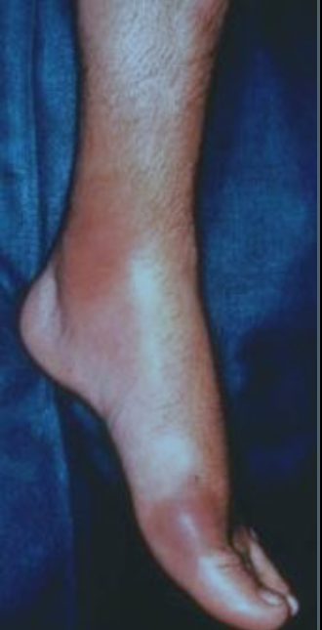
Polling question
38 year old man with acute, disabling pain and redness in left foot/ankle
PMH: HTN on HCTZ
Began while drinking beer/eating wings last night
Same thing happened twice before
Can only bear minimal weight
Tenderness is so exquisite that he couldn’t bear the pressure from the sheet in bed
Had 2 Percocet at home
  They only helped a little
Not sick/no fever

Slide 20
Choose the best answer for what to do in the office
A: If you (or a colleague) know how to tap either joint, do it
B: Begin allopurinol
C: Prescribe Naproxen 500 mg BID
D: Have nurse give Toradol 60 mg IM now
E: All of the above

Slide 21
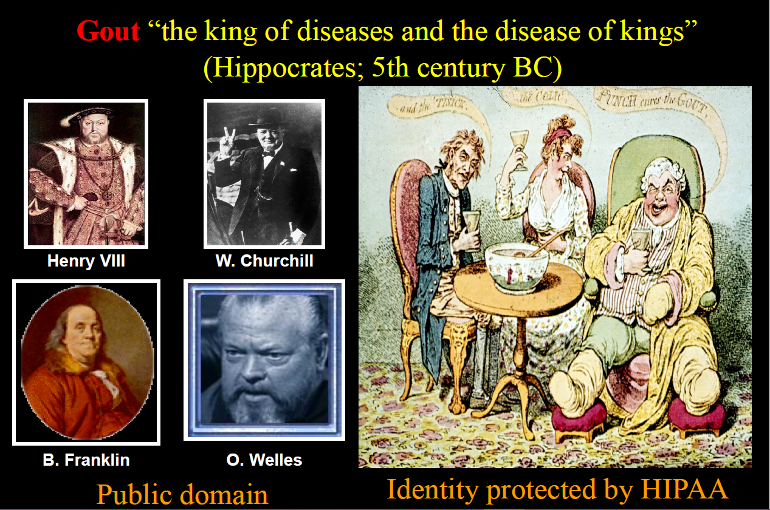

Slide 22
Gout and diet
Don’t let anybody convince you that diet change won’t be worthwhile
Old handouts of low purine diets for gout are wrong
  Plant-based purines don’t elevate uric acid
Some meats, gravies, and meat sauces are worse than others, but they all are at least moderately high in purines
HFCS is an enormous contributor to gout
Alcohol
  Beer is terrible for gout
  Liquor is pretty bad
  Wine seems fine

Slide 23
Gout and diet : what to eat
Cherries!
  A cup of cherries daily markedly decreases gout flareups.
  Cherry concentrate or cherry juice work
Whole food, plant-based diet
Vitamin C helps lower uric acid/gout
  But it can raise kidney stone risk

Slide 24
Comorbidities and Med effect
Renal disease: diminished uric acid clearance
Thyroid disease (both high and low) may increase risk
Diuretics substantially increase uric acid
ARBs, Amlodopine, Indomethacin lower uric acid

Slide 25
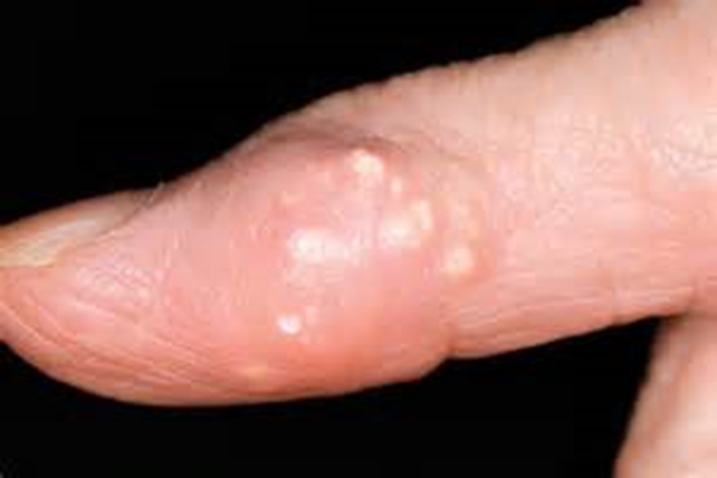
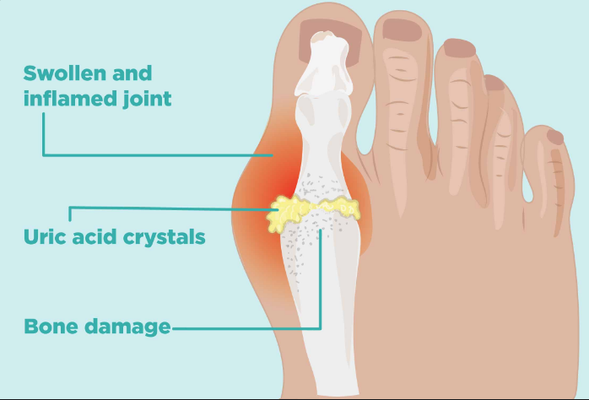
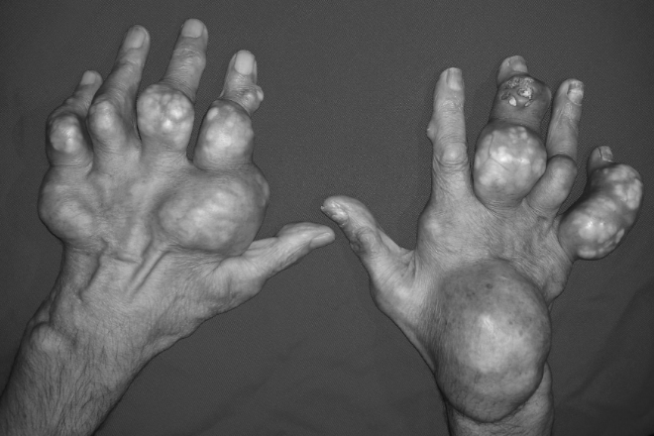
Typical gout flare
Tophaceous gout
Polyarticular gout flares: 20 %

Slide 26
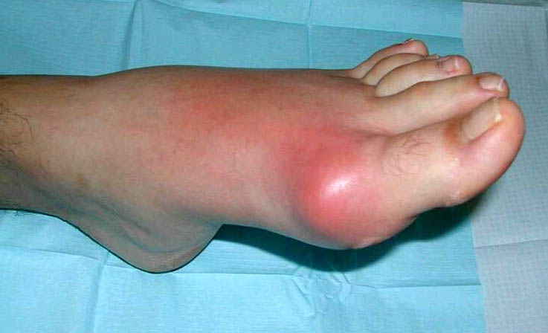
Podagra

Slide 27
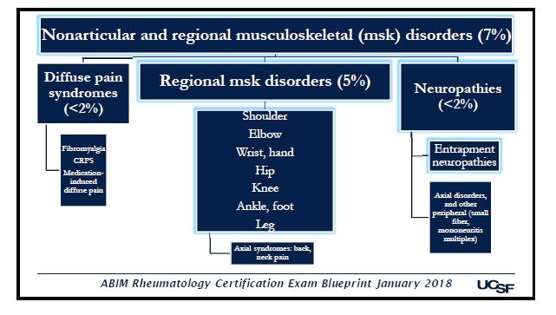
Polyarthralgia, mono
Articular
No articular
Synovitis (+)
Synovitis (-)
OA, chronic
Symmetric or Asymmetric
Peripheral and axial
AVN
Charcot joint
Hypermobility S
Peri-articular pain
<6 W
>6 W
Symmetric
Asymmetric
Symmetric
Asymmetric
Careful f/up
Septic arthritis
Gout
CPPD
Other infections: Lyme
Systemic rheumatic disease (SRD)
Systemic rheumatic disease
Gout?
-Viral arthritis
-Early SRD
ESR, CRP, ANA, RF, anti-CCP, creatinine, UA, joint aspiration, specific imaging
ESR, CRP, HLAB27, ANA, RF, anti-CCP, creatinine, UA, swap culture, joint aspiration,
Specific imaging
Check: LFTs, CBC, consider hepatitis serology (A,C,C)
Parvo B19 serology
ESR, CRP, ANA, RF, anti-CCP, creatinine, UA, joint aspiration, specific imaging
J
J + SM
AS
PsA
ReA
IBD
RA
Bechet’s
Gout
Sarcoidosis
RA
SLE,
SLE-drug induced
Sjogren’s S
Scleroderma
chikungunya
PsA, PMR

Slide 28
Choose the best answer for what to do in the office
A: Tap it if able
B: Begin allopurinol
C: Prescribe Naproxen 500 mg BID
D: Have nurse give Toradol 60 mg IM now
E: All of the above
Would also
  Check labs
  Consider Colchicine instead of NSAID
  Have a serious dietary discussion
  Replace HCTZ with Irbesartan
  X-ray

Slide 29
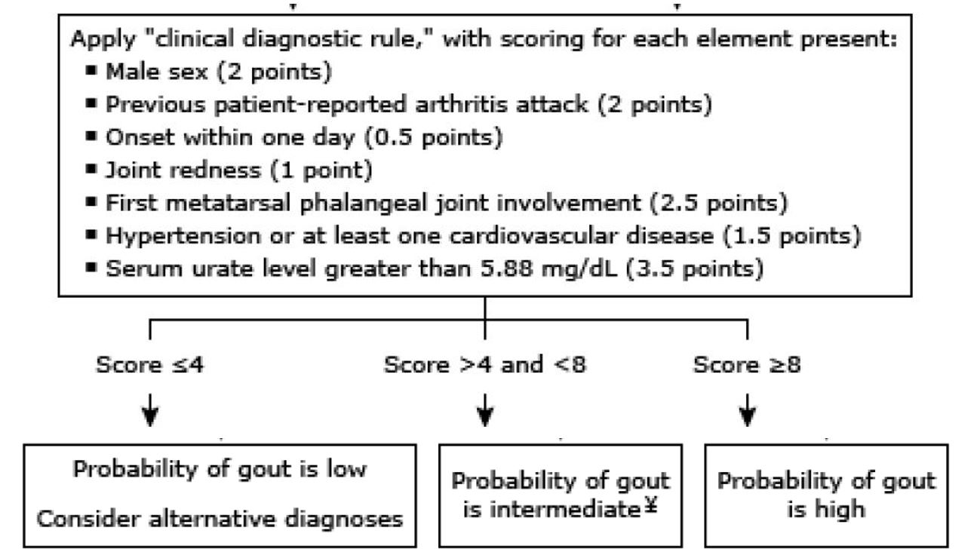
Diagnosis in the absence of joint aspiration

Slide 30
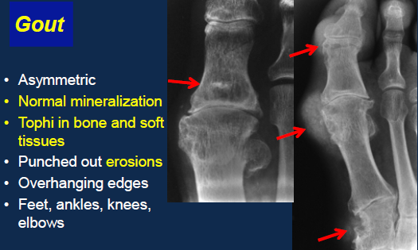
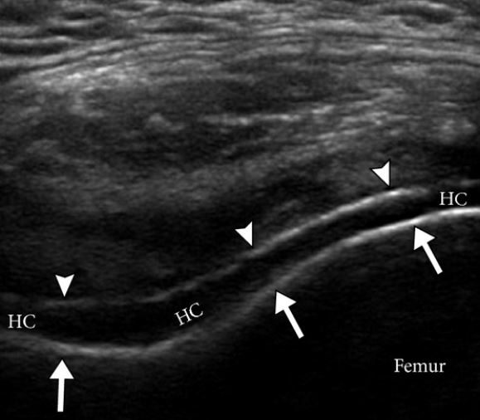
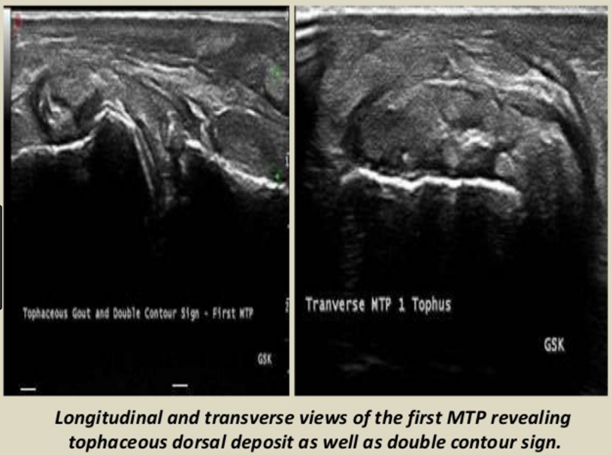
Gout diagnosis
Labs
Uric acid
CBC, COMP
ESR,
CRP,
joint aspiration,
Specific imaging
USG

Slide 31
Treatment choices for gouty flare
Full dose NSAID works quickly and reliably
  Indomethacin is pretty harsh on the stomach
Colchicine can work quickly and be suggestive diagnostically
  Less helpful if not begun within the first day or two
  If colchicine alone works rapidly that’s almost certainly going to be because the presentation is gout or pseudogout
  2 tabs ASAP (1.2 mg) and 1 tab (0.6 mg) an hour later
  May then use 0.6mg BID for another day or two if still needed
Steroid injection into affected joint(s)
Systemic steroids

Slide 32
Opioids for acute gout?
The pain is absolutely severe enough to warrant it
But Colchicine and anti-inflammatories work very well and very quickly
Not unreasonable to give a couple of days’ worth of Vicoden in a patient you deem to be at low risk of aberrant behavior.

Slide 33
Uric acid management in gout: xanthine oxidase inhibitors
Most people with gout should be on a uric acid lowering medicine right from the beginning
  Unless lifestyle change is expected to be major or if there are causative meds that can be DC’ed/switched out.
  A Myth has hampered gout treatment
    Allopurinol used in the setting of an acute gout flare-up is NOT contraindicated as we’d been taught.
    By waiting until later to initiate treatment
      You have lost time, increasing risk of recurrence
      You have missed out on a way to connect the importance of the new medicine to the painful disease
If the diagnosis is clear, consider beginning Allopurinol while you are treating acutely

Slide 34
But the standard is less aggressive
Indications in UpToDate for urate lowering therapy
  Frequent or disabling gout flares
  Tophi and structural joint damage
  Gout with renal insufficiency

Slide 35
Uric acid management in gout
Uric acid level may drop up to 2 points with acute gout
  Inflammation leads to increased uric acid transport
  Not because (another myth) it gets sequestered in the joint
Uric acid lowering meds are generally well tolerated and probably even beneficial
  Allopurinol seems to decrease CVD risk
  Allopurinol is finally well accepted in CKD thanks to some reassuring studies (but titrate more slowly)
  BUT: Allopurinol hypersensitivity can be life-threatening
    Genetic risk to be sought in Han Chinese and Thai patients (and Korean patients with CKD)
      Test HLA-B*5801 allele before rx

Slide 36
Uric acid management in gout
Allopurinol 100 mg daily (can start at 50 mg in CKD), titrate up by 100 mg every 2-4 weeks (more slowly in CKD)
Max dose of allopurinol is 900mg per day
  Comes as 100mg, 200mg, and 300 mg tabs
Goal is uric acid under 6
  Closer to 4, really, if you can get there easily
  This allows all of the crystals to gradually dissolve
Febuxostat only if allopurinol not effective at max allowed dose, or is contraindicated, But …
  Much more expensive
  2017 FDA update: increased CV risk when compared to Allopurinol

Slide 37
Other Meds: beyond the scope of this lecture, besides a quick mention
Probenecid
  Uricosuric
  Consider second line if uric acid excretion is low
Pegloticase
  For complicated cases
Interleukin 1 inhibitors for acute gout
  Infusion
  Very expensive
  For now, this will only be a hospital treatment
If I can’t control it despite adherence:
  Rheum if no CKD
  Renal if CKD

Slide 38

Mobilization flares
This is what makes gout tough to treat
Uric acid lowering leads to gout flares!
  Despite the uric acid being at goal
Gout is not just uric acid crystals in the joint space.
  The gout flare occurs when the WBCs in the joint or soft tissues treat the crystals as foreign invaders
  As stable, innocuous, crystals partially dissolve they can lead the white cells to recognize them.
    At least, this is how I describe it to patients
This is why you’ve got to convince patients to take these meds forever
  You only want them to deal with this risk once in their lifetime

Slide 39
Mobilization Flares
Begin prophylaxis when uric acid lowering meds begun
Continue for 3 to 12 months after uric acid has reached goal
  At least 6 months if tophi are present
  At a grand rounds from a Rheumatologist a few years ago, he said that this is an even bigger deal than we ever thought and he recommends 12 months for everybody
Choices
  Daily NSAIDs [BID Alleve +/-],Colchicine [1 tab daily], or low dose Prednisone
    qOD or ½ pills if moderate likelihood of intolerance
  Nothing…just treat flares ASAP and counsel intensely
    If comorbidities make these too dangerous

Slide 40
Gout summary
Treat your patients like royalty…their joints act like it
Gout is profoundly acute and intense
Address lifestyle, comorbidities, and aggravating meds right from the start
Cherries, vitamin C, and choose ARBs for HTN
Treat almost everybody with Allopurinol right from the start and forever (vs. UpToDate)
Great counseling is needed to get people safely through their time of mobilization flare risk.
  Only you can convince them that they need to take a medicine that might cause a gouty attack in order to not have gout!

Slide 41
Hepatitis C and Rheumatology
HCV can induce vasculitis, sicca syndrome, arthralgia/arthritis, and fibromyalgia
Often leads to development of auto-antibodies
  RF, anti-CCP, anti SSA/SSB, ANA, cANCA, anti-Cardiolipin, anti-DNA
We should probably be screening HCV for everybody with suspicion of rheumatologic disease
Known liver disease has implications for DMARD tx.
    “Rheumatic manifestations of hepatitis C virus chronic infection: Indications for a correct diagnosis World J Gastroenterol. 2016 Jan 28; 22(4): 1405-1410 ncbi.nlm.nih.gov/pmc/articles/PMC4721975/

Slide 42
Cardiovascular implications of inflammatory conditions
Table 3. Risk-Enhancing Factors for Clinician-Patient Risk Discussion
Risk-Enhancing Factors
Family history of premature ASCVD (males, age <55 y; females, age <65 y) Primary hypercholesterolemia (LDL-C 160–189 mg/dL [4.1–4.8 mmol/L]; non–HDL-C 190–219 mg/dL [4.9–5.6 mmol/L])* Metabolic syndrome (increased waist circumference [by ethnically appropriate cutpoints], elevated triglycerides [>150 mg/dL, nonfasting], elevated blood pressure, elevated glucose, and low HDL-C [<40 mg/dL in men; <50 mg/dL in women] are factors; a tally of 3 makes the diagnosis) Chronic kidney disease (eGFR 15–59 mL/min/1.73 m² with or without albuminuria; not treated with dialysis or kidney transplantation) Chronic inflammatory conditions, such as psoriasis, RA, lupus, or HIV/AIDS
ABI indicates ankle-brachial index; AIDS, acquired immunodeficiency syndrome; apoB, apolipoprotein B; ASCVD, atherosclerotic cardiovascular disease; eGFR, estimated glomerular filtration rate; HDL-C, high-density lipoprotein cholesterol; HIV, human immunodeficiency virus; LDL-C, low-density lipoprotein cholesterol; Lp(a), lipoprotein (a); and RA, rheumatoid arthritis.

Slide 43
Polling question
A high Westergren erythrocyte sedimentation rate (ESR) and a C-reactive protein (CRP) mean:
A: Suspect a rheumatologic condition
B: Suspect a malignant condition
C: Suspect an infectious condition
D: Nothing without clinical context
E: All of the above

Slide 44
Inflammatory markers
Systemic inflammation is usually identified in inflammatory markers
The most common ones we use are C-Reactive Protein and Erythrocyte Sedimentation Rate (CRP and ESR)
They generally represent activity of disease
Normal ESR is higher in women and increases with age
Many non-Rheum things lead to inflammation
  Infection
  Malignancy
  Metabolic Syndrome and other chronic diseases

Slide 45
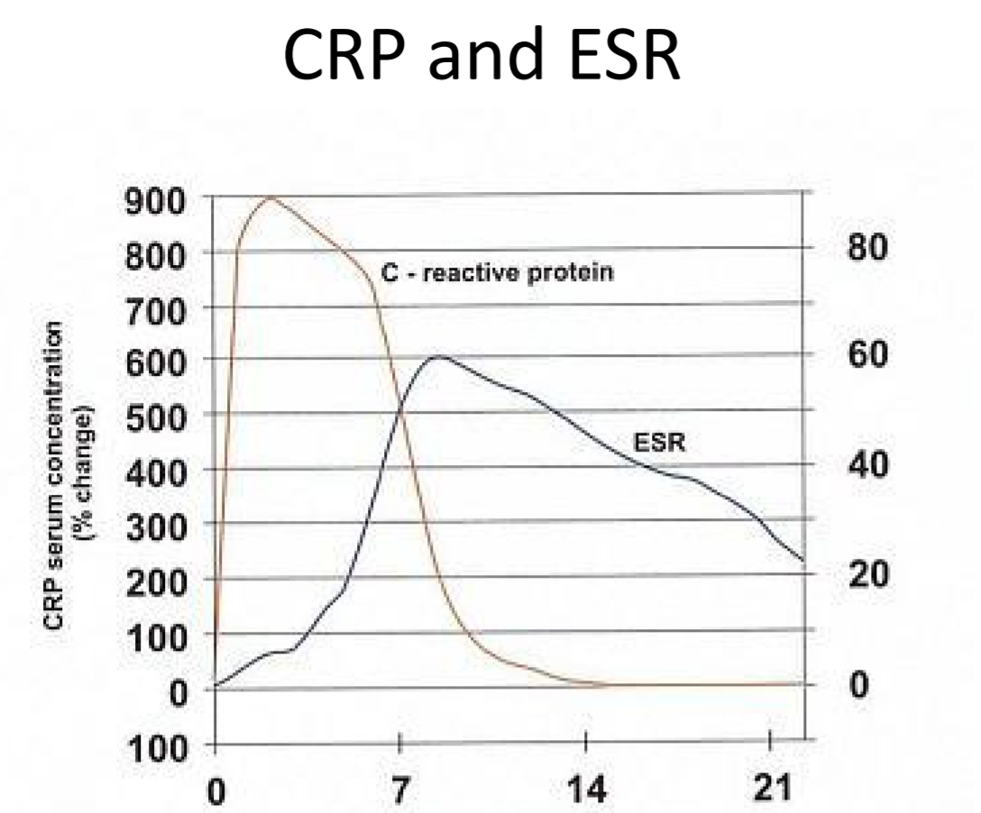
Biological markers of inflammation

Slide 46
Other acute phase reactants
Ceruloplasmin
Fibrinogen (this is primarily what increases ESR)
Complements
Haptoglobin
Alpha-1 antitrypsin
Ferritin
Platelets
TIBC (Transferrin) goes down with inflammation

Slide 47
ANA issues/Lupus?
Selected slides also from ConferMED ECHO

Slide 48
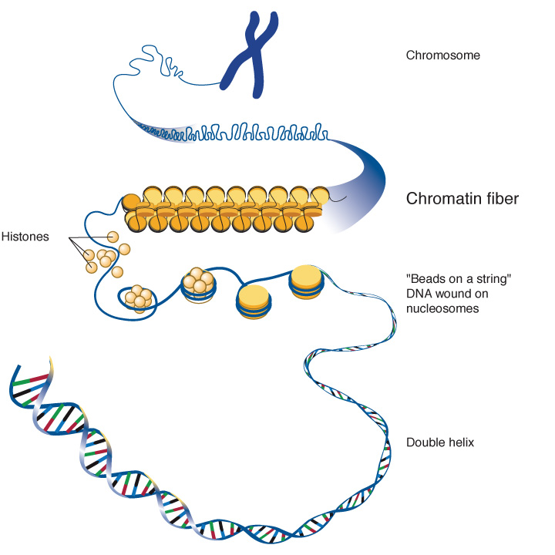
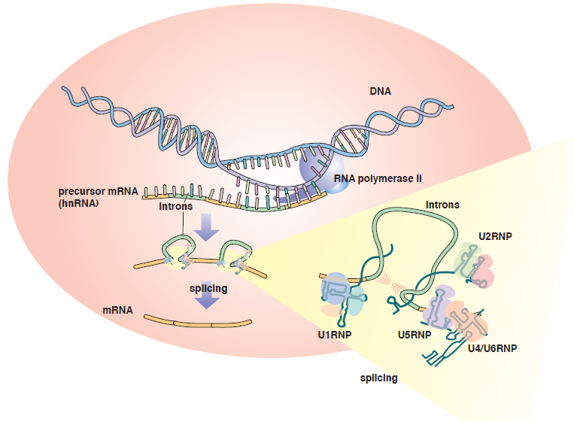
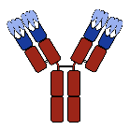
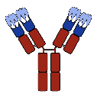
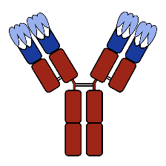
Antinuclear antibodies overview
ANAs are auto antibodies that target components in the cell nucleus and can bind to DNA, RNA and proteins, as well as complexes of nucleic acids with proteins
The first group: antibodies that recognize DNA, histones and nucleosomes.
The second group: ANAs that bind to complexes of RNA with RNA-binding proteins (RBPs); (snRNPs)

Slide 49
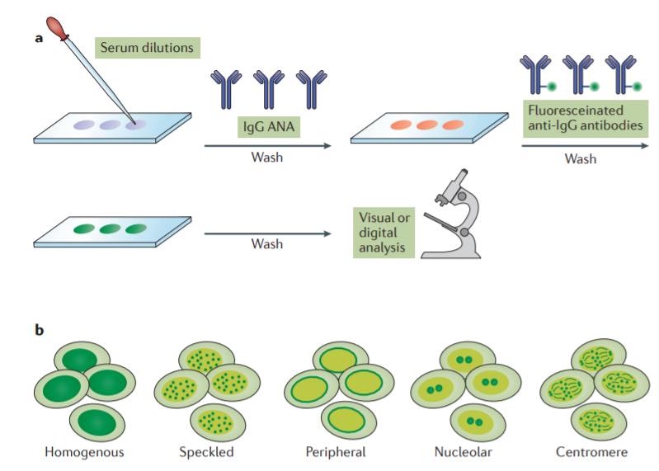

Which ANA test should be ordered?
IFA testing for identifying the presence of ANAs:
Gold standard declared by The American College of Rheumatology (ACR)
1:40
1:80
1:160
Notes:
a | In the top panel, the experimental procedure of an indirect immunofluorescence assay (IFA) is illustrated. A slide with tissue culture cells is exposed to dilutions of serum. Following washing steps to remove unbound antibodies, the slide isincubated with a fluoresceinated anti-IgG reagent. Following another washing step, fluorescence microscopy is performed. At present, in most laboratories, a technician visually inspects the slide to determine the presence and pattern of fluorescence. In determining the positivity of a sample, the dilution in which fluorescence is still visible is assessed.
b| The bottom panel illustrates some of the more common staining patterns of ANAs. Each pattern is associated with certain ANAs and diseases. The results of IFA can be reported in terms of the end-point titre and staining pattern. For some sera, a mixture of different ANAs is present and, depending on their relative titre, more than one pattern can be observed. For example, a serum can be characterized as 1:640 homogeneous and 1:2,560 speckled. As IFA kits can differ in features related to the cell line, conditions of fixation and properties of anti-IgG reagents, the results can vary. Therefore, it is important to know the characteristics of different assays for interpreting their results. In general, a titre of >1:40 or 1:80 is considered significant meaning that the serum is considered to be ANA positive.

Slide 50
Indications and algorithm to order ANA
Specific signs and symptoms for systemic inflammatory conditions:
alopecia, rashes, photosensitivity, Raynaud’s phenomenon, periungual changes, lymphadenopathies, oral ulcers, arthralgia, joint swelling/deformities, myalgia, parotid enlargement, unexplained dyspnea/dysphagia, constitutional symptoms (fever, weight loss…), miscarriages, blood clots, uveitis, unexplained neuropathic pain/neuropathy/weakness, unexplained psychosis
When do we order ANA?
History and physical (H&P)
General lab findings:
anemia, leukopenia/leukocytosis, thrombocytopenia/thrombocytosis, elevated inflammatory markers (ESR/CRP, ferritin, fibrinogen, LDH, ALK phos)
Proteinuria
Autoimmune disease suspected
Absence of H&P and lab findings
If we do not find some of the described findings in the right, there is not a reason to suspect an autoimmune disease. We should not order ANA
No
Negative
Yes
ACR’s Top 5 recommendation :
to not test ANA subserologies (dsDNA, Sm, RNP, SSA, SSB, Scl-70, and centromere) without a positive ANA and clinical suspicion of immune-mediated disease
Positive
-Further testing to identify specific Ab (ANA subserologies (dsDNA, Sm, RNP, SSA, SSB, Scl-70, and centromere)
-Make the diagnosis based on H&P antibody profile, and diagnosis criteria
ANA indirect immunofluorescence (IFA) (Gold standard)

Slide 51

Case 1
Patient is a 26 y/o white female who sometimes gets widespread raised urticarial rashes (very itchy, comes and goes during the day). She started complaining of fatigue and joint pain in her hands in the last few weeks.
Physical: skin rash (see picture), MSK examination wnl, rest of PE wnl
PMH- IBS, takes linzess. Does not take any other meds.
FH: mother with HTN, cousin with h/o miscarriages and DVTs

Slide 52
Case 1 (cont)
PMD ordered: CBC, COMP, peripheral smear, TSH, ESR, and CRP
Labs returned:
WBC 3.1, RBC 3.66, Hgb 10.7, Hct 32.8
plts 76, decreased on smear
slight anisocytosis and microcytosis
MCV 89.6
CMP and TSH normal
CRP 1.25, ESR 43
Would you order ANA?

Slide 53
Case 1 (cont)
Patient is a 26 y/o white female who sometimes gets widespread raised urticarial rashes (very itchy, comes and goes during the day). She started complaining of fatigue and joint pain in her hands in the last few weeks.
Physical: skin rash (see picture), MSK examination wnl, rest of wnl
PMH- IBS, takes linzess. Do not take any other meds.
FH: mother with HTN, cousin with h/o miscarriages and DVTs

Slide 54



Case 1 (cont)
Fatigue, arthralgia, urticaria (?), cousin with APLs?
Anemia, leukopenia, thrombocytopenia, elevated ESR
H&P
AD suspected?
Yes
ANA IFA
Negative
Reassess H&P
Positive 1:340,
homogeneous pattern
dsDNA, histones, chromatin, nucleosomes
Notes:
Why the IFA pattern is important?
(reflex, or breakdown)

Slide 55
Case 1 (cont)
What do we have?
ANA +, 1:340, homogenous pattern, + H&P
When do we refer to rheum?
Here, but ideally with further workup you can reach a diagnosis. Rheum will confirm diagnosis and guide management
SLE, drug-induced lupus, | Alopecia, rash, oral ulcers, hem abnormalities, serositis, arthralgia, Jaccoud arthropathy, proteinuria
Sjögren's syndrome (SS), | Eyes/mouth dryness, parotid enlargement..
scleroderma (SSc), | Skin tightening,
rheumatoid arthritis (RA), | Synovitis, joint erosions, morning stiffness
Hashimoto's thyroiditis, primary biliary cholangitis (PBC), and autoimmune hepatitis | TSH, LFTs
What are we thinking? SLE?
Identify specific Ab Diagnosis criteria
ANA breakdown IFA:
-Anti dsDNA, anti-chromatin,
-Anti-smith,
-anti-RNP,
-anti SSA/SSB
-Scl-70, anti-centromere
SLICC
2019 EULAR/ACR Classification Criteria for SLE

Slide 56

2019 EULAR/ACR Classification Criteria for SLE
Case 1 (cont)
ANA breakdown:
-POSITIVE : Anti dsDNA, anti-chromatin
-NEGATIVE: Anti-smith, RNP, SSA/SSB, Scl-70, anti-centromere
Score≥ 10, Pt has 13

Slide 57
Summary Case 1
H&P
Consistent with AD
AD suspected?
ANA breakdown:
-Anti dsDNA, anti-chromatin positive. Rest negative.
Yes
Based on H&P and ANA pattern, what might be the diagnosis? SLE?
Order ANA IFA
2019 EULAR/ACR Classification Criteria for SLE = 13, meets SLE
And we need more labs
Positive 1:340,
homogeneous pattern

Slide 58

Case 2
Patient with positive ANA; Homogeneous pattern; ana titer 1:80. hx hypothyroid, hyperlipidemia, no other signs and symptoms of AD
H&P
Not consistent with AD
AD suspected?
How do we interpret this positive ANA?
Hashimoto’s thyroiditis has a higher ANA positivity prevalence (45 %)
ANA is positive in 30% of healthy population
What do we do? Nothing
ANA is useful in the context of + signs and symptoms for an AD, otherwise disregard
No
Order ANA IFA
Positive 1:80,
homogeneous pattern

Slide 59
Case 3
Patient with positive direct ANA and fatigue, what should we do?
H&P
AD suspected?
No
yes
Order ANA breakdown..etc
Disregard + ANA IFA
+ Direct ANA ELISA
Order ANA IFA
Negative
Positive 1:80,
homogeneous pattern

Slide 60

Malar Rash

Slide 61

Malar Rash
Spares nasolabial folds
Notes:
The malar rash typically occurs in the Photosensitivity distribution
The rash is typically Erythematous, sometimes scaly patch
Not specific for SLE-also seen in dermatomyositis

Slide 62

Discoid Lupus

Slide 63

Good to have a review article

Slide 64
Drug Induced Lupus – Clinical features
Advanced age
Male predominance
Constitutional symptoms
Arthritis/arthralgias
Serositis (pleural/peritoneal/pericardial –itis)
Autoimmune hemolytic anemia/thrombocytopenia
Antihistone antibodies

Slide 65
Most commonly associated drugs
Definite
  Procainamide
  Hydralazine
  Isoniazid
  Phenytoin
  Chlorpromazine
  Quinidine
  TNF-alpha inhibitors
  Minocycline
  Statins
Possible
  Methyldopa
  Sulfonamides
  Methimazole
  Nitrofurantoin
  Beta Blockers
  PTU
  D-penicillamine
  Carbamazepine
  Captopril

Slide 66
“Hmm…I wonder if this is a Rheum case”: What ROS/PMH should I ask about?
Constitutional: Fever. Unexplained weight loss. Fatigue. Swollen nodes
Derm: Rashes. Photosensitivity. Hair loss. Pallor. Nail change
HEENT: Dry mouth. Dry eyes. Vision problems. Eye pain. Photosensitivity. Oral sores. Facial swelling (parotids)
Heme: blood clots, excessive bleeding/bruising, frequent infections
Neuro/Psych: Confusion. Paresthesias. Weakness
Pulm: Dyspnea. Cough
GU: genital sores. Frothy urine. Hematuria. Pregnancy loss.

Slide 67
RA
Prevalence 1% lifetime risk.
Peaks ages 30-50 years, but can occur at any age
After 10 years of RA, 35% of patients have disability
Risk increased
  With age
  In smokers (and former smokers)
  In females
  When family history

Slide 68
How it presents
Symmetric polyarthralgias: Early rheumatoid arthritis tends to affect your smaller joints first — particularly the joints that attach your fingers to your hands and your toes to your feet. As the disease progresses, symptoms often spread to the wrists, knees, ankles, elbows, hips and shoulders.
Synovitis
Morning stiffness (>=1 hour)
Abnormal inflammatory markers (CRP, ESR, CBC, etc.)
Findings on imaging
Elevated RF (Rheumatoid Factor) and anti-CCP
  Anti-CCP is better. 50% may be negative early, while 80% will have positive markers later
  Extent of elevation somewhat helpful

Slide 69

RA- Distribution

Slide 70

OA (DJD)-Distribution
Bouchard’s
Heberden’s
Latinis, K., Dao, K, Shepherd, R, Gutierrez, E, Velazquez, C. The Washington Manual Rheumatology Subspecialty Consult., LWW, 2003.

Slide 71
It’s worth pointing out
By a certain age, DJD is fairly universal
So you can have both RA and OA

Slide 72
When do you suspect RA?
Polyarthralgia
Articular
Not Articular
Synovitis (+)
Synovitis (-)
OA, chronic
Symmetric or Asymmetric
Peripheral and axial
AVN
Charcot joint
Hypermobility S
Peri-articular pain
<6 W
>6 W
Symmetric
Asymmetric
Symmetric
Asymmetric
Careful f/up
Septic arthritis
Gout
CPPD
Other infections: Lyme
Systemic rheumatic disease (SRD)
Systemic rheumatic disease
-Viral arthritis
-Early SRD
ESR, CRP, ANA, RF, anti-CCP, creatinine, UA, joint aspiration, specific imaging
ESR, CRP, HLAB27, ANA, RF, anti-CCP, creatinine, UA, swap culture, joint aspiration,
Specific imaging
Check: LFTs, CBC, consider hepatitis serology (A,C,C)
Parvo B19 serology
ESR, CRP, ANA, RF, anti-CCP, creatinine, UA, joint aspiration, specific imaging
J
J + SM
AS
PsA
ReA
IBD
RA
Bechet’s
Gout
Sarcoidosis
RA
SLE,
SLE-drug induced
Sjogren’s S
Scleroderma
chikungunya
PsA, PMR
Notes:
J=Joint SM systemic manifestations

Slide 73







Risk of systemic involvement
pleuritis/pleural effusion) and parenchymal lung diseases (eg, interstitial fibrosis, pulmonary nodules, bronchiolitis obliterans, and organizing pneumonia)
-Focal glomerulonephritis (mesangioproliferative type without rapid progression of renal dysfunction); -membranous nephropathy
-rheumatoid vasculitis
-Anemia
-Felty syndrome
-Large granular lymphocyte syndrome
-Lymphoproliferative disease
Nerves -Carpal tunnel syndrome
-compressive myelopathy or radiculopathy
-mononeuritis multiplex
-symmetric polyneuropathy
OSTEOPENIA: systemic,
Local (erosions), peraticular
MUSCLE WEAKNESS: myositis
Skin disease: rheumatoid nodules, neutrophilic dermatosis, PG
Eye involvement: Scleritis and peripheral ulcerative keratitis

Slide 74

RA diagnosis?

Slide 75

RA diagnosis?
Specific imaging
-Bilateral wrists and hands
-X ray any other joint with symptoms
-If you suspect subclinical synovitis order USG
-Chest X ray: 20% of the pts develop ILD
Labs
CBC, COMP
ESR,
CRP,
ANA,
RF,
anti-CCP,
creatinine,
UA,
joint aspiration,

Slide 76
Treatment for a newly diagnosed RA patient
Once RA is diagnosed, what to do?
Step 1: We already have CBC and COMP, why is this important? Anemia, LFTs, kidneys
Step 2: Also order hepatitis C/B workup, HIV, and quantiferon or/PPD in preparation for biologics (if in the future are required) for the rheumatologist or for yourself.
Step 3: Apply a disease activity index, for example CDAI, DAS28 among others (see below a link to the calculation online)
Step 4: Depending on the score of the disease activity index then you can start treatment
CDAI: https://www.mdcalc.com/clinical-disease-activity-index-cdai-rheumatoid-arthritis
DAS28: https://www.mdcalc.com/disease-activity-score-28-rheumatoid-arthritis-esr-das28-esr

Slide 77

Let’s diagnose 1 case and treat it
42 y/o F with complaint of pain all over her body, joints for 2 months. See hands in the picture. CMP, CBC, ANA, RF all normal. However anti-CCP elevated at 104 (per our lab controls strong positive >59). CRP=13, ESR 59.

Slide 78
RA diagnosis
3+2+1+1 = 7

Slide 79

How active is her disease? : CDAI
2
2
6
6
16

Slide 80

Rheumatoid Nodule

Slide 81
How do we treat her? DMARDs
-MTX 10mg weekly + folic acid 1 mg daily (except on day of MTX) and Prednisone 10 mg
-Labs 2-4 weeks after starting treatment CBC, LFTs to look for side effects.
-Repeat CBC, LFTs and inflammatory markers (ESR/CRP) every 3 months. If the labs are normal at that moment and the disease activity is still moderate, you can increase the MTX dose in 2.5 mg (12.5 mg weekly). You can go up to 20 mg. After 17.5 mg, the dose should be divided in am and pm in the same day to improve absorption
-Taper of prednisone 10 mg 1st week, then 7.5 mg 2nd week, then 5 mg 3rd week, then 2.5 mg the 4th week, and at that moment MTX effect is already on board. The taper after this is 1 mg every week until prednisone is tapered off completely
-After 2 months you will repeat CDAI and the treatment is adjusted based on CDAI, which is called the “treat to target approach.”
-MTX Downside: careful with liver dz. Always look for drug interactions. Category X in pregnancy

Slide 82
What other DMARDS?
Sulfasalazine
Hydroxychloroquine (Plaquanil): need baseline Ophthalmologic eval and follow up
Triple Therapy: MTX/Sulfasalazine/Plaquanil
Biologics/TNF agents: My current stance on these is that because they’re too difficult to get insurance to cover, they are crazy expensive, and because they are not needed for straightforward milder cases, I don’t prescribe them.
  But under the right circumstance, I’d change my mind
  Beyond the scope of this didactic
Important: NSAIDS are not DMARDS
  But Prednisone really isn’t either
  OK to use, but not in order to minimize DMARD use

Slide 83


Slide 84


Slide 85
PCP’s role in RA
It’s general standard of care for all RA cases to be evaluated by Rheumatologists, But
  PCP’s can work-up and make the diagnosis
  PCP’s can initiate treatment or even manage fully if there will be a delay in Rheum consult
    Uninsured
    If straightforward case
    Barriers to specialty care
    An interested PCP willing to put in the work
    Availability of eConsultation
If stabilized by Rheum, might transition to PCP care
For systemic disease, really need Rheumatology

Slide 86
“I have Rheumatoid Arthritis”
Lots of initial patients over the years have told me they have RA
  Maybe they mix it up with OA
  Maybe a provider once told them that they might have RA
  Maybe there’s secondary gain
  Maybe they were misdiagnosed
If they haven’t been on DMARDS, have had joint pains for years, and have no visible synovitis, rheumatoid nodules, or RA deformities, it’s probably not RA
And then if the labs don’t show it, that’s icing on the cake

Slide 87

Let’s talk about some surprising connections
Plant-based diet for prevention and treatment of autoimmune conditions
  https://youtu.be/pAxygdQbY34
Adverse childhood events astounding correspondence
The autoimmune ACE study found that for every additional ACE after a score of 2, the risk of developing rheumatoid arthritis or some other autoimmune illness increased by 20%

Slide 88
RA: summary
Symmetric chronic polyarthritis that starts peripherally
Many people who think they have RA are mistaken
Use EULAR criteria to make diagnosis and CDIA for severity score to guide treatment decisions
Destructive to joints – early dx leads to early DMARD use which leads to minimization of suffering/disability
Methotrexate is usual first line med
Your role is what you choose it to be
  But if you know what to do, beginning MTX can decrease destruction while you’re waiting for a Rheumatologist.
  If you’re unsure, steroids or NSAIDS

Slide 89
A case/polling question
Patient is a 65 y.o. man with 3 months of aching and stiffness of muscles surrounding the shoulders and the hips. Symptoms are symmetric. Good ROM. Some fatigue. ROS otherwise OK. ESR: 75 [i.e. very high], CK: normal. The likely dx is:
A: Rheumatoid Arthritis (RA)
B: Polymyalgia Rheumatica (PMR)
C: Fibromyalgia
D: Post-viral myositis

Slide 90

How does it compare?

Slide 91
PMR AND GCA: conditions of older patients not to miss
PMR
  Polymyalgia Rheumatica
GCA
  Giant Cell Arteritis
  Also known as Temporal Arteritis
    Though, in rare cases, the temporal arteries are not involved

Slide 92


Slide 93

What’s the workup?
ESR: Usually over 50, 20% over 100, but 5-20% normal
CRP: nearly always substantially elevated in PMR
CBC w/ diff: generally fine
CK: should be normal
Comp met profile, TSH, and vitamin D
Maybe RF, anti-CCP, ANA
Consider malignancy, but no workup
Consider emotional source for pain
Imaging in selected patients
  U/S and MRI can show subdeltoid/subacromial bursitis
  But this may not be sensitive nor specific
    And your radiologist may say “we don’t do this”

Slide 94
It’s PMR, what do I do?
Look for GCA!!!!
Counsel about risk of GCA!
  New onset HA, monocular visual impairment, or jaw pain with mastication (jaw claudication)
Steroids!!!! – yes, you!
  Symptoms are generally 50-70% better within 3 days of Prednisone 10-20mg/day
  Almost all patients respond completely within 3 weeks of beginning treatment
  If low dose prednisone doesn’t work, it’s probably not PMR
  UpToDate or eConsultant can guide you on following this…or send to Rheum
  Prednisone dose is brought down
  Condition usually lasts a couple to several years

Slide 95
Don’t forget Statins!
Statin induced myalgia is real and pretty common
Can also cause arthralgias and neuralgias
Unless there’s been a recent CV event, have patient stop the statin for 4-6 weeks and then reevaluate
  Check CK before holding if possible.

Slide 96


Slide 97
Giant Cell (Temporal) Arteritis
Age
  Virtually never occurs in individuals younger than 50
  Incidence peaks in 7th decade
New headache
Jaw claudication
Amaurosis fugax (eye goes black) or other unilateral visual disturbance…….risk of devastating vision loss
High stroke risk
Increased inflammatory markers
High coexistence with PMR

Slide 98
Polling question
After exam and labs, you strongly suspect Temporal arteritis, the most important thing to do now is:
A: Send quickly for temporal artery biopsy
B: Begin 10 to 20 mg Prednisone daily
C: Rx topical lidocaine for temporal region
D: Refer to Rheumatology

Slide 99

BIOPSY!
Unfortunately, when I’ve asked radiology for an US or an MRA for this, radiology has told me they can’t help with this. Hopefully, we will be able to rule GCA in without a biopsy one day, but for now, we need to biopsy

Slide 100
What to do when you suspect GCA
Unlike PMR
  this diagnosis is not made clinically
  Dangerous outcomes can happen quickly
Start steroids immediately – yes, you!
  If you wait for a Rheumatologist, your patient could stroke or go blind
  High dose: 60 mg daily
  Threatened or established visual loss at diagnosis: IV
Arrange biopsy right away
  Steroids will alter biopsy results if you delay for too long
    But should be unchanged for the first month
  I send an urgent consult to a general surgeon or vascular
  Generous, bilateral biopsy helps sensitivity tremendously

Slide 101
What to do when you suspect GCA
If it’s likely and you have access to urgent Rheum—call them
  It’s not off your plate until it’s truly on theirs
Refer to a Rheumatologist if you haven’t been able to rule it out
Primary care could manage this
  I discourage it unless there are obstacles to Rheum care

Slide 102


Next case/polling question
Young woman with Raynauds’
Noticing fingers and face feeling progressively tighter for 6 months
Nonhealing ulcers on fingertips
Dry cough and some dyspnea
Difficulty swallowing food
Lots of fatigue
Aching and stiffness around many joints which seems to be tendinous

Slide 103
What should we do?
A: Obtain ANA, scleroderma specific antibodies, along with CBC, CMP, and inflammatory markers
B: Refer to Rheumatology
C: Refer to GI and Pulmonary
D: All of the above

Slide 104


Slide 105
Scleroderma
Notes:
Literally means hardened skin
Although pathophysiology between two categories are similar as well as skin findings,
They are two separate entities with respect to prognosis.
Only rare cases of localized scleroderma have shown any evidence of visceral involvement.

Slide 106


Slide 107

Linear Scleroderma
Linear bands of hard,
translucent, shiny skin
Flexion contracture
Muscle atrophy
Notes:
Sclerotic areas occuring in linear distribution often on limbs
Limbs often indurated with associated indentation or puckering
May lead to contractures
Wasting of muscle and bone

Slide 108


Slide 109

Morphea
Flesh colored, erythematous or purplish
patches
Firm Hyperpigmented
plaque
Ivory plaque

Slide 110


Slide 111

Standardized mortality ratio

Slide 112

>= 9 is diagnostic of SSc

Slide 113
Auto-antibodies in Scleroderma
ANA: Positive in 75-95% of Scleroderma cases
    https://www.ncbi.nlm.nih.gov/pmc/articles/PMC165038/
  UpToDate says 95%
    “and therefore a negative test should prompt consideration of other fibrosing illnesses”
  Different staining patterns depending on subtype
Anti-Scl-70
Anti-Centromere antibody (ACA)
AntiRNA Polymerase III Ab
Others
Very specific

Slide 114
Seronegative spondyloarthropathies
Ankylosing spondylitis (the prototype)
Psoriatic arthritis
Reactive arthritis
  Formerly called Reiter’s syndrome)
Enteropathic arthritis
Undifferentiated spondyloarthropathy

Slide 115


Slide 116

A quick nod to RheumTutor

Slide 117

Bamboo spine

Slide 118



Heel enthesitis

Slide 119
Why are these diseases classified together?
They share these characteristics…
HLA-B27 association
Enthesitis (both juxtaärticular and extraärticular)
Axial skeleton arthritis (generally secondary to juxtaärticular enthesitis)
  Spondylitis (inflammation of vertebral bodies)
  Sacroiliitis (inflammation of sacroiliac joint)
Peripheral arthritis (generally a synovitis)
  Asymmetric
Extraärticular manifestations (besides enthesitis)
Seronegativity
  Rheumatoid factor and ANA negative

Slide 120
HLA-B27 Association
Ankylosing spondylitis: 95%
  Ethnically matched controls: 8%
Reactive arthritis: 70%
Enteropathic arthritis: 50%
Psoriatic arthritis: 35%

Slide 121
Ankylosing spondylitis
Inflammatory back pain requires 4 of these 5 criteria (serves as a screening tool for AS)
  Young onset (< 40 years)
  Morning stiffness (> 30 minutes)
  Chronic (> 3 months)
  Activity improves the pain (rest does not)
  Insidious (not acute)

Slide 122
Ankylosing spondylitis
Restriction of lumbar movement
  Shober’s test – mark the patient’s back at the level of the posterior iliac spine. Place one finger 5 cm below this mark and a 2nd finger 10 cm above this mark. Patient is instructed to touch his toes. If the distance between fingers increases < 5 cm, lumbar flexion is limited.
Anterior uveitis (iritis or iridocyclitis) (25%)
  Acute eye pain
  Increased lacrimation
  Photophobia
  Blurred vision
Aortitis with fibrosis
  Aortic insufficiency
  Third degree heart block (5%)

Slide 123
Sacroiliitis
https://www.youtube.com/watch?v=TFdv7dGweR4
https://www.youtube.com/watch?v=ukDJ_OxOuBY

Slide 124
Ankylosing spondylitis
Radiographic evaluation
Sacroiliac joints
Grade 0 | Normal
Grade 1 | Suspicious changes
Grade 2 | Minimal abnormality – small localized areas with erosion or sclerosis without alterations in joint width
Grade 3 | Unequivocal abnormality – moderate or advanced sacroiliitis with ≥ 1 of the following: erosions, sclerosis, widening, narrowing, or partial ankylosis
Grade 4 | Severe abnormality – total ankylosis

Slide 125

Ossification of SI joint space

Slide 126
Reactive arthritis
Pathogenesis
Clinical syndrome triggered by specific etiologic agents in a genetically susceptible host
Follows 1-4 weeks after a
  Urogenital infection (affects principally men)
    Usually C. trachomatis
  Enteric infection (affects both genders equally)
    Salmonella
    Shigella
    Campylobacter
    Yersinia

Slide 127
Reactive arthritis
Clinical
Peripheral arthritis
  Asymmetric additive oligoarthritis (usually)
  Synovitis
    Warm
    Edematous
    Tender
    Pain with active or passive movement
  Usually lower extremity joints (knee, ankle, subtalar)
Conjunctivitis

Slide 128
Reactive arthritis
Clinical
Nongonococcal urethritis
  Occurs in postenteric or postvenereal disease
    When it occurs in postvenereal disease, C. trachomatis is often the etiology
  When present, is usually the first symptom
  In men
    Mild dysuria
    Mucopurulent urethral discharge
    May present as prostatitis or epididymitis
  In women
    Dysuria
    Purulent vaginitis or cervicitis with vaginal discharge
  Asymptomatic urethritis often features sterile pyuria

Slide 129
Reactive arthritis
Clinical (continued)
Keratoderma blenorrhagica
  A papulosquamous skin rash
  Comprises vesicles that become hyperkeratotic, forming crusts before disappearing
    Palms/soles
    Penis (causing circinate balanitis
Oral ulcers (usually shallow and painless)
Inflammatory back pain (50% of patients)
Enthesitis (40%)
Dactylitis (40%)
Anterior uveitis (20% of patients)

Slide 130


Reactive arthritis
Keratoderma blenorrhagica

Slide 131
Reactive arthritis
Evaluation
Synovial fluid analysis
  Pleocytosis (5,000 to 50,000 WBC/mcL) with polymorphonuclear cell predominance
  Protein levels
  Glucose normal
  Gram stain and culture are sterile
Urethral or cervical smears in patients with clinical urethritis
  C. trachomatis
  N. gonorrhoeae

Slide 132
Enteropathic Arthritis
Clinical
Affects 10-20% of patients with inflammatory bowel disease (IBD)
Peripheral arthritis affects 10-20% of IBD patients
  Generally affects knees, ankles, and feet
  Always indicates active IBD
Radiographic axial arthritis affects 10% of IBD patients
  Frequently asymptomatic
  Independent of bowel inflammation

Slide 133
PCP Role in Seronegative SpA
Reactive arthritis without systemic complications
  NSAIDS
  Intra-Articular Steroids
  Prednisone approx. 20 mg per day if not controlled for short time
  Rheum should manage for prolonged symptoms, prolonged need for steroids, if becomes chronic (more than 6 months), or recurrent
All others are likely to be disabling and require DMARDS and they should be managed by Rheumatology if possible

Slide 134


Polling question
30 year old woman was seen in walk-in for this nail complaint and prescribed biotin and iron
She went to a different walk-in 2 months later for this rash and was given Lotrisone.

Slide 135



It’s now 6 months later, she’s seeing you but doesn’t mention the walk-in visits
A couple of months of progressive joint swelling as seen here.
What do you think?

Slide 136
Polling question
A: Send to ED for IV penicillin for disseminated gonorrhea.
B: Obtain Lyme titer
C: Send for X-ray, Rx NSAIDS, and refer to Rheum for suspected psoriatic arthritis (PsA)
D: Refer to hand surgeon for repair

Slide 137
Clinical manifestations
Distal arthritis, characterized by involvement of the DIP joints
Asymmetric oligoarthritis, in which less than five small and/or large joints are affected in an asymmetric distribution
Symmetric polyarthritis, similar to and, at times, indistinguishable from rheumatoid arthritis
Arthritis mutilans, characterized by deforming and destructive arthritis
Spondyloarthritis (SpA), including both sacroiliitis and spondylitis

Slide 138

Psoriatic arthritis: Distal Arthritis

Slide 139

“Sausage Digit” Dactylitis

Slide 140

Psoriatic arthritis: arthritis mutilans

Slide 141
Psoriatic arthritis: PCP approach
I refer all cases to Rheumatology
  Frequently destructive arthritis that often requires escalation to biologics
In the interim
  Don’t use steroids unless very severe flare
    AEs: erythroderma or pustular psoriasis
  NSAIDS OK for mild arthritis
  Begin methotrexate if Rheumatology will be delayed for a long time

Slide 142

Psoriatic Arthritis

Slide 143

Poll Question
A 38 y.o. female landscape worker is seen for a sunburn and given Prednisone.
By the next week, the sunburn is gone but her shoulder is still red (see image)
You see her the following week and the redness is gone but her right knee is in lots of pain. There’s erythema, warmth, and puffiness without effusion
She has been having temps to 100.5 along with mild flu-like symptoms which are improving

Slide 144
Choose the best treatment acute option
A: Give a 2-3 week course of Amoxicillin
B: Refer to Rheumatology
C: Biopsy the area of the faded rash
D: Obtain ANA and ANCA

Slide 145
Don’t forget Lyme disease when thinking arthritis
Secondary Lyme often comes without the erythema migrans rash
  The arthritis can develop 4 days to 2 years after EM rash
Intermittent or persistent arthritis attacks in one or a few large joints, with the knee being most likely
Lyme arthritis should always come with a positive Lyme test
  Early Lyme is often seen before serologic conversion
    Arvikar SL, Steere AC. Diagnosis and treatment of Lyme arthritis. Infect Dis Clin North Am. 2015;29(2):269–280. doi:10.1016/j.idc.2015.02.004

Slide 146
What about “Chronic Lyme Disease”
It’s real
But it’s not an infectious condition (lots of controversy)
When the Lyme diagnosis is not found/treated quickly this becomes more likely
Can look like a variety of chronic syndromes
  “Brain fog”….Chronic Fatigue Syndrome
  Chronic polyarthralgias
    Can consider Rheumatology for maybe Hydroxychloroquine
  Fibromyalgia
  Mood disorders
OK to treat with one or two long antibiotic courses, but beware of “Lyme doctors”

Slide 147
Polling question
45 year old female
Grittiness and feeling of foreign body in both eyes
Very dry mouth.
  Needs to take 2 sips of water after every bite of food or she can’t swallow it
Fatigue
Gradual development of diffuse muscle aches
“Cheeks swollen”
  Which you identify to be bilateral parotid enlargement

Slide 148
Polling question: thoughts/actions?
A: Recommend artificial tears and send to Ophtho
B: Order anti-Ro (SS-A or SS-B antibody)
C: Examine mouth for candida
D: All of the above

Slide 149
Sjogren’s
SS has “benign” and “systemic”
manifestations.

Slide 150
Sjogren’s
Benign manifestations include:
Dry and painful eyes
Dry and painful mouth
Myalgias, fatigue
Impaired cognition (executive
function)— trying to distinguish
“fibromyalgia” from “depression”

Slide 151
SS Related Health Care Costs
Dry or painful eyes are now most
common cause of visits to
Ophthalmologists in US and Japan.
Lost productivity (over $160 billion/year just
for dry eyes (especially in computer users
where decreased blink rate is 90%.)

Slide 152
Sjogrens Demographics
0.5 -1% of the population
More than 90% of patients are women
Middle-age is most common
  but patients can be any age

Slide 153
The European-American Consensus Criteria, 2002
Symptoms of dry eyes and dry mouth
  Inability to eat a dry cracker without water
  Water by bed at night
Objective signs of dry eyes and dry mouth
(Schirmer’s test, tear break up)
(Saliva flow)
Evidence of a systemic autoimmune cause for the dryness
  Positive anti-Ro (SS-A or SS-B antibody)
  Positive minor salivary gland biopsy (focus score >1)

Slide 154
Clinical Manifestations
Benign—glandular dryness
Systemic--extraglandular

Slide 155
Treatment of Dry Eye
Benign Symptoms
Artificial tears and lubricants
Punctal occlusion
Do not use preserved tears more than 4x/day
Topical cyclosporin (Restasis)
Recognize and treat blepharitis

Slide 156
Treatment of Dry Mouth
Artificial Saliva, Mouth Rinses and Sprays
Secretagogues-pilocarpine and cevimeline
Fluoride to prevent caries
Treat oral candida (often under dentures)

Slide 157
Dry Mouth
Avoid medications with anti-cholinergic side effects (esp. over the counter medications at night) such as Benadryl or amitryptylline
Keep nasal passages open to avoid mouth breathing
Recognize gastric reflux at night (laryngo-tracheal reflux)

Slide 158

Systemic:
Rash distinct from SLE
(erythema annulare)

Slide 159

Arthritis distinct from RA

Slide 160
Systemic: hematologic
Many patients in Hematology clinic with mixed cryoglobulinemia, hemolytic anemia or ITP actually have SS

Slide 161
Systemic: Sjogren’s is quite different than SLE
--Interstitial pneumonitis (not pleurisy), interstitial nephritis (not glomerulonephritis)
--Higher frequency of lymphoma
--Genome Screens support this with Homing receptors found in SS but not SLE (CXCR5)
--The antibody to Ro (SS-A) or La (SS-B) do not fulfill criteria for SLE
--Many older patients labeled with mild SLE actually have SS

Slide 162

High Risk of Lymphoma

Slide 163

Polling question
You saw and treated this 7 yr old for a strep throat a couple of weeks ago (+ rapid test)
Now he has several days of
  Colicky abdominal pain
  Knee arthritis
  Hematuria
The rash is palpable and does not blanch under pressure
  It does not extend above the buttocks

Slide 164
What’s the most likely diagnosis?
A: Inverse psoriasis
B: Juvenile Idiopathic Arthritis (JIA/JRA)
C: Scurvy
D: Henoch-Schonlein Purpura (HSP)

Slide 165
Henoch-Schonlein Purpura (HSP)
IgA mediated leucocytoclastic vasculitis
Most common small vessel vasculitis in children
Usually preceded by URI or Strep infection
Age: 2-13 years old
Usually self limited
Notes:
Remember that purpura blanch on pressure and then can progress to petechiae, can occur in crops, last 3-10 days
Edema occurs in dependent areas – LE, buttocks, scrotum, eyelids
Complications of HSP include: nephrotic sydrome, bowel perforation, testicular torsion from scrotal edema

Slide 166
HSP: Clinical Manifestations
Rash
  Palpable purpura
  Angioedema
Abdomen
  Colicky pain (may precede skin rash)
  Intussusception- currant jelly stool
    Ileoileal
Arthritis
  Large joints: knees, ankles, wrists
  Periarticular therefore no damage to joint
Renal
  Hematuria
  Proteinuria

Slide 167
HSP: Laboratory Evaluation
NORMAL PLATELETS
Mild/mod ↑ WBC
Urinalysis
  Range from normal to nephritic picture
↑ ESR
ANA/RF negative
C3, C4 normal
ANCA negative

Slide 168
HSP: Clinical Course
Usually self-limited disease in childhood
Resolution of symptoms in 6-8 weeks
Recurrence in 33% within the first few months
Prognosis dependent upon renal involvement
  Ranges from GN to Renal insufficiency
Monitoring
  Weekly Uas and BP measurements with active lesions then monthly x 6 months

Slide 169
HSP: Treatment
Supportive therapy for joint and abdominal complaints
NSAIDs may aggravate abdominal complaints
  Avoid in pts with renal manifestations
Controversial role of steroids
  Inability to hydrate
  Renal disease
  Severe arthritis

Slide 170
Juvenile Idiopathic Arthritis (JIA)/(JRA)
Synovial inflammation leading to bone/joint erosion
Morning stiffness, limp, or falling often
Easy fatigability
Joint swelling
Minimal pain
Joint NEVER red or exquisitely tender
Alteration of activities
Loss of function
Abnormal labs
  Alarmingly high granulocytes, ESR, Platelets
  Negative ANA, Rheum. factor
Notes:
What is arthritis? Arthritis is defined as swelling in a joint, tenderness upon palpation or manipulation of a joint, and restriction of range of motion of a joint. Arthritis is a clinical descriptive term and does not necessarily indicate the etiology. Juvenile rheumatoid arthritis is an autoimmune disorder in children which leads to chronic synovial inflammation leading to bone and joint erosion. Classic clinical features that occur in kids with chronic arthritis include morning stiffness, limp and “clumsiness”. Parents will often describe their kids are falling often, with loss of function and alteration of activities due to pain and swelling. Chronic inflammation may lead to fatigue, weight loss, and poor growth. Important to note, that while these children have swollen joints, with tenderness on manipulation and restriction, these joints are NEVER red or exquistively tender, and children should NOT report bone pain or night time wakening. The pain is described as aching and is not severe. Redness, severe pain, bone pain or nighttime wakening are key words that should imply a process other than JRA.

Slide 171
Juvenile Idiopathic Arthritis (JIA)
Oligoarticular
  Persistent
  Extended (>4 joints after 6 months)
RF Positive Polyarticular
RF Negative Polyarticular
Systemic Onset
Psoriatic Arthritis
Enthesitis-related Arthritis
Other
Notes:
The newer and more commonly used classification system is broader and includes more subtypes such as enthesitis related arthritis, psoriatic arthritis, systemic onset disease, polyarticular JIA divided into RF positive and negative, as well as oligoarticular arthritis which is divided into persistent oligoarticular and extended disease-meaning that after 6 months of symptoms patients developa more polyarticular course.

Slide 172
Systemic JRA
Males = Females
Quotidian fever
Arthritis
Visceral involvement
  HSM
  LAD
  Serositis
Leukocytosis
Rash
  Evanescent, salmon colored
ANA and RF negative
Notes:
Systemic JIA is a unique subgroup in that the etiology is more common to that of Crohns disease than of the other subgroups of JIA. This is considered an autoinflammatory disease, and is treated with other types of medications than the other subgroups. Males are as commonly affected as females, and the peak ages of onset are 2-6 years of age. As its name implies, in addition to arthritis, there are systemic features which predominate and may precede arthritis features by days, weeks and sometimes even months. This can make diagnosis very difficult and patients often undergo fever of unknown origin workups prior to a diagnosis of systemic disease. They may undergo bone marrow biopsies, and other invasive procedures. Hallmarks are quotidian fevers, an evanescent, salmon colored rash which is linear or circular ~2-5mmin size, and typically located over the trunk and proximal extremities. In addition, patients may have visceral involvement such as hepatosplenomegaly, lymphadenopathy, and serositis. These patients are typically ANA, and RF negative.

Slide 173


“Fleeting salmon-color rash”
Macular or wheal-like
Not pruritic
Irregular
May coalesce with fever
Notes:
These are pictures of the evanescent salmon colored rash that is typically fleeting, usually with febrile spikes. The rash is not pruritic, but may be wheal like. Important to note that in patients with dark pigmentation, the rash may be difficult to discern.

Slide 174
Quotidian Fever Pattern
Notes:
The quotidian fever pattern is depicted below. Typically there are fever spikes in the morning and evening, with return to baseline in between, and occassionally mild hypothermia between febrile episodes.

Slide 175
What is our role in JRA/JIA?
It’s a diagnosis of exclusion, so check UpToDate for conditions to rule out
I’d refer all patients to Rheumatology quickly
For mild symptoms, use NSAIDS
For substantial symptoms, severe fevers, or concerns for serious systemic involvement, would send to the ED of a children’s center.

Slide 176



Slide 177


Sores
30 year old woman with recurrent aphthous ulcers (canker sores).
You are writing for “miracle mouthwash” when she mentions that her joints ache.
She then asks for Acyclovir since her GYN hasn’t called her back for a recurrence of herpes
  “but it doesn’t do anything anyway”

Slide 178
What do you think?
A) Unrelated genital HSV and canker sores
B) Radiation poisoning
C) Behcet’s disease
D) SLE

Slide 179

Thank You for your attention and participation.
Questions and answers

