Slide 1
Experiences from a Quality Improvement Effort
Karla Mowdy APRN, PMHNP – BC
Eveline Gwaabe APRN, PMHNP – BC
June 8th, 2023
Nurse Practitioner & Post-Doctoral
Training Programs

Slide 2
Background
We decided to look at patient portal (Healow) usage.
Patient Portal is not being used to its full potential
Some functional aspects the providers were not aware of its capabilities
2
Notes:
EVELINE
We Felt that the Patient Portal is not being used to its full potential and some functional aspects

Slide 3
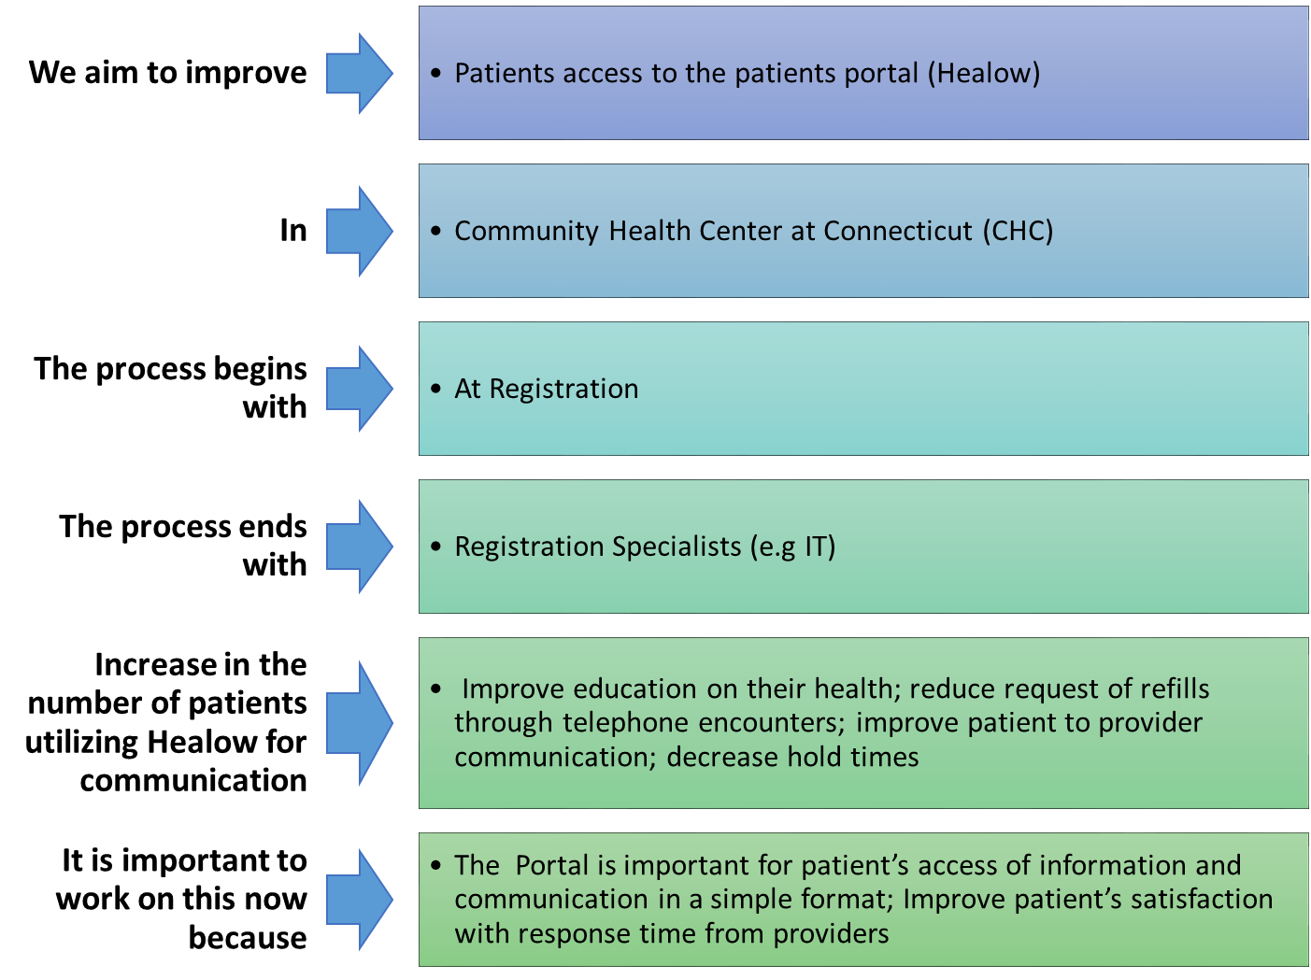
Aim Statement
3
Notes:
EVELINE
For this project we aimed to improve access to the patient portal Healow
T

Slide 4
The way you can see Healow Patient Portal access from ECW
Notes:
EVELINE

Slide 5
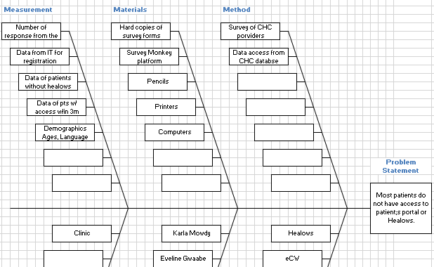
Notes:
EVELINE

Slide 6
Stakeholders
Dr. Armah, Chief Psychiatry Officer
Dr. Melman Psychiatry
Nicole Seagriff DNP, APRN, FNP-BC -Clinical Program Director, National Nurse Practitioner Residency Program, Associate Faculty, Weitzman Institute.
Tierney Giannotti SR Program Specialist - Population Health
IT Services
6
Notes:
Our Stake holders are:
EVELINE

Slide 7
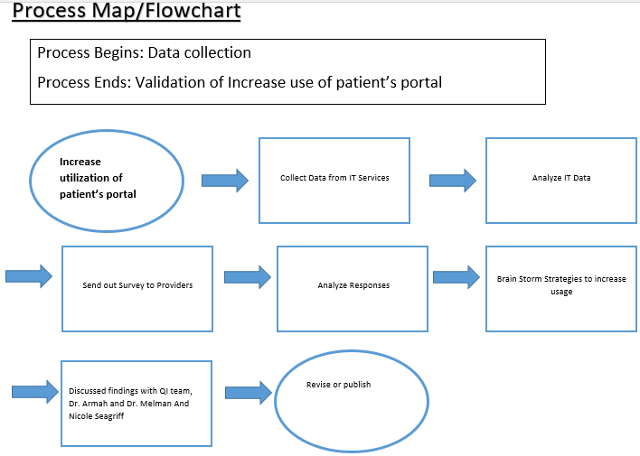
Process
7
Notes:
EVELINE

Slide 8
Data Prior 12 months from 4/23/2023
137522 list of active patients who had any component of an office visit in the last three years Medical, Dental, Behavioral Health
Data had an exception for COVID Only Patients/Non-CHC
Out of 137522 unique MRNs, only 23836 MRNs had used Portal >= 1 time in the last three years
Data was given in Tableau Dashboard
The only providers that show in our data are Primary Providers—no behavioral health or Chiro or Dentist show. Because they have to be assigned a PCP in order to have a portal
8
Notes:
Karla

Slide 9
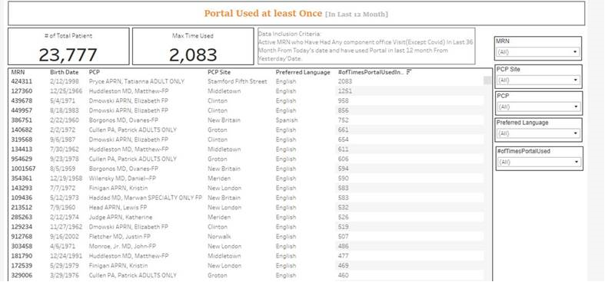
Example of Data
Notes:
Karla

Slide 10
Site Portal Use
Portal USERS
New Britain | 3852 | 16%
Meriden | 3788 | 16%
New London | 2965 | 12%
Middletown | 2503 | 11%
Hartford | 1774 | 7%
Stamford Fifth Street | 1385 | 6%
Danbury | 1311 | 6%
Clinton | 1077 | 5%
Waterbury | 1040 | 4%
Norwalk | 913 | 4%
Groton | 857 | 4%
Unknown | 852 | 4%
Bristol | 672 | 3%
Enfield | 583 | 2%
Stamford | 264 | 1%
Grand Total | 23836
Notes:
Most New Britain
Least Stamford Once again we need to figure out why we have unknown in the data.

Slide 11
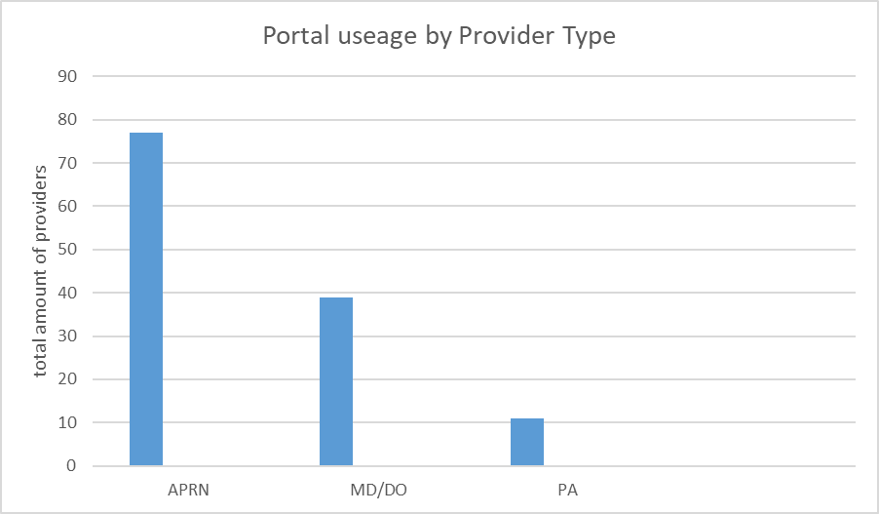
Notes:
APRN: 77, MD/DO: 39, PA: 11

Slide 12
More Data Top 5 Providers/ Lowest Providers
Unknown Provider 852 3.6%
Camano Selca APRN, Larissa 462 1.9%
Dmowski APRN, Elizabeth FP 461 1.9%
Minhas MD, Divjot FP 449 1.9%
Smith APRN, Tonya FP 448 1.9%
Marden APRN, Nicole | 1 | 0.0%
Rivas Siracusa APRN, Lissette Maria | 1 | 0.0%
Spaight MD, Deb | 1 | 0.0%
Tzellas MD, Andrew IM ADULTS ONLY | 1 | 0.0%
Notes:
The only providers that show in our data are Primary Providers—no behavioral health or Chiro or Dentist show. Because they have to be assigned a PCP in order to have a portal

Slide 13
Providers whose patients use it the most
Portal USES
Dmowski APRN, Elizabeth FP | 23607 | 3.6%
Smith APRN, Tonya FP | 15109 | 2.3%
Yim APRN, Andrew - ADULTS ONLY | 14372 | 2.2%
Huddleston MD, Matthew-FP | 13594 | 2.1%
Allyn APRN, Michelle L ADULTS ONLY | 13542 | 2.1%

Slide 14
Patient Portal use by patients at each site
Portal USESd
Meriden | 114247 | 17%
New Britain | 106351 | 16%
New London | 82606 | 13%
Middletown | 72493 | 11%
Clinton | 40682 | 6%
Stamford Fifth Street | 40108 | 6%
Danbury | 34045 | 5%
Hartford | 30493 | 5%
Waterbury | 27519 | 4%
Norwalk | 27423 | 4%
Groton | 26028 | 4%
Bristol | 21237 | 3%
Enfield | 16493 | 3%
Unknown | 10494 | 2%
Stamford | 6074 | 1%
Grand Total | 656293

Slide 15
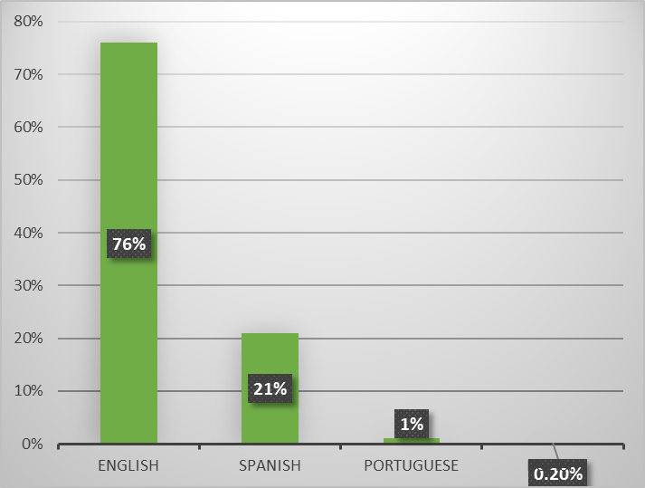
Primary languages use of the portal

Slide 16
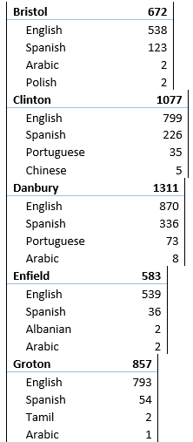
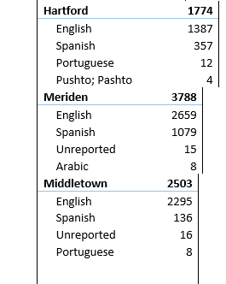
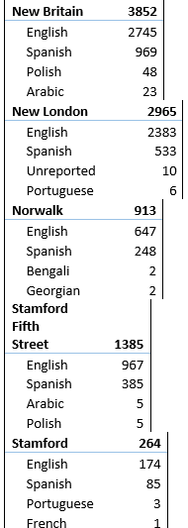
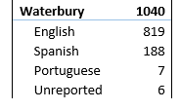

Slide 17
Data Average Age of Portal User
Is estimated to be 39 Years old

Slide 18
Our Approach to Change
List your ideas of things to change- Increase patient portal use by utilizing IT services for setting up the patient with the portal through phone communication as they do for telehealth.
Describe one or more PDSA cycles.
Plan: Increase patient portal usage, utilizing IT services
Do: Collect data
Study: Analyze Data
Action: Incomplete - TBD
What did you learn from your change efforts? That we work well together, teamwork. That there is someone in the company Tierney Giannotti who is very willing to help and get data for us. That QI projects are time intensive. IF you cannot finish the project by the end of the residency, it is OKAY it can continue thereafter.
18
Notes:
Karla

Slide 19
Results
We were not able to complete the Survey to Providers so we did not have that data. We also needed more stakeholders from the beginning.
Data was presented on Tableau Dashboard; we were not granted access to it, so we had to wait for the information to be transcribed. So we were not able to easily look at all the data at once.
Success is that we did get data and could see who uses the portal more by providers and patients and at which sites.
We learned that it takes much time and involves more people than we thought. Collect the data as soon as possible.
19
Notes:
Karla

Slide 20
Conclusions/Implications
What is/are the next steps for the work you initiated? Complete a Provider and Patient Survey but only at Danbury.
What would you do differently if you were starting this effort again? Collect data earlier. Narrow our project to just one site, like Danbury. Review projects from prior residency to see if we could continue one that was already started.
What advice do you have for future NP residents making improvement efforts at your site? Try to avoid doing such a broad project; narrow it to one site and then work outward from there.
20
Notes:
EVELINE

