Slide 1
Screening For Postpartum Depression at CHC
A QI Project by Erwin Nepomuceno, APRN, FNP-C, Dana Loo, APRN, PNP-C and Cecilia Hackerson, APRN,FNP-C
Representing CHC Meriden and CHC Hartford
June 22, 2023
Notes:
erwin

Slide 2
Process Flowchart
Identify Issue: postpartum depression
Identify problem statement
Identify stakeholder
Identify measures and data to collect
Identify beginning and ending of metric monitored
Identify how to collect data
Data collection
Data analysis
Isolate root cause
Develop solutions
Present QI problem, data, and solutions
Notes:
erwin

Slide 3
Background
Postpartum depression (PPD) is Major Depressive Disorder that occurs in the postpartum period and includes symptoms such as depressed mood, anhedonia, changes in weight, changes in sleep, feelings of worthlessness or failure, and thoughts of death or suicide.
PPD affects birthing parents worldwide. Research suggests rates of birthing parents affected by PPD are increasing from 11% in 2012 to 13% in 2019. Prevalence seems to increase within the first 6 weeks postpartum, but symptoms may arise much later.
Notes:
Dana
References:
https://mchb.tvisdata.hrsa.gov/PrioritiesAndMeasures/NationalOutcomeMeasures
https://www.ncbi.nlm.nih.gov/pmc/articles/PMC7587887/

Slide 4
Background
The ability to screen at multiple well-child checks from birth to 12 months is important in identifying individuals experiencing symptoms of PPD, particularly at the 1 and 2 month physicals since we know symptom onset is generally around the 4-6 week period.
However, social situations may not always allow for the birthing parent to be present at well visits.
Risk factors for PPD include previous history of anxiety/depression, labor complications, birthing parents aged 13-19, and lack of social or financial support.
Notes:
Dana
Social situations: foster care, cultural practices (i.e. confinement month), preference for another caregiver to accompany child

Slide 5
Background
Screening tools:
Edinburgh Postpartum Depression Screen (EDPS)
PHQ-2
PHQ-9
Notes:
Cecilia
Both the Edinburgh postpartum depression screen and PHQ are both effective in screening for postpartum depression

Slide 6
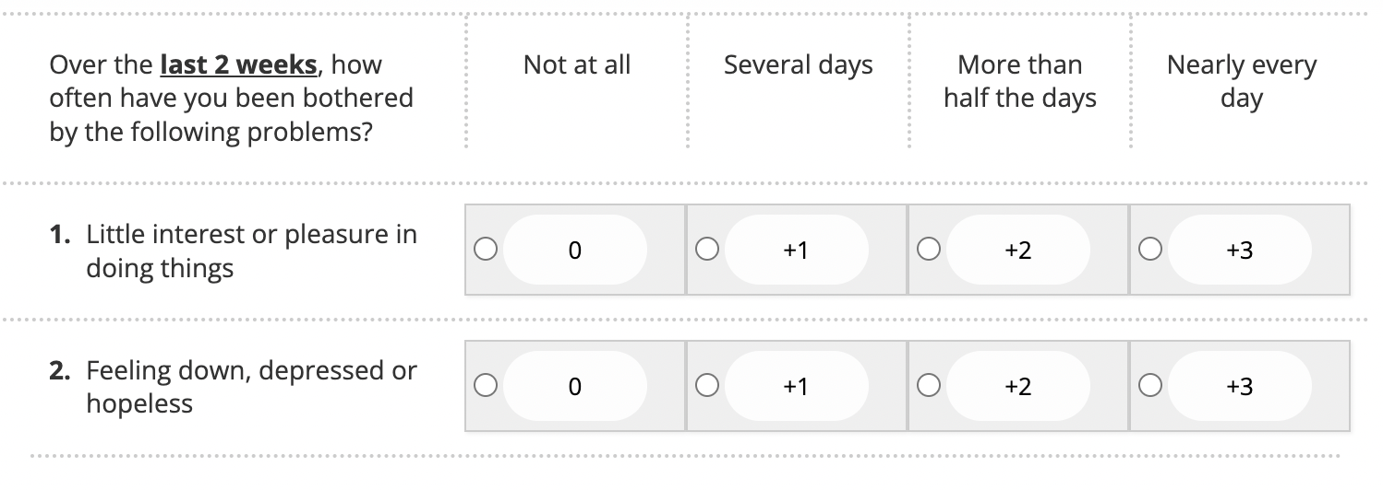
PHQ-2
Notes:
Cecilia

Slide 7
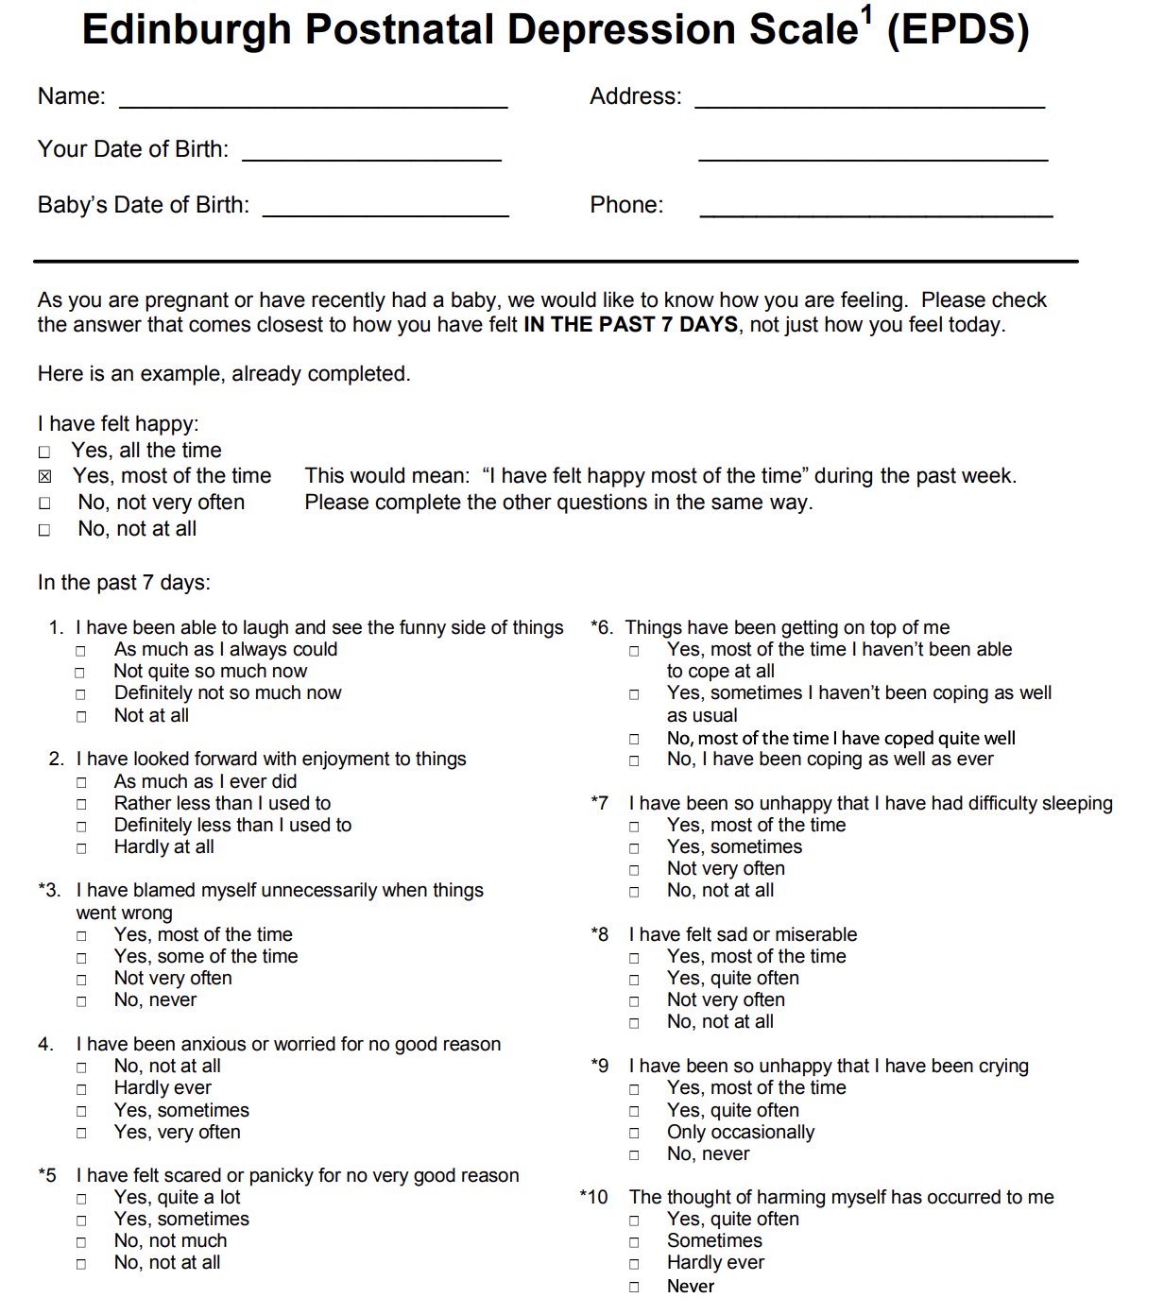
Edinburgh
Postnatal Depression Scale
Notes:
Cecilia

Slide 8
Problem Statement:
On a child's WCC visit, is there a process or policy in place to screen the birthing parent for postpartum depression if they are not present during the infant’s well child check visit?
We aim to improve the rates of screening for PPD of the birthing parents who are not present during WCC for postpartum depression.
Notes:
Dana

Slide 9
Stakeholders
Medical Assistants
Some patients opt out of the screening (i.e. don’t complete forms)
Variability of when to initiate screening (newborn visit vs. 1 month visit)
Variability of which screening tool to use (PHQ-2, PHQ-2, EDPS)
Providers
If we call the birthing parent to screen vs. screening in-office, how do we assess for safety and provide care for parents with positive screens over the phone?
Many ask questions about mood, suicidality, and social supports, but don’t necessarily include the scoring of screening tools
CHC QI/Data/IT teams
Patients
Many are asked about their postpartum mood in both the pediatrician’s office and in their OB follow-up appointments
Notes:
Dana

Slide 10
Fishbone Diagram
MEASURES
MATERIALS
METHODS
How many birthing parents are not present during WCC.
Office supplies
How frequent are birthing parents not present for WCC.
Data
Survey
AIM
Available appts for screening
Awareness, willingness and availability
Availability and if it is working
Conducive environment
ENVIRONMENT
PEOPLE
TECHNOLOGY
Notes:
Erwin
Materials:
Supplies: paper, pen, printer, laptop, internet connection, working email
Methods:
Survey: through email or online link or traditional pen and paper
Environment:
Conducive environment: - for birthing moms to open up
People:
Awareness, Willingness, and availability - of birthing mothers and office staff
Technology:
Availability and if it is working: Internet, email, survey link, eCW, office communication tool

Slide 11
Current Process for Screening CHC Patients for PPD
CHC Policy:
1. Mothers who receive prenatal care at CHCI will be screened for perinatal depression as part of the intake/risk assessment process or during the initial prenatal visit, again at 28 weeks and at the 6 week postpartum visit.
2. At the infant’s first visit with the PCP (newborn visit or 1 week visit), MAs will provide mothers with information about postpartum depression, CHCI’s screening policy, and CHC’s follow up process for mothers who screen positive. This will be a standard part of CHC routine Pediatric care at every subsequent wcc visit for the first year of life, so mothers who do not want to be tested must elect to opt out. Providers will also discuss this with mothers at that first visit. Screening will begin at the next visit (1 week, 2 weeks, etc.) using the PHQ-2 screening tool or PHQ9 in adolescent mother documented as a smart form or in the vitals section in eCW.
3. At the infant’s next visit (at age 1 week, 2 weeks, or next visit after information given), mothers who do not opt-out of screening will have screening performed by the Medical Assistant and this should be clearly documented in the chart. In the case that another caregiver (i.e. father, grandparent, foster parent or temporary guardian, older sibling, etc.) brings the infant to their visit, this screening may be deferred with notation that the screen was Not Applicable (NA) in the vitals section in ECW.
Notes:
Cecilia

Slide 12
DATA
Data that we were able to collect:
---> At what age of the newborn is the postpartum depression screening completed with moms?
---> Rates of screening by CHC as an organization
---> Rates of screening by Meriden CHC
---> Rates of screening by Hartford CHC
Data that we couldn’t collect:
-XXX-> Any details about calling birthing parent to screen if they are not present during WCC?
-XXX-> Demographics of birthing parents, including history of depression prior to delivery of infant.
Notes:
Dana

Slide 13
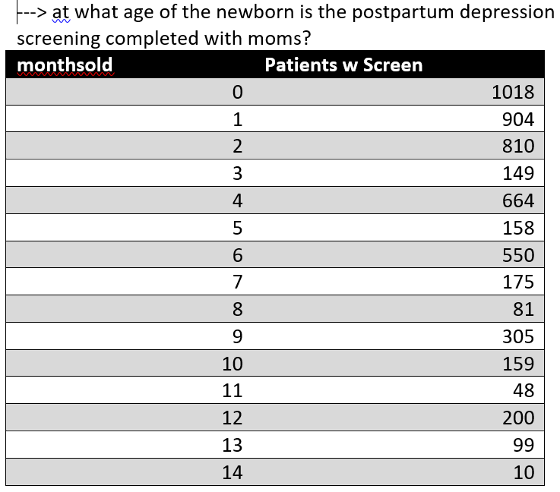
Notes:
Data

Slide 14
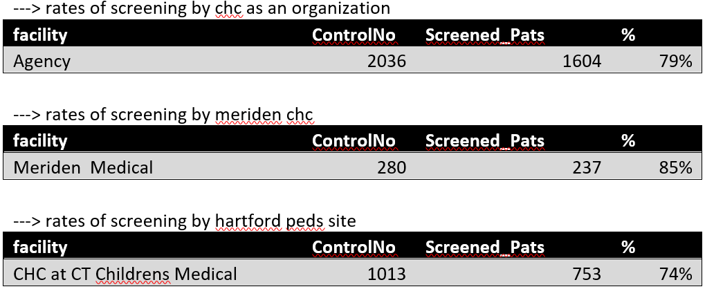
Notes:
Dana

Slide 15
Data analysis:
Per CHC policy birthing mothers who do not opt out are screened for PPD at every wcc visit.
The data shows how many birthing mothers are screened but doesnt explain how many mothers opted out or not screened even when present.
Notes:
Erwin

Slide 16
Data Analysis:
2. The data doesn't show if the percent not screened was due to:
Birthing mothers who opted out.
Birthing mothers who were not present during the WCC.
A failure to screen by staff.
3. Data doesn’t specify if screening was done once or at every WCC.
Notes:
Erwin

Slide 17
Possible Root Cause
1. Insufficient data collected or proper process in place to reflect policy.
2. There is great variability who shows up during wcc but no data to reflect this.
3. No process in place to screen birthing mothers when they are not present.
4. Need for Smart Forms to be available for EPDS in addition to PHQ-2 and PHQ-9.
5. Paper versions of the screening tools are not available in all languages.
Notes:
Erwin

Slide 18
Proposed added process:
Birthing mother NOT present during WCC
MA informs MP that birthing mother is not present during the visit
MP sends notification to inform birthing mother about PPD and need for screening through:
CDSS reminder
Texting bin / appt recall
Message through patient portal
Notes:
Cecilia
Updating the CDSS alert
Not always possible if patient drops off the schedule with no MA/MP warning
Texting bin if patient has not rescheduled the visit
Would need to incorporate PSA’s and call center staff into this plan
Message through patient portal
Not available at Hartford site

Slide 19
Reflection on project
Challenges
The variations between workflow and patient population in Hartford and Meriden
Barriers
Difficulty obtaining data
Data is incomplete
Unclear CHC policy
Successes
Ability to work through data and find other areas of improvement in the postpartum visits
Future explorations:
How many parents who screen positive for PPD seek treatment?
Notes:
Dana

