Slide 1
QI Project Experiences and Updates from CHC Post-Docs
Megan Culp, Areti Zikopoulos, Rosarimar Rodriguez, and Emily Gray

Slide 2
Background
The problem: The behavioral health intake process is multifaceted and complex, which can often lead new hires/residents to feel overwhelmed and confused.

Slide 3
Background - BH Intake Components
Consent, confidentiality
History of present illness
BH Treatment History
Substance use and other addictive behaviors
Legal history
DCF history
Personal history
Trauma History
Mental status exam
Suicide/homicide risk assessment
Spirituality/Religion
Leisure time
Medications
Case formulation
Disposition
Assessment/diagnosis

Slide 4
Aim Statement
Our goal is to create a comprehensive, streamlined instructional packet outlining the required steps for a behavioral health intake assessment for new hires and residents.

Slide 5
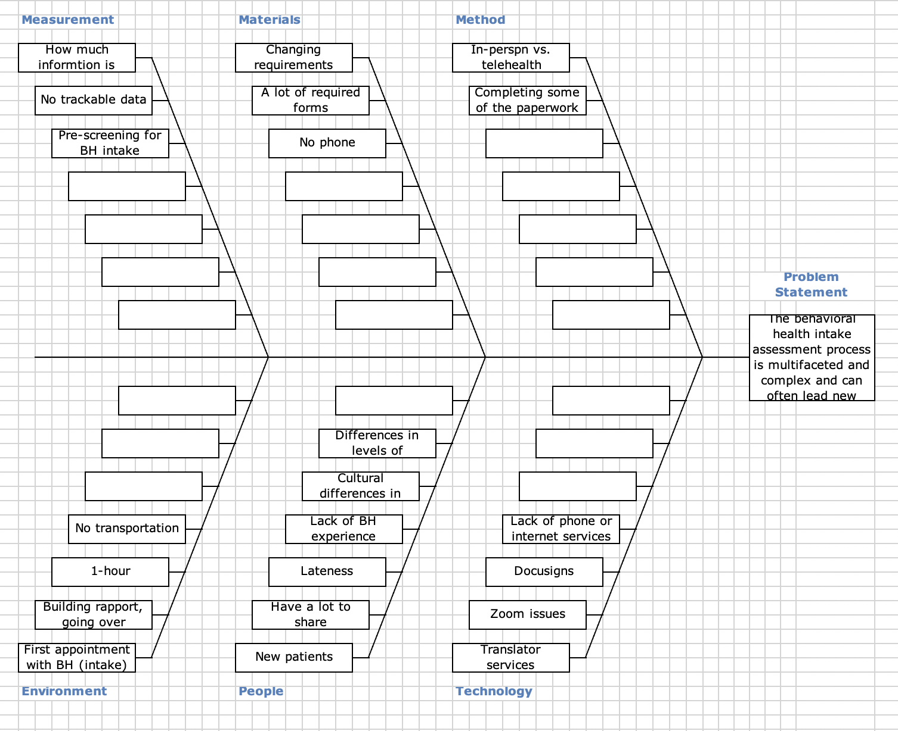
FishBone
Chart

Slide 6
StakeHolders
Stakeholders identified:
Chief Behavioral Health Officer, Tim Kearney
BH providers in BH QI meetings

Slide 7
StakeHolders
BH QI Meeting
BH providers provided feedback on our QI project plan. We were able to confirm that this is a presenting issue across sites.
Meeting with Tim
We identified the requirements from different agencies for the intake process.
BH QI Meeting
They were able to offer recommendations and identified barriers and limitations
Meeting with Tim
We discover the company is also trying to find a solution for the presenting issue.

Slide 8
Challenges We Faced
Challenge 1
Challenge 2
Challenge 3
Different schedules between team members that impacted our opportunities to coordinate meetings.
Purchasing data collector
Funding
Limitations from different accreditation/funding agencies to improve the intake interview process.
Notes:
Funding survey monkey for the specific answers options we proposed
(DPH=Department of Public Health)
Agencies like: Joint Commision, DCF, DPH SA (Substance Abuse), DPH POCA (Psychiatric Outpatient Clinic for Adults), HRSA, DDS (Department of Developmental Services), Private insurances

Slide 9
Questionnaire
1. Do you find the current intake process inefficient or
challenging to complete? Yes No
2. Do you typically finish all parts of the intake in the
allotted time-slot? Yes No
3. If no, are there any specific areas you find you most
often choose to skip?
List of intake section headings
4. Please answer the following on a scale from 1 (very
easy) to 5 (very difficult):
How difficult is it for you to complete the intake appointment?
5. For telehealth intake appointments, how often are you
sending the Rights and Responsibilities Form via
docu-sign?
25% 50% 75% 100%
6. Do you typically know that Language Services will be
necessary for an intake with sufficient notice?
Yes No

Slide 10
Questionnaire
8. If you could change anything about the intake process, what would it be?
9. What questions did you have about the intake process when you were first hired at CHC?
10. Do you have any comments about the current intake process that were not asked in this survey that you would like to share?
5. For telehealth intake appointments, how often are you
sending the Rights and Responsibilities Form via
docu-sign? 25% 50% 75% 100%
6. Do you typically know that Language Services will be necessary for an intake with sufficient notice? Yes No
7. Please choose one of the following. Would you prefer the intake paperwork:
Stay the same
Have the paperwork already sent to patient prior to
intake
Have one DocuSign form with all required intake documents included
Front desk providing required paperwork for patient

Slide 11
Ideas for future projects
Intake packet to be completed prior to appointment with BH provider (i.e., consents, releases, care plan)
Intake team to complete centralized intakes
Notifications prior to intake if patient requires interpreter

Slide 12
Questions

