Slide 1

Quality Improvement:
Implementing Diabetic Retinopathy Screening
Presented by: Katy Kellogg, FNP & Tatsiana Franco, PA-C

Slide 2

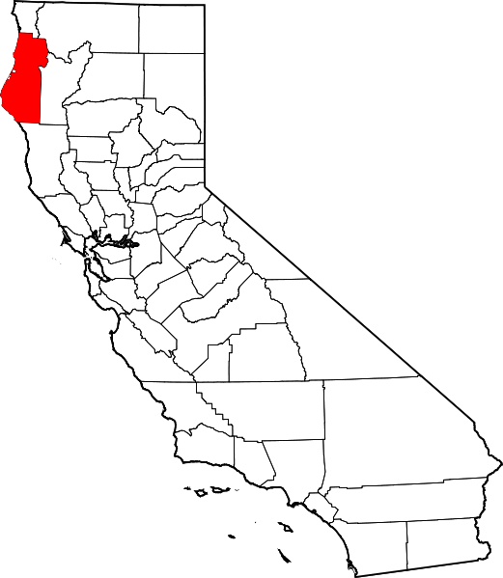


Background
Rural Community with limited access to health care
Lack of Ophthalmologists who provide diabetic retinal screening:
  Not taking new patients for retinal screening
  Wait time for screening is 1.5+ years for established patients

Slide 3
Aim Statement
Our goal is to improve the rate for in-house diabetic retinopathy exams in Eureka Community Health Centers, Family Medicine

Slide 4

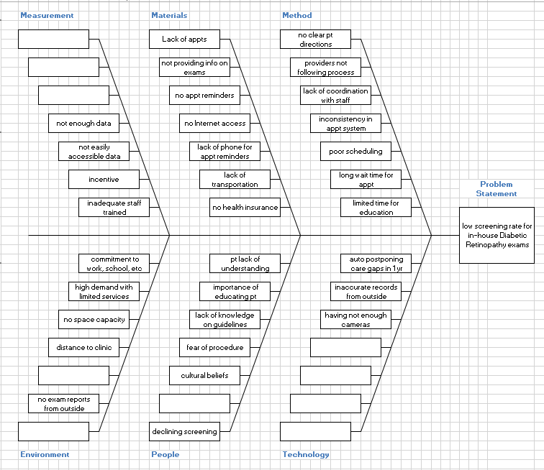

Slide 5

Stakeholders
(MAs, LVN, RN, Clinic Coordinator, Front Desk Clerk, Clinic Manager, NP)
During QI meeting, stakeholders provided with feedback on current screening and future QI plan, discussed barriers in screening process and possible solutions.
Challenges from Stakeholders Perspective
previously tried to implement in-clinic retinal screening with minimal success
screening required trained operators
time consuming process that takes 15-30 minutes
limited access to warm handoffs due to staffing
required additional space and specific environment for screening
needed community partners to read the images

Slide 6

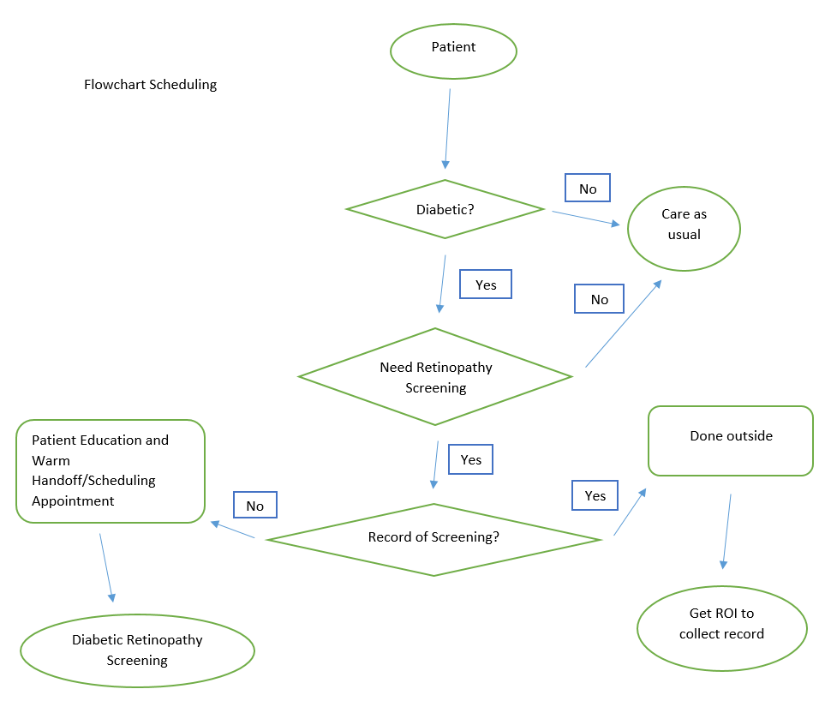
Initial Process

Slide 7
PDSA Cycle
Plan/Do:
Identify diabetic patients that are due for diabetic retinal exam
Do robust calls and assess the need for screening
Educate patients on importance of retinal screening
Place educational DM retinopathy posters in rooms
Create dot phrase and visual images for outreach
Obtain record If patient had screening done elsewhere
Provide options for exam, either through warm handoffs same day or in the future
Add additional 2 additional clinics for diabetic retinal screenings
Train supportive staff to do screening

Slide 8

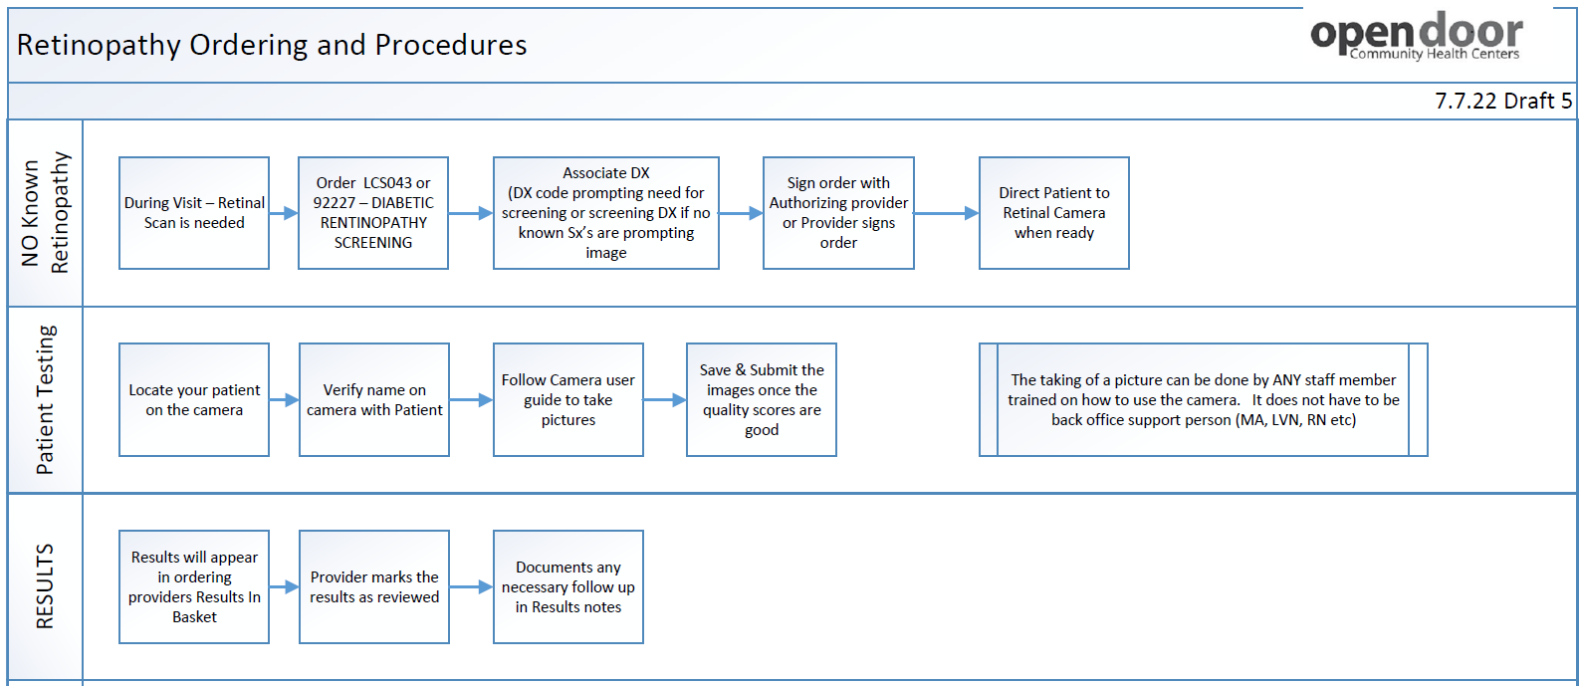
Diabetic Retinal Screening Workflow - WHO

Slide 9
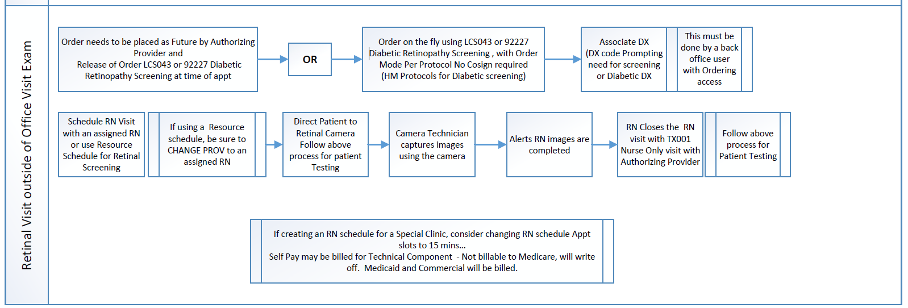
Diabetic Retinal Screening Workflow - Scheduled

Slide 10

PDSA Cycle
Study: More patients had retinal screening done during their appointments with providers. Patients were scheduling future appointments. More appointment slots are needed. Completion rate increased.
October – 23 %
November – 23%
December – 24%
January – 26%
February – 29%
March – 32%
April – 35%
May – 36%

Slide 11

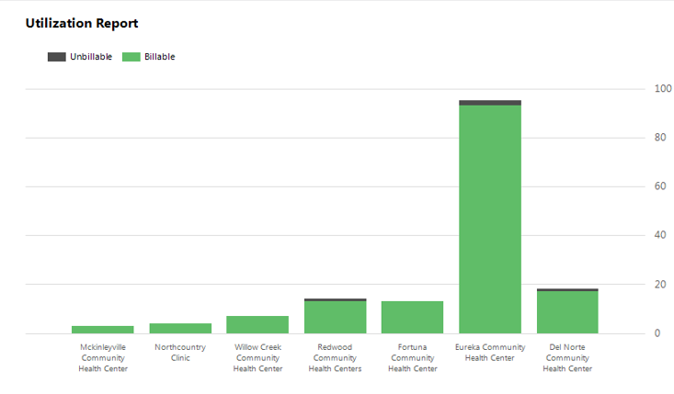
Results
1/2/2023-3/14/2023
Implemented Retinal Clinic

Slide 12

Lessons Learned
Challenging due to different levels of administrative buy-in and available resources
Difficulty with image capture (staying in dark room for 5 minutes to allow eyes to dilate)
Some patients more challenging than other to take images (history of cataract/glaucoma, eyelid problem, older patients, patients with tremors, smaller and less responsive to light pupils with opiate use, lighter eyes)
Warm handoffs (WHOs) challenging if only limited staff trained (need someone not rooming patients or having a few designated people to take pictures)
Scrub the schedule for possible WHOs for patients being seen in clinic that day
Need to educate patients about why this is important
Along with increased efforts at retinal imaging, also increased efforts to obtain retinopathy reports from specialists for patients with established retinopathy
Notes:
Pace of busy clinic can mean patients leave without getting their pictures done if no one can take images right before/after their visit.

Slide 13

PDSA cycle
Act:
Expand implementation to remaining sites
Explore use of non-clinical staff for retinal photography
Saturday and After Hours Clinics for Retinal Imaging
Partnerships with local Ophthalmologist for rapid referral for referable retinal pathology
Consider adding drops for dilation
NEW 2023 Medicaid Quality Measure Goal 56.61%
Notes:
For partnership

Slide 14
Questions?

