Slide 1

STRATEGIC
FOCUSED
Quality Improvement Seminar
Natalie Ewashkow & Mark Splaine
October 26, 2023
RELEVANT
INTERACTIVE
TEAM WORK
INFORMATIVE
FUN
SKILL BUILDING
Nurse Practitioner & Physician Assistant
Training Programs
Notes:
NATALIE

Slide 2
Session Goals
Hear about and discuss many of the things you are noticing and wondering about
Review the evidence for the team-based care approach in primary care
Share some examples of team-based care in your setting
2
Notes:
NATALIE

Slide 3
Roles
Theory burst presenter
  Mark
Facilitator, timekeeper & technical genius
  Natalie
Take-home thoughts
  Mark
3
Notes:
NATALIE

Slide 4
Agenda
Welcome and announcements (10 mins)
Theory burst on team-based care (20 mins)
Examples of team-based care (15 mins)
Brief break (5 mins)
Assignment small group discussion (30 mins)
Summary and take-home points (5 mins)
Preview of next session (5 mins)
4
Notes:
NATALIE

Slide 5
Curriculum Plan
  An overview of Quality Improvement (10/12/23)
  Care Observations & Stakeholder Considerations (10/26/23)
  Organizing your Improvement Project (11/9/23)
  Global Aim and Fishbone Diagram (11/30/23)
  Process Mapping (Flowcharts) (12/14/23)
  Measurement to Inform Change (1/11/24 & 1/25/24)
  An Approach to Testing a Change (2/8/24)
  Communication about your Improvement Effort (2/22/24)
  Stakeholder Analysis & Conflict Management (3/14/24)
  Managing Up and Gaining Leadership Buy-In (3/28/24)
  Negotiation (4/11/24)
  Negotiation and More About Cycles of Change (4/25/24)
  Sustaining your Improvement Effort (5/9/24)
  Resident Presentations (5/23/24, 6/13/24, 6/27/24)
Notes:
NATALIE

Slide 6
Office Hours
Natalie holds office hours for all residents on the 1st Thursday of each month from 12:30-1:30pm ET
Mark is available to meet with any resident or team from DePaul, HealthLinc, Holyoke, Open Door, Yakima or CHC, Inc. if you need an alternative time – just email to set up a time
6
Notes:
NATALIE

Slide 7
More About Projects
Nov-Jan
Charter
Jan-Feb
Data
Feb-Apr
Planning & Making Change
Aim
Fishbone
Stakeholders
Flowchart
Change Ideas
Apr-Jun
  Assess/revise changes
  Collect data
  Prepare presentation
Two expectations – periodic sharing & presentation
As much about the journey as the product
7
Notes:
MARK

Slide 8
High Performing, Patient-Centered, Team-Based
Primary Care
What does the evidence tell us?
Notes:
MARK

Slide 9






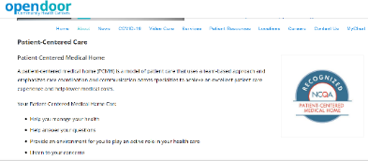



Patient-Centered Medical Home
9
Notes:
MARK

Slide 10
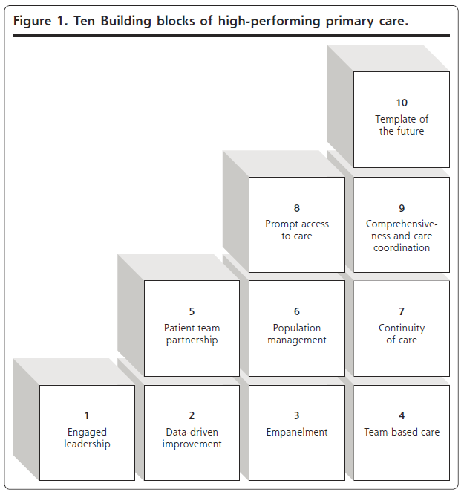
High Performing Primary Care
Foundational or first-tier blocks (1-4)
First-tier blocks support achievement of upper blocks (5-10)
Bodenheimer T, et. al. Ann Fam Med 2014;166-171. doi:10.1370/afm.1616
Notes:
MARK

Slide 11
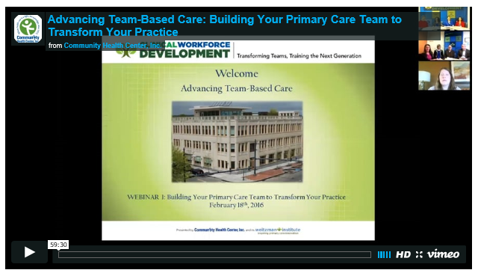
National Cooperative Agreement (NCA) Webinars
https://vimeo.com/635689772/3b16008074
11
Notes:
MARK

Slide 12
Advancing Team-Based Care Webinar
Why are teams important?
What do the data show about impact of teams?
What lessons were learned from studying 30 high-performing practices?
What is the composition of teams?
How do teams enable practices to become high performing?
What are the key functions/competencies of excellent primary care?
Additional webinars on many of the above topics can be accessed using the link below
  https://learn.chc1.com/course/view.php?id=6
12
Notes:
MARK

Slide 13
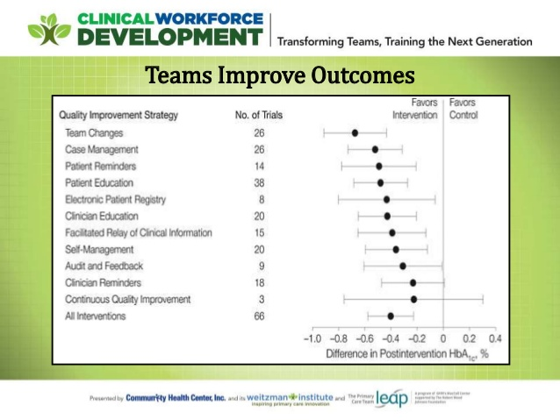
13
Notes:
MARK

Slide 14
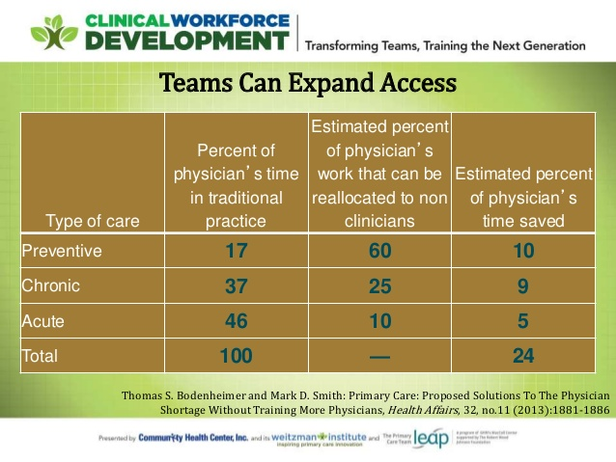
14
Notes:
MARK

Slide 15

15
Notes:
MARK

Slide 16
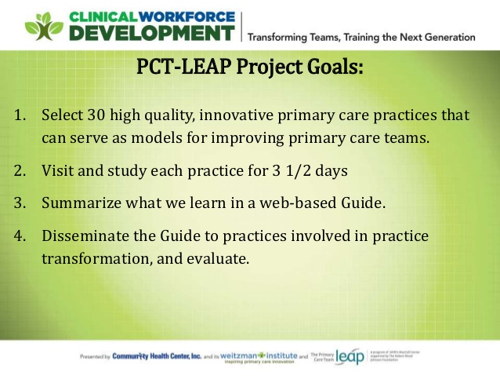
16
Notes:
MARK

Slide 17
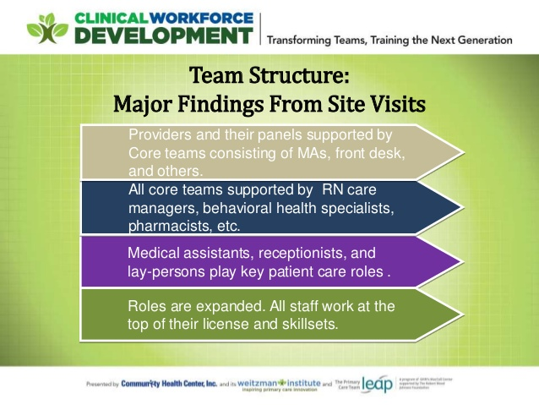
17
Notes:
MARK

Slide 18
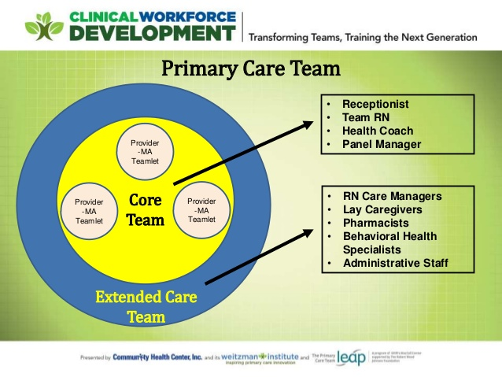
18
Notes:
MARK

Slide 19

https://improvingprimarycare.org
19
Notes:
MARK

Slide 20
Examples from Sites
We will ask for volunteers to share an example of team-based care you have seen at your site
  DePaul
  CHC Stamford
  Yakima
  HealthLinc
  CHC New Britain
In your response, please include any information you may have regarding:
  Who you work with directly when you provide care
  Which health professional disciplines are available at your site
We will hear from as many sites as time allows
20
Notes:
MARK

Slide 21



Break!
Take five minutes to recharge and refresh.
21
Notes:
MARK

Slide 22
Session II Assignment
Now we will focus on your assignment for today’s session
We will divide into two breakout rooms
  Natalie, and Mark will facilitate the discussion in each room
We will do two rounds of sharing in each group
  Round 1: a quality improvement priority for your organization
  Round 2: an example of something you noticed and are wondering about in their clinic setting
Each group will ask for a volunteer to report on highlights of the discussion
After the small group discussion, we will return to the large group to hear each reporter’s summary ideas
22
Notes:
www.clinicalmicrosystem.org
22
NATALIE

Slide 23
What haven’t we figured out yet?
Questions or issues that remain unclear?
23
Notes:
NATALIE

Slide 24
Take-home Thoughts
Nicole – share 1 or 2 ideas you will take away from our discussion
24
Notes:
NATALIE

Slide 25
Summary
You have learned about frameworks to guide your thinking about how to organize improvement work
You have identified some of your organization’s priorities for improvement
You have begun to investigate processes in the clinical environment that you think can be improved with quality improvement interventions
  Consider using one of these processes for your team’s QI project
We have discussed the person-centered, team-based approach to primary care and emphasized the great opportunity at health centers to provide integrated care
25
Notes:
NATALIE

Slide 26
Assignment for Session III
Send a list of who you will be working with and what you will focus on for your QI project to Mark and Natalie by 11/8/23
Work with your project team to make a draft of the project charter
Send your draft project charter to us by Wednesday, 11/8/23 at 6pm EST
26
Notes:
www.clinicalmicrosystem.org
26
NATALIE

Slide 27

Notes:
NATALIE

Slide 28

A PROJECT CHARTER adds structure as you plan
What are we trying to accomplish? & Why?
Will we know if the change made an impact?
  A tool for training and/or communication
  Baseline data
  Goals
  Measures
  Stakeholders
  Barriers
  Expectations
  Ideas
28
Notes:
NATALIE

Slide 29
Date charter revised
Problem Statement
Create this statement with team
Team Members
Central Question/ Why work on this now?
Include coach, sponsor and each member (core and extended)
Measures
What is the impact anticipated OR what are the current losses
Scope
Goal Statement
Measurement from PI Goals
Milestones/ Dates
Goals from PI Goals spreadsheet – baseline and follow up.
Date team first meeting and date project charter created
Document first & last process steps.
Deliverables and when they are due
If implementation goal –evidence that it is implemented?
List areas of exclusion for this project
Create this statement with team
Date each PDSA launched, completed.
Project Charter Template
Notes:
NATALIE

Slide 30
Session III Highlights
We will hear reports from several groups about their draft project charter for their project idea
We will introduce and briefly discuss the templates for creating:
  A global aim statement
  A fishbone diagram
30
Notes:
www.clinicalmicrosystem.org
30
NATALIE

Slide 31
References
The Primary Care Team Guide (https://improvingprimarycare.org)
Bodenheimer T, Ghorob A, Willard-Grace R, Grumbach K. Ann Fam Med 2014;166-171. doi:10.1370/afm.1616
NCA Implementing Team-Based Care Webinar (https://vimeo.com/635689772/3b16008074)
Batalden PB, Davidoff F. Qual Saf Health Care. 2007; 16:2-3
31
Notes:
www.clinicalmicrosystem.org
31
NATALIE

