Slide 1
Postgraduate Nurse Practitioner Residency & Fellowship Program Learning Collaborative
Session One: Tuesday November 21st, 2023
Notes:
Meaghan

Slide 2
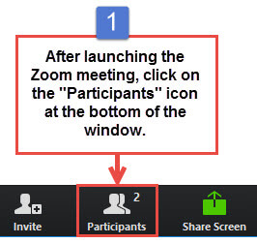
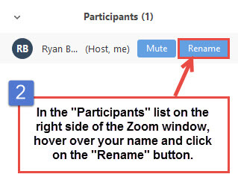
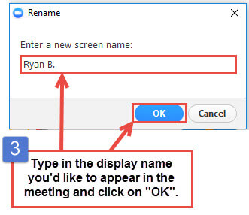
Get the Most Out of Your Zoom Experience
Please keep yourself on MUTE to avoid background/distracting sounds
Use the CHAT function or UNMUTE to ask questions or make comments
Please change your participant name to your full name and organization
“Meaghan Angers CHCI”
Notes:
Meaghan

Slide 3
Session 1 Agenda
1:00-1:15 | Introduction to CHCI, Collaborative Expectations, & Role of the Coach
1:15-1:30 | Team Introductions: Part I
1:30-1:35 | Program Drivers
1:35-1:45 | Developing Mission and Vision Statement
1:45-1:50 | Resource Assessment
1:50-2:05 | Team Introductions: Part II
2:05-2:15 | Support from Leadership/Board of Directors
2:15-2:20 | Communication Within Your Organization About the PGR Program
2:20-2:25 | Basic Overview of Program Structure
2:25-2:30 | Q/A, Wrap-Up and Evaluation
Notes:
Meaghan

Slide 4
Learning Collaborative Faculty
Margaret Flinter, APRN, PhD, FAAN
Co-PI, NTTAP
CHCI’s Senior Vice President/Clinical Director
Director Emeritus, WI, Senior Investigator
Founder of America’s first nurse practitioner residency program
Kerry Bamrick, MBA
Executive Director, NNPRFTC
Coach Mentor
Charise Corsino, MA
Program Director, NP Residency Programs
Coach Mentor
Nicole Seagriff, DNP, APRN, FNP-BC
Clinical Program Director
Kathleen Thies, PhD, RN
Consultant, Researcher
Evaluation Faculty
Amanda Schiessl, MPP
Deputy Chief Operating Officer, MWHS
Co-PI & Project Director, NTTAP
Bianca Flowers
Project Manager, NTTAP
Meaghan Angers
Project Manager, NTTAP
4
Notes:
Meaghan

Slide 5
Moses Weitzman Health System Affiliates
Notes:
Primary care has been at the heart of Community Health Center, Inc.’s (CHC) mission since its founding in 1972. Grounded in our mission, the Moses/Weitzman Health System (MWHS) was established to support exponential growth and continued innovation. The MWHS is the parent company of CHC; the Community eConsult Network, Inc. (CECN) d/b/a ConferMED; the National Institute for Medical Assistant Advancement (NIMAA); and the Consortium for Advanced Practice Providers. The Weitzman Institute (founded by CHC) is embedded in the MWHS. Each affiliate will continue to have its own board of directors and its own mission. The name of the health system honors Lillian Reba Hyman Moses (1924–2012) and Gerard (Gerry) Weitzman (1938–1999), who were among the earliest supporters and board members of CHC.

Slide 6
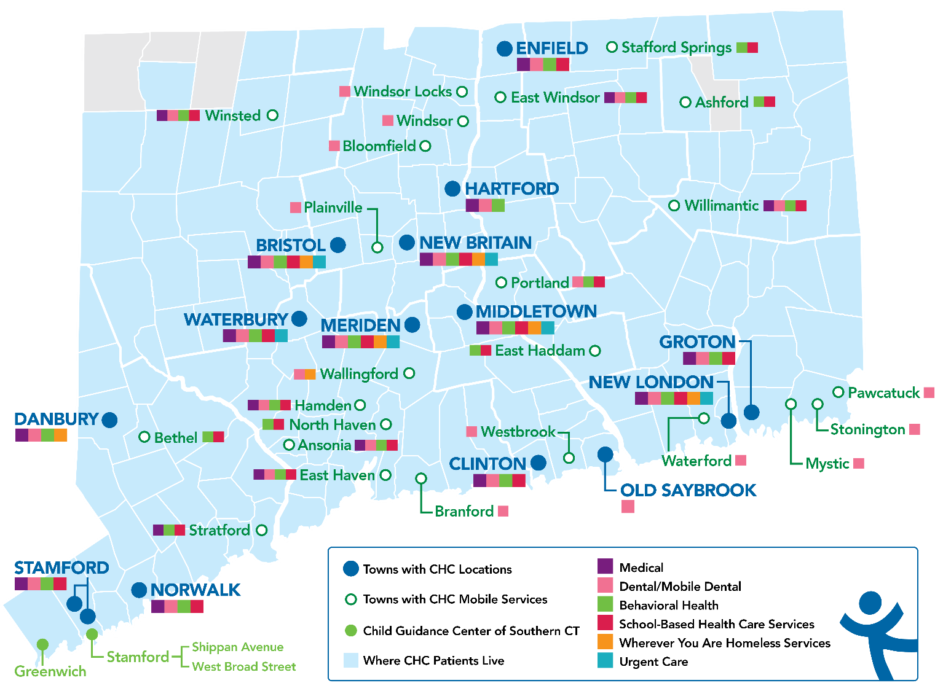
Locations and Service Sites in Connecticut
CHC Profile:
Founded: May 1, 1972
Staff: ~1,200
Total Patients Served: 102,275
Clinical Sites across CT: 19
SBHCs across CT: 180+
Students & Residents/year: 390
Three Foundational Pillars:
Clinical Excellence
Research & Development
Training the Next Generation

Slide 7
National Training and Technical Assistance Partners
Clinical Workforce Development
Provides free training and technical assistance to health centers across the nation through national webinars, learning collaboratives, activity sessions, trainings, research, publications, etc.
Notes:
Meaghan

Slide 8
2023-2024 Cohort
Bartz-Altadonna Community Health Center | California
Charles B. Wang Community Health Center | New York
Chase Brexton Health Care | Maryland
Community Clinic Association of Los Angeles County (CCALAC) | California
Crossing Healthcare | Illinois
Hope Christian Health Center | Nevada
Klamath Health Partnership | Oregon
Nasson Health Care | Maine
Neighborhood Outreach Access to Health | Arizona
Peninsula Community Health Services | Washington
Penobscot Community Health Center, Inc. | Maine
Primary Health Network | Pennsylvania
WellSpace Health | California
Wheeler Health | Connecticut
8
Notes:
Meaghan

Slide 9
Collaborative Structure and Expectations
Notes:
Meaghan

Slide 10
Welcome to the Postgraduate Nurse Practitioner Residency & Fellowship Program Learning Collaborative!
The Postgraduate Residency Programs Learning Collaborative is a 6-month participatory learning experience offered by the National Health Center Training and Technical Assistance Partners (NTTAP) Cooperative Agreement for the Development Area of Clinical Workforce Development, funded by the Health Resources and Services Administration, and hosted by Community Health Center, Inc. (CHCI) in Middletown, CT.
The Collaborative is designed to provide transformational strategies and coaching support to help Federally Qualified Health Centers (FQHCs) implement postgraduate residency programs in nursing. The Collaborative will provide a series of videoconference learning sessions with FQHCs from across the country, ongoing mentoring, technical assistance, and access to web-based tools.
Notes:
Meaghan

Slide 11
Objectives of the Learning Collaborative
Build the case for starting a postgraduate residency program in their organizations.
Identify the clinical and financial resources required to support a postgraduate residency program.
Identify the operational and administrative activities that support a postgraduate residency program.
Develop the structure and curriculum for a postgraduate residency program.
Evaluate postgraduate resident learner outcomes and the impact of the postgraduate residency program.
Prepare for program accreditation
Contribute to the learning among participating FQHCs by engaging in Learning Collaborative activities.
Notes:
Meaghan

Slide 12
Learning Collaborative Structure
Six 90-minute Learning Collaborative video conference sessions
Bi-weekly calls between coach mentors and practice coach
Bi-weekly team workgroup meetings
Use Online Moodle Learning Network (Share Your Work, Resources, etc.)
Learning Session Dates
Learning Session 1 | Tuesday November 21st
Learning Session 2 | Tuesday December 19th
Learning Session 3 | Tuesday January 16th
Learning Session 4 | Tuesday February 13th
Learning Session 5 | Tuesday March 5th
Learning Session 6 | Tuesday April 2nd
12
Notes:
Meaghan

Slide 13
Conditions of Success
Attendance at collaborative learning sessions and engagement in weekly coach/mentor calls
Engagement in work between sessions that included protected time to meet as a team, trust and respect.
Commitment of trained coaches to improving their skills and helping teams achieve results
Support of practice leadership for time, resources, spread and sustainability
Notes:
Kerry

Slide 14
Coach Mentor and Team Coach Roles
Role of Coach Mentor | Role of Team Coach
Meet with Team Coaches bi-weekly to discuss progress Work directly with Team Coach to identify successes and work through challenges/barriers. Mentors Team Coach on how to run an effective meeting for their team and develop their coaching skills Be available for individual sessions with Team Coaches for specific team and program development | Teach team how to prepare and facilitate effective meetings Provide coaching support between and during weekly internal team meetings Participate in bi-weekly Zoom calls with Coach Mentors to discusses progress, challenges, and stuck points. Help team follow timelines, complete assignments, and progress reporting Share team’s progress with the Coach Mentor and other Team Coaches during collaborative sessions
Notes:
Kerry

Slide 15
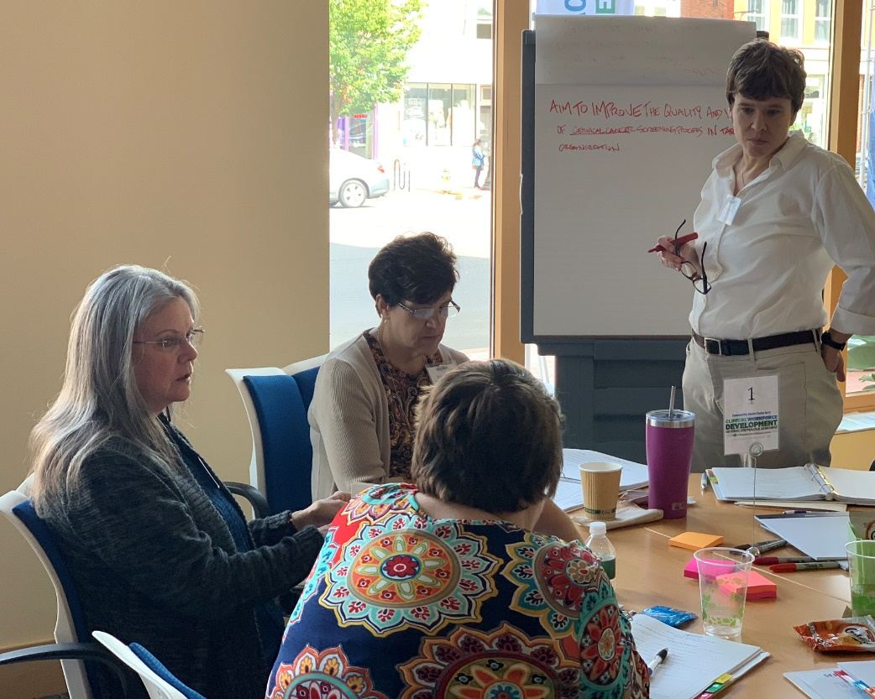
Team Coach Role
Help and support teams working together to use new skills, achieve their aims, document their work
Help teams complete assessments and action period assignments to stay on track
Help teams run effective weekly team meetings and facilitate teamwork
Notes:
Kerry

Slide 16
Team Introductions
 | Order of Introductions
1 | Bartz-Altadonna Community Health Center
2 | Charles B. Wang Community Health Center
3 | Chase Brexton Health Care
4 | Community Clinic Association of Los Angeles County (CCALAC)
5 | Crossing Healthcare
6 | Hope Christian Health Center
7 | Klamath Health Partnership
Name of your practice, size, etc.
Names and positions of participating team members
Goals for the learning collaborative
Notes:
Meaghan

Slide 17
Bartz-Altadonna Community Health Center
Our CHC NTTAP Collaborative Team
Mary Cummings
Pamela Griffin
Silvia Salomon
Chief Executive Officer
Chief of Staff
Chief of Programs, QI/QA,
Compliance, Claims and Risk Officer

Slide 18
GOALS & Objectives
To create a retention plan and build bench strength
To become premier medical training site
To add skills to our providers toolbox
First FQHC in area-served community for 11+ years
Population served provides a rich training ground for residents
Allows Bartz to be self-sufficient and not have to rely on other organizations
The only other residency program in the area is an MD program with the local private hospital
PCMH Certified
Senior medical staff can expand their skills through developing teaching practices
Participating medical staff will experience more job diversity and grow from new challenges
Develops leadership practice among the providers
Encourages participating providers to consider increasing their scope of medicine and license
Area served has experienced huge losses in Family medicine providers
Provides residents with the opportunity to work within our organization to find out if they are a fit and Bartz is also able to determine the same
Ongoing residency programs provide a stream of practitioners and increases patient access to care
Many residents become familiar with the area and patients and want to continue working within the clinic

Slide 19
Charles B. Wang Community Health Center – New York, New York
Established 1971
5 locations in Manhattan and Queens
55,000 patients; 277,000 visits
Predominantly Asian population; 80% speak best in non-English language
Challenges:
1 Recruiting Primary Care Staff
2. Providing appropriate training and supervision to NPs

Slide 20
Goals
Ensure nurse practitioners and newer physicians have a core knowledge and practice base
Create training platform for education, interactive learning, and forum to share in experiences
Instill a culture of training and learning
Recruit a pipeline of new NPs to fill positions in Adult Medicine
Develop formal team structures of care teams
Recruit new and existing physicians and NPs to be clinician – educators.
Staff
Perry Pong, MD Former Chief Medical Officer, at CBWCHC 16 years and prior at a NYC teaching hospital for 17 years
Julie Yoshimachi, DNP, Director of Hepatitis B Program, Preceptor Columbia University NP students
Helang Cho Kravitz, MD, Internal Medicine Assistant Chief, Site Director for CUNY Introduction to Medicine course
Catherine Lee, MD, Internal Medicine Chief
Virginia Lee, FNP, CDE
Ady Oster, MD, Chief of Population Health

Slide 21
Rebecca Coppola, Director, NP Fellowship Program
Notes:
Chase Brexton Mission: To provide compassionate and integrated high quality health care that honors diversity, addresses health inequities, and advances wellness in the communities we serve.

Slide 22
Program Participation Goals
Develop our understanding of the accreditation process
Prepare for incoming post-graduate fellows in July 2024, with emphasis on:
Quality Improvement Structures
Evaluation Processes
Notes:
Vision: To increase the capacity of FQHCs to meet the needs of sexual and gender health minorities and people living with HIV through preparing and retaining excellent FNP staff.
Mission: To develop the capacity of newly graduated FNPs as clinicians who diagnose and manage acute and chronic illness, prevent disease, and promote health & wellness, as members of a collaborative interdisciplinary team in an FQHC environment.

Slide 23
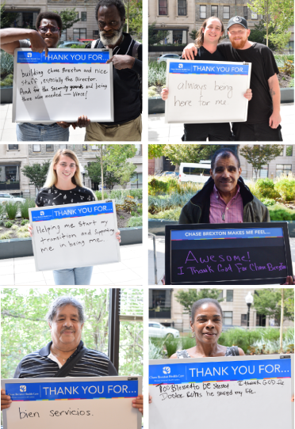
Chase Brexton NP Fellowship Team
Rebecca Coppola, CRNP – Director
Niemah Chapman, CRNP – Mentor
Annie V. Mouafo, CRNP – Mentor
Leah Hart, CRNP – Mentor
Aalok Malankar, MD – Mentor
Sallie Rixey, Consultant – Advisor (Mentor of Mentors)
Sebastian Ruhs, CMO – Leadership Team Sponsor

Slide 24
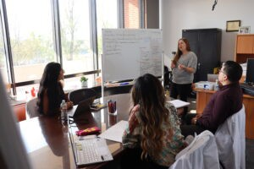
FNP Community Care Residency Program
Community Clinic Association of Los Angeles County: is a non-profit member association comprised of 65 health centers. We provide our members with training, advocacy, and technical assistance in many areas including workforce.
Nurse Practitioner Residency Program
Our Program: in partnership with the Chin Family Institute for Nursing, we have developed a 12-month post graduate residency program for newly graduated Family Nurse practitioners. Our program aims to train the next generation of primary care health professionals by improving their clinical skills, confidence, productivity, job satisfaction, as well as contribute to employer satisfaction and workforce retention.
Team:
Alexander Gil, Workforce Program Manager
Lisa Fisher, Vice President of Member Relations
Lorie H. Judson, Executive Director of the Chin Family Institute for Nursing
Zoe-Anne Fitzhugh, Consultant for the Chin Family Institute for Nursing

Slide 25
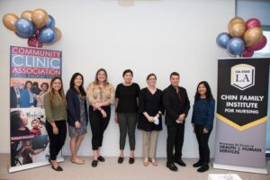
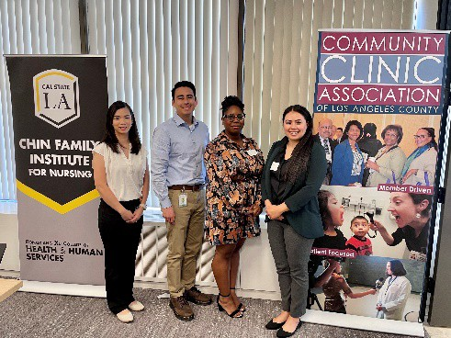
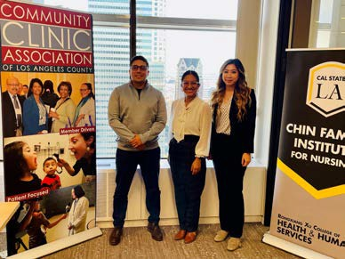
Goals for participation:
Nurse Practitioner Residency Program
Learn ways to improve our program and make it sustainable.
Learn about the accreditation process and requirements.
Learn how to expand our program to include Physician Assistants.
Learn best practices from others.

Slide 26
Crossing Healthcare
Decatur, IL

Slide 27
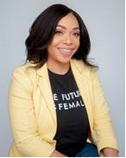
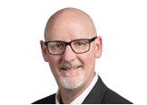
Team Coach
Zachary Sowa, DMSc, PA-C
Associate Medical Director
Crossing Healthcare
zsowa@crossinghealthcare.org
Team Member
Kendall Wallace, APRN, FNP-BC
Family Medicine Nurse Practitioner
Crossing Healthcare
Kwallace@crossinghealthcare.org
Team Member
Amanda Jacobsen, PA-C
Physician Assistant
Crossing Healthcare
ajacobsen@crossinghealthcare.org

Slide 28
Goals for collaborative
We hope to streamline the onboarding process and provide structure and consistency within the Advanced Practice Provider (APP) positions. APP’s are more likely to succeed and develop career satisfaction if they feel comfortable with their onboarding process at a new position. They also experience greater success when they feel appropriately trained to manage the types of unique patients seen at an FQHC.
We also hope to better understand the APP’s role in supporting and improving the core components of a Community Health Center and establish clear guidelines for achieving success and sustainability in this setting.

Slide 29
Hope Christian Health Center
Faith Based FHQC
KEY PLAYERS:
MYLES ADAMSON, APRN- Director of Outreach & Corporate Location Clinic
EILEEN CHAVEZ, APRN- Medical Director of Recuperative Care Center & MLK Location Clinic
DARLENE FRANCISCO, APRN KATHY NGUYEN, APRN

Slide 30
ORGANIZATIONAL GOALS
To enhance the clinical competence of nurse practitioners by providing exposure to a wide range of complex patient cases and diverse clinical settings.
To have effective collaboration and communication skills necessary for providing patient-centered care within a multidisciplinary healthcare team.
Equip nurse practitioners with the knowledge and skills to critically evaluate and apply current evidence in their clinical practice.
Instill a commitment to delivering safe, high-quality healthcare and contribute to initiatives aimed at improving patient outcomes.
Provide opportunities for nurse practitioners to participate in spiritual care training and workshops.
Promote compassionate care that considers patients, spiritual needs, providing emotional and spiritual support as appropriate.

Slide 31
Klamath Health Partnership
Six site, CHC in Klamath County in rural Southern Oregon
Project Team:
Jan Hallock, DO – Family Physician and Education Director
Jennifer Ochoa – Student Coordinator
Cord Van Riper – Chief Operations Officer

Slide 32
Klamath Health Partnership Collaboration Goals
Build
Build on education and rotation curriculum to better train new NP and PA hires
Enhance
Enhance clinical onboarding and grow future faculty
Improve
Improve PA and NP retention
Develop
Develop policies and procedures around postgraduate APP residency program
Stretch
Use learnings to plan future family medicine residency program

Slide 33
Program Drivers:
Building the Case for a Postgraduate Residency Program
Notes:
Kerry

Slide 34
Program Drivers
What are your drivers?
Recruitment
Training
Retention
Clinical Workforce
Your organization should ask:
Why do we want to start a postgraduate residency training program?
Notes:
Kerry
CHC’s Drivers –
Increase the nation’s ability for every person to have an expert primary care provider, but particularly in underserved communities and special populations.
Provide new NPs committed to practice careers as PCPs with an intensive training experience focused on training to clinical complexity and high performance.
Provide a highly structured transition from university to practice that supports the development of confidence, competence, and mastery in the FQHC setting.
Utilize the postgraduate training year to develop expertise in high volume/high burden condition such: chronic pain, HIV, Hepatitis C, addiction.
Introduce new PCPs to innovations like Project ECHO®, eConsults, team-based care, data driven QI.
Create a nationally replicable, sustainable model of primary care based postgraduate training for new NPs.

Slide 35
CHC’s Drivers for Developing the Model of
Postgraduate NP Residency Training
Increase the nation’s ability for every person to have an expert primary care provider, but particularly in underserved communities and special populations
Provide new NPs committed to practice careers as PCPs with an intensive training experience focused on training to clinical complexity and high performance
Provide a highly structured transition from university to practice that supports the development of confidence, competence, and mastery in the FQHC setting
Attract new NPs to safety net settings in communities rural and urban, large and small, and prevent attrition through intensive support in first year
Utilize the postgraduate training year to develop expertise in high volume/high burden condition such: chronic pain, HIV, Hepatitis C, addiction
Introduce new PCPs to innovations like Project ECHO®, eConsults, team-based care, data driven QI
Create a nationally replicable, sustainable model of FQHC-based postgraduate training for new NPs
Notes:
Kerry

Slide 36
Polling Questions
What is your primary reason for starting a postgraduate training program?
Recruitment and Retention
Committed to Training
Staff Development
Staff Satisfaction
Patient Access
Unsure
Notes:
Kerry

Slide 37
Developing a Mission/Vision Statement
Notes:
Charise

Slide 38
Mission and Vision: Define your program’s mission and vision
But Why?
Focuses your program’s future
Provides your team with a common foundation and focus
Supports in making strategic decisions
Provides a consistent external message to key stakeholders
Notes:
Charise

Slide 39
Mission Statement
Mission – your program’s mission statement should define the core purpose of your program. The statement will provide a clear and concise focus of the program which will remain over time even components or activities change.
Tip – Be clear and concise, while also
communicating the essential components
Notes:
Charise

Slide 40
CHCI’s Mission Statement
CHC’s Nurse Practitioner Residency Training Program provides new Nurse Practitioners with the depth, breadth, and intensity of training to clinical complexity and high performance primary care in the service delivery setting of a community health center that leads to competence, confidence and mastery as a primary care provider and improved health outcomes for the patients they care for and the health system as a whole.
Notes:
Charise

Slide 41
Vision Statement
Vision – your program’s vision statement should define your program’s aspiration goals and preferred future. It is a forward thinking statement about the desired change your program will have.
Tip – Think about the larger goals you are trying
to achieve in starting a program and what
it will accomplish looking forward 5 years
Notes:
Charise

Slide 42
CHCI’s Vision Statement
CHC’s Nurse Practitioner Residency Training Program aims to train the next generation of an expert primary care workforce and to develop future Nurse Practitioner leaders in Community Health Centers and other safety net settings that will contribute to providing and improving the access to and quality of health care to our nation’s most vulnerable populations.
Notes:
Charise

Slide 43
Communicating Your Mission and Vision
Mission and Vision Statements should be reflected in your core program documents
Your team should refer back to your mission and vision often especially for your internal decision making
Be sure to prominently feature your mission and vision in external communication for the benefit of applicants, stakeholders and interested parties
Notes:
Charise

Slide 44
Strategies for Developing Mission and Vision Statements
with your Team
Each team member can draft their own idea of the mission and vision statement for the program
Share them with the group
Discuss which parts you like best from team member’s statements or pull out key words that resonate with your team
Develop a new statement based on what your team members came up with
Or maybe one of your team members knocked it out of the park and you all agree on that!
Notes:
Charise

Slide 45
Resource Assessment:
Clinical and Financial Resources
Notes:
Charise

Slide 46
Resource
Assessment
Notes:
Charise

Slide 47
Team Introductions
 | Order of Introductions
8 | Nasson Health Care
9 | Neighborhood Outreach Access to Health
10 | Peninsula Community Health Services
11 | Penobscot Community Health Center, Inc.
12 | Primary Health Network
13 | WellSpace Health
14 | Wheeler Health
Name of your practice, size, etc.
Names and positions of participating team members
Goals for the learning collaborative

Slide 53
Our Goal: Transforming the Health of Our Community.
Notes:
We are NOAH! Our goal is “Transforming the Health of Our Community”. From Scottsdale to Glendale, Arizona NOAH serves the north Valley providing affordable, high-quality healthcare services.
Serving over 40,000 neighbors, our model of care places patients’ needs at the center of attention as we deliver comprehensive health services including medical, dental, behavioral health, nutrition, preventive health, eligibility assistance and health education programs.

Slide 54
NOAH’s mission is to provide compassionate, quality healthcare for our community.
We believe in improving the health of our neighbors.
Our vision is to be a community health leader in:
Providing accessible and affordable healthcare.
Offering patient-centered and compassionate service.
Improving health outcomes.
Educating patients and healthcare professionals.
Ensuring efficient and effective use of resources.
Our Goals for this Collaborative:
Align our residency program with our mission and vision statements of transforming healthcare through excellence in education, innovation, and service.
We hope to learn the tools and skills needed to:
Foster a culture of continuous learning and improvement.
Enhance the training skills of our clinical staff to better build the knowledge and competence of our residents.
Promote a culture of collaboration, communication, and teamwork.
Increase the retention and job satisfaction of our residents.
Enhance our patient’s access to care to improve health outcomes.
NOAH offers:
Family Medicine, Dental, Counseling, Pediatric, Psychiatry, Telehealth, Nutrition Services, and Community Resource Assistance
Where can you find us?
NOAH is made up of 7 health centers in beautiful Glendale, Phoenix, and Scottsdale, Arizona.

Slide 55
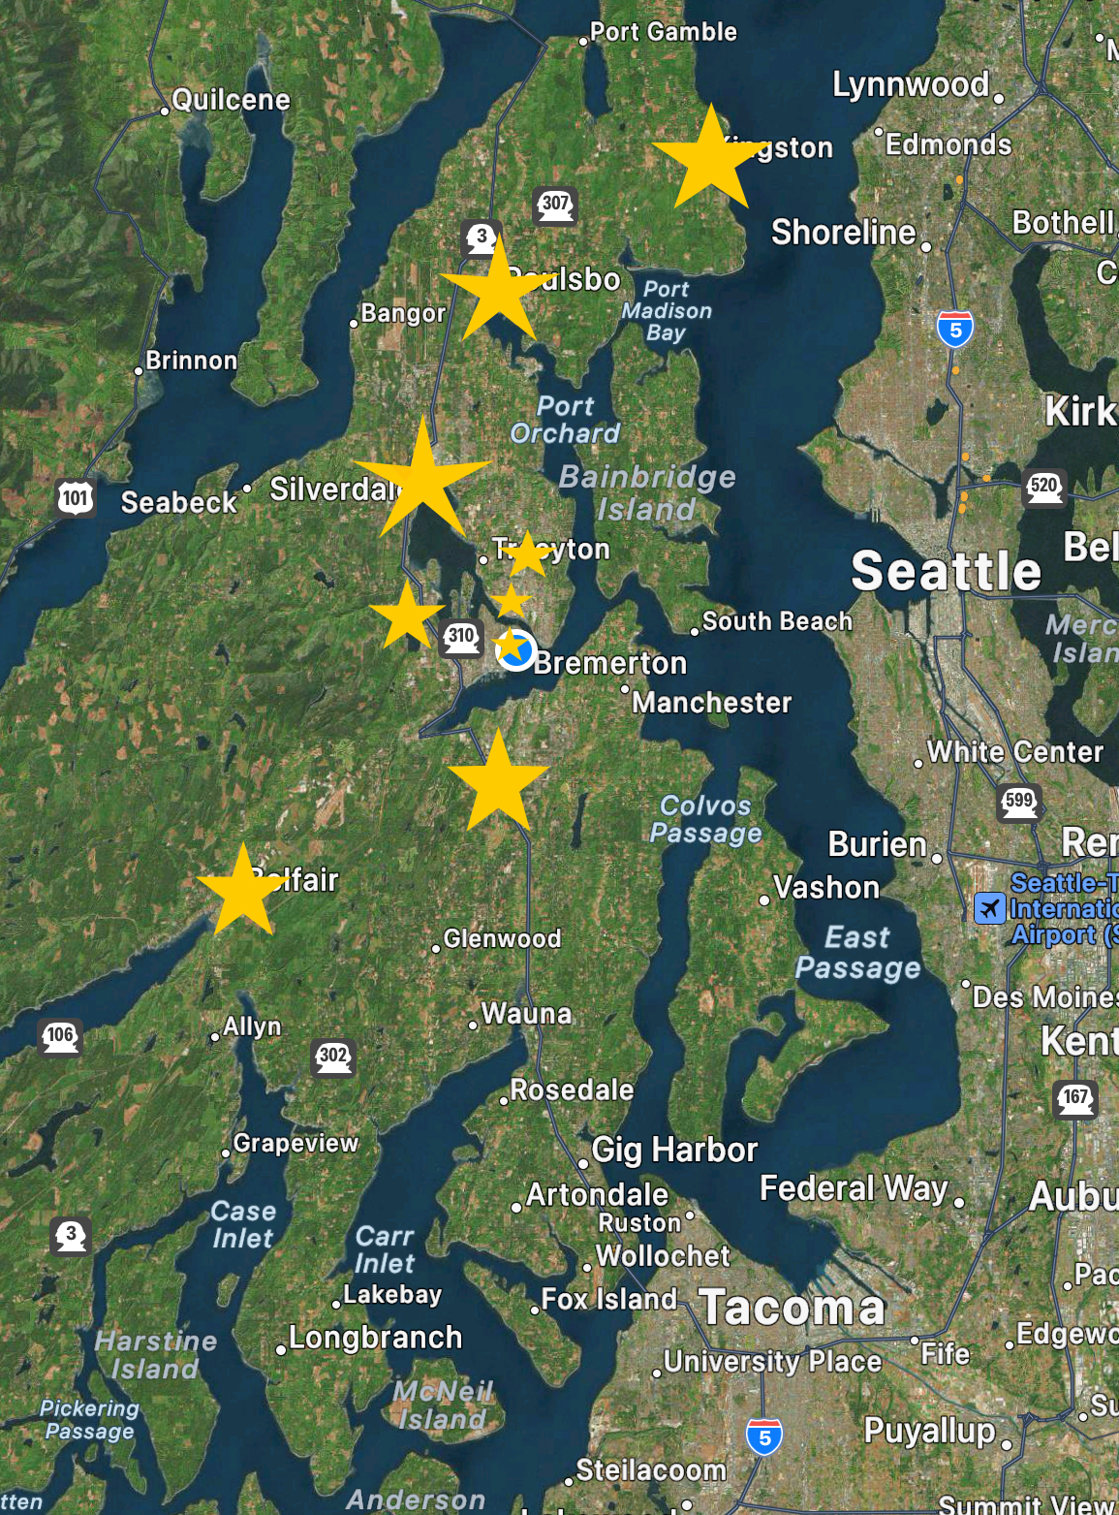
Peninsula Community Health Services
12 medical clinics
11 school-based clinics
6 pharmacies
7 dental clinics
Onsite BH staff including psychiatry and counseling
Mobile fleet (medical, dental, counseling)
Pharmacy and Psych NP residencies
MA and DA apprentice programs
Dr. Regina Bonnevie- Rogers, MD
Chief Medical Officer
Cyndi Greenlee, ARNP
Associate Medical Director
Lindsay Jones, MA
Medical Program Director
Notes:
Hi, I’d like to introduce Peninsula community health. my name is Cyndi Greenlee, I’m the Associate medical Director and also a nurse practitioner. I seeing patients two days per week in clinic, and am part of our mobile team seeing patients out in the community. I will be our team coach. My team includes Regina Bonnevie Rogers as our Chief medical officer and Lindsay Jones our medical program director. Dr. Bonnevie-Rogers completed the psych NP residency version of this class about 3 years ago. Lindsay will be on this learning adventure with me. PCHS is a federally qualified community health center on the kitsap peninsula, about an hour ferry ride from Seattle.

Slide 56
Goals for this class:
Develop accredited residency
Structure of program
Interviews!
Finding the right learners
Coaching preceptors
Preceptor schedules
Get started fall 2024

Slide 57
At PCHC, our vision for success is a community in which everyone has access to quality, cost-effective health care, where people are empowered to advocate for their personal goals and needs and are supported by community-based resources, and where health encompasses physical and emotional wellness, personal dignity and a sense of belonging.
FNP Postgraduate Training Team Members
Federally Qualified Health Center: Largest in Maine, second largest in New England
There have been more than 350,000 annual visits by 65,000 patients during recent years.
We have approximately 750 employees and 200 providers.
Candace Davis, FNP
Nurse Practitioner Residency Director
Katie Stevens, MBA
Nurse Practitioner Residency Manager
Mission: We provide comprehensive, integrated primary health care services for all to improve the health and wellbeing of our patients and the Maine communities we serve.

Slide 58
Goals for Participation in Collaborative
Improve our program through the work with this collaborative.
Solidify our Curriculum, SOPs and Handbook.
Help ensure our program has all the elements needed to become an accredited program.
Mission: We provide comprehensive, integrated primary health care services for all to improve the health and wellbeing of our patients and the Maine communities we serve.

Slide 59
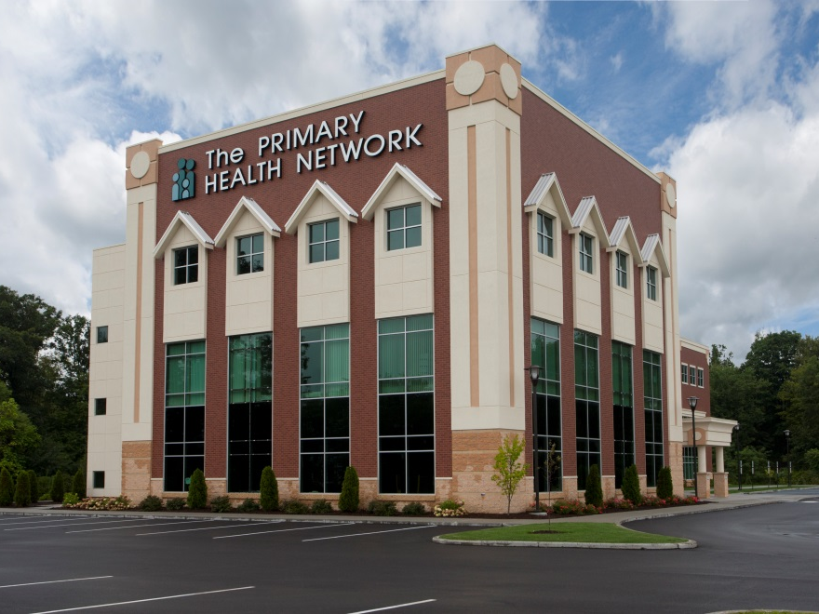

Slide 60
Primary Health Network
Team Members
Angela Hogue, MD – Chief Medical Officer
Easton McKinney, CRNP – Nurse Practitioner
George Pokrant, RN – Senior Director Medical Operations
Ashlee Montgomery – Program Administrator
Notes:
More commonly known today as Community Health Centers
Limited access to healthcare: low-income individuals, uninsured and underinsured, immigrants, homeless, etc.

Slide 61
Participation Goals
Obtain guidance in developing the structure of a Nurse Practitioner Residency Program (NPRP) within our organization
Furthering our knowledge regarding clinical, financial, and administrative resources that are required vs optional for a program
Learning about the accreditation process for NPRPs
As the largest Federally Qualified Health Center in Pennsylvania, we hope the establishment of a residency program will help with provider recruitment, retention, and increase provider satisfaction.
Notes:
More commonly known today as Community Health Centers
Limited access to healthcare: low-income individuals, uninsured and underinsured, immigrants, homeless, etc.

Slide 63
Everybody deserves to be seen, no matter who you are, where you come from, where you work or what place you call home.

Slide 64
Mission
Achieving regional health through high quality comprehensive care.
NP/PA Fellowship Vision
WSH INSTITUTE envisions an inter-professional collaborative 1 or 2 year fellowship that will provide clinical training to recently graduated nurse practitioners and physician assistants, within 12 months of completion of an accredited program.

Slide 65
WellSpace Health Team
Tina Frushour, Health Professions Manager
Alyssa Spencer, PA-C
Darcy Wikoff, NP-C
Outcomes: Fellows will have supported learning experiences in adult primary care, continuity practice, immediate care, pediatrics, women’s health, specialty care, behavioral health and substance use disorder treatments. In addition, there is a focus on achieving health equity, leadership development, and quality assessment and improvement.
Job satisfaction of fellows as well as current healthcare providers who participate in the education process. Upon graduation the fellows will be prepared to confidently deliver high quality, evidence - based, culturally competent and compassionate primary care with a focus on addressing needs of complex patients in the underserved community.

Slide 67
About Wheeler
Wheeler provides comprehensive solutions that address complex health issues, providing individuals, families and communities with accessible, innovative care that encourages health, recovery and growth at all stages of life. Our integrated approach to primary and behavioral health, education, and recovery creates measurable results, positive outcomes and hopeful tomorrows for more than 60,000 individuals across Connecticut each year.
Team Members and Roles
Maria Banevicius, APRN Lead Provider in New Britain | Rebecca Eleck, MD Medical Director | Michael Twist, DO Psychiatric Medical Director
Teresa Domack, MD Director of Medical Education | Linda Russo VP of Quality Operations | Hilary St. Pierre Clinical Quality Director
Scott Berman, MD Psychiatrist | Rebecca Blake Director of Recruitment | Deedee Kokoszka Director of Training and Development
 | John Sponauer VP of Marketing Communications and Philanthropic Giving

Slide 68
Our Goals
Start a NP and PA residency program.
Facilitate retention of our current medical team by providing ample opportunities for them to precept, teach, and lead new projects.
Recruit and train phenomenal advanced practice providers who are passionate about working with our patient population.
Living Our Values
Our goals and approach to the residency program align with—and require—a lived commitment to each of our organizational values.

Slide 69
Support from Leadership/Board of Directors: Presenting the case for a postgraduate residency program
Notes:
Kerry

Slide 70
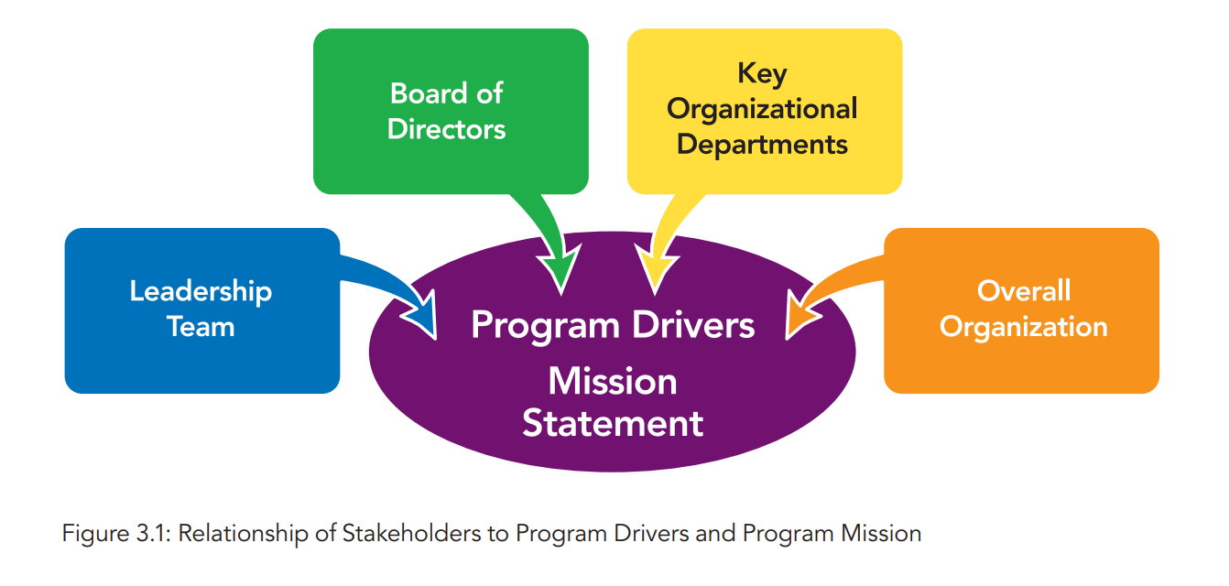
Top to Bottom Support
Flinter, M., & Bamrick, K. (2017). Training the next generation: Residency and fellowship programs for nurse practitioners in Community Health Centers. Retrieved from https://www.weitzmaninstitute.org/sites/default/files/NPResidencyBook/NPResidencyBook.pdf
Notes:
Kerry

Slide 71
Guiding Principles For Communication
Flinter, M., & Bamrick, K. (2017). Training the next generation: Residency and fellowship programs for nurse practitioners in Community Health Centers. Retrieved from https://www.weitzmaninstitute.org/sites/default/files/NPResidencyBook/NPResidencyBook.pdf
Notes:
Kerry

Slide 72
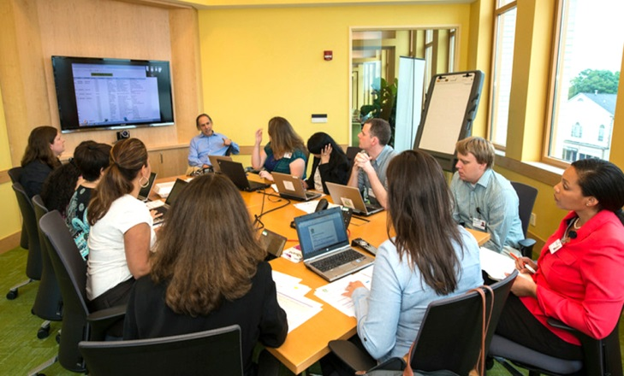
Leadership and Board of Directors
CEO, leadership team and BOD must be fully committed to the training program and allocating the necessary resources
What do they need to know:
Mission Statement & Program Drivers
National Landscape
Outcomes
Program Structure
Resource Assessment
Finances
Develop your presentation and use data to support your case!
Notes:
Kerry

Slide 73
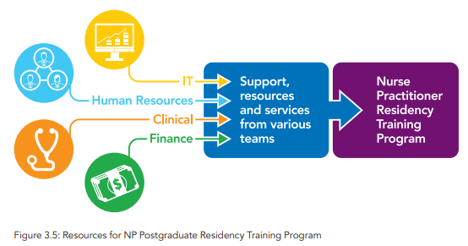
Key Organizational Departments: Finance, Human Resources, IT, Operations, Clinical and Support Staff
Understanding the role and support each department will need to provide
Structure for communicating and completing required tasks
Identifying leads in each department that your team can work with to implement key program components
Developing policies and procedures that all parties agree to follow for key program tasks
Flinter, M., & Bamrick, K. (2017). Training the next generation: Residency and fellowship programs for nurse practitioners in Community Health Centers. Retrieved from https://www.weitzmaninstitute.org/sites/default/files/NPResidencyBook/NPResidencyBook.pdf
Notes:
Kerry

Slide 74
Communication Within Your Organization
About the Postgraduate Residency Program
Notes:
Kerry

Slide 75
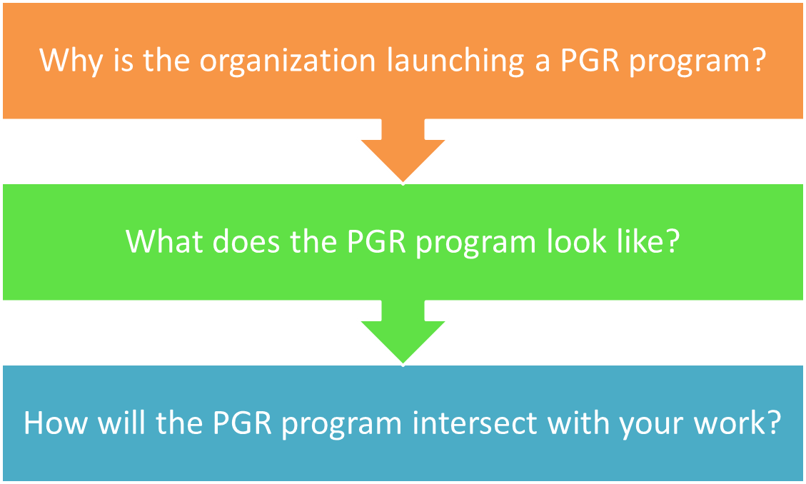
Overall Organization Communication and Education
Communicate organization’s plan to launch a postgraduate residency program
Notes:
Charise

Slide 76
Stakeholder Analysis
Stakeholder
Has something to gain/lose through outcomes of the project
Has a powerful bearing on outcome of the project
Is affected by the project
Stakeholder Analysis
Define ways to engage stakeholders to maximize positive impact
Identify who needs to know about the project
Develop how the project should be presented/framed
Assess opinions/thoughts about the project
Notes:
Charise

Slide 77
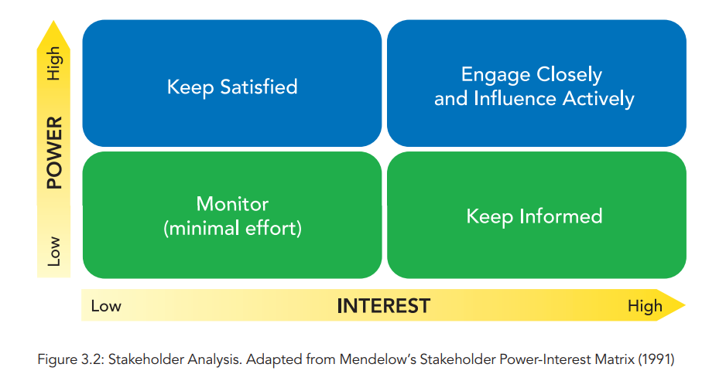
Stakeholder Grid
Interest
Measures to what degree the stakeholder is likely to be affected by the project and what degree of interest or concern they have in or about it
Power
Measures the influence they have over the project and to what degree they can help achieve or block the desired change
Stakeholders with high power and interests aligned with the project, are the people it is important to fully engage and bring on board.
Notes:
Charise

Slide 78
Stakeholder Communication Plan
Who are your key stakeholders?
What are you objectives in communicating with them about the project?
What are they key messages you want to communicate?
How will it be communicated?
When and how often will you communicate?
Notes:
Charise

Slide 79
Basic Overview of Program Structure
Notes:
Charise

Slide 80
Core Elements of a Postgraduate NP Residency
12 Months Full-time Employment | Training to Clinical Complexity and High Performance Model of Care team-based care, inter-professional collaboration, integrated care, data driven QI ,expert use of technology | Full Integration into Home Site and Organization
Precepted Continuity Clinics (40%); Residents develop and manage a panel of patients with the exclusive attention of an expert preceptor (NP, PA or Physician) Specialty Rotations (20%); Experience in primary care specialty areas to expand and enhance resident practice knowledge and skills Mentored Clinics (20%); Work within a primary care team focusing on diversity of chief complaints, efficiency, episodic and acute care Didactic Sessions (15%); Topics that are high volume, complexity and/or burden topics in primary care. Includes participation in Project ECHO sessions for managing chronic pain, treating HIV/Hep C, opioid addiction, complex pediatrics Quality Improvement Training (5%); Training to a high performance QI model, including front line QI improvement, data driven QI, and leadership development.
Notes:
Charise

Slide 81
Questions?
Notes:
Meaghan

Slide 82
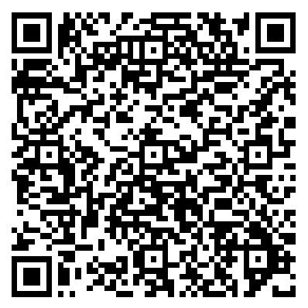
Assignments
List out your key program drivers
Draft your Mission and Vision Statement
Complete the Resource Assessment
Develop presentation and if possible present to leadership/board (if have not already done so)
CME and Resource Page
Access Code: PGR2023
https://education.weitzmaninstitute.org/content/postgraduate-nurse-practitioner-np-residency-and-npphysician-associate-pa-training-programs
Notes:
Meaghan

Slide 83
Next Steps
Coach Calls:
Tuesday November 28th 1:00pm Eastern / 10:00am Pacific
Tuesday December 12th 1:00pm Eastern / 10:00am Pacific
Session 2: Tuesday December 19th 1:00pm Eastern / 10:00am Pacific
Notes:
Meaghan

Slide 84
Contact Information
Amanda Schiessl
Program Director/Co-PI
Amanda@mwhs1.com
Meaghan Angers
Program Manager
angersm@mwhs1.com
REMINDER: Complete evaluation in the poll!
Next Learning Session is Tuesday December 19th!
Notes:
Meaghan

Slide 85
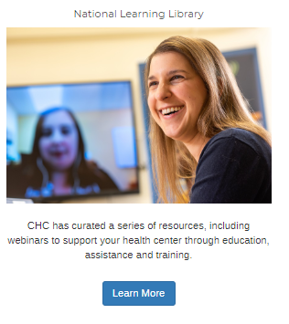
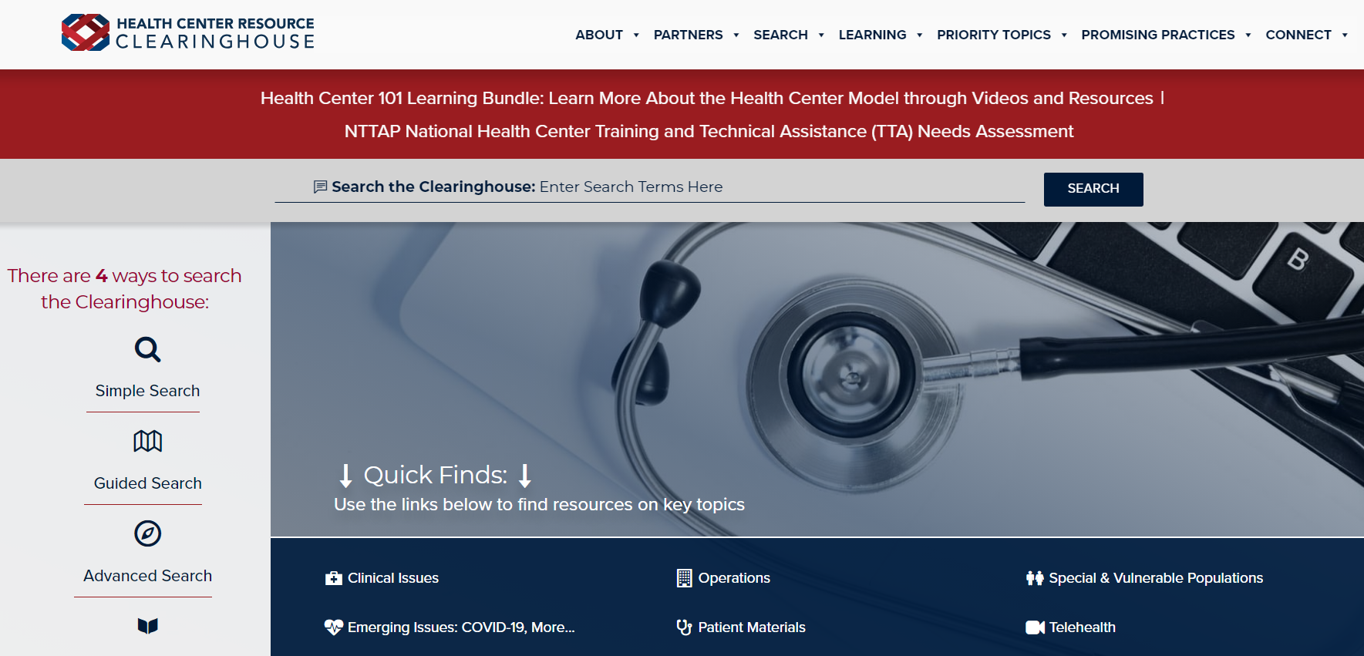
Explore more resources!
National Learning Library: Resources for Clinical Workforce Development
Health Center
Resource Clearinghouse
https://www.weitzmaninstitute.org/ncaresources
https://www.healthcenterinfo.org/
85
Notes:
Meaghan

