Slide 1
Comprehensive Care Learning Collaborative
Session One: Wednesday December 6th, 2023
Notes:
Meaghan

Slide 2
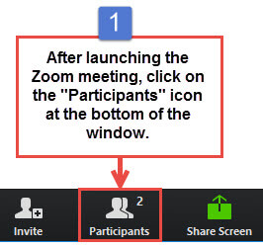
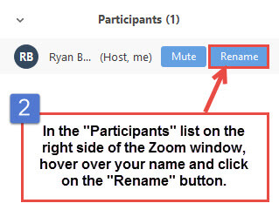
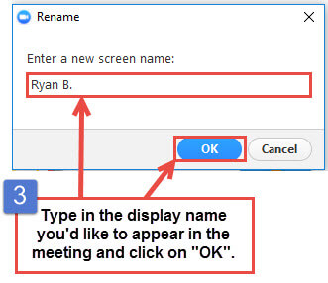
Get the Most Out of Your Zoom Experience
Please keep yourself on MUTE to avoid background/distracting sounds
Use the CHAT function or UNMUTE to ask questions or make comments
Please change your participant name to your full name and organization
“Meaghan Angers CHCI”
Notes:
Meaghan

Slide 3
Session 1 Agenda
1:00 – 1:10 | Introduction to CHCI, Collaborative Expectations, & Role of the Coach
1:10 – 1:25 | Making Your Team Work: Role of Leadership & What Engaged Leadership Looks Like
1:25 – 1:40 | Team Introductions
1:40 – 2:15 | Fundamentals of Primary Care: Primary Care’s Challenges
2:15 – 2:25 | Quality Improvement: Assessing Your Practice
2:25 – 2:30 | Q & A and Next Steps
Notes:
Meaghan

Slide 4
Community Health Center Inc. and NTTAP Introduction
Notes:
Meaghan

Slide 5
Learning Collaborative Faculty
NTTAP Faculty, Collaborative Design,
and Facilitation
Amanda Schiessl, MPP
Project Director/Co-PI, NCA
Amanda@mwhs1.com
Margaret Flinter, APRN, PhD, FAAN
Co-PI, NCA & Senior Vice President/Clinical Director
Margaret@mwhs1.com
Bianca Flowers
Program Manager
flowerb@mwhs1.com
Meaghan Angers
Program Manager
angersm@mwhs1.com
Mentors, Coaching Faculty
Deborah Ward, RN
Quality Improvement Consultant
WardD@mwhs1.com
Tom Bodenheimer, MD
Physician and Founding Director, Center for Excellence in Primary Care
Rachel Willard, MPH
Director, Center for Excellence in Primary Care
Evaluation Faculty
Kathleen Thies, PhD, RN
Consultant, Researcher
ThiesK@mwhs1.com
5
Notes:
Meaghan
Pause to let Tom/Kathleen/Deb introduce

Slide 6
Moses Weitzman Health System Affiliates
Notes:
Primary care has been at the heart of Community Health Center, Inc.’s (CHC) mission since its founding in 1972. Grounded in our mission, the Moses/Weitzman Health System (MWHS) was established to support exponential growth and continued innovation. The MWHS is the parent company of CHC; the Community eConsult Network, Inc. (CECN) d/b/a ConferMED; the National Institute for Medical Assistant Advancement (NIMAA); and the Consortium for Advanced Practice Providers. The Weitzman Institute (founded by CHC) is embedded in the MWHS. Each affiliate will continue to have its own board of directors and its own mission. The name of the health system honors Lillian Reba Hyman Moses (1924–2012) and Gerard (Gerry) Weitzman (1938–1999), who were among the earliest supporters and board members of CHC.

Slide 7
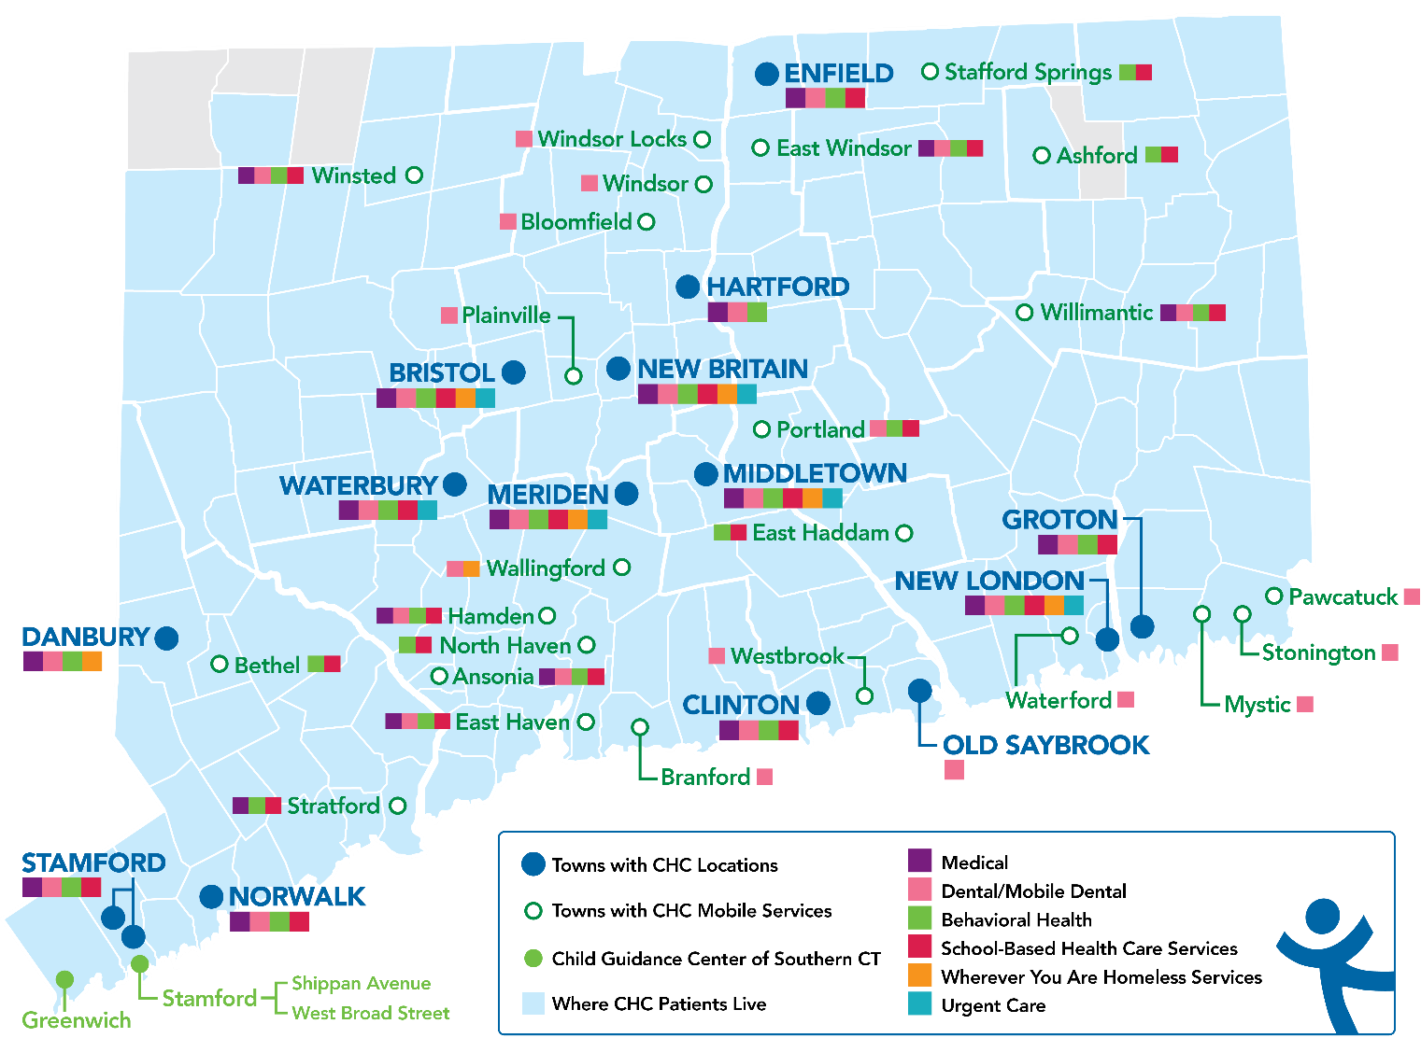
Locations and Service Sites in Connecticut
CHC Profile:
Founded: May 1, 1972
Staff: ~1,200
Total Patients Served: 102,275
Clinical Sites across CT: 19
SBHCs across CT: 180+
Students & Residents/year: 390
Three Foundational Pillars:
Clinical Excellence
Research & Development
Training the Next Generation

Slide 8
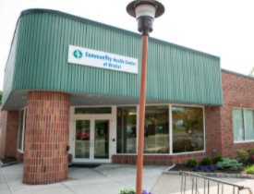
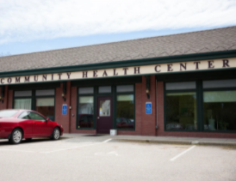
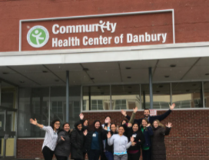
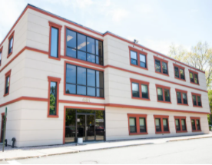
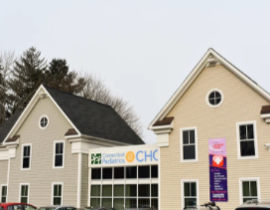
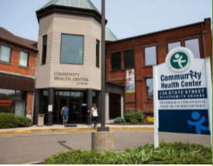
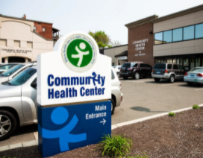
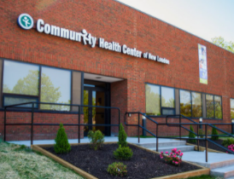
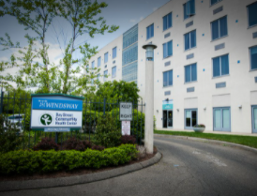
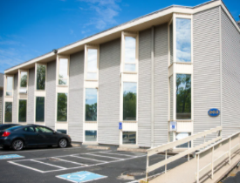
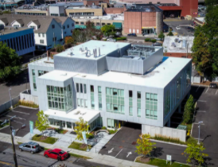
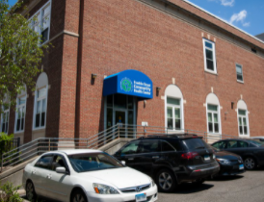
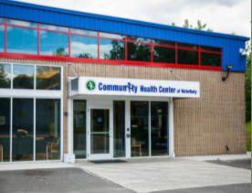
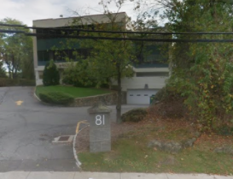
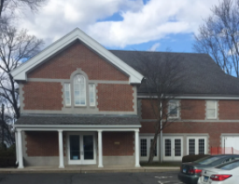

Slide 9
National Training and Technical Assistance Partners
Clinical Workforce Development
Provides free training and technical assistance to health centers across the nation through national webinars, learning collaboratives, activity sessions, trainings, research, publications, etc.
Notes:
Meaghan

Slide 10
2023-2024 Cohort
Organization | Location
Brockton Neighborhood Health Center | Massachusetts
Brooklyn Plaza Medical Center | New York
Klamath Health Partnership | Oregon
The Wright Center for Community Health | Pennsylvania

Slide 11
Collaborative Structure and Expectations
Notes:
Deb

Slide 12
Welcome to the Comprehensive and Team-Based Care Learning Collaborative!
The Comprehensive Care and Advancing Team-Based Care Learning Collaborative is an 8-month participatory learning experience offered by the National Health Center Training and Technical Assistance Partners (NTTAP), funded by the Health Resources and Services Administration, and hosted by Community Health Center, Inc.
The Collaborative is designed to provide organizations that are:
Beginning or restarting their move to high performance team-based comprehensive primary care with knowledge about the basic principles and best practices of care and the strategies to plan for implementation; and
Provide transformational strategies and coaching support to help primary care practices implement and advanced models of team-based care.
Notes:
Deb

Slide 13
Collaborative Structure and Expectations
Eight 90-minute Zoom Learning Sessions
Session 1
Dec. 6th
Session 2
Jan. 17th
Session 3
Feb. 7th
Session 4
March 6th
Session 5
April 3rd
Session 6
May 1st
Session 7
May 29th
Session 8
June 19th
Between Session Action Periods:
Meet weekly/regularly as a team
Meet weekly with coach mentors
Complete deliverables
Notes:
Deb

Slide 14
Collaborative Structure and Expectations
You will use assessments of their current team based care model to identify areas for process improvement and role optimization.
You will submit deliverables demonstrating participation in Learning Collaborative.
You will contribute to the learning among participating practice teams by engaging in Learning Collaborative activities.
14
Notes:
Deb

Slide 15
Conditions of Success
Attendance at collaborative learning sessions and engagement in weekly coach/mentor calls
Engagement in work between sessions that included protected time to meet as a team, trust and respect.
Commitment of trained coaches to improving their skills and helping teams achieve results
Support of practice leadership for time, resources, spread and sustainability
Notes:
Deb

Slide 16
Roles and Responsibilities
Role of Coach Mentor | Role of Team Coach | Team Members
Meet with Team Coaches weekly to discuss progress Work directly with Team Coach to identify successes and work through challenges/barriers. Mentors Team Coach on how to run an effective meeting for their team and develop their coaching skills Be available for individual sessions with Team Coaches for specific team and program development | Teach team how to prepare and facilitate effective meetings Provide coaching support between and during weekly internal team meetings Participate in weekly Zoom calls with Coach Mentors to discusses progress, challenges, and stuck points. Help team follow timelines, complete assignments, and progress reporting Share team’s progress with the Coach Mentor and other Team Coaches during collaborative sessions | Team members are staff from the care team who deliver specific services to the clients. They represent most or all patient facing roles. Members are empowered and engaged to make decisions They implement specific actions such as PDSA testing They are based on complementary expertise and skills and not just their availability of time
Notes:
Deb

Slide 17
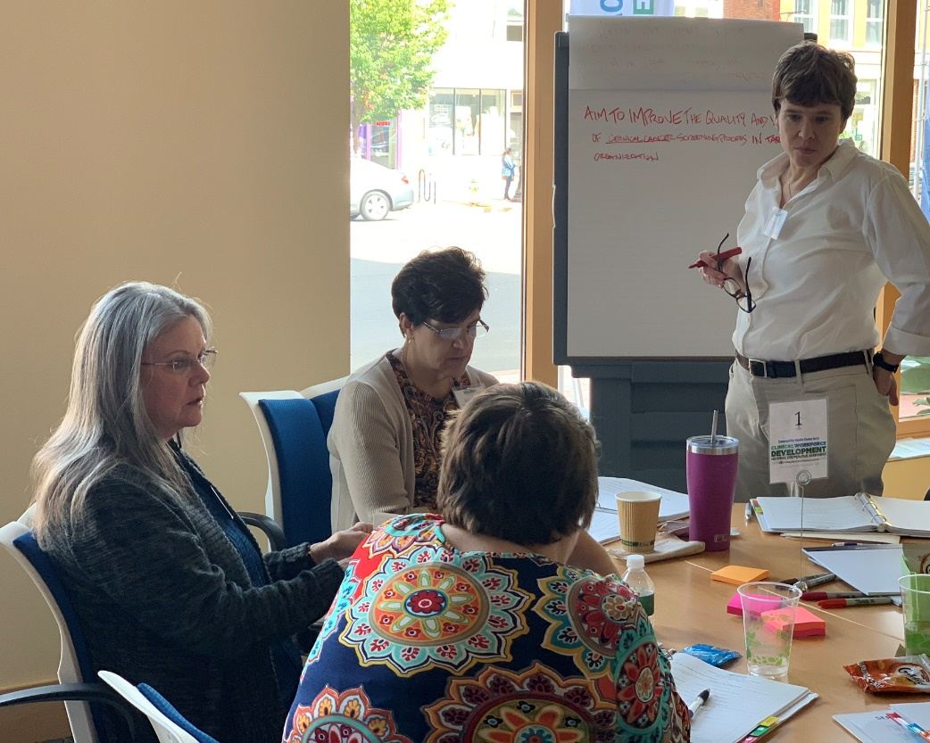
Team Coach Role
Help and support teams working together to use new skills, achieve their aims, document their work
Help teams complete assessments and action period assignments to stay on track
Help teams run effective weekly team meetings and facilitate teamwork
Notes:
Deb

Slide 18
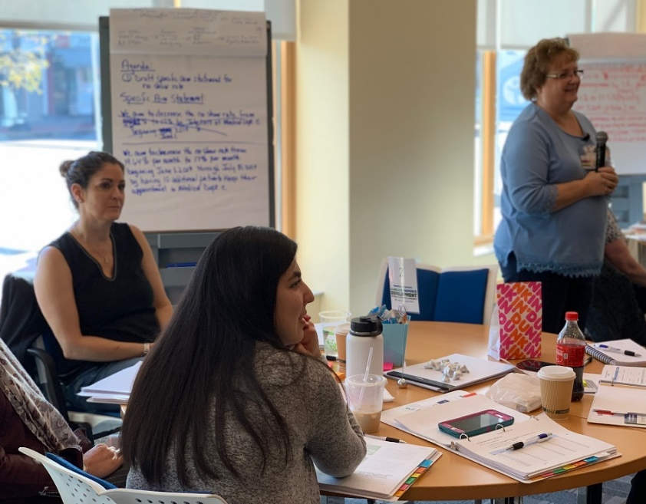
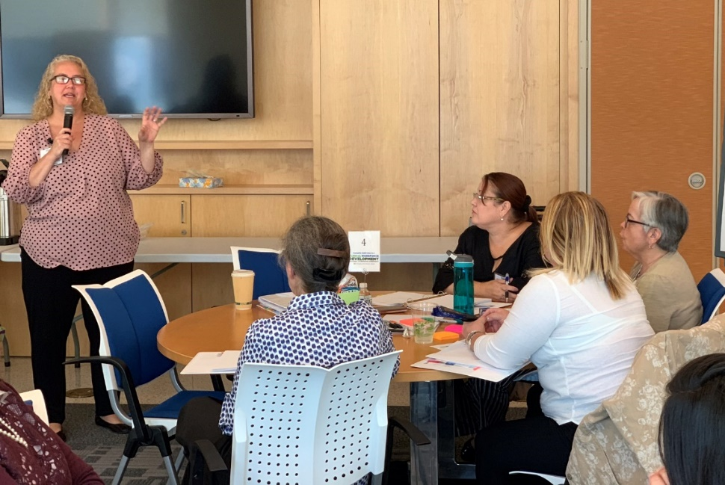
Weekly CHCI Coach Mentor Meetings
CHCI Coach Mentor Role: Deb Ward and Tom Bodenheimer
Provide support and resources for developing coaching and improvement skills
Assess progress and address challenges, help teams stay on track
Provide individual support as needed
Notes:
Deb

Slide 19
Role of Leadership on Creating Change and Partnerships Margaret Flinter, Senior Vice President and Clinical Director
Notes:
Introduction
Building interest in the work you’re doing by also aligning it with the interests of other people in your organization – everybody on front lines, but leadership team as well
“Ask not what my leadership can do for me, but ask what I can do for leadership” – we’re all in this together
Everyone needs to think of themselves as a leadership in the organization
Everyone contributes to the financial bottom line
Everyone is accountable for the outcomes that we get to patients and communities we serve
Personal experience of being all along the continuum and many perspectives of working in healthcare (i.e. housekeeping department, front line clinician, hybrid front line clinician, executive and decision making world)

Slide 20
Leadership’s Role In Supporting Comprehensive Team Based Care
Full Engagement
Tangible and intangible support
Communications strategy internal and external
Investments
Recognition
Notes:
Core roles of leadership of team-based care in community health centers is providing healthcare for people and trying to improve their health, improve their outcomes, and create a healthier society – what you are doing is core and central to the mission of community health centers.
Give big picture overview of each bullet point (individual slides for each topic)
Full Engagement
Role of leadership is first and foremost full engagement in the work of the organization, including clinical care delivery model
Clinical leadership is part of the executive team – equally responsible to thinking about investment in and return on investment
Tangible/Intangible
How leadership supports this work through the tangible resources
But also intangible - you know when you have support of leadership for an initiative (i.e. it is talked about, written about, surfaces in different areas of organization, sense of pride)
Communications Strategy
Guiding strategy both internally and externally - need leadership to talk about your ideas and asking if it can have space in town hall/website/etc. or it does not exist; need to be an active contributor
Investments
Investments leadership needs to make in staff, time and funds for training, etc.
Recognition
Important to all of us; public recognition in meetings, town halls, and websites for the work that you are doing to transform care.

Slide 21
Full Engagement
Ties high performing, comprehensive team based care to the mission, vision, and goals of the organization
Assigns senior leader as sponsor and champion as requested
Engages visibly and publicly to support the work of the clinical and operational leaders engaged in the transformation
Ensures that board members and relevant board committees understand the work and its importance
Notes:
Full engagement ties to this idea of high performing comprehensive team based care because it is tied to mission, vision, and goals of the organization
If you’re in the business of trying to advance a model of high performing team base care – you want to see those words appear in critical documents (i.e. mission statement, vision, and goals)
If it does not appear, thinking about re-writing your organization’s goal/mission/etc.
Ask of your senior leadership for there to be a senior leader that is a sponsor/champion of this transformational work that you are trying to do.
Demonstrate that it is worthy of their time to be a sponsor for a project of such significance as advancing high performing model of team based care, which has the power to improve health, reduce health disparities, and increase life expectancy in those groups.
Importance of visibility and public engagement
Board of directors need to understand this work
Involve quality assurance/quality improvement committee for community health centers because they are the ones thinking of the clinical mission of the organization and how to improve healthcare and health outcomes – great board to keep up to date on the work you are doing for full engagement of leadership.

Slide 22
Tangible and Intangible Support of Leadership
Assignment and prioritization of resources
Human Resources
IT/Informatics/Business Intelligence
Facilities
QI/Lean/Practice Redesign
Time!
Notes:
Focus by department - if you are working together as a team to effect change, think about:
What do you need from human resources?
Working with HR department to clarify roles and responsibilities, job descriptions, titles, content of positions, and training to support all of that (last thing is asking for new positions)
HR Department that can respond with the training for staff that you need to accomplish the goals that you lay out
HR needs to hear from CEO level that it is a priority
Won’t be able to make the case for change if you don’t have the data to support it and won’t have the data without having IT/Business Intelligence on board
None of us have the time past the initial PDSA to be tracking this in a manual way; need people to get data out of systems and tools that we already have
Senior leadership can help make this a priority with IT/Business Intelligence team
Ways ahead of when clinicians had their own private office, nurses had nursing station.. most of us are sitting in a group that is multidisciplinary or inter-professional – looks like the team taking care of patients
Facility redesign to support team base care model
Quality improvement team is essential
Giving people time for practice design
Importance of process improvement and process mapping – taking the time to plan out what you are going to do
Community health center movement and anyone in the business of high performing primary care understands that there has to be training in quality improvement, there has to be coaches, there has to be some kind of support structure in place to create change beyond the dream or vision of the person that may have had the instigating idea.

Slide 23
Communications
Early and often throughout the organization
Internal website
Public facing website
Patient welcome and orientation packets
Town Halls
Notes:
Communications is a critical function of leadership
Not responsible for communicating your idea, but responsible for creating the real-estate/wallpaper/space for your idea to be communicated (i.e. internal website, SharePoint, public facing website, town halls, patient facing material)
You have to create the “it” for people to trumpet it for you.

Slide 24
Investments
Staff
Time and funds for training
Roles
Business Intelligence
Notes:
Staff is the last item that leadership makes available
CFO is right to question you when you say “I need another person to do this”
Last option we look at because it means you already created efficiencies that you can be responsible for, but there are times when a new role/position is needed
Need to have analysis of why this is a benefit to organization or why it warrants additional staff people

Slide 25
Ensuring Return on Investment is Measured and Monitored
Quality awards
Changes in performance on UDS
Value based contracts and incentives
Patient satisfaction
Staff satisfaction
Notes:
It would be somewhere between irresponsible and unwise for your leadership team to NOT have expectations that there is measurable results from the work you are doing and investments being made – whether they are in effort and time of the other departments (i.e. HR/IT/Facilities) or in dollars
Want to leave you with this idea that it does not always tie back to visits:
In the community health center world and generally in U.S. healthcare – the visit has become the “king” (carries return of money) so the priority on the revenue generation is measured in visits, controlling costs is secondary, but there has been a significant change in this arena in last couple of years.
Measure of financial success is changing:
Quality awards: tied directly to the work you do in the model of high performing team based care
Change in performance on UDS: ties directly to quality awards and special initiatives
Value based contracts and incentives: through Medicare/Medicaid/private insurance – these have all been increasing in recent years
Patient satisfaction
Staff satisfaction
Any questions before we move to Deb’s presentation on standardization and playbooks

Slide 26
Team Introductions
 | Order of Introductions
1 | Brockton Neighborhood Health Center
2 | Brooklyn Plaza Medical Center
3 | Klamath Health Partnership
4 | The Wright Center for Community Health
Name of your practice, size, etc.
Names and positions of participating team members
Goals for the learning collaborative
Notes:
Meaghan

Slide 27
Brockton Neighborhood Health Center
“The ED can Wait” Team

Slide 28
ED UTILIZATION GROUP
Patricia Augustin- Post Hospital Discharge Nurse Care Coordinator
Luisa Schaeffer- Patient Engagement Specialist ( ER Focus)
Dr. Nikhil Gohokar- Provider Champion
Ayotola Olugbenga- Population Health Manager
DoPham Linh- Pharmacist
Annette Thomas- QI and Lean Director
Tahirah Ashby- QI Interns

Slide 29
GOALS
To use an interprofessional collaborative practice to reduce the rate of frequent (but often preventable) ED utilization among BNHC patients by addressing a comprehensive range of patient needs, including review of medical history and current status, medication management, addressing health-related social needs, identifying and addressing behavioral health needs, and offering nursing assistance, to provide a holistic approach to care and minimize the risk of returning to the ER.
To utilize a systematic approach utilizing performance improvement tools to reduce ED utilization

Slide 30
Brooklyn Plaza Medical Center

Slide 31
Klamath Health Partnership

Slide 32
The Wright Center for Community Health: Team Overview and Goals
Team:
Colleen Dougherty, DNP - Chief Operating Ofﬁcer
Kathleen Barry, MS - Deputy Chief Operating Ofﬁcer
Marianne Linko, LPN - Deputy Chief Operating Ofﬁcer Laura Sweeney, CMA - Co-Medical Assistant Manager

Slide 33
Goals for Collaborative
Review key tools to help with problem solving and work efﬁciencies
Deﬁne common language for a newly formed team to be on the same page
Use this collaborative to work through new organizational issues we are focused on improving
Goal: Deﬁne comprehensive team based workﬂow to improve screening and preventive initiatives (ie immunizations, testing, etc) for overall health center quality metric scores

Slide 34
Fundamentals of Primary Care: Primary Care’s Challenges
Introduction to CEPC, History of LEAP, & Building Blocks of Primary Care

Slide 35
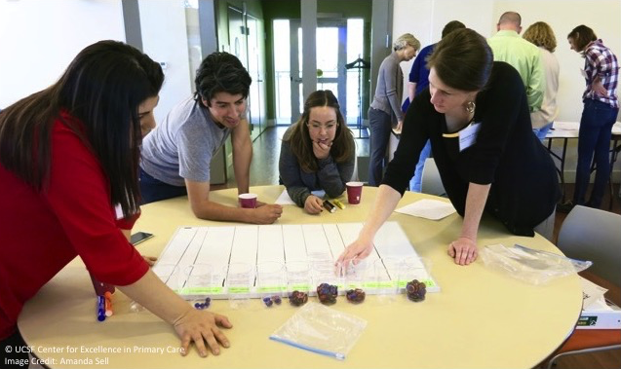
Center for Excellence in Primary Care (CEPC)
Situated in the UCSF Department of Family and Community Medicine, CEPC identifies, develops, and disseminates promising innovations in primary care to improve the patient experience, enhance population health and health equity, and restore joy and satisfaction in the practice of primary care.
http://cepc.ucsf.edu/

Slide 36
Why do we need teams?
A patient-care team is a group of diverse clinicians and practice staff who communicate with each other regularly about the care of a defined group of patients and participate in that care.
Rather than a lone clinician being responsible for the care of a panel of patients, the team shares that responsibility.
On an effective team, everyone on the team makes important contributions to the care of the team’s panel of patients.
Question: why are teams necessary in primary care? Please answer this question either by speaking or writing in the chat.

Slide 37
Why do we need effective teams in primary care?
Patient access is poor and getting worse
Continuity of care is under stress
Panel sizes are too large because not enough clinicians choose primary care careers (clinicians are physicians, nurse practitioners and physician assistants)
Poor access and large panels are major contributors to burnout
Effective teams can help solve these challenges; poorly functioning teams cannot
Today we will focus on primary care’s challenges. In the following two learning sessions we will focus on teams.

Slide 38
Access is getting worse
2015 household survey: 48% of people in US who were sick could not obtain same/next-day appointment. [Commonwealth Fund, 2015 International Profiles of Health Care Systems]
2017 secret shopper calls to 2000 practices in 30 cities. New patient wait times for primary care appointments
2014: 20 days
2017: 30 days
Source: Merritt Hawkins 2017 Survey of Physician Appointment Wait Times

Slide 39
Challenges to continuity of care
Continuity of care means patients seeing the same primary care clinician or team whenever they need care, whether in person, by phone/video visit, or through the electronic patient portal
US primary care acute visits per capita decreased by 30%, 2002 – 2015
At the same time, more and more patients are seeking primary care in urgent care, retail clinic, and emergency departments
As a result, many patients are seeing different primary care clinicians in different sites with little communication among the clinicians
Continuity of care is associated with:
Better preventive care Better chronic care Greater patient satisfaction Lower healthcare costs

Slide 40
Primary care panels are too large
7500 primary care physicians enter the workforce each year; 8500 retire each year
Major increase in NPs/PAs helps relieve the shortage
Clinician-population ratio going down (physicians, NPs, PAs)
As a result, panel sizes are too large. U.S. average 2194. Norway: 1100
With a panel of 2500, it takes a primary care physician without a team 26.7 hours per day to provide excellent care; with an effective team it takes 9.3 hours per day
Panel size in FQHCs is smaller because FQHC patients have more chronic conditions, more severe chronic conditions, more problems with social determinants of health
Write in the chat if you know the average panel size in your health center
Bodenheimer T. Revitalizing primary care, Parts 1 and 2. Ann Fam Med 2022;20:464-468, 469-478; Porter et al. J Gen Intern Med 2022, July 1

Slide 41
Poll #1
In your health center, nurse practitioners and physician assistants:
a. Have their own panels
b. Some have their own panels; others help physicians care for their panels
c. None have their own panels

Slide 42
Primary care clinicians in health centers
NPs and PAs are a critical component of the primary care system in low-income communities around the U.S.
HRSA’s 2020 UDS report: In FQHCs,
NP/PA FTEs (14,565)
Nurse Practitioners: 11,086
Physician Assistants: 3,479
Physician FTEs: 14,317

Slide 44
Burnout
National survey, % of physicians reporting burnout in 2020:
All physicians: 38%
Primary care physicians: Over 50%
Shanafelt TD et al. Mayo Clinic Proceedings 2022;97:491-506.
Survey of 740 primary care clinicians and staff in 2 local health systems:
53% of clinicians and staff reported burnout
Higher rates of burnout were associated with leaving practice.
Willard-Grace R et al. Burnout and health care workforce turnover. Ann Fam Med 2019;17:36-41.
Burnout is strongly associated with reductions in work hours (Shanafelt TD et al. Mayo Clin Proc 2016;91:422-431)
More burnout means more physicians leaving or cutting their hours, leading to more work for everyone else
Effective teams can greatly mitigate burnout

Slide 45
Poll #2
I feel that burnout:
a. Is a significant problem among staff, but not clinicians, at my health center
b. Is a significant problem among clinicians but not staff at my health center
c. Is a significant problem among staff and clinicians
d. Is not an important problem at my health center

Slide 46
Burnout
The Maslach Burnout Inventory measures 3 components of burnout
Two of these are:
Emotional exhaustion
Cynicism
Emotional exhaustion: “I have too much work.” Seeing too many patients too fast for too many days
Cynicism: feeling alienated from the work: “I don’t like my work” – EMR documentation
In one study,
27% of the average physician’s day was face time with patients.
49% was spent on EMR and administrative work
Sinsky et al.. Ann Intern Med 2016;165:753-760
Even with burnout, many primary care clinicians feel great joy in our work

Slide 47
Burnout
As access gets worse, burnout increases
Patients are calling to get into the clinic or dropping in, creating chaos in the daily schedule
As panel size increases, burnout increases
Almost all burnout studies are about physicians; most nursing burnout studies focus on hospital nursing
In a recent letter to the New York Times, a California family physician suggested that burnout is not the best term. It should be overwork.

Slide 48
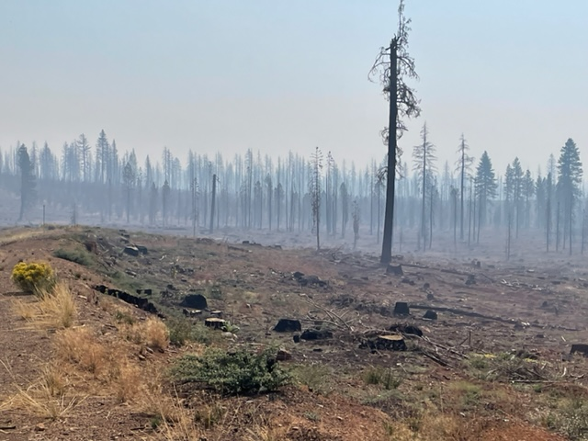
The devastation and the beauty of California
Emblematic of the 2 sides – burnout and joy -- of primary care

Slide 49
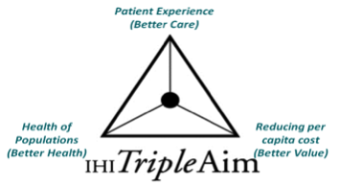
Don Berwick and the Triple Aim
In 2008, Don Berwick, a pediatrician and the nation’s foremost leader on improving health care, unveiled the doctrine of the triple aim
The triple aim:
Improving the patient experience of care
Improving the health of populations
Reducing the cost of health care
The triple aim was widely accepted as health care’s overarching goals
Source: Berwick DM et al. The triple aim: care, health, and cost. Health Affairs 2008;27:759-769.

Slide 50
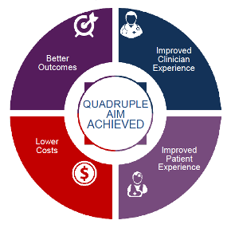
The Quadruple Aim
As evidence of clinician and health worker burnout grew, the idea was introduced that the three aims were not achievable without a satisfied health workforce
This led to the addition of a fourth aim:
Improving the worklife of clinicians and staff
The fourth aim helps to achieve the other 3 aims because health worker dissatisfaction is associated with: poor patient experience, reduced patient adherence to treatment plans thereby worsening population health, and higher costs of care
Source: Bodenheimer and Sinsky. From triple to quadruple aim: care of the patient requires care of the provider. Ann Fam Med 2014;12:573-576.

Slide 51
The LEAP Project Learning from Effective Ambulatory Practices
Funded by the Robert Wood Johnson Foundation, chaired by Ed Wagner and Margaret Flinter
2012-2013: LEAP project teams performed detailed 3-day site visits to 31 primary care practices
The practices had been selected through a careful process of identifying the highest-performing primary care practices in the country
Extensive site visit notes were taken and the 31 practices participated in a learning community to identify and interpret themes from the site visits.

Slide 52
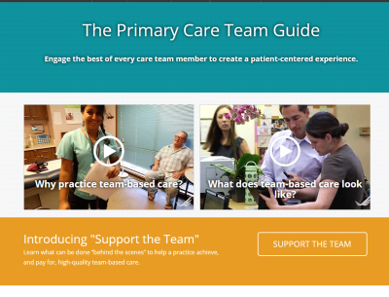
LEAP’s Primary Care Team Guide
LEAP has produced a terrific web-based primary care team guide
The team guide offers learning modules, materials on the different team members, and practice assessment tools on team-based care
It is worth spending time with this website
http://www.improvingprimarycare.org

Slide 54
10 Building Blocks of High-Performing Primary Care

Slide 55
10 Building Blocks: How were they developed?
Case Study Methodology
Site visits to 23 highly-regarded practices
Our experience as practice coaches at 25 additional practices
Review of existing models and research
8 hospital-based clinics
7 integrated delivery system sites
6 FQHCs
2 independent private practices
What do we mean by “high-performing”?
Practices known as innovators
Reputation for high performance in one or more of the quadruple aims
7 of 23 had 5 or fewer physicians

Slide 56
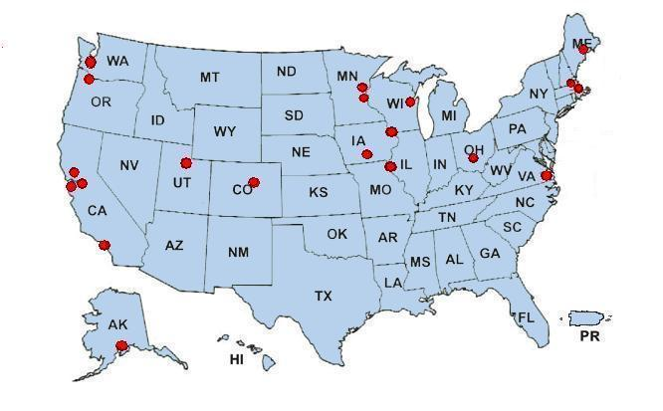
23 High-Performing Practices
Martin’s Point- Evergreen Woods
Group Health Olympia
Fairview Rosemont Clinic
Harvard Vanguard Medford
Multnomah County Health Dept
ThedaCare
Brigham and Women’s and MGH Ambulatory Practice of the Future
Allina
Mayo Red Center
Medical Associates Clinic
North Shore Physicians Group
Cleveland Clinic- Stonebridge
Clinic Ole
Clinica Family Health Services
Sebastopol Community Health
Mercy Clinics
Univ of Utah- Redstone
Newport News Family Practice
Quincy, Office of the Future
La Clinica de la Raza
West Los Angeles- VA
South Central Foundation
These 23 are only a small sample of the many high-performing primary care practices in the U.S.
Notes:
56
Tom/Rachel

Slide 57
Population
management
Patient-team
partnership
Data-driven
improvement
Template of
the future
Empanelment
Access
Team-based
care
Engaged
Leadership
Comprehensiveness
and care
coordination
Continuity

Slide 58
What are the foundational building blocks (1,2,3,4)? Write in the chat which BBs need to be addressed first
Access
Data-Driven Improvement
Template of the Future
Patient-Team Partnership
Engaged Leadership
Continuity
Population Management
Team-Based Care
Comprehensiveness and Care Coordination
Empanelment

Slide 59
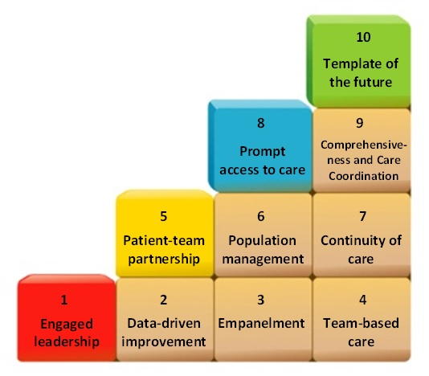
The 10 Building Blocks of High-Performing Primary Care Bodenheimer et al, Ann Fam Med 2014:12:166

Slide 60
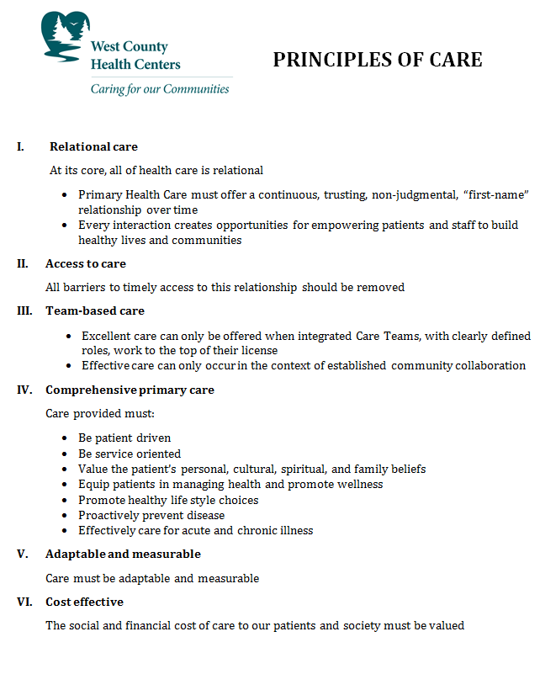
BB1: Creating practice-wide vision with concrete goals and objectives
Primary Health Care must offer a continuous, trusting, non-judgmental, “first-name” relationship over time
All barriers to timely access to this relationship should be removed.
Concrete Goals (examples)
By December 31, 2022, the % of diabetic patients with A1c > 9 will be reduced from 20% to 12%
By July 1, 2023, all patients will be able to obtain an appointment with their own primary care clinician within 5 days of making the request

Slide 61
BB2 | Data-Driven Improvement
Relevant data
Accurate data
Shared and discussed with everyone
Data drilled down to clinician/team level
Data analyzed by race/ethnicity/income to uncover inequities

Slide 62
BB3 | Empanelment
Empanelment: Linking patients with a primary care clinician/team
Advantages:
Patient and clinician/team know each other
Allows clinic to offer and to measure continuity of care
Allows calculation of panel size
Provides denominator for quality measures
patient
team
patient
team
patient
team
Empanelment Guide http://www.improvingchroniccare.org/downloads/empanelment.pdf

Slide 63
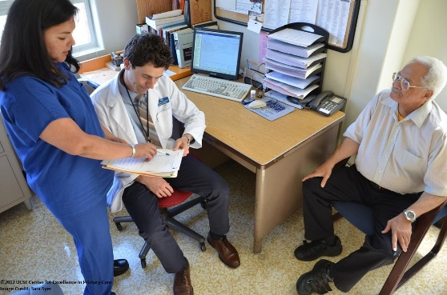
BB4 | Team-Based Care
Anatomy
A stable team structure
Colocation
Defined roles
Standing orders or protocols
Defined workflows
Staffing ratios adequate to facilitate new roles
Ground rules
Physiology
Culture shift: Share the Care
Training and skills checks
Communication

Slide 64
Patients and Teams
Primary care practices are getting larger
But patients prefer small practices
Study of 367 practices of different sizes
Patients were asked | how was your visit?
Small practices | 64% excellent
Large practices |48% excellent
Patients want to know their team members
“Physicians and staff knowing me is very important”
In small practices, patients report: “I know the people in the practice and the people in the practice know me”
Teams can divide a large practice into smaller units that are more comfortable for patients
There will be extensive discussion of teams in the next 2 learning sessions.

Slide 65
Questions?

Slide 66
Quality Improvement Assessment of your practice

Slide 67
Assess Your Practice What is your current state?
Patient measures
Panel size
UDS measures re: diabetes and hypertension
Satisfaction surveys
Disparities between groups by gender, race/ethnicity, age
Process measures
UDS measures re: screening
Cycle time
No show rates
Staff measures
Primary Care Team Guide Assessment
Team skills self-assessment
Role activity assessment
How accessible is your data? How reliable is your data? Who sees it?

Slide 68
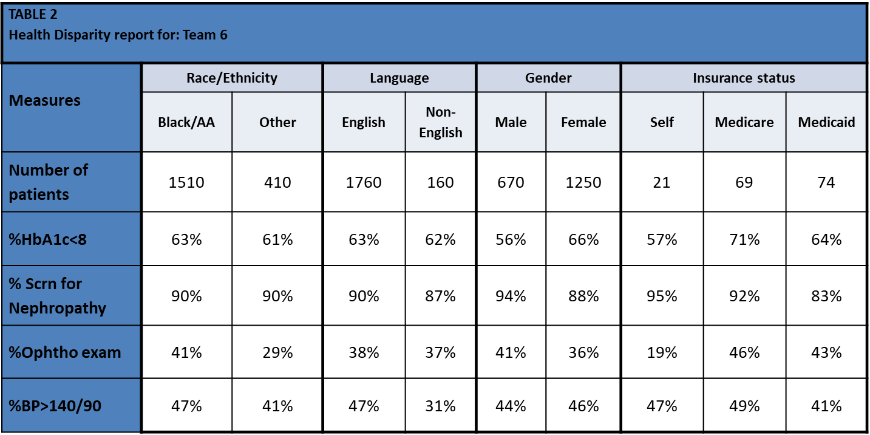
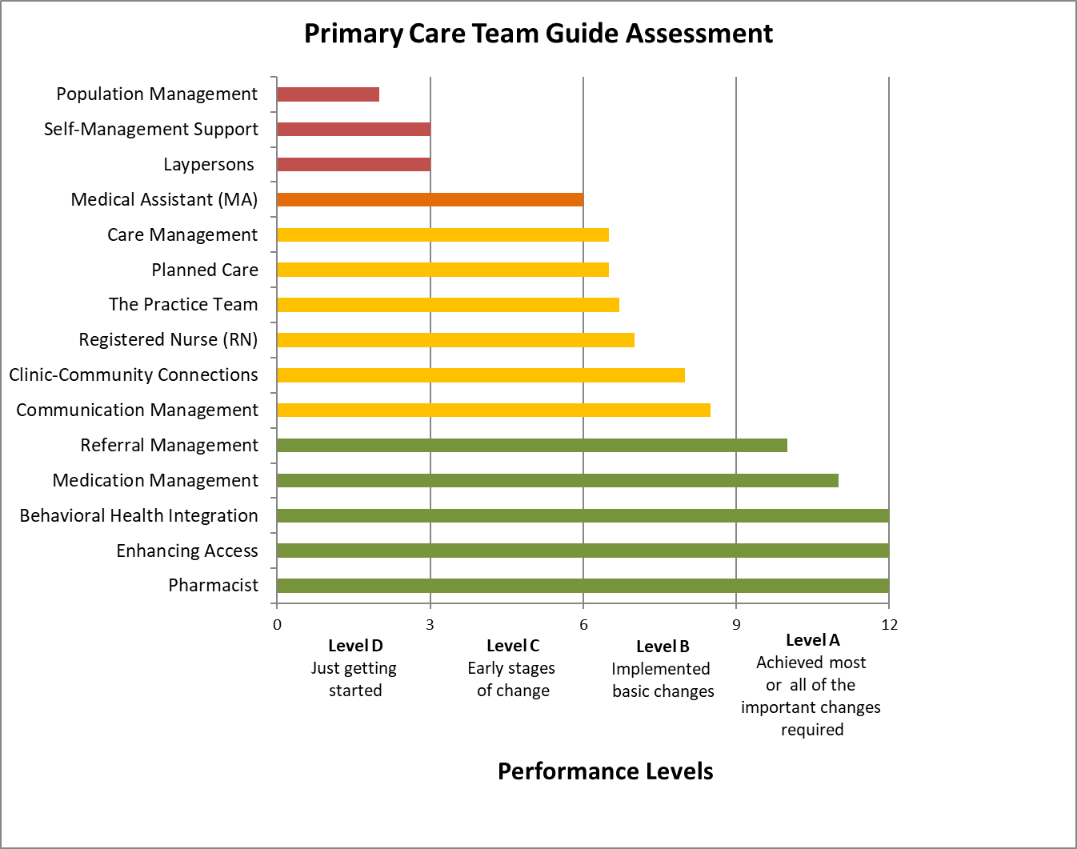
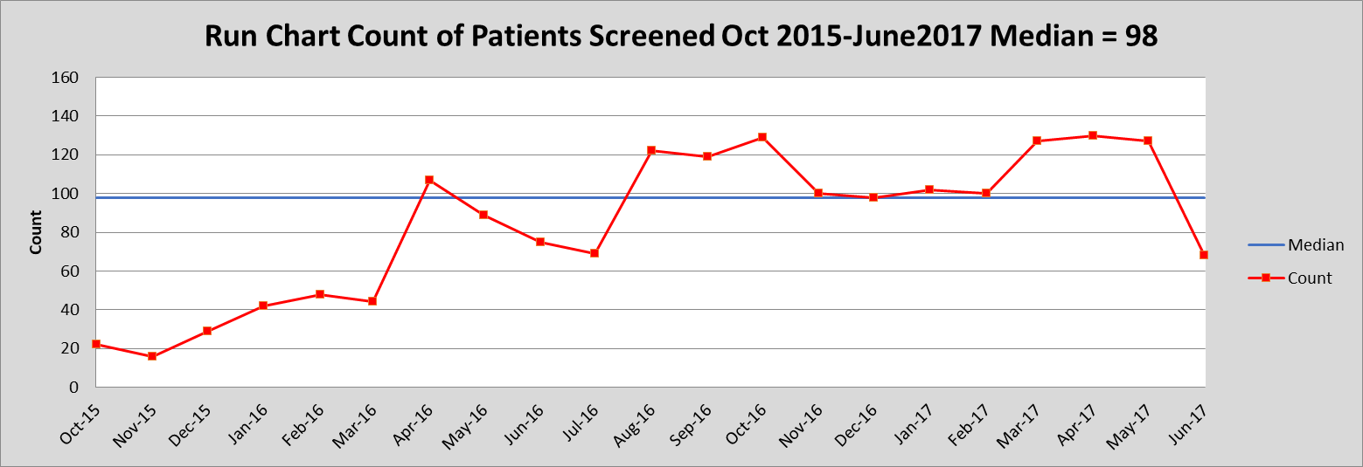
How do you share data with staff?
How accessible is your data? How reliable is your data? Who sees it?

Slide 69
How do these building blocks and functions map to your practice assessment?
Does your organization use data to drive improvement?
Are workflows standardized? Roles defined?
Who checks to see if a patient is due for colorectal cancer screening or an A1c? Who can order these?
Who manages the care of patients with chronic conditions? How do they do that?

Slide 70
Sample Results from Primary Care Team Assessment Guide: Self-Reported Levels March April 2021
 | ORGANIZATION NAME
The Practice Team | C
Medical Assistant (MA) | B
Registered Nurse (RN) | B
Laypersons | C
Pharmacist | D
Enhancing Access | A
Self-Management Support | C
Population Management | D
Planned Care | C
Care Management | C
Medication Management | D
Referral Management | C
BH Integration | A
Communication Mgt | D
Clinic-Community | C
Areas for Improvement:
Level C:
The Practice Team
Laypersons
Self-Management Support
Planned Care
Care Management
Referral Management
Clinic Community
Level D:
Pharmacist
Population Management
Medication Management
Communication Management

Slide 71
Questions?

Slide 72
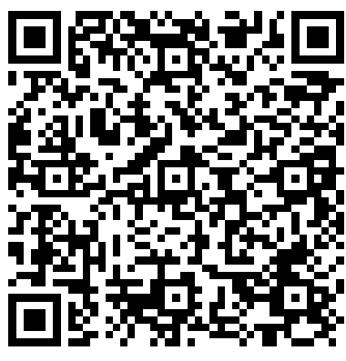
Action Period 1 Assignments
Conduct your weekly team meetings
Coaches attend weekly Mentor calls
Discuss the results of your team’s Primary Care Team Practice Assessment; Coach Skills Self-Assessment; and Team-Skills Self-Assessment in light of the presentation in Session 1.
What are your strengths and weaknesses?
What surprised you?
Assignment: Submit Role Activity Assessment.
Assignment: Develop a plan for how you will engage your colleagues and leadership regarding your participation in this Collaborative (“engagement plan” template available on Moodle)
CME and Resource Page
Access Code: TBC2023
https://education.weitzmaninstitute.org/content/nttap-comprehensive-and-team-based-care-learning-collaborative-2023-2024

Slide 73
Next Steps
Coach Calls:
Wednesday December 13th 1:00pm Eastern / 10:00am Pacific
Wednesday December 20th 1:00pm Eastern / 10:00am Pacific
Wednesday December 27th 1:00pm Eastern / 10:00am Pacific
Wednesday January 3rd 1:00pm Eastern / 10:00am Pacific
Wednesday January 10th 1:00pm Eastern / 10:00am Pacific
Session 2: Wednesday January 17th 1:00pm Eastern / 10:00am Pacific

Slide 74
NTTAP Contact Information
Amanda Schiessl
Project Director/Co-PI
Amanda@mwhs1.com
Bianca Flowers
Project Manager
flowerb@mwhs1.com
Meaghan Angers
Project Manager
angersm@mwhs1.com
REMINDER: Complete evaluation in the poll!
Next Learning Session is Wednesday January 17th!

Slide 75
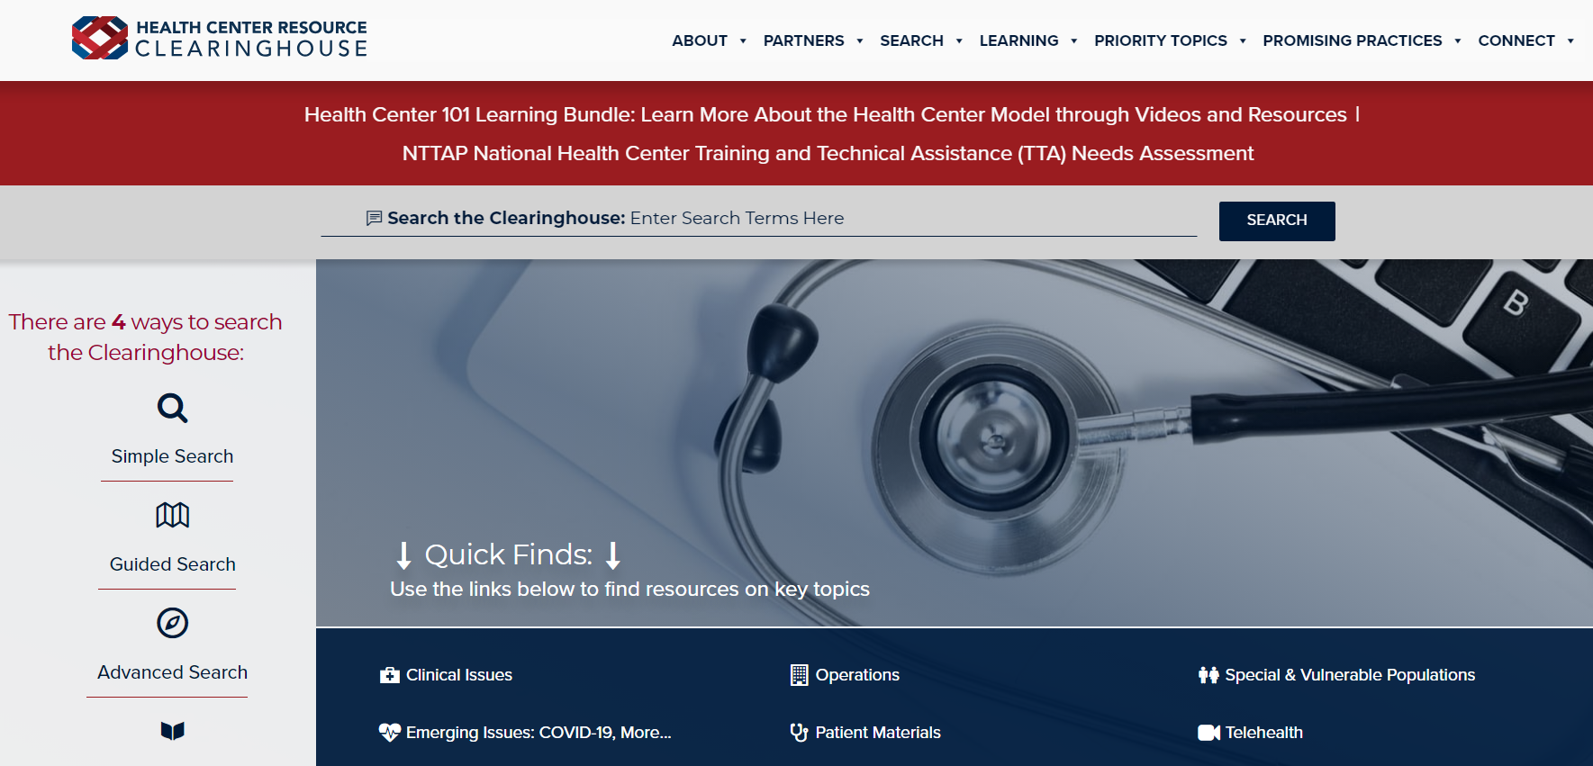
Explore more resources!
National Learning Library: Resources for Clinical Workforce Development
Health Center
Resource Clearinghouse
https://www.weitzmaninstitute.org/ncaresources
https://www.healthcenterinfo.org/
75
Notes:
Meaghan

