Slide 1

Postgraduate Nurse Practitioner Residency & Fellowship Program Learning Collaborative
Session Two: Tuesday December 19th, 2023
Notes:
Meaghan

Slide 2
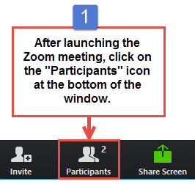
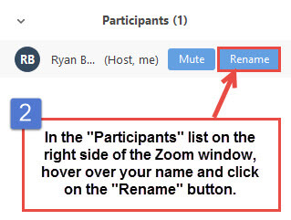
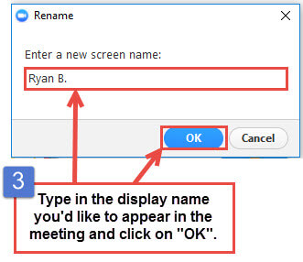
Get the Most Out of Your Zoom Experience
Please keep yourself on MUTE to avoid background/distracting sounds
Use the CHAT function or UNMUTE to ask questions or make comments
Please change your participant name to your full name and organization
  “Meaghan Angers CHCI”
Notes:
Meaghan

Slide 3
Session 2 Agenda
1:00-1:05 | Introduction and Agenda
1:05-1:25 | Overview of Program Structure & Key Program Staff and Responsibilities
1:25-2:20 | Value of Academic Clinical Partnerships Presentation from Yale University Presentation from UMass Chan Medical School
2:20-2:25 | Using the Progress Checklist
2:25-2:30 | Q/A, Wrap-Up and Evaluation
Notes:
Meaghan

Slide 4


National Training and Technical Assistance Partners
Clinical Workforce Development
Provides free training and technical assistance to health centers across the nation through national webinars, learning collaboratives, activity sessions, trainings, research, publications, etc.
Notes:
Meaghan

Slide 5
Learning Collaborative Faculty
Margaret Flinter, APRN, PhD, FAAN
  Co-PI, NTTAP
  CHCI’s Senior Vice President/Clinical Director
  Director Emeritus, WI, Senior Investigator
  Founder of America’s first nurse practitioner residency program
Kerry Bamrick, MBA
  Executive Director, NNPRFTC
  Coach Mentor
Charise Corsino, MA
  Program Director, NP Residency Programs
  Coach Mentor
Nicole Seagriff, DNP, APRN, FNP-BC
  Clinical Program Director
Kathleen Thies, PhD, RN
  Consultant, Researcher
  Evaluation Faculty
Amanda Schiessl, MPP
  Co-PI & Project Director, NTTAP
Bianca Flowers
  Project Manager, NTTAP
Meaghan Angers
  Project Specialist, NTTAP
5
Notes:
Meaghan

Slide 6
Learning Collaborative Structure
Six 90-minute Learning Collaborative video conference sessions
Bi-weekly 60-minute coaching calls between coach mentors and practice coach
Team workgroup meetings
Learning Session Dates
Learning Session 1 | Tuesday November 21st
Learning Session 2 | Tuesday December 19th
Learning Session 3 | Tuesday January 16th
Learning Session 4 | Tuesday February 13th
Learning Session 5 | Tuesday March 5th
Learning Session 6 | Tuesday April 2nd
6
Notes:
Meaghan

Slide 7
2023-2024
Cohort
Bartz-Altadonna Community Health Center | California
Charles B. Wang Community Health Center | New York
Chase Brexton Health Care | Maryland
Community Clinic Association of Los Angeles County (CCALAC) | California
Crossing Healthcare | Illinois
Hope Christian Health Center | Nevada
Klamath Health Partnership | Oregon
Nasson Health Care | Maine
Neighborhood Outreach Access to Health | Arizona
Peninsula Community Health Services | Washington
Penobscot Community Health Center, Inc. | Maine
Primary Health Network | Pennsylvania
WellSpace Health | California
Wheeler Health | Connecticut
7
Notes:
Meaghan

Slide 8
Overview of Program Structure &
Key Program Staff and Responsibilities
Notes:
Charise

Slide 9
Core Elements of a Postgraduate NP Residency
12 Months Full-time Employment | Training to Clinical Complexity and High Performance Model of Care team-based care, inter-professional collaboration, integrated care, data driven QI ,expert use of technology | Full Integration into Home Site and Organization
Precepted Continuity Clinics (40%); Residents develop and manage a panel of patients with the exclusive attention of an expert preceptor (NP, PA or Physician) Specialty Rotations (20%); Experience in primary care specialty areas to expand and enhance resident practice knowledge and skills Mentored Clinics (20%); Work within a primary care team focusing on diversity of chief complaints, efficiency, episodic and acute care Didactic Sessions (15%); Topics that are high volume, complexity and/or burden topics in primary care. Includes participation in Project ECHO sessions for managing chronic pain, treating HIV/Hep C, opioid addiction, complex pediatrics Quality Improvement Training (5%); Training to a high performance QI model, including front line QI improvement, data driven QI, and leadership development.
Notes:
Charise

Slide 10
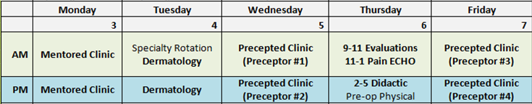
CHCI’s Program Schedule - Week
Program
Staff and Resources
Notes:
Charise

Slide 11
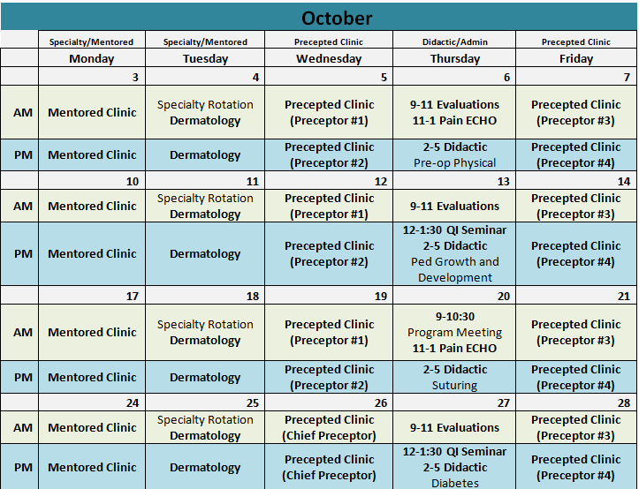
CHCI’s Program Schedule - Month
Notes:
Charise

Slide 12
Key Program Staff and Responsibilities
Administrative – Program Coordinator/Manager
Responsibilities
Skills
Organized and detail oriented
Knows organization
Experience and/or training in program management
Suggested Time Commitment
Dependent on size of the program – could be combined with other job role
Starting out –
2 to 3 trainees-
.4 to .5 FTE
Responsible for the oversight of the administration of the program. Manage day to day implementation and logistics of the program, as well as troubleshoot issues.
Notes:
Kerry

Slide 13
Key Program Staff and Responsibilities
Clinical – Clinical Program Director or NP or PA Lead
Responsibilities
Skills
Trained in clinical discipline of the program
Commitment to training
Understanding of clinical delivery of care in area of training
Suggested Time Commitment
Dependent on size of the program
On average: 2 to 3 trainees
- .2 to .4 FTE
Responsible for the clinical oversight of the program including curriculum development and delivery
Notes:
Kerry

Slide 14
Key Program Staff and Responsibilities
Clinical – Preceptors
Responsibilities
Skills
Expert provider in their discipline
Commitment to training
Suggested Time Commitment
Postgraduate Training Program
– 4 to 8 hours per week
Responsible for direct training and supervision of trainees
Notes:
Kerry

Slide 15
Specific Roles and Responsibilities (timing)
Early Months (September through January)
(or at Stage of 1-2 patients per hour):
The preceptor should see all patients with the postgraduate trainees initially, for the first few weeks (3-4 weeks)
After the first few weeks, the preceptor should see the patient at some point during the visit, observing and repeating physical exams and relevant history taking, as needed
Provide guidance and instructions on all aspects of the patient visit, including charting, the verbal presentation and the written note
Create an addendum in the patient’s progress notes or co-sign the note after the postgraduate trainee has completed the note.
Notes:
Kerry

Slide 16
Specific Roles and Responsibilities (timing)
Later Months (February through August)
Reassess the postgraduate trainees’ comfort and mastery with clinical decision-making, physical exams, concise history taking and develop a precepting plan that meets the needs of the trainee
Help with time management and efficient practice skills in an ongoing fashion
Review all cases and repeat/observe history and physical exams, as needed
Provide guidance and instruction on all aspects of the patient visit (review entire written note and provide feedback as indicated)
Create an addendum or co-sign the patient’s progress note after the postgraduate trainees have completed the note
As the postgraduate trainees become more skilled, the preceptor should become more focused on guidance with time management, practice and panel management
Notes:
Kerry

Slide 17
Questions?
Notes:
Kerry

Slide 18
Value of Academic Clinical Partnerships
Notes:
Charise

Slide 19
Polling Question
Do you have existing academic partners
or an academic partner in mind?
Notes:
Charise

Slide 20
History of Partnership
Margaret Flinter, CHC’s Sr. VP and Clinical Director and YSN trained FNP joined CHC in 1980 as CHC’s first NP.
She took her first YSN student in 1981 and CHC has had YSN students ever since
Currently take placements for both RN and NP students – started with just NP students but have expanded to include all specialties
Many CHC NP providers are YSN alumni and some hold faculty appointments
About a third of CHC NP residents have historically come from YSN including the first cohort which included 3 of our 4 residents
YSN has always served as a trusted partner for consultation and discussions around issues concerning trainees, students, and other timely topics related to clinical workforce.
Notes:
Charise

Slide 21
Yale University Student & Trainee Placements
Total Number of Students for 2023: 46
  Opportunity to get clinical experiences and exposure to community health
  Pathway – rotation to residency
  26% of trainees completed 2 or more clinical rotations at CHC
Notes:
Charise

Slide 22
Student
Clinical Placement
Postgraduate Resident
Full-Time Provider
Preceptor/
Faculty
Developing a
Clinical Workforce
Notes:
Charise
This is the goal we strive to reach -
Wheel – concept of our whole clinical workforce; creating a flowing wheel that feeds your pipeline
Predictable flow of primary care providers

Slide 23
Developing a Formal Partnership
Funding Opportunities and Grant Partnership
  2019 HRSA released the ANE-NPR grant-funding
    Formal Clinical-Academic partnership required - CHC and YSN formally partnered
  2020 HRSA released second round of funding
    ANE-NPRIP – CHC and YSN built upon their current partnership
  2023 HRSA ANE-NPRF funding released
    CHC and YSN continued well-established partnership
Basic overview of how to establish that partnership
Notes:
Charise

Slide 24
Process of the Partnership
Key Piece: Need someone identified from the school that is the champion; and then 1-2 identified from the health center
NP Program Director and Key Academic Clinical Partnership meet regularly to update on each “world” – academic and residency program
  Collaboration of resources
  Consistent Meetings
  Identifying a champion
Evolution over time / sustainability
Notes:
Ami
Regular meetings at establishment and then transition to where the needs are

Slide 25
Updates on Trends in Graduate NP Education
Updated National Task Force (NTF) standards requiring increases in all NP program clinical hours requirements to 750 hours.
Focus in increasing diversity of NP workforce and faculty and strengthening DEIB content in curriculum
Move toward competency based education for all specialties
Notes:
Ami

Slide 26
Collaboration: Simulation
Needs Assessment through CHCI determined more geriatric focused training and we were also expanding our geriatric training
Wanted to integrate for simulation based experiences into the residency program
Yale helped facilitate for the first time, so CHCI trainers could be trained
Yale was able share these resources and technical support with CHCI and implement a new model of training for their residents
Notes:
Ami

Slide 27
Collaboration: Developing New Programs
Specialty rotations: Helpful to consult with academic program
Used resources from the university for content and curriculum
Example: Adult Gero Program
  Yale shared resources with CHCI to help develop this program
  Professor/faculty came to speak
Example: Psych Program
Notes:
Ami

Slide 28
Value of the Academic Clinical Partnership
For Residency Program:
For Academic Partnership:
Having understanding of upcoming academic classes
  Current trends in academic education and graduate needs
  Insights to potential applicants
Knowledge in residency program to share with students
  What residency curriculum looks like?
  What they look for in students?
  What does application and interview process look like?
  What relevant experience does the student need (i.e. volunteer roles)?
  Access to clinical resources
Creates seamless transition from student to graduate to resident
Notes:
Charise (Residency) / Ami (Academic)
For Residency Program - Example: COVID stressed out ability to place students in pediatric rotations

Slide 29
The Academic Clinical Partnership for NP Residencies
Jill M. Terrien PhD, ANP-BC

Slide 30
Objectives
Describe the academic partner role
How to recruit an academic partner
Contributions and value of the academic partner

Slide 31
Massachusetts Community Health NP Residency – One Academic Partner model
Family Health Center (FQHC) had a FNP residency since 2009
  approached GSN with another local FQHC to lead grant
  3 additional CHC partners identified
What is in it for the GSN?
  Continues public service mission through partnerships
  Future preceptors for GSN students
  Possible future students and educators

Slide 32
Structure
Shared leadership/equal partners
  outlined in the grant application’s org chart – no hierarchy, clear roles
  productive, documented monthly team (Advisory Council) meetings
  shared decision making/problem solving
  Residency directors (Clinical Liaisons) have their own meetings, responsible for certain tasks (e.g., recruitment/ hiring of NP residents)

Slide 33
A Theme: Sustainability
GSN is a partner, not the expert, not a crutch… continually ask, how is this sustained post grant funding?
Centrally developed/site approved policies and procedures
Shared commitment to didactics
  Monthly case presentations by residency directors
    Came from resident feedback sessions with the GSN-we learned along the way
    Allows residency directors to get to know other residents
    Primary Care 101 series development (2019-2023)
  Each site contributes sessions (local expertise or outside organization like New England AIDS Education and Training Center, Mass DPH)
  Commitment to wellness – Balint sessions and TEND (external/safe) sessions

Slide 34
Resident relations
Academic team gets to know residents
Host didactic sessions
4x a year resident feedback sessions to project manager and evaluator
In-person graduation in 2022 and will continue in 2023!
Grant requirement – job hunting assistance
But - we want them to stay! (employment post residency is a consideration)
Annual session on:
  CV development and grant citation for their CV
  Some job search resources… more info on loan repayment

Slide 35
Value of the Academic Partner & Identifying one
Contributions
Preceptor support
Affiliating w/an academic partner
Didactic sessions
Ongoing evaluation
Support/troubleshooting
Simulation
Advisory board-8 mtgs/yr
Faculty appointments
Preceptor CE
Teaching of Tomorrow
New England Precepting Academy (HRSA Grant)
Access to medical library
Are your NP’s/PA’s (employees) from a local university?
Do NP/PA students precept with you?
Who appeals to you?

Slide 36
Questions?

Slide 37
Using the Progress Checklist
Notes:
Meaghan

Slide 38
Purpose of the Progress Checklist
  To help you track your progress
  To help us identify where you need more help
  To help your coaches identify areas in which you need more encouragement and reminders
Notes:
Meaghan
Available in the WEP and will send it in the chat
Can use throughout the LC and update as you complete items

Slide 39
Team name: Date:
What is your team's progress on implementing the following?
 | Have not started | Started working on it | Working on it | Making progress | Completed
 | 1 | 2 | 3 | 4 | 5
GENERAL
Define goals and develop a shared aim. Example: Improvement of workforce development.
Define specific, measurable outcomes and objectives.
Ensure that each team member is competent to perform their defined and delegated functions and tasks. Example: Provide education and support for staff providing involved in didactic, clinical, and supervision activities for residents.
Notes:
Meaghan

Slide 40
What To Do
Can be completed during a team meeting or the coach can complete it separately based on conversations with the team members
Just check the box or color it in
Display it as you work
Can fill out on your own throughout the learning collaborative and will help you understand remaining steps post-learning collaborative!
Notes:
Meaghan

Slide 41
Wrap-Up
Notes:
Meaghan
Launch evaluation

Slide 42
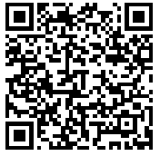
Assignments
Continue to develop a draft presentation for leadership/board and present if possible
List core program elements
Begin Progress Checklist
Google Drive
https://drive.google.com/drive/folders/1WgVbObv-KgPfz5UyKgSuXsWj09Skq1pp?usp=sharing
Notes:
Meaghan

Slide 43
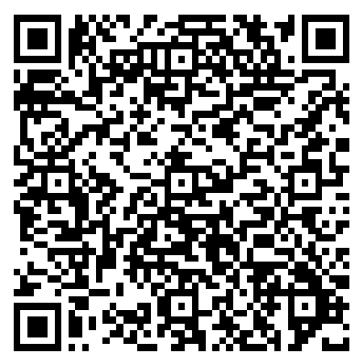
Reminders
Coach Calls:
  Tuesday January 2nd 1:00pm Eastern / 10:00am Pacific
Session 3: Tuesday January 16th 1:00pm Eastern / 10:00am Pacific
CME and Resource Page
Access Code: PGR2023
https://education.weitzmaninstitute.org/content/postgraduate-nurse-practitioner-np-residency-and-npphysician-associate-pa-training-programs
Notes:
Meaghan

Slide 44
Contact Information
Amanda Schiessl
Program Director/Co-PI
Amanda@mwhs1.com
Meaghan Angers
Program Manager
angersm@mwhs1.com
REMINDER: Complete evaluation in the poll!
Next Learning Session is Tuesday January 16th!
Notes:
Meaghan

Slide 45


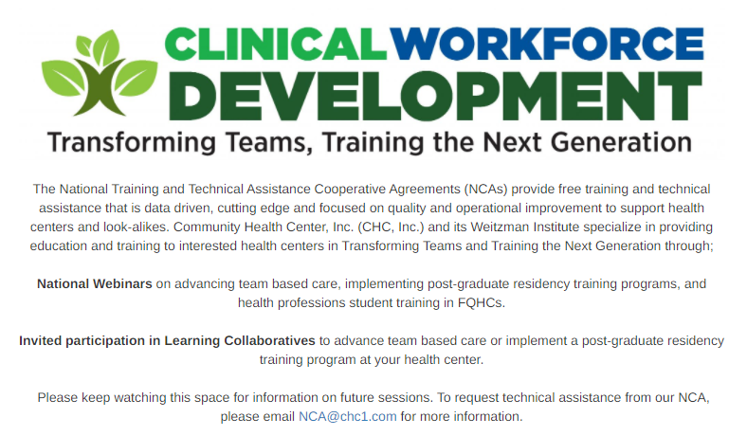

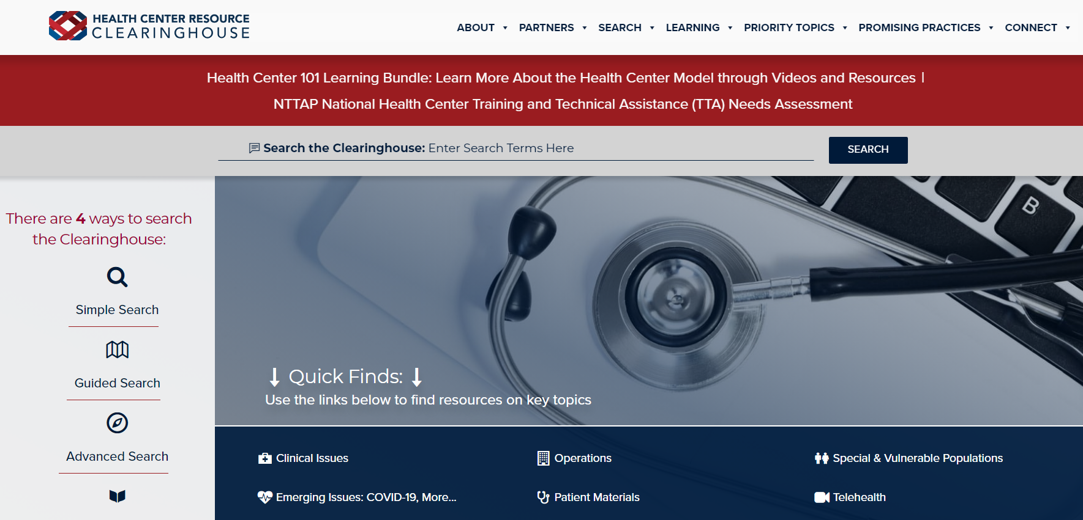
Explore more resources!
National Learning Library:
Resources for Clinical Workforce Development
Health Center
Resource Clearinghouse
https://www.weitzmaninstitute.org/ncaresources
https://www.healthcenterinfo.org/
45
Notes:
Meaghan

