Slide 1
STRATEGIC
FOCUSED
Quality Improvement Seminar
Natalie Ewashkow & Mark Splaine
December 14, 2023
RELEVANT
INTERACTIVE
TEAM WORK
INFORMATIVE
FUN
SKILL BUILDING
Nurse Practitioner & Physician Assistant
Training Programs

Slide 2
Session Goals
Review details of how to approach flowcharting
Share examples of strategies to consider when doing flowcharting
Hear about and discuss the example of a process you chose to explore in detail
2

Slide 3
Roles
Theory burst presenter
Mark
Interactive discussion leader
Natalie
Technical genius
Sarah
Take-home thoughts report-out
Nicole
3

Slide 4
Agenda
Welcome (10 minutes)
Example of QI tools to introduced to date (10 minutes)
Fishbone diagram example (10 minutes)
Theory burst on flowcharting (10 minutes)
Break (5 minutes)
Small group discussion of flowcharting strategies (30 minutes)
Summary and take-home points (5 mins)
Preview of next session (10 minutes)
4

Slide 5
Curriculum Plan
An overview of Quality Improvement (10/12/23)
Care Observations & Stakeholder Considerations (10/26/23)
Organizing your Improvement Project (11/9/23)
Global Aim and Fishbone Diagram (11/30/23)
Process Mapping (Flowcharts) (12/14/23)
Measurement to Inform Change (1/11/24 & 1/25/24)
An Approach to Testing a Change (2/8/24)
Communication about your Improvement Effort (2/22/24)
Stakeholder Analysis & Conflict Management (3/14/24)
Managing Up and Gaining Leadership Buy-In (3/28/24)
Negotiation (4/11/24)
Negotiation and More About Cycles of Change (4/25/24)
Sustaining your Improvement Effort (5/9/24)
Resident Presentations (5/23/24, 6/13/24, 6/27/24)

Slide 6
Reports on Fishbone Diagrams
We will hear from some teams:
1
2
Share a couple of things your group learned when developing your fishbone diagram

Slide 7
Poll Question
Prior to your work on today’s assignment, did you have any prior experience creating a flowchart (process map)? (select one)
Yes, I have done this many times.
Yes, I have done this once before.
Somewhat, I am familiar with the tool but have not created one before.
No, this is a new tool for me.
Thanks for sharing!

Slide 8
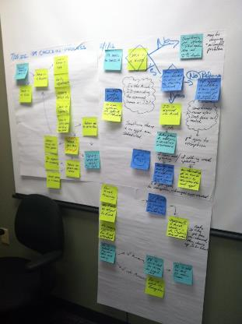
Flowcharting/ Process Mapping
Tips and strategies for using this tool

Slide 9
Morning Routine

Slide 10
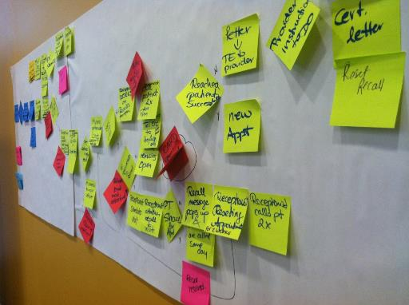
What is a Process Map?
Process maps are used to visualize how healthcare, and its complex processes, are delivered. It is used for determining the step by step flow of the process, its timing, handoffs, and identifying outputs that can be visualized, measured, and studied. (Marriott, 2018)

Slide 11
How does this help?
Teamwork
View of current work
Identifies unwanted variation, waste, delays, and rework
Generate ideas for improvement
Document Processes
Describe and understand the work
Analyze and improve on processes
“You don’t learn to Process Map. You Process Map to learn.” - Dr. Myron Tribus

Slide 12
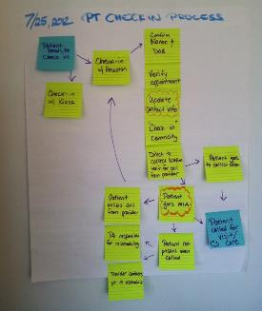
Getting Started
Identify the people with ‘local knowledge’
Identify purpose
Choose a process
Start and end points
Think about the details
Consider ‘walking the process’ yourself

Slide 13
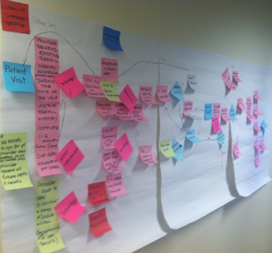
Helpful Hints
Current process
Not what you WANT the process to be
Ask:
“What happens first”, and “what happens next”
Use:
The flowchart template provided
Copy/paste specific shapes that represent specific steps of the process (found on the next slide)

Slide 14
Shapes
Start & End: An oval is used to show the materials, information or action (inputs) to start the process or to show the results at the end (output) of the process.
Activity: A box or rectangle is used to show a task or activity performed in the process. Although multiple arrows may come into each box, usually only one arrow leaves each box.
Decision: A diamond shows those points in the process where a yes/no question is being asked or a decision is required.
Connector/Break: A circle with either a letter or a number identifies a break in the process map and is continued elsewhere on the same page or another page.
Cloud – represents the “Don’t know”
Arrow – Process flow direction

Slide 15
Level of Focus (Granularity)
The Big Picture – 30,000 feet
A high level flowchart is a good place to start process mapping

Slide 16
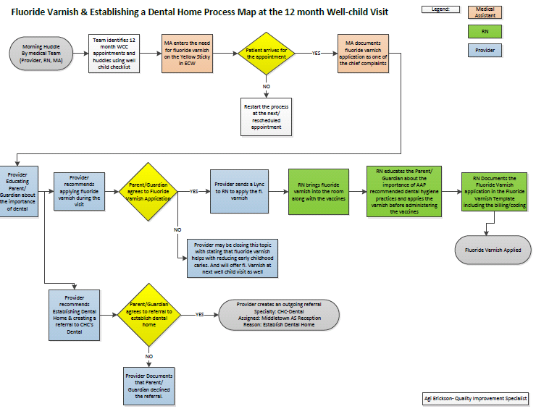

Slide 17
Break!
Take five minutes to recharge and refresh.
17

Slide 18
Flowchart Discussion
We will break into project groups (15 minutes)
Review your draft flowchart and make any enhancements you can think of based on today’s discussion
Consider the following questions:
Who are the stakeholders for the process?
How might you use the flowchart as a communication tool with stakeholders?
What aspect of the flowchart might be ripe for further focus?
What challenges or barriers do you anticipate in working on this process?
Nominate someone from your group to share a brief summary of your small group’s discussion
18

Slide 19
Small Groups for Flowchart Discussion
We will break into project groups:
CHC Meriden
CHC Meriden/New Britain
DePaul
CHC Hartford
HealthLinc
Holyoke HC
CHC Middletown/New Britain A & B
Yakima
CHC Stamford
Open Door

Slide 20
Poll Question
Which of the following best describes your team’s experience in drafting your flowchart? (select one)
We just winged it and figured it out.
We watched one or more of the videos and had no problem generating a draft.
We generated a draft, but got stuck in a few places.
We found this hard to do and would like some assistance.
Our experience is not captured in any of the options.
Thanks for sharing your information!

Slide 21
Highlights from Project Groups
Reporter’s summary from some groups -- share 1 or 2 highlights from the discussion

Slide 22
What haven’t we figured out yet?
Questions or issues that remain unclear?
22

Slide 23
Take-home Thoughts
Nicole – share 1 or 2 ideas you will take away from our discussion
23

Slide 24
Summary
You have learned about a framework to guide your thinking about how to organize improvement work
Now we reviewed an important tool for quality improvement work – process mapping (flowcharting)
Based on your submissions, it is clear you are already gaining new insights into the process by using this tool.
Our next step will be to link measurement to the process and outcomes of the process
24

Slide 25
Upcoming Office Hours & Teams
The next office hours will be on 1/4 all from 12:30-1:30pm EST
We would like to meet with each project team once during December or January. Please let us know when your team would like to do this using this link: https://doodle.com/meeting/participate/id/dLYZEJWe
Email us if none of the times work for your team and you would like to meet at another time.
This discussion will be for us to learn a bit more about your project plan and to think together how we can assist you in your work
25
Notes:
www.clinicalmicrosystem.org
25

Slide 26
Upcoming Session VI Highlights
Our next session will be on Thursday, 1/11/24
We will discuss tips and strategies for finding and developing measures to enhance your understanding of an improvement effort
We will break into small groups to discuss draft examples of measures related to your projects
26
Notes:
www.clinicalmicrosystem.org
26

Slide 27
Assignment for Session VI
Review this Balanced Measures video as a group
After watching the video, review your flowcharts and brainstorm which balanced set of measures to select using the Balanced Measures template
Continue to revise your flowchart based on today’s discussion, or additional ideas you have about the actual process as needed
Send a summary of your set of measures for your process to Mark by Tuesday (1/9/24) at 6pm EST
Contact Mark if you have questions or need assistance
27
Notes:
www.clinicalmicrosystem.org
27

Slide 28
References
Marriott, R. (2018). Process mapping – The foundation for effective quality improvement. ScienceDirect, 48(7), 177-181. https://doi.org/10.1016/j.cppeds.2018.08.010
28
Notes:
www.clinicalmicrosystem.org
28

Slide 29
Thank you Natalie & Nicole!
We wish you all the best in your new roles.
29

Slide 30
Happy Holidays!
30

