Slide 1
Comprehensive Care Learning Collaborative
Session Two: Wednesday January 17th, 2024
Notes:
Meaghan

Slide 2
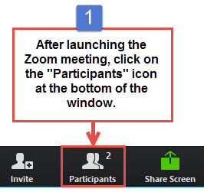
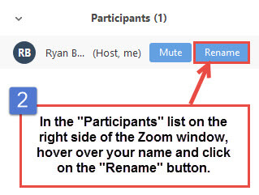
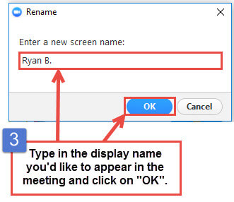
Get the Most Out of Your Zoom Experience
Please keep yourself on MUTE to avoid background/distracting sounds
Use the CHAT function or UNMUTE to ask questions or make comments
Please change your participant name to your full name and organization
  “Meaghan Angers CHCI”
Notes:
Meaghan

Slide 3
Session 2 Agenda
1:00 – 1:05 | Introduction
1:05 – 1:15 | TBC Spotlight: Catherine’s Health Center
1:15 – 1:30 | Teamlet Structure and Functions
1:30 – 1:45 | Making Your Team Work: Team Development Communication Plan and Stakeholder Analysis
1:45 – 2:15 | Building a Collaborative Team Culture
2:15 – 2:25 | Quality Improvement Refresh: Global Aim Statement
2:25 – 2:30 | Q/A, Next Steps, and Evaluation
Notes:
Meaghan

Slide 4
Learning Collaborative Faculty
NTTAP Faculty, Collaborative Design,
and Facilitation
Amanda Schiessl, MPP
  Project Director/Co-PI, NCA
  Amanda@mwhs1.com
Margaret Flinter, APRN, PhD, FAAN
  Co-PI, NCA & Senior Vice President/Clinical Director
  Margaret@mwhs1.com
Bianca Flowers
  Program Manager
  flowerb@mwhs1.com
Meaghan Angers
  Program Manager
  angersm@mwhs1.com
Mentors, Coaching Faculty
Deborah Ward, RN
  Quality Improvement Consultant
  WardD@mwhs1.com
Tom Bodenheimer, MD
  Physician and Founding Director, Center for Excellence in Primary Care
Rachel Willard, MPH
  Director, Center for Excellence in Primary Care
Evaluation Faculty
Kathleen Thies, PhD, RN
  Consultant, Researcher
  ThiesK@mwhs1.com
4
Notes:
Meaghan

Slide 5
Collaborative Structure and Expectations
Eight 90-minute Zoom Learning Sessions
Session 1
Dec. 6th
Session 2
Jan. 17th
Session 3
Feb. 7th
Session 4
March 6th
Session 5
April 3rd
Session 6
May 1st
Session 7
May 29th
Session 8
June 19th
Between Session Action Periods
Meet Weekly as a Team
Conduct Daily Huddles
Complete Assignments and upload to Moodle
Use Online Moodle Learning Network (Share Your Work, Resources, etc.)
Between Sessions
Coaches Meet with Mentors Weekly
Faculty Support
Discussion Board
Notes:
Meaghan

Slide 6

2023-2024 Cohort
Organization | Location
Brockton Neighborhood Health Center | Massachusetts
Brooklyn Plaza Medical Center | New York
Klamath Health Partnership | Oregon
Migrant Health Center, Western Region, Inc. | Puerto Rico
The Wright Center for Community Health | Pennsylvania
Notes:
Meaghan

Slide 7
Team-Based Care Spotlight:
Catherine’s Health Center

Slide 8


“We provide access to high quality, affordable and compassionate health care for the West Michigan community.”
How It Started
Catherine’s Health center started as a vaccine clinic in the basement of the St. Alphonsus Parish in Grand Rapids, Michigan on February 14, 1996.
How It’s Going
Catherine’s Health Center became a Federally Qualified Health Center in 2020 with a single adult primary care office on the North side of Grand Rapids.
In 2021 we added a dental office and this year we have opened 2 new sites on the south side of Grand Rapids with full life primary care, dental, SUD, and behavior health services.
We have big growth goals for the future as we go from 4,000 annual patients in 2021 to a goal of 19,000 annual patients in the coming years.
Notes:
Good Morning/Good Afternoon everyone. My name is Mick, I am a nurse care manager and the senior manager of quality at Catherine’s Health Center. It’s been a while since I first introduced Catherines, so I’m going to take a second to introduce us again. Catherines Health Center is located in Grand Rapids Michigan and started in 1996 in the basement of a church as a free clinic. In 2006 we moved into our own clinic, a repurposed elementary school.
In 2020 we were approved for FQHC status and have been working tirelessly to grow ever since. We opened 2 new clinics last year, and our NTTAP project has been working with the clinic that opened in August in Wyoming, a city on the south side of Grand Rapids. Many in this group were new to healthcare, but all of them were new to each other, so there has been a lot of growth and change in the last year.

Slide 9
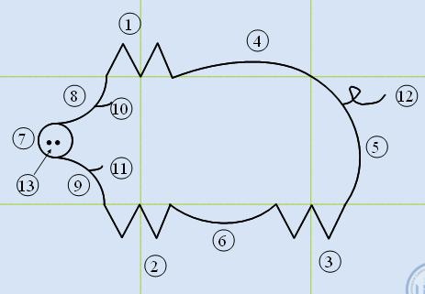
Team Builders
Notes:
We started with some surveys and initially I was hesitant to start meetings off with team builders, we had a lot to do and I wanted to be respectful of everyone’s time.
But quickly the team requested that we take some time in the morning to warm up, at 8:30 on a Friday morning, people needed a moment for their coffee to start working. It turned out to be incredibly valuable, as we got to get moving and get to know each other better. Some warmups were fun, building airplanes, guessing drawings, or picking up skittles with chop sticks. Some helped us learn about the process like making PDSAs for keeping coins spinning, drawing a pig in a grid with only verbal instructions, and making a process map for making PB & Js.
We also took time to check in, learn about how we communicated with each other in person, over teams, and in the chart, or to talk about why what we were doing is important. All these things helped us work better together in the day-to-day work and be quicker to help each other on difficult days. But after 5-10 minutes (sometimes 15-20) it would be time to get to work.
Team dynamics are unique to every group and not the direct focus of NTTAP’s education, but would be what I encourage your team leads to discuss in their weekly meetings with NTTAP, learning how to navigate all of the opportunities and barriers was by far the most valuable thing to come out of those meetings.

Slide 10
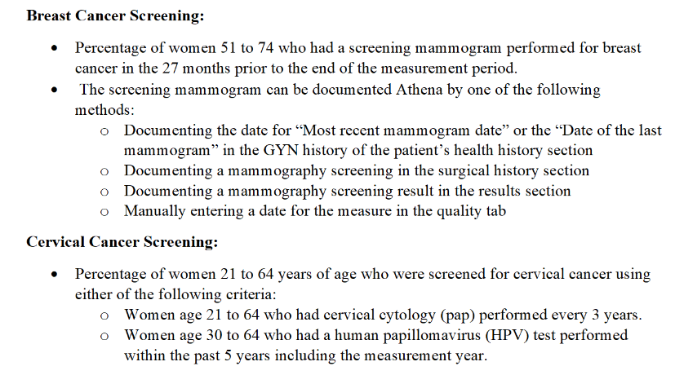
UDS Review
Notes:
To decide on our area of improvement we reviewed our UDS measures and discussed what UDS is, where it comes from, why the measures are important, and how to satisfy them. We then looked at how the Wyoming clinic’s numbers stacked up versus where we were as a system to decide what measure we would focus on improving.

Slide 11
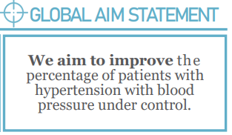
Global Aim Statement
Notes:
So we landed on HTN as our goal. At our starting point, 41% of our patients with HTN had a blood pressure WNL at their last office visit. Caterine’s goal as a system is 65%.

Slide 12
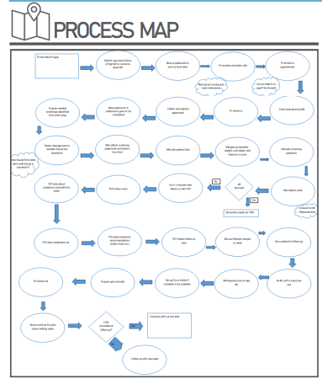
Process Map
Notes:
With our global aim in place we began work on our Fishbone diagram, leaving 6 large sheets for each section of the fishbone along the walls of the conference room and writing down all the barriers for our patients to get their blood pressure WNL, then assigning them to one of the sections of bones of the fish. The conversation really got started with our process map. As you can see it has a large number of steps in it as it goes from setting up an appointment to getting blood pressure under control.
This may have been one for the most helpful steps in the process considering how new everyone was to the office. It gave us a chance to see the whole flow and how everyone contributed to a patient’s health when they came in. We had a lot more ideas as we ran through this process and ended up adding them back to the fishbone after we finished. ( I joked at the time that our parking lot was turning into a parking structure) The final fishbone has over 60 areas to address to improve blood pressure that we can come back to at any time. We narrowed our options down to two areas, or bones, and picked our specific aim from there.

Slide 13
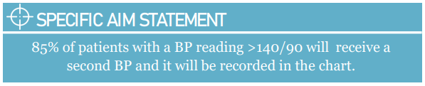
Specific Aim
Notes:
All improvement starts with accurate information, so our specific aim was to make sure we were taking second blood pressures when the first was out of range, and that we were taking our blood pressures well. Are these patients really hypertensive? Are they maybe better controlled than we think? The team was initially very confident that this was happening already, but we found that since January, second blood pressures were only taken about 33% of the time. We sat down to make sure we all had an agreed upon the way we were taking blood pressures by looking through AMA’s best practices, and remind each other how we should be doing them. Feet flat on the floor, arm resting comfortably, no talking, ect. Initially we wanted to have a 3rd manual BP check, but found that AMA suggested against that, which helped streamline our process and focus our efforts where they mattered most.

Slide 14
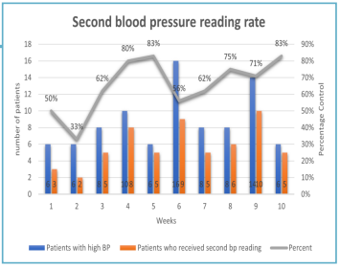
2nd BPs
Notes:
If you look near the bottom of our poster here, you can see the weekly rate of second blood pressure readings being taken. We started off a little rocky, but quickly started figuring it out. Of note, on average 50% of second blood pressures taken were WNL. So very quickly we are getting a much better picture of our patient’s health.
Our goal was to get 85% of our patients with elevated blood pressures rechecked, and with the number of patients we saw with elevated bps usually between 6-10, that often meant we had to get everyone, while we often fell short of the 85% still the improvement was amazing. We went through several iterations to increase our rate, getting the second bp before providers saw the patient, getting the second after, using magnets on the doors as a visual reminder, and landed on leaving the cart in the room until the second BP was taken.
You can see at week 6 there was a dramatic drop in numbers, this as around the time we lost 2 of our MAs in a clinic with 2 providers. Our numbers have continued to increase even as we get coverage from other sites and have increased the number of providers at our site. That really speaks to the importance of working really hard on small goals, that they were able to bounce back and keep using their system even when they worked so short staffed.

Slide 15
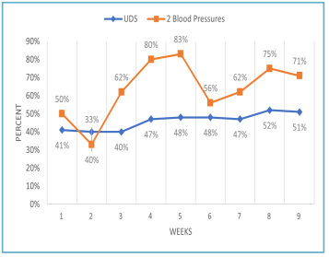
HTN Control
Notes:
Now for the big, overall numbers.
Our team saw an increase from 41-51% in the 9 weeks before I submitted these graphs, and saw an increase the target patient population from 77 to 95. The next week we started getting previously seen patients back in and our control percentage sits at 60% with 98 patients after 2 and a half months, a 20 percentage point increase in control with an almost 30% increase in population size.

Slide 16
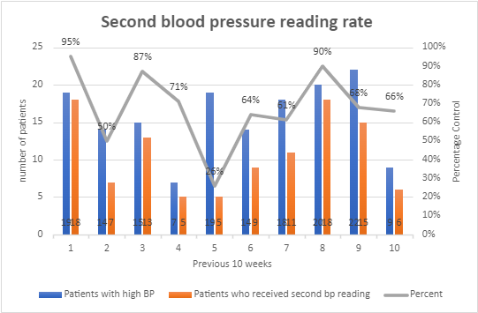
2nd BPs Now
Notes:
Now for the big, overall numbers.
Our team saw an increase from 41-51% in the 9 weeks before I submitted these graphs, and saw an increase the target patient population from 77 to 95. The next week we started getting previously seen patients back in and our control percentage sits at 60% with 98 patients after 2 and a half months, a 20 percentage point increase in control with an almost 30% increase in population size.

Slide 17
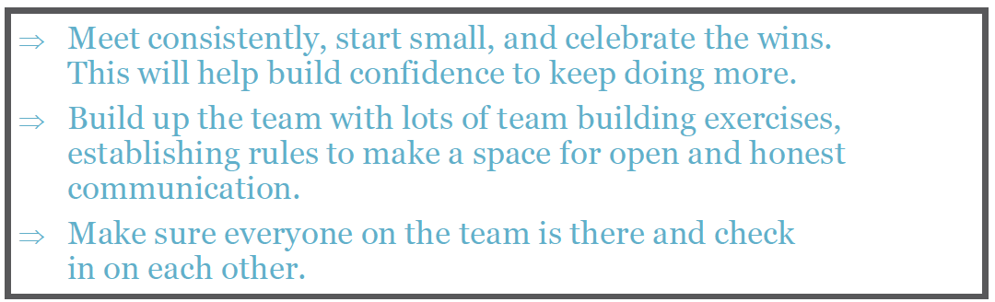
Take Aways
Notes:
So I sat down with the team a few weeks ago to ask about our takeaways, and we had a lot of them. I did my best to condense them down to what you see in the recommendations section. The highlights being to meet consistently and start small. They appreciated having someone from every part of the clinic involved so they could get perspectives on what they were doing from team members who may not do that work daily or look at things from a different perspective.
Making sure to take a lot of time to build the team up, we have been able to get very vulnerable around each other in this space, and that is very rare in a professional setting. It has built a team that is more ok with saying they don’t know something, a crucial first step to growth, as well as made everyone more comfortable checking in with each other. They also emphasized the importance of remembering who they are doing this work for, the patients.
We have learned a lot of new tools for improvement and how we capture the work that we do. We have started using a huddle board for better communication at the morning huddles and started learning the process for making standing orders.

Slide 18
Next Steps
Continue our work at the Wyoming Clinic
Spread the process to the rest of the system
Keep up the changes we have already made
Notes:
Now it’s time to take this process and make it ours. We will be working at our regular meeting times for the rest of the month to finish making a standing order for MAs to hand out blood pressure cuffs, and to set up a space for this work to continue without the NTTAP structure behind it. Our potential next areas of improvement include diabetes control and better integrating our community health workers. We will also be reviewing all the things we have done to help teach other clinics in this system so they can better own their work as well. And, of course, how to make sure we keep taking our second blood pressures and remember what we learned over the last 8 months.

Slide 19
Thank you!
Notes:
To end I would just like to thank NTTAP for this awesome program and the support they have given us. I would like to thank Ed Millermaier, the value of your wisdom and coaching in and outside of our meetings can’t be overstated. But most importantly, I would like to thank the team at Catherine’s Wyoming clinic. Without your passion for your patients, the vulnerability you showed in our meetings, and your willingness to try something new, none of this would have been successful.

Slide 20
Team Structure and Functions
Tom Bodenheimer
Center for Excellence in Primary Care
University of California, San Francisco
Notes:
Tom

Slide 21
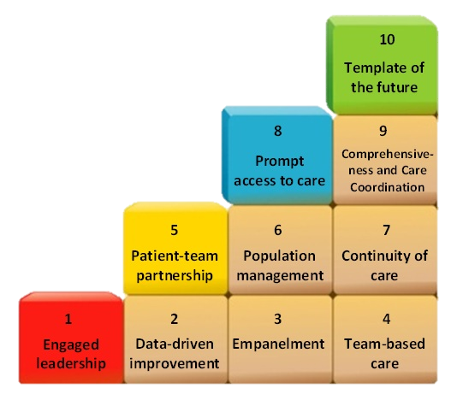
The 10 Building Blocks of
High-Performing Primary Care
Bodenheimer et al, Ann Fam Med 2014:12:166
Teams
Notes:
Tom
Our building blocks to high performing primary care were developed as a roadmap to guide practices during transformation. Transforming to a primary care medical home requires more than checking boxes and capturing screen shots.
I will spend the rest of the presentation discussing how the blocks were developed, the overall sequencing, practical implementation of the components of each block and showcase exemplars from high-performing sites and from other clinics that we are familiar with or coach.

Slide 22
Core teams (teamlets) and interprofessional teams
Patient
Panel
Patient
Panel
Patient
Panel
Clinician/MA
Teamlet
Clinician/MA
Teamlet
Clinician/MA
Teamlet
Interprofessional team: RN, behavioral health professional, social worker, pharmacist, physical therapist, community health worker
1 Team, 3 Teamlets
Notes:
Tom

Slide 23
Let’s talk about the core team,
also called the clinician/MA teamlet
In our visits to bright-spot practices, many had implemented the teamlet model
The same clinician and MA almost always work together
Patients empaneled to a teamlet are almost always cared for by that teamlet
Notes:
Tom

Slide 24
Advantages of the teamlet structure
Through the
patient’s eyes
Patients prefer small practices over large practices [Rubin et al, JAMA 1993;270:835].
Teamlets convert large, often impersonal practices into small units comfortable for patients.
For clinicians
Working in stable teamlets is associated with lower burnout rates than working in teams with shifting personnel or no teams [Willard- Grace et al, J Am Board Fam Med 2014;27:229].
Familiarity: patients know their teamlet members and teamlets know their patients.
Notes:
Tom

Slide 25
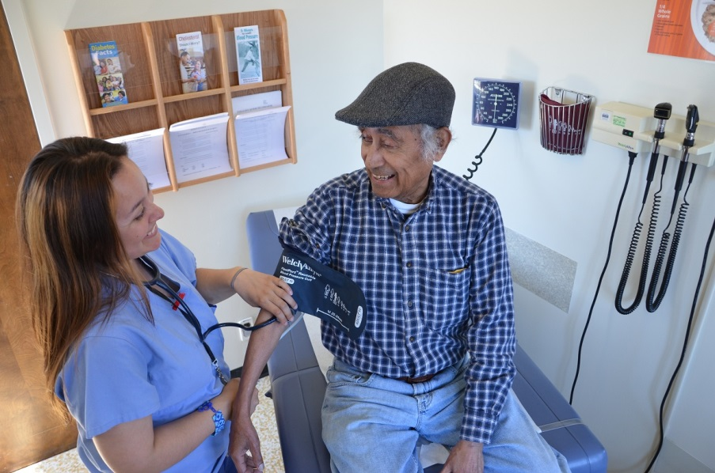
Medical Assistants
750,000 in US, projected to add 120,000 new jobs by 2031
Average pay 2021: $18/hour
Most in physician offices – 58%
Many unfilled MA job openings
90% women, 24% Latina, 10% African-American, 8% Asian
Sources: Bureau of Labor Statistics. Occupational Outlook Handbook 2022 Chapman et al, Research Brief: The Increasing Role of Medical Assistants in Small Primary Care Physician Practice: Key Issues and Policy Implications (Feb. 2010) (http://futurehealth.ucsf.edu/)
Notes:
Tom
May convey information and follow protocols under license of clinician
Training programs vary widely– only 15% receive national certification

Slide 26
Polling Question
Do MAs at your health center work with one primary care clinician?
Almost always
As much as possible given schedules
We don’t link MAs to a particular clinician
Unsure
Notes:
Tom

Slide 27
Some primary care functions
that MAs can perform
Panel management
Medication reconciliation
Health coaching
In-room documentation
Notes:
Tom

Slide 28

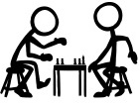










Panel Management
Estimated 50% of preventive care activities could be shared with MAs
Evidence shows that it improves…
  Cancer screening rates
  Diabetes lab tests
  Diabetes retinal screening rates
  Smoking cessation counseling
  Depression screening
  Control of blood pressure
Panel Management: Ensuring that ALL of the patients in our panel get recommended preventive and chronic care services
Source: Altschuler, Ann FamMed 2012;10. Kantor, Perm J 2010;14(3). Baker, Qual Saf Heath Care 2009;18(5). Blash, UC Davis Family Practice Center, www.futurehealth.ucsf.edu. Jean-Jacques, Ann Fam Med, 2012;10. Chen & Bodenheimer, Arch Intern Med 2011;171.
Notes:
Tom

Slide 29
Panel Management
In the pre-visit, MAs use an EMR screen that tells whether a patient has care gaps: not up to date on immunizations, cancer screenings, diabetes care
After identifying the care gaps, MAs close the gaps (give immunization, do A1c test, give patient stool occult blood test kit, make appointment for mammo or PAP) using standing orders
MAs can also consult patient registries that provide lists of patients with care gaps and contact those patients to close those gaps
Panel Management: Ensuring that ALL of the patients in our panel get recommended preventive and chronic care services
Source: Altschuler, Ann FamMed 2012;10. Kantor, Perm J 2010;14(3). Baker, Qual Saf Heath Care 2009;18(5). Blash, UC Davis Family Practice Center, www.futurehealth.ucsf.edu. Jean-Jacques, Ann Fam Med, 2012;10. Chen & Bodenheimer, Arch Intern Med 2011;171.
Notes:
Tom

Slide 30
Polling Question
Do you provide time for MAs to do panel management?
MAs don’t do panel management
They do panel management but we don’t reserve extra time
They do panel management & we make sure they have time for it
Unsure
Notes:
Tom

Slide 31
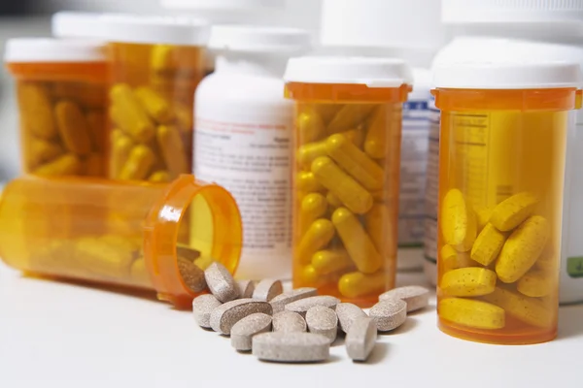
Medication Reconciliation
Med rec has 2 parts:
1. Detective work: What is the patient actually taking?
  MA function
2. What should the patient actually take?
  Clinician function
Notes:
Tom

Slide 32
Health Coaching
Health coaching means collaborating with patients on medication adherence and healthy lifestyles
MAs, nurses, pharmacists, social workers, community health workers can be trained to do health coaching
Evidence shows that it improves…
  Improve medication adherence
  Type 2 diabetes control
  Depression improvement
  High blood pressure control
  Patient engagement and satisfaction
Health Coaching: MAs helping patients with chronic conditions to improve their self-management.
Source: Altschuler, Annals of Family Medicine 2012;10. Margolius Annals of Family Medicine 2012;10. Nelson, Health Aff 2010;29. Ivey, Diabetes Spectrum 2012;25. Geinsichen, Annals of Internal Medicine 2009;151.
Notes:
Tom

Slide 33
Health Coaching
The problem with health coaching is that it takes time and takes focus
Can’t be done as part of pre-visit (rooming) tasks
For terrific overview on health coaching, read Ghorob A. Health Coaching: Teaching Patients to Fish. Family Practice Management May/June, 2013
CEPC Health Coaching Curriculum https://cepc.ucsf.edu/content/health-coaching-curriculum
Health Coaching: MAs helping patients with chronic conditions to improve their self-management.
Source: Altschuler, Annals of Family Medicine 2012;10. Margolius Annals of Family Medicine 2012;10. Nelson, Health Aff 2010;29. Ivey, Diabetes Spectrum 2012;25. Geinsichen, Annals of Internal Medicine 2009;151.
Notes:
Tom

Slide 34
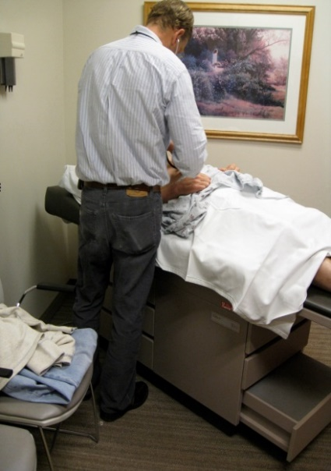
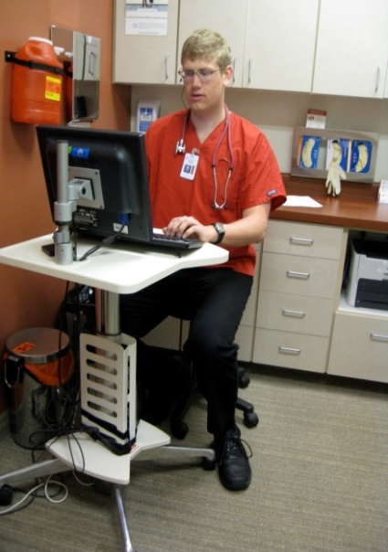
In-room documentation (scribing)
Scribe model (Shasta Community Health Center)
Average productivity rate markedly increased for clinicians with scribes
Clinician burnout greatly reduced
There is evidence that it improves…
  Clinician & patient experience
  Improved clinical outcomes
  Increased productivity
Source: Ammann Howard K, et al . Adapting EHR Scribe Model to Community Health Centers: The Experience of Shasta Community Health Center’s Pilot. Blue Shield of California Foundation Report. 2012 Feb; Bodenheimer T, Ann Fam Med 2022:20:469-478.
Notes:
Tom

Slide 35

Making Your Team Work
Team Development Refresh
Notes:
7 minutes
Kathleen

Slide 36
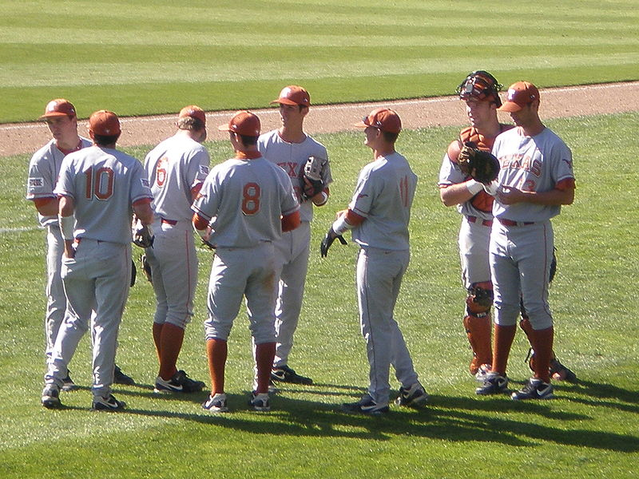
Baseball Teams
Know the roles of the pitcher, catcher, basemen, outfielders…and the umpire.
They have a manager.
They have a coach.
Batters have studied how pitchers pitch;
pitchers have studied how batters bat.
They know their scores. And the scores of other teams.
They know different ball parks and where the boundaries for a home run are.
They know their fans.
They practice….a lot.
They stay in shape.
Notes:
Kathleen

Slide 37
Normalizing Change: What We Know
Before you can change practice, you must change the individuals who work in the organization--that is, their values, attitudes, relationships, skills, and behavior. NOT a linear process!
Start with changing their minds [values, attitudes] about the work ahead….coherence.
Build relationships and ownership about how the work will be done….cognitive participation.
Get into the weeds of the work together, develop new skills, try new ways of working….collective action.
Track your progress and revise as needed….reflexive appraisal.
Notes:
Kathleen

Slide 38
Team Development Refresh:
Normalization Process Theory
Coherence
Clarity of purpose, expectations & value
Why are we here? How is the learning collaborative different from other projects? Who is in charge? What is expected? Is this worth my time?
Failure to build coherence from the start leads to conflict, and will make it impossible to move forward.
Cognitive Participation
Relational work of team-work.
Do we have the right people? How do I fit in?
Ownership not “buy-in.” Do we all want the same thing?
Without ownership and a shared mental model for how to do the work, the team lacks direction and gets frustrated. The loudest voice wins.
Collective Action
Operational work of teams: a shared mental model, a systematic approach— Improvement Ramp!
Do we have the necessary resources? Data? Time?
The team is delving into the work - “in the weeds” of change
Trust each other’s expertise and commitment. Progress is being made.
Reflexive Monitoring
Appraisal work that people do to assess and understand how change is working. It does not end.
What fine-tuning do we need to do to make sure it is sustainable?
Without reflexive monitoring, the work cannot spread, be sustained, or be revised/improved as needed.
Notes:
Kathleen

Slide 39
Sources of Conflict
Lack of Coherence
I don’t know who is in charge. I don’t understand the purpose. I don’t know what is expected. I don’t value this.
  Lack of Relational Work/Cognitive Participation
  No ownership. Not on the same page. No shared mental model of how to do the work. Jumping to solutions before determining what the issue is. No direction. Too many loud voices. I don’t know where I fit in. Insecurity about being a team member. Bullying

Slide 40
Sources of Conflict
  Lack of Collective Action
  Insufficient resources and administrative support. Failure to use shared mental model/systematic approach. Wrong set of skills/won’t develop new ones. Slackers and the overworked. Lack of engagement.
  Lack of Reflexive Monitoring
  No tracking. Pilot becomes policy without testing spread. No sense of accomplishment —I wasted my time.

Slide 41

Developing a Communication Plan & Stakeholder Analysis
Notes:
7 minutes
Kathleen

Slide 42
Why do you need a plan to engage and communicate with stakeholders?
Control the narrative: drive the story of the work you are doing by being proactive; don’t leave it to others to guess.
Communicate on a regular basis with stakeholders in different parts of your organization
Make sure that the group implementing the innovation shares a consistent message
Anticipate/address concerns, questions and challenges.
Notes:
Kathleen

Slide 43
Step 1. Identify stakeholders
A stakeholder is someone/some department who has something to gain or lose when change is introduced.
Who is currently involved in the work that will change?
Who currently oversees this work? Who currently is accountable for the outcomes of the work?
Who will be affected by changing how this work is done and how? New roles? New workflows? New responsibilities?
What departments or sites need to be involved? Who are their leaders and how to you get to them? (Site Directors, HR, IT, etc.)
What is the opinion of the stakeholders regarding the planned change: Against? Supportive? Doesn’t matter one way or the other.
Notes:
Kathleen
who needs to know about the change efforts, what their positions and interests are, and how the change should be presented and framed so that the positive impact of their influence can be maximized. Different stakeholders need different types of information about your work, and with different levels of detail.

Slide 44
Table 1. Example of identifying stakeholders
Stakeholder | Strongly against | Moderately against | Neutral | Moderately supportive | Strongly supportive
Providers |  |  |  | C | D
IT |  | C |  | D
HR |  |  | C D
Nursing |  |  | C |  | D
Reception | C |  |  | D
Other stakeholder
C= current position D= desired position Who do you need to influence in what direction?
Notes:
Kathleen

Slide 45
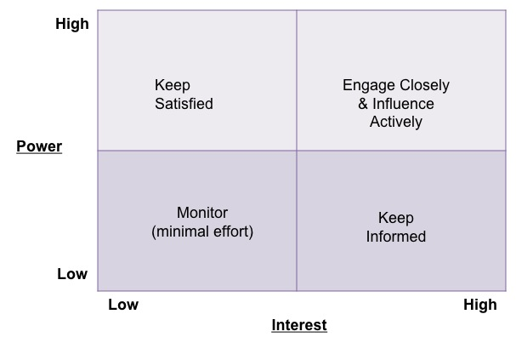
Step 2. Analyze the position of stakeholders relative to their power and interest.
What are the formal channels through which each stakeholder gets important information? The informal channels?
Notes:
Kathleen

Slide 46
COMMUNICATION PLAN FOR IMPORTANT PROJECT DATE: November 2023 PROJECT LEAD: Mrs. Peacock
Who: Stakeholder | Why communicate with this person? | What: Message(s) for this person | Who: Who in your project group is in the best position to communicate with this person? | When and how often? | How: What venues or media will be used?
Mr. Green, CEO | Has invested in time for us to meet. Will need his/her support to implement the innovation. | Assure him/her that we are using time well. Update on progress of group, lessons learned from other groups, ideas for implementation and application. Keep good energy. | Colonel Mustard, Director of Big Department and Project Lead | Monthly meeting of directors. One-on-one meetings as appropriate to request resources as needed or ask advice. | Oral report monthly but written report added to meeting minutes.
Step 3. Communication plan:
Who, what, when, where, why, how
Notes:
Kathleen

Slide 47
Final Advice
Managing up: communicating with someone above you in leadership
Be clear about expectations
Manage their expectations about your work
Manage the relationship between this leader and your work group
Leaders often move on to the next BIG Thing and suddenly promised resources disappear
Leaders want things to move more quickly and are convinced they have the solutions—you need to explain how your group works and why
Your boss has a boss: don’t leave your boss out on a limb
Speak with one voice and stay on message
Don’t gossip or complain about your work group: it erodes trust
Ask for advice, suggest solutions
Notes:
Kathleen

Slide 48
Building a Collaborative Team Culture
Tom Bodenheimer and Rachel Willard-Grace
Center for Excellence in Primary Care
University of California, San Francisco
Notes:
Tom

Slide 49
Collaborative Team Culture
Share the care
Ground rules
Standing orders/protocols
Defined roles with training and skills checks
Communication
Notes:
Tom

Slide 50
Culture Shift: Share the Care
From “I” – clinician makes all decisions
Share the care is a culture shift
Sharing the care is not only delegating tasks to non-clinician team members; it is re-allocating responsibilities so that all team members contribute meaningfully to the health of the panel
to
“We” – the team takes responsibility for their panel
Tasks
Responsibilities
Notes:
Tom

Slide 51
Task or Responsibility?
Doing an electrocardiogram on a patient
Checking the registry to see which patients in your panel are overdue for colorectal cancer screening and arranging for screening to be done
Calling a patient to give normal lab results
Weighing a patient
Conducting a 4 session health coaching class for patients with diabetes
Teaching newly hired MA how to perform med-rec
Doing med-rec with a patient
Scribing for your teamlet clinician
Notes:
Tom

Slide 52

Please write in the chat examples of how you have shared the care in your clinic by delegating responsibilities to non-clinician team members.
Notes:
Tom

Slide 53
Sharing the care has positive effects
Medical assistants taking responsibility to ensure that all patients have received appropriate cancer screening improved screening rates (Baker. Qual Saf Health Care.2009;18(5):355-359; Kanter, Perm J. 2010;14(3):38-43).
Teams with a collaborative team climate were associated with better diabetes management, patient satisfaction, and patient activation (Becker and Roblin. Medical Care 2008;46:795-805; Bower, Campbell, Bojke, & Sibbald. Qual Saf Health Care 2003;12:273-279).
An observational study of 27 practices found that moving toward a “share the care” culture increases physician and staff satisfaction (O’Malley et al. JGIM 2015;30;183-192).
Notes:
Tom

Slide 54
Ground Rules
Ground rules are expected behaviors for everyone on a team
Should be agreed on by everyone on the team; that allows the team to hold a team member accountable if he/she violates the ground rule
Two situations needing ground rules
  Meetings: who runs the meeting, who sets agenda,
  step forward/step back
  Team behavior during patient care times: being on time, being respectful of patients and team members, giving feedback to team members (including clinicians) who are not empathetic, what to do if someone violates a ground rule he/she agreed to
Notes:
Tom

Slide 55
Collaborative Team Culture
Share the care
Ground rules
Standing orders/protocols
Defined roles with training and skills checks
Communication
Notes:
Tom

Slide 56
Sharing the care is done using standing orders
What is a standing order?
  A protocol approved by the medical and administrative leadership of a health care facility that empowers RN, medical assistants, or other team members to provide a specific service to appropriate patients.
Sharing the care cannot be done without standing orders
Standing orders must conform to state laws and regulations
Standing orders must be approved by the medical director of the clinic or health system within which the clinic resides
Notes:
Tom

Slide 57
Some primary care functions that can be re-allocated among the team with standing orders
Panel management: making sure patients receive all the routine chronic and preventive care services on a timely basis
Health coaching: Helping patients set goals and make action plans to improve health-related behaviors, for example healthy eating, physical activity, and taking medications
Chronic medication refills: Taking this important but time-consuming function away from clinicians and having RNs responsible for chronic medication refills
RN care management for patients with diabetes: RNs can titrate medication doses using a standing order (not allowed in all states)
Notes:
Tom

Slide 58
Example of Standing Order for MAs
West County Health Centers CARE TEAM DIABETES PROTOCOL
MAs may, without consulting the medical provider, perform the following tasks:
Order Hemoglobin A1C if not done in the last 6 months
Order fasting LIPID PROFILE if not done in the last 1 year
Order urine Microalbumin/Creatinine ratio if not done in the last 1 year
Order a DIABETIC EYE EXAM if not done in the last 1 year, and assign the case to the referral coordinator to track
Perform a PHQ2 if not done in the last 1 year and refer for clinical follow up if answered yes to either of the questions.
Schedule an Office Visit for the following:
A DIABETIC FOOT EXAM if not done in the last 1 year
An Office Visit if patient has not been seen in the last 6 months
Influenza vaccination if not received in the last 1 year and within the months of November and April
Approved by Medical Director, West County Health Centers ________________
Notes:
Tom

Slide 59
Defined roles with training and skills checks
Example
To share the care at Ocean Park Health Center in San Francisco, MAs were delegated the responsibility to do foot exams on each patient with diabetes every 6 months.
MAs must:
1) Take a test on how to do a diabetic foot exam,
2) Observe 10 foot exams, and
3) Perform 10 foot exams under observation by the nursing director before being cleared to
do foot exams on their own.
Every year the nursing director observes each MA doing foot exams to make sure they are being done with high quality
If you have an example of how a team member was trained and authorized to perform a new function, please write it in the chat.
Notes:
Tom

Slide 60
Communication
Minute to minute communication through co-location
Huddles
Team meetings
Notes:
Tom

Slide 61
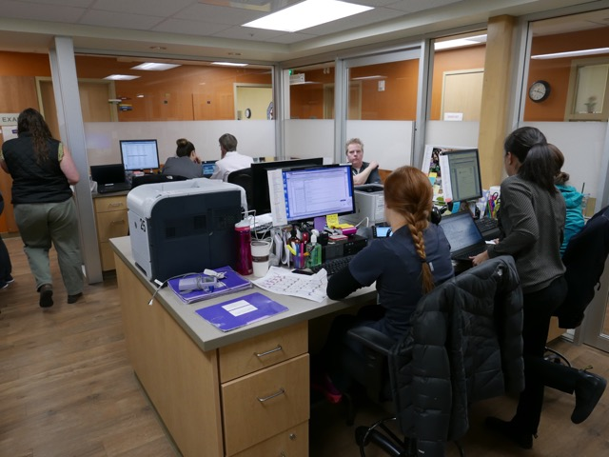
Co-location
Minute-to-minute communication is most easily done when the team works together in one shared space
Ideally, the clinic architecture is changed to create pods
Yet it isn’t necessary to re-model the clinic to achieve co-location
For example, at Univ of North Carolina Family Medicine Center, 2 stand-up work stations were created along hallways and the clinician and MA work right next to each other for easy communication
Central Washington Family Medicine Residency at Yakima
Notes:
Tom

Slide 62
Polling Question
Are your teams co-located (work together in a shared space)?
Yes for all teams
Yes for some teams
No and there are plans to co-locate
No and there are no plans to co-locate
Unsure
Notes:
Tom

Slide 63
Co-location
Co-located practices report that some physicians initially resist colocation but embrace it when they find that it saves them time.
Teams with many face-to-face interactions among all team members deliver higher quality cardiovascular disease care at a lower cost [Mundt et al, Ann Fam Med 2015;13:139-148]
In three studies, co-location was associated with improved team collaboration and coordination [MacNaughton K et al, BMC Health Services Research 2013;13:486; Sims S. et al. J Interprof Care 2015;29:20; O’Malley AS et al, JGIM 2015;30:183].
Notes:
Tom

Slide 64
Communication: Huddles
Huddles are brief (5 – 10 minute) stand-up discussions about patients coming in that day
Every morning, or also huddle after lunch
MAs may review (“scrub”) the charts of patients coming in that day and lead huddles:
  Ms. G is overdue for PAP smear and mammogram
  Mr. K needs an A1c, cholesterol, creatinine, foot exam and referral for eye exam
  Mr. T’s dog died yesterday and he is very upset
Deciding who will handle the different patient needs speeds clinic time and improves quality
Many clinics use teamlet huddles – only the clinician and MA.
For a good huddle video, Google: Planned care huddle Youtube, Michael Zimmerman, 2008
Notes:
Tom

Slide 65
Communication: Team Meetings
Some practices have siloed meetings
  Clinicians meet with clinicians
  Nurses meet with nurses
  MAs meet with MAs
Those have value, but cannot take the place of all-team meetings
Monthly all-team meetings, with everyone suggesting agenda items in advance, can
  Solidify team cohesion, starting with brief bonding exercises or going around the room to see how each person is doing
  Discuss challenges and get ideas on how to improve services and clinic operations (e.g., what to do when patients are late or how the team will implement COVID vaccination)
  Share data on clinic projects and celebrate accomplishments
  Discuss team ground rules
Notes:
Tom

Slide 66
Take Home Points
Teams that share the care and build a collaborative culture are better for patients, clinicians and staff
Ground rules, agreed upon by all team members, define accepted behaviors and help create team cohesion
Standing orders, allowed by state regulators and approved by health system leaders, are needed to authorize the functions of team members
Teams need a clear division of tasks with training and skills checks to make sure team members are functioning with high quality
Team communication is improved by co-location, brief daily huddles, and regular team meetings.
Notes:
Tom

Slide 67

Sharing the care is a beautiful thing
Notes:
Tom

Slide 68

Quality Improvement Refresh:
Global Aim Statement
Notes:
Deb

Slide 69
The Stages of Improvement
Step #3: Global Aim
On-Going Data Collection & Review
Notes:
Deb

Slide 70
The Global Aim is a documented statement of what you propose to improve in your focus area.
Notes:
Deb

Slide 71

Global Aim Statement
Based on what you found in your data: what’s the problem or general theme?
States clearly where you want to start your work
Identifies where you want to focus the work
Identifies why it is important to work on the identified process
Creates an opportunity to build consensus for the team
Notes:
Deb

Slide 72
Writing a Structured Global Aim
The aim is to improve the quality and value of...(name the process).
The process starts with...(name start point) and the process ends when…(name end point).
By working on this we expect to:
    (Name better, hoped for results).
It is important to work on this now because….(list reasons)
Notes:
Deb

Slide 73
Example of Structure Global Aim
We aim to improve... the process of colon cancer screening at the Middletown clinic site
The process starts with... identifying patients who are due for colon cancer screening and the process ends when… screening results are documented in the patient record .
By working on this we expect to:
  improve the rate of colon cancer screening in adults (UDS measure)
It is important to work on this now because….
a. we need to improve our UDS measures for reimbursement purposes
b. We want to improve patients’ health through early intervention
Notes:
Deb

Slide 74
Global Aim Template
Theme for improvement: ____________________________________________________________
(Based on your practice assessment)
We aim to improve: _________________________________________________________________
(Name the process)
In: _______________________________________________________________________________
(Clinical location in which process is embedded)
The process begins with: _____________________________________________________________
(Name where the process begins)
The process ends with: _______________________________________________________________
(Name the ending point of the process)
By working on the process, we expect: __________________________________________________
It’s important to work on this now because: __________________________________________________
Notes:
Deb

Slide 75
Example of Structured Global Aim
We aim to improve the rate of cervical cancer screening for Dr. Smith’s panel in Pod A at the Main St. Clinic. The process begins during pre-visit planning by identifying the patients who are due for/eligible for screening based on UDS definition of eligibility. The process ends with documentation in the EMR that screening has been completed. By working on this, we expect to improve our UDS measure for cervical cancer screening, clarify the process for how documentation of screening by providers outside of our clinic gets into the EMR, and reduce gaps in care. It’s important to work on this now because our screening rate has declined, and we have new staff we can train to a new workflow.
Notes:
Deb

Slide 76
Statement is broad, but clear
What: colon cancer screening
Who: adult patients [see UDS definition for specifics]
Where: at the Middletown site
Why: better patient care, improved performance
Start: with identifying patients who are due for screening when they come in for a visit
End: documentation in the record is the end because that is how the UDS measure is counted
Notes:
Deb

Slide 77
Common Mistakes
The theme is too broad and/or is not based on an assessment of your practice, e.g., “communication”
The global aim will be difficult to measure, e.g., “improve the efficiency of …..”
The global aim includes a strategy, e.g., “we will improve the UDS measure by doing [this or that].” Save strategies for the PDSA.
The location—which will identify the team and/or population of patients—is not clear
The process does not have a clear beginning, that is, what does someone do to get the process started?
The end of the process gets mixed up with the outcome measure. For example, the end is not “increased screening rate,” the end is that someone “documented in the record.”
Expectations are too high!
Notes:
Deb

Slide 78
Questions?

Slide 79
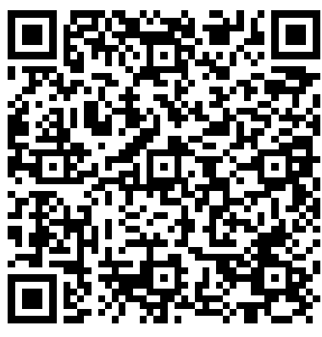
Action Period 2 Deliverables
Conduct your weekly team meetings
Narrow down topic you would like to work on (i.e. UDS measure, workflow, etc.).
Deliverable: Complete communication plan to share/discuss during coach calls
Deliverable: Develop Problem Statement based on UDS data Assignment: Develop Global Aim
Google Drive
https://drive.google.com/drive/folders/1VFv0Ar6VbdVDS_fkY6fPXQw36Tq0A1Wg?usp=drive_link

Slide 80
Reminders
CME and Resource Page
Access Code: TBC2023
https://education.weitzmaninstitute.org/content/nttap-comprehensive-and-team-based-care-learning-collaborative-2023-2024
Coach Calls:
  Wednesday January 24th 1:00pm ET / 10:00am PT
  Wednesday January 31st 1:00pm ET / 10:00am PT
Session 3: Wednesday February 7th 1:00pm ET / 10:00am PT
Notes:
Meaghan

Slide 81
NTTAP Contact Information
Amanda Schiessl
Project Director/Co-PI
Amanda@mwhs1.com
Bianca Flowers
Project Manager
flowerb@mwhs1.com
Meaghan Angers
Project Manager
angersm@mwhs1.com
REMINDER: Complete evaluation in the poll!
Next Learning Session is Wednesday February 7th!
Notes:
Meaghan

Slide 82


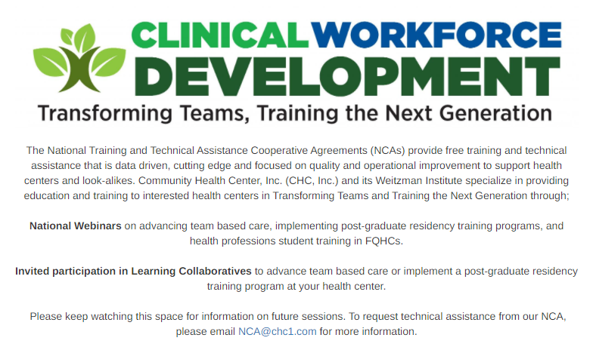

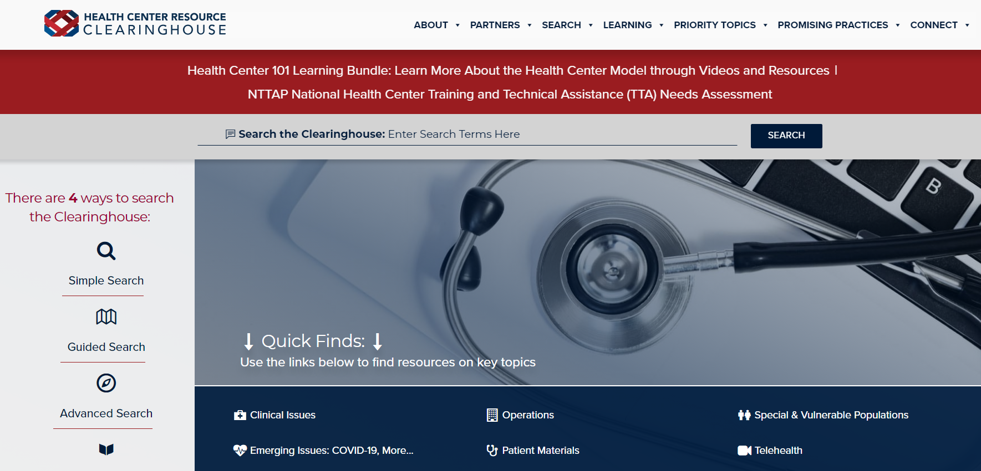
Explore more resources!
National Learning Library:
Resources for Clinical Workforce Development
Health Center
Resource Clearinghouse
https://www.weitzmaninstitute.org/ncaresources
https://www.healthcenterinfo.org/
82
Notes:
Meaghan

