Slide 1


HIV Prevention Learning Collaborative
Session One: January 29th, 2024
Notes:
Meaghan

Slide 2
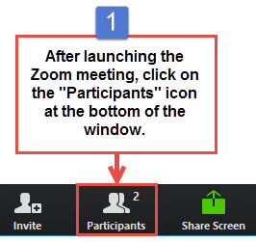
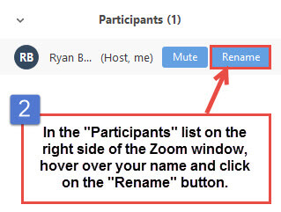
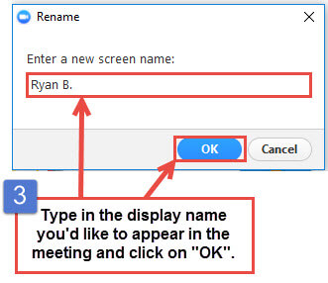
Get the Most Out of Your Zoom Experience
Please keep yourself on MUTE to avoid background/distracting sounds
Use the CHAT function or UNMUTE to ask questions or make comments
Please change your participant name to your full name and organization
  “Meaghan Angers CHCI”
Notes:
Meaghan

Slide 3
Session 1 Agenda
1:00 – 1:10 | Introduction to CHCI, Collaborative Expectations, & Role of the Coach
1:10 – 1:25 | Team Introductions: Part I
1:25 – 1:45 | Population-Based Approach to HIV Prevention and PrEP Prevalence/Incidence of HIV and need for HIV prevention What is a population-based approach? Why it matters. Sex positive language Cultural Humility Equity in services for HIV prevention and PrEP
1:45 – 2:00 | Team Introductions: Part II
2:00 – 2:25 | HIV Prevention 101: the Basics Strategies for Prevention Evidence
2:25 – 2:30 | Q & A and Next Steps
Notes:
Meaghan

Slide 4
Community Health Center Inc. and
NTTAP Introduction
Notes:
Meaghan

Slide 5
NTTAP Faculty, Collaborative Design, and Facilitation
Amanda Schiessl, MPP
  Deputy Chief Operating Officer
  Project Director/Co-PI, NCA
Margaret Flinter, APRN, PhD, FAAN
  Co-PI, NCA & Senior Vice President/Clinical Director
Bianca Flowers, MPH
  Program Manager
Meaghan Angers
  Program Manager
Dr. Marwan Haddad, MD, MPH, AAHIVS,
  Medical Director, Center for Key Populations
Kasey Harding, MPH
  Program Director, Center for Key Populations
Mentors, Coaching Faculty
Jeannie McIntosh, APRN, FNP-C, AAHIV
  Nurse Practitioner, Center for Key Populations
  mcintosj@chc1.com
Maria Lorenzo
  Community Based Services Manager, Center for Key Populations
  LorenzM@chc1.com
Evaluation Faculty
Kathleen Thies, PhD, RN
  Consultant, Researcher
  ThiesK@chc1.com
Notes:
Meaghan

Slide 6

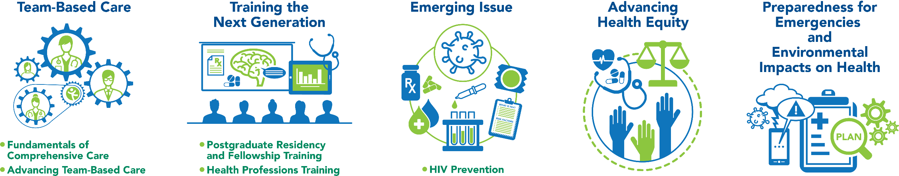
National Training and Technical Assistance Partners
Clinical Workforce Development
Provides free training and technical assistance to health centers across the nation through national webinars, learning collaboratives, activity sessions, trainings, research, publications, etc.
Notes:
Meaghan

Slide 7




Moses Weitzman Health System Affiliates
Notes:
Primary care has been at the heart of Community Health Center, Inc.’s (CHC) mission since its founding in 1972. Grounded in our mission, the Moses/Weitzman Health System (MWHS) was established to support exponential growth and continued innovation. The MWHS is the parent company of CHC; the Community eConsult Network, Inc. (CECN) d/b/a ConferMED; the National Institute for Medical Assistant Advancement (NIMAA); and the Consortium for Advanced Practice Providers. The Weitzman Institute (founded by CHC) is embedded in the MWHS. Each affiliate will continue to have its own board of directors and its own mission. The name of the health system honors Lillian Reba Hyman Moses (1924–2012) and Gerard (Gerry) Weitzman (1938–1999), who were among the earliest supporters and board members of CHC.

Slide 8

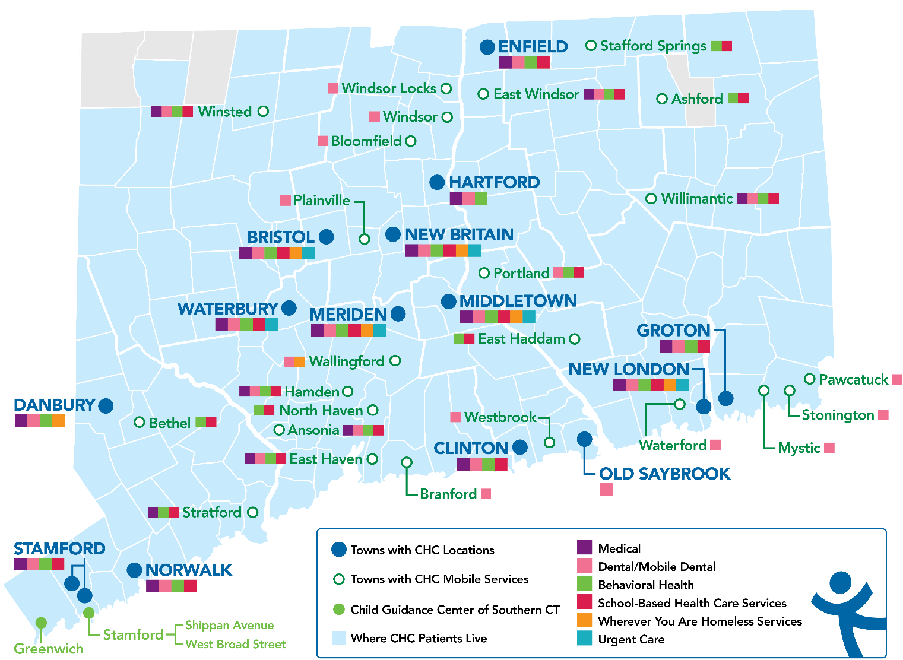
Locations and Service Sites in Connecticut
CHC Profile:
Founded: May 1, 1972
Staff: ~1,200
Total Patients Served: 102,275
Clinical Sites across CT: 19
SBHCs across CT: 180+
Students & Residents/year: 390
Three Foundational Pillars:
  Clinical Excellence
  Research & Development
  Training the Next Generation

Slide 9


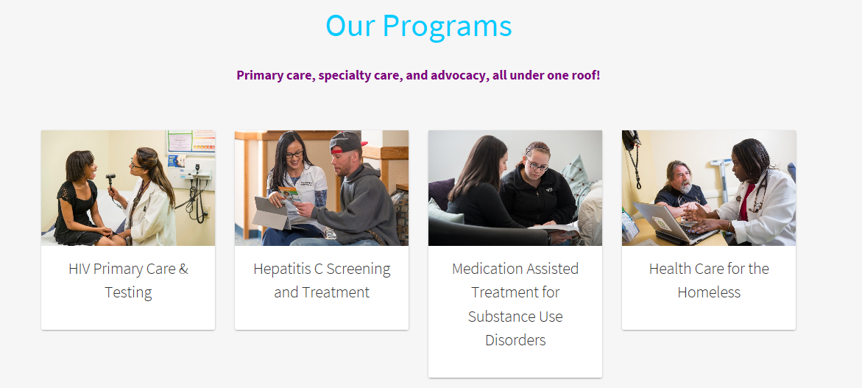
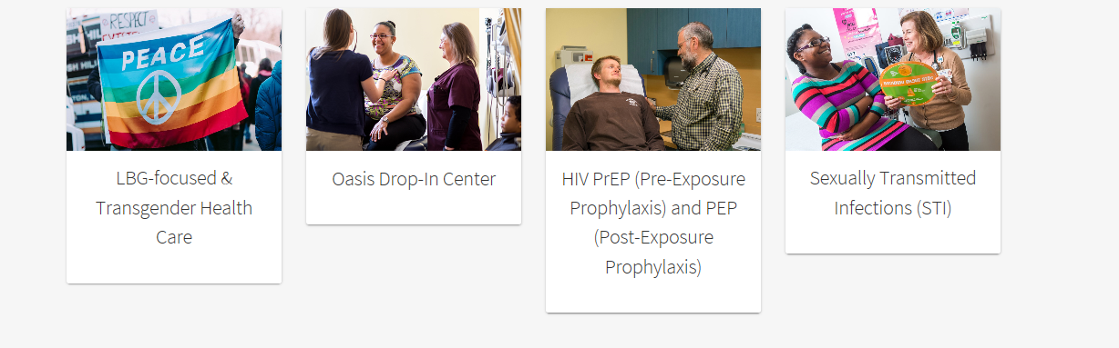
The Center for Key Populations is the first center of its kind that focuses on key groups who experience health disparities secondary to stigma and discrimination
and who belong to communities that have suffered many barriers to healthcare.
The Center brings together healthcare, training, research, and advocacy for:
People who use drugs, the LGB and Transgender populations,
the homeless and those experiencing housing instability,
the recently incarcerated, and sex workers.
HIV Primary Care
and Testing
Hepatitis C Screening and Treatment
Medication Assisted Treatment for Substance Use Disorders
Health Care for the Homeless
LGBTQ-focused
Health Care
Community
Drop-In Center
HIV PrEP
(Pre-Exposure Prophylaxis
and PEP
Post-Exposure Prophylaxis)
Sexually
Transmitted
Infections
Notes:
Meaghan

Slide 10
Dr. Marwan Haddad
I have been providing HIV primary care for over 20 years; I joined CHC in 2006.
Established CHC’s Center for Key Populations with Kasey Harding in 2016.
I do and have done HIV prevention, HIV management, substance use disorder work in Lesotho, Uganda, Ukraine, Jamaica, and Malaysia. (Clinton Foundation, HRSA-PEPFAR, NIH grants)
I am currently the Immediate Past Chair of the HIV Medicine Association of the Infectious Diseases Society of America.
I was born in Lebanon, grew up in Greece, studied in the U.S., France, and Canada.
Moved from Canada in 2015 to the U.S. to be with my now husband.
We have the most beautiful boy and girl twins who are 9 years old. (Also our dog Coco and our guinea pigs Brownie and Buttercup)

Slide 11
Kasey Harding
I got my start as a director of residential services for people living with HIV in Hartford, CT.
Began work as the Ryan White Program Director at CHC in 2005.
Certified as a Quality Improvement Coach by the Dartmouth Institute in 2015.
Helped to establish the Center for Key Populations with Dr. Haddad in 2016 and have the BEST job on the planet!!!
Joined the HRSA team to provide HIV/QI to Presidents Emergency Plan for AIDS Relief (PEPFAR) in 2018.
I have five beautiful children who are the light of my life.

Slide 12
Jeannie McIntosh
Family Nurse Practitioner and HIV Specialist with CKP. Started working at CHCI over 7 years ago. Graduate of CHCI’s FNP Residency and CKP Fellowship.
Clinical focus: HIV treatment and prevention, viral hepatitis, substance use health, LGBTQI+ health, healthcare for the homeless, farmworker health, and harm reduction
Originally from Seattle, WA.
I love to travel and study languages. Prior to becoming an NP I spent four years studying and working in Southeast Asia and Latin America.
In my free time I like to cook, hike, listen to music and hang out with my cat Captain.

Slide 13
Maria Lorenzo
Working at CHCI for 24 years
Community Based Services Manager for the Center for Key Populations (CKP)
Provide administrative/operations oversight for- Ryan White Services, Prevention (PrEP), HIV/Hep C Testing, and Education, Wherever You Are Program (Healthcare for the Homeless), Oasis-Drop-in Center
Provide support/supervision to PrEP, and HIV/Hep C Testing programs.
For fun – I love to travel to PR to be with family and I love to play Bingo!

Slide 14
Collaborative Structure & Expectations
Notes:
Meaghan

Slide 15
Welcome to the HIV Prevention
Learning Collaborative!
Learning Collaborative Objectives
Assess readiness to participate utilizing Partnerships for Care (P4C).
Develop the knowledge, skills, and attitudes for developing and providing a population-based approach to HIV prevention and PreP.
Contribute to the learning among participating practice teams by engaging in Learning Collaborative activities.
Notes:
Meaghan

Slide 16
Learning Collaborative Structure
Six 90-minute Learning Collaborative video conference sessions
Bi-weekly calls between coach mentors and practice coach
Internal team workgroup meetings
Use the Weitzman Education Platform to access resources and receive CME credit
Learning Session Dates
Learning Session 1 | Monday January 29th
Learning Session 2 | Monday February 26th
Learning Session 3 | Monday March 25th
Learning Session 4 | Monday April 22nd
Learning Session 5 | Monday May 20th
Learning Session 6 | Monday June 10th
Notes:
Meaghan

Slide 17
Conditions of Success
Attendance at collaborative learning sessions and engagement in bi-weekly coach/mentor calls
Engagement in work between sessions that included protected time to meet as a team, trust and respect.
Commitment of trained coaches to improving their skills and helping teams achieve results
Support of practice leadership for time, resources, spread and sustainability
Notes:
Meaghan

Slide 18
Role of Coach Mentor Jeannie McIntosh & Maria Lorenzo | Role of Team Coach 1-2 representatives from your health center!
Meet with Team Coaches bi-weekly to discuss progress Work directly with Team Coach to identify successes and work through challenges/barriers. Mentors Team Coach on how to run an effective meeting for their team and develop their coaching skills Be available for individual sessions with Team Coaches for specific team and program development | Teach team how to prepare and facilitate effective meetings Provide coaching support between and during weekly internal team meetings Participate in bi-weekly Zoom calls with Coach Mentors to discusses progress, challenges, and stuck points. Help team follow timelines, complete assignments, and progress reporting Share team’s progress with the Coach Mentor and other Team Coaches during collaborative sessions
Notes:
Meaghan

Slide 19
Affinia Healthcare | St. Louis, Missouri
Asian American Health Coalition dba HOPE Clinic | Houston, Texas
East Central Oklahoma Family Health Center | Wetumka, Oklahoma
FirstMed Health and Wellness | Las Vegas, Nevada
Hi-Desert Memorial Health Care District | California
International Community Health Services | Seattle, Washington
Jane Pauley Community Health Center | Indianapolis, Indiana
North County Health Project, Inc. DBA TrueCare | San Marcos, Califonia
Promise Healthcare | Champaign, Illinois
The HealthCare Connection, Inc. | Cincinnati, Ohio
WellSpace Health | Sacramento, California
2024 Cohort
Notes:
Meaghan

Slide 20
Team Introductions – Part 1
 | Order of Introductions
1 | Affinia Healthcare
2 | Asian American Health Coalition dba HOPE Clinic
3 | East Central Oklahoma Family Health Center
4 | FirstMed Health and Wellness
5 | International Community Health Services
Name of your practice, size, etc.
Names and positions of participating team members
Goals for the learning collaborative
Notes:
Team intros

Slide 21

TEAM
VP OF THE COMMUNITY DEPARTMENT - Sonia Deal
DIRECTOR - Juliana Castellanos
CHW - Amiyah Cole

Slide 22
Goals of participation
Equip staff with practical skills and tools for implementing evidence-based HIV prevention programs.
Ensure up-to-date with the latest developments, research, and best practices in the field of HIV prevention.
Establish mechanisms to assess the effectiveness of HIV prevention initiatives and adjust strategies based on feedback and outcomes.
Strengthen the understanding of HIV prevention strategies and interventions among participants.
Foster a collaborative learning environment to encourage knowledge sharing and effective teamwork in HIV prevention efforts.

Slide 23



Asian American Health Coalition of the Greater Houston
Area
HOPE CLINIC | HOPE HEALTH
PHARMACY

Slide 24
About HOPE Clinic
Established as a Federally Qualified Health Center in 2012, HOPE Clinic now
boasts five locations and an in-house pharmacy. Committed to inclusivity,
we are expanding our patient care to embrace individuals from all backgrounds, including those living with HIV.
Our mission is to provide quality, unbiased healthcare to Greater Houston
residents, serving the low-income, uninsured, underinsured, and those with limited English proficiency.
In our pursuit of inclusivity, we're training our staff to cater to the specific
needs of HIV patients. By promoting cultural competence, we aim to create a welcoming environment for everyone seeking compassionate healthcare.
Our pharmacy team is joining this learning collaborative in order to break
down barriers and strive to make healthcare accessible and respectful to all.

Slide 25

East Central Oklahoma Family Health Center
HIV Prevention Team
We received the Health Resources and Services Adminstration (HRSA) Ending the HIV Epidemic-Primary Care HIV Prevention grant in July 2023. We are working to implement a well-rounded HIV prevention program. Our goals are to increase HIV screening, decrease the stigma associated with HIV through education and outreach, and linking patients to HIV care while meeting their primary care needs.

Slide 26
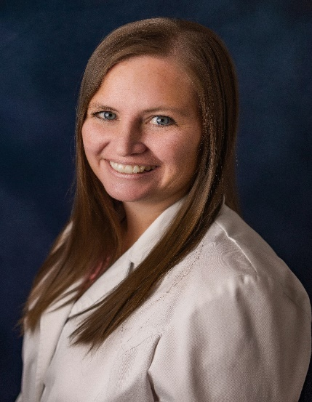
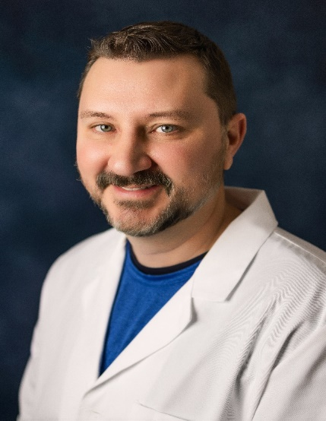

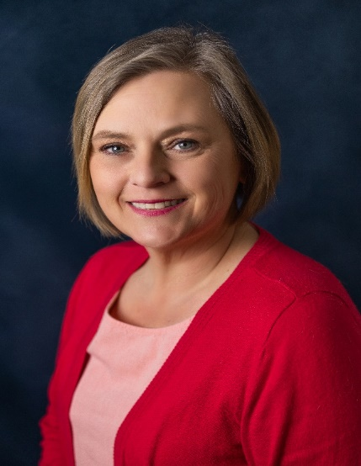
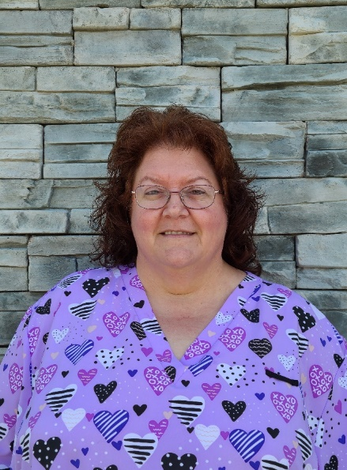
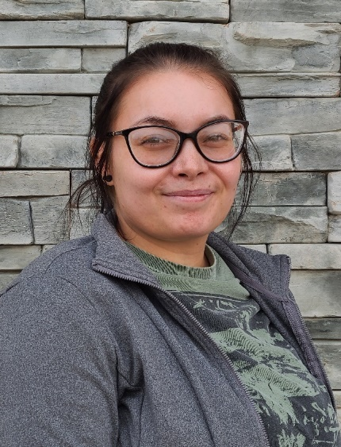
Meet our team!
Leslie Hughes, APRN
Coach
John Manning, APRN Co-coach
Kristen Otwell,
HIV Community Health Worker
Joanna Schmidt, LCSW
Melissa Sorrell, RN
Serra DeQuinzio, Receptionist

Slide 27

FirstMed Health & Wellness
A nonprofit community healthcare clinic providing preventive and primary health care services to individuals and families in Southern Nevada
Chief Executive Officer: ANGELA QUINN Vice President: SONYA HARRIS Chief Medical Officer: LILNETRA GRADY Chief Operation Officer: MYESHA WILSON
We also offer services for cancer prevention, detection and management and infectious disease like HIV, sexually transmitted infections and diseases, and Hepatitis C
Our Services:
Primary Care for Adults & Adolescents
Behavioral Health Services for Adults & Adolescent (Therapy & Psychiatry)
Housing Program
Crisis Intervention for Established clients
Sliding Scale Program
Patient Services:
Bus Passes / Uber Rides / Transportation Resources
Food Pantry / Hygiene Products / Household Supplies / Pet Food / Clothes for Employment
Insurance Enrollment
Assistance for: SNAP / TANF / Identification Cards / Social Security
We Provide:
Community Health Workers that assist with Medical Referrals and Community Resources for our clients.
Help clients Navigate through the Health System
HIV Care:
    Provide HIV Care Plans
    Prescribe PrEP and PEP
    Assist with Ryan White Enrollment
HIV Prevention
    Provide HIV Testing and Testing for STI’s.
    Provide Community Outreach Events
    Provide Safer Sex-Kits

Slide 28

FirstMed Health & Wellness
OUR GOALS:
    Learn Ways to Increase PrEP and PEP intake in the LGBTQ+ Community
    Learn Different Ways to Educate Minorities of PrEP & PEP.
    Learn Strategies to Improve HIV/STI Testing & Screenings
    Ways to Encourage Medication Adherence
    Learn Strategies for Community Outreach

Slide 29

International Community Health Services (ICHS)
NTTAP HIV Prevention Learning Collaborative 2024

Slide 30
About Us
Background
International Community Health Services (ICHS) is an FQHC serving more than 30,000 patients across King County, Washington. More than 70 languages are spoken by the clinic’s patients, >50% of whom have limited English proficiency. 77% are people of color, 70% have Medicare/Medicaid or are uninsured, and more than 80% are considered low income.
Vision
Healthier People. Thriving Families. Empowered Communities. A Just Society.
Mission
Deeply rooted in the Asian Pacific Islander community, ICHS provides culturally and linguistically appropriate health and wellness services and promotes health equity for all.

Slide 31

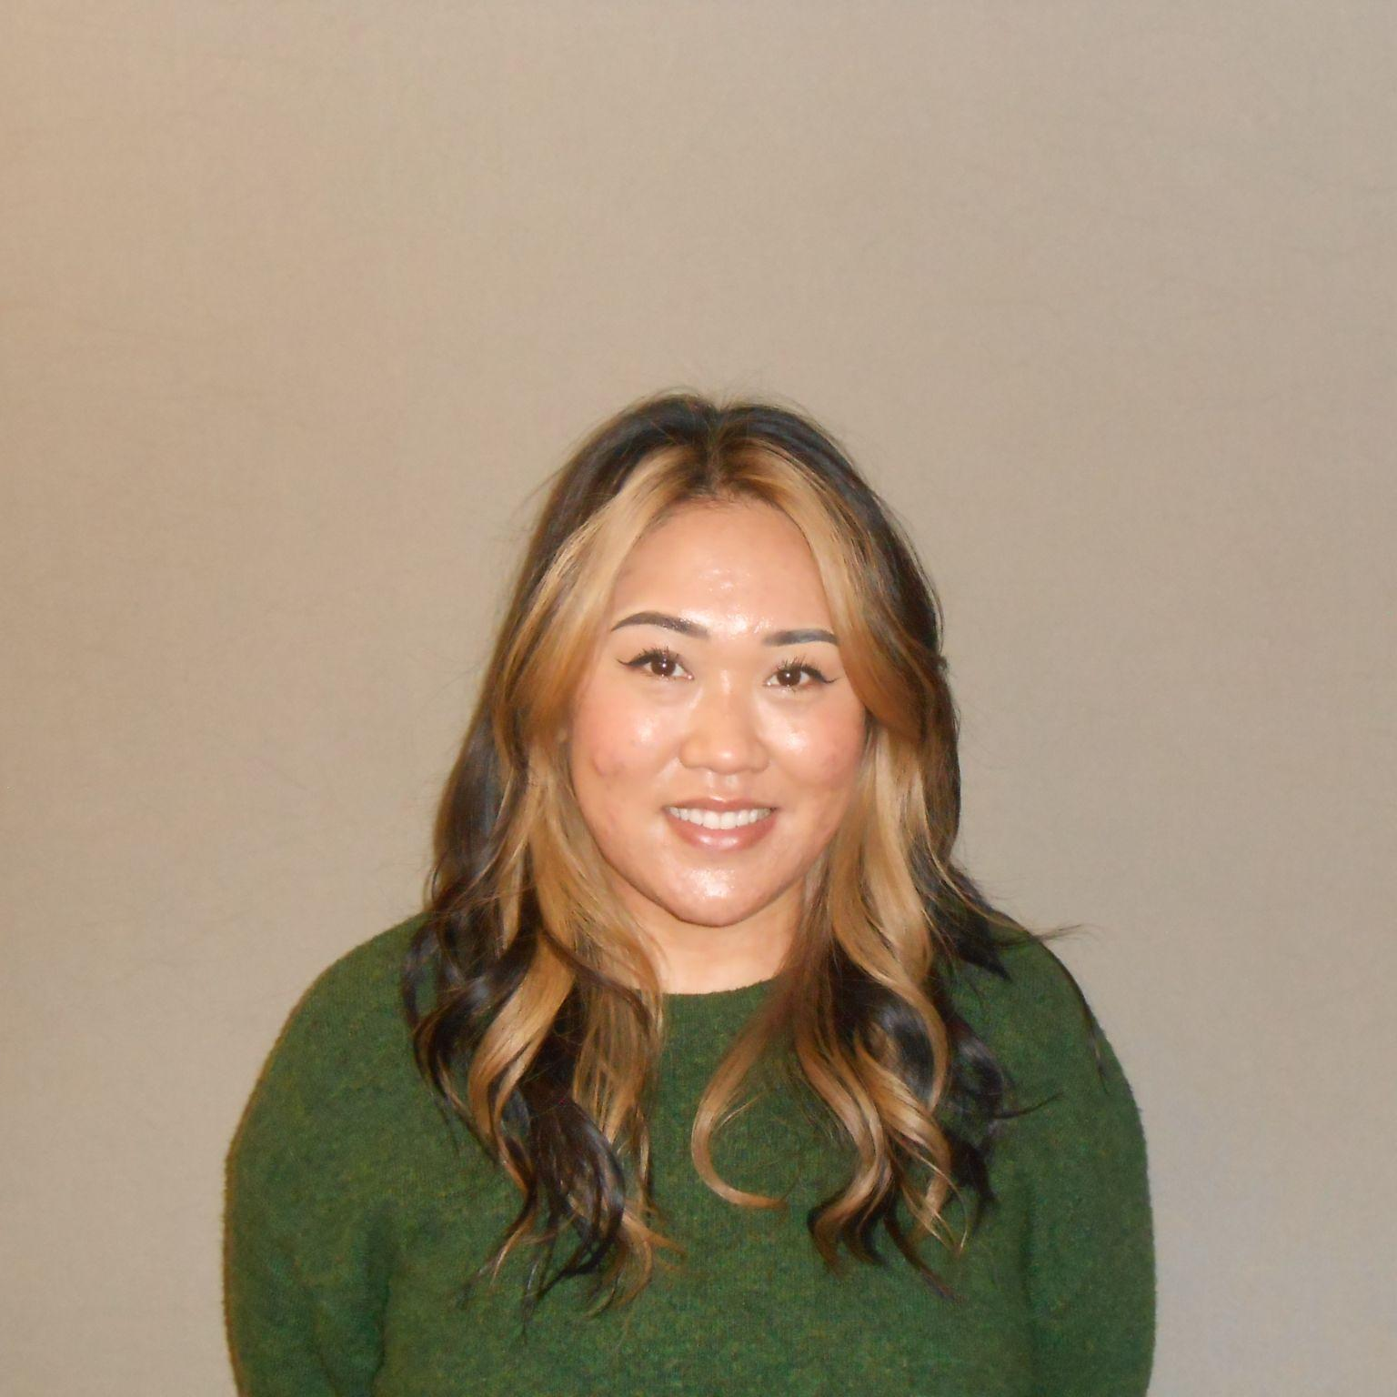
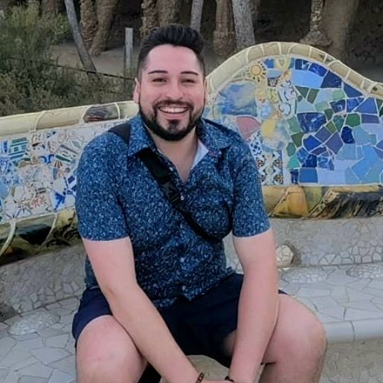
Meet the Team
Antonio Foles, MPH, MBA
Savanh Chansombath
Omar Ramos
Health Education Administrator
Lead Health Educator - LTBI
Lead Health Educator - HIV

Slide 32

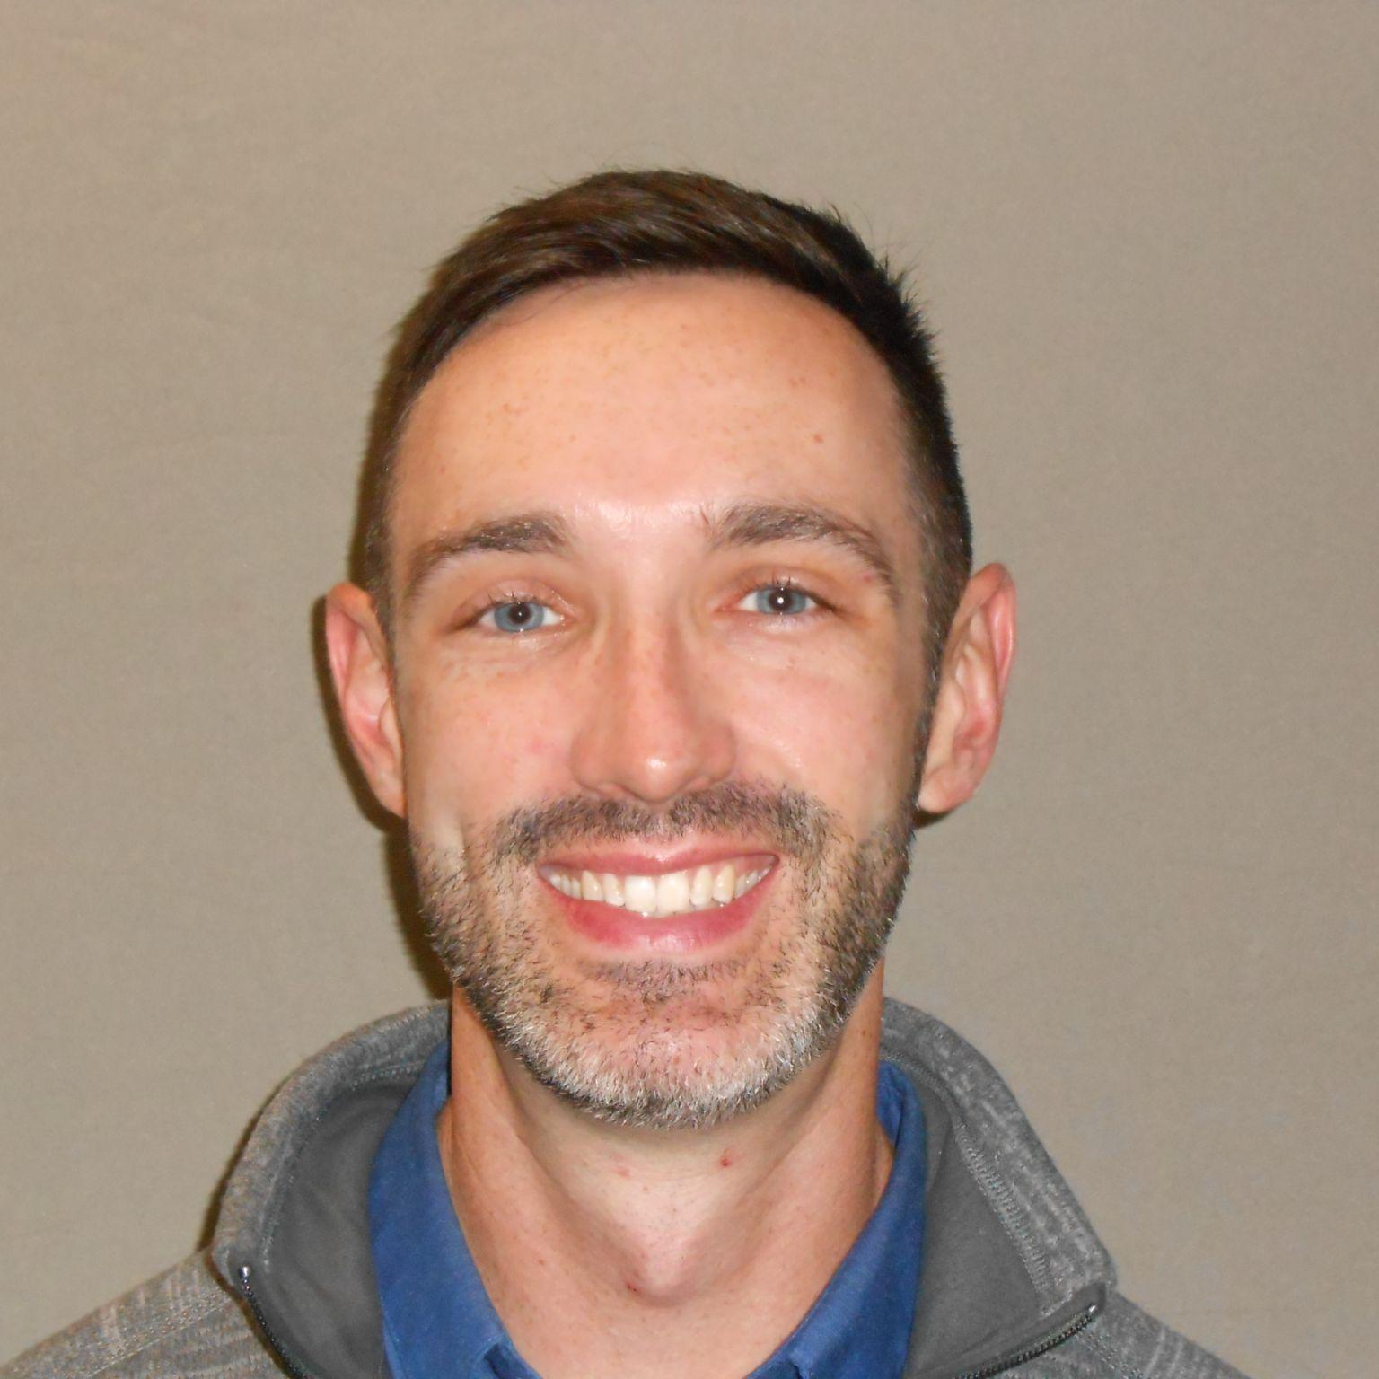
Meet the Team
Trudy Thompson
Zahra Masroori
John Marrin, DNP, FNP-BC
Health Educator
Health Educator
Provider Project Lead - HIV

Slide 33
ICHS Goals for Collaborative
Identify areas of improvement for current PrEP access models (provider and pharmacy-led)
Identify new ways to improve HIV screening rates among patient population
1
3
Improve sexual history and other health history intake and better align these workflows across clinical care teams
Develop better engagement strategies for HIV/PrEP/STI communication and outreach
2
4

Slide 34
Population-Based Approach to
HIV Prevention and PrEP
Notes:
Marwan

Slide 35
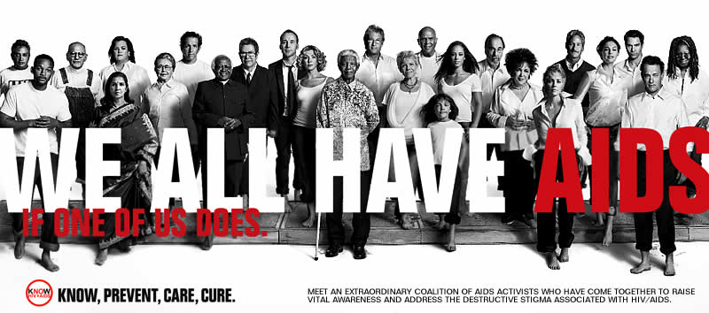
Epidemiology of HIV
About 1.2 million people with HIV are living in the U.S. in 2021.
1 in 8 (about 13 %) unaware of their infection.
In 2021, 36,136 new infections occurred.
Notes:
Marwan

Slide 36
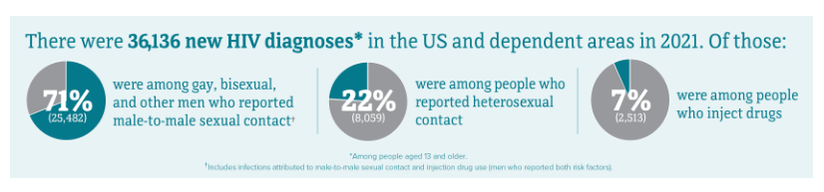
HIV Incidence
CDC.GOV

Slide 37

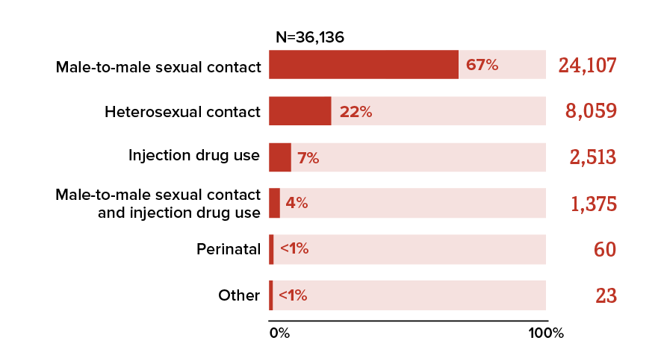
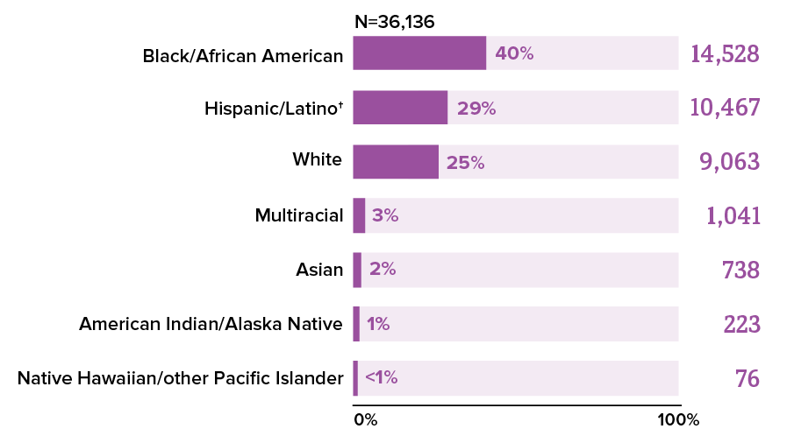

New HIV Diagnoses in the United States 2021
≈18% on PrEP*
≈82%
Without PrEP
New Diagnoses in 2021: 36,136
  71% among MSM
  69% among Black and Hispanic
37
Volume 34 | HIV Surveillance | Reports | Resource Library | HIV/AIDS | CDC
Notes:
Marwan

Slide 38
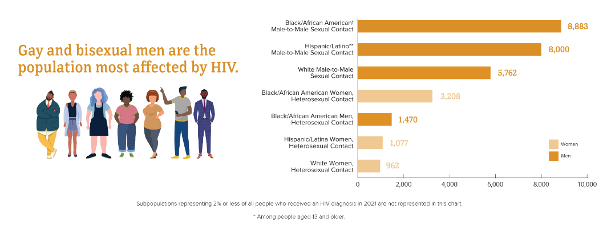
CDC.GOV

Slide 39
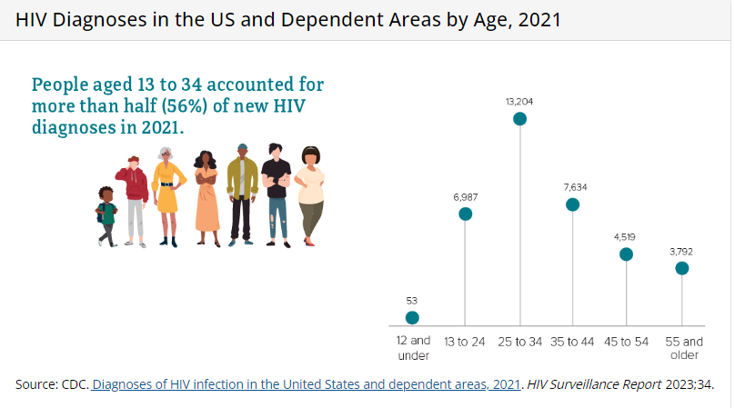
CDC.GOV

Slide 40
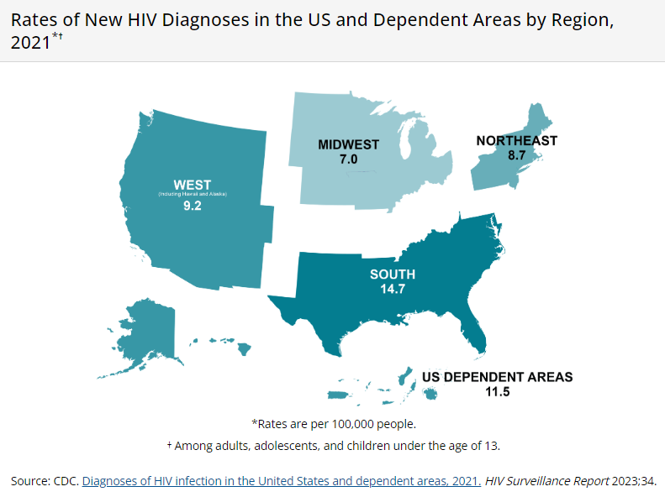
CDC.GOV

Slide 41
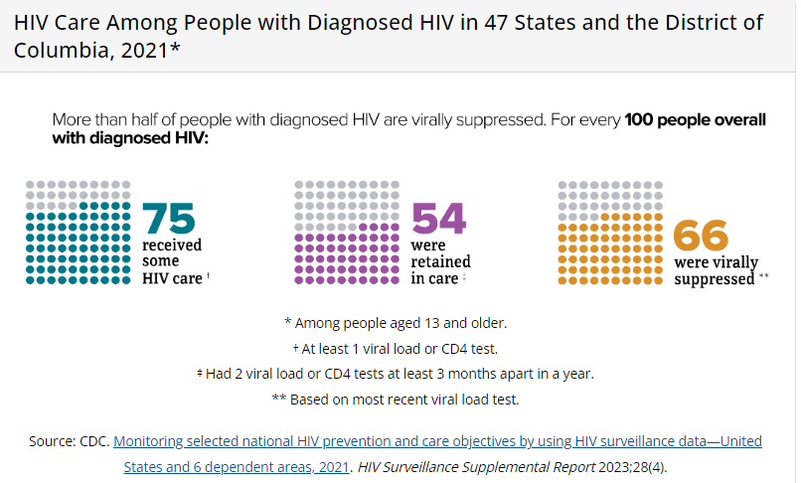
CDC.GOV

Slide 42
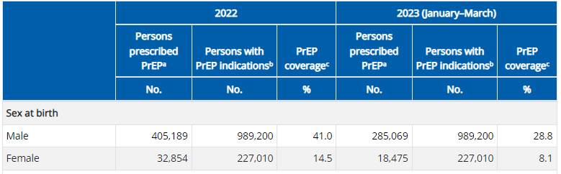
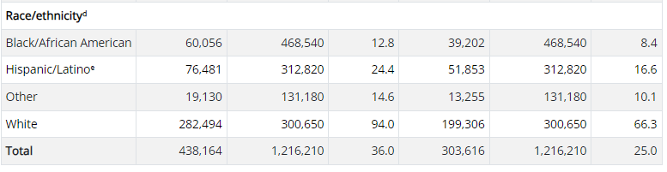

PrEP in the
United States 2022-2023
About 1.2 million persons in the US are likely to benefit from PrEP^{[1]}
  1 in 4 sexually active MSM: 814,000^{[2]}
  1 in 5 PWIDs: 73,000^{[2]}
  1 in 200 heterosexual adults: 258,000^{[2]}
In 2022, 36% of those who could benefit from PrEP were prescribed PrEP.
Blacks and Hispanics account for 69% of new HIV infections but their PrEP use is too low.
  94% of Whites who could benefit from PrEP were prescribed it.
  13% of Blacks who could benefit were prescribed it.
  24% of Hispanics who could benefit were prescribed it.
42
1. Harris. MMWR Morb Mortal Wkly Rep. 2019;68:1117. 2. Smith. Ann Epidemiol. 2018;28:.e9. 3. Sullivan. J Int AIDS Society. 2020;23:e25461.
42
https://www.cdc.gov/hiv/library/reports/surveillance-data-tables/vol-4-no-3/index.html
Notes:
Marwan

Slide 43

Population-Based Approach
Actively reaches people who may benefit from the health service or intervention.
Increases access to the service or intervention to more people.
Can lead to addressing health inequities.
Notes:
Marwan

Slide 44
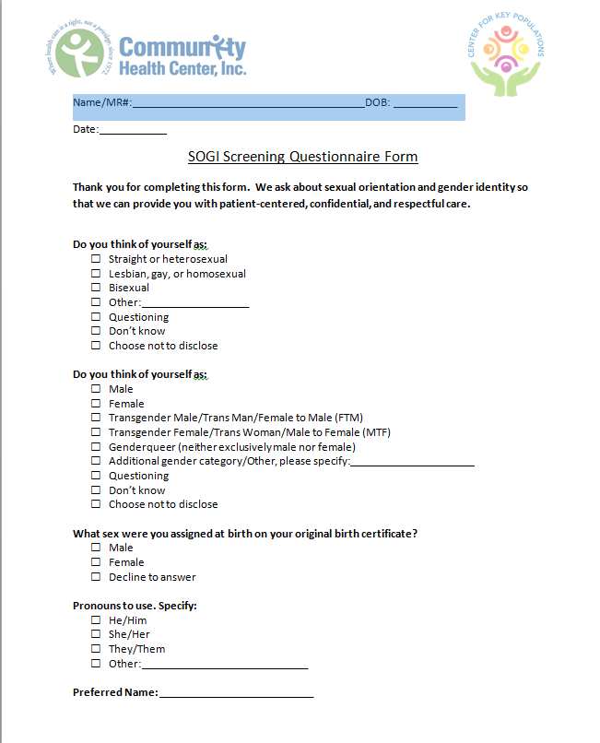



Population-Based Approach
Using sexual orientation and gender identity (SOGI) information, positive STI results to reach out to potential at-risk individuals.
Targeting messaging to at-risk populations.
Making access to services readily available where people are at.
Notes:
Marwan

Slide 45
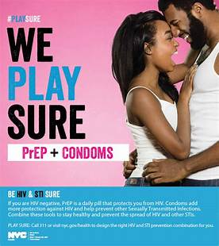

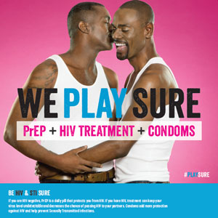
Sex Positive, Status Neutral Approach
Notes:
Marwan

Slide 46
Sex Positive, Status Neutral Goals
Promote healthy sex lives.
Invite open and comfortable dialogue about sex.
No matter who you are, who or how many you have sex with, and what kind of sex you like.
Straight, bi, gay, pansexual; cis, trans, or non-binary gender; living with or without HIV.
Empower with knowledge and choice.
Protect through prevention, screening, and treatment.
Notes:
Marwan

Slide 47

Sex Positive, Status Neutral Goals
Determine who needs STI and HIV screening.
Identify who is at risk for HIV and refer to PrEP.
Identify who is living with HIV and link them to care.
Notes:
Marwan

Slide 48

Sex Positive, Status Neutral Goals
Be comfortable talking about sex.
Check any judgment at the door.
Make no assumptions.
Notes:
Marwan

Slide 49
Creating an Affirming and Safe Environment in Your HIV Prevention Program: Basic Principles
Cultural Humility
Awareness of Intersectionality
Understanding Gender Identity and Sexual Orientation
How Stigma and Discrimination Impact Health Outcomes
Trauma-Informed Care
Language Matters
Notes:
Jeannie

Slide 50

Cultural Humility
Notes:
Jeannie

Slide 51
Notes:
Jeannie

Slide 52
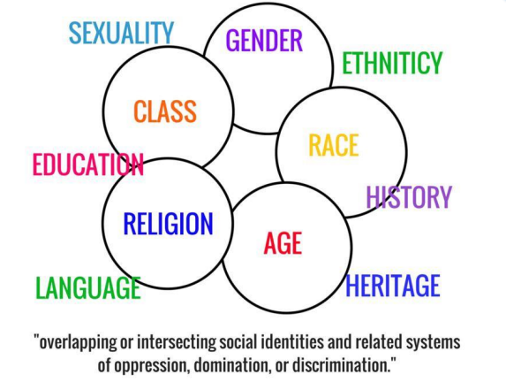
Intersecting Identities
Notes:
Jeannie

Slide 53

What do we mean by LGBT?
LGBT
  Lesbian
  Gay
  Bisexual
  Transgender
L, G, B, T
  Usually referred to as “one” community
  Many similarities, especially when it comes to stigma and discrimination
  Must keep in mind that they represent diverse communities with differing healthcare risks and needs
Notes:
Jeannie

Slide 54

Sexual Orientation and Gender Identity
are Not the Same
All people have a sexual orientation and gender identity
How people identify can change
Terminology varies
Gender Identity ≠ Sexual Orientation
Notes:
Jeannie

Slide 55
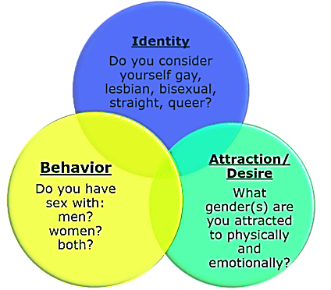
Sexual Orientation
Dimensions of Sexual Orientation:
Gay
Lesbian
MSM = man who has sex with men
Bisexual
Heterosexual
Queer
Questioning
Asexual
Aromantic
Polyamorous
Pansexual
T4T
Notes:
Jeannie

Slide 56
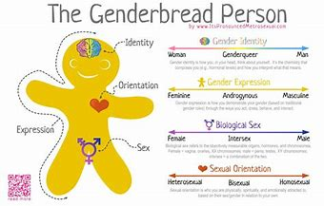
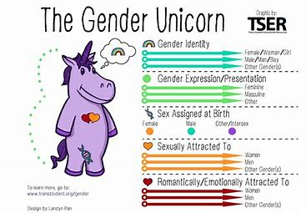
Gender Identity & Gender Expression
Gender identity
  A person's internal sense of their gender
    Do I identify as male, female, both, neither?
Gender expression
  How one presents themselves through their behavior, mannerisms, speech patterns, dress, and hairstyles
Notes:
Jeannie

Slide 57


Notes:
Jeannie

Slide 58
Stigma, Discrimination, and Health
Stress/Anxiety/Depression
Health Disparities/Inequities
Interpersonal
Structural
Intrapersonal (Internalized) Stigma
Stigma
Notes:
Jeannie

Slide 59
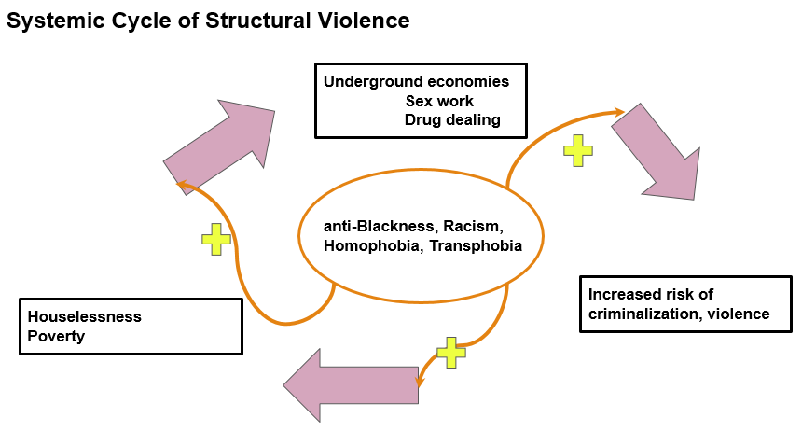
Notes:
Jeannie

Slide 60
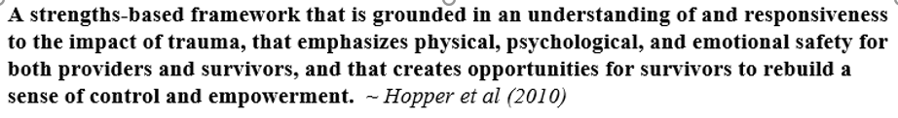
Trauma Informed Care (TIC)
Examples of TIC in Clinical Practice:
Screening for trauma and adverse childhood experiences (ACEs)
Creating a safe physical environment
Before physical examination explain what you are doing and ask for permission
Use affirming and sensitive language
Avoid making assumptions about patient’s identity, family structure, relationships, etc.
Involving patient in deciding plan of care
Training staff at all levels in trauma awareness
Notes:
Jeannie

Slide 61
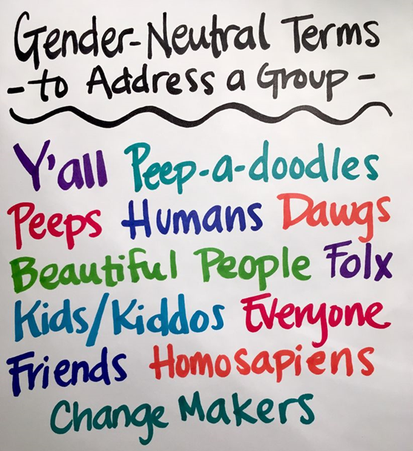
Affirming Language & Sensitive Communication
You cannot always correctly guess someone’s gender identity or sexual orientation based on how they look or sound.
Listen to how people describe their own identities and partners—use the same terms, if comfortable .
Treat every patient identifying as LGBTQI+ as a unique individual rather than making group generalizations.
To avoid assuming gender or sexual orientation with new patients:
  Instead of: “How may I help you, sir?”
  Say: “How may I help you?”
  Instead of: “He is here for his appointment.”
  Say: “The patient is here in the waiting room.”
  Instead of: “Do you have a wife?”
  Say: “Are you in a relationship?
  Instead of:” What are your mother and fathers’ names?”
  Say: “What are your parents’ names?”
Notes:
Jeannie

Slide 62
Name & Pronouns
It is important to use the correct name and pronouns when referring to a patient.
Ex: He/him/his
She/her/hers
They/their/theirs
Name and pronouns may change over time.
A patient may choose to use a different name and pronouns in different contexts.
If you are unsure about a patient’s name or pronoun
  “What name and pronoun would you like me to use?” OR
  “My name is __ and my pronouns are ___. What are yours?”
If you accidentally use the wrong term or pronoun
  “I’m sorry. Thank you for letting me know.”
If a patient’s name doesn’t match insurance or medical records
  “Could your chart/insurance be under a different name?”
  “What is the name on your insurance?”
https://www.minus18.org.au/pronouns-app/
http://www.theyismypronoun.com/
Notes:
Jeannie

Slide 63

Notes:
Jeannie

Slide 64

Diversity, Equity, and
Inclusion Intentionality
Notes:
Jeannie

Slide 65
Team Introductions – Part 2
 | Order of Introductions
6 | Jane Pauley Community Health Center
7 | Promise Healthcare
8 | The HealthCare Connection, Inc.
9 | WellSpace Health
Name of your practice, size, etc.
Names and positions of participating team members
Goals for the learning collaborative
Notes:
Team intros

Slide 66
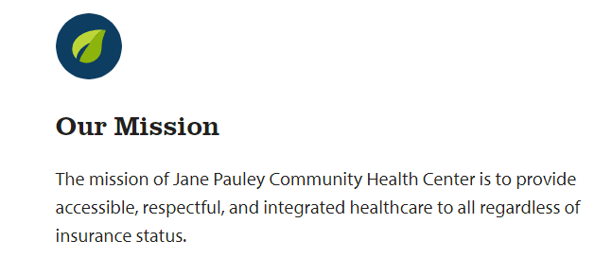
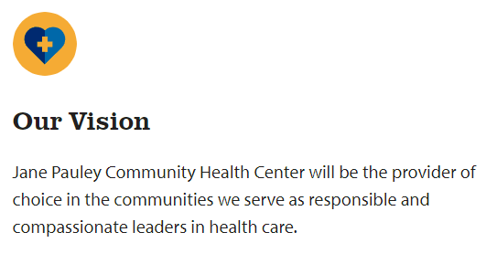
Jane Pauley CHC - Overview
Founded in 2009 and awarded FQHC status in 2011. Jane Pauley CHC offers services at 10 family medicine locations serving 4 counties in central Indiana.

Slide 67
Our HIV Project Team
Project Name: | Improving HIV Screening and Access to Prevention Services
Start Date: | 01/25/2024 |  | End Date: | 06/25/2024
Background Information: In 2023 JPCHC applied for and received Primary Care HIV Prevention Funds from HRSA. These funds were awarded to strengthen HIV prevention services across the JPCHC network of clinics with the goals of increasing HIV screening, increasing PrEP utilization, and timely entry to HIV care for those testing positive for HIV. JPCHC currently has as routine HIV screening rate of 51%. Sexual health and HIV risk assessment are not consistently included in routine care visits; and very few patients are utilizing PrEP.
Objectives: There are three main objectives for the HIV project team. Increase routine HIV screening and counseling rates across the JPCHC network. Increase comfort and completion of sexual history. Increase access to HIV prevention services and PrEP utilization. Increase % of patients linked to HIV care and treatment within 30 days.
Deliverables:
HIV screening process maps HIV prevention referral process maps A set of written HIV prevention protocols to include: Sexual history documentation HIV screening and counseling Use of and distribution of point of care testing kits PrEP services Positive HIV test follow-up Training and Implementation Plan
Team Members:
Name / Title |  | Team Role |  |  | JPCHC Location
Amber Melchior, RN |  | Facilitator |  |  | HIV Services
Aaron Knapp, Director of Pharmacy |  | Pharmacy - SME |  |  | Pharmacy
Janelle Jenkins, Clinical Systems Analyst |  | Data - SME |  |  | IT
Steph Branson, Quality and Development Specialist |  | Training / Quality – SME |  |  | Clinical Quality
Michelle Meinzer, RN |  | Nursing – SME |  |  | PCC – Shadeland
Heather Wilkins, CMA |  | MA – SME |  |  | Anderson 1210B
Desirae Hamilton, CMA |  | MA – SME |  |  | Post Road
Ashley Dugan, Site Coordinator |  | Front office – SME |  |  | Arlington
Dawn Houchin, Practice Manager |  | Operations/Admin – SME |  |  | Shelbyville
Nancy Curd, Director of Enabling Services |  | Outreach – SME |  |  | Enabling Services
Twaambo Situmbeko, FNP |  | Clinician – SME |  |  | 16th Street
07/25/2023
November 2023
December 2023
Notice of award for Primary Care HIV Prevention Funds
Manager of HIV Prevention hired and onboarded.
January 2024
Manager of HIV Prevention Services began assembling HIV Prevention project Team
HIV Project Team kickoff meeting – 01/25/2024
Identification of subject matter experts across various roles and locations.
HIV Project Team confirmed
Job descriptions created for an dedicated HIV prevention outreach staff member and a RN care coordinator.

Slide 68
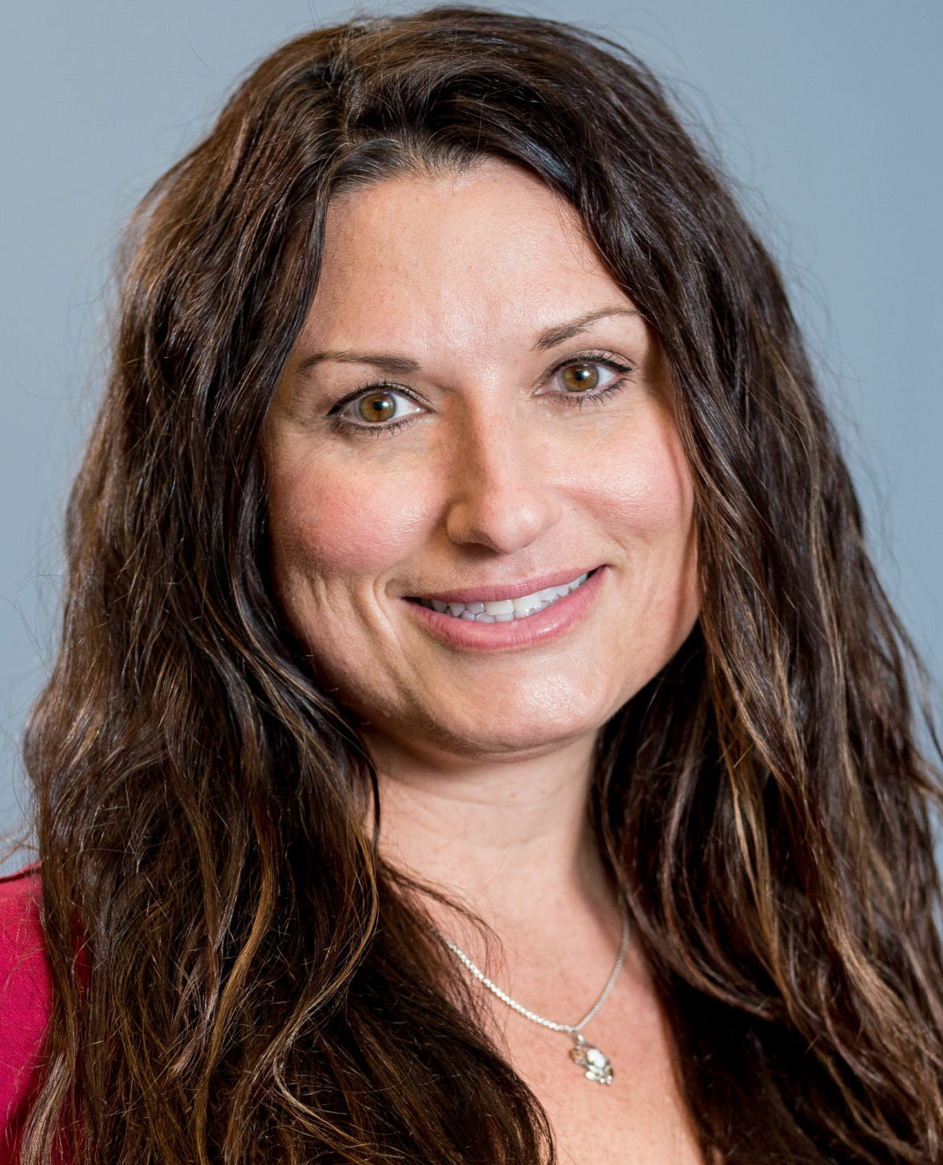
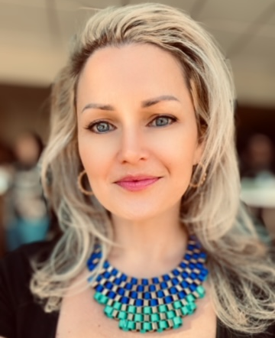

Promise Healthcare
Melonie Richardson
Chief Medical Officer
Zina Soltis
VP of Risk, Quality, & Compliance
Tandrea Cross
Quality Program Supervisor

Slide 69
Promise’s
Participation Goals
Improve HIV and STI screening rates and develop scripting for providers
Incorporate HIV testing as part of standard STI testing workflow
Increase knowledge of PrEP (pre-exposure prophylaxis) to prevent HIV
Develop protocol and scripting for medical providers to prescribe PrEP

Slide 70

The HealthCare Connection
FQHC located in Northern Cincinnati Founded in 1967
Primary Care, OB/GYN, Behavioral Health, Infectious Diseases, Dental
340B pharmacy
Serve over 20,000 patients across 9 locations
  Large immigrant, Latino(a), and Black population
  “PrEP desert”

Slide 71
The HealthCare Connection
Goals:
Decrease disparities in PrEP access and prescriptions.
Reduce HIV transmission
Increase awareness of PrEP in community
Increase access to services to better health outcomes
HIV Prevention/PrEP Core Team
Matthew Bauer* | Chief Medical Officer, Infectious Diseases Physician
Cheryl Coleman | Director of Quality Improvement & Risk Management
Janet Pressley-Barr | Population Health RN
Megan Deeley | Population Health RN
Sarah Tolbert | RN Clinic Manager - Lincoln Heights (LH)
Jada Johnson | RN Clinic Manager - Mt. Healthy (MH)
Ashley Collins | Physician - Family Medicine MH
Rachael Tayce | Nurse Practitioner - LH
Lashandra Duncan | Nurse Practitioner - GCB
Angie Hartman | Sr. Director of School Based Health & Vision (SBHC)
Quyen Wiggins | Nurse Practitioner - SBHC
Kelsey Neal | Dentist
Patricia Harris | LPN - MH
Vicki Norman | Behavioral Health Counselor - SBHC

Slide 72
WellSpace Health – STI Grant
Infectious Diseases Team
Our Mission
Teresa Posas, Health Center Manager
Yareli Pulido Lamas, Medical Assistant
Mario Lopez Mendez, PrEP Navigator
Roxane Gaedeke, Clinical Quality Manager – Public Health
Nina Traverso, Clinical Quality Program Coordinator – Public Health
Build active, inclusive, and meaningful engagements with communities that effectively represent priority populations affected by the STI epidemic.
Mobilize public health partners to develop a clinic-level plan to increase quality comprehensive sexual health services, strengthen clinic infrastructure, and increase available provisions of sexual health services.
Notes:
Everyone can contribute toward this goal:
Letting patients know we offer PrEP, rapid HIV tests, free condoms and lube
Asking when was the last time they had an STI/HIV test
Review vaccination status for HPV, Hep B

Slide 73
Our Goals
To gain insight from other collaborative organizations that will inform the development of a strategic plan for improving our HIV prevention program.
To learn best practices for gaining internal support for investing in our HIV prevention program.
Improve the identification and coordination of individuals diagnosed with HIV to appropriate care, treatment, and support services.
Establish referral pathways between testing sites, healthcare providers, and support organizations for those testing positive.
Implement strategies to address barriers to care, such as transportation or stigma, to ensure individuals are linked to medical care promptly.

Slide 74
HIV Prevention 101: the Basics
Notes:
Marwan

Slide 75

HIV Prevention Strategies
Risk reduction counseling
  Barrier methods, partners, syringe services
STI testing and treatment
PEP (post-exposure prophylaxis)
HIV testing
PrEP (pre-exposure prophylaxis)
Treatment as Prevention
U=U (Undetectable = Untransmittable)

Slide 76
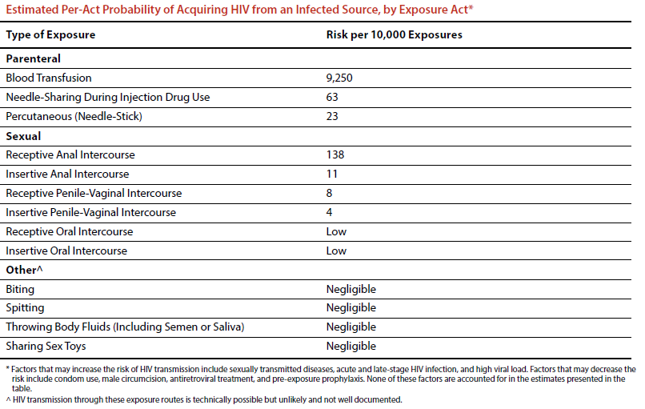

Slide 77
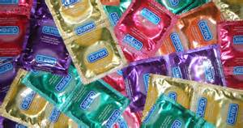
Condom Use Protection Against HIV
Consistent condom use with usual rates of breakage and slippage protects about 80% (with range: 35 to 94%)
  Estimates mainly based on heterosexual couples.
  Very few studies in MSM or with anal sex.
Holmes KK, Levine R, Weaver M. Effectiveness of condoms in preventing sexually transmitted infections. Bull World Health Organ. 2004 Jun;82(6):454-61. PMID: 15356939; PMCID: PMC2622864.

Slide 78
HIV Testing
CDC and USPSTF recommend routine HIV testing for 13 (15)-64 year olds.
  Recommendation for those at higher risk to get tested at least once a year.
Importance of HIV testing
  People with HIV who are aware of status can get HIV treatment
    Promote individual health
    Prevent transmission
  People who don’t have HIV but are at-risk can make decisions about their health, including PrEP.

Slide 79
Who Should We Be Testing?
All patients 13-64 years of age, at least once
  USPSTF recommends starting at age 15
Any patient suspected of acute HIV infection
Pregnant women
Patients with TB
Patients seeking STD treatment and attending STD clinics
Patients with HBV/HCV
Patients starting new sexual relationships
Occupationally exposed individuals
Patients with ongoing risk, at least annually
  People who inject drugs and their sex partners
  Persons who exchange sex for money or drugs
  Sex partners of persons with HIV
  MSM or heterosexual persons who themselves or their partners have had more than one sexual partner since their last HIV test
CDC MMWR Sept 26, 2006

Slide 80

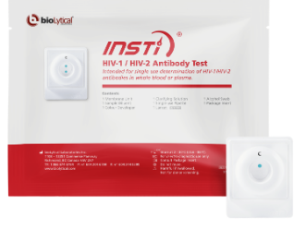
HIV Tests
Routine HIV Test
  4th generation Ab/Ag testing
    Blood test (results in 1-2 weeks)
    Sensitivity >99.7%, Specificity 100%
Rapid Tests
  INSTI HIV1/2 Ab IgM/IgG (3rd generation)
    Blood test (results in 1 minute)
    Sensitivity >99.8%, specificity >99.5%
    Picks up infection by 3 weeks
  Alere Determine HIV1/2 Ab/Ag(4th generation)
    Blood test (results in 15 minutes)
    Sensitivity 100%, specificity 99.8%
    Picks up infections earlier (by 1-2 weeks).
  Positive results require confirmation

Slide 81
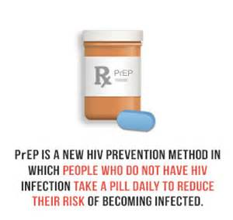
Pre-Exposure Prophylaxis (PrEP)
An individual without HIV takes antiretroviral medication(s) before potential HIV exposure.

Slide 82
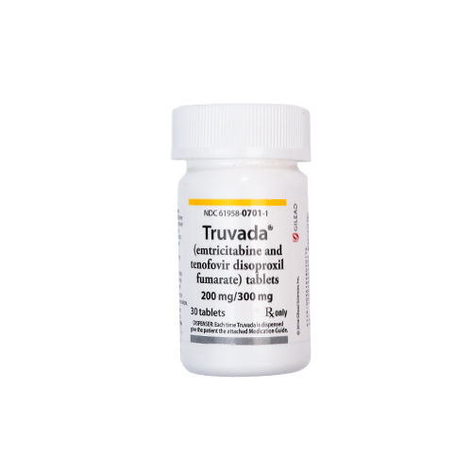
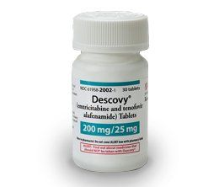
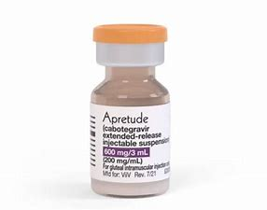
PrEP Prescribing Choices
TDF/FTC (Truvada or generic) for MSM, transgender women, heterosexually active men and women, and people who inject drugs who meet PrEP prescribing criteria.
  Dosed as a single pill once daily
  ONLY for MSM/transgender women, can be dosed on demand (2-1-1)
TAF/FTC (Descovy) for MSM and transgender women at sexual risk.
  Dosed as a single pill once daily
Injectable cabotegravir (Apretude) for adults/adolescents 35 kg + at sexual risk.
  Monthly injection for 2 months then every other month.

Slide 83
PrEP with TDF/FTC Works!
Study | Efficacy Overall, % | Blood Samples With TFV Detected, % | Efficacy By Blood Detection of TFV, %
iPrEx^{[1]} | 44 | 51 | 92
iPrEx OLE^{[2]} | 49 | 71 | NR
Partners PrEP^{[3]} | 67 (TDF) 75 (TDF/FTC) | 81 | 86 (TDF) 90 (TDF/FTC)
TDF2^{[4]} | 62 | 80 | 85
Thai IDU^{[5]} | 49 | 67 | 74
Fem-PrEP^{[6]} | No efficacy | < 30 | NR
VOICE^{[7]} | No efficacy | < 30 | NR
FTC, emtricitabine; NR, not reported; PrEP, pre-exposure prophylaxis; TDF, tenofovir disoproxil fumarate; TFV, tenofovir.
1. Grant RM, et al. N Engl J Med. 2010;363:2587-2599. 2. Grant RM, et al. Lancet Infect Dis. 2014; 14:820-829. 3. Baeten JM, et al. N Engl J Med. 2012;367:399-410. 4. Thigpen MC, et al. N Engl J Med. 2012;367:423-434. 5. Choopanya K, et al. Lancet. 2013;381:2083-2090. 6. Van Damme L, et al. N Engl J Med. 2012;367:411-422. 7. Marrazzo J, et al. CROI 2013. Abstract 26LB.
Notes:
FTC, emtricitabine; NR, not reported; PrEP, pre-exposure prophylaxis; TDF, tenofovir disoproxil fumarate; TFV, tenofovir.
Oral PrEP works, but adherence is critical. For IPrEx, when you analyze efficacy with the detection of tenofovir in the person’s blood, it showed that if you took tenofovir as instructed, the efficacy of PrEP was 92%.

Slide 84
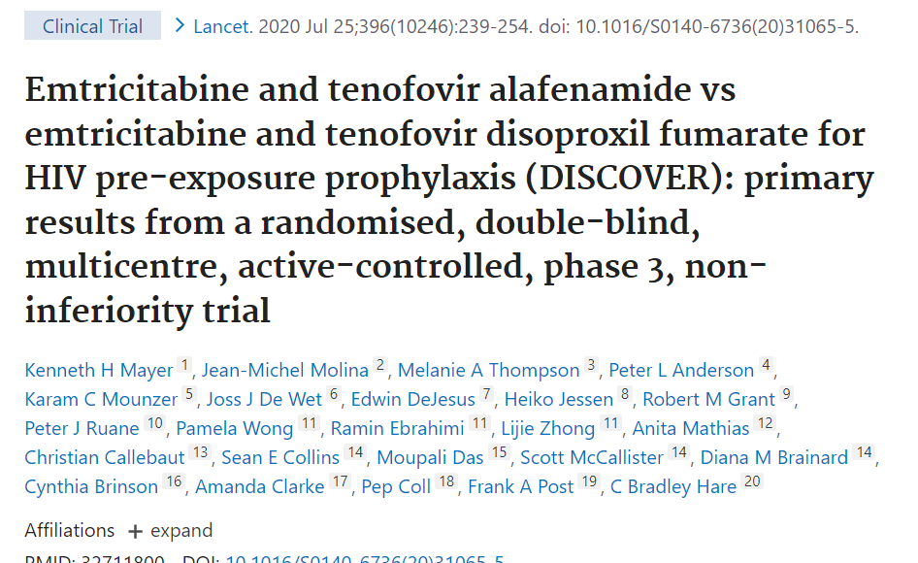
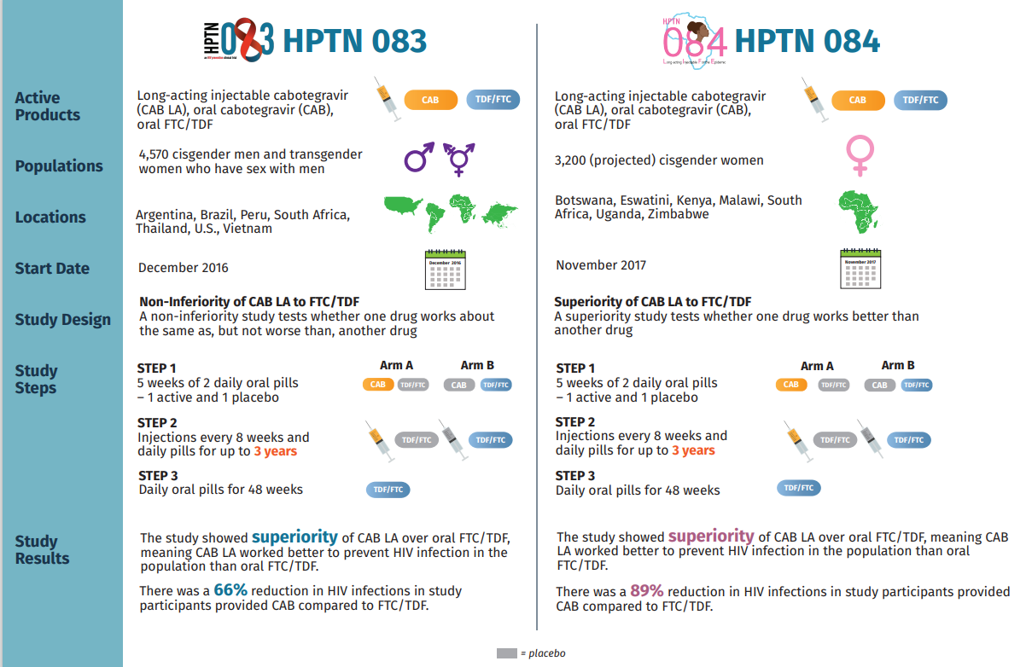
PrEP with TAF/FTC Works!
PrEP with Cabotegravir Works!

Slide 85
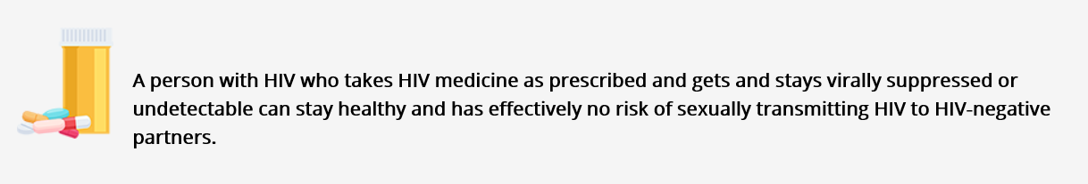
What is Treatment As Prevention?
https://www.cdc.gov/hiv/risk/art/index.html

Slide 86
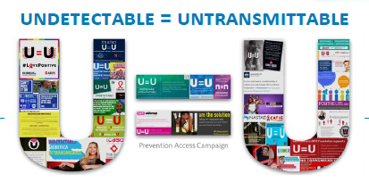
Prevention Access Campaign: 2016
https://www.preventionaccess.org/

Slide 87

Risk by Transmission Category
https://www.cdc.gov/hiv/risk/art/index.html

Slide 88


Scientific Evidence

Slide 89

When does TasP become effective?

Slide 90
Questions?

Slide 91

Next Steps
Agenda items for your meetings during this action period
Review the results of your Organizational Readiness to Implement Change (ORIC) and Partnership for Care (P4C) Health Center Readiness Assessment
Review tools you currently use for assessing gender/gender identification, race/ethnicity, sexual orientation, and sexual behavior
Review data for current uptake of HIV prevention in your organization, that is, do patients come back for ongoing care?
Review current strategies for outreach to at-risk populations
Assignments
Narrative on health center [details provided in syllabus]
Develop profile on population of patients whom you consider to be at-risk
CME and Resource Page
Access Code: HIV2024
https://education.weitzmaninstitute.org/content/nttap-hiv-prevention-learning-collaborative-2024
Notes:
Meaghan

Slide 92
NTTAP Contact Information
Amanda Schiessl
Project Director/Co-PI
Amanda@chc1.com
Bianca Flowers
Project Manager
flowerb@chc1.com
Meaghan Angers
Project Specialist
angersm@chc1.com
REMINDER: Complete evaluation in the poll!
Upcoming Coach Calls: Monday February 5th & February 19th
Next Learning Session is Monday February 26th!
Notes:
Meaghan

Slide 93




Explore more resources!
National Learning Library:
Resources for Clinical Workforce Development
Health Center
Resource Clearinghouse
https://www.weitzmaninstitute.org/ncaresources
https://www.healthcenterinfo.org/
93
Notes:
Meaghan

