Slide 1


HIV Prevention Learning Collaborative
Session Two: February 26th, 2024
Notes:
Meaghan

Slide 2
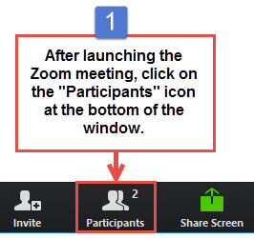
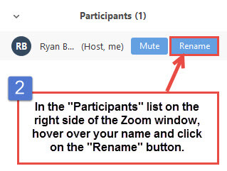
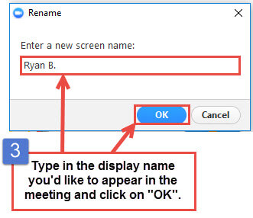
Get the Most Out of Your Zoom Experience
Please keep yourself on MUTE to avoid background/distracting sounds
Use the CHAT function or UNMUTE to ask questions or make comments
Please change your participant name to your full name and organization
  “Meaghan Angers CHCI”
Notes:
Meaghan

Slide 3
Session 2 Agenda
1:00 – 1:05 | Welcome
1:05 – 1:40 | Overview of Screening Tools
1:40 – 2:05 | SOGI Data Collection
2:05 – 2:25 | Sexual Risk Assessment
2:25 – 2:30 | Q & A and Next Steps
Notes:
Meaghan

Slide 4
Learning Collaborative Structure
Six 90-minute Learning Collaborative video conference sessions
Bi-weekly calls between coach mentors and practice coach
Internal team workgroup meetings
Use the Weitzman Education Platform to access resources and receive CME credit
Learning Session Dates
Learning Session 1 | Monday January 29th
Learning Session 2 | Monday February 26th
Learning Session 3 | Monday March 25th
Learning Session 4 | Monday April 22nd
Learning Session 5 | Monday May 20th
Learning Session 6 | Monday June 10th
Notes:
Meaghan

Slide 5
NTTAP Faculty, Collaborative Design, and Facilitation
Amanda Schiessl, MPP
  Deputy Chief Operating Officer
  Project Director/Co-PI, NCA
Margaret Flinter, APRN, PhD, FAAN
  Co-PI, NCA & Senior Vice President/Clinical Director
Bianca Flowers, MPH
  Program Manager
Meaghan Angers
  Program Manager
Dr. Marwan Haddad, MD, MPH, AAHIVS,
  Medical Director, Center for Key Populations
Kasey Harding, MPH
  Program Director, Center for Key Populations
Mentors, Coaching Faculty
Jeannie McIntosh, APRN, FNP-C, AAHIV
  Nurse Practitioner, Center for Key Populations
  mcintosj@chc1.com
Maria Lorenzo
  Community Based Services Manager, Center for Key Populations
  LorenzM@chc1.com
Evaluation Faculty
Kathleen Thies, PhD, RN
  Consultant, Researcher
  ThiesK@chc1.com
Notes:
Meaghan

Slide 6


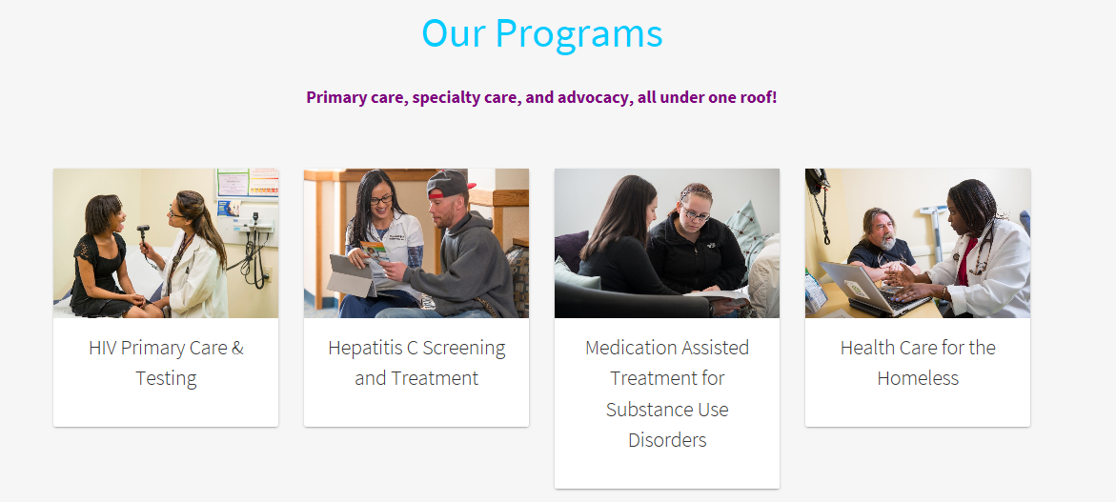
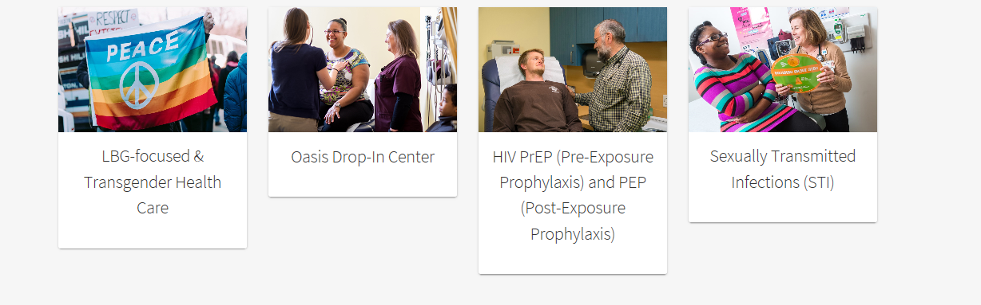
The Center for Key Populations is the first center of its kind that focuses on key groups who experience health disparities secondary to stigma and discrimination
and who belong to communities that have suffered many barriers to healthcare.
The Center brings together healthcare, training, research, and advocacy for:
People who use drugs, the LGB and Transgender populations,
the homeless and those experiencing housing instability,
the recently incarcerated, and sex workers.
HIV Primary Care
Viral Hepatitis Screening and Treatment
Substance Use Health
Health Care for the Homeless
LGB Health and Gender Affirming Care
Migrant Farmer Health Program
HIV Prevention: Testing, PrEP,
and PEP
Sexually
Transmitted
Infections
Notes:
Meaghan

Slide 7
Affinia Healthcare | St. Louis, Missouri
Asian American Health Coalition dba HOPE Clinic | Houston, Texas
East Central Oklahoma Family Health Center | Wetumka, Oklahoma
FirstMed Health and Wellness | Las Vegas, Nevada
Hi-Desert Memorial Health Care District | California
International Community Health Services | Seattle, Washington
Jane Pauley Community Health Center | Indianapolis, Indiana
North County Health Project, Inc. DBA TrueCare | San Marcos, Califonia
Promise Healthcare | Champaign, Illinois
The HealthCare Connection, Inc. | Cincinnati, Ohio
WellSpace Health | Sacramento, California
2024 Cohort
Notes:
Meaghan

Slide 8
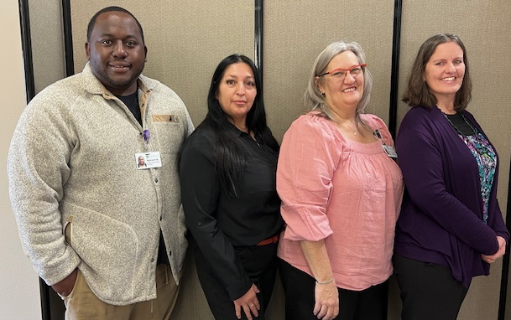

Hi-Desert Memorial Health Care District / Morongo Basin Healthcare District
FQHC since 2013 with multiple locations serving rural California desert communities offering adult and pediatric medical, chiropractic, phlebotomy, dental, behavioral health, and transportation services
Our HIV Prevention Team (pictured):
Malcolm Bryant, CHW
Gladys Cardenas, CHW
Dianna Anderson, Community Programs Manager
Kathy Alkire, Community Outreach/Patient Education RN
Additional Team Members:
Joe Ruddon, Chief Community Program Officer
Tina Huff, NP, Chief Clinical Operations Officer
Dr. Jack Cruikshank, HIV Prevention Physician Champion

Slide 9


Hi-Desert Memorial Health Care District / Morongo Basin Healthcare District
HIV Presentations and Education:
  Community organizations, fairs, and events
  Colleges, Gyms, and Senior Centers
  Shopping and Pregnancy Centers
  Tattoo Parlors and Smoke Shops
Team Distribution:
  Over 4,000 male and female condoms, lube
  Over 800 rapid, at-home HIV test kits
Program Goals:
Improve HIV/ STI assessments to determine risk and ensure testing and screening through EHR
Increase Provider/Staff knowledge of HIV prevention/care/treatment and patient compliance/adherence strategies
Develop best practices utilizing latest research and developments for clinical practices
Develop best practice strategies for outreach to increase population knowledge
Increase HIV screening compliance to 80%
Improve PrEP awareness to 60%
Distributing Red Ribbons and HIV test kits on World AIDS Day

Slide 10
Overview of Screening Tools
Notes:
Marwan

Slide 11
HIV Prevention: Taking a History
2 Main Questions:
  What information do we need to deliver optimal care
  How do we collect the information
Same as for all patients.
Pay specific attention to health disparities.
Be aware of contexts that increase health risks:
  Risk factors for smoking, substance use, or engaging in sexual risk behaviors
  Incidence of trauma/abuse/victimization
Ask about social support; be aware of possible rejection by family or community of origin, harassment, and discrimination.
Other social determinants of health (SDOH)

Slide 12
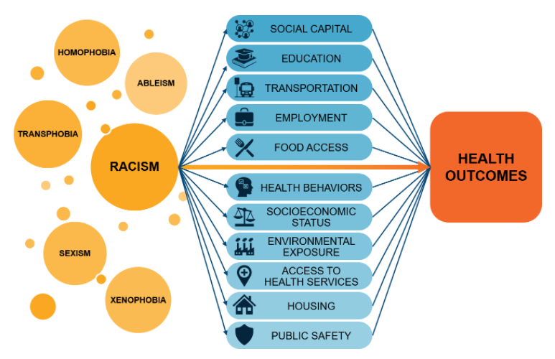
Race and Racism
Implicit and Explicit bias both in the community and within the healthcare system
Longstanding history of mistrust, experimentation, unequal care
Lack of representation in healthcare

Slide 13
Screening Tools
Which ones do you want to use?
  Which ones are being used already?
  Which ones do you want to or can you add?
How will they be administered?
  Digitally?
  On paper?
  Orally?
Who will administer them?
  Patient
  Medical assistant
  Nursing
  Medical provider
  Behavioral health provider
  Front desk staff
What trainings are needed?
  Discipline specific?
  How often?
  Who will give the trainings?
What are the workflows to be implemented?
How are you going to respond to positive screenings?

Slide 14
Routine Screening
Can occur prior to Medical or Behavioral Health (BH) provider entering the room completed by front desk, MA, or RN
  Through portal, check-in kiosks, smart tablets
Set intervals for conducting screenings and updating information
Overlap with BH and medical screenings – ex. PHQ-2 and PHQ-9

Slide 15
SDOH Screening: Gathering SDOH Data Before a Visit
Address (zip code), phone number, email address
Language(s)
Insurance Status
Guardian/Decision-maker
Permission to share (social support)

Slide 16
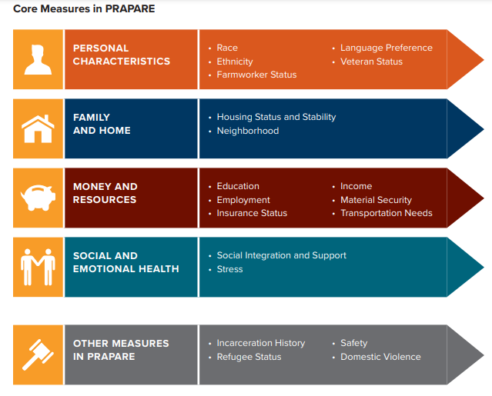
PRAPARE:
The Protocol for Responding to and Assessing Patients’ Assets, Risks, and Experiences
SDOH Specific Screening Tool by the National Association of Community Health Centers (NACHC)

Slide 17
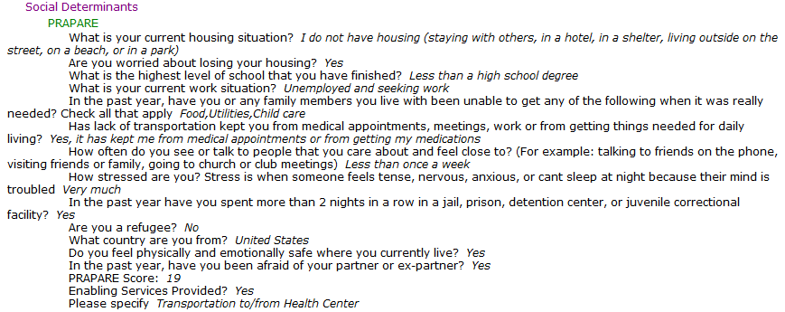
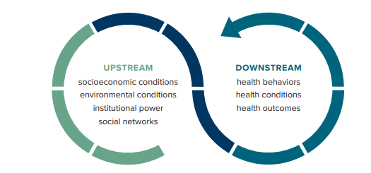
PRAPARE
In the medical record

Slide 18
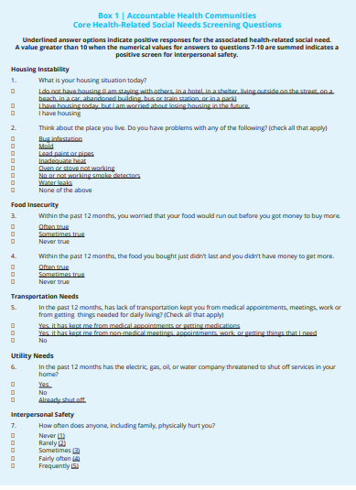
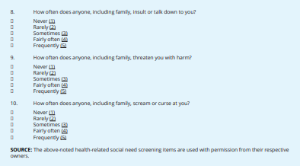
Other SDOH Specific
Screening
Tools
Accountable Health Communities (AHC) Health-Related Social Needs (HRSN) Screening Tool Developed by the Centers for Medicaid and Medicare Services

Slide 19
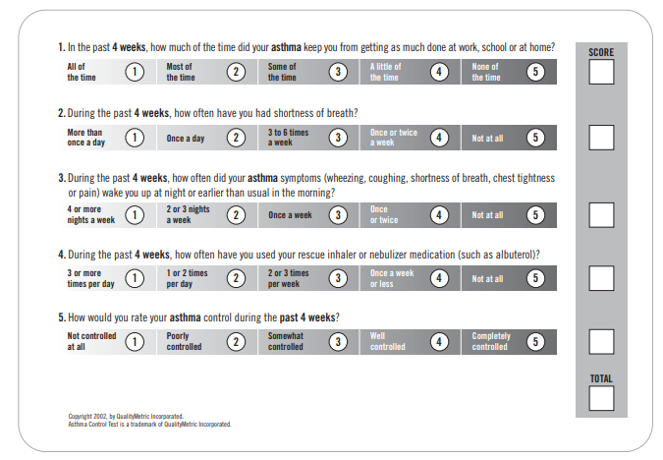
Using Traditional Tools to open up discussion around SDOH
Consider discussing housing/environment after the Asthma Control Test (ACT)

Slide 20
Key Visits
Initial Visits/Establishing Care
  What brought them to the health center, where are they coming from
  Who do they live with, what does their home look like
  Family/support
  Employment, disability
  “Is there anything else you want to share with me about you or your health”
Physicals and Well-Child Visits
  Consistent access to utilities, stable housing, child-care, family structure and support, pets, access to supplementary food/services (WIC, SNAP), neighborhood safety, education at home
  Don’t forget about the parent
Complaint-based visits
Every visit

Slide 21
Built in EMR Social History Fields
Language(s) spoken
How you like to learn (ie, verbal, written, etc)
Literacy (ie reads well in English, does not read well in Spanish, etc)
Smoking
Substance use (specific screenings)
Sexual History
SOGI (eCW now has specific tab)
Housing/Living With
Marital Status
Occupation
Religious Affiliation
Domestic Violence
Support System
Confidential Contact

Slide 22
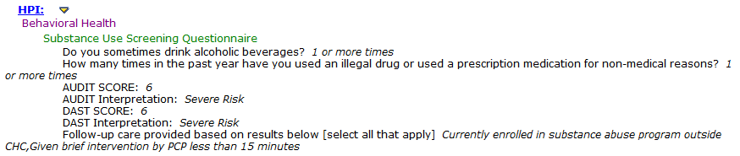
SBIRT
Screening,
Brief Intervention, Referral to Treatment
Utilizes AUDIT (Alcohol Use Disorders Identification Test) and DAST (Drug Abuse Screening Test) scores to screen for risk for and current use of substances followed by a brief intervention and referral to treatment if necessary
Notes:
Not shown as part of the first screening question is if they drink alcohol, for men how many times in the last year have they had 5 or more drinks, and for women 4 or more drinks. This would be a positive screen and trigger further questions.

Slide 23
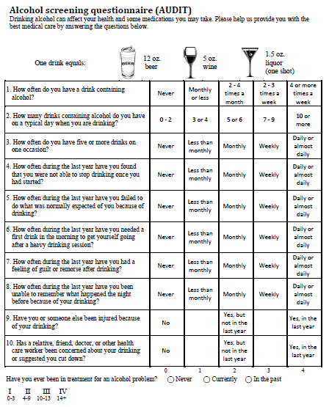
AUDIT
https://www.sbirt.care/pdfs/tools/AUDIT.PDF

Slide 24
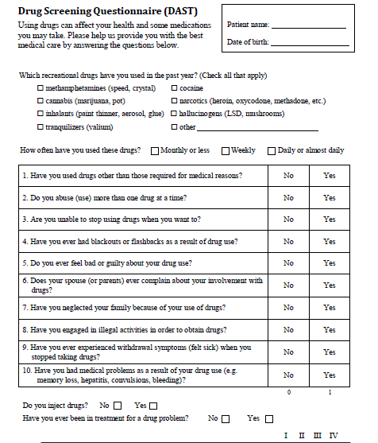
DAST
https://www.sbirt.care/pdfs/tools/DAST.PDF
Notes:
Substance use may redirect treatment plan by becoming the priority – connecting to local services for detox, residential/rehab, clinic BH and substance use services, or intensive outpatient depending on substance use/alcohol use disorder severity, polysubstance use etc. Patient may be the sole “breadwinner” in the household and not able to go to residential or time off for detox or they may not have consistent transportation to get them to intensive outpatient programs.

Slide 25
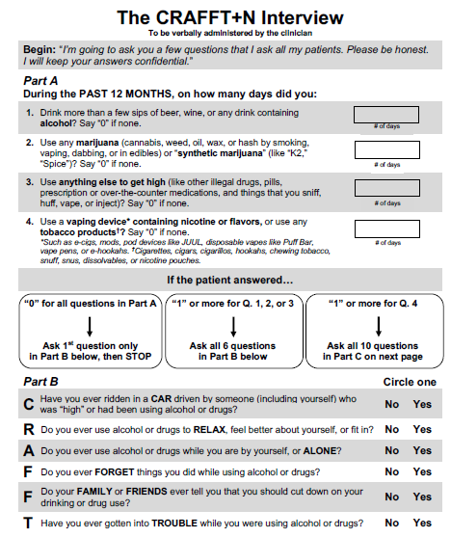
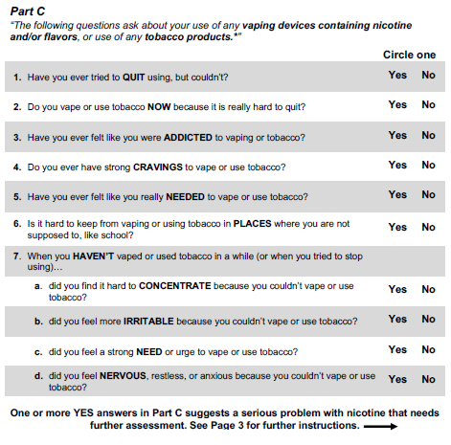
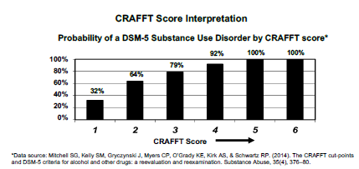
CRAFFT
(Adolescents)

Slide 26
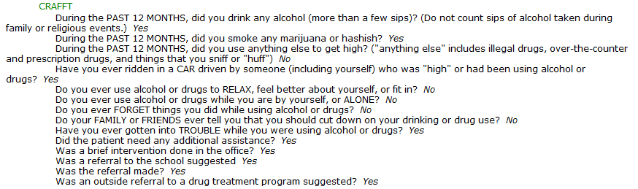
CRAFFT
(Adolescents)

Slide 27
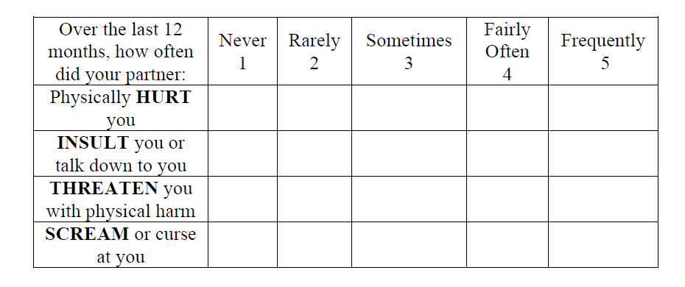
Intimate Partner Violence Screening
HITS – Hurt, Insult, Threaten, Scream
Notes:
Next steps – recommend Myplan app https://www.myplanapp.org/
Provide domestic violence hotline
Refer to local DV shelter
Connect with BH
Doesn’t address neighborhood safety, racism, toxic stress
Are there children in the home – need to involve child services, trust in system, access to care etc

Slide 28

Adverse Childhood Events

Slide 29
Beyond Screenings –
How to have difficult conversations
Who did you bring with you today or who came with you today?
  Ask for accompanying person to briefly leave the room for time alone
Have you ever had to trade sex for money, drugs, or housing?
Tell me about your typical day/what does a typical day look like to you?
Food insecurity: Do you have trouble accessing food or are there days when you aren’t sure where or how you’ll obtain your next meal

Slide 30
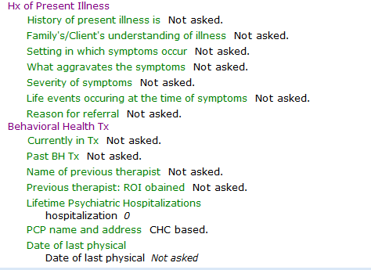
Use of Data and Measurement-Based Care in Behavioral Health
Informal screening tool
Behavioral health intake
Notes:
Intake – mainly qualitative data utilizing an already created intake template – clinicians at their discretion can utilize additional measures/screening tools to assess for specific issues (e.g., PHQ-9 to assess for depression, GAD-7 to assess for anxiety, Columbia Suicide Severity Rating Scale to assess for suicidality, Mood Disorder Questionnaire (MDQ) to assess for mood disorders broadly, but specifically symptoms of mania/hypomania, BH clinicians can also assess using DSM-V cross cutting measures, which target symptom criteria for DSM-V diagnoses, ACES to assess for childhood trauma)
Additionally, the intake template has specific open-ended questions targeting SDOH (e.g., housing, highest level of education, race/ethnicity, employment status, relationship status, etc.), and clinicians are encouraged to ask their own follow up questions to further assess each domain should there be an identified need (e.g., should an individual identify that they are in a relationship, follow up questions will be asked to assess for safety concerns, IPV, etc.

Slide 31
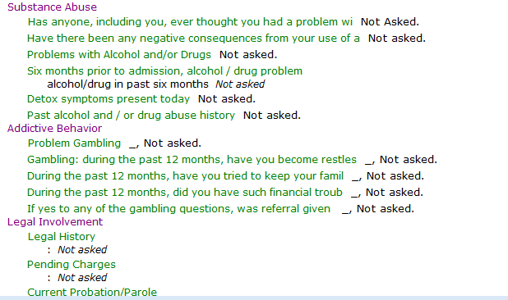
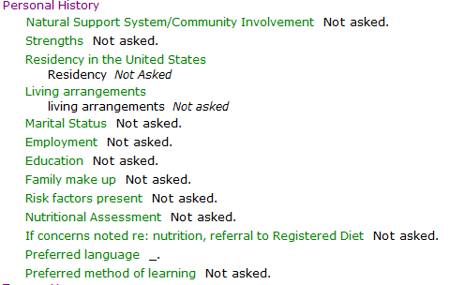
Notes:
Intake – mainly qualitative data utilizing an already created intake template – clinicians at their discretion can utilize additional measures/screening tools to assess for specific issues (e.g., PHQ-9 to assess for depression, GAD-7 to assess for anxiety, Columbia Suicide Severity Rating Scale to assess for suicidality, Mood Disorder Questionnaire (MDQ) to assess for mood disorders broadly, but specifically symptoms of mania/hypomania, BH clinicians can also assess using DSM-V cross cutting measures, which target symptom criteria for DSM-V diagnoses, ACES to assess for childhood trauma)
Additionally, the intake template has specific open-ended questions targeting SDOH (e.g., housing, highest level of education, race/ethnicity, employment status, relationship status, etc.), and clinicians are encouraged to ask their own follow up questions to further assess each domain should there be an identified need (e.g., should an individual identify that they are in a relationship, follow up questions will be asked to assess for safety concerns, IPV, etc.

Slide 32
Use of Data and Measurement-Based Care in Behavioral Health
Formal screening tools/measures
  PHQ-9
  GAD-7
  CSSRS (suicide severity assessment)
  MDQ (mood disorder assessment)
  DSM-V Cross Cutting Measures
  ACES

Slide 33
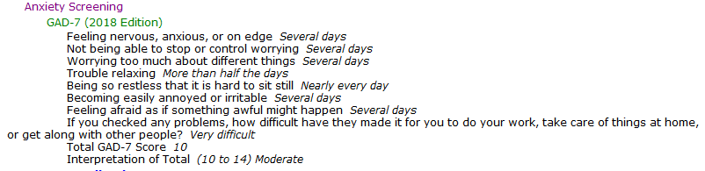
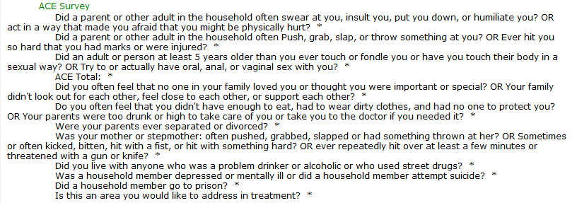

Slide 34
SOGI Data Collection

Slide 35
CKP Quality Improvement Team:
Choosing the Initiative
Why Choose Sexual Orientation and Gender Identity (SO/GI) Collection?
  CKP team passionate about initiative
  SO/GI Collection met many of the criteria required to have a successful outcome
    SO/GI part of the Uniform Data System (UDS) required by HRSA.
    CHC senior leadership buy-in and support.
    Grant funding
    Strategic partnership (CDC/NACHC/Fenway/CHC collaboration)
    Agency-wide initiative

Slide 36
CKP QI Team: Preliminary Decisions
Who should be involved as part of the Quality Improvement initiative:
  CKP Directors
  Medical providers
  Medical Assistants
  Nursing
  IT/Data/EHR (Coach)
  Case manager
  PrEP navigator
  Outreach worker
  Front desk staff (when needed)

Slide 37
CKP QI Team: Decisions to Work Through
When during the patient visit process can SO/GI be collected?
Who will collect it?
How will it be collected?
Where will the information be documented in the health records and what will it look like?
What type of training is needed and who will require it?

Slide 38
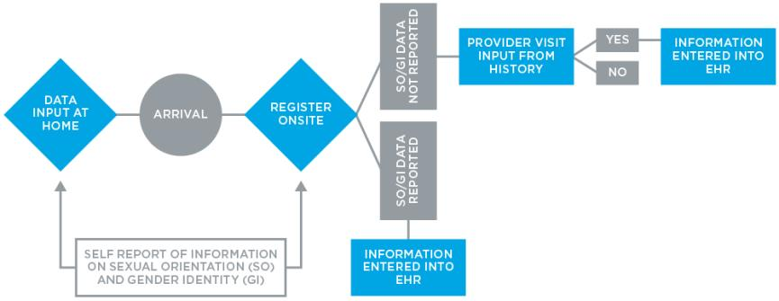
Opportunities for SOGI Data Collection

Slide 39
SO/GI Initiative at CHC
Opted to collect information at medical visit.
Created structured data fields in the EHR under Social History for SO/GI.
PDSAs done by CKP team, nursing, behavioral health, then expand to more medical providers and pediatrician through QI/Clinical Microsystem.
Trainings
  On LGBTQ cultural humility
    At Grand Rounds and at All Staff meetings
  On SO/GI collection
    To the various specific disciplines involved, e.g. providers, MAs, RNs, front desk staff, access to care
  Follow up trainings where required.
Agency-wide kick off date: September 1, 2016
Patient Portal access to SO/GI questionnaire set up as well.

Slide 40
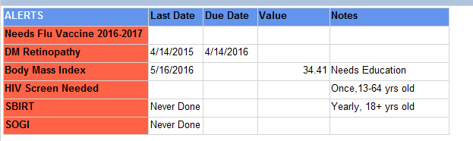
SO/GI Collection Process
SO/GI information will appear on the Planned Care Dashboard, as a one time ever collection:
  if all components missing
  if sexual orientation, gender identity, or sex at birth is missing
  if patient has chosen a gender identity different from sex at birth and preferred name and pronoun are missing

Slide 41
SO/GI Collection Process
Information will be collected through a questionnaire and entered in Social History in the EHR, eClinicalWorks (eCW).
Preferred name and pronouns to use for patients will automatically be pulled to Practice and Phone Management Systems (NOVO /Centricity) so all staff can address patients correctly.

Slide 42
Key Steps in Collecting SO/GI: Medical Assistants
The purpose is to collect sexual orientation and gender identity (SOGI) information on all patients 13 years + coming in for a medical visit
The MA checks the planned care dashboard during their huddle.
If the patient requires any SOGI component, the MA prepares the SOGI questionnaire to give to the patient.
When the patient presents for the visit, the MA rooms the patient and hands the SOGI questionnaire to the patient.
The MA will inform the patient that CHC is collecting this information on all patients as a standard of care and that the provider will review the questionnaire with them.
Any questions they may have about the questionnaire can be discussed with the provider if needed.

Slide 43
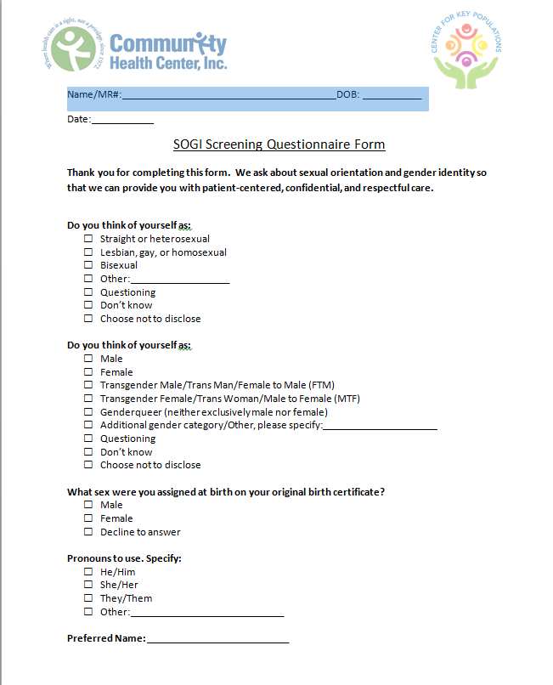
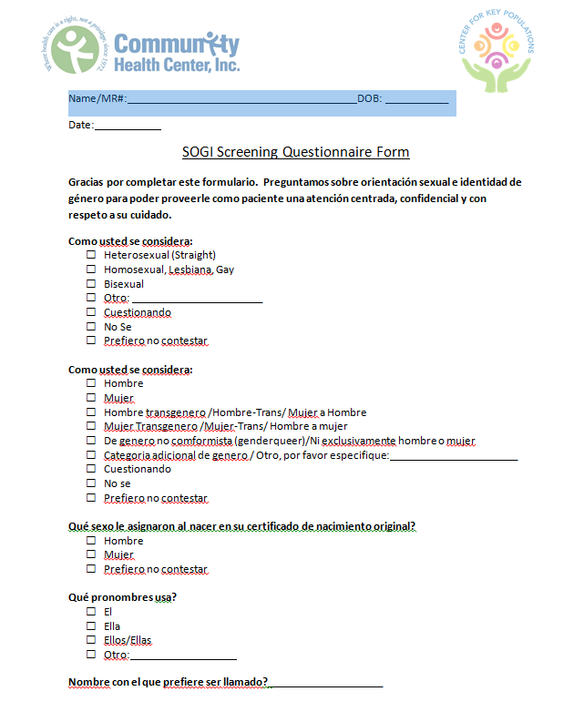

Slide 44
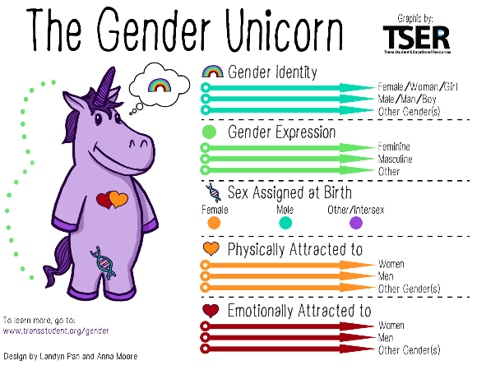
SOGI
Screening

Slide 45
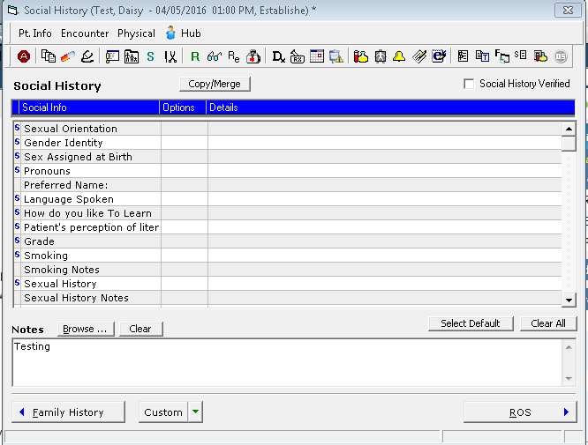
SO/GI Information
in Social
History

Slide 46
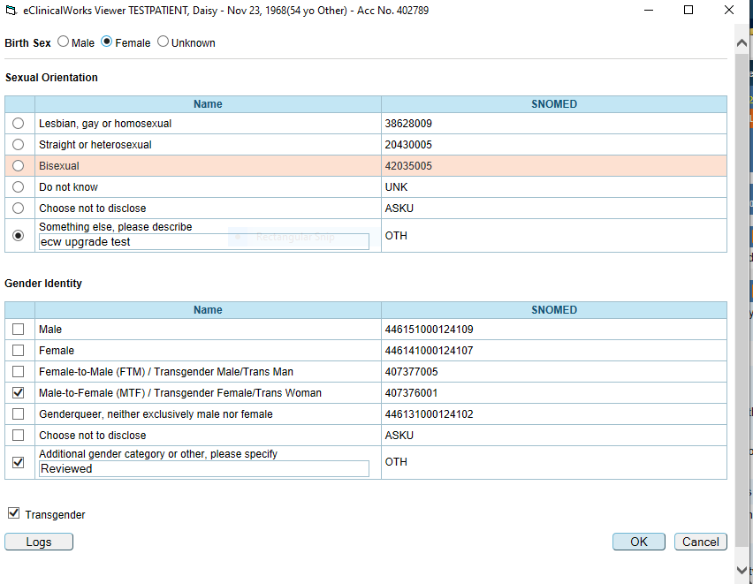
The SO/GI Box in Patient
Information

Slide 47
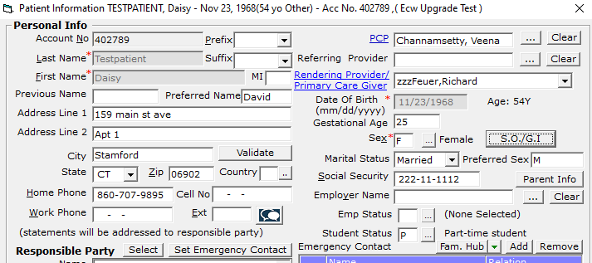
Preferred Name and Pronouns

Slide 48
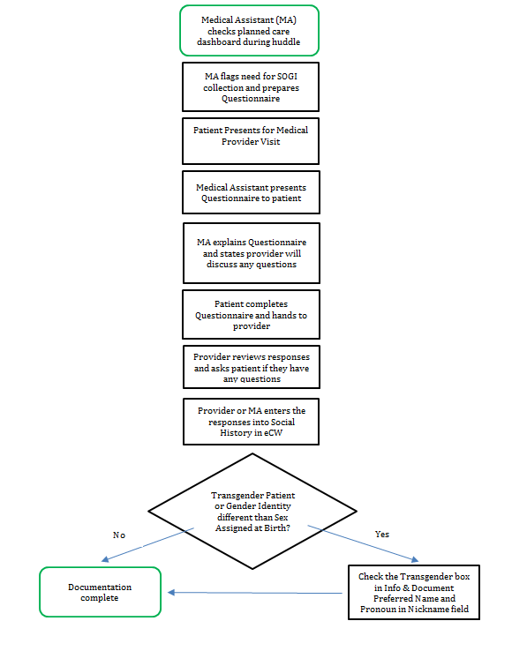
SO/GI Playbook:
Medical Assistants

Slide 49
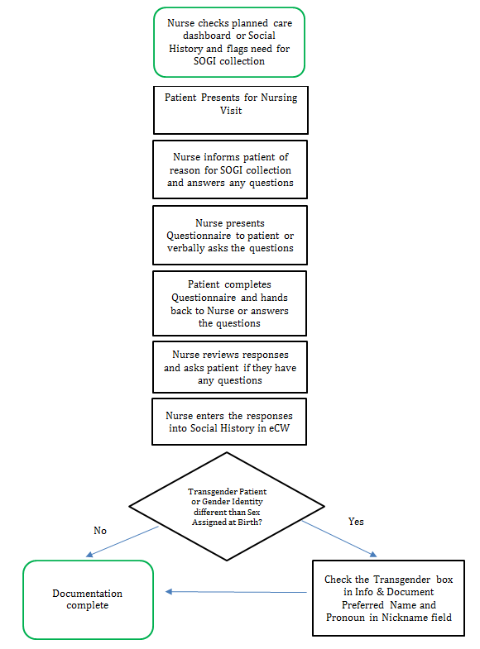
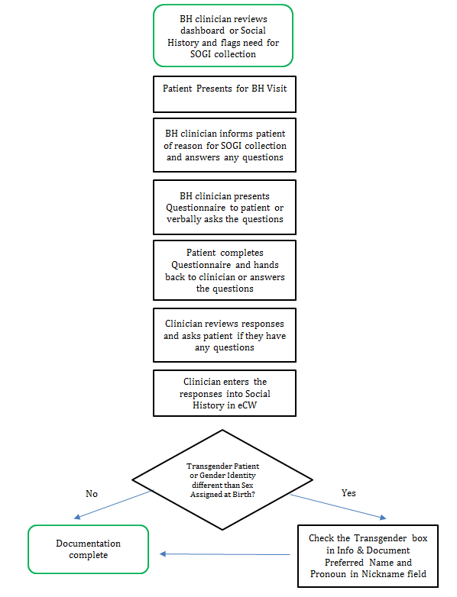
SO/GI Playbook: Nursing and Behavioral Health

Slide 50
Timeline for Rollout
PDSA 1: Pod
Evaluate & Create Action Plan
PDSA 3: Expand to other clinical teams
Data Review
Report out to
Performance
Improvement (PI)
Committee
Data Review
Training
Decision on Agency Roll-Out
EHR Change
Playbook
Training for Microsystem Team
Newsletter Article to Agency
Data Review
Data Review

Slide 51
Timeline for Rollout
PSA, MA, Provider Training
Agency Go-Live
Data review PI Committee Meeting
Data Review
PI Committee Meeting
Aug ‘16
Sept ‘16
Oct ‘16
Nov ‘16
Dec ‘16
Jan ‘17
System Change
Site Meetings
& Retraining
Internal Resource Page
Published
Dashboards
NOVO

Slide 52
Agency-wide 6-Month SO/GI Collection Rates

Slide 53
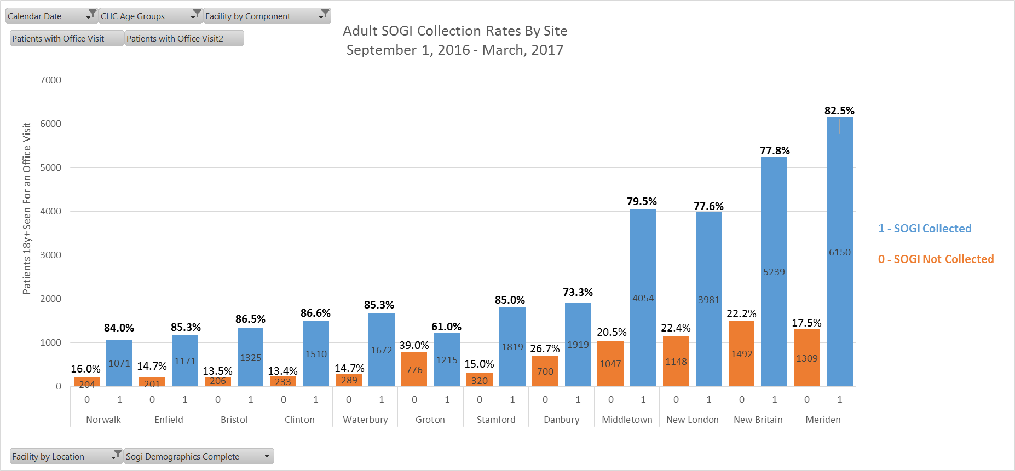
SO/GI Collection Rates by Site

Slide 54
Sexual Orientation Summary by Age Group
ADULTS 18+
ADOLESCENTS 13-17
NON Heterosexual includes Other, Don’t Know and Questioning.

Slide 55
Transgender Population by Age Group

Slide 56
Staff Reaction to SO/GI Standardization
“We have heard so much about what was going on in [another CHC] site and were wondering when this would get around to us.”
~MA in Enfield
“I have a daughter who is transgender and I asked her about the training we received and the process we are using. She was very interested in how we would be using the data collected and not just the fact that we collected it. I would like to know more about our long-term goals.”
~ RD in NB
“Everything gets put on the MA’s to do but this is something that feels right to do as an agency. When I heard what the patient response was in the first sites I couldn’t wait for it to move to our site.”
~ MA in New London

Slide 57
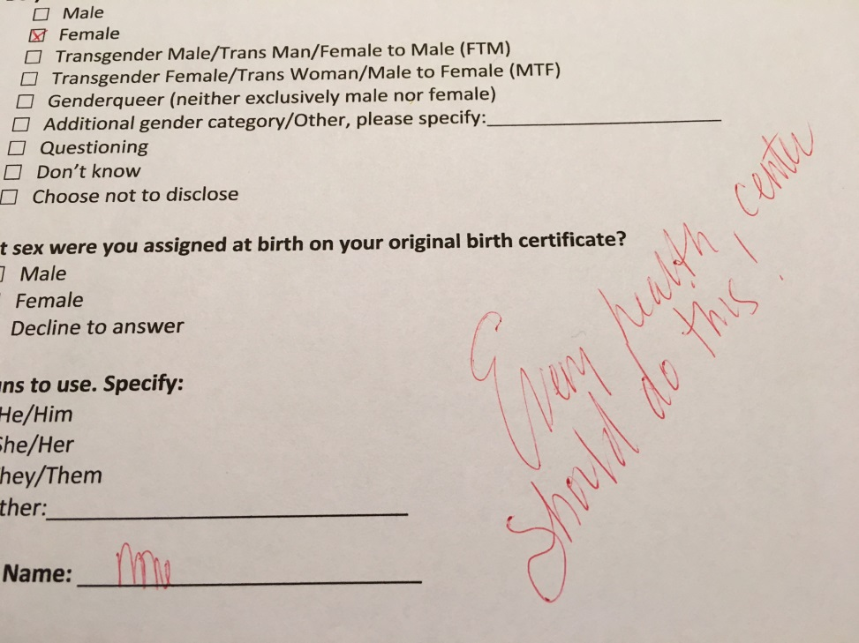
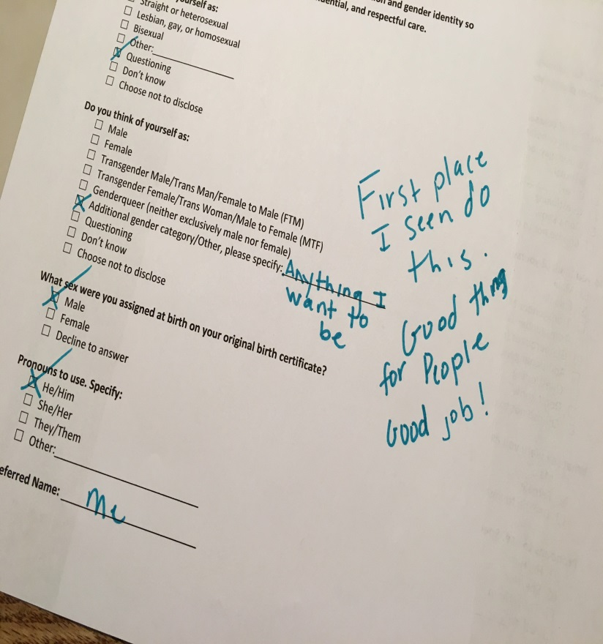
Use positive patient feedback to
sustain momentum!
Notes:
It can be useful to think about sexual orientation as being composed of three dimensions: identity, behavior, and attraction/desire. For most people, identity, behavior, and attraction/desire align (for example, a woman who is attracted to men, has sexual relationships with men, and identifies as straight). However, sometimes these dimensions do not align (for example, a man who identifies as straight, is married to a woman, but feels a strong attraction to men).

Slide 58
Implementation Climate
Facilitators
Barriers
Agency with progressive values
Leadership buy – in and support
Well-trained, willing, enthusiastic staff
Large patient population willing to give feedback and input
Pieces for agency-wide implementation already in place
  Screening workflows
  Planned care dashboard
  Staff meetings/trainings
  QI/PDSA/SDSA culture
Some patients less receptive to SOGI data collection
Competition with multiple other standards/clinical expectations
Limitations of EHR
Practice management database and EHR are different
Large agency with multiple sites with centralized phone systems
Staff turnover
Notes:
The implementation climate is the degree to which your health center has the absorptive capacity for change, and the extent of support available within the organization to transform primary care for LGBT people. In this table, describe the facilitators or supports on the left and the barriers or weaknesses on the right.

Slide 59
Implementation:
Compatibility of Intervention with Workflow
Facilitators
Barriers
Medical assistants able to administer SOGI data forms during routine interaction prior to OV
Planned care dashboard available
Patient portal available and SOGI able to be collected through portal
Providers have limited time available to enter SOGI data into EHR
SOGI collection input by MA not completely in line with busy workflow
Limited number of patients access and use patient portal.
SOGI collection at registration very difficult
Notes:
The compatibility of the intervention with workflow asks you to consider perceived risks and needs related to the intervention and how the intervention fit with existing workflow. In this case, the intervention would include any changes you made in support of transforming your health center for improved LGBT health, so collecting SO/GI data, taking sexual health histories, conducting risk-based screenings, providing STI or HIV testing, offering PrEP for HIV, policy changes, etc. In this table, describe the facilitators or supports on the left and the barriers or weaknesses on the right.

Slide 60
Lessons Learned
Standardization is on-going and the process requires continuous attention.
Prioritize a true change in agency culture not just process.
Find and lead with your site champions.
Facilitate collaborations with internal departments early in the process (i.e.: data, business intelligence).
Be prepared for the “hoops” you need to jump through to get to an agency wide initiative – committee presentations, BOD approval.
Patient feedback can invigorate enthusiasm in staff.
Collaboration with other community agencies is essential.

Slide 61
Lessons Learned
Training to all levels of staff is arduous but necessary in standardization – remember to include administration, IT, billing, finance, facilities.
Communication to the correct individuals is a key to success.
Recognition of key staff (especially those with increased work load) is essential.
Trainings, monitoring, and evaluation must be ongoing.
Leadership buy-in can make or break an initiative.
Assign a key point of contact for questions, concerns and suggestions.
Highlight successes often!

Slide 62
Sexual Risk Assessment

Slide 63
Sexual Health Assessment
May come up as part of a visit.
  During related patient complaints; when taking social hx, past medical hx, reproductive hx
May be performed as part of routine screening.
  By provider or other trained clinical team member; on paper; on computer or smart screen; through patient portal
  Bottom Line
  Sexual health assessment should be done on every patient and should be performed regularly.

Slide 64
How to Broach the Subject
Let patients know:
  you take a sexual history from all patients.
  it is important for emotional and physical health.
  it is confidential.
  you take it regularly because sexual behaviors/STI exposures/sexual function/pregnancy desires and concerns all can change over time.
  Bottom Line
  Ask permission to proceed.
  “I would like to ask you some questions about your sexual health. Is that OK with you?”

Slide 65
How to Approach a Sexual Health Assessment
Be sensitive and open.
Be aware of your body language and facial expressions.
Don’t let your beliefs interfere with providing best care.
Avoid leading questions.
  “You always use condoms, right?”
  “You only sleep with your husband, right?”
Avoid terms like ‘promiscuous’ or ‘sleep around’.
  Bottom Line
  Avoid being judgmental.
  Practice questions out loud and with others.

Slide 66
How to Approach a Sexual Health Assessment
Sexual orientation does not always determine sexual behaviors.
  How a person identifies and who they have sex with do not always align.
  These can change over time.
Use gender neutral terms until you know the gender of the partner(s).
Sexual behavior should not be stereotyped.
  Many elderly people are sexually active.
  Heterosexual couples do have open relationships.
  Gay couples do decide to be monogamous.
  Some gay men don’t like to give oral sex or receive anal sex.
  Bottom Line
  Make no assumptions.

Slide 67
Goals of Sexual Health Assessment
Does patient require STI screening?
What parts do we need to screen?
Does patient require STI treatment?
Is sexual functioning as desired?
Does patient require STD/HIV prevention and/or family planning?
  Bottom Line
  Promote healthy sex lives.
  Empower with knowledge and choice.
  Protect through prevention, screening, and treatment.

Slide 68
The 5 P’s of Sexual Health Assessment
Partners
Practices
Past history of STDs
Protection from STDs
Pregnancy plans

Slide 69
I. Partners
Have you been sexually active in past year?
How many partners do you have currently? In past year? (1 or more than 1)
Do you have sex with men, women, transmen, transwomen, other?
Do/did your partner(s) have other partners?

Slide 70
II. Practices
Have you (or your partners) had sex with someone you did not know or just met?
Have you (or your partners) had sex under the influence of drugs or alcohol?
Have you (or you partners) received or given money/shelter/drugs for sex?
Do you have concerns about your sex life?
  Sexual function, desire, satisfaction, orientation, identity

Slide 71
III. Past History of STDs
Have you had or been exposed to:
  GC
  Chlamydia
  Herpes (oral/genital)
  Warts (HPV)
  Syphilis
  Trichomonas
  Hepatitis B
  Hepatitis A
  HIV
When? Treated? Recurrence of symptoms?

Slide 72
STD Symptoms
Genital itching/burning
Anal itching/burning
Genital discharge/pus/drip
Anal discharge/pus/drip
Sore throat
Rash
Genital/anal sores
Genital/anal pain

Slide 73
IV. Protection from STDs Education
Explain difference between HIV and STD prevention, e.g. PrEP, condoms.
Unlikely to get HIV from oral sex but you can get STDs, e.g. GC, chlamydia
Sharing sex toys without condoms can give you STDs.
Condoms greatly reduce risk of STDs but still possible to get through areas not covered by condom.
Hepatitis A/B and HPV vaccinations available.

Slide 74
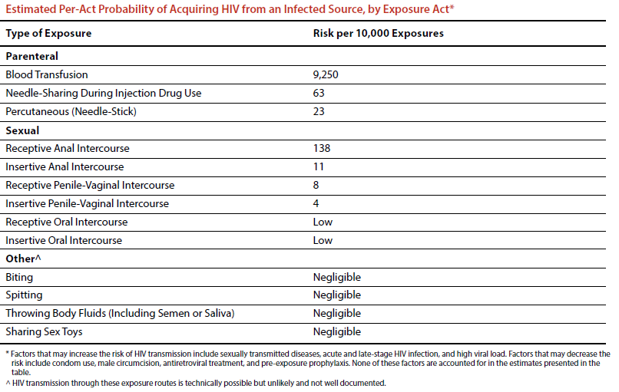

Slide 75
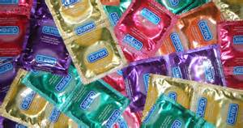
Condom Use Protection Against HIV
Consistent condom use with usual rates of breakage and slippage protects about 80% (with range: 35 to 94%)
  Estimates mainly based on heterosexual couples.
  Very few studies in MSM or with anal sex.
Holmes KK, Levine R, Weaver M. Effectiveness of condoms in preventing sexually transmitted infections. Bull World Health Organ. 2004 Jun;82(6):454-61. PMID: 15356939; PMCID: PMC2622864.

Slide 76
V. Pregnancy Plans
Do you have plans or desires to have (more) children?
  Do you have concerns around pregnancy?
  What are you doing to prevent pregnancy?
  Do you want information on birth control?
  Do you have questions about fertility options?

Slide 77
6 Essential Sexual Health Questions:
To Determine STD Screening/Treatment
Have you ever had any type of sex ?
  Oral, Vaginal, Anal?
When was the last time?
Are partners men, women, transmen, transwomen? How many (1 or more than 1)?
Do you use condoms/PrEP? Always, sometimes, never?
Any symptoms?
Were you exposed to any STDs that you know?

Slide 78
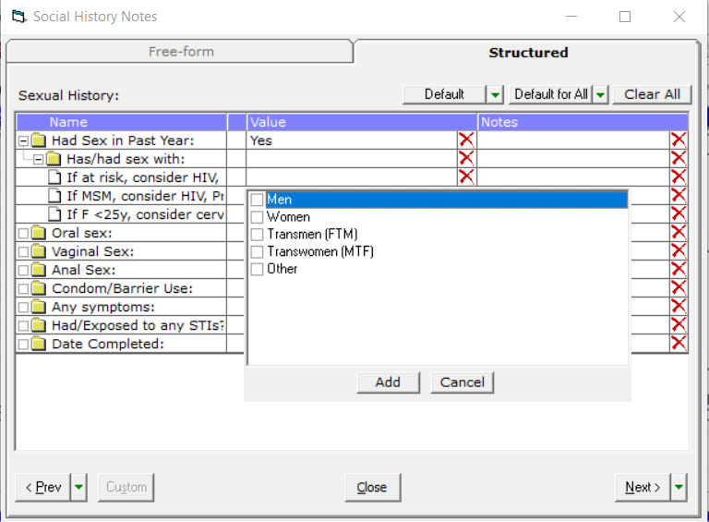

Slide 79
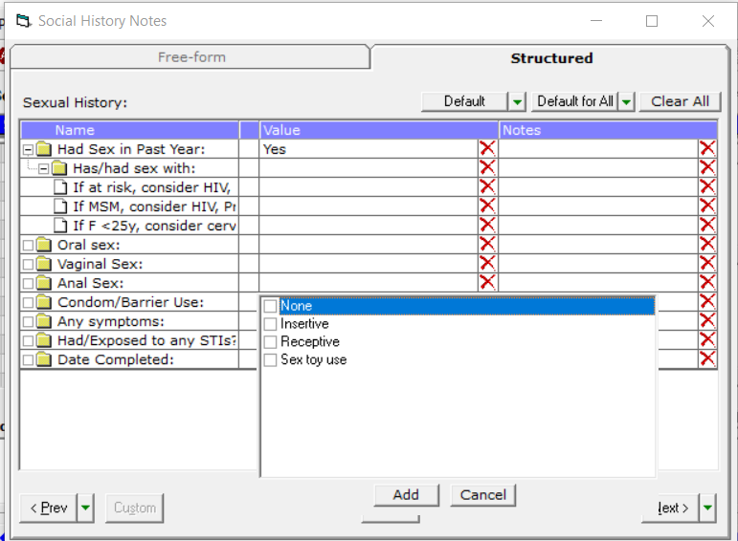

Slide 80
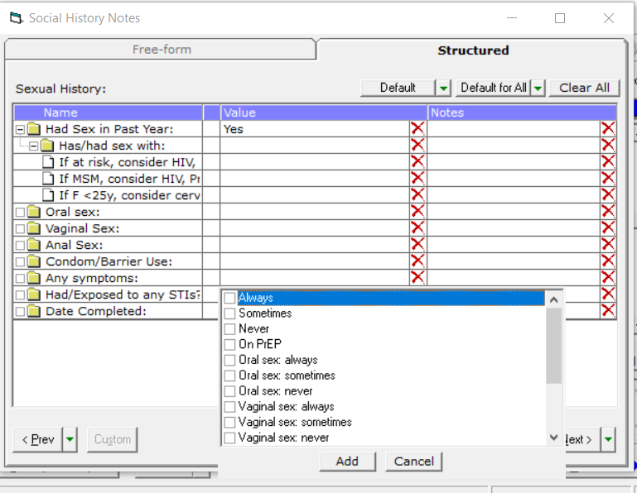

Slide 81
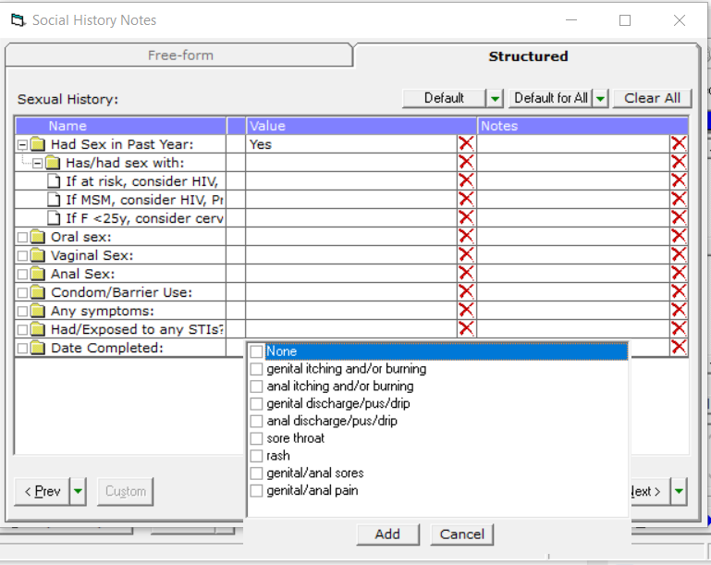

Slide 82
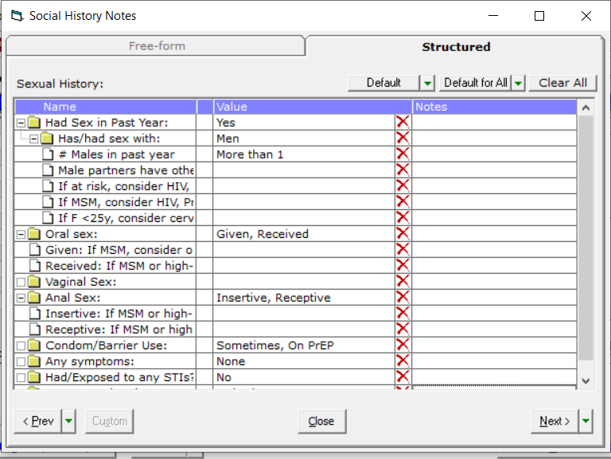
Example of Sexual Health Assessment

Slide 83
Questions?

Slide 84
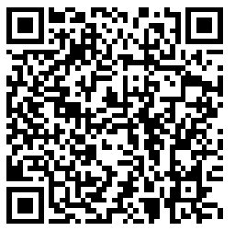
Next Steps
Agenda items for your meetings during this action period
Conduct internal team meetings and discuss how you will use the data from the SOGI and Sexual Risk Assessment tools in your electronic health record
Assignments
Set up process for collecting Sexual Orientation and Gender Identity (SOGI) (i.e. questionnaire, template in EHR, etc.)
Set up process for collecting Sexual Risk Assessment and STI Testing (i.e. portal, iPad, template in EHR, etc.)
CME and Resource Page
Access Code: HIV2024
https://education.weitzmaninstitute.org/content/nttap-hiv-prevention-learning-collaborative-2024
Notes:
Meaghan

Slide 85
NTTAP Contact Information
Amanda Schiessl
Project Director/Co-PI
Amanda@mwhs1.com
Bianca Flowers
Project Manager
flowerb@mwhs1.com
Meaghan Angers
Project Manager
angersm@mwhs1.com
REMINDER: Complete evaluation in the poll!
Upcoming Coach Calls: Monday March 4th & March 18th
Next Learning Session is Monday March 25th!
Notes:
Meaghan

Slide 86



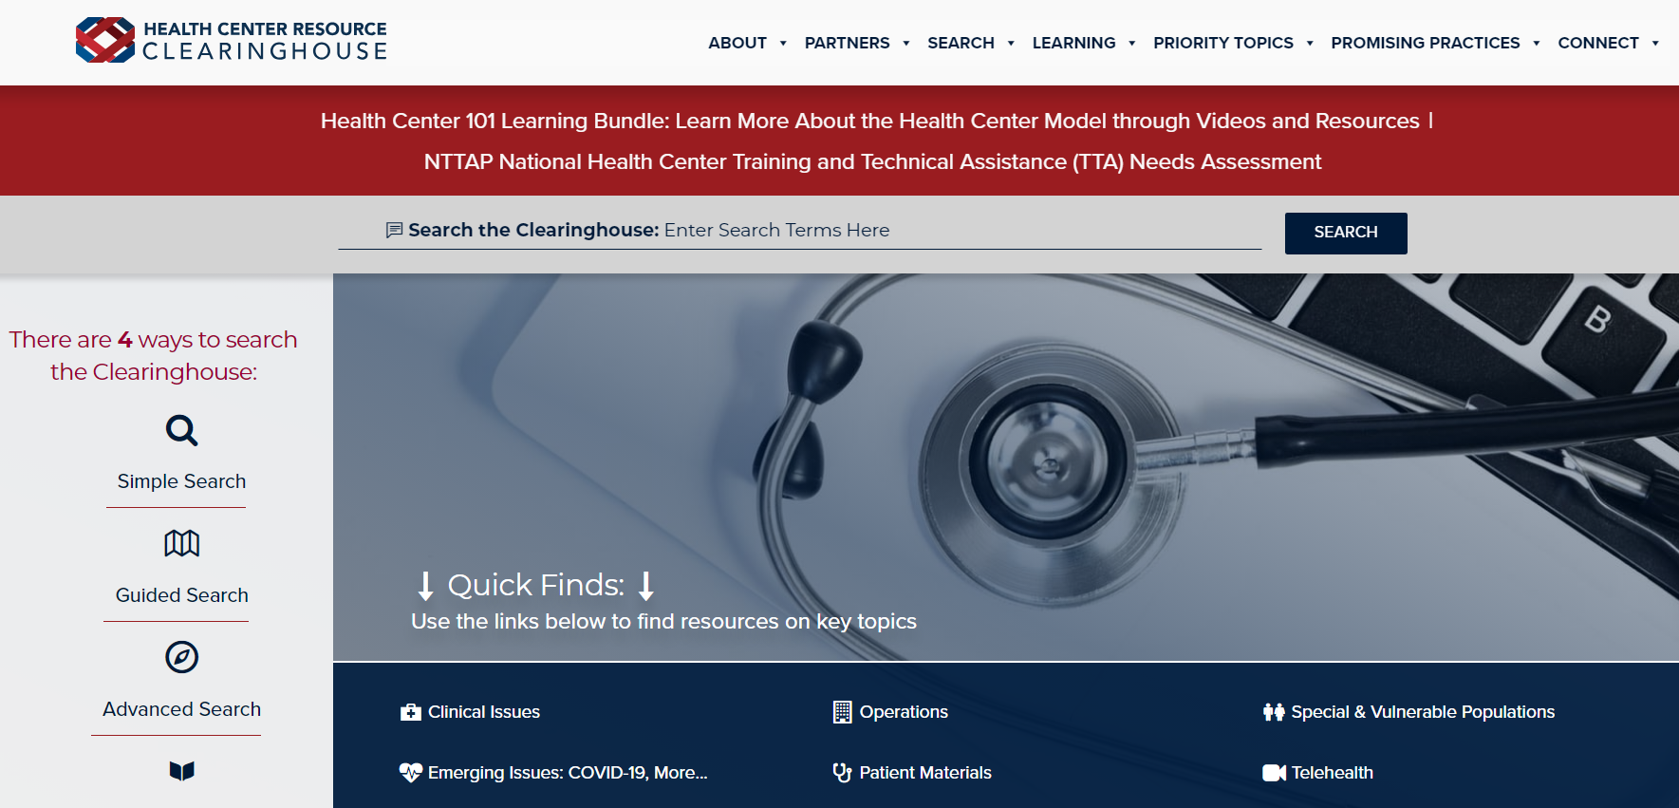
Explore more resources!
National Learning Library:
Resources for Clinical Workforce Development
Health Center
Resource Clearinghouse
https://www.weitzmaninstitute.org/ncaresources
https://www.healthcenterinfo.org/
86
Notes:
Meaghan

