Slide 1
Health Profession Student Training
Learning Collaborative
Session One: February 6th, 2024
Notes:
Meaghan

Slide 2
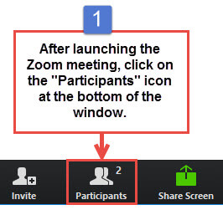
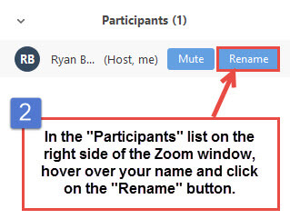
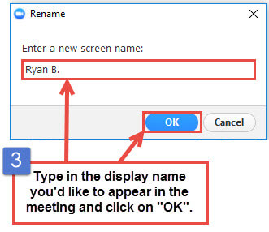
Get the Most Out of Your Zoom Experience
Please keep yourself on MUTE to avoid background/distracting sounds
Use the CHAT function or UNMUTE to ask questions or make comments
Please change your participant name to your full name and organization
“Meaghan Angers CHCI”
Notes:
Meaghan

Slide 3
Session 1 Agenda
3:00 – 3:15 | Introduction to CHCI, Collaborative Expectations, & Structure
3:15– 3:30 | Team Introductions: Part I
3:30 – 3:45 | Overview of Effective HPS Training Program, Playbook Guide, & Learning Collaborative Deliverables
3:45 – 4:00 | Team Introductions: Part II
4:00 – 4:25 | Play 1 and 2: Partnerships
4:25 – 4:30 | Q & A, Next Steps, Evaluation
Notes:
Meaghan

Slide 4
Community Health Center Inc. and NTTAP Introduction
Notes:
Meaghan

Slide 5
Learning Collaborative Faculty
Margaret Flinter, APRN, PhD, FAAN
Co-PI, NTTAP
CHCI’s Senior Vice President/Clinical Director
Amanda Schiessl, MPP
Co-PI & Project Director, NTTAP
Victoria Malvey
Interprofessional Student Specialist
Bianca Flowers
Project Manager, NTTAP
Meaghan Angers
Project Manager, NTTAP
Notes:
Meaghan

Slide 6
National Training and Technical Assistance Partners
Clinical Workforce Development
Provides free training and technical assistance to health centers across the nation through national webinars, learning collaboratives, activity sessions, trainings, research, publications, etc.
Notes:
Meaghan

Slide 7
Moses Weitzman Health System Affiliates
Notes:
Meaghan
Primary care has been at the heart of Community Health Center, Inc.’s (CHC) mission since its founding in 1972. Grounded in our mission, the Moses/Weitzman Health System (MWHS) was established to support exponential growth and continued innovation. The MWHS is the parent company of CHC; the Community eConsult Network, Inc. (CECN) d/b/a ConferMED; the National Institute for Medical Assistant Advancement (NIMAA); and the Consortium for Advanced Practice Providers. The Weitzman Institute (founded by CHC) is embedded in the MWHS. Each affiliate will continue to have its own board of directors and its own mission. The name of the health system honors Lillian Reba Hyman Moses (1924–2012) and Gerard (Gerry) Weitzman (1938–1999), who were among the earliest supporters and board members of CHC.

Slide 8
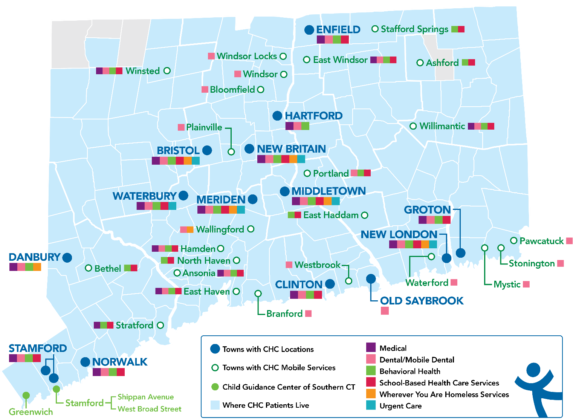
Locations and Service Sites in Connecticut
CHC Profile:
Founded: May 1, 1972
Staff: ~1,200
Total Patients Served: 102,275
Clinical Sites across CT: 19
SBHCs across CT: 180+
Students & Residents/year: 390
Three Foundational Pillars:
Clinical Excellence
Research & Development
Training the Next Generation
Notes:
Meaghan

Slide 9
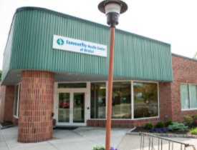
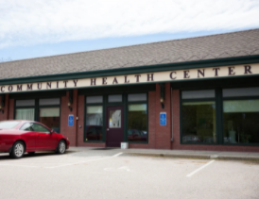
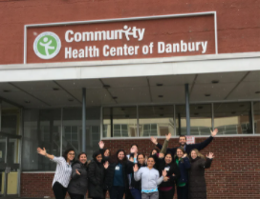
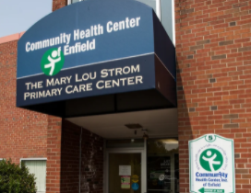
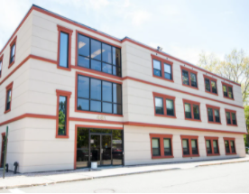
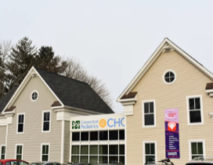
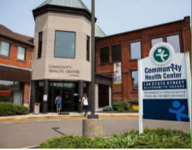
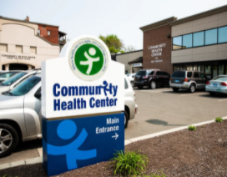
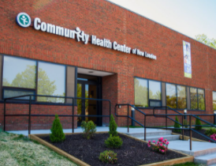
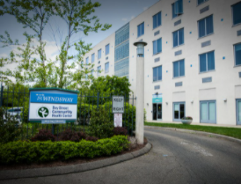
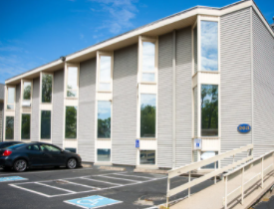
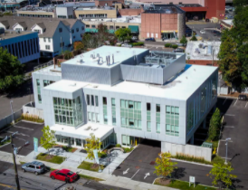
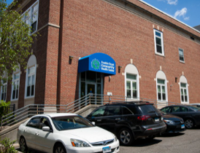
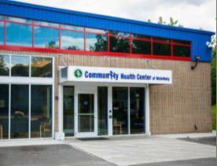
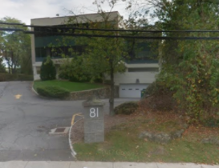
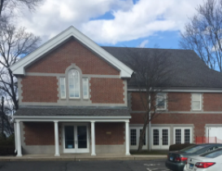
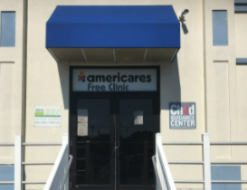
Notes:
Meaghan

Slide 10
CHC Student & Resident Overview: 2023
311 Students and Residents completed their placements at CHC in 2023
Student disciplines include non-clinical research, resident, and medical
Placements primarily onsite, with some remaining hybrid/remote
As of Fall 2023, began to implement stipends for NP and MD students
Notes:
Victoria

Slide 11
Collaborative Structure & Expectations
Notes:
Meaghan

Slide 12
Welcome to the Health Professions Student Training Learning Collaborative!
The Health Profession Student Training Learning Collaborative is a 6-month participatory learning experience offered by the National Health Center Training and Technical Assistance Partners (NTTAP) for Clinical Workforce Development, funded by the Health Resources and Services Administration, and hosted by Community Health Center, Inc. (CHCI) in Middletown, CT.
The Collaborative is designed to provide transformational strategies and coaching support to help health centers evaluate, replicate, and sustain a health profession student (HPS) training program.
Notes:
Meaghan

Slide 13
Objectives of the Learning Collaborative
Use assessment of their current readiness to train health profession students to identify areas for process improvement
Use quality improvement concepts and skills with coaching support to systematically establish a sustainable health professions student training program
Contribute to the learning among participating health centers by engaging in Learning Collaborative activities
Notes:
Meaghan

Slide 14
Learning Collaborative Structure
Six 90-minute Learning Collaborative video conference sessions
Bi-weekly calls between coach mentors and practice coach
Bi-weekly team workgroup meetings
Use Online Moodle Learning Network (Share Your Work, Resources, etc.)
Learning Session Dates
Learning Session 1 | Tuesday February 6th
Learning Session 2 | Tuesday March 5th
Learning Session 3 | Tuesday March 26th
Learning Session 4 | Tuesday April 16th
Learning Session 5 | Tuesday May 14th
Learning Session 6 | Tuesday June 11th
Notes:
Meaghan

Slide 15
Conditions of Success
Attendance at collaborative learning sessions and engagement in weekly coach/mentor calls
Engagement in work between sessions that included protected time to meet as a team, trust and respect.
Commitment of trained coaches to improving their skills and helping teams achieve results
Support of practice leadership for time, resources, spread and sustainability
Notes:
Meaghan

Slide 16
Coach Mentor and Team Coach Role
Role of Coach Mentor Amanda Schiessl & Victoria Malvey | Role of Team Coach
Meet with Team Coaches bi-weekly to discuss progress Work directly with Team Coach to identify successes and work through challenges/barriers. Mentors Team Coach on how to run an effective meeting for their team and develop their coaching skills Be available for individual sessions with Team Coaches for specific team and program development | Teach team how to prepare and facilitate effective meetings Provide coaching support between and during weekly internal team meetings Participate in bi-weekly Zoom calls with Coach Mentors to discusses progress, challenges, and stuck points. Help team follow timelines, complete assignments, and progress reporting Share team’s progress with the Coach Mentor and other Team Coaches during collaborative sessions
Notes:
Meaghan

Slide 17
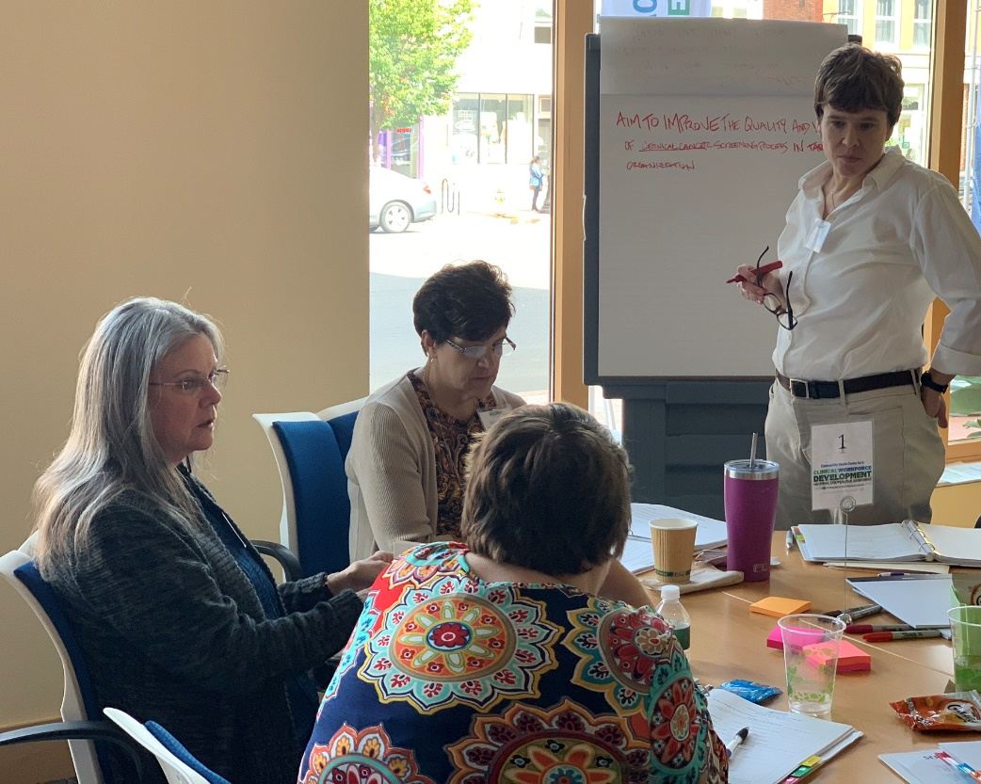
Team Coach Role
Help and support teams working together to use new skills , achieve their aims, document their work
Help teams complete assessments and action period assignments to stay on track
Help teams run effective weekly team meetings and facilitate teamwork
Notes:
Meaghan

Slide 18
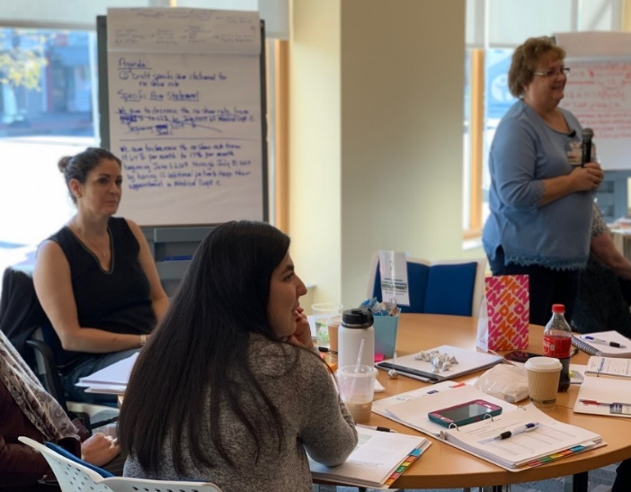
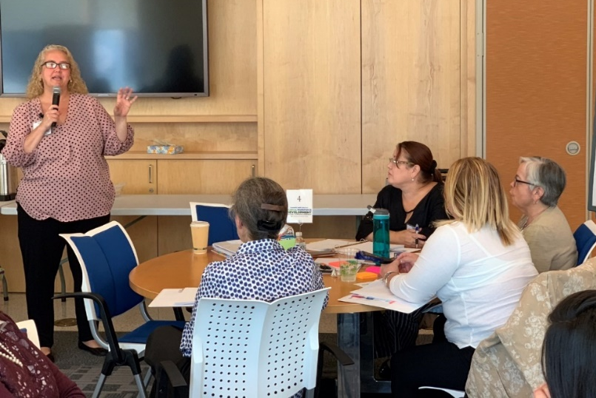
Bi-Weekly Coach Mentor Meetings
CHCI Coach Mentor Role: Amanda Schiessl & Victoria Malvey
Provide support and resources for developing coaching and improvement skills
Assess progress and address challenges, help teams stay on track
Provide individual support as needed
Notes:
Meaghan

Slide 19
2024 Cohort
Five Rivers Health Centers | Ohio
Jessie Trice Community Health Center | Florida
Northshore Health Centers | Indiana
Sun Life Health | Arizona
SWLA Center for Health Services | Louisana
Tepeyac Community Health Center | Colorado
Thundermist Health Center | Rhode Island
Upper Great Lakes Family Health | Michigan
Wellspace Health | California
Notes:
Meaghan

Slide 20
Team Introductions – Part 1
 | Order of Introductions
1 | Five Rivers Health Centers
2 | Jessie Trice Community Health Center
3 | Northshore Health Centers
4 | Sun Life Health
5 | SWLA Center for Health Services
Name of your practice, size, etc.
Names and positions of participating team members
Goals for the learning collaborative
Notes:
Team intros

Slide 21
Five Rivers Health Centers and Ohio Association of Community Health Centers

Slide 22
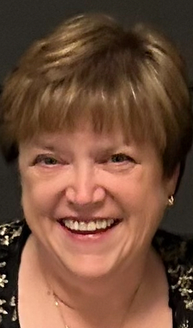
Five Rivers Health Centers
Rebecca Dupras
Clinical Nurse Educator
Goal for this educational opportunity is: To improve the current on-boarding process for Health Professions Students. To forge enhanced relationships with area programs that we partner with in student intern and externships. To explore the options of implementing our own training program for Medical Assistants.

Slide 23
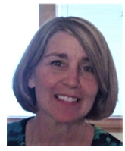
Ohio Association of Community Health Centers
Carrie Farquhar
Director of Workforce Development
Goal for this educational opportunity is: To improve the current HP-ET statewide program that OACHC administers and to be effective in planning for additional HP-ET programs we are developing.

Slide 24
JESSIE TRICE COMMUNITY HEALTH SYSTEM
Health Professions Student Training Learning Collaborative
Arianne Cordon-Duran, MD
Acordon-duran@jtchs.org
305-805-1700
www.JTCHS.org

Slide 25
ABOUT JTCHS…
Jessie Trice Community Health Center, Inc. (JTCHC) is one of Miami-Dade County’s preeminent federally qualified community healthcare centers, governed by a remarkably dedicated Board of Directors (51% of the members are users of the medical services) and a diverse, incredibly talented, committed family of providers and staff.
The Jessie Trice Community Health Center, Inc. is a Florida 501 (c) 3, not-for-profit, Federally Qualified Health Center, which has been serving Miami-Dade County since 1967. The target population is the uninsured and underinsured, 95% of which live at or below the Federal Poverty Level of 200%.

Slide 26
THE TEAM
Dr. Jocelyn Lawrence: Chief Medical Officer / DIO
Dr. Arianne Cordon-Duran Physician /Program Director
Gladys Opong-Tetteh, PhD Program Coordinator
Chantal Herron Medical Student Coordinator

Slide 27
GOALS FOR THE COLLABORATIVE
Mainstream processes related to medical student rotations at the organization (i.e., on-boarding, evaluations, policies)
Have similar processes in place for developing residency
Train educators and staff on these processes

Slide 29
Our Team
Amanda Trojanowski – Business Operations Manager
Meaghan McArdle – Director of Employee Relations
Lauren Marciniak – Senior Director of Business Operations
Miranda Redlark – Director of Executive Administration
Madeline Palichuk – Employment Manager
Raquel Hall – Executive Administrative Assistant

Slide 30
Our
Goals
Create a student program that allows the influx of students into NorthShore easily.
Establish a way to track students, their documents, and the time they will be at NorthShore.
Create a process of evaluation so that students can be considered for hire at NorthShore after completing their student program.
Create good communication channels for the program between students, providers, and administration.

Slide 32
Sun Life Education Admin Staff
Camena Johnson, BHA
Education Department Assistant
Matthew Bertsch, PharmD, 340B ACE, CPEL
Director of Education/Pharmacy

Slide 33
About Sun Life Health
FQHC and HRSA grantee
For over 40 years, Sun Life Health has been an integral part of providing health, wellness education and resources to the community, as well as playing an active role in improving the overall economic development of Pinal County.
In 1976, Sun Life Family Health started with one small office in Pinal County, staffed with one full-time and one part-time physician providing 12,000 patient visits per year. Today, as a non-profit Community Health Center Sun Life serves over 47,000 patients, 30 percent of whom are children.
Born out of the Community Health Center Movement that had been sweeping the country in effort to bring accessible, high quality and culturally effective healthcare to all people. We have an unfailing concern for the well-being of our patients, as we provide the best possible experience for every person that walks through our doors. This mission is echoed most in the following quote from the late health center movement leader, Wilford A. Payne (1945-2016).

Slide 34
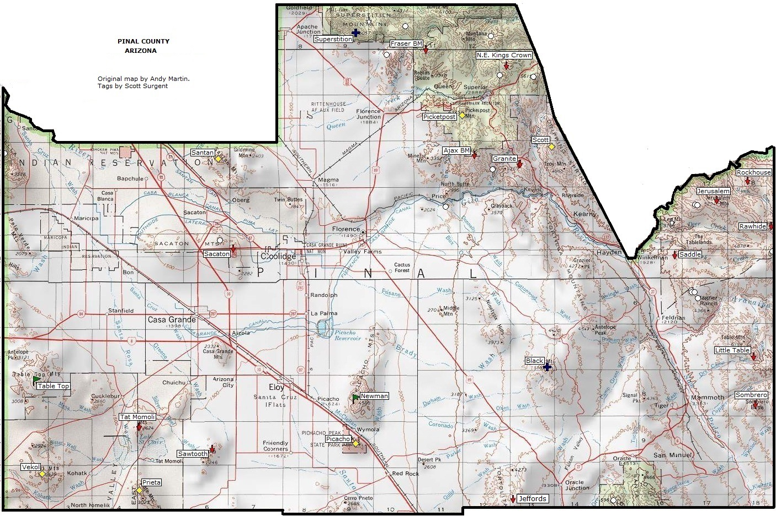
About Sun Life Health
14 Locations
8 In-House Pharmacies Owned by Sun Life
Some sites are over 100 miles apart
Some only medical or pharmacy in town
34
Pinal County, AZ

Slide 35
Pillars of Education
Education of Future Healthcare Workers
Residencies
Clinical and Nonclinical Rotations
Development of training programs
Education of Ourselves/Employees
Development and standardization of clinical training and internal workforce development programs
Support internal training initiatives
Education of Our Patients
Standardization of Patient Education materials
Development of additional initiatives around patient education
Education of the Community
Engage with the community to host educational events and seminars
Development of additional initiatives around community education

Slide 36
Goals of Participation
Meet likeminded organizations and gain insight into how they are operating their training programs.
Discover best practice models for tracking and onboarding student learners.
Discover best practices for retaining students as staff.
Implement models learned to enhance Sun Life’s Education Department.

Slide 37
HEALTH PROFESSIONS STUDENT TRAINING LEARNING COLLABORATIVE
SWLA CENTER FOR HEALTH SERVICES
Team Members:
Organization leadership representation- Paulette Lofton, MBA
Designated coach to lead the team through the work of the Collaborative- Dr. Latonia Miller-Harrison Direct oversight by the organization’s Director of Risk and Corporate Compliance- Sharon Dunbar, MSN RN Quality Improvement- Andre’ St. Julien, BSN, RN
Human Resources- Germaine Breaux, MS
Representation regarding the “Models to Train the Next Generation:
✴ Nurse Practitioner Residency and Fellowship Training Programs- Latoya Granger, APRN, FNP-BC
✴ Behavioral Health: Students, Externs, and Residents- Shannon Vallair, LPC-S
✴ Administrative Fellowship- Crystal Decuir MSN, RN-BC
✴ Medical Assistants: Serving as Externship Organization- Crystal Decuir MSN, RN-BC
✴ RN and MA student training programs- Crystal Decuir MSN, RN-BC

Slide 38
GOALS
SWLA Center for Health Services’ goals for participation in the Collaborative are as follows:
Identify the resources and tools required to implement an evidence-based training
program for various members of the healthcare community.
Develop a student-trained collaborative that is invaluable and a sustainable link between students, health care professionals, community health centers, academic institutions, community organizations, and the community.
Cultivate a student-trained program that provides service learning for students to gain practical experience in an interdisciplinary setting and cultural competence to increase access to culturally appropriate health services.
Create a comprehensive health training program to serve as a pipeline for health
professionals.

Slide 39
Overview of an Effective HPS Training Program
Notes:
Amanda

Slide 40
Strategic Workforce Planning
CHC has followed three common pathways:
Establishing relationships with academic partners for pre-licensure training
Sponsoring program for postgraduates (MD, NP, PA, Post Doc), and
Incorporating opportunities for certificate level training (MA).
Notes:
Amanda

Slide 41
Health Center Team Accomplishments
Developed a standardized affiliation agreement template for academic partners with direct oversight by the organization’s Director of Risk and Corporate Compliance
Standardized the learner experience across all departments and promoted interdisciplinary learning across the health center (e.g. uniform application and onboarding process, IT system access)
Created tools to evaluate student capacity and effectiveness of the training program
Successfully implemented a playbook and passed it off to the incoming Student Coordinator
Equipped learners to be interested in a career in a community health setting
Notes:
Amanda

Slide 42
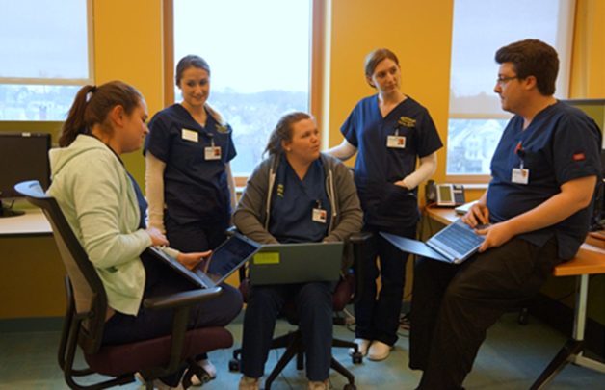
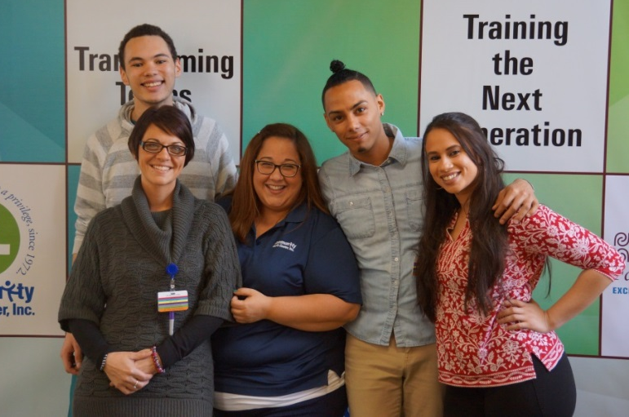
Essential components to organizing and supporting safe, high quality, satisfying, and productive educational and training experiences
Identify your wishes and priorities
Identify your capacity
Identify your infrastructure requirements
Nurse Manager, Patrick Murphy, with Quinnipiac University DEU Nursing Students
CHC/NIMAA Inaugural Medial Assistants
Notes:
Amanda
It’s important to begin by identifying the essential components to organizing and supporting safe, high quality, satisfying, and productive educational and training experience.
The first step would be to identify the goals you would like to achieve with developing a process for hosting students at your health center.
Identify your wishes and priorities:
Which professions/work group?
Which schools/universities /training programs?
Which sites/preceptors?
An important step in minimizing burden is by identifying your capacity.
Identify your capacity:
How many sites?
How many preceptors?
How many hours/days?

Slide 43
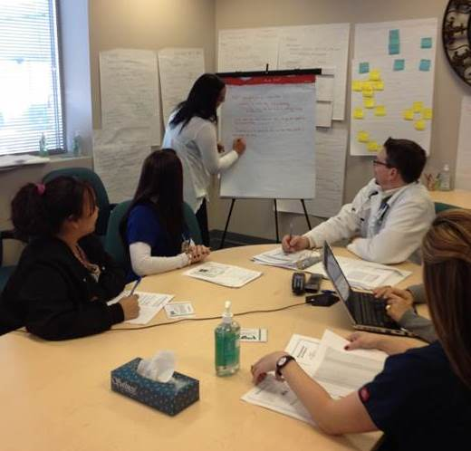
Scaling Up: Making It Work Assemble a team and a coach
Create a process map of the student experience from start to finish
Develop a comprehensive “playbook” to solidify the program and process to use as a base for continual improvement
Working towards creating a strong quality improvement infrastructure including coaches
CHC Clinical microsystem goes to work on designing a system
Notes:
Amanda
Consider: Assembling a team and a coach
Create a process map of the student experience from start to finish
Develop a comprehensive “playbook” to solidify the program and process to use as a base for continual improvement
We hope that everyone is working towards creating a strong quality improvement infrastructure including coaches
If you don’t, identify someone that can coach or reach out to the NCA for additional resources on process mapping

Slide 44
Healthcare Students Playbook
Purpose: Tool to promote a highly organized, streamlined, and efficient process that supports the needs of the organization, the academic/training institutions, and the students
Notes:
Amanda
Purpose: To promote a highly organized, streamlined, and efficient process that supports the needs of CHC, the academic/training institutions, and the students.
A process map that was created will be used to walk you all through some important plays from our playbook.

Slide 45
Learning Collaborative Road Map
Notes:
Amanda

Slide 46
Team Introductions – Part 2
 | Order of Introductions
6 | Tepeyac Community Health Center
7 | Thundermist Health Center
8 | Upper Great Lakes Family Health
9 | Wellspace Health
Name of your practice, size, etc.
Names and positions of participating team members
Goals for the learning collaborative
Notes:
Team intros

Slide 47
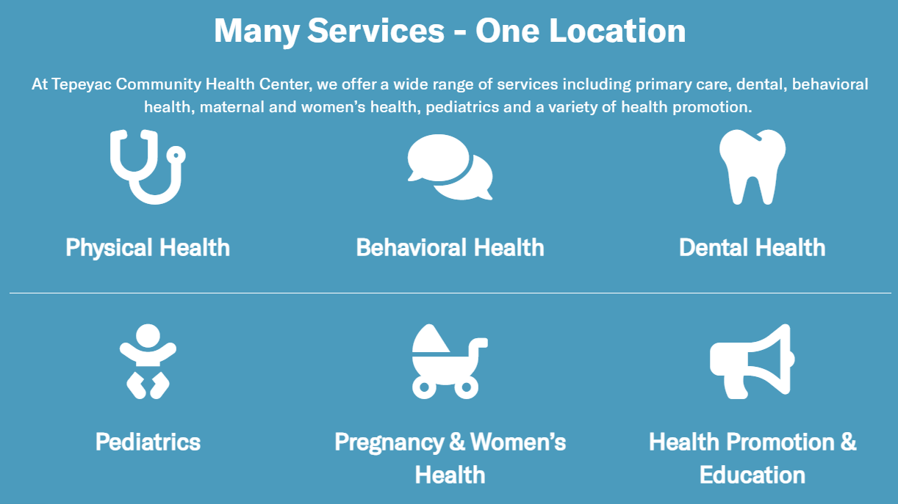
Inspiring health, wellbeing, and humanity in our community, through all of life’s stages.
Tepeyac Community Health Center is a non-profit community health center in Denver, CO, that has provided affordable and accessible integrated care for more than 25 years.
Our team’s goal is to build meaningful and sustainable health professions student training programs to continue Tepeyac’s rich history of caring for underserved families and individuals with love, humor, and humility.
Tepeyac Community Health Center 2101 E. 48th Ave Denver, CO 80216

Slide 48
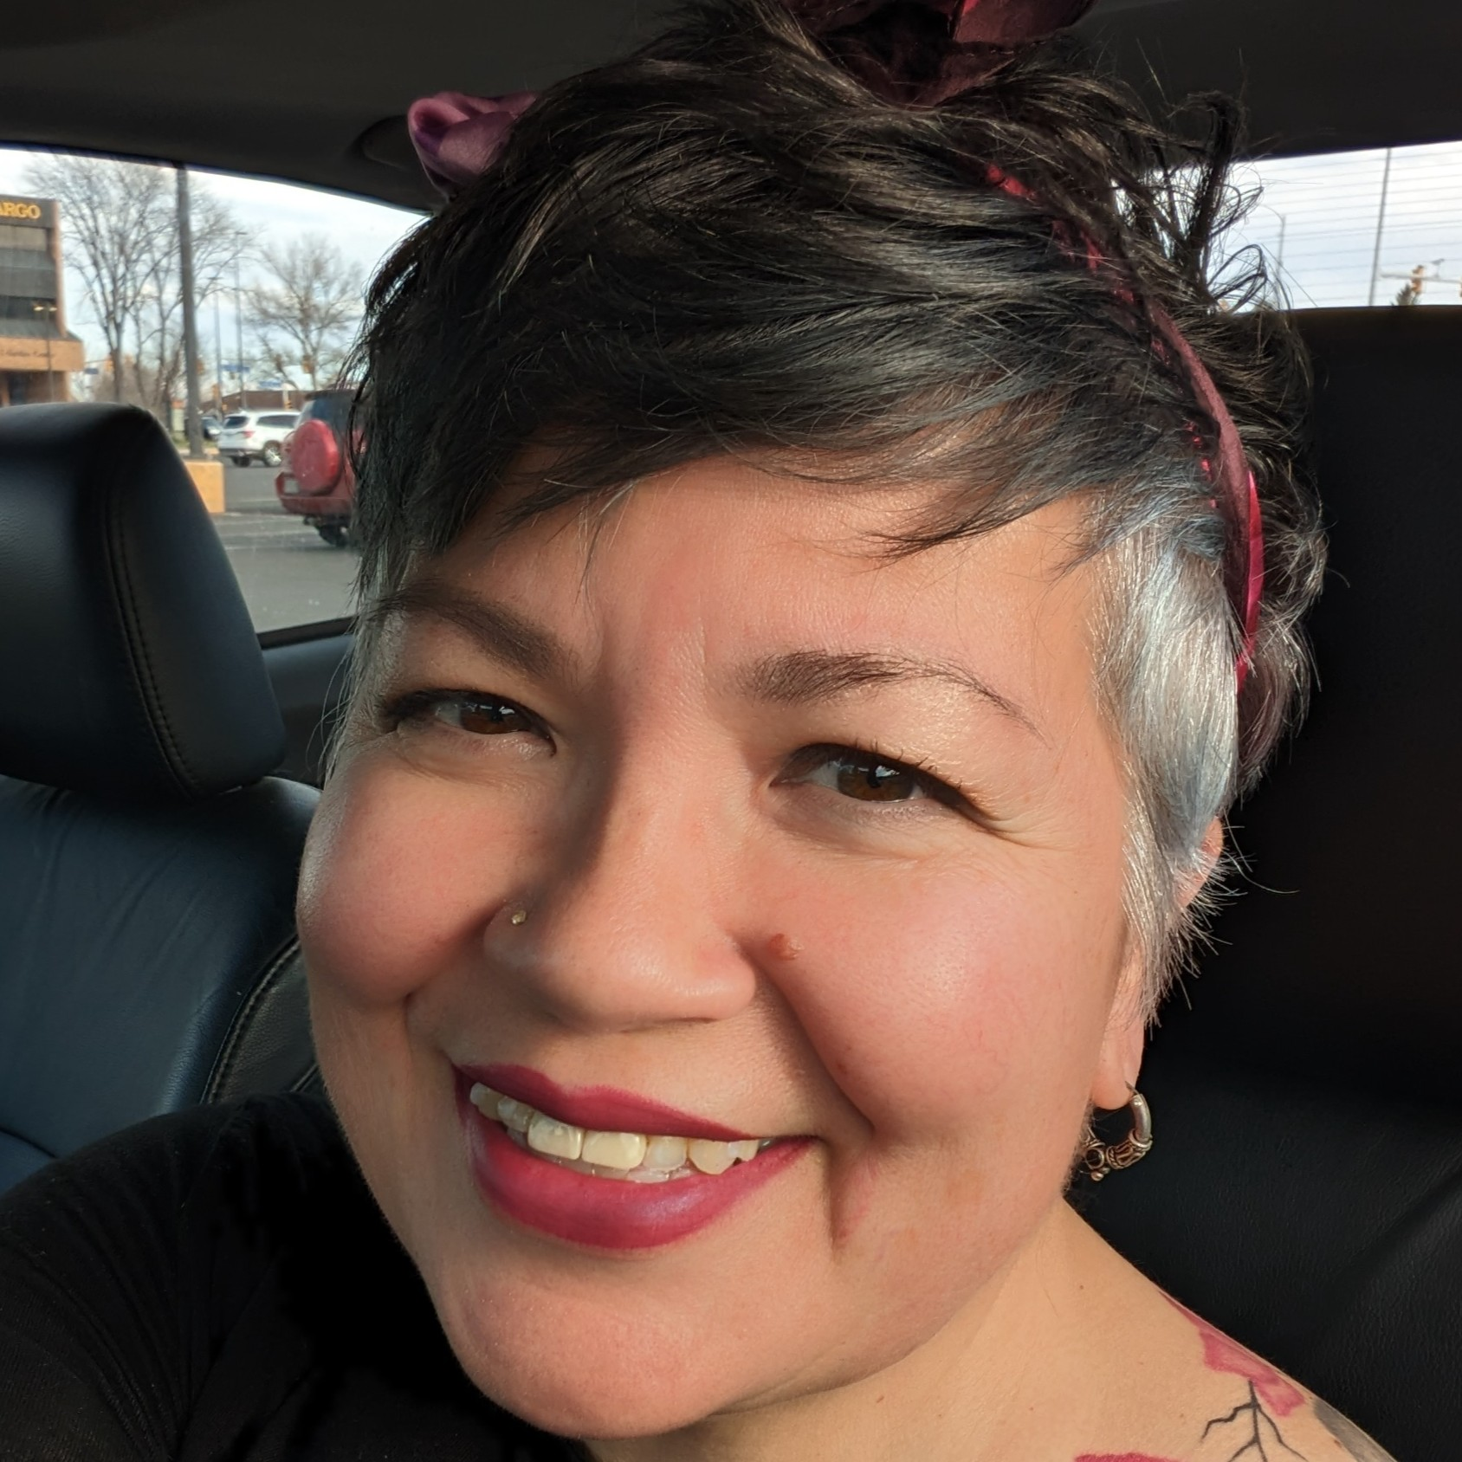
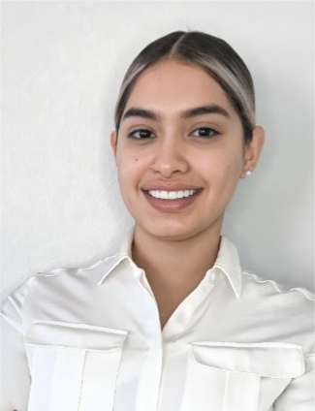
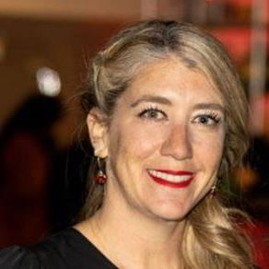
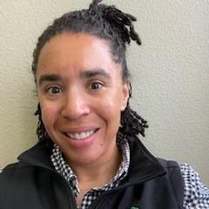
Tepeyac’s Core Team
Gina Middleton
HR Manager – Opportunity Now
Team Coach
Erika Delgado
HR Coordinator - Opportunity Now
Mili Vazquez Pereira
Senior Director, People & Culture
Amber Mozet
HR Manager

Slide 49
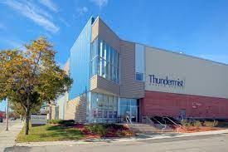
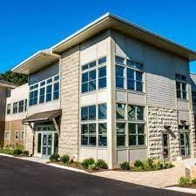
THUNDERMIST HEALTH CENTER
Woonsocket, RI
Warwick, RI
Wakefield, RI
Thundermist Student Trainee Programs & Partnerships
Medical Students
UG Nursing
Graduate Nursing
UG Nursing
UG Social Work
Graduate Social Work
Community Health Workers
Medical Assistants Dental Assistants Dental Hygienists
Dental Medicine Students

Slide 50
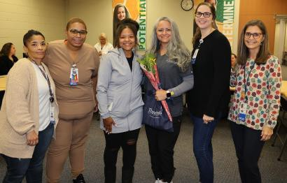
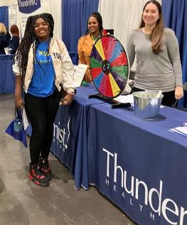
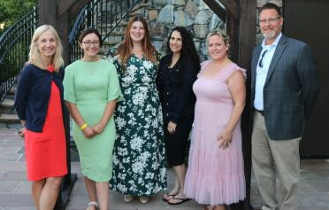
Learning Collaborative Team
Claire Haynes, BSN, RN is the Senior Director of Clinical Initiatives, with over 12 years of dedicated service as a staff nurse at Thundermist. Over the past 9 years, she has held leadership positions, supporting site nurses and medical assistants as Director/Senior Director of
Nursing. Following challenges brought on by COVID-19, Claire’s role has evolved to focus significantly on workforce development including efforts to sustain staffing levels and establish new pathways for the recruitment and development of medical assistants and nurses.
Jennifer Gaviria MSW, LICSW is the Director of Behavioral Health Workforce Development at Thundermist, bringing over 7.5 years of dedicated service to the organization. Since 2019, she has successfully overseen and mentored cohorts of 6-8 Bachelor of Social Work (BSW) and Master of Social Work (MSW) students, contributing significantly to their professional growth. Jennifer is committed to enhancing the internship program by streamlining processes and prioritizing sustainability for a lasting impact on Thundermist's behavioral health initiatives.
Andrew Jarbeau is the Associate Vice President of Human Resources, previously the Director of Talent Acquisition. Since starting a Thundermist 1.5 years ago, Andrew has been instrumental developing recruitment strategies resulting in significant organizational growth. He has redesigned a loan repayment guarantee program and implemented a technology platform allowing employees access to loan forgiveness. Andrew is committed to prioritizing impactful employee retention and recruitment strategies.
Amy Weinstein is the Director of Workforce Development at Thundermist. Amy began in her newly created role one year ago to manage a Congressional Appropriation grant which provided training, certification and degree attainment to Dental & Medical Assistants; RN’s and Behavioral Health professionals. Amy’s role has evolved to sustain, grow and develop workforce programs organization-wide with a focus on developing partnerships and creating career pathways for employees and community members.

Slide 51
Shelby Santti, Program Director and Danielle Taseris, Human Resources Director

Slide 52
INTRODUCTION
Upper Great Lakes Family Health Center (UGL) is a Federally Qualified Health Center in Michigan’s rural and medically underserved Upper Peninsula including 12 clinics in 10 different locations offering primary care, behavioral health, pediatrics, women’s health, senior health, dental, sports injury, and school-based services.
The Upper Peninsula Area Health Education Center (UP AHEC) is a Health Resources Services Administration (HRSA) grant funded organization in which UGL is the host partner.
Community Based Student Education
Workforce Development
Pipeline Programs
Recruitment/Retention
Goals? To learn ways in which we can improve our already existing health professions student training program

Slide 54
Everybody deserves to be seen, no matter who you are, where you come from, where you work or what place you call home.

Slide 55
Mission
WellSpace Institute
WellSpace Institue is a non-profit training and education institute created to uplift historically disenfranchised communities through healthcare workforce programs and initiatives. WellSpace has successfully graduated students from its healthcare leadership program, medical assistant certificate program, and Community Health Worker certificate program.
Achieving regional health through high quality comprehensive care.

Slide 56
WellSpace Health Team
Tina Frushour, Health Professions Manager
Jessica Poage, Administrative Assistant to Medical Directors
WellSpace Institute Programs
FNP Clinical Practicum
Preceptorship Programs
Extern Placements
Intern Placements
Coming Soon: NP/PA Fellowship Program

Slide 57
Plays 1 and 2: Partnerships
Notes:
Victoria

Slide 58
Playbook Overview
Play 1: Partnership Approval and Communications with Schools
Play 2: Affiliation Agreement Management
Play 3: Student Capacity
Play 4: Initiating the Onboarding of a Student
Play 5: Communication with Student
Play 6: Student is Trained
Play 7: Student Arrives
Play 8: Student Documentation and Reporting
Play 9: Off-boarding
Notes:
Victoria

Slide 59
Choosing Partners
Your current state:
Respond to individuals requests via varied pathways
Future state recommendations:
Identify one individual to respond to all application questions and requests (e.g. Executive Assistant, HR Coordinator)
Determine who will assess and review school affiliation requests (e.g. group of stakeholder leaders who determine strategic value of each relationship)
Notes:
Victoria
Current state – it’s happening, but for future consider

Slide 60
Restructuring Communication with Partners
Begin to prepare existing partnerships on the new process
Prepare to collaborate with contact personnel at academic institution to complete forms, contract/agreement or addendums in regards to existing partnerships and new
Work with clinical leadership team to determine current and future site capacity to accommodate placements overall to make determinations on affiliations
Notes:
Victoria

Slide 61
Communication Plan: Lateral and Vertical
Purpose: To keep stakeholders apprised of and engaged in your work
Most clinical entities in the organization will be affected by the presence of students, trainees, interns and/or residents: you need their support
Who, what, when, where, why, how (template on the Weitzman Education Platform)

Slide 62
Strategy Around Partnership Review and Approval
Decision to affiliate with university can be based on some of the following:
Geography
Ranking
Strategic partnership
Capacity for requested discipline
Current staff alumni
Willing and available preceptors
Contributions to pipeline
Ability to contribute stipends/compensation for students
Notes:
Victoria

Slide 63
Best Practices for Communicating with Academic Partners
Maintain clear and constant communication on expectations on capacity and possibility for placements
Continue to respond accordingly to all application questions including providing updates
An affiliation agreement creates the foundation to accept requests for placement – NOT committing to placements
Notes:
Victoria

Slide 64
Recommended Components to Include in Affiliation Agreement
Start/end date
School assumes responsibility to assure infection control/immunization/health statement requirements are met
Termination procedure
Contact information
Liability insurance
Emergency process
Student's learning objectives (Very important to have these objectives on file to ensure appropriate response to supplemental learning opportunities)
Confidentiality/privacy
Stipend/compensation information (if applicable)
Notes:
Victoria

Slide 65
Affiliation Agreement Management & Addendums
Development of a process, system and location for affiliation agreement storage
Ensure affiliation agreements are up to date
Organization Template for Clinical and Non Clinical Affiliation Agreements & Addendums
Notes:
Victoria

Slide 66
Key Takeaways
Structured and efficient communication
Process for strategic decision making
Effective affiliation agreements that outline the responsibilities of each partner
Organized processes for maintaining and storing affiliations
Development of a strong foundational process that is maintained overtime
Notes:
Victoria

Slide 67
Questions?

Slide 68
Next Steps
Agenda items for your meetings during this action period
Meet with key stakeholders to discuss play 1 and 2 in the HPS Training Playbook Guide
Complete the Organizational Readiness to Implement Change (ORIC) and Readiness to Train Assessment (RTAT)
Draft a Goal, Value and Aim Statement
Assignments
Review and adapt the affiliation agreement template
Draft and submit plays 1 and 2
CME and Resource Page
Access Code: HPS2024
https://education.weitzmaninstitute.org/content/nttap-health-professions-student-training-learning-collaborative-2024
Notes:
Meaghan

Slide 69
NTTAP Contact Information
Amanda Schiessl
Project Director/Co-PI
Amanda@chc1.com
Bianca Flowers
Project Manager
flowerb@chc1.com
Meaghan Angers
Project Specialist
angersm@chc1.com
REMINDER: Complete evaluation in the poll!
Upcoming Coach Calls:
Tuesday February 13th and Tuesday February 27th
Next Learning Session is Tuesday March 5th!
Notes:
Meaghan

Slide 70
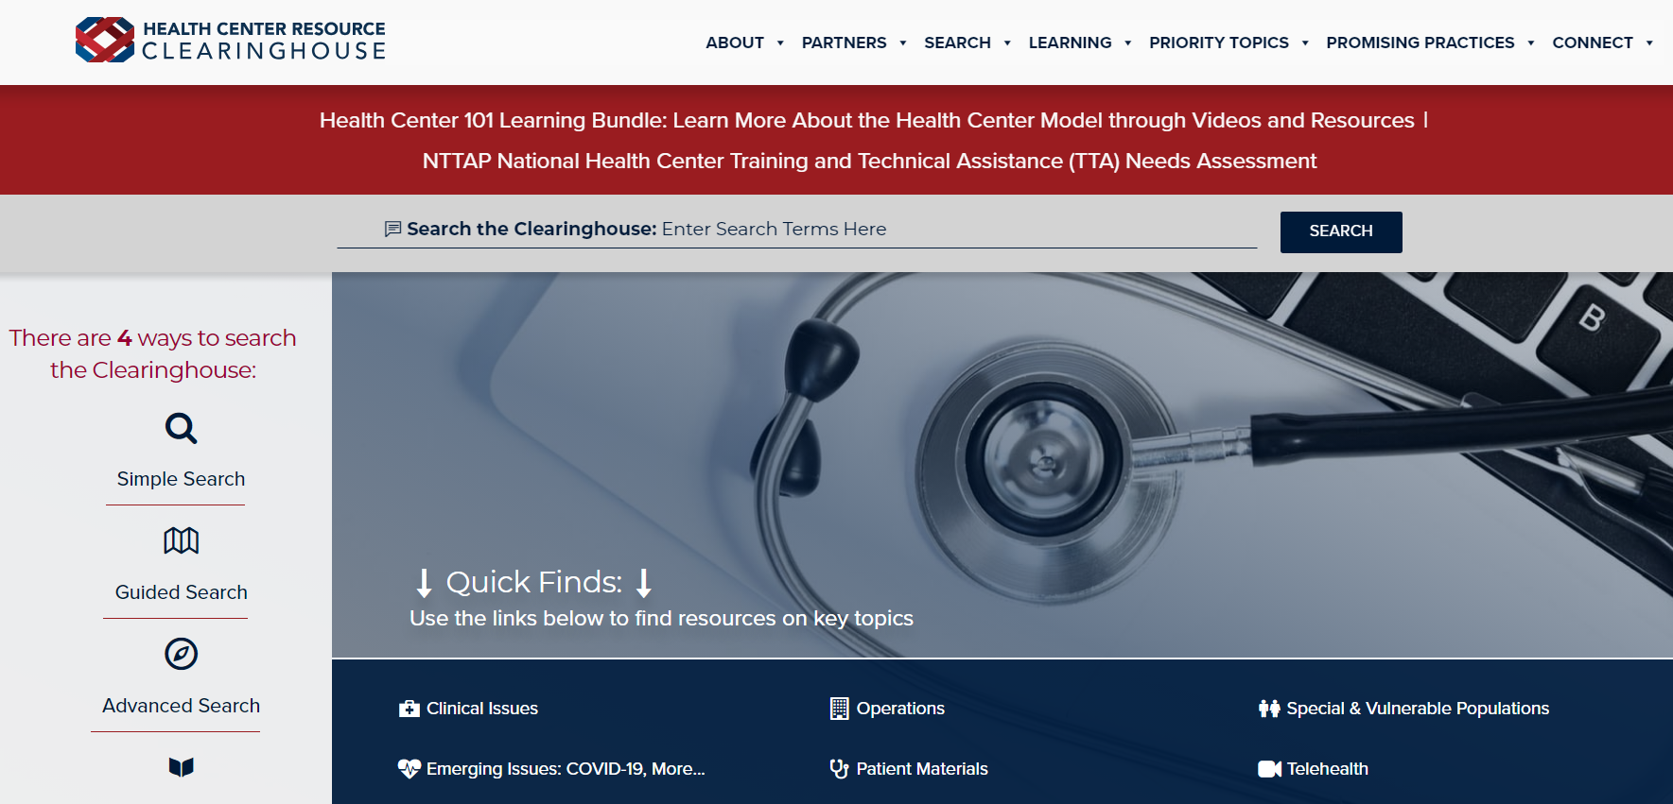
Explore more resources!
National Learning Library: Resources for Clinical Workforce Development
Health Center
Resource Clearinghouse
https://www.weitzmaninstitute.org/ncaresources
https://www.healthcenterinfo.org/
70
Notes:
Meaghan

