Slide 1
Postgraduate Nurse Practitioner Residency & Fellowship Program Learning Collaborative
Session Four: Tuesday February 13th, 2024
Notes:
Meaghan

Slide 2
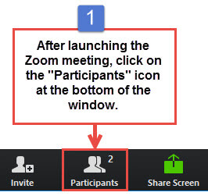
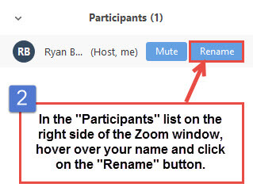
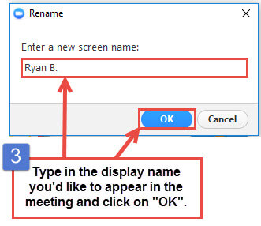
Get the Most Out of Your Zoom Experience
Please keep yourself on MUTE to avoid background/distracting sounds
Use the CHAT function or UNMUTE to ask questions or make comments
Please change your participant name to your full name and organization
“Meaghan Angers CHCI”
Notes:
Meaghan

Slide 3
Session 4 Agenda
1:00-1:05 | Introduction and Agenda
1:05-1:20 | Finances, Sustainability, and Return on Investment
1:20-1:35 | Contracts and Agreements Program Policies
1:35-1:55 | Curriculum Development Overview
1:55-2:10 | Didactics Presentation Training
2:10-2:25 | Postgraduate Residency Simulation Training
2:25-2:30 | Q/A, Wrap-Up and Evaluation
Notes:
Meaghan

Slide 4
National Training and Technical Assistance Partners
Clinical Workforce Development
Provides free training and technical assistance to health centers across the nation through national webinars, learning collaboratives, activity sessions, trainings, research, publications, etc.
Notes:
Meaghan

Slide 5
Learning Collaborative Faculty
Margaret Flinter, APRN, PhD, FAAN
Co-PI, NTTAP
CHCI’s Senior Vice President/Clinical Director
Director Emeritus, WI, Senior Investigator
Founder of America’s first nurse practitioner residency program
Kerry Bamrick, MBA
Executive Director, Consortium for Advanced Practice Providers
Coach Mentor
Charise Corsino, MA
Program Director, NP Residency Programs
Coach Mentor
Nicole Seagriff, DNP, APRN, FNP-BC
Clinical Program Director
Kathleen Thies, PhD, RN
Consultant, Researcher
Evaluation Faculty
Amanda Schiessl, MPP
Co-PI & Project Director, NTTAP
Bianca Flowers
Project Manager, NTTAP
Meaghan Angers
Project Manager, NTTAP
5
Notes:
Meaghan

Slide 6
Learning Collaborative Structure
Six 90-minute Learning Collaborative video conference sessions
Bi-weekly calls between coach mentors and practice coach
Bi-weekly team workgroup meetings
Use the Weitzman Education Platform (Share Your Work, Resources, etc.)
Learning Session Dates
Learning Session 1 | Tuesday November 21st
Learning Session 2 | Tuesday December 19th
Learning Session 3 | Tuesday January 16th
Learning Session 4 | Tuesday February 13th
Learning Session 5 | Tuesday March 5th
Learning Session 6 | Tuesday April 2nd
6
Notes:
Meaghan

Slide 7
2023-2024 Cohort
Bartz-Altadonna Community Health Center | California
Charles B. Wang Community Health Center | New York
Chase Brexton Health Care | Maryland
Community Clinic Association of Los Angeles County (CCALAC) | California
Crossing Healthcare | Illinois
Hope Christian Health Center | Nevada
Klamath Health Partnership | Oregon
Nasson Health Care | Maine
Neighborhood Outreach Access to Health | Arizona
Peninsula Community Health Services | Washington
Penobscot Community Health Center, Inc. | Maine
Primary Health Network | Pennsylvania
WellSpace Health | California
Wheeler Health | Connecticut
7
Notes:
Meaghan

Slide 8
Finances, Sustainability, and Return on Investment

Slide 10
Resources
Finances, Sustainability, and Return on Investment
Bob Block, Former CHCI Chief Financial Officer, Presentation
Danielle Potter, APRN Residency Program Director at El Rio Health, Presentation
Alan Wengrofsky, Community Health Care Network CFO, presentation at the 2023 Consortium for Advanced Practice Providers Conference
CHAS Health – Lesson Learned in Finances and Operations
Training the Next Generation Book – Chapter 5
Pro Forma Analysis template available for download on the Weitzman Education Platform
Matthew Roman, Chief Operating Officer of Thundermist Health Center, will be attending the coaching call on March 12th

Slide 11
Introduction to Contracts/Agreements

Slide 12
Contracts & Agreements
Immediately following the offer provide selected candidates with a formal employment contract.
Determine method of delivery (electronic or direct mail) and length of time to return signed contract
The contract can be a modified version of your organization’s existing employment contract. Items that may differ in the contract include:
Will your program has a post residency contractual commitment?
Term of the contract- 12 month residency program
Practice location
Salary
PTO
CME
Employment requirement post residency year- determine length of commitment and subsequent year salaries.

Slide 13
Program Policies & Procedures

Slide 14
Program Policies & Procedures
Stepwise Increase of APRN Resident Clinical Scheduling Policy
NP Residency Program Precepting Policy
NP Residency Program Assessment of Training Sites
CHCI Clinical Guidelines for Medical Providers
CHCI Formal Residency Agreement
CHCI HR Personnel Records Policy
CHCI Disciplinary Action Process Policy
CHCI Grievance and Due Process Policy
Applicant Process for CHCI’s Nurse Practitioner Residency Training Program
CHCI Benefits Overview
CHCI Employment Health Documentation Requirements
Employee Infection Control Levels Policy
Universal Flu Prevention Policy
IC HR Employee Tuberculosis Screening Policy
Non Discrimination Policy
*Items highlighted are policies that come from your organization and can be used in full or modified to meet the program needs

Slide 15
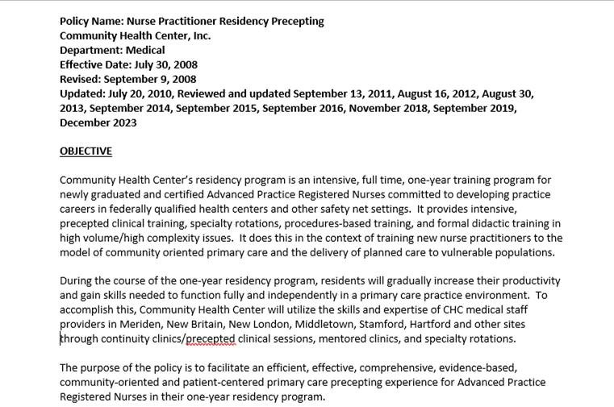
Precepting
Policy

Slide 16
Formal Agreement

Slide 17
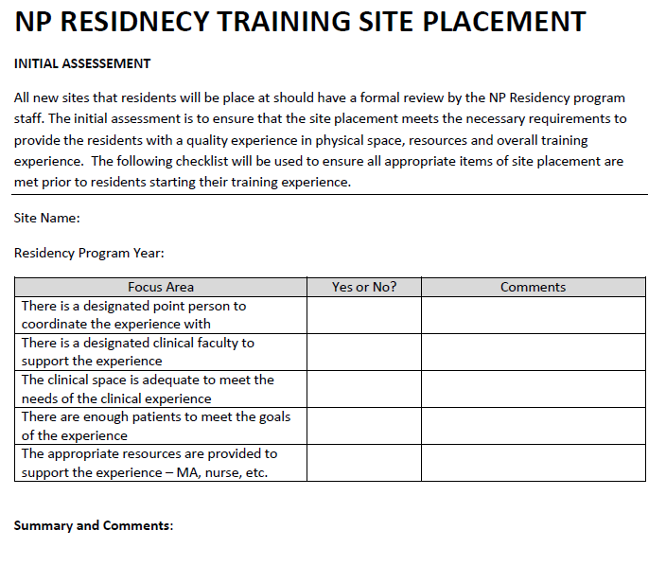
Assessment of Training Sites

Slide 18
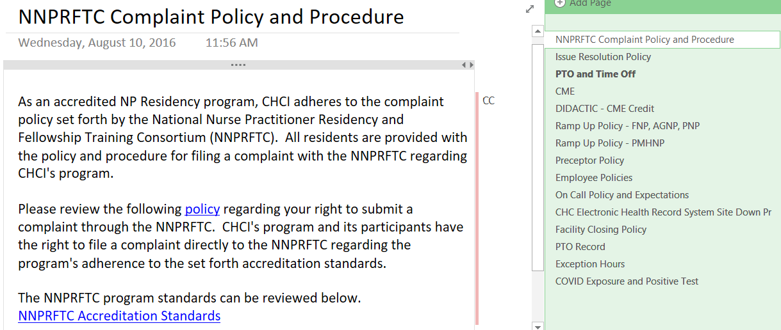
Sharing Policies and Procedures with your Trainees

Slide 19
Curriculum Development:
Program Goals and Objectives

Slide 20
Consortium for Advanced Practice Providers The Standards
Standard 1 – Mission, Goals and Objectives
Standard 2 – Curriculum
Standard 3 – Evaluation
Standard 4 – Program Eligibility
Standard 5 – Administration
Standard 6 – Operations
Standard 7 – Staff
Standard 8 – Postgraduate Trainee Services
https://www.apppostgradtraining.com/wp-content/uploads/2023/02/Accreditation-Standards-2023.pdf

Slide 21
Consortium for Advanced Practice Providers Standard 2: Curriculum
Clinically based practice and patient care experience
Regularly scheduled didactic sessions
System-based learning and quality improvement
Population-based health focus
Technology
Equity and social justice
Leadership and professional development
Social Determinants of Health (SDOH)
Certificate of Completion
https://www.apppostgradtraining.com/wp-content/uploads/2023/02/Accreditation-Standards-2023.pdf

Slide 22
Consortium for Advanced Practice Providers
Competency Domains
Patient-centered Care
Knowledge for Practice
Practice-Based Learning and Improvement
Interpersonal and Communication Skills
Professionalism
Systems-Based Practice
Interdisciplinary Collaboration
Personal and Professional Development
Technology and Telehealth
Diversity, Equity, and Inclusion
https://www.apppostgradtraining.com/wp-content/uploads/2023/02/Accreditation-Standards-2023.pdf

Slide 23
Core Elements of a Postgraduate NP Residency
12 Months Full-time Employment | Training to Clinical Complexity and High Performance Model of Care team-based care, inter-professional collaboration, integrated care, data driven QI ,expert use of technology | Full Integration into Home Site and Organization
Precepted Continuity Clinics (40%); Residents develop and manage a panel of patients with the exclusive attention of an expert preceptor (NP, PA or Physician) Specialty Rotations (20%); Experience in primary care specialty areas to expand and enhance resident practice knowledge and skills Mentored Clinics (20%); Work within a primary care team focusing on diversity of chief complaints, efficiency, episodic and acute care Didactic Sessions (15%); Topics that are high volume, complexity and/or burden topics in primary care. Includes participation in Project ECHO sessions for managing chronic pain, treating HIV/Hep C, opioid addiction, complex pediatrics Quality Improvement Training (5%); Training to a high performance QI model, including front line QI improvement, data driven QI, and leadership development.
Notes:
Charise

Slide 24
Program Mission
Program Goals and Objectives
Learner Outcomes
Competencies and Curriculum Objectives
SPECIFICITY

Slide 25
Goals and Objectives: Program Level
Program Goals: broad, long-term
What the program aims to achieve as its end point.
Not intended to be measured; must clearly lead to objectives and outcomes that are measurable
Program Objectives
The specific activities, strategies, actions, content the program will offer to achieve the program goals
Measurable
Curricular elements: Types of activities, used to meet the Program Objectives, e.g., clinical rotation, didactics, seminars.
Notes:
SUPPORT the achievement of competence, confidence, and mastery in all domains of primary care that are needed to serve as a full scope, primary care provider in a complex FQHC setting through a highly structured transition experience that includes the necessary depth, breadth, volume and intensity of clinical practice.

Slide 26
Putting it together
Program Goal #2 | SUPPORT the achievement of competence, confidence, and mastery in all domains of primary care that are needed to serve as a full scope, primary care provider in a complex FQHC setting……
Program Objective(s) for Goal #2 | Establish and meet targets for each NP resident panel for diversity of patients by age, gender, clinical complexity and challenges, and cultural diversity Require residents to complete rotations in 10 specialty areas Require accomplishment in a specified number of clinical procedures by each resident
Curricular Element linked to Objective | Clinical-based practice and patient care experiences
Curriculum objective at the competency level | Clinical Learning Objective for curriculum element precepted clinic: Provide patient-centered care that is compassionate, valued, appropriate and effective for the treatment of health problems and the promotion of health (competency #1)
Learner outcome | 1. Assess for, diagnose, treat and manage over time common medical conditions experienced in primary care (subdomain of competency #1): Hypertension, diabetes…..
Notes:
Kathleen

Slide 27
Curriculum Development:
Elements and Learning Objectives

Slide 28
Developing Learner Goals and Objectives
Common conditions to assess your trainees during precepted clinic
List of procedures for your trainees to develop competency in
Specialty Rotations learning objectives
Didactic sessions and corresponding learning objectives
Other educational components to assess

Slide 29
Common Conditions to Assess Learner
Hypertension | Chronic Pain | Hepatitis C
Diabetes | COPD | Alcoholism
Depression | Chronic rental failure | Substance use
Obesity | Heart failure | Women’s Health
Asthma | HIV | MAT

Slide 30
Example of Procedures for Learner
PROCEDURE | TARGET #
IUD | 10
NEXPLANON | 5
EKG INTERPRETATION | 20
JOINT INJECTIONS | 10
BIOPSY | 10
SUTURING | 10

Slide 31
Specialty Rotations
Adult Psychiatry | Healthcare for the Homeless
Child and Adolescent Psychiatry | Center for Key Populations
Women’s Health | Urgent Care
Orthopedics | School Based Health Center
Pediatrics | Newborn Nursery

Slide 32
Developing Learning Objectives Specialty Rotations
Each specialty rotation should have its own specific learning objectives
What are the clinical knowledge and skills you want your trainees to obtain by participating in the rotation
Tie in competency domains when possible
Use objectives to build your evaluation
Example outline for specialty rotation objectives
Perform comprehensive history and physical exam
Know the appropriate screening and diagnostic tests to order including…
Identify clinical situations when appropriate to order a consult or e-consult
Know the appropriate medications commonly used in (specialty) including…
Assess for, diagnose, treat and manage common medical conditions experienced in (specialty) including…
Perform clinical procedures commonly see in (specialty) including…

Slide 33
Example: Healthcare for the Homeless Specialty Rotation
Overview
The rotation is a 4 week longitudinal experience in health care for the homeless. During this rotation residents will have the opportunity to work within homeless shelters and domestic violence shelters to provider comprehensive primary care to a highly complex and vulnerable patient population.
Learning Objectives:
Perform relevant history and physical exam understanding the complex health problems associate with the homeless experience
Know the appropriate screening tests to order
Understand and utilize the role of government, social agencies, health service providers and community resources in providing services to persons experiencing homelessness and under-housing
Provide cost effective treatment plans while being sensitive to patients housing status, social and economic resources, and ensure treatment compliant
Assess for, diagnose, and treat common medical conditions experienced by the homeless population including mental health, substance abuse, infectious diseases, wound and skin infections, Understand various social determinants of health that can impact the patients health and well-being, including the connection between health, housing and poverty

Slide 34
Didactics
Topic | Presenter | Credentials | Title | Learning Objectives
Performing the Pre-Op Physical | Dan Wilensky | MD | Chief Preceptor and Medical Consultant to NP residency, CHC Clinician | Gain comfort with the pre-op consultation Learn recognized language for the progress note Be able to decide on testing Anticipate lesser-considered issues and their implications

Slide 35
Didactics Presentation Training
Tempestt S. Latham, MPH, RDH

Slide 36
I am A..
NP Residency Program Specialist
Adjunct Faculty
Public Heath Educator
Tempestt S. Latham, MPH, RDH
Dog Mom
Avid Crocheter
Plant Enthusiast
Notes:
Tempestt

Slide 37
Notes:
Tempestt- Why do you do didactics?
(zoom poll or embedded survey)

Slide 38
Notes:
Tempestt
What is your presentation style?
what are some key elements in didactics you've attended or facilitated that made them enjoyable?

Slide 39
01
02
03
Identify characteristics of an effective didactic presenter
Explain a well-designed didactic PPT
Identify tools & resources for didactic presentation
Notes:
Tempestt

Slide 40
01
Characteristics of an Effective Didactic Presenter
Notes:
Tempestt

Slide 41
What Type of Presenter are You?
Notes:
Tempestt

Slide 42
Knowledge
Attitude
Appearance
Audience
Voice/Tone
Eye Contact
Attitude
Notes:
Tempestt

Slide 43
02
A Well-Designed
Presentation
Notes:
Tempestt

Slide 44
Notes:
Tempestt

Slide 45
Welcome
Introduce yourself
Get to know your audience
Use inclusive language
Notes:
Tempestt
Regular attendees - build on previous discussions
New audience - Rate topic knowledge, share experiences, or have an icebreaker

Slide 46
Notes:
Tempestt

Slide 47
Notes:
Tempestt

Slide 48
Notes:
Tempestt

Slide 49
Title
Disclosures
CME statement
Objectives
Content
References
Notes:
Tempestt

Slide 50
Notes:
Tempestt

Slide 51
03
Tools & Resources for
Didactic Presentations
Notes:
Tempestt
have attendees pull there objectives to review and discussion

Slide 52
Notes:
Tempestt
Join early to check technology
Prepare questions for silence in open discussion
Make recommendations that consider
Diversity Factors
Population type
Add references & resources

Slide 53
Blooms
Taxonomy
Canva
Tools &
Resources
Slido
Assesments
Youtube
Surveys
Ice Breakers
Show/Tell/Do
Terms
APA
Notes:
Tempestt

Slide 54
Notes:
Tempestt

Slide 55
Abdominal Pain Part 1
Notes:
Tempestt

Slide 56
References
Thomas, M., Wieser, M., & Fittipaldi, D. (2019). Utilizing Bloom’s Taxonomy for Facilitating Effective and Meaningful Online Classroom Discussions. Marketing Management Association Annual Conference Proceedings, 1–9.
Churches, A. 2012. Bloom’s Digital Taxonomy. Available: http://edorigami.wikispaces.com/Bloom%27s+Digital+Taxonomy [2014, 19 March].
Churches, A. 2008. Bloom’s Digital Taxonomy. Unpublished.
Laufenberg, D. 2010. How to learn? From mistakes. Available: http://www.ted.com/talks/diana_laufenberg_3_ways_to_teach [2014, 19 March].
Notes:
Tempestt

Slide 57
Postgraduate Residency Simulation Training
Laina Cross, MSN, APRN, FNP-C
Lindsay Marmaras, MSN, APRN, FNP-C

Slide 58
Disclosures
We have no financial disclosures
or conflicts of interest in relation
to the material presented today.
Notes:
LM
IRB approval for retrospective, de-identified analysis

Slide 59
Outline
Simulation Model
Overview of the Community Health Center, Inc. Nurse Practitioner Residency Program simulation training program
Past simulation topics
Outcomes and resident feedback
Implications & Future Plans
Notes:
LM

Slide 60
Simulation Model
Standardized patients
Setting: in-person or telehealth
Small groups (1 “provider” and 1-2 “observers”)
Pre-brief: “what happens in sim stays in sim”
Simulation evaluation
SET-M
Debrief
PEARLS Model
Notes:
LC
For each simulation experience, the resident participants started with a prebrief, as led by [Laina and Lindsay], to outline that “what happens in sim, stays in sim” and ask each individual to suspend reality for 30 minutes in order to fully immerse in the clinical situation.
Simulations generally lasted ~30 minutes, and providers were encouraged to “step out of the room” and black out their screens/mute their microphones as needed to collect their thoughts and come up with a treatment plan.
During debrief following the simulation, the observers were tasked with presenting the case to the group, as if presenting to a preceptor, and a discussion of strengths/areas for improvement was undertaken. Debrief is a great opportunity to ask residents WHY they chose the specific antibiotic regimen, or probe further on additional considerations, patient education that may have gone undiscussed, etc.

Slide 61
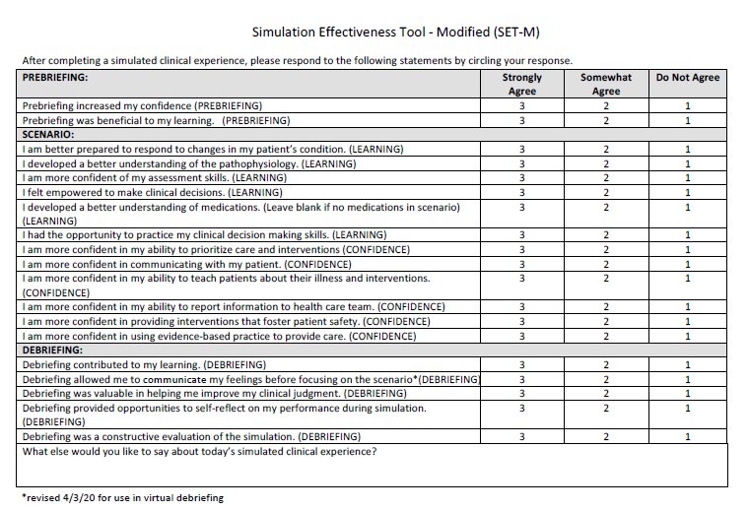
Simulation Model
Notes:
LC
https://static1.squarespace.com/static/5fad419ff89b0151b02dabc1/t/601944a8d9bfea17a24e1c07/1612268712811/Simulation+Effectiveness+Tool+SETM.pdf

Slide 62
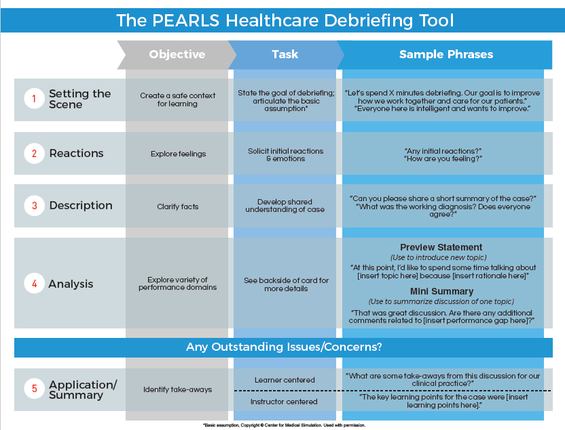
Notes:
LC
Promoting Excellence and Reflective Learning in Simulation (PEARLS)
https://debrief2learn.org/pearls-debriefing-tool/

Slide 63
Simulation Topics
Topic selection
Past simulation topics
Adolescent suicidality
Care for the difficult patient
Geriatric ED follow-up
Notes:
LM
ADOLESCENT SUICIDALITY:
Complete a thorough safety assessment
Determine appropriate disposition
Review of parental consent/teen assent and confidential discussion topics
Review of black box warning for SSRIs
CARE FOR THE DIFFICULT PATIENT:
Controlled substance expectations/laws/policies
De-escalation
Saying no
Safe prescribing practices
Checking PMP; CMA/UDS

Slide 64
Simulation-based learning experience: ED discharge/untreated UTI
Telehealth video visit
Participants: 10 FNP residents, 2 AGNP residents
Goals:
Review of ED discharge records
Evaluation of basic home safety/fall risk and home support system
Lab interpretation (urine culture interpretation and antibiotic selection)
Review of Beers list medications
Polypharmacy and de-prescribing for older adult patients
Establish appropriate follow-up and care coordination
Notes:
LM
81 y/o female presents for telehealth follow-up with PCP after ED visit after a fall.
Upon review of labs, UTI identified but not treated in the ED.
Residents were tasked with interpreting lab results, identifying AKI, and selecting an appropriate antibiotic regimen for this patient based on urine C&S results, kidney function, and patient allergies.
Although not prompted, many residents also took on the task of deprescribing medications that may pose a risk to older adults, or that were contraindicated in the setting of AKI
As with real life clinical encounters, there were many layers to unwrap – “pick your own adventure” – and each resident provider addressed the patient encounter in a different way.

Slide 65
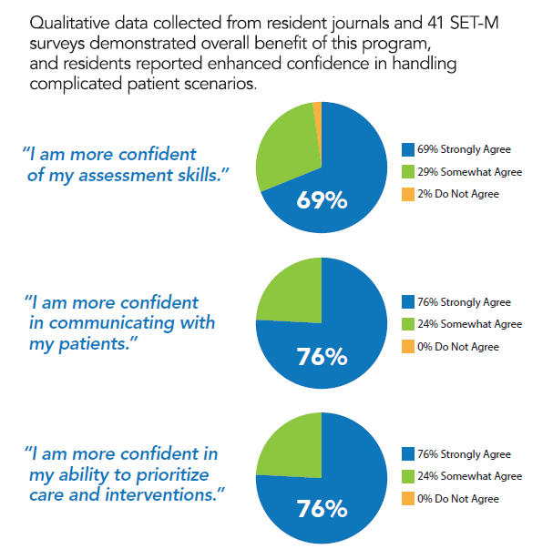
Impact of simulation for CHCI NP Residents (n=41)
Notes:
LC
41 individual SET-M survey responses were analyzed following the telehealth simulation experiences – from both providers and observers. Participants were given a statement, as noted in quotation marks above, and asked to respond using a Likert scale of “1: do not agree, 2: somewhat agree, or 3: strongly agree.”
Overall, we saw a net positive response, from both providers and observers, as to the benefits of telehealth simulation experiences in enhancing confidence and providing the opportunity to experience and practice new patient scenarios in a safe, low-stakes setting.

Slide 66
Impact of simulation experience for CHC NP Residents
“It was very helpful! I’d recommend including more sim in the residency.”
“This was a great learning experience and I was glad I had more practice with suicidal patient interaction because I have [not] had this yet in my precepted clinics.“
“I am so grateful for the topic that we covered— definitely a clinical weakness of mine and I appreciate all opportunities to learn how to provide the best care in these situations.“
Notes:
LM

Slide 67
Implications & Future Plans
Simulations are welcomed by residents and present opportunities for observation/assessment by faculty
Areas of interest for future simulations:
Pregnant patient with substance use disorder
Pregnancy complications
Psychiatric prescribing in primary care
Documentation efficiency
And more!
Notes:
LM

Slide 68
Acknowledgements
CHCI NP Residency Team:
Charise Corsino, Margaret Flinter, Nicole Seagriff
Yale School of Nursing Simulation Team:
Linda Caruso, Linda Ghampson, Christine Rodriguez, Tricia Siefker
Jessica Horstmann, Sarah Freiberg
Notes:
LC (CHC) LM (YSN and others)

Slide 69
Questions?
Notes:
Meaghan
Launch evaluation

Slide 70
Wrap-Up
Notes:
Meaghan

Slide 71
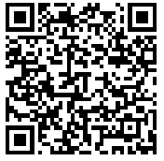
Deliverables
Draft didactic curriculum
Continue to work on Progress Checklist
Begin drafting showcase presentation
Google Drive
https://drive.google.com/drive/folders/1WgVbObv-KgPfz5UyKgSuXsWj09Skq1pp?usp=sharing
Notes:
Meaghan

Slide 72
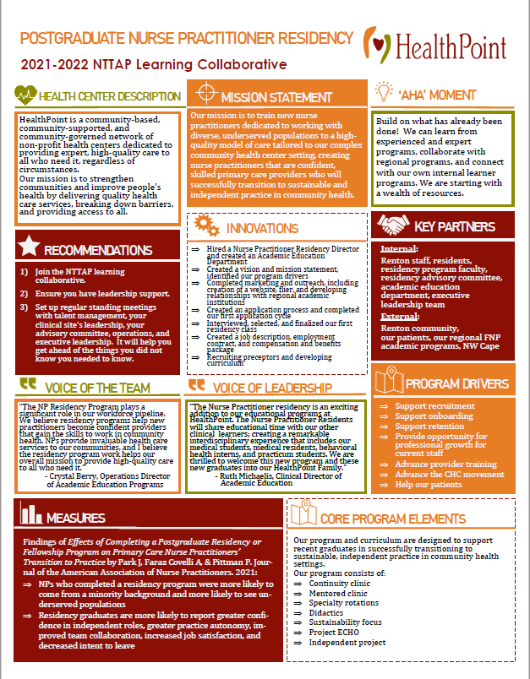
Showcase Overview
Due Date: Monday March 18th
Showcase Date: Tuesday April 2nd
Team coaches will be sent a template, including:
Innovations*
‘Aha’ Moments*
Recommendations to others*
Aim Statement
Measures/Impacts
Key Partners
Quote from leadership
Quote from team member
Process Map or other visuals (i.e. photos, graphs)
*Required
72
Notes:
Meaghan

Slide 73
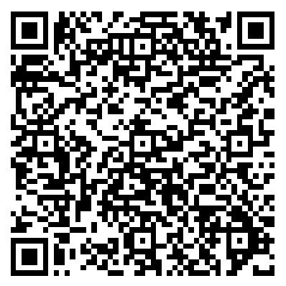
Reminders
Coach Calls:
Tuesday February 27th 1:00pm Eastern / 10:00am Pacific
**Tuesday March 12th 1:00pm Eastern / 10:00am Pacific
Session 5: Tuesday March 5th 1:00pm Eastern / 10:00am Pacific
CME and Resource Page
Access Code: PGR2023
https://education.weitzmaninstitute.org/content/postgraduate-nurse-practitioner-np-residency-and-npphysician-associate-pa-training-programs
Notes:
Meaghan

Slide 74
Contact Information
Amanda Schiessl
Program Director/Co-PI
Amanda@mwhs1.com
Meaghan Angers
Program Manager
angersm@mwhs1.com
REMINDER: Complete evaluation in the poll!
Next Learning Session is Tuesday March 5th!
Notes:
Meaghan

Slide 75
Explore more resources!
National Learning Library: Resources for Clinical Workforce Development
Health Center
Resource Clearinghouse
https://www.weitzmaninstitute.org/ncaresources
https://www.healthcenterinfo.org/
75
Notes:
Meaghan

