Slide 1
HIV Prevention Learning Collaborative
Session Three: March 25th, 2024
Notes:
Meaghan

Slide 2
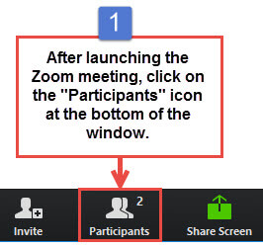
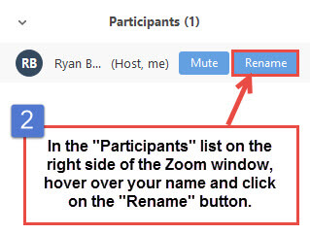
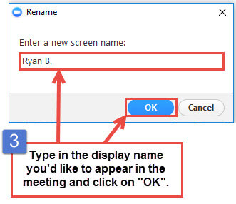
Get the Most Out of Your Zoom Experience
Please keep yourself on MUTE to avoid background/distracting sounds
Use the CHAT function or UNMUTE to ask questions or make comments
Please change your participant name to your full name and organization
“Meaghan Angers CHCI”
Notes:
Meaghan

Slide 3
Session 3 Agenda
1:00 – 1:05 | Welcome
1:05 – 1:30 | Ending the HIV Epidemic: Using Health IT to Support Primary Care HIV Prevention
1:30 – 1:50 | HIV Screening and Diagnostic Testing
1:50 – 2:25 | STI Testing and Screening
2:25 – 2:30 | Q & A and Next Steps
Notes:
Meaghan

Slide 4
Learning Collaborative Structure
Six 90-minute Learning Collaborative video conference sessions
Bi-weekly calls between coach mentors and practice coach
Internal team workgroup meetings
Use the Weitzman Education Platform to access resources and receive CME credit
Learning Session Dates
Learning Session 1 | Monday January 29th
Learning Session 2 | Monday February 26th
Learning Session 3 | Monday March 25th
Learning Session 4 | Monday April 22nd
Learning Session 5 | Monday May 20th
Learning Session 6 | Monday June 10th
Notes:
Meaghan

Slide 5
NTTAP Faculty, Collaborative Design, and Facilitation
Amanda Schiessl, MPP
Deputy Chief Operating Officer
Project Director/Co-PI, NCA
Margaret Flinter, APRN, PhD, FAAN
Co-PI, NCA & Senior Vice President/Clinical Director
Bianca Flowers, MPH
Program Manager
Meaghan Angers
Program Manager
Dr. Marwan Haddad, MD, MPH, AAHIVS,
Medical Director, Center for Key Populations
Kasey Harding, MPH
Program Director, Center for Key Populations
Mentors, Coaching Faculty
Jeannie McIntosh, APRN, FNP-C, AAHIV
Nurse Practitioner, Center for Key Populations
mcintosj@chc1.com
Maria Lorenzo
Community Based Services Manager, Center for Key Populations
LorenzM@chc1.com
Evaluation Faculty
Kathleen Thies, PhD, RN
Consultant, Researcher
ThiesK@chc1.com
Notes:
Meaghan

Slide 6
The Center for Key Populations is the first center of its kind that focuses on key groups who experience health disparities secondary to stigma and discrimination and who belong to communities that have suffered many barriers to healthcare.
The Center brings together healthcare, training, research, and advocacy for: People who use drugs, the LGB and Transgender populations, the homeless and those experiencing housing instability, the recently incarcerated, and sex workers.
HIV Primary Care
Viral Hepatitis Screening and Treatment
Substance Use Health
Health Care for the Homeless
LGB Health and Gender Affirming Care
Migrant Farmer Health Program
HIV Prevention: Testing, PrEP, and PEP
Sexually Transmitted Infections
Notes:
Meaghan

Slide 7
Affinia Healthcare | St. Louis, Missouri
Asian American Health Coalition dba HOPE Clinic | Houston, Texas
East Central Oklahoma Family Health Center | Wetumka, Oklahoma
FirstMed Health and Wellness | Las Vegas, Nevada
Hi-Desert Memorial Health Care District | California
International Community Health Services | Seattle, Washington
Jane Pauley Community Health Center | Indianapolis, Indiana
North County Health Project, Inc. DBA TrueCare | San Marcos, Califonia
Promise Healthcare | Champaign, Illinois
The HealthCare Connection, Inc. | Cincinnati, Ohio
WellSpace Health | Sacramento, California
2024 Cohort
Notes:
Meaghan

Slide 8
ENDING THE HIV EPIDEMIC
USING HEALTH IT TO SUPPORT PRIMARY CARE HIV PREVENTION
Notes:
HITEQ

Slide 9
About The HITEQ Center
HITEQ Topic Areas
Virtual and digitally enabled care
Access to comprehensive care using health IT and telehealth
Privacy and security
Advancing interoperability and standards based exchange
Electronic patient engagement and digital health Readiness for value based care
Using health IT and telehealth to improve documentation integrity and health equity
Using health IT or telehealth to address emerging issues: behavioral health, HIV prevention, and emergency preparedness
The HITEQ Center is a HRSA-funded National Training and Technical Assistance Partner (NTTAPs) that supports health centers to become data-driven and equitable by providing training, technical assistance, and resources for effective use of data, health IT, and EHRs. This support aims to enhance the quality, security, and documentation of care while addressing barriers and maximizing value.
A national website with health center-focused resources, toolkits, training, and a calendar of related events.
Learning collaboratives, trainings, and on-demand technical assistance on key topic areas.
The HITEQ Center is a HRSA-funded National Training and Technical Assistance Partner operated by JSI Research & Training, Inc. and Westat.
This project is supported by the Health Resources and Services Administration (HRSA) of the U.S. Department of Health and Human Services (HHS) as part of awards totaling $693,000 with 0% financed with non-governmental sources. The contents are those of the author(s) and do not necessarily represent the official views of, nor an endorsement, by HRSA, HHS, or the U.S. Government. For more information, please visit HRSA.gov.
Website: www.HITEQcenter.org | Email: hiteqinfo@jsi.com
Notes:
HITEQ

Slide 10
THE ROLE OF HEALTH IT IN HIV PREVENTION
HITEQ focuses on the primary role and the value of using your EHR and broader health IT system in HIV screening and prevention. The primary role of health IT in this is in standardizing, supporting decision making, and monitoring.
There is also an important role for digital patient engagement and digitally enabled care.
Access our EHE resources at this link.
Notes:
HITEQ

Slide 11
HIV PREVENTION HEALTH IT FUNCTIONS
STANDARDIZING
Once you have your plan for how HIV screening and prevention, such as PrEP services will be done at your clinic, the EHR can be used to standardize that approach with templates, order sets, alerts, etc.
CLINICAL DECISION SUPPORT
Particularly in primary care, clinicians are not always familiar with the details of what, for example, is needed to initiate and sustain PrEP. Clinical decision support tools can take some of that burden off of clinicians, giving then recommendations when appropriate.
MONITORING
With standardized, structured data within your health IT system, you are then able to use that information to build reports or dashboards that can monitor progress, outcomes, and even adherence to processes.
DIGITAL PATIENT ENGAGEMENT
Digital tools, whether those built into our EHR or third party tools, support outreach and engagement with patients beyond the clinic visit.
Notes:
HITEQ

Slide 12
LET’S LOOK AT EACH
Following, we’ll discuss a couple of examples for each of these key functions. These might serve as ideas or inspiration as to what you might do in your health center.
Notes:
HITEQ

Slide 13
STANDARDIZATION
SETTING THE EXPECTATION
Using care guidelines, alerts, and pre-visit planning in your EHR can set the expectation as to when and how HIV screening should be done.
For example, adding HIV screening (defined by the eCQM as one HIV test between the patient’s 15th and 66th birthday) can be added to
pre-visit planning tools as a way to reinforce the expectation. Similarly, alerts can be used to notify care teams when a patient is in need of an HIV test, or when they may benefit from PrEP, based on established guidelines.
SETTING DOCUMENTATION STANDARDS
Standardizing documentation is critically important for understanding the status of HIV prevention services in your health center. Using templates, favorites, smart phrases and other EHR tools can help ensure consistent documentation, when and where needed to use that information meaningfully for measurement, monitoring, and population health management.
Also consider the value of HIEs or other data exchange, where things like HIV test results from other providers may be available– thereby limiting duplication of services.
Notes:
HITEQ

Slide 14
CLINICAL DECISION SUPPORT
Algorithms can take into account test results, diagnoses, and other structured data fields to support decision making for clinicians. These can typically be as broad or narrow as needed.
For example, you health center may decide on an algorithm that looks at whether the patient has a documented HIV test result in their chart, and if not, prompts for a test. Or, you may create an algorithm that looks for a set of diagnoses, such as certain STIs and/ or OUD, and prompts for PrEP if those are identified in the chart.
Note that the success of algorithms relies on standardization.
ALGORITHMS
TEMPLATES AND FLOWSHEETS
CDS systems help providers to interpret or determine next steps based clinical results, document patients' health status, and prescribe medications such as PrEP through the use of alerts, reminders, and customized data entry forms.
Data entry forms, such as templates and flowsheets can pull information in from different parts of the patient chart, and when used with clinical decision supports can prompt for
appropriate action.
Notes:
HITEQ

Slide 15
MONITORING
DASHBOARDS OR REPORTS
Standardized information and defined processes lend themselves to regular monitoring which is useful for performance and continuous quality improvement. It’s also useful for monitoring changes to your processes to identify opportunities for retraining.
For example, you may use dashboards or reports to monitor performance on clinical quality measures like HIV screening and HIV linkage to care rates; but you may also create or use missed opportunity reports that identify patients who were seen but didn’t receive and HIV screening (and didn’t have opt-out documented).
REGISTRIES OR WORK LISTS
Keeping patients engaged in their care, including maintaining them on PrEP typically involves outreach and follow-up. Using your health IT systems to create registries or worklists for these purposes can be useful in taking the burden off teams to track outside of the system.
For example, a health center can use their analytics tools to generate a weekly list of patients who are in their last week of their PrEP prescription (according to the rx order date if you don’t have information about when the rx was filled). Then someone from the care team can reach out to these patients to bring them in.
Notes:
HITEQ

Slide 16
DIGITAL PATIENT ENGAGEMENT
Digital patient engagement encompasses direct-to-consumer telehealth (meaning, between a provider at your health center and the patient somewhere else), facilitating patient access to providers through originating site telehealth, direct messaging, etc. and automated outreach such as through EHR driven SMS/ email campaigns.
These tools can open a whole new world of services for patients, increase retention, and increase adherence.
Notes:
HITEQ

Slide 17
THANK YOU!
HITEQINFO@JSI.COM
WWW.HITEQCENTER.ORG
Notes:
HITEQ

Slide 18
HIV Screening and Diagnostic Testing
Notes:
Marwan

Slide 19
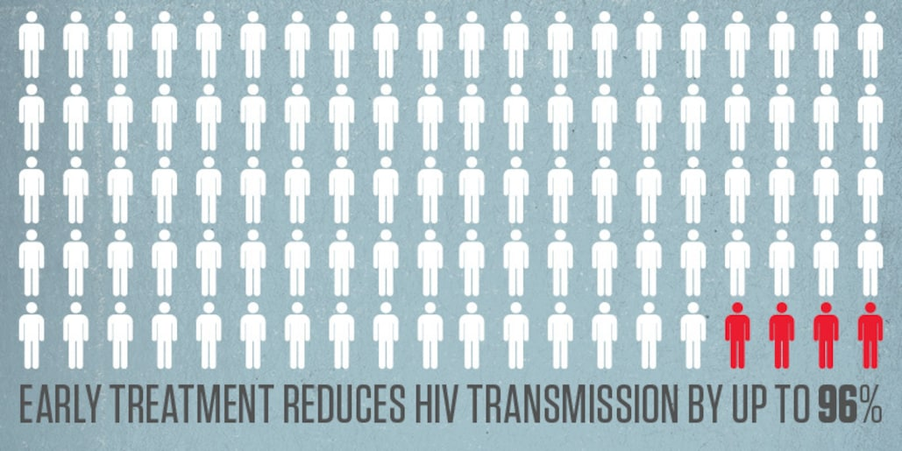
Routine HIV Testing Recommendations
Test every patient between the ages of 13 – 64 at least once.
Test every patient who has risk factors at least annually.
Confirm immediate linkage to care for every patient who tests positive.
Notes:
Marwan

Slide 20
OPT-OUT TESTING:
Part of consent to routine medical care
Opportunity to ask questions
Option to decline
Separate written/oral consent not required
Prevention counseling not required in conjunction with testing.
STATUS NEUTRAL APPROACH: promoting support and engagement in care regardless of test result.
People with HIV who are aware of status can get HIV treatment
Promote individual health
Prevent transmission
People who don’t have HIV and are at-risk can make decisions about their health, including PrEP.
Notes:
Marwan

Slide 21
Risk-Based Screening
Any patient suspected of acute HIV infection
Patients seeking STI treatment
Pregnant women
Patients with TB
Patients with viral hepatitis (HBV/HCV)
Patients starting new sexual relationships
Occupationally exposed individuals
Notes:
Marwan

Slide 22
PATIENTS WITH ONGOING RISK - at least annually
People who inject drugs and their sex partners
Persons who exchange sex for money or drugs
Sex partners of persons with HIV who are not virally suppressed.
MSM or heterosexual persons who themselves or their partners have had more than one sexual partner since their last HIV test*
*Should include transgender individuals, bisexual women.
Notes:
Marwan

Slide 23
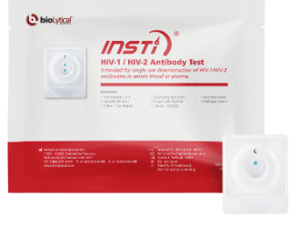
Types of HIV Tests
4th generation Ab/Ag test
Venous blood draw; checks HIV Abs and P24 antigen (a viral protein)
Results available in 1-2 weeks
Can detect HIV as early as 2 weeks after exposure
Sensitivity >99.7%, Specificity 100%
Rapid Tests*
INSTI HIV ½ Ab IgM/IgG (3rd gen)
Finger stick blood test with results in 1 min.
Sensitivity >99.8%, specificity >99.5%
Picks up infections by 3 weeks after exposure
Alere Determine HIV1/2 (4th gen) used at CHCI
Finger stick blood test with results in 15 mins.
Sensitivity 100%, specificity 99.8%
Picks up infections as early as 2 weeks after exposure
* Positive results require confirmation
Notes:
Marwan

Slide 24
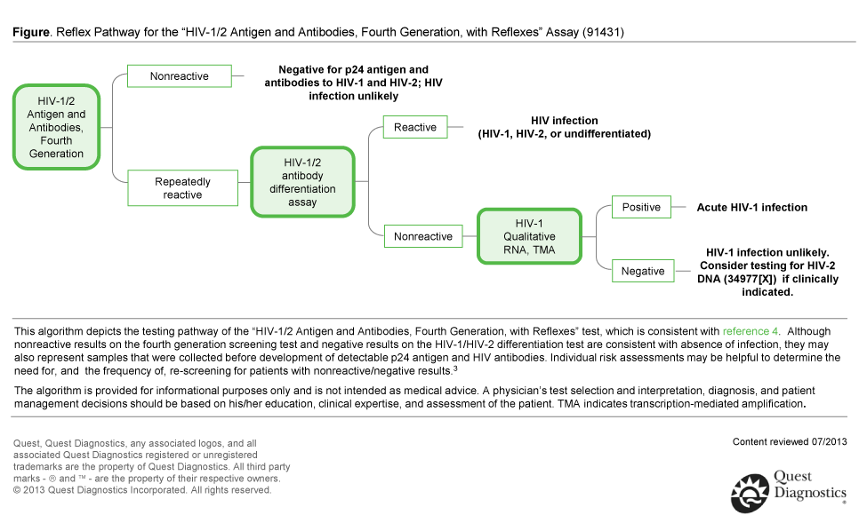
Notes:
Marwan

Slide 25
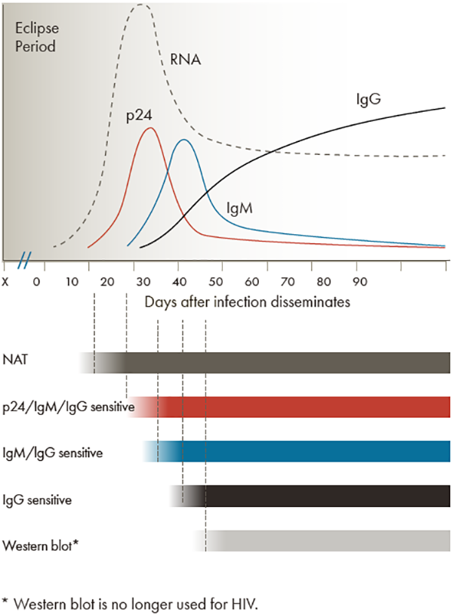
https://www.cdc.gov/hiv/clinicians/screening/diagnostic-tests.html
Notes:
Marwan

Slide 26
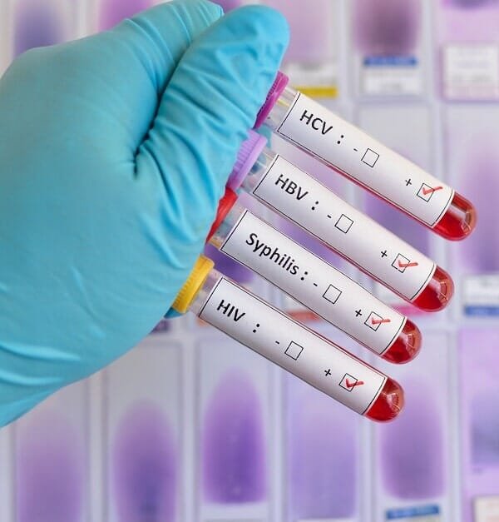
CHCI Operations: Implementing an HIV Screening Policy and Workflow
Panel Management
MA uses planned care dashboard to assess need for routine HIV test
MA electronically adds HIV testing to list of necessary labs for visit so PCP can order
Result
PCP reviews labs and informs patient of result
Positive HIV test is reported to CHC – Center for Key Populations
Linkage to Care
Patient is linked to care with PCP at CHC with HIV expertise
Patient is connected to support services as needed or desired and tracked by organization via HIV Dashboard.
Notes:
Marwan

Slide 27
Planned Care Dashboard & Clinical Expectation: Universal HIV Screening
Notes:
Marwan

Slide 28
Community Health Center Data
Measure | Year | Data | Explanation/Comment
Number of patients between 13-64 with at least one HIV test result | 2018 | 64% | CHC continued to experience difficulty with adolescent HIV testing. The rate of routine HIV testing rose to 81% when we excluded 13-17 year old patients.
Number of patients between 13-64 with at least one HIV test result | 2021 | 75% | Although Covid created challenges training and education geared directly toward pediatric providers and pediatric focused sites increased the routine HIV testing numbers dramatically.
Number of high risk patients with annual HIV test. (Previous 3 years) | 2018 | 41% | High risk is patient with one confirmed positive STI test – provider education was lacking and planned care dashboard was not populating
Number of high risk patients with annual HIV test (Previous 3 years) | 2021 | 62% | Change to planned care dashboard, increased provider education, monitoring by PrEP and outreach team.
Notes:
Marwan

Slide 29
Routine HIV Testing Quality Improvement Plan
Data Analysis
# of eligible patients with no HIV test ordered.
# of eligible patients with HIV tests ordered but not obtained.
# of eligible pediatric/adolescent patients with HIV test ordered/obtained
Training/Education
Annual Clinical grand rounds
Organization Training – Town Hall
Data Dissemination by site/provider
Pediatric/Adolescent Specific Training
Competition/Recognition
Communication/QI
Monthly Meetings with Outreach/Prevention Team to work on QI
QI input from Champions
CKP Team feedback
Meaningful Use
PrEP
Target high risk populations with outreach
Disseminate information widely
Patient Education
Plans for the Future of Routine HIV Testing
Notes:
Marwan

Slide 30
Questions?
Notes:
Marwan

Slide 31
STI Testing and Screening
Notes:
Jeannie

Slide 32
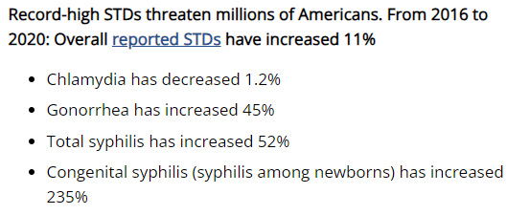
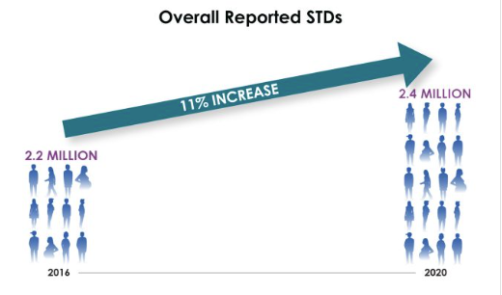
Rising STI Rates in the U.S.
Disproportionately affecting young people under 25, racial and ethnic minority groups, and gay and bisexual men.
Reported STDs in the United States, 2020 (cdc.gov)

Slide 33
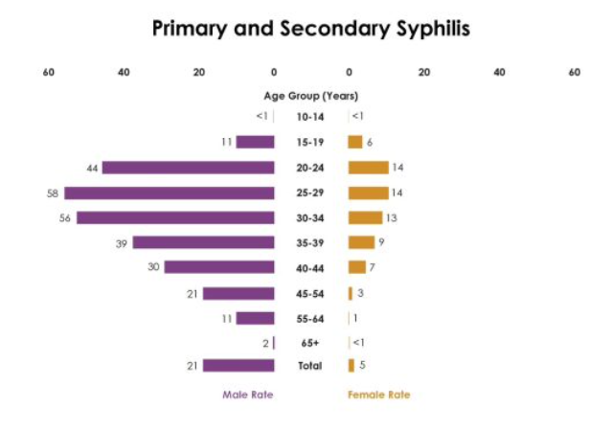
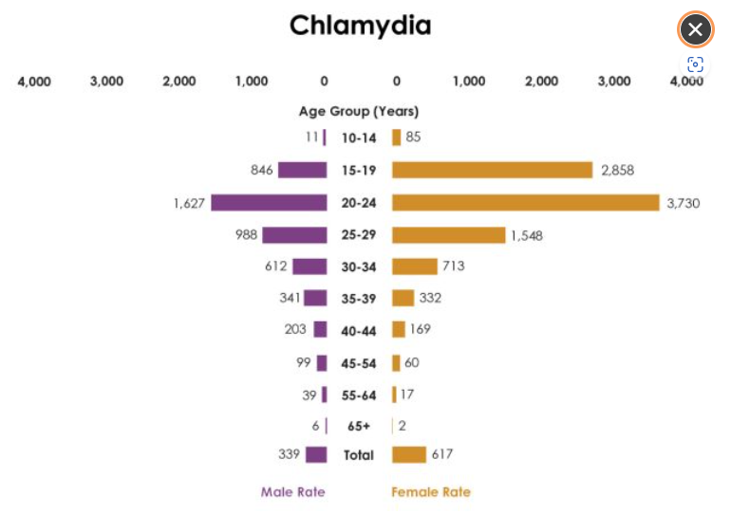
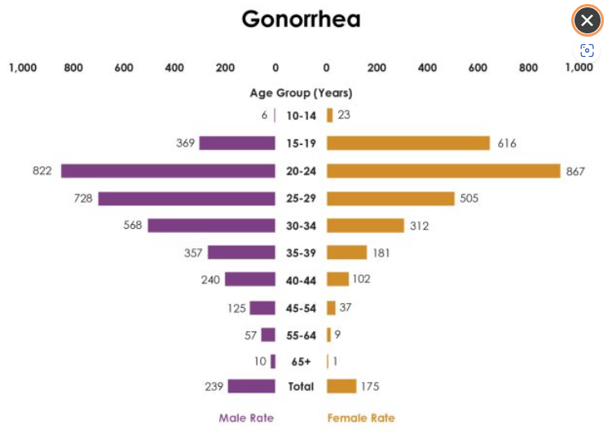
Reported STDs in the United States, 2020 (cdc.gov)

Slide 34
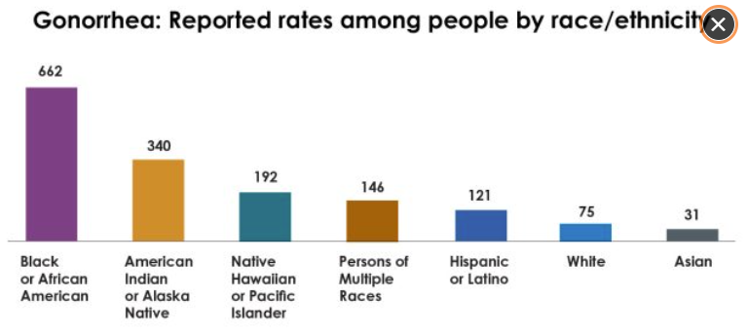
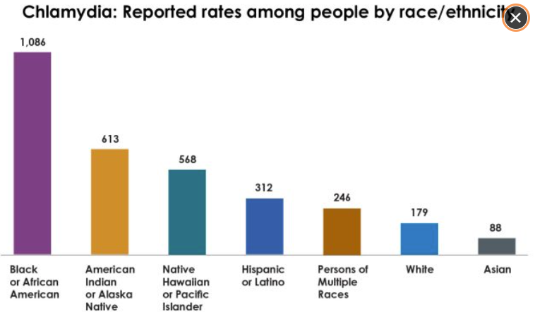
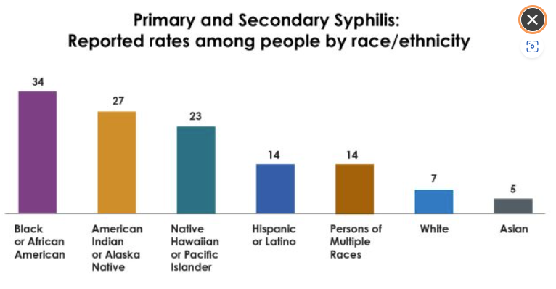
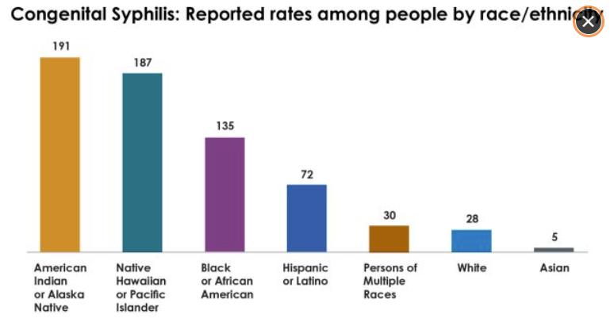
Reported STDs in the United States, 2020 (cdc.gov)

Slide 35
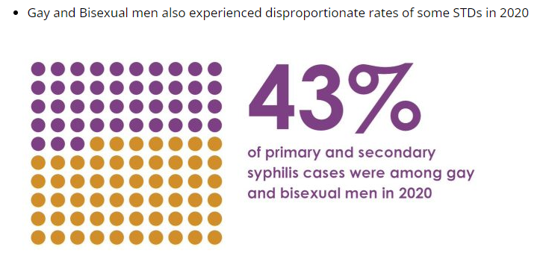
Reported STDs in the United States, 2020 (cdc.gov)

Slide 36
Extra-genital gonorrhea (GC) and chlamydia (CT) infections are common among MSM:
Estimated prevalence of extra-genital GC/CT in MSM (CDC, 2015)
2017 systematic review of 115 studies:
Prevalence of rectal CT (9%) > prevalence of rectal GC (4.7%)
STI | Pharyngeal | Rectal
Gonorrhea | 7.3% | 5.4%
Chlamydia | 2.3% | 8.9%
Centers for Disease Control and Prevention, 2015. Sexually transmitted diseases treatment guidelines, 2015. Annals of Emergency Medicine, 66(5), pp.526-528. https://www.cdc.gov/std/tg2015/specialpops.htm#msm
CDC. Clinic-based testing for rectal and pharyngeal Neisseria gonorrhoeae and Chlamydia trachomatis infections by community-based organizations–five cities, United States, 2007. MMWR Morb Mortal Wkly Rep 2009;58:716–19.
Dewart, C.M., Bernstein, K.T., DeGroote, N.P., Romaguera, R. and Turner, A.N., 2018. Prevalence of rectal chlamydial and gonococcal infections: a systematic review. Sexually transmitted diseases, 45(5), p.287.
Notes:
Jeannie

Slide 37
STI rates in transgender and gender non-conforming persons:
Data is more limited but GC/CT rates among trans women appear similar to those of cisgender MSM
HIV prevalence of 14% among trans women in US (44% in Black transwomen, 26% in Hispanic trans women)
Neovaginal STI infections can occur s/p vaginoplasty
Very limited data on STIs in trans men and non-binary individuals.
Trans men may be at increased risk for delayed cervical cancer diagnosis due to avoidance (or difficulty accessing) pap smears – consider HPV self-swab as alternative?
6. https://www.cdc.gov/std/treatment-guidelines/trans.htm
Notes:
Jeannie

Slide 38
STI Screenings: Background
CDC recommends that basic STI care services should be available in all primary care settings.⁷
Screenings should include (at a minimum) gonorrhea, chlamydia, syphilis, HIV, viral hepatitis, cervical cancer
Clinical laboratory services to include:
Urogenital nucleic acid amplification test (NAAT) for GC and CT
Extra-genital (pharyngeal and rectal) NAAT for GC and CT
Treponemal and nontreponemal serologic tests for syphilis
Fourth-generation HIV test
7. Barrow RY, Ahmed F, Bolan GA, Workowski KA. Recommendations for Providing Quality Sexually Transmitted Diseases Clinical Services, 2020. MMWR Recomm Rep 2020;68(No. RR-5):1–20. DOI: http://dx.doi.org/10.15585/mmwr.rr6805a1
Notes:
Jeannie

Slide 39
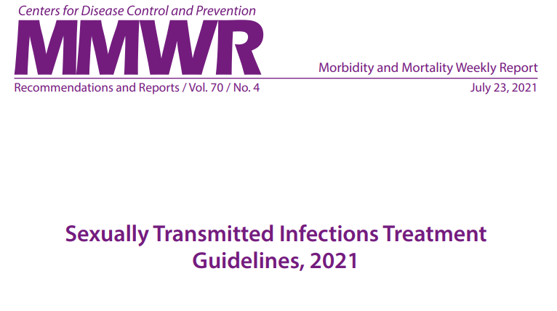
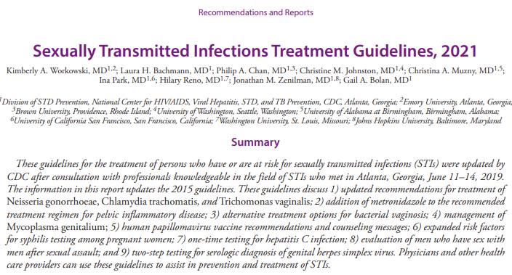

Slide 40
Summary of Asymptomatic STI Screening Recommendations
Asymptomatic Screening | STI s | Frequency
Sexually active <25: women, pregnant women, transmen/gender diverse with cervix | Chlamydia, Gonorrhea | Annual More frequent based on risk (e.g. 3-6 months)
Sexually active MSM | Chlamydia/Gonorrhea (3-sites), Syphilis, HIV, HBV | Annual More frequent based on risk (e.g. 3-6 months)
Persons with HIV | Chlamydia, Gonorrhea, Syphilis, HBV, Trichomonas (women), HCV (MSM) | Annual More frequent based on risk (e.g. 3-6 months)
All: 13-64 year olds | HIV | At least once
All: 18+ year olds | HCV | At least once
All pregnant individuals | HIV, Syphilis, HBV, HCV | At least once
Center for Key Populations: Reimagining Primary Care

Slide 41
Summary of At-Exposure Risk
STI Screening Recommendations
At-Exposure Risk Based on Sexual History | STIs | Frequency
All at exposure risk | Chlamydia/Gonorrhea (3-site testing where appropriate), Syphilis, HIV, HBV, HCV | Annual More frequent based on risk (e.g. 3-6 months)
Women at exposure risk | Trichomonas | Annual More frequent based on risk (e.g. 3-6 months)
Center for Key Populations: Reimagining Primary Care

Slide 42
CDC STI Treatment Guidelines 2021: Asymptomatic Screenings
Cis-Women:
Chlamydia/Gonorrhea
All sexually active <25
Sexually active 25+ if at increased risk
New sex partner, >1 partner, a partner with other partners, sex partner with a STI
If positive, test after 3 months to rule out reinfection
Consider rectal chlamydia and pharyngeal/rectal gonorrhea screening based on sexual exposures and shared decision making.
Syphilis:
If at risk of exposure
History of incarceration or transactional sex, geography, race/ethnicity.

Slide 43
HERPES:
Type-specific HSV serologic testing to be considered if presenting for STI evaluation, esp. if more than one partner.
TRICHOMONAS:
Consider in high prevalence settings, e.g. STI clinics, correctional facilities and in asymptomatic at high risk (multiple partners, transactional sex, drug misuse, history of STI or incarceration).
HIV:
All 13-64 (opt out); all who seek STI evaluation/treatment.
HBV:
At risk (more than one partner in last 6 months, STI evaluation/treatment, past or current IDU, HBV+ sex partner)
HCV:
All 18+ (unless positivity rate <0.1%)
Notes:
Jeannie

Slide 44
CDC STI Treatment Guidelines 2021: Asymptomatic Screenings
Pregnancy:
Chlamydia/Gonorrhea
All <25
25+ if at increased risk
New sex partner, more than one partner, a partner with other partners, sex partner with a STI
Rescreen during third trimester
Test of cure for chlamydia 4 weeks after treatment
Retest within 3 months for reinfection
Syphilis:
All at first prenatal visit
Retest at 28 weeks and at delivery if at risk of exposure
Lives in community with high syphilis morbidity; drug use, STI in pregnancy, >1 partner, new partner, partner with STIs
Center for Key Populations: Reimagining Primary Care

Slide 45
CDC STI Treatment Guidelines 2021:
Asymptomatic Screenings
Pregnant Women:
Herpes:
Not routinely.
Consider type-specific HSV serologic testing if at risk.
HIV:
All at first prenatal visit
Retest in 3rd trimester if at risk of exposure
Drug use, STI in pregnancy, >1 partner, new sex partner, lives in high HIV prevalence area, partners with HIV
Rapid testing at delivery if not previously screened
HBV:
All at first prenatal visit; retest if at risk.
HCV:
All
Center for Key Populations: Reimagining Primary Care

Slide 46
CDC STI Treatment Guidelines 2021:
Asymptomatic Screenings
Men who have sex with women:
Chlamydia/Gonorrhea
Insufficient evidence for screening low risk
Could consider screening for chlamydia in young men in high prevalence settings
Adolescent clinics, correctional facilities, STI/sexual health clinics
Syphilis
Consider in younger than 29 years in high prevalence settings
Any at risk of exposure
History of incarceration or transactional sex, geography, race/ethnicity
Herpes
Type-specific HSV serologic testing to consider if presenting for STI evaluation, esp if >1 partner
HIV
All 13-64 (at least once)
All who seek STI evaluation/treatment
HBV
At risk e.g. sexual or percutaneous exposure
HCV
All 18+ (at least once)
Center for Key Populations: Reimagining Primary Care

Slide 47
CDC STI Treatment Guidelines 2021:
Asymptomatic Screenings
Men who have sex with men:
Chlamydia/Gonorrhea
At least annually at sites of contact regardless of condom use
Chlamydia: urethra, rectum
Gonorrhea: urethra, rectum, pharynx
Every 3-6 months if at continued risk of exposure
On PrEP
If they or their sex partners have other partners
Syphilis
At least annually
Every 3-6 months if at continued risk of exposure
Center for Key Populations: Reimagining Primary Care

Slide 48
CDC STI Treatment Guidelines 2021: Asymptomatic Screenings
Men who have sex with men:
Herpes:
Type-specific HSV serologic testing to consider if infection status is unknown with previously undiagnosed genital tract infection.
HIV:
At least annually if HIV status unknown/negative and patient or partners have had >1 partner since last HIV test.
More frequent (e.g. every 3-6 months) if at continued risk of exposure
HBV:
All should be tested for HBsAg, HBVcAb, HBVsAb
HCV:
All (at least once)
Center for Key Populations: Reimagining Primary Care

Slide 49
CDC STI Treatment Guidelines 2021: Asymptomatic Screenings
Transgender and Gender Diverse Persons:
Chlamydia/Gonorrhea
Screening recommendations should be adapted based on anatomy.
E.g. persons with cervix annual routine screening if < 25.
Consider screening at rectal site (chlamydia) and pharyngeal/rectal sites (gonorrhea) based on sexual exposure.
Syphilis
Consider at least annually based on sexual exposure
HIV
Discuss and offer to all.
Frequency based on level of exposure risk.
Center for Key Populations: Reimagining Primary Care

Slide 50
CDC STI Treatment Guidelines 2021: Asymptomatic Screenings
Persons with HIV:
Chlamydia/Gonorrhea/Syphilis
At first evaluation after HIV diagnosis and at least annually after that.
More frequent screening based on risk.
Herpes:
Type-specific HSV serologic testing considered for persons presenting for STI evaluation.
Trichomonas:
For women at entry to care and at least annually thereafter.
HBV:
All should be tested for HBsAg, HBVcAb, HBVsAb
HCV:
All at initial evaluation
Annual in MSM with HIV
Center for Key Populations: Reimagining Primary Care

Slide 51
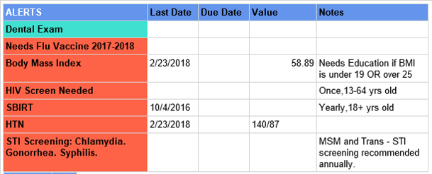
STI Screening on Planned Care Dashboard
Routine annual STI Screening for specific groups:
Women 13-24 (chlamydia/gonorrhea)
MSM/Transfeminine individuals (3-site testing chlamydia/gonorrhea, syphilis)
PrEP patients (3-site testing chlamydia/gonorrhea, syphilis)
Notes:
Marwan

Slide 52
Clinical Expectations for Medical Providers
Notes:
Marwan

Slide 53
Evidence: Benefits of Rectal Swab Self-Collection
A 2016 study in a cohort of MSM over 1 year found:
Without extra-genital testing, >70% of CT and >80% of GC would have been missed. ¹⁰
A 2019 meta-analysis showed self-collection increased uptake of STI testing services relative to clinician-collection.¹¹
Self-collection:
Helps overcome barriers associated with stigmatization of MSM and transwomen.^{9,12}
Is preferred by patients vs. invasive nature of clinician-collection.^{13,14}
Has been shown to be equally or more effective than clinician-collection.^{15,16}
9. Reisner et al. 2017. Comparing self-and provider-collected swabbing for HPV DNA testing in female-to-male transgender adult patients: a mixed-methods biobehavioral study protocol. BMC infectious diseases, 17(1), p.444.
10. Anschuetz et al (2016). Extragenital screening in men who have sex with men diagnoses more chlamydia and gonorrhea cases than urine testing alone. Sexually Transmitted Diseases, 43(5), 299–301. https://doi. org/10.1097/OLQ.0000000000000435
11. Ogale et al. 2019. Self-collection of samples as an additional approach to deliver testing services for sexually transmitted infections: a systematic review and meta-analysis. BMJ global health, 4(2), p.e001349.
12. Rosenberger et al. 2011. Reactions to self-sampling for ano-rectal sexually transmitted infections among men who have sex with men: A qualitative study. Archives of sexual behavior, 40(2), pp.281-288.
13. Paudyal et al. 2015. Obtaining self-samples to diagnose curable sexually transmitted infections: a systematic review of patients’ experiences. PloS one, 10(4), p.e0124310.
14. Yared et al. 2017. Optimizing Screening for Sexually Transmitted Infections in Men Using Self-Collected Swabs—A Systematic Review. In Open Forum Infectious Diseases (Vol. 4, No. Suppl 1, p. S104). Oxford University Press.
15. Lunny et al. 2015. Self-collected versus clinician-collected sampling for chlamydia and gonorrhea screening: a systemic review and meta-analysis. PLoS One, 10(7), p.e0132776.
16. Sexton et al. (2013). How reliable is self-testing for gonorrhea and chlamydia among men who have sex with men? (Vol. 62).
Notes:
Marwan

Slide 54
CHC Rectal Self-Collection Study
33 MSM and Transwomen due for STI screening
Mean age 40, range 19-59
39% White, 18% Black, 39% Hispanic, 3% Other
70% Gay/Lesbian, 6% Bisexual, 6% Straight, 9% Other, 9% Chose Not to Disclose
79% Male, 15% Transfemale, 6% Chose Not to Disclose
Offered rectal self-collection or clinician-collection.
Informed consent obtained.
Written instructions given and reviewed.
Survey questionnaire filled out after collection.
Notes:
Marwan

Slide 55
Aggregate Data
Notes:
Marwan

Slide 56
Given a choice… | n
I prefer to swab my own bottom | 23
I prefer to have my provider swab my bottom | 0
I do not have a preference | 10
TOTAL | 33
Notes:
Marwan

Slide 57
Evidence: Nurse-based, Self-Collection in Community Health Settings
A nurse-led screening program for CT and GC at an HIV center conducted 976 screens and detected 143 infections that would otherwise have been missed.¹⁷
17.4% prevalence of GC/CT in MSM screened (n=571)
Rectal CT 9.8% (n=56) and GC 4.2% (n=24)
Pharyngeal CT 1.7% (n=10) and GC 3.9% (n=23)
Urethral CT 2.6% (n=16) and GC 1.3% (n=8)
All MSM found self-collection acceptable
17. Soni, S. and White, J.A., 2011. Self-screening for Neisseria gonorrhoeae and Chlamydia trachomatis in the human immunodeficiency virus clinic—high yields and high acceptability. Sexually transmitted diseases, 38(12), pp.1107-1109.
Notes:
Marwan

Slide 58
STI Nursing Visit – Nuts and Bolts
Provider-directed visit
Standing order for patient-directed visit (near future)
History including 5 P’s
Anatomical inventory
Sexual History
STI History
Sexual Health and Family Planning
Testing:
Urine and pharyngeal swab collection
Self collection of rectal/vaginal swabs
HIV rapid test
Lab orders for blood draw (HIV, syphilis, HCV, HBV)
Vaccinations (e.g. HAV, HBV, HPV)
Patient education/counseling (PrEP, condom distribution)
Notes:
Marwan

Slide 59
CDC STI TREATMENT WALL CHART: wall-chart.pdf (cdc.gov)
Center for Key Populations: Reimagining Primary Care

Slide 60
Center for Key Populations: Reimagining Primary Care

Slide 61
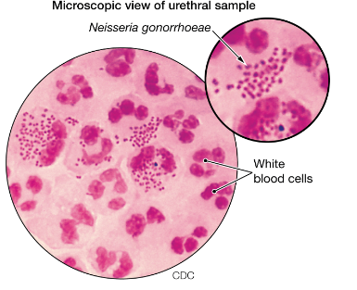
CDC STI Treatment Guidelines 2021:
Gonorrhea Treatment
Treat gonorrhea infections with a single 500 mg IM injection of ceftriaxone.
For persons weighing ≥150 kg (300 lb), use 1 g of IM ceftriaxone.
If chlamydia not excluded, also treat with doxycycline 100 mg orally twice daily for 7 days.
During pregnancy, azithromycin 1 g as a single dose recommended.
For Expedited Partner Therapy (EPT), partner may be treated with a single 800 mg oral dose of cefixime.
If chlamydia not excluded, add doxycycline 100 mg twice daily for 7 days.
Gram stain of male urethral discharge with polymorphonuclear leukocytes with intracellular gram-negative diplococci

Slide 62
CDC STI Treatment Guidelines 2021:
Gonorrhea Treatment
Test-of-cure not needed if uncomplicated urogenital or rectal gonorrhea unless symptoms persist.
If pharyngeal gonorrhea, test-of-cure (NAAT or culture) is recommended 7-14 days after initial treatment, regardless of regimen used.
Be mindful can have high potential for false positive with NAAT.
Patients treated for gonorrhea should be retested three months after treatment to ensure there is no reinfection.

Slide 64
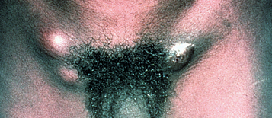
Lymphogranuloma Venereum (LGV)
Due to Chlamydia trachomatis serovars L1, L2,or L3.
Different than serovars A-K that cause typical chlamydia infection which presents with relatively mild or asymptomatic infection.
Symptoms and Signs:
Can cause genital ulcers, typically self limited at site of inoculation; lymphadenopathy, usually inguinal/femoral and unilateral; or proctocolitis
Can cause severe inflammation and invasive infection
Can lead to chronic colorectal fistulas and strictures
Reactive arthropathy
Can be asymptomatic

Slide 65
Lymphogranuloma Venereum (LGV)
Proctocolitis is most common presentation among MSM and women.
Cam mimic IBD– mucoid or hemorrhagic rectal discharge, anal pain, constipation, fever, or tenesmus.
Has been seen in outbreaks among MSM with HIV
LGV-associated lymphadenopathy can be severe with bubo formation
Fluctuant or suppurative inguinal or femoral lymphadenopathy.
Oral ulceration and cervical lymphadenopathy can also occur.
Can have secondary bacterial infection or other sexually and non sexually transmitted pathogens.

Slide 66
Diagnosis
Definitive diagnosis made with LGV-specific molecular testing (PCR-based genotyping).
Can differentiate LGV from non-LGV C. trachomatis in rectal specimens .
Not widely available and results can take time.
Otherwise, diagnosis made with positive chlamydia NAAT at symptomatic anatomic site, a clinical suspicion, and local epidemiology, along with exclusion of other etiologies for signs and symptoms.
Severe symptoms of proctocolitis, e.g. bloody discharge, tenesmus, and rectal ulcers can indicate LGV.
LGV chlamydia serology should not be used routinely as a diagnostic tool for LGV because utility has not been established and interpretation has not been standardized.
Might support LGV diagnosis in cases of isolated lymphadenopathy for which diagnostic material for NAAT cannot be obtained.

Slide 67
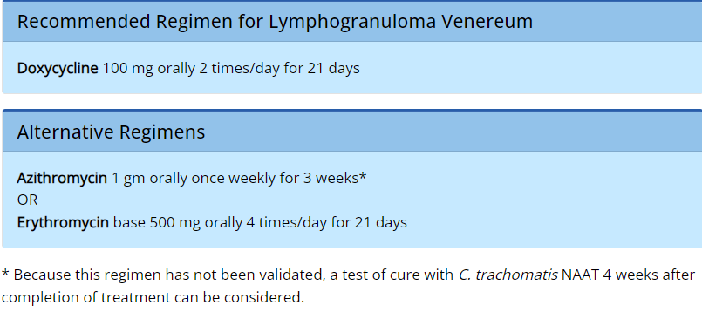
Treatment
If clinical syndrome consistent with LGV, presumptively treat.
Severe proctocolitis with bloody discharge, tenesmus, and ulceration.
In cases of severe inguinal lymphadenopathy with bubo formation, esp if recent history of genital ulcer.
Buboes might require aspiration through intact skin or incision and drainage to prevent formation of inguinal or femoral ulcerations

Slide 68
Treatment Duration
Optimal treatment duration for symptomatic LGV has not been studied.
21-days is based on long standing clinical practice and is highly effective with cure rates >98.5%.
Shorter courses might be effective on basis of small retrospective study in MSM with rectal LGV, half were symptomatic, who received 7-14 day course and had 97% cure rate.
Longer courses of therapy might be required in setting of fistulas, buboes, and other forms of severe disease.
Asymptomatic LGV is effectively treated with 7 day course of doxycycline.

Slide 69
Follow up
Follow until signs and symptoms resolve.
Retest for chlamydia 3 months after treatment.
Sex partners within 60 days of diagnosis/symptoms should be evaluated and tested for chlamydial infection.
Asymptomatic partners can be presumptively treated with a chlamydia regimen such as doxycycline 100 mg 2 times a day for 7 days.

Slide 70
Notes:
Jeannie

Slide 71
Prevalence of Mycoplasma genitalium
Men
Causes symptomatic and asymptomatic urethritis
~ 15-20% of NGU, ~20-25% of non-chlamydial NGU, ~40% of persistent or recurrent urethritis
Infection with Chlamydia trachomatis common in certain geographic areas but M genitalium is often only pathogen found.
Insufficient data to implicate in epididymitis or prostatitis
Rectal infection has been reported in 1-26% of MSM
Women
Associated with cervicitis, PID, preterm delivery, spontaneous abortion, and infertility
Detected in 10-30% of cervicitis; 4-22% in PID; one study found 60% prevalence in post-abortal PID; rectal infection among 3% of women.
Frequently asymptomatic
Consequences of asymptomatic infection unknown in men and women.
Most data available are from cross sectional or observational studies.

Slide 72
Diagnosis
NAAT is FDA cleared for use with urine and urethral, penile, endocervical, and vaginal swab samples.
If resistance testing is available (very limited availability), it should be performed.
Culture can take up to 6 months and is limited to research settings.
Who should be tested?
Men with recurrent NGU.
Women with recurrent cervicitis.
Consider in women with PID.
When should testing NOT be performed?
If asymptomatic
If extra-genital
If testing not available, suspect infection in cases of persistent or recurrent urethritis or cervicitis and for PID.

Slide 73
Mycoplasma genitalium Resistance
Resistance to azithromycin rapidly increasing.
Macrolide resistance correlated with treatment failure ranges from 44-90% in US, Canada, Western Europe and Australia.
Treating macrolide-susceptible infections with azithromycin 1 g dose resulted in resistance in 10-12% of cases.
Prevalence of quinolone resistance much lower.

Slide 74
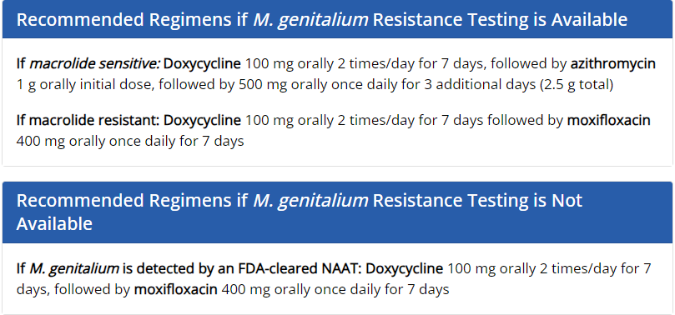
Treatment
2-stage approach, ideally using resistance-guided therapy
First step is doxycycline (reduces organism load and facilitates organism clearance)
PID treatment less clear: initial empiric therapy is doxycycline for 14 days; if tested and detected, then follow with moxifloxacin 400 mg daily for 14 days.

Slide 75
Follow Up and Treatment of Partners
Test of cure is not recommended for asymptomatic infections.
Persons with persistent symptoms can get tested and if present, treat with moxifloxacin.
Sex partners can be tested and treated if positive. If unable to test the partner, same regimen given to patient can be provided to partner.

Slide 76
Notes:
Jeannie

Slide 77
Alternative Syphilis Treatment
Doxycycline 100 mg twice a day for all except in pregnancy.
Primary or Secondary: treat for 14 days
Late latent or unknown duration: treat for 28 days
If penicillin allergic and have bicillin available, consider desensitization.

Slide 78
Notes:
Jeannie

Slide 79
Notes:
Jeannie

Slide 80
Other STI Treatments on Summary Chart
Epididymitis
Pelvic Inflammatory Disease
Genital Warts (HPV)
Pediculosis Pubis
Scabies
Notes:
Jeannie

Slide 81
Potential Barriers to Screening
Provider and clinical team discomfort
Lack of rectal screening in MSM may be due to multiple barriers, including access to care, stigma, and discrimination.
With decreased funding to STI clinics across the nation, primary care clinics like community health centers will need to provide the access to STI screening and treatment.
Reisner, S.L., Deutsch, M.B., Peitzmeier, S.M., Hughto, J.M.W., Cavanaugh, T., Pardee, D.J., McLean, S., Marrow, E.J., Mimiaga, M.J., Panther, L. and Gelman, M., 2017. Comparing self-and provider-collected swabbing for HPV DNA testing in female-to-male transgender adult patients: a mixed-methods biobehavioral study protocol. BMC infectious diseases, 17(1), p.444.
Notes:
Marwan

Slide 82
Summary
STI rates continue to rise and infections are rates are disproportionately high in certain population subsets.
Primary care clinics need to scale up screening and education to stem the rise.
Implementing best practice guidelines, collecting and analyzing QI data, and streamlining clinic workflow around sexual history taking and STI screening are key to this process.
Focusing on extra-genital testing
Adoption of self collection testing
Nurse-led screening and testing
Other innovations– same-day access, home-testing, telehealth
We need to acknowledge and address racial and ethnic disparities in STI rates
Notes:
Marwan

Slide 83
Questions?

Slide 84
Next Steps
Agenda items for your meetings during this action period
If you do not have protocols for routine HIV and STI testing/screening, discuss how to develop them.
Assignments
Review or develop current protocols for routine HIV and STI testing/screening
Review or develop a draft workflow for routine HIV and STI testing/screening, including universal testing
Review or develop a draft workflow for identifying at-risk patients and directing them to the appropriate providers for treatment
CME and Resource Page
Access Code: HIV2024
https://education.weitzmaninstitute.org/content/nttap-hiv-prevention-learning-collaborative-2024
Notes:
Meaghan

Slide 85
NTTAP Contact Information
Amanda Schiessl
Project Director/Co-PI
Amanda@mwhs1.com
Bianca Flowers
Project Manager
flowerb@mwhs1.com
Meaghan Angers
Project Manager
angersm@mwhs1.com
REMINDER: Complete evaluation in the poll!
Upcoming Coach Calls: Monday April 1st & 15th
Next Learning Session is Monday April 22nd!
Notes:
Meaghan

Slide 86
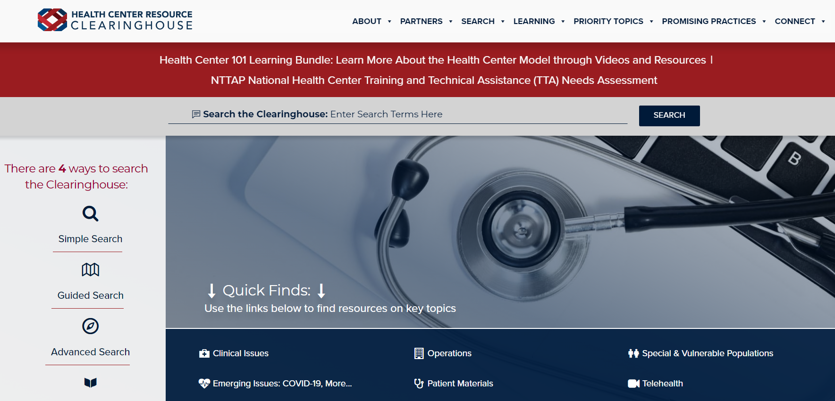
Explore more resources!
National Learning Library: Resources for Clinical Workforce Development
Health Center
Resource Clearinghouse
https://www.weitzmaninstitute.org/ncaresources
https://www.healthcenterinfo.org/
86
Notes:
Meaghan

