Slide 1

Health Profession Student Training
Learning Collaborative
Session Two: Tuesday March 5th, 2024
Notes:
Meaghan

Slide 2
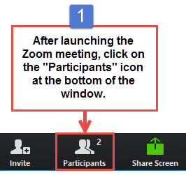
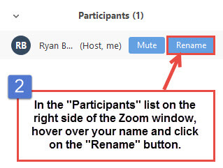
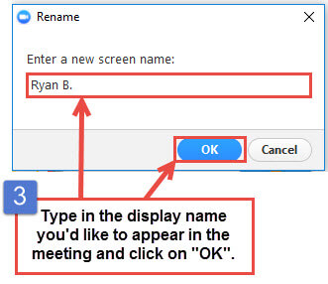
Get the Most Out of Your Zoom Experience
Please keep yourself on MUTE to avoid background/distracting sounds
Use the CHAT function or UNMUTE to ask questions or make comments
Please change your participant name to your full name and organization
  “Meaghan Angers CHCI”
Notes:
Meaghan

Slide 3
Session 2 Agenda
3:00 – 3:05 | Introduction to CHCI, Collaborative Expectations, & Structure
3:05– 3:30 | Presentation from Alluvion Health
3:30 – 3:35 | Team Introductions
3:35 – 3:45 | Session 1 Recap and Team Reports
3:45 – 4:25 | Play 3: Capacity
4:25 – 4:30 | Q/A and Wrap-Up
Notes:
Meaghan

Slide 4
Learning Collaborative Faculty
Margaret Flinter, APRN, PhD, FAAN
  Co-PI, NTTAP
  CHCI’s Senior Vice President/Clinical Director
Amanda Schiessl, MPP
  Co-PI & Project Director, NTTAP
Victoria Malvey
  Interprofessional Student Specialist
Bianca Flowers
  Project Manager, NTTAP
Meaghan Angers
  Project Manager, NTTAP
Notes:
Meaghan

Slide 5

National Training and Technical Assistance Partners
Clinical Workforce Development
Provides free training and technical assistance to health centers across the nation through national webinars, learning collaboratives, activity sessions, trainings, research, publications, etc.
Notes:
Meaghan

Slide 6
Learning Collaborative Structure
Six 90-minute Learning Collaborative video conference sessions
Bi-weekly calls between coach mentors and practice coach
Bi-weekly team workgroup meetings
Use the Weitzman Education Platform to access resources and receive CME credit
Learning Session Dates
Learning Session 1 | Tuesday February 6th
Learning Session 2 | Tuesday March 5th
Learning Session 3 | Tuesday March 26th
Learning Session 4 | Tuesday April 16th
Learning Session 5 | Tuesday May 14th
Learning Session 6 | Tuesday June 11th
Notes:
Meaghan

Slide 7
2024 Cohort
Five Rivers Health Centers | Ohio
Jessie Trice Community Health Center | Florida
Northshore Health Centers | Indiana
Primary Health Care, Inc. | Iowa
Sun Life Health | Arizona
SWLA Center for Health Services | Louisana
Tepeyac Community Health Center | Colorado
Thundermist Health Center | Rhode Island
Upper Great Lakes Family Health | Michigan
Wellspace Health | California
Notes:
Meaghan

Slide 8

Presentation from Alluvion Health
Leesha Ford, MSN, RNC-OB, CNE

Slide 9
Team Introduction

Slide 10
Health Professions Student Training Learning Collaborative
Primary Health Care, Inc.

Slide 11
The Team
Kirstin Bounds: Training Coordinator and Team Coach
Jenny Brown: Chief Human Resources Officer
Rachael Miller: Credentialing Director
Lisa Thang: Recruitment and Retention Director
Amanda Wagoner: Talent Acquisition Partner
Johanna Fernandez Rodriguez: Talent Acquisition Partner

Slide 12

Team Goals
Identify specific areas for process improvement in our student onboarding
Develop a playbook for PHC’s student onboarding and engagement
Create a job description for Student Coordinator

Slide 13
Session 1 Recap
Notes:
Amanda

Slide 14
Key Takeaways
Structured and efficient communication
Process for strategic decision making
Effective affiliation agreements that outline the responsibilities of each partner
Organized processes for maintaining and storing affiliations
Development of a strong foundational process that is maintained overtime
Notes:
Amanda

Slide 15
Health Center Team Progress
2 organizations have drafted their play 1 and 2
Beginning to have conversations with leadership to understand current partnerships and direction the organization wants to move to
  Excitement, support, and engagement surrounding formalizing the process
  Taking the time to secure champions and engage a team
Drafting and formalizing mission / vision
Notes:
Amanda

Slide 16
Team Reports

Slide 17
SWLA Center for Health Services (SWLA)
Team Report
What it was like to sit down with your team and complete Play 1 and 2?
Our committee met to discuss and clarify the information needed for each play. After identifying the specific departments for information gathering, the departmental leaders met individually with the project lead to discuss additional details of requested information. Next, the departmental leaders submitted the requested information. The project lead created the first draft of Plays 1 and 2. Thereafter, the draft was submitted to the committee for review and feedback. After consideration of feedback, changes were made and additional information was included. The final draft was submitted to the NTTAP team.
Were there any highlights or key findings from this experience?
This exercise is allowing SWLA to compile its’ current processes, from various departments, used to administer the health professions student training program in one succinct document. Various departments play a critical role in assisting potential health profession students with, program acceptance, onboarding, school and SWLA compliance, and training regarding the program. One succinct document promotes more efficiency and effectiveness regarding SWLAs health profession student training program. Moreover, compiling policies allows for additional opportunities to review and amend policies as needed.
Notes:
SWLA

Slide 18
Five Rivers Health Centers
Team Report
What it was like to sit down with your team and complete Play 1 and 2?
I am really a team of one, so I completed Play 1 and 2 by myself. I sent a copy to Carrie and received great feedback. I also had our director of our People Department (HR) look at everything and she made some great recommendations also. I have made some changes to the wording that I used.
Were there any highlights or key findings from this experience?
One highlight for me is that I now have letters that I can just copy and paste and send to people who are requesting information and I do not have to re-invent the letters each time I send a reply to someone.
Did you or are you encountering any challenges and barriers?
Since I am the only one working on the plays at Five Rivers, time to work on the projects has been a challenge. Carrie was a huge help at proofing my work.
Anything else that was interesting from your discussion!
Once again as a party of one, there was no team discussion. I did use our director of the people department preview both plays to make sure they aligned with our mission and values and processes.
Notes:
Five Rivers Health Centers

Slide 19
Play 3: Capacity
Notes:
Victoria

Slide 20
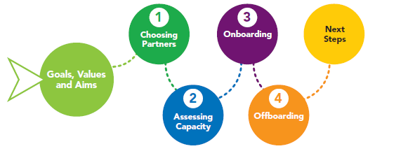
Learning Collaborative Road Map
Notes:
Victoria

Slide 21
Playbook Overview
Play 1: Partnership Approval and Communications with Schools
Play 2: Affiliation Agreement Management
Play 3: Student Capacity
Play 4: Initiating the Onboarding of a Student
Play 5: Communication with Student
Play 6: Student is Trained
Play 7: Student Arrives
Play 8: Student Documentation and Reporting
Play 9: Off-boarding
Notes:
Victoria

Slide 22
Aspects of Assessing Organizational Capacity
Assess and approve your organization’s clinical staff on their availability to precept
Maintain an available preceptor capacity report
Communicate with available preceptors regarding their interest
Assess secondary review for available space, day(s) of the week
Formally match preceptors to students
Notes:
Victoria

Slide 23
Using the Readiness to Train Assessment Tool (RTAT) to understand capacity
Additional Resources Subscale: The following resources are available and sufficient to implement and carry out the health professions training program: Staff (e.g., interested and qualified preceptors/ supervisors).
  Use results from this subscale to determine readiness
    Full Readiness [4.00-5.00] – begin outreach to preceptors
    Approaching Readiness [3.99-3.00) – need to discuss with leadership further to assess readiness
    Developing Readiness [1.00-2.99] – may need to determine a different program to invest in
Notes:
Victoria

Slide 24
Who is available to precept?
Assess and approve your organization’s clinical staff on their availability to precept
  Do you have a list of clinical staff to review?
  Who will review/approve?
  Who will maintain this list?
Notes:
Victoria

Slide 25
Report of All Eligible Preceptors
Notes:
Victoria

Slide 26
What is the criteria for availability?
Review of below factors when considering availability
  Performance (e.g. unlocked notes every week)
  Other commitments (e.g. leadership role, faculty positions)
  Personal factors (e.g. in school, personal leave)
  Fit for teaching/training
  Length of time in organization
Ensure that you have someone at the table who can provide this information (e.g. leadership/supervisors)
Ensure preceptors understand time commitment (e.g. one semester)
Notes:
Victoria

Slide 27
Creating a Spreadsheet of Available Preceptors
Notes:
Victoria

Slide 28
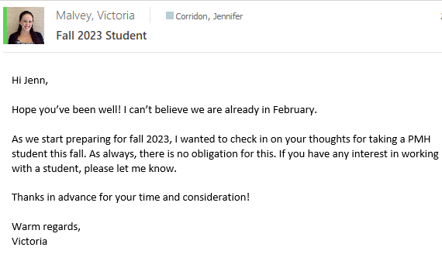
Identifying willing and available preceptors
Email to Assess Preceptor’s Initial Interest
Notes:
Victoria

Slide 29
VERY IMPORTANT –
Conducting Secondary Review
Although you may have a willing and available preceptor, a quality student training experience requires –
  Adequate space on site (e.g. desk, set-up, parking)
  Adequate training time to EHR
  Set up in systems (e.g. email, EHR accounts)
  Equipment (e.g. laptop)
  Adequate onboarding to organization
Notes:
Victoria

Slide 30
Once you’ve secured willing and
available preceptors…
Assessing credential, experience and clinical interests to prepare for match with academic affiliations
Identify preceptor preferences
Prepare communication to preceptors early in advance on student details
Assist in facilitating interview process (if applicable)
Keep On-Site Directors, Operations Managers, and Clinical Leadership involved in conversation
Notes:
Victoria

Slide 31
Willing and Available Preceptors Assigned to Academic Affiliation Requests
Notes:
Victoria

Slide 32
Negotiations with Academic Affiliations
Working with clinical leadership to match available and willing preceptors with the academic affiliation requests
Juggling organization priorities, preceptor preferences and academic affiliation requests
Finalizing the number of placements that the organization can accommodate for the requested affiliation agreements
Notify the academic institutions of available placements only after internal communication and confirmation has occurred
  Availability subjective to organization’s providers and willingness, not to school’s demands on capacity
Notes:
Victoria

Slide 33
Student Assignment to Slots
Receiving names associated with slots from academic institutions
Send Welcome email to students (Cc preceptor, site coordinator and On-Site Director)
Inform students of onboarding requirements and instructions for submission
Keep spreadsheet of student name and materials received and still pending
Keep student, site coordinator, and preceptor informed if start date is changed
Request associated syllabus/curriculum to share with preceptors
Communicate information to preceptors prior to assigning student slot
Notes:
Victoria

Slide 34
Questions?

Slide 35

Next Steps
Agenda items for your meetings during this action period
Meet with key stakeholders to present play 1 and 2 in the HPS Training Playbook Guide
Review Play 3 in the HPS Training Playbook Guide
Draft process map for play 3
Assignments
Submit rough draft of play 3
Google Drive Link: https://drive.google.com/drive/folders/1l8mFwbFw2-2Z_QgmndDL_a1Dcsmr08HX
CME and Resource Page
Access Code: HPS2024
https://education.weitzmaninstitute.org/content/nttap-health-professions-student-training-learning-collaborative-2024
Notes:
Meaghan

Slide 36
NTTAP Contact Information
Amanda Schiessl
Project Director/Co-PI
Amanda@chc1.com
Bianca Flowers
Project Manager
flowerb@chc1.com
Meaghan Angers
Project Specialist
angersm@chc1.com
REMINDER: Complete evaluation in the poll!
Upcoming Coach Calls: Tuesday March 12th
Next Learning Session is Tuesday March 26th!
Notes:
Meaghan

Slide 37





Explore more resources!
National Learning Library:
Resources for Clinical Workforce Development
Health Center
Resource Clearinghouse
https://www.weitzmaninstitute.org/ncaresources
https://www.healthcenterinfo.org/
37
Notes:
Meaghan

