Slide 1
Health Profession Student Training
Learning Collaborative
Session Three: Tuesday March 26th, 2024
Notes:
Meaghan

Slide 2
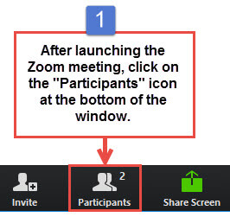
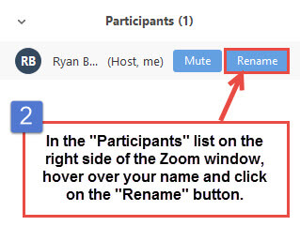
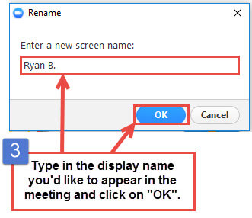
Get the Most Out of Your Zoom Experience
Please keep yourself on MUTE to avoid background/distracting sounds
Use the CHAT function or UNMUTE to ask questions or make comments
Please change your participant name to your full name and organization
“Meaghan Angers CHCI”
Notes:
Meaghan

Slide 3
Session 3 Agenda
3:00 – 3:05 | Introduction
3:05 – 3:45 | Play 4-7: Onboarding
3:45 – 4:00 | Strategic Workforce Planning
4:00 – 4:25 | Models for Training the Next Generation: Postgraduate NP and NP/PA Training Programs
4:25 – 4:30 | Wrap-Up
Notes:
Meaghan

Slide 4
Learning Collaborative Faculty
Margaret Flinter, APRN, PhD, FAAN
Co-PI, NTTAP
CHCI’s Senior Vice President/Clinical Director
Amanda Schiessl, MPP
Co-PI & Project Director, NTTAP
Victoria Malvey
Interprofessional Student Specialist
Bianca Flowers
Project Manager, NTTAP
Meaghan Angers
Project Manager, NTTAP
Notes:
Meaghan

Slide 5
National Training and Technical Assistance Partners
Clinical Workforce Development
Provides free training and technical assistance to health centers across the nation through national webinars, learning collaboratives, activity sessions, trainings, research, publications, etc.
Notes:
Meaghan

Slide 6
Learning Collaborative Structure
Six 90-minute Learning Collaborative video conference sessions
Bi-weekly calls between coach mentors and practice coach
Bi-weekly team workgroup meetings
Use the Weitzman Education Platform to access resources and receive CME credit
Learning Session Dates
Learning Session 1 | Tuesday February 6th
Learning Session 2 | Tuesday March 5th
Learning Session 3 | Tuesday March 26th
Learning Session 4 | Tuesday April 16th
Learning Session 5 | Tuesday May 14th
Learning Session 6 | Tuesday June 11th
Notes:
Meaghan

Slide 7
2024 Cohort
Five Rivers Health Centers | Ohio
Jessie Trice Community Health Center | Florida
Northshore Health Centers | Indiana
Primary Health Care, Inc. | Iowa
Sun Life Health | Arizona
SWLA Center for Health Services | Louisana
Tepeyac Community Health Center | Colorado
Thundermist Health Center | Rhode Island
Upper Great Lakes Family Health | Michigan
Wellspace Health | California
Notes:
Meaghan

Slide 8
Play 4 – 7: Onboarding
Notes:
Victoria

Slide 9
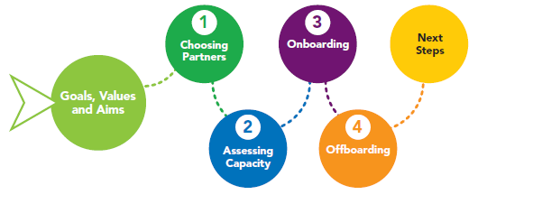
Learning Collaborative Road Map
Notes:
Victoria

Slide 10
Playbook Overview
Play 1: Partnership Approval and Communications with Schools
Play 2: Affiliation Agreement Management
Play 3: Student Capacity
Play 4: Initiating the Onboarding of a Student
Play 5: Communication with Student
Play 6: Student is Trained
Play 7: Student Arrives
Play 8: Student Documentation and Reporting
Play 9: Off-boarding
Notes:
Victoria

Slide 11
Onboarding: Key Elements
Communication
Human Resources
Information Technology
Training
Facilities and Operations
Notes:
Victoria

Slide 12
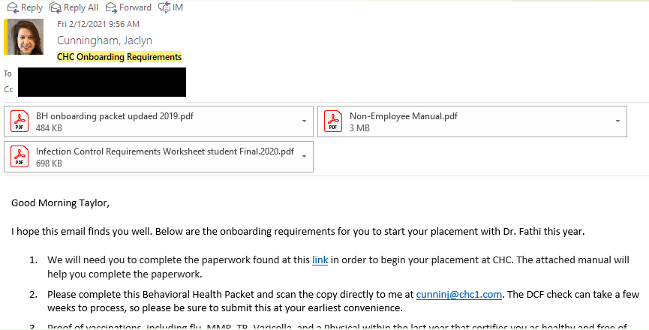
Play #4: Initiating the Onboarding of a Student
Notes:
Victoria

Slide 13
Play #5: Communication with Students
Effective communication from the initial point of contact is key to a quality student experience
Formally welcome and communicate onboarding details to the student(s)
Ensure all onboarding paperwork is completed prior to beginning placement
Orientate students to company rules and regulations including HIPAA regulations
Initiate onboarding process with Information Technology, Facilities and Training
Notes:
Victoria

Slide 14
COVID-19 Specific Onboarding Details
Through the COVID 19 pandemic across the nation, this role will requires additional responsibilities as follows:
Monitor barriers to satisfying infection control requirements (e.g. PCPs limiting routine care due to COVID-19)
Ensure background checks have been submitted accordingly
Identify students who do not have access to personal laptops for placements
Coordinate fit testing if deemed necessary for placements
Determine appropriate method for collecting needed Human Resources documentation
Refine onboarding communication for students completing placements virtually
Notes:
Victoria

Slide 15
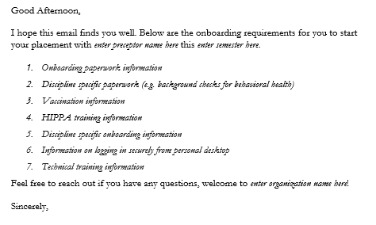
Welcome Email Example
*Onboarding communication for students participating in rotations on site during the COVID-19 pandemic will need additional instructions on appropriate PPE, instructions for onsite logistics, etc. Please ensure to tailor the above email based on that information.
Notes:
Victoria

Slide 16
Important Onboarding Best Practices
Email student and school representatives (include student preceptor on communications as well)
Incorporate students into existing HR processes if possible (e.g. contingent worker onboarding)
Strive to schedule health record training as close to start date as possible
Remember details like dress code, ID badges, parking, directions, etc.
Add the students to the internal distribution list especially important during pandemic
Notes:
Victoria

Slide 17
Managing Expectations with Student/Affiliations
A student’s ability to begin placement is contingent on a variety of factors (e.g. infection control, background checks, IT set up, technical training). It is important to effectively communicate with preceptors, academic partners and the students about their progress towards completion
Once a student has satisfied all requirements, communication to all key players should be initiated
For virtual placements, supervisors can determine start dates once requirements are satisfied
For in-person placements, it is important to discuss start dates with operations, leadership and preceptors to ensure compliance with all COVID-19 guidelines
Notes:
Victoria

Slide 18
Play 5: Communication with Students
Information Technology
Notes:
Victoria

Slide 19
Information Technology (IT)
Ensure a process/pathway for communicating necessary information to IT
IT process for identifying the students technological needs for account and equipment set ups
Access/needs varies based on discipline, remote/onsite, etc.
Work together with IT to determine the necessary time needed to set up accounts
Maintaining and managing IT equipment
Notes:
Victoria

Slide 20
Student Laptop Process
For students logging in remotely from their own laptop, coordinate a time for students to meet remotely with IT prior to electronic health record training
Ensure students are able to access their account successfully with their account prior to their placement
Students are required to keep laptops on-site – they are not able to take them
For on-site student laptops, ensure there is a standardized sign-in and sign-out process
Submit termination tickets to IT, so students do not have account access beyond the final date of their placement
Require DUO as a mean to log-in from the schools/remote if they are not on-site (same process as a CHCI employee)
Notes:
Victoria

Slide 21
IT Support
We do provide IT Support to students via email and/or phone – same process as staff
Student schedule is difficult to work with and have to reach them after hours
Notes:
Victoria

Slide 22
Questions?
Notes:
Victoria

Slide 23
Play #6: Student is Trained
Training on the electronic health record policies, standards, and functions of your organization and appropriate clinical discipline is important to setting the foundation for the student experience
Notes:
Victoria

Slide 24
Play #6: Key Steps
Identify the appropriate training needs for each student
Account for access needs to effectively train but ensure appropriate conversations with IT on access
Collaborate with the appropriate departments to identify the next available technical training
Notes:
Victoria

Slide 25
Play #6: Key Steps
Utilize existing training schedule and opportunities to abbreviate for students (e.g. attend first hour of three hours employee training)
Coordinate with student(s) regarding accommodating training prior to start
Providing students with dates/times and ensure that they understand that if unable to attend will impact start date
Do not accommodate one offs
Notes:
Victoria

Slide 26
Play #7: Student Arrives or Begins Virtually
IMPORTANT: Assure that key personnel/departments have been notified in advance, and all equipment/space is prepared for student arrival
Coordinate appropriate facilities access (e.g. badges) and space (e.g. desk, chair) for student prior to arrival
Communication details to the student (e.g. time, parking)
Ensure student has all details, access and training on joining remote prior to start
Communicate with site operations and clinical leadership
Ensure that the site has appropriate equipment for the student
Notes:
Victoria

Slide 27
Questions?

Slide 28
Strategic Workforce Planning
Notes:
Amanda

Slide 29
CHC’s Clinical-Related Workforce Development Efforts
Program | Established Year
Clinical Psychology Doctoral Psychology Internship – Child Guidance Center of Southern Connecticut (CGC) | 2003
Nurse Practitioner (NP) Residency Program | 2007
Clinical Hosting (Nurse Practitioners, Dental Hygiene, BSN Nursing, Behavioral Health, Chiropractic, MD, Dietician) | 2009
Postdoctoral Psychology Residency Program | 2011
National Nurse Practitioner Residency and Fellowship Training Consortium – NNPRFTC | 2015
National Institute for Medical Assistant Advancement – NIMAA | 2016
Center for Key Populations Fellowship | 2017
Clinical Students Programs: Caring for Underserved Populations & Clinical Longitudinal Immersion in the Community Grant | 2019
Psychology GPE Doctoral Practicum Students | 2019 – 2021 funding period
Weitzman Education – Joint Accreditation | 2020 (accreditation rec.)
Notes:
Amanda

Slide 30
CHC’s Non-Clinical Workforce Development Efforts
Program | Established Year
Wesleyan University Communities Class Research | 2006
Administrative Fellowship | 2017
AmeriCorps / ConnectiCorps | 2019
Summer Fellows | 2020
Truman-Albright Health Policy Fellowship | 2020
AcademyHealth Delivery Science Systems Fellowship | 2022
Notes:
Amanda

Slide 31
What does it mean to “Grow Your Own” workforce?
Involves educating trainees on a career providing care for the medically underserved
Present a unique opportunity to prepare pre-licensure and postgraduate health professionals to practice with confidence and competence at a high level of performance, not to just fill a job vacancy
New graduates often lack training in settings that welcome vulnerable populations, and therefore are often overwhelmed by the complexity of the patients that health centers serve.
https://www.weitzmaninstitute.org/wp-content/uploads/2022/02/NPResidencyBook.pdf
Notes:
Amanda

Slide 32
Investment in Your Workforce
Objectives for Organizations
Objectives for Trainee
Professional responsibility
Creates clinical workforce pathways
Provide clinical staff opportunity to teach
Train to a high performing model of care
Opportunity to increase confidence and competency
Train to the needs of underserved populations
Notes:
Amanda

Slide 33
Benefits to “Grow Your Own” workforce
Investing in “growing your own” allows health centers to recruit individuals within their own communities who represent the diversity of the community, particularly underserved populations.
For instance, Black, Hispanic, American Indian, Alaska Native, and Native Hawaiian and other Pacific Island people are under-represented in nearly every health care occupation
Without a strong understanding of the population, the interprofessional care team cannot effectively provide access to comprehensive, affordable, and linguistically appropriate health services that will be ready to address the health disparities of their patient populations.
https://nap.nationalacademies.org/catalog/25983/implementing-high-quality-primary-care-rebuilding-the-foundation-of-health
Notes:
Amanda

Slide 34
Strategic Workforce Planning
CHC has followed three common pathways:
Establishing relationships with academic partners for pre-licensure training
Sponsoring program for postgraduates (MD, NP, PA, Post Doc)
Incorporating opportunities for certificate level training (MA)
Notes:
Amanda
Health centers need to provide opportunities for high quality, effective training and career advancement. This requires health centers to both partner with other institutions that offer the formal degree/certification programs, but also to develop their own training programs and career advancement strategies. When developing these training programs, health centers should consider the needs and demographics of the population and economic and sociocultural contexts of the community.

Slide 35
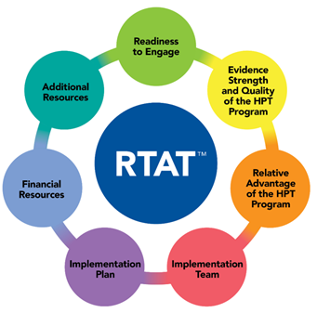
Utilizing the Readiness to Train Assessment Tool (RTAT) for Strategic Workforce Planning
As part of HRSA’s Health Professions Education & Training (HP-ET) initiative, Community Health Center (CHC), Inc., a HRSA-funded National Training and Technical Assistance Partner (NTTAP), received funding to develop a tool to help health centers assess and improve their readiness to engage in health professions training programs.
Creating this tool required extensive literature review to create the framework/subscales and that process gave us expertise at to what health professions training is and made us realize there was no clear definition of HPT before creating this tool
Access the tool: https://www.chc1.com/rtat/
Notes:
Amanda
Will provide more information on the tool and utilizing it at your organization towards the end of the presentation.
The RTAT is a 41-item, 7-subscale structure of the survey was derived through exploratory factor analysis.
Cronbach’s alphas (.79 -.97) indicated good to excellent reliability.
The instrument covers dimensions of health center readiness for engaging with HPT programs that were deemed critical to evaluate by the project’s subject matter experts.
The advantage of the RTAT™ is that it covers organizational readiness dimensions that are relevant to all kinds of health professions training programs and types of health centers.
The seven sub-scales that emerged from the data analysis represent seven areas of readiness:
Readiness to engage (8 items),
Evidence strength and quality of the HPT program (4 items),
Relative advantage of the HPT program (4 items),
Financial resources (3 items),
Additional resources (3 items),
Implementation team (4 items), and
Implementation plan (15 items).

Slide 36
How do we identify models using the RTAT?
Results inform:
Determinations of individual health center readiness to engage with HPT programs
Determinations of readiness at various levels for the purposes of evaluation and support
Development of a system of effective and instructionally useful strategies to improve readiness
Readiness improvement
Decisions cannot happen in silos
The RTAT is designed to take again and again – can download the PDF on our website (www.chc1.com/RTAT), create survey, and follow instructions on how to aggregate the data
36
Notes:
Amanda

Slide 37
Road Map for Growing Your Own Training Programs
Create a working group to bring together key stakeholders (HR, clinical leaders, IT)
Complete the Readiness to Train Assessment (RTAT) with your organization
Determine health professions pathway
Deeper dive into replicable models, best practice, and partnership opportunities
Assess your organization’s capacity and infrastructure
Designate a champion for this initiative
Develop a plan and a team to go from planning to implementation
Notes:
Amanda

Slide 38
Questions?

Slide 39
Postgraduate Nurse Practitioner and Nurse Practitioner/Physician Associate Training Programs
Charise Corsino, Program Director, NP Residency Programs
Notes:
Charise

Slide 40
Objectives
Learn the framework for building a clinical workforce pipeline
Identify the drivers of implementing postgraduate training program at your health center
Understand the key components and resources needed postgraduate training programs
Identify the benefits of implementing postgraduate training programs
Notes:
Charise

Slide 41
Poll:
Have you thought about starting a Postgraduate NP or NP/PA Training Program at your health center?
Notes:
Charise

Slide 42
Building a Clinical Workforce Pipeline at Federally Qualified Health Centers
Student
Clinical Placement
Postgraduate Trainee
Full-Time Provider
Preceptor/
Faculty
Notes:
Charise
A new slide – but I think this framework is really important and also has been an increasing factor in our success if getting NPs interested in primary care and community health as well as a pipeline to for residents and training

Slide 43
CHC Student & Resident Overview
311 Students and Residents completed their placements at CHC in 2023
Student disciplines include non-clinical research, resident, and medical
Placements primarily hybrid/remote
Of the students trained since 2018, CHCI has employed 84 students following their placements and retained 64% of those employees as of March 2024.
Notes:
Charise
CHCI’s dedication to training the next generation of the healthcare workforce is seen in the educational and training placements offered across the agency in all disciplines including medical, dental, behavior health, as well as some non-clinical students and residents/fellows such as our Administrative Fellowship. CHCI has been providing health professional education and training for decades. In 1981, CHCI hosted its first clinical student placement, a nurse practitioner, and has not stopped since; today CHCI hosts clinical placements for more than 400 trainees on average each year. Of the students trained since 2018, CHCI has employed 84 students following their placements and retained 64% of those employees as of March 2024. CHCI has affiliation agreements with over 20 different educational institutions, including Yale University, Univeristy of Connecticut (UConn), Tunxis Community College, University of Bridgeport, Wesleyan University, Quinnipiac University, and health care institutions including, Middlesex Health System, St. Francis Hospital, and UConn School of Medicine. Over 30 years ago, CHCI established a collaborative relationship with the Family Medicine Residency Program of Middlesex Hospital under which residents and faculty joined CHCI’s maternal care and prenatal program. This collaboration has given generations of family medicine residents an intensive exposure to the health center model of care. CHCI has a long-standing commitment to collaborating with academic institutions to pilot, test and scale innovative clinical placements with the objectives of providing comprehensive didactic and clinical experiences that prepare students to deliver effective integrated care services, and preparing students upon graduation to provide high-value care within complex health settings for medically underserved communities.

Slide 44
Growth and Development of CHCI Postgraduate Residency Training Programs
Notes:
Charise

Slide 45
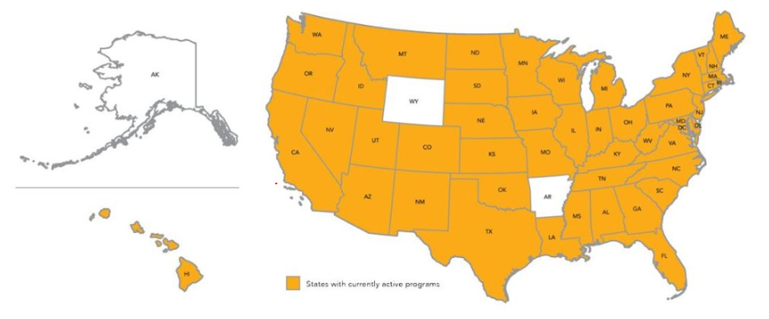
National Landscape:
Postgraduate Residency/Fellowship Programs
APP Postgraduate Training Programs Total 500+ Programs Nationally (continues to grow)
Over 100 in health centers!
Notes:
Charise
Since we’ve started in 2007, this is how the movement have grown
Always growing

Slide 46
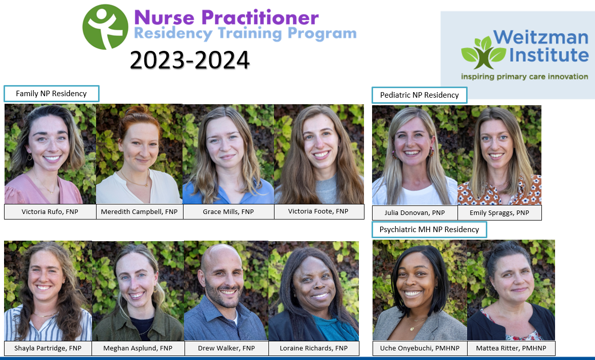
CHCI NP Residency Program Today
Country’s first program (est. 2007)
Operating for 17 years
Graduated 155 alumni
Recipient competitive HRSA grants for
Advanced Nursing Education
NP Residency Tracks:
Family NPs (est. 2007)
Psych MH NPs (est. 2015)
Pediatric NPs (est. 2019)
Post-residency Fellowship (est. 2017)
Notes:
Charise

Slide 47
Why Start a Postgraduate Residency Program?
Address the shortage of expert providers, particularly for vulnerable populations
Give new primary care medical and behavioral health providers the opportunity for postgraduate residency training in fully integrated primary care settings
Support the development of confidence, competence and mastery in the health center setting
Reduce attrition due to burnout and distress during the initial postgraduate year
Provide the depth, breadth, volume, and intensity of clinical training
Prepare the next generation of leadership for health centers
For the common good
For the good of your organization
For the good of clinicians
Notes:
Charise

Slide 48
Program Drivers
Your organization should ask:
Why start a postgraduate residency training program?
What are your drivers?
Recruitment
Training
Retention
Clinical Workforce
Notes:
Charise

Slide 49
Drivers in Developing a Model for Postgraduate NP Training
Increase the nation’s ability for every person to have an expert primary care provider, but particularly in underserved communities and special populations.
Provide new NPs committed to practice careers as PCPs with an intensive training experience focused on training to clinical complexity and high performance.
Provide a highly structured transition from university to practice that supports the development of confidence, competence, and mastery in the FQHC setting.
Utilize the postgraduate training year to develop expertise in high volume/high burden condition such: chronic pain, HIV, Hepatitis C, addiction.
Create a nationally replicable, sustainable model of primary care based postgraduate training for new NPs.
Notes:
Charise

Slide 50
Core Elements of Postgraduate NP Residency
12 Months Full-time Employment | Training to Clinical Complexity and High Performance Model of Care | Full Integration at Organization
Team-based care Integrated care Inter-professional collaboration | Data driven QI Expert use of technology Primary care innovations
Clinical Based Training Experiences (80% of time) | Education (20% of time)
Precepted Continuity Clinics (40%); Develop and manage a panel of patients with the exclusive and dedicated attention of an expert preceptor. Specialty Rotations (20%); Experience in core specialty areas most commonly encountered in primary care focused on building critical skills and knowledge for primary care practice. Mentored Clinics (20%); Focused on diversity of chief complaints, efficiency, and acute care working within a variety of primary care teams. | Didactic Education - High volume and burden topics most commonly seen in primary care. Project ECHO – Case-based distance learning in high complexity issues like chronic pain, treating HIV, Hepatitis C, and MOUD Quality Improvement Training - Training to a high performance QI model, including frontline process improvement, collecting and reviewing data, and leadership development

Slide 51
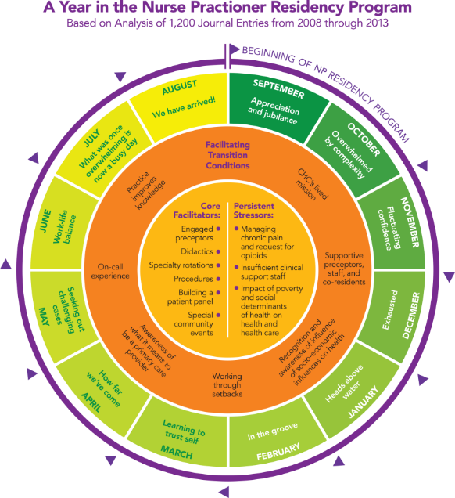
Thematic Elements of Postgraduate NP Residency Year Flinter, Margaret, Ann Marie Hart, Journal of Nursing Education and Practice (2016).
A Year in the
NP Residency Program
Based on Analysis of
1,200 Journal Entries
From 2008 through 2013
Notes:
Charise

Slide 52
Residency Recruitment
Have a particular focus on candidates committed to community health and who have done rotations in health centers or similar settings
Have noted strong connections for candidates who have experience at health centers and particularly at CHC
Benefits of having rotations at CHC:
Understand patient population, culture, and pace
Work directly with a provider and their teams who are either preceptors or former residents
Often get to see and interact with current residents in real time and observe their experience training in the residency
Notes:
Charise
Current reflections on recruitment for residency – impact of clinical placement wanting to work at an FQHC

Slide 53
Resources
Training the Next Generation E-Book https://www.weitzmaninstitute.org/NPResidencyBook
Building the Case for Implementing Postgraduate NP Residency and NP/PA Training Programs Webinar https://vimeo.com/655094514
Postgraduate Nurse Practitioner Residency and Fellowship Program Learning Collaborative
Notes:
Charise

Slide 54
Questions?
Notes:
Charise

Slide 55
Next Steps
Agenda items for your meetings during this action period
Meet with key stakeholders and present play 3
Review play 4-7 in the HPS Training Playbook Guide
Draft process map for play 4-7
Assignments
Submit rough draft of plays 4-7
Google Drive Link: https://drive.google.com/drive/folders/1l8mFwbFw2-2Z_QgmndDL_a1Dcsmr08HX
CME and Resource Page
Access Code: HPS2024
https://education.weitzmaninstitute.org/content/nttap-health-professions-student-training-learning-collaborative-2024
Notes:
Meaghan

Slide 56
NTTAP Contact Information
Amanda Schiessl
Project Director/Co-PI
Amanda@chc1.com
Bianca Flowers
Project Manager
flowerb@chc1.com
Meaghan Angers
Project Specialist
angersm@chc1.com
REMINDER: Complete evaluation in the poll!
Upcoming Coach Calls: Tuesday April 2nd
Next Learning Session is Tuesday April 16th!
Notes:
Meaghan

Slide 57
Explore more resources!
National Learning Library: Resources for Clinical Workforce Development
Health Center
Resource Clearinghouse
https://www.weitzmaninstitute.org/ncaresources
https://www.healthcenterinfo.org/
57
Notes:
Meaghan

