Slide 1

Postgraduate Nurse Practitioner Residency & Fellowship Program Learning Collaborative
Session Five: Tuesday March 5th, 2024
Notes:
Meaghan

Slide 2
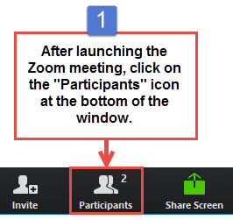
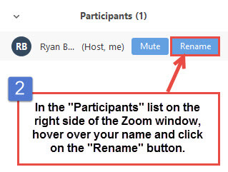
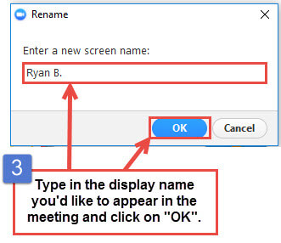
Get the Most Out of Your Zoom Experience
Please keep yourself on MUTE to avoid background/distracting sounds
Use the CHAT function or UNMUTE to ask questions or make comments
Please change your participant name to your full name and organization
  “Meaghan Angers CHCI”
Notes:
Meaghan

Slide 3
Session 5 Agenda
1:00-1:05 | Introduction and Agenda
1:05-1:25 | Evaluation of the residency program & resident learner
1:25-1:40 | Orientation
1:40-1:55 | Graduation
1:55-2:15 | Introduction to Accreditation
2:15-2:25 | Questions?
2:25-2:30 | Wrap-Up and Evaluation
Notes:
Meaghan

Slide 4

National Training and Technical Assistance Partners
Clinical Workforce Development
Provides free training and technical assistance to health centers across the nation through national webinars, learning collaboratives, activity sessions, trainings, research, publications, etc.
Notes:
Meaghan

Slide 5
Learning Collaborative Faculty
Margaret Flinter, APRN, PhD, FAAN
  Co-PI, NTTAP
  CHCI’s Senior Vice President/Clinical Director
  Director Emeritus, WI, Senior Investigator
  Founder of America’s first nurse practitioner residency program
Kerry Bamrick, MBA
  Executive Director, Consortium for Advanced Practice Providers
  Coach Mentor
Charise Corsino, MA
  Program Director, NP Residency Programs
  Coach Mentor
Nicole Seagriff, DNP, APRN, FNP-BC
  Clinical Program Director
Kathleen Thies, PhD, RN
  Consultant, Researcher
  Evaluation Faculty
Amanda Schiessl, MPP
  Co-PI & Project Director, NTTAP
Bianca Flowers
  Project Manager, NTTAP
Meaghan Angers
  Project Manager, NTTAP
5
Notes:
Meaghan

Slide 6
Learning Collaborative Structure
Six 90-minute Learning Collaborative video conference sessions
Bi-weekly calls between coach mentors and practice coach
Bi-weekly team workgroup meetings
Use the Weitzman Education Platform (Share Your Work, Resources, etc.)
Learning Session Dates
Learning Session 1 | Tuesday November 21st
Learning Session 2 | Tuesday December 19th
Learning Session 3 | Tuesday January 16th
Learning Session 4 | Tuesday February 13th
Learning Session 5 | Tuesday March 5th
Learning Session 6 | Tuesday April 2nd
6
Notes:
Meaghan

Slide 7
2023-2024
Cohort
Bartz-Altadonna Community Health Center | California
Charles B. Wang Community Health Center | New York
Chase Brexton Health Care | Maryland
Community Clinic Association of Los Angeles County (CCALAC) | California
Crossing Healthcare | Illinois
Hope Christian Health Center | Nevada
Klamath Health Partnership | Oregon
Nasson Health Care | Maine
Neighborhood Outreach Access to Health | Arizona
Peninsula Community Health Services | Washington
Penobscot Community Health Center, Inc. | Maine
Primary Health Network | Pennsylvania
WellSpace Health | California
Wheeler Health | Connecticut
7
Notes:
Meaghan

Slide 8
Let’s Review
Session 1
Session 2
Session 3
Session 4
Session 5
Program Drivers
Mission/Vision
Resource Assessment
Support from Leadership/ Board of Directors
Overview of Program Structure
Value of Academic Clinical Partnerships
Overview of Program Structure
Key Program Staff and Responsibilities Using the Progress Checklist
Preceptors, Mentors, & Faculty
Marketing and Recruitment
Reviewing Candidate Applications
Interviewing & Selecting Candidates
Finances, ROI, and Sustainability
Program Policies and Procedures
Contracts/ Agreement
Curriculum Development
Evaluation of the Postgraduate Residency Program
Evaluation of the Resident Learner
Orientation
Graduation
Introduction to Accreditation by the Consortium
8
Notes:
Meaghan

Slide 9
Evaluation – Postgraduate Residency Program

Slide 10
Purpose of Evaluation
Be anchored in your program’s mission
Integrated throughout the Program – from recruitment to graduation
Create explicit expectations for trainee
Document programmatic success and challenges
Foster improvement positive growth, creativity and innovation
Notes:
Charise

Slide 11

Characteristics of Good Evaluation
Systematic formative (on-going) and summative (final) data collection
Designed before the program begins
Clearly communicated to all program participants
Bi-directional
Overall program review
Identify strengths and opportunities for improvement
Notes:
Charise

Slide 12

Questions Guiding the Evaluation Process
What will be evaluated?
What criteria will be used to judge program performance?
What standards of performance on the criteria must be reached for the program to be considered successful?
What evidence will indicate performance on the criteria relative to the standards?
What conclusions about program performance are justified based on the available evidence?
Notes:
Charise

Slide 13
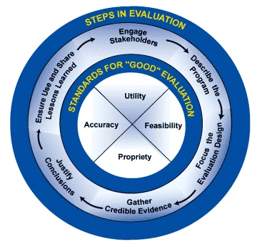
Evaluation Process: How Do You Do It?
Steps in Evaluation
  Engage stakeholders
  Describe the program
  Focus the evaluation design
  Gather credible evidence
  Justify conclusions: Analyze, synthesize and interpret findings, provide alternate explanations
  Feedback, follow up and disseminate: Ensure use and share lessons learned
Notes:
Charise

Slide 14
Evaluation – General Guidelines
Must use an objective, systematic and cumulative evaluation process that is based on the Program’s core elements, competencies and curriculum components
Notes:
Charise

Slide 15
Core Evaluation Components
Assessing the Postgraduate Trainee
Organizational Evaluation
Clinical Faculty Evaluation
Ongoing Program Evaluation
Notes:
Charise

Slide 16

Fitting the Pieces Together: Program Evaluation
Trainee
Overall Program
Preceptor
Faculty
Staff
Program Curriculum
Institution
Notes:
Charise

Slide 17
Evaluating the Postgraduate Trainee
Assess the performance and development of each trainee
Periodic, objective assessment focused on core competencies in clinical and professional areas
Include identification of deficiencies or performance concerns
Develop clear process for promptly identifying and addressing trainee’s issues including a performance improvement plan with measurable outcomes
Notes:
Charise

Slide 18
The Postgraduate Trainee
Trainee’s self-assessment of competency
Trainee’s evaluation of all core program components:
  Preceptors for continuity and specialty clinics
  Weekly didactic sessions, etc.
Preceptors’ assessments of the trainee’s performance
Trainee’s reflective self assessment of their experience
Final programmatic evaluation
Assist the trainee in assembling the assessment elements
  Learning portfolio
  Coaching sessions
Notes:
Charise

Slide 19
Clinical Faculty Evaluation
Established process to regularly evaluate all clinical faculty, including preceptors and didactic faculty
  Evaluators include (but not limited to) trainees and program director
Have clear process for promptly identifying and addressing any faculty performance issues including performance improvement plan with measurable outcomes
Notes:
Charise

Slide 20
Organizational Evaluation
The Program must review and assess the operational impact of the Program on the overall organization and evaluate for improvements or efficiencies in the business operations
  Financial
  Administrative
  Operational
A documented process for initial and on-going evaluation of all sites used for trainees’ clinical practice experiences
  The site itself (resources provided, staff, etc.)
  The trainee’s experience at the site
Recommend Residency Advisory Committee
Notes:
Charise

Slide 21
Ongoing Program Evaluation
  Established process
  Periodic, at least annual evaluation
  Suggested areas to document the findings
  Postgraduate trainee completion rates; withdrawals or dismissals
  Postgraduate trainee evaluations of core program elements
  Preceptor evaluations of trainees’ performance
  Graduate employment data
  Alumni satisfaction
  Employer satisfaction (if possible)
  Program staff turn over
  Suggested areas for documentation of evaluation process and subsequent action plan - Identified strengths and weaknesses, opportunities for improvement
  Structural or content program adjustments to address areas needing improvement
  Evidence of improvement resulting from implementation of action plan
Notes:
Charise

Slide 22
Evaluation – Didactic Learning Objectives
Know the characteristics of good evaluation
Understand the process of evaluation
Understand the connection with curriculum
Understand how the accreditation standards serves as a foundation for program development
Notes:
Charise

Slide 23
Importance of Evaluation
Helping to clarify program plans
Links the curriculum to outcomes
Improving communication among participants and partners
Gather feedback needed to improve and be accountable for program outcomes/effectiveness
Gain insight about best practices and innovation
Determine the impact of the program
Empower program participants and contribute to organizational growth
Notes:
Charise

Slide 24
Conclusion –
5 Basic Steps to Program Evaluation
Use the accreditation standards as a roadmap
Develop a written plan linked to program curriculum
Collect data
Analyze data
Communicate and improve
Notes:
Charise

Slide 25
Evaluation – Resident Learner

Slide 26
Evaluations – What We Evaluate
Competency Domains
Evaluation is planned, ongoing, and bi-directional
Regular assessments of NP Residents
Resident evaluation of program including experiences and preceptors
Ongoing internal program evaluation
Patient Care
Practice-Based Learning and Improvement
Interpersonal and Communication Skills
Systems-based Practice
Knowledge for Practice
Inter-professional Collaboration
Personal and Professional Development
Technology and Telehealth*
Diversity, Equity, and Inclusion*
Professionalism
Resident
Program
Faculty
* New competency domains 2023 Accreditation Standards
Notes:
Charise

Slide 27
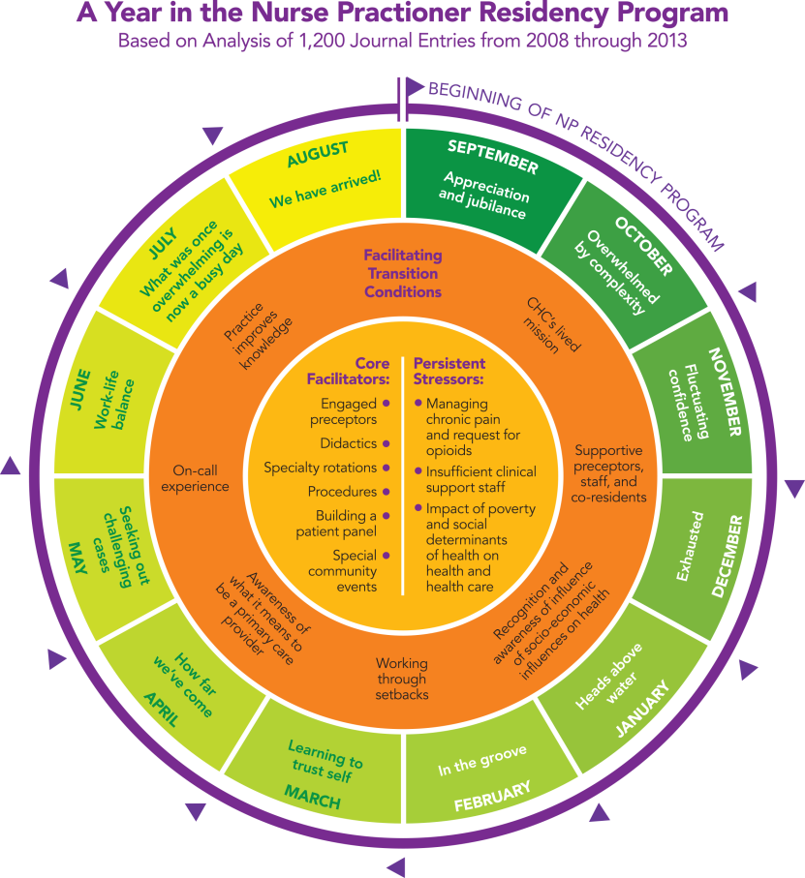
Residency Experience and Outcomes
Focus on managing complex patients, expert use of data, specialty training in priority areas, full scope of practice, and preparing for careers as PCP.
Develop a panel of approximately 300-400 patients/1,000 visits
Portfolio of clinical procedures commonly seen in primary care
Quality Improvement project focused on improvement within practice setting
Notes:
Charise

Slide 28
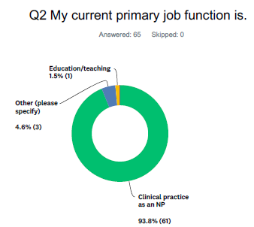
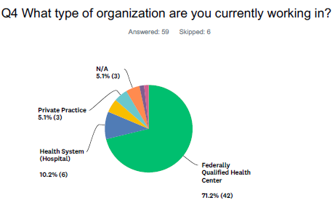
Evaluation of Program – Alumni
Demonstrate achievement of program goals and objectives
Provides overall outcome measures for your training program
Recommend collecting annual data on your cohort of alumni
Notes:
Charise

Slide 29
Residency Program Management & Evaluations
There are many strategies for approaching program management and evaluations:
  Microsoft products - Word, Excel, One Note
  Survey monkey, Qualtrics, My Evaluations
  Larger Platform- Medical Education Management Software (Med Hub/New Innovations)
  Allows for greater program management capabilities
Notes:
Charise

Slide 30
Factors to Consider When Choosing
Program Management Tools
Does your organization have any existing education management software/residency management software?
How large is your program?
Are you looking for a free resource or do you have the budget to purchase a platform?
What are your priorities in a system – having a single system? Simplicity? Automation?
Notes:
Charise

Slide 31
Questions?

Slide 32
Orientation
Notes:
Kerry

Slide 33

Orientation
Intensive orientation
To the PROGRAM
To the ORGANIZATION
To the SITE
To the COMMUNITY
The basics
Takes place over the course of 3 to 4 weeks
Includes both organizational and clinical trainings
Completed in person at the service delivery site
Notes:
Kerry

Slide 34
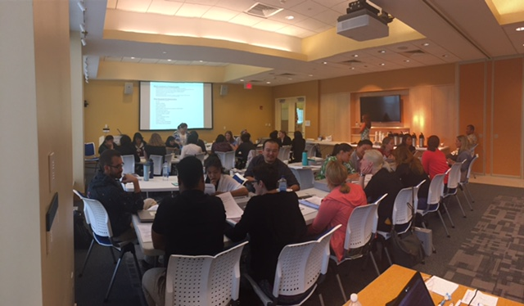
Employee Orientation
Residents should go through your normal employee orientation that all new staff go through
Will cover organizational trainings, policies and procedures, technical training
Coordinate with your HR team to know what they cover in orientation – reduce any redundancies between program and employee orientation
Should include intensive EMR training
Notes:
Kerry

Slide 35
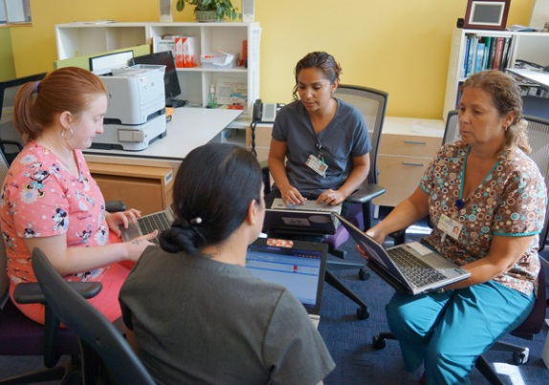

Site Orientation
Shadowing all positions on staff
  Front desk staff
  Nurse, Medical Assistant, PCP
  Behavioral Health
  Dental
  Other services: nutritionist, pharmacist, diabetes educator lactation consultant
Notes:
Kerry

Slide 36

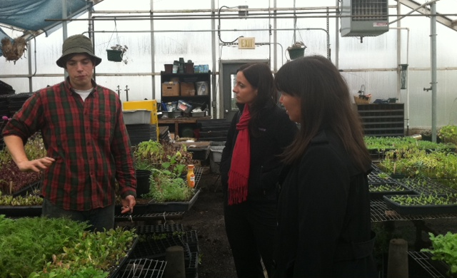
Community Orientation
Introduction to UDS data
Community Tours – meetings with community leaders and key stakeholders
Community Immersion Excursion – walking tour of community
Community Event
Notes:
Kerry

Slide 37
Graduation
Notes:
Kerry

Slide 38


Graduation Planning
Start planning early
Assemble a team
Create a task list with timeline
Document everything
Notes:
Kerry

Slide 39
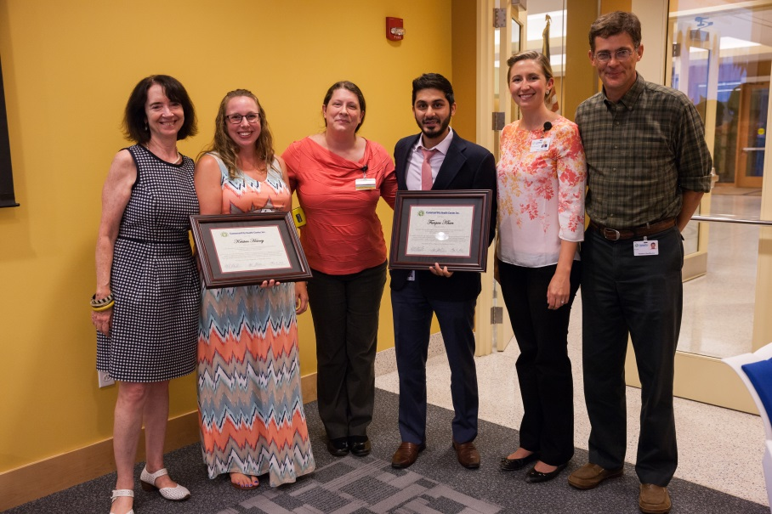
Graduation Planning Considerations
3-4 Month Check-list
Set a date and time
Send Save-the-Date
Budget
Venue
Guest List
Food
Begin thinking about Program & Gift
Notes:
Kerry

Slide 40
6 - 8 Week Check-List
Collect RSVPs
Continue working on Program
1-2 Week Check-List
Confirm with all vendors/contributors (caterer, photographer, venue)
Send reminders to all guests
Finalize program/event briefing and confirm with all contributors
Notes:
Kerry

Slide 41
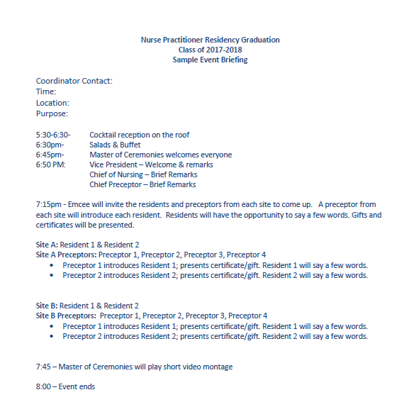
Sample Program
Notes:
Kerry

Slide 42
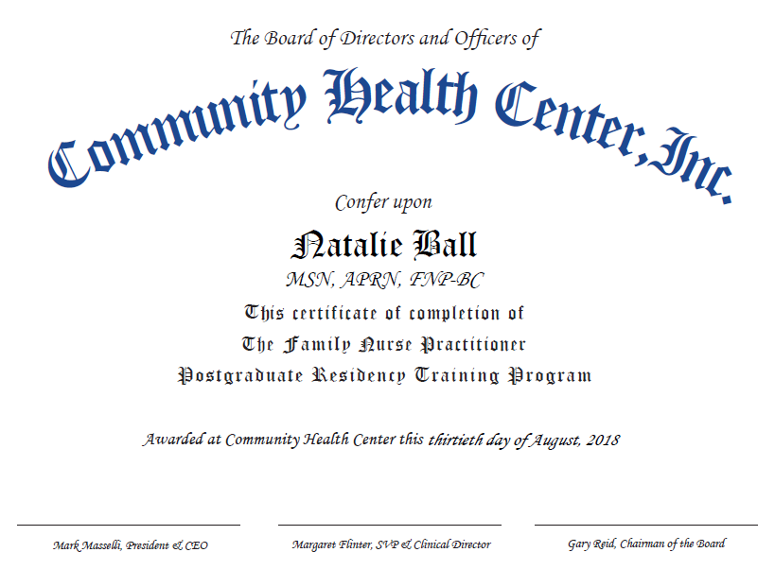
Sample Certificate
Notes:
Kerry

Slide 43
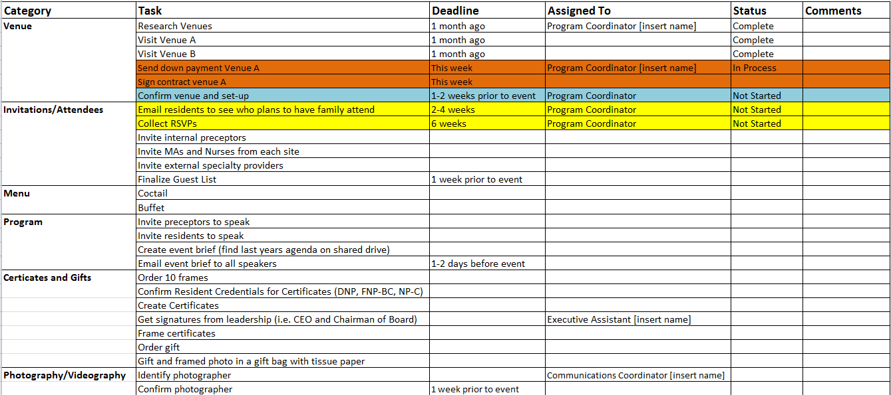
Timeline Example
Notes:
Kerry

Slide 44
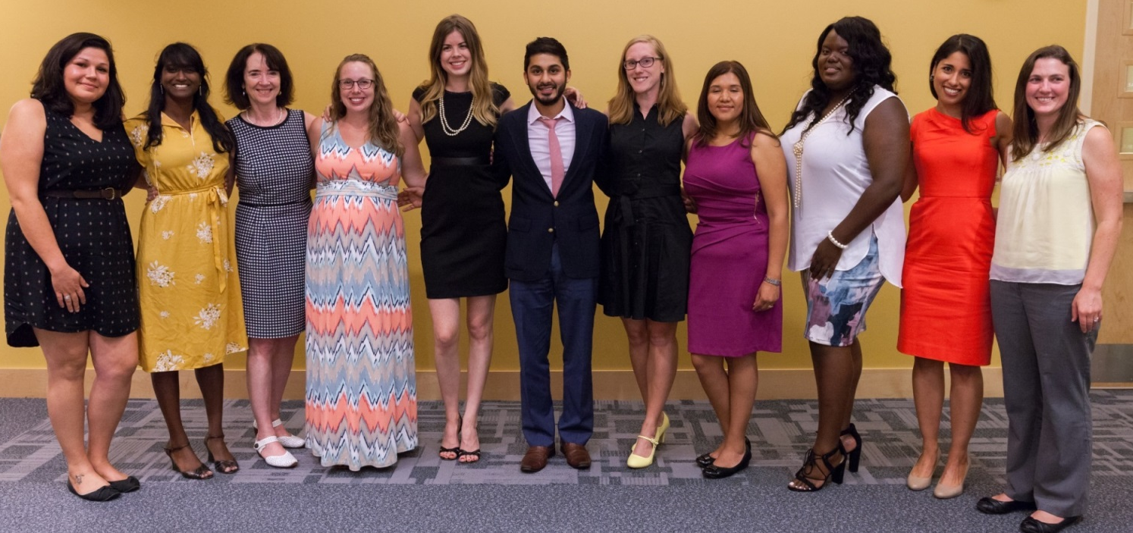
After the Event
Debrief – Meet with key individuals to celebrate successes and review lessons learned for next time.
Notes:
Kerry

Slide 45
NP Residents’ Portfolio
Residents receive a portfolio that includes all of their patient visit data, as well as all of their reflective journals.
Number of visits
Number of procedures
Panel size
Breakdown of patient by age, common conditions, etc.
Reflective Journals
Evaluation data
CME and QI certificates
Notes:
Kerry

Slide 46

Anchoring Your Program Around the Accreditation Standards

Slide 47

History of the Consortium
2010: Convened as informal consortium in 2010 by 4 FQHC-based postgraduate NP
training programs
2013: Identified accreditation as a goal early on; no available existing sources of accreditation at the time; committed to developing program that is eligible for US Dept. of Education Federal recognition
2013–2015: Accreditation Standards: authored by 10 NP nationally recognized expert authors—written by NP program directors for NP program directors; Self Study Guide
2015: CHCI formally incorporated a new 501c3, the NNPRFTC, to advance the postgrad NP training movement, including developing of accreditation program
2016: Accreditation action for first 2 programs
2017-Present: 17 accredited programs, others in the pipeline
2019: U.S. Department of Education Petition for Federal Recognition as an Accreditor
2020: 3 programs received renewal of accreditation. Awaiting US Dept. of Education on next step in the recognition process.
2022: The consortium receives Federal Recognition by the United States Department of Education
2023- Consortium Name Change, 2023 Accreditation Standards Released and Expansion of Scope petition submitted to the U.S. Department of Education.
2024- Expansion of Scope Approval to become Federally recognized for NP/PA Postgraduate Training Programs
Notes:
Kerry

Slide 48
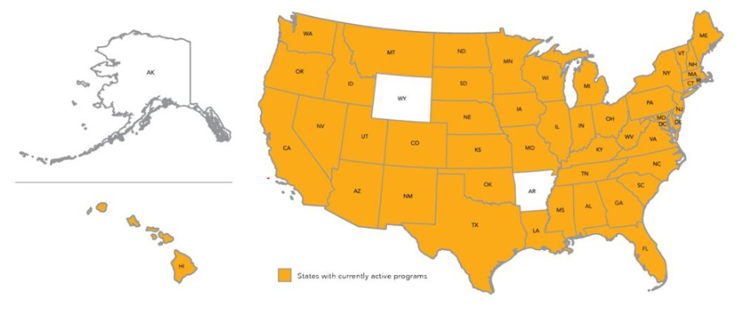
APP Postgraduate Training Programs
Total 500+ Programs Nationally (continues to grow)
Notes:
Kerry

Slide 49
Accreditation Defined
External, independent review of a health care training program against nationally-accepted Standards and its own policies, procedures, processes, and outcome (AAAHC)
Peer-reviewed, voluntary program evaluation
Practice-based determination of adherence to National Standards
National acknowledgement of quality

Slide 50
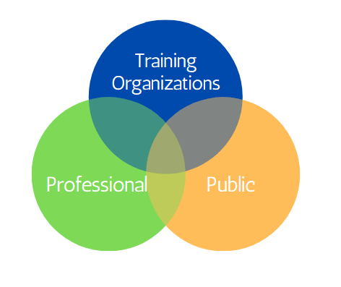
Benefits of Accreditation

Slide 51

Consortium’s Standards Driving
Excellence in Program Design
Standard 1: Mission, Goals, Objectives
Standard 2: Curriculum
Standard 3: Evaluation
Standard 4: Program Eligibility
Standard 5: Administration
Standard 6: Operations
Standard 7: Staff
Standard 8: Postgraduate Trainee Services

Slide 52
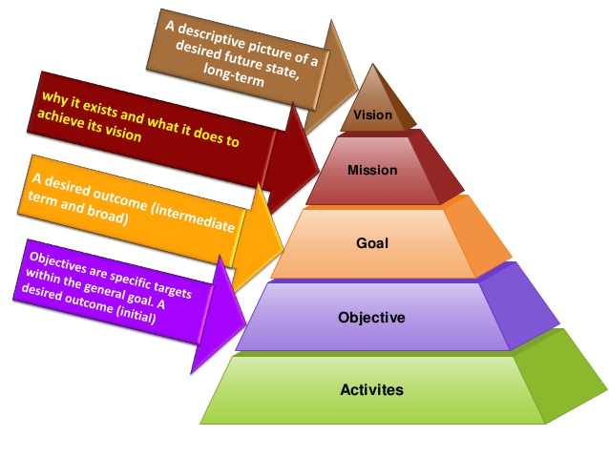
    - Recruitment and retention of PCPs are crucial in patient care
    To educate and retain NPs
    Prepare NPs for post-graduate autonomy
    Improve confidence and competence
    Improve job satisfaction
    Specific objectives within general goals
    Detailed curriculum
Notes:
Kerry

Slide 53
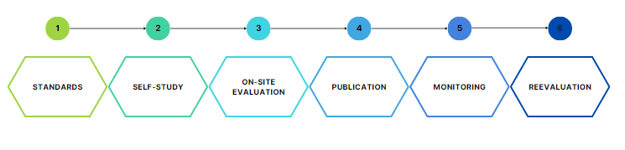
US. Department of Education
Accreditation Process
6 Major Steps

Slide 54
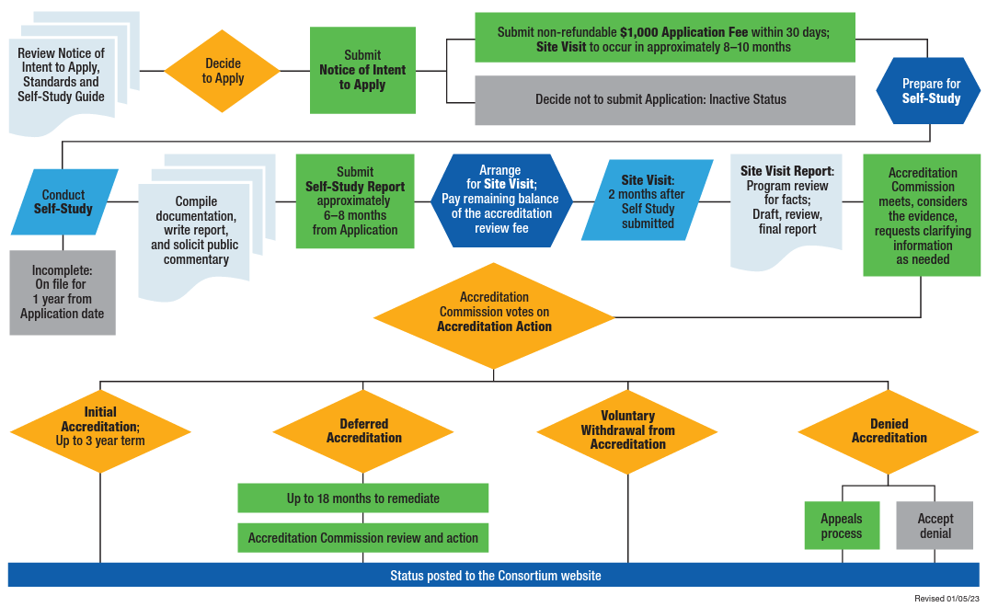
Accreditation Process

Slide 55
Consortium Accreditation Sample Timeline
General Timeframe, Application to Decision (10-12 months)
Intent to Apply
Application
Self Study: internal program evaluation
1.5 day On-site Visit: external program evaluation (completed by 2 trained site visitor peers (educator, administrator, clinician)
Site Visit Report: reviewed by program, submitted to Accreditation Commission for accreditation consideration
Decision: Accredited, Deferral, or Denial of Accreditation
Posted to Consortium website
Annual and Interim Reports
Extensive technical support available throughout the process

Slide 56
Consortium Accreditation Costs
Total Cost: $10,000
$1,000 non-refundable application fee
$9,000 review fee: due prior to the site visit (discounted fee schedule for Federal Programs)
For programs with multiple tracks:
  $10,000 plus $6,500 for each additional track (possible travel costs)

Slide 57
Consortium Accreditation
Accreditation Awarded for 3 Years
First award is retroactive to current class
Eligible for continuing Accreditation if Standards continue to be met
Receive Consortium for Advanced Practice Providers seal, which can be displayed on all communications, in accordance with the Consortium policies and procedures

Slide 58

Accreditation Anchors Program Development

Slide 59
Accredited Programs
As of March 2024: Consortium has accredited 34 APP Postgraduate Training Programs with several in the pipeline pursuing accreditation.
View Accredited Programs here: https://www.apppostgradtraining.com/accreditation/accreditation-status-and-public-commentary/

Slide 60
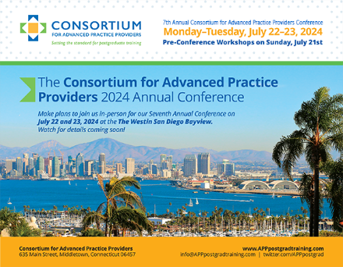
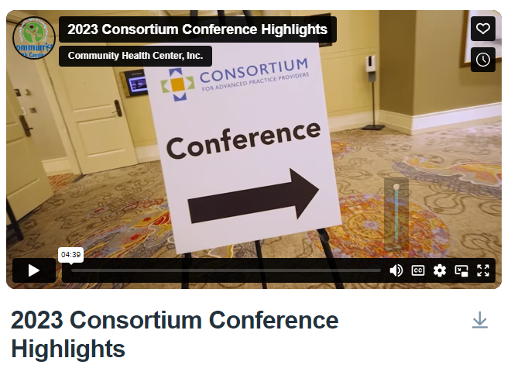
2024 Annual Conference
https://www.apppostgradtraining.com/2023/11/07/save-the-date-for-the-annual-conference/
https://vimeo.com/851295345/4cfb0e9473
Notes:
Kerry

Slide 61
Questions?
Notes:
Meaghan

Slide 62
Wrap-Up
Notes:
Meaghan

Slide 63
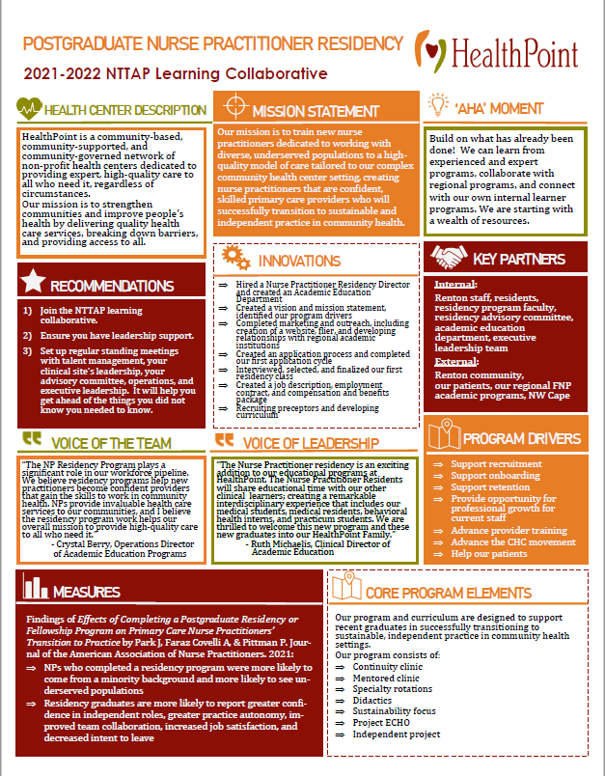
Showcase Overview
Due Date: Monday March 18th
Showcase Date: Tuesday April 2nd
Team coaches will be sent a template, including:
  Innovations*
  ‘Aha’ Moments*
  Recommendations to others*
  Aim Statement
  Measures/Impacts
  Key Partners
  Quote from leadership
  Quote from team member
  Process Map or other visuals (i.e. photos, graphs)
*Required
63
Notes:
Meaghan

Slide 64
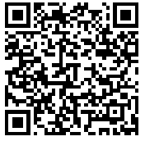
Deliverables
Continue to work on Progress Checklist
Showcase presentation
Google Drive
https://drive.google.com/drive/folders/1WgVbObv-KgPfz5UyKgSuXsWj09Skq1pp?usp=sharing
Notes:
Meaghan

Slide 65
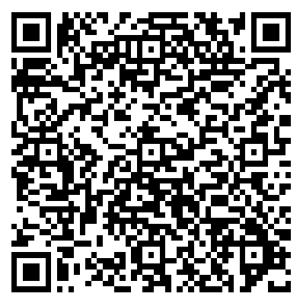
Reminders
Coach Calls:
  **Tuesday March 12th 1:00pm Eastern / 10:00am Pacific
  Tuesday March 26th 1:00pm Eastern / 10:00am Pacific
Session 6: Tuesday April 2nd 1:00pm Eastern / 10:00am Pacific
CME and Resource Page
Access Code: PGR2023
https://education.weitzmaninstitute.org/content/postgraduate-nurse-practitioner-np-residency-and-npphysician-associate-pa-training-programs
Notes:
Meaghan

Slide 66
Contact Information
Amanda Schiessl
Program Director/Co-PI
Amanda@mwhs1.com
Meaghan Angers
Program Manager
angersm@mwhs1.com
REMINDER: Complete evaluation in the poll!
Next Learning Session is Tuesday April 2nd!
Notes:
Meaghan

Slide 67


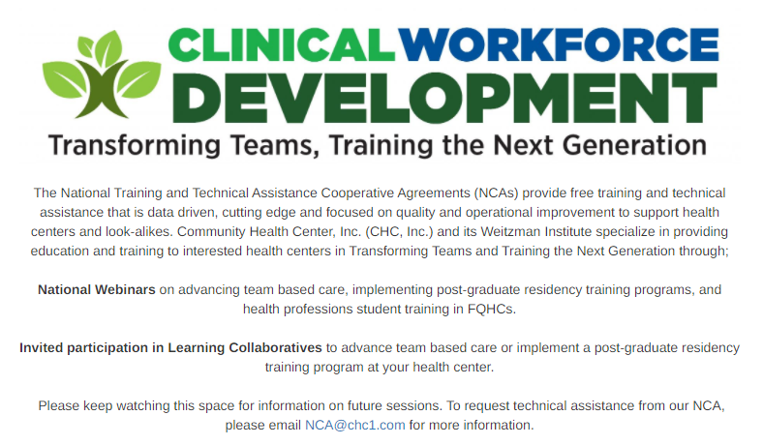

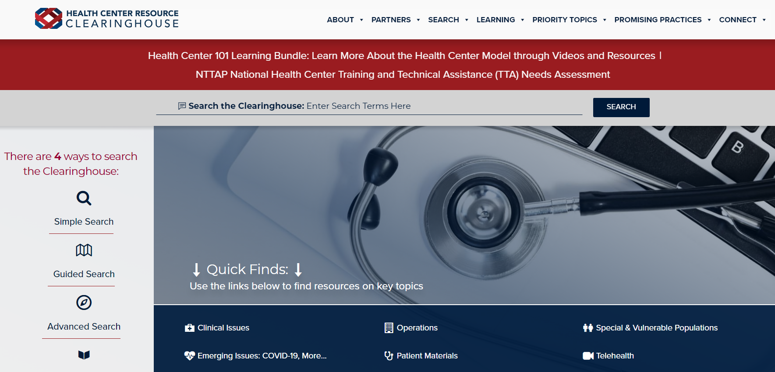
Explore more resources!
National Learning Library:
Resources for Clinical Workforce Development
Health Center
Resource Clearinghouse
https://www.weitzmaninstitute.org/ncaresources
https://www.healthcenterinfo.org/
67
Notes:
Meaghan

