Slide 1
STRATEGIC
FOCUSED
Quality Improvement Seminar
Mark Splaine
March 28, 2024
RELEVANT
INTERACTIVE
TEAM WORK
INFORMATIVE
FUN
SKILL BUILDING
Nurse Practitioner & Physician Assistant
Training Programs

Slide 2
Session Goals
Discuss conflict management styles and how they can assist in team dynamics
Review and discuss effective strategies when communicating with leaders
Consider approaches to developing yourself as a leader
2

Slide 3
Roles
Theory burst presenter
Mark
Technical genius
Sarah
Take-home thoughts report-out
Mark
3

Slide 4
Agenda
Welcome (5 minutes)
Conflict management styles (15 minutes)
Managing up/working with leaders (20 minutes)
Take-home points and looking ahead (10 minutes)
Break (5 minutes)
Project Team work (30 minutes)
4

Slide 5
Curriculum Plan
An overview of Quality Improvement (10/12/23)
Care Observations & Stakeholder Considerations (10/26/23)
Organizing your Improvement Project (11/9/23)
Global Aim and Fishbone Diagram (11/30/23)
Process Mapping (Flowcharts) (12/14/23)
Measurement to Inform Change (1/11/24 & 1/25/24)
An Approach to Testing a Change (2/8/24)
Communication about your Improvement Effort (2/22/24)
Stakeholder Analysis & Conflict Management (3/14/24)
Managing Up and Gaining Leadership Buy-In (3/28/24)
Negotiation (4/11/24)
Negotiation and More About Cycles of Change (4/25/24)
Sustaining your Improvement Effort (5/9/24)
Resident Presentations (5/23/24, 6/13/24, 6/27/24)

Slide 6
Last Session
We learned about how important input from stakeholders are related to a planned change
Discussed strategies for further engaging stakeholders
Discussed approaches for managing conflict
6

Slide 7
Assignment
Download the Conflict Management Style Assessment document (sent separately)
Complete the questionnaire and score your results
Be prepared at our next session to share some things you have considered since learning your conflict resolution style
7
Notes:
www.clinicalmicrosystem.org
7

Slide 8
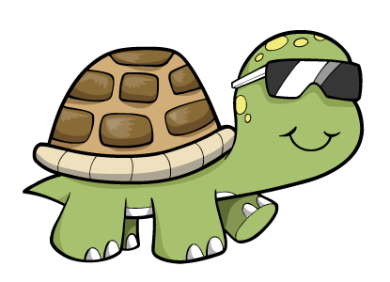
How do you handle conflict?
Which Type Are You?
OWL
Collaborating
TURTLE
Avoiding
TEDDY BEAR
Accommodating
FOX
Compromising
SHARK
Competing
Notes:
After completing the Conflict Management style assessment, what was your type? Did it seem right?
Owl Collaborating
Owls highly value both their goals and their relationships. They view conflict as a problem to be solved and seek a solution that achieves both their goals and the goals of the other person. Owls see conflicts as a means of improving relationships by reducing tensions between two persons. They try to begin a discussion that identifies the conflict as a problem, and strive to resolve tensions and maintain the relationship by seeking solutions that satisfy both themselves and the other person.
Turtle Avoiding
Turtles tend to value avoiding confrontation more than either their goals or relationships. They often find it easier to withdraw from a conflict than to face it. This might even include completely giving up relationships or goals that are associated with the conflict.
Shark Competing
Sharks typically value their goals over relationships, meaning that if forced to choose, they would seek to achieve their goals even at the cost of the relationship involved. Sharks are typically more concerned with accomplishing their goals than with being liked by others. They might try to force opponents to accept their solution to the conflict by overpowering them.
Teddy Bear Accommodating
Teddy Bears typically value relationships over their own goals; if forced to choose, Teddy Bears will often sacrifice their goals in order to maintain relationships. Teddy Bears generally want to be liked by others, and prefer to avoid conflict because they believe addressing it will damage relationships. Teddy Bears try to smooth over conflict to prevent damage to the relationship.
Fox Compromising
Foxes are moderately concerned with both their goals and their relationships with others. Foxes typically seek a compromise; they give up part of their goals and persuade the other person in a conflict to give up part of their goals. They seek a conflict solution in which both sides gain something; the middle ground between two extreme positions. They are willing to sacrifice part of their goals in order to find agreement for the common good.

Slide 9
Group Discussion
We will open the discussion to any group (please unmute or add comments to the chat)
Questions
Were you surprised by your results?
How might you use this information in your interactions with colleagues/clients/patients?
9
Notes:
www.clinicalmicrosystem.org
9

Slide 10
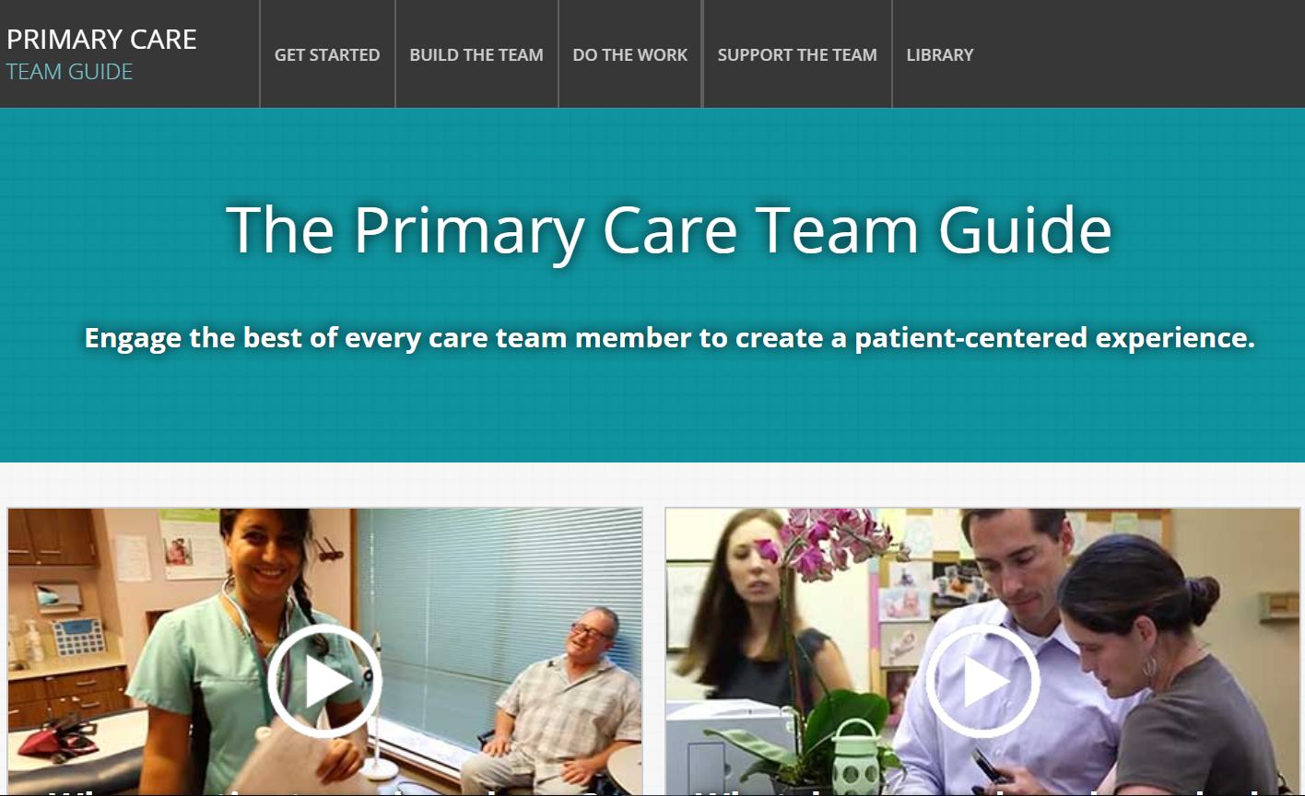
https://improvingprimarycare.org
10

Slide 11
Working Effectively in Teams
Providers (PCPs) need to:
View themselves as team leaders or team members with lead responsibility for clinical decision making, but shared responsibility for overall patient care and panel management.
Develop their capacity to lead a team and coach others to reach their full potential.
Understand the roles and expertise of other team members, and support the goal that all team members work at the top of their license, training, and competence.
Share power, control, and decision-making with others on the team.
Move toward a culture of mutual respect and trust between PCPs and other staff.
Develop systems that allow all team members to communicate effectively and efficiently about patient care needs.
Look for opportunities to relinquish activities and tasks that do not require PCP-level medical knowledge, judgement, diagnostic skills, or decision making.

Slide 12
Communicating Up and Across
Strategies for Communicating with Leadership and Colleagues
12

Slide 13
How Can Leadership Buy-In Help?
Obtaining support from others (e.g., survey response)
Accessing data
Getting on the agenda
Communicating about project effort
Gaining visibility
13
Notes:
www.clinicalmicrosystem.org
13

Slide 14
Poll Question
How do you feel when interacting with leaders at your organization? (check any that apply)
Uncertain – I don’t do it very much
Nervous
Confident
Under pressure
Like I have something to prove
Comfortable
14
Notes:
www.clinicalmicrosystem.org
14

Slide 15
Leaders Are…
Keep These Things in Mind
Very busy
Balancing many priorities
Visionary & strategic
Responsible for financial and clinical outcomes
Prefer data over anecdote to make decisions

Slide 16
Action Steps To Consider
Learn organization/leader priorities
Demonstrate how your project aligns with core agency goals and objectives
Understand the impact on finance as well as on staff and patients
Use data to make your case

Slide 17
Example: Same Day Access Clinic
The Problem:
Too many patients being diverted to urgent care due to filled schedules
The Solution:
Test an in-house urgent care clinic
The team aligned their project with key agency goals:
improve patient satisfaction
reduce ER utilization

Slide 18
The Team Used Data to Demonstrate Results

Slide 19
Some Insights from Garrett
A successful improvement effort is likely achieved by a combination of forged relationships and convincing data.
It may be difficult to gain buy-in from leaders and influencers in an organization that one is new to. Even if you have a great idea, it’s important to remember that when organizations have become used to doing things a certain way and, particularly, when a change affects a workflow, you might encounter resistance – even if the idea for change is a good one.
For insiders who have been around for a while, it may not be readily apparent that a component of a workflow or a policy (or a lack of policy) affects efficiency and that there may be better ways to do things.
For an outsider who’s just started somewhere, it may be obvious from the first time they encounter it.
Charting or graphing data over time can help you show a member of your organization’s leadership where the issue lies which can help aid your suggestions of how to improve it.
19
Notes:
www.clinicalmicrosystem.org
19

Slide 20
Some Insights from Garrett
Just like our QI projects do, prompting someone from your organization that you feel like there may be a better way to do something that will make everyone’s life easier (including the patient’s) and that you would like to trial it first with a small team is an easier way to introduce and test your hypotheses without disrupting the current workflow of the organization as a whole; it’s a way to say, “I can respect that this is the way things have been done for some time and I’m not trying to break down all of the walls, but I think I can make it better.”
As you collect your data, if you can show that it will improve workflow, efficiency, and overall satisfaction for staff, patients, and the organization, you’re more likely to be successful.
In regard to relationships, as you build those connections overtime, you create trust. As other members of the team see your value and your suggestions will hold much more weight than they might have in the beginning.
20
Notes:
www.clinicalmicrosystem.org
20

Slide 21
Communicate Clearly & Succinctly
In the time it takes in an elevator ride – could you describe your project?
Need for change
Vision of the new state
Additional elements:
Problem / issue
Benefit
Where we are
What others can do
Notes:
of project. For teams struggling to get started in terms of need and vision, it can be the place to begin to bring some focus to the team's more rambling discussion of need and/or vision.
Timing
Either after agreement has been reached about the details of both need and vision, or as a precursor to more detailed discussion of the two. At a minimum, the team needs its Elevator Speech ready for the questions which will inevitably arise once the project is announced to the broader constituent base.
Elevator Speech
Being able to clearly and simply state the need for change and describe the future state is essential for rallying the support and commitment of key constituents. Many teams found it very useful to work together to package these into a 90-120 second speech that can be given whenever a team member is confronted with the opportunity to sell the team’s project to a key stakeholder. The metaphor of an “elevator speech” is useful in challenging the team to be clear, precise and simple in the creating of this speech.
Uses
This is an excellent tool to help the team link the need for change with the vision of the future. For teams that have thoroughly debated and documented both the need and vision, this is a synthesis event whereby they distill the essence

Slide 22
What is your next communication step in your project?
22

Slide 23
What haven’t we figured out yet?
Questions or issues that remain unclear?
23

Slide 24
Take-home Thoughts
Mark – share 1 or 2 ideas you will take away from our discussion
24

Slide 25
Summary
Gaining leadership buy-in can enhance you QI effort by increasing visibility of your work, leveraging resources, and helping to engage others in your effort.
Leaders commonly appreciate updates on projects that include information about the goal of the project, current status, results to date, and relationship to organizational objectives.
It is helpful to remember that leaders are pulled in many directions, so keeping your communication short and to the point is always appreciated.
25

Slide 26
Session XII Assignment
Read the overview of the negotiation case (Word doc)
Your team will be assigned a role in the live negotiation during our next session
If your team is one of the negotiation participants, please do the following:
Read your confidential instructions carefully
Meet as a team to prepare your negotiation strategy and plan
Contact Mark if you have questions
Be prepared to participate in the live negotiation during our next session on 4/11/24
Notes:
www.clinicalmicrosystem.org
26

Slide 27
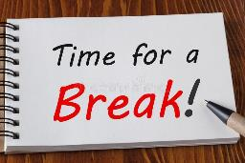
Break!
Take five minutes to recharge and refresh.
27

Slide 28
QI Office Hours
1st Thursday from 12:30-1:30pm ET
(Next April 4th)

Slide 29
Project Group Work
Meet with your team in breakout rooms:
DePaul CHC (Courtney, Jamie, Shermese)
CHC Hartford (Emily, Julia)
HealthLinc (Erica, Irene, Jenny, Valerie)
Holyoke HC (Muriel)
CHC Meriden (Meghan, Shayla)
CHC Meriden/New Britain (Mattea, Uchechi)
CHC Middletown/NB (Tori, Victoria)
CHC Middletown/NB (Grace, Meredith)
Open Door (Jessa, Jessica, Pasha)
CHC Stamford (Drew, Loraine)
Yakima (Kayla, Rodrigo)

Slide 30
FYI – Additional Slides about Managing Up and Communicating with Leaders
30

Slide 31
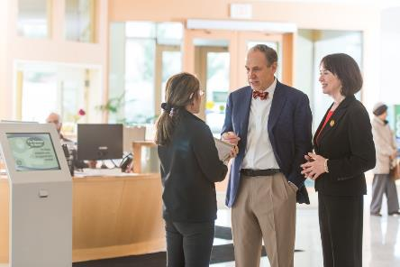
Communicating Up and Across: Strategies for Communicating with Leadership and Colleagues

Slide 32
Types of Communication
Virtual (Zoom, Skype, Facetime, Phone)
Crisis (the collection, processing, and dissemination of information required to address a crisis situation)
Presentation (A succinct report out to peers or leadership)
Elevator (a brief & descriptive explanation in the time it takes to ride the elevator)

Slide 33
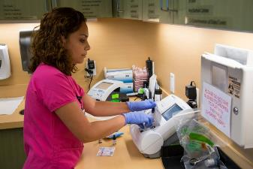
Know Your Stakeholders
Projects often fail when key stakeholders are:
unaware, unsupportive, unengaged
Projects can fail when we don’t properly anticipate the impact of a change

Slide 34
Remember to do a Stakeholder Analysis…
Who will need to be actively involved?
Who might be impacted?
Who might be threatened by the changes brought about by your project?
Don’t forget IT, HR, Finance!

Slide 35
Stakeholder Analysis
Stakeholder | Strongly against | Moderately against | Neutral | Moderately supportive | Strongly supportive
Not all stakeholders need to be “strongly supportive” for successful change

Slide 36
Communication Plan
Audience | Objectives | Message(s) | Media & Methods | Timing & Frequency | Who/When Where

Slide 37
The Process of Communication
Establish a regular communication process with leadership or a specific stakeholder
Know your topic: be able to speak about it succinctly and clearly

Slide 38
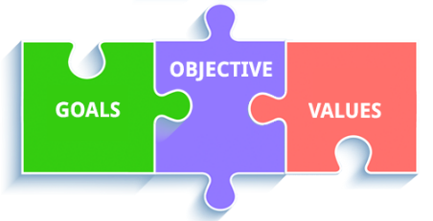
Demonstrate how your project aligns with core agency goals and objectives

Slide 39
Understand the impact on finance as well as on staff and clients/patients

Slide 40
Use data to make your case

Slide 41
Developing Political Skill
Think before you speak
Practice influence
Socially astute
Be sincere, professional integrity and authenticity are crucial
Knowledge expert has authority
Messenger is the persuader and not necessarily the message
Network, network, network
Notes:
Book: Political Skill at Work by Gerald Ferris
Politically skilled managers have impulse control
Managers comfortable with their interpersonal power tend to have good judgment about when to assert themselves, which in turn results in more cooperative relationships.
Socially astute managers tend to be perceptive observers of others and of social situations. In social settings, they accurately interpret their own behavior and those of others. Strong power of discernment and highly self-aware.
Leaders who possess a strong networking ability, they are able to garner working relationships, negotiate and managing conflict. Skilled networkers know when to call on others and reciprocate in the relationship

Slide 42
References
Abbajay, M. (2018). Managing up: How to move up, win at work, and succeed with any type of boss. John Wiley & Sons, Inc.
Biesenbach, R. (2018). Unleash the power of storytelling: Win hearts, change minds, get results. Eastlawn Media.

