Slide 1
Comprehensive Care Learning Collaborative
Session Four: Wednesday March 6th, 2024
Notes:
Meaghan

Slide 2
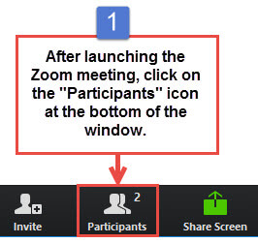
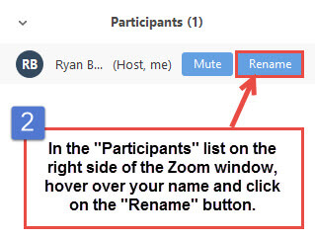
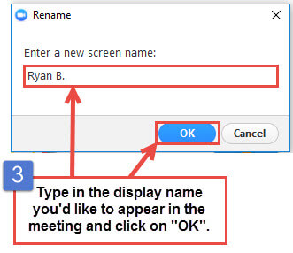
Get the Most Out of Your Zoom Experience
Please keep yourself on MUTE to avoid background/distracting sounds
Use the CHAT function or UNMUTE to ask questions or make comments
Please change your participant name to your full name and organization
“Meaghan Angers CHCI”
Notes:
Meaghan

Slide 3
Session 4 Agenda
1:00 – 1:05 | Introduction
1:05 – 1:30 | Role of MA and RN in Care Coordination & Utilizing Standing Orders
1:30 – 2:00 | Team-Based Care: Understanding Barriers
2:00 – 2:20 | Quality Improvement Refresh: Data and Specific Aim Statements
2:20 – 2:30 | Q/A, Next Steps, and Evaluation
Notes:
Meaghan

Slide 4
Learning Collaborative Faculty
NTTAP Faculty, Collaborative Design,
and Facilitation
Amanda Schiessl, MPP
Project Director/Co-PI, NCA
Amanda@mwhs1.com
Margaret Flinter, APRN, PhD, FAAN
Co-PI, NCA & Senior Vice President/Clinical Director
Margaret@mwhs1.com
Bianca Flowers
Program Manager
flowerb@mwhs1.com
Meaghan Angers
Program Manager
angersm@mwhs1.com
Mentors, Coaching Faculty
Deborah Ward, RN
Quality Improvement Consultant
WardD@mwhs1.com
Tom Bodenheimer, MD
Physician and Founding Director, Center for Excellence in Primary Care
Rachel Willard, MPH
Director, Center for Excellence in Primary Care
Evaluation Faculty
Kathleen Thies, PhD, RN
Consultant, Researcher
ThiesK@mwhs1.com
4
Notes:
Meaghan

Slide 5
National Training and Technical Assistance Partners
Clinical Workforce Development
Provides free training and technical assistance to health centers across the nation through national webinars, learning collaboratives, activity sessions, trainings, research, publications, etc.
Notes:
Meaghan

Slide 6
Collaborative Structure and Expectations
Eight 90-minute Zoom Learning Sessions
Session 1
Dec. 6th
Session 2
Jan. 17th
Session 3
Feb. 7th
Session 4
March 6th
Session 5
April 3rd
Session 6
May 1st
Session 7
May 29th
Session 8
June 19th
Between Session Action Periods
Meet weekly as a team
Conduct daily huddles
Complete deliverables and upload to the Google Drive
Use the Weitzman Education Platform to access resources and receive CME credit for learning sessions
Between Sessions
Coaches meet with coach-mentors weekly
Faculty support
Complete deliverables
Notes:
Meaghan

Slide 7
2023-2024 Cohort
Organization | Location
Brockton Neighborhood Health Center | Massachusetts
Brooklyn Plaza Medical Center | New York
Klamath Health Partnership | Oregon
Migrant Health Center, Western Region, Inc. | Puerto Rico
The Wright Center for Community Health | Pennsylvania
Notes:
Meaghan

Slide 8
Role of MA and RN in Care Coordination & Utilizing Standing Orders
Mary Blankson, Chief Nursing Officer
Community Health Center, Inc.
Notes:
Mary

Slide 9
MA Involvement in Key Functions or Competencies
Track, identify, and reach out to patients with care gaps
Provide patient-centered, evidence-based services
Provide follow-up and care outside the office
Meet patient needs in a timely manner
Population Management
Planned Care
Clinic-Community Connections
Enhanced Access
The
Quintuple Aim
Self-management Support
+ Health Equity Lens
Referral management
Communication Management
Medication management
Care Management
Behavioral Health Integration
Notes:
Mary
Talking point – enhanced access, population management and communication around huddles
Patient Experience
Pop Health
reducing cost
Care team well-being
Health equity

Slide 10
Team Practice Assessment: How Do We Shift Levels Toward A?
Components | Level D | Level C | Level B | Level A
MAs in our practice…. | Mostly take vital signs and room patients. | Perform a few clinical tasks beyond rooming patients, such as reviewing medication lists or administering a PHQ-2 | Perform a few clinical tasks and collaborate with the provider in managing the panel (reviewing exception reports, making out-reach calls) | Collaborate with the provider in managing the panel, and play a major role providing preventive service, and service to chronically ill patients, such as self-management, coaching, or follow-up phone calls.
 | 1-3 | 4-6 | 7-9 | 10-12
Notes:
Mary
talk about team guide assessment use MA
Continued journey and repeat taking it to keep mapping journey; good to reference back to it; not just a starting place or report card but a bench mark of journey

Slide 11
Role Activity Assessment
Notes:
Mary
Not all teams have done this – good reminder; help emphasize importance

Slide 12
What does it mean to implement TBC?
Defining your Core and Extended Team Structure
Meeting Regularly, Huddling Daily
Creating new responsibilities and provide training
Strategically redistributing work among team members
Increasing communication among the team, practice, patients.
Improving efficiencies (electronic and clinical workflows)
Standardizing processes to reflect new model (making hundreds available, playbooks)
Using a plan for optimizing model , spreading, and continuously improving
Notes:
Mary
Creating culture that encourages gifts and talents of the workforce; valued member of team with unique skills and talents
Emphasis on culture shift
Motivational interview skills
During our interviews, this was the model we used to help you identify the core team members for collaborative participation.
Core team can be 1-3 provider and MA dyads. At a minimum , your core team is a dyad.

Slide 13
Role of the Medical Assistant
Pre-visit planning/planned care
Begin process of medication reconciliation
Scribing for providers
Delivering or arranging preventive services
Participating in quality improvement work
Health coaching and motivational interviewing
Providing telephone or in-person follow-up
Notes:
Mary
Talk about how much the role has expanded; met one MA and you met MA; creativity with the role to solve organizational problems and meet specific needs of pop.

Slide 14
How do effective practices deliver planned care?
Encounters are organized so that relevant team members deliver all needed care.
MA reviews patient data prior to the encounter to identify needed services.
Identify the key clinical tasks associated with evidence-based care and decide who does them.
Notes:
Mary

Slide 15
How do effective practices manage medications?
Medication reconciliation is a process, not a task.
A critical intervention for both patient and practice—often begun by MA at intake.
Pharmacists and RNs play important roles in complex med. rec., titrating medications, and addressing non-adherence and other drug problems.
Notes:
Mary

Slide 16
How do effective practices deliver planned follow-up and Care Management (outside of visits)
Follow-up between office visits is a core function of the practice team.
Care teams regularly monitor patients and promote self-monitoring.
Consider new technology with RPM
Follow-up can range in intensity from periodic status checks by telephone or e-mail (MA) to active care management (RN).
Higher risk patients (poor disease control, frailty, etc.) receive regular follow-up (monitoring) AND active care management.
Notes:
Mary

Slide 17
Role of the Registered Nurse
Function within three domains of primary care:
episodic/acute and preventive/routine care
chronic disease management
practice operations, including supervision of staff and practice improvement
RNs can meet many of the patients’ needs that providers either handled alone or did not have time to address, freeing up providers for visits that require their diagnostic skills while also improving patient care and satisfaction.
Notes:
Mary
triage, immunizations, wound care—traditional
Newer: chronic disease mgt and practice operations/QI

Slide 18
Focus Areas of RN Practice
Standing orders: developed by and executed under the authority of providers to manage common episodic health conditions or complaints, such as urinary tract infections (UTI), administer vaccines, order a retinal exam for patients with diabetes
Orders for Individual Patient: developed by and executed under the authority of providers, and unique to an individual patient’s plan of care, e.g., changing inhalers for a patient on an asthma action plan; titrating insulin
Complex care management: proactively address the needs of sub-populations of patients, such as those transitioning from hospital to home, or with complex healthcare needs, such as patients with diabetes, HIV, or multiple co-morbidities, such as heart disease, depression and substance use; don’t wait for patient to worsen between visits.
Notes:
Mary
These areas of practice support population management, self-management support, medication management, care management

Slide 19
Discussion Questions
Do you provide time for MAs, LPNs and/or RNs to do both panel management AND pre-visit planning? Or do you treat these processes as one in the same?
How do you engage MAs and/or RNs and increase their interest in the accountability of their patient panel?
Where does panel management work happen? In the pod? Or elsewhere?
What does the process of MAs and/or RNs checking for vaccines and Rx refills look like? How long does it typically take per patient?
How do patients check out after visit? Do they do so in the room with the MA and/or RN? Or at the front desk?
Notes:
Emphasize difference between panel management and huddle
Fix these questions up to include Role of RN

Slide 20
Team-Based Care: Understanding Barriers
Dr. Tom Bodenheimer Center for Excellence in Primary Care University of California, San Francisco
Notes:
Tom

Slide 21
What is a powerful team?
Remember from Learning Session 1:
Primary care patient access is poor and getting worse
Panel sizes are too large because few clinicians choose primary care careers
Poor access and large panels are major contributors to burnout
Powerful teams can help solve these challenges; poorly functioning teams cannot
Notes:
Tom

Slide 22
What is a powerful team?
A powerful team is a team that adds capacity to see more patients, thereby improving access and reducing burnout
Interprofessional team members add capacity by seeing patients independently, taking little or no clinician time
Interprofessional team members help over paneled clinicians care for their panels, thereby reducing clinician burnout
When interprofessional team members have standing orders to see patients independently, they often have greater work life satisfaction
Medical assistants can also add capacity, saving clinician time by providing panel management functions
Notes:
Tom

Slide 23
What is a powerful team? Examples:
In many states, pharmacists can independently care for patients with diabetes or hypertension -- including ordering and interpreting labs and adjusting medications – under collaborative practice agreements.
Health centers can organize RN co-visits with the RN doing most of the visit and the clinician coming in at the end to check the RN’s work and complete the orders the RN entered into the EMR. RN co-visits can add substantial capacity.
Notes:
Tom

Slide 24
Barriers to building powerful interprofessional teams
The barriers are real and need to be addressed. In making goals and action plans, consider the barriers and which would be the most difficult to overcome. But don’t let barriers paralyze you.
We can’t recruit the personnel we need
Only practitioners are reimbursed
Who knows when the alternative payment model will actually arrive
No time to train and mentor staff in their enhanced roles
Scope of practice laws
Will patients accept their care?
Notes:
Tom

Slide 25
Activity: 10 minutes
Let’s pretend that you have set an overall goal to build a powerful interprofessional team. One specific goal focuses on RNs.
You would like your RNs to become care managers for patients with diabetes who see patients independently and can change medication doses under standing orders. Your first action plan is to hold a meeting with the RNs in the clinic to discuss their work, whether they are satisfied with their roles, what they might think about RN care management.
Write in the chat: what barriers you would need to overcome to move toward the goal of RNs becoming care managers?
25
Notes:
Tom

Slide 26
RN care management for patients with diabetes: Barriers and who is causing the barrier
 | Federal/ state government, professional associations, professional schools | Health system leaders | Physician reluctance | Team member reluctance | Patient reluctance
We can’t recruit RNs | Nursing associations and nursing schools emphasize hospital nursing. Lack of RN faculty restricts number of slots in nursing schools | Leaders prioritize the number of hospital nursing jobs over ambulatory jobs. They pay clinic RNs 60% of what hospital RNs make.
RNs are not trained in primary care functions | Nursing schools usually don’t teach ambulatory care nursing | Not interested in developing in-house ambulatory training for RNs | Providers may want RNs to only do phone triage, which shields physicians from patients wanting same-day care | RNs may be satisfied with more traditional RN functions such as triage, wound care, and patient navigation | Patients may want to see their doctor rather than an RN care manager
RNs are not allowed to do care management (especially adjusting medication doses) | State nursing boards may not allow RNs to adjust medication doses | Even when the state allows medication adjustment under standing orders, health system leaders may say No | Providers may not trust RNs to adjust medications and may refuse to write standing orders | RNs may not feel comfortable adjusting medication doses
Lack of a business case. Only clinicians (doctors, NPs, PAs) are reimbursed. RNs are an expense and don’t generate revenue | Medicare and Medicaid generally set payment rules, which insurance companies follow | Health system leaders may take a narrow view of business case. They want revenues to equal expenses each month. Rather than getting revenue from P4P for better metrics, or greater patient satisfaction bringing new in more patients.
Notes:
Tom

Slide 27
Clinician and staff satisfaction leads to less turnover. Turnover is a huge expense to the clinic
Cost
Quality/Safety
Patient experience
Work experience
Increase in visits or panel size
Billable services by RNs, PTs, Pharmacists
Redeployment of staff to higher value activities
Metrics to watch for team-based care
Don’t just look at revenue vs. expense out
Patient experience surveys; good performance can lead to P4P money and can attract new patients
Improvements screening rates or disease control
Reduced readmissions
Reduced ED use
Notes:
Tom

Slide 28
Regulatory barriers: A case study
California allows MAs to give injections for immunizations
San Francisco General Hospital:
MAs give immunizations
Standing orders enable MAs to identify and administer immunizations without patient-specific clinician orders
UCSF Health System:
MAs cannot give injections at all. RNs or LVNs give the injections.
Many UCSF residents work at both SF General and UCSF hospitals; in one place they can rely on MAs to take care of immunizations by themselves while in another place the MAs cannot even give the shots
Notes:
Tom

Slide 29
Empowering MAs to give childhood vaccinations independently: Barriers and who is causing the barrier
 | Federal/ state government, professional associations, professional schools | Health system leaders | Physician reluctance | Team member reluctance | Patient reluctance
We can’t recruit enough MAs | The economy is in a worker-shortage period | MAs are poorly paid and don’t choose medical assistant careers
MAs are not trained to identify which kids need which vaccines; how to administer the vaccines safely | Low-quality commercial MA training programs. Better community college MA programs may have limited curriculum. | Health system lawyers may be overly cautious | Providers feel only they can decide which vaccines to give, even though there is a standard vaccine schedule. MAs would consult if there were questions for particular patients | MAs may be reluctant, feeling uncomfortable with the responsibility, or because they are already working too hard | Less of an issue because patients are used to staff giving vaccines
MAs are not authorized to decide on which vaccines and to give the injection | State regulations may require that only clinicians and nurses can administer injections | Even when the state allows MAs to give injections, health system leaders may say No | Providers may not trust RNs to decide which vaccines to give to which patients, and refuse to create standing orders | MAs may not feel comfortable with this responsibility
Lack of a business case. | Medicare, Medicaid and insurance may pay little for vaccine administration | Health system leaders may worry that they would need to hire more MAs. Even though the time it takes clinicians, or the expense of using RNs, would cost more. Taking a narrow view of business case. Rather than saving clinician time and thereby increasing access and market share.
Notes:
Tom

Slide 30
Take Home Points
Powerful teams can make primary care more do-able: more trained people to care for overly large panels
There are a number of barriers to building these teams. The big ones are:
Business case
Restrictive laws and regulations
Difficult to recruit team members
Training and mentoring is key and takes personnel and time
It is necessary to analyze where is the barrier: government, health system leaders, physicians, staff, patients
The business case is more complex than having revenues = expenses each month. Leaders should take a longer view and see improvements as an investment
Notes:
Tom

Slide 31
Questions?

Slide 32
Quality Improvement Refresh
Data Collection
Specific Aim Statements
Notes:
Kathleen

Slide 33
The Stages of Improvement
Step #6: Assessment and Baseline Data
On-Going Data Collection & Review
Notes:
Kathleen

Slide 34
Key Takeaways
Types and sources of data
Numerators and denominators
Percent v percentage points: how many patients is that?
Data plan
Notes:
Kathleen

Slide 35
What kind of data do you have?
Most of your data, such as UDS measures, involve counting patients or counting events in clearly defined groups/categories. It is ratio data with a natural zero so that you can divide, multiply, find percentages. Here are some common types of data that our teams work with:
No show data: What is our no show rate?
Screening data: What is our screening rate for mammograms?
Chronic disease measures: What percent of our patients with hypertension are in good control?
Notes:
Kathleen

Slide 36
Counting Data: Numerators and Denominators
KEY STEP: DEFINE YOUR GROUPS.
If you can’t define your groups, you can’t measure/count them.
Groups can be patients, events (appointments), things (syringes).
Use clear definitions for the population and the subset/sample.
Population is inclusive: Population A is all patients eligible for screening
Subsets are mutually exclusive: either a patient has been screened (Subset A1) or has not been screened (Subset A2); can belong to only one group
Numerator: Subset A1 = all eligible patients who were screened (as evidence by documentation in the chart) (sample/subset of population)
Denominator: Population A = all patients eligible for screening who should be screened (population)
Beware of small denominators! 5/6=83% 5/10=50% 5/16=31.2%
Note there can be multiple mutually exclusive subsets in a population: A1…A2…A3…
Notes:
Kathleen

Slide 37
From the Workbook
Definition | A no-show is a patient who did not show up for a scheduled visit within a specific time frame and thus was not seen. Patients who call to cancel are not “no-shows.” Patients who are late but are eventually seen are not “no-shows.”
Time frame | July 2019
Population and subsets | -- Population A: all patients who had an appointment in July 2019 whether they attended the appointment or not (N=100) --Subset A1: patients who had an appointment in July 2019 and attended appointment as documented (N=80) --Subset A2: patients who had an appointment in July 2019 and did NOT attend the appointment as documented (N=20)
Source of data/evidence | As documented in the EMR
Numerators and denominators | No show rate = Subset A2/ Population A = 20/100 or 20% in July --Numerator: Subset A2 --Denominator: Population A
Notes:
Kathleen

Slide 38
Challenges with data
Clarity of definition: What is the definition of “patients who had an appointment in July 2019 and missed the appointment?”
Consistency with definition: Check to be sure that your EHR collects the data in a way that is consistent with the definition you are using to sort your patients into groups, e.g., UDS.
Documentation: Was the event documented correctly? What if someone showed up late but was still seen?
Population in the denominator: How many patients don’t belong in the denominator? They are no longer patients, they don’t meet eligibility criteria, etc.
Notes:
Kathleen

Slide 39
Percent vs. Percentage Point
We aim to increase screening rate for cervical cancer in eligible female patients by 15% from January to February.
Baseline?
If baseline is 22%, increase of 15% is: 22% * 1.15 =Target 25.3%
We aim to increase screening rate for cervical cancer in eligible female patients by 15 percentage points from 22% from January 31 to 37% by February 28.
Baseline and target are more clear
Baseline 22% + 15 points = Target 37%
Notes:
Kathleen

Slide 40
How many more patients do you need to screen to hit your target?
Month | # eligible patients: population A+B | # screened eligible patients: Subset A | 15% Percent increase | 15 Percentage points increase
January 1 Baseline | 150 | 33 | Baseline 22% | Baseline 22%
February 28 Target % | 150† |  | 22% * 1.15 =Target 25.3% | 22% + 15 points = Target 37%
How many more patients need to be screened in February? |  |  | Target 38 patients which is 5 more patients | Target 56 patients, which is 23 more patients
†Challenge: Obviously the January 1 baseline is based on December 31. What will you use for your denominator if you don’t yet know how many eligible patients will actually keep their appointments? You can use the denominator from the previous month, or estimate it based on an average of previous time periods.
Notes:
Kathleen

Slide 41
Specific Aim Statement Template
We aim to ___________ (improve, increase, decrease) the _____________ (quality, number/amount, percentage) of___________________ (name the process) by _____ percent
OR
from ________ (baseline data number/amount/percentage) to __________ (number/amount/percentage)
by _______ (date)
in ___________ (location)

Slide 42
Using data in a specific aim
We aim to increase screening rate for cervical cancer in *eligible female patients by 15 percentage points from 22% as of January 1 to 37% by February 28 at Clinic A.
Who: *eligible female patients defined by UDS
Who: eligible patients enrolled in the clinic based on at least one visit the past year.
When: January 1 to February 28
Where is the data: EMR
What dates will you ask BI to collect? January 1- February 28
Where: Clinic A
How much: Does this reflect the current baseline and an achievable goal?
Notes:
Kathleen
Note: this is number of percentage points

Slide 43
Data Plan
Name of data | Definition: Numerator | Definition: Denominator | Dates of interest | How to get the data
Lipid screening | Number of patients who had a fasting lipid panel in the measurement year | Number of patients who are prescribed HIV antiretroviral therapy and who had a medical visit at least once in the measurement year | January 1, 2021-December 31, 2021 | Where does the data live? Who has it? When to get it?
Notes:
Kathleen

Slide 44
Questions?

Slide 45
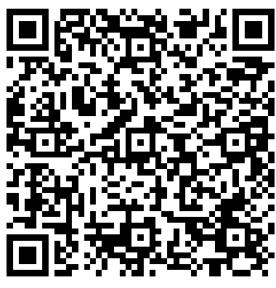
Action Period 4 Deliverables
Conduct your weekly team meetings
Assignment: Develop your Specific Aim Statement
Google Drive
https://drive.google.com/drive/folders/1VFv0Ar6VbdVDS_fkY6fPXQw36Tq0A1Wg?usp=drive_link

Slide 46
Reminders
CME and Resource Page
Access Code: TBC2023
https://education.weitzmaninstitute.org/content/nttap-comprehensive-and-team-based-care-learning-collaborative-2023-2024
Coach Calls:
Wednesday March 13th 1:00pm ET / 10:00am PT
Wednesday March 20th 1:00pm ET / 10:00am PT
Wednesday March 27th 1:00pm ET / 10:00am PT
Session 5: Wednesday April 3rd 1:00pm ET / 10:00am PT
Notes:
Meaghan

Slide 47
NTTAP Contact Information
Amanda Schiessl
Project Director/Co-PI
Amanda@mwhs1.com
Bianca Flowers
Project Manager
flowerb@mwhs1.com
Meaghan Angers
Project Manager
angersm@mwhs1.com
REMINDER: Complete evaluation in the poll!
Next Learning Session is Wednesday April 3rd!
Notes:
Meaghan

Slide 48
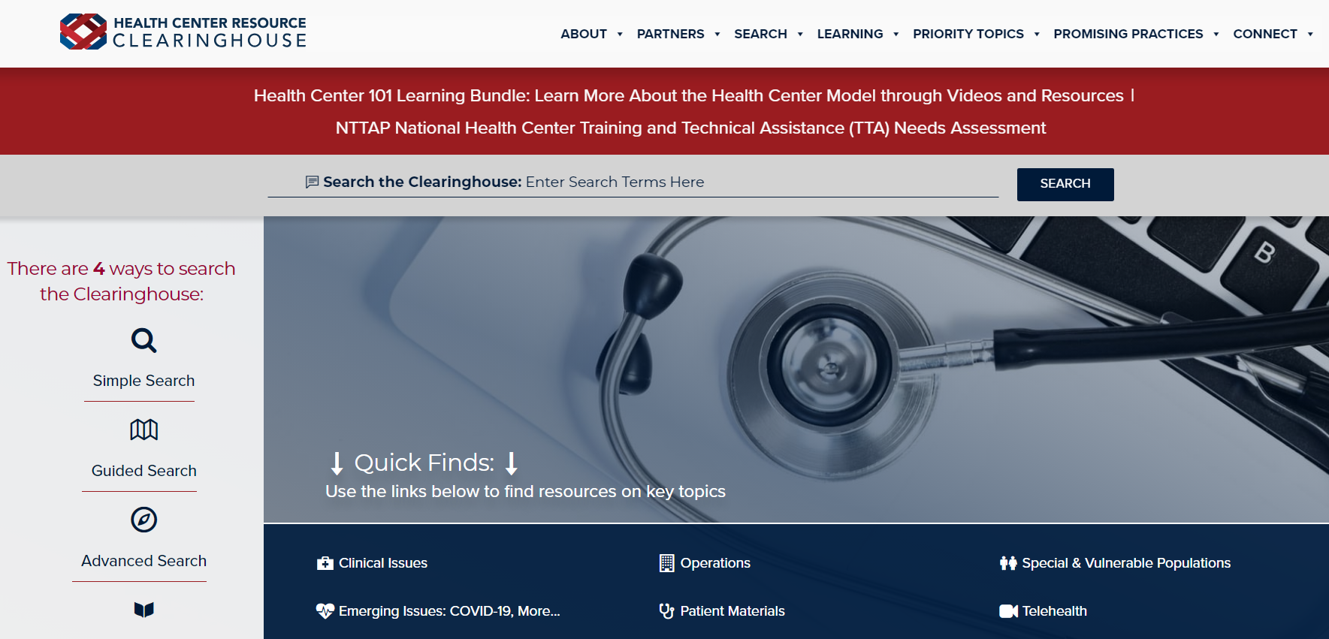
Explore more resources!
National Learning Library: Resources for Clinical Workforce Development
Health Center
Resource Clearinghouse
https://www.weitzmaninstitute.org/ncaresources
https://www.healthcenterinfo.org/
48
Notes:
Meaghan

