Slide 1
Advancing Team-Based Care Learning Collaborative
Learning Session 5: Wednesday April 3rd, 2024
Notes:
Meaghan

Slide 2
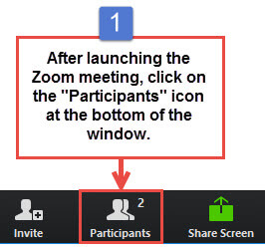
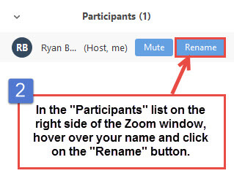
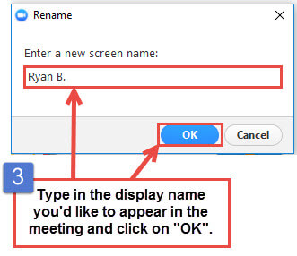
Get the Most Out of Your Zoom Experience
Please keep yourself on MUTE to avoid background/distracting sounds
Use the CHAT function or UNMUTE to ask questions or make comments
Please change your participant name to your full name and organization
“Meaghan Angers CHCI”
Notes:
Meaghan

Slide 3
Session 5 Agenda
1:00 – 1:05 | Welcome
1:05 – 1:15 | Role of Business Intelligence
1:15 – 1:40 | Role of Population Health Management
1:40 – 2:10 | Meaningful Integration of HIT for Team-Based Care
2:10 – 2:25 | Quality Improvement Refresh: PDSA Cycles
2:25– 2:30 | Q/A, Next Steps, and Evaluation
Notes:
Meaghan
PDSA cycles refresh is usually takes 20 minutes

Slide 4
Learning Collaborative Faculty
NTTAP Faculty, Collaborative Design,
and Facilitation
Amanda Schiessl, MPP
Project Director/Co-PI, NCA
Amanda@mwhs1.com
Margaret Flinter, APRN, PhD, FAAN
Co-PI, NCA & Senior Vice President/Clinical Director
Margaret@mwhs1.com
Bianca Flowers
Program Manager
flowerb@mwhs1.com
Meaghan Angers
Program Manager
angersm@mwhs1.com
Mentors, Coaching Faculty
Deborah Ward, RN
Quality Improvement Consultant
WardD@mwhs1.com
Tom Bodenheimer, MD
Physician and Founding Director, Center for Excellence in Primary Care
Rachel Willard, MPH
Director, Center for Excellence in Primary Care
Evaluation Faculty
Kathleen Thies, PhD, RN
Consultant, Researcher
ThiesK@mwhs1.com
4
Notes:
Meaghan

Slide 5
National Training and Technical Assistance Partners
Clinical Workforce Development
Provides free training and technical assistance to health centers across the nation through national webinars, learning collaboratives, activity sessions, trainings, research, publications, etc.
Notes:
Meaghan

Slide 6
Collaborative Structure and Expectations
Eight 90-minute Zoom Learning Sessions
Session 1
Dec. 6th
Session 2
Jan. 17th
Session 3
Feb. 7th
Session 4
March 6th
Session 5
April 3rd
Session 6
May 8th
Session 7
May 29th
Session 8
June 19th
Between Session Action Periods
Meet weekly as a team
Conduct daily huddles
Complete deliverables and upload to the Google Drive
Use the Weitzman Education Platform to access resources and receive CME credit for learning sessions
Between Sessions
Coaches meet with coach-mentors weekly
Faculty support
Complete deliverables
Notes:
Meaghan

Slide 7
2023-2024 Cohort
Organization | Location
Brockton Neighborhood Health Center | Massachusetts
Brooklyn Plaza Medical Center | New York
Center for Family Health & Education | California
Klamath Health Partnership | Oregon
Migrant Health Center, Western Region, Inc. | Puerto Rico
The Wright Center for Community Health | Pennsylvania
Notes:
Meaghan

Slide 8
Center for Family Health & Education

Slide 9
Who are we:
FQHC dedicated to serving underserved and low-income populations by providing affordable and Accessible Healthcare services
Our team is made up of
A-CMO
Director of Operations
Quality Assurance Coordinator
Staff Educator
Dental Provider
Clinic Manager
Dental Assistant
Receptionist

Slide 10
Our Goal:
Our Goal is to enhance our Quality Assurance process to create a more effective workflow
We hope to accomplish this by
Gathering tools that help strengthen our team dynamic
Following the PDSA cycle with guidance from the Collaborative to ensure we are following the right steps

Slide 11
Role of Business Intelligence
Nick Ciaburri, Director of Business Intelligence
Community Health Center, Inc.
Notes:
Nick

Slide 12
What is Business Intelligence?
“BI systems combine data gathering, data storage, and knowledge management with analytical tools to present complex internal and competitive information to planners and decision makers. Implicit in this definition is the idea (perhaps the ideal) that business intelligence systems provide actionable information delivered at the right time, at the right location, and in the right form to assist decision makers”
(Negash, 2004, p. 178).
Notes:
Nick

Slide 13
Dashboards and Reports
The end-users (executives to MAs) see customized reports and dashboards produced by BI.
These dashboards and reports are built in collaboration with the end-users, and there are many iterations tested until all parties are satisfied that these products are usable and the data is actionable.
To get this end product: BI team had to build the data warehouse which transforms and cleans the data from the EHR to make it more usable for reporting.
Notes:
Nick

Slide 14
Best Practices for Actionable Data
You can collect all the data you want, but if it is not structured in a way that is useful and meaningful, staff will not be able to use it in a timely manner to provide or to improve patient care.
BI Team works closely with the clinical chiefs, senior administrators and the population health team to identify what data are most important to them and their staff, what they are trying to improve, and when/how often they need to see the information.
For data validity – conduct chart reviews.
Notes:
Nick

Slide 15
Challenges to Data Accessibility and Validity
Biggest challenge to data validity: ensuring that the denominator in a measure is correct.
It is one thing to count how many patients were screened/not screened for cancer (numerator); it is another to count how many were supposed to be screened based on eligibility criteria (denominator).
Biggest challenge to data integrity: invalid and/or inaccurate data entry by end-users
For our BI team, end-users include every staff person who enters any kind of data into the electronic health record and other HIT systems, such as billing and coding. That is, data integrity involves everyone with access to these records.
Notes:
Nick

Slide 16
Questions?

Slide 17
Role of Population Health Management
Tierney Giannotti, MPA, Senior Program Manager for Population Health
Moses / Weitzman Health System
Notes:
Tierney

Slide 18
Defining Population Health
Kindig and Stoddart’s definition (2003) “the health outcomes of a group of individuals, including the distribution of such outcomes within the group.”¹
Focuses on populations “within specific geopolitical area” and goes beyond their clinical health to include “social, economic, environmental, and individual behavioral and genetic traits.”
CDC: Population health brings significant health concerns into focus and addresses ways that resources can be allocated to overcome the problems that drive poor health conditions in the population²
Sources:
Kindig D, Stoddart G. What is population health? American Journal of Public Health 2003 Mar;93(3):380-3.
Center for Disease Control and Prevention. What is Population Health? https://www.cdc.gov/pophealthtraining/whatis.html
18
Notes:
Tierney

Slide 19
Population Health Management
It is not a department or job description.
It is the combined efforts and use of data, systems, and processes that occur across several levels of functioning within a health center
Everyone contributes to population health, beginning with individual patient encounters using a team-based approach to care, and extending out to value-based contracts with external agencies.
Tools and Strategies: (1) Identifying Gaps in Care, (2) Closing Care Gaps & Patient Outreach, (3) Risk Stratification, and (4) Feedback loops/reporting
Notes:
Tierney

Slide 20
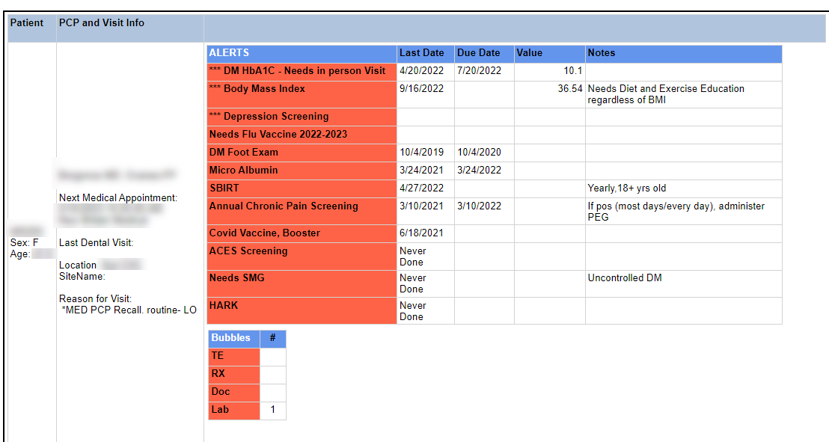
Clinical Dashboard: Identifying Gaps in Care
Key piece of population health management are clinical dashboards, specifically the Planned Care Dashboard which is the engine driving all visits in primary care at CHC.
MA does the pre-visit planning by reviewing the dashboard to identify what preventive services a patient is due to receive.

Slide 21
Job Tools to Support Care Gap Closure
More than 40 care gaps on the Planned Care Dashboard
Provides instructions on the process and who is responsible for each segment of the process
Dashboards are not useful if there are no clear workflows in place for how to provide the care that the dashboard flags as needed.

Slide 22
Beyond the Dashboards: Closing Care Gaps & Patient Outreach
Population health extends beyond the primary health care teams.
Three primary ways to close care gaps at CHCI
Close care gaps in real time when the opportunity arises (i.e. when a patient is seen for an acute visit, order the HbA1c that is due)
Identify patients for whom the care gap has been addressed, but for whom we do not have a record indicating it was addressed (i.e. receive care elsewhere, go to at outside lab or radiologist for screenings and tests)
Reach out to patient by text or phone to schedule a visit or remind them of one so that they get the care they need to receive.

Slide 23
Discussion Question
How do you close your care gaps at your health center?
Who does it?
Please type your answer in the chat or unmute.

Slide 24
Lessons Learned for Clinical Dashboards
Conduct chart reviews and site visits to learn from the clinical team what is and what is not working.
Consider all of the various ways staff learn:
Email written instructions
Screenshots of the process
Video of the rationale for addressing the care gap and the process for completing it
Notes:
Not everyone has BI Department; not everyone can build planned care dashboard
Understanding who patients with diabetes are, registry of patients with different conditions – making full use of information and disseminate data to those who need it
Dashboard is only as good if people use it.

Slide 25
Risk Stratification and Strategies to Mitigate Risk
In Connecticut, the HUSKY Medicaid PCMH+ program uses the Johns Hopkins Adjusted Clinical Groups (ACG) System to assign risk scores to patients, which are in turn available to providers who care for those patients
Use risk score for integrated care meetings
Provide that information to call center staff
Notes:
Talk about risk score and what we do with it; integrated care meetings, when patients calls call center, if high risk, put in front of call center staff (prior behavior predicts future behavior)

Slide 26
Quarterly Chronic Disease Management Report
Reports sent to care team (MA, Nurse and Provider) quarterly and compares rates of key measures to their own site and agency-wide.

Slide 27
Polling Question
Is your health center engaged with value-based contracts?
(Yes/No/Unsure)

Slide 28
Defining Value-Based Care
Value-based care is a healthcare delivery model in which providers, including physicians and hospitals, are paid based on patient care outcomes.
Under value-based care agreements, providers are rewarded for helping patients improve their health, reduce the effects and incidence of chronic disease, and live healthier lives in an evidence-based way.
The “value” in value-based care is derived from measuring health outcomes against the cost of delivering the outcomes. The value extends to all—patients, providers, payers, suppliers, and society as a whole.
https://catalyst.nejm.org/what-is-value-based-care
28
Notes:
Tierney

Slide 29
Value-Based Contracts
Give careful consideration to the requirements of the payor
Quality Measures; Hierarchical Condition Categories
Timelines
Portals; Data Accuracy
Philosophy for your agency that is well articulated and understood:
Crosswalk metrics so that internal clinical expectations are understood in the context of value based metrics
Benefits: Additional data about your patients you may not have – can enhance quantitative knowledge about patients; Supports targeted investments to achieve optimal health outcomes
Pitfalls: Takes considerable work and dedicated staff to make it effective and worth time and effort
Notes:
Poll: Is your health center engaged with value-based contracts? (Yes/No/Unsure)
“We do not do something for a patient based on value-based plan. We will do for all patients”
How to pay for TBC
Not necessarily ready to dive into contracts
But, might be worthy to mention

Slide 30
Examples of Elements of Value-Based Contracts
Incentive to implement certain visit types (i.e. Annual Wellness Visits, Transition Care Management)
Per member per month payment
Lump sum for financial savings
Bonus payment for each care gap you close

Slide 31
Questions?

Slide 32
Meaningful Integration of HIT for Team-Based Care
Taylor Miranda Thompson
Senior Quality Initiatives Manager
Colorado Community Health Network
tmiranda@cchn.org

Slide 33
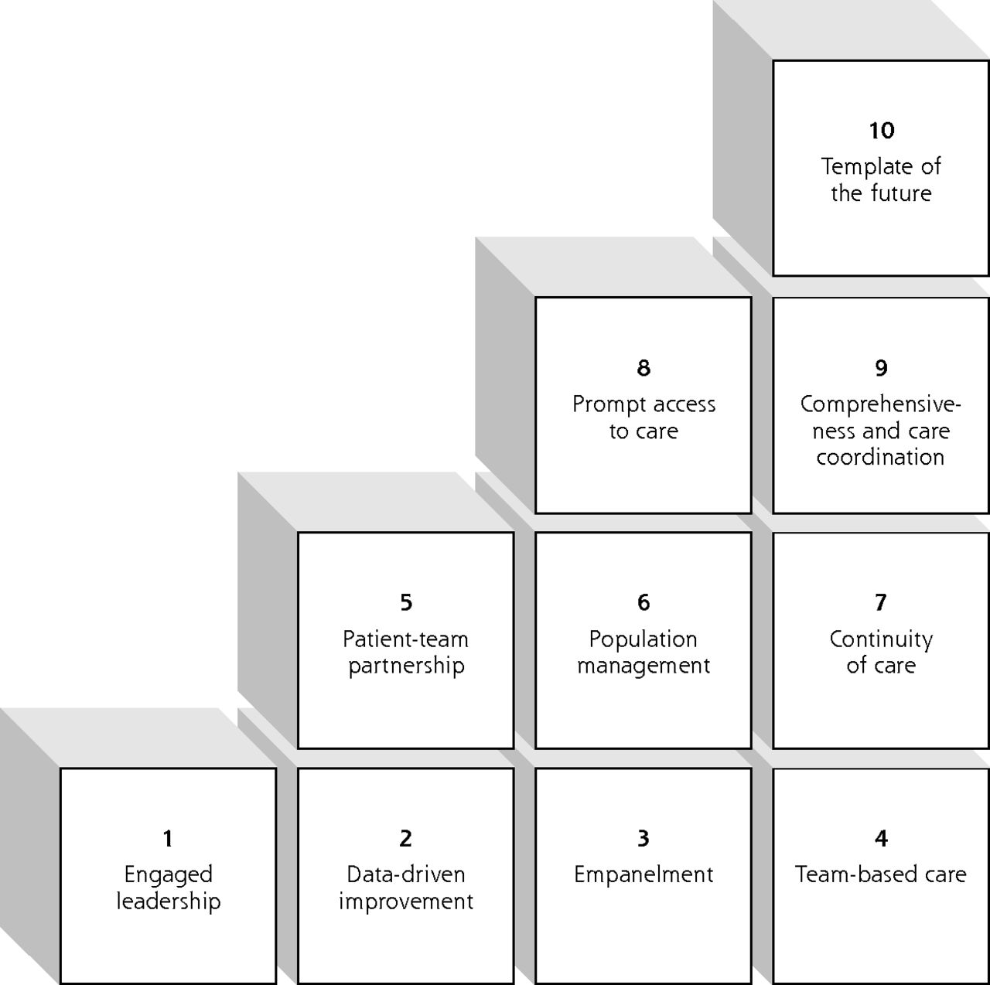
Building Blocks of
Team-Based Care

Slide 34
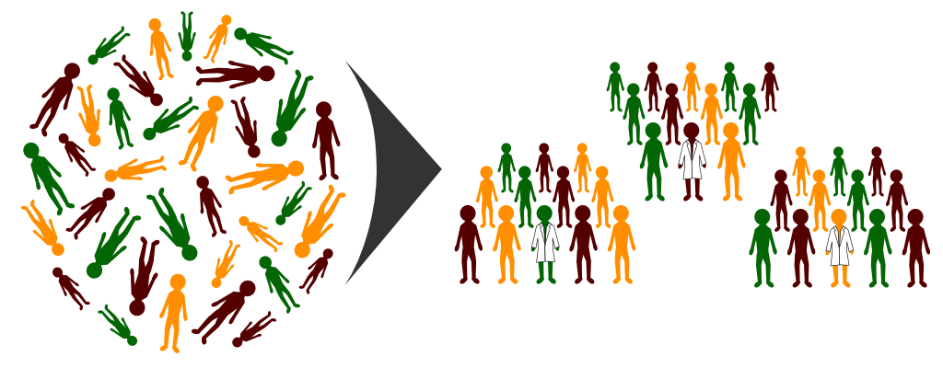
Empanelment
Process of assigning a portion of the practice’s patients to a provider/care team
Care team assumes responsibility for coordinating and providing all primary care services for their panel of patients

Slide 35
Team-based Roles & Responsibilities
Use of BI/HIT is not just an IT function
Establish clear responsibilities by role and ensure training
Role | Action
Front Desk | Each Monday, run outreach registries for patients If patient has alerts due next week: Outreach to schedule If patient has appt scheduled: Do not contact, indicate in “Reason for Appt” that patient has chronic disease, preventive care, and/or OB alerts due If patient needs information about prep for visit (e.g. fasting for labs), contact patient with instructions Document all contact attempts within the TE template in NextGen with your initials

Slide 36
Team-Based Roles & Responsibilities and HIT
Who needs to access the data?
In what form?
Different reports or uses of reports for different roles/functions (e.g., CCM vs. Pre-visit planning)

Slide 37
A Morning in the Life of a Primary Care Clinic
Time | What’s Happening?
3:00 PM (day before) | Pre-visit planning: Review of registries or chart scrubbing tools to plan next day’s huddle, obtain outstanding labs or referral notes
7:45 AM | Daily Huddle: Brief team check-in to review patients on the schedule, walk-in slots, anticipate equipment or staffing needs, obtain necessary records
8:15 AM | MA - First patient roomed: Intake, select appropriate template, documentation of vital signs, screenings, pending “standing order” items
8:15 AM | Front Desk- Receives a call from a new patient that would like to schedule with a provider that is accepting new patients
8:35 AM | Care coordinator - Managing and placing referral to specialist
9:00 AM | Nurse - Reviewing lab report and calling patients with results; follow up protocols

Slide 38
A Morning in the Life of a Primary Care Clinic
Time | What’s Happening?
3:00 PM (day before) | Pre-visit planning: Review of registries or chart scrubbing tools to plan next day’s huddle, obtain outstanding labs or referral notes
7:45 AM | Daily Huddle: Brief team check-in to review patients on the schedule, walk-in slots, anticipate equipment or staffing needs, obtain necessary records
8:15 AM | MA - First patient roomed: Intake, select appropriate template, documentation of vital signs, screenings, pending “standing order” items
8:15 AM | Front Desk- Receives a call from a new patient that would like to schedule with a provider that is accepting new patients (empanelment report/ understanding of open/closed panels)
8:35 AM | Care coordinator - Managing and placing referral to specialist
9:00 AM | Nurse - Reviewing lab report and calling patients with results; follow up protocols

Slide 39
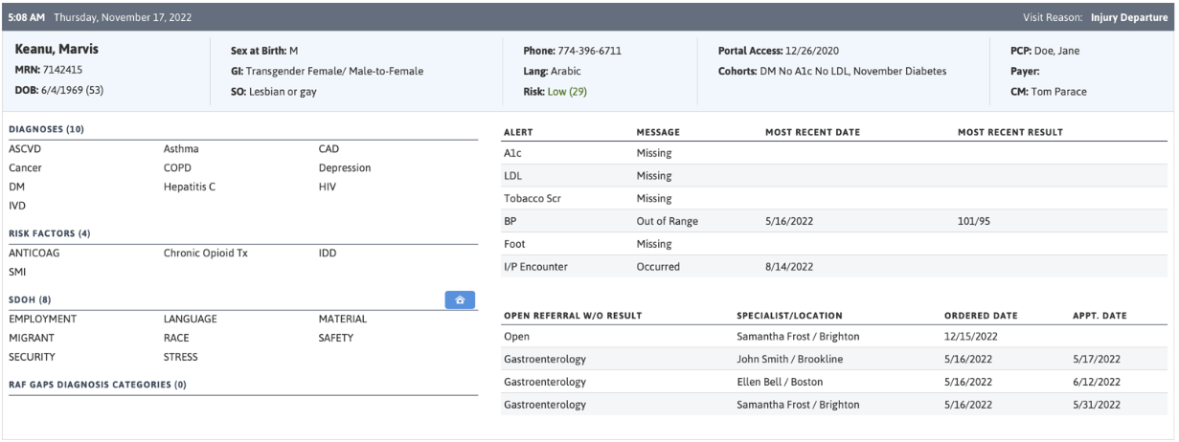
Example Report: Using HIT to Drive TBC
Source: Fictional patient from https://www.azarahealthcare.com/blog/the-azara-effect
Notes:
Fictional patient example from Azara DRVS Pre-visit planning tool – this is one example of a commonly used tool in CHCs (there are many other platforms/ softwares available that can populate similar reports)

Slide 40
Example: Pre-Visit Planning Process using Azara DRVS Report
https://vimeo.com/227406460

Slide 41
Using HIT to Support Top of Scope Work
Note: “Top of Scope” might differ by scope of practice guidelines in your state
Consider how infrastructure supports top of scope
Huddles – Access to reports; time within schedule for nursing staff and other team members to review reports, prepare
Standing orders – Facilitates trust and confidence that non-licensed staff are working according to guidelines, not having to guess when an action is appropriate
Simple – A1c, FIT test
Complex – Nursing labs and review with protocols and provider review in place
UTI, STI, Strep Culture
Sharing the care – What constraints are placed that could be opened up to share the division of work among team members?
E.g., Telephone Encounters

Slide 42
How to get started
Choose one day on the calendar (could be tomorrow, next week) as a reflection day
Consider the “bottlenecks” in your day
What is one process you could improve?
How does HIT support this process?
What might need to change in order to improve it?
Is it possible to test this change on a small scale?
How would you know whether the test is successful?

Slide 43
Questions?
Thank you!
Taylor Miranda Thompson, CCHN
tmiranda@cchn.org

Slide 44
Plan
Do
Check/
Study
Act
Quality Improvement Refresh: Developing & Using PDSAs
Notes:
Deb

Slide 45
The Stages of Improvement
Step #7: PDSA
On-Going Data Collection & Review
Notes:
Deb

Slide 46
Model for Improvement
What are we trying to accomplish? (Aim)
How will we know that a change is an improvement? (Measures)
What change can we make that will result in improvement? (Solution/Change)
Three questions...
Act
Plan
…coupled with
an approach for
testing change.
Study
Do
Langley GJ, et. al. The Improvement Guide (2nd Edition), 2009.
Notes:
Deb

Slide 47
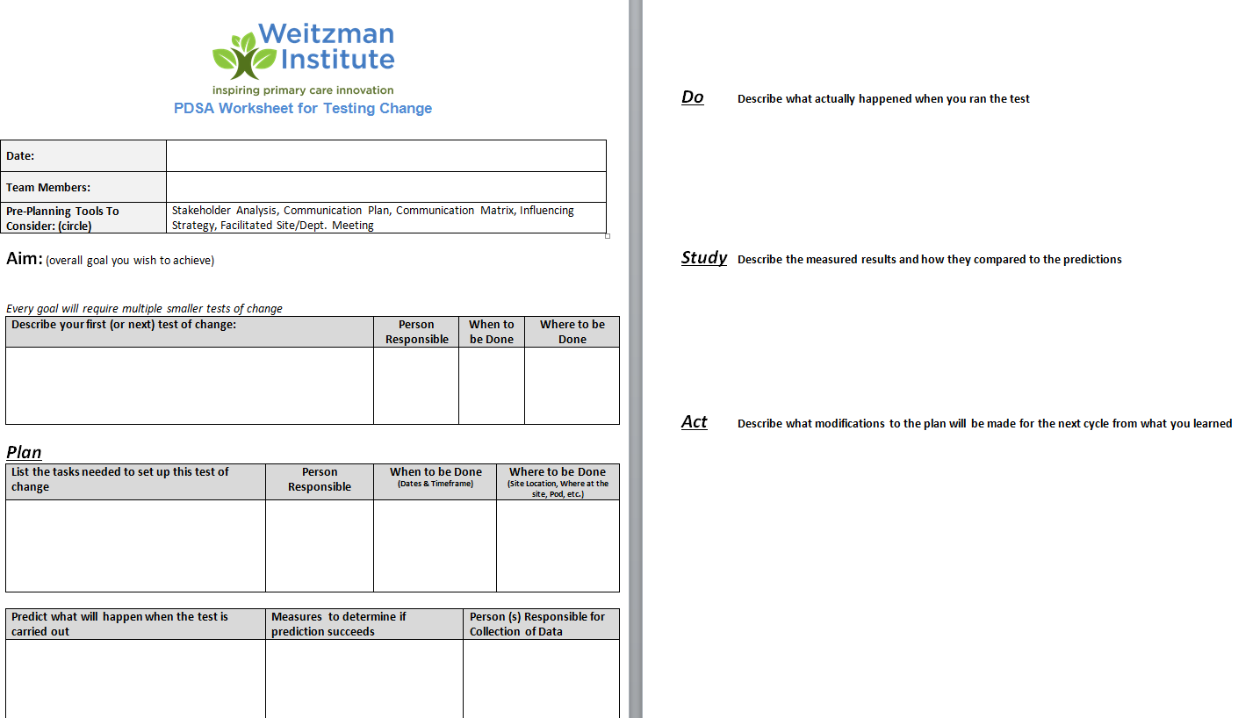
Notes:
Deb

Slide 48
PLAN: Comes from Specific Aim Statement
WHAT are we striving to accomplish?
WHAT will we do?
WHEN will this occur (what is the timeline)?
HOW MUCH? What is the specific, numeric improvement we wish to achieve?
FOR WHOM? Who is the target population?
Notes:
Deb

Slide 49
DO
Implement the improvement
Collect and document the data
Document the problems, unexpected observations, lessons learned, and knowledge gained
Notes:
Deb
The “Do” phase is as it sounds – just do it! This marks the implementation of the improvement, and during this phase it’s important to not only collect and document data around the improvement, but also to document the other things listed. QI efforts generate many learnings and it’s important to capture these.

Slide 50
STUDY
Analyze the results: Was an improvement achieved?
Document lessons learned, knowledge gained, and any surprising results that emerged.
Notes:
Deb
This phase involves analyzing the effect of the intervention.
Compare the new data to the baseline data to determine whether an improvement was achieved, and whether the measures in the aim statement were met.
And again – document!

Slide 51
ACT
Take action:
Adopt - standardize
Adapt – change and repeat
Abandon – start over
Notes:
Deb
This phase marks the culmination of the planning, testing, and analysis regarding whether the desired improvement was achieved as articulated in the aim statement, and the purpose is to act upon what has been learned.
If the improvement was achieved, it’s time to adopt it as standard practice
If the improvement wasn’t quite achieved, but we feel it was close, we will adapt our “test,” and either extend the testing period or revise something and repeat the testing cycle
If the improvement simply wasn’t achieved, we need to start back at the planning phase and reconsider the problem at hand.
Once we have adopted and standardized the improvement, we still need to monitor the situation and make sure the improvement holds.

Slide 52
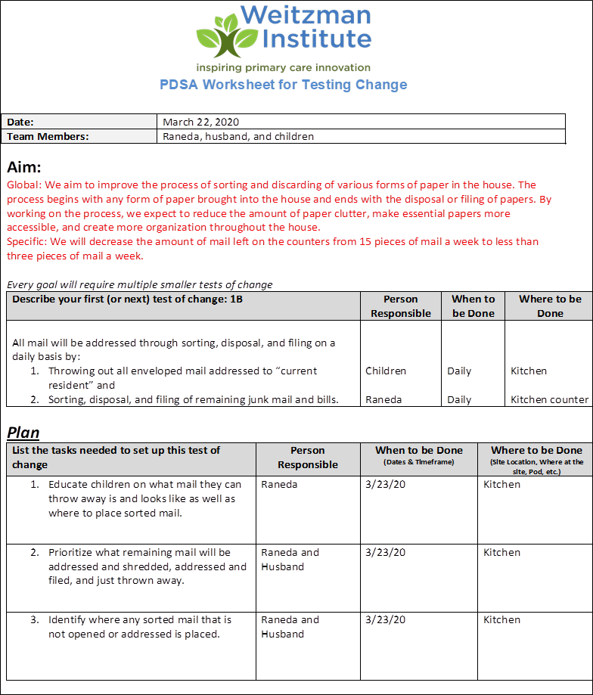
Notes:
Deb

Slide 53
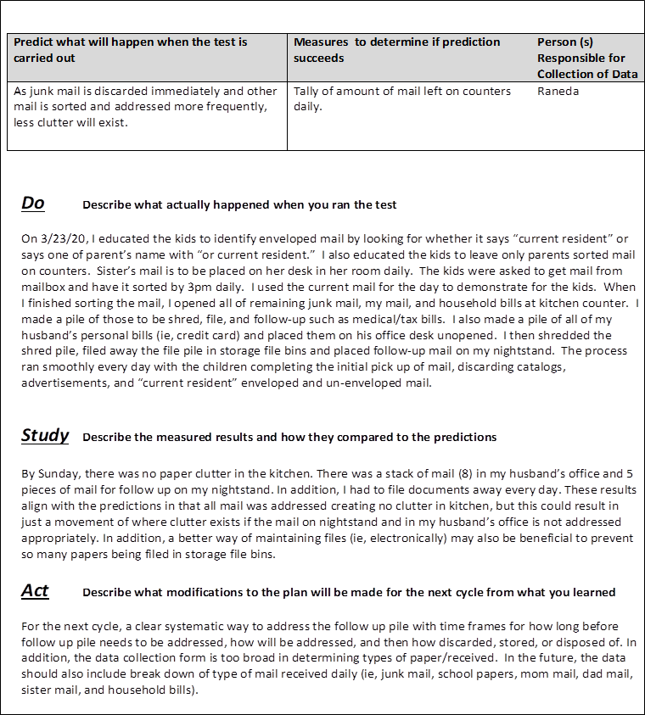
Notes:
Deb

Slide 54
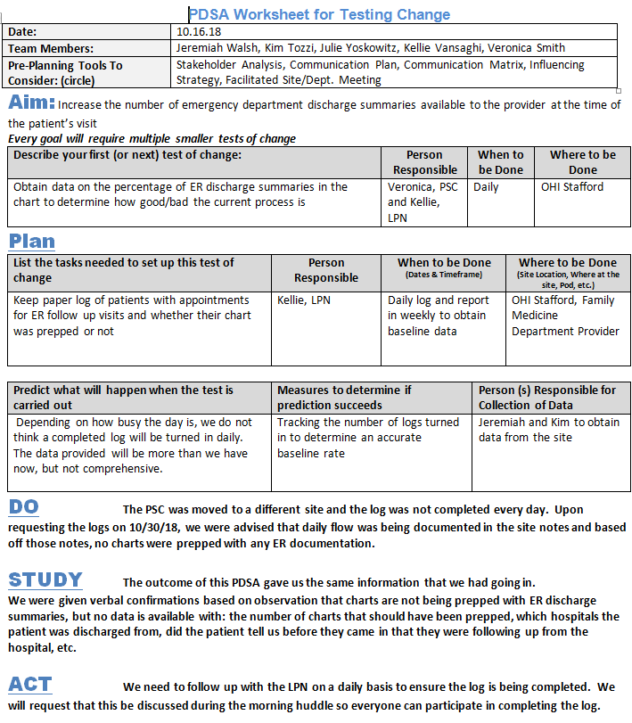
PDSA
Example

Slide 55
SUSTAIN
Once you’ve adopted:
Monitor – reports, dashboards, quarterly meetings
Maintain – who is the owner, process for looking into measures when they fall below?
Check-In – conversations, connections, accountability, transparency, trust
Develop a playbook – a recipe to perform the new process, training tool
Notes:
Deb

Slide 56
Questions?

Slide 57
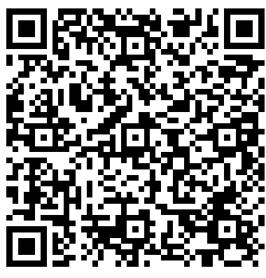
Action Period 5 Deliverables
Conduct your weekly team meetings
Assignment: Develop PDSA
Google Drive
https://drive.google.com/drive/folders/1VFv0Ar6VbdVDS_fkY6fPXQw36Tq0A1Wg?usp=drive_link

Slide 58
Reminders
CME and Resource Page
Access Code: TBC2023
https://education.weitzmaninstitute.org/content/nttap-comprehensive-and-team-based-care-learning-collaborative-2023-2024
Coach Calls:
Wednesday April 10th 1:00pm ET / 10:00am PT
Wednesday April 17th 1:00pm ET / 10:00am PT
Wednesday April 24th 1:00pm ET / 10:00am PT
Wednesday May 1st 1:00pm ET / 10:00am PT
Session 6: Wednesday May 8th 1:00pm ET / 10:00am PT
Notes:
Meaghan

Slide 59
NTTAP Contact Information
Amanda Schiessl
Project Director/Co-PI
Amanda@mwhs1.com
Bianca Flowers
Project Manager
flowerb@mwhs1.com
Meaghan Angers
Project Manager
angersm@mwhs1.com
REMINDER: Complete evaluation in the poll!
Next Learning Session is Wednesday May 8th!
Notes:
Meaghan

Slide 60
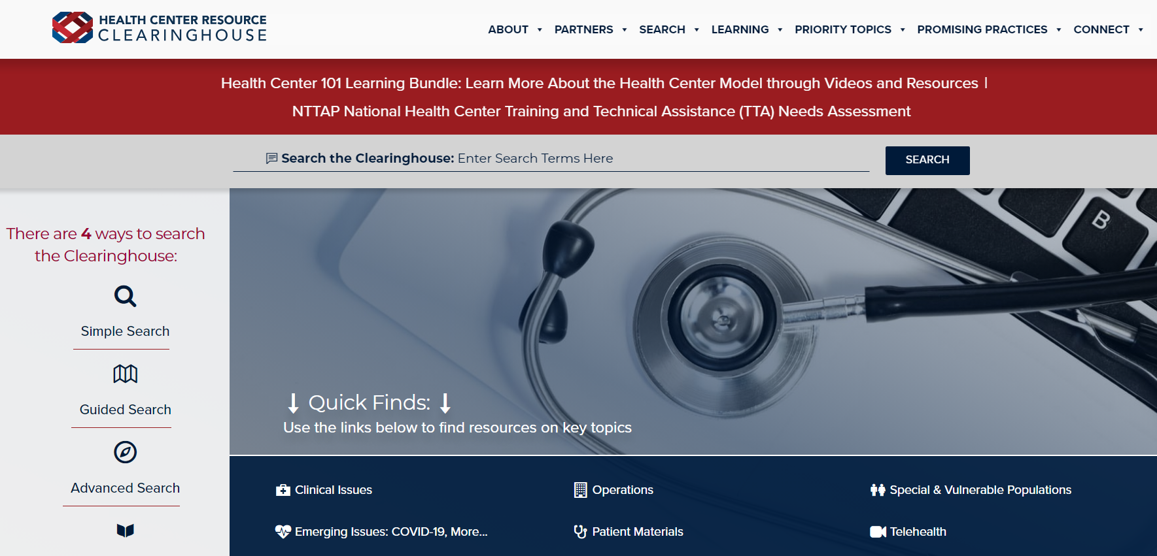
Explore more resources!
National Learning Library: Resources for Clinical Workforce Development
Health Center
Resource Clearinghouse
https://www.weitzmaninstitute.org/ncaresources
https://www.healthcenterinfo.org/
60
Notes:
Meaghan

