Slide 1
Health Profession Student Training
Learning Collaborative
Session Four: Tuesday April 16th, 2024
Notes:
Meaghan

Slide 2
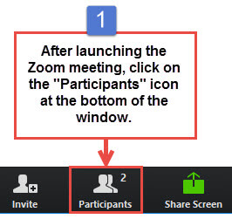
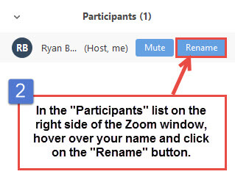
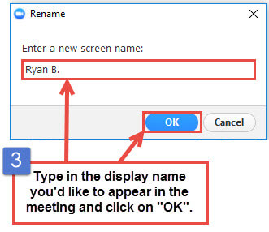
Get the Most Out of Your Zoom Experience
Please keep yourself on MUTE to avoid background/distracting sounds
Use the CHAT function or UNMUTE to ask questions or make comments
Please change your participant name to your full name and organization
“Meaghan Angers CHCI”
Notes:
Meaghan

Slide 3
Session 4 Agenda
3:00 – 3:05 | Welcome & Introduction
3:05 – 3:40 | Behavioral Health: Students, Externs, and Residents
3:40 – 4:00 | Administrative Fellowship
4:00 – 4:20 | Quality Improvement Refresh: Standardization and Spread, Playbooks
4:20 – 4:30 | Wrap-Up
Notes:
Meaghan

Slide 4
Learning Collaborative Faculty
Margaret Flinter, APRN, PhD, FAAN
Co-PI, NTTAP
CHCI’s Senior Vice President/Clinical Director
Amanda Schiessl, MPP
Co-PI & Project Director, NTTAP
Victoria Malvey
Interprofessional Student Specialist
Bianca Flowers
Project Manager, NTTAP
Meaghan Angers
Project Manager, NTTAP
Notes:
Meaghan

Slide 5
National Training and Technical Assistance Partners
Clinical Workforce Development
Provides free training and technical assistance to health centers across the nation through national webinars, learning collaboratives, activity sessions, trainings, research, publications, etc.
Notes:
Meaghan

Slide 6
Learning Collaborative Structure
Six 90-minute Learning Collaborative video conference sessions
Bi-weekly calls between coach mentors and practice coach
Bi-weekly team workgroup meetings
Use the Weitzman Education Platform to access resources and receive CME credit
Learning Session Dates
Learning Session 1 | Tuesday February 6th
Learning Session 2 | Tuesday March 5th
Learning Session 3 | Tuesday March 26th
Learning Session 4 | Tuesday April 16th
Learning Session 5 | Tuesday May 14th
Learning Session 6 | Tuesday June 11th
Notes:
Meaghan

Slide 7
2024 Cohort
Five Rivers Health Centers | Ohio
Jessie Trice Community Health Center | Florida
Northshore Health Centers | Indiana
Primary Health Care, Inc. | Iowa
Sun Life Health | Arizona
SWLA Center for Health Services | Louisana
Tepeyac Community Health Center | Colorado
Thundermist Health Center | Rhode Island
Upper Great Lakes Family Health | Michigan
Wellspace Health | California
Notes:
Meaghan

Slide 8
Behavioral Health: Students, Externs, and Residents
Dr. Tim Kearney, Chief Behavioral Health Officer
Notes:
Tim

Slide 9
Polling Question
Do you have a behavioral health training program at your organization?
Yes
No
Unsure
Have you thought about starting a behavioral health training program at your organization?
Yes
No
Unsure
Notes:
Tim

Slide 10
Overview of BH Landscape
Clinical Providers:
Therapists
Social worker, marriage and family therapist, counselor, psychologist, drug and alcohol counselor
Medication providers:
Psychiatrist, psychiatric nurse practitioner, prescribing psychologists
Level of licensure
Licensed Independent Practitioners (LIP)
Licensed to Practice Under Supervision
Student or Resident Under supervision of appropriately credentialed LIP
Notes:
Tim

Slide 11
Behavioral Health Student Training Levels:
Externship
Still in training program prior to receiving degree
Internship
Completed all training with the exception of dissertation
Postdoctoral Residency
Completed training and received PhD, but in order to get licensed, you need a year under supervision before exams
Nationally competitive program
APA Accredited internship
In placement as part of their training
Each discipline has a different variation
APA Accredited Postdoc Residency program
APPIC
Notes:
Tim
Not included on slide – speak to each one how it works at CHC
Considerations of which discipline you are training
7 in CT, will vary state-to-state
At what level are you training?

Slide 12
Considerations in Selecting Training Students vs. Post Graduates
Students
Post Graduate Trainees
Student program builds a relationship with local programs and community partnerships.
Promotes relationships for engagement in residency programs or being hired on as staff.
Typically no salary.
Follows academic year.
Less intensive supervision.
Resident can carry larger case load, take on a wider range of responsibilities.
Hired as employees.
12 month program.
12
Notes:
Tim

Slide 13
Considerations in Program Design Students vs. Post Graduates
Students
Post Graduate Trainees
Fewer hours.
Prioritization of face-to-face time.
Selective didactic programming.
School requirements
Tailoring training to specific training goals.
Promoting leadership opportunities.
Increased breadth of training experiences.
External accreditation and licensing standards
13
Notes:
Tim

Slide 14
For the common good
What are your drivers for a behavioral health training program?
For the good of your agency
For the good of the resident
Notes:
Tim

Slide 15
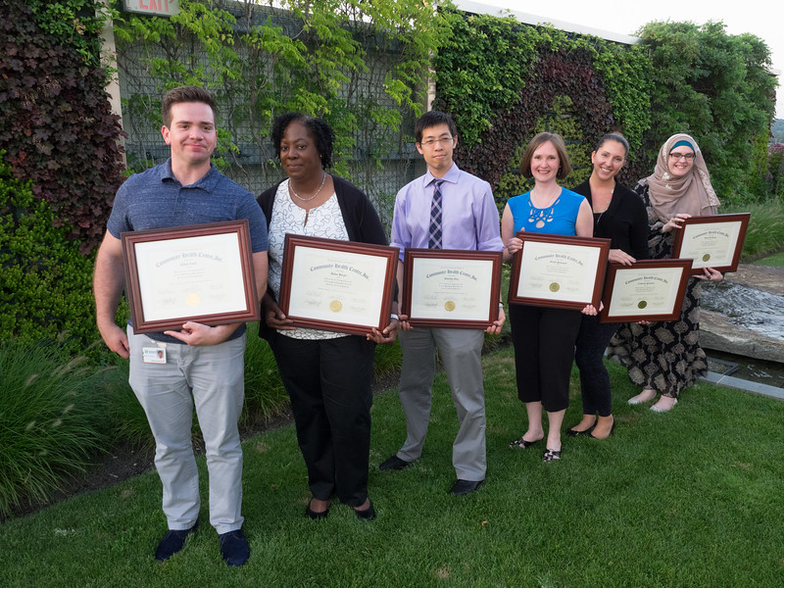
For the Common Good
To develop staff to address behavioral health needs of our clients, particularly using those trained to an integrated model of primary care and behavioral health
Notes:
Tim
For the common good
Increase the pool of qualified, effective well trained psychologists
Provide quality training settings for upcoming psychologists who need supervised hours for licensure
Shape the future of the field by teaching postdocs how to conceptualize the role of the psychologist by what they see and what they do in their last year of supervised experience prior to licensure

Slide 16
For the Good of Your Health Centers
Influx of new energy and enthusiasm with the most recent evidence based knowledge
Increased staff satisfaction
Professional development:
Learning to supervise
Increasing skill of clinical teaching
Recognition of skill
Passing on knowledge
Improved retention
Increased access for clients
Opportunity to build a strong talent pool from which to hire through training pipeline
May generate income based on billing
Notes:
Tim
Have students increases staff satisfaction –
by giving staff the opportunity to expand their own professional skills in learning how to supervise and the opportunity for clinical teaching (often across discipline).
Staff consistently tell us they enjoy the experience and learn from their students
by increasing variety of daily activities for staff – varied work day is consistently linked in the literature to job satisfaction
by being recognized as a role model and someone who is able to teach how to be an excellent clinician.
by passing on knowledge and feeling the reward of watching a resident’s skill level increase
Of course not all of these apply to every supervisor, and some staff have no interest or no skill in clinical teaching and would not want to (and probably should not be asked) to supervise, but for most of our staff participating in the program in a big plus
In addition to the rewards for staff, residents in and off themselves, may bring many benefits to the agency, including
increased intellectual rigor to clinical team meetings and supervision. While those of us in the clinical setting for decades keep up with continuing education and some professional reading, our postdocs are fresh out of school with great ideas and current knowledge – some tremendously applicable to our settings, some maybe a little ivory towerish, all of it blowing a breath of fresh air into our agency
postdocs bring additional minds and hands to put to work for program development – fresh, trained eyes may spot something we do not see or bring us ideas we can borrow from another setting where they saw something in action we can adapt to our situation, and their lowered clinical load allows them time to work to plan and implement ideas
postdocs require supervision ( 3 per week for us) and didactic training (another 2 for us) as well as the real time consultations that occur during the clinical day, but on balance, they see clients for many more hours per week than we spend in teaching, supervision, and consulting and that represents a net gain in access for our clients
depending on how your state allows for billing for work done under supervision (most private insurances not allow it but the CT Medicaid program does under specific conditions which our postdoc program meets) you may find that your postdoc program is a break even or even a moneymaking operation. Many agencies who cannot bill find the other benefits compelling and start a program anywayl
As we will show you on the next slide, postdoctoral residencies also give the opportunity to train a group of bright young psychologists to our model and then hire the best of them who want to stay in the area. And as a segue into the next slide, even if they don’t stay we have helped to produce a good employee who can continue to contribute to the field elsewhere.

Slide 17
For the Good of the Student
Prepares trainees to work with vulnerable populations in an FQHC setting
Builds confidence within a clinical setting to become an independent clinician with enhanced treatment abilities and leadership skills
Learn by doing and introject a picture of the role of a behavioral health provider in an integrated care setting that informs professional self image at the start of a career
Prepares the student for the next steps in professional development
Increases competitiveness in the job market for those who do not remain at their training site by providing a broad clinical exposure
Notes:
Tim
Student means all levels of training
For the Good of the Resident:
High quality setting that prepares the postdoc for the job market
Further clinical experience, training, and the consolidation of professional identity
Build confidence within a clinical setting to become an independent clinician with enhanced treatment abilities and leadership skills,.
Experience in the job setting will increase postdocs success at first independent job setting and thus improve retention and morale

Slide 18
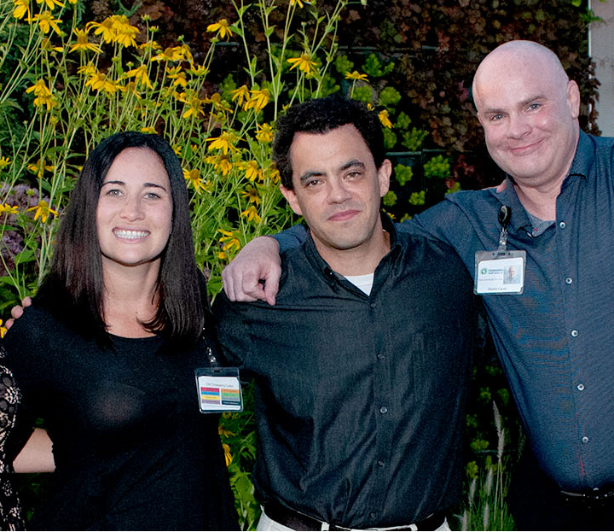
The Road to Developing a Student Training Program
Answer the question: What are your drivers for a behavioral health training program?
Identify requirements of training: discipline/level
Assess your own resources (physical, human, financial)
Secure board, leadership, and clinical buy-in
Develop financial and strategic plan including potential partners
Costs and benefits:
Direct and indirect costs
Return on Investment: immediate and longer term
Benefits beyond the financial return
Notes:
Tim

Slide 19
Elements of Training Program
Didactic Series
Group and individual supervision
Leadership training opportunities
Additional training opportunities
Clinical exposure and scaffolding
19
Notes:
Tim
Didactic types - OUD/SUD Treatment, Multicultural Considerations, Trauma Informed Care, Integrated Care, Treating Chronic Health Conditions, Providing Telebehavioral Health, Conducting Group Treatment

Slide 20
What we have Learned
The importance of collecting data
Trainees improve processes and systems by providing feedback to staff about workflow issues
Supervision training is needed
One day per week for didactics, supervision, and cohort activity is invaluable
Be very clear about expectations and what you can and cannot offer
20
Notes:
Tim
2. Thinking of what software platform you use, your agency may already have one which can save money. It’s not only for accreditation, it also reports that we have to generate external resources. Feedback from trainees to improve your program.

Slide 21
NTTAP Resources
Implement Behavioral Health Training Programs to Address a Crucial National Shortage in Community Health Care Settings Webinars Slides | Video
Developing a Postdoctoral Residency Program in Community Health Slides | Video
Notes:
Tim

Slide 22
Questions?
Notes:
Tim

Slide 23
Administrative Fellowships
Manjari Mishra, Administrative Fellow
Wildaline Figaro, Administrative Fellow
Notes:
Manjari / Wildaline

Slide 24
Polling Question
Do you have an administrative fellowship program at your organization?
Yes
No
Unsure
Have you thought about starting an administrative fellowship program at your organization?
Yes
No
Unsure
Notes:
Manjari / Wildaline

Slide 25
What is an Administrative Fellowship?
A program typically administered by healthcare organizations to train master’s-level, post- graduate students on the management and delivery of healthcare services.
Program lengths vary between six months and two years, with most programs offering of a one year curriculum.
While postgraduate fellowships are not required, a majority of healthcare focused graduates pursue fellowship opportunities.
Notes:
Manjari / Wildaline
So, what is an administrative fellowship? These are 6 month to 2-year long, healthcare administration training programs for postgraduates. Fellowship organizations span across the healthcare spectrum from consulting agencies and professional societies to healthcare delivery systems—both large and small. Some fellowships offer a general experience giving fellows experiences working in multiple departments through respective dept. rotations or through strategic project work, while other fellowships offer an experience in a specific focus area such as a finance administrative fellowship. Fellows report to the fellowship director who is usually a member of the leadership team, but also often work closely with rotational or project leads which could be project managers, vice presidents, or directors within the organization. April Joy is actually one of the rotation preceptors for the fellowship at CHC, so I’ll give her a moment to share her experience and the value fellows can bring to organizations.

Slide 26
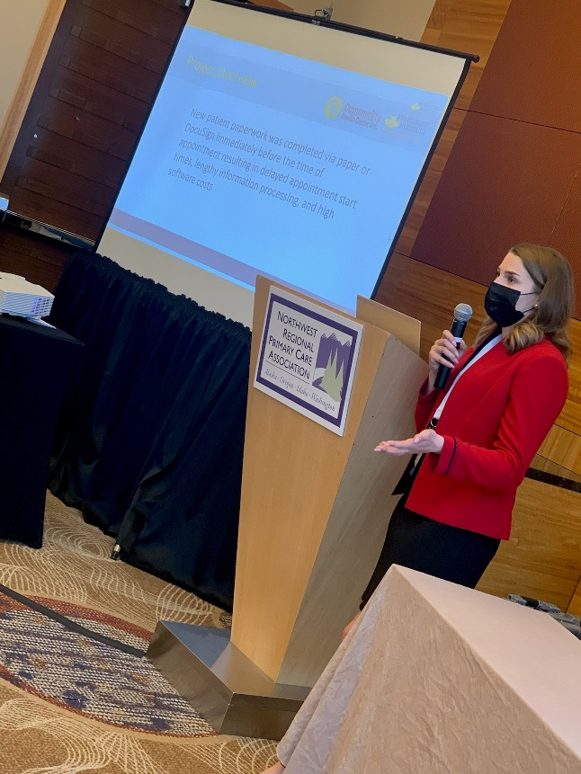
Why should I consider establishing an Administrative Fellowship?
Succession planning
Diverse backgrounds, skillsets, and perspectives
Training the next generation
Notes:
Manjari / Wildaline

Slide 27
What should I consider before establishing an Administrative Fellowship?
How much access is my agency willing to grant the fellow? (leadership, sensitive info)
General fellowship or specialized fellowship? How many?
What experiences do I want to ensure my fellow is exposed to?
How long will it take for fellow to gain this experience?
Notes:
Manjari / Wildaline
Rough draft Break this slide up
- Each organization customizes their fellowship program according to its leadership philosophy. Key considerations may include whether fellows will serve as learners (e.g. participating in shadowing experiences), contributors (e.g. leading projects or completing key individual assignments) trainees or some combination of both, cultural values the organization wishes to impart such as matters of faith (for faith based organizations), patient safety, or outstanding customer service, and whether the organization expects to retain fellows or prepare them for external job searches

Slide 28
What should I consider before establishing an Administrative Fellowship?
Who will serve as fellowship director?
Who will serve as rotational or project leads?
Will my fellow rotate departments or work on an all-encompassing strategic projects?
Will my agency support fellows in their search for full-time opportunities or create positions for them post fellowship?
Notes:
Manjari / Wildaline
- Each organization customizes their fellowship program according to its leadership philosophy. Key considerations may include whether fellows will serve as learners (e.g. participating in shadowing experiences), contributors (e.g. leading projects or completing key individual assignments) trainees or some combination of both, cultural values the organization wishes to impart such as matters of faith (for faith based organizations), patient safety, or outstanding customer service, and whether the organization expects to retain fellows or prepare them for external job searches

Slide 29
CHC’s Experience
Fellow perspective
Why did you choose a fellowship? Why a fellowship at an FQHC specifically?
How was your overall fellowship experience?
What was your visibility and access to leadership?
What are the hours and stress level of a fellowship?
What advice would you give to future fellowship preceptors?
Notes:
Manjari / Wildaline
-Regardless of the organization’s philosophy, the fellowship should be designed to ensure that fellows hit the ground running and gain practical experience. Fellows should be challenged to stretch and take risks in a controlled environment; this opportunity to fail, recover and learn distinguishes fellowships from both classroom experiences and full time (post fellowship) roles.

Slide 30
Establishing an Administrative Fellowship Program: A Practical Toolkit to Support and Develop Future Community Health Center Leaders
https://conferences.nachc.org/nachc/articles/5187/view
Notes:
Manjari / Wildaline

Slide 31
Questions?
Notes:
Manjari / Wildaline

Slide 32
Quality Improvement Refresh: HPS Training Playbook Guide and Standardization & Spread
Deb Ward, Consultant, CHC
Notes:
Deb

Slide 33
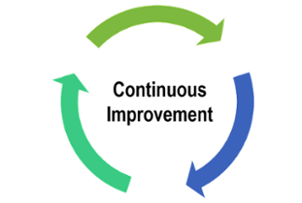
Testing Changes (PDSAs) to ….. Standardizing (SDSAs) to…. Testing by Another POD Before a Broader Spread
Notes:
Deb

Slide 34
What is Spread?
Spread is the process of taking a successful implementation process from a pilot, and replicating that change or package of changes (playbook) in other teams within a practice or other practices.
During implementation, teams learn valuable lessons necessary for successful spread including key resource issues, best sequence of tasks, and how to help team members adopt and adapt a change.
Spread efforts benefit from the use of the PDSA cycle. Teams adopting the change have the skills to test the standard and work toward achieving the results of other teams.
Notes:
Deb

Slide 35
Testing Changes to Spread Collaborative Expectations
Broad
Spread
and
Sustainability
A BIG
Deal
Standardizing
SDSAs & Documentation
Use and improve Playbook
Try change in another POD, then try in another POD
Testing Changes (PDSAs)
A POD
Notes:
Deb

Slide 36
It is never too early to plan for spread however certain things should be in place before actually carrying out the plan.
Notes:
Deb

Slide 37
You can spread a successful PDSA process to another POD
You can create a playbook describing the new standardized steps and process
You can create sustainable change that positively impacts patients
Notes:
Deb

Slide 38
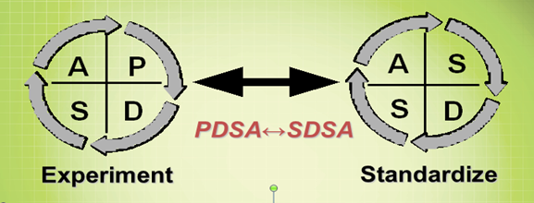
Is the Process Standardized?
Is the process failure free over time?
Can your team count on it not to fail when everyone is following the process?
If one person overlooks it, will another catch it?
Are there clear specifications and communication?
Is the process supported by technology to reduce failure (EHR)?
A process recognizable by your team as “the way we do things” here
Is there an expectation that that the evidence based process will be followed?
Is the process LEAN with minimal steps in the process?
Notes:
Deb

Slide 39
How Will You Know?
A process recognizable by all in the workplace as “the way we do things” here
Five staff members can regularly articulate the process steps when asked individually to describe
A “miss” (defect) in the process flow can be immediately identified so that it can corrected
There is a process in place to identify a failed step in process
There is a communication plan to support correcting a process defect to all areas
Measures clearly indicate that the process is working
Notes:
Deb

Slide 40
Communicating Spread
Does leadership have all of the information they need to confidently speak with staff about the standardization?
Have you gotten the approval of any committee or group internally that is required for standardization?
Do you have a strategy to train the necessary staff on the standardization before it is implemented?
Do you have (at the very least) the framework for a playbook that agency staff can use a reference?
Have you developed a plan for evaluation with timelines and individuals responsible for measurement?
Notes:
Deb

Slide 41
What is a Playbook?
Collection of processes and tools that have been tested using improvement science and resulted in a ‘way we want process done’.
Playbook serve as repository for standard processes (SDSAs), ensuring improvement does not ‘slip’.
The purpose is to provide a common and easy to access place to post and search all standardized processes and tools – using technology.
Quality by Design, 2007
Notes:
Deb

Slide 42
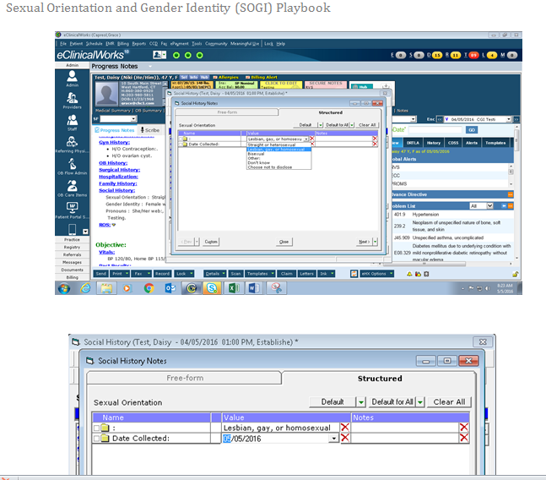
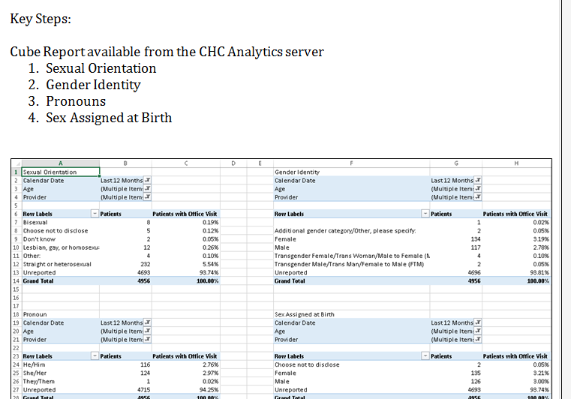
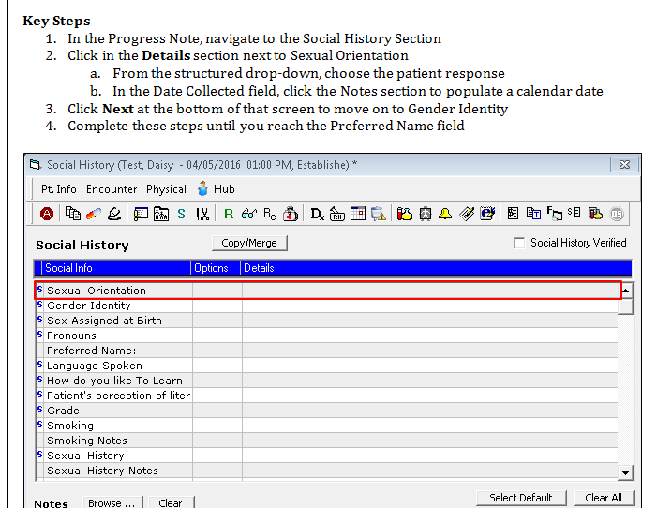
What is a playbook & Why is it important?
IHI.org
Geisinger Quality Institute
Notes:
Deb

Slide 43
Health Professions Student Training Playbook Overview
Play 1: Partnership Approval and Communications with Schools
Play 2: Affiliation Agreement Management
Play 3: Student Capacity
Play 4: Initiating the Onboarding of a Student
Play 5: Communication with Student
Play 6: Student is Trained
Play 7: Student Arrives
Play 8: Student Documentation and Reporting
Play 9: Off-boarding
Notes:
Deb

Slide 44
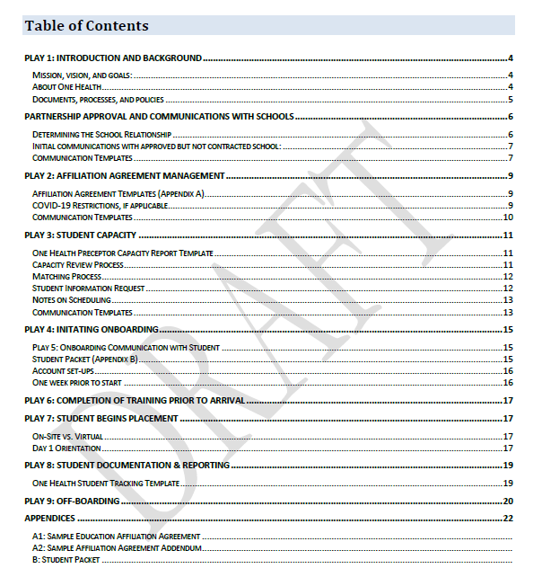
Playbook Example
Notes:
Deb

Slide 45
Lessons Learned
Standardization is on-going and the process requires continuous attention.
Prioritize a true change in agency culture not just process.
Facilitate collaborations with internal departments early in the process (i.e.: data, business intelligence)
Be prepared for the “hoops” you need to jump through to get to an agency wide initiative – committee presentations, BOD approval
Patient feedback can invigorate enthusiasm in staff
Training to all levels of staff is arduous but necessary in standardization – remember to include administration, IT, billing, finance.
Communication to the correct individuals is a key to success.
Recognition for key staff (especially those with increased work load) is essential
Leadership buy-in can make or break an initiative.
Assign a key point of contact for questions, concerns and suggestions.
Highlight successes often!
Notes:
Deb

Slide 46
Questions?
Notes:
Deb

Slide 47
Next Steps
Agenda items for your meetings during this action period
Meet with key stakeholders and present play 3
Review play 4-7 in the HPS Training Playbook Guide
Draft process map for play 4-7
Assignments
Submit rough draft of plays 4-7
Google Drive Link: https://drive.google.com/drive/folders/1l8mFwbFw2-2Z_QgmndDL_a1Dcsmr08HX
CME and Resource Page
Access Code: HPS2024
https://education.weitzmaninstitute.org/content/nttap-health-professions-student-training-learning-collaborative-2024
Notes:
Meaghan

Slide 48
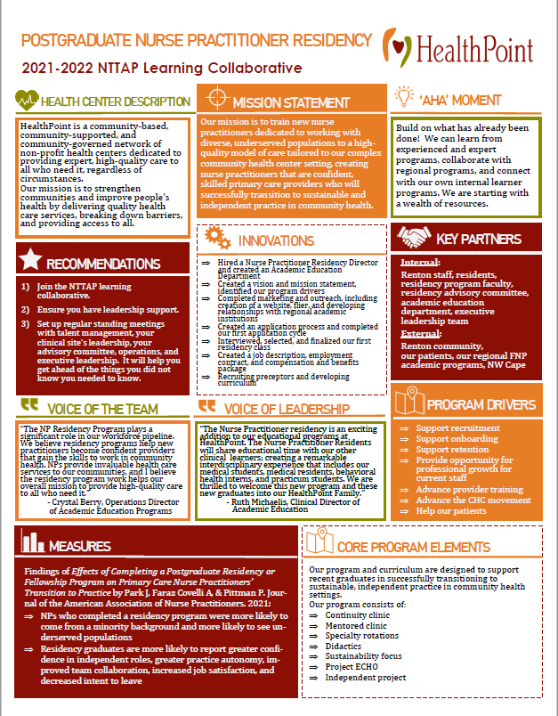
Showcase Overview
Due Date: Wednesday May 29th
Showcase Date: Tuesday June 11th
Team coaches will be sent a template, including:
Innovations*
‘Aha’ Moments*
Recommendations to others*
Aim Statement
Measures/Impacts
Key Partners
Quote from leadership
Quote from team member
Process Map or other visuals (i.e. photos, graphs)
*Required
48
Notes:
Meaghan

Slide 49
NTTAP Contact Information
Amanda Schiessl
Project Director/Co-PI
Amanda@chc1.com
Bianca Flowers
Project Manager
flowerb@chc1.com
Meaghan Angers
Project Specialist
angersm@chc1.com
REMINDER: Complete evaluation in the poll!
Upcoming Coach Calls: Tuesday April 23rd & May 7th
Next Learning Session is Tuesday May 14th!
Notes:
Meaghan

Slide 50
Explore more resources!
National Learning Library: Resources for Clinical Workforce Development
Health Center
Resource Clearinghouse
https://www.weitzmaninstitute.org/ncaresources
https://www.healthcenterinfo.org/
50
Notes:
Meaghan

