Slide 1

Postgraduate Nurse Practitioner Residency & Fellowship Program Learning Collaborative
Session Six: Tuesday April 2nd, 2024
Notes:
Meaghan

Slide 2
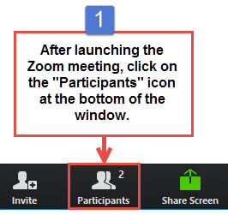
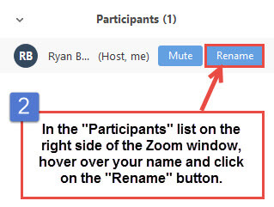
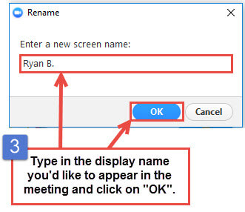
Get the Most Out of Your Zoom Experience
Please keep yourself on MUTE to avoid background/distracting sounds
Use the CHAT function or UNMUTE to ask questions or make comments
Please change your participant name to your full name and organization
  “Meaghan Angers CHCI”
Notes:
Meaghan

Slide 3
Session 6 Agenda
1:00-1:05 | Introduction and Agenda
1:05-2:10 | Showcase – 8 minutes each 1:05-1:13pm Chase Brexton Health Care 1:13-1:21pm Community Clinic Association of Los Angeles County (CCALAC) 1:21-1:29pm Crossing Healthcare DBA Community Health Improvement Center 1:29-1:37pm Hope Christian Health Center 1:37-1:45pm Nasson Health Care DBA York County Community Action Corporation 1:45-1:53pm Primary Health Network 1:53-2:01pm WellSpace Health 2:01-2:09pm Wheeler Health
2:10-2:30 | Wrap-Up and Evaluation
Notes:
Meaghan

Slide 4
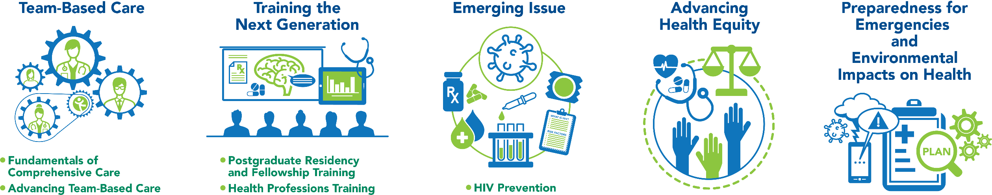
National Training and Technical Assistance Partners
Clinical Workforce Development
Provides free training and technical assistance to health centers across the nation through national webinars, learning collaboratives, activity sessions, trainings, research, publications, etc.
Notes:
Meaghan

Slide 5
Learning Collaborative Faculty
Margaret Flinter, APRN, PhD, FAAN
  Co-PI, NTTAP
  CHCI’s Senior Vice President/Clinical Director
  Director Emeritus, WI, Senior Investigator
  Founder of America’s first nurse practitioner residency program
Kerry Bamrick, MBA
  Executive Director, Consortium for Advanced Practice Providers
  Coach Mentor
Charise Corsino, MA
  Program Director, NP Residency Programs
  Coach Mentor
Nicole Seagriff, DNP, APRN, FNP-BC
  Clinical Program Director
Kathleen Thies, PhD, RN
  Consultant, Researcher
  Evaluation Faculty
Amanda Schiessl, MPP
  Co-PI & Project Director, NTTAP
Bianca Flowers
  Project Manager, NTTAP
Meaghan Angers
  Project Manager, NTTAP
5
Notes:
Meaghan

Slide 6
Learning Collaborative Structure
Six 90-minute Learning Collaborative video conference sessions
Bi-weekly calls between coach mentors and practice coach
Bi-weekly team workgroup meetings
Use the Weitzman Education Platform (Share Your Work, Resources, etc.)
Learning Session Dates
Learning Session 1 | Tuesday November 21st
Learning Session 2 | Tuesday December 19th
Learning Session 3 | Tuesday January 16th
Learning Session 4 | Tuesday February 13th
Learning Session 5 | Tuesday March 5th
Learning Session 6 | Tuesday April 2nd
6
Notes:
Meaghan

Slide 7
2023-2024
Cohort
Bartz-Altadonna Community Health Center | California
Charles B. Wang Community Health Center | New York
Chase Brexton Health Care | Maryland
Community Clinic Association of Los Angeles County (CCALAC) | California
Crossing Healthcare | Illinois
Hope Christian Health Center | Nevada
Klamath Health Partnership | Oregon
Nasson Health Care | Maine
Neighborhood Outreach Access to Health | Arizona
Peninsula Community Health Services | Washington
Penobscot Community Health Center, Inc. | Maine
Primary Health Network | Pennsylvania
WellSpace Health | California
Wheeler Health | Connecticut
7
Notes:
Meaghan

Slide 8
Let’s Review
Session 1
Session 2
Session 3
Session 4
Session 5
Program Drivers
Mission/Vision
Resource Assessment
Support from Leadership/ Board of Directors
Overview of Program Structure
Value of Academic Clinical Partnerships
Overview of Program Structure
Key Program Staff and Responsibilities Using the Progress Checklist
Preceptors, Mentors, & Faculty
Marketing and Recruitment
Reviewing Candidate Applications
Interviewing & Selecting Candidates
Finances, ROI, and Sustainability
Program Policies and Procedures
Contracts/ Agreement
Curriculum Development
Evaluation of the Postgraduate Residency Program
Evaluation of the Resident Learner
Orientation
Graduation
Introduction to Accreditation by the Consortium
8
Notes:
Meaghan

Slide 9

Showcase!
Notes:
Meaghan

Slide 10
Showcase Objectives
Tell the story of your health center’s work during this learning collaborative in a clean, crisp, visual format
Generate reflections among you and the other team members about your involvement in this learning collaborative
Share your work in future meetings with other health center staff including leadership and external stakeholders (i.e. health center board, community partners, and funders)
Notes:
Meaghan

Slide 11
Showcase Order
1:05-1:13pm Chase Brexton Health Care
1:13-1:21pm Community Clinic Association of Los Angeles County (CCALAC)
1:21-1:29pm Crossing Healthcare DBA Community Health Improvement Center
1:29-1:37pm Hope Christian Health Center
1:37-1:45pm Nasson Health Care DBA York County Community Action Corporation
1:45-1:53pm Primary Health Network
1:53-2:01pm WellSpace Health
2:01-2:09pm Wheeler Health
Notes:
Meaghan

Slide 12
Next Steps
Due Friday April 12th
Submit Progress Checklist
Submit all completed/drafted work
Complete Post-Collaborative Surveys
Post-Collaborative Surveys
Each team member, please complete the Post-Collaborative Evaluation Survey: https://Qualtrics.ca1.qualtrics.com/jfe/form/SV_3PBk1cmAyECDxtQ
As a team, please complete the Post-Collaborative Readiness to Train Assessment Tool (RTAT): https://Qualtrics.ca1.qualtrics.com/jfe/form/SV_87wnfltnRcwicTQ
Ask each team member to complete the Post-Collaborative Organizational Readiness to Implement Change (ORIC): https://Qualtrics.ca1.qualtrics.com/jfe/form/SV_0D3hS0kPaQBzW3c
Reminders
6-month Check-in Call: Tuesday October 1st from 1:00-2:00pm Eastern
If you are launching in Fall 2024, please reach out to schedule 1-on-1 calls as needed.
Notes:
Meaghan

Slide 13
Questions?
Notes:
Meaghan

Slide 14

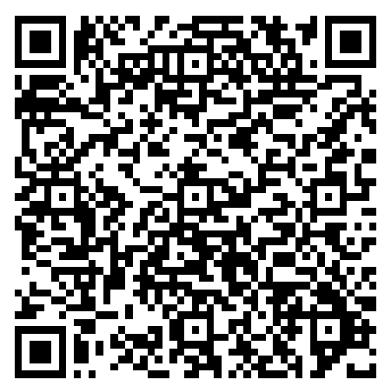
NTTAP Contact Information
CME and Resource Page
Access Code: PGR2023
https://education.weitzmaninstitute.org/content/postgraduate-nurse-practitioner-np-residency-and-npphysician-associate-pa-training-programs
Amanda Schiessl
Program Director/Co-PI
Amanda@mwhs1.com
Meaghan Angers
Program Manager
angersm@mwhs1.com
REMINDER: Complete evaluation in the poll!
Notes:
Meaghan

Slide 15


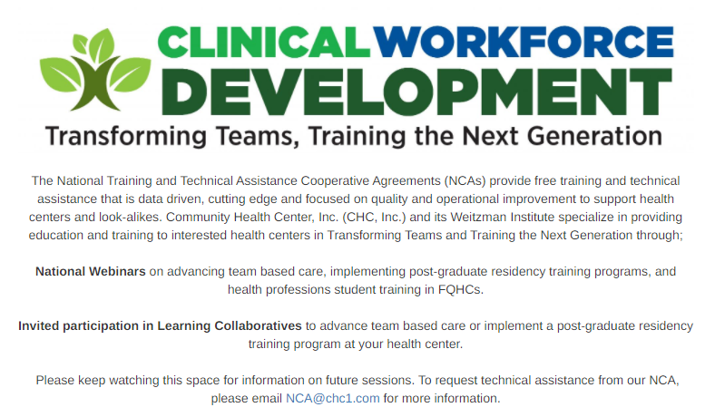

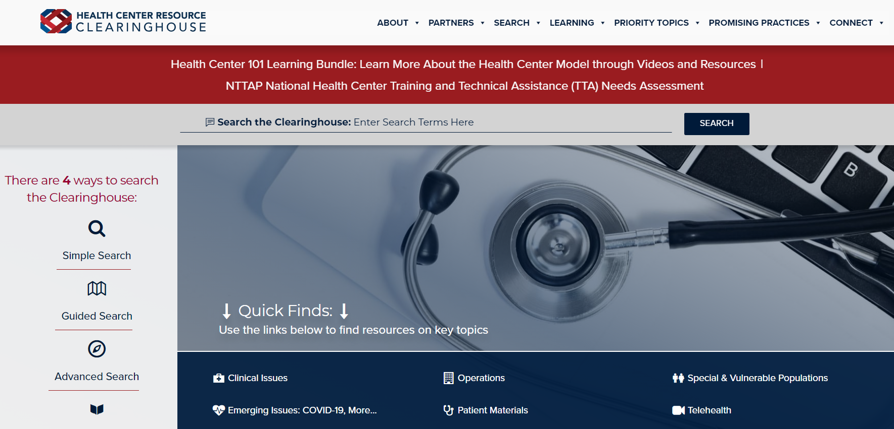
Explore more resources!
National Learning Library:
Resources for Clinical Workforce Development
Health Center
Resource Clearinghouse
https://www.weitzmaninstitute.org/ncaresources
https://www.healthcenterinfo.org/
15
Notes:
Meaghan

