Slide 1

STRATEGIC
FOCUSED
Quality Improvement Seminar
Mark Splaine
May 9, 2024
RELEVANT
INTERACTIVE
TEAM WORK
INFORMATIVE
FUN
SKILL BUILDING
Nurse Practitioner & Physician Assistant
Training Programs

Slide 2
Session Goals
Learn and review strategies in order to successfully sustain and spread a proven improvement process
Translate ideas from the strategies to thinking about the spread of your own QI effort
To look ahead and discuss some upcoming sessions in our seminar series
2

Slide 3
Roles
Theory burst presenter
  Mark
Reflections, nuggets and pearls
  Sarah
Technical genius
  Sarah
Take-home thoughts
  Mark
3

Slide 4
Agenda
Welcome and check-in (5 mins)
Theory burst (15 mins)
  Sustaining cycles
  Playbooks
Discussion about sustaining & spreading (15 mins)
Upcoming presentations (15 mins)
Summary and take-home points (5 mins)
Break (5 mins)
Breakout rooms in project teams (30 mins)
4

Slide 5
Curriculum Plan
  An overview of Quality Improvement (10/12/23)
  Care Observations & Stakeholder Considerations (10/26/23)
  Organizing your Improvement Project (11/9/23)
  Global Aim and Fishbone Diagram (11/30/23)
  Process Mapping (Flowcharts) (12/14/23)
  Measurement to Inform Change (1/11/24 & 1/25/24)
  An Approach to Testing a Change (2/8/24)
  Communication about your Improvement Effort (2/22/24)
  Stakeholder Analysis & Conflict Management (3/14/24)
  Managing Up and Gaining Leadership Buy-In (3/28/24)
  Negotiation (4/11/24)
  Negotiation and More About Cycles of Change (4/25/24)
  Sustaining your Improvement Effort (5/9/24)
  Resident Presentations (5/23/24, 6/13/24, 6/27/24)

Slide 6
Sustaining and Spreading Improvement Efforts
Sustaining Cycles (SDSA)
Playbooks
6

Slide 7
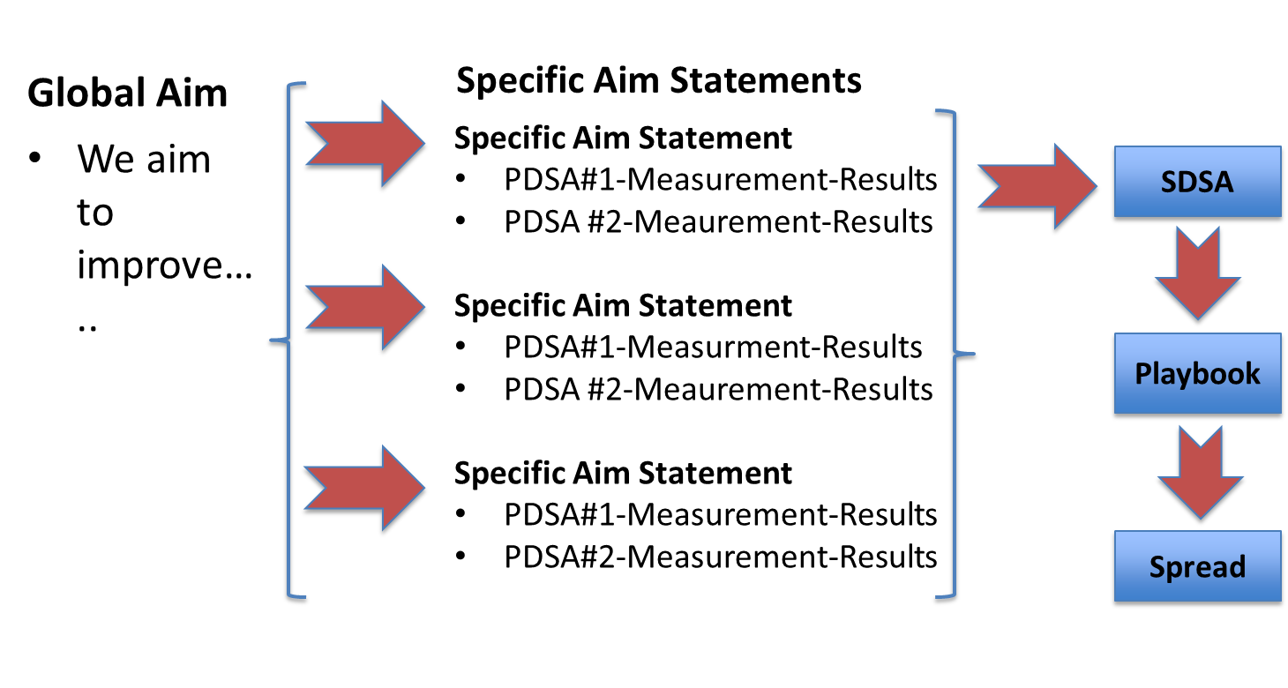
Journey of Typical QI Effort

Slide 8
Building Sustainability
Leadership
Brainstorming
Fishbone Diagram (root cause analysis)
Stakeholder Analysis
Process Mapping
Project Charter
PDSA
Communication Planning
Influencing Strategy
Communication / Documentation
Buy-In
Open Communication
Staff feels comfortable sharing
Support
All points can be accounted; staff, procedures, equipment, systems, software
QI Tools

Slide 9
P
S
A
D
S
S
A
D
Experiment
Standardize
Notes:
From the reading – Chapter 14 – Quality by Design - Never think that once a process is in the SDSA cycle it will stay constant. Ongoing review and evaluation will tell you whether the best known practice is in place and may reveal that you need to move back to PDSA
PDSA – is the quick, small test. SDSA is the standardizing of that improvement into every day routine.
Standardize and stabilize the process in order to learn if it actually can be done on a regular basis as part of your regular routine. Document what helped to maintain the consistency. What are things that are helping you perform the tasks in a standardized way? What metrics did you put in place to see if it was actually done consistently and if it wasn’t, what stopped you?
What is learned as part of the SDSA process, may have you go back to test and do another PDSA to test another way of performing a task or improving a process.

Slide 10
A
S
Standardize
How shall we standardize the process and embed it in daily work?
What type of environment can support standardization?
Act
Do we need to modify the standardization?
Design new PDSA
Study
What have we learned?
What do the measures show?
Are there needs for change?
Do
What are we learning as we do the standardization?
Any problems or surprises?
S
D
Notes:
Like the PDSA, you will test and learn and revise based on the results. With the SDSA, you may go back and forth between standardizing and then realizing you need to test something additional. Your ultimate goal now is to set standards and refine and document the detailed flow so that the process is clear and standardizing for everyone.

Slide 11
Establish Initial Sustainability Structure
Documentation
  Finalize new and complete process map
  Each step and staff responsible
Schedule regular check-ins
  Reflect on process
  Monitor results
  Avoid slippage
Identify owner who leads SDSA phase
Communication to Senior Leaders
  PDSAs, SDSA, etc.

Slide 12
Ongoing Support to Sustain
Be ears, eyes, and support to those engaged in it
Offer opportunities to debrief frequently
Celebrate completion of phases & success of project
Post and send results to others at your site, your leadership, other teams

Slide 13
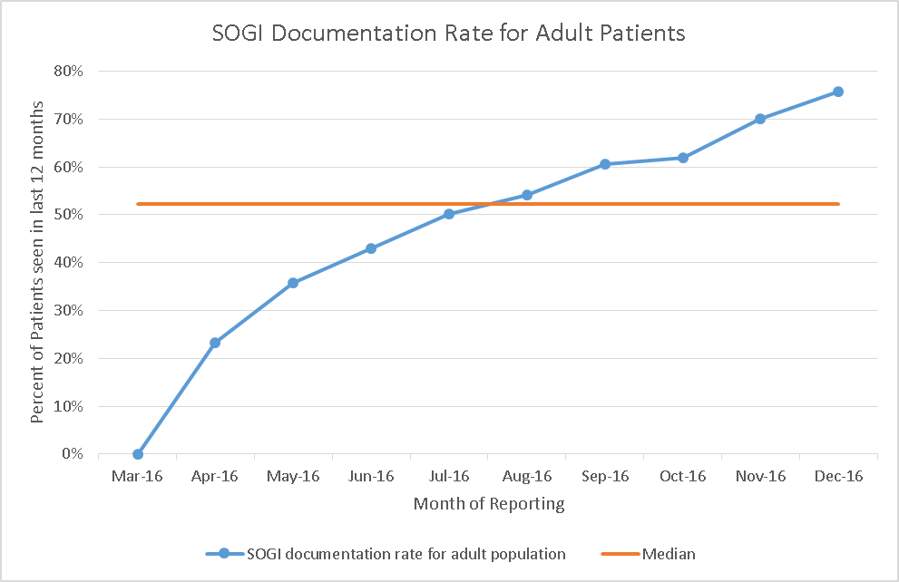
Importance of Measurement
Pod was able to increase SOGI collection rates from 0% to over 70% of patients seen in 12 months.
Team reported low burden to collect & document data
December marked transition to SDSA

Slide 14
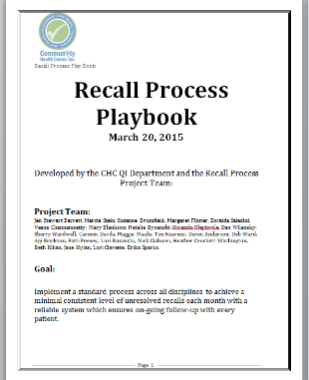
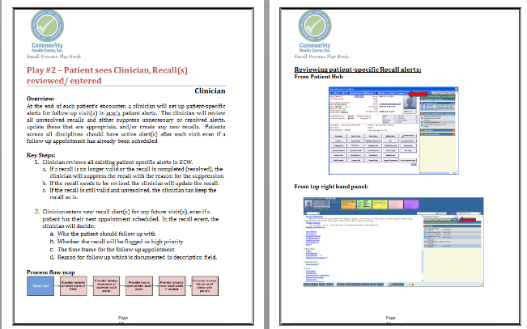
The Playbook

Slide 15
Essential information
The Title
The Team
and
The Goal

Slide 16
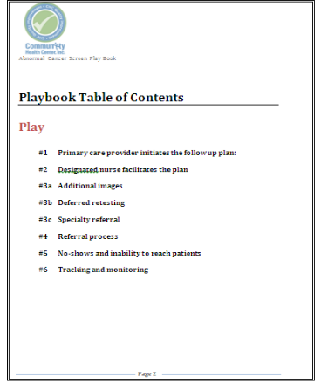
Table of Contents
Each step is assigned a “play” with a number and title clearly documented. The title will be used as a descriptor on each page or new “play”.

Slide 17
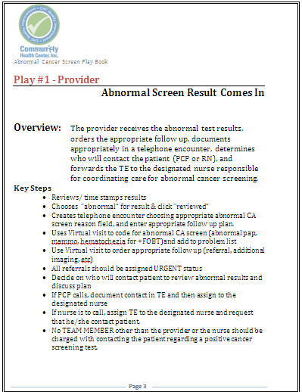
The Play
Each “Play” Describes:
Who is involved? (job title – not name)
The specific section title of the process & task from the table of contents.
An overview of the that section including the goal of the “play”.
Key action steps involved in completing the “play”.

Slide 18
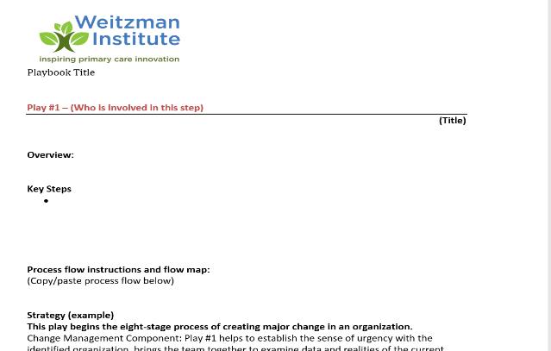
Content of Play

Slide 19
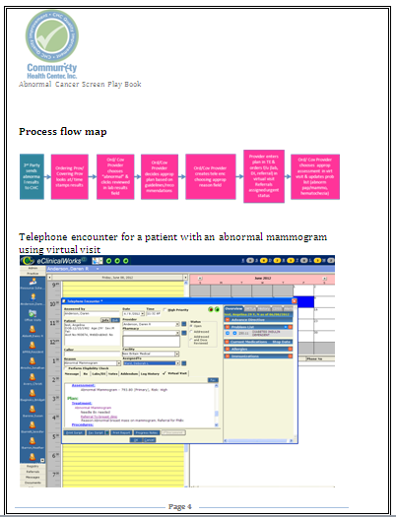
Use Pictures and Charts
Insert:
Sections of the process map that pertain to specific “play”.
Visuals like screen prints of EHR or scheduling system to add detail to the narrative process.

Slide 20
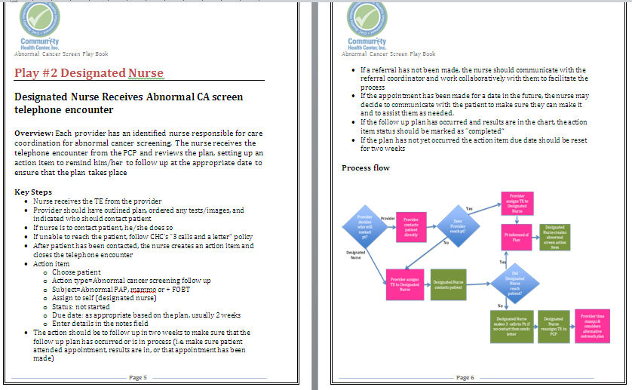
On to the Next Play…

Slide 21
Spread Can Occur at Different Levels
Broad
Spread
and
Sustainability
(A BIG Deal!)
Standardizing
SDSAs & Documentation
Use and improve Playbook
Try change in another site, then spread to another
Testing Changes (PDSAs)

Slide 22
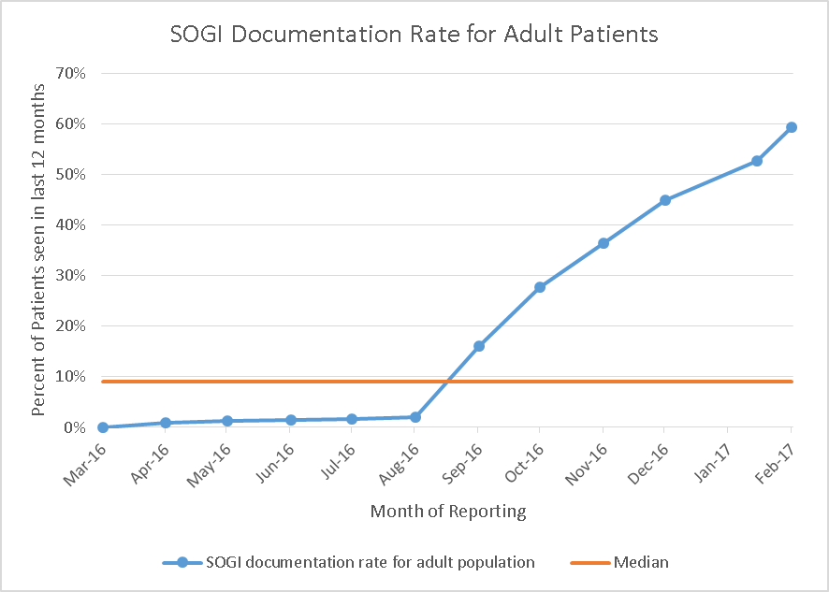
Document Impact Over Time
60% of patients seen within last 12 months
Agency Roll-Out

Slide 23
Nuggets from Sarah
Some tips and reflections from a previous operations leader….
23
Notes:
www.clinicalmicrosystem.org
23

Slide 24
For Your Team’s Presentation
Consider next steps as well as sustaining and spreading your project efforts
Question – What would it take to sustain your project?
  Are there specific challenges that need to be addressed/overcome?
  Is there an opportunity to continue or spread your work (to another provider, pod, or site)?
  Who would need to be involved (you, future postdocs/residents, others)?
24
Notes:
www.clinicalmicrosystem.org
24

Slide 25
Discussion
What are your team’s thoughts about project next steps, sustaining/spreading, and possibly passing on their project
  DePaul CHC
  CHC Stamford
  Open Door
25
Notes:
www.clinicalmicrosystem.org
25

Slide 26
What haven’t we figured out yet?
Questions or issues that remain unclear?
26

Slide 27
Poll Questions
How are you feeling about sharing an update on your project in one of our upcoming meetings?
  I feel ready; we have a good amount to share.
  I feel OK; we still have some things to work out, but I know I can get there.
  I feel a bit unsure; we have made progress, but we are struggling a bit with what to share.
  I feel very unsure; we would appreciate some help on how to pull together the story of our project.
27

Slide 28
Team Presentations
May 23rd
  Open Door
  CHC Middletown/NB (Tori & Victoria)
  CHC Middletown/NB (Grace & Meredith)
June 13th
  CHC New Britain (Mattea & Uche)
  CHC Hartford (Emily & Julia)
  Yakima (Kayla, Rodrigo)
  HealthLinc
June 27th
  DePaul CHC
  CHC Stamford (Drew, Loraine)
  CHC Meriden (Meghan, Shayla)
  Holyoke HC (Muriel)

Slide 29
We sent you a template to possibly use for your presentation…
  Let’s take a quick look at the content
29

Slide 30
Presentation Best Practices
Be creative in preparing your slides – include graphics and tools we have discussed
Decide who will share your slides (us or one of you)
Prepare ahead regarding who is doing what during the presentation (use today)
Think about hand-offs as you are transitioning to a different group member
Remember you only have 10 minutes to present
Practice as a group and individually

Slide 31
Assignment for Next Session
Prepare your team’s presentation
The teams who are presenting on May 23rd should send their summary to Mark by the evening of Wednesday, May 22nd
This will allow time for review and to be sure we have your presentation ready to share just in case
31
Notes:
www.clinicalmicrosystem.org
31

Slide 32
Final Session Format
Each team will do a 10 minute presentation during one of the final three seminar sessions
The presentation will be followed by 10 minutes of questions and discussion
In our May 23rd session, we will include a debrief discussion of what went well in the session presentations

Slide 33
Take-home Thoughts
1 or 2 ideas you will take away from our discussion

Slide 34
Reference
Nelson E, Batalden P, Godfrey M. Quality By Design. 2007; Chapter 14, pp. 278-283.

Slide 35



Break!
Take five minutes to recharge and refresh.
35

Slide 36
Breakout Rooms in Your Project Teams
(Mark available to join for consultation if needed)

