Slide 1
Drivers of Change Impacting Education and Training in Health Service Psychology
Catherine Grus, PhD
Chief Education Officer
American Psychological Association
June 21, 2023 Trends in the Training Field: Adapting for Action

Slide 2
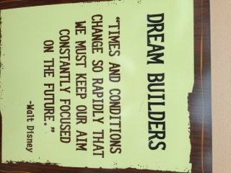

Slide 3
Overview
Drivers of change to consider in:
the current psychology workforce
the future psychology workforce
education and training
clinical practice

Slide 4
Driver 1: Current Psychology Workforce Key Point(s): Unmet need and a stressed workforce

Slide 5
Gap in Supply and Unmet Need
Source: APA, 2018, Psychologist Workforce Projections 2015-30.

Slide 6
Change in Demand by Age Group
Older adults
+54% or +5790 FTEs by 2030
Driven by shifting population demographics
Only 3% of psychologists specialize in geropsychology (APA, 2021 HSP Survey)
Workforce shortages in geropsychologists (Moye et al., 2019)
Children & adolescents
+1% or +330 FTEs by 2030
Represent 29% of total demand in 2030
Adults
Flat growth or -200 FTEs by 2030
Represent 45% of total demand in 2030
Source: APA, 2018, Psychologist Workforce Projections 2015-30; APA, 2021 Health Service Psychologist Survey..

Slide 7
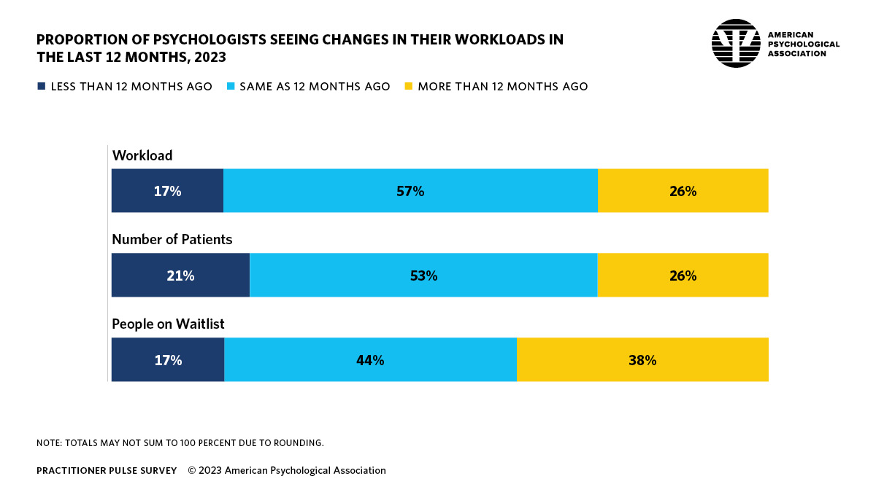
Psychologist Workload Capacity
Source: APA, 2023 Practitioner Pulse Survey.

Slide 8
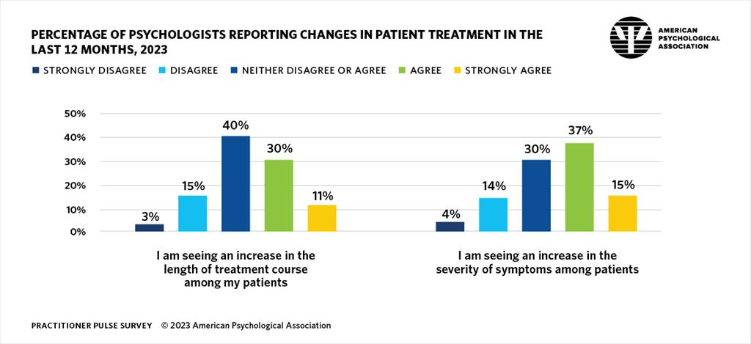
https://www.apa.org/pubs/reports/practitioner/2023-psychologist-reach-limits

Slide 9
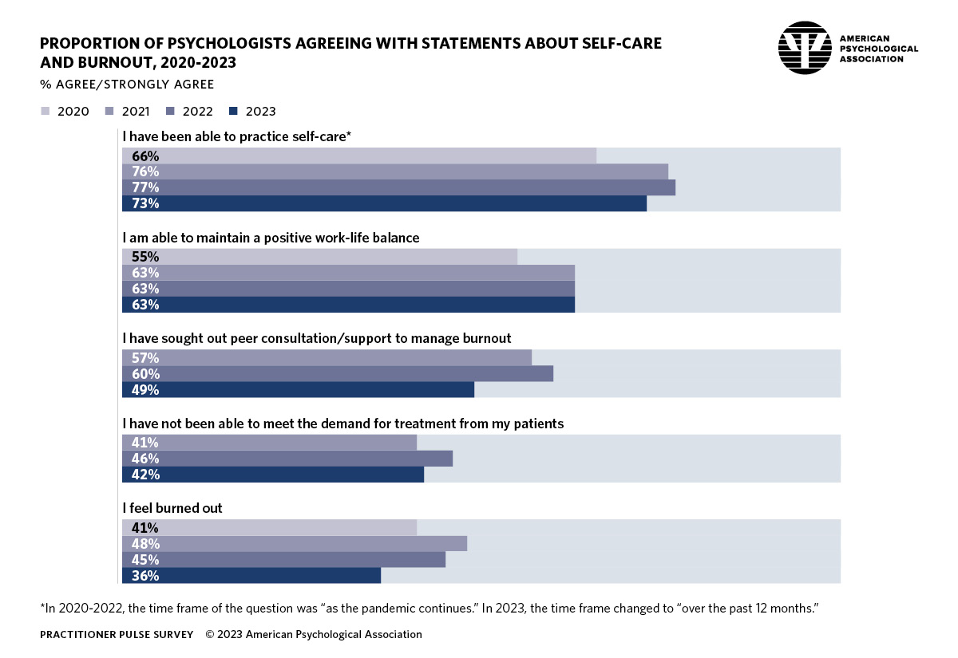

Slide 10
Driver 2: The Future Psychology Workforce Key Point: Psychology remains a popular career option but efforts will be needed to ensure a future workforce

Slide 11
First, some good news

Slide 12
Psychology in Higher Education - Now

Slide 13
Degrees Awarded
Data Source: American Psychological Association;
Integrated Postsecondary Education Data System, Department of Education

Slide 14
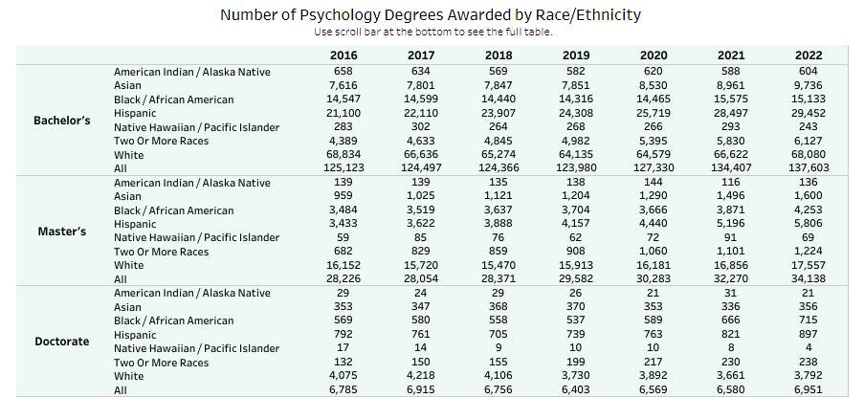
Degrees Awarded by Race/Ethnicity
Source: American Psychological Association; Integrated Postsecondary Education Data System (IPEDS)

Slide 15
Degree Pathways
3.7 Million Psych Majors
https://www.apa.org/workforce/data-tools/degrees-pathways
Notes:
Only 1 in 7 go on to obtain a graduate degree in psych

Slide 16
and the news we need to be planning for,

Slide 17
Enrollment/Demographic Cliff
Declines in US birth rates since 2008 mean there are fewer individuals who will enter into higher education
Without proactive efforts in a few years psychology could see dramatic drops in numbers of students studying psychology

Slide 18
Birth by Race/Ethnicity

Slide 19
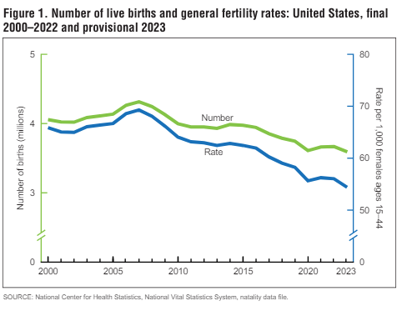
Birth Rates

Slide 20
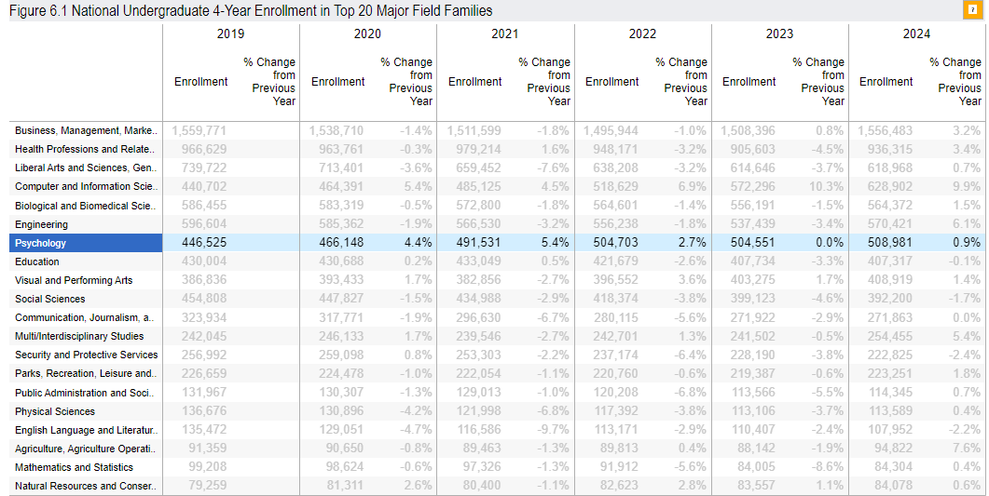
Spring 2024 Current Term Enrollment Estimates
Source: National Student Clearinghouse Research Center
Notes:
PAB primarily associate degrees but some bachelors

Slide 21
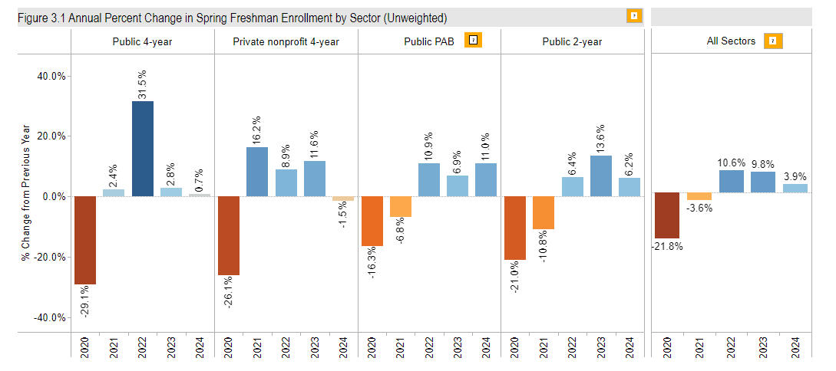
Enrollments by Institution Type

Slide 22
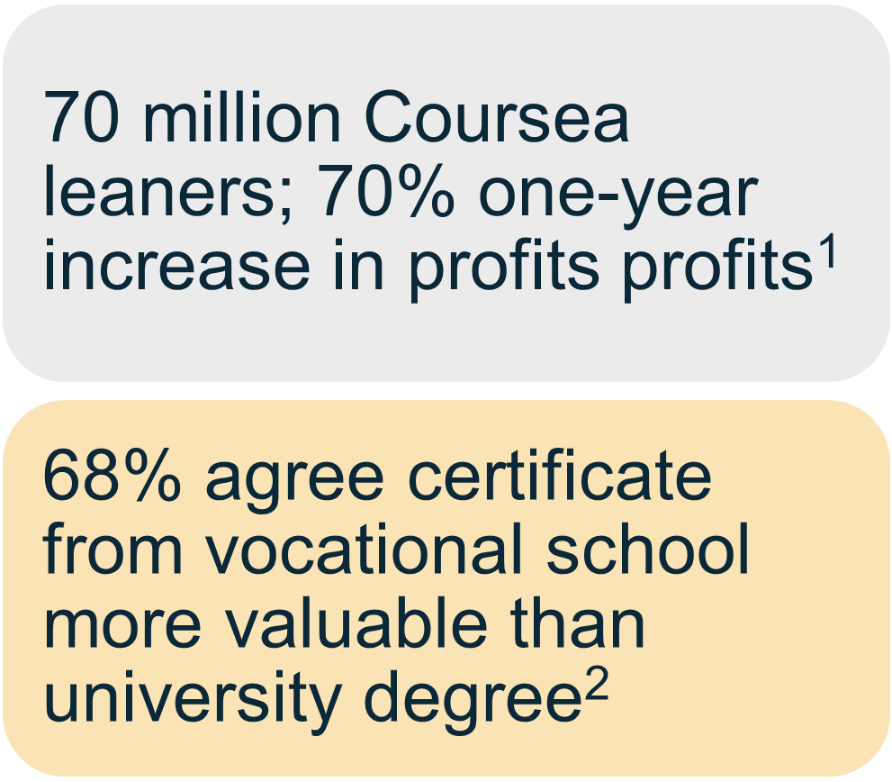
Changing Educational Landscape: Growth in Alternative Educational Models
Wire, 2021^{; 2}Pearson, 2019
¹Business Wire, 2021^{; 2}Pearson, 2019
Notes:
In global survey of over 11,000 learners from 19 countries found that… Certificate and Credentialing

Slide 23
Other Factors to Consider
Affordability of higher education
COVID-19 pandemic

Slide 24
Driver 3: Education and Training Key Point: How and what we teach is evolving

Slide 25
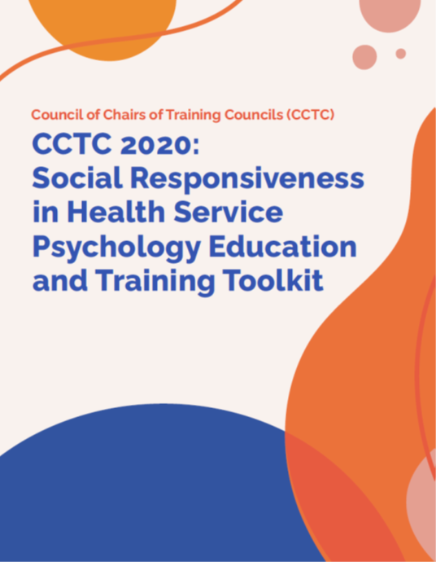
CCTC Social Responsiveness Toolkit
Social responsiveness toolkit
9 modules provide strategies and resources for educators
Special issues of TEPP and PPRP provide further support for enhancing socially responsive education and training
Social Responsiveness Toolkit
Notes:
Modules include:
Module 1: Diversifying the HSP pipeline
Module 2: Revisiting Our Program Structures With Increased Shared Governance
Module 3: Liberating and Transforming Our Curriculum Toward Social Responsiveness Across All Levels of Training
Module 4: Moving Toward Socially Responsive HSP Research Training
Module 5: Socially Responsive Ethics and Professionalism
Module 6: Social Justice and Advocacy
Module 7: Community Engagement
Module 8: Socially Responsive Evaluation of Students, Faculty and Supervisors
Module 9: Lifelong Learning

Slide 26
CCTC Social Responsiveness Toolkit
Module 1: Diversifying the HSP pipeline
Module 2: Revisiting Our Program Structures With Increased Shared Governance
Module 3: Liberating and Transforming Our Curriculum Toward Social Responsiveness Across All Levels of Training
Module 4: Moving Toward Socially Responsive HSP Research Training
Module 5: Socially Responsive Ethics and Professionalism
Module 6: Social Justice and Advocacy
Module 7: Community Engagement
Module 8: Socially Responsive Evaluation of Students, Faculty and Supervisors
Module 9: Lifelong Learning

Slide 27
APA Racial Equity Action Plan
Proposes actions that APA will undertake related

Slide 28
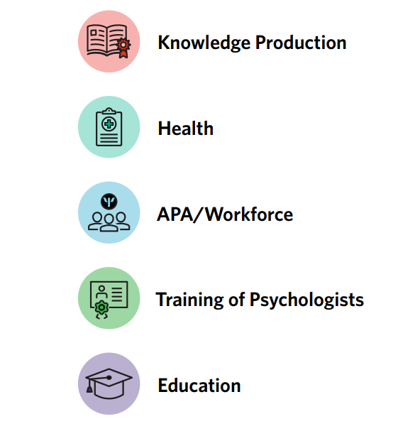
Racial Equity Action Plan August 2022

Slide 29
Content Domains
Knowledge Production: Integrate the use of equitable and inclusive approaches to advance racially-conscious knowledge production and scholarship.
Health: Utilize the full breadth of the field of psychology to promote, contribute, and advance health equity in communities of color.
APA/Workforce: Efforts that promote an equitable, diverse, and inclusive work environment within APA staff, the association at-large, and the broader psychology workforce, and serve as an exemplar for using EDI principles as foundational to fostering psychologically healthy workplaces.
Educational Equity: Efforts that work to address racial inequities within learning institutions of all levels and promote racially conscious and equitable training to open pathways for students of color in pursuit of careers in psychology.

Slide 30
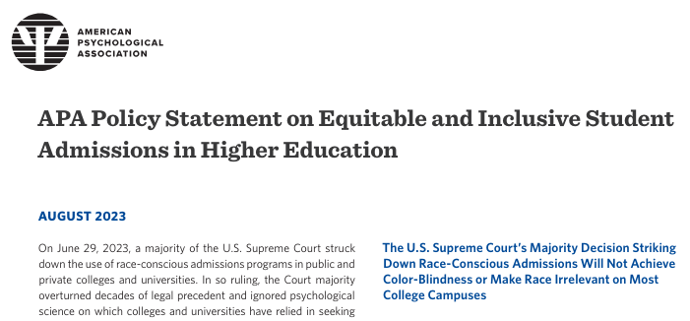
Supreme Court Decision – Race and Admissions
APA Policy Statement
Dept of ED guidance to increase diversity and opportunity
Dept of ED guidance on Tittle IV
Dept of ED Dear Colleague letter post supreme court decision on race and admissions
Use of the GRE in admissions Monitor Article

Slide 31
Artificial Intelligence
Acknowledgements:
Tony Habash, D.Sc., Chief Information Officer & Chief Business Integration Officer
Lindsay Childress-Beatty, JD, PhD, Chief of Ethics
Jared Skillings, PhD, ABPP, Chief of Professional Practice

Slide 32
AI & Society
Help society deal with AI adoption
Help society deal with AI implications and concerns
AI & Psychology
What psychologists need to know about AI
Creating that connection intentionally
AI & APA
Using AI for Improve Operations
Using AI for game-changing opportunities.
What AI industry need to know about psychologist role in AI
Impact on directorates’ priorities
Impact on all aspects of psychology
Advocacy

Slide 33
Psychologists have a significant role in designing AI (partnership between psychology and AI industry)
Psychologists play a crucial role in helping to develop ethical guidelines for generative AI
Helping to design generative AI systems that are safe and effective based on psychologists’ understanding of human behavior.
Help evaluate the impact of generative AI on individuals and society: Psychologists can lead and help research the impact of AI on society by providing insights into the psychological effects of generative AI.
Assessing and mitigating the EDI concerns that could be generated from AI algorithms.

Slide 34
From What They Can Do for Us to What They Can Be for Us
Calculates
Organizes
Surveils
Monitors
Corrects
Reminds
Teaches
Advises
Confidant
Decides
Supervises
Co-Create
Tool
Teammate
The era of generative AI will shift human-machine relationships.
We need the machine and human experts to get these relationships right.

Slide 35
Generative AI and Education: One year+ since ChatGPT
Initial reactions
Concerns about ensuring academic integrity
Keep it out of the classroom
Current focus
How, not if, to integrate
Understanding what generative AI is and its limitations (e.g., bias)
Understanding responsible use by students, educators, researchers
Policy development
Career development considerations

Slide 36
Generative AI in the Classroom
Personal Tutor
Concept clarification
Article summary
Real word application
Brainstorming
Provide talking points for discussion facilitation
Exam preparation
Generate practice questions
Writing coach
Grammar and style checks
Argument strengthening
Revision strategies
Stats tutor
Selecting the correct analysis

Slide 37
ETHICAL ISSUES FOR PSYCHOLOGISTS
Protecting Confidentiality/Privacy – Do you know where the data are going?
Gaining Adequate Competence – Need for sophistication, especially in interdisciplinary arenas
Responsibility for the Scientific Basis – Augmenting human abilities, not replacing them. The human remains the expert.

Slide 38
Potential Impact of Generative AI on Psychological Research
Source: ChatGPT
Increased access to information |  | Generative AI can be used to analyze large datasets of psychological data. This can help researchers to identify patterns and trends in the data and to develop new insights into human behavior and cognition.
Enhanced creativity |  | Generative AI can be used to generate new ideas for research projects. This can help researchers to expand their knowledge and to develop new theories.
Reduced costs |  | Generative AI can be used to analyze large datasets of psychological data more quickly and efficiently than traditional methods.

Slide 39
Resources
ChatGPT and your assessments: Do they need to change?
How to use ChatGPT as a learning tool
Artificial Intelligence and the Future of Teaching and Learning

Slide 40
Post-doctoral Training Landscape
Source: data collected by APPIC, shared with permission

Slide 41
Current Snapshot of Postdoctoral Selection
7
Postdoc applicants get their top ranked positions:
94% of current intern applicants got their 1st or 2nd choice position
76% of current intern applicants got their 1st choice position
32% of Postdoc positions were unfilled per TD Survey; this is consistent with last year
Programs feel pressure to make early offers in hopes of filling.
Average length of time an offer was held: 6.2 days.
Salary of postdoc positions accepted:
o $50,000-59,000 – 47.2%
o $60,000-$69,000 = 29.5%
o $70,000-$79,000 – 13.1%

Slide 42
APA 2010 Model Licensing Act & Licensure Variability
Defined entry-level practice as following internship
At present, 18 U.S. and 4 Canadian jurisdictions do not require postdoctoral experience for licensure.
Many of the states that have removed postdoctoral training have significant rural populations and may have a greater shortage of providers.

Slide 43
1
Availability of Entry-Level Staff Positions
Applicants most often find themselves in private practices if they secure a job following internship, though VAs also hire graduating interns.
N = 161

Slide 44
15
Trainee Perspectives and Calls to Action
Reduce barriers for entrance into the profession, as well as highlighting the additional barriers faced by those with minoritized identities (Galan et al., 2021; Gee et al., 2021; Hood et al., 2022; Palitsky et al., 2022; Szkody et al., 2022)
Decreased tolerance for relocation
Greater dissatisfaction with low postdoctoral training program stipends and a greater emphasis on "living wage"
Perception of dubious value of postdoctoral training
Trainees often do not believe they need specialty or focus area training
Interns' peers are as useful as internship TDs, supervisors, and other sources of information about post-internship plans.
•

Slide 45
Driver 4: Clinical Practice Key Point: How we provide care is changing

Slide 46
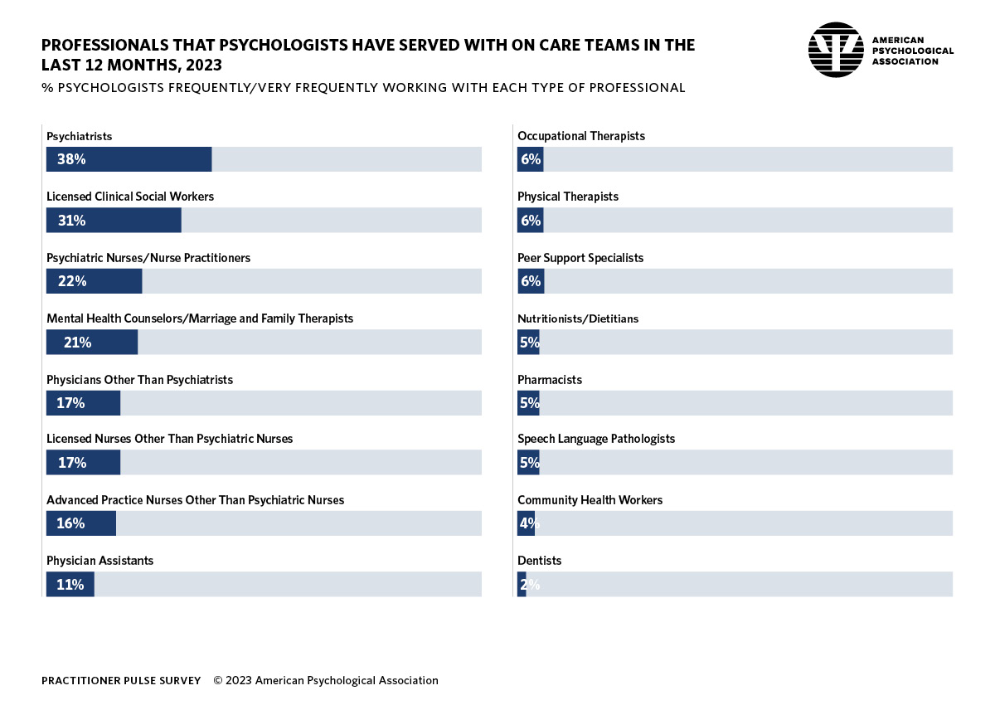

Slide 47
Self-Reported Primary Specialties
Source: APA, 2021 Health Service Psychologist Survey.

Slide 48
Technology
Digital therapeutics
the use of software programs to deliver evidence-based and validated interventions to treat or manage mental and behavioral health disorders
Digital mental health tools
Apps and computer software
Wellness

Slide 49
Generative AI Implications for the Practice of Psychology
Personalized Treatment Plans: AI algorithms can analyze individual patient data to create tailored treatment plans, considering factors like genetic predispositions, behavioral patterns, and responses to therapies for more effective interventions.
Increased Accessibility to Mental Health Services: AI-powered tools can expand access to mental health support by offering cost-effective and convenient solutions, especially in underserved areas or for individuals hesitant to seek traditional therapy.
Improved Diagnostic Accuracy: AI can assist psychologists in analyzing large datasets, leading to more accurate and timely diagnoses of mental health conditions by identifying subtle patterns and markers.
Source: ChatGPT
49

Slide 50
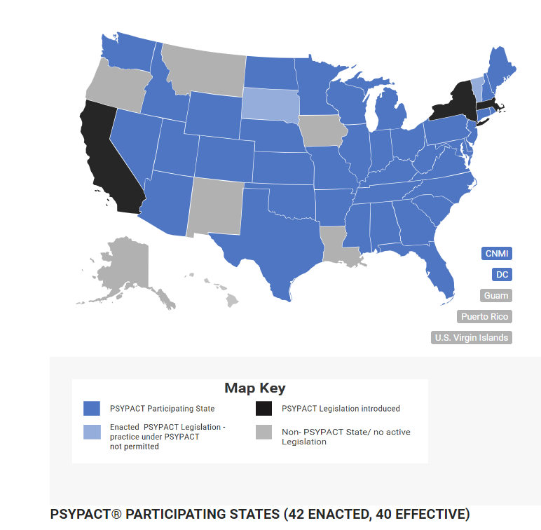
Interjurisdictional Practice

Slide 51
Population health
“improving the health, health equity, safety, and wellbeing of entire populations, including individuals within those populations”

Slide 52
Population Health Approach
Goal
People
Effective & Efficient
Clinical Care
Diagnosed
Mitigate Risk & Early Intervention
At Risk
Keeping People Healthy
Healthy
Notes:
NEW PARADIGM – population health framework
-Focuses on the entire population.
Goals differ depending on the portion of the population you are targeting.

Slide 53
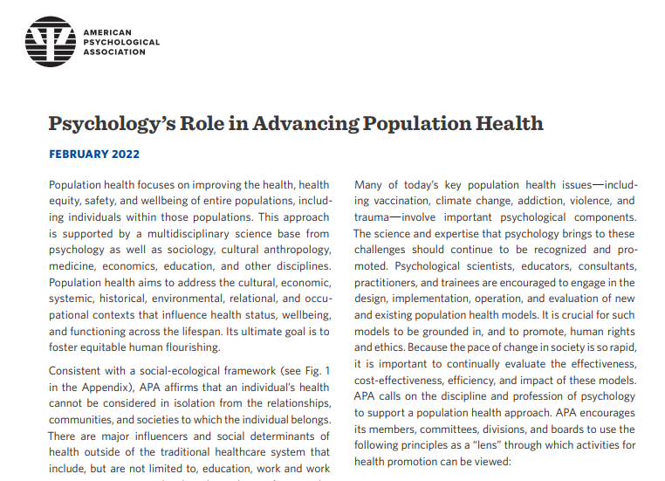
APA Population Health Policy Statement

Slide 54
Psychology as a Multi-tiered Profession
Assembly on the Value and Distinctiveness of the Doctoral Degree
The doctoral degree/license adds significant value within our multi-tiered profession.
Evaluation, specialty practice, leadership, interprofessional teamwork
Areas that include and go beyond direct service provision
Multiple tiers within the profession may be important to advance population health, wherein doctoral psychologists' practice with a scope of greatest complexity in both breadth and depth.
Science characterizes and distinguishes psychology, and it undergirds all education and practice.
Doctoral professionals are adept at understanding and utilizing science to make complex decisions to improve the health of the people and communities we serve.
Equity, diversity, and inclusion (EDI) is foundational to psychology and effective health care.
The psychology workforce must diversify and reflect the U.S. population.
Developing and maintaining competence in EDI is essential across the professional lifespan of the psychology practitioner.

Slide 55
Delphi Poll
Conducted in order to provide a glimpse into the field’s probable future 10 years from now.
Master’s level providers with psychology degrees will increase their contribution to psychology more than other providers
Telehealth will increase more than other modalities
Specialization, supervision, leadership, and consultation differentiate master’s and doctoral
Training will include more emphasis on technology and EDI
More psychologists will work in integrated care, fewer in independent private practice
Neimeyer, G. J., Macura, Z., Grus, C. L., Skillings, J. L., Bufka, L. F., & Rose, S. A. (2022). The future of education and practice in health service psychology: A Delphi study. Professional Psychology: Research and Practice, 53(2), 116.

Slide 56
Summit on the Future of Education and Practice – Vision for Moving Forward
Inclusive
Master’s practitioners
Interprofessional collaborative practice
Expansive
New roles, responsibilities, services
Representative
Increased diversity in the workforce
What we teach, how we teach, our science
Responsive
Continuous quality improvement efforts

Slide 57
Psychology as a Multi-tiered Profession
Accreditation
Education and Training Competencies
Define required training elements for Programs
Guidance on expected learning outcomes for Students and Faculty
Title and Scope of Practice
What can be done and what title can be used for Practitioners
Areas of Current Work

Slide 58
Closing Comments
Change is inevitable, the choice is incremental or transformative
How many are needed?
At what educational level?
What should we be teaching?
What will we be doing?
How do we ensure a vibrant future?

Slide 59
“The future depends on what you do today.”
― Mahatma Gandhi

Slide 60
Thank you!
Catherine Grus
cgrus@apa.org

