Slide 1
Health Profession Student Training
Learning Collaborative
Session Six: Tuesday June 11th, 2024
Notes:
Meaghan

Slide 2
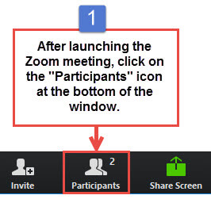
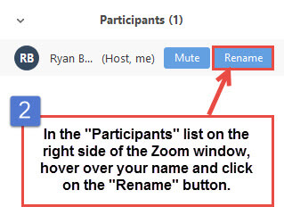
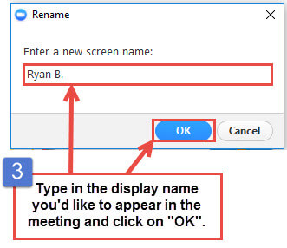
Get the Most Out of Your Zoom Experience
Please keep yourself on MUTE to avoid background/distracting sounds
Use the CHAT function or UNMUTE to ask questions or make comments
Please change your participant name to your full name and organization
“Meaghan Angers CHCI”
Notes:
Meaghan

Slide 3
Session 6 Agenda
3:00 – 3:10 | Welcome & Introduction
3:10 – 4:00 | Showcases 3:10-3:20 Five Rivers Health Centers 3:20-3:30 Jessie Trice Community Health System 3:30-3:40 SWLA Center for Health Services 3:40-3:50 Tepeyac Community Health Center 3:50-4:00 Thundermist Health Center
4:00 – 4:15 | Wrap-Up
Notes:
Meaghan

Slide 4
Learning Collaborative Faculty
Margaret Flinter, APRN, PhD, FAAN
Co-PI, NTTAP
CHCI’s Senior Vice President/Clinical Director
Amanda Schiessl, MPP
Co-PI & Project Director, NTTAP
Victoria Malvey
Interprofessional Student Specialist
Bianca Flowers
Project Manager, NTTAP
Meaghan Angers
Project Manager, NTTAP
Notes:
Meaghan

Slide 5
National Training and Technical Assistance Partners
Clinical Workforce Development
Provides free training and technical assistance to health centers across the nation through national webinars, learning collaboratives, activity sessions, trainings, research, publications, etc.
Notes:
Meaghan

Slide 6
Learning Collaborative Structure
Six 90-minute Learning Collaborative video conference sessions
Bi-weekly calls between coach mentors and practice coach
Bi-weekly team workgroup meetings
Use the Weitzman Education Platform to access resources and receive CME credit
Learning Session Dates
Learning Session 1 | Tuesday February 6th
Learning Session 2 | Tuesday March 5th
Learning Session 3 | Tuesday March 26th
Learning Session 4 | Tuesday April 16th
Learning Session 5 | Tuesday May 14th
Learning Session 6 | Tuesday June 11th
Notes:
Meaghan

Slide 7
Let’s Review:
Session 1
Session 2
Session 3
Session 4
Session 5
Play 1: Partnership Approval & Communication with Schools
Play 2: Affiliation Agreement Management
QI Refresh: Agenda, Meeting Skills, Role of Coach
Play 3: Determining and assessing organizational capacity – preceptors, student acceptance, & secondary review
Play 4: Initiating the Onboarding of the Student
Play 5: Communication with Student
Play 6: Student is Trained
Play 7: Student Arrives
Postgraduate NP and NP/PA Training Programs
Behavioral Health Students
Administrative Fellowships
QI Refresh: Standardization and Spread, Playbooks
CT AHEC Spotlight
NIMAA
Play 8: Student Documentation & Reporting
Play 9: Off-boarding
Notes:
Meaghan

Slide 8
Thank You Teams!
Five Rivers Health Centers | Ohio
Jessie Trice Community Health Center | Florida
Northshore Health Centers | Indiana
Primary Health Care, Inc. | Iowa
Sun Life Health | Arizona
SWLA Center for Health Services | Louisana
Tepeyac Community Health Center | Colorado
Thundermist Health Center | Rhode Island
Upper Great Lakes Family Health | Michigan
Wellspace Health | California
Notes:
Meaghan

Slide 9
Showcase!
Notes:
Meaghan

Slide 10
Showcase Objectives
Tell the story of your health center’s work during this learning collaborative in a clean, crisp, visual format
Generate reflections among you and the other team members about your involvement in this learning collaborative
Share your work in future meetings with other health center staff including leadership and external stakeholders (i.e. health center board, community partners, and funders)
Notes:
Meaghan

Slide 11
Showcase Order
3:10-3:20 Five Rivers Health Centers
3:20-3:30 Jessie Trice Community Health System
3:30-3:40 SWLA Center for Health Services
3:40-3:50 Tepeyac Community Health Center
3:50-4:00 Thundermist Health Center
Notes:
Meaghan

Slide 12
Next Steps
Due Tuesday June 27th
Submit completed or drafted deliverables to the Google Drive.
Complete Post-Collaborative Surveys –
Each team member, please complete the post-collaborative evaluation survey https://Qualtrics.ca1.qualtrics.com/jfe/form/SV_54KuDSJSTT5upAa
Each team member, please complete the post-collaborative Organizational Readiness to Implement Change https://Qualtrics.ca1.qualtrics.com/jfe/form/SV_6LJApytHJhUoLlQ
As a team, complete the post-collaborative Readiness to Train Assessment Tool https://Qualtrics.ca1.qualtrics.com/jfe/form/SV_0k6b82AWZpvxnoO
Reminders
6-month Check-in Call: Tuesday December 10th 3:00-4:00pm Eastern
If you have questions or encounter barriers prior to December 10th, please reach out to via email to schedule 1-on-1 calls as needed.
Notes:
Meaghan

Slide 13
Questions?
Notes:
Meaghan

Slide 14
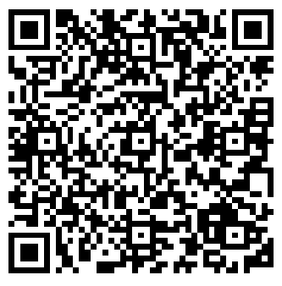
NTTAP Contact Information
CME and Resource Page
Access Code: HPS2024
https://education.weitzmaninstitute.org/content/nttap-health-professions-student-training-learning-collaborative-2024
Amanda Schiessl
Project Director/Co-PI
Amanda@mwhs1.com
Bianca Flowers
Project Manager
flowerb@mwhs1.com
Meaghan Angers
Project Manager
angersm@mwhs1.com
REMINDER: Complete evaluation in the poll!
Final Coach Call: Tuesday June 18th
Note: Time change to 4:00pm Eastern!
Notes:
Meaghan

Slide 15
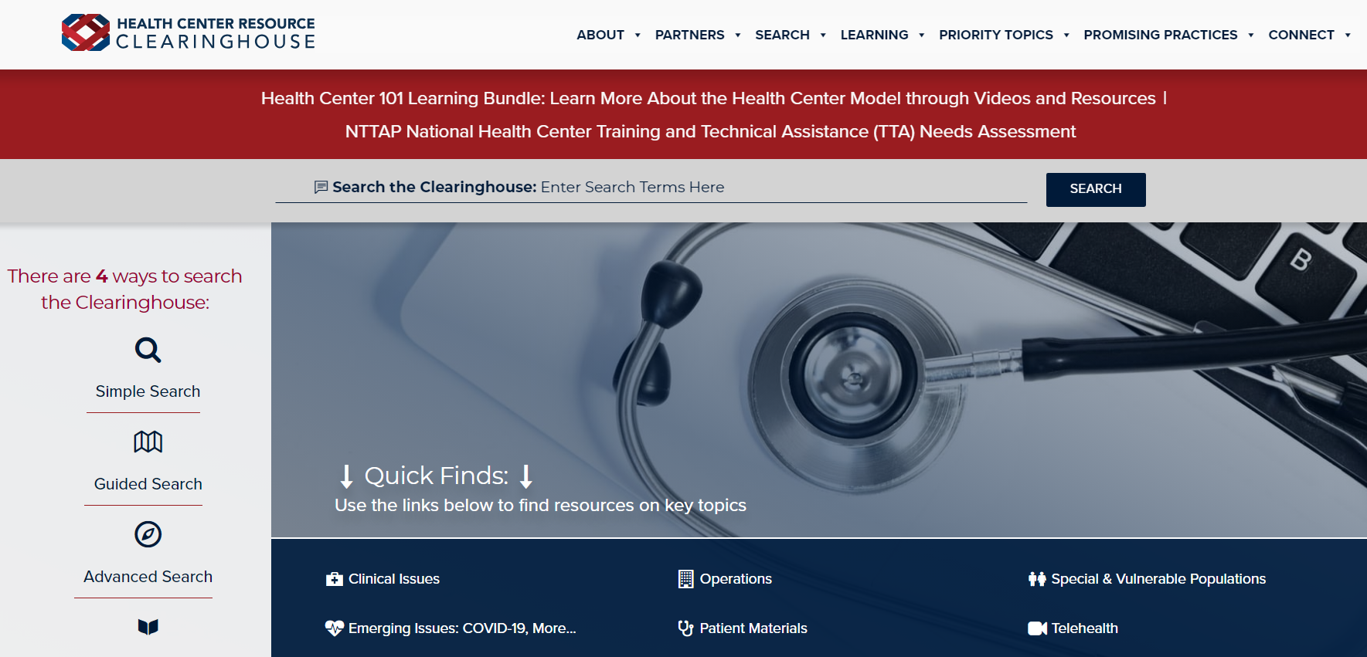
Explore more resources!
National Learning Library: Resources for Clinical Workforce Development
Health Center
Resource Clearinghouse
https://www.weitzmaninstitute.org/ncaresources
https://www.healthcenterinfo.org/
15
Notes:
Meaghan

