Slide 1
Learning Collaborative Session #2:
Aim Statements and Gap Analysis

Slide 2
Today’s Agenda
Welcome
Overview of Technology and Reminders
Environmental Scan
Next Steps and Q & A

Slide 3
Technology: Your Zoom Window
Sound
Muting/Unmuting
Press *6 to unmute phone audio
Webcam
Please share!
Chat
Questions
Sharing resources/ideas
Notes:
A few logistical reminders before we get started… Please keep yourselves on mute throughout the session to avoid background noise. We welcome you to use the chat function or coming off mute to engage with faculty and your fellow learners through out the session. And lastly, we love to be able to see all of you who join our learning community so if you’re able to, please share your camera with us.

Slide 4
Technology: Your Zoom Window
Closed Captioning & Live Transcript
Click on the caret or icon
Select ‘show subtitles’ for closed captioning on screen
Select ‘view full transcript’ for live transcript pop-out window
Change Your Name
Click on the three dots
Click ‘Rename’
Type in your name
Notes:
You may change your name at any time throughout the session by clicking on the three dots near your name, and selecting rename. Please use this function to change your name to include your first and last name – health care center name. We welcome you to use this feature to share your pronouns with us if you wish! To continue to make our activities more accessible, closed captioning and live transcription is also available to use as well.

Slide 5
Continuing Education Credits
In support of improving patient care, this activity has been planned and implemented by The France Foundation and Moses/Weitzman Health System, Inc. and its Weitzman Institute and is jointly accredited by the Accreditation Council for Continuing Medical Education (ACCME), the Accreditation Council for Pharmacy Education (ACPE), and the American Nurses Credentialing Center (ANCC), to provide continuing education for the healthcare team.
Through Joint Accreditation, credits are also available under the following bodies:
American Academy of PAs (AAPA)
American Dental Association’s Continuing Education Recognition Program (ADA CERP)
American Psychological Association (APA)
Association of Social Work Boards (ASWB)
Commission on Dietetic Registration (CDR)
Notes:
The Moses Weitzman Health System is jointly accredited to provide continuing education credits for your participation in these live Learning Collaborative sessions.

Slide 6
Financial Disclosures
With respect to the following presentation, there have been no relevant (direct or indirect) financial relationship between the presenters/activity planners and any ineligible company in the past 24 months which would be considered a relevant financial relationship.
The views expressed in this presentation are those of the presenters and may not reflect official policy of Moses/Weitzman Health System, Inc. or its Weitzman Institute.
We are obligated to disclose any products which are off-label, unlabeled, experimental, and/or under investigation (not FDA approved) and any limitations on the information that are presented, such as data that are preliminary or that represent ongoing research, interim analyses, and/or unsupported opinion.

Slide 7
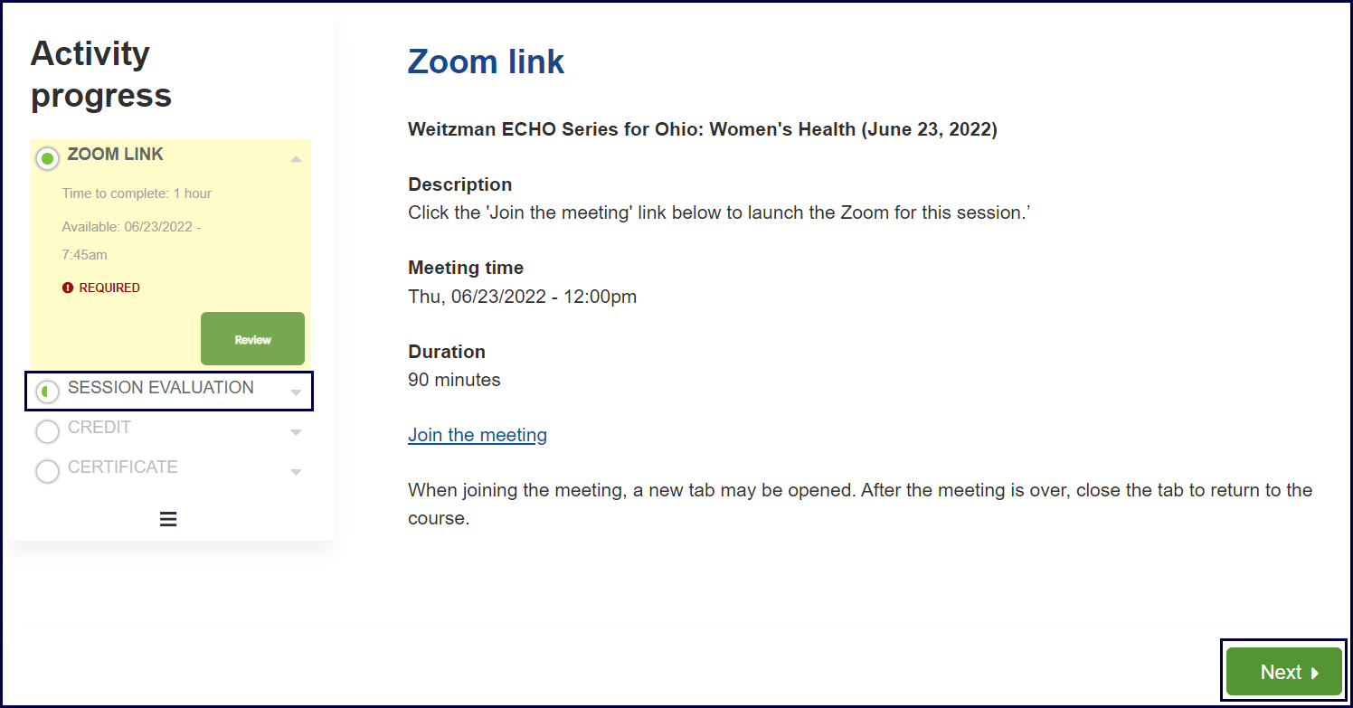
Program Logistics Post-session: Completing the Session Evaluation & Claiming Your CME/CE Credit
After the live session has ended,
Select the Next button
OR
Select Session Evaluation in the left-hand navigation bar
Notes:
We use the Weitzman Education Platform for everything from accessing live sessions to claiming credits. In order to claim CE credits and certificate, please complete the following steps on the Weitzman Education Platform after the live learning collaborative session has ended. I will send you these instructions in a post-session email as well!
After today’s session, select the Next button OR Select Session Evaluation in the left-hand navigation bar on the Weitzman Education Platform, and select Next.

Slide 8
Program Logistics Post-session: Completing the Session Evaluation & Claiming Your CME/CE Credit
Complete the questions in the session evaluation.
Select the Submit button at the bottom of the evaluation.
View your credits awarded and download your certificate by selecting them in the left-hand navigation bar.
Notes:
Next…
Complete the questions in the session evaluation
Select the Submit button at the bottom of the evaluation.
View your credits awarded, and download your certificate by selecting them in the left-hand navigation bar.

Slide 9
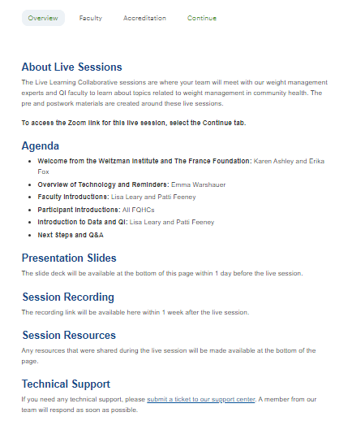
Program Logistics: Session Recordings & Materials
All session recordings and materials shared during the session will be available
on the Weitzman Education Platform within one week of each session
Return to the Overview tab of the live activity, Live Session–Module 1: Introduction to Data and QI
Scroll down to the Session Recording and Session Resources headers
You will then be able to click on Session Recording and Session Resources listed below the headers to access the resources.
Instructions will be shared with you after this session.
Notes:
Also on the Weitzman Education Platform are all session recordings and materials shared during the live sessions. These will be available on the Weitzman Education Platform within one week of each session. You will need to complete the following steps and use the provided access code to view the recordings. I will also send you these instructions in a post-session email.
Return to the Overview tab of the live activity, to find today’s session you would choose – Live Session – Module 1: Introduction to Data and QI
Scroll down to the Session Recording and Session Resources headers
You will then be able to click on Session Recording and Session Resources listed below the headers to access the resources.

Slide 10
At the Weitzman Institute, we value a culture of equity, inclusiveness, diversity, and mutually respectful dialogue. We want to ensure that all feel welcome.
If there is anything said in our program that makes you feel uncomfortable, please let us know.
Notes:
At Moses/Weitzman Health System, we value a culture of equity, inclusiveness, diversity and mutually respectful dialogue. We want to ensure that all feel welcome. If there’s anything said in today’s session that makes you feel uncomfortable, please let us know and if you have any questions regarding the program logistics I have mentioned today, please feel free to email me.

Slide 11
Series Learning Objectives
Ascertain metrics of your healthcare center against key performance measures related to the obesity care
Identify barriers to diagnosing and treating obesity for patients in your healthcare center
Formulate an improvement plan for establishing diagnostic and treatment plans for patients with obesity in your healthcare center
Develop an improvement plan for managing holistic care of patients with obesity in your healthcare center

Slide 12
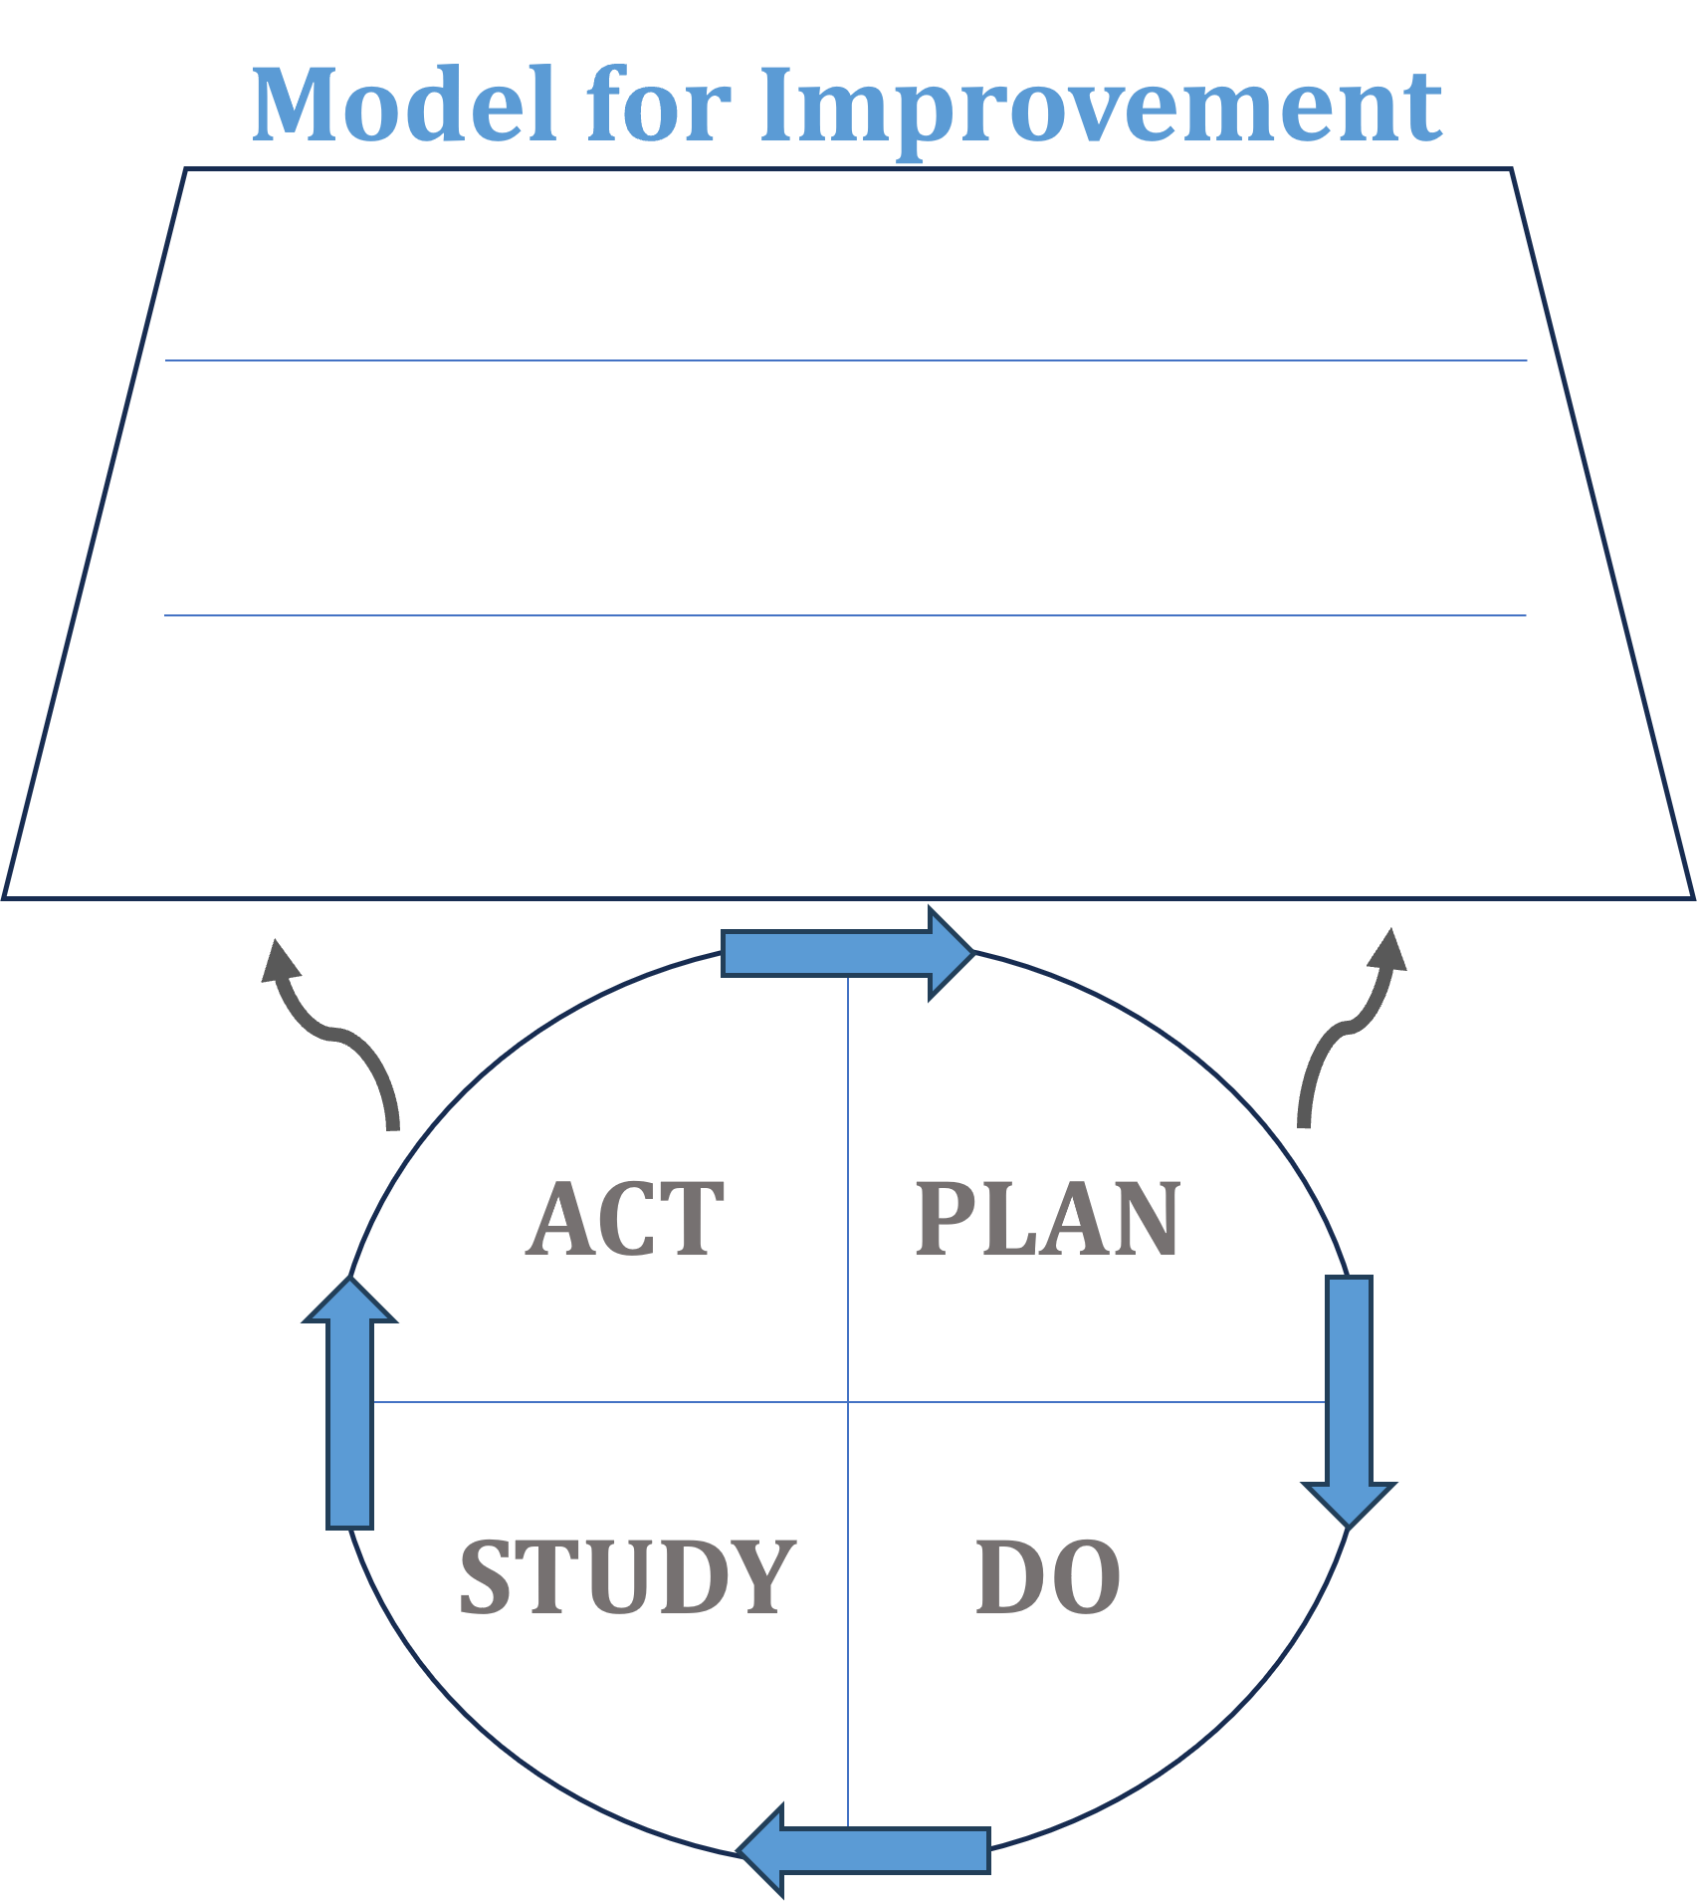
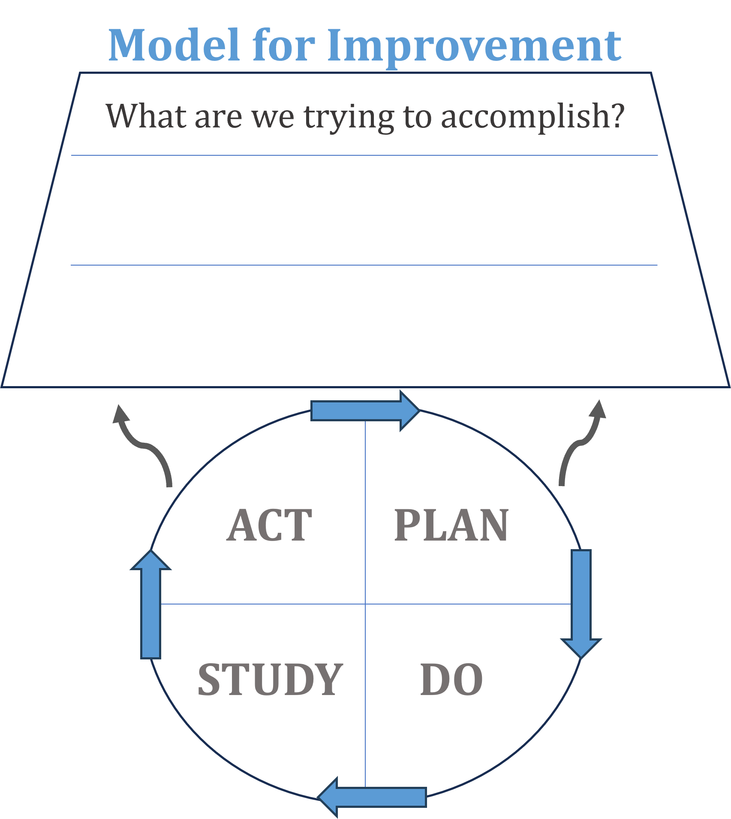
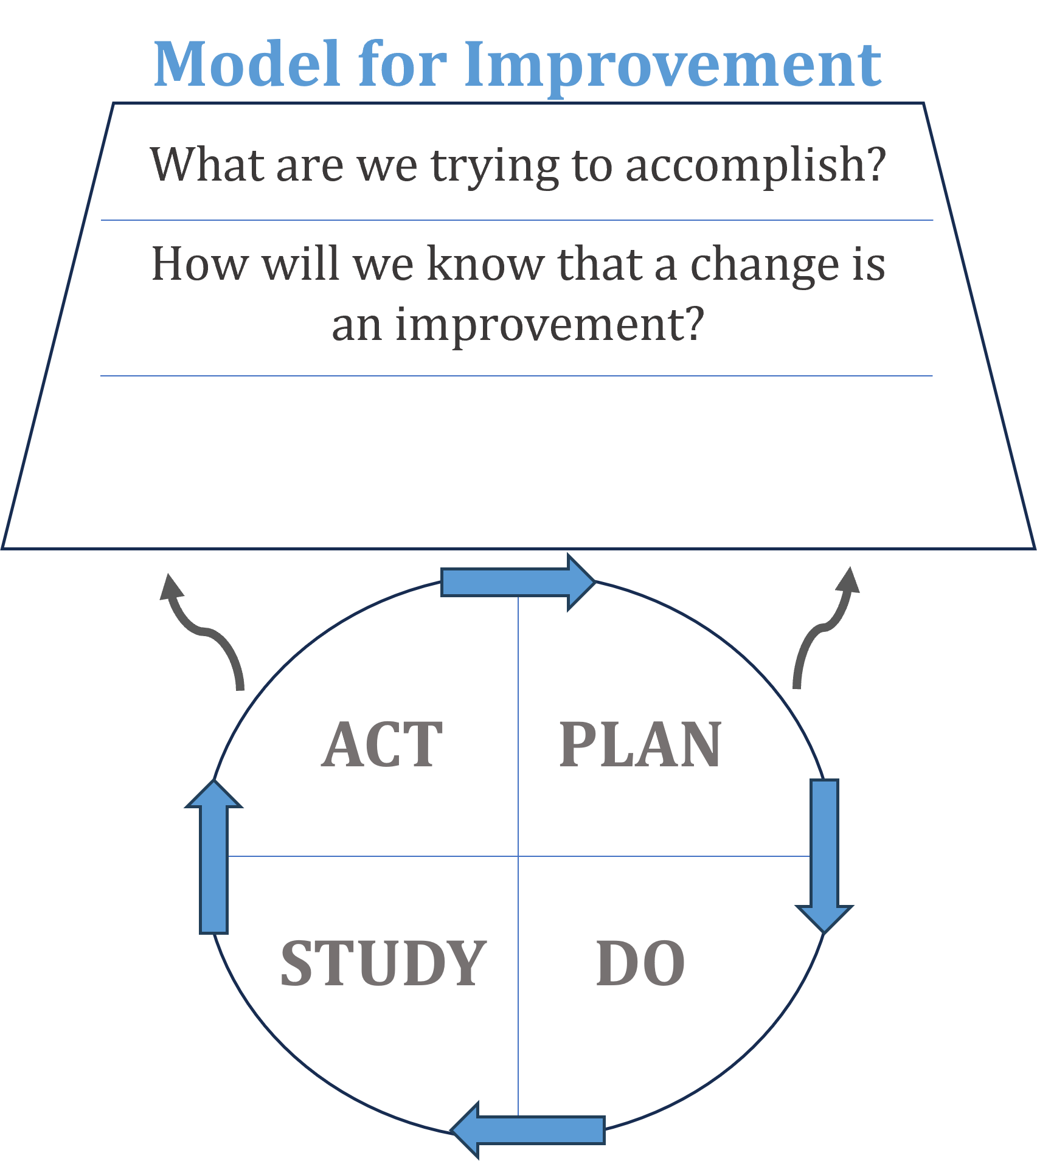
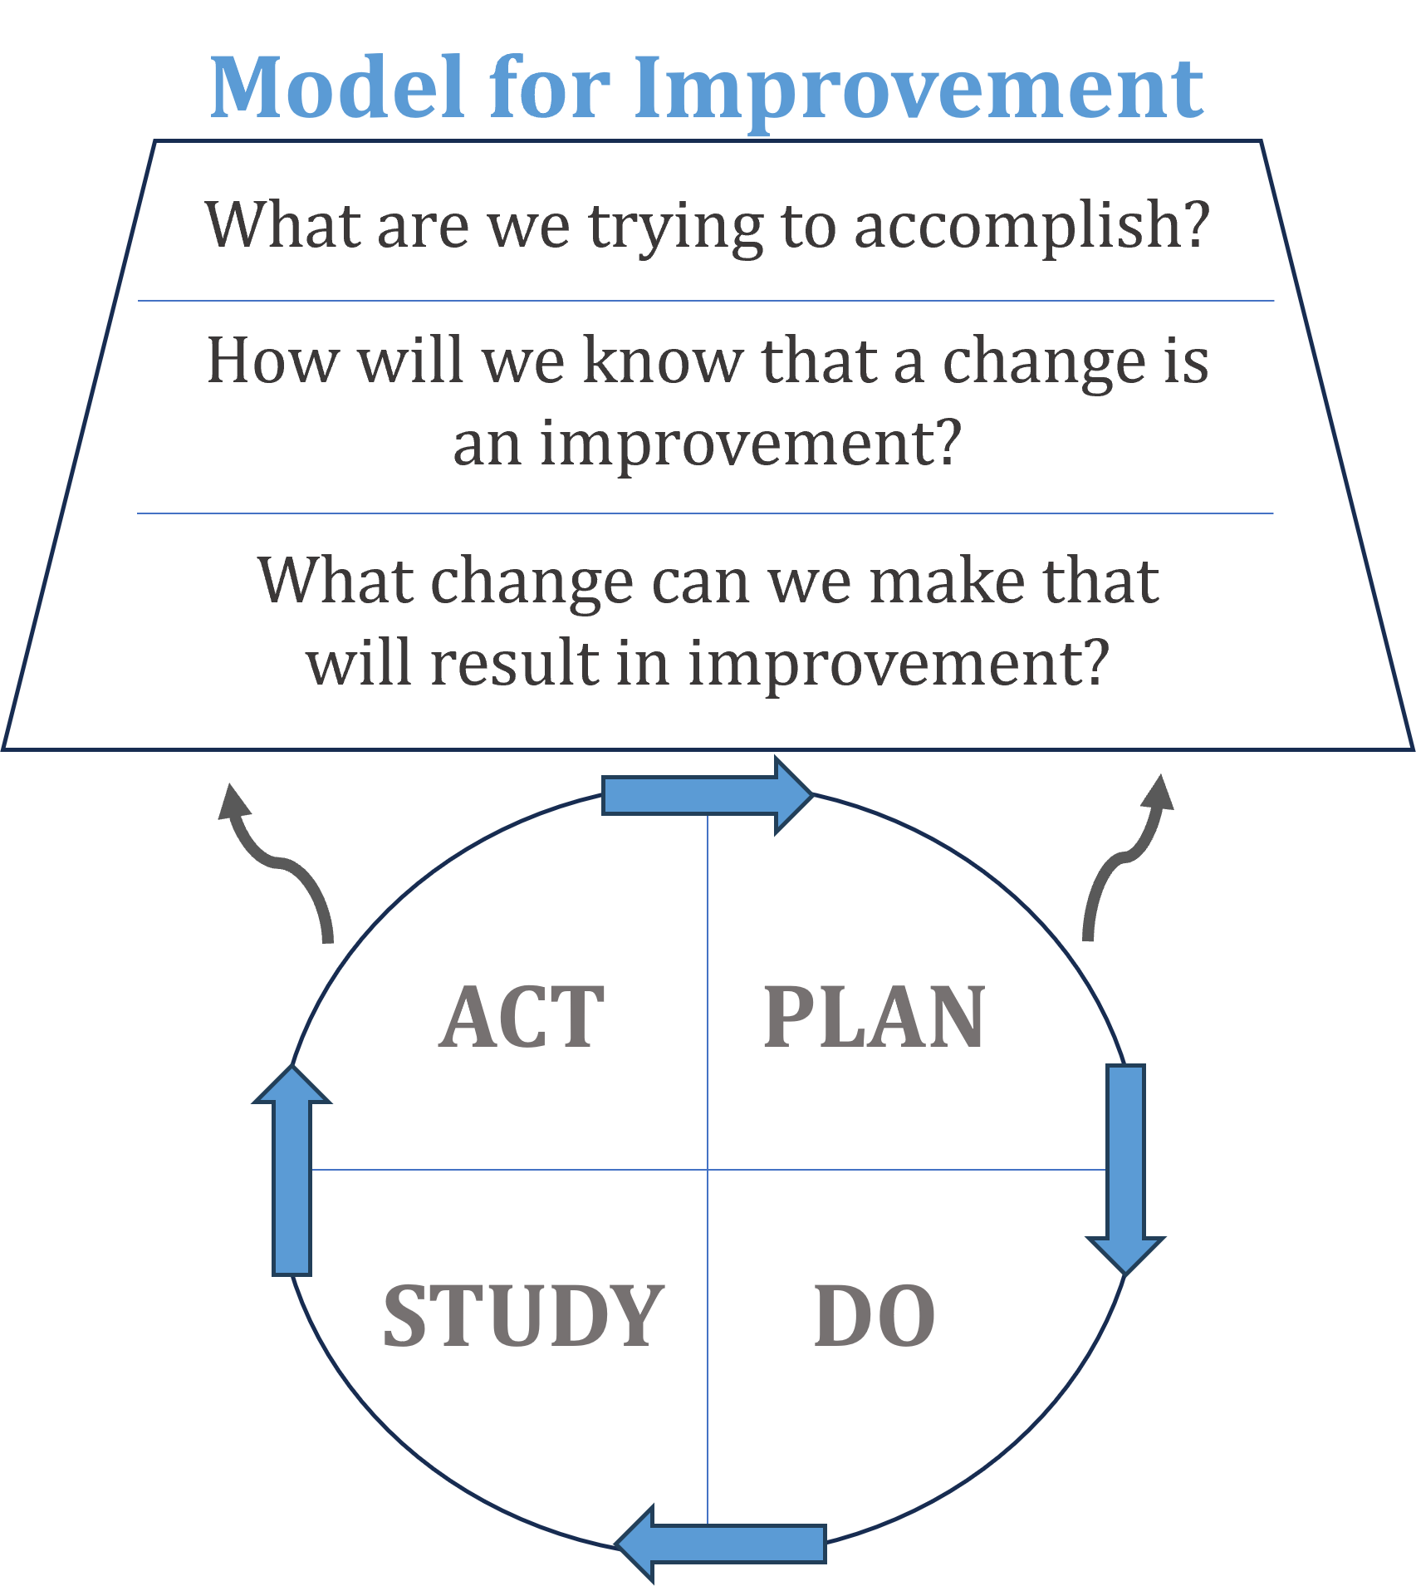
The Model for Improvement
Langley, G. J., Moen, R., Nolan, K. M., Nolan, T. W., Norman, C. L., & Provost, L. P. (2009). The Improvement Guide: A Practical Approach to Enhancing Organizational Performance (2nd ed.). San Francisco, CA: Jossey-Bass Publishers.
Notes:
The essence of this session is how to create a measurable goal.

Slide 13
The Big Question…
“What are we trying to accomplish?”
Develop a clear, concise, and specific objective
Target population, desired outcome, metrics, and benchmarks for success
Measurable, achievable, and time-bound
Aligns with organizational strategic goals and priorities
Reflects stakeholder perspectives and priorities (Patients, frontline staff, leadership)
Keeps the team focused on purpose, goals, and tasks
Purpose Statement | Global Aim Statement | Specific Aim Statement

Slide 14
Obesity and Overweight Measurement Examples
Operational Tracking:
Obesity/overweight prevalence (BMI measurements)
Prevalence of obesity-related complications
Quality Performance:
Obesity diagnosis
Documented follow-up plan
Change in weight over time
Anti-obesity medication prescriptions
Assessment of obesity-related complications
Patient-centered Care:
Patient-reported outcomes
https://www.hsph.harvard.edu/obesity-prevention-source/obesity-prevention/healthcare/healthcare-obesity-prevention-recommendations-complete-list/
Notes:
Use the chat or go off mute to share – what might be the most difficult to track.

Slide 15
Balanced Measures: Obesity & Overweight Measurement Examples
Clinical Outcomes
Obesity/overweight prevalence
Obesity diagnosis
Change in weight over time
Patient-reported outcomes
Anti-obesity medication prescriptions
Cost
Direct/indirect
Satisfaction
Patient, families, caregivers
Staff
Process Measures
Documented follow-up plan

Slide 16
Narrowing the Focus
Purpose Statement
A broad declaration of your project's overall goal.
PURPOSE STATEMENT
Global Aim Statement
More specific than the purpose, outlining what you intend to achieve and how.
GLOBAL AIM STATEMENT
SPECIFIC AIM STATEMENT
Specific Aim Statement
Detailed and actionable goals.

Slide 17
Narrowing the Focus
Purpose Statement
The purpose of this quality improvement project is to: increase documented follow-up plans for patients with overweight/obesity
The purpose of this quality improvement project is to: improve the follow-up process for patients with overweight/obesity
The purpose of this quality improvement project is to: enhance access to weight management services for underserved populations in our community
PURPOSE STATEMENT
Global Aim Statement
We aim to improve the process of: Clinical outcomes of patients undergoing obesity management interventions within our healthcare center
The process for this project primarily resides: Within the care coordination process
The process begins with: The screening and diagnosis of obesity in patients during routine patient visits
The process ends when: Patients who are diagnosed with obesity undergo interventions aimed at improving clinical outcomes such as BMI, blood pressure, glycemic control (HbA1c levels for diabetic patients), and reduction in obesity-related comorbidities (e.g., hypertension, diabetes)
The benefits of working on improving this process:
Improved patient health outcomes
Reduced healthcare utilization
Enhanced quality of life for patients
It is most important to work on this project now because: Improving obesity-related clinical outcomes is critical for promoting long-term health and well-being
GLOBAL AIM STATEMENT
SPECIFIC AIM STATEMENT
Specific Aim Statement
We will improve clinical outcomes for patients undergoing obesity management interventions within our healthcare center by
reducing the mean BMI by at least 5% within the next 12 months.
Notes:
Creating a simple purpose statement before jumping into creating a global and specific aim can be helpful. Bring team together to brainstorm words, sentences, concepts, ideas – then wordsmithing together – and multi-voting on the statement that best describes at a high level what you would ultimately want to achieve with this project. Then the global aim to drill down and the specific aim to drill down even further.

Slide 18
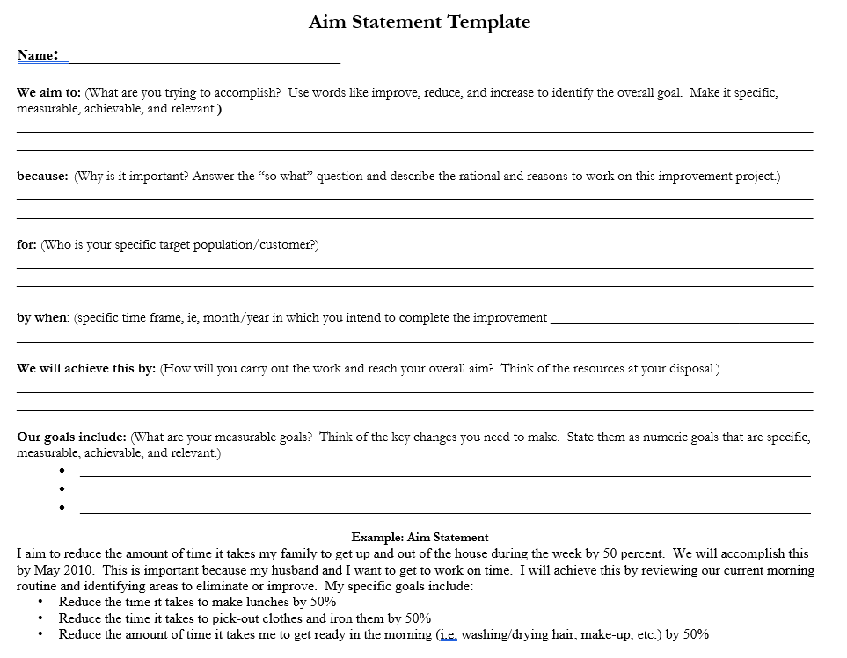

Slide 19
The Purpose of the Purpose Statement
Bringing the team together around the common language, focus, measures, direction
The purpose of this quality improvement project is to: increase documented follow-up plans for patients with overweight/obesity
The purpose of this quality improvement project is to: improve the follow-up process for patients with overweight/obesity
The purpose of this quality improvement project is to: enhance access to weight management services for underserved populations in our community
Notes:
Creating a simple purpose statement before jumping into creating a global and specific aim can be helpful. Bring team together to brainstorm words, sentences, concepts, ideas – then wordsmithing together – and multi-voting on the statement that best describes at a high level what you would ultimately want to achieve with this project. Then the global aim to drill down and the specific aim to drill down even further.

Slide 20
Global Aim Statement
We aim to improve the process of:
The process for this project primarily lives at this specific location:
The process begins when this action takes place:
The process ends when happens at location
These are the benefits of working on improving this process:
…
…
…
It is most important to work on this project now because:
Notes:
Global Aim template.

Slide 21
Specific Aim Statement
We will (improve, increase, or decrease) the (# or %)
by (amount)
OR from (baseline amount) to
(amount)
by this date or timeframe: .
Notes:
Specific Aim template

Slide 22
Aim Examples
Global Aim:
We aim to improve the process of: Clinical outcomes of patients undergoing obesity management interventions within our healthcare center
The process for this project primarily resides: Within the care coordination process
The process begins with: The screening and diagnosis of obesity in patients during routine patient visits
The process ends when: Patients who are diagnosed with obesity undergo interventions aimed at improving clinical outcomes such as BMI, blood pressure, glycemic control (HbA1c levels for diabetic patients), and reduction in obesity-related comorbidities (e.g., hypertension, diabetes)
The benefits of working on improving this process:
Improved patient health outcomes
Reduced healthcare utilization
Enhanced quality of life for patients
It is most important to work on this project now because: Improving obesity-related clinical outcomes is critical for promoting long-term health and well-being
Specific Aim:
We will improve clinical outcomes for patients undergoing obesity management interventions within our healthcare center by
reducing the mean BMI by at least 5% within the next 12 months.

Slide 23
Aim Examples
Global Aim:
We aim to improve the process of: Diabetes management in our primary care clinic
The process for this project primarily lives: During patient appointments and follow-ups
The process begins when: A diabetic patient schedules an appointment or presents for follow-up care
The process ends when: The patient receives comprehensive diabetes management and education
The benefits of working on improving this process:
Better disease control
Reduced complications
Improved patient quality of life
It is most important to work on this project now because: Effective diabetes management is essential for preventing long-term complications
Specific Aim:
We will achieve a 20% increase in the proportion of diabetic patients with controlled HbA1c levels (HbA1c < 7%)
within one year (or by April 30, 2025) through the implementation of a comprehensive diabetes management program.

Slide 24
Aim Examples
Global Aim:
We aim to improve the process of: Patient discharge in our hospital.
The process for this project primarily lives: At the hospital's discharge desk.
The process begins when: A patient's medical team confirms discharge readiness.
The process ends when: The patient successfully completes the discharge process at the hospital's exit.
The benefits of working on improving this process:
Enhanced patient satisfaction
Smoother transitions of care
Improved patient outcomes
It is most important to work on this project now because: Optimizing discharge processes can positively impact patient experience and overall hospital efficiency.
Specific Aim:
We will increase the patient satisfaction scores related to discharge processes from an average of 3.5 to 4.5
(on a 5-point Likert scale) by the end of six months (or November 30, 2024).

Slide 25
Strategies for Setting Clear Aims

Slide 26
Make It SMART
Specific
What will be achieved?
What are the next steps and actions?
Incorporate flexibility?
Timeline to check back.
Measurable
Be sure baseline is incorporated from x to x.
What data will be collected to know if the goal has been met?
What does success look like?
Attainable/ Achievable
What resources are available?
Who are the leadership sponsors to remove barriers?
Realistic & Relevant
Does the goal align with organizational values, goals, and priorities?
How will the ultimate result matter?
Timely
Timeline?
Is the scope appropriate for time allotted?
Be sure not to skip steps because of time pressure.
Notes:
Use the smart goal template to “check your work” as you and the team create these statements to assure they are specific, measurable, achievable, realistic, and timely.

Slide 27
SWOT Analysis
S
W
O
T
STRENGTHS
WEAKNESSES
OPPORTUNITIES
THREATS
What needs to be improved?
What are some of the weak components within the process?
What resources are not adequate?
What is done better elsewhere?
What are the barriers and challenges?
Who does not support this change?
What problems should we anticipate or prepare for?
What factors cannot be controlled?
What is going well or is done well?
What could go well?
What is unique?
What are the solid qualities of this process?
What are the goals?
What would this improve?
What else could this process impact positively?
What demands are shifting?
What can be improved?

Slide 28
Brainwrite vs. Brainstorm
Notes:
Brainwrite BEFORE brainstorming as a team to allow for all members time to process and think of their responses

Slide 29
The SWOT in Action
EXAMPLE: The purpose of this quality improvement project is to: increase documented follow-up plans for patients with overweight/obesity by increasing the utilization of screening tools facilitating the diagnosis of patients with overweight/obesity from 50% to 90% within the next six months, as measured in the E.H.R and staff adherence to process.
S
O
T
W
STRENGTHS
WEAKNESSES
OPPORTUNITIES
THREATS
Better symptom management
Enhanced quality of life for patients
Improved patient satisfaction
Patient engagement in self-care
Stronger care coordination across the health center
Clinician bias/stigma
Lack of buy-in from stakeholders
Competing priorities
Lack of support from leadership
Staffing shortages
Financial constraints
Documentation of overweight/obesity has been correlated with weight loss
Measurable and provides direction and accountability
BMI is an easy measure to calculate
Employee consistent adherence to process
Additional time to train and support staff
Limited time
Limited technology
Notes:
Here are the components and results of the SWOT on this example.

Slide 30
Identifying Solutions to Test

Slide 31
GAP ANALYSIS
Gap
Key Steps to Bridge the Gap
Current State
Desired State
Action Plan & Road Map
1
Assess the current discharge planning process and adherence
Identify strengths & weaknesses in current practices and future.
2
Engage stakeholders in project–through meetings, touch-bases, and communications
Present current state challenges and rationale for improvements
3
Collaborate with interdisciplinary teams on discharge protocols
Create a list of all components affected (med rec, dietary, activity, symptom monitoring, etc.)
Notes:
A visual to demonstrate where you are now and where you want to go. In between is where you can map out all of the strategies and tasks within your action plan/road map.

Slide 32
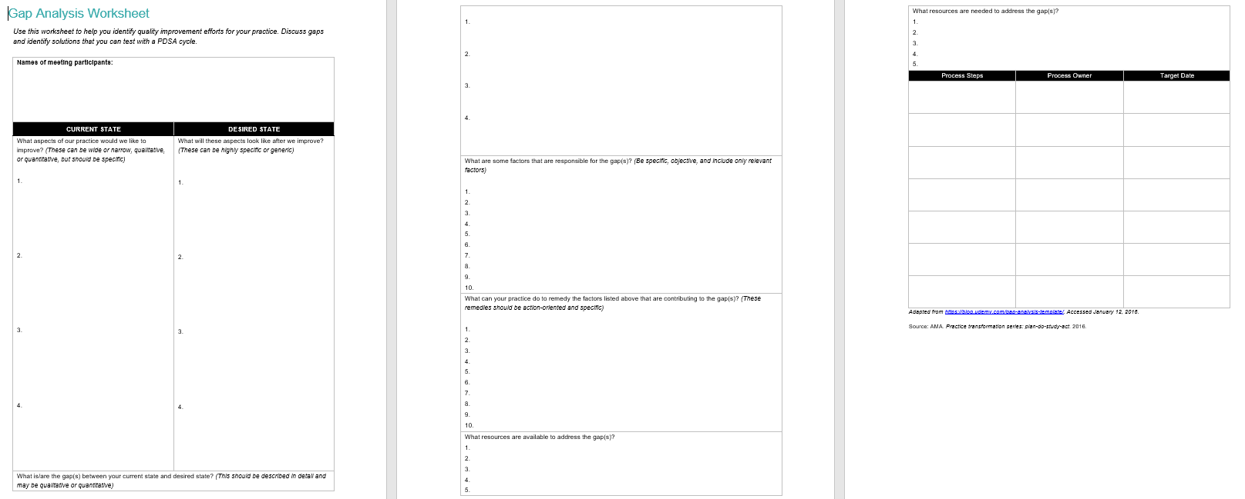

Slide 33
Thank You
Continuous learning and application throughout program
Office hours (we are here for you!)
Questions?

Slide 34
Post-work Overview
Post-work completed as a team:
Continue to meet regularly with your participating team members
Download the Aim Statement and Gap Analysis templates
Discuss and complete the Aim Statement and Gap Analysis together
Share team members' reflections and goals to brainstorm each section of the Aim Statement. Then, finalize the Aim Statement together
Share team members' reflections on your health center gaps from the article you read to brainstorm the Gap Analysis. Then, complete the Gap Analysis together
Submit the Aim Statement on this page. (Only the team lead needs to submit)
Submit the Gap Analysis on this page. (Only the team lead needs to submit)
Post-work due by July 10th

Slide 35
References
Creighton, S. (2021). How to define the AIM statement for your improvement project. How to Define the Aim Statement for Your Improvement Project. Retrieved from https://blog.lifeqisystem.com/define-aim-statement-quality-improvement
Godfrey, MM, Nelson, EC, Batalden, PB, Berry, SA (2017). Quality by Design: A Clinical Microsystems Approach. Hoboken, NJ: John Wiley & Sons, Inc.
Institute for Healthcare Improvement. (2024). https://www.ihi.org/
Institute of Medicine, Committee on Quality of Health Care in America. (2009). Crossing the Quality Chasm: A New Health System for the 21st Century. Washington, DC: National Academy Press.
Langley, GJ, Moen, R, Nolan, KM, Nolan, TW, Norman, CL, Provost, LP (2009). The Improvement Guide: A Practical Approach to Enhancing Organizational Performance (2nd ed.). San Francisco, CA: Jossey-Bass Publishers.
Moran, JW, Riley, BR, Beitsch, L (2023). Twelve essential questions to help improve your project’s AIM statement. Process Excellence Network. Retrieved from https://www.processexcellencenetwork.com/lean-six-sigma-business-performance/articles/twelve-questions-to-help-improve-your-aim-the-aim

