Slide 1
Experiences from a Quality Improvement Effort
Victoria Foote and Victoria Rufo
Community Health Center Inc.
Connecticut, U.S.
June 2024
Nurse Practitioner & Post-Doctoral
Training Programs

Slide 2
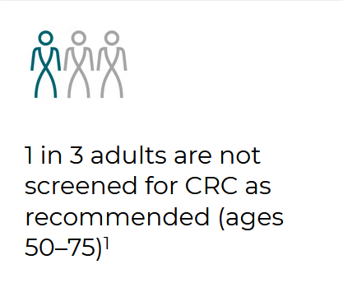
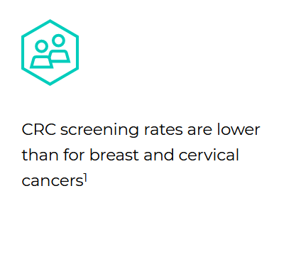
Background
"Overall colorectal screening rate in the US is 59% (2021), well short of the National Colorectal Cancer Roundtable national goal of 80%"
Low rates of diagnostic imaging completion in our population leads to a delay in care, high healthcare cost, and poor patient outcomes.
‹#›

Slide 3
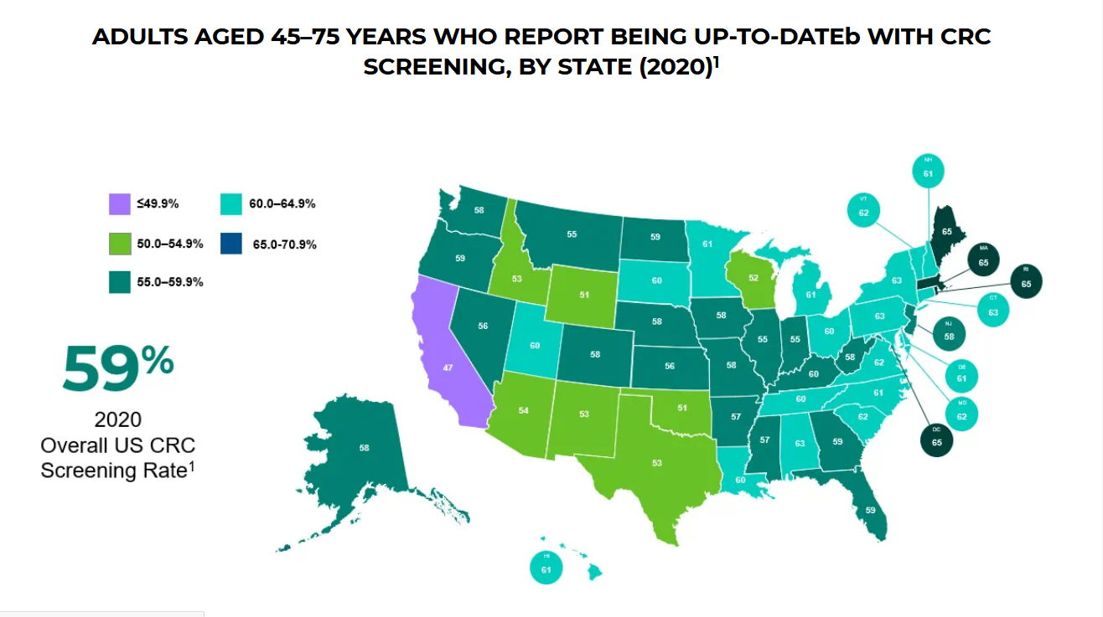

Slide 4
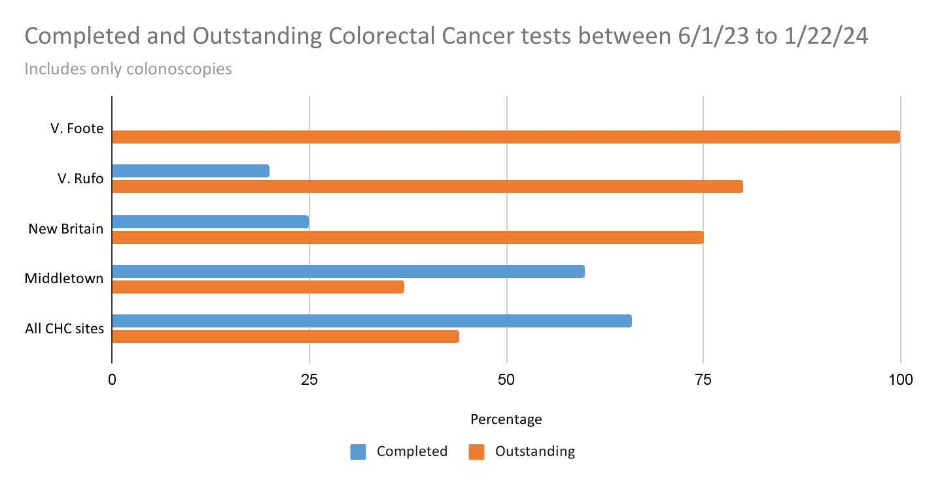

Slide 5
Aim Statement
To improve the quality and value of patient care and health outcomes by increasing colon cancer screening rates
‹#›

Slide 6
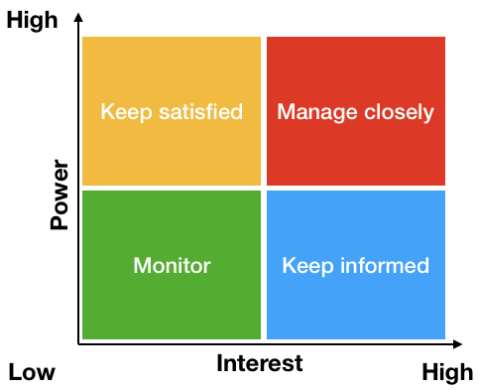
Stakeholders
Provider
Medium Power
Informed / manage
Patient
Variable Power
Monitored / informed
Diagnostic Imaging
High Power
High Interest -DI
They have fairly high power (send test, remind patients, figure out place for them to go, find info afterwards)
They will responsible for managing this so they have very high interest
‹#›

Slide 7
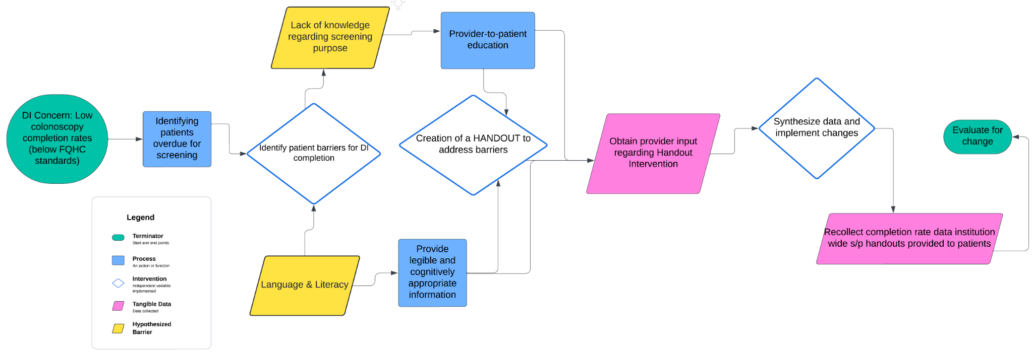
QI Process Flowchart

Slide 8
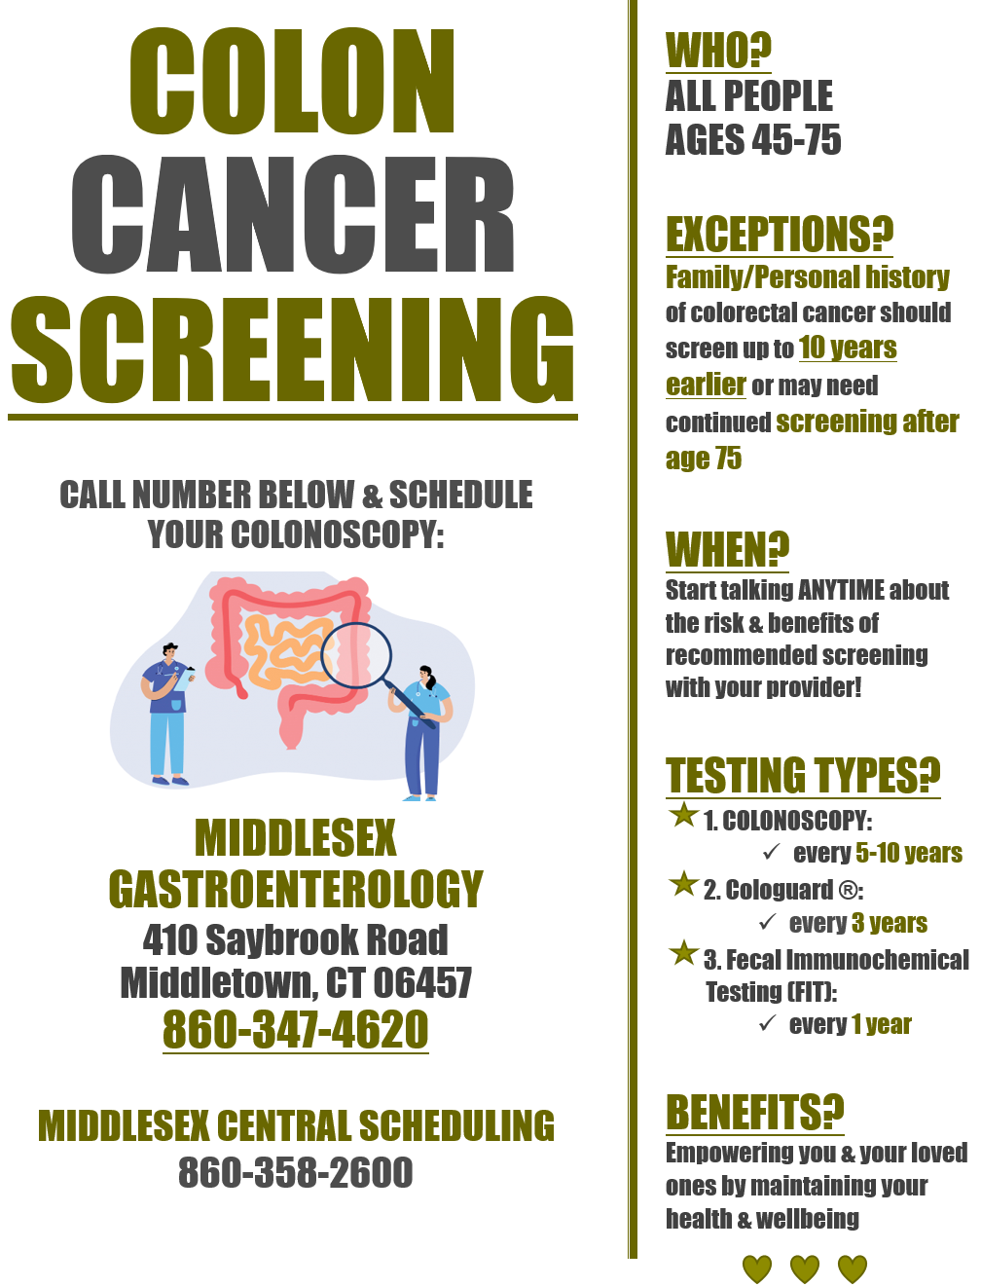
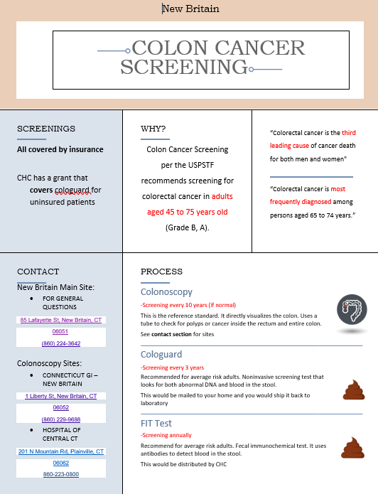
Handouts
A
B

Slide 9
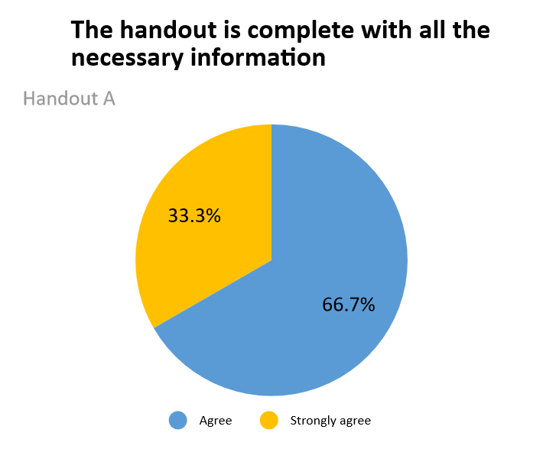
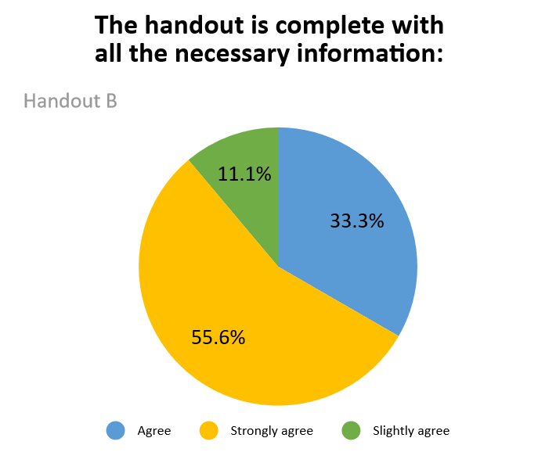
Data
‹#›

Slide 10
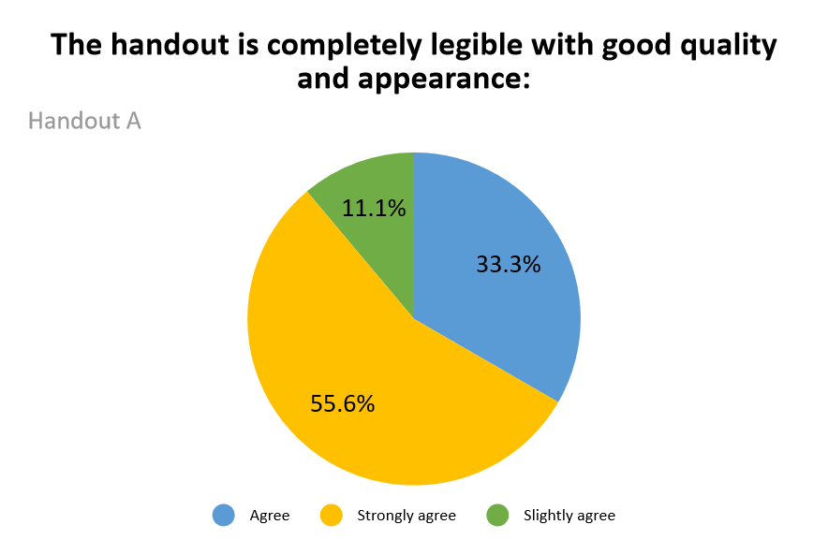
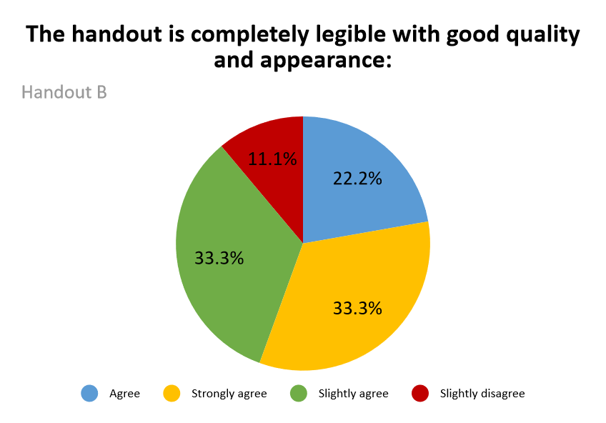
Additional Data

Slide 11
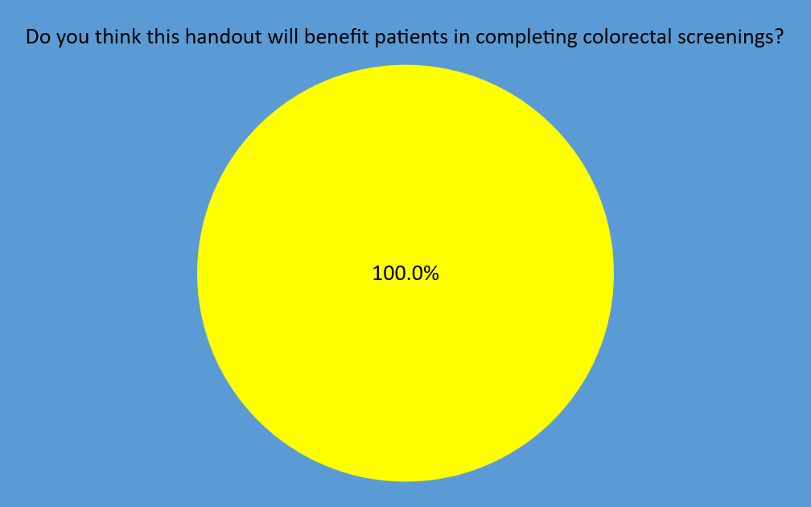
Are there any barriers that this handout doesn’t address?

Slide 12
Approach to Change
PDSA cycle
Key points (part 1)
Providers care about their patients
Diversity of patient population is important to consider
Legibility and complete information are valuable
‹#›
Notes:
Complete final handout for both New Britain and Middletown site
Recruit providers to be part of data
Collect baseline data
Distribute handouts. Collect data
Analyze data on colorectal cancer screening completion
Survey: providers and patients

Slide 13
Results
Key points (part 2)
Barriers: time, difficulty with schedule coordination
Challenges: time, provider workload / motivation
Success factors: related to patient care
Learning applications
Simplify things
Small changes can lead to big outcomes
‹#›

Slide 14
Conclusions and Implications
Additional PDSA cycle
Advice
Start small
Detection of colorectal cancer rates is increasingly becoming more important as more colorectal occurrences increase in young individuals
‹#›

Slide 15
References
De Kanter, C., Dhaliwal, S., & Hawks, M. (2022). Colorectal Cancer Screening: Updated Guidelines From the American College of Gastroenterology. American family physician, 105(3), 327–329.
Exact Academy (6/2023) Screening Rates. https://www.exactsciences.com/exactacademy/colorectal-cancer-screening/adherence/screening-rates

